Slide 1

High NI Gain Micromesh Structures and the LARDs Initiative:
Low-cost Amplification and Readout Device
Dr A. G. McLean
Postdoctoral researcher
Email: alasdair.mclean@adelaide.edu.au
9th Edition of the International CYGNUS Workshop
Kobe, Japan
24/FEB/2026

Slide 2
Motivation
Micromesh Structures for Negative Ion Gases

Slide 3
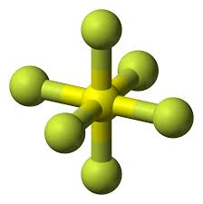
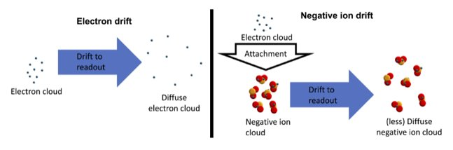
Why use SF₆ in a Directional Dark Matter Search?
SF₆
Pros
Large fluorine content – improvement in SD WIMP-Nucleon cross section
Electronegative/Negative Ion Drift (NID) gas – significantly reduced diffusion during drift phase
Nontoxic – CS₂ used previously is toxic and potentially explosive
Con
Very difficult to produce significant gas gains – typically limited to ~10³
Electron must be stripped from NI before amplification
Limits sensitivity to low energy recoils

Slide 4
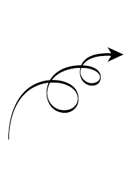
What can we do to Improve Charge Amplification in SF₆?
The Problem with Gaseous Electron Multipliers (GEMs):
Multi-stage amplification often required for significant amplification -> charge lost during transfer
Positive ion backflow –> charge buildup alters field strength and shape
Dipole like electric field shape –> path dependent amplification
The Solution -> micromesh structures:
Multi-stage amplification in a single "stand alone" unit
Suppression of positive ion backflow
Uniform amplification fields
MMThGEM?

Slide 5
The Multi-Mesh ThGEM
An ideal NID gain stage?

Slide 6
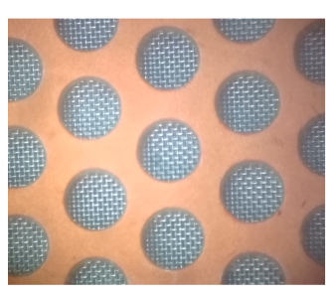
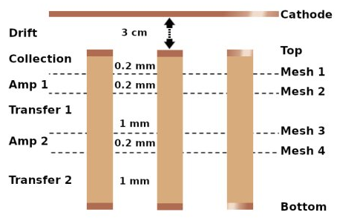
Is the MMThGEM an Ideal NID Gain Stage?
P = 1.2 mm
D = 0.8 mm
Problem:
Single "stand alone" unit with multistage amplification – solved ✅
Mesh electrode to suppress positive ion backflow –solved ✅
Mesh electrode create uniform electric field – solved ✅
Let's see...

Slide 7
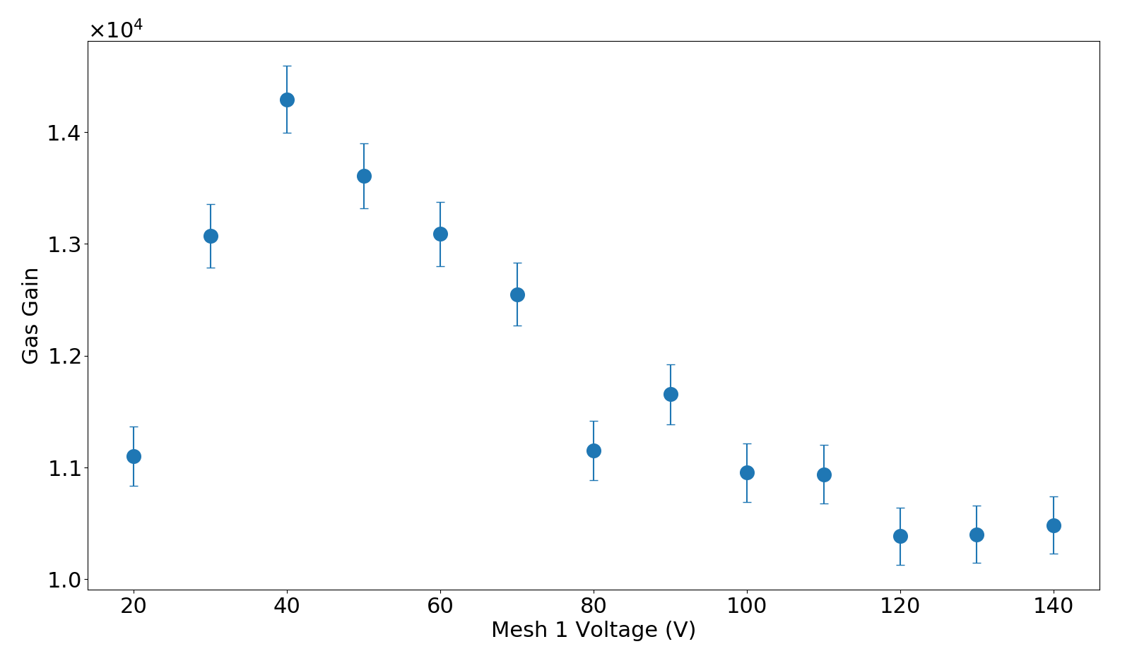
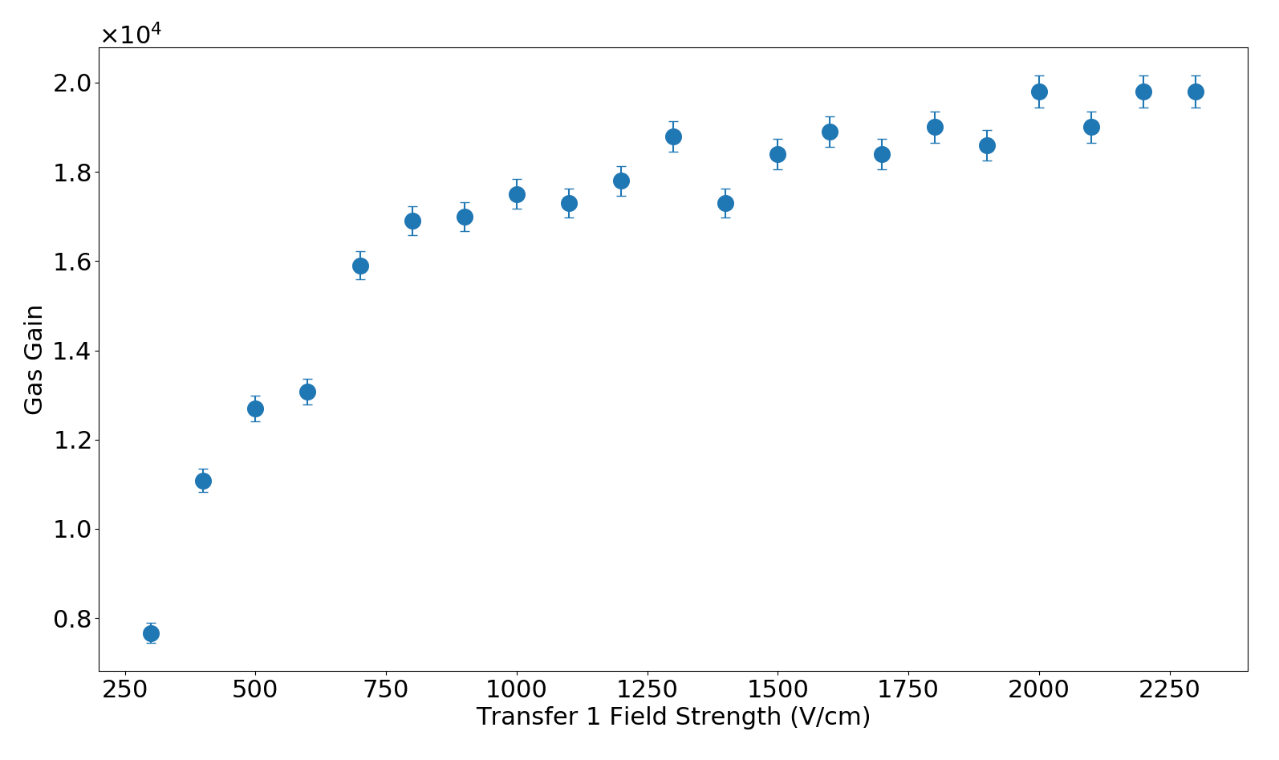
Optimisation of MMThGEM
Clear peak
Clear plateau
A.G. McLean et al 2024 JINST 19 P03001

Slide 8
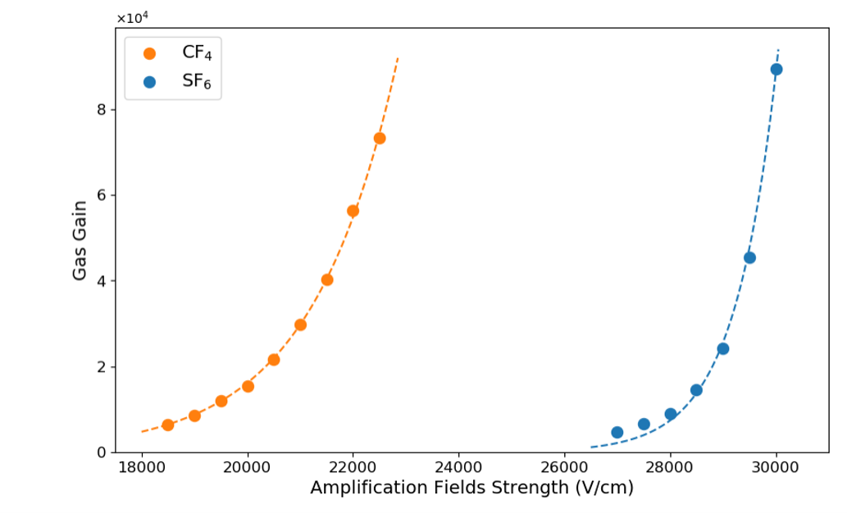
Outstanding NID Gas Gain
A.G. McLean et al 2024 JINST 19 P03001

Slide 9
Coupled MMThGEM-Micromegas
A high NI gain detector with 2D/3D readout

Slide 10
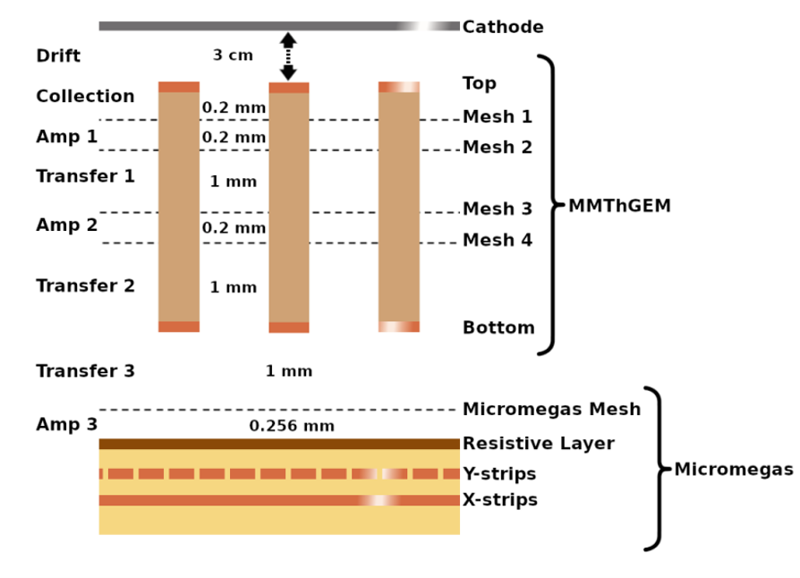
What's next for the MMThGEM?
MMThGEM is a planar device (i.e. 1D readout)
Needs to be coupled to a segmented anode readout plane for 2D/3D
Strip readout = Micromegas
arXiv:2602.12658

Slide 11
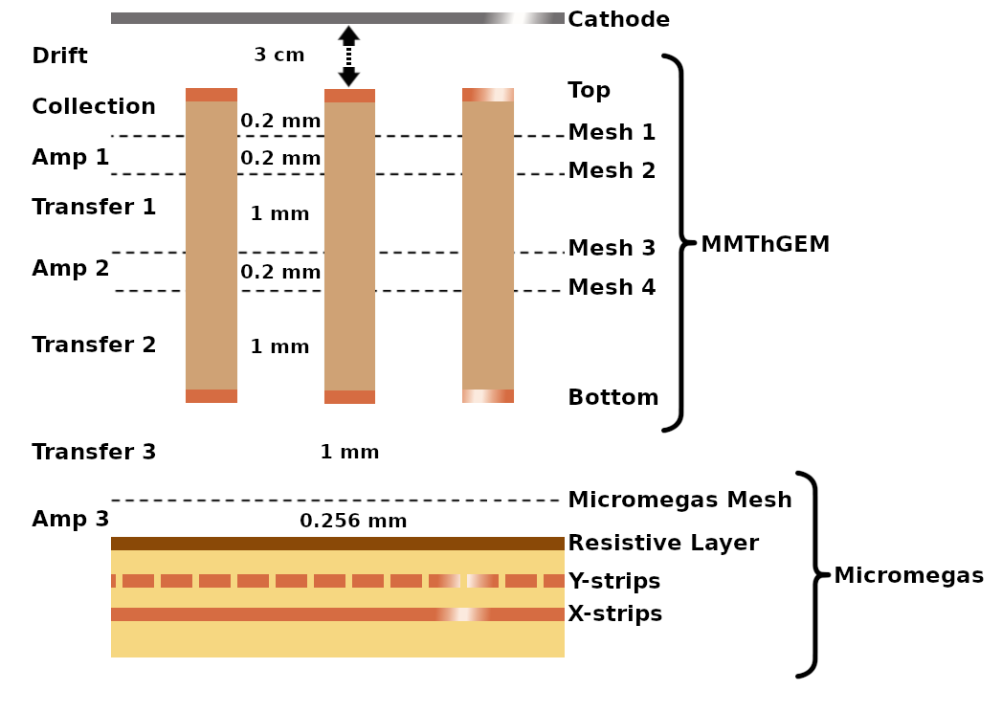
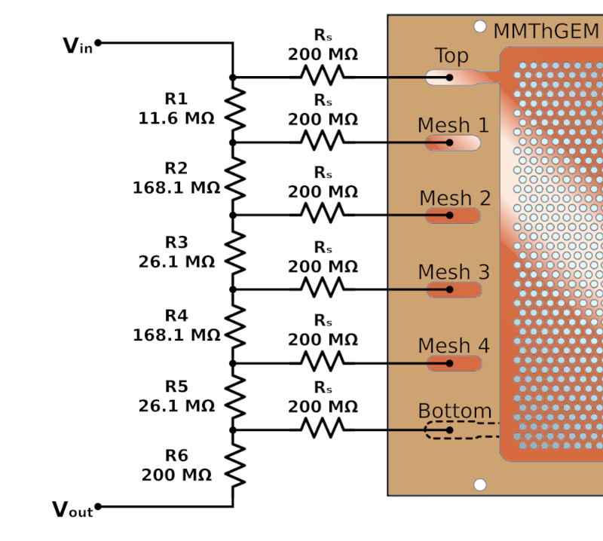
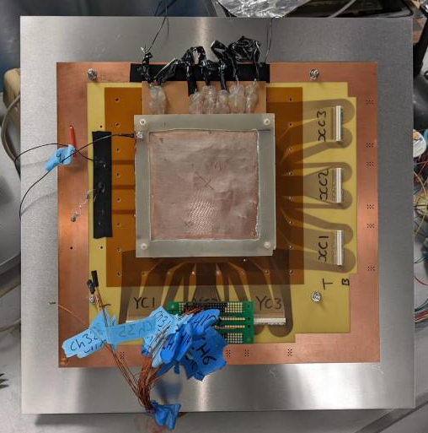
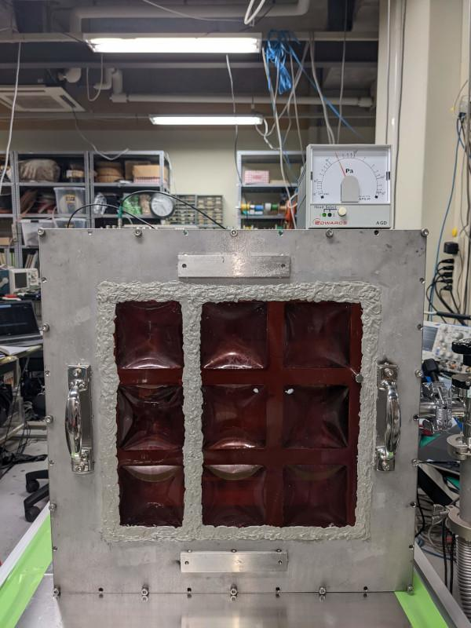
Coupled MMThGEM-Micromegas
Micromegas Device -
Perpendicular x-y strip readout plane
Resolution/strip pitch: 250 μm
Strip width: 100 μm (y) and 220 μm (x)
Active area: 10 x 10 cm
Amplification gap: 256 μm
Diamond Like Carbon (DLC) layer: 50 MΩ/□
(MMThGEM is used as a gain stage device)
Starting in the Kobe test vessel
Biasing Scheme for MMThGEM
Resistor chain soldered to electrode contacts
Resistor values dictated by previous optimisation
Reduces the number of HV feedthroughs required for operation

Slide 12
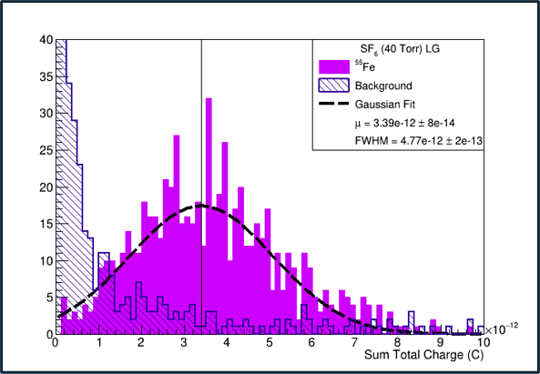
Unparalleled NID Charge Amplification
Additional amplification field provided by micromegas results in 10⁵ gain for the first time
(1.22 ± 0.08) × 10⁵
arXiv:2602.12658

Slide 13
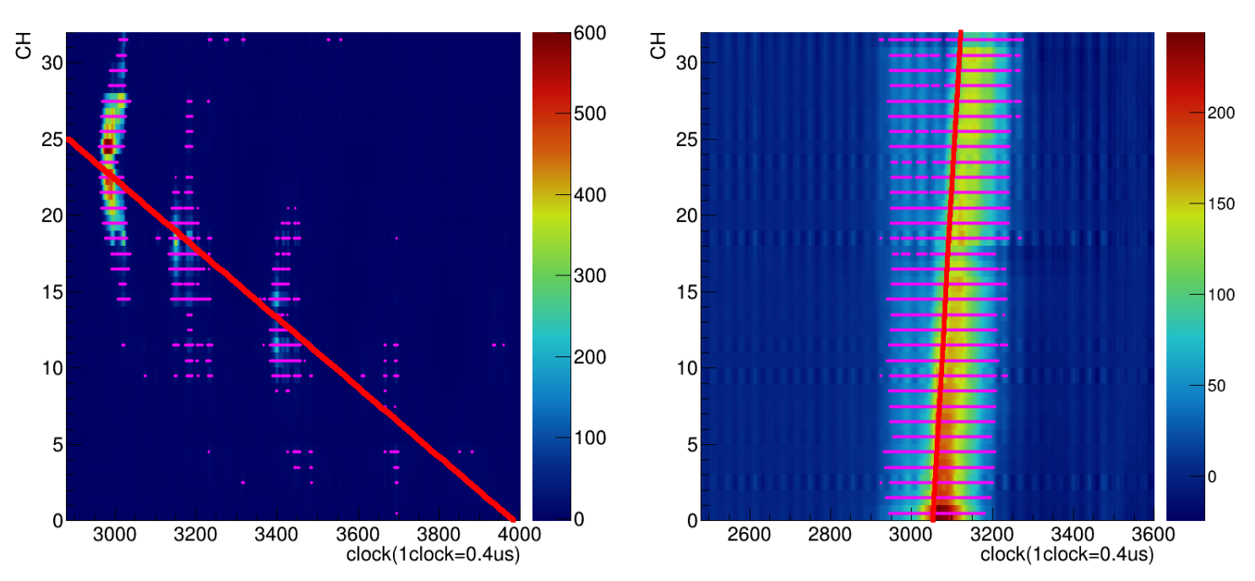
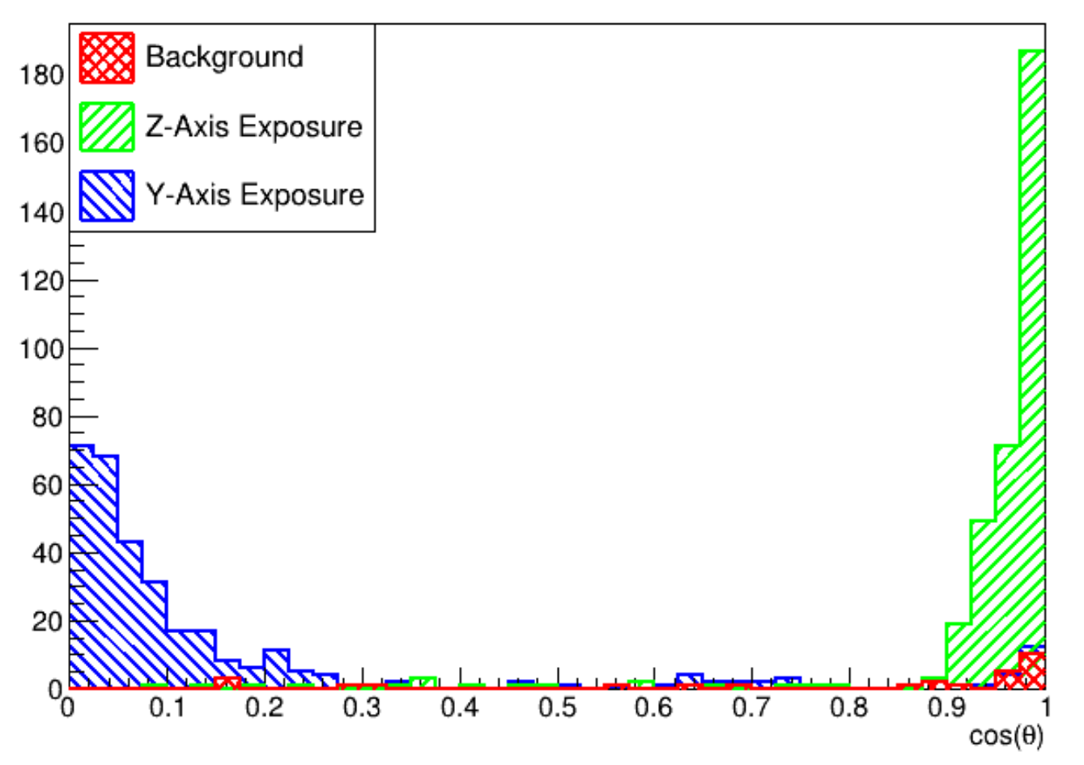
Clear angular separation of perpendicular exposures with alphas
arXiv:2602.12658

Slide 14
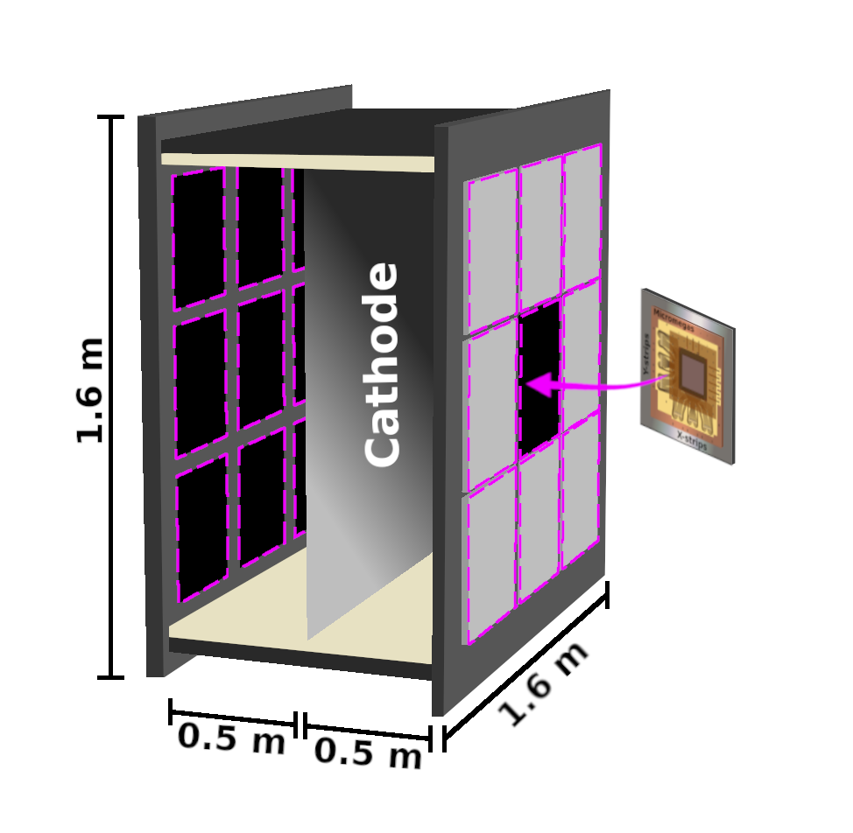
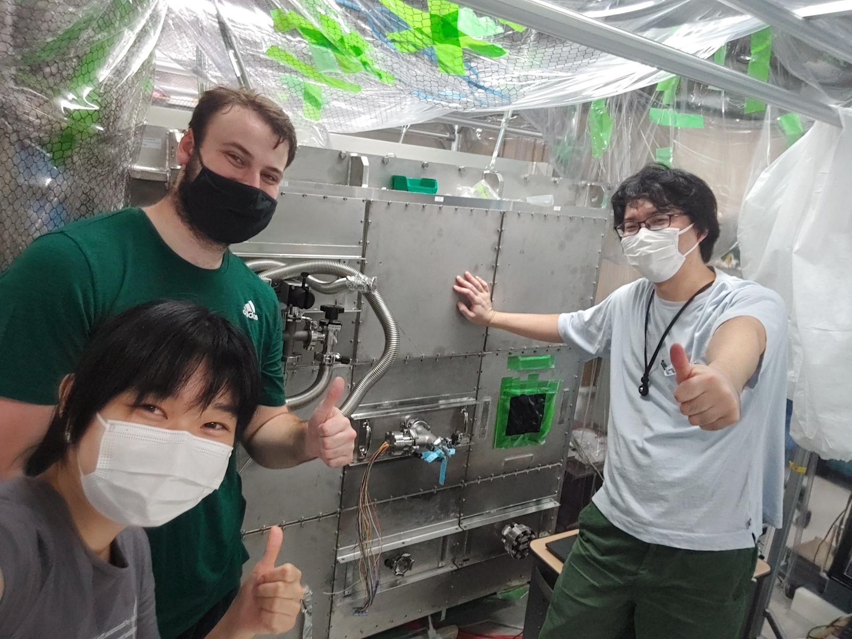
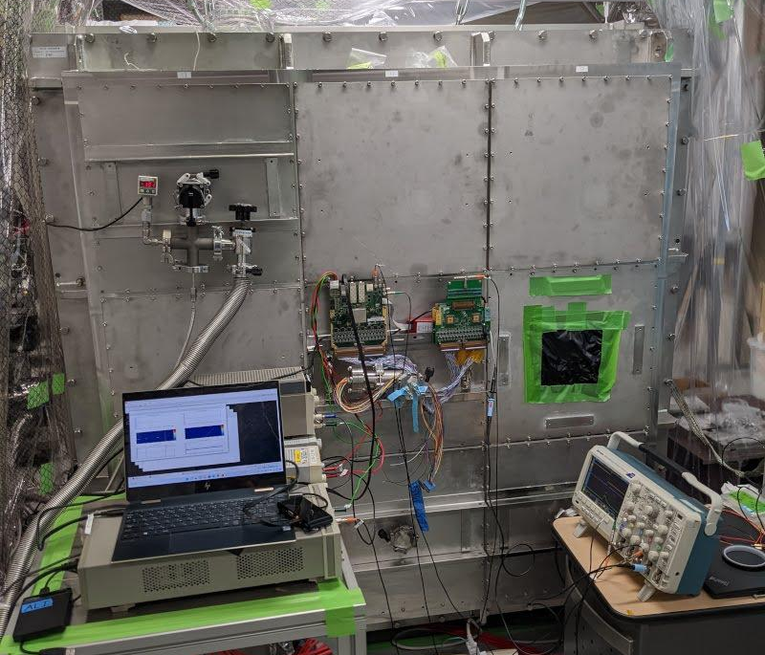
CYGNUS-m³ Scale C/N-1.0 “BENTO” Vessel
Kentaro and Satoshi welcome your detector modules for testing!
The C/N-1.0 vessel at Kobe University
Large CYGNUS-10 scale vessel - 50 cm drift length
Modular design which can support up to 18 readout detector planes
MMThGEM-Micromegas was transferred to the central panel on the BENTO vessel
Detector mounting conveniently fits test vessel dimensions
CYGNUS-10 Scale Kobe “BENTO” Vessel
²⁵²Cf source positioned externally
x

Slide 15
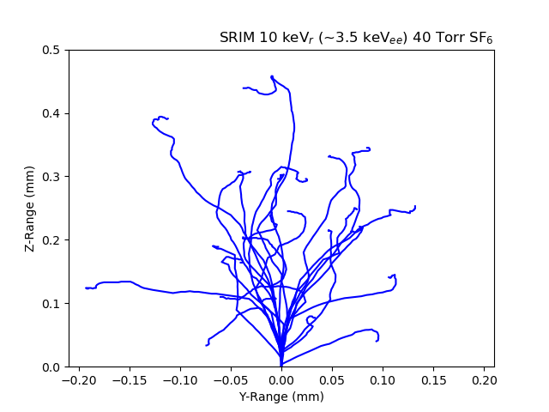
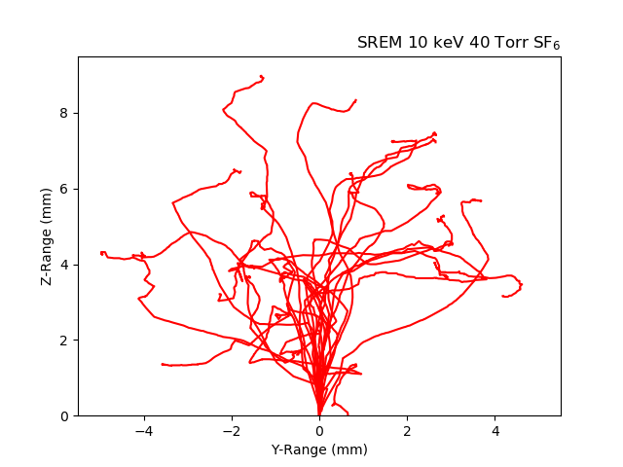
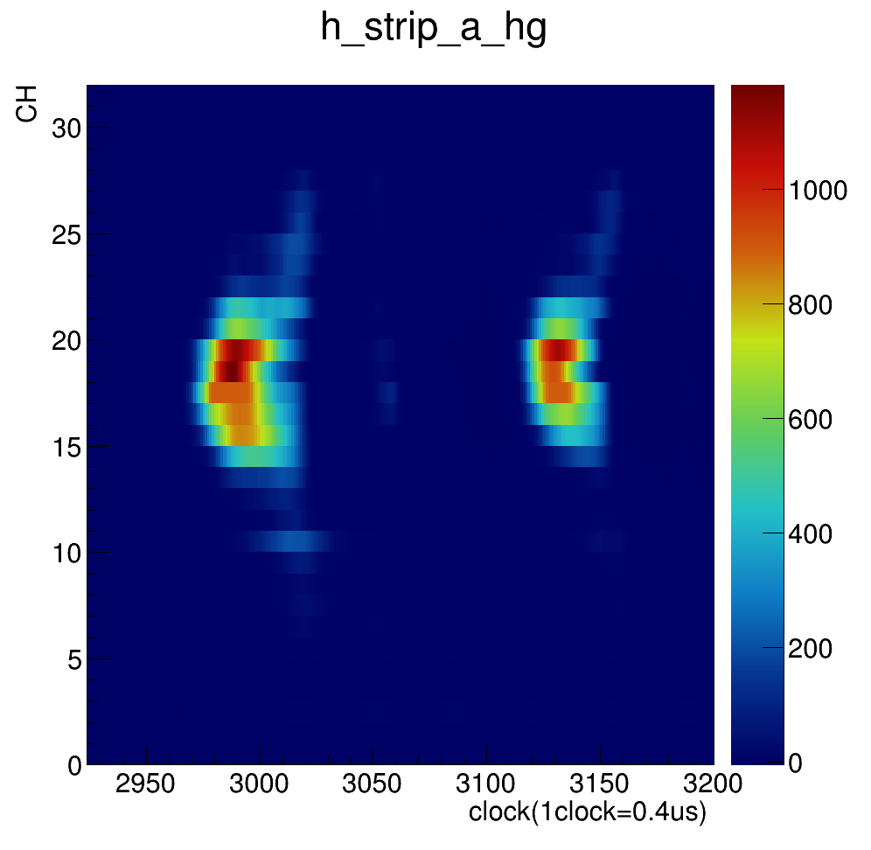
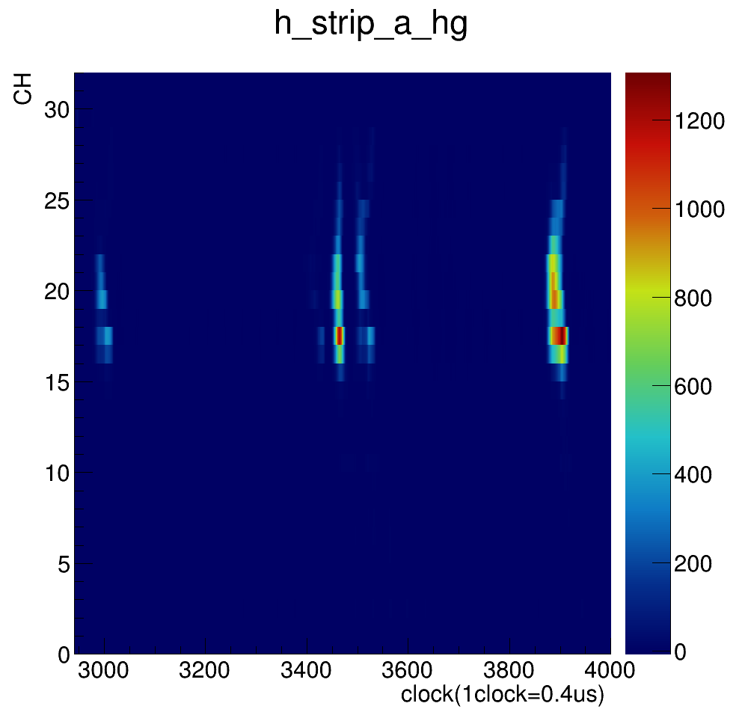
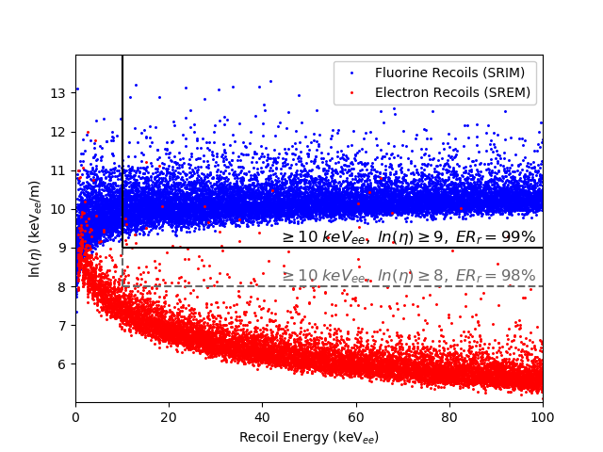
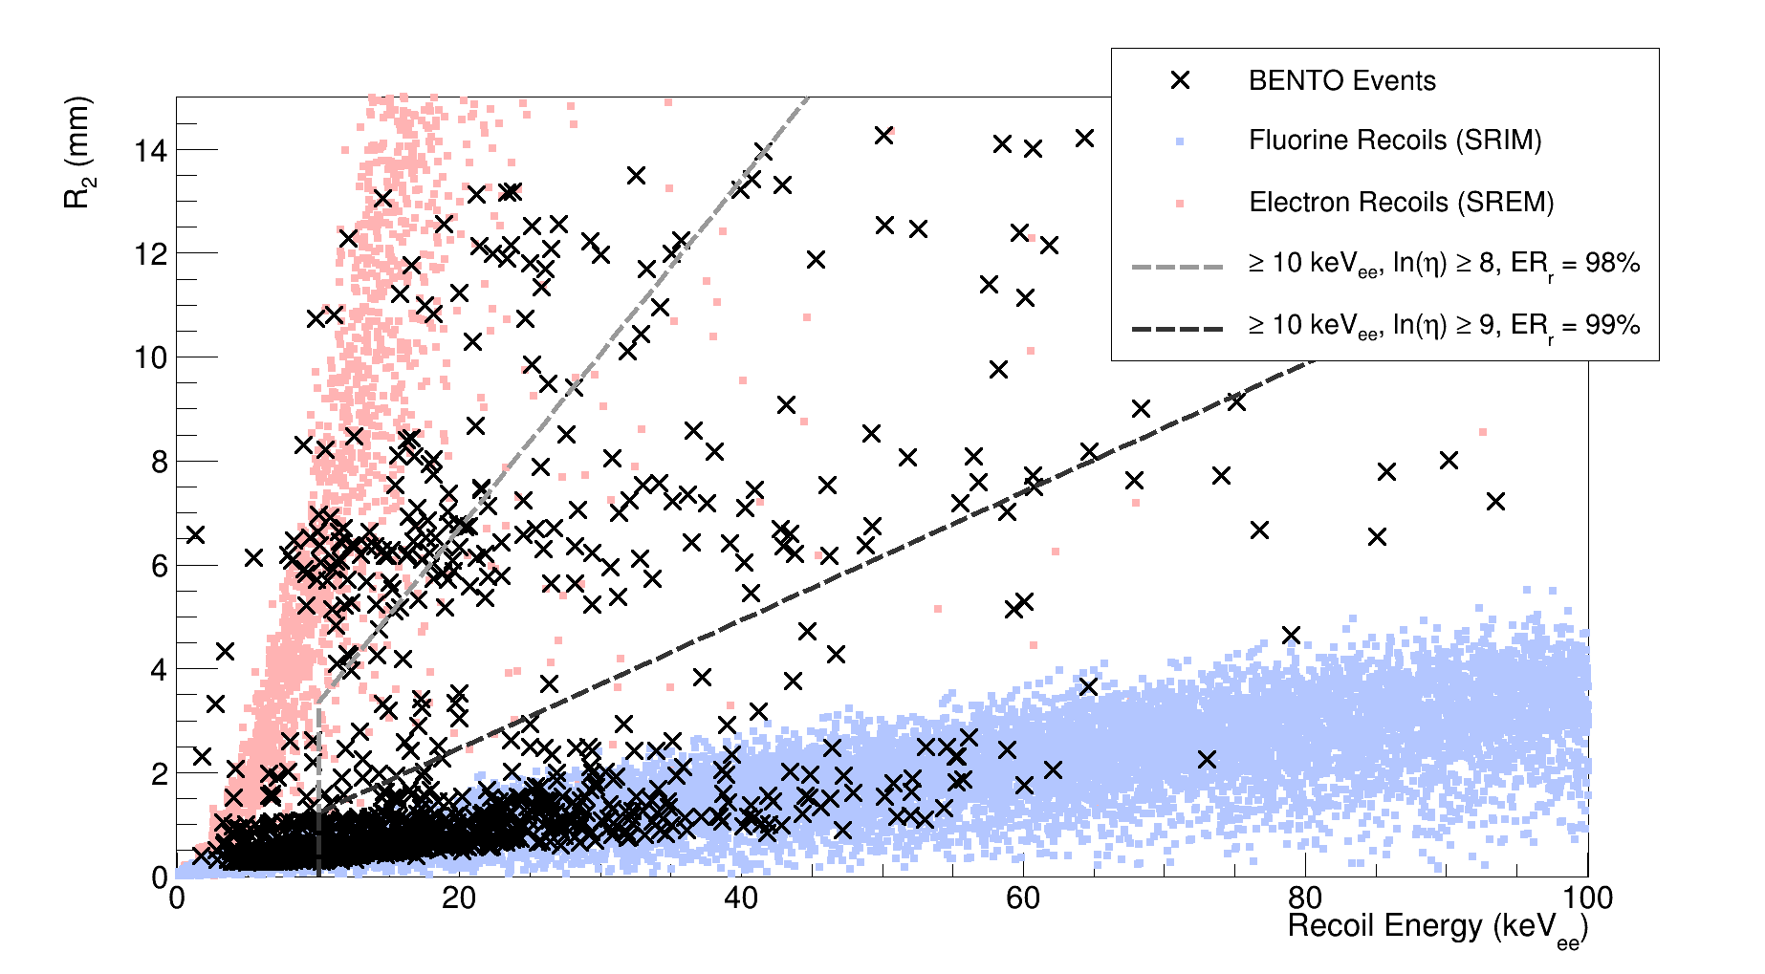
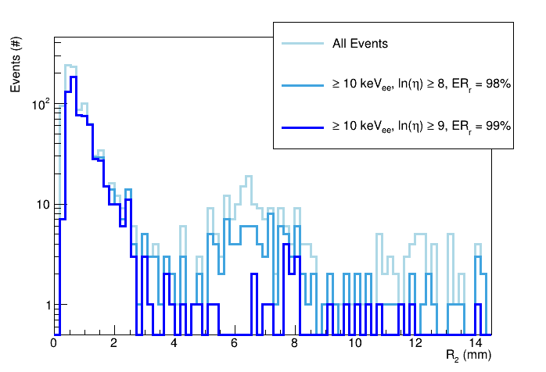
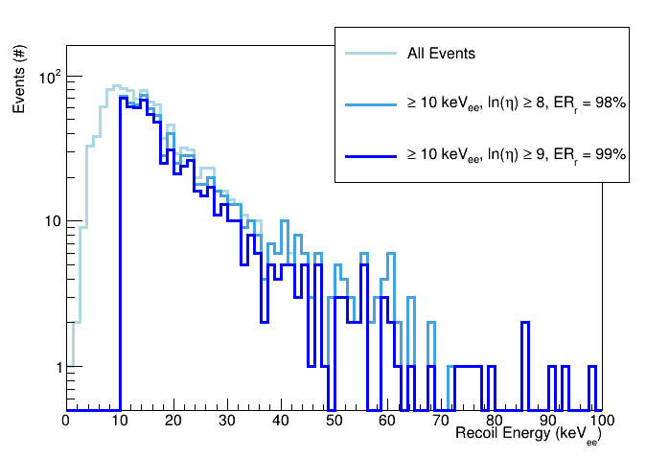
CYGNUS-m³ Scale “BENTO” Vessel
Supplementary simulations
Possible evidence of head-tail asymmetries and SF₅⁻ minority peaks with ~30% amplitude of main peak!
Further work required to confirm this is not due to MMThGEM hole pitch or other artifact
With simulated cuts applied, range and energy spectra are consistent with NR results previously obtained with Cf-252 NRs elsewhere.
Next step: scale up readout channels...
arXiv:2602.12658

Slide 16
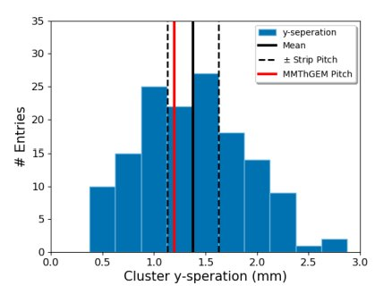
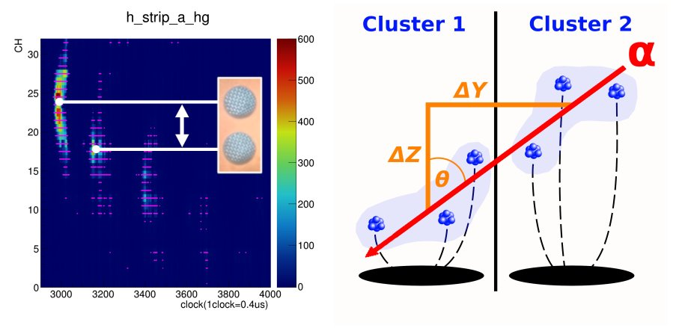
Coupled detector performs well, however...
Resolution is limited by the coarse MMThGEM hole diameter and pitch
Large 0.8 mm diameter limits spatial reconstruction capability
Large 1.2 mm pitch induces charge discontinuity effect – makes reliable track reconstruction challenging

Slide 17
What can we do about this?
Remove effect of hole geometry via deconvolution algorithm?- not impossible but tried before with limited success
Reduce diameter and pitch size? - limited by construction techniques
Remove the issue altogether? - introducing a new initiative...

Slide 18
LARD: a Low-cost Amplification and Readout Device
A 'hot-swappable' platform for detector development

Slide 19




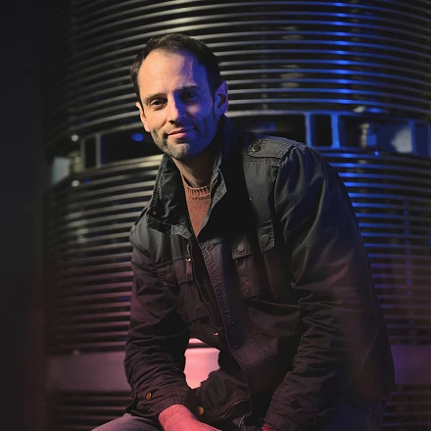

LARD: 3D Printed Micromesh Structures
Main Challenges with MPGD development:
GEMs are expensive
Long lead times for prototyping
Scarce expertise in design and manufacture
Initiative between University of Adelaide, Australian National University and Queen Mary University London to create 3D printed mesh structures as a gain stage
Initial R&D group:
Alasdair McLean
Adelaide University
Robert Renz Marcelo Gregorio
Australian National University
Dominic Howgill
Queen Mary University London
Growing R&D group:
Victoria Bashu
Australian National University
Lindsey Bignell
Australian National University
Gregory Lane
Australian National University
Open to growing collaboration...

Slide 20
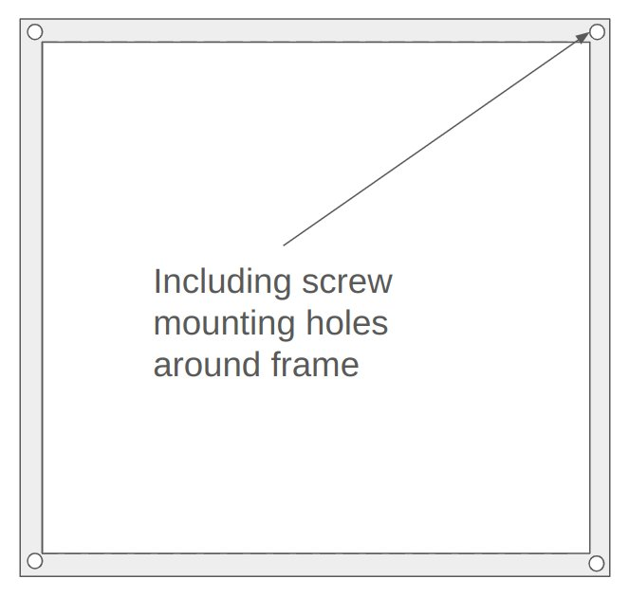



LARD: Concept of a "Hot-Swappable" Detector
Mounting Frame
Gap structure
3D printed parts:
Mounting frame (x2)
Gap structure
Conductive mesh between layers for biasing
"Bread"
Burger analogy
"Meat"
"Bread"

Slide 21
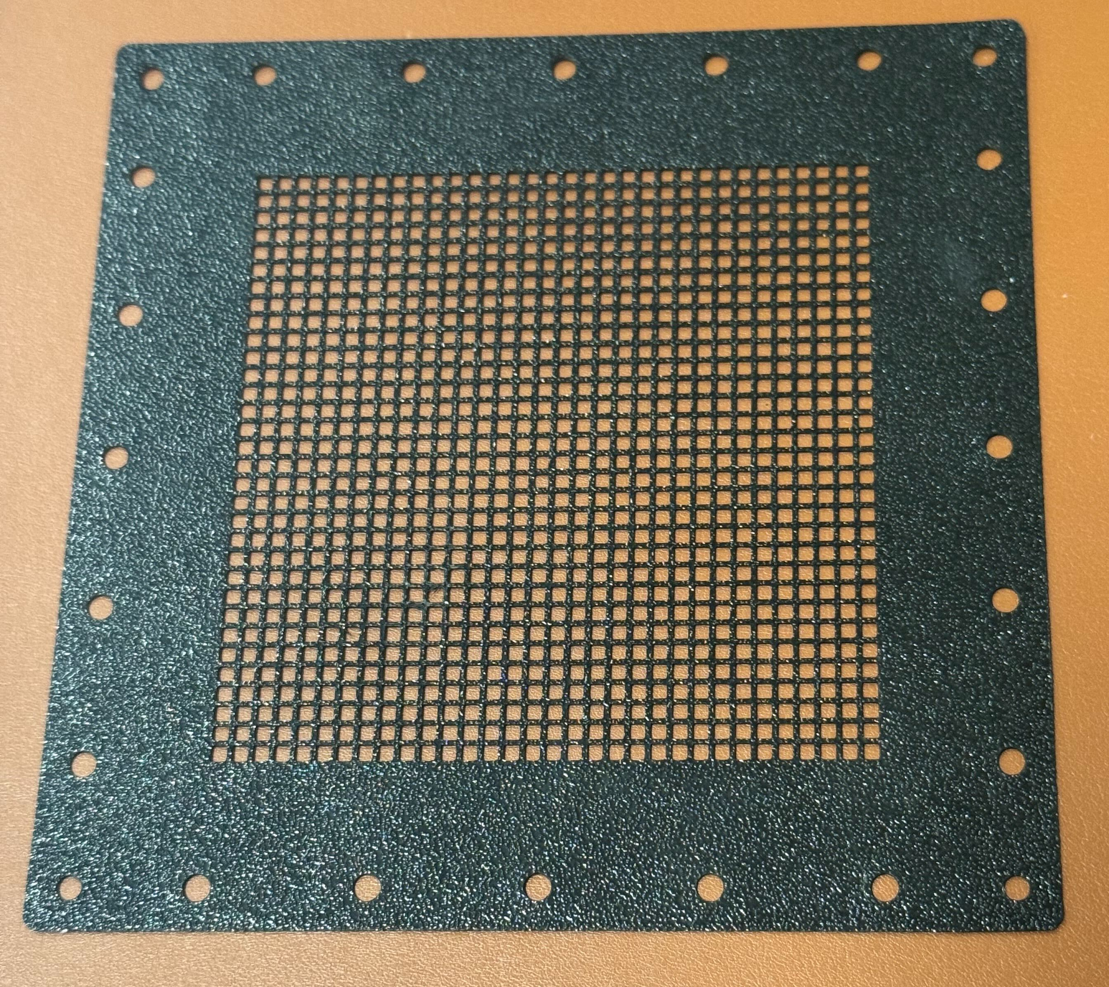
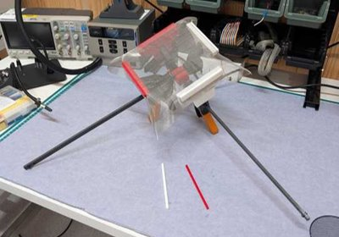
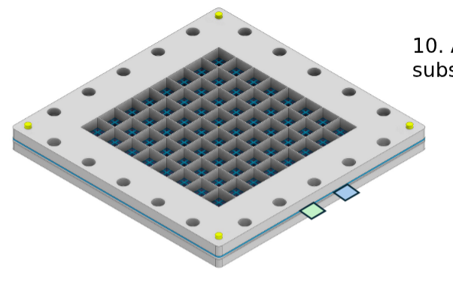
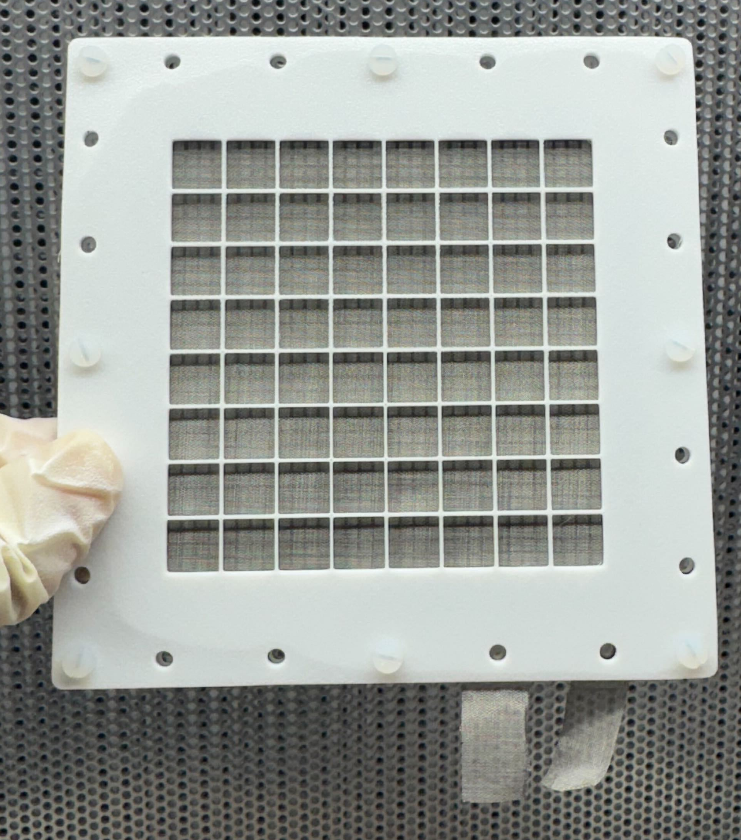
LARD V2 Prototype
Manufacturing procedure
High-precision 3D printing capability:
500 µm thickness (scope to go thinner)
Single pass printing to maximise support structure transparency
Mesh tensioning jig:
Techniques developed by University of Melbourne (Prof. Martin Sevior's Group)
x/y axis tensioning works better than the drum design
CAD model of LARDs V2 Prototype (left) and fully assembled prototype (right)

Slide 22
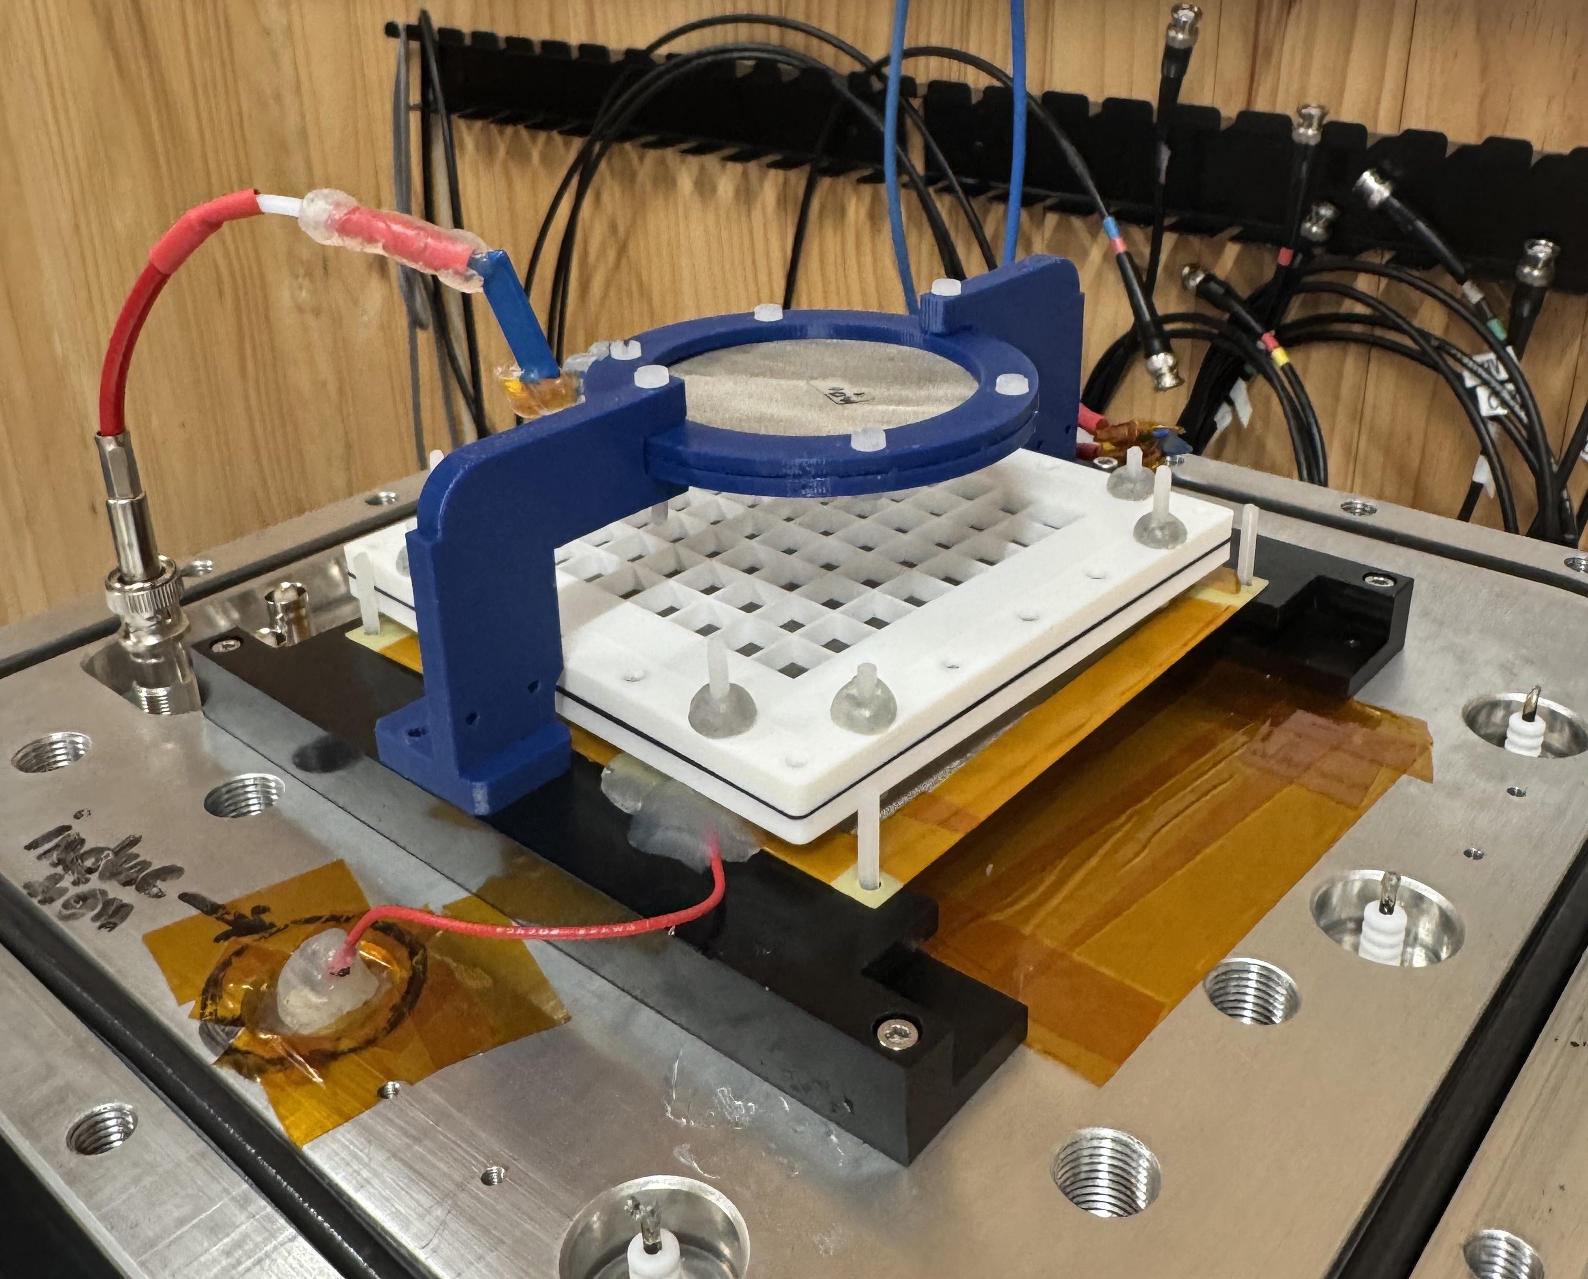
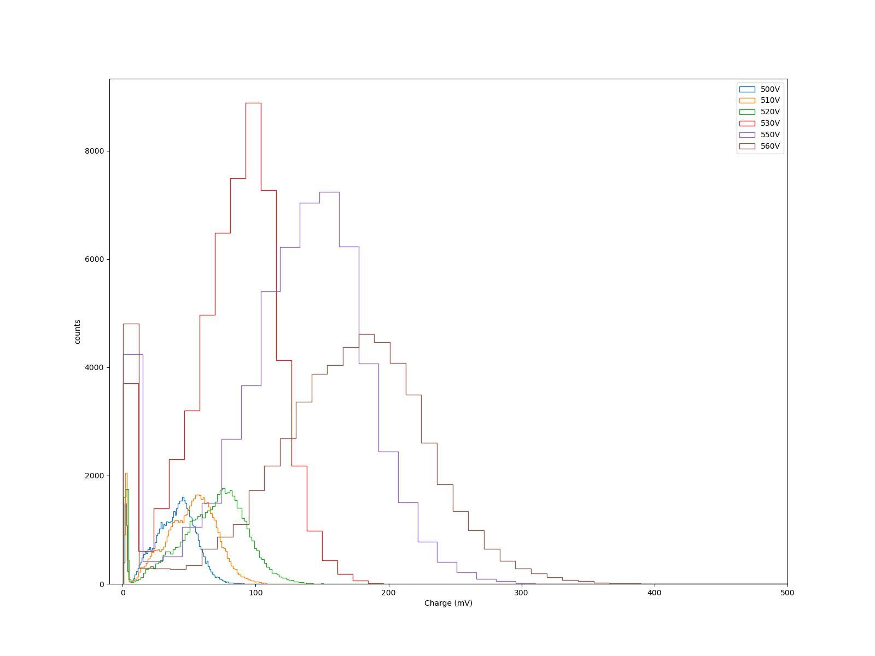
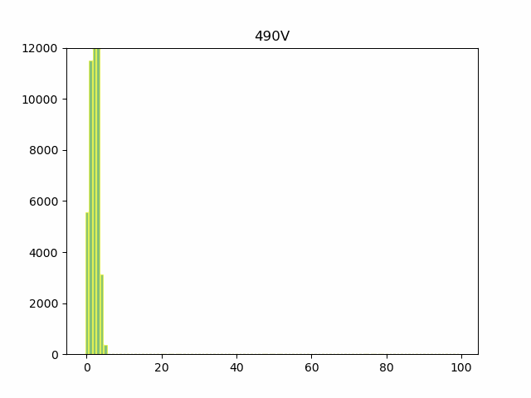
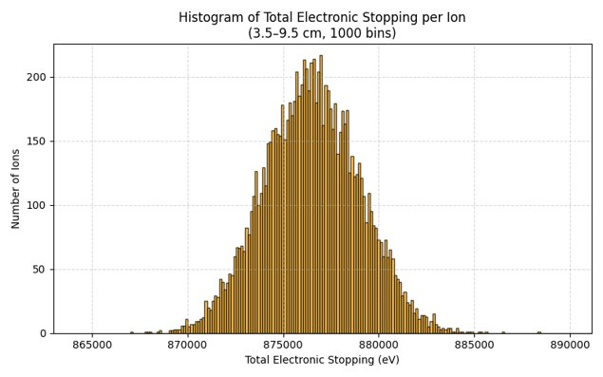
LARDs: Performance Testing
First light testing with alpha source
"easy" gas target (40 Torr CF4)
Good agreement with SRIM simulations
Estimated gain ~ 50 (set to go higher)
Counts (#)
Performance testing and analysis by V. Bashu (PhD candidate, ANU)
Signal Amplitude

Slide 23

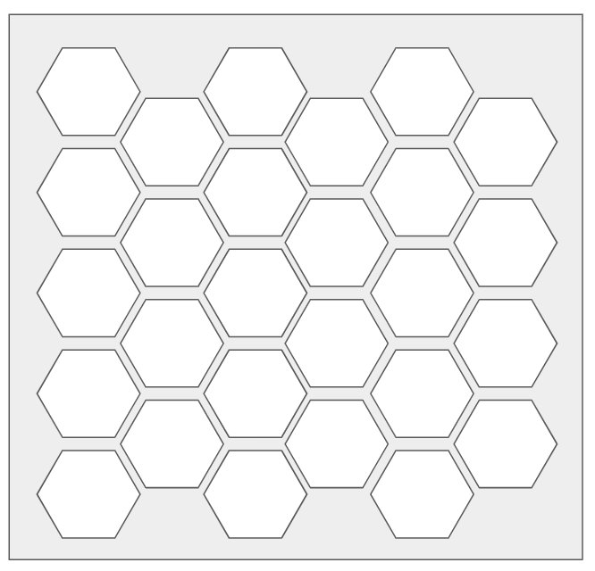
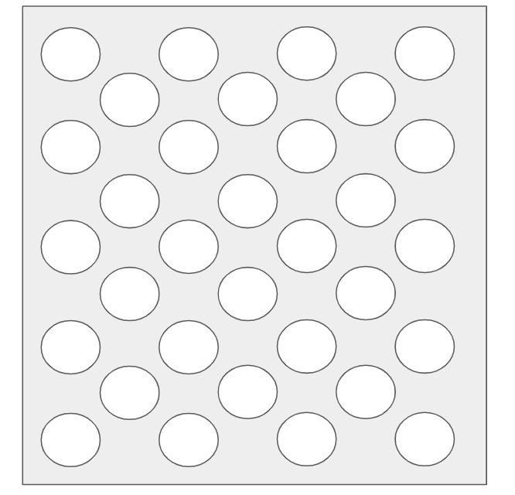
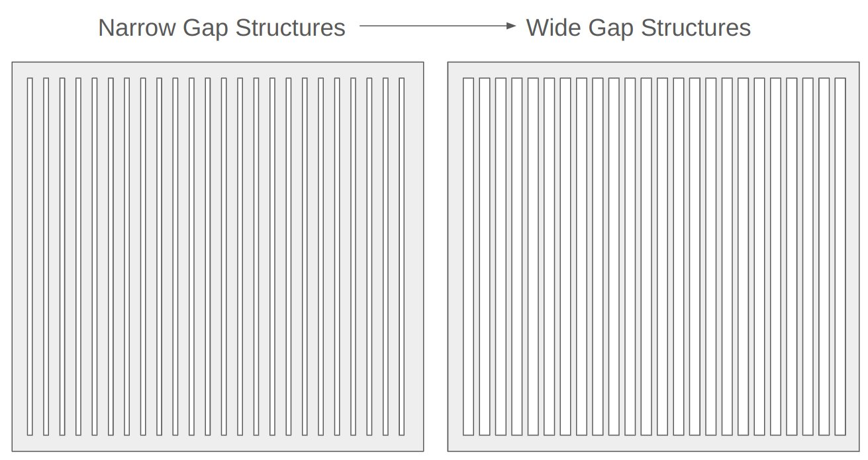
LARDs: What's next?
Platform for fundamental micromesh MPGD research – thickness, hole width, pitch, geometry, mesh parameters etc...
Comparison to industry standard GEM
"Stack-ability" - can we replicate or improve the NI MMThGEM amplification results without the issue of the coarse hole structure?
Scope for CYGNET implementation – highly scalable
?
"Bread"
"Meat"
"Bread"
"Meat"
"Bread"

Slide 24
Summary

Slide 25
Summary and Outlook
MMThGEM micromesh structures have shown huge potential with 10⁵ gas gain in SF₆
MMThGEM design currently limiting positional/track reconstruction capability
Practical solution: continue developing LARD as an in-house MPGD R&D capability
Lots of scope for novel MPGD research output

Slide 26
Thanks for listening
Any questions?

Slide 27
Acknowledgements
Thank you to:
Kentaro Miuchi, Satoshi Higashino and wider Kobe group for hosting the field research with the coupled MMThGEM-Micromegas testing (and organising this fantastic conference!)
Dominic Howgil, Robert Renz Marcelo Gregorio, Lindsey Bignell, Gregory Lane, Victoria Bashu without whom the LARDs development would not be possible
Neil Spooner for your continued support and guidance

