Slide 1

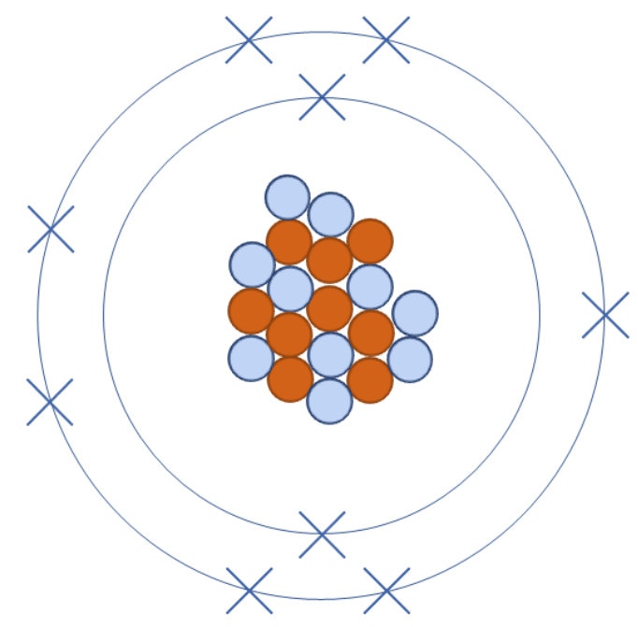


A 40‑L Gaseous TPC with X/Y Strip Readout for Cost‑Effective Directional Recoil Detection
Michael Litke
$$ν$$
$$ν$$

Slide 2
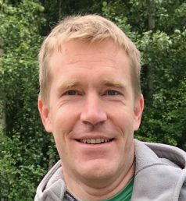
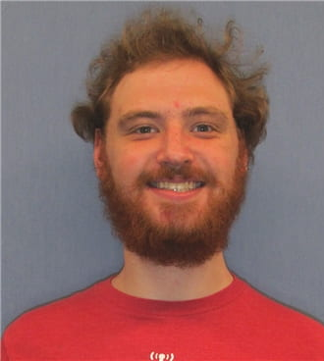


Vahsen lab TPC R&D
Prof Sven Vahsen
Dr Majd Ghrear (frmr PhD student)
Shashank Jayakumar (post doc)
Michael Litke (PhD Student)
Aleczander Paul (PhD student)
Sola Long (PhD Student)
Gage Wettlaufer (frmr undergrad)

Slide 3
Motivation and history of directional recoil detection at UH
Overview off the 40L TPC
40 L TPC commissioning status
Plans at Oak Ridge National Lab

Slide 4
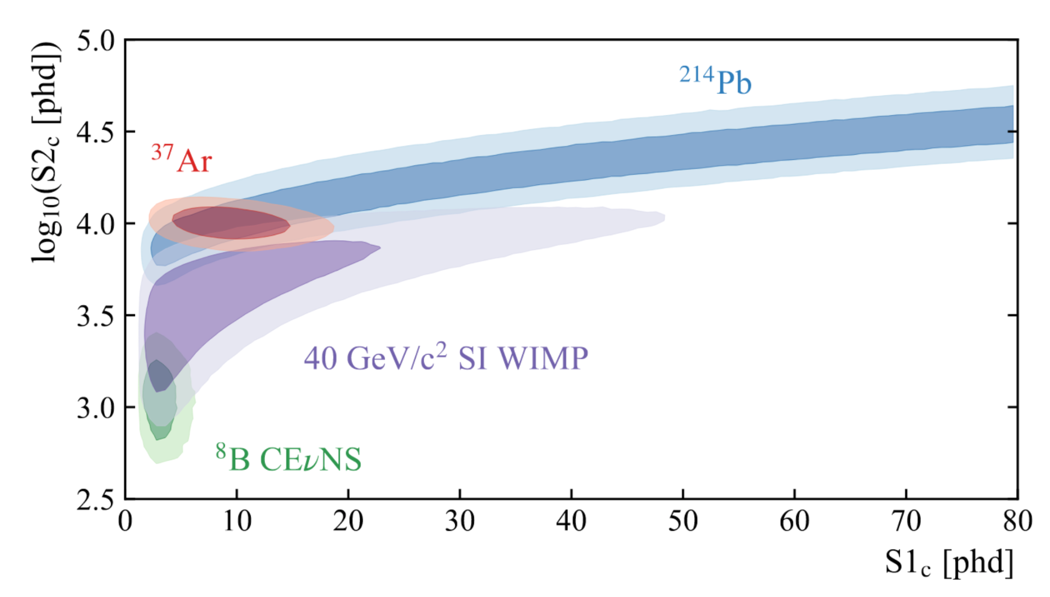
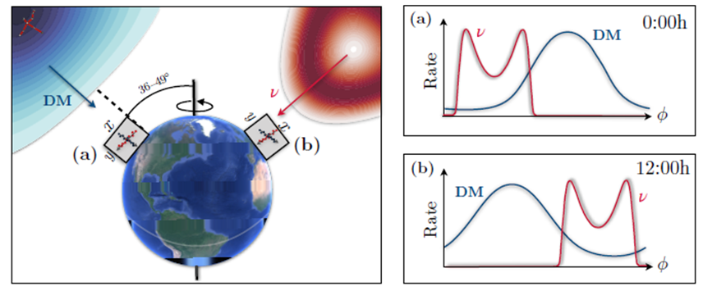
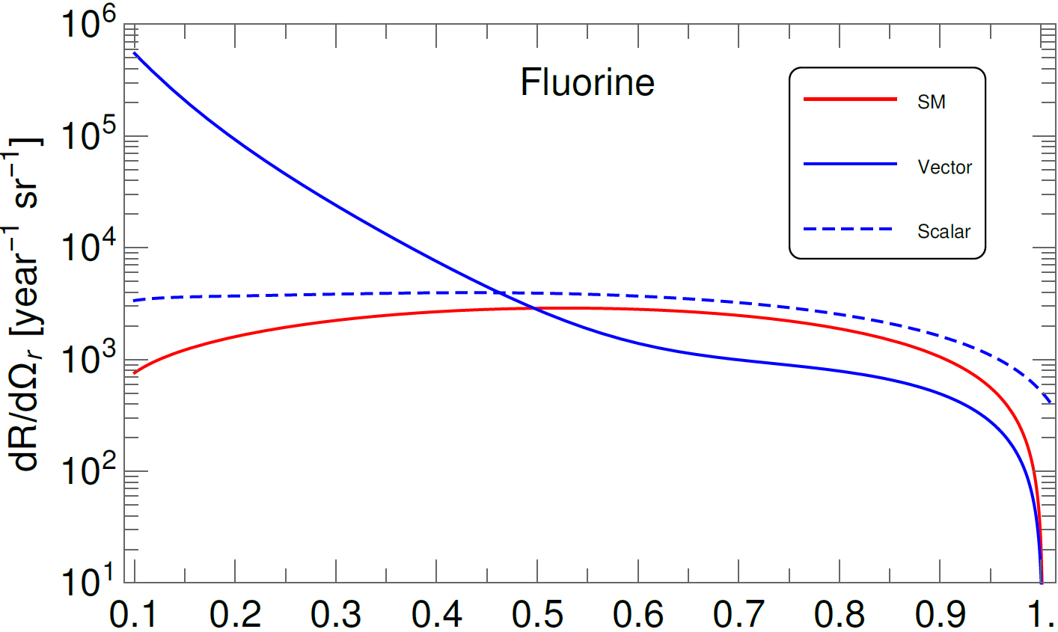
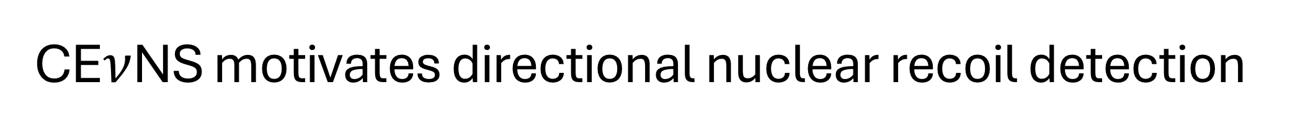
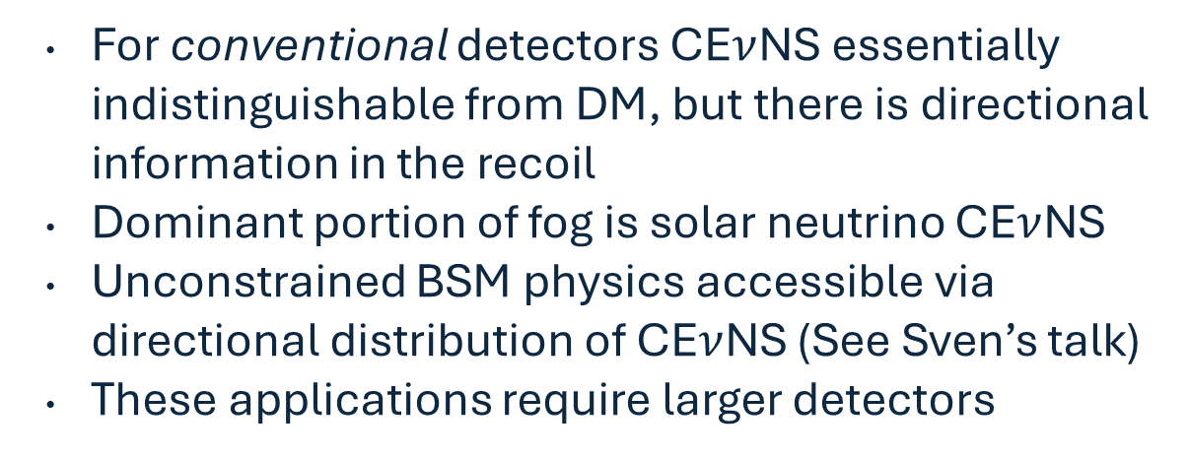
CE$ν$NS motivates directional nuclear recoil detection
For conventional detectors CE$ν$NS essentially indistinguishable from DM, but there is directional information in the recoil
Dominant portion of fog is solar neutrino CE$ν$NS
Unconstrained BSM physics accessible via directional distribution of CE$ν$NS (See Sven’s talk)
These applications require larger detectors
[LZ Collaboration 2201.0285]
Abdullah et all arXiv:2003.11510
Vahsen et al. [arXiv:2102.04596]
4

Slide 5
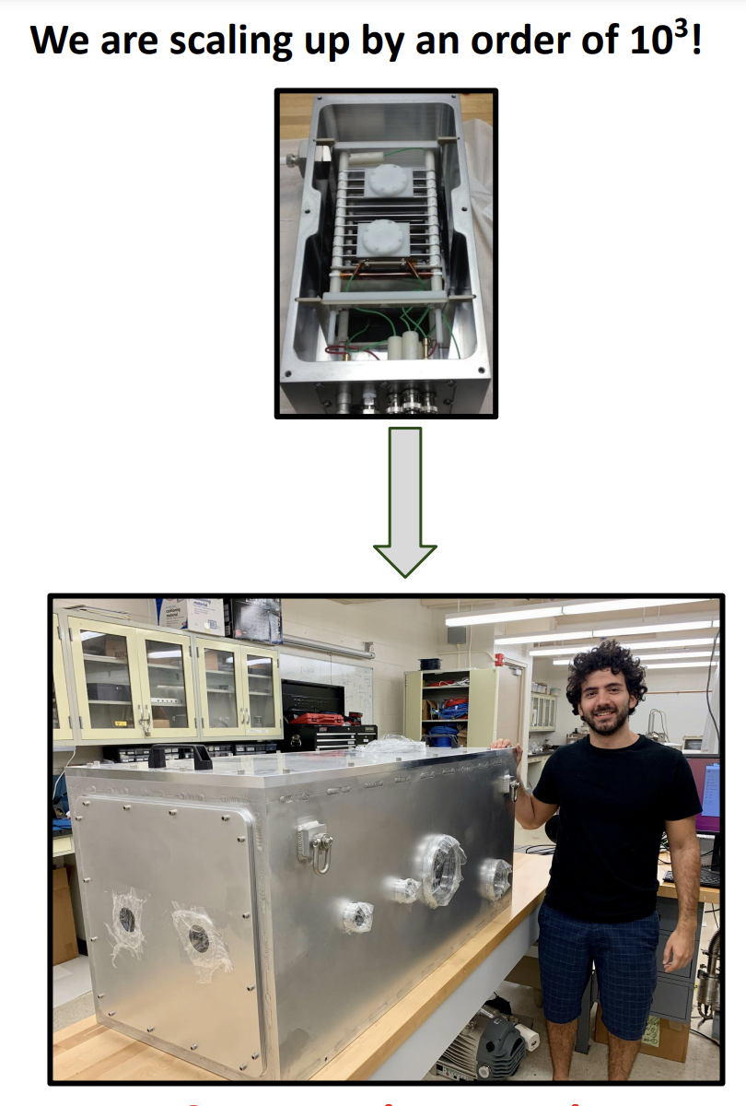
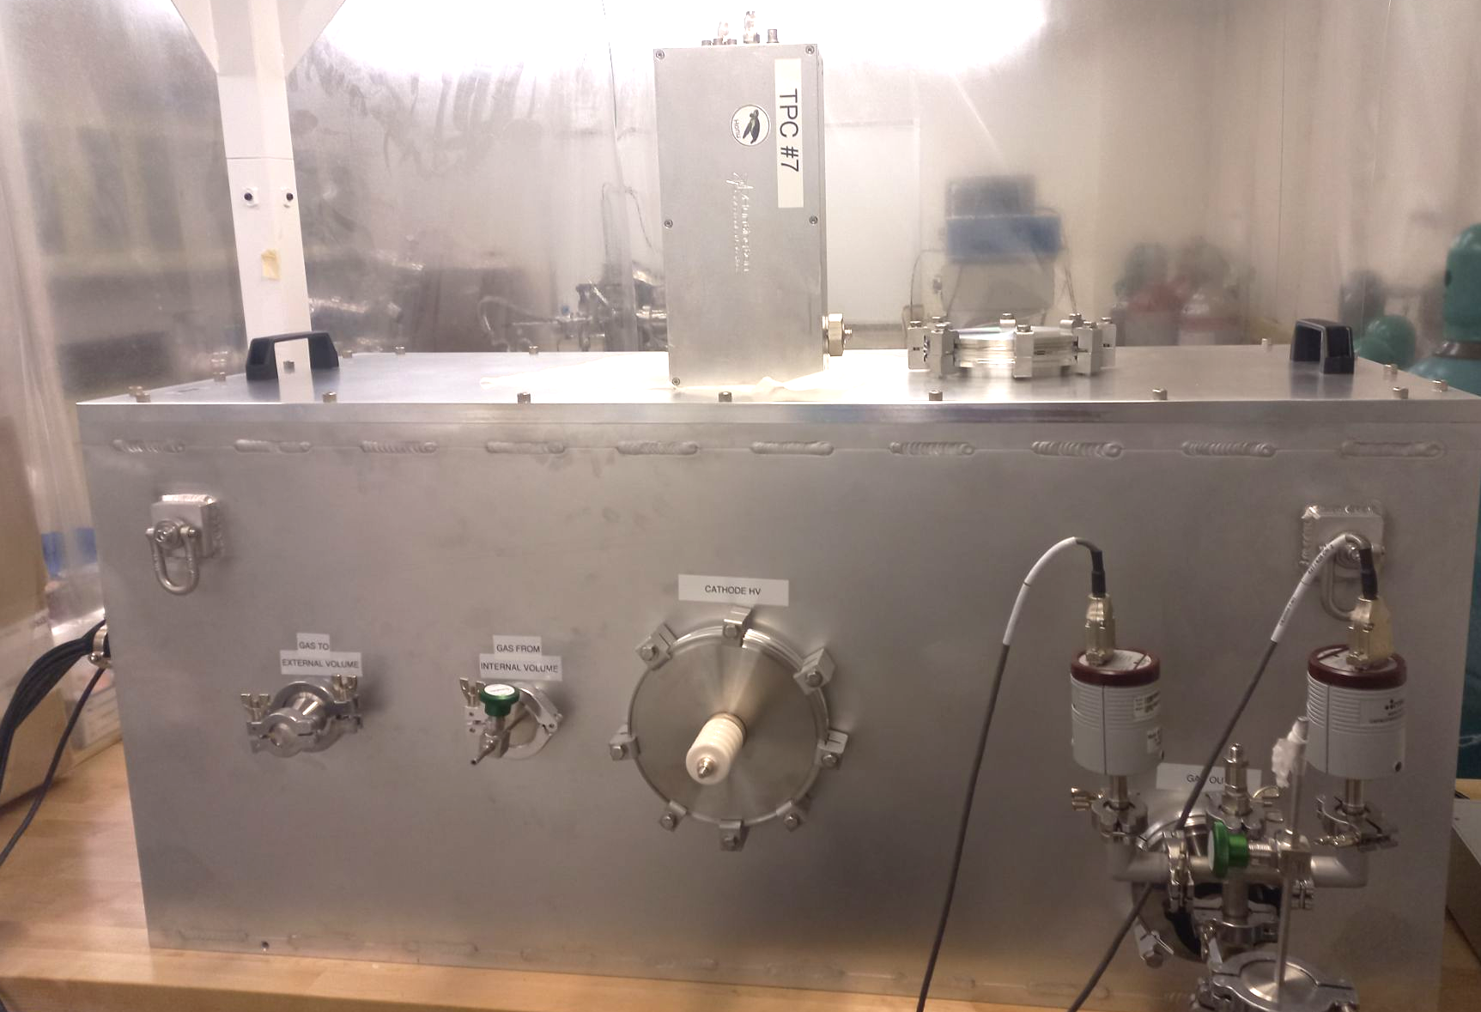
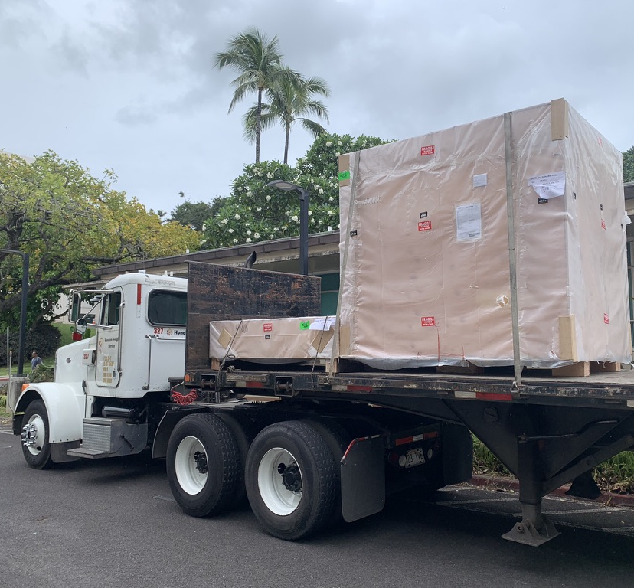
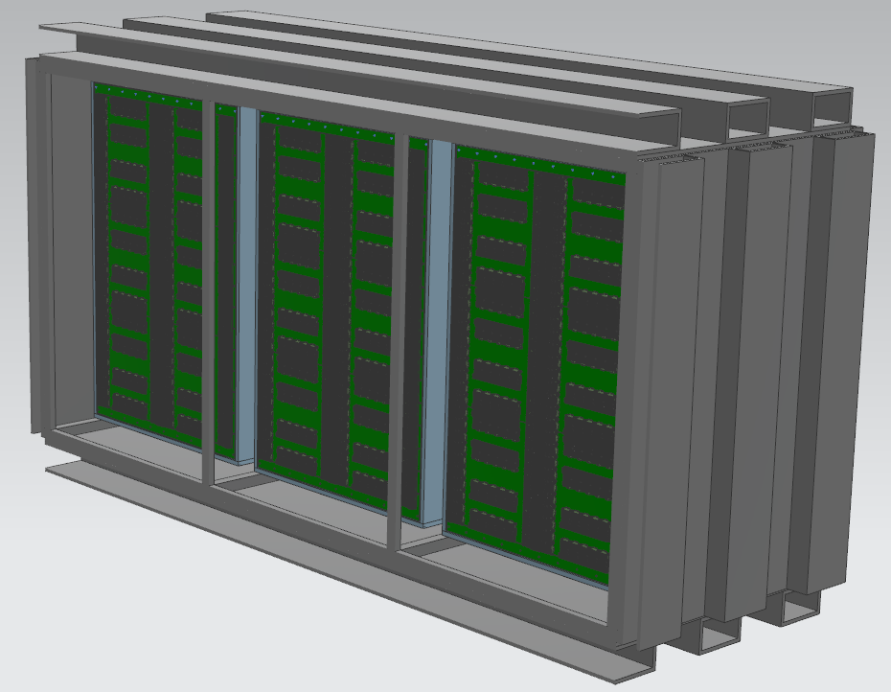
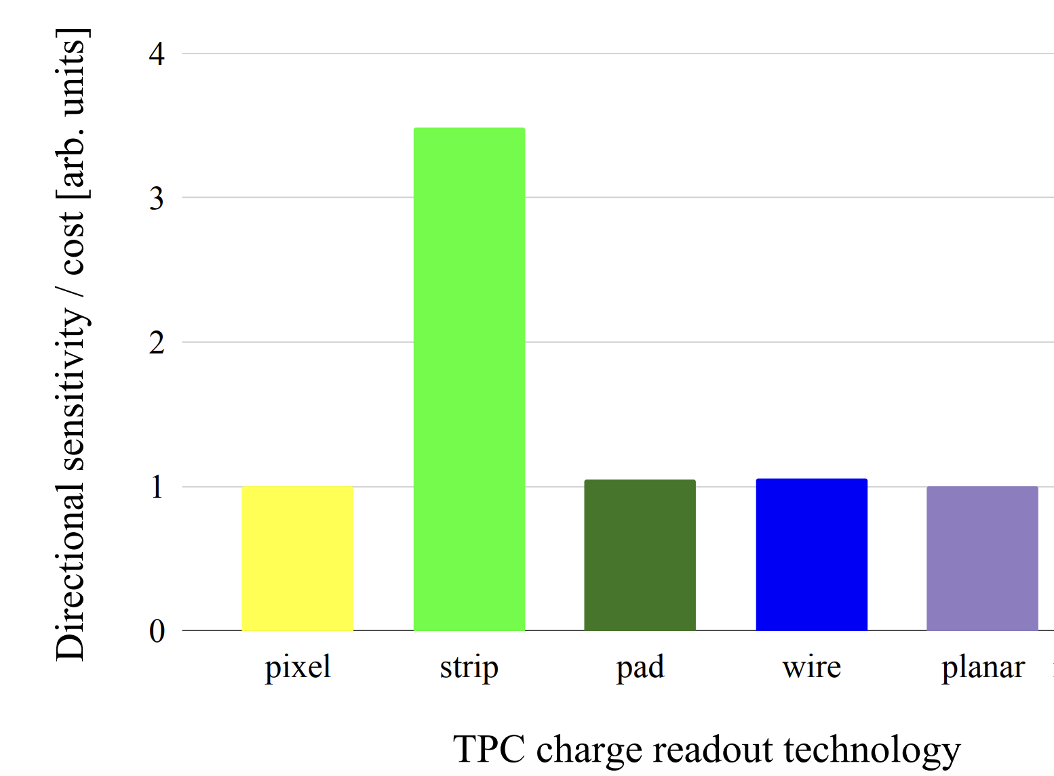


Scalable directional detectors
40 cm³
1$m^{3}$
x1000
x25
x10
40 L
10$m^{3}$
Sola Long will discuss the BEAST TPCs in more depth
Best Raw Performance
Main barrier to scaling up is cost
  ASIC pixel chips are very expensive per unit area
Very large experiments will have to use multiple separate volumes
  40L is a protype unit cell for future much larger detectors
Best directional WIMP sensitivity / unit cost

Slide 6
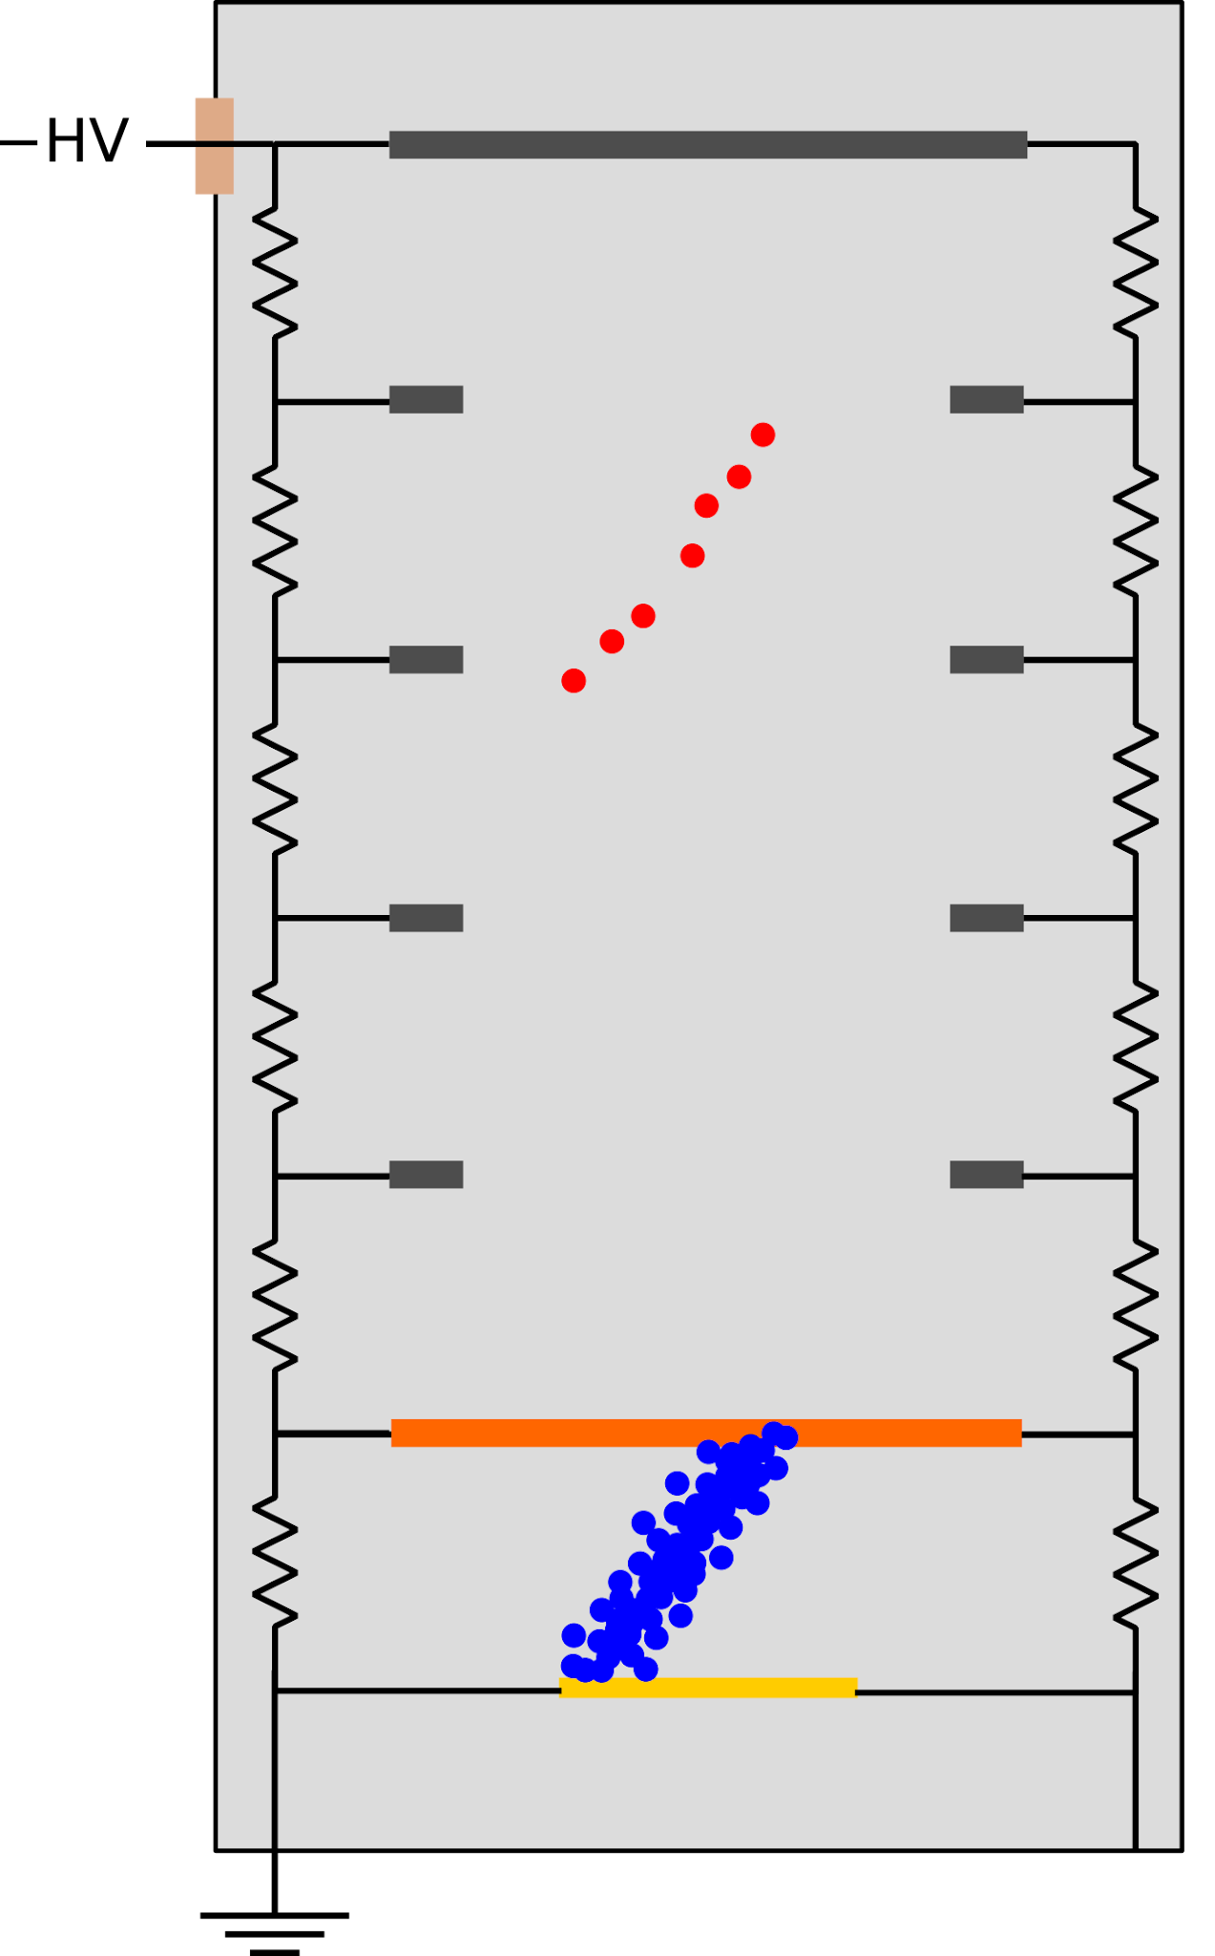
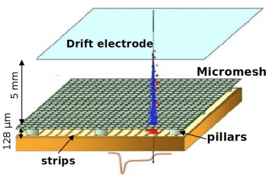
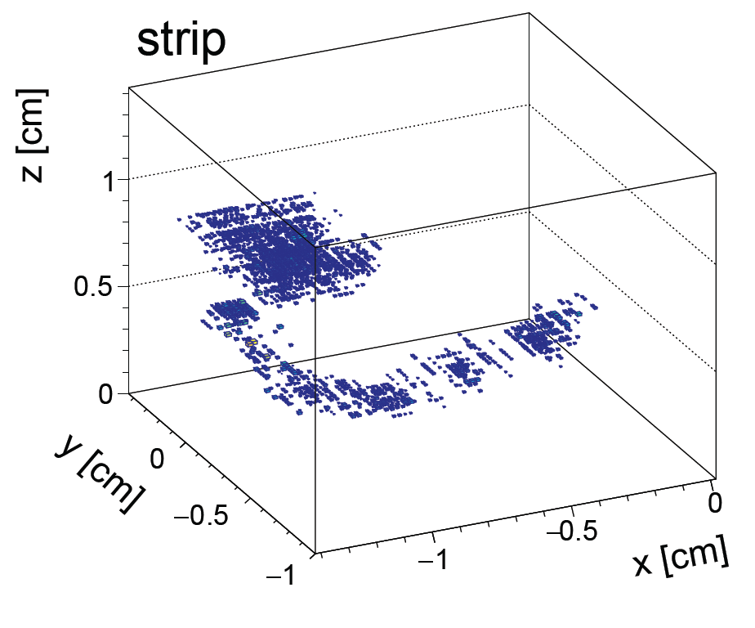
A Brief explanation of our Micromegas based Gas TPCs
Sequence of events in a single detection:
  Target gas held in a uniform electric field
  Incoming particle generates some ionization
  Charge cloud drifts into high field region, is amplified
  Amplified charge reaches readout strips and generates a signal
Regions are separated by a woven wire mesh (the mesh is called a micromegas: Micro-mesh gaseous structure)

Slide 7
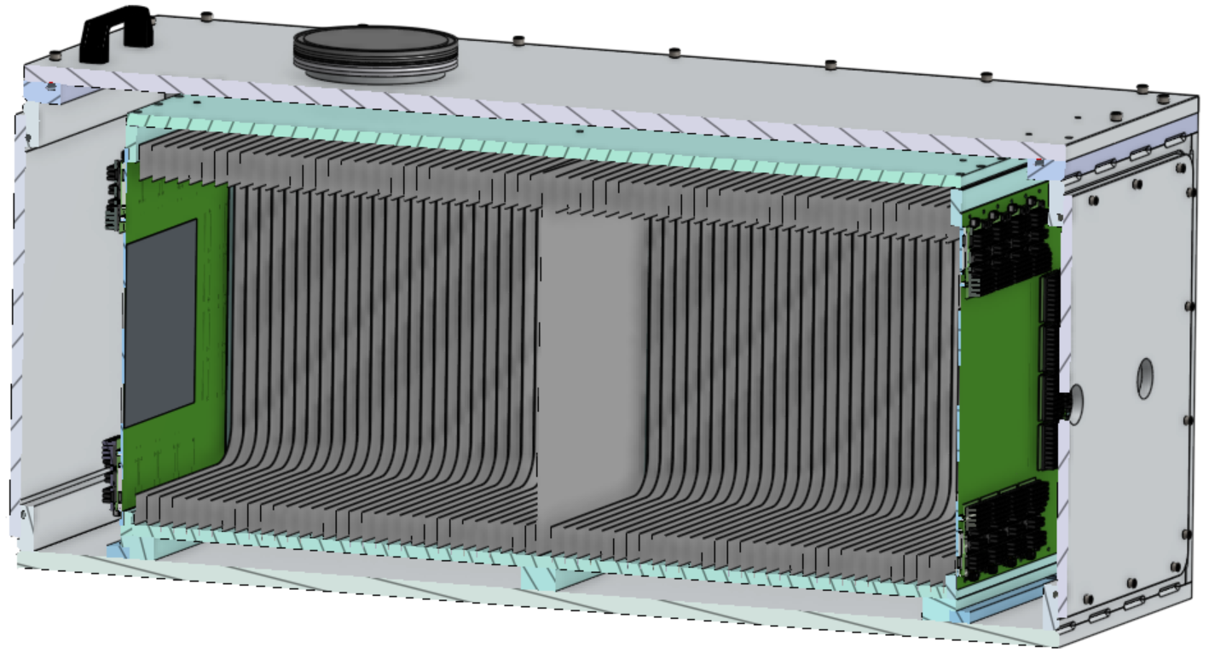
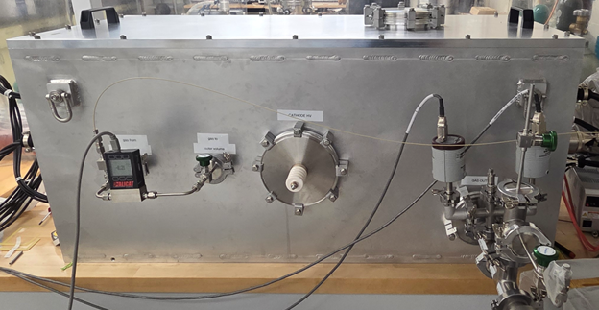
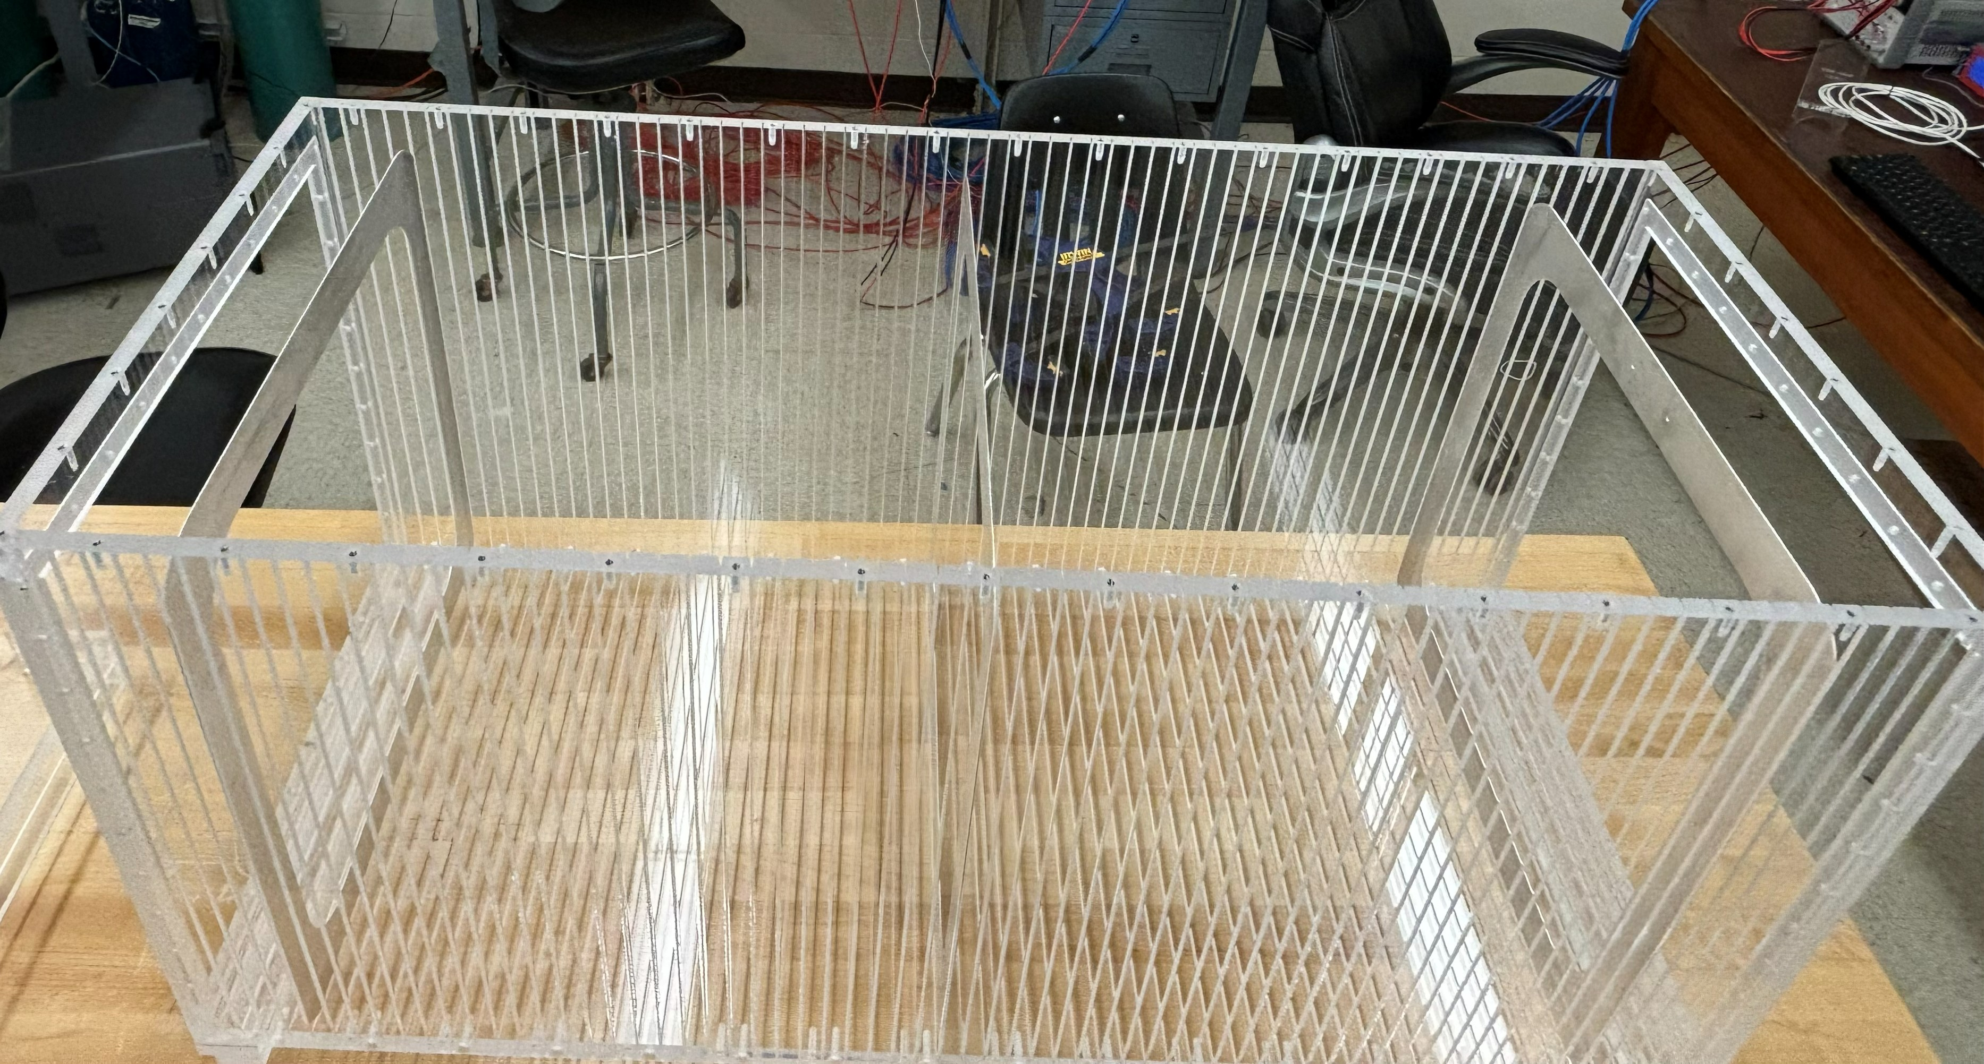
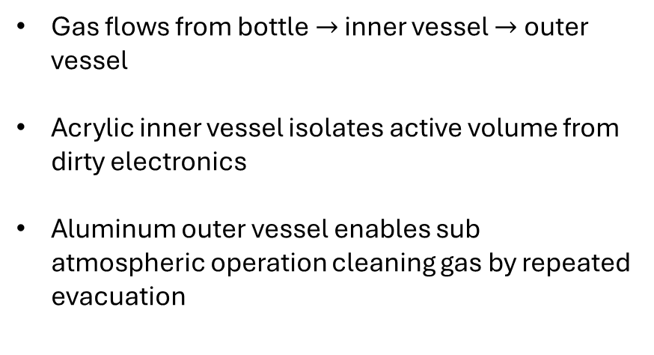
40L detector overview: two vessel scheme
Gas flows from bottle $→$ inner vessel $→$ outer vessel
Acrylic inner vessel isolates active volume from dirty electronics
Aluminum outer vessel enables sub atmospheric operation cleaning gas by repeated evacuation
Sensitive area
Outer vessel
Cathode
Inner vessel
Field cage rings
Readout electronics

Slide 8
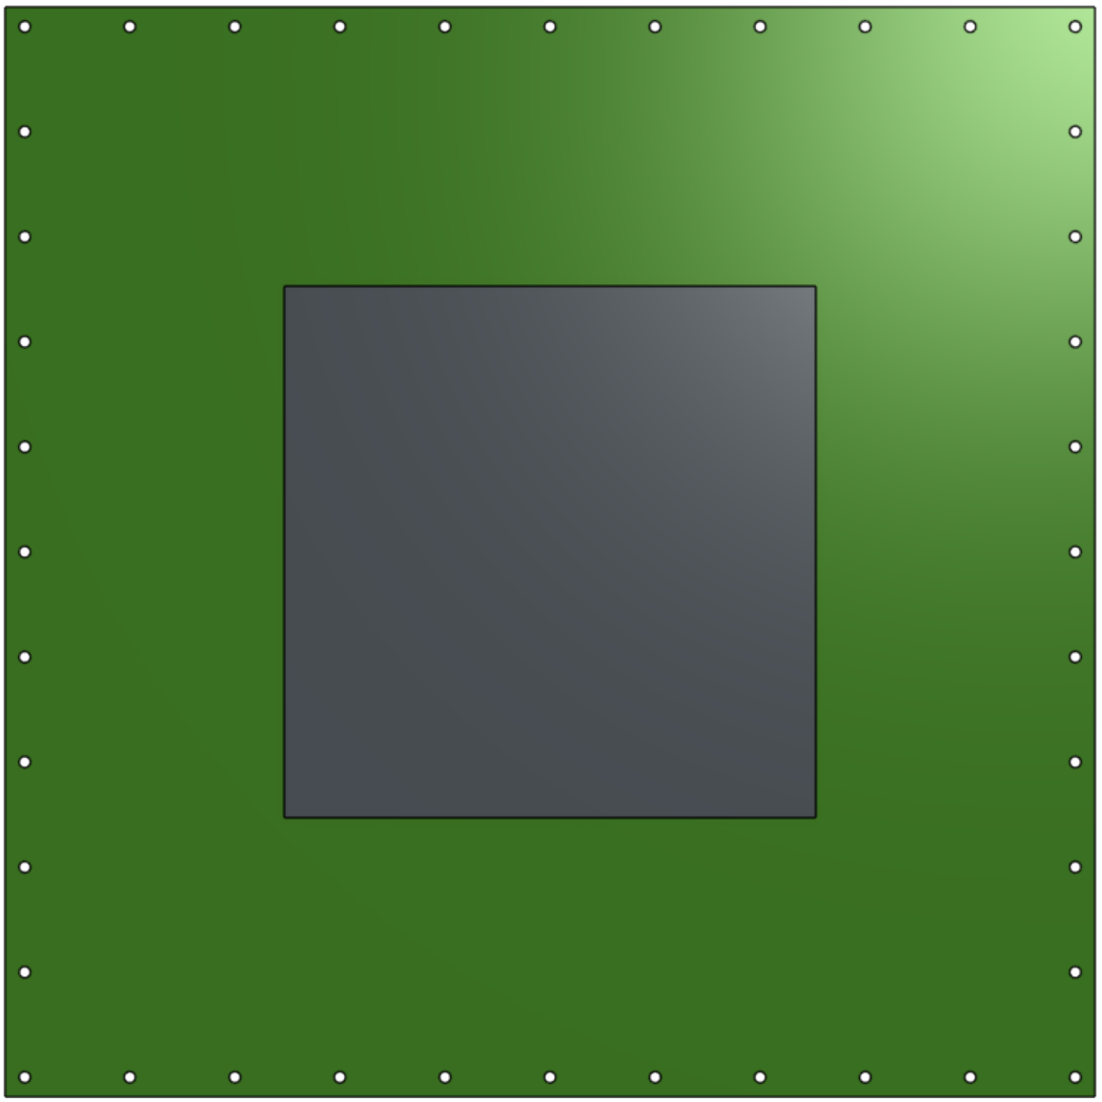
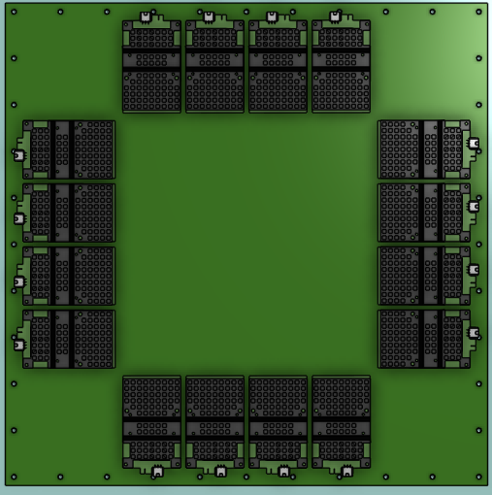
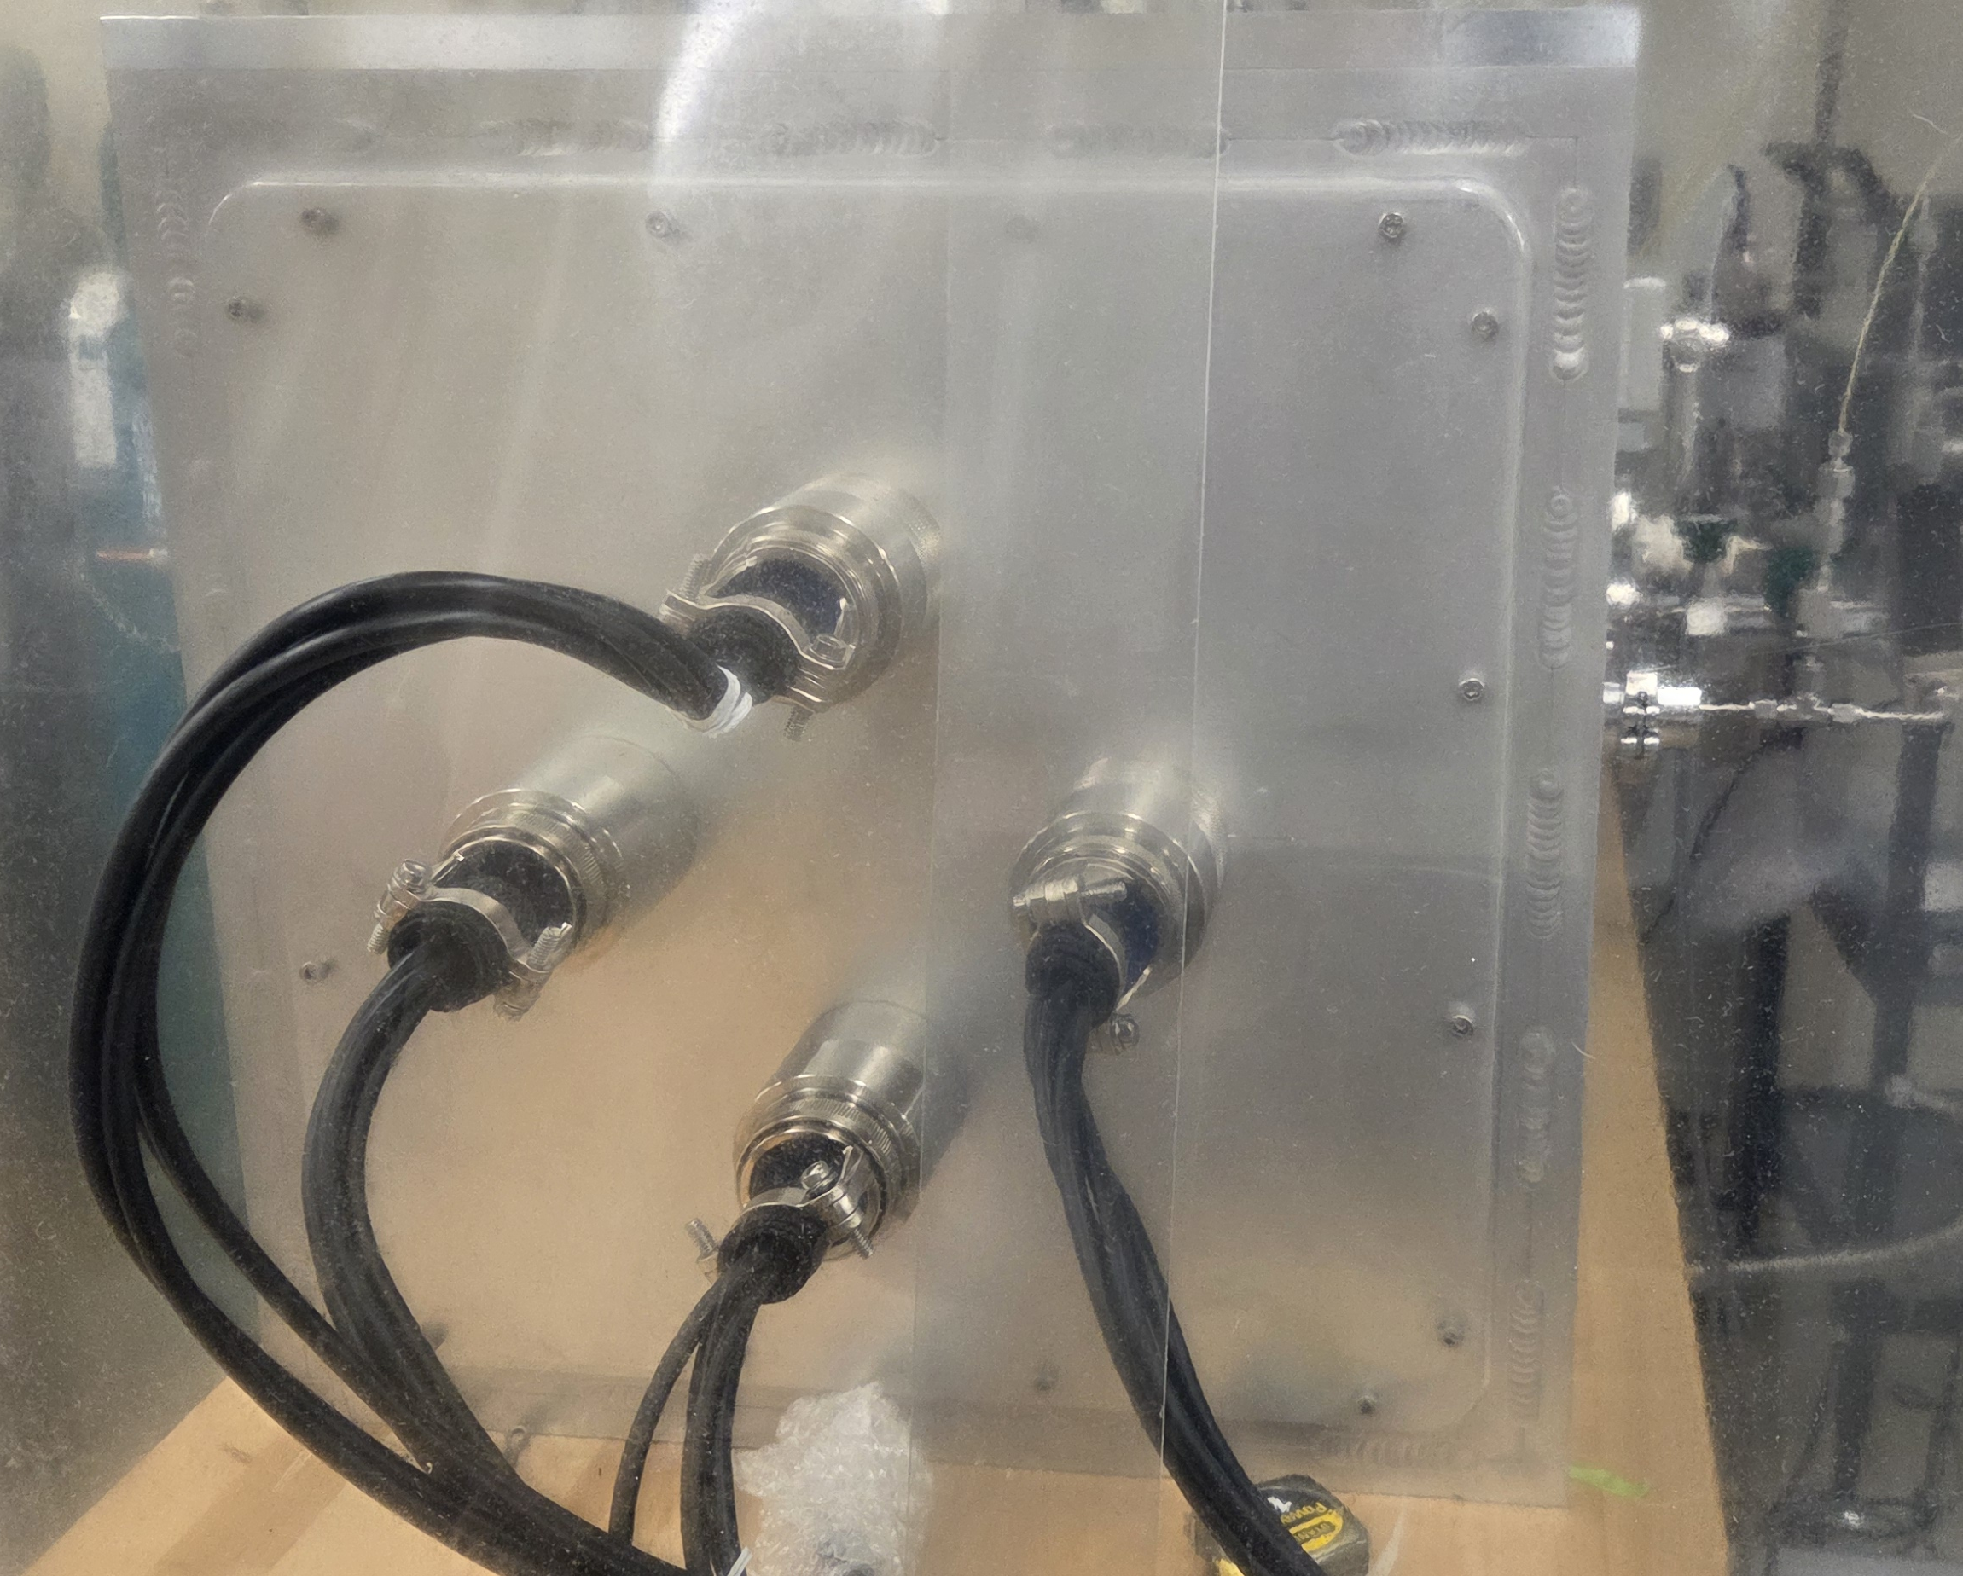
40L detector overview: readout plane
Micromegas amplification w XY strip readout
20x20 cm sensitive area containing 4000 total strips
Signal digitized with 16 CERN VMM preamps, readout via CERN SRS electronics (see Aleczander Paul’s talk for more on this)
Preamps + digitization inside outer vessel allows for only 4 feedthroughs on each side of the detector
Front Back

Slide 9
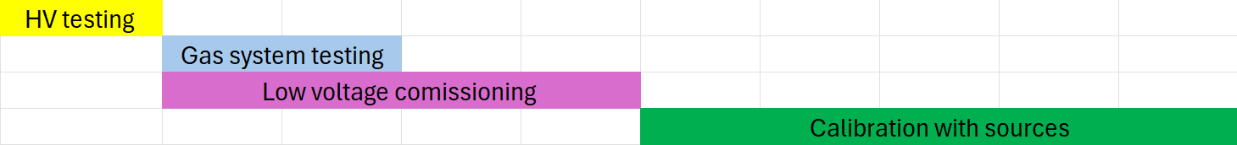
Commissioning steps
HV testing (complete):
Testing for sparking in components exposed to high voltages
Gas system testing (ongoing):
Leak testing, flow resistance, gas purity
Low voltage commissioning (ongoing, see Aleczander Paul’s talk):
VMM cooling system, DAQ testing
Source calibration (planned):
Fe-55 for gain calibration, gain resolution measurement
Angular resolution measurement with alpha particles
Neutron source to conduct first nuclear recoil measurements

Slide 10
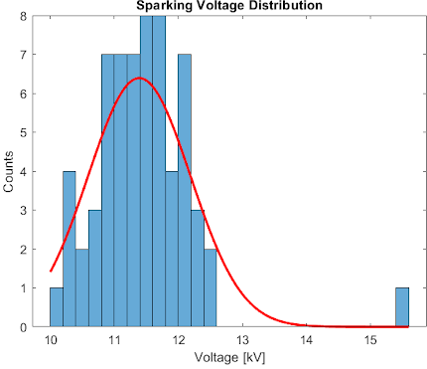
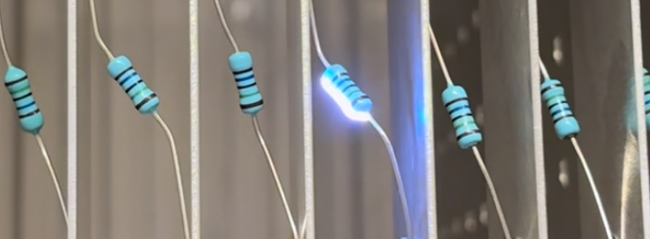
Spark testing the field cage rings
Goal of HV testing: detect any HV components that might lead to sparking at low E-fields
Drift field will be 544 V/cm for initial testing with our reference gas He:CO (70:30) 816 V between rings
We tested in air. Max E-field strength before breakdown is ~4x higher in air than in He:C02
Goal: 2x safety factor minimum acceptable sparking voltage of 816x4x2=6428 V
  All ring pairs sparked well above this threshold
Also performed an absolute potential test: applied 30kV to cathode without sparking anywhere.
  HV system fully passed testing

Slide 11
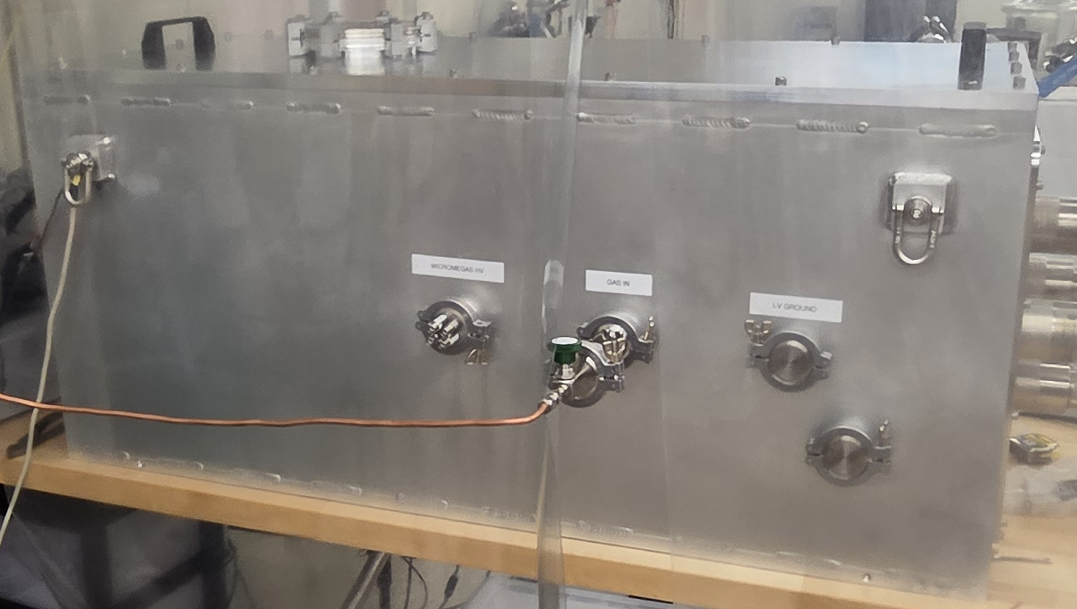
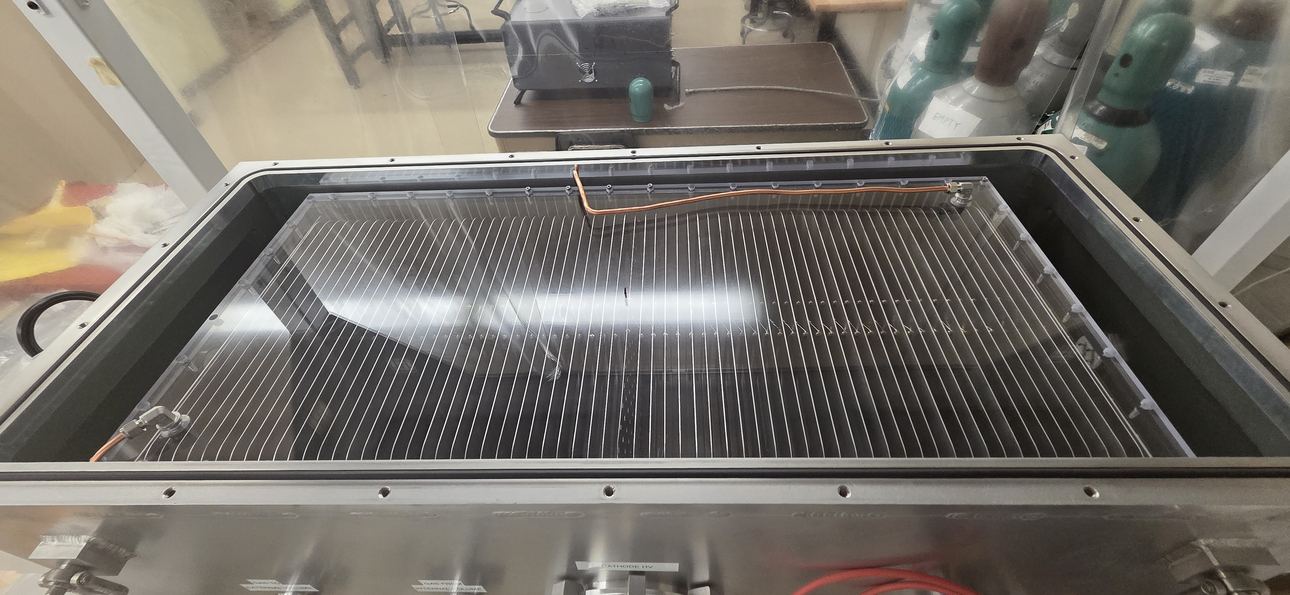
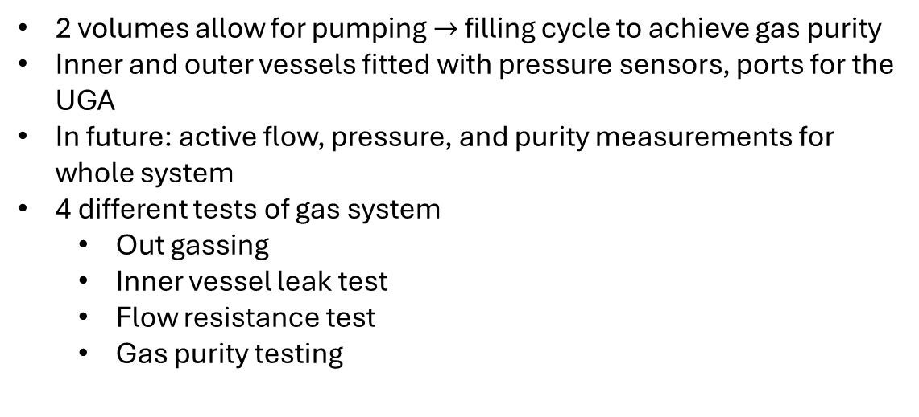
New gas system
Outer vessel
P sensor
Gas bottle
Pump
Inner vessel
Valve 2
Vent
OV sniffer port
Gas analyzer
P sensor
Valve1
IV sniffer port
2 volumes allow for pumping $→$ filling cycle to achieve gas purity
Inner and outer vessels fitted with pressure sensors, ports for the UGA
In future: active flow, pressure, and purity measurements for whole system
4 different tests of gas system
  Out gassing
  Inner vessel leak test
  Flow resistance test
  Gas purity testing

Slide 12
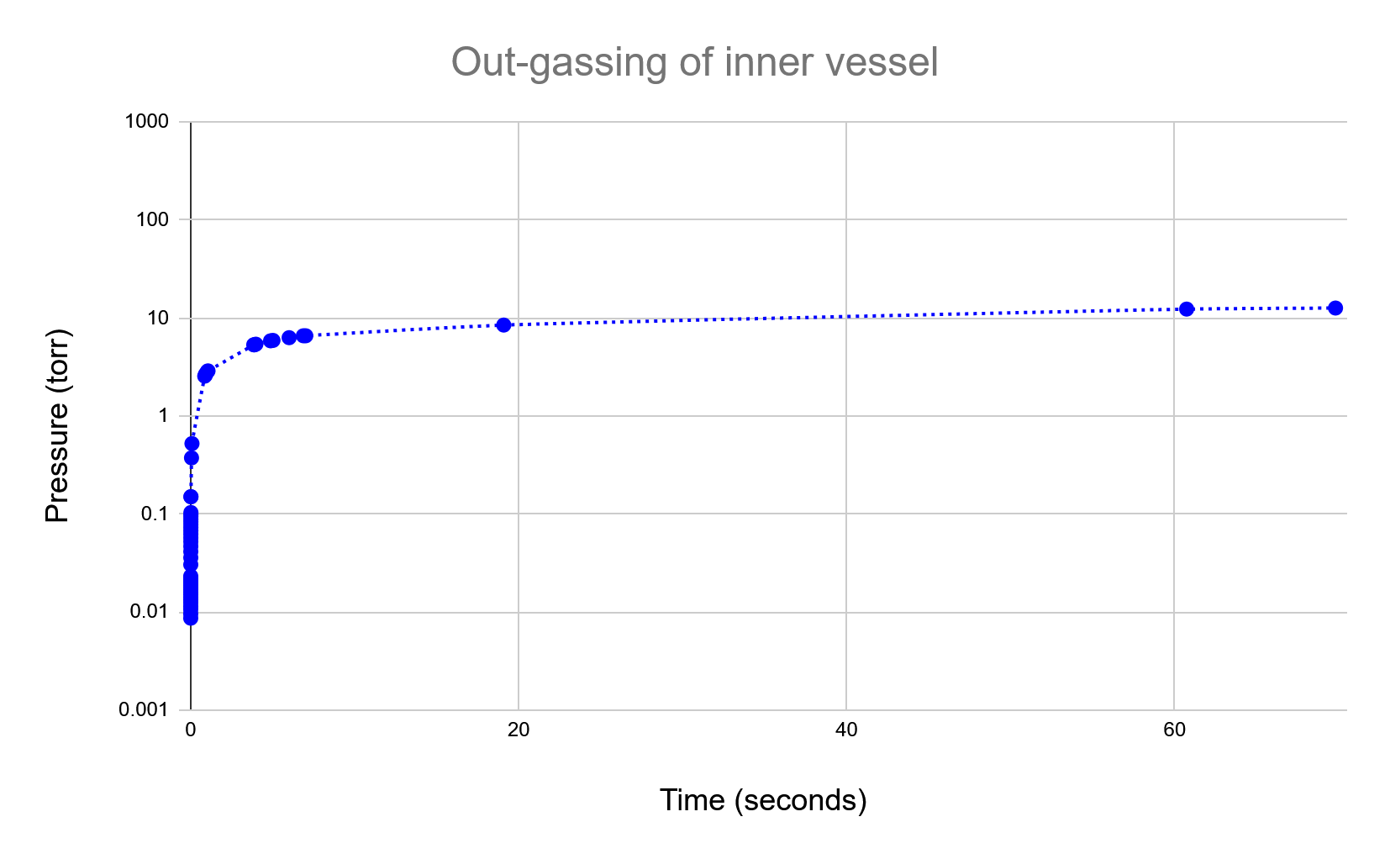
Out-gassing test
Procedure:
With lid off of inner vessel:
Pump detector down to ~1mtorr
Shut off pump and observe rise in pressure
Baseline rate of rise for a known no virtual leak scenario
outgassing rate agreed with prediction by mechanical engineer, dominated by acrylic of inner vessel
Closed Open Helium Air Vacuum

Slide 13
Inner vessel leak testing
Outer vessel
P sensor
Procedure:
Flow helium into inner vessel while outer vessel open, all other valves closed
Use sniffer tube to find any leaks
Observed several large leaks from inner to outer vessel. Spent time improving this. We want flow from inner to outer vessel, so seal not required to be perfect
Gas bottle
Pump
Inner vessel
Vent
OV sniffer port
Valve 2
Gas analyzer
P sensor
Valve1
Closed
Open
IV sniffer port

Slide 14
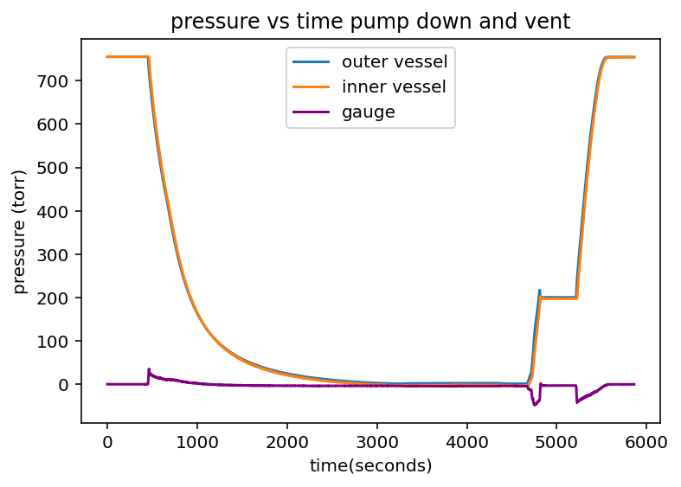
Flow resistance test
Closed
Open
Outer vessel
P sensor
Pump
Inner vessel
Valve 2
(open)
Vent
OV sniffer port
P sensor
Valve1
IV sniffer port
Outer vessel
P sensor
Pump
Inner vessel
Valve 2
(open)
Vent
OV sniffer port
P sensor
Inner vessel holds ~20torr at very high flow rates
  this may be sufficient for operation - t.b.d
Need more instrumentation to fully characterize flow resistance curve
Valve1
IV sniffer port

Slide 15
Gas purity testing (ongoing)
Closed Open Helium Air Vacuum
Goal: determine best initial gas purity that can be reached with repeated evacuation + purging with N2 or He, without/before continuously flowing target gas
Need electronegative species (mainly O2 & H20) below ~ 10ppm
Purity plateauing after 2 cycles suggests a virtual leak, most likely in the pump valve
If outgassing barrier to good purity flowing needed for operation

Slide 16
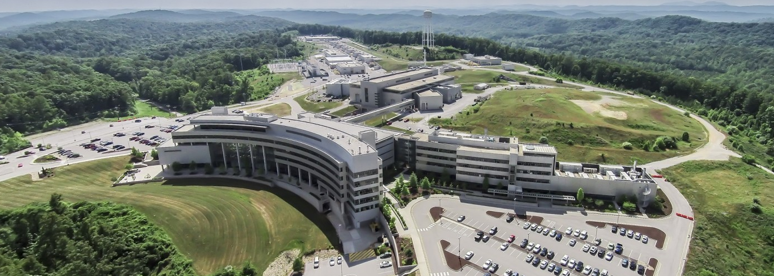
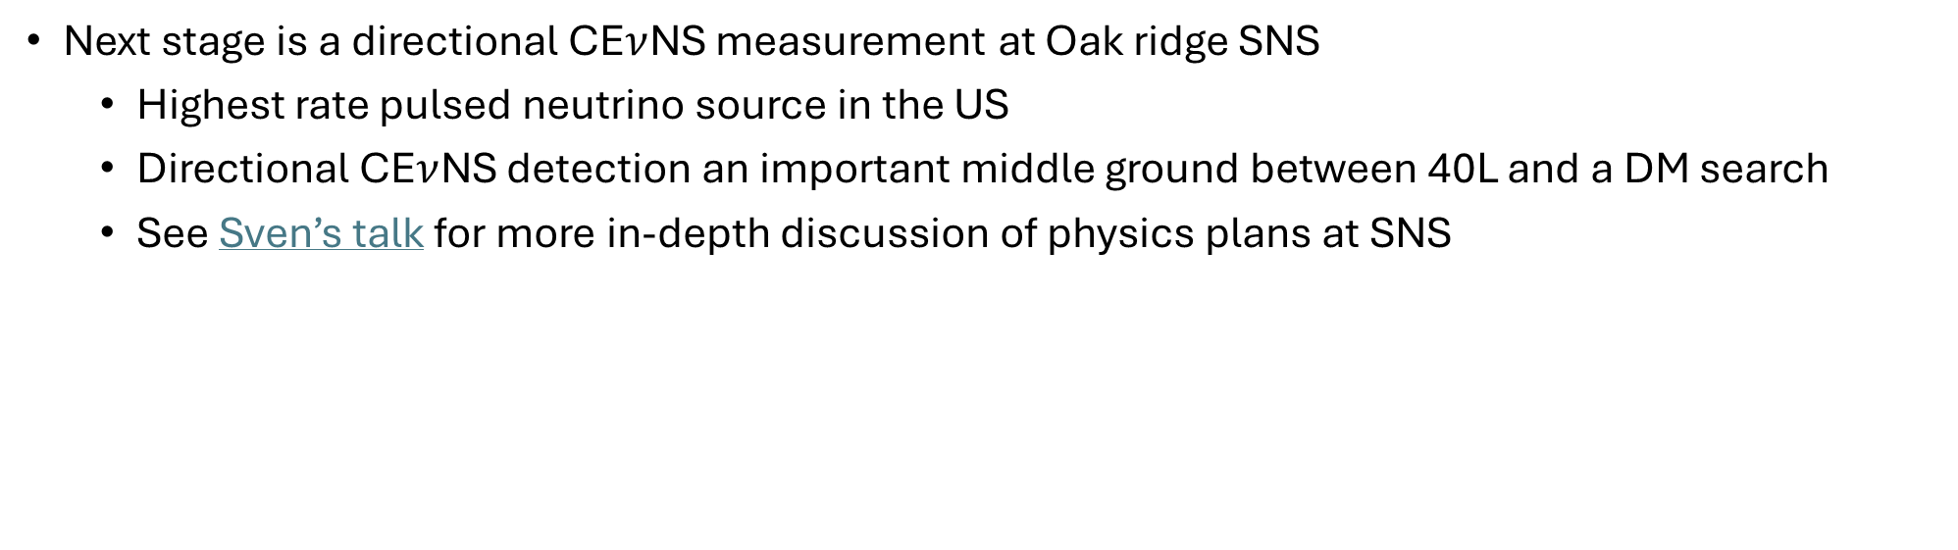
Plans at Oak Ridge
Next stage is a directional CE$ν$NS measurement at Oak ridge SNS
  Highest rate pulsed neutrino source in the US
  Directional CE$ν$NS detection an important middle ground between 40L and a DM search
  See Sven’s talk for more in-depth discussion of physics plans at SNS

Slide 17
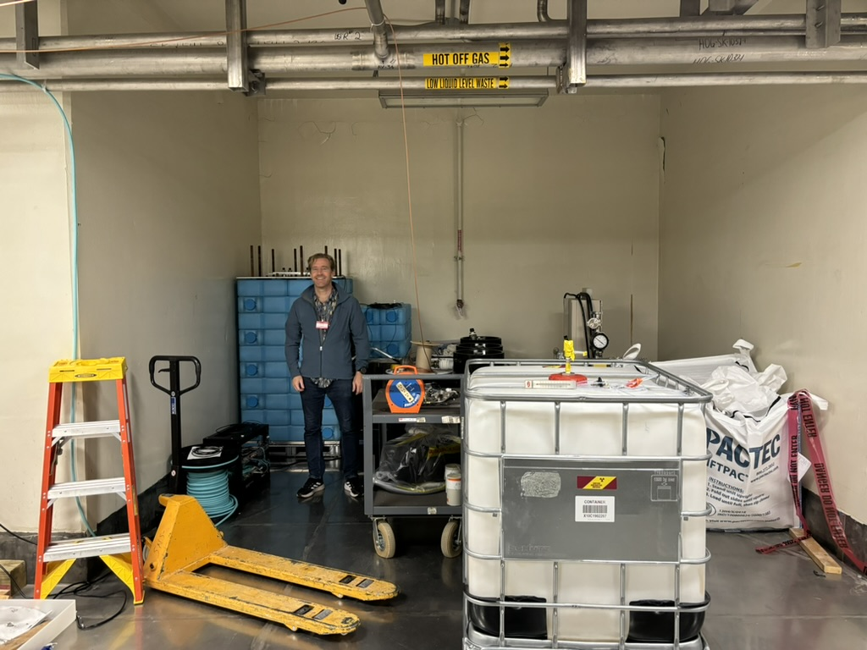
Site selection at SNS
A
B
Proton beam
S
C
Neutrino Alley
A: 6-meter position B: 12-meter position
Prof Vahsen standing in position B
Neutrino alley not suitable for low pressure GAS TPC, new site is needed
Neutron background measurements at A&B using BEAST TPCs and 40L planned for next year. Looking at background and possible shielding

Slide 18
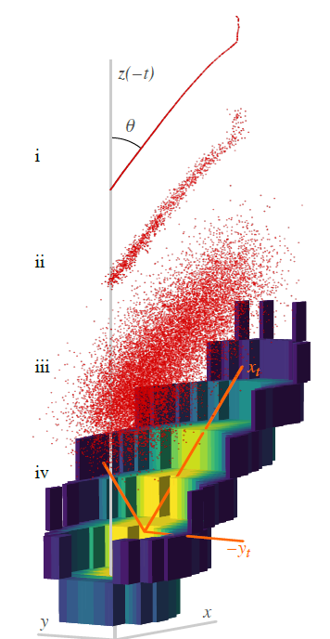
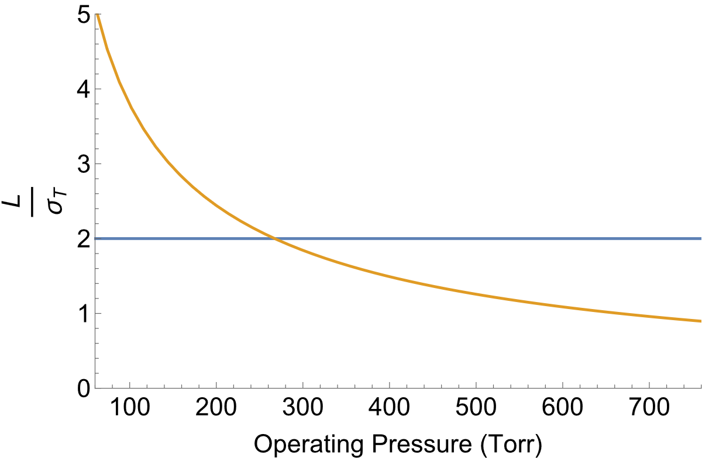
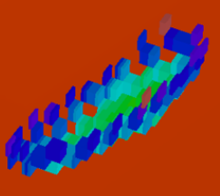
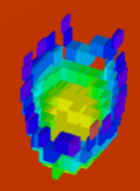
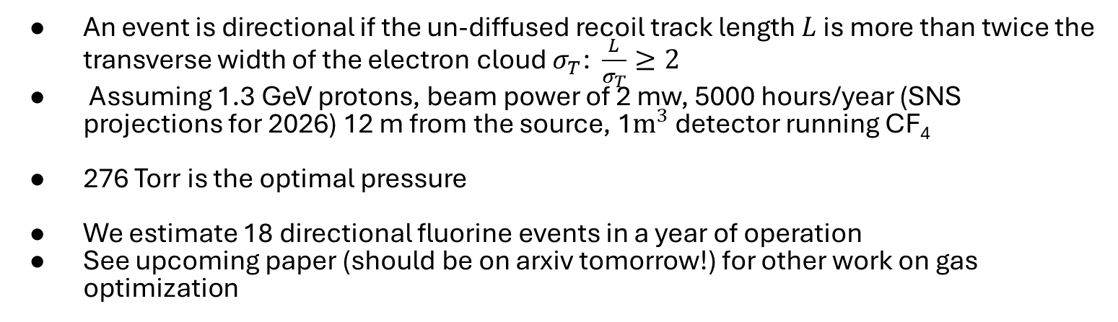


Preliminary Gas Optimization
An event is directional if the un-diffused recoil track length $L$ is more than twice the transverse width of the electron cloud $σ_{T}$: $\frac{L}{σ_{T}}≥2$
Assuming 1.3 GeV protons, beam power of 2 mw, 5000 hours/year (SNS projections for 2026) 12 m from the source, 1$m^{3}$ detector running CF₄
276 Torr is the optimal pressure
We estimate 18 directional fluorine events in a year of operation
See upcoming paper (should be on arxiv tomorrow!) for other work on gas optimization
Image from: arXiv:2106.15829
$$L$$
More directional
less directional
$$2σ_{T}$$

Slide 19
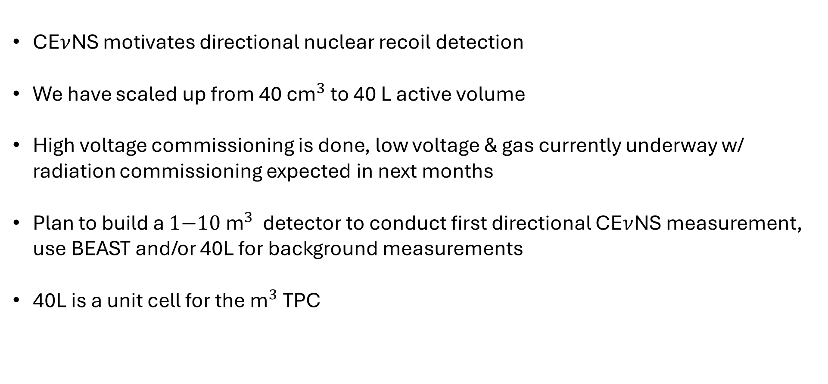
Conclusions and future plans
CE$ν$NS motivates directional nuclear recoil detection
We have scaled up from ${\text{40} \text{cm}}^{3}$ to 40 L active volume
High voltage commissioning is done, low voltage & gas currently underway w/ radiation commissioning expected in next months
Plan to build a ${\text{1−10 }\text{m}}^{3}$ detector to conduct first directional CE$ν$NS measurement, use BEAST and/or 40L for background measurements
40L is a unit cell for the ${\text{m}}^{3}$TPC

Slide 20
Backup

Slide 21
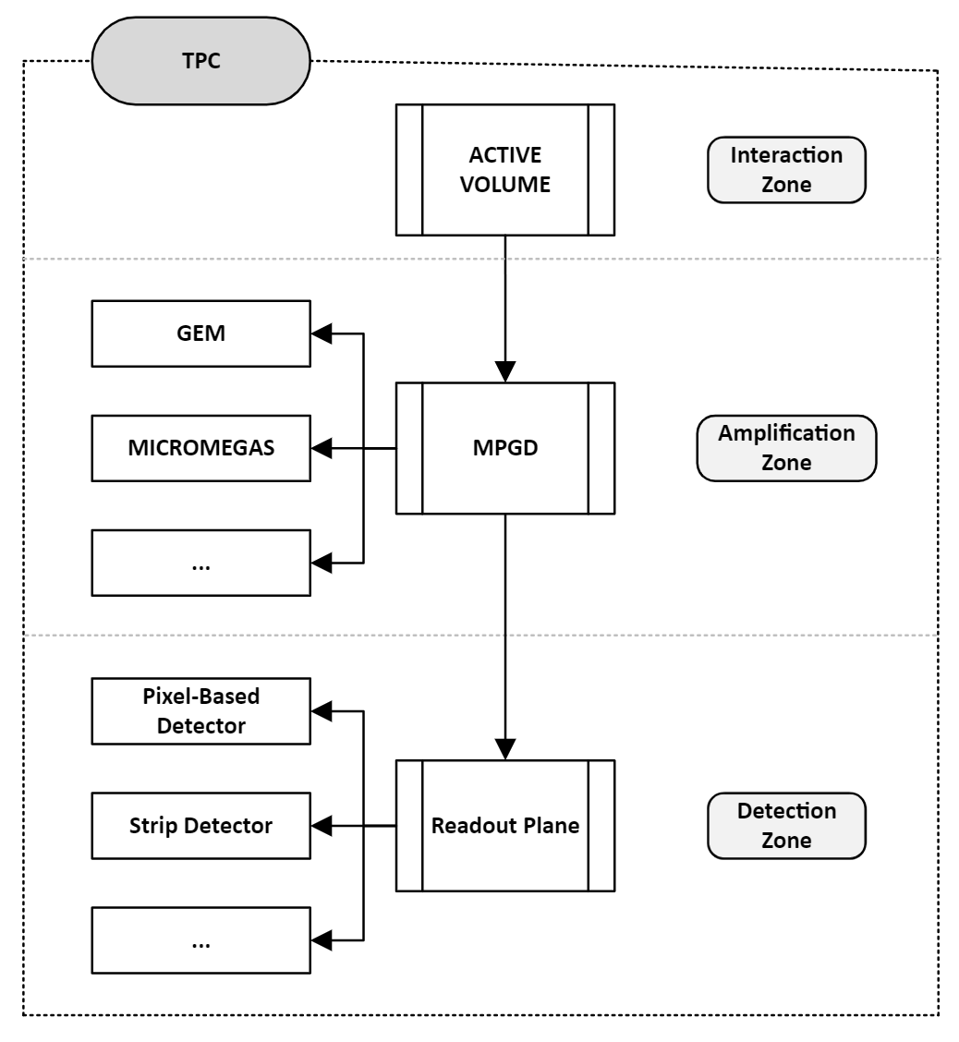
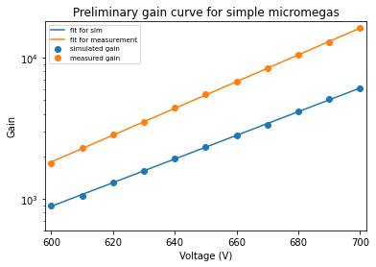
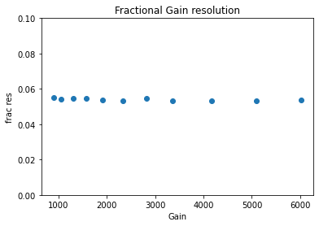
Simulating the new readout system
Simulated gain curve is exponential and grows at very nearly the same rate as the measured gain curve, but there is an overall discrepancy of about a factor of 2
The fractional resolution of our simple micromegas approaches 5.3%, which is about half of the measured value.
We observed no positional dependence for the simulated gain
Current area of simulation
Future work

Slide 22
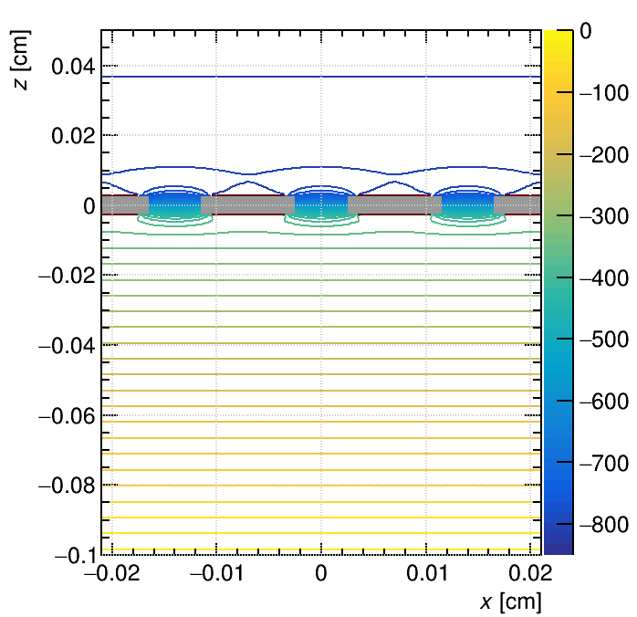
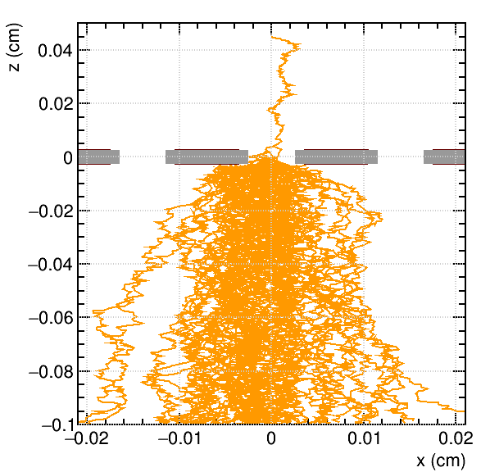
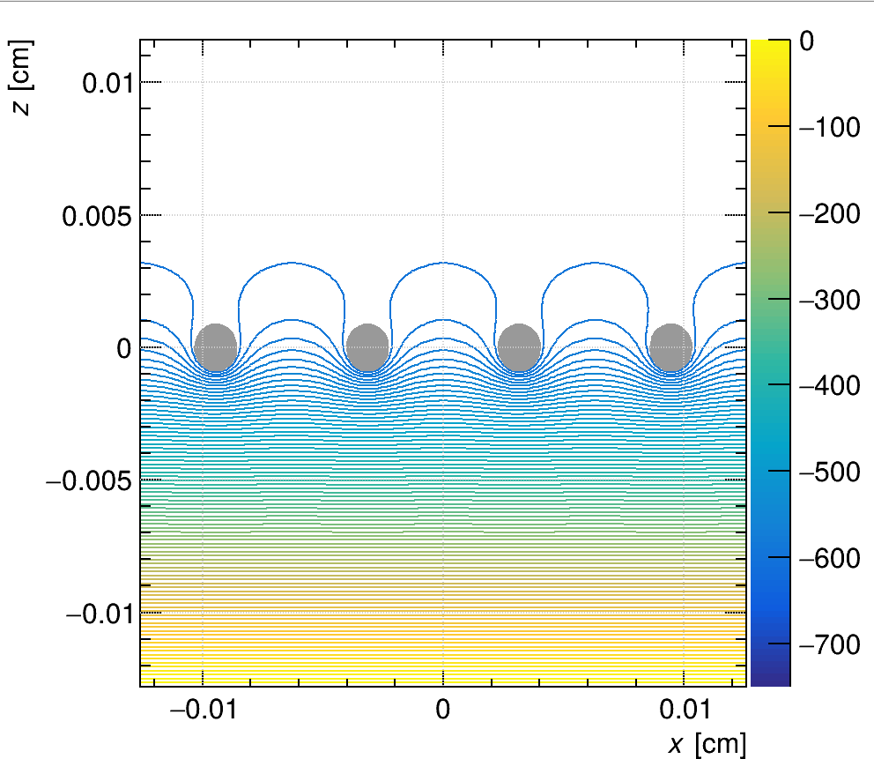
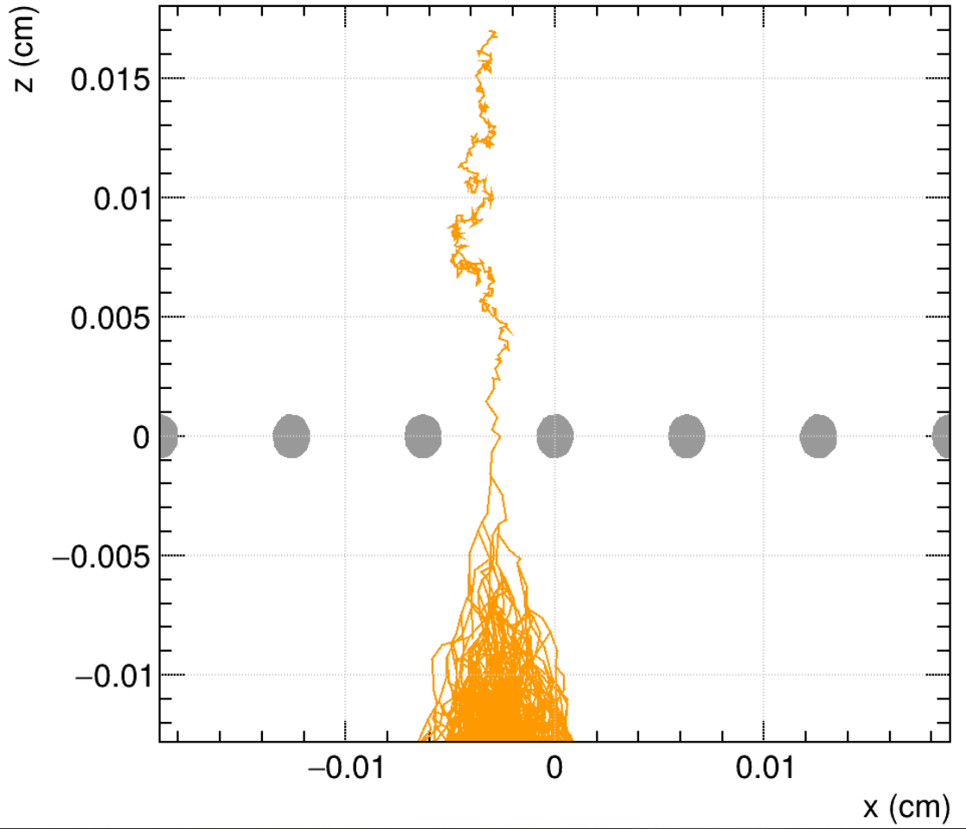
Gems to Micromegas
GEMs above Micromegas below
Micromegas + strips combo is well established and reduced cost vs gems + pixels

Slide 23
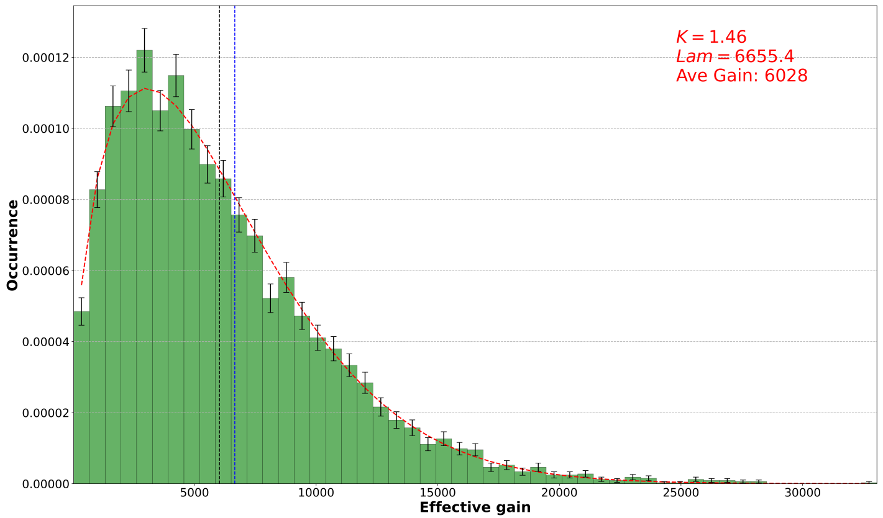

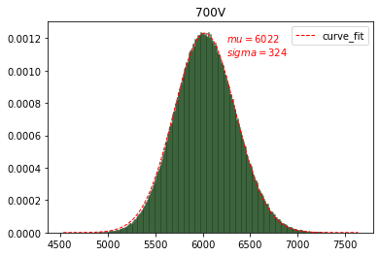
Backup slide: Gain distributions
Top: gain distribution for a series of single electrons each starting above the center of an opening in the mesh, with the mesh voltage at -700V relative to ground . Fit is a Weibull distribution:
Bottom: Average gain of many samples of the Weibull distribution. This is equivalent to what you would get from measuring the gain for a series of multi-electron events, since each one effectively samples the above distribution many times and the gain you measure is the average of those samples. Due to the central limit theorem this is a gaussian with an average value equal to the average value of the Weibull distribution

Slide 24
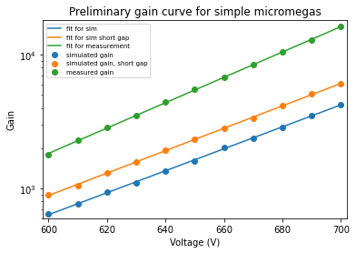
Backup slide: Gain curve
The simulated gain curve is exponential and grows at very nearly the same rate as the measured gain curve
The overall difference between the curves is about a factor of 2 and can be mostly attributed to a combination of variability in actual detector gain based on things like the specific gas bottle used, and on the amp gap distance being poorly constrained.
  Small differences in the amp gap will change the field strength and thus the gain dramatically
  The measured gain varied by up to 50% between gas bottles

Slide 25

Backup slide: Fractional gain resolution
Fractional gain resolution is defined as $\frac{σ}{μ}$. We care bout the value of this at high gains, since it asymptotically approaches its minimum value, and we operate at the highest achievable gain for a given physical detector. The pointier the distribution the lower the fractional resolution, the better.
The simulated fractional gain resolution at high gain has a value of .053
This is lower than the measured gain by quite a bit (real fractional gain resolution is about 11%, not 5.3%). This is expected since this simulation does not account for ionization statistics or variation in primary ionization due to changes in the gas mixture

Slide 26





Neutrino generation
The energy spectra of the resulting neutrinos follow well defined functions very closely:
$π^{+}→μ^{+}+ν_{μ}$is a 2-body decay, and therefore monoenergetic
$μ^{+}→e^{+}+{\overline{ν}}_{μ}+ν_{e}$ is a 3-body decay so it produces a range of energies for the decay products
Cutoff at 52.85MeV for ${\overline{ν}}_{μ}$ is from kinematics. Specifically, it is half of the muon mass

Slide 27
Picking and optimizing a new gas
Currently using a 70:30 He:C02 mix picked for neutron detection in the BEAST TPCs & 40L detector.
  Helium has a low neutron number, so we looked at how CF4 would perform over a year.
Pressure is proportional to events and inversely proportional to directionality, so we have to optimize pressure to get most directional events possible

Slide 28


Assessing and optimizing detector performance
There are 5 things we need to calculate to assess and optimize the performance of a hypothetical detector
  Differential rate $\frac{dR}{dE}$ of CE$ν$NS events
  Angular distribution $\frac{dR}{dΩ_{r}}$ of CE$ν$NS events
  A measure of directionality
  Total number of directional CE$ν$NS events
  The best operating pressure for a given gas
The first 2 can be derived from the double differential cross section: $\frac{d^{2}σ}{dE_{r}dΩ_{r}}=\frac{1}{2π}\frac{dσ}{dE_{r}}δ(cos\left(θ_{r}\right)−\frac{E_{ν}+m_{N}}{E_{ν}}\sqrt{\frac{E_{r}}{2m_{N}}})$
The directionality can be calculated based on event parameters and gas properties, which we can use to calculate the best operating pressure
Allowed recoil angles for a He-4 at SNS (dotted black curve) [arXiv:2003.11510]

Slide 29


Comparing calculations to the literature: $\frac{d^{2}R}{dE_{r}dΩ_{r}}$
My calculations
Plot from arXiv:2003.11510
Paper calculates total of 2300 events for a year of runtime I get 2350

Slide 30

Inputs and assumptions for the performance estimate
There are 4 inputs to estimating the number of directional events
  A measure of directionality (next slide)
  Electron transport and recoil track length properties of CF4 (obtained from the work done by DM-TPC and CYGNUS NEWAGE in arXiv:0905.2549 and arXiv:2101.09921 respectively)
  Double differential rate $\frac{d^{2}σ}{dE_{r}dΩ_{r}}$ of CE$ν$NS events (my calculation is ~50% lower than the literature [arXiv:2003.11510], so this estimate is conservative)
Assuming 1.3 GeV protons with a beam power of 2 mw for 5000 hours per year at SNS (sns projections for 2026) at the 12-meter position with a 1 cubic meter detector running CF4 taking data for a year

Slide 31

Recoil track length
The CYGNUS NEWAGE group in Japan measured the recoil track length of nuclear recoils in cf4 at 75 torr
Track length scales as $\frac{1}{p}$, so we multiply their curve by $\frac{75 torr}{p}$ to get $L(E_{r},p)$
Image from arXiv:2101.09921

