Slide 1
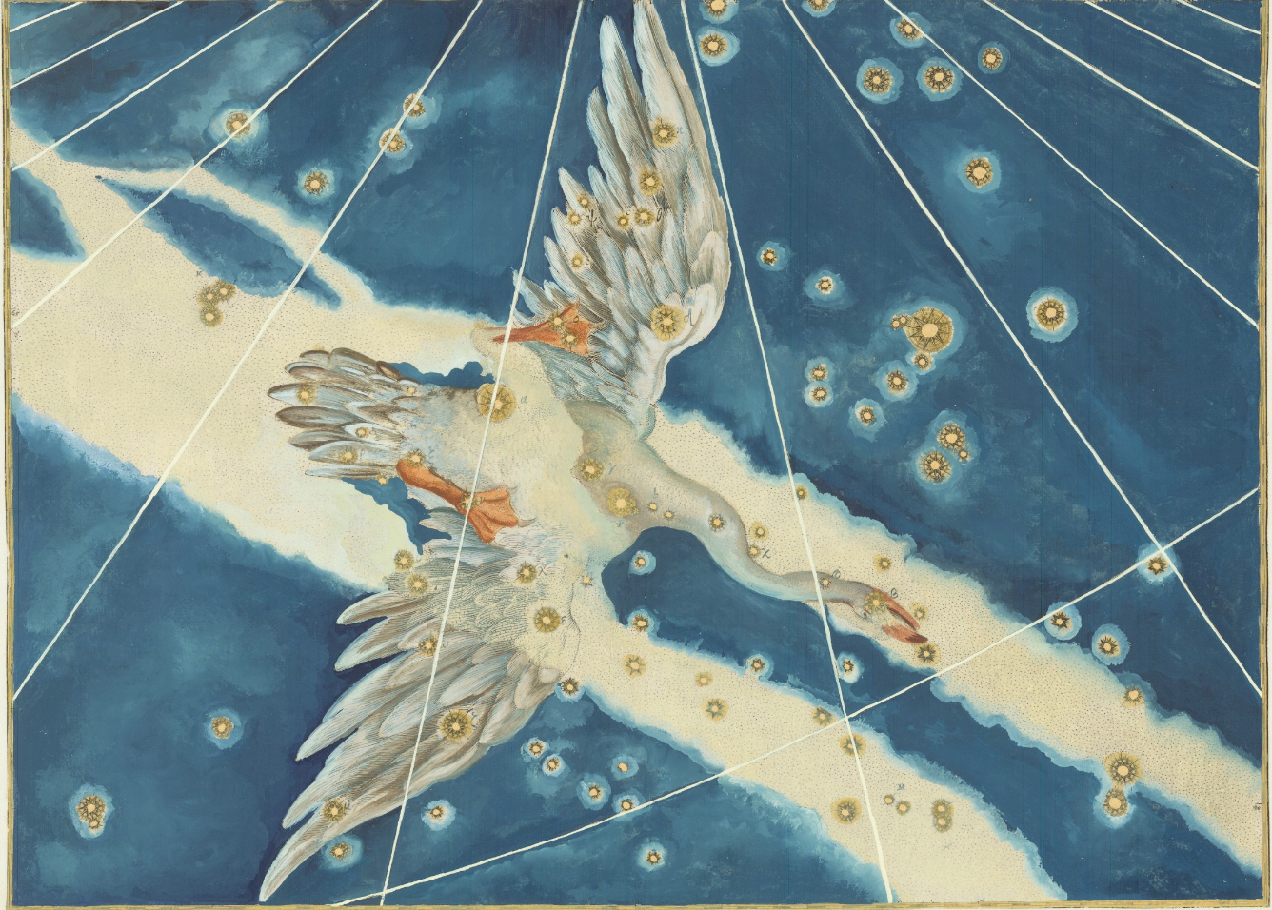


An overview of
CYGNUS’ reach
for dark matter and
neutrino searches
Chiara Lisotti, supervised by Dr. Ciaran O’Hare

Slide 2
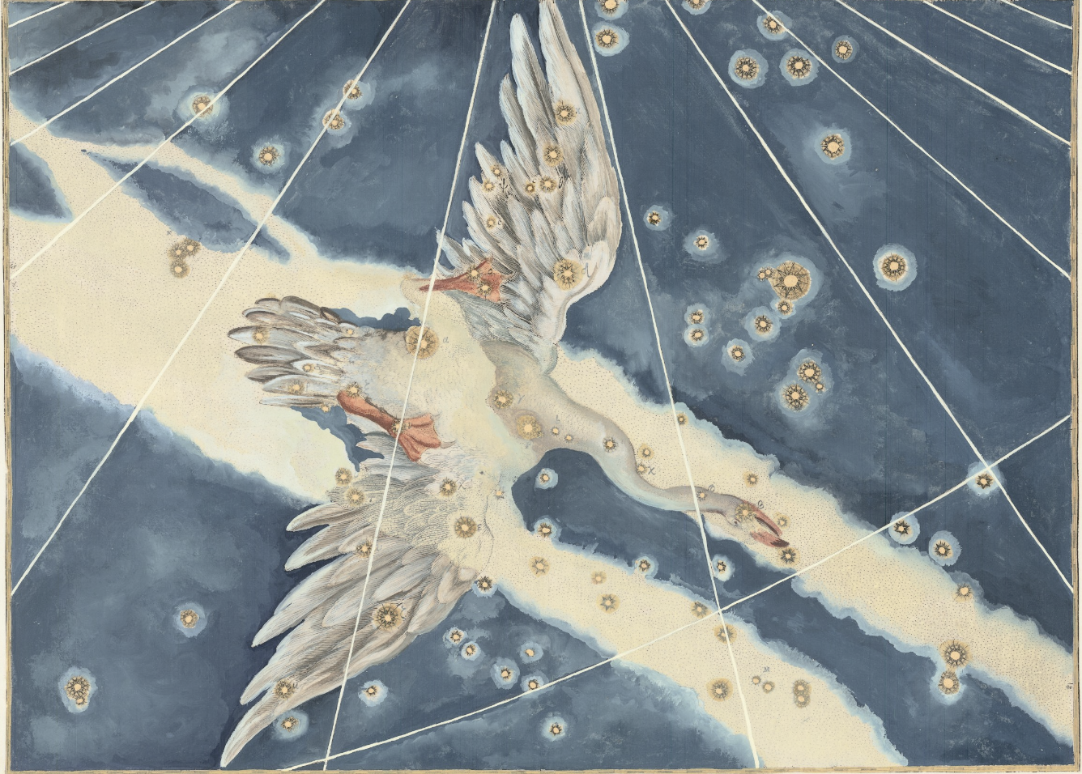
Outline:
SOLAR
NEUTRINOS
BEYOND
NEUTRINOS
CYGNUS
EXPERIMENT AND PERFORMANCES
...AND MORE
NEUTRINO SOURCES
CONCLUSIONS
I
II
III
IV
V

Slide 3

I
Why directionality?
1

Slide 4
I
Why directionality?
1

Slide 5
I
Why are we here?
1

Slide 6
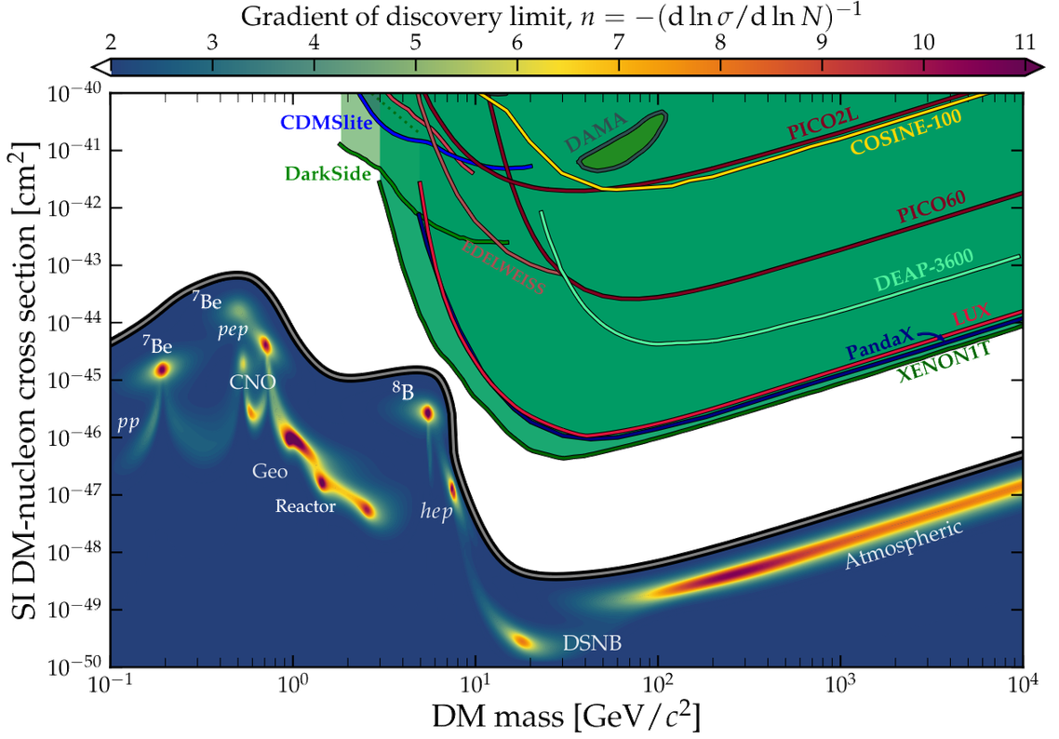
I
Why are we here?
Uncovering the nature of particle dark matter still remains a challenge
WIMPs have been the focus for most large dark matter experiments
As these experiments grow in size, they inch closer to the neutrino fog, where the solar neutrino background drowns out any WIMP signal
O’Hare et al. [2203.05914]
1

Slide 7
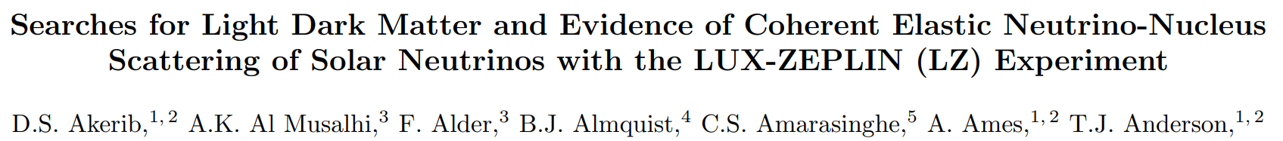
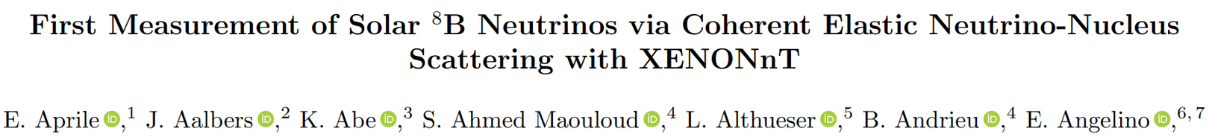
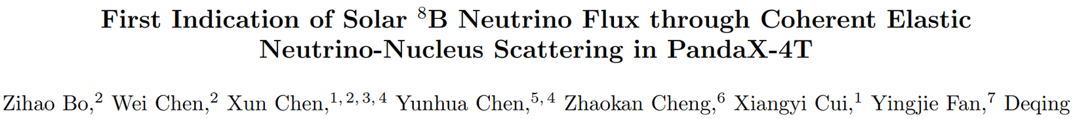
I
Why are we here?
...and the large Xenon-based experiments have already reached the neutrino fog!
[2512.08065]
[2408.02877]
[2407.10892]
1

Slide 8
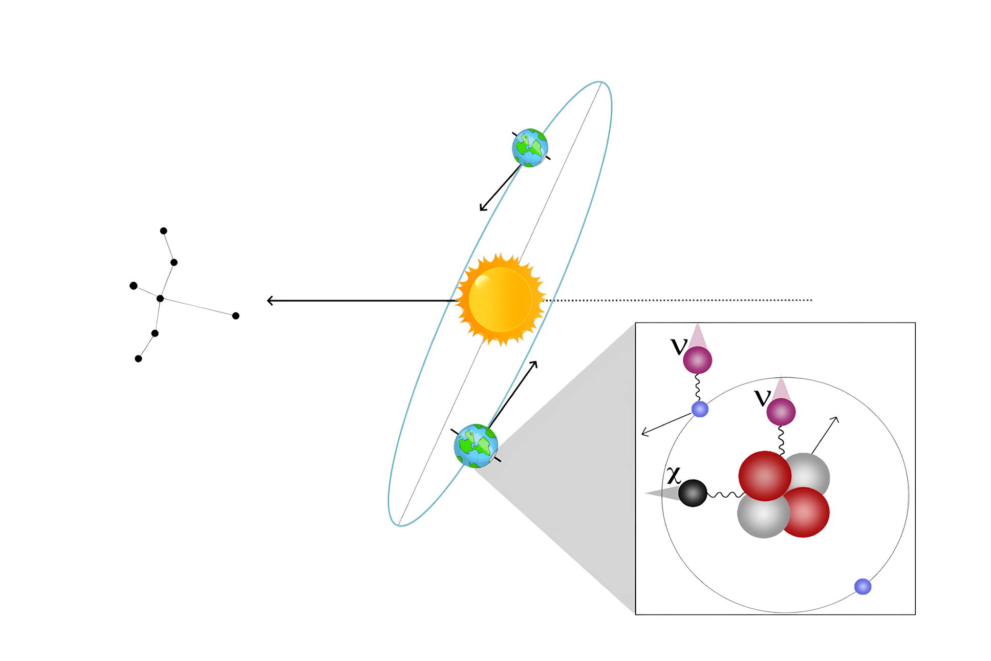
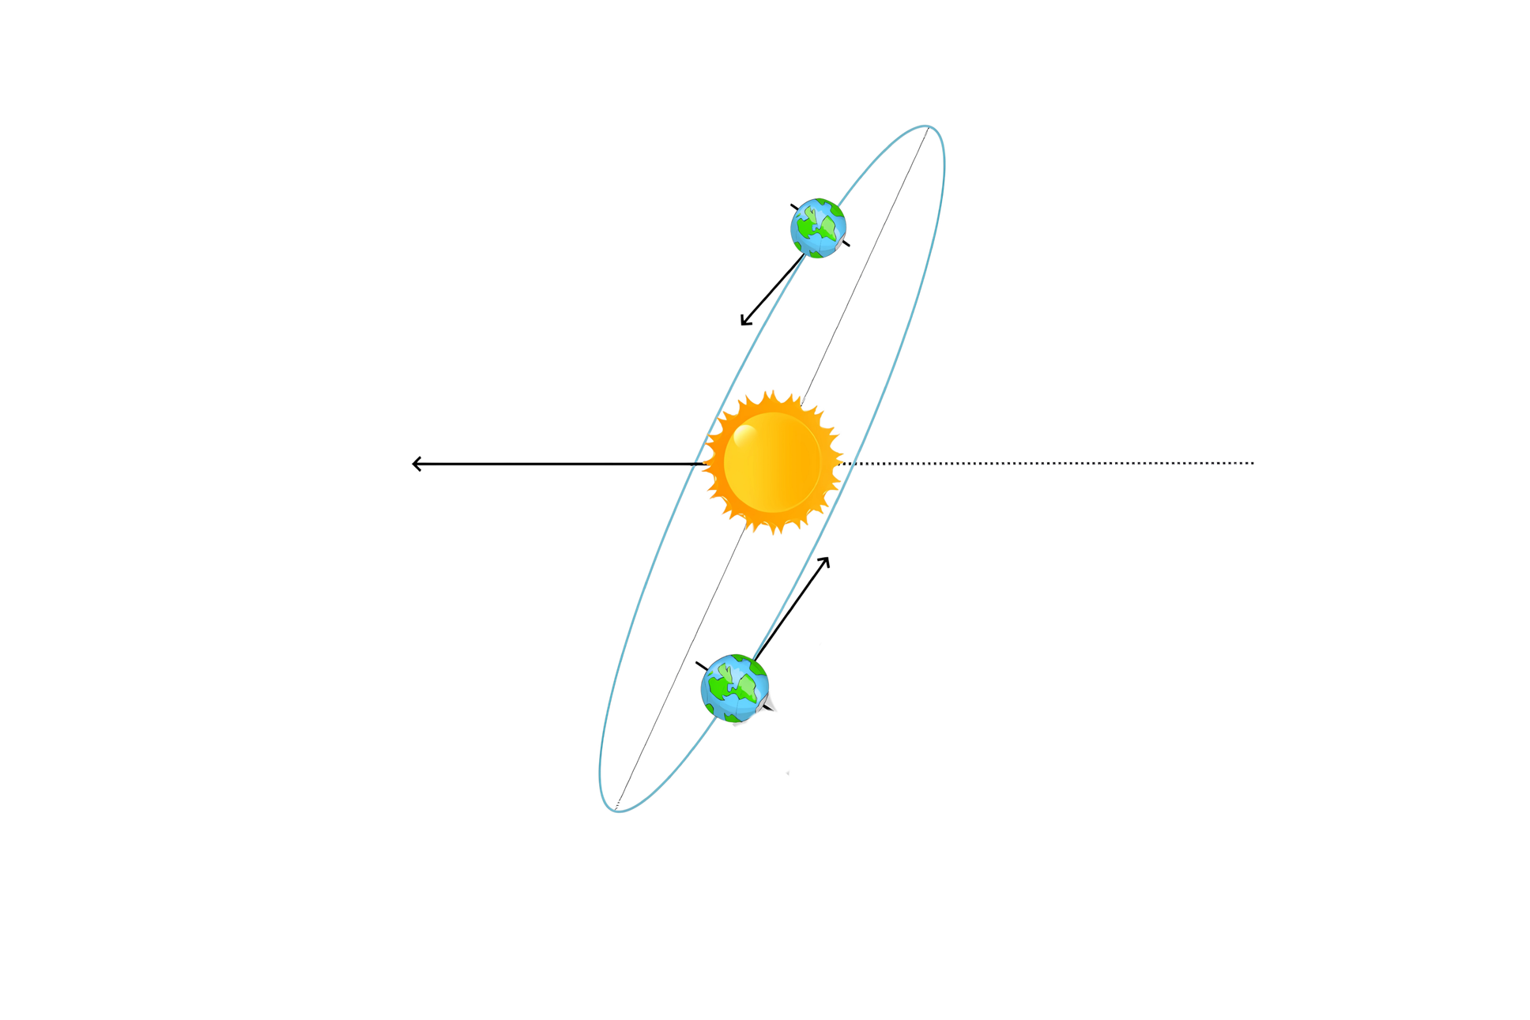


GALACTIC PLANE
CYGNUS
CONSTELLATION
2

Slide 9

GALACTIC PLANE
CYGNUS
CONSTELLATION
2

Slide 10
GALACTIC PLANE
CYGNUS
CONSTELLATION
2

Slide 11

GALACTIC PLANE
CYGNUS
CONSTELLATION
W,Z
Z
?
2

Slide 12
GALACTIC PLANE
CYGNUS
CONSTELLATION
W,Z
Z
?
2

Slide 13

GALACTIC PLANE
CYGNUS
CONSTELLATION
W,Z
Z
?
2

Slide 14


GALACTIC PLANE
CYGNUS
CONSTELLATION
W,Z
Z
?
2

Slide 15
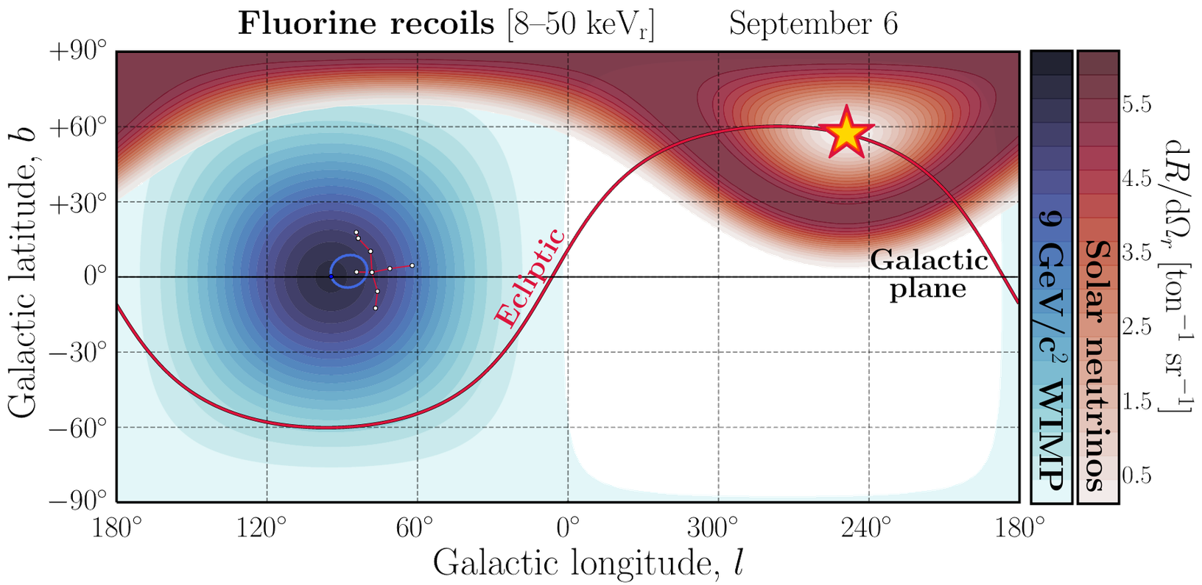
Total angular distribution for WIMP and solar neutrino fluorine recoils
Vahsen, O’Hare, et al. [2008.12587]
3

Slide 16
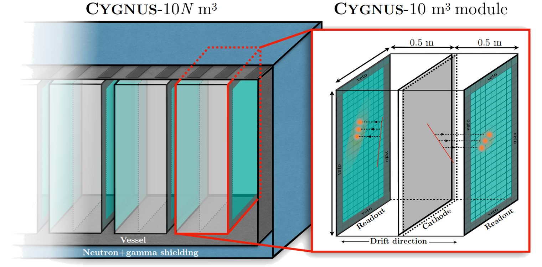

CYGNUS Experiment
Vahsen, O’Hare, et al. [2008.12587]
4

Slide 17
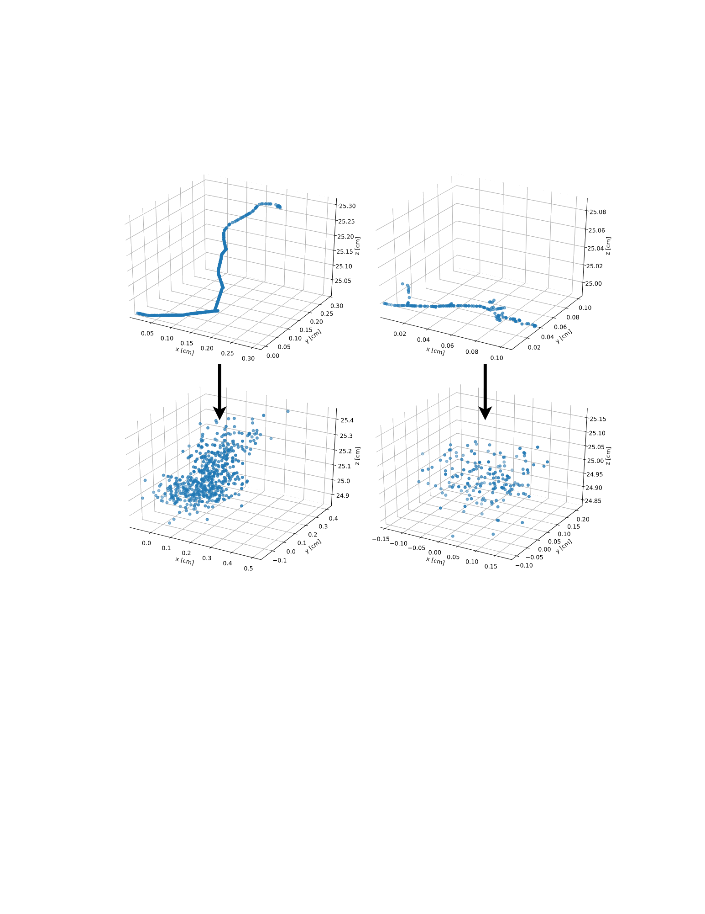
Experimental Considerations
(from a theory student’s perspective)
Nuclear recoils (20 keVr)
Helium in 20 Torr SF6
Fluorine in 20 Torr SF6
Predrift
Vahsen, O’Hare, et al. [2008.12587]
5

Slide 18
Experimental Considerations
(from a theory student’s perspective)
Nuclear recoils (20 keVr)
Helium in 20 Torr SF6
Fluorine in 20 Torr SF6
Postdrift
Vahsen, O’Hare, et al. [2008.12587]
5

Slide 19
Experimental Considerations
(from a theory student’s perspective)
Nuclear recoils (20 keVr)
Helium in 20 Torr SF6
Fluorine in 20 Torr SF6
Postdrift
Vahsen, O’Hare, et al. [2008.12587]
5

Slide 20
Experimental Considerations
(from a theory student’s perspective)
Nuclear recoils (20 keVr)
Helium in 20 Torr SF6
Fluorine in 20 Torr SF6
Postdrift
Vahsen, O’Hare, et al. [2008.12587]
5

Slide 21
Experimental Considerations
(from a theory student’s perspective)
Nuclear recoils (20 keVr)
Helium in 20 Torr SF6
Fluorine in 20 Torr SF6
Postdrift
Vahsen, O’Hare, et al. [2008.12587]
We must account for detector performances to make realistic predictions
5

Slide 22
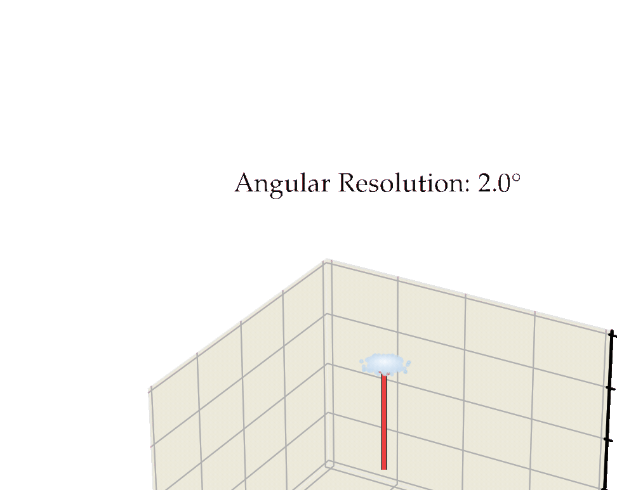

1000 events initially pointing towards the +ve z axis after smearing
The dots here correspond to the vector endpoints
6

Slide 23
1000 events initially pointing towards the +ve z axis after smearing
The dots here correspond to the vector endpoints
6

Slide 24
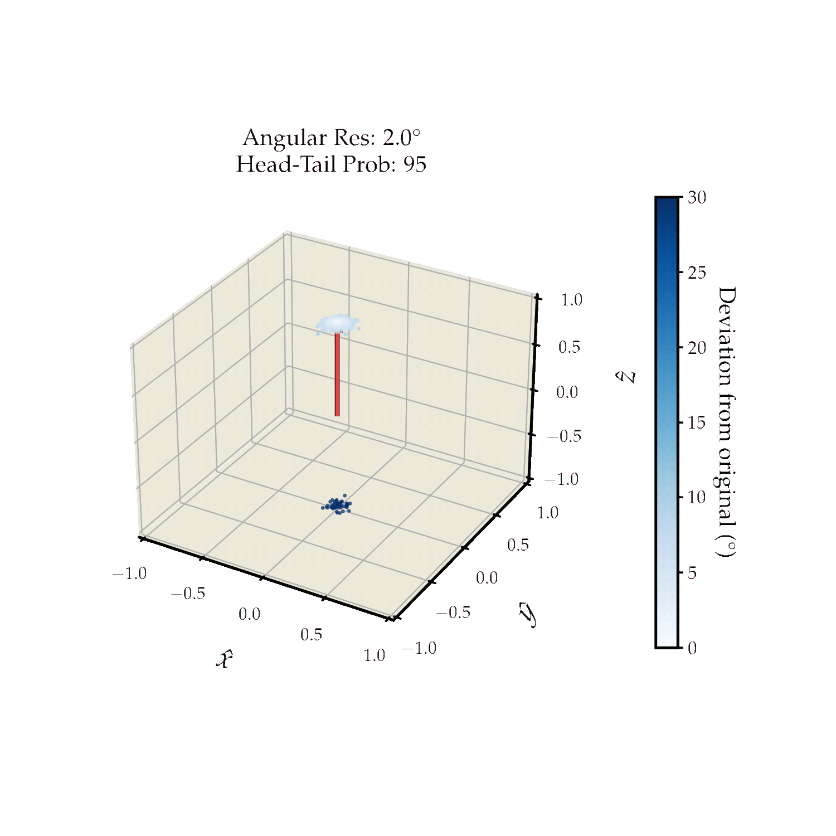
%
1000 events initially pointing towards the +ve z axis after smearing
The dots here correspond to the vector endpoints
6

Slide 25
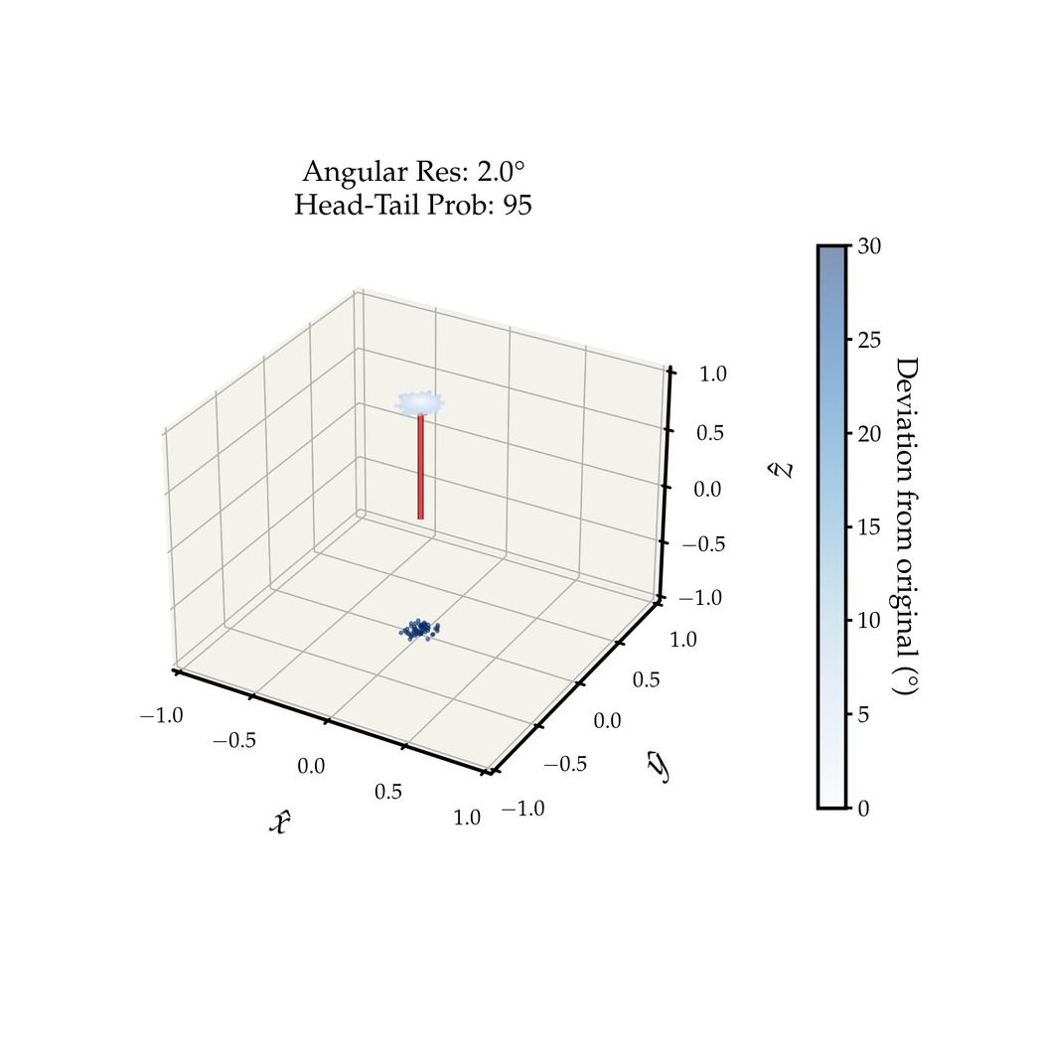

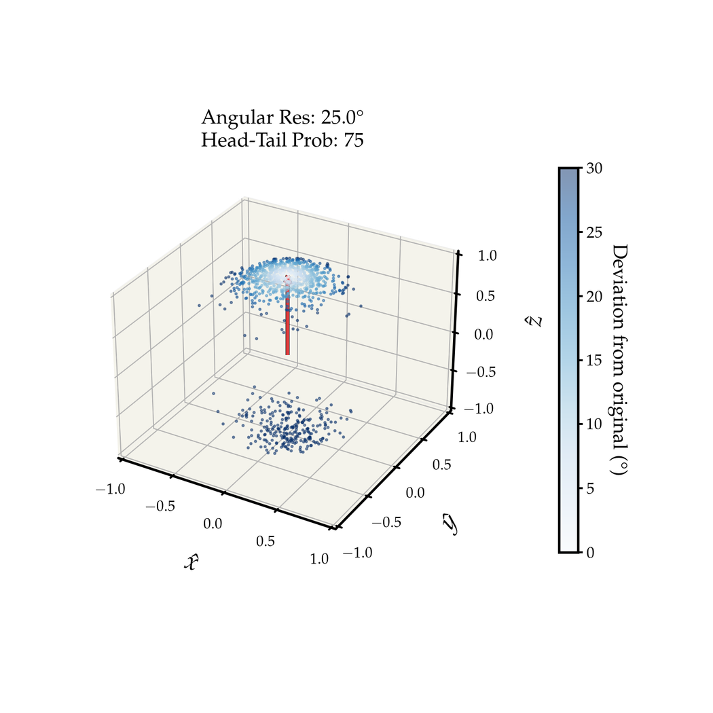
In each case, we will consider three performance benchmarks:
Idealised
Realistic
Poor
%
%
%
9

Slide 26
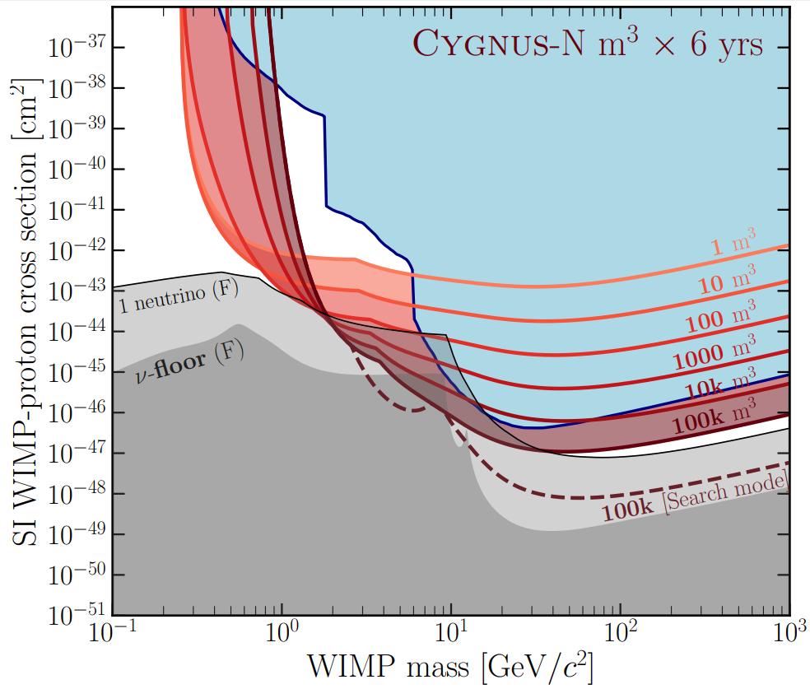
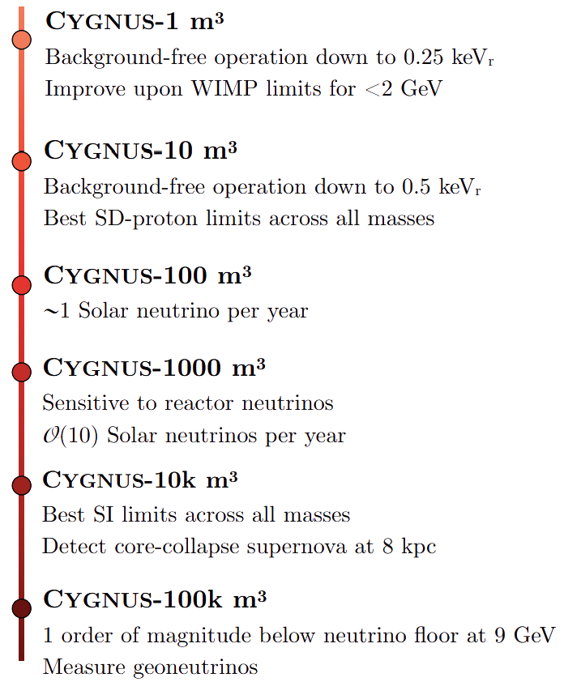
Vahsen, O’Hare, et al. [2008.12587]
7

Slide 27
Before CYGNUS can reach scales capable of detecting dark matter signals, there will be stepping-stone detectors...
8

Slide 28
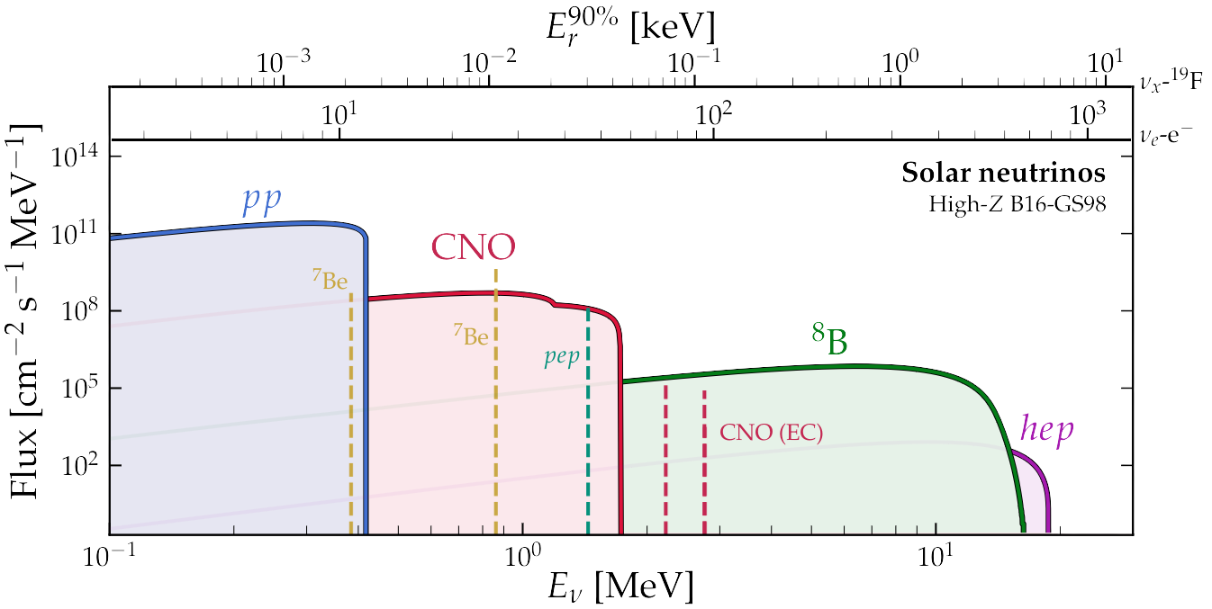
II
CYGNUS for Solar Neutrinos
Before CYGNUS can reach scales capable of detecting dark matter signals, there will be stepping-stone detectors... can be used to detect solar neutrinos via electron recoils!
8

Slide 29
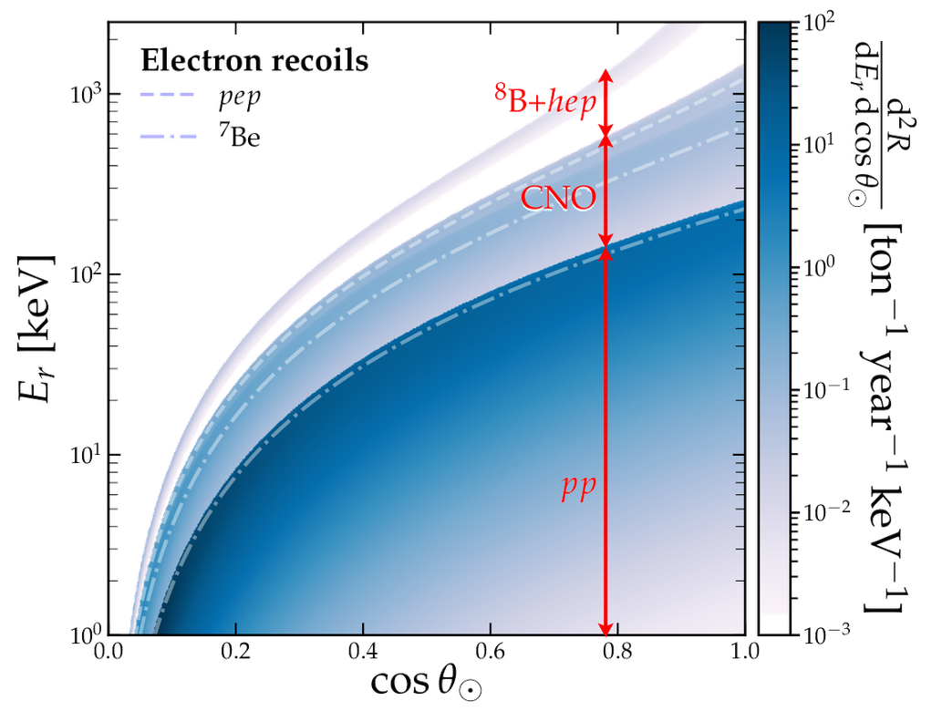
II
CYGNUS for Solar Neutrinos
Before CYGNUS can reach scales capable of detecting dark matter signals, there will be stepping-stone detectors... can be used to detect solar neutrinos via electron recoils!
9

Slide 30
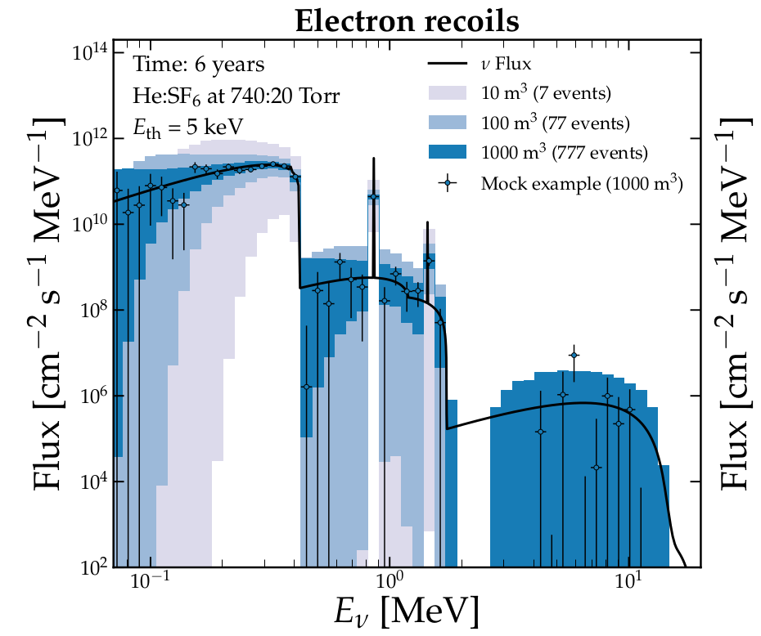
II
CYGNUS for Solar Neutrinos
Before CYGNUS can reach scales capable of detecting dark matter signals, there will be stepping-stone detectors... can be used to detect solar neutrinos via electron recoils!
9

Slide 31
II
CYGNUS for Solar Neutrinos
Before CYGNUS can reach scales capable of detecting dark matter signals, there will be stepping-stone detectors... can be used to detect solar neutrinos via electron recoils!
A 10 m³ detector can already measure pp flux!
9

Slide 32
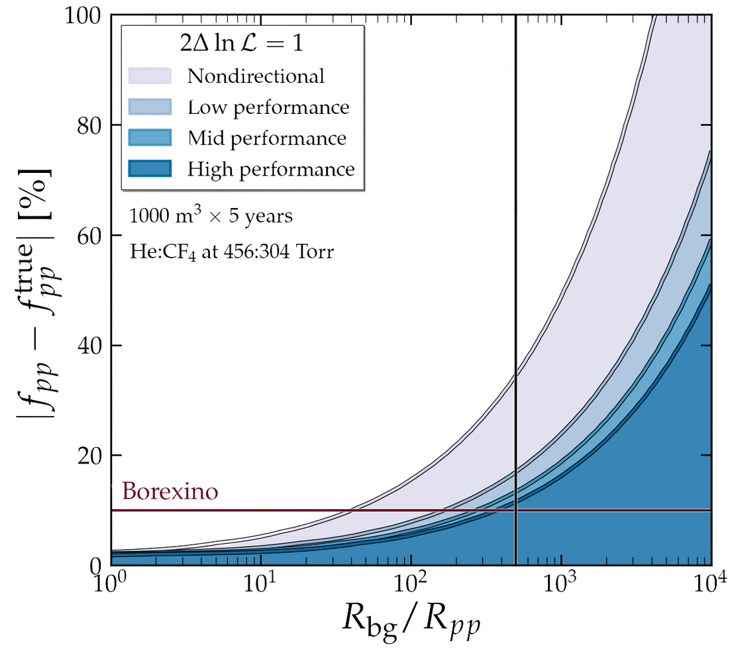
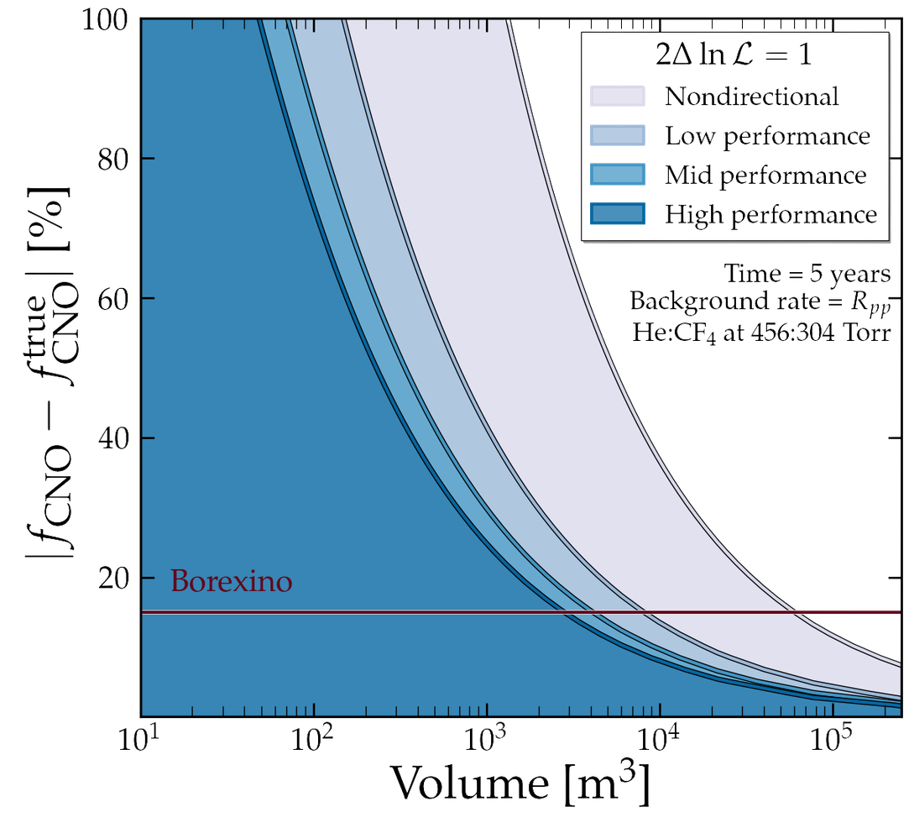
and, in the future...
CYGNO (factor of 3 BG reduction)
CL, O’Hare, et al., [2404.03690]
+ see Samuele Torelli’s thesis for benchamrk performances and simulations
10

Slide 33
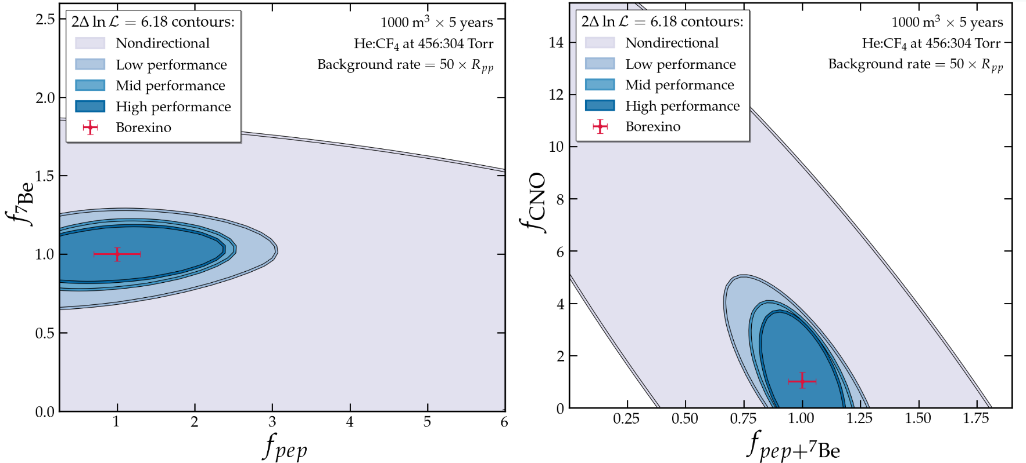
and, in the future...
CL, O’Hare, et al., [2404.03690]
+ see Samuele Torelli’s thesis for benchamrk performances and simulations
11

Slide 34
What about neutrino physics bSM?
12

Slide 35
What about neutrino physics bSM?
Non-Standard Interactions!
12

Slide 36
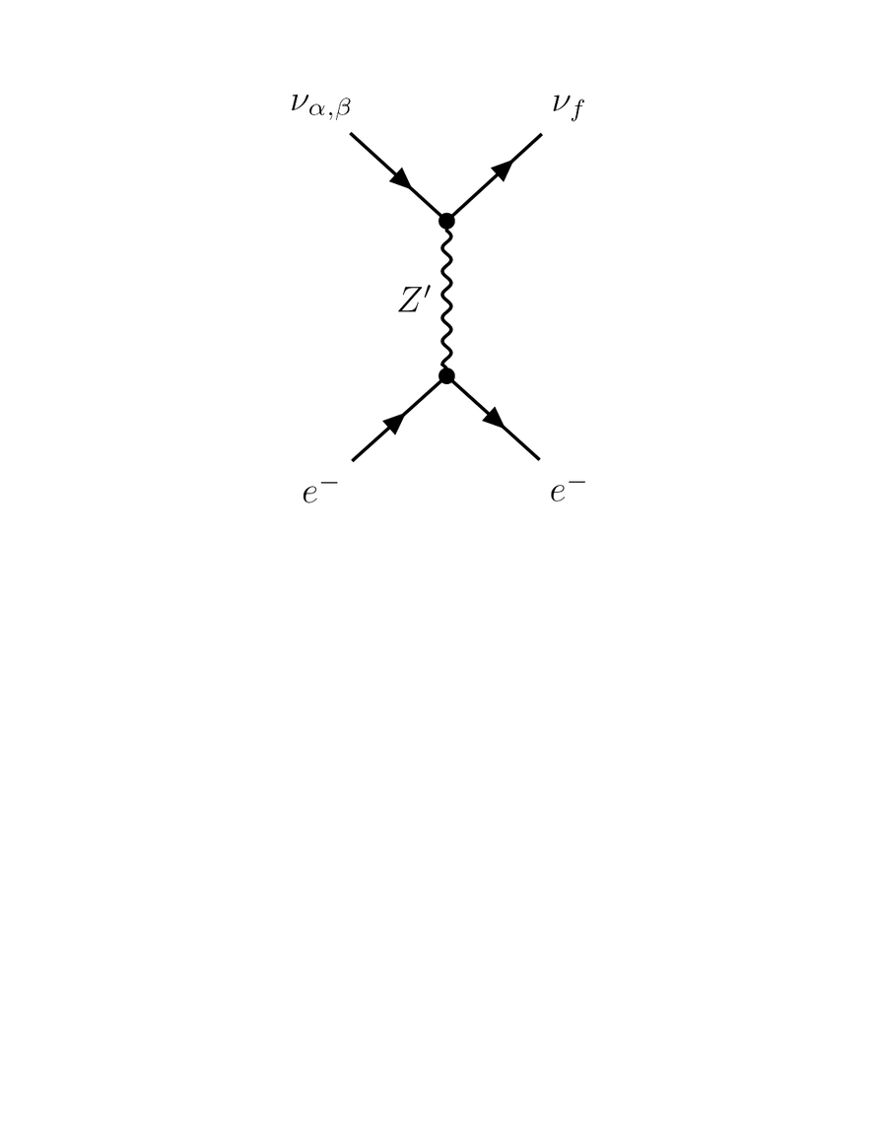
What about neutrino physics bSM?
Non-Standard Interactions!
Let us add a new vector mediator
Light
if mass ≲ q
12

Slide 37
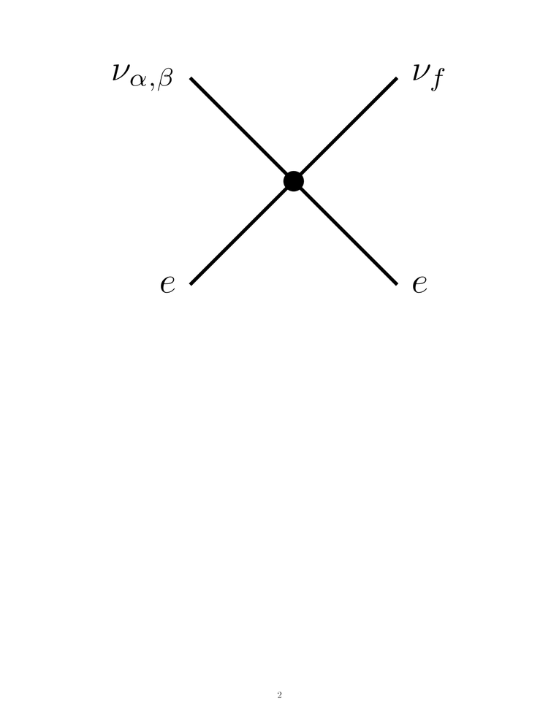
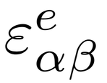

What about neutrino physics bSM?
Non-Standard Interactions!
Let us add a new vector mediator
Light
if mass ≲ q
Heavy
if mass >> q
≈ effective 4-fermion
interaction
with free parameters
12

Slide 38
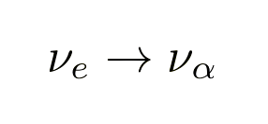
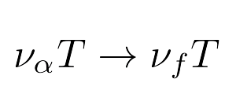
NSIs will impact
propagation
scattering
where α is not necessarily = f
13

Slide 39
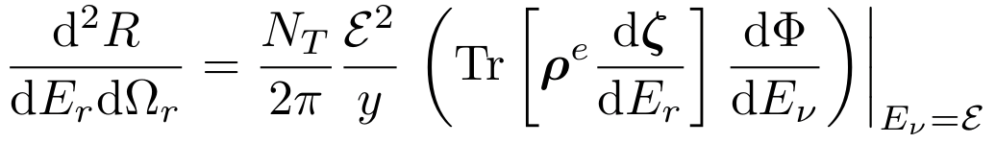

NSIs will impact
propagation
scattering
where α is not necessarily = f
13

Slide 40
NSIs will impact
propagation
scattering
where α is not necessarily = f
usual SM double differential rate + terms
13

Slide 41
NSIs will impact
propagation
scattering
where α is not necessarily = f
usual SM double differential rate + terms
(setting these coupling strength terms to 0 recovers the SM rate)
13

Slide 42
What about neutrino physics bSM?
Non-Standard Interactions!
Let us add a new vector mediator
Light
if mass ≲ q
Heavy
if mass >> q
≈ effective 4-fermion
interaction
with free parameters

Slide 43
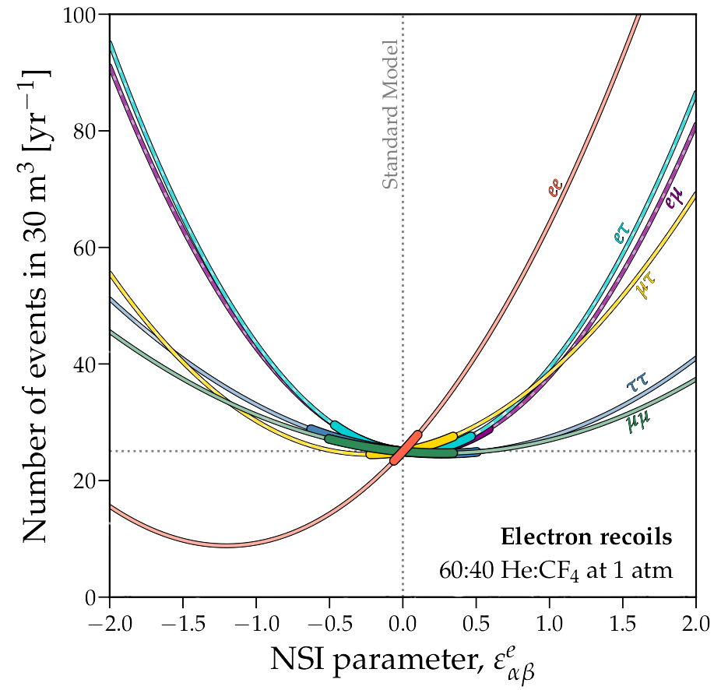
Suppression or enhancement of number of events!
Hard to discriminate from SM in the region [-0.5, 0.5]...
Chandra Shekar, CL, et al., [2506.09322]
14

Slide 44
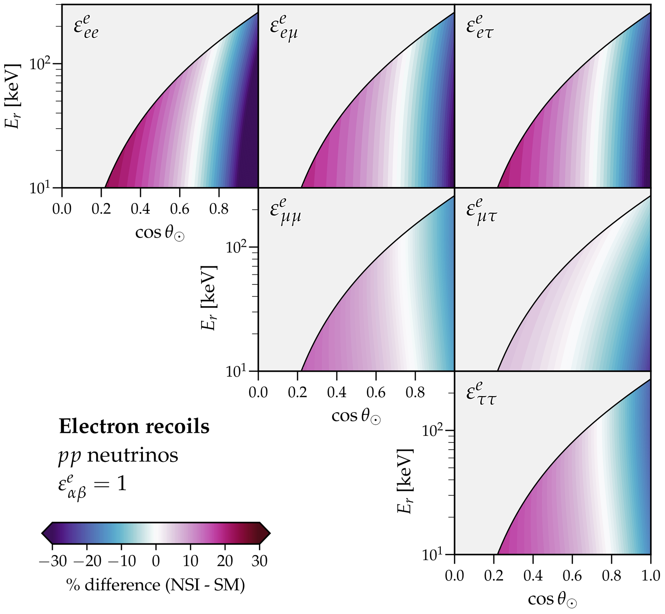
Differences in shape here; these are not present for the total event rate...
Direction can help us disentangle
SM and NSI effects!
Chandra Shekar, CL, et al., [2506.09322]
15

Slide 45
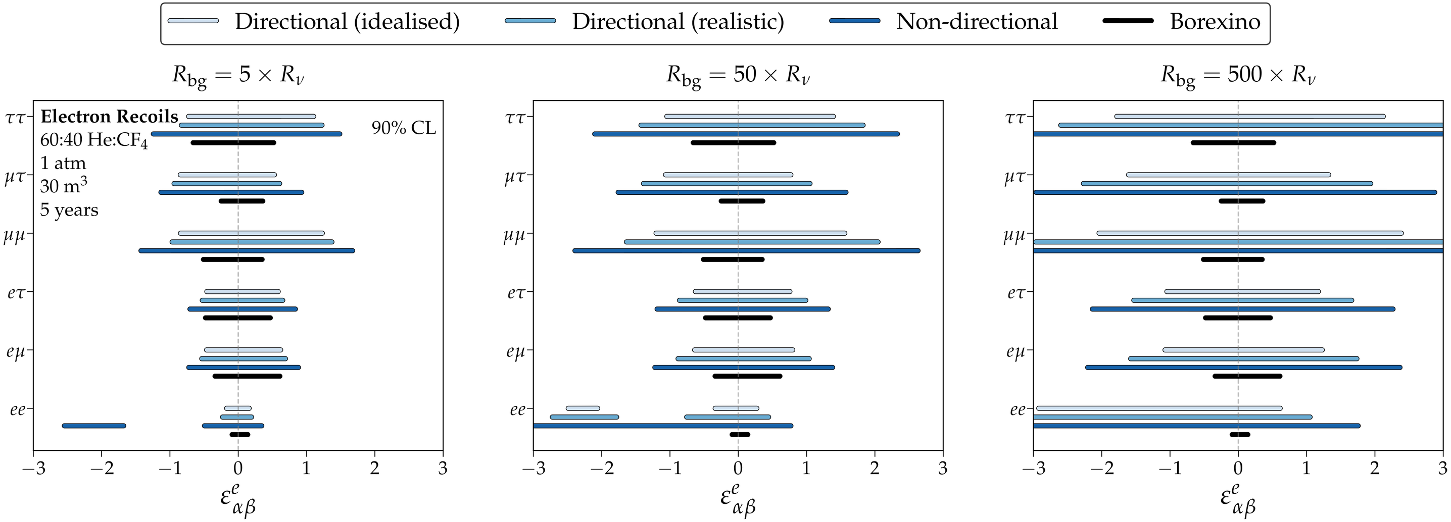
16

Slide 46
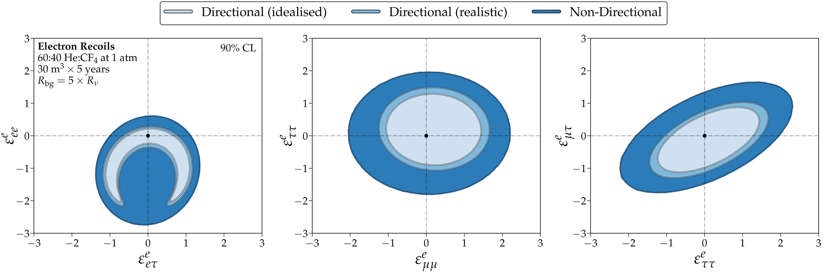
Chandra Shekar, CL, et al., [2506.09322]
16

Slide 47
What about neutrino physics bSM?
Non-Standard Interactions!
Let us add a new vector mediator
Light
if mass ≲ q
Heavy
if mass >> q
≈ effective 4-fermion
interaction
with free parameters

Slide 48
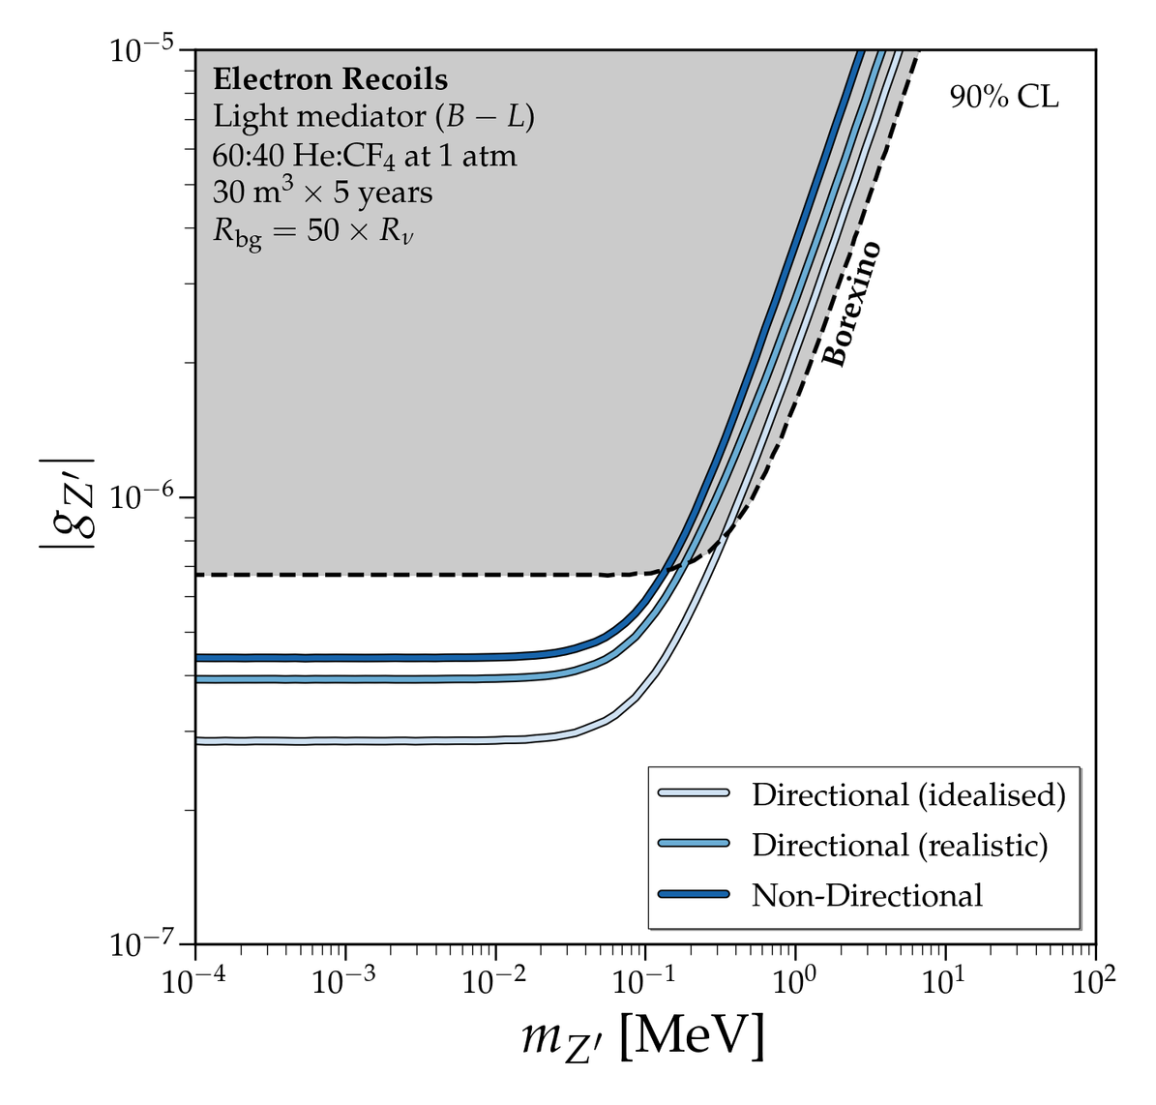
Lower threshold means we can probe smaller masses!
Other DM detectors could reach these exclusion limits
Chandra Shekar, CL, et al., [2506.09322]
17

Slide 49
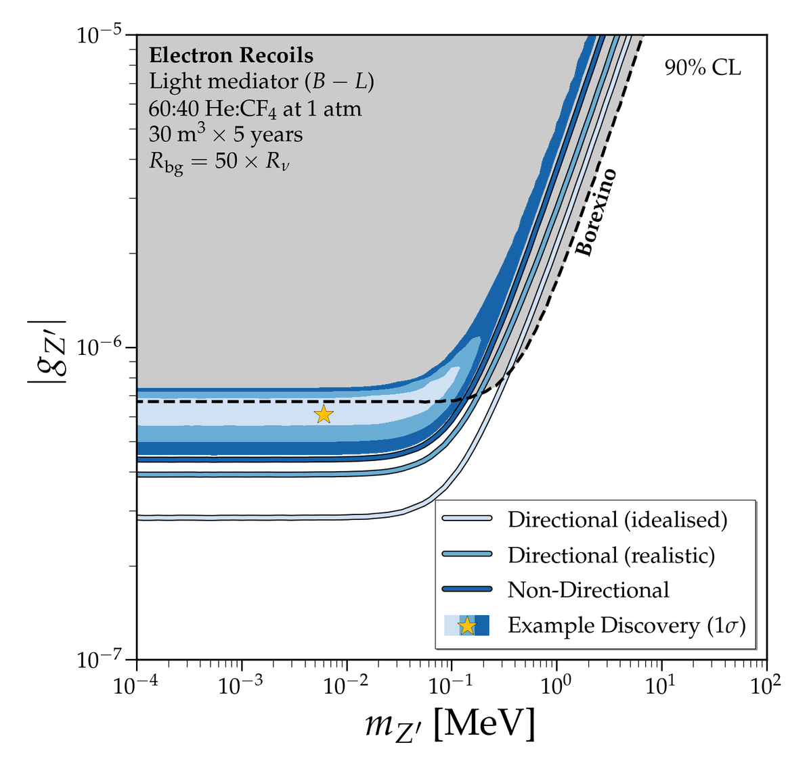
Lower threshold means we can probe smaller masses!
Other DM detectors could reach these exclusion limits
But it’s the background rejection that comes with directionality that would make a positive discovery possible!
Chandra Shekar, CL, et al., [2506.09322]
17

Slide 50
Where else can we look for neutrinos?
18

Slide 51
III
Where else can we look for neutrinos? CCSNs
18

Slide 52
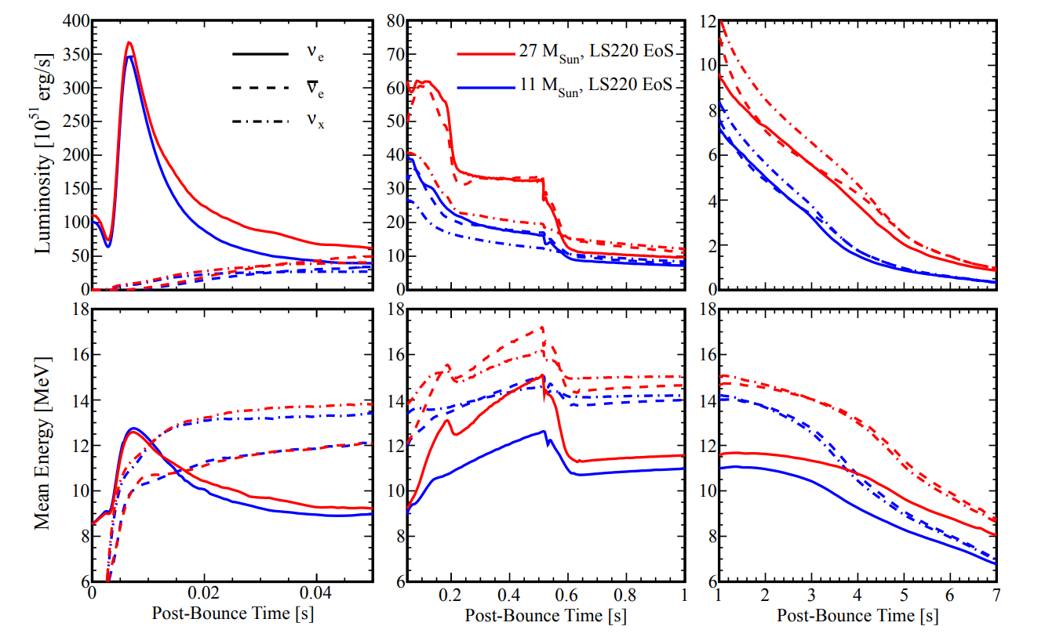
III
Where else can we look for neutrinos? CCSNs
Neutronisation Burst
18

Slide 53
III
Where else can we look for neutrinos? CCSNs
Neutronisation Burst
shock wave moves outwards:
free protons+neutrons released
18

Slide 54

III
Where else can we look for neutrinos? CCSNs
Neutronisation Burst
$$ν_{e}$$
via electron capture
shock wave moves outwards:
free protons+neutrons released
18

Slide 55
III
Where else can we look for neutrinos? CCSNs
Accretion Phase
18

Slide 56
III
Where else can we look for neutrinos? CCSNs
Accretion Phase
material keeps falling towards
the core and is heated
18

Slide 57

III
Where else can we look for neutrinos? CCSNs
Accretion Phase
$$ν_{x}$$
via e-e⁺
annihilation
material keeps falling towards
the core and is heated
18

Slide 58
III
Where else can we look for neutrinos? CCSNs
Explosion
18

Slide 59
III
Where else can we look for neutrinos? CCSNs
Explosion
18

Slide 60
III
Where else can we look for neutrinos? CCSNs
Cooling of NS
Lang et al., [2506.09322]
18

Slide 61
Through CE$ν$NS, we could reconstruct this neutrino flux!
19

Slide 62
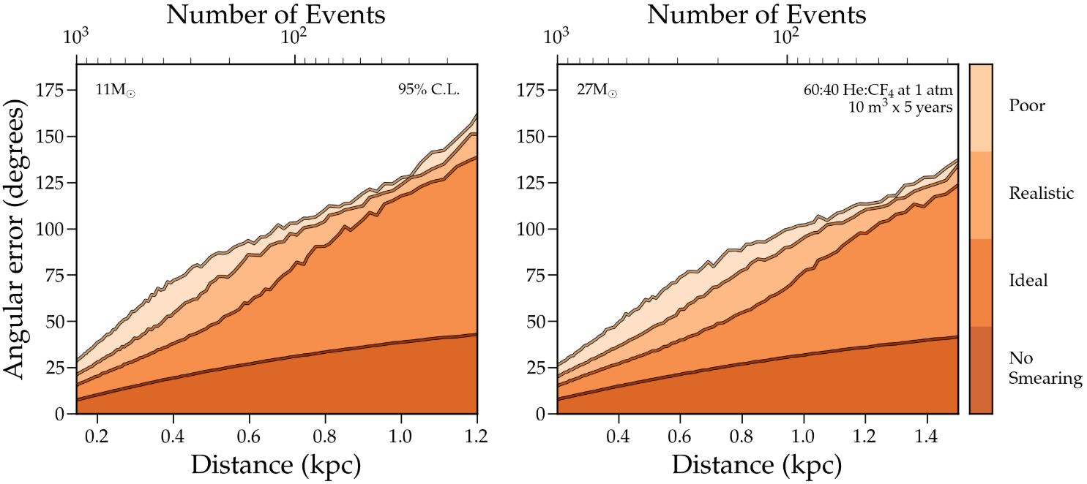
Through CE$ν$NS, we could reconstruct this neutrino flux!
...and triangulate its source, aiding multimessenger astronomy!
19

Slide 63
Through CE$ν$NS, we could reconstruct this neutrino flux!
!!! THIS IS EXTREMELY PRELIMINARY !!!
...and triangulate its source, aiding multimessenger astronomy!
19

Slide 64



III
Where else can we look for neutrinos? SNS!
proton beam
liquid mercury target
20

Slide 65

III
Where else can we look for neutrinos? SNS!
neutrons
liquid mercury target
20

Slide 66
The majority of pions stop in the target, where they decay
20

Slide 67
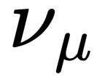


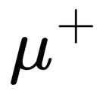
The majority of pions stop in the target, where they decay
20

Slide 68
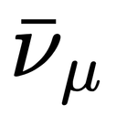



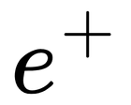
The majority of pions stop in the target, where they decay
20

Slide 69
What if we placed a CYGNUS module there?

Slide 70
If you want answers to this question, make sure to attend Sven’s talk tomorrow at 2.25 pm!!!
...no spoilers!

Slide 71
Beyond Neutrinos...

Slide 72
Vahsen, O’Hare, et al. [2008.12587]
21

Slide 73

...but what about sub-GeV?
Vahsen, O’Hare, et al. [2008.12587]
21

Slide 74
...but what about sub-GeV?
  not enough energy deposition when scattering in detector
Vahsen, O’Hare, et al. [2008.12587]
21

Slide 75
...but what about sub-GeV?
  not enough energy deposition when scattering in detector
  unless...
Vahsen, O’Hare, et al. [2008.12587]
21

Slide 76
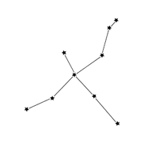

IV
Relativistic DM
Halo DM
22

Slide 77
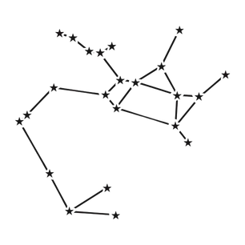
Halo DM
DM produced in
supernovae
22

Slide 78
Halo DM
DM produced in
supernovae
22

Slide 79
Halo DM
DM produced in
supernovae
Cosmic Rays
22

Slide 80

Halo DM
DM produced in
supernovae
Cosmic Rays
22

Slide 81
Halo DM
DM produced in
supernovae
Cosmic Ray
upscattered DM
Baracchini, DeRocco, Dho, [2009.08836]
Bringmann and Pospelov, PRL 2019
22

Slide 82
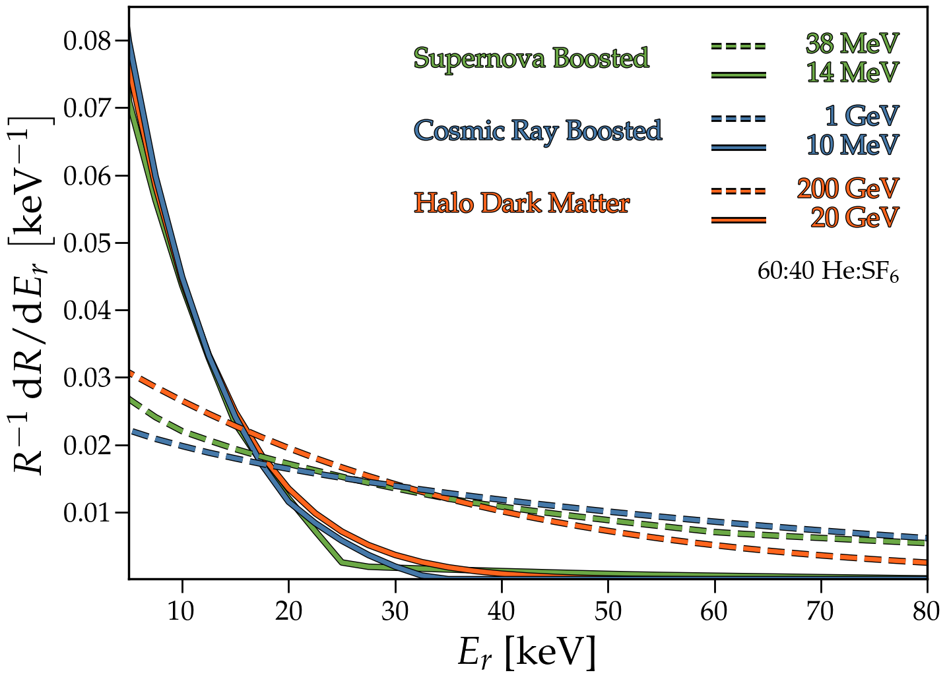
How to discern semi-relativistic sub-GeV DM and WIMPs,
assuming an identical number of events?
23

Slide 83
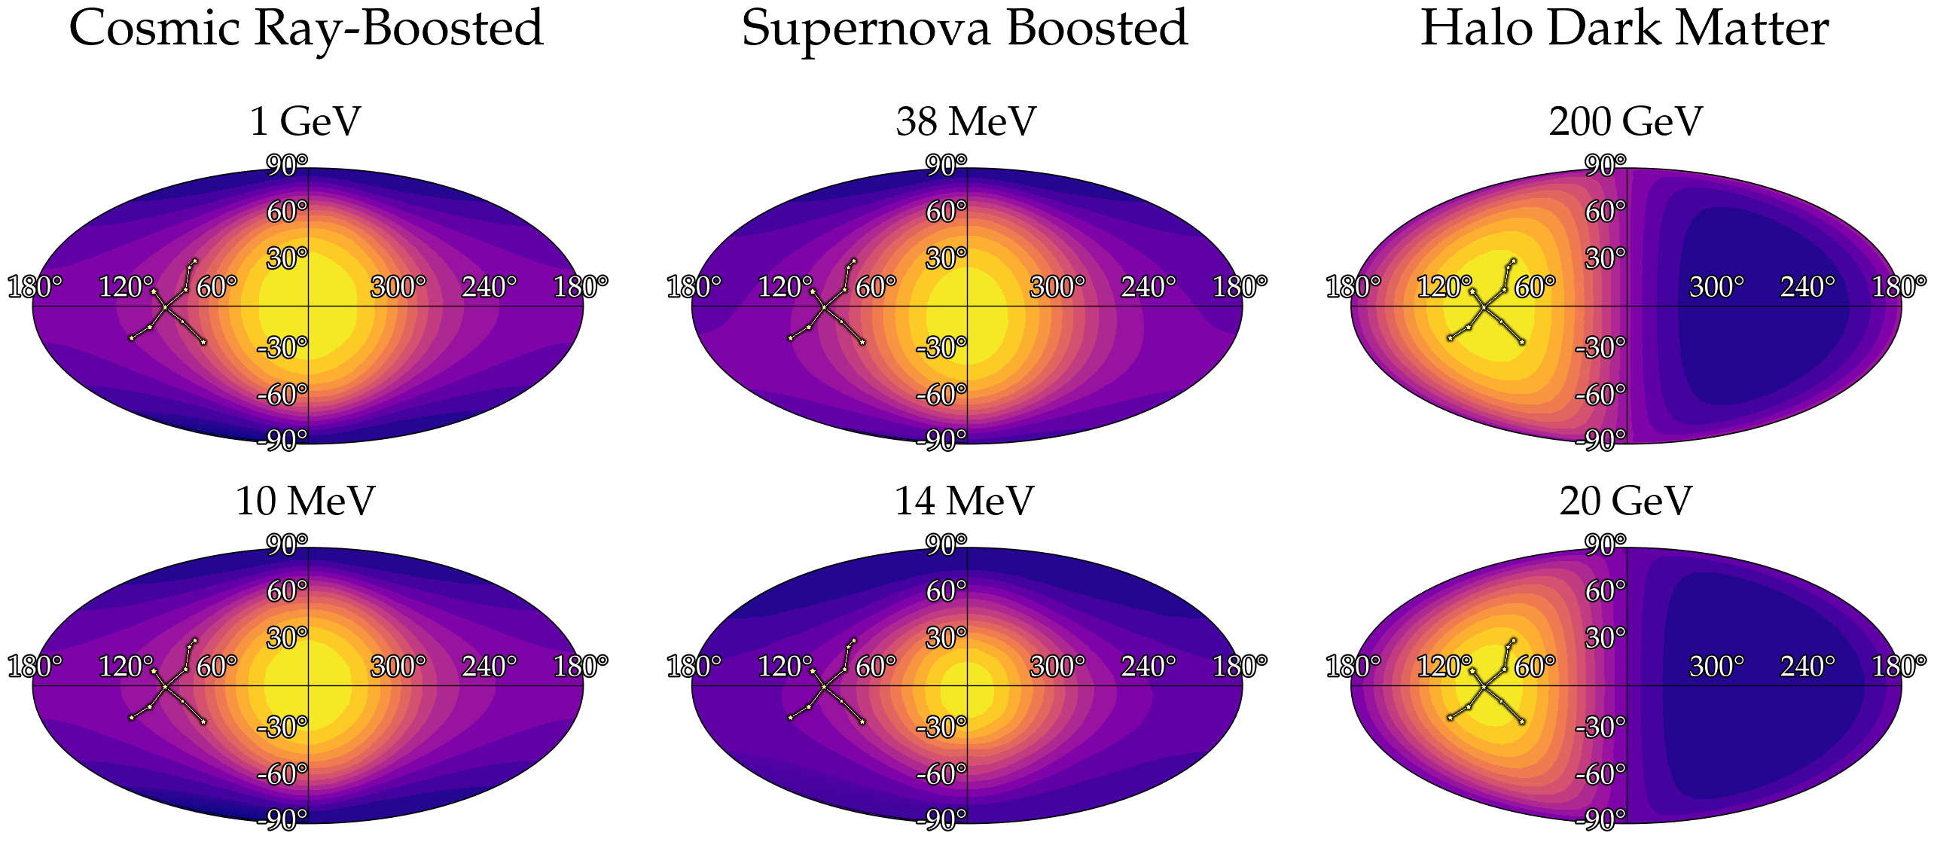
24

Slide 84
How many events are needed to resolve the signal within a certain resolution of the true direction?

Slide 85
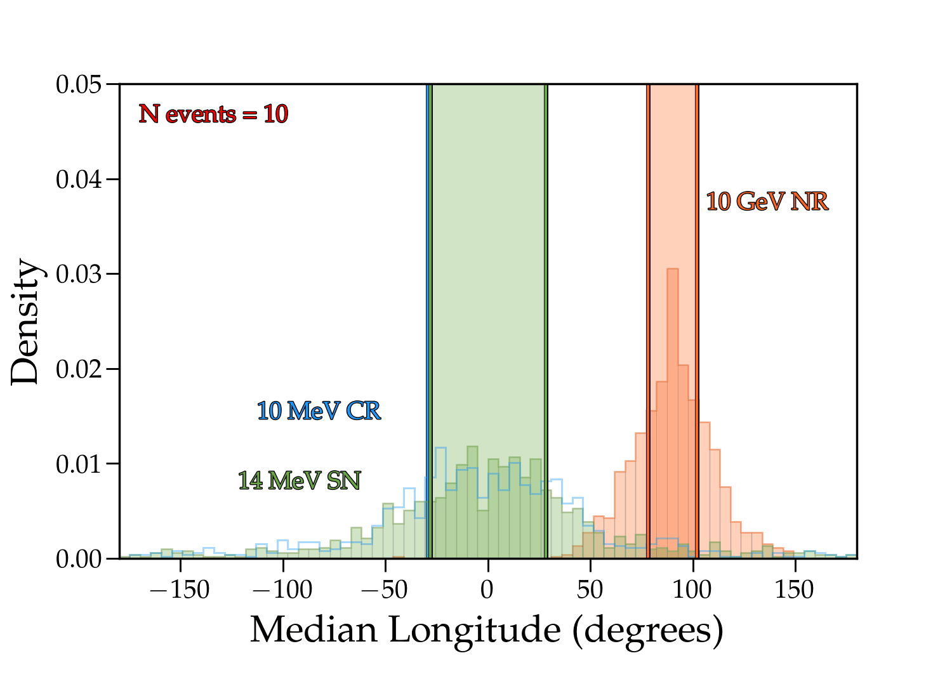
25

Slide 86
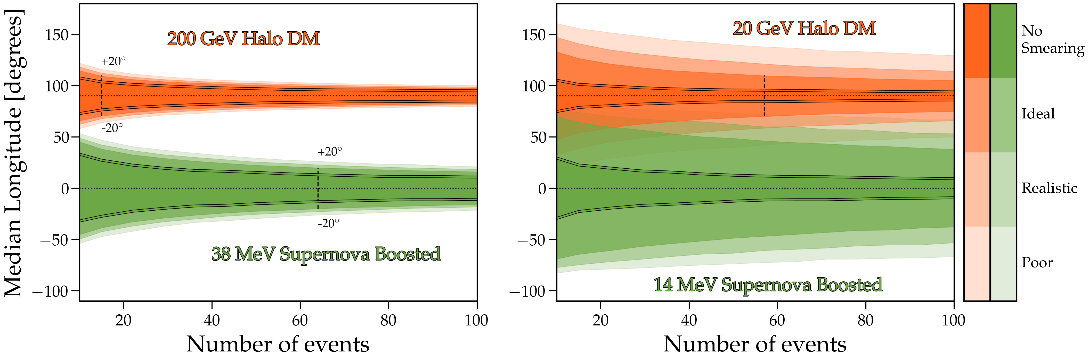
25

Slide 87
How many events are needed to resolve the signal within a certain resolution of the true direction?
How many to reject isotropy
(and tell these signals apart from the background)?

Slide 88
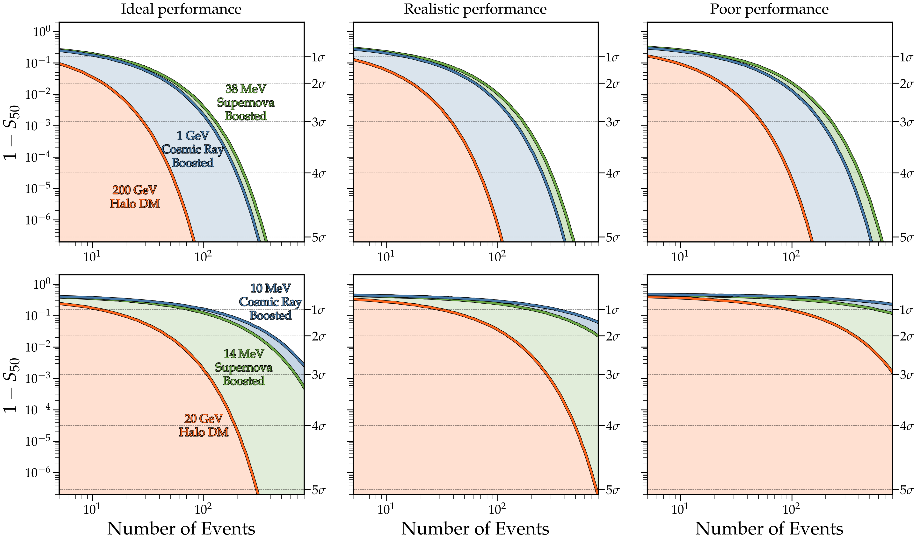
26

Slide 89

Conclusions
While the desired aim of CYGNUS would be to unambiguously detect DM, stepping-stone stages of the experiment can still be used to perform some interesting physics:
solar neutrino flux complementary reconstructions & subsequent non standard interaction studies through electron recoils
SNS, CCSN neutrinos through
Finally, beyond neutrinos, we saw how directional detection allows the separation of relativistic MeV-scale DM and halo DM

Slide 90
Thank you!

Slide 91
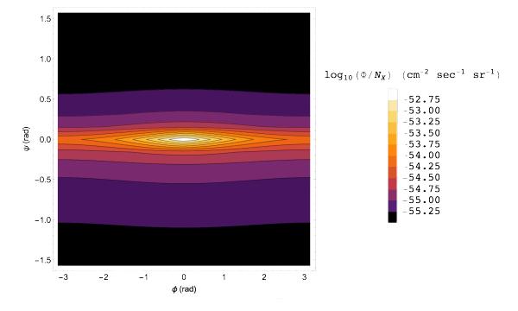
[2009.08836]

Slide 92
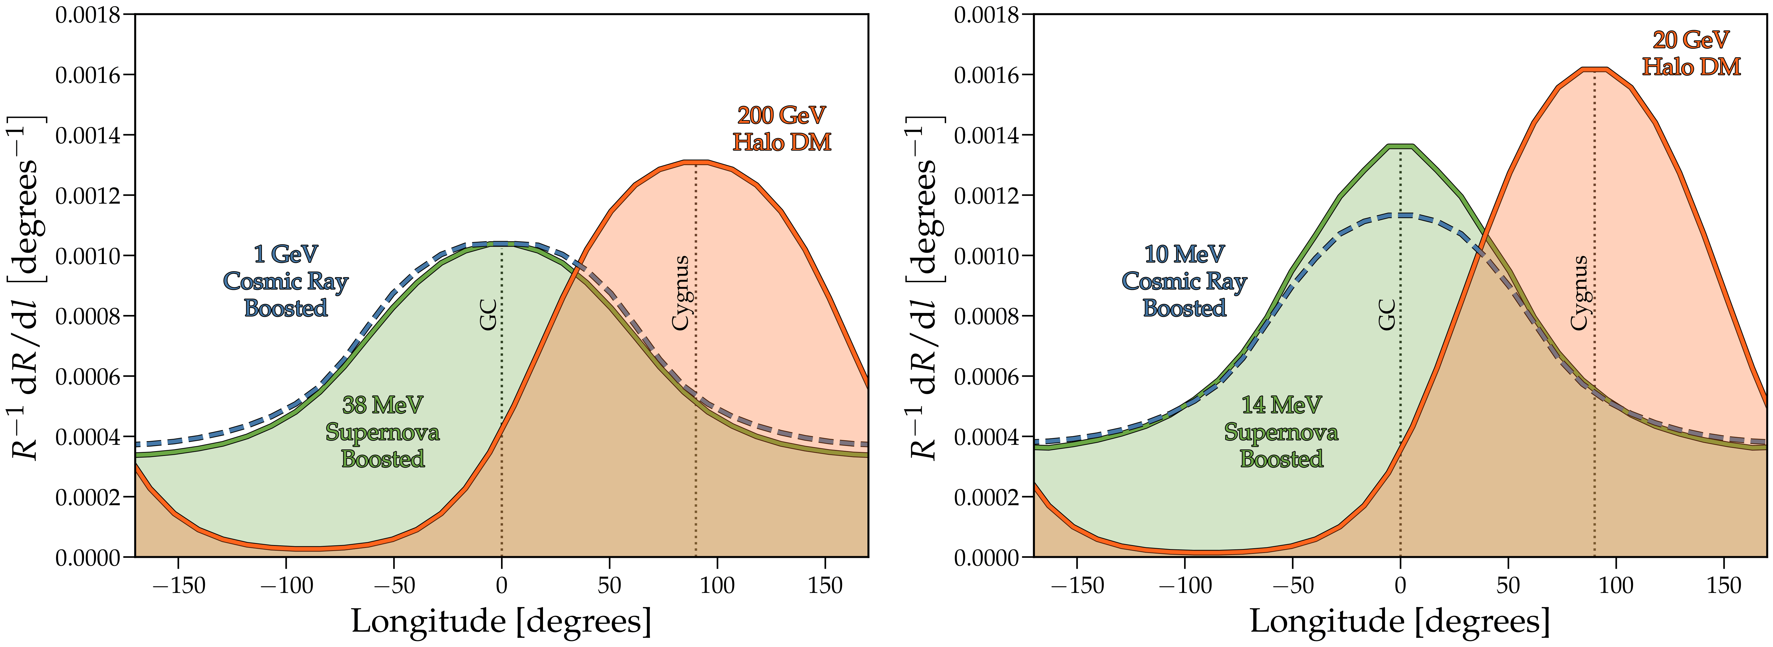

Slide 93


Slide 94


Slide 95



Slide 96


Slide 97


neutrino density matrix at detector:
where

Slide 98


Slide 99


Slide 100


Slide 101


Slide 102



Slide 103

This is the same neutrino flux that made the first ever
measurement possible with the COHERENT experiment at Oak Ridge labs!

