Slide 1


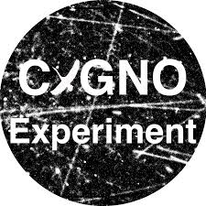
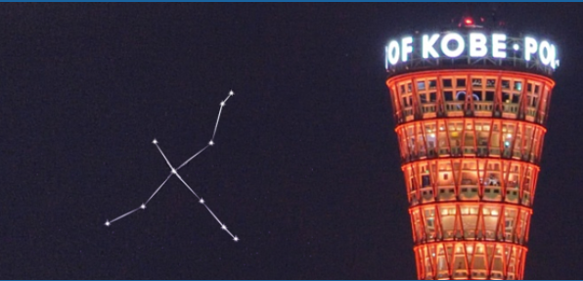







Space-charge saturation effect
and correction at high gain
in CYGNO GEM-based detectors
Giorgio Dho on behalf of Antonietti, Baracchini, Benussi, Bonali, Capoccia, Caponero, de Carvalho, Cavoto, Costa, Croce, Dané, Di Marco, D'Astolfo, D'Imperio, Fiorina, Iacoangeli, Islam,
Jùnior, Maccarrone, Mano, Gregorio, Marques, Mazzitelli, McLean, Messina, Meloni, Monteiro, Nobrega, Pains, Paoletti, Petrucci, Piacentini,
Pierluigi, Pinci, Renga, Russo, dos Santos, Saviano, Scamporlino, Silva, Spooner, Tesauro, Tomassini, Tozzi
Istituto Nazionale di Fisica Nucleare (INFN-LNF), Frascati (RM), Italy
CYGNUS workshop 2026
G. Dho, LNF Feb 23 2026

Slide 2
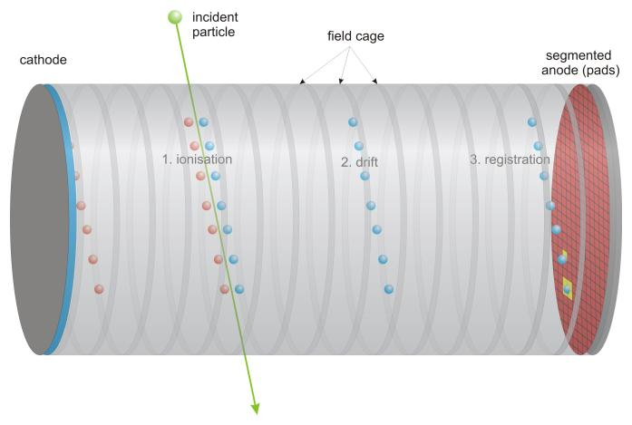
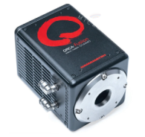
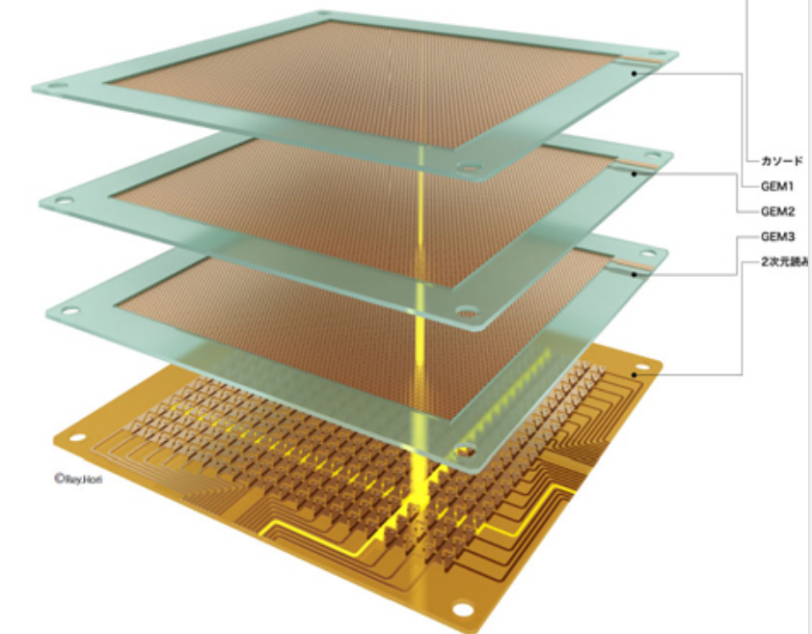
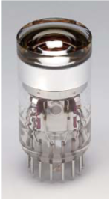
CYGNO Experiment
See Fiorina’s presentation earlier this morning
CYGNO project aims to construct a large directional detector, O(10-100) m³, for rare event searches (DM, Solar neutrinos)
TPC
Amplification Stage
Optical readout
z axis
READOUT
He:CF₄ gas 60/40:
room temperature
atmospheric pressure
F gives spin dependent sensitivity He for low DM mass sensitivity CF4 scintillates in visible range
Optical readout
PMT
sCMOS cameras
Decoupled from gas less contamination
Gas Electron Multipliers
(GEMs)
Grants large gains with high granularity O(50) um
G.Dho 1

Slide 3
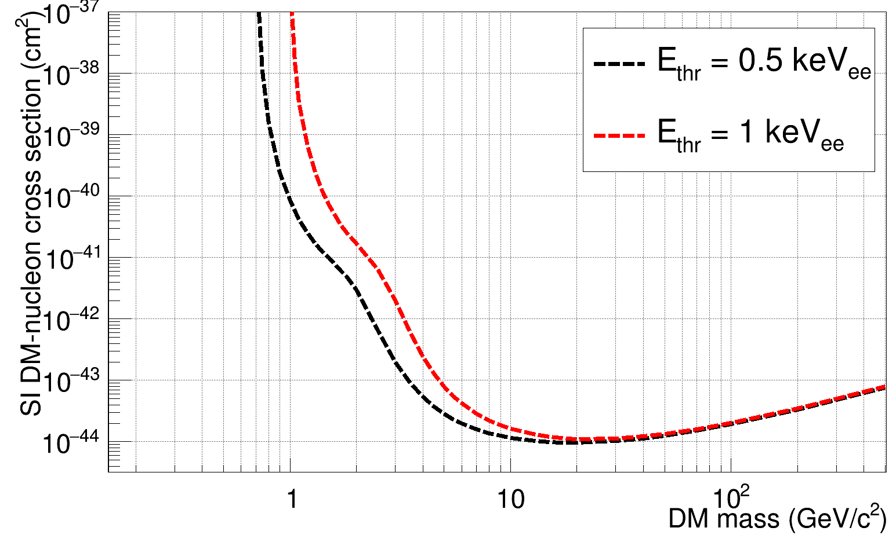
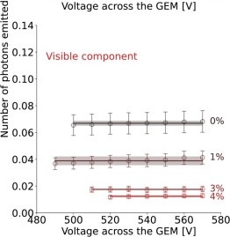
Why Do We Need Large Gain
Higher gain allows to:
Improve energy threshold
Detect all the low energy deposits of a recoil
Optical readout with camera requires high gain
N: lens aperture I: magnification
Solid angle coverage
Pro: Large area framed by camera
Price: Little solid angle coverage
Conversion efficiency
0.07 ph/secondary e⁻
He:CF₄ with isobutane %
Amaro et al., EPJC, https://doi.org/10.1016/j.physletb.2024.138759
G.Dho 2

Slide 4
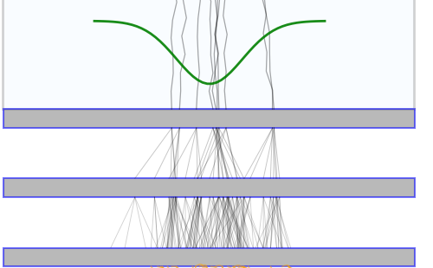

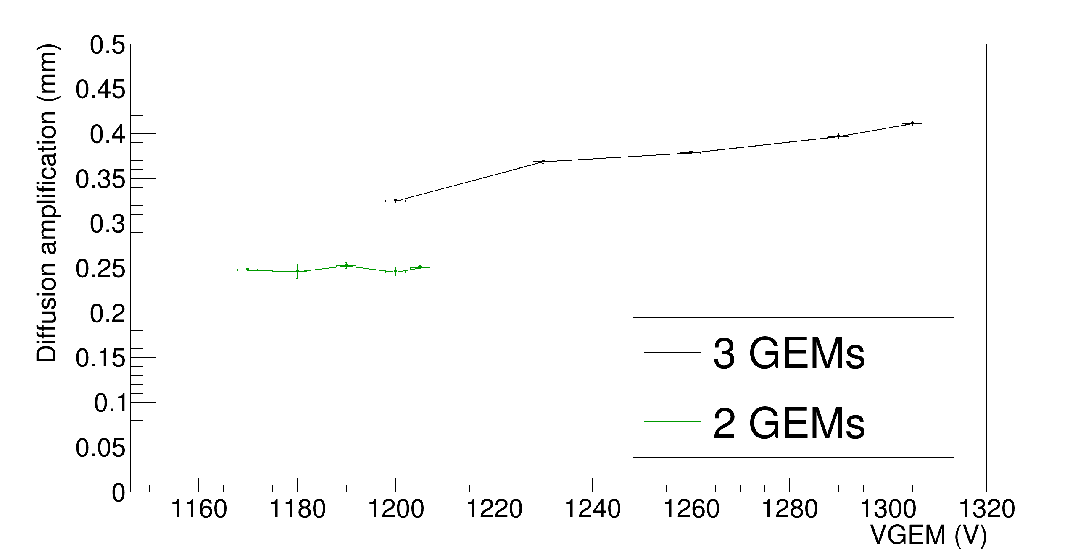
Balance Between Tracking and Gain
You want more gain? Put more GEMs!
Technically works, but increases the number of transfer gaps
Not an efficient process
Diffusion from amplification stage increases
STD of light distribution caused by amplification stage of short round tracks
Measured with CYGNO prototype: MANGO
Dho et al., EPJC, https://doi.org/10.1140/epjc/s10052-024-13471-5
Bad for a directional detector
G.Dho 3

Slide 5

Push GEM voltage
So just push GEM voltage to the limit of sparking
This is what we do
Numbers in our gas mixture:
LNF (1000 mbar): max 460 V each GEM
LNGS (910 mbar): max 440 V each GEM
G.Dho 4

Slide 6
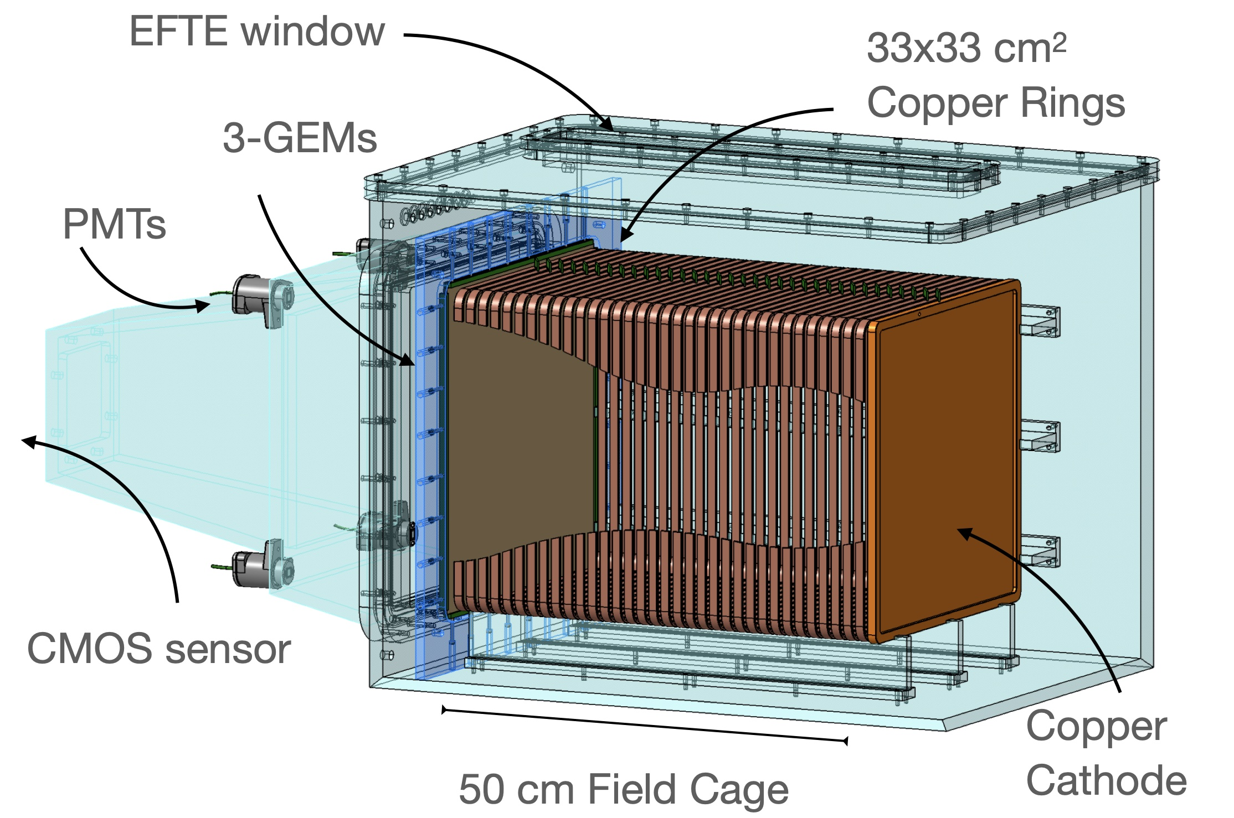

Push GEM voltage
So just push GEM voltage to the limit of sparking
This is what we do
However, data with ⁵⁵Fe source (5.9 keV photoelectrons) as a function of drift distance in LIME (@ LNGS):
Numbers in our gas mixture:
LNF (1000 mbar): max 460 V each GEM
LNGS (910 mbar): max 440 V each GEM
Light yield (AU)
Drop of 40% from 33 cm to 4 cm
Drift distance z (cm)
G.Dho 4

Slide 7
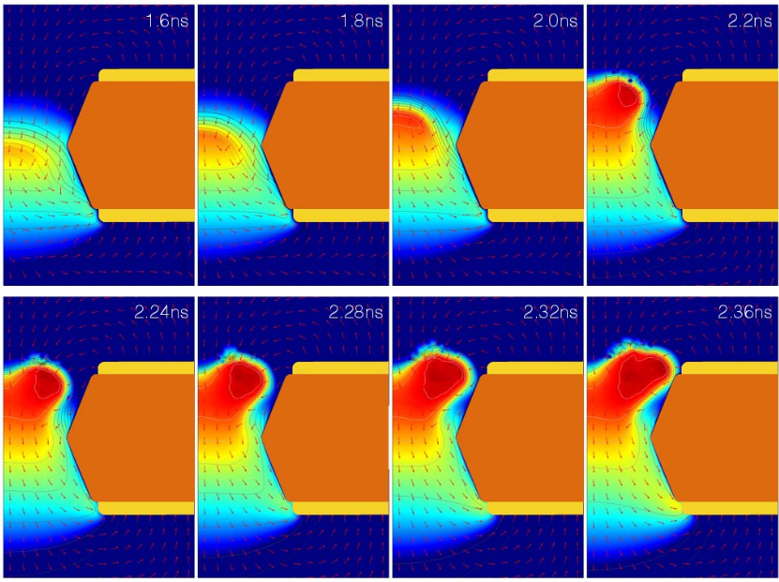
What Is Going On?
Sort of know problem when too much charge undergoes avalanche
Space-charge saturation effect
Charge density is key events closer to anode diffuse less more saturated
Colour: ion density
Electric field from GEMs is shielded by ion field
Oliveri et al., NSS/MIC, https://doi.org/10.1109/nssmic.2015.7581778
Can we model this?
G.Dho 5

Slide 8
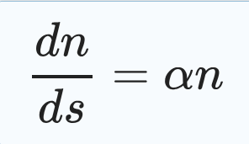
Space-Charge Effect Model
New paper! Amaro et al., EPJC, https://doi.org/10.1140/epjc/s10052-026-15318-7
Start from GEM charge generation in GEM: Townsend equation
G.Dho 6

Slide 9
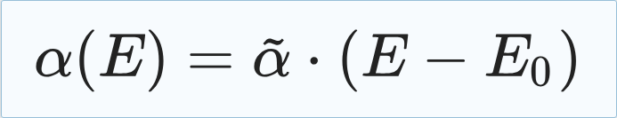
Space-Charge Effect Model
New paper! Amaro et al., EPJC, https://doi.org/10.1140/epjc/s10052-026-15318-7
Start from GEM charge generation in GEM: Townsend equation
First order linear dependence on electric field of Townsend coeff
Golovatyuk et al., NIM A, https://doi.org/10.1016/S0168-9002(00)01172-4
G.Dho 6

Slide 10

Space-Charge Effect Model
New paper! Amaro et al., EPJC, https://doi.org/10.1140/epjc/s10052-026-15318-7
Start from GEM charge generation in GEM: Townsend equation
First order linear dependence on electric field of Townsend coeff
Assume the electric field is shielded by n itself
Golovatyuk et al., NIM A, https://doi.org/10.1016/S0168-9002(00)01172-4
G.Dho 6

Slide 11
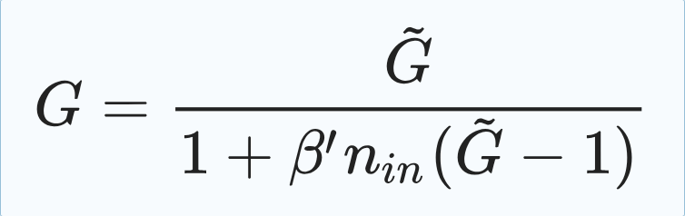
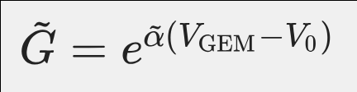
Space-Charge Effect Model
New paper! Amaro et al., EPJC, https://doi.org/10.1140/epjc/s10052-026-15318-7
Start from GEM charge generation in GEM: Townsend equation
First order linear dependence on electric field of Townsend coeff
Assume the electric field is shielded by n itself
Solve equation for 1 GEM
Golovatyuk et al., NIM A, https://doi.org/10.1016/S0168-9002(00)01172-4
Unsaturated Gain
G.Dho 6

Slide 12
Space-Charge Effect Model
New paper! Amaro et al., EPJC, https://doi.org/10.1140/epjc/s10052-026-15318-7
Start from GEM charge generation in GEM: Townsend equation
First order linear dependence on electric field of Townsend coeff
Assume the electric field is shielded by n itself
Solve equation for 1 GEM
Golovatyuk et al., NIM A, https://doi.org/10.1016/S0168-9002(00)01172-4
Unsaturated Gain
~ 0: no effect
0<< && <<1: saturation
~ 1: no gain
G.Dho 6

Slide 13
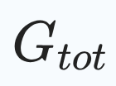
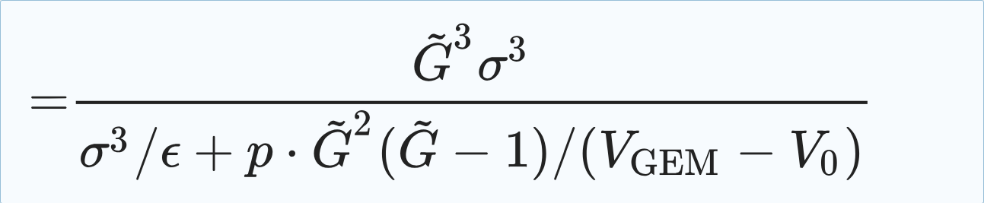
Space-Charge Effect Model II
New paper! Amaro et al., EPJC, https://doi.org/10.1140/epjc/s10052-026-15318-7
In CYGNO,
We use 3 GEMs: between each stage there is extraction and collection efficiency All accounted in ε
The charge density reaching the GEM holes depends on electron cloud size: diffusion σ
Rewriting the previous expression:
G.Dho 7

Slide 14
Space-Charge Effect Model II
New paper! Amaro et al., EPJC, https://doi.org/10.1140/epjc/s10052-026-15318-7
In CYGNO,
We use 3 GEMs: between each stage there is extraction and collection efficiency All accounted in ε
The charge density reaching the GEM holes depends on electron cloud size: diffusion σ
Rewriting the previous expression in 4:
Measurable: Diffusion coefficient
Parameter: V₀
Parameter: total efficiency
Parameter: geometrical and saturation
Parameter: Townsend coefficient α
G.Dho 7

Slide 15
Space-Charge Effect Model II
New paper! Amaro et al., EPJC, https://doi.org/10.1140/epjc/s10052-026-15318-7
In CYGNO,
We use 3 GEMs: between each stage there is extraction and collection efficiency All accounted in ε
The charge density reaching the GEM holes depends on electron cloud size: diffusion σ
Rewriting the previous expression:
Measurable: Diffusion coefficient
Parameter: V₀
Parameter: total efficiency
Parameter: geometrical and saturation
Parameter: Townsend coefficient α
Can we measure/test this?
G.Dho 7

Slide 16
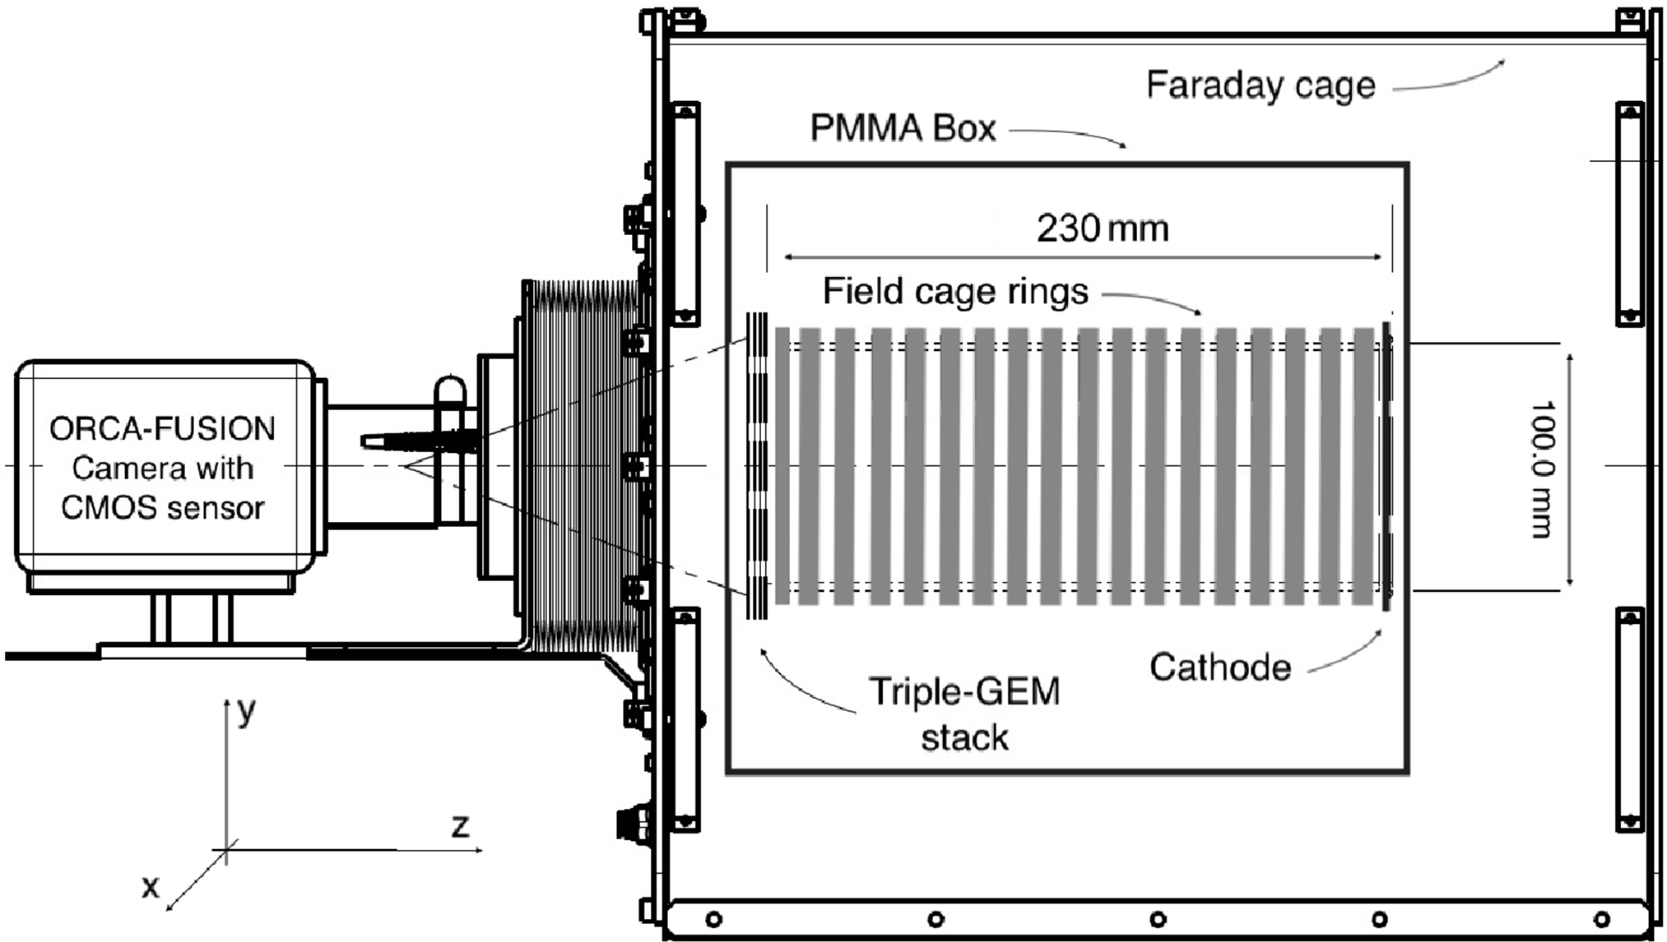
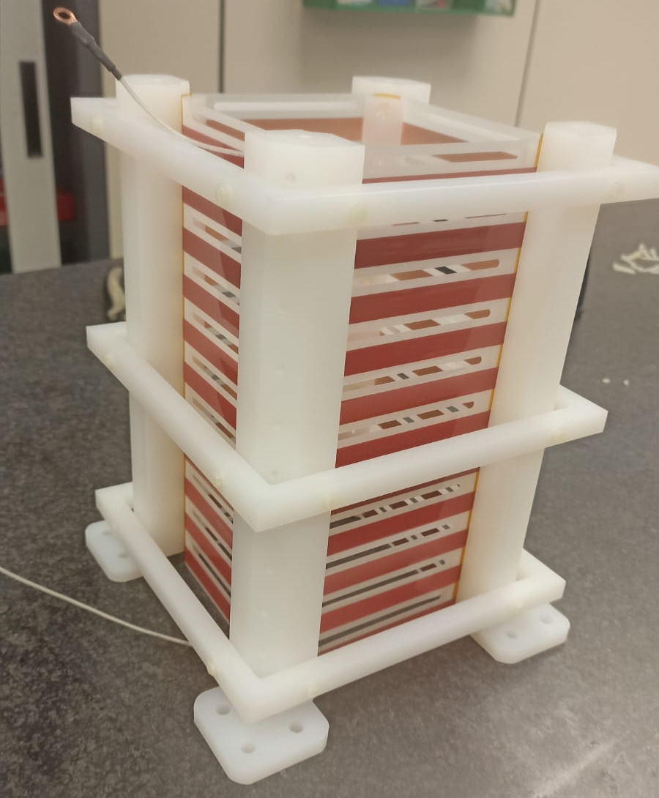
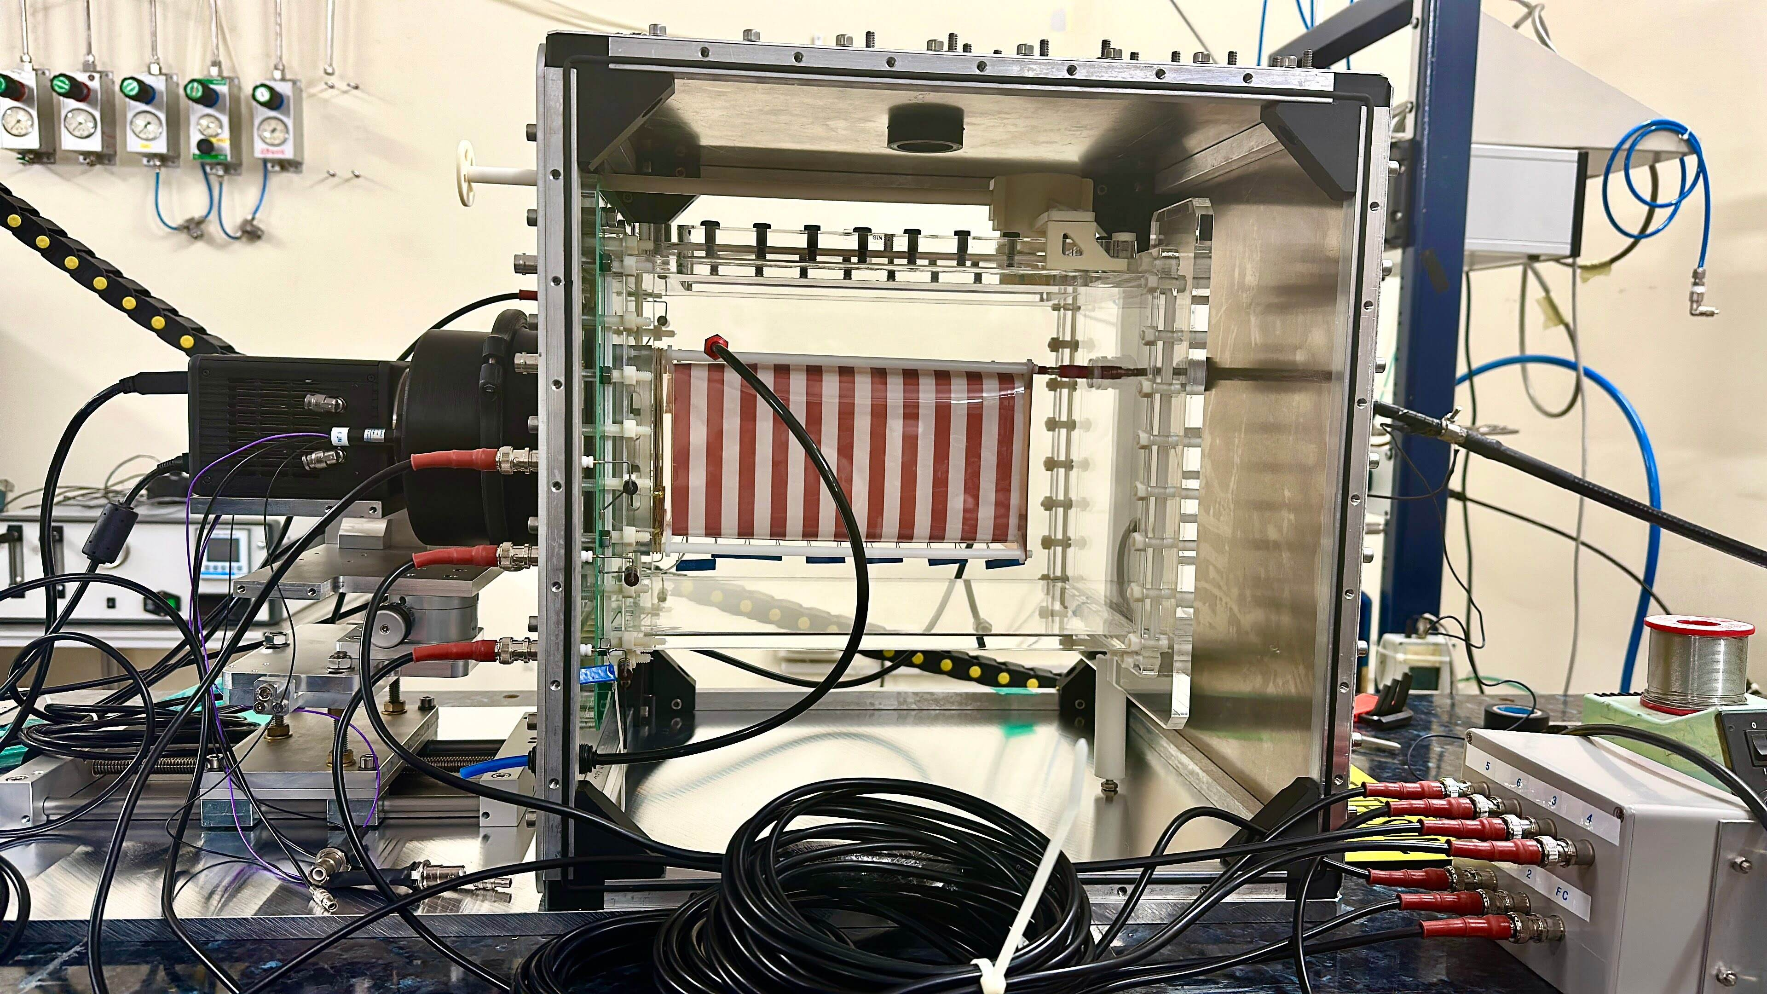
GIN Detector
CYGNO prototype at Laboratori Nazionali Frascati (LNF)
Gas TPC with 10x10 cm² readout area and 23 cm drift
Triple GEM amplification stage
2 PMTs, 1 ORCA Quest2 camera with EHD lens
Field cage made of PET sheet with deposited copper strips
Movable source ⁵⁵Fe holder (5.9 keV x-rays)
Camera sensor
Movable source holder
G.Dho 8

Slide 17
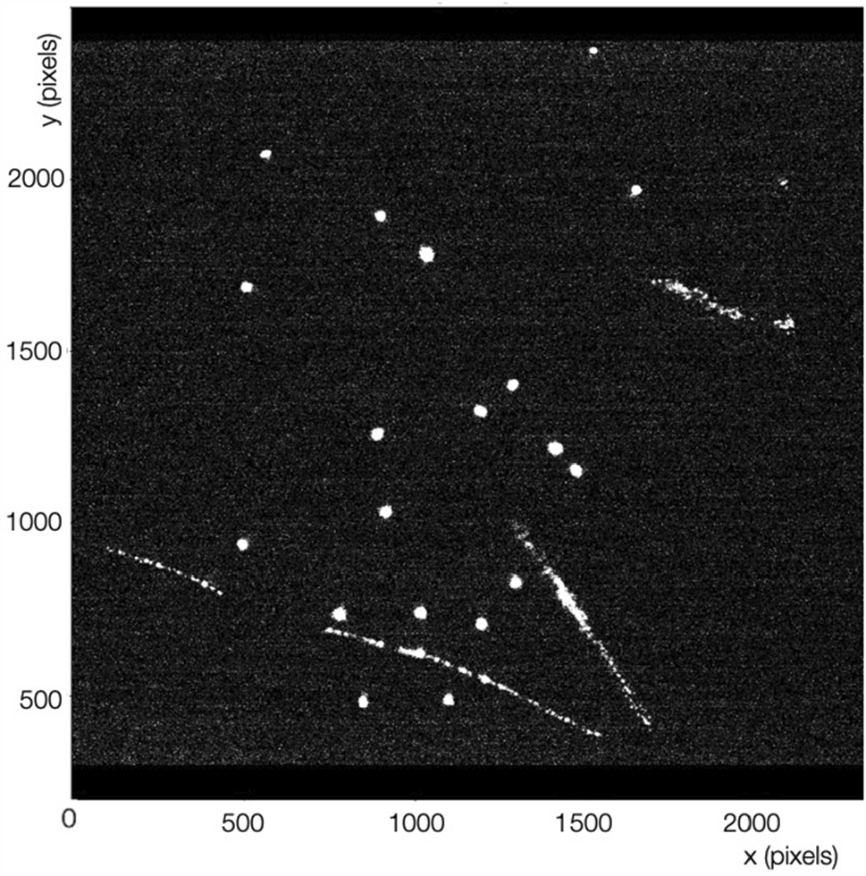
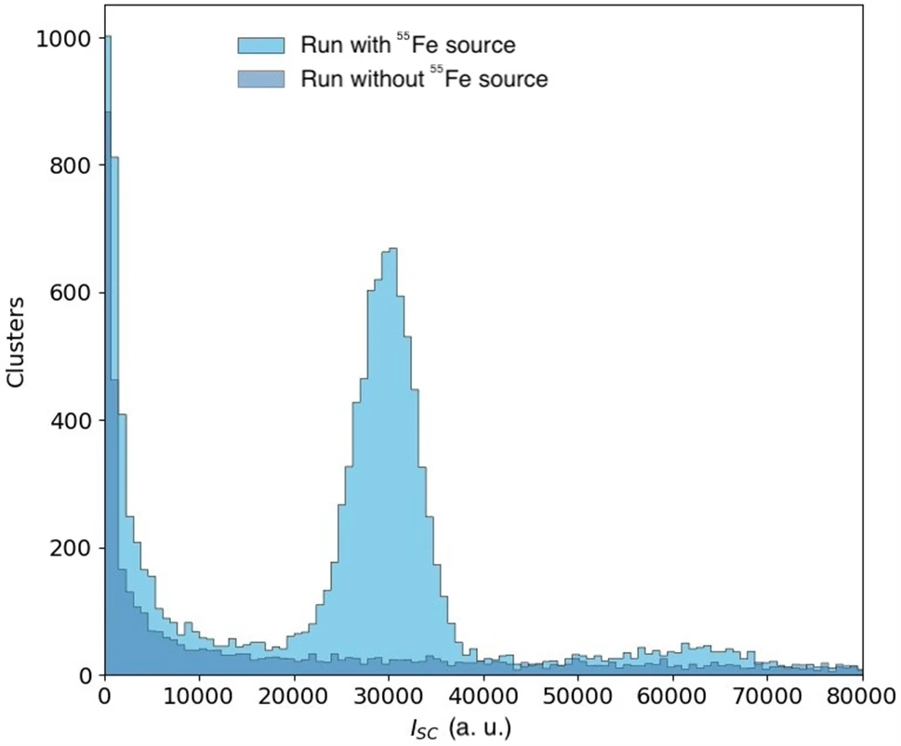
GIN Detector Data Acquisition
Data is taken with and without the ⁵⁵Fe source
Source movable along 11 different positions along z (drift direction)
Analysis of clusters allows to retrieve: energy, sigma of the spatial distribution.
G.Dho 9

Slide 18
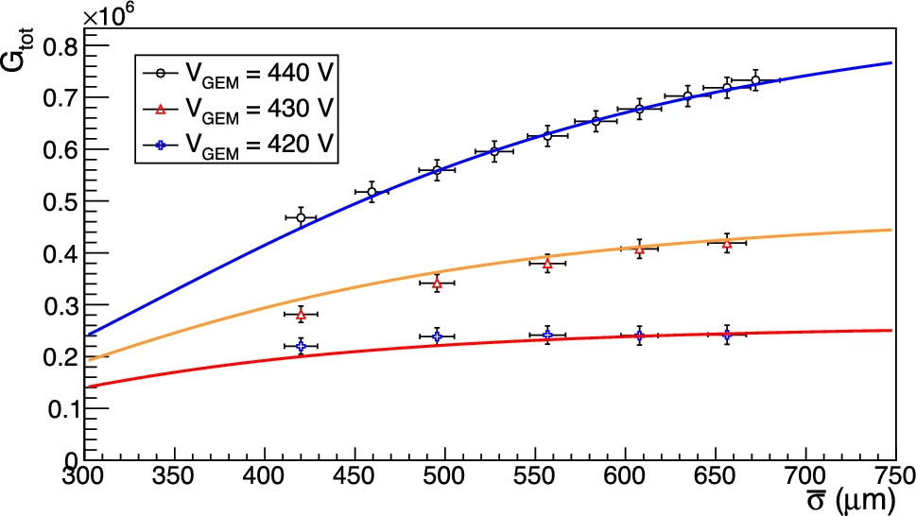
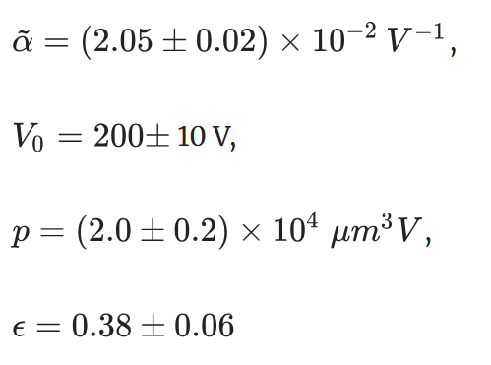
Model Fit
Exploiting data taken with different VGEM, and position a combined fit of our model can be performed
Model works on separated dataset!
PAPER:
Amaro et al., EPJC, https://doi.org/10.1140/epjc/s10052-026-15318-7
G.Dho 10

Slide 19
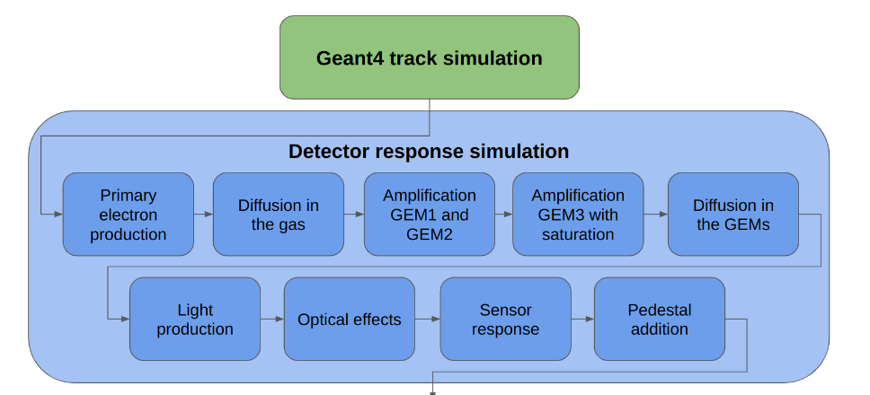
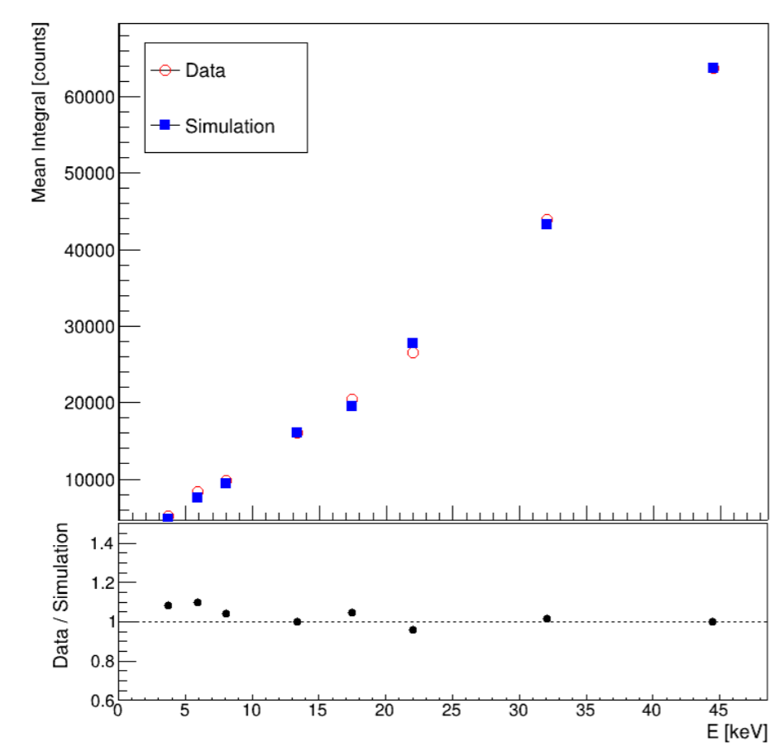
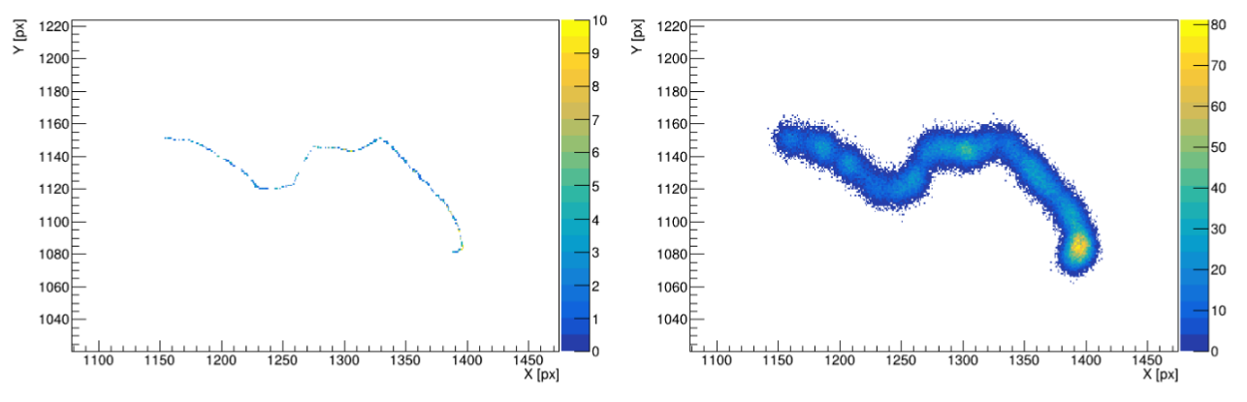
Model into Simulation
This model has been included in our detector simulation yielding very promising results
Amaro et al., eprint, https://arxiv.org/pdf/2601.01435
G.Dho 11

Slide 20
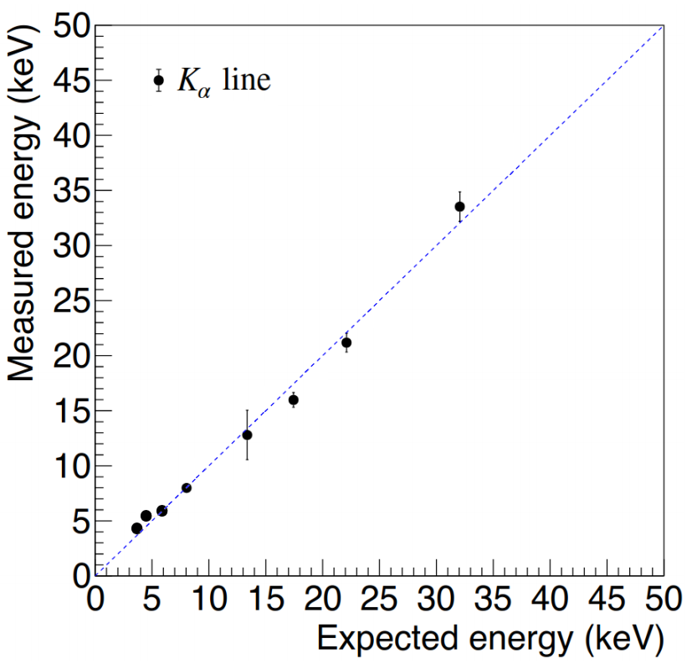
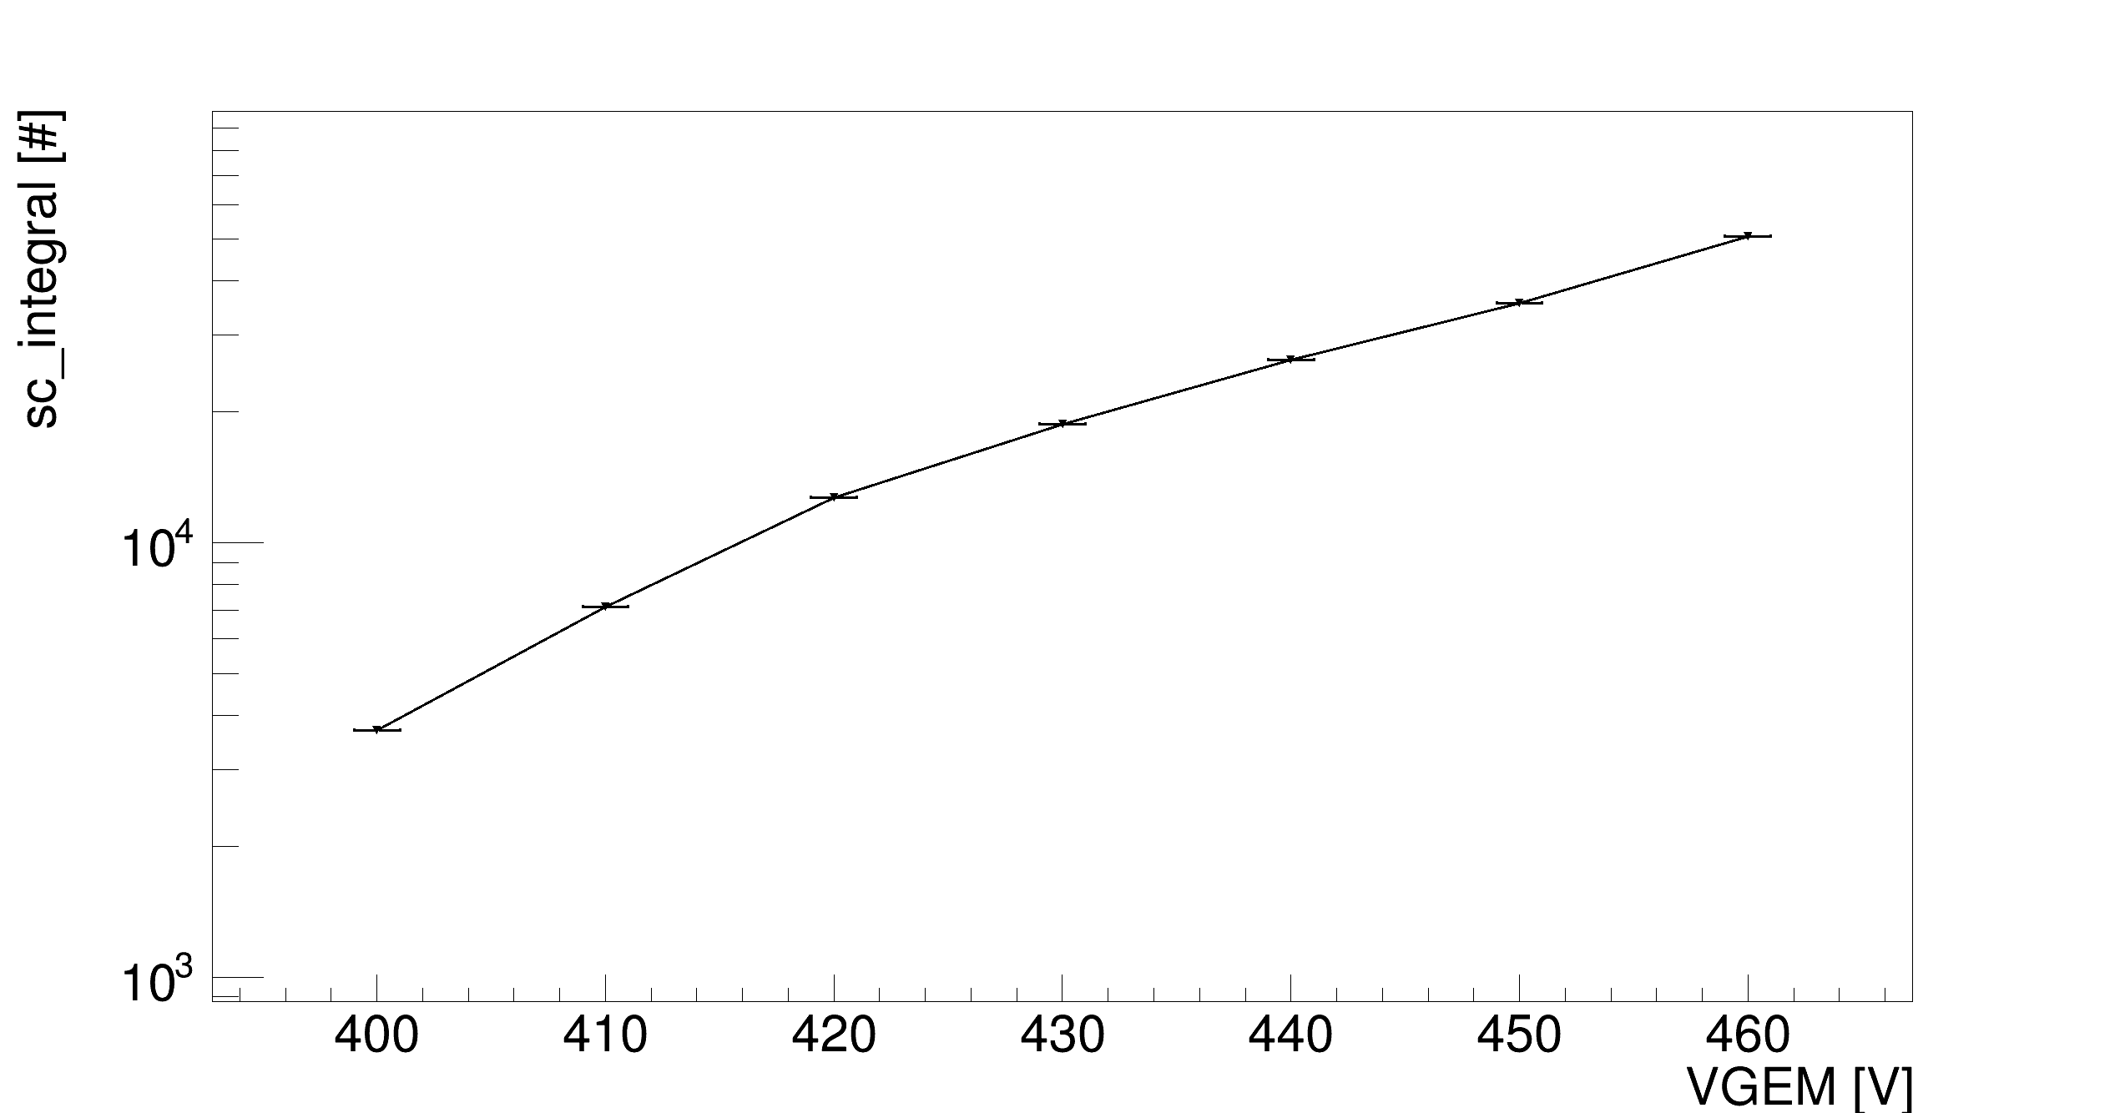
How does Saturation appear
Energy non-linearity
To be measured different sources are needed
Topology changes along the energies
Under study by LNGS group
Non-exponential gain
It naturally occurs for GEMs in wide ranges of VGEM
Absolute saturation measurable only in small VGEM ranges
z-dependence of light yield
Complicates the energy determination
Dependent on drift field as well due to absorption
Light yield (AU)
Light yield (AU)
Topological deformation Worsening ER/NR discrimination
G.Dho 12

Slide 21
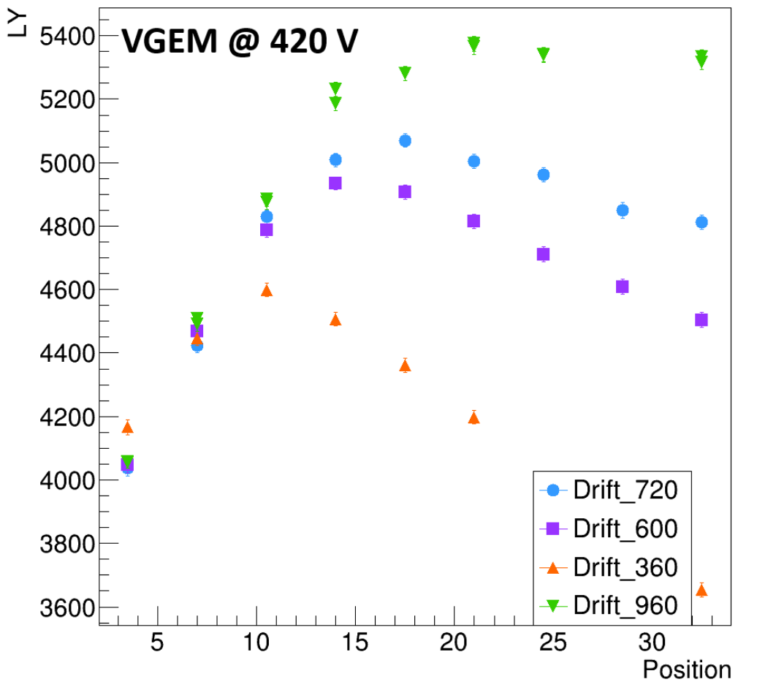
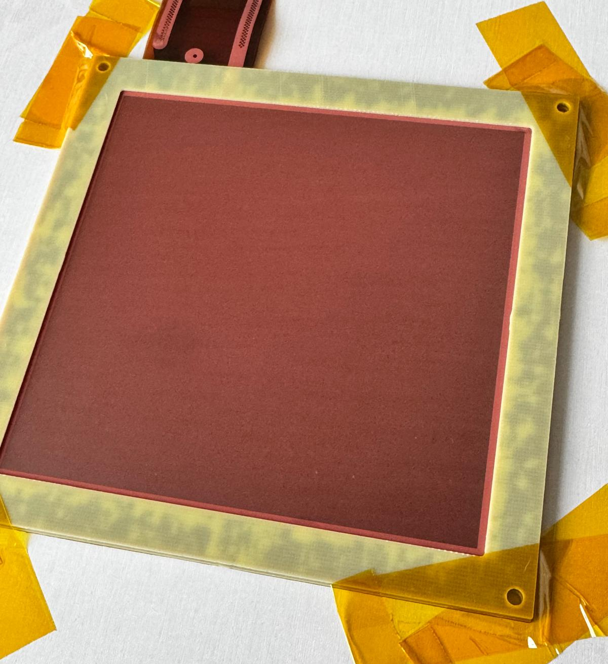
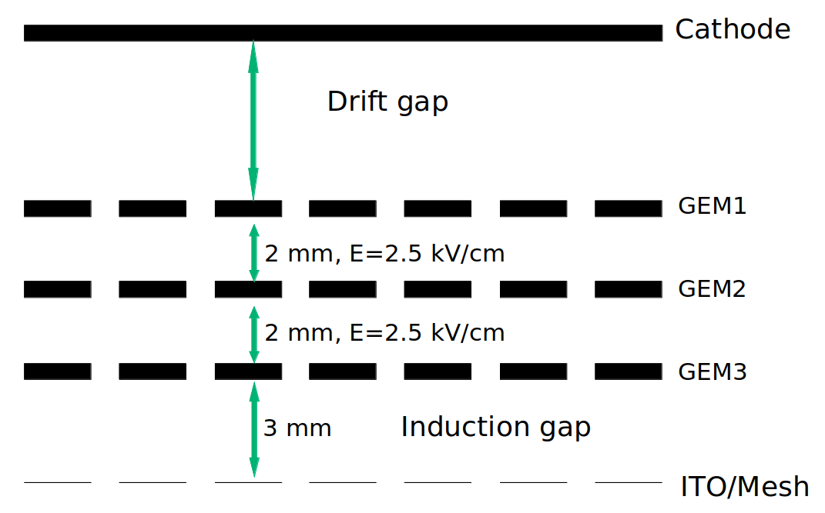
How Do We Work Around This
Lower VGEM and drift field
Reduces the spread in z
Diffusion increases lowering drift field
Lower light yield (about half)
Some data with LIME at LNGS taken in this configuration
Tackle experimentally
V-Bond GEM
Procedure to modify GEM structure
Visible effect: opaque copper
Intense electric field below last GEM
Extra electrode to distort electric field below last GEM
Saturation reduced to about ~ 20%
Dho et al., EPJC, https://doi.org/10.1140/epjc/s10052-024-13471-5
G.Dho 13

Slide 22
How Do We Work Around This
Lower VGEM and drift field
Reduces the spread in z
Diffusion increases lowering drift field
Lower light yield (about half)
Some data with LIME at LNGS taken in this configuration
Tackle experimentally
V-Bond GEM
Procedure to modify GEM structure
Visible effect: opaque copper
Intense electric field below last GEM
Extra electrode to distort electric field below last GEM
Saturation reduced to about ~ 20%
Dho et al., EPJC, https://doi.org/10.1140/epjc/s10052-024-13471-5
G.Dho 13

Slide 23
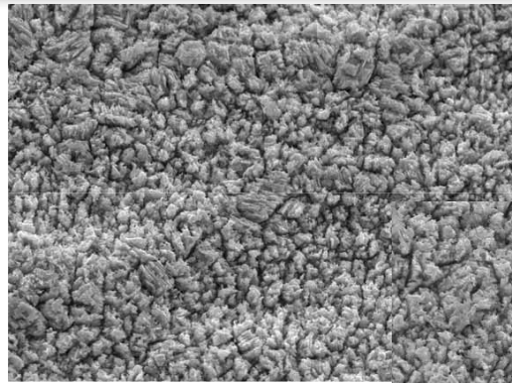
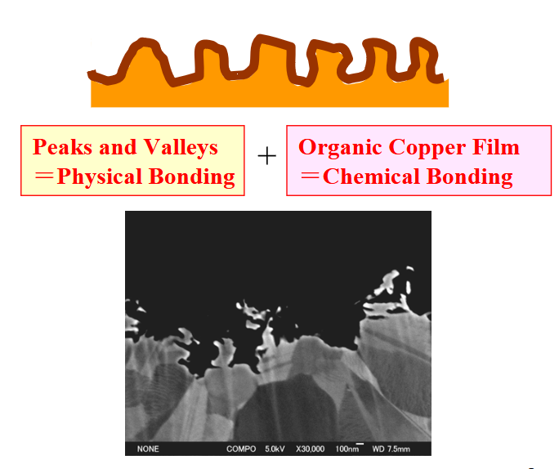
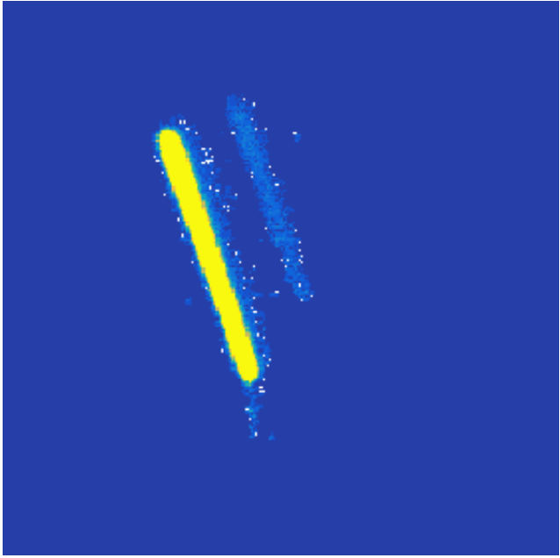
V-Bond GEM
After the GEM is etched the V-Bond procedure is applied
Bath of chemicals which etches non perfect Cu crystals generating small valleys
Depth about 500 nm, width similar
Generation of small film of 10 nm of organic copper film (unknown)
Originally thought to remove reflections seen in LIME data
Intense tracks were reflecting over window and smooth copper
With V-Bond GEM become opaque: NO reflections
https://www.mec-co.com/en/product/electronic-substrate/sekisou/
G.Dho 14

Slide 24
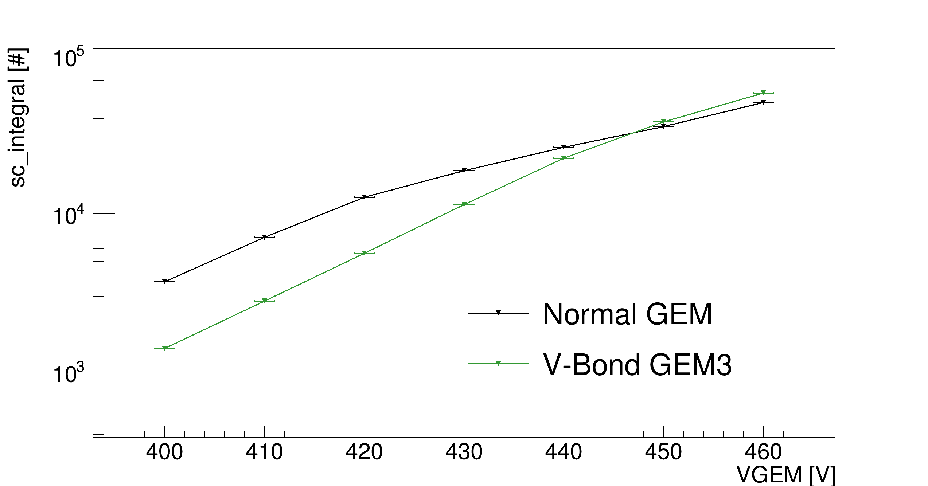
Gain Scan
In GIN detector GEM3 (closest to optical readout) was replaced with a V-Bond GEM
A simple VGEM scan showed interesting hints of lower saturation
Light yield (AU)
G.Dho 15

Slide 25
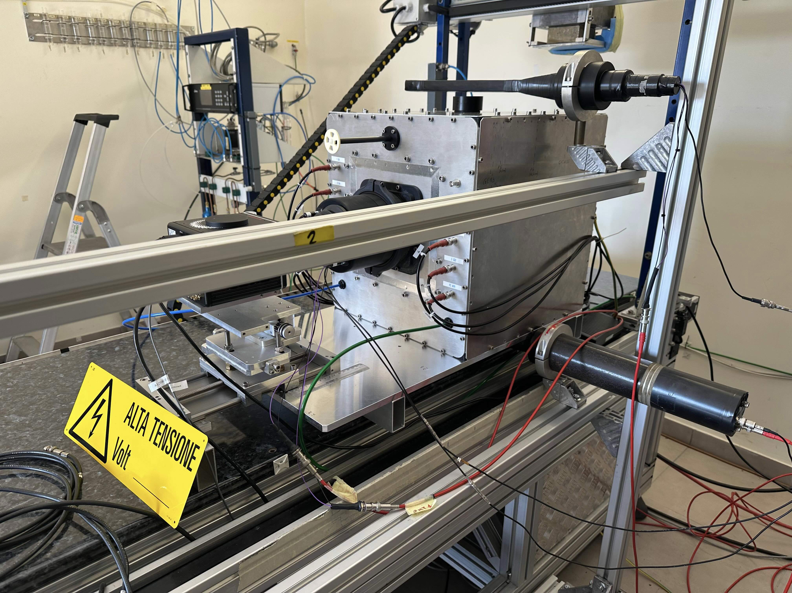
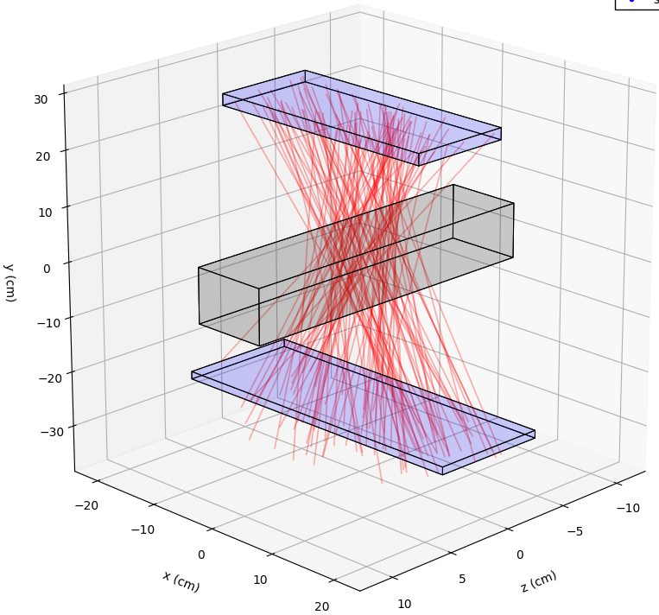
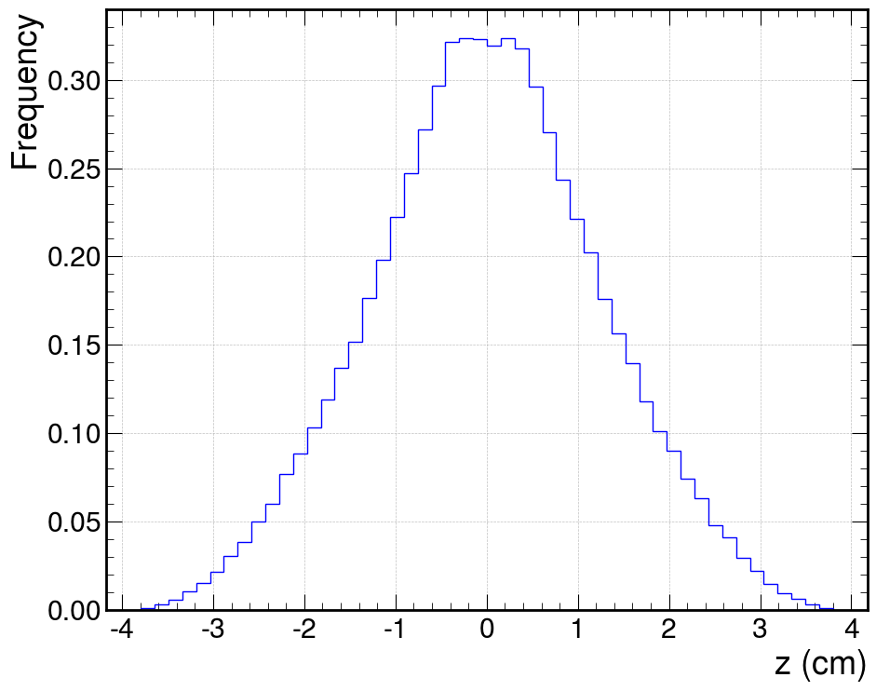
Modified GIN Setup
As this GEM might behave differently, we modified GIN to measure saturation
Two scintillators added above and below GIN to tag muons (about 30x7x2 cm³)
System is movable along z, to perform drift gap scans with muons
Simulated distribution of z coordinate of muon with respect to nominal centre of scintillator
Average: 0 with error of < 100 µm Sigma: 1.2 cm
G.Dho 16

Slide 26
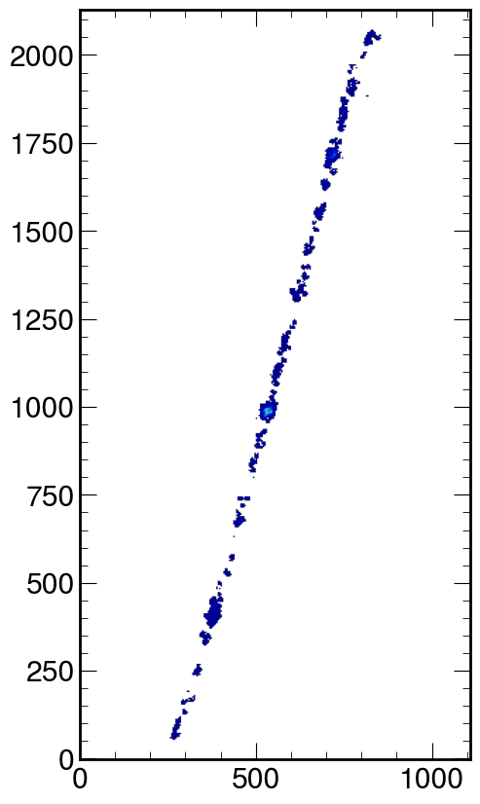
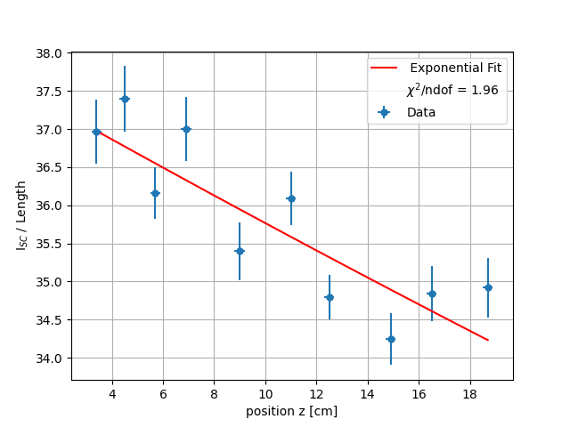

Attenuation Length
To correct for absorption along the drift we employ muons tagged by the system
Muons have the least energy deposit density, no saturation
Intensity (I_{SC}) estimated with truncated method on Landau distributions
VGEM = 440V
E_{drift} = 1 kV/cm
$$G=e^{−λ_{abs}z}$$
λ_{abs} = (200 ± 40) cm
G.Dho 17

Slide 27
Drift Distance Scan
Now, a similar scan in z with ⁵⁵Fe source
After correcting for attenuation length (blue points) real saturation can be extracted
Peak-to-peak fluctuation = 1%
No saturation @ 440 V LNF with V-Bond GEM
G.Dho 18

Slide 28
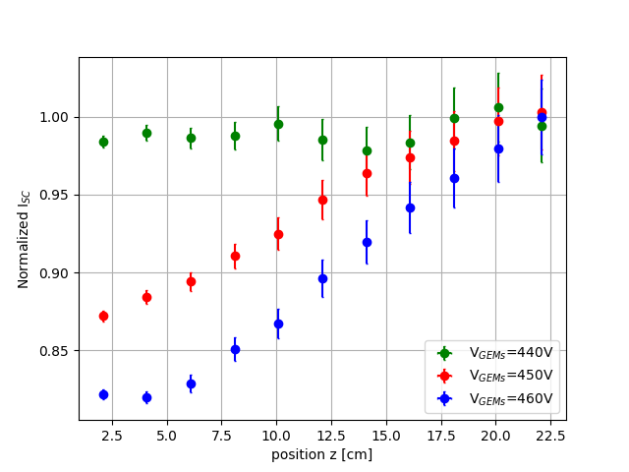
Absolute Saturation
Study repeated with 450 and 460 V.
Used muons to estimate non saturated gain increase when increasing GEM voltage
Saturation appears back again
At maximum voltage saturation is below 20%
Effectively reduced saturation but keeping the same light yield
Paper in preparation
G.Dho 19

Slide 29
Absolute Saturation
Study repeated with 450 and 460 V.
Used muons to estimate non saturated gain increase when increasing GEM voltage
Selected solution for CYGNO-04 demonstrator
Paper in preparation
G.Dho 19

Slide 30
Conclusion
Within the CYGNO experiment it is really important to increase as much as possible the amplification gain while keeping the best detector performances
Pushing the GEM to maximum voltage causes the onset of space charge saturation effects which limit the detector uniform response
An effective modelisation of the phenomenon appears to work consistenly with data taken with a prototype at LNF laboratories
The V-Bond procedure applied to GEM was tested with a modified version of the same CYGNO prototype
Saturation is measured reduced by more than half while preserving the same light output which already guarantees 0.5 keV_{ee} energy threshold
Other R&D activities are under study with possibly even better results
G.Dho 20

Slide 31
Backup
G.Dho

Slide 32
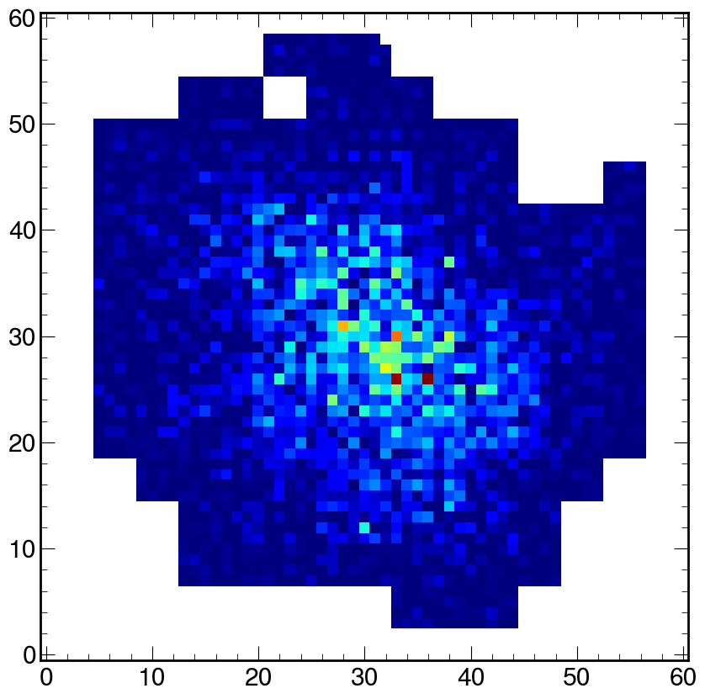
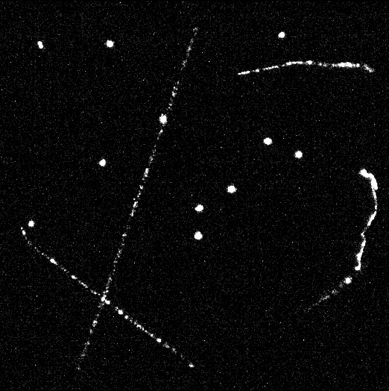
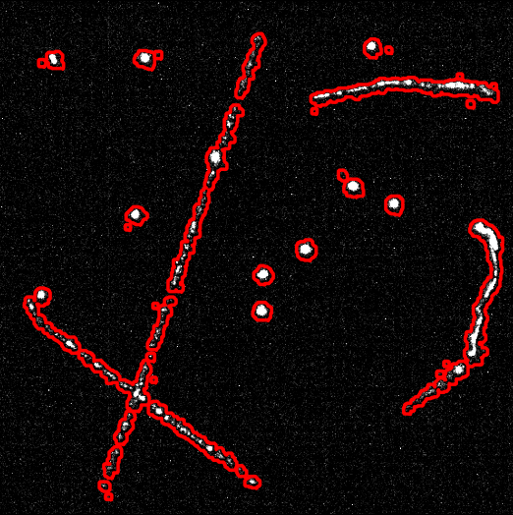
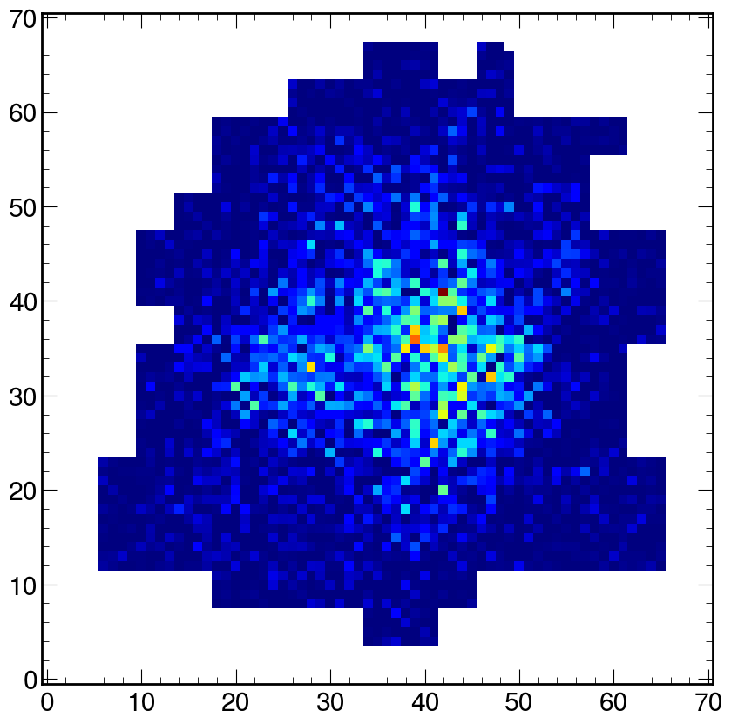
Reconstruction
Reconstruction algorithm of CYGNO based on DBSCAN and fittin procedure to merge pieces of long tracks
Muon
⁵⁵Fe electron recoils
G.Dho

Slide 33
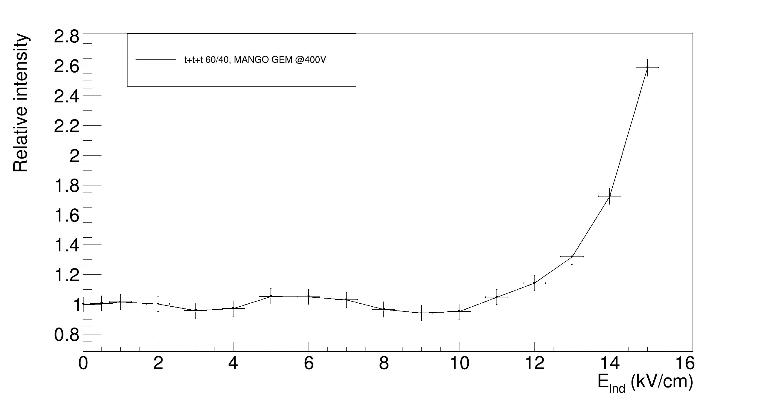
Studies with ITO I
Dho et al., EPJC, https://doi.org/10.1140/epjc/s10052-024-13471-5
Modification of amplification stage adding an extra electrode 3mm below the last GEM
New electrode: ITO (indium-tin-oxide) transparent sheet (85%)
Very strong electric fields applied in this induction gap (<15 kV/cm)
Lowering the GEM HV, above a certain field, the light yield increases exponentially
MANGO prototype @ LNGS
G.Dho

Slide 34
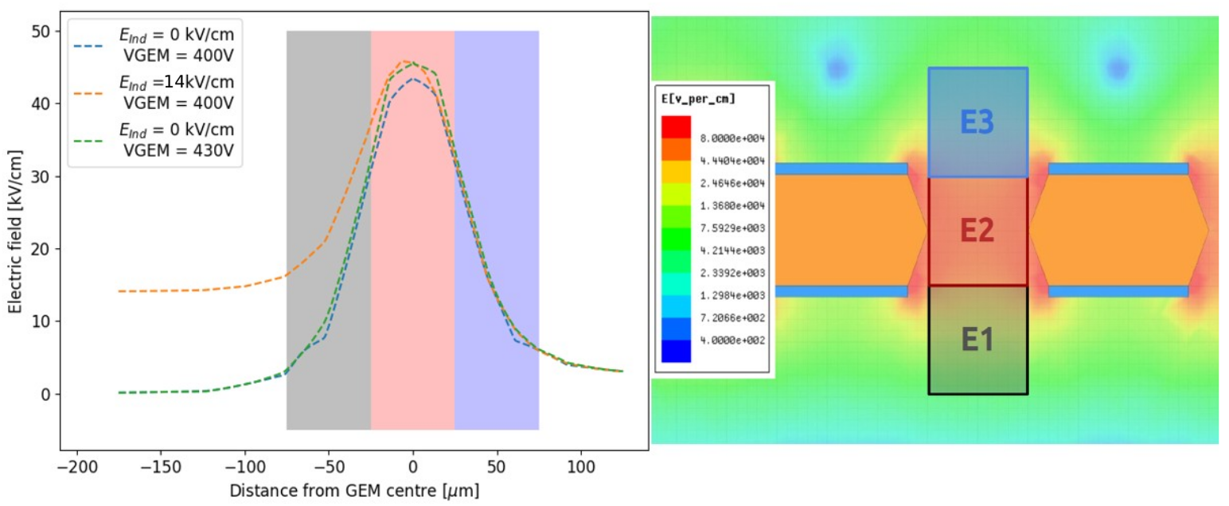
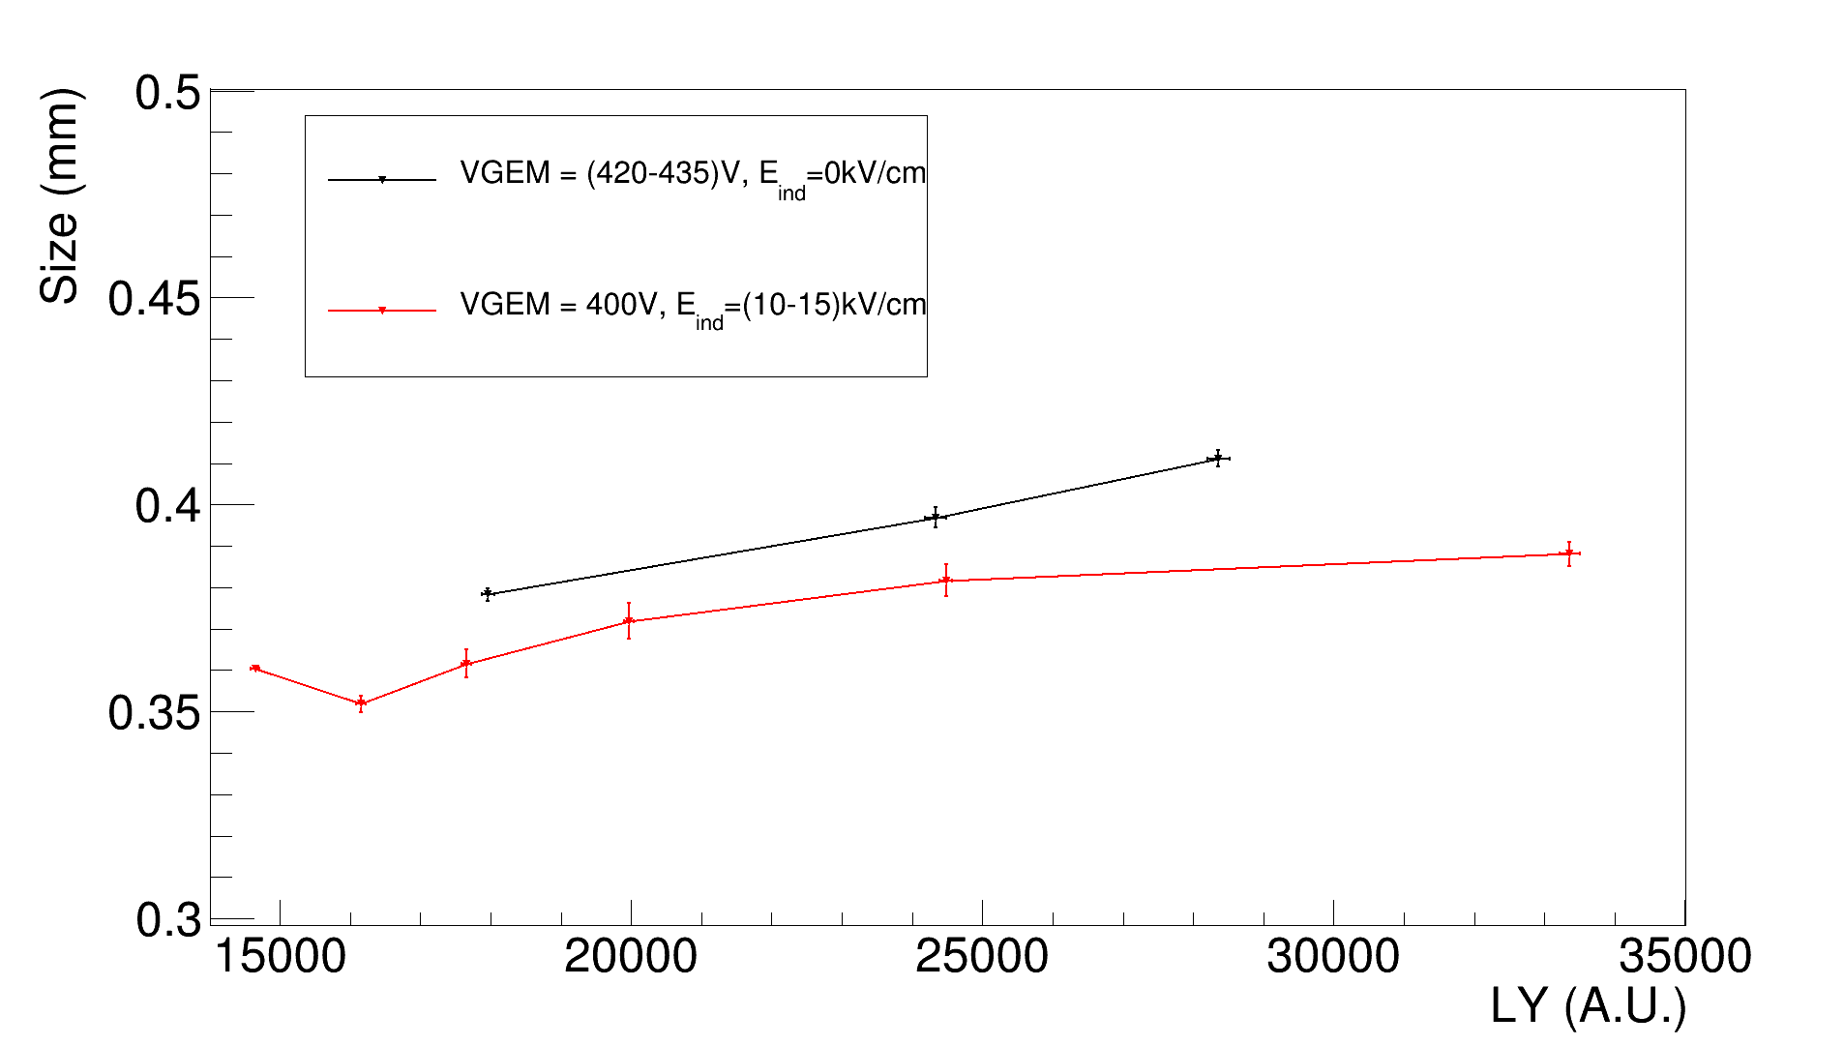

Studies with ITO II
Simulation of electric field with Ansys of GEM hole region
Large deformation of field intensity below GEM hole when E_{ind} is high
A wider region has electric field strong enough to generate amplification, yet with low intensity
Light yield achieved is larger than using triple GEM and with reduced intrinsic diffusion
LY vs diffusion
G.Dho

Slide 35

Studies with ITO III
Exploting GEM1 voltage scan with low voltage GEM configuration for GEM2/3 and ⁵⁵Fe source (1 cm away from GEMs)
Absolute unsaturated behaviour of GEM1 scan is obtained (how much the gain should increase every 10 V more I power up GEM1)
G.Dho

Slide 36

Studies with ITO IV
Different configuration with 3 GEMs and ITO are tested and absolute saturation is calculated
Low VGEM no E_{ind}: LY 9800 ± 150 Sat 0%
High VGEM no E_{ind}: LY 30700 ± 200 Sat (34.5 ± 1.6)%
Low VGEM high E_{ind}: LY 31300 ± 200 Sat (1.7 ± 1.5)%
Med VGEM high E_{ind}: LY 64700 ± 400 Sat (29.1 ± 1.5)%
Paper in preparation
G.Dho

Slide 37
Why Less Saturation with V-Bond?
The V-Bond technique is likely causing rough copper crystals around the GEM holes to be removed.
This might place the electrodes further from the holes
Reducing electric field
Indeed, applying the same voltages, the light gain is lower than standard GEM
Widening the amplification region
This could be similar to ITO studies causing the wider region the imprint less saturation
G.Dho

