Slide 1


Dynamical Solution to the Eta Problem in Spectator Field Models
Sana Elgamal, Keisuke Harigaya
PIKIMO-25

Slide 2
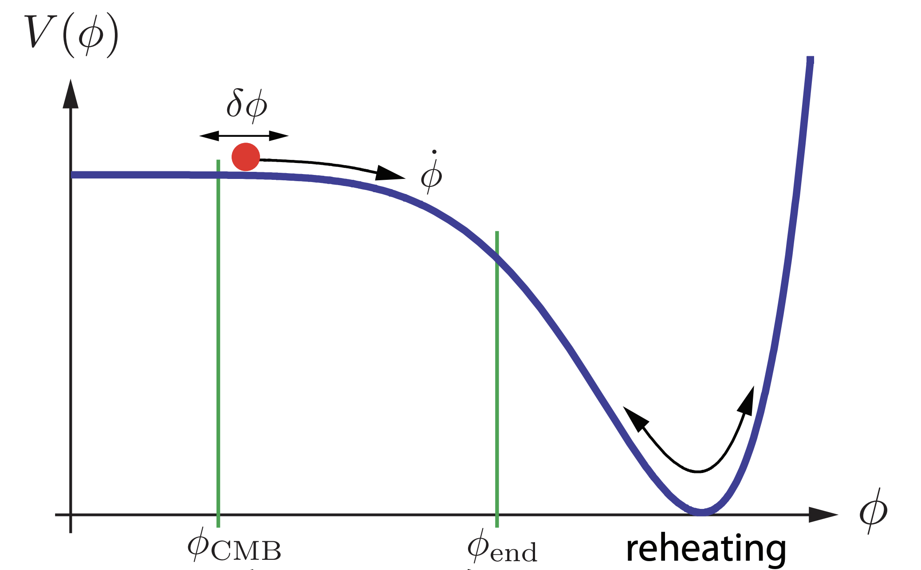

Inflation
A long enough period of exponential expansion in the early universe
Provides a quantum origin for the cosmological perturbations
Achieved using a scalar field “inflaton” $φ$which is slowly rolling down its potential
Image credit: Baumann

Slide 3





Inflation
A long enough period of exponential expansion in the early universe
Provides a quantum origin for the cosmological perturbations
Achieved using a scalar field “inflaton” $φ$which is slowly rolling down its potential
Hubble horizon
$$∝a^{3/2}$$
$log$(Physical scales)
$$H^{−1} \sim const.$$
$$∝a^{2}$$
INFLATION
RD
MD
$$\log{a}$$
Image credit: Baumann

Slide 4





Inflation
A long enough period of exponential expansion in the early universe
Provides a quantum origin for the cosmological perturbations
Achieved using a scalar field “inflaton” $φ$which is slowly rolling down its potential
Hubble horizon
$$∝a^{3/2}$$
$$λ_{phys}∝a$$
$log$(Physical scales)
$$H^{−1} \sim const.$$
$$∝a^{2}$$
$${δφ}_{k}$$
$${δφ}_{k}$$
$${δφ}_{k}$$
INFLATION
RD
MD
$$\log{a}$$
Image credit: Baumann

Slide 5
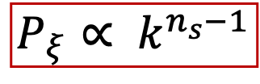
Inflation
A long enough period of exponential expansion in the early universe
Provides a quantum origin for the cosmological perturbations
Achieved using a scalar field “inflaton” $φ$which is slowly rolling down its potential
Hubble horizon
$$P_{ξ}∝ k^{n_{s}−1}$$
$$∝a^{3/2}$$
$$λ_{phys}∝a$$
A
B
C
$log$(Physical scales)
$$H^{−1} \sim const.$$
A
B
C
$$∝a^{2}$$
INFLATION
RD
MD
$$\log{a}$$
If potential is sufficiently flat a nearly scale-invariant spectrum $n_{s}$ is close to 1
Image credit: Baumann

Slide 6
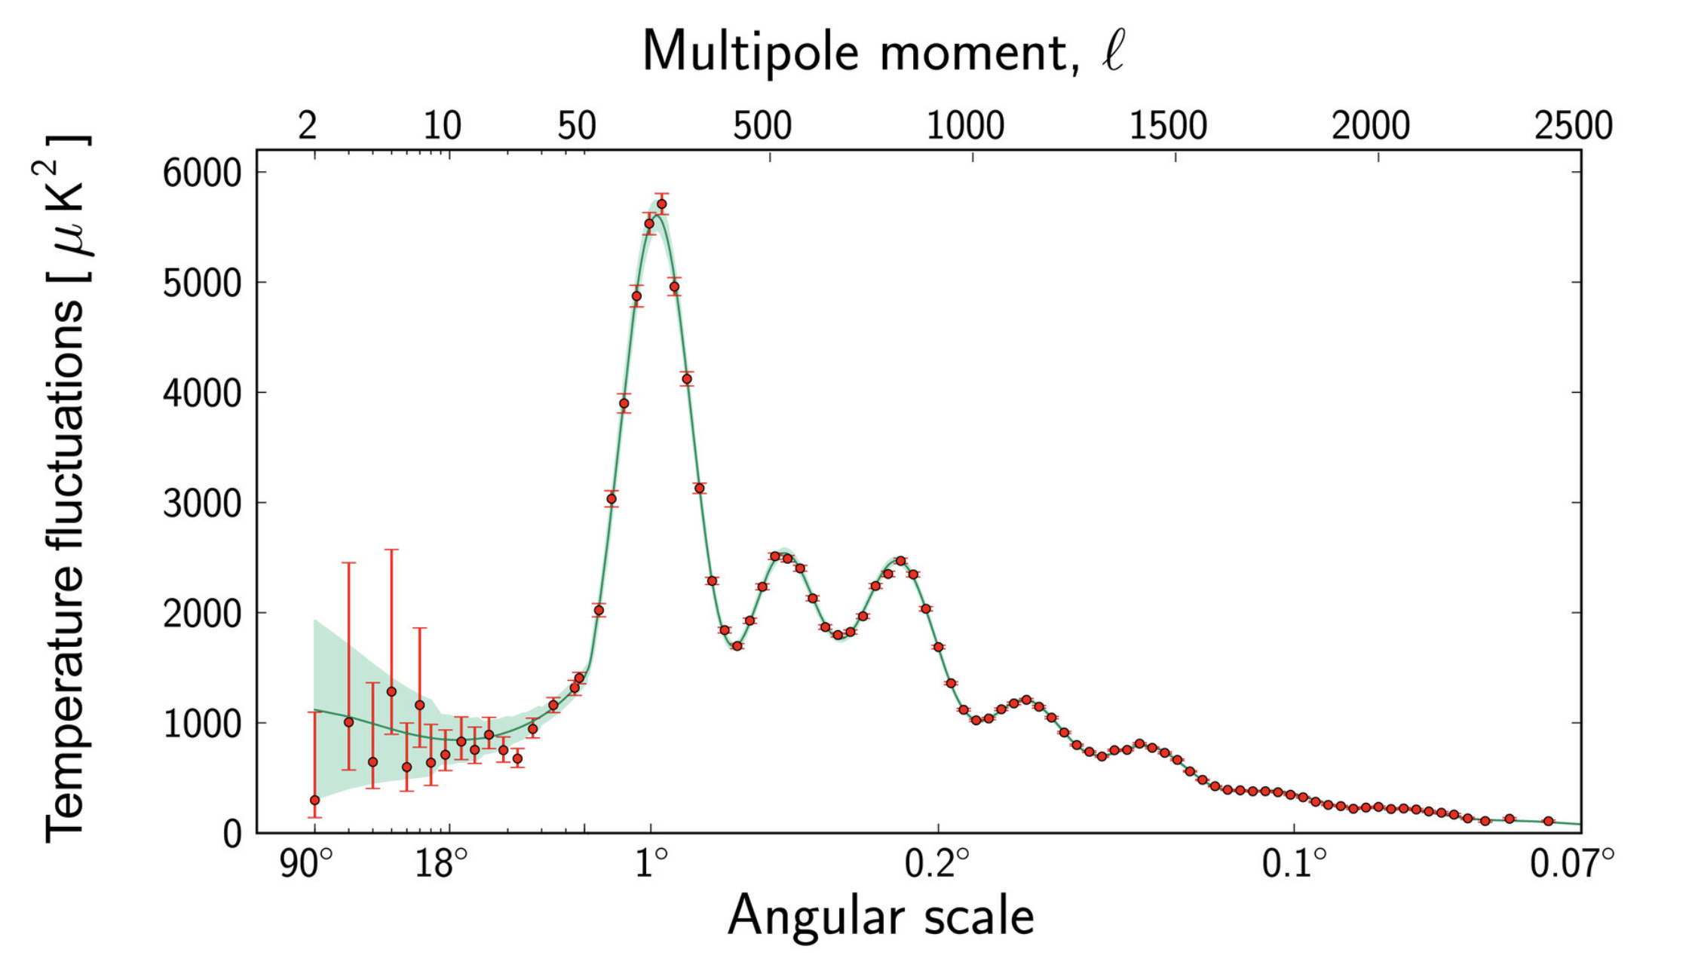
Inflation
A long enough period of exponential expansion in the early universe
Provides a quantum origin for the cosmological perturbations
Achieved using a scalar field “inflaton” $φ$which is slowly rolling down its potential
$$P_{ξ}∝ k^{n_{s}−1}$$
A
B
C
If potential is sufficiently flat a nearly scale-invariant spectrum $n_{s}$ is close to 1
Image credit: Baumann

Slide 7
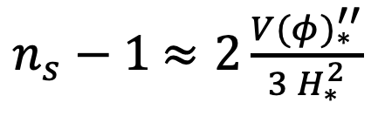

The Inflaton Must be Light
$n_{s}−1$ $≈2\frac{{V(φ)}_{∗}^{′′}}{3{ H}_{∗}^{2}}$
$∗$means evaluated at horizon crossing

Slide 8

The Inflaton Must be Light
$$≡η_{φ}$$
$n_{s}−1$ $≈2\frac{{V(φ)}_{∗}^{′′}}{3{ H}_{∗}^{2}}$
$∗$means evaluated at horizon crossing

Slide 9

The Inflaton Must be Light
$$≡η_{φ}$$
$n_{s}−1$ $≈2\frac{{V(φ)}_{∗}^{′′}}{3{ H}_{∗}^{2}}$
$∗$means evaluated at horizon crossing
To get a nearly scale-invariant perturbations spectrum (${|n}_{s}−1|\sim 𝒪\left(0.01\right)$)
$${ η}_{φ}= \frac{{V(φ)}_{∗}^{′′}}{3{ H}_{∗}^{2}}=\frac{m_{φ, eff}^{2}}{3{ H}_{∗}^{2}}\sim 𝒪(0.01)$$

Slide 10
The Inflaton Must be Light
$$≡η_{φ}$$
$n_{s}−1$ $≈2\frac{{V(φ)}_{∗}^{′′}}{3{ H}_{∗}^{2}}$
$∗$means evaluated at horizon crossing
To get a nearly scale-invariant perturbations spectrum (${|n}_{s}−1|\sim 𝒪\left(0.01\right)$)
$${ η}_{φ}= \frac{{V(φ)}_{∗}^{′′}}{3{ H}_{∗}^{2}}=\frac{m_{φ, eff}^{2}}{3{ H}_{∗}^{2}}\sim 𝒪(0.01)$$
The inflaton must be much lighter than the Hubble scale

Slide 11

The Eta Problem of the Inflaton
Focus on the mass term of the inflaton potential
$$V_{vac}\left(φ\right)=\frac{1}{2}m_{φ}^{2}φ^{2}+…$$

Slide 12
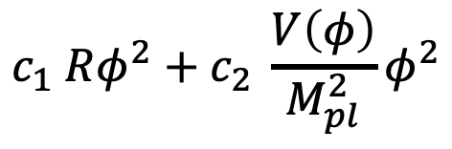


The Eta Problem of the Inflaton
Focus on the mass term of the inflaton potential
$$V_{vac}\left(φ\right)=\frac{1}{2}m_{φ}^{2}φ^{2}+…$$
During inflation, one is allowed to write down the following terms
$$c_{1} Rφ^{2}+c_{2} \frac{V\left(φ\right)}{M_{pl}^{2}}φ^{2}$$
$$≡ cH^{2}φ^{2}$$

Slide 13
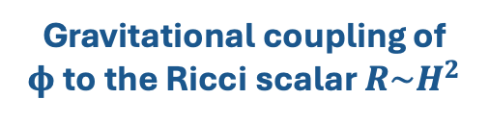
The Eta Problem of the Inflaton
Focus on the mass term of the inflaton potential
$$V_{vac}\left(φ\right)=\frac{1}{2}m_{φ}^{2}φ^{2}+…$$
During inflation, one is allowed to write down the following terms
$$c_{1} Rφ^{2}+c_{2} \frac{V\left(φ\right)}{M_{pl}^{2}}φ^{2}$$
$$≡ cH^{2}φ^{2}$$
Gravitational coupling of $φ$to the Ricci scalar $R\sim H^{2}$

Slide 14
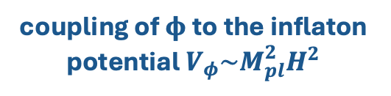
The Eta Problem of the Inflaton
Focus on the mass term of the inflaton potential
$$V_{vac}\left(φ\right)=\frac{1}{2}m_{φ}^{2}φ^{2}+…$$
During inflation, one is allowed to write down the following terms
$$c_{1} Rφ^{2}+c_{2} \frac{V\left(φ\right)}{M_{pl}^{2}}φ^{2}$$
$$≡ cH^{2}φ^{2}$$
Gravitational coupling of $φ$to the Ricci scalar $R\sim H^{2}$
coupling of $φ$to the inflaton potential $V_{φ}\sim M_{pl}^{2}H^{2}$

Slide 15
The Eta Problem of the Inflaton
Focus on the mass term of the inflaton potential
$$V_{vac}\left(φ\right)=\frac{1}{2}m_{φ}^{2}φ^{2}+…$$
During inflation, one is allowed to write down the following terms
$$c_{1} Rφ^{2}+c_{2} \frac{V\left(φ\right)}{M_{pl}^{2}}φ^{2}$$
$$≡ cH^{2}φ^{2}$$
Hubble-induced Mass
Gravitational coupling of $φ$to the Ricci scalar $R\sim H^{2}$
coupling of $φ$to the inflaton potential $V_{φ}\sim M_{pl}^{2}H^{2}$

Slide 16
The Eta Problem of the Inflaton
Focus on the mass term of the inflaton potential
$$V_{vac}\left(φ\right)=\frac{1}{2}m_{φ}^{2}φ^{2}+…$$
During inflation, one is allowed to write down the following terms
$$c_{1} Rφ^{2}+c_{2} \frac{V\left(φ\right)}{M_{pl}^{2}}φ^{2}$$
$$≡ cH^{2}φ^{2}$$
Hubble-induced Mass
Gravitational coupling of $φ$to the Ricci scalar $R\sim H^{2}$
coupling of $φ$to the inflaton potential $V_{φ}\sim M_{pl}^{2}H^{2}$
Eta problem of the inflaton
Even if $m_{φ}^{2}≪H^{2}$, unless $c\sim 𝒪\left(0.01\right),$now $η_{φ} \sim 𝓞(1)$

Slide 17

Spectator Field Models
Requiring $φ$ to source inflation and generation of perturbations is a serious restriction

Slide 18
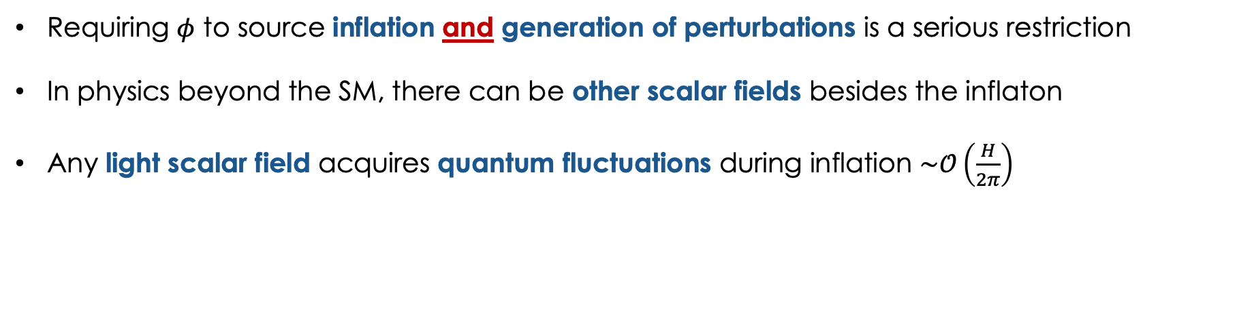
Spectator Field Models
Requiring $φ$ to source inflation and generation of perturbations is a serious restriction
In physics beyond the SM, there can be other scalar fields besides the inflaton
Any light scalar field acquires quantum fluctuations during inflation $\sim 𝒪\left(\frac{H}{2π}\right)$

Slide 19
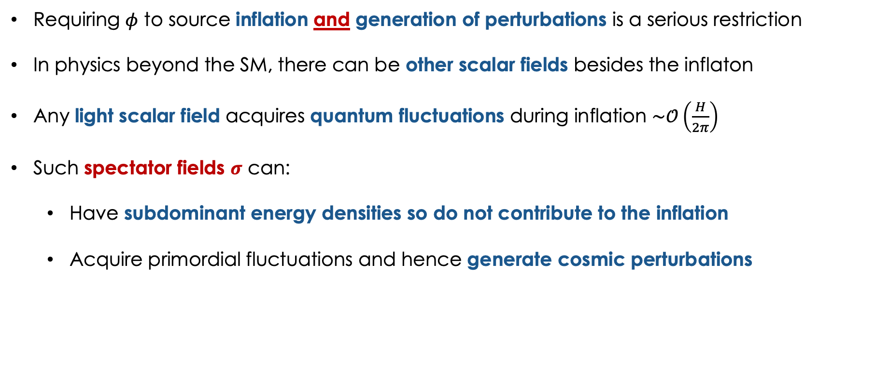

Spectator Field Models
Requiring $φ$ to source inflation and generation of perturbations is a serious restriction
In physics beyond the SM, there can be other scalar fields besides the inflaton
Any light scalar field acquires quantum fluctuations during inflation $\sim 𝒪\left(\frac{H}{2π}\right)$
Such spectator fields $σ$ can:
  Have subdominant energy densities so do not contribute to the inflation
  Acquire primordial fluctuations and hence generate cosmic perturbations
$$δσ → ζ$$

Slide 20
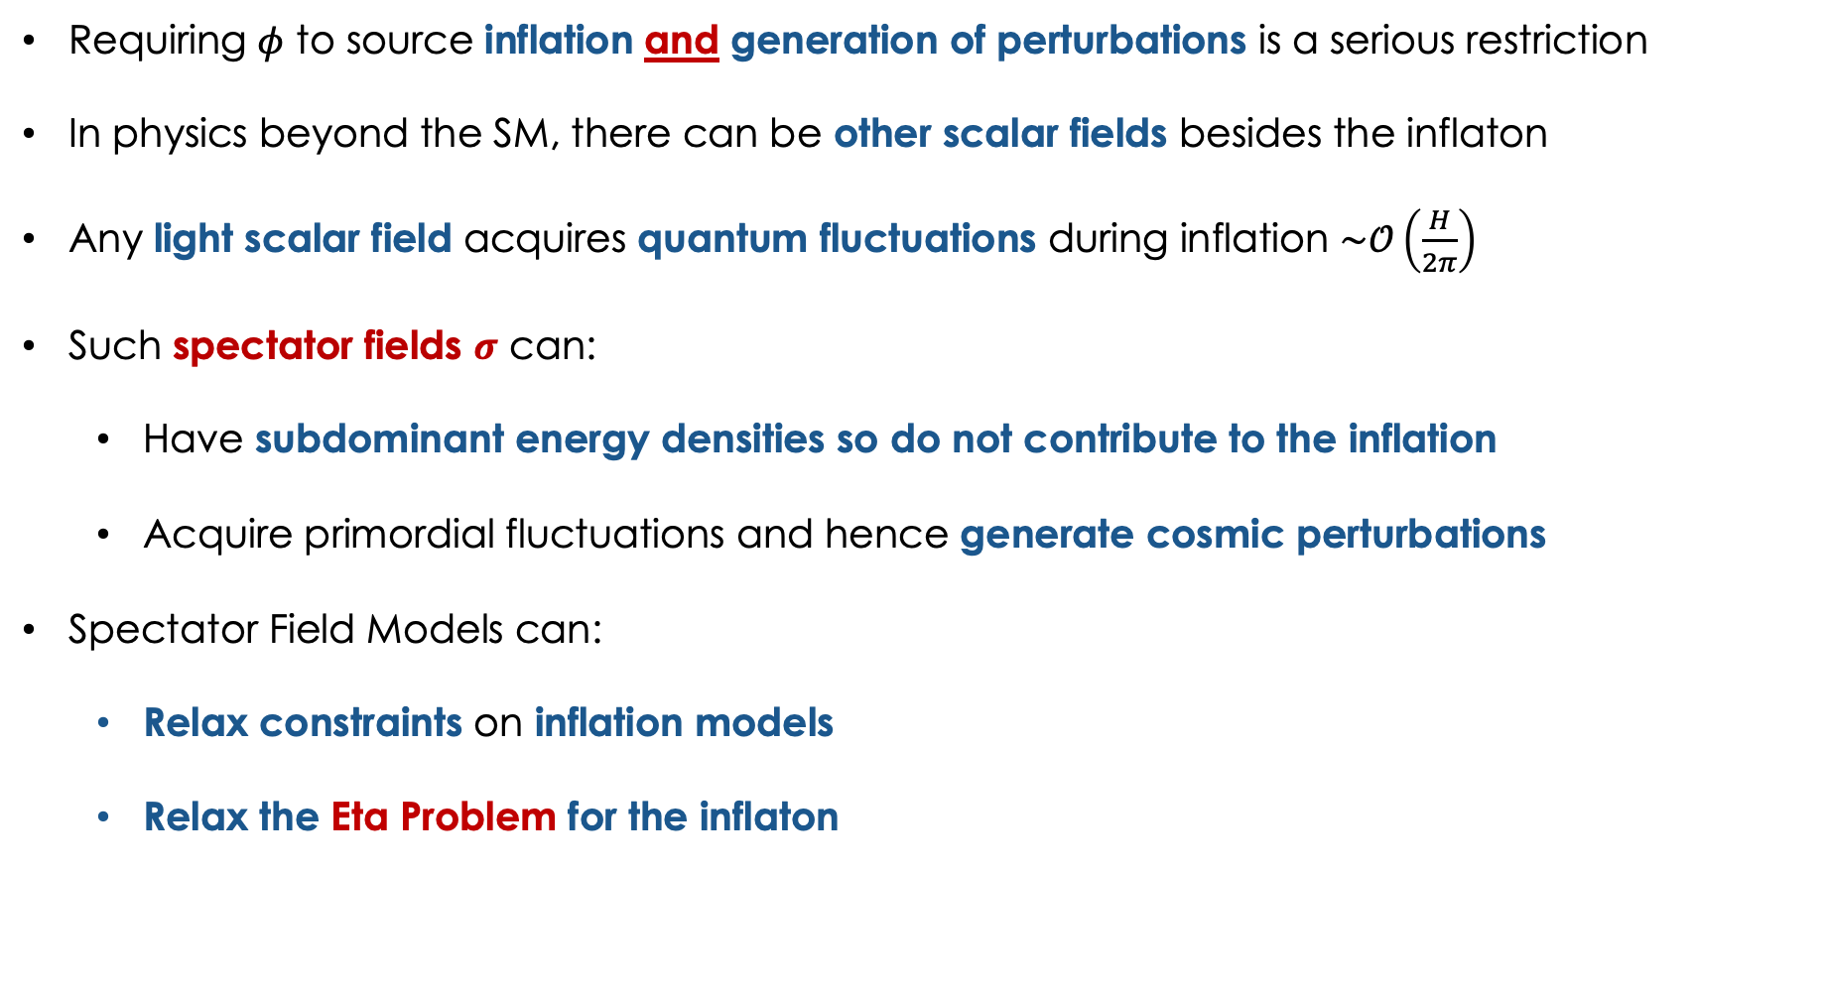
Spectator Field Models
Requiring $φ$ to source inflation and generation of perturbations is a serious restriction
In physics beyond the SM, there can be other scalar fields besides the inflaton
Any light scalar field acquires quantum fluctuations during inflation $\sim 𝒪\left(\frac{H}{2π}\right)$
Such spectator fields $σ$ can:
  Have subdominant energy densities so do not contribute to the inflation
  Acquire primordial fluctuations and hence generate cosmic perturbations
Spectator Field Models can:
  Relax constraints on inflation models
  Relax the Eta Problem for the inflaton
$$δσ → ζ$$

Slide 21

The Eta Problem of Spectator Fields
The spectator field $σ$ must be light to produce the nearly scale-invariant spectrum

Slide 22
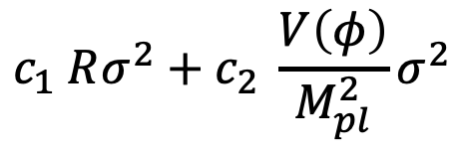

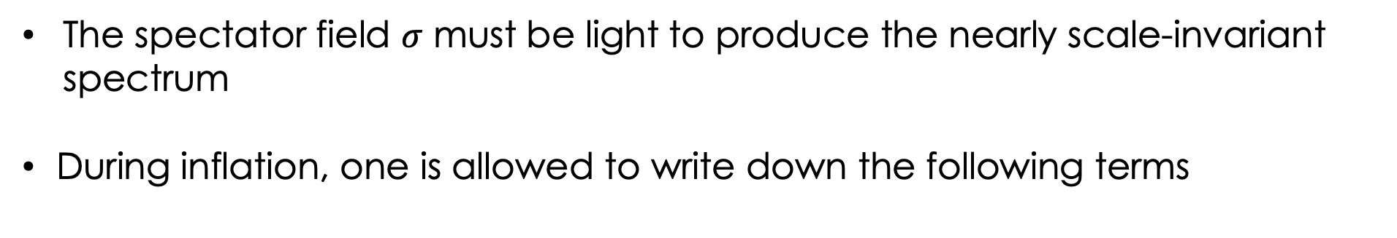
The Eta Problem of Spectator Fields
The spectator field $σ$ must be light to produce the nearly scale-invariant spectrum
During inflation, one is allowed to write down the following terms
$$c_{1} Rσ^{2}+c_{2} \frac{V\left(φ\right)}{M_{pl}^{2}}σ^{2}$$
$$≡ cH^{2}σ^{2}$$
Hubble-induced Mass

Slide 23
The Eta Problem of Spectator Fields
The spectator field $σ$ must be light to produce the nearly scale-invariant spectrum
During inflation, one is allowed to write down the following terms
$$c_{1} Rσ^{2}+c_{2} \frac{V\left(φ\right)}{M_{pl}^{2}}σ^{2}$$
$$≡ cH^{2}σ^{2}$$
Hubble-induced Mass
Spectator Field models have their own Eta problem

Slide 24
The Eta Problem of Spectator Fields
The spectator field $σ$ must be light to produce the nearly scale-invariant spectrum
During inflation, one is allowed to write down the following terms
$$c_{1} Rσ^{2}+c_{2} \frac{V\left(φ\right)}{M_{pl}^{2}}σ^{2}$$
$$≡ cH^{2}σ^{2}$$
Hubble-induced Mass
Spectator Field models have their own Eta problem
However, this Eta problem is one that we can solve!

Slide 25
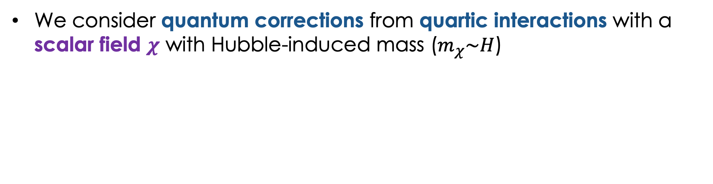
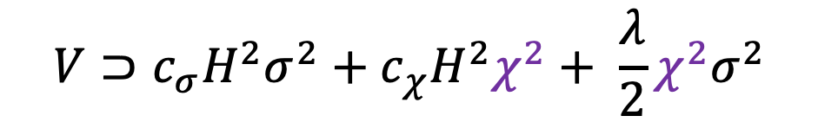
Quantum Corrections to Hubble-induced Mass
We consider quantum corrections from quartic interactions with a scalar field $χ$ with Hubble-induced mass ($m_{χ}\sim H$)
$$V⊃{c_{σ}H}^{2}σ^{2}+{c_{χ}H}^{2}χ^{2}+ \frac{λ}{2}χ^{2}σ^{2}$$

Slide 26
Quantum Corrections to Hubble-induced Mass
We consider quantum corrections from quartic interactions with a scalar field $χ$ with Hubble-induced mass ($m_{χ}\sim H$)
Renormalizes the mass term
$$V⊃{c_{σ}H}^{2}σ^{2}+{c_{χ}H}^{2}χ^{2}+ \frac{λ}{2}χ^{2}σ^{2}$$

Slide 27
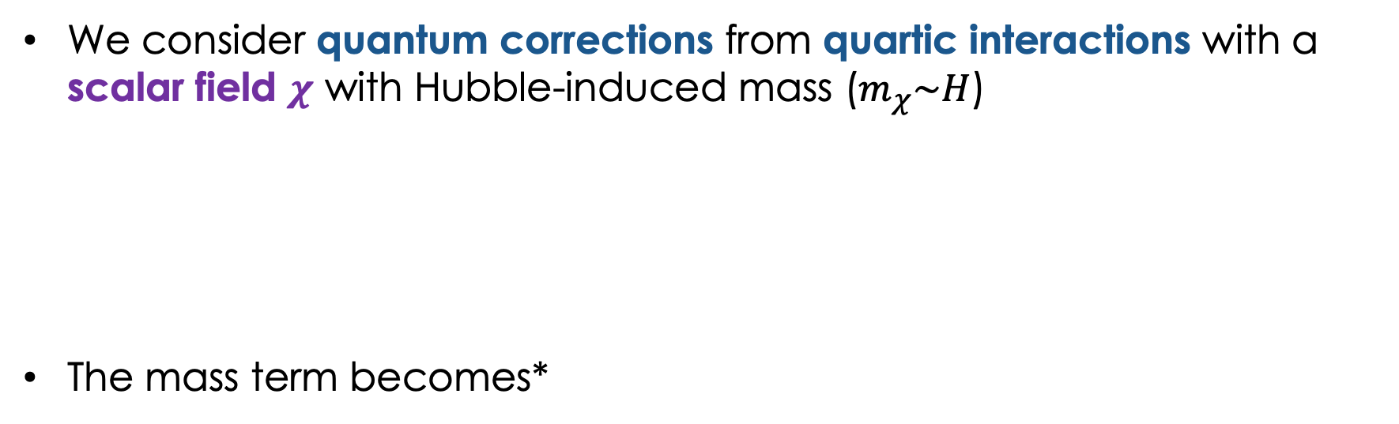

Quantum Corrections to Hubble-induced Mass
We consider quantum corrections from quartic interactions with a scalar field $χ$ with Hubble-induced mass ($m_{χ}\sim H$)
The mass term becomes*
Renormalizes the mass term
$$V⊃{c_{σ}H}^{2}σ^{2}+{c_{χ}H}^{2}χ^{2}+ \frac{λ}{2}χ^{2}σ^{2}$$
$$V_{H}\left(σ\right)= cH^{2}σ^{2}+bH^{2}σ^{2}\log\left(\frac{σ}{M}\right)$$
loop factor $\sim 𝓞\left(0.01\right)$
*Quartic terms can be shown to cancel by supersymmetry

Slide 28





Quantum Corrections to Hubble-induced Mass
We consider quantum corrections from quartic interactions with a scalar field $χ$ with Hubble-induced mass ($m_{χ}\sim H$)
The mass term becomes*
Renormalizes the mass term
$$V⊃{c_{σ}H}^{2}σ^{2}+{c_{χ}H}^{2}χ^{2}+ \frac{λ}{2}χ^{2}σ^{2}$$
$$H^{2}$$
$$×$$
$$χ$$
$$σ$$
$$σ$$
$$V_{H}\left(σ\right)= cH^{2}σ^{2}+bH^{2}σ^{2}\log\left(\frac{σ}{M}\right)$$
loop factor $\sim 𝓞\left(0.01\right)$
*Quartic terms can be shown to cancel by supersymmetry

Slide 29

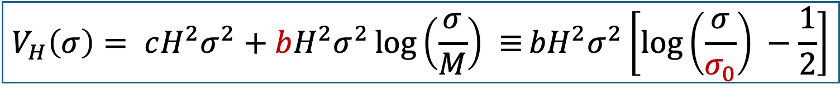
Quantum Corrections to Hubble-induced Mass
We consider quantum corrections from quartic interactions with a scalar field $χ$ with Hubble-induced mass ($m_{χ}\sim H$)
The mass term becomes*
Renormalizes the mass term
$$V⊃{c_{σ}H}^{2}σ^{2}+{c_{χ}H}^{2}χ^{2}+ \frac{λ}{2}χ^{2}σ^{2}$$
$$H^{2}$$
$$×$$
$$χ$$
$$σ$$
$$σ$$
$$V_{H}\left(σ\right)= cH^{2}σ^{2}+bH^{2}σ^{2}\log\left(\frac{σ}{M}\right) ≡bH^{2}σ^{2}\left[\log\left(\frac{σ}{σ_{0}}\right) −\frac{1}{2}\right]$$
loop factor $\sim 𝓞\left(0.01\right)$
$$V_{H}′\left(σ_{0}\right)≡0$$
*Quartic terms can be shown to cancel by supersymmetry

Slide 30
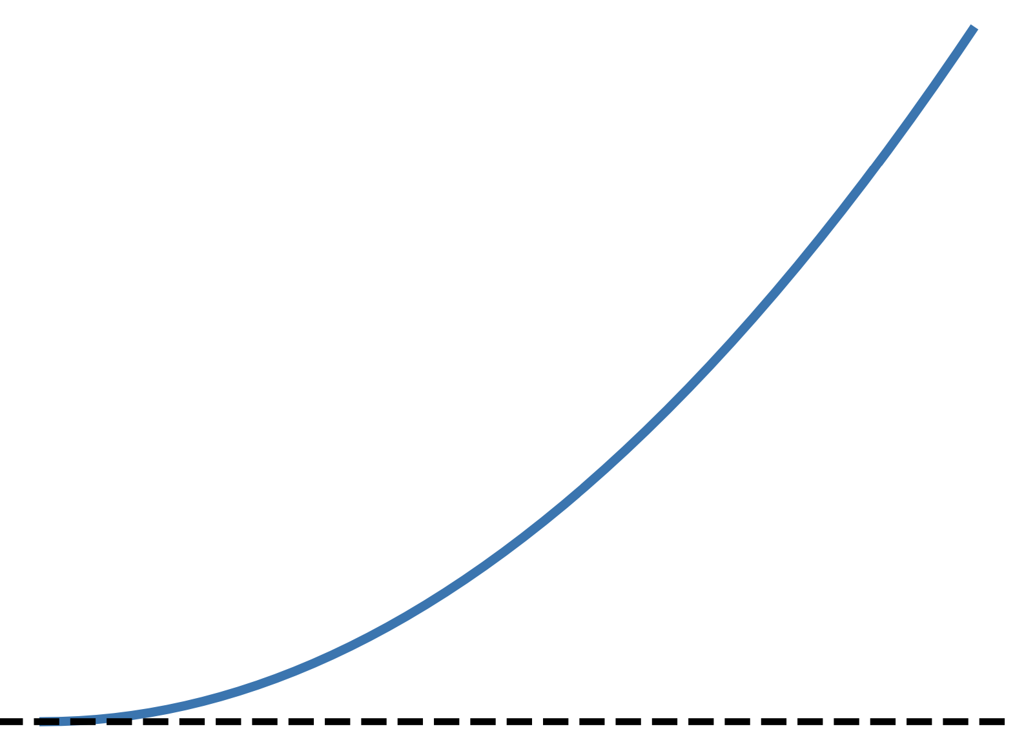
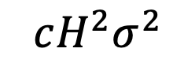

Quantum Corrections to Hubble-induced Mass
$$cH^{2}σ^{2}$$
$$σ$$

Slide 31
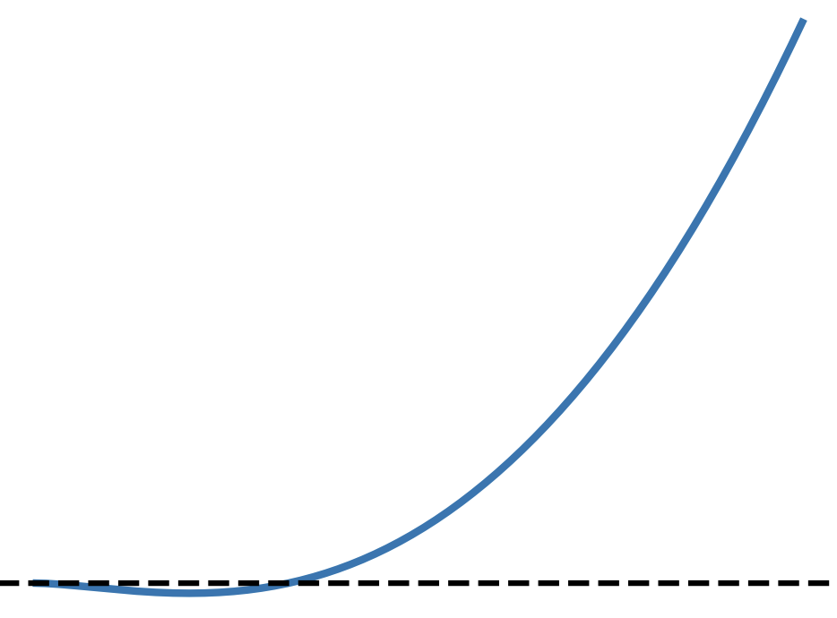
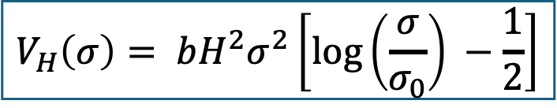



Quantum Corrections to Hubble-induced Mass
Quantum Corrections to the Hubble-induced mass create a minimum around which the potential is flatter
$$V_{H}\left(σ\right)= bH^{2}σ^{2}\left[\log\left(\frac{σ}{σ_{0}}\right) −\frac{1}{2}\right]$$
$$cH^{2}σ^{2}$$
$$V_{H}\left(σ\right)$$
Quantum Corrections
$$σ$$
$$σ$$
$$σ_{0}$$

Slide 32
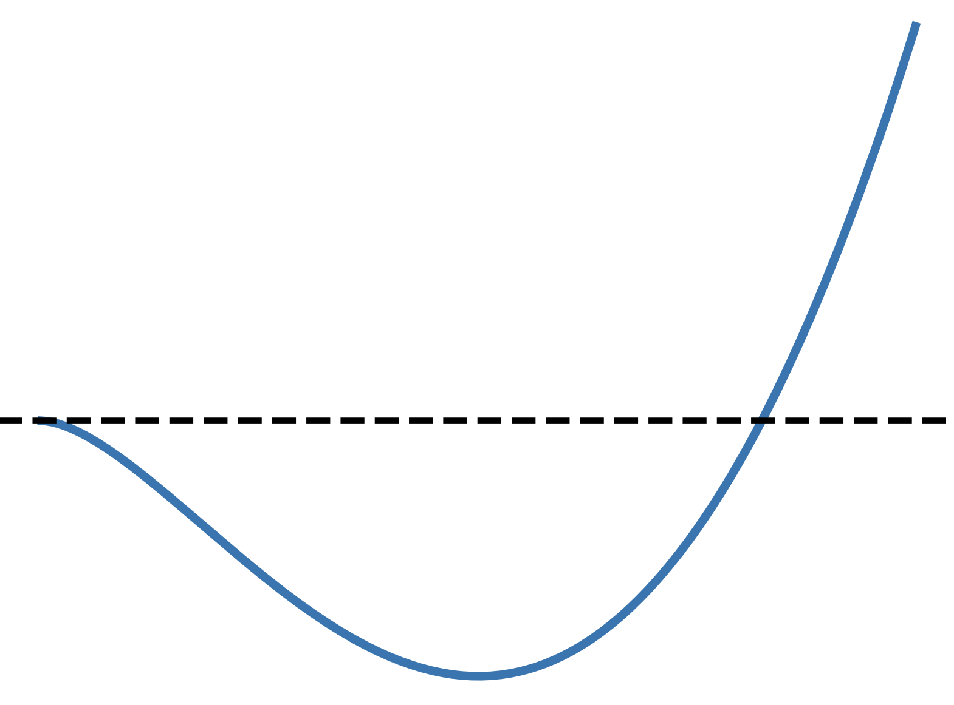

Quantum Corrections to Hubble-induced Mass
Quantum Corrections to the Hubble-induced mass create a minimum around which the potential is flatter
$$V_{H}\left(σ\right)= bH^{2}σ^{2}\left[\log\left(\frac{σ}{σ_{0}}\right) −\frac{1}{2}\right]$$
$$cH^{2}σ^{2}$$
$$V_{H}\left(σ\right)$$
Quantum Corrections
$$σ$$
$$σ$$
$$σ_{0}$$

Slide 33
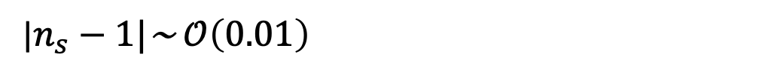



The Eta Parameter
$n_{s}−1≈2η_{σ}$
$η_{σ}=\frac{{V(σ)}_{∗}^{′′}}{3{ H}_{∗}^{2}}\sim 𝒪(0.01)$ around the minimum
|$n_{s}−1|$~ $𝒪\left(0.01\right)$
$η_{σ}$
$$σ/σ_{0}$$

Slide 34
The Eta Parameter
$n_{s}−1≈2η_{σ}$
$η_{σ}=\frac{{V(σ)}_{∗}^{′′}}{3{ H}_{∗}^{2}}\sim 𝒪(0.01)$ around the minimum
|$n_{s}−1|$~ $𝒪\left(0.01\right)$
$η_{σ}$
$$σ/σ_{0}$$
A nearly scale-invariant power spectrum is a natural prediction!

Slide 35
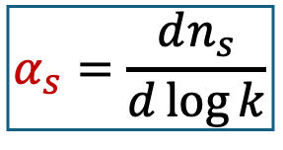
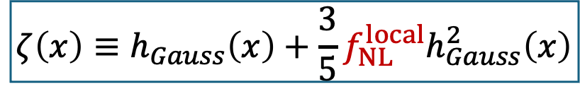

Non-Gaussianity and Running (Curvaton Model)
Assuming a curvaton model with a quadratic vacuum potential
Running
$$α_{s}=\frac{dn_{s}}{d\log{k}}$$
Non-Gaussianity
$$ζ\left(x\right)≡h_{Gauss}\left(x\right)+\frac{3}{5}f_{NL}^{local}h_{Gauss}^{2}\left(x\right)$$
$$f_{NL}^{local}=−0.9±10.2$$
Planck

Slide 36
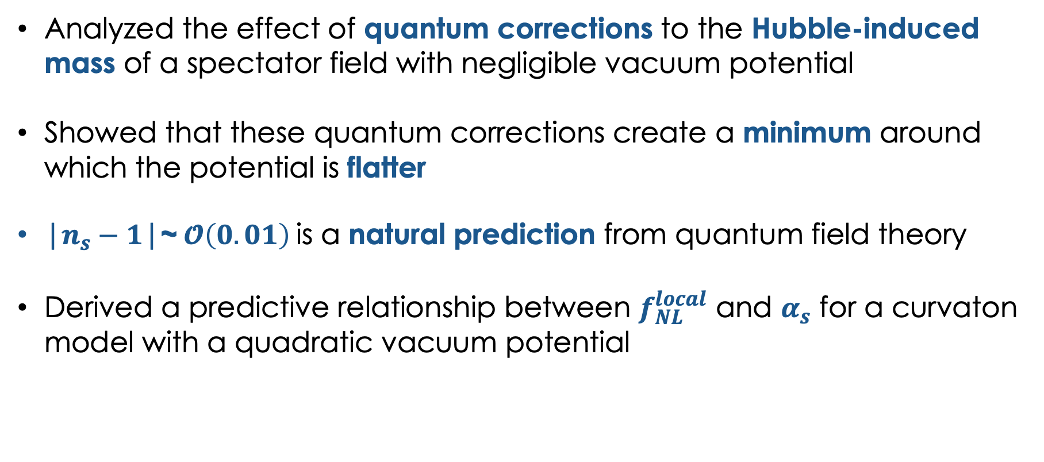
Contributions
Analyzed the effect of quantum corrections to the Hubble-induced mass of a spectator field with negligible vacuum potential
Showed that these quantum corrections create a minimum around which the potential is flatter
|$n_{s}−1$|~ $𝓞\left(0.01\right)$ is a natural prediction from quantum field theory
Derived a predictive relationship between $f_{NL}^{local}$ and $α_{s}$ for a curvaton model with a quadratic vacuum potential

Slide 37
Thank you!

Slide 38
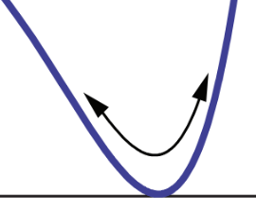


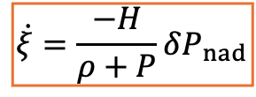









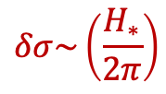


Spectator Field Models
$φ$ (or its decay products)
$σ$ oscillates ($H\sim m_{σ}$)
$$σ$$
(or its decay products)
$$∝a^{−3}$$
$$∝a^{−4}$$
$σ$ dominates
$σ$ decays
$$\log{ρ}$$
$$∝a^{−3}$$
$$m_{σ}≪H$$
OSCILLATION
$$∝a^{−4}$$
INFLATION
MD
BBN
$$\dot{ξ}=\frac{−H}{ρ+P}δP_{nad}$$
$$δσ\sim \left(\frac{H_{∗}}{2π}\right)$$
$$\log{a}$$
$$a_{osc}$$
$$a_{dec}$$

Slide 39
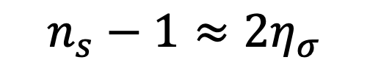
Evolution of Spectral Index
$$n_{s}−1≈2η_{σ}$$

Slide 40
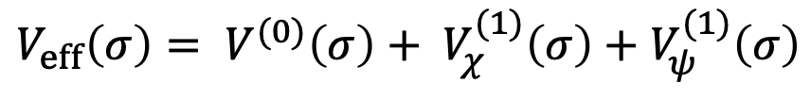
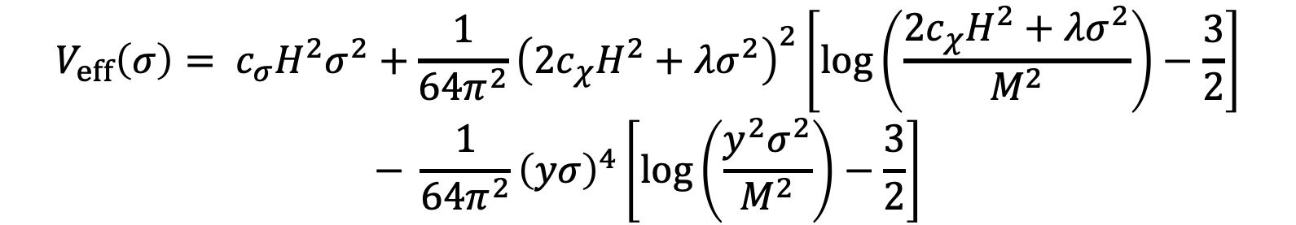

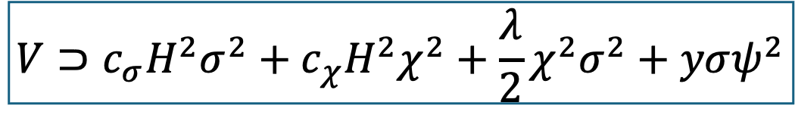
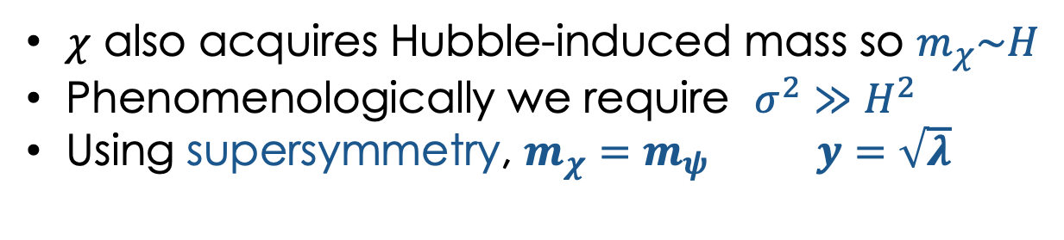
Coleman-Weinberg Potential
$$V⊃c_{σ}H^{2}σ^{2}+{c_{χ}H}^{2}χ^{2}+\frac{λ}{2}χ^{2}σ^{2}+yσψ^{2}$$
$$V_{eff}\left(σ\right)= V^{(0)}\left(σ\right)+ V_{χ}^{(1)}\left(σ\right)+V_{ψ}^{(1)}\left(σ\right)$$
fermion
$$V_{eff}\left(σ\right)= {c_{σ}H}^{2}σ^{2}+\frac{1}{64π^{2}}{\left({2c}_{χ}H^{2}+λσ^{2}\right)}^{2}\left[log\left(\frac{{2c}_{χ}H^{2}+λσ^{2}}{M^{2}}\right)−\frac{3}{2}\right]$$
$$− \frac{1}{64π^{2}}{\left(yσ\right)}^{4}\left[log\left(\frac{y^{2}σ^{2}}{M^{2}}\right)−\frac{3}{2}\right]$$
scalar
$χ$ also acquires Hubble-induced mass so $m_{χ}\sim H$
Phenomenologically we require $σ^{2}≫$ $H^{2}$
Using supersymmetry, $m_{χ}=m_{ψ}$ $y=\sqrt{λ}$
$$m_{χ, eff}={2c}_{χ}H^{2}+λσ^{2}$$

Slide 41
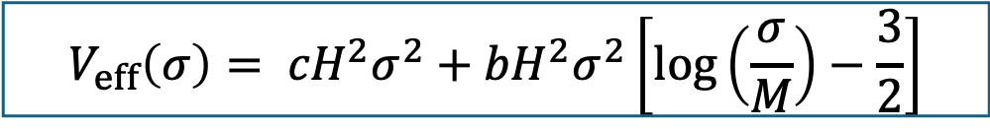
Coleman-Weinberg Potential
The two quartic terms cancel (using supersymmetry)!
scalar
fermion
$$V_{eff}\left(σ\right)= {c_{σ}H}^{2}σ^{2}+\frac{1}{64π^{2}}{\left({2c}_{χ}H^{2}+λσ^{2}\right)}^{2}\left[log\left(\frac{λσ^{2}}{M^{2}}\right)−\frac{3}{2}\right]− \frac{λ^{2}σ^{4}}{64π^{2}}\left[log\left(\frac{λσ^{2}}{M^{2}}\right)−\frac{3}{2}\right]$$
$$V_{eff}\left(σ\right)= {cH}^{2}σ^{2}+{bH}^{2}σ^{2}\left[log\left(\frac{σ}{M}\right)−\frac{3}{2}\right]$$

Slide 42


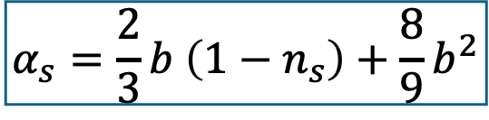
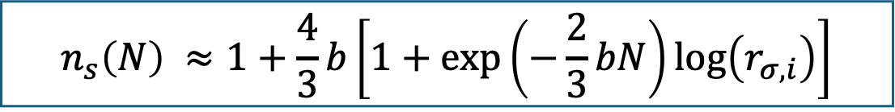
Non-Gaussianity, Spectral Index, and Running
Initial normalized spectator field value
$$n_{s}\left(N\right) ≈1+\frac{4}{3}b\left[1+\exp\left(−\frac{2}{3}bN\right)\log\left(r_{σ,i}\right)\right]$$
$$α_{s}=\frac{2}{3}b \left(1−n_{s}\right)+\frac{8}{9}b^{2}$$
$$f_{NL}≈−\frac{5}{4}exp\left\{\frac{4b_{m}}{\sqrt{9+16a_{m}}}\left(N_{f}−N_{end}\right)+\frac{2}{3}b\left(N_{end}−N_{∗}\right)\right\}≡−\frac{5}{4}exp\left\{\frac{2}{3}b ∆N\right\}$$
Planck
$$f_{NL}^{local}=−\frac{5}{4}exp\left[\frac{∆N}{4}\left(n_{s}−1+\sqrt{8α_{s}+{\left(1−n_{s}\right)}^{2}}\right)\right]$$
$$f_{NL}^{local}=−0.9±10.2$$

Slide 43





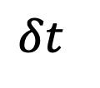

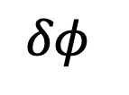
Inflation
A long enough period of exponential expansion in the early universe
Provides a quantum origin for the cosmological perturbations
Achieved using a scalar field “inflaton” $φ$which is slowly rolling down its potential
Hubble horizon
$$∝a^{3/2}$$
$$λ_{phys}∝a$$
$log$(Physical scales)
$$H^{−1} \sim const.$$
$$ζ_{k}$$
$$ζ_{k}$$
$$ζ_{k}$$
$$∝a^{2}$$
$${δφ}_{k}$$
$${δφ}_{k}$$
$${δφ}_{k}$$
INFLATION
RD
MD
$$\log{a}$$
$$δφ$$
$$δt$$
$$ζ$$
$$Φ$$
$$δ$$
Vacuum fluctuations
Induced local time delay
Curvature perturbation
Gravitational potential
Density perturbation
Image credit: Baumann

