Slide 1


Stringent Constraints on Gravitational Wave Signatures of Dark Electromagnetism
Ian Harris, University of Illinois
Based on the work of 2511.xxxxx, in preparation with Yoni Kahn
PIKIMO 17, Northwestern University
November 8, 2025

Slide 2
Outline
Why E&M, and why neutron stars
What gives an observable signal
How to acquire a dark charge, and which constraints hamper this:
Gravitational accretion
Thermal production
Neutron decay

Slide 3
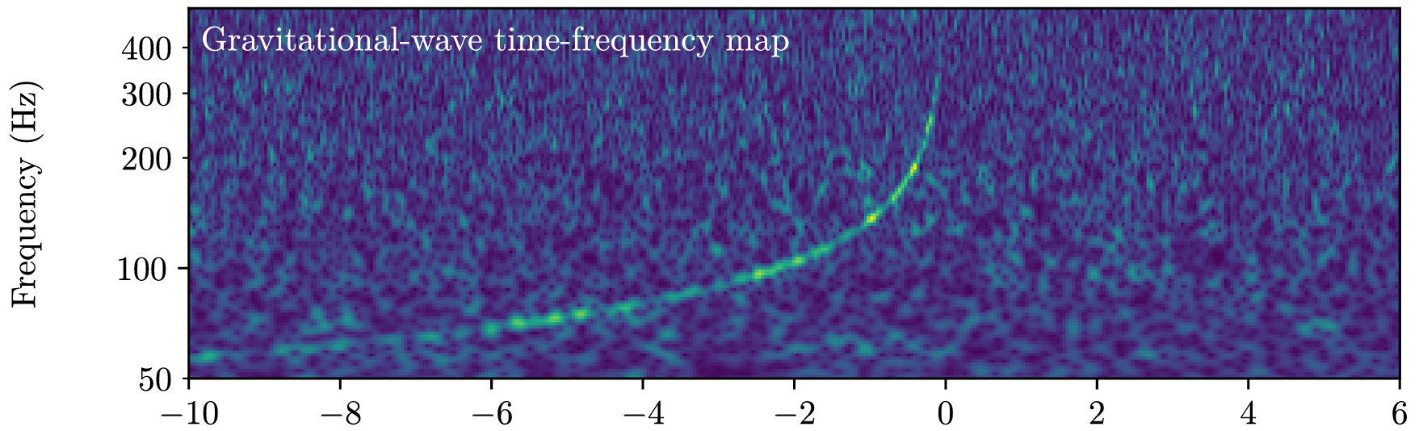
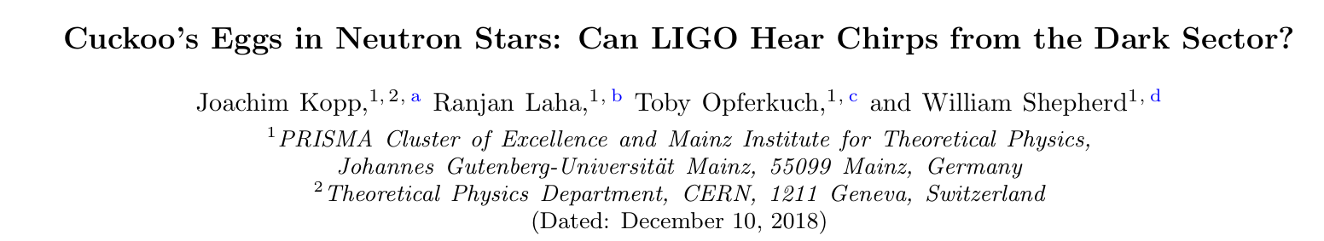
Why Neutron Stars
Strong gravity through focusing
E&M gives unique signatures
LIGO signatures → bounds on hidden sectors
GW170817, binary NS merger. From 1710.05834, LIGO, VIRGO, Fermi Gamma-ray Burst, INTEGRAL

Slide 4
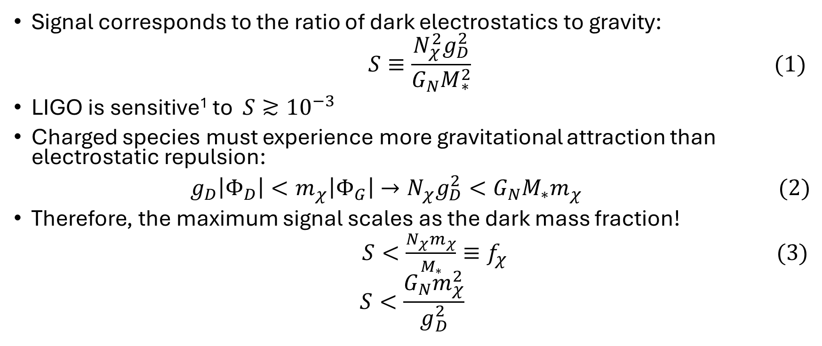
LIGO Signal in an NS Binary
Signal corresponds to the ratio of dark electrostatics to gravity:
$$S≡\frac{N_{χ}^{2}g_{D}^{2}}{G_{N}M_{∗}^{2}} (1)$$
LIGO is sensitive¹ to $S≳{10}^{−3}$
Charged species must experience more gravitational attraction than electrostatic repulsion:
$g_{D}\left|Φ_{D}\right|<m_{χ}\left|Φ_{G}\right|→N_{χ}g_{D}^{2}<G_{N}M_{∗}m_{χ } (2)$
Therefore, the maximum signal scales as the dark mass fraction!
$S<\frac{N_{χ}m_{χ}}{M_{∗}}≡f_{χ} (3)$
$$S<\frac{G_{N}m_{χ}^{2}}{g_{D}^{2}}$$
¹C. B. Owen, A. Tucker, Y. Kahn, & N. Yunes, 2503.04916

Slide 5
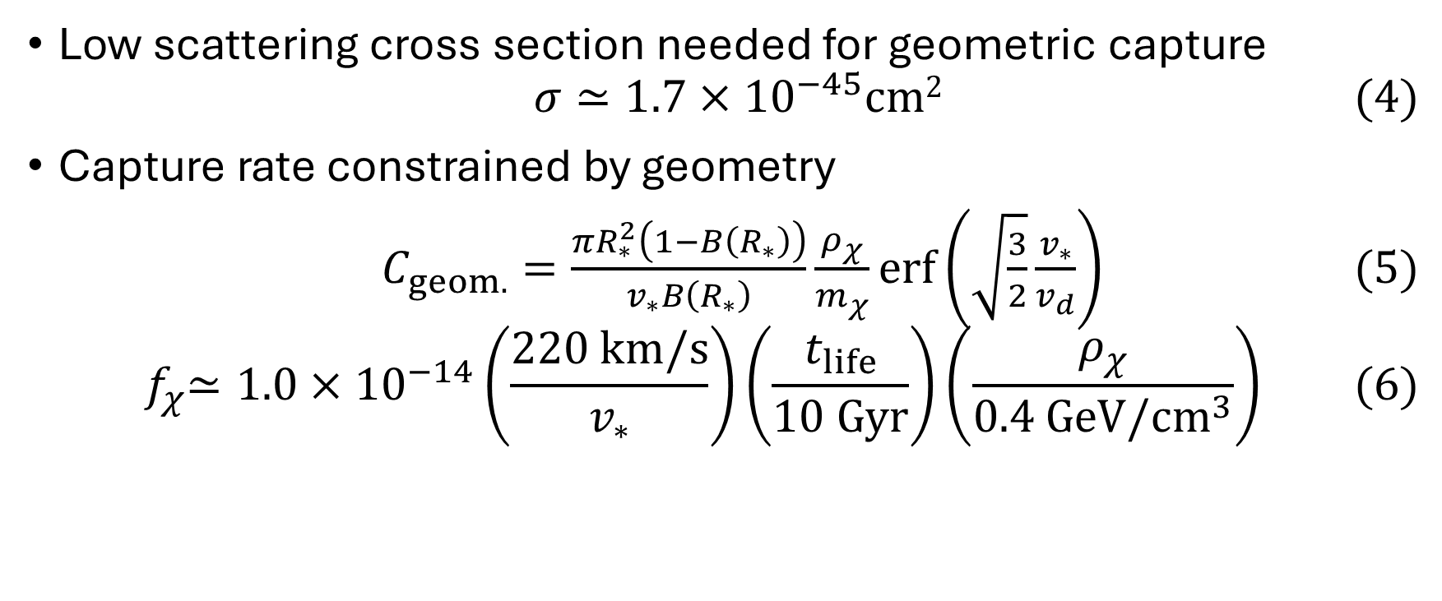
Accreting Ambient DM
Low scattering cross section needed for geometric capture
$$σ≃1.7×{10}^{−45}cm2 (4)$$
Capture rate constrained by geometry
$C_{geom.}=\frac{πR_{∗}^{2}\left(1−B\left(R_{∗}\right)\right)}{v_{∗}B\left(R_{∗}\right)}\frac{ρ_{χ}}{m_{χ}}erf\left(\sqrt{\frac{3}{2}}\frac{v_{∗}}{v_{d}}\right) (5)$
$${ f}_{χ}≃1.0×{10}^{−14}\left(\frac{220 km/s}{v_{∗}}\right)\left(\frac{t_{life}}{10 Gyr}\right)\left(\frac{ρ_{χ}}{0.4 GeV/{cm}^{3}}\right) (6)$$
N. F. Bell, G. Busoni, S. Robles, 1807.02840v2

Slide 6
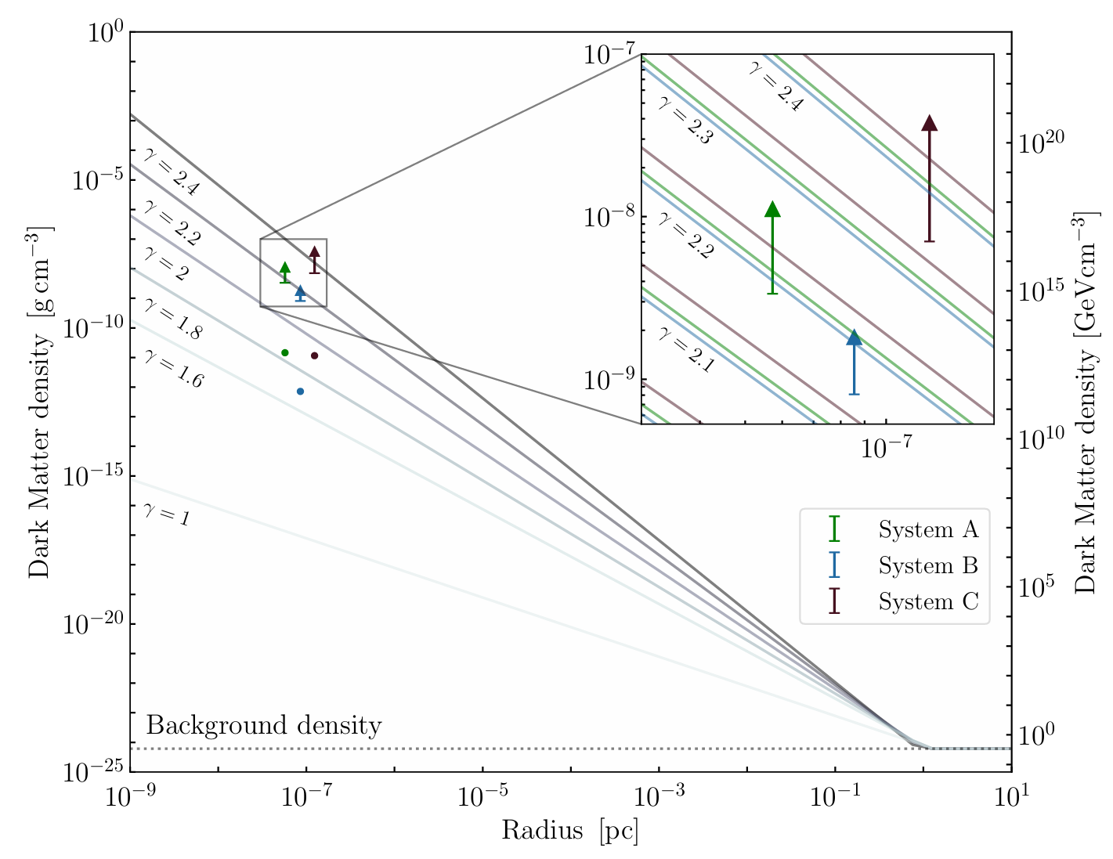
Spike or Mound, Can the Density Abound?
It can, though galactic effects may wash it out
Long-range DM is already constrained to be a ~6% subfraction¹
NS binary candidate must live very close to the galactic center
¹M. Kaplinghat, S. Tulin, & H. B. Yu, 1508.03339
S. Roy et. al., 2408.15317
F. Scarella & B. Kavanagh, 2510.11635

Slide 7
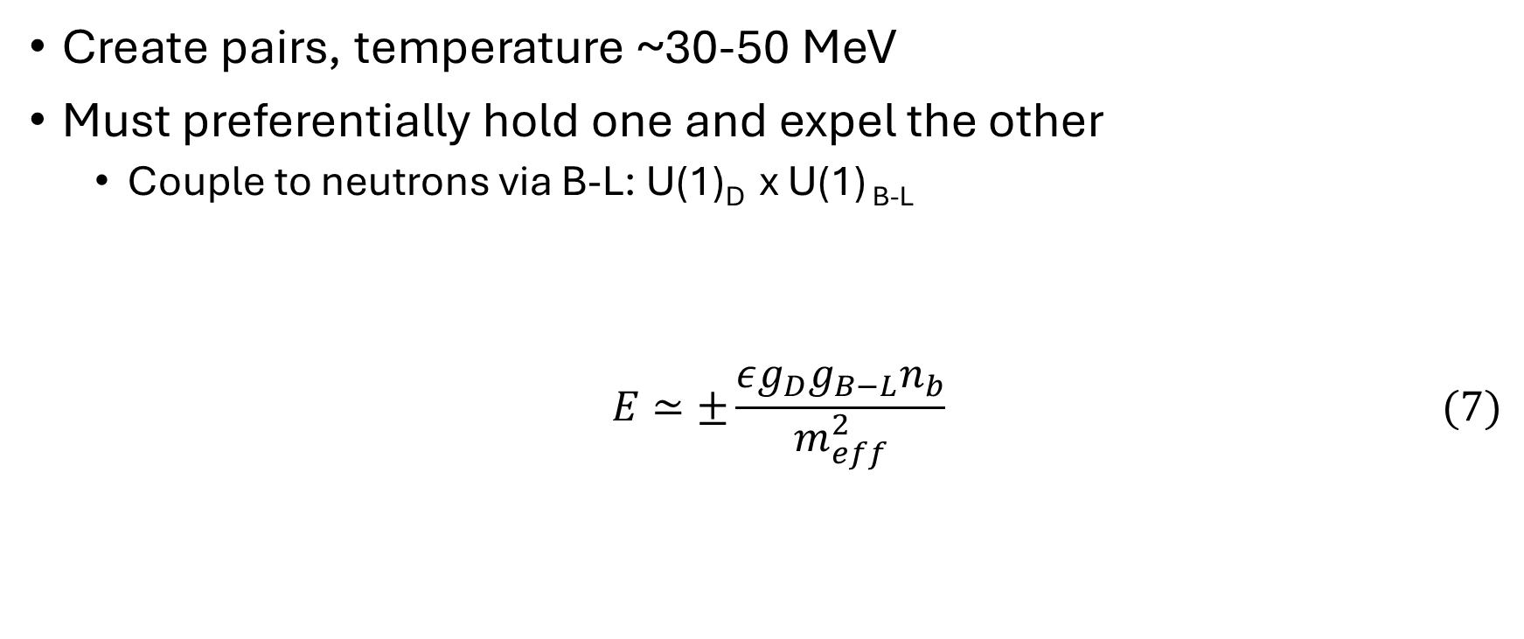
Thermal Production in the Progenitor Supernova
Create pairs, temperature ~30-50 MeV
Must preferentially hold one and expel the other
Couple to neutrons via B-L: U(1)_{D} x U(1) _{B-L}
$$E≃±\frac{εg_{D}g_{B−L}n_{b}}{m_{eff}^{2}} (7)$$
Long-range
Any-range
A. Nelson, S. Reddy, & D. Zhou, 1803.03266

Slide 8
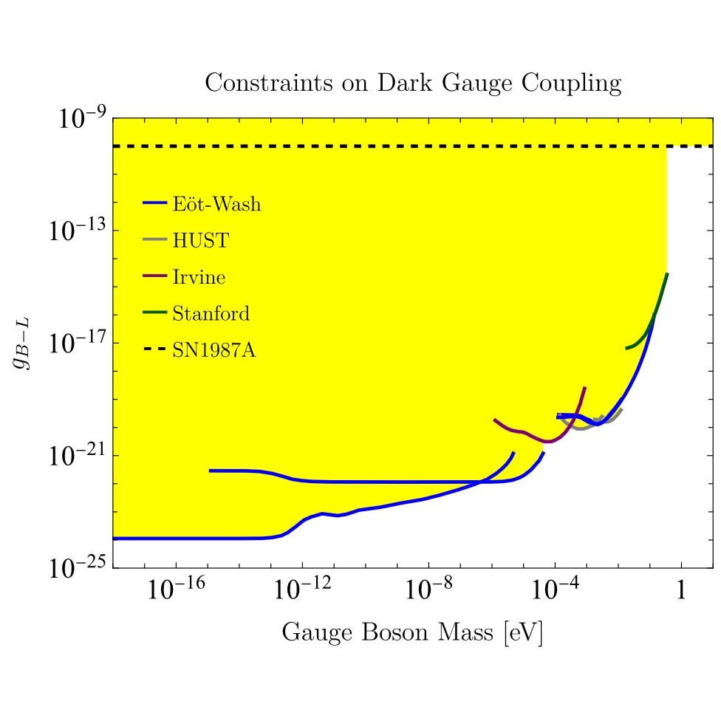
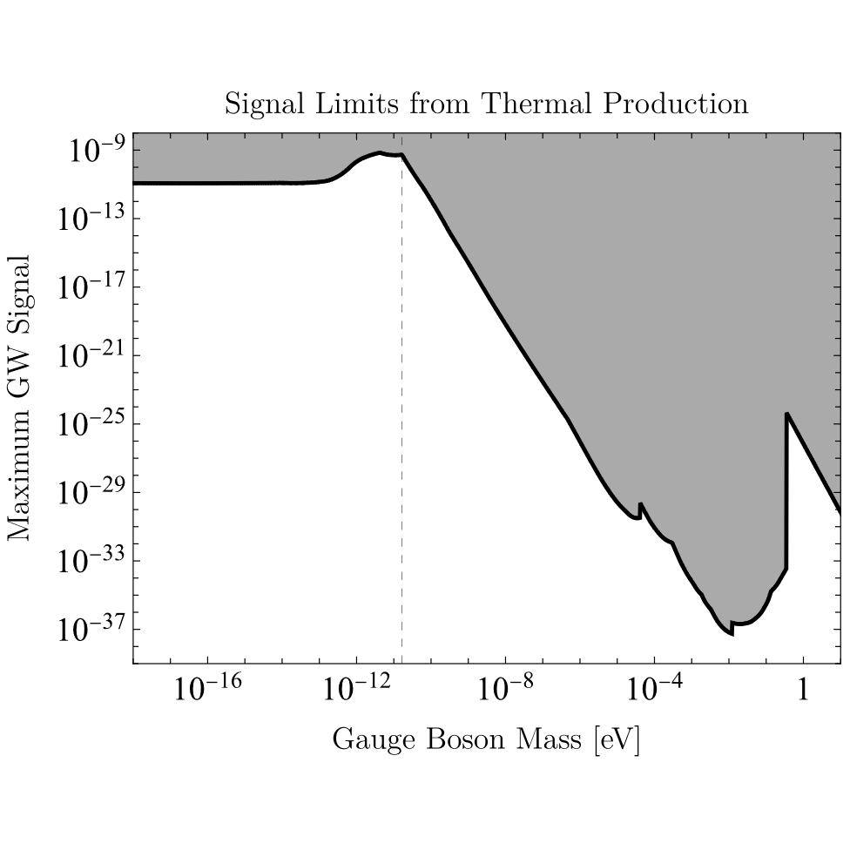
Pleading the Fifth (Force)
1207.2442, hep-ph/0611184, 2102.00022, 1803.03266

Slide 9
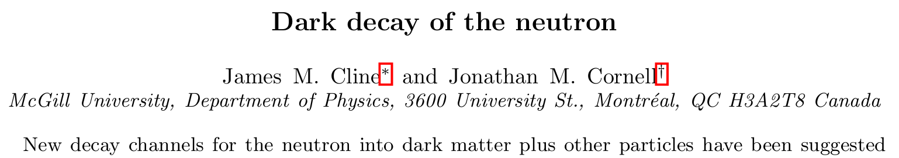
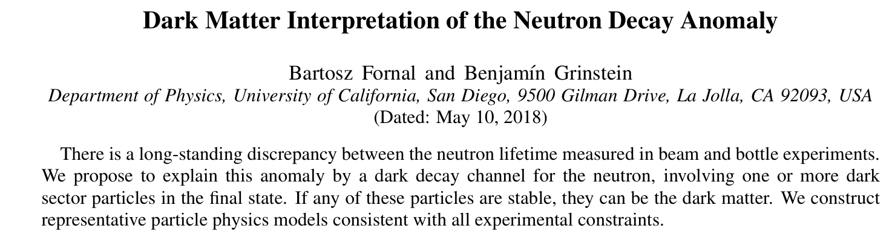
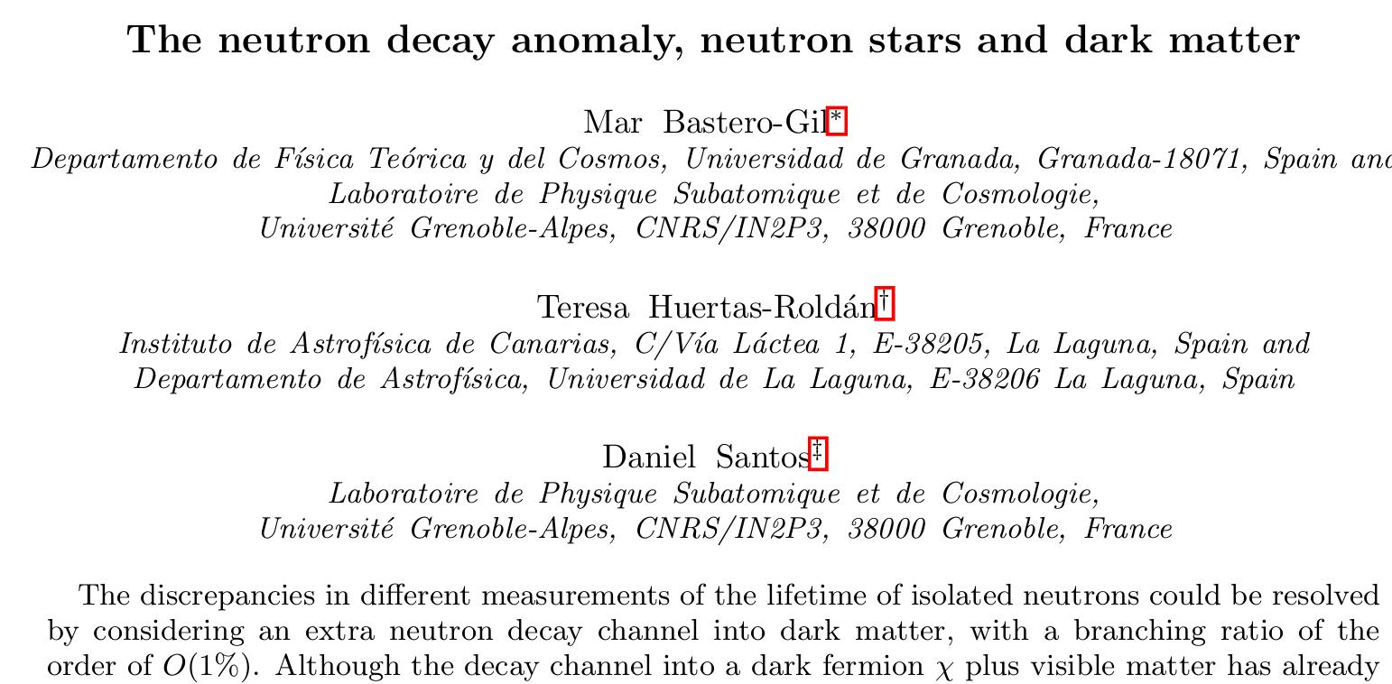
Neutron Decay

Slide 10
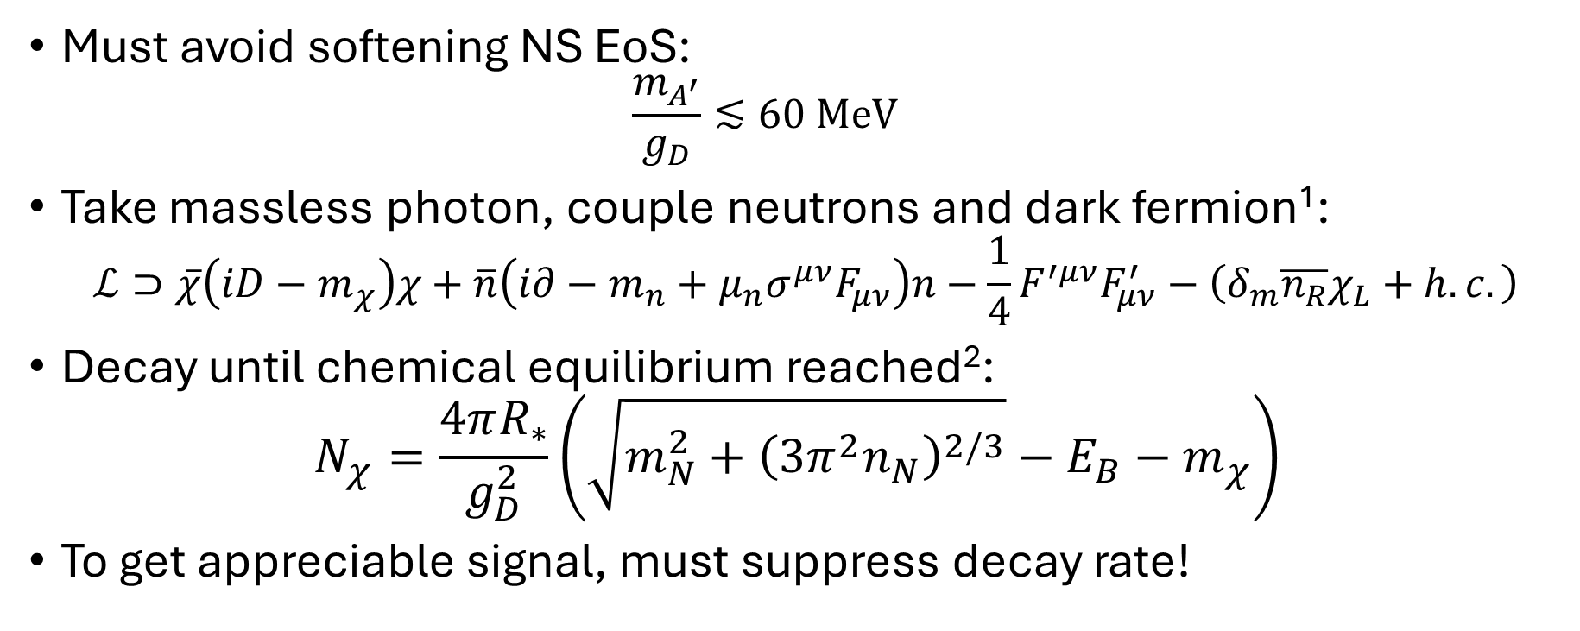




Vector Decay, N→$χA^{′}$
Must avoid softening NS EoS:
$$\frac{m_{A^{′}}}{g_{D}}≲60 MeV$$
Take massless photon, couple neutrons and dark fermion¹:
$$ℒ⊃\overline{χ}\left(iD−m_{χ}\right)χ+\overline{n}\left(i∂−m_{n}+μ_{n}σ^{μν}F_{μν}\right)n−\frac{1}{4}F^{′μν}F_{μν}^{′}−\left(δ_{m}\overline{n_{R}}χ_{L}+h.c.\right)$$
Decay until chemical equilibrium reached²:
$$N_{χ}=\frac{4πR_{∗}}{g_{D}^{2}}\left(\sqrt{m_{N}^{2}+{\left(3π^{2}n_{N}\right)}^{2/3}}−E_{B}−m_{χ}\right)$$
To get appreciable signal, must suppress decay rate!
$$\left(8\right)$$
$$\left(9\right)$$
$$\left(10\right)$$
¹J. M. Cline & J. M. Cornell, 1803.04961
² J. Kopp, R. Laha, T. Opferkuch, & W. Shepherd, 1807.02527

Slide 11
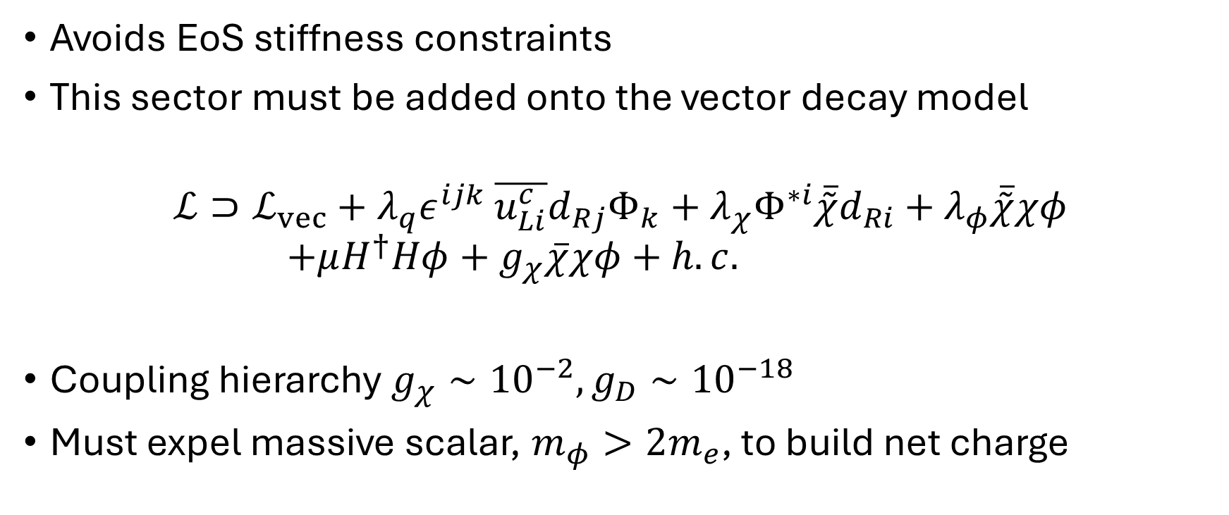
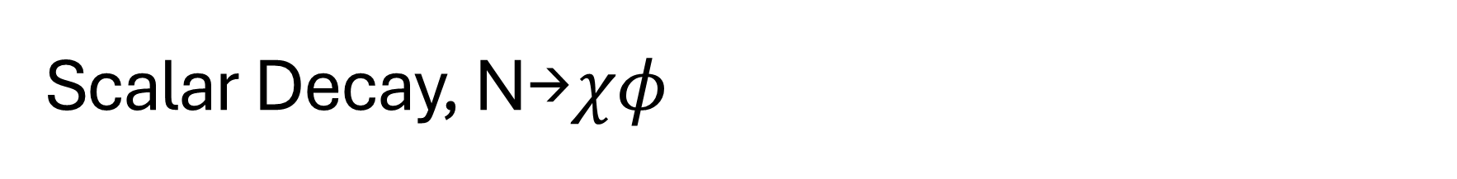

Scalar Decay, N→$χφ$
Avoids EoS stiffness constraints
This sector must be added onto the vector decay model
$$ℒ⊃ℒ_{vec}+λ_{q}ε^{ijk} \overline{u_{Li}^{c}}d_{Rj}Φ_{k}+λ_{χ}Φ^{∗i}\overline{\tilde{χ}}d_{Ri}+λ_{φ}\overline{\tilde{χ}}χφ$$
$$+μH^{†}Hφ+g_{χ}\overline{χ}χφ+h.c.$$
Coupling hierarchy $g_{χ}∼{10}^{−2},g_{D}∼{10}^{−18}$
Must expel massive scalar, $m_{φ}>2m_{e}$, to build net charge
$$\left(11\right)$$
B. Grinstein, C. Kouvaris, N. G. Nielsen, 1811.06546

Slide 12
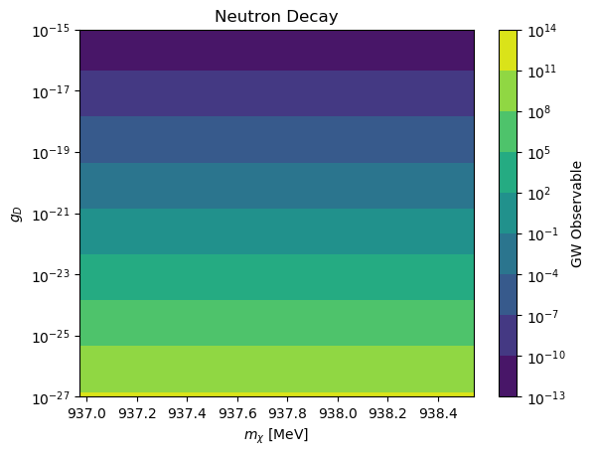


Scalar Decay Limits
$$N_{χ}=\frac{4πR_{∗}}{g_{D}^{2}}\left(\sqrt{m_{N}^{2}+{\left(3π^{2}n_{N}\right)}^{2/3}}−E_{B}−m_{χ}\right)$$
$$≃2×{10}^{59}≃100×N_{N}$$
$$\left(10\right)$$

Slide 13
Summary
Gravitational accretion can only yield sufficient millicharged DM inside a large central overdensity
Thermal production requires a mechanism to expel antifermions, which is overly constrained by fifth-force bounds
Neutron decay is either overly constrained, or would consume the entire host
It would be very difficult to do so, but this is a great analogy

Slide 14
Backup

Slide 15
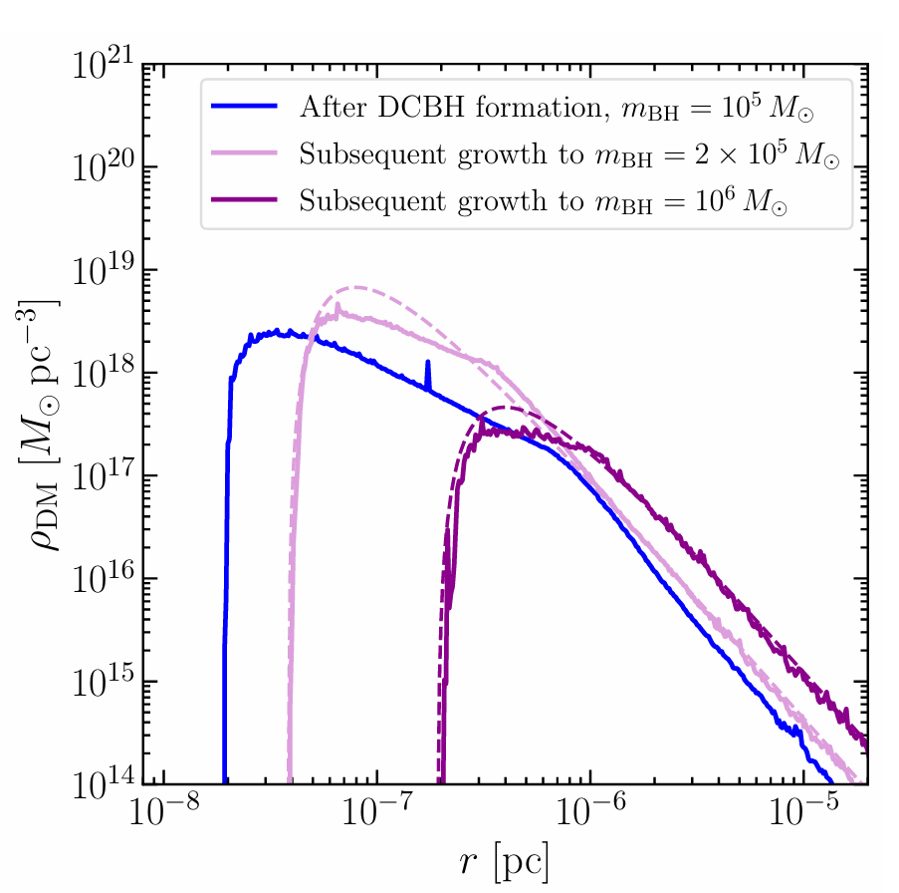
DM Mounds
G. Bertone et. al., 2404.08731v2

Slide 16
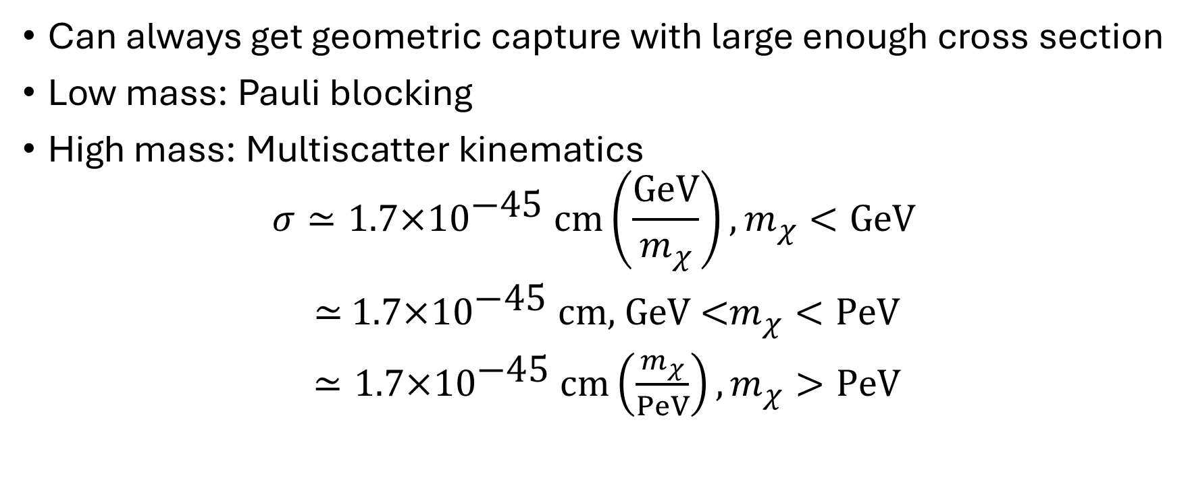
Geometric Capture Constraints
Can always get geometric capture with large enough cross section
Low mass: Pauli blocking
High mass: Multiscatter kinematics
$$σ≃\text{1.7}\text{×}{\text{10}}^{\text{−}\text{45}} \text{cm}\left(\frac{GeV}{m_{χ}}\right),m_{χ}<GeV$$
$≃$ $\text{1.7}\text{×}{\text{10}}^{\text{−}\text{45}} \text{cm}\text{, }\text{GeV}\text{ <}m_{χ}<PeV$
$≃\text{1.7}\text{×}{\text{10}}^{\text{−}\text{45}} \text{cm}\left(\frac{m_{χ}}{PeV}\right),m_{χ}>PeV$
(12)

Slide 17
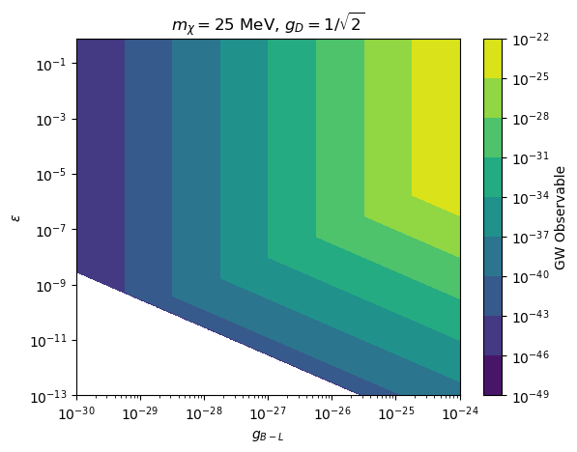
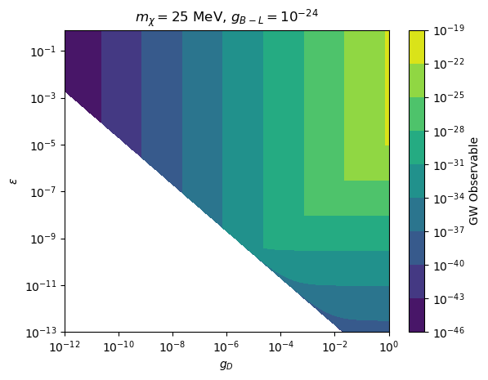
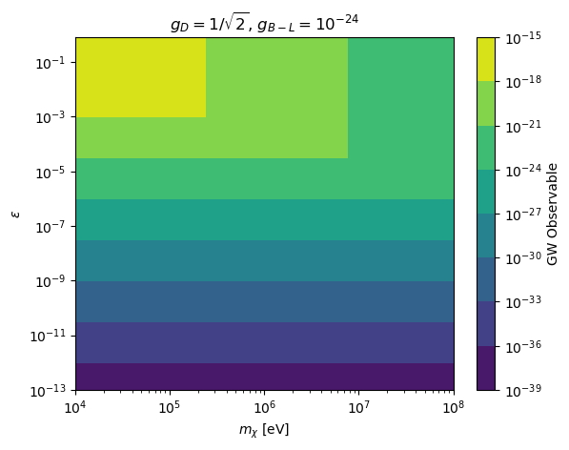
Full Thermal Production Constraints
Require antifermion expulsion
Restrict pair production

Slide 18
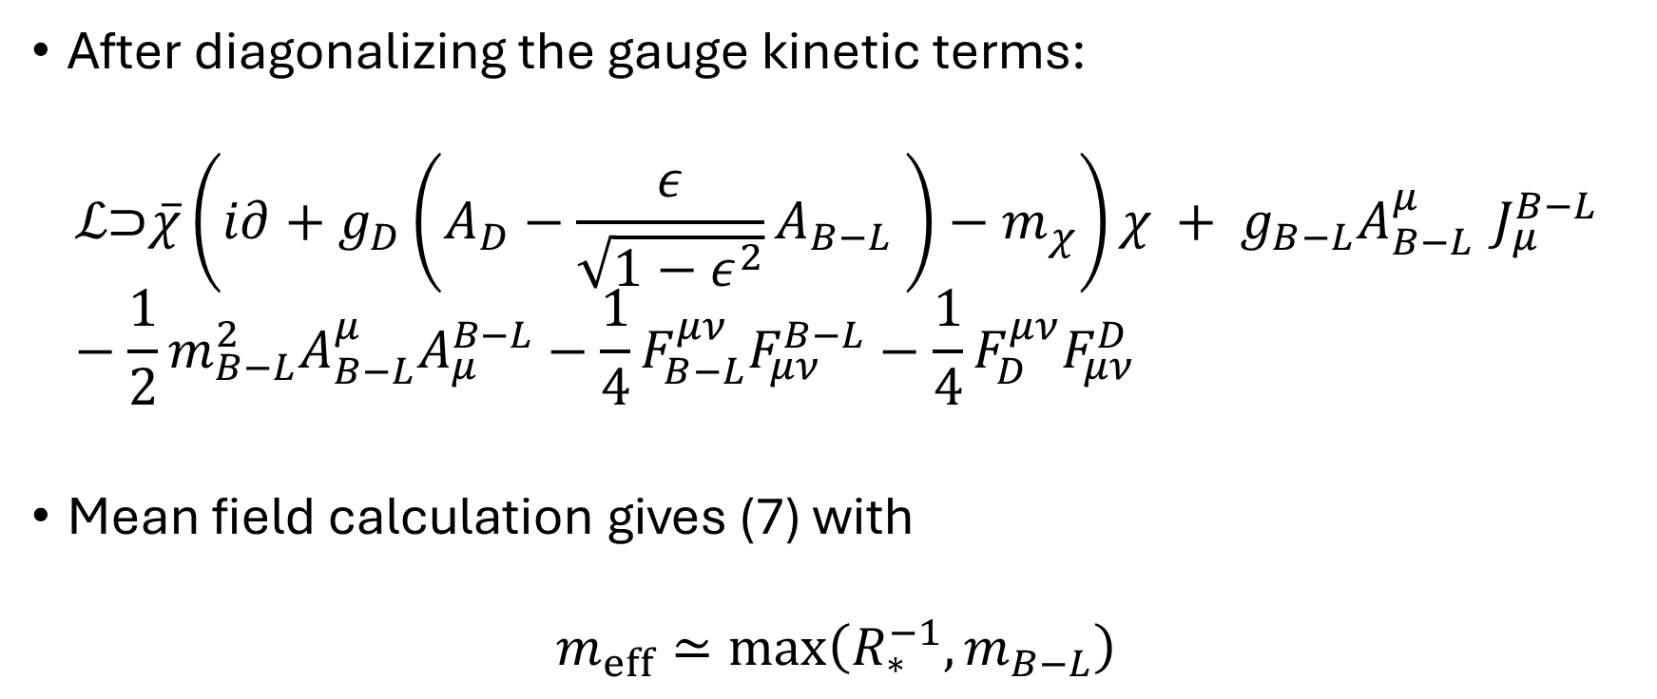
Minimal Model, Baryon (minus lepton) Coupling
After diagonalizing the gauge kinetic terms:
$$ℒ\text{⊃}\overline{χ}\left(i∂+g_{D}\left(A_{D}−\frac{ε}{\sqrt{1−ε^{2}}}A_{B−L} \right)−m_{χ}\right)χ + g_{B−L}A_{B−L}^{μ}{ J}_{μ}^{B−L}−\frac{1}{2}m_{B−L}^{2}A_{B−L}^{μ}A_{μ}^{B−L}−\frac{1}{4}F_{B−L}^{μν}F_{μν}^{B−L}−\frac{1}{4}F_{D}^{μν}F_{μν}^{D}$$
Mean field calculation gives (7) with
$$m_{eff}≃max\left(R_{∗}^{−1},m_{B−L}\right)$$
(13)
(14)

