Slide 1
Initiatives involving industry and showcasing socio-economic impact
Thomas Bergauer

Slide 2
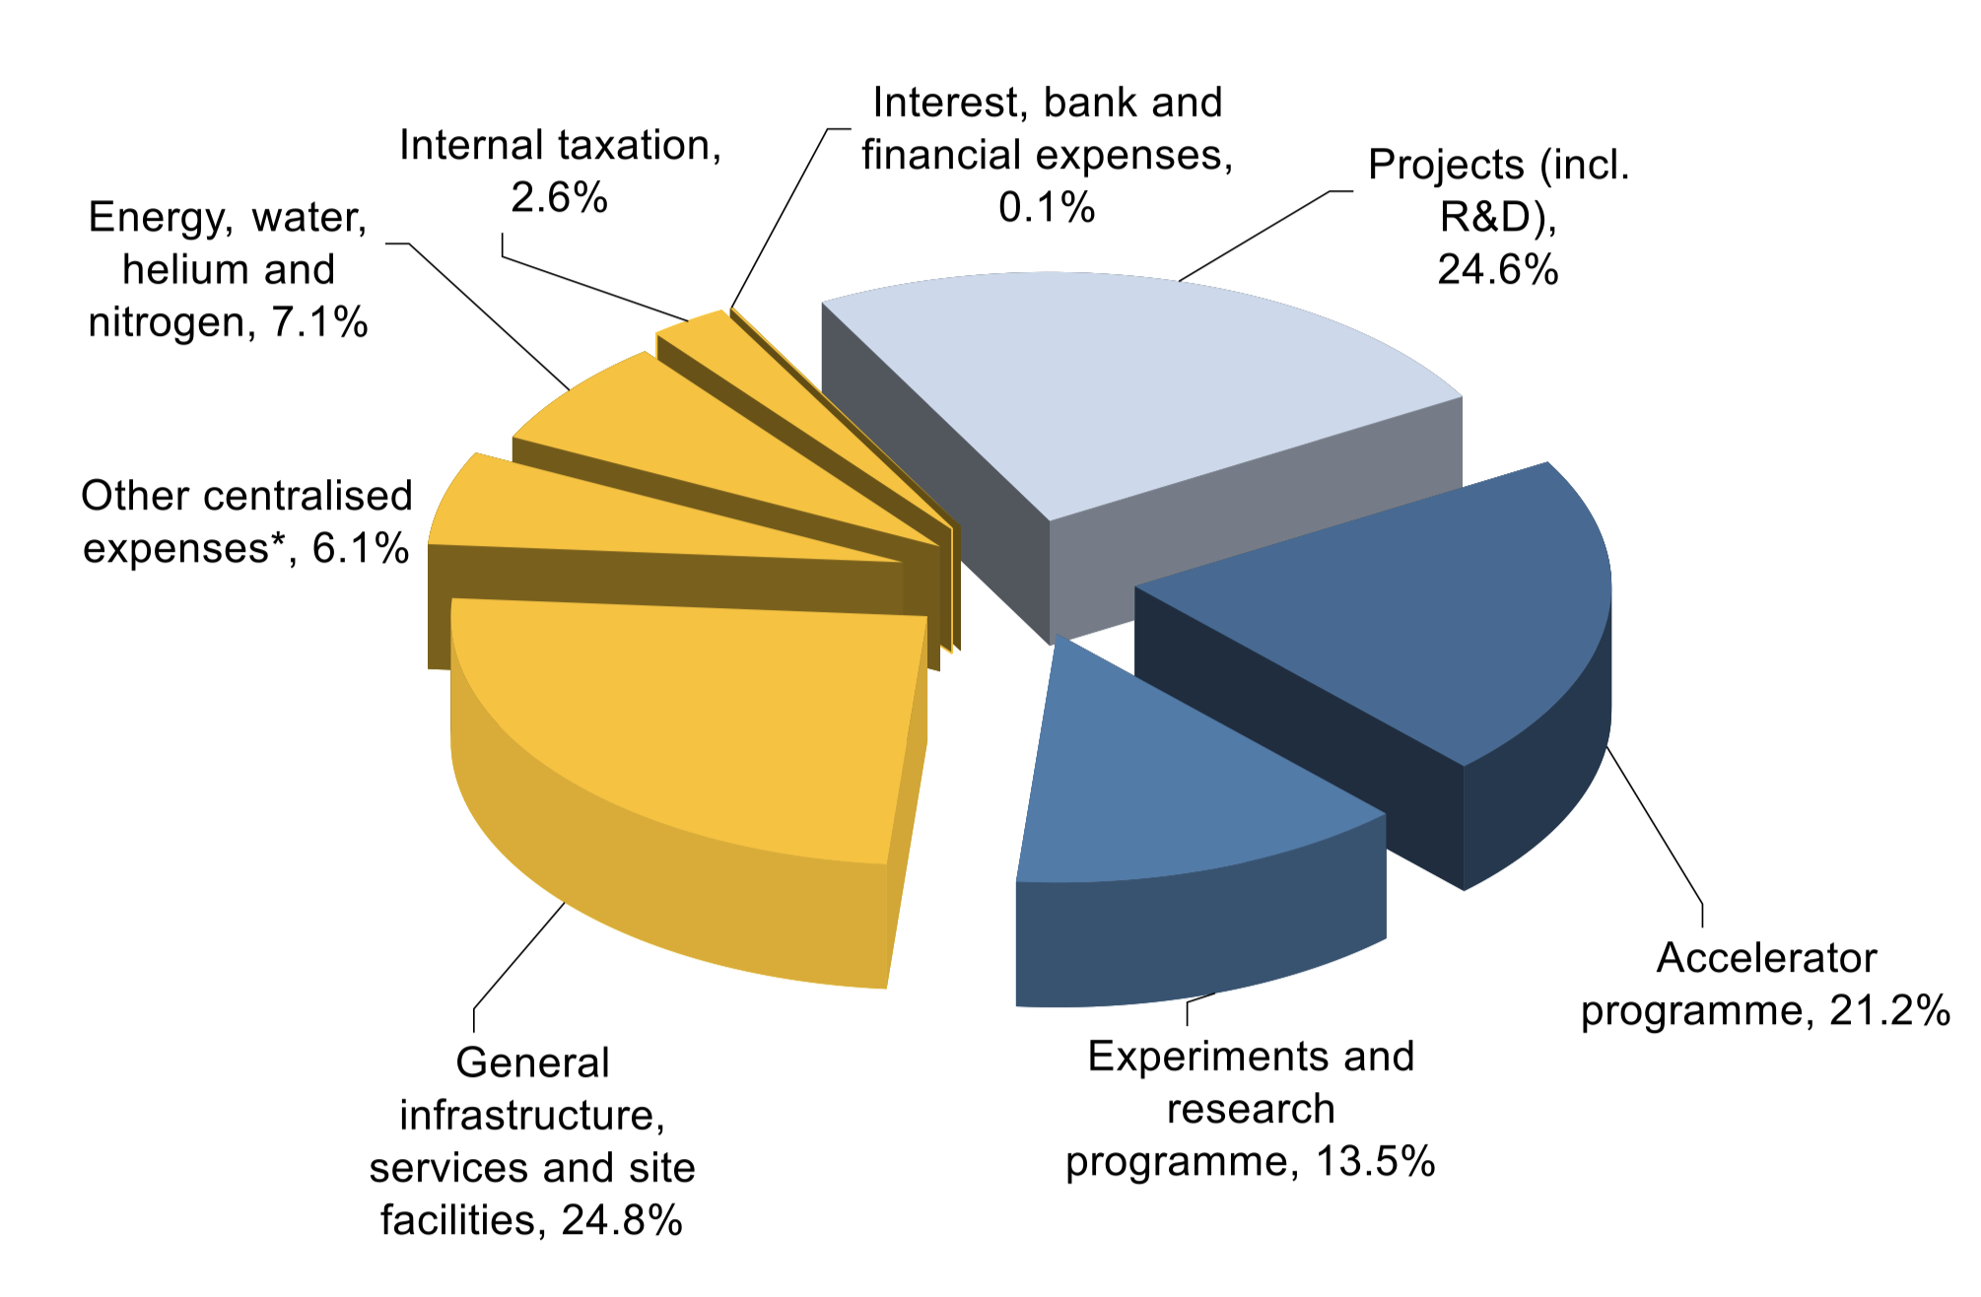
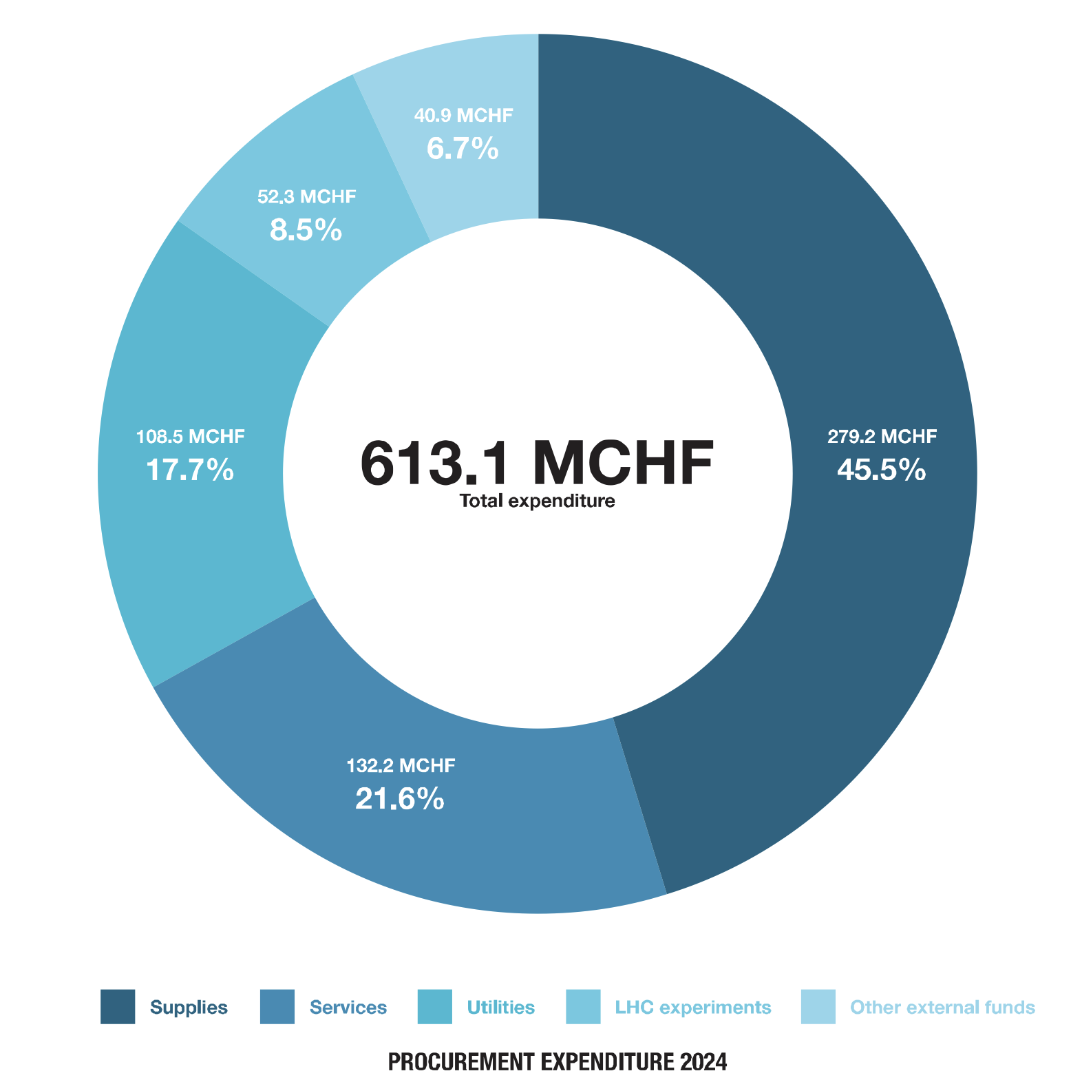
CERN Budget and Expenditure
CERN Budget: The Member States’ contributions for 2024 total 1255.4 MCHF [final budget 2024]
Austria: 27,4 MCHF [link]
CERN Expenditure: 613 MCHF (2024) [annual report] is half of CERN budget
Industrial return coefficient: defined as the ratio between that Member State's percentage share of the value of all Supply contracts and that Member State's percentage contribution to the CERN Budget over the same period.

Slide 3
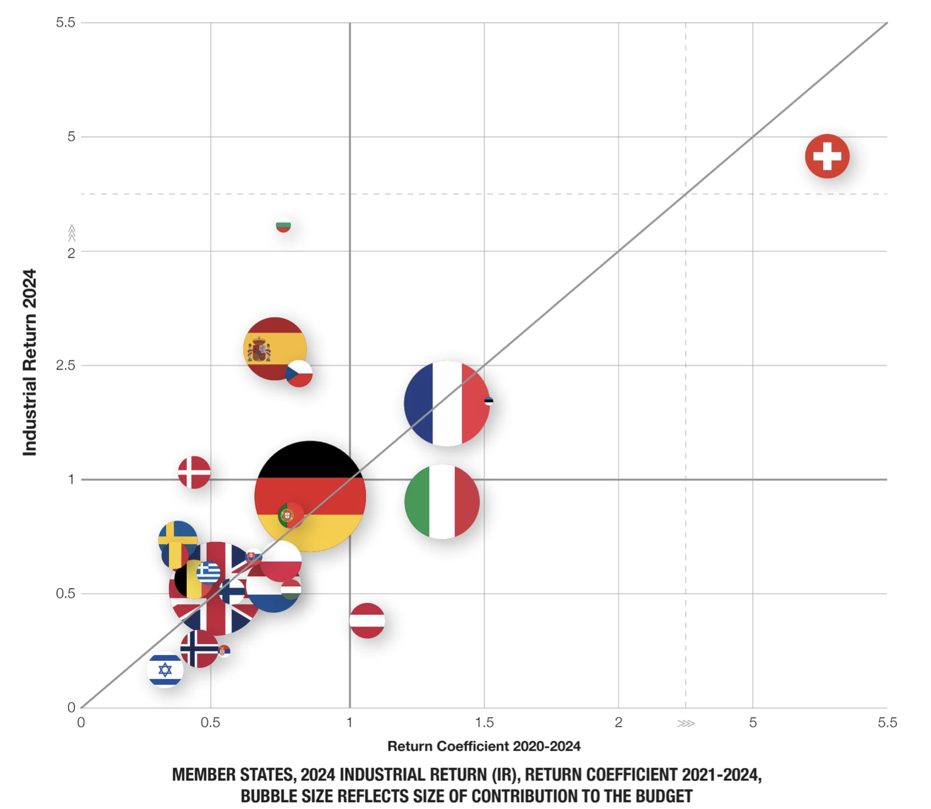
Industrial return Coefficient

Slide 4
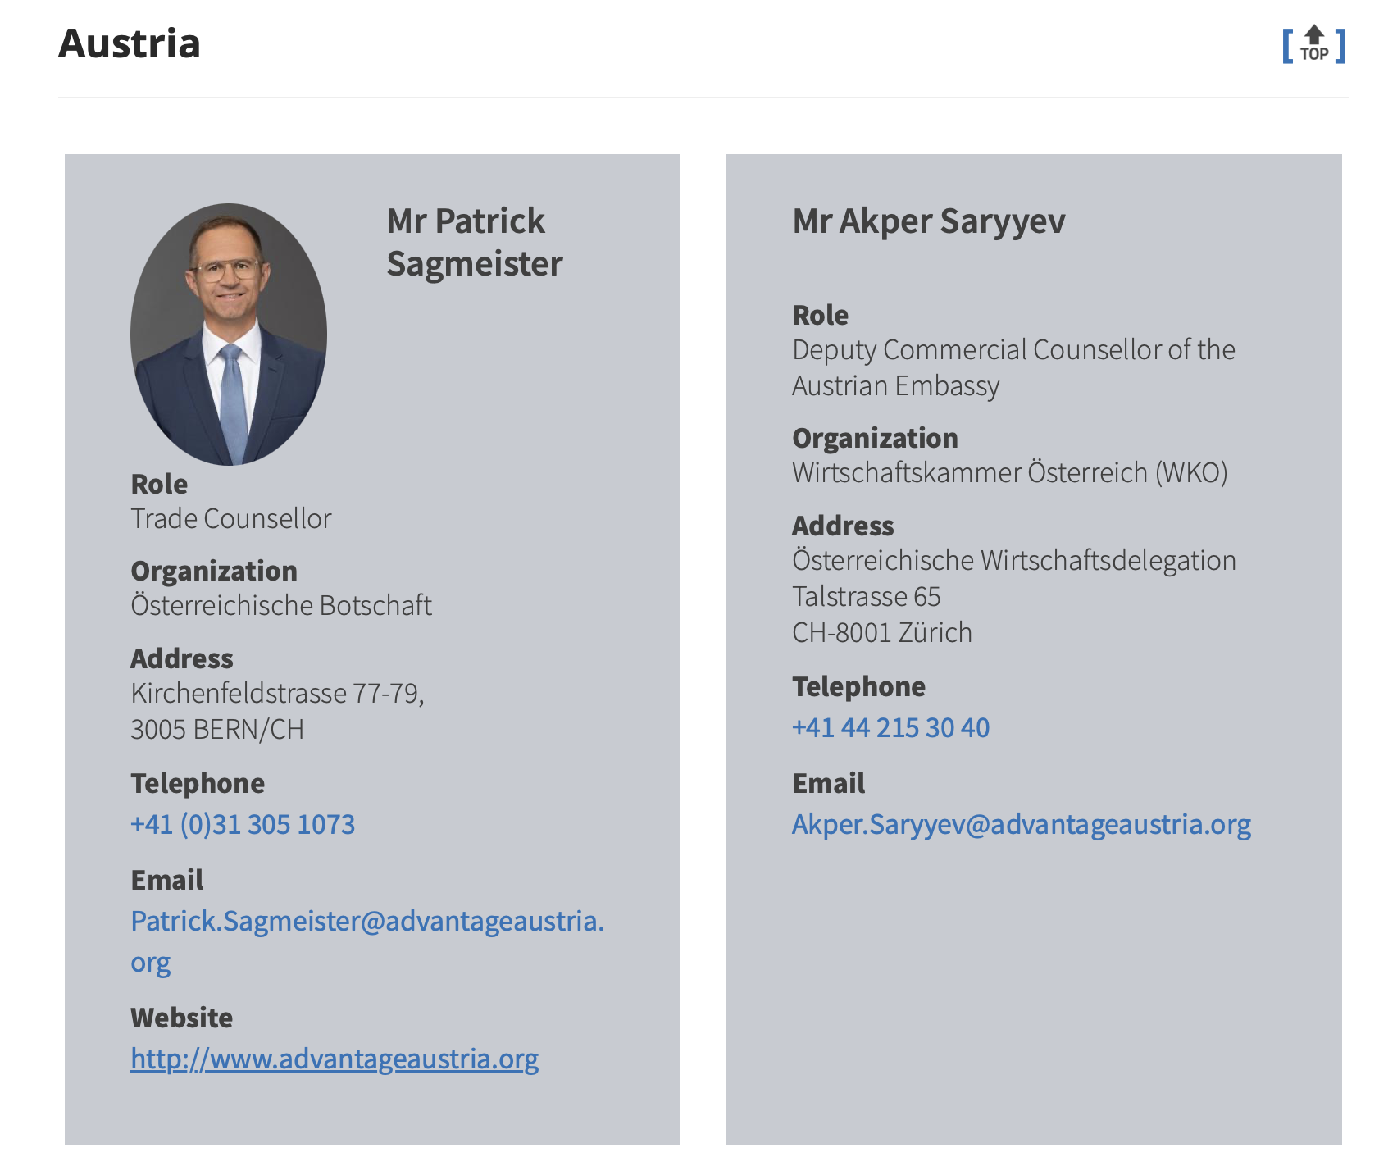
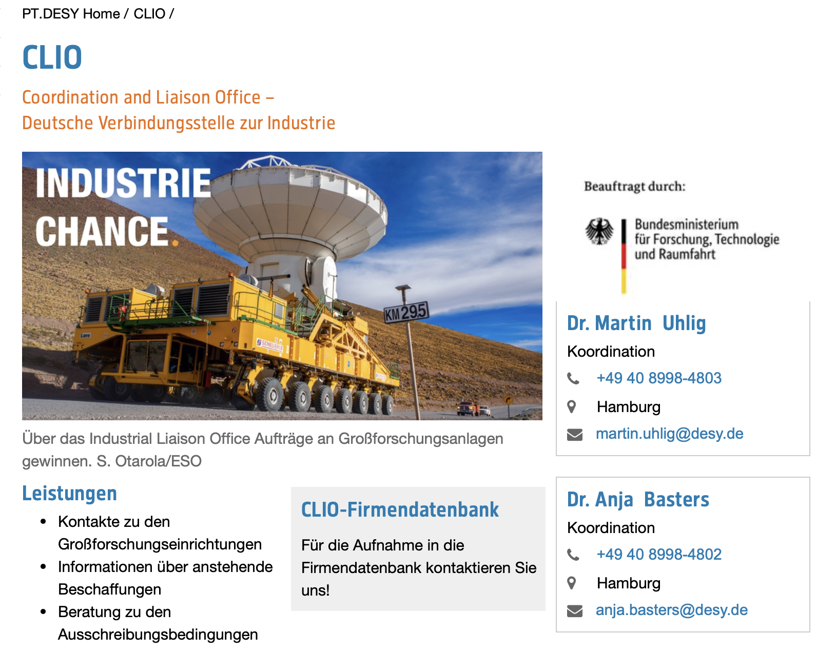
Big Science Sweden
Industrial Liaison Officers
Each CERN member state nominates liaison people who are supposed to bring CERN industrial orders to suitable local industry
List of ILOs: https://procurement.web.cern.ch/contact/who-contact-your-country
In most countries this is a local, national position embedded in trade chambers, business incubator centers, or dedicated offices
Germany: DESY, Netherlands: NIKHEF, Switzerland: EPFL, UK: STFC, Sweden: Big Science Sweden,
Austria is the only country (except Belgium), where ILO sits in Geneva and is a trade counsellor and member of the embassy

Slide 5
International Examples

Slide 6
International Examples

Slide 7
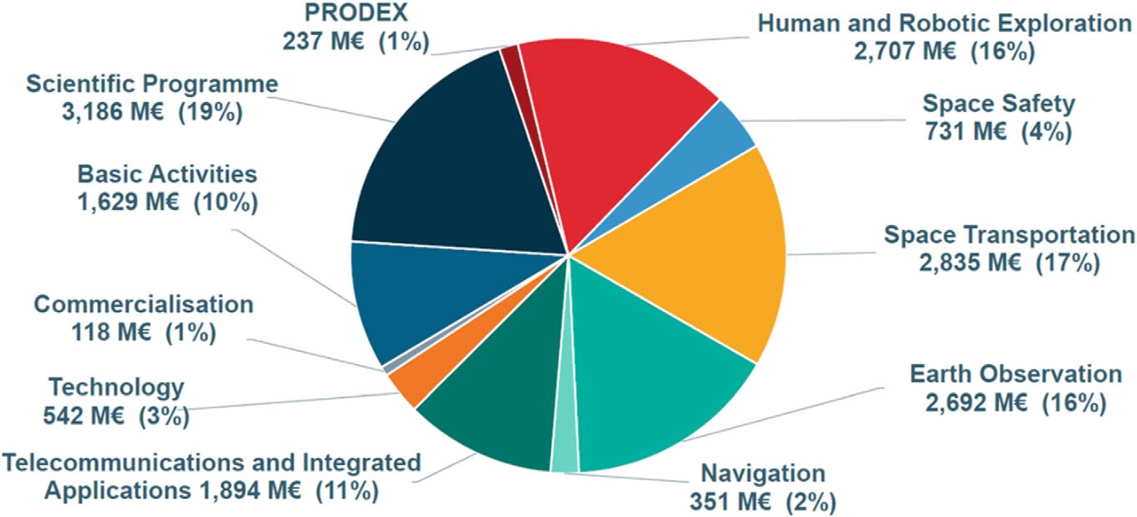
European Space Agency Example
ESA Budget 2025: € 7.68 billion (compared to CERN ~1.2 billion)
Member State contributions at around €4.8 billion
EU share at around €1.7 billion,
"other sources" ~€1.2 billion.
Funding in Austria
2019: 50 Mio € [FFG]
2023: 57 Mio €
2024-2026: increase to 70/73/76 Mio € [link]
Geographical Return
ESA Convention https://www.esa.int/About_Us/Law_at_ESA/ESA_Convention
Return coefficient similar to CERN
Austrian „Weltraumstrategie“: https://austria-in-space.at/de/austria-in-space/weltraumstrategie.php
Special funding programs in FFG ASAP

Slide 8
Österreichische Weltraumstrategie

Slide 9
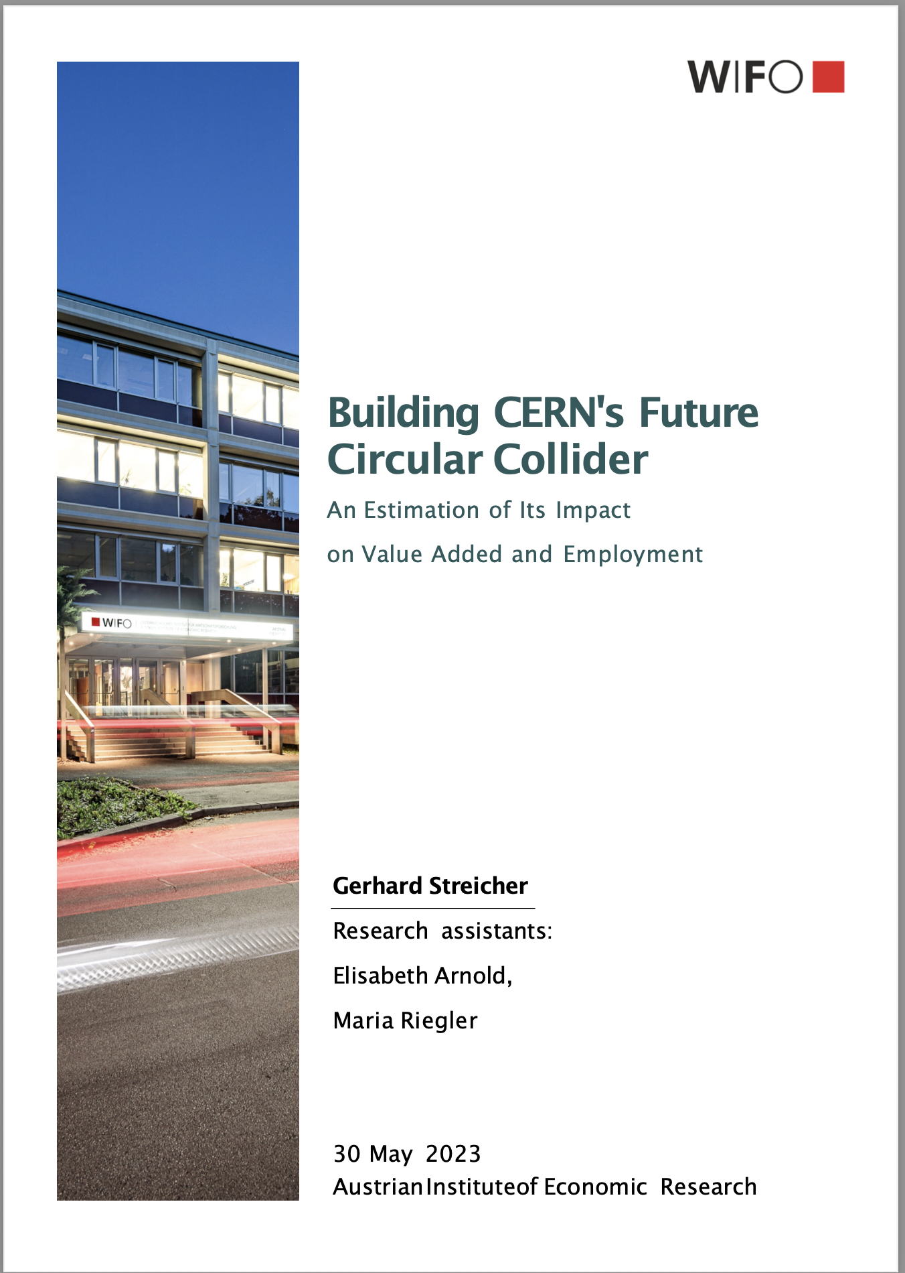

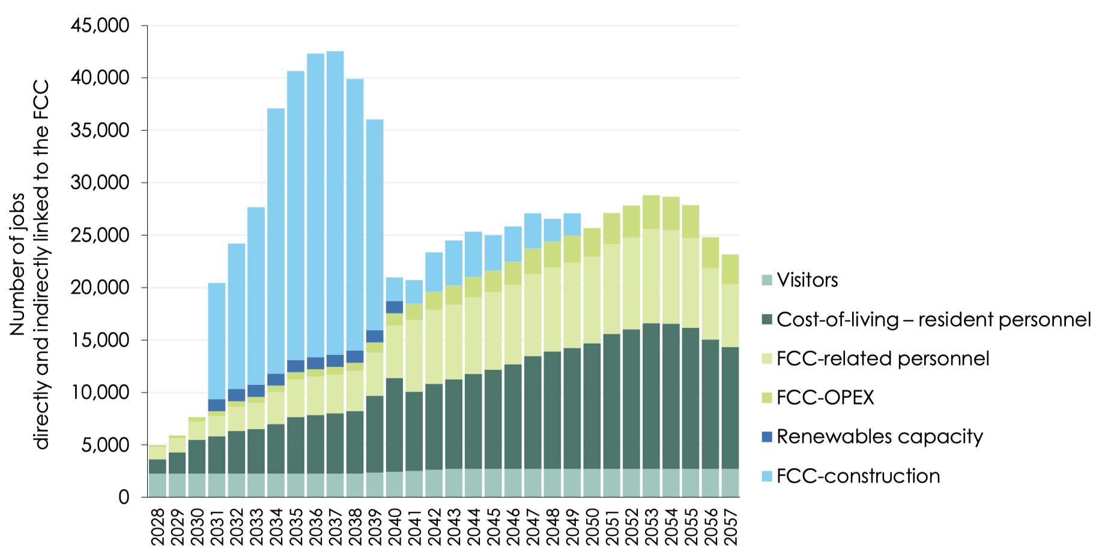
Socio-Economic impact
Funding agencies need to be convinced that investment in CERN and building FCC is a good investment
R&D developments do not bring benefits for HEP community alone
Technologies, materials and research that find their way directly into medicine, industry and everyday life.
Society at large: job creation, education, training
Documentation exists:
CEBR Study
WIFO Study on FCC

Slide 10
Summary
CERN funding scheme enables industrial return to foster economic impact
ESA does this much stronger than CERN, but space sciences is also much more present at funding agency FFG, ministry and industry
Austrian is most of the time “poorly balanced” for the Industrial Return Coefficient
Approach Austrian ILO and discuss possible way to bring it closer to industry
Approach Wirtschaftskammer and discuss ways to collaborate
Provide information on CERN to decision makes on socio-economic impact
Initiate studies or collect existing information
Cooperation with the university of economics?

