Slide 1
RECFA Meeting 2026
Thomas Bergauer

Slide 2
ECFA/PECFA/RECFA
ECFA is the European Committee for Future Accelerators
  PECFA is the Public RECFA section, RECFA is the Restricted ECFA
  Mandate is defined in Terms of Reference: https://ecfa.web.cern.ch/ecfa-terms-reference
Aim: Long-range planning of European high-energy facilities
  To achieve these aims ECFA can engage in - among others - the following activities:
  regular meetings of Restricted and Plenary ECFA; → next one on 20/21 Nov @ CERN
  ad hoc symposia and conferences sponsored or organized by ECFA; e.g. JENAS Oxford 2025
  study groups, set up by ECFA, or jointly with other organizations, for special problems;
  demographic studies of the high-energy physics community and resources in the ECFA participating countries, repeated at regular intervals, by means of visits to the participating countries by Restricted ECFA;
  monitoring of the ongoing implementation of the European Strategy for Particle Physics in the CERN Member States under activity (d), presentation of corresponding status reports to the European Strategy Session of Council.

Slide 3
Austrian Country visits
Every 6-7 years, Next Austrian country 11 Sept 2026: https://indico.cern.ch/event/1567710/
last Austrian Visit April 2018: https://indico.cern.ch/event/737860/

Slide 4
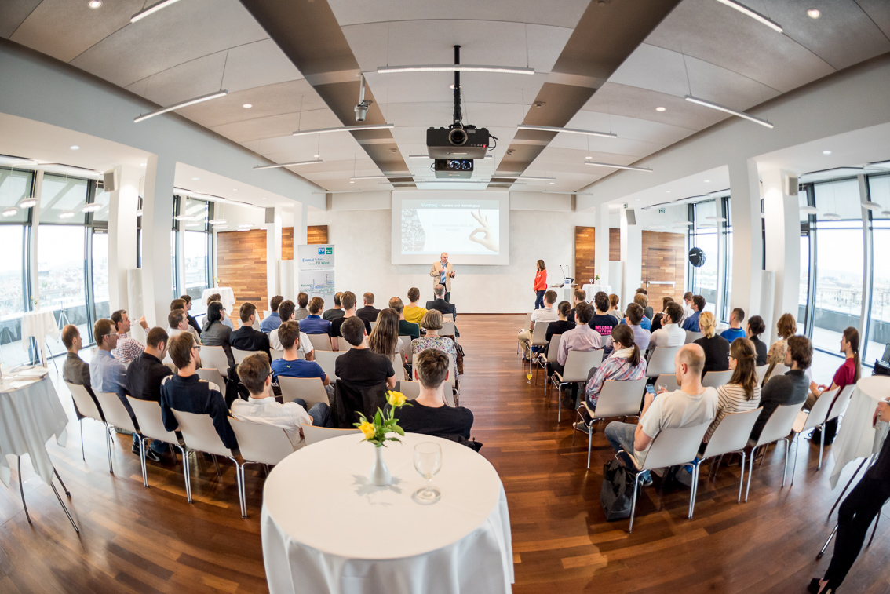
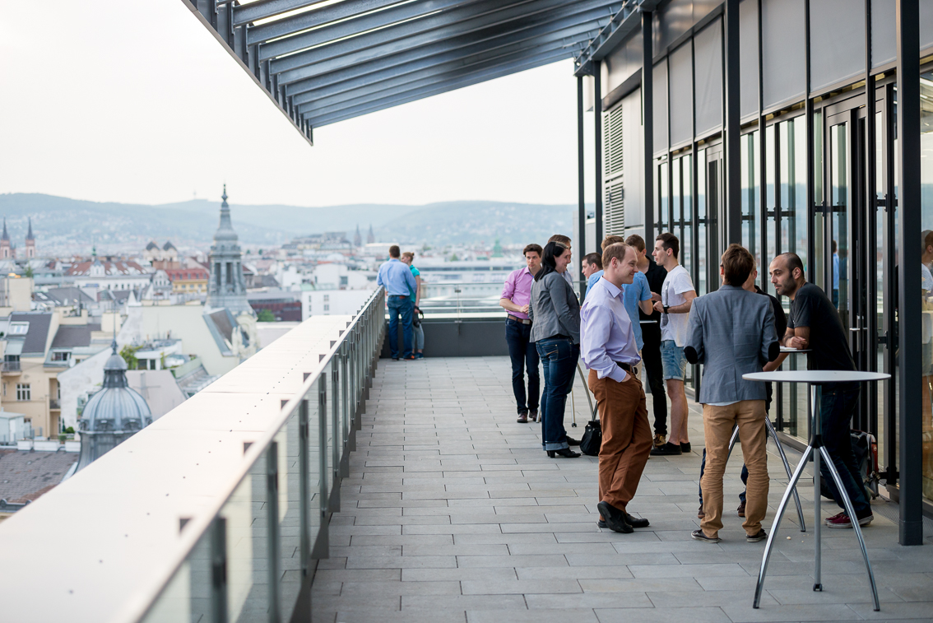
RECFA Visit 11 Sept 2026
Proposed Site: TUtheSky (alternative: PSK)
Attendance:
  25 RECFA representatives,
  ~10-15 speakers,
  everybody else interested (open meeting)
Short Lunch, coffee on site
Dinner at a nice location for RECFA + speakers
Preparation:
  Written Country report (~15 pages about Austria’s education system, GDP for research, CERN membership fee, industrial return coefficient, number of universities in total vs. HEP groups, funding agencies, number of physics students starting/finishing)
  Presentations at Open Session → see next page

Slide 5
RECFA Visit 11 Sept 2026
Open Topics for the program of the open session:
Opening
  Ministry representative?
  Funding agency representative (FWF, FFG)?
  HEPHY/SMI → MBI merger
Thematic Talks for Experiments rather “MBI”
  CMS, Belle, ALICE, AD
  Separate talk on Detector R&D and Hardware activities?
How many theory talks do we need (MBI, TU Wien, Graz,..)
  Better thematic, i.e. QCD, BSM, Cosmic Messenger, rather than “institutions”
Astroparticle Physics: Innsbruck representative? Gravitational waves!
Talk on “accelerator” R&D
  FCC-talk on tunnel excavations (Boku, Leoben) and/or magnets (USTEM)?
  MedAustron?

Slide 6
The end.

