Slide 1

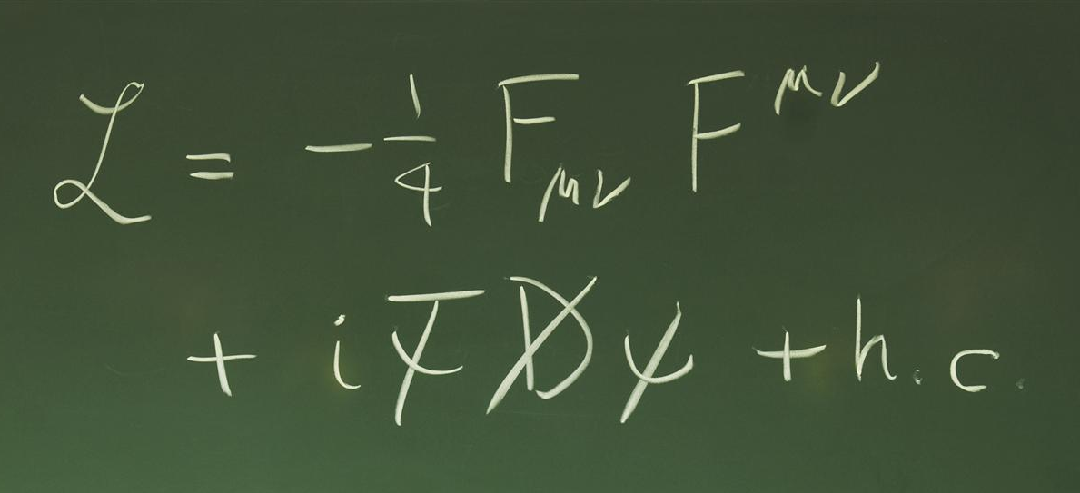
High Energy Physics - Theory
Rudi Rahn, 3.11.2025

Slide 2
First things first
MSCA fellow at UniVie
Semi-Numerical calculations for resummation in SCET
Who?
What?
Survey of Austrian theory groups’ ideas (+my interpretations)
This talk will be vague, with a few concrete ideas

Slide 3

Symbolic summary
Impressive precision for some processes and observables
Less impressive in other areas
Theory is very focused on precision: N^{n}LO, N^{n}LL, …
Driven by experimental uncertainties
[see e.g. talk by Alessandro Vicini @ Radcor 2025 in Puri]

Slide 4

Symbolic summary
Making precise predictions even more precise

Slide 5
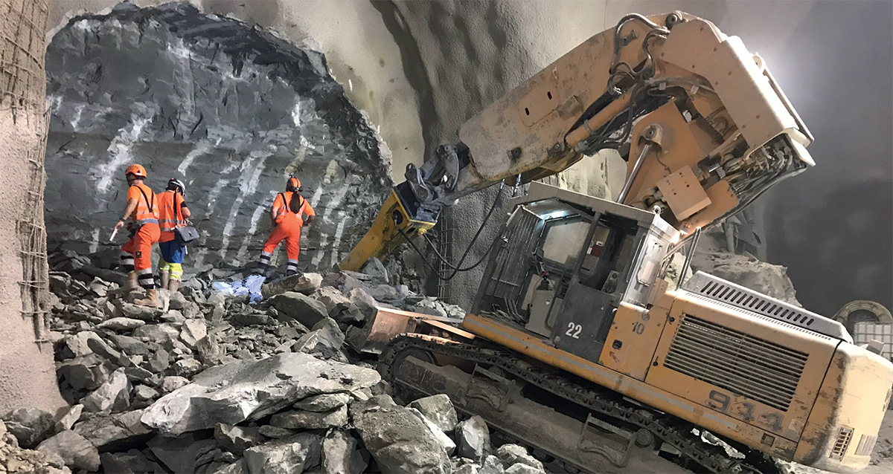
Analogy of the day: Digging holes
Digging for the HL-LHC

Slide 6

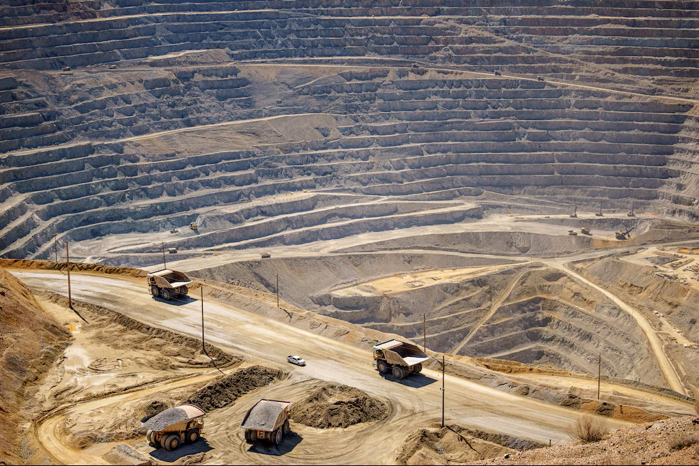
Digging theory holes
Tree level
Multi-loop level
Tunnel vision
Diminishing returns
Who cares?
Increased costs
Delving too greedily

Slide 7

The dirt
Hadronisation
SM as a quantum theory
Electroweak physics
These are accuracy problems!

Slide 8
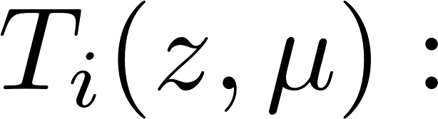
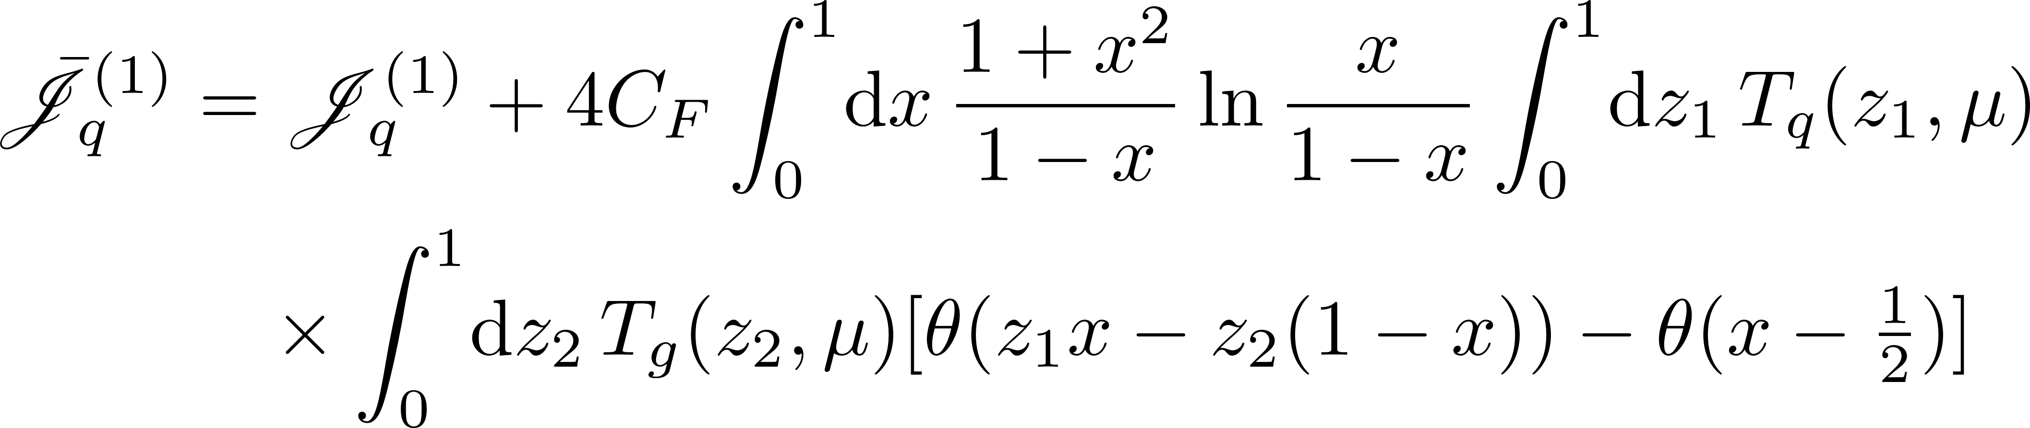
An example
Track functions are a type of fragmentation function:
They are useful (I’ve used them)
They are also a symptom Tailor-made to avoid talking about hadronization
Maybe a laboratory?
[Chang et al., ‘13]
Probability that momentum fraction z of parton i hadronises into charged particles (i.e. tracks)

Slide 9
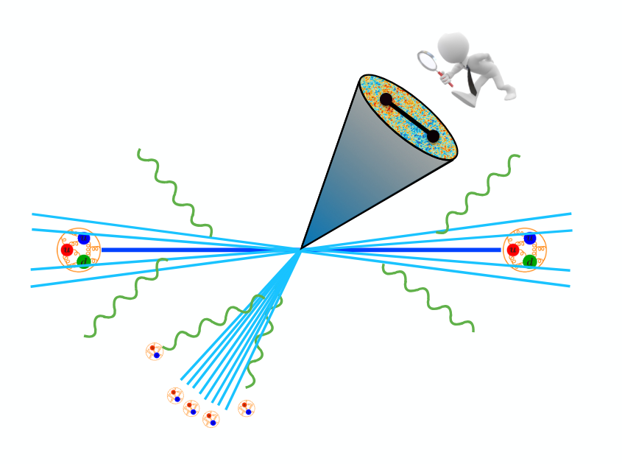
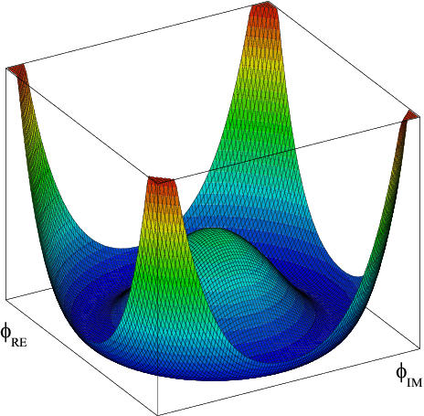
Pouring concrete
Look for IR physics in the high energy processes: Underlying event, hadrons from IS photons, jet substructure
Improve MC event generators subleading colour, logarithmic accuracy,…
Top & toponium physics Spin entanglement, unstable particle effects, ttH
[Stolen from B. Mecaj]
EW physics

Slide 10


Pouring concrete
All this requires data!
All sources needed, including hadron collisions
The HL-LHC is vital!

Slide 11

What happens when you dig too deep?

Slide 12
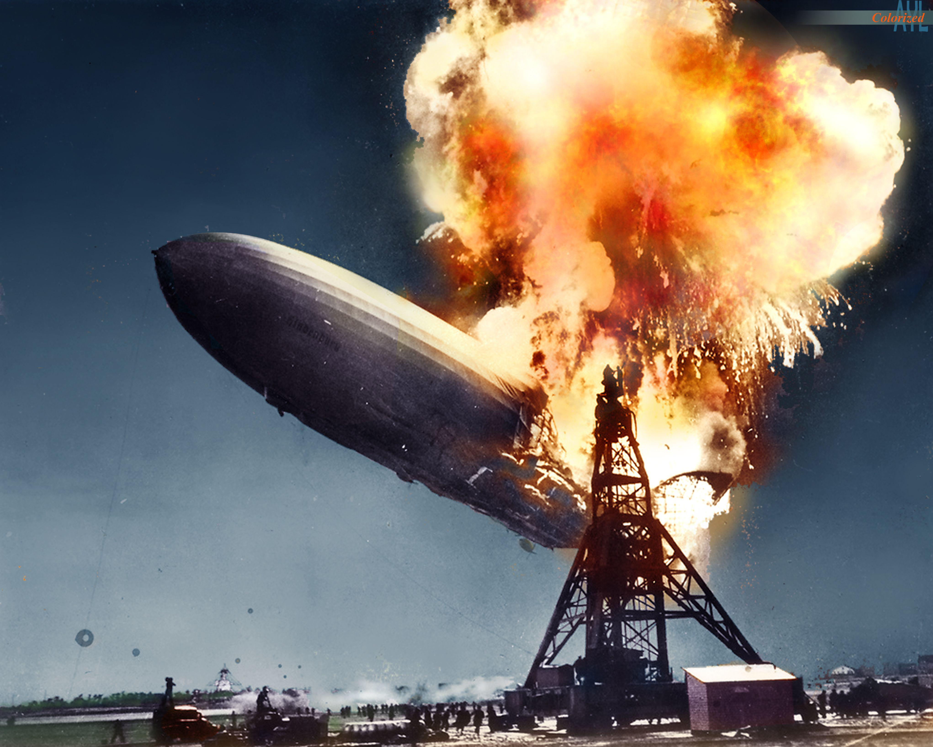
Learn from disasters
Theory efforts for muon g-2 (colorized)

Slide 13
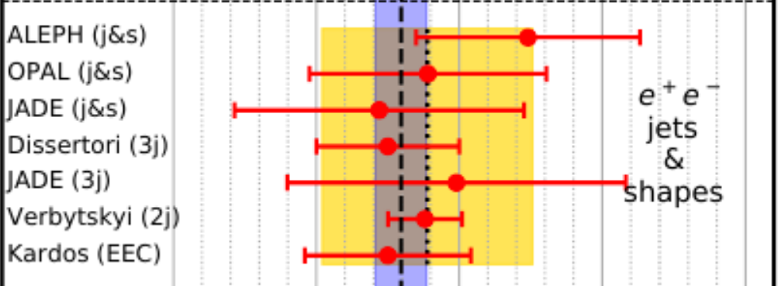
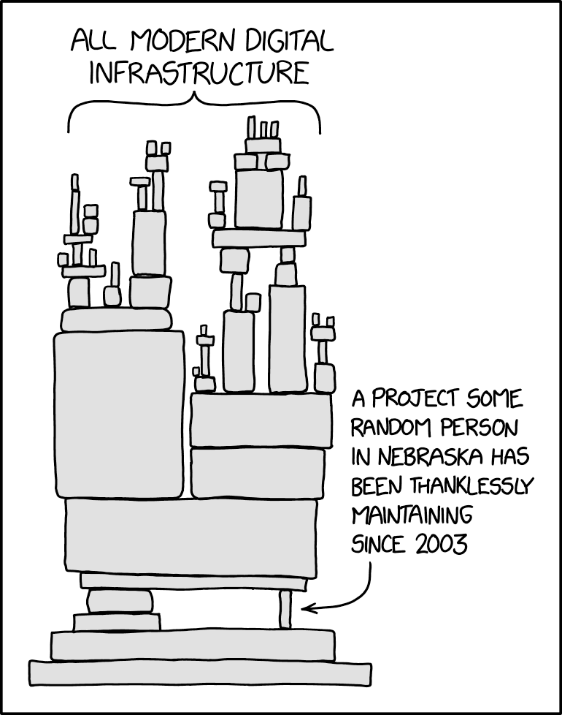
Learn from disasters
All theory calculations
Theory efforts for muon g-2 (colorized)
Not our finest hour, either…
Parton showers, perturbation theory,…
It is difficult to tell whether a theoretical tool is actually under control
Redundancy! Analytic resummation, Lattice, ML?,…

Slide 14

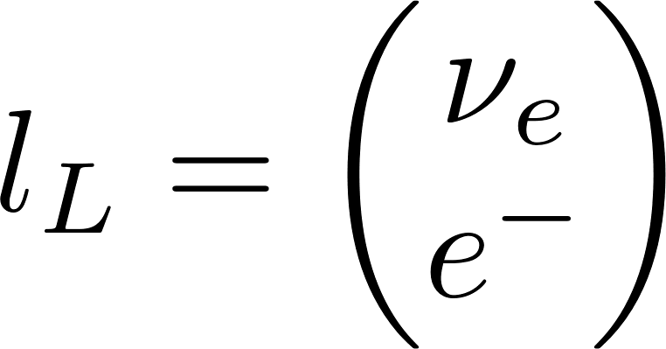
Electroweak physics
There is dissatisfaction with how electroweak physics is treated:
“We do QCD, EW effects are somebody else’s problem”
“Just treat it like QCD”
Something better is needed EW Sudakov effects, EW PDFs, EW final states,…
e.g.

Slide 15
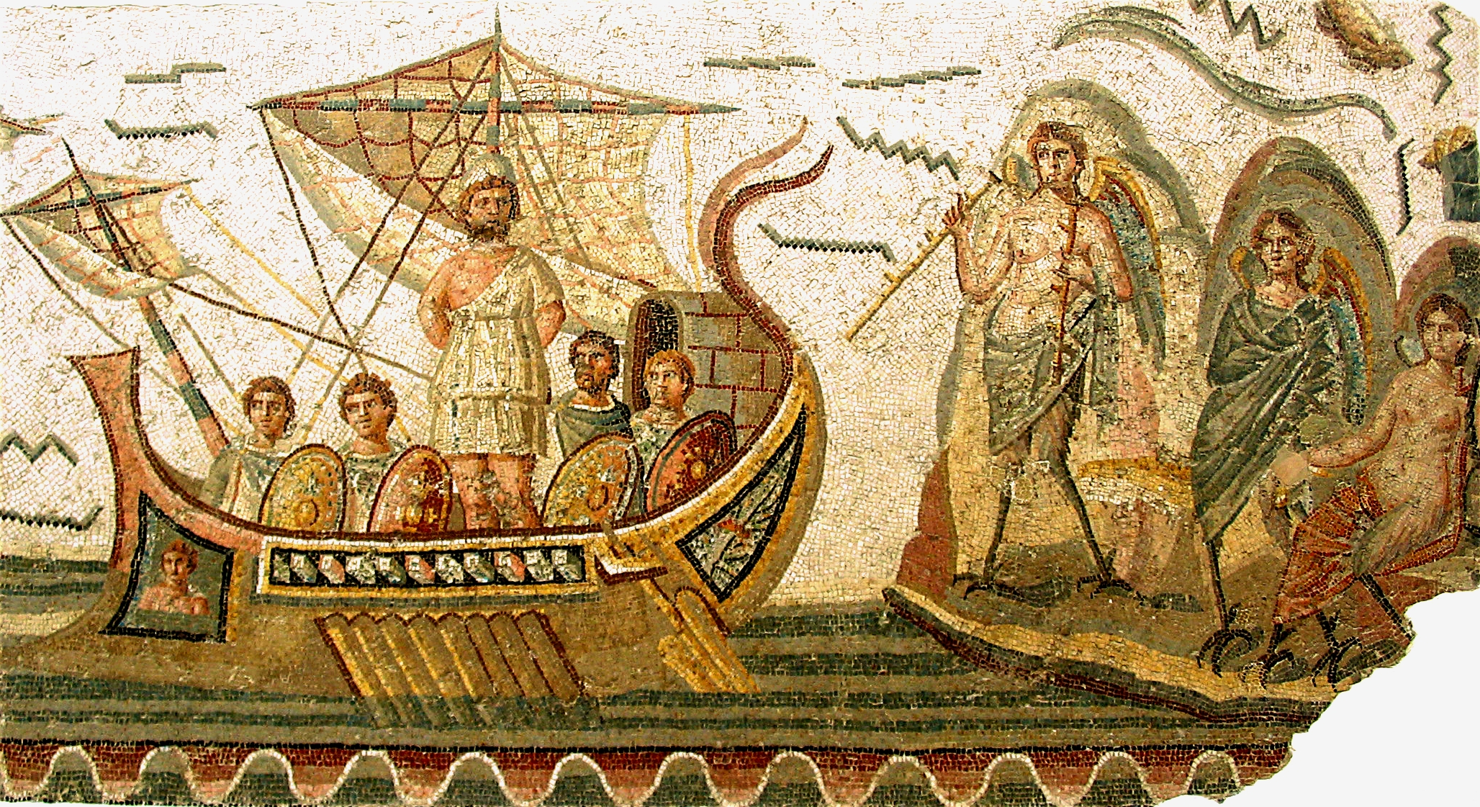
Machine learning and computing
Observation: Vague on what ML can do for theory specifically
ML reproduces patterns, theory explains and provides patterns (ideally) Danger: ML missing vital physics if it’s not in the training data, e.g. Super Leading Logs
Computing: Generally not sustainable, maybe Quantum computing?

Slide 16
Summary
Precision is the wrong paradigm for the future
It’s the accuracy, stupid!
Data to refine and identify tools will be crucial
IR physics in high energy setting, mixed EW/QCD physics mentioned often

Slide 17

Thanks!

