Slide 1
Assessment of large-scale accelerator projects at CERN ESG WG2a key findings
G. Arduini – CERN
Acknowledgements: WG2a members

Slide 2
Mandate
Comparison of the technical readiness and an assessment of the time and cost estimates of the various accelerator projects proposed as the next flagship accelerator at CERN.
The technical assessment should address:
The presented technical readiness and timescales of each machine (R&D, construction steps and schedule, uncertainties)
Assessment of the uncertainties in the presented cost estimates (FCC-ee costing assumptions as a reference).
Uncertainties on machine performance (luminosity and any other relevant parameter), required developments and risks associated if not achieved
The accelerators to be assessed are those that have submitted to the ESPP explicit machine proposals (in alphabetical order): CLIC, FCC-ee/FCC-hh, LCF, LEP3, LHeC, and Muon Collider.

Slide 3
Composition
Gianluigi Arduini (CERN – convener)
Frederick Bordry (CERN – co-opted acc. expert)
Reinhard Brinkmann (DESY, DE – co-opted acc. expert)
Phil Burrows (Oxford/JAI, UK – convener)
Klaus Desch (U. Bonn, DE)
Sinead Farrington (STFC-RAL, UK)
Fabiola Gianotti (CERN)
Kazunori Hanagaki (KEK, JP)
Norbert Holtkamp (SLAC, USA – co-opted acc. expert)
Jacqueline Keintzel (CERN – Sc. Secr.)
Ben Kilminster (U. Zurich – CH)
Tadeusz Lesiak (IFJ PAN, Krakow, PL)
Leonid Rivkin (PSI,CH – co-opted acc. expert)
Franck Sabatié (IRFU, CEA, F)
Mike Tuts (Columbia U., USA)
Antonio Zoccoli (INFN, IT)

Slide 4
Future Colliders Comparative Evaluation
Working group established by CERN Directorate in June 2023, involving Project Leaders of main projects and other experts
Membership: G. Arduini, M. Benedikt, F. Gianotti, K. Jakobs, M. Lamont, R. Losito, M. Meddahi, J. Mnich, N. Mounet, D. Schulte, F. Sonnemann, S. Stapnes, F. Zimmermann
Goal: compare FCC and alternative scenarios in a consistent way, using common assumptions and methodology, in view of the ESPP Update 2026
Deliverables:
Summaries of FCC-ee and alternative options for implementation at CERN
Metrics for comparison
Comparative evaluation of the potential options for realization at CERN
Credible and consistent timelines for implementation and time to first physics
Working Group report submitted as input to ESPP2026 on 26/5/2025
https://indico.cern.ch/event/1439855/contributions/6542430/

Slide 5
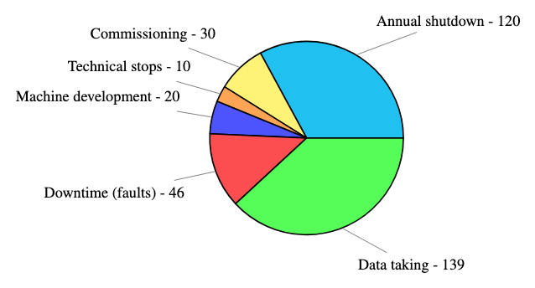
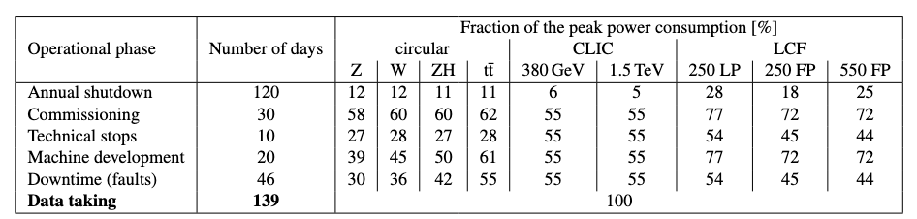
Performance comparison
Common assumptions for the operational scenarios for e⁺/e⁻ colliders
integrated luminosity estimate per year (summed over all IPs)
electricity consumption per year, knowing the peak wall plug power and the fraction used during each operation phase, provided by the projects.
Contributed to standardise/normalise the input provided by the projects to the ESPP2026

Slide 6
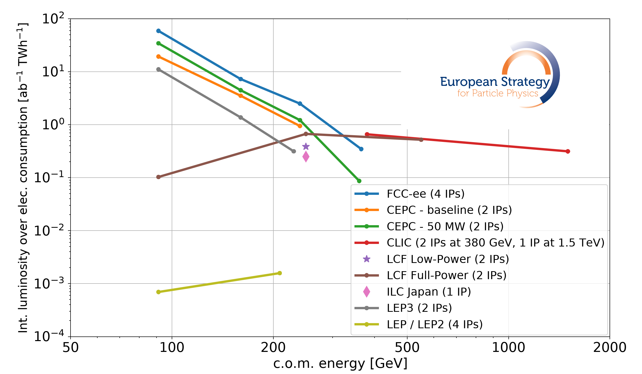
Performance comparison (e⁺/e⁻ colliders)
Circular colliders (CC) are more efficient than Linear Colliders (LC) at energies up to at least 300 GeV. Note the improvement w.r.t. LEP/LEP2
LC (CLIC) can reach the O(TeV) region (no synchrotron radiation loss)
CC can accommodate more experiments operating in parallel
FCC-ee collision energy can be varied between 90 and 240 GeV seamlessly at unparalleled luminosity.
LC baselines include polarized e⁻ beam. For LCF e⁺ too.
LEP3 proposal still at pre-conceptual design level: larger uncertainty on luminosity, power consumption
ID281
Notes:
FCC-ee energy flexibility is reduced after the upgrade for operation at the highest energy
and operation at lower energy will be possible, albeit at lower luminosity.

Slide 7
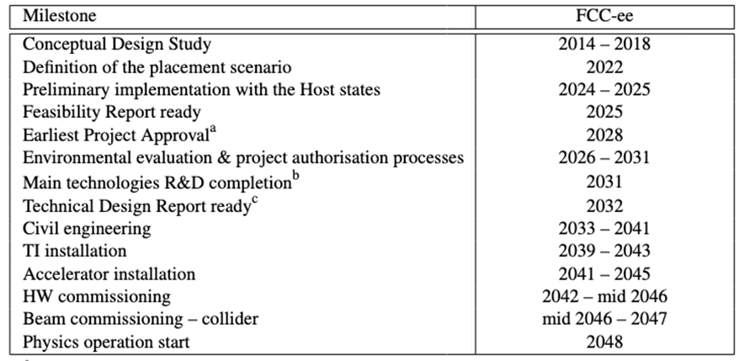
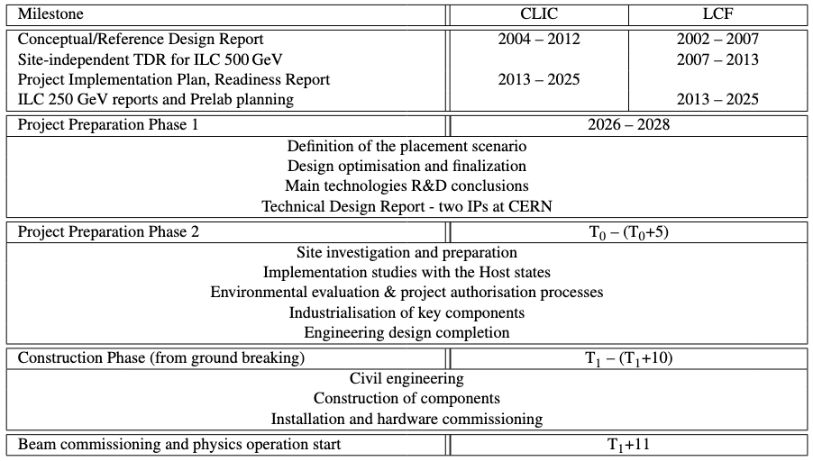
Project timeline
Financial and personnel commitments for HL-LHC operations imply that a future collider cannot realistically start operation before mid 40s
FCC feasibility study completed and detailed timeline established considering the above constraints
CLIC, and particularly LCF@CERN, would require a preparation phase (with corresponding resources) to reach a level of detail comparable to the FCC FS ➔ Difficult to conduct two territorial implementation studies in parallel in the Host States
CLIC/LCF: only relative timelines with respect to decision points (and considering the above constraint)
Notes:
For CLIC & LCF, timeline depends on several dates which will be defined later:
T₀ is determined by a process in 2028-29 to validate the progress and promise of the project for a further development towards implementation.
T₁ for Preparation Phase 2 will be determined by the processes needed, by the CERN Council and with host-states, for project approval and to start construction.

Slide 8
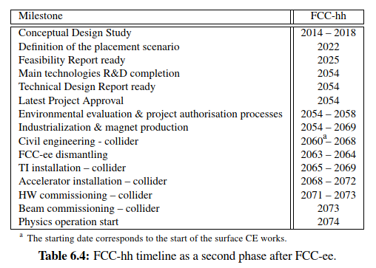
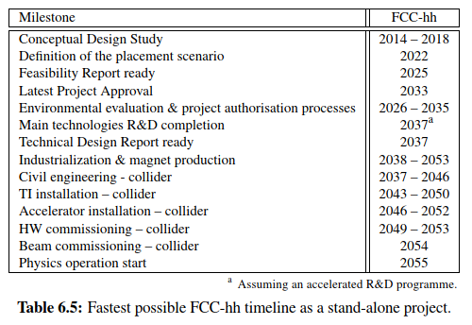
Project timeline
As a 2nd phase after FCC-ee, FCC-hh could start operation in mid 2070s
On a technically-limited timescale (assuming accelerated R&D) a stand-alone FCC-hh with 14 T Nb₃Sn dipoles could start operation around mid 2050s

Slide 9
Re-use of the LHC tunnel
General considerations:
major infrastructure investments and operating costs
delay of the implementation of a next-generation collider by at least one decade
cannot be considered as “bridge” options but as alternative to other proposed colliders

Slide 10
WG2a: Methodology
Projects’ assessment based on:
Scope level-of-definition
Technical Readiness Level of major sub-systems
R&D
Test facilities/demonstrators
Performance uncertainty
Site preparation status
Schedule uncertainty
Cost uncertainty
Risk level-of-definition
The scope of a project is a detailed description of all the goals, objectives, tasks necessary for successful project completion.
Required R&D, R&D plan level of definition, funding status
Need of new major test facility and its scope level of definition
Notes:
The scope of a project is a detailed description of all the goals, objectives, tasks necessary for successful project completion.

Slide 11
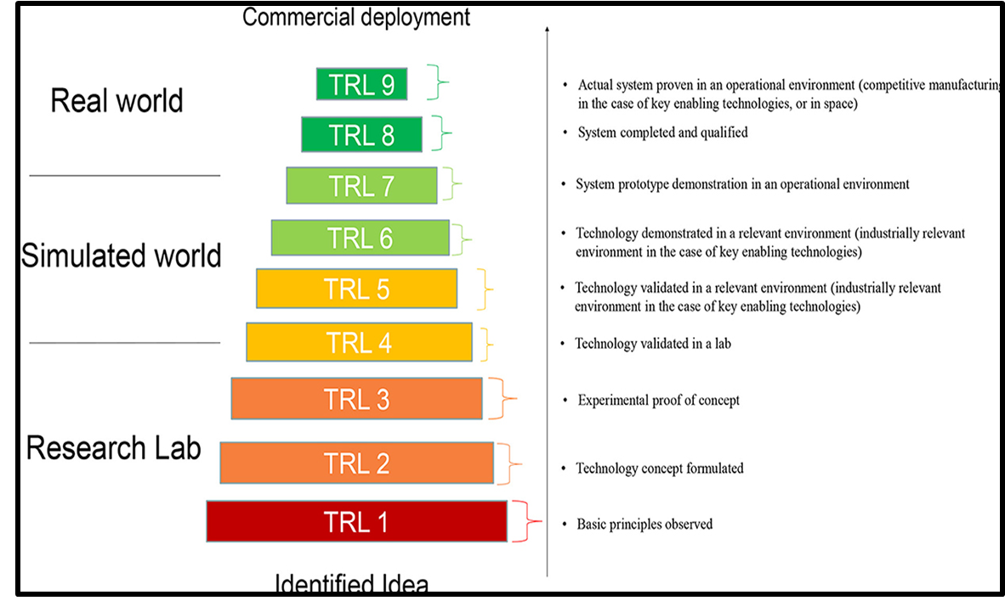
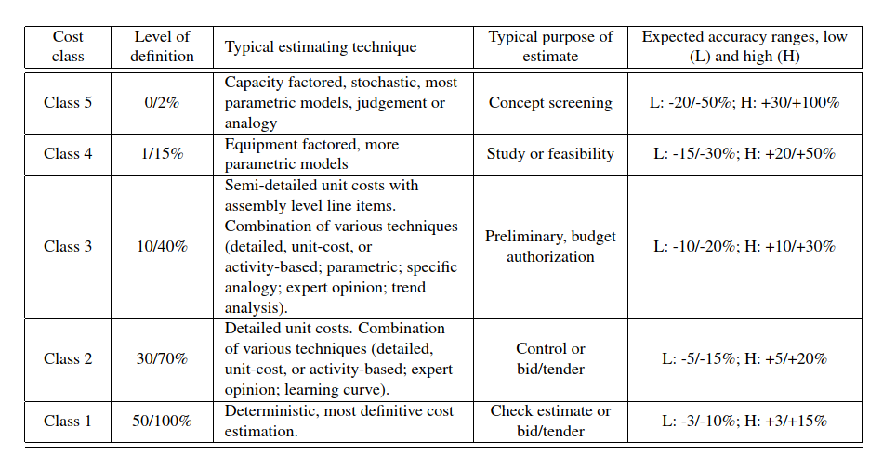
WG2a: Methodology
Technical Readiness Level: a standardized 9-level scale to measure how mature and deployment-ready a technology is — from concept (TRL 1) to fully operational (TRL 9)
Cost-weighted average of the TRL scores of the main subsystems considered to define the colour code.
Performance uncertainty: defined 3 ranges of luminosity uncertainty factors (<3, >3 and <10, >10)
Cost Uncertainty: AACE® (Association for the Advancement of Cost Engineering) International cost estimate classification matrix
Notes:
TRL provides and idea of the required R&D to reach maturity. The larger the cost of the sub-systems and larger is the cost risk associated for the project

Slide 12
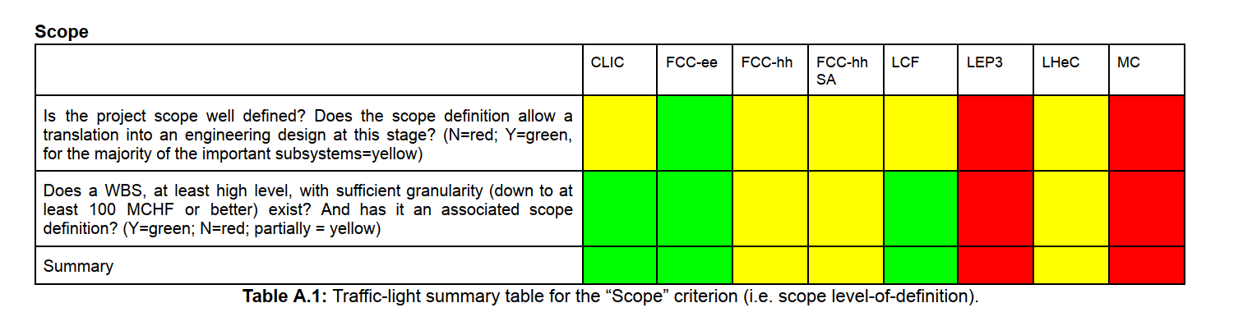
WG2a: Methodology
For each criterion:
a set of questions have been addressed
a “traffic light” colour code associated to the answers
Summary colour code are provided for each of the criteria considered
based on the information submitted to the ESPP2026 and/or made available by the proponents in reply to a questionnaire sent to them
The assessment refer to the present status of the projects

Slide 13
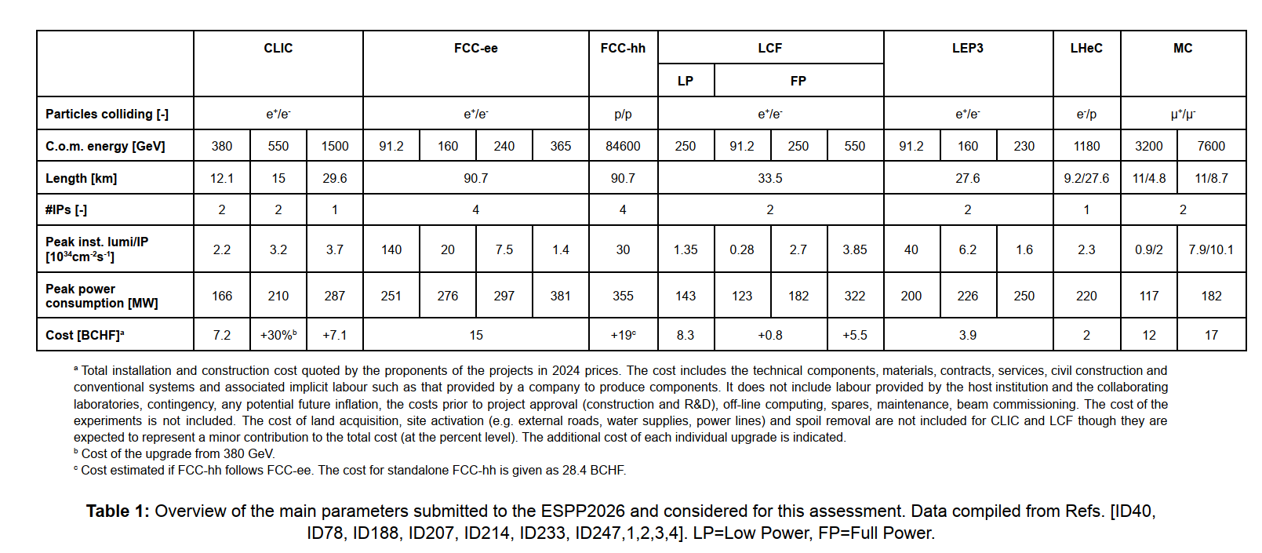
Parameters considered

Slide 14
Compact Linear Collider (CLIC) 380 GeV/1.5 TeV
ID78
ID78
Based on the Two-Beam Acceleration Concept:
12 GHz RF power extracted from High intensity lower energy beam (decelerated) to accelerate lower intensity main beam to high energy ➔ Proof of Concept at CTF3
High gradient (70-100 MV/m) ➔ More compact accelerator
Lower current (limited by wakefields, power consumption) as compared to SRF LC
Recent doubling of repetition rate and two IPs sharing the available beam
12.1 km for 380 GeV/29 km for 1.5 TeV

Slide 15
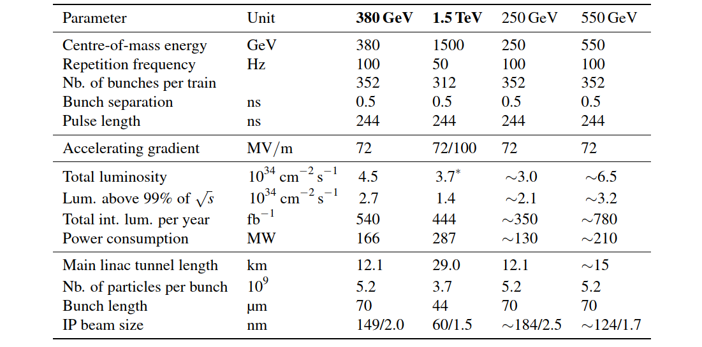

CLIC design parameters
$$L∝\frac{N_{b}P_{beam}}{γσ_{x}^{∗}σ_{y}^{∗}}H_{D}$$
ID78
1.5 TeV ➔ longer tunnel
Operation at lower energies possible only at lower luminosities
Lower rep. rate as compared to circular colliders (kHz)
Tight bunch spacing – short pulses – bunch-by-bunch IP feedback difficult
No SR losses but significant beam power continuously damped
Small beam size to compensate for lower current/low rep. rate
e⁻ beam polarization (±80%)
7.24 BCHF (380 GeV) + 7.1 BCHF (1.5 TeV)

Slide 16
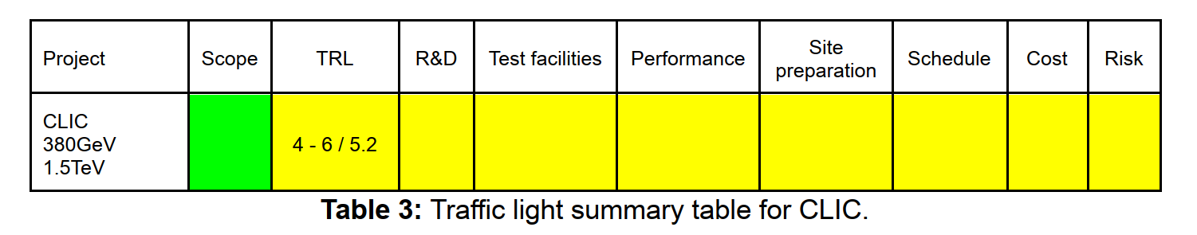
CLIC
Scope level-of-definition: CLIC design pursued for several decades and is mature ➔ scope is well defined
TRL, R&D, Prototype/Test facility:
Proof of principle of Two-Beam-Acceleration at CTF3 though efficiency of the process partly validated and on a small scale as compared to CLIC ➔ larger scale demonstration necessary (more RF modules, longer pulses, etc).
Validation studies for the Final Focus System (FFS) ➔ continued operation and upgrades of the ATF2 test facility at KEK needed
R&D requirements:100 MCHF and 570 FTEy for preparation to construction (not including extended test facility) ➔ only partly funded
Performance uncertainty: Performance level predicted by start-to-end simulations. Smaller beam size, larger impedance make CLIC more challenging than LCF (larger uncertainty on luminosity – factor 3 to 10). Break-down rates to be demonstrated for 100 MV/m operation required for 1.5 TeV
Notes:
CTF3 has achieved 50% energy extraction form 25 A beam transported over less than 20 m while CLIC is aiming for 90% energy extraction from 100 A drive beam transported over 880 m.
~ 140 us times two for the 3 TeV CLIC version, 48 us for the present 380 GeV version, 1.4 us in CTF3
Chromaticity for FFS not tested at ATF2 (design even more challenging than LCF). IP feedback cannot act bunch to bunch due to small bunch spacing.

Slide 17
CLIC
Site preparations status: territorial implementation studies (including detailed site/geological investigations) necessary to confirm placement of tunnels and surface facilities.
The orientation/depth of the tunnel is determined by the maximum energy:
3 TeV in principle possible (50 km) ➔ power consumption would approach 600 MW
Schedule uncertainty: schedule is well understood but uncertainties on:
Demonstration of TBA scheme at a larger scale
production, quality control, acceptance tests of ~20000 (UP machining) structures challenging
assume conditioning of the structure in the tunnel once the machine is built
Cost uncertainty: Sufficiently fine granularity. Major sub-systems in Class 3-4. No experience in large scale production.
Risk level-of-definition: Main risks analysed. Formal risk management plan would be prepared in the next phase
Notes:
UP ultra precision

Slide 18
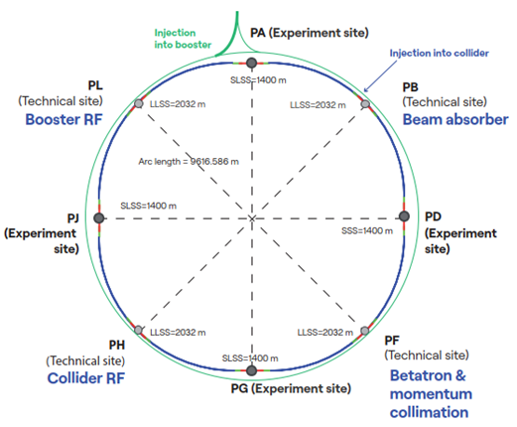
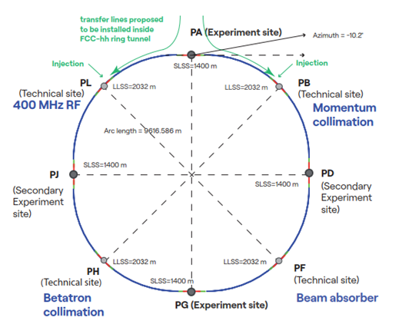
FCC integrated programme
Stage 1: FCC-ee
90 ➔ 365 GeV e⁺e⁻
Stage 2: FCC-hh
(~85 TeV, 14 T)
2046 - 2065
2070 - 2100
90.7 km circumference
Common civil engineering and technical infrastructures

Slide 19
FCC-hh standalone
FCC-hh
(~85 TeV, 14 T)
>2055 (if only technical considerations)
Dictated by magnet R&D and industrialization

Slide 20
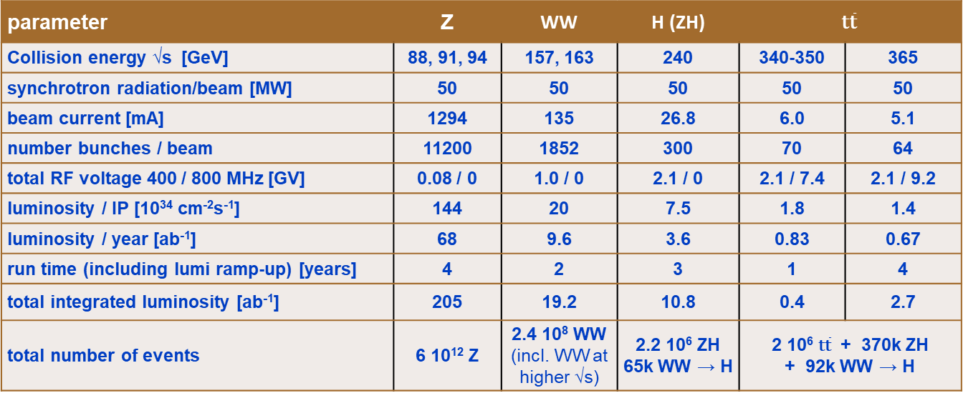

FCC-ee design parameters
ID233
$L∝$ $\frac{ρ}{β_{y}^{∗}}\frac{P_{SR}}{γ^{3}}$
parameter | Z | WW | H (ZH) | $$\text{t}\overline{\text{t}}$$
Collision energy √s [GeV] | 88, 91, 94 | 157, 163 | 240 | 340-350 | 365
synchrotron radiation/beam [MW] | 50 | 50 | 50 | 50 | 50
beam current [mA] | 1294 | 135 | 26.8 | 6.0 | 5.1
number bunches / beam | 11200 | 1852 | 300 | 70 | 64
total RF voltage 400 / 800 MHz [GV] | 0.08 / 0 | 1.0 / 0 | 2.1 / 0 | 2.1 / 7.4 | 2.1 / 9.2
luminosity / IP [10³⁴ cm⁻²s⁻¹] | 144 | 20 | 7.5 | 1.8 | 1.4
luminosity / year [ab⁻¹] | 68 | 9.6 | 3.6 | 0.83 | 0.67
run time (including lumi ramp-up) [years] | 4 | 2 | 3 | 1 | 4
total integrated luminosity [ab⁻¹] | 205 | 19.2 | 10.8 | 0.4 | 2.7
total number of events | 6 10¹² Z | 2.4 10⁸ WW (incl. WW at higher √s) | 2.2 10⁶ ZH 65k WW → H | 2 10⁶ $\text{t}\overline{\text{t}}$ + 370k ZH + 92k WW → H
Large energy span at high luminosity
Limited by electricity consumption
Many bunches, high current, like LHC and B factories, different from LEP
Large RF system to compensate for SR loss and cover large intensity/energy range
High luminosity with Crab waist collision scheme demonstrated at DAΦNE and SuperKEKB
Requires top-up injection (SR sources, existing e+/e- colliders) high machine availability/system reliability
Power consumption 250-380 MW
15 BCHF
Notes:
Power consumption ranging from 251 MW to 381 MW

Slide 21
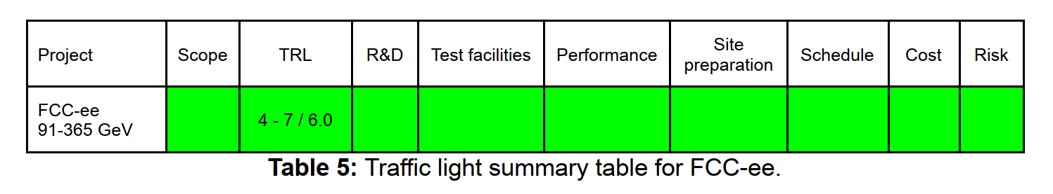
FCC-ee
The FCC Feasibility Study has been reviewed by expert committees, CERN Council and its subordinate bodies. Recommendations made after the mid-term review implemented.
Scope level-of-definition: substantial detail with well-developed WBS
TRL:
Collider/booster have a high TRL level because of the mature technologies generally used, CE risks understood and partially carried in the project as actual cost
Injector designs were recently updated and are mature
Lower-level systems (SRF, photon beam dumps, etc) have lower TRL but lower cost too
R&D and test facility demonstrator:
Plan well defined and reviewed. The resources to complete preparatory activities prior to construction start in 2033: 200 MCHF and 900 FTEy. Funding for a pre-TDR phase has been identified in the CERN Medium Term Plan (MTP).
No new demonstrator/test facility required. Past and operating e⁺/e⁻ colliders and light sources provide valuable experience
Notes:
Pre-TDR funding is the only case where this has been done.

Slide 22
FCC-ee
Performance uncertainty:
high current, crab-waist scheme, very small β* demonstrated at PEP-II / KEKb / SuperKEKb, experience from LEP/LEP2 provide guidance for beam-beam limits at similar range of energies
Realistic to expect uncertainty lower than factor 3 in luminosity and ramp-up < 5 years
Site preparation status: thorough territorial implementation study. Geological investigations well advanced
Schedule uncertainty: credible schedule with risks inherent to a large construction project (as for the others..)
Cost uncertainty: extensively reviewed ➔ Overall cost uncertainty at Class 3. Sound for this stage of the project. Cost estimate stable and uncertainty reduced (as compared to mid-term review)
Risk level-of-definition: Formal risk management plan for the construction phase available and regularly being updated/evaluated. Major uncertainties and risks identified and mitigation strategies in place.
Notes:
The cost estimate went from 14 976 MCHF to 15 282 MCHF and the uncertainty estimate decreased from 121% to 117%.
Territorial implementation ongoing with very good collaboration with the host states.

Slide 23
FCC-hh design parameters
ID247
parameter | FCC-hh | HL-LHC
collision energy cms [TeV] | 85 | 14
dipole field [T] | 14 | 8.33
circumference [km] | 90.7 | 26.7
beam current [A] | 0.5 | 1.1
synchr. rad. per ring [kW] | 1200 | 7.3
peak luminos. [10³⁴ cm⁻²s⁻¹] | 30 | 5 (lev.)
events/bunch crossing | 1000 | 132
stored energy/beam [GJ] | 6.5 | 0.7
integr. luminosity / IP [fb⁻¹] | 20000 | 3000
Unprecedented energy
High Field SC magnets
LTS/HTS
High SR power intercepted at 40-60 K
“almost” a lepton machine
Challenge for the experiments
Machine protection!
Power consumption 355 MW
19 BCHF as second phase/28.4 BCHF as stand-alone

Slide 24
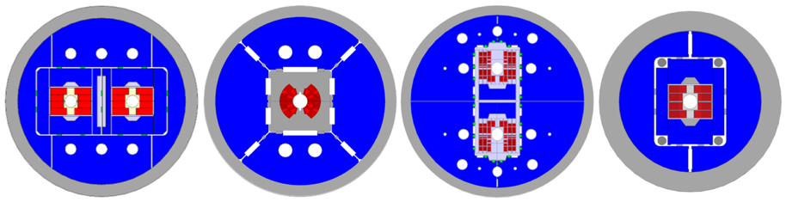
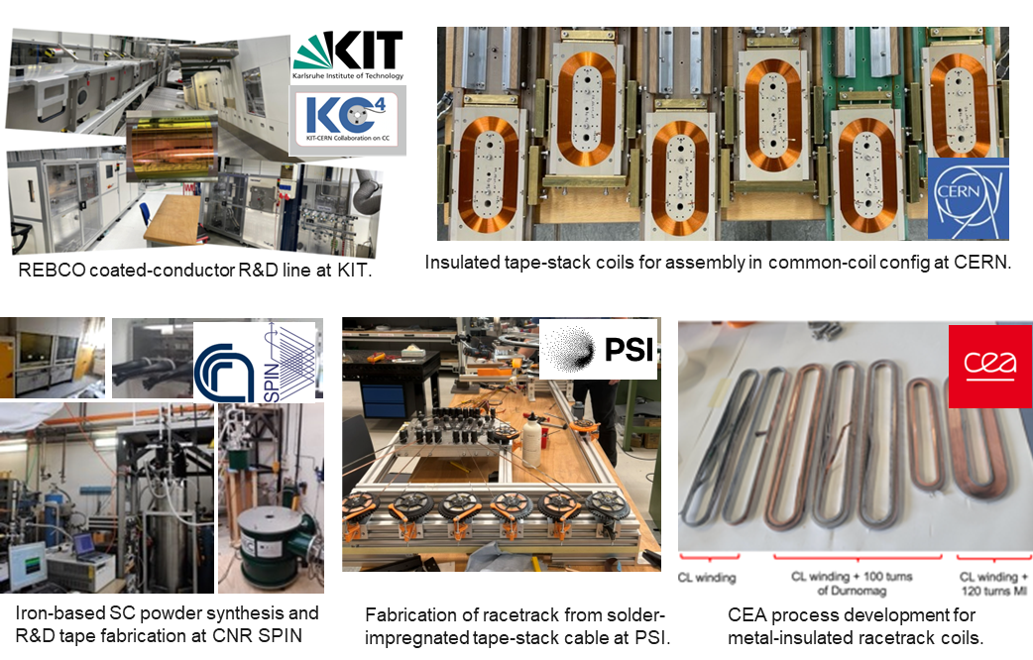


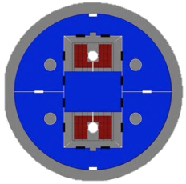



LTS and HTS R&D ongoing
Nb₃Sn:
12- and 14-T short demonstrators
different coil geometries
tests scheduled for 2026
HTS R&D in various domains:
ReBCO and IBS Conductor R&D
racetrack coil developments
Operation at higher field and/or temperature
Notes:
Rare-earth barium copper oxide
IBS: Iron-based Superconductor

Slide 25
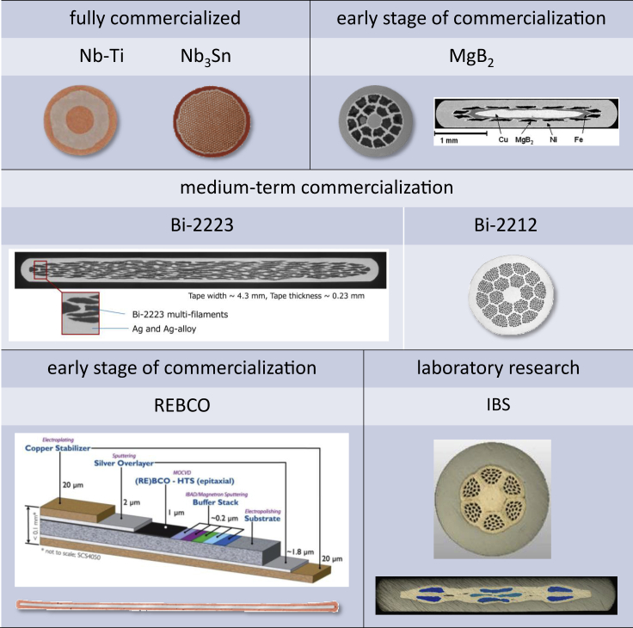
LTS/HTS conductors
ReBCO is produced as a flat tape 4-12 mm wide
Screening currents, which are induced in all types of conductors during a magnet ramp, increase with the major dimension of the superconductor.
Keeping ramp losses low and achieving good, stable, and reproducible field quality during injection, ramp, and physics is more challenging with ReBCO tapes than other conductors with smaller filament sizes (Nb-Ti: 5μm, Nb₃Sn:50 μm).

Slide 26
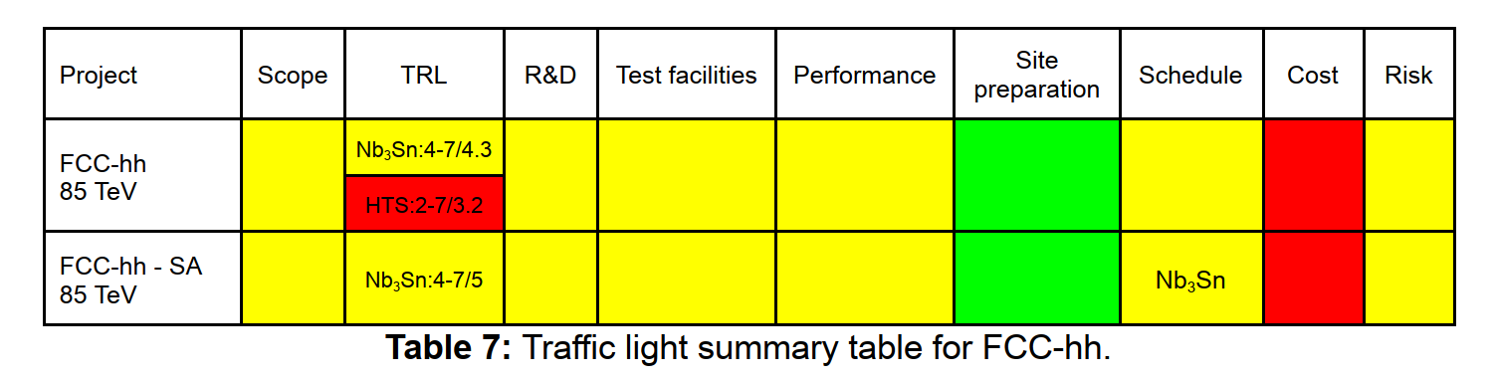
FCC-hh
Scope level-of-definition: sufficiently detailed for most of the subsystems in the baseline configuration (Nb₃Sn)
TRL: lowest values for collider dipole magnets and for the injector chain (to be defined based on the FCC-hh magnet technology). HTS option has a lower TRL.
R&D: ongoing for Nb₃Sn magnets but no industrialisable design for at least 15-20 years. HTS approach actively pursued but likely on a 10-year longer timescale, with higher risk at this stage. HFM programme ongoing
Performance uncertainty: extensive LHC experience ➔ luminosity achievable within a factor <3 ➔ levelling scenario (pile-up, SR power, beam-beam, other) to determine exact integrated value. Energy (85 TeV achievable) and power consumption have uncertainties depending on the magnet technology.
Site preparation status: benefit from the work done for FCC-ee (limited additional CE)
Notes:
Beam dump lines and transfer lines are the additional CE + surface buildings for assembly of major detectors (2 assumed) for which space reservation has been made.

Slide 27
FCC-hh
Schedule uncertainty:
technically limited schedule determined by the readiness of the dipoles: earliest commissioning is 2050-55 with Nb₃Sn magnets and 2060-2070 with HTS
Cost uncertainty: Dominant uncertainty from the magnet cost (Class 5)
Risk level-of-definition: risk management plan partially developed (as compared to FCC-ee)
As a standalone project risk and uncertainties associated with CE similar to those for FCC-ee. Dipole development would be based on the Nb₃Sn technology. HTS accelerator magnet technology not expected to be available for commissioning in 2050-55. 12 T option (73 TeV) could represent a lower cost pathway.
Notes:
No financial considerations here

Slide 28
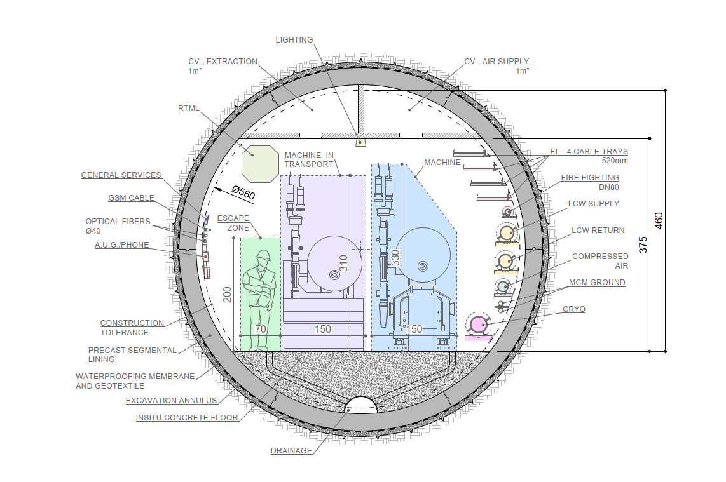
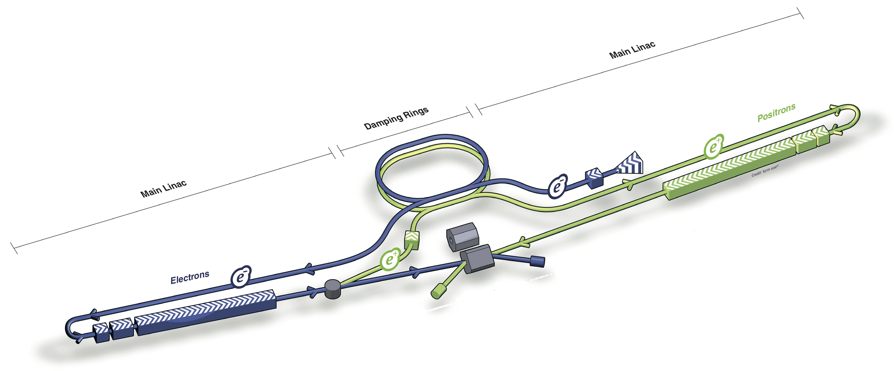
Linear Collider Facility (LCF) 250/550 GeV
ID40
Based on International Linear Collider design (250 GeV c.o.m. energy) considered for Japan but:
Double repetition rate: 5 ➔ 10 Hz (upgrade option to double number of bunches)
Two separate IPs sharing the available intensity
Longer (smaller diameter) tunnel (33.5 km) to accommodate extension to 550 GeV
High gradient 1.3 GHz Superconducting RF (31.5 MV/m) with Q₀=2×10¹⁰ (2×ILC specifications) @ 2K
Operational experience at Eu-XFEL, though at <70% of the LCF gradient
33.5 km

Slide 29
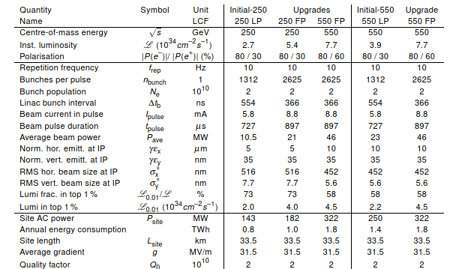
LCF
Operation at lower energies possible only at lower luminosities
Polarized e⁺/e⁻ beams
Lower rep. rate as compared to circular colliders (kHz)
nm beam size at the IP due to lower repetition frequency
No SR losses but significant beam power continuously damped ➔ e⁺ production, beam dump critical
8.3 BCHF (LP) + 0.8 BCHF (FP) + 5.5 BCHF (550 GeV – FP)

Slide 30
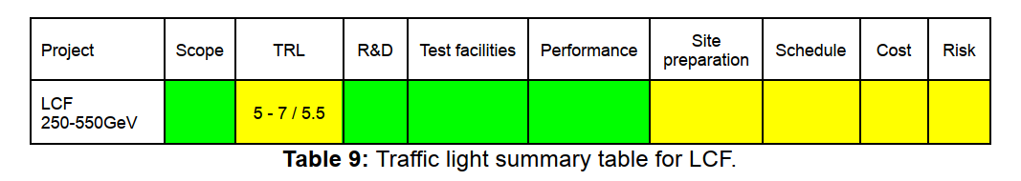
LCF
Scope level-of-definition:
based on the mature ILC design, though recent doubling IP number and more ambitious SRF cavity parameters. WBS is detailed enough to support translation into engineering designs for most systems. Lower gradient as compared to CLIC ➔ higher cost
TRL, R&D, test-facilities:
SRF cavities’ specifications, not yet demonstrated in operation ➔ R&D programme needed. Associated cost risk in case specs not achieved is within project cost uncertainties (for the 250 GeV c.o.m. energy scenario)
Polarized e⁺ source, beam dump, and RF modulators currently have the lowest TRLs
Final Focus System (FFS) to be further validated at ATF2 ➔ upgrades required
185 MCHF and 750 FTEy are necessary ➔ funding situation presently unclear
Notes:
The total of material and personnel (185+150 MCHF at 0.2 MCHF/FTEy) represent ~6% of the overall cost (excluding civil engineering)
RF modulators for tunnel installation are different from those for XFEL
Excluding ATF2 upgrade?

Slide 31
LCF
Performance uncertainty: detailed start-to-end simulations. Luminosity uncertainty < factor 3 (performance of the challenging e⁺ source, especially for the intensity/luminosity upgrade and machine availability concerns related to the tunnel geometry)
Site preparation status: Access points and possible interferences/synergies with existing surface infrastructure to be addressed. Geological investigations needed.
Schedule uncertainty: Credible schedule, based on SRF experience so far but project start uncertainty related to funding for R&D and preparation phase.
Cost uncertainty: credible estimate, based on ILC cost update. Major sub-systems in Class 3-4. CE has largest cost uncertainty (Class 4).
Risk level of definition: risk management plan for the construction phase not yet available. Analysis of the major risks conducted and main mitigation strategies defined.
Notes:
CE cost uncertainty possibly followed by tech infrastructure given the change in tunnel diameter.

Slide 32
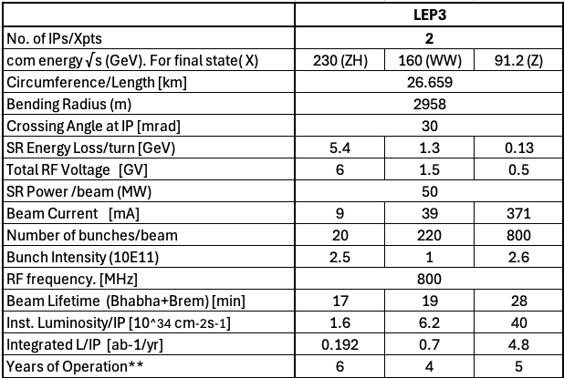
Possible reuse of the LHC tunnel LEP3
ID188
2 experiments as compared to 4 for FCC-ee
Limited to 230 GeV c.o.m. energy
Pre-conceptual design not yet validated by simulation studies ➔ extrapolation from FCC-ee (including injectors) and earlier preliminary studies (2017)
SC (HTS) magnets (quadrupoles/sextupoles), large SRF system and high-energy booster installed in the same tunnel of the collider ➔ integration studies to assess extent of CE
1/3.4 ρ/circumference of FCC-ee
1/3.4 of FCC-ee current
1/5-1/3 of FCC-ee luminosity/IP
Power consumption 200-250 MW
3.9 BCHF

Slide 33
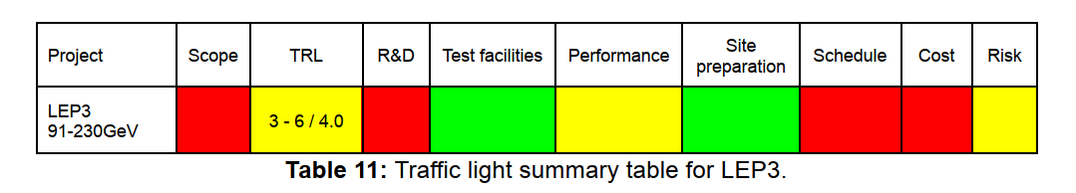
LEP3
Scope level-of-definition: scope only partly defined due to the early phase, cannot be translated into a complete engineering design at this stage.
TRL, R&D, Prototype/Test facility:
Baseline HTS nested quadrupoles/sextupoles ➔ lowest TRL components ➔ critical for achieving the desired performance, in terms of both luminosity and power efficiency. Several other components (SRF) require specific adaptation from FCC-ee design
No major new test facilities needed
Further definition of the project scope required (need 25 MCHF and 40 FTEy for a CDR) ➔ Necessary step to detail R&D programme, timeline, resources required for a full engineering design
Performance uncertainty: Extensive experience with circular colliders exists ➔ moderate confidence in the feasibility but absence of a detailed lattice design and full-scale simulations introduces significant uncertainty in nominal luminosity (>3 and <10), time to reach it and power consumption.

Slide 34
LEP3
Site preparation status: Reusing the LHC tunnel, injectors on the Prévessin site ➔ minimum territorial implementation studies required
Schedule uncertainty:
lack of a CDR/detailed WBS ➔ schedule only outlined
dismantling and disposal of LHC/HL-LHC equipment (especially components with high radiation levels such as collimators, dumps, and experimental insertion devices) ➔ Implications for the possible reuse of the LHC as an injector for FCC-hh.
uncertainty on the R&D progress
Cost uncertainty: difficult to assess due to the early phase of the study (CE work, disposal and storage of LHC equipment, HTS magnet design and cryogenics, technical infrastructure modifications/consolidation require further analysis at this stage)
Risk level-of-definition: no formal risk management plan for the construction phase, some risks have been identified and potential mitigation measures outlined

Slide 35
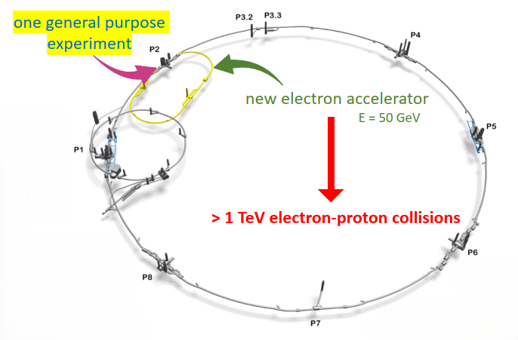

Possible reuse of the LHC tunnel LHeC
ID214
Schematic view
Beam Energy [GeV]
Luminosity [10³⁴cm⁻²s⁻¹]
Normalized emittance γε_{x,y} [μm]
Beta Function β∗_{x,y} [m]
rms Beam size σ∗_{x,y} [μm]
Beam Current @ IP [mA]
Bunch Spacing @ IP [ns]
Bunch Population [10¹¹]
Bunch charge [nC]
LHeC
p | e⁻
7000 | 50
2.3
2.5 | 20
0.07 | 0.1
4 | 4
1100 | 50
25 | 25
2.2 | 0.078
35 | 1.24
$\sqrt{s}$=1.18 TeV
1/3 LHC circumference
2.5 GW beam power
2.5 GW beam power
HL-LHC – 7 TeV
HL-LHC proton beam parameters
50 mA e⁻ current
Power consumption 250 MW (LHC injectors excluded)
~2 BCHF
Notes:
A rather detailed cost estimate was prepared in 2018 and benchmarked against comparable accelerator projects. This estimate has not yet been reviewed and has been extrapolated to 2024 values considering the European Union (EU) domestic Producer Price Index (PPI) and the EUR/CHF exchange rate evolution.

Slide 36
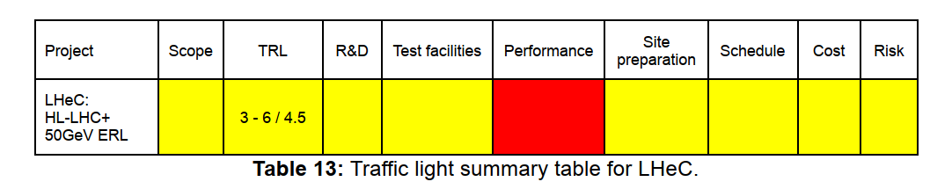
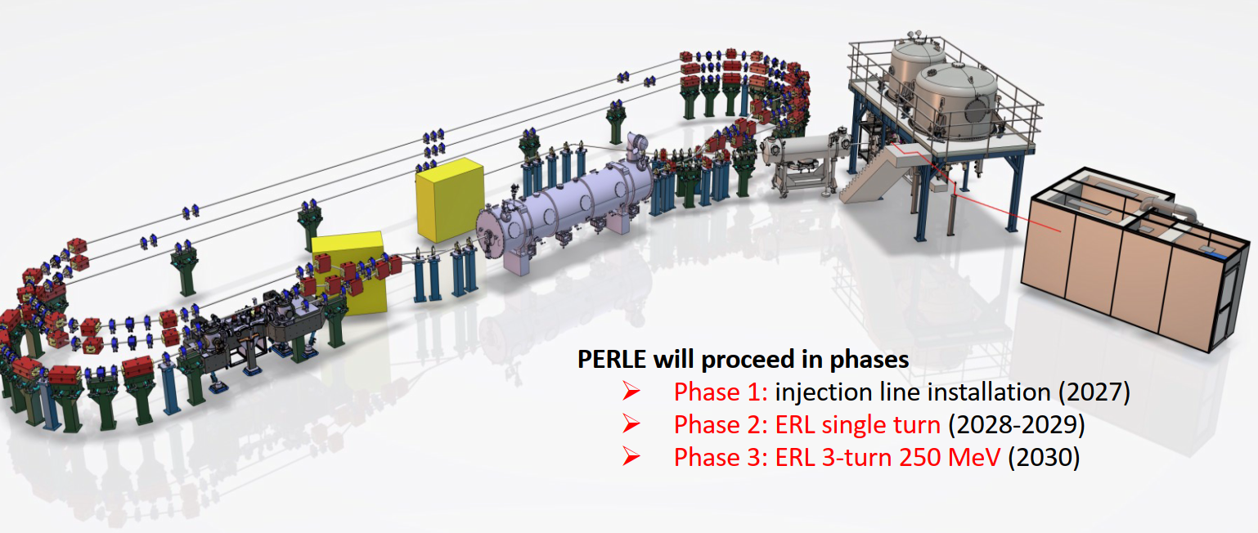
LHeC
Scope level-of-definition: LHeC design developed over past decade ➔ advanced conceptual stage, but no detailed WBS at present
TRL, R&D, test-facilities:
Three-pass recirculation/energy recovery at high current/energy (~2.5 GW beam power) with ppm losses
Need demonstrator of this key LHeC element ➔ PERLE (Powerful Energy Recovery Linac for Experiments) being built at IJCLab - Orsay
46 MEUR and 328 FTEy required, ~25% unfunded ➔ some uncertainty in the R&D timeline
89 MeV-20 mA
250 MeV – 20 mA
Notes:
3 orders of magnitude higher than presently achieved

Slide 37
LHeC
Performance uncertainty:
40% of the nominal LHeC beam current to be tested at PERLE. Impact of e⁻ beam disruption at IP on beam losses/energy recovery efficiency can’t be tested
absence of energy recovery ➔ current/luminosity reduction (> factor 10)
new beam dynamics regime might imply longer performance ramp-up
Site preparation status: modest territorial implementation work
Schedule uncertainty:
timeline can only be reliably established after the successful PERLE completion
potential interference between CE works and HL-LHC operations
Cost uncertainty: 2018 estimate (benchmarked with similar projects) ➔ extrapolation to 2024. Expect cost uncertainty class 3-4. Reliable update depends on PERLE results
Risk level of definition: No formal risk management plan for the construction phase, some key risks have been identified
Notes:
Arising from collisions with the high-brightness, high-rigidity LHC beam,
2024 data: updated considering main economic indicators

Slide 38
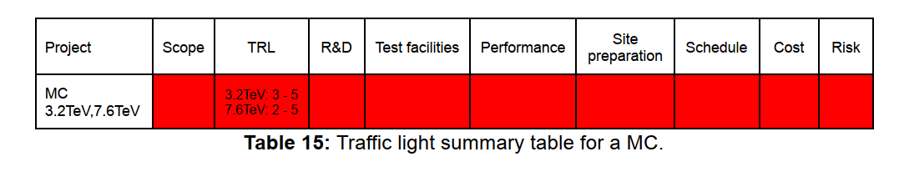
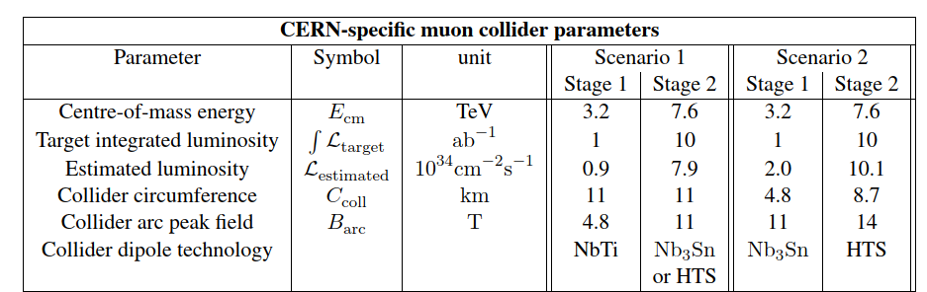
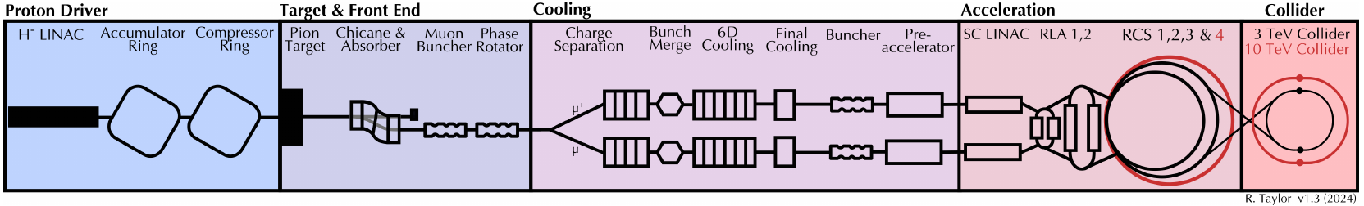
Muon Collider
ID207
Together with FCC-hh, promises a potentially energy-efficient path toward high-luminosity collisions at 10 TeV pCM.
Not yet the level of maturity of the other ESPP2026 Large-Scale Project proposals assessed by WG2a.
IMCC main focus: assessment of the key technological and operational challenges of a MC in preparation for a possible conceptual design study.
Scope level-of-definition:
Only a preliminary WBS has been developed, project scope cannot support translation into an engineering design, yet
Notes:
Parton centre of momentum

Slide 39
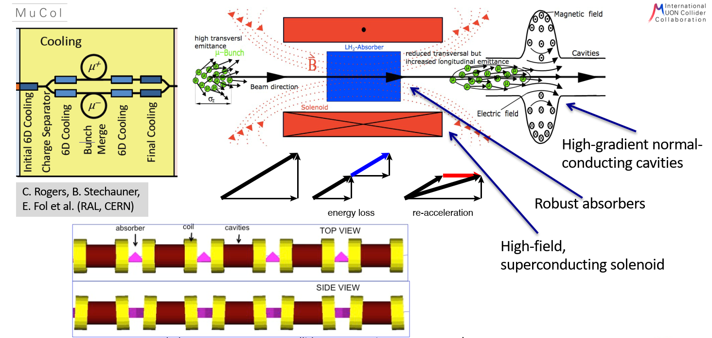
Muon Collider
TRL, R&D, test-facilities:
6D Cooling demonstrator is a crucial milestone
Ionization cooling provided by Low-Z wedge absorbers
Solenoid magnets to focus the beam at the absorber location
Warm RF cavities (20-30 MV/m) in strong magnetic field - O(10 T) - to restore the beam longitudinal momentum
O(km) length cooling channel
Quite a number of technological challenges
R&D roadmap developed (including 6D cooling demonstrator technology but no detailed scope definition for the test facility, yet) at least 300 MCHF and 1800 FTEy over ten years required
The above R&D is vital to answer key open questions
Notes:
From Interim report: https://arxiv.org/abs/2407.12450

Slide 40
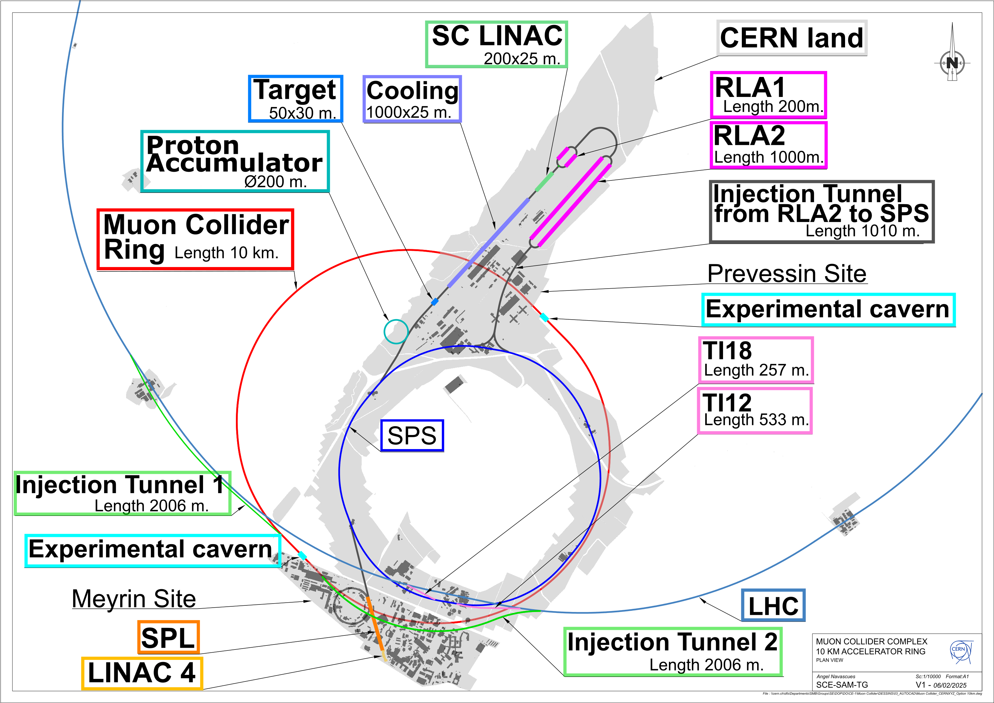
Muon Collider
Performance, schedule, cost: Realistic estimates appear not to be possible before R&D/demonstrator results are available.
Site preparation:
SPS and LHC tunnels could be reused for the Rapid Cycling Synchrotrons ➔ design and integration studies are necessary.
Ionizing radiation generated at distance by the large ν flux from muon decays is an issue and potential showstopper to be addressed for any selected location and in particular for those close to populated areas, as the CERN site.
Risk: No formal risk register/mitigation available but status for the various subsystems indicated. Comprehensive simulations tools are necessary to assess the design robustness.

Slide 41
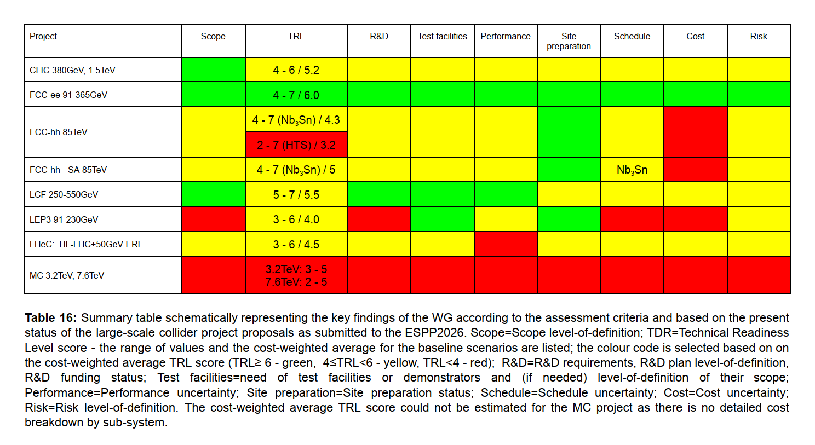
Summary SCHEMATIC assessment

Slide 43
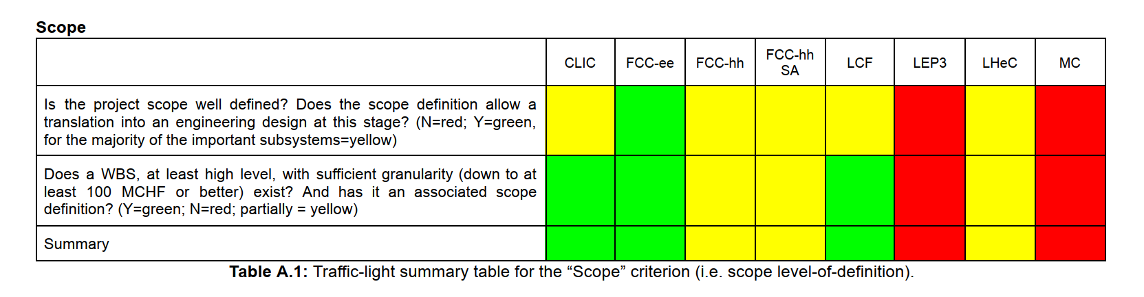
Scope

Slide 44
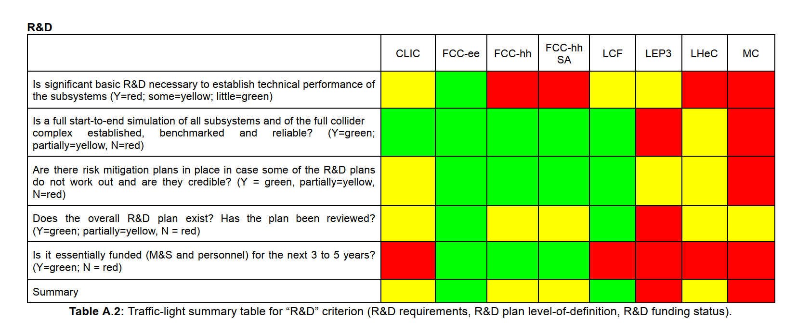
R&D

Slide 45
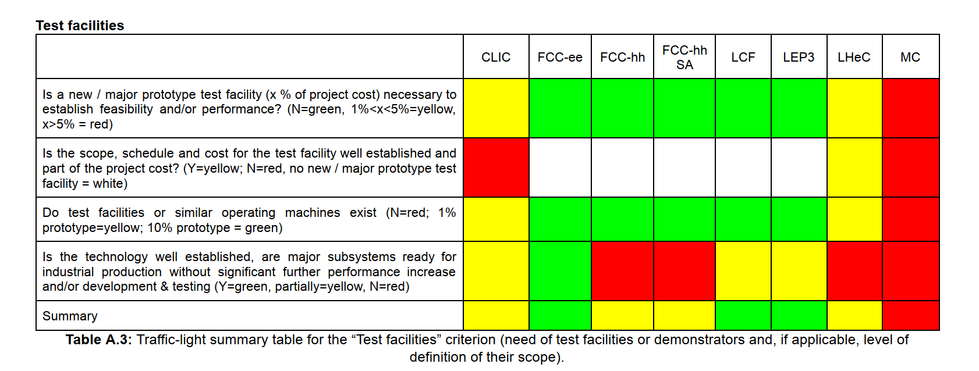
Test facilities

Slide 46
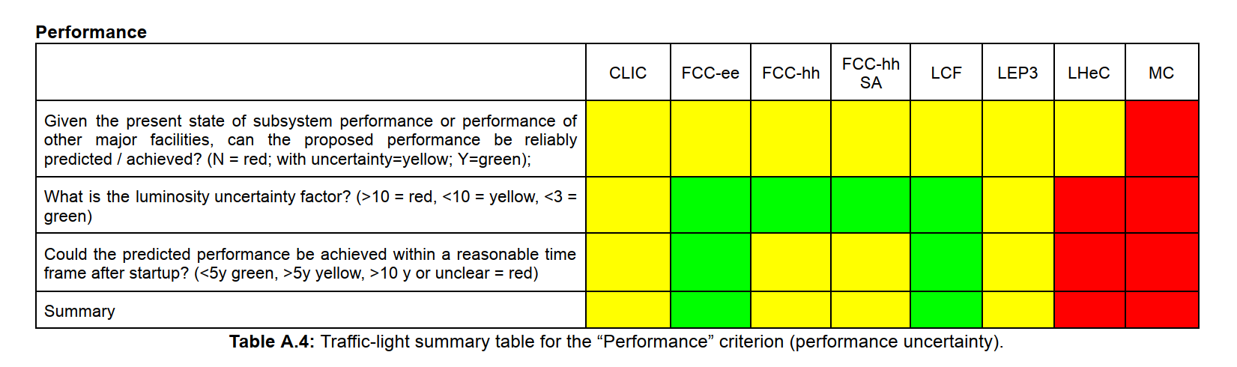
Performance

Slide 47
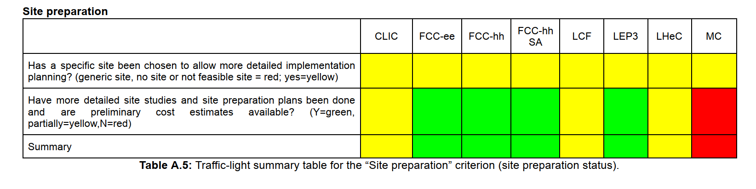
Site preparation

Slide 48
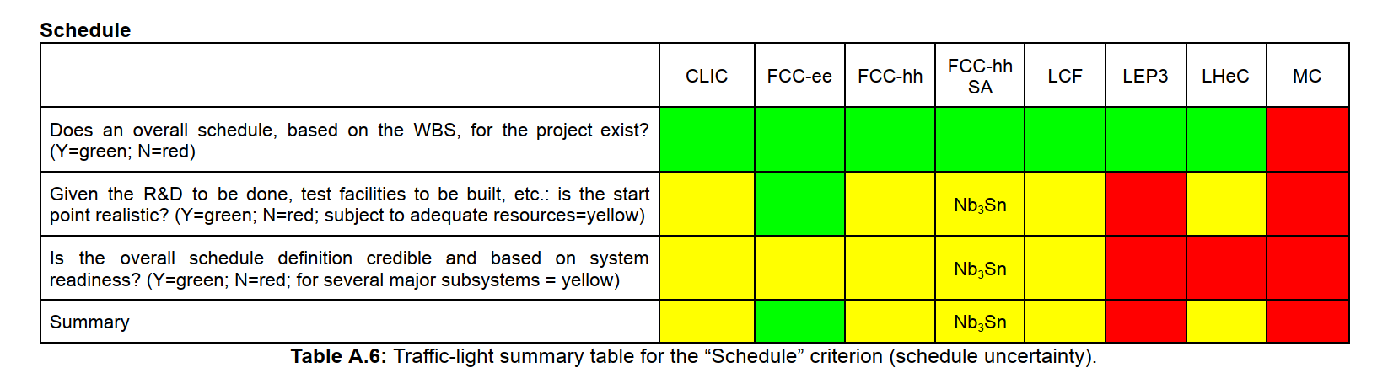
Schedule

Slide 49
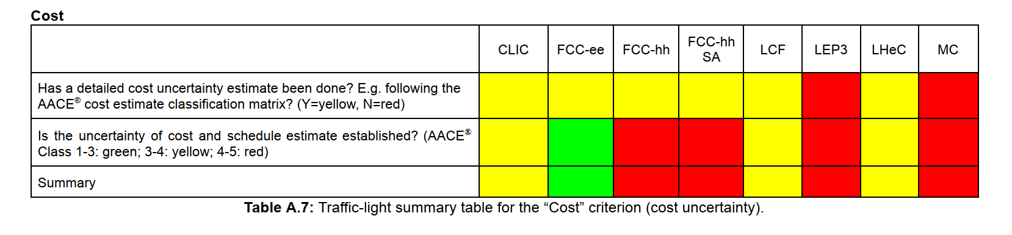
Cost

Slide 50
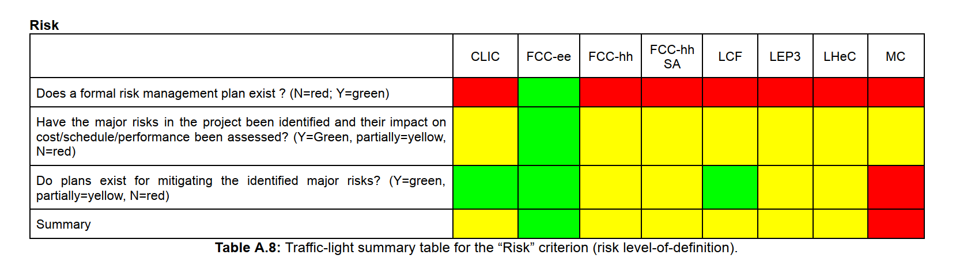
Risk

Slide 51
TRL
TRL | Description | Example
1. Basic principles observed | Scientific research begins to be translated into applied research and development. | A new propulsion concept is identified in academic research.
2. Technology concept formulated | Practical applications are identified but not yet proven. | Theoretical model for new propulsion system created.
3. Experimental proof of concept | Active research and lab experiments validate basic functionality. | Prototype parts are tested in lab to confirm basic principles.
4. Technology validated in lab | Components are integrated and tested together in a lab environment. | Subsystems of the propulsion system work together in controlled tests.
5. Technology validated in relevant environment | Technology tested in an environment similar to intended use. | Propulsion tested in a vacuum chamber simulating space.
6. Technology demonstrated in relevant environment | Prototype system tested under operationally relevant conditions. | Full propulsion prototype tested on a suborbital vehicle.
7. System prototype demonstrated in operational environment | Prototype works in the real operational environment. | Propulsion system flown on a real spacecraft.
8. System complete and qualified | Technology has been proven to work and is qualified through testing and demonstration. | Flight-ready propulsion system successfully integrated into production spacecraft.
9. Actual system proven in operational environment | Technology is fully mature and used in real missions or production. | Propulsion system in regular use in commercial or government missions.

Slide 52
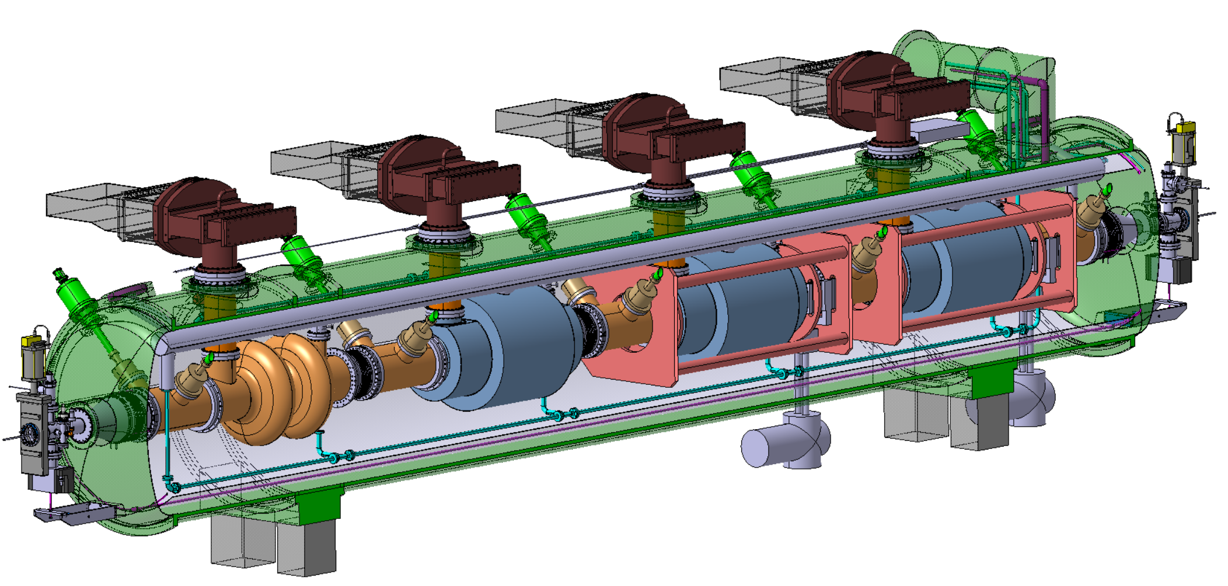
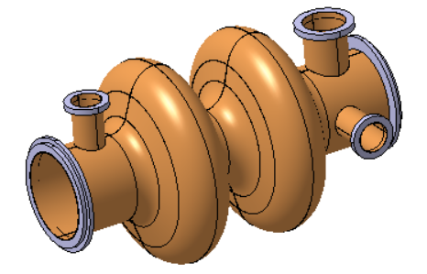
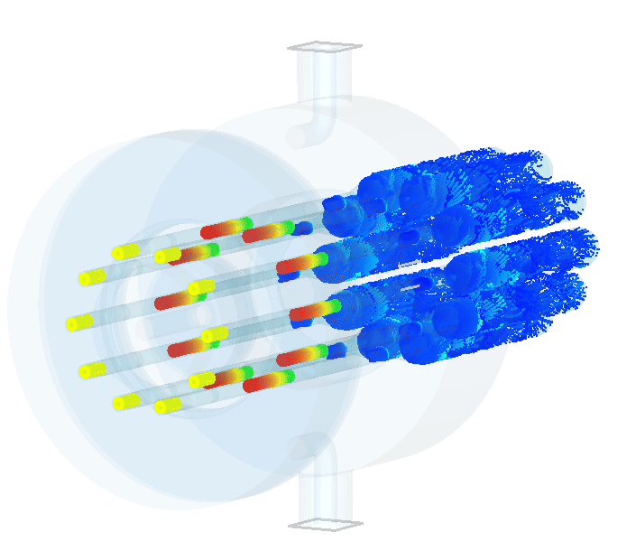

FCC-ee RF
400 MHz Collider
Power source: Multibeam Tristron
Very efficient ~90 % ! <<OPEX
3 m long
50 kV
500 kW, CW
X 264
X 66
Superconducting elliptical cavity
400 MHz, 2-cell, copper Nb coated
1.5 m. long
400 MHz Cryomodule
X 264
800 MHz Collider + Booster
X (408 + 448 booster)
X (102 + 112 booster)
X 204
+ 448 x 10 kW SSA booster
Superconducting elliptical cavity
800 MHz, 6-cell, bulk Nb
Nb₃Sn if R&D is successful
Large SRF Facility being built at CERN
800 MHz Cryomodule

Slide 53



Luminosity vs. circumference
LEP3 pre-conceptual design to reuse the LEP/LHC tunnel
Smaller circumference ➔ smaller radius of curvature ρ
Lower current at constant P_{SR} ➔ I_{beam}$∝$ρ
Larger RF system for the same energy V_{RF} ~ γ⁴/ρ ⎝ LEP3 maximum energy 230 GeV
More compact lattice cells requiring higher gradient quadrupoles / sextupoles (~1/ρ²) if we want to maintain small emittances ➔ power consumption ➔ SC magnets.
Feasibility, integration in existing tunnel need to be further studied
Full simulations required to assess with more confidence performance, cost, power consumption
$U_{0}∝\frac{γ^{4}}{ρ}$
$$ε∝γ^{2}θ^{3}$$
$$θ≡bending angle/cell$$

Slide 54

WG2a: Activities
18 meetings in total
15 meetings with external experts starting in August:
Review of the information available for each project
Definition of the criteria and general questions to be submitted to all proponents
Definition of additional questions (if needed)
Q/A sessions (when needed – limited time!!)
“Normalisation” sessions
Report drafting sessions

