Slide 1
Constraining cosmology from reionisation bubbles using an Alcock-Paczynski test
Emilie Thélie, TCCAP Fellow at UT Austin
Collaborating with J. Munoz (UT Austin), A. Liu, F. Del Balso (McGill University)
1/13

Slide 2
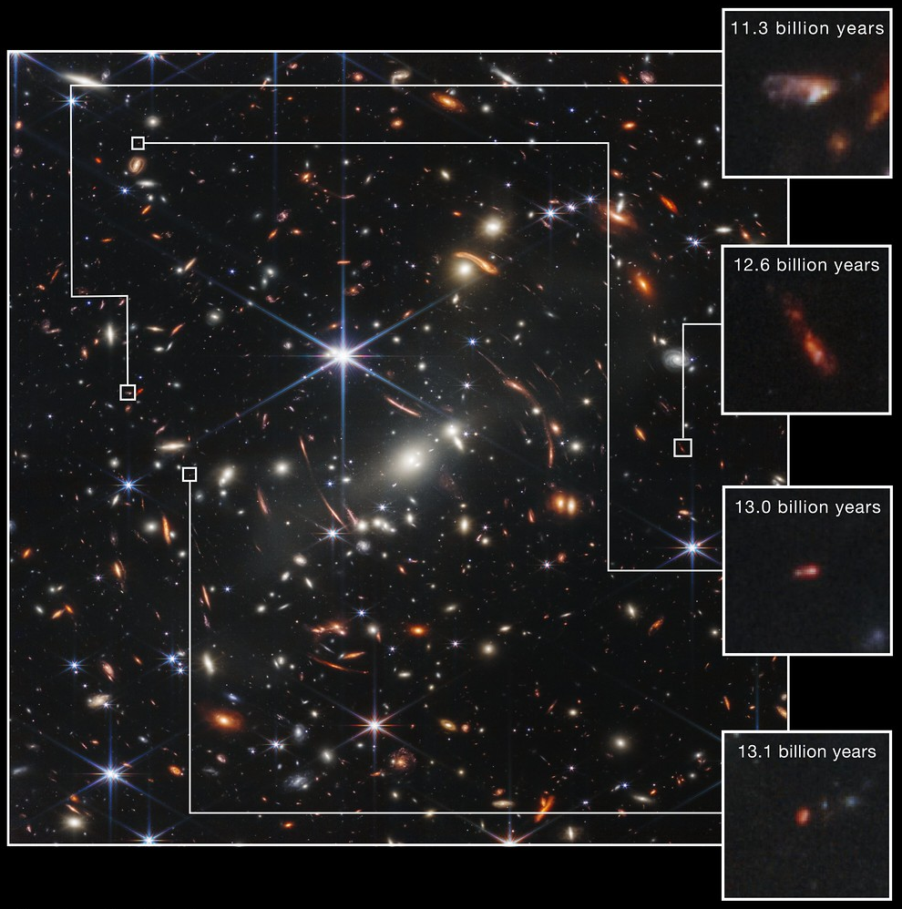
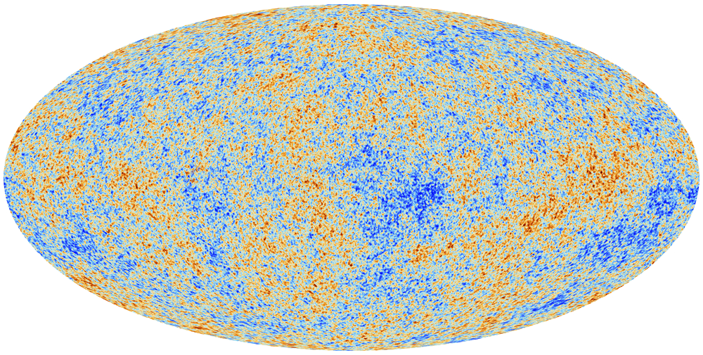
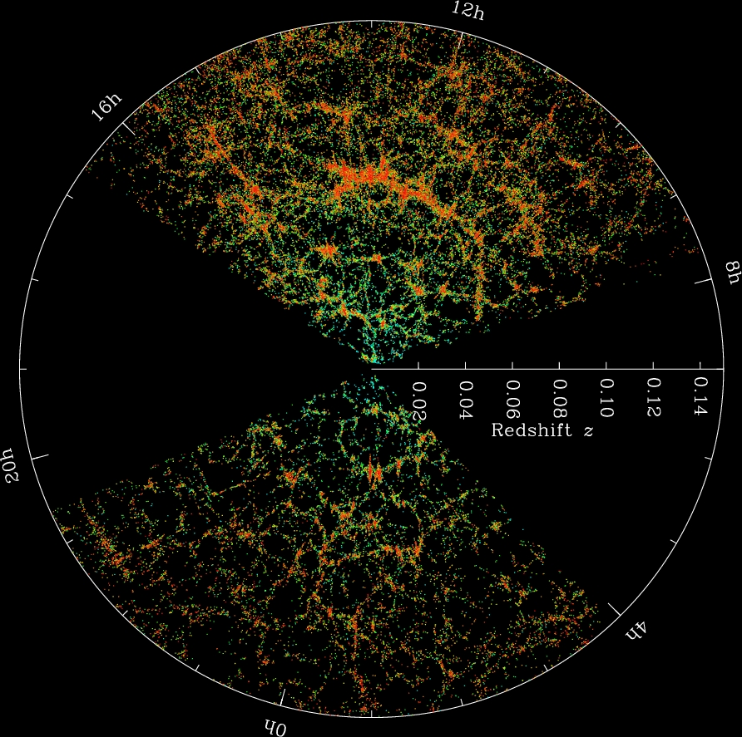

The Epoch of Reionisation (EoR)
Lyman-$α$ signal from e.g. a $z=2$ quasar
Epoch of Reionisation
Last big transition of our Universe: the intergalactic gas goes from totally neutral to totally ionised
After the emission of the CMB, all the gas of the Universe is neutral.
We know that today the gas of the Universe is ionised.
Timeline from CMB
Credit: ESA
2/13

Slide 3
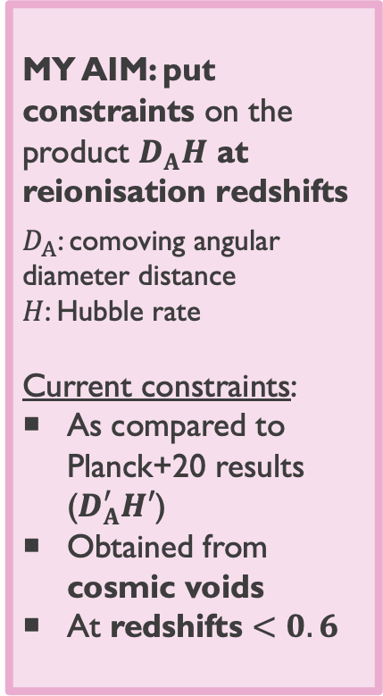
Constraining cosmology with Alcock-Paczynski tests
Introduction
Thelie+25
MY AIM: put constraints on the product $D_{A}H$ at reionisation redshifts
$D_{A}$: comoving angular diameter distance
$H$: Hubble rate
Current constraints:
As compared to Planck+20 results ($D_{A}^{′}H′$)
Obtained from cosmic voids
At redshifts $<0.6$
?
3/13

Slide 4
Constraining cosmology with Alcock-Paczynski tests
Introduction
Standard rulers (e.g. CMB, BAO)
Measuring the Hubble rate H
Uncalibrated standard spheres (e.g. cosmic voids, ionised bubbles)
Standard candles (e.g. cepheids, supernovae)
4/13

Slide 5
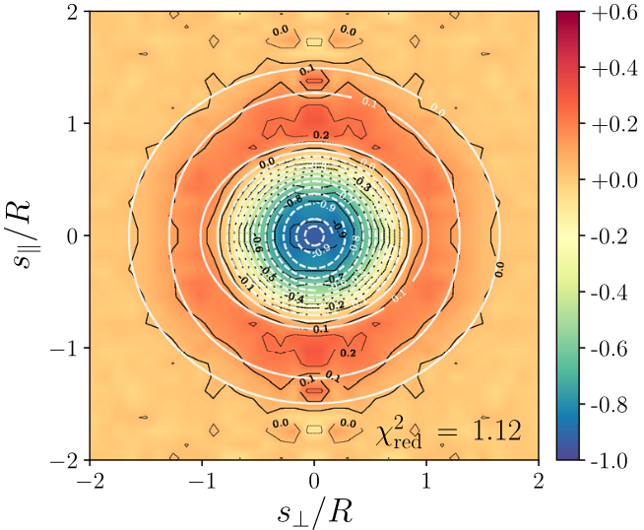
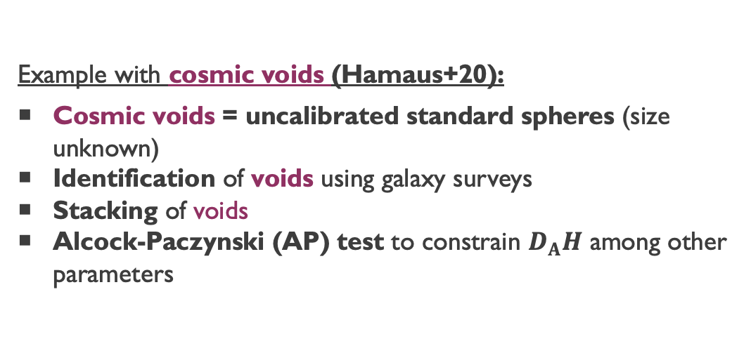
Constraining cosmology with Alcock-Paczynski tests
Introduction
Standard rulers (e.g. CMB, BAO)
Measuring the Hubble rate H
Uncalibrated standard spheres (e.g. cosmic voids, ionised bubbles)
Standard candles (e.g. cepheids, supernovae)
Void stack
Example with cosmic voids (Hamaus+20):
Cosmic voids = uncalibrated standard spheres (size unknown)
Identification of voids using galaxy surveys
Stacking of voids
Alcock-Paczynski (AP) test to constrain $D_{A}H$ among other parameters
Hamaus+20
4/13

Slide 6
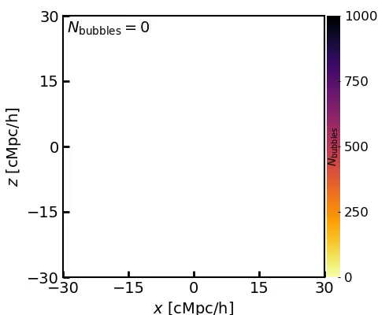
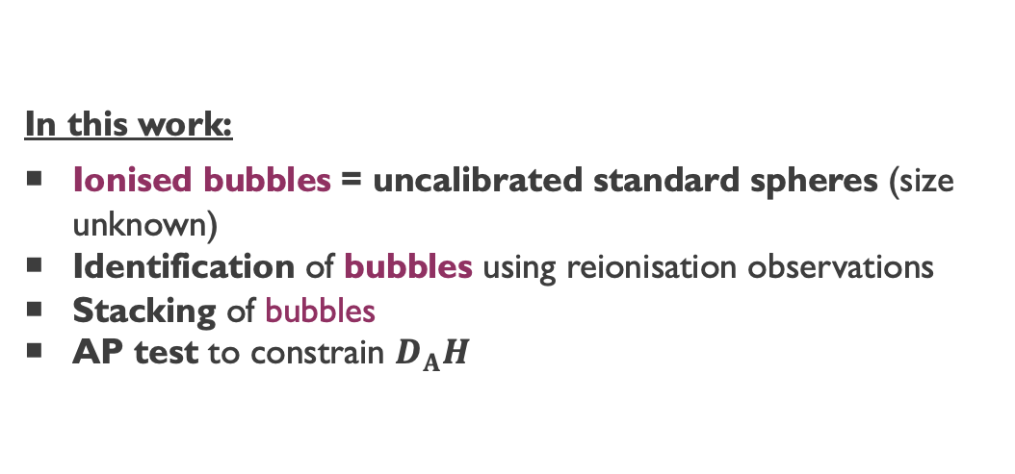
Constraining cosmology with Alcock-Paczynski tests
Introduction
Standard rulers (e.g. CMB, BAO)
Measuring the Hubble rate H
Uncalibrated standard spheres (e.g. cosmic voids, ionised bubbles)
Standard candles (e.g. cepheids, supernovae)
Bubble stack
In this work:
Ionised bubbles = uncalibrated standard spheres (size unknown)
Identification of bubbles using reionisation observations
Stacking of bubbles
AP test to constrain $D_{A}H$
5/13

Slide 7
Constraining cosmology with Alcock-Paczynski tests
Introduction
Standard rulers (e.g. CMB, BAO)
Measuring the Hubble rate H
Uncalibrated standard spheres (e.g. cosmic voids, ionised bubbles)
Standard candles (e.g. cepheids, supernovae)
Bubble stack
In this work:
Ionised bubbles = uncalibrated standard spheres (size unknown)
Identification of bubbles using reionisation observations
Stacking of bubbles
AP test to constrain $D_{A}H$
5/13

Slide 8
Constraining cosmology with Alcock-Paczynski tests
AP test
Use of observed ”standard spheres” (e.g. cosmic voids) to constrain the expansion history of the Universe
Standard spheres in our case: ionized bubbles during Reionisation
Geometrical distortions when converting sky angles to comoving distances
Thelie+25
Thelie+(in prep.)
6/13

Slide 9
Constraining cosmology with Alcock-Paczynski tests
AP test
Use of observed ”standard spheres” (e.g. cosmic voids) to constrain the expansion history of the Universe
Standard spheres in our case: ionized bubbles during Reionisation
Geometrical distortions when converting sky angles to comoving distances
Thelie+25
6/13

Slide 10
Constraining cosmology with Alcock-Paczynski tests
AP test
Use of observed ”standard spheres” (e.g. cosmic voids) to constrain the expansion history of the Universe
Standard spheres in our case: ionized bubbles during Reionisation
Geometrical distortions when converting sky angles to comoving distances
Thelie+25
6/13

Slide 11
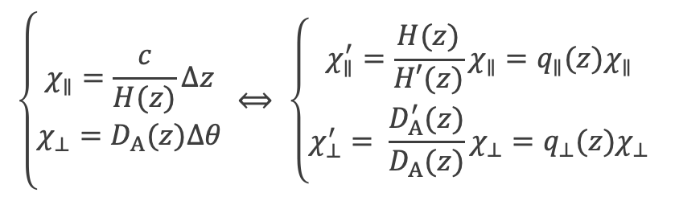
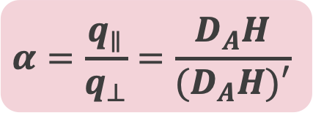
Constraining cosmology with Alcock-Paczynski tests
AP test
Use of observed ”standard spheres” (e.g. cosmic voids) to constrain the expansion history of the Universe
Standard spheres in our case: ionized bubbles during Reionisation
Geometrical distortions when converting sky angles to comoving distances
Thelie+25
$$\left\{\begin{aligned}χ_{∥}=\frac{c}{H(z)}Δz \\ χ_{⊥}=D_{A}(z)Δθ\end{aligned} ⟺ \left\{\begin{aligned}χ_{∥}^{′}=\frac{H(z)}{H′(z)}χ_{∥}=q_{∥}(z)χ_{∥} \\ χ_{⊥}^{′}= \frac{D_{A}^{′}(z)}{D_{A}(z)}χ_{⊥}=q_{⊥}(z)χ_{⊥}\end{aligned}\right.\right.$$
We can probe the following ratio:
$$α=\frac{q_{∥}}{q_{⊥}}=\frac{D_{A}H}{(D_{A}H)′}$$
6/13

Slide 12
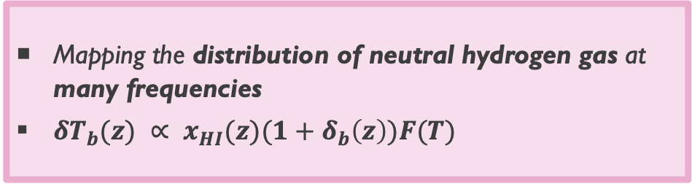
21-cm signal
Mapping the distribution of neutral hydrogen gas at many frequencies
$δT_{b}(z) ∝ x_{HI}(z)(1+δ_{b}\left(z\right))F(T)$
7/13

Slide 13
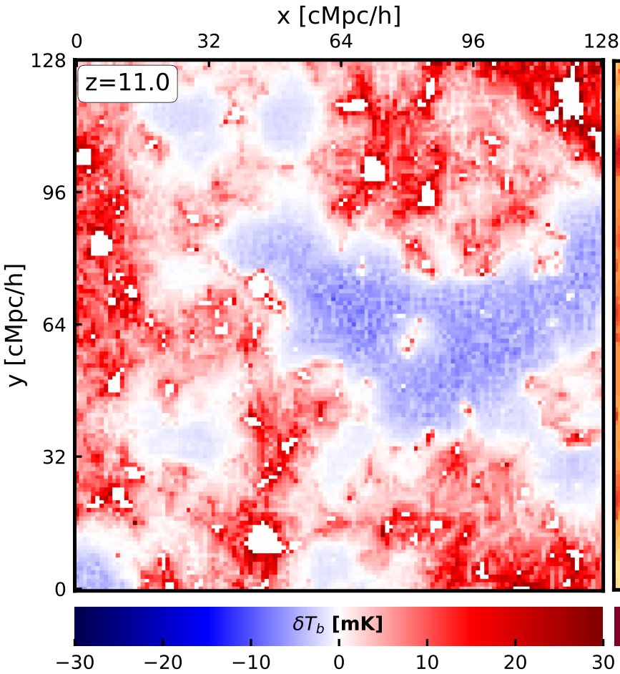
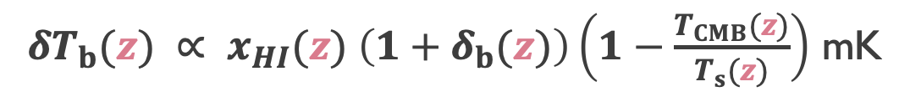
21-cm signal
Mapping the distribution of neutral hydrogen gas at many frequencies
$δT_{b}(z) ∝ x_{HI}(z)(1+δ_{b}\left(z\right))F(T)$
$δT_{b}(z) ∝ x_{HI}(z) \left(1+δ_{b}(z)\right)\left(1−\frac{T_{CMB}(z)}{T_{s}(z)}\right)$ mK
21 cm map (21cmFAST semi-analytical model – 256 cMpc/h)
Hiegel, Thélie+23
7/13

Slide 14
21-cm signal
Mapping the distribution of neutral hydrogen gas at many frequencies
$δT_{b}(z) ∝ x_{HI}(z)(1+δ_{b}\left(z\right))F(T)$
Ionisation state of the hydrogen gas
$δT_{b}(z) ∝ x_{HI}(z) \left(1+δ_{b}(z)\right)\left(1−\frac{T_{CMB}(z)}{T_{s}(z)}\right)$ mK
21 cm map (21cmFAST semi-analytical model – 256 cMpc/h)
Hiegel, Thélie+23
7/13

Slide 15
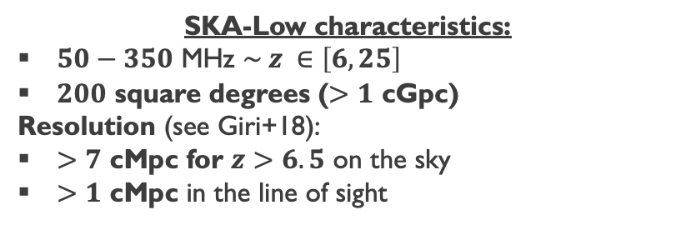
21-cm signal
SKA light cones
Mapping the distribution of neutral hydrogen gas at many frequencies
$δT_{b}(z) ∝ x_{HI}(z)(1+δ_{b}\left(z\right))F(T)$
SKA-Low characteristics:
$50−350$ MHz $\sim z ∈\left[6,25\right]$
$200$ square degrees ($>1$ cGpc)
Resolution (see Giri+18):
$>7$ cMpc for $z>6.5$ on the sky
$>1$ cMpc in the line of sight
SKA-Low
Credit: SKAO
SKA-Low: Observations of the redshifted 21 cm signal via tomography imaging.
NB. Scanning frequencies is equivalent to scanning time/redshift.
8/13

Slide 16
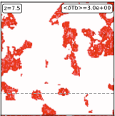
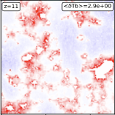
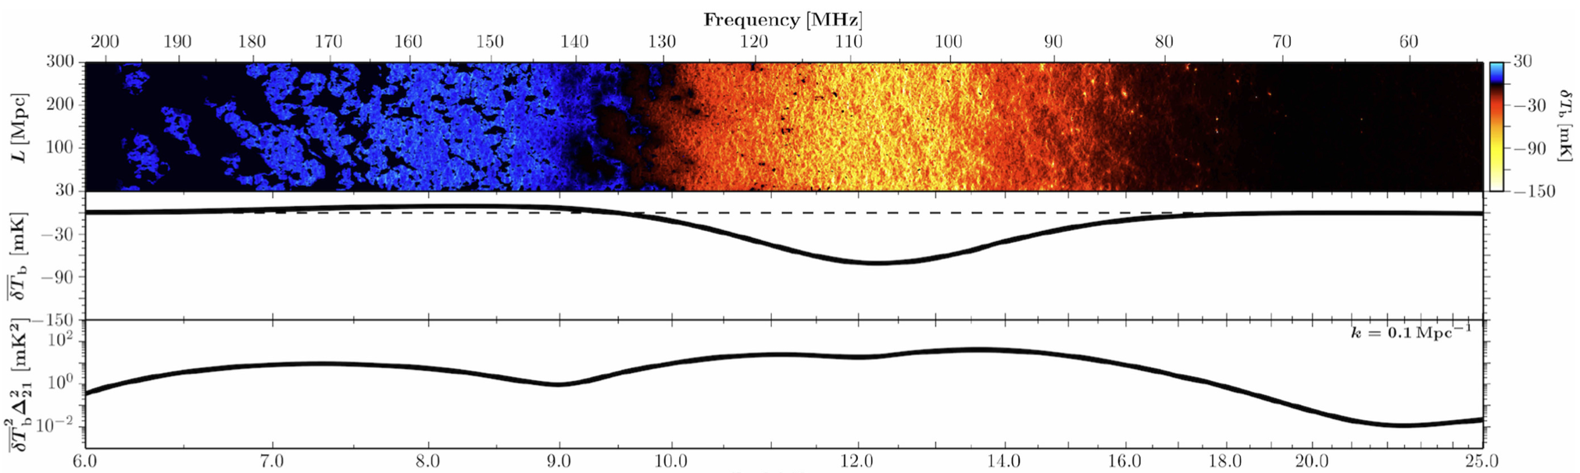
21-cm signal
SKA light cones
Mapping the distribution of neutral hydrogen gas at many frequencies
$δT_{b}(z) ∝ x_{HI}(z)(1+δ_{b}\left(z\right))F(T)$
SKA-Low characteristics:
$50−350$ MHz $\sim z ∈\left[6,25\right]$
$200$ square degrees ($>1$ cGpc)
Resolution (see Giri+18):
$>7$ cMpc for $z>6.5$ on the sky
$>1$ cMpc in the line of sight
SKA-Low
Credit: SKAO
SKA-Low: Observations of the redshifted 21 cm signal via tomography imaging.
NB. Scanning frequencies is equivalent to scanning time/redshift.
21 cm ligthcone from 21cmFAST
Park+19
Time
Redshift
Reionisation
Cosmic Dawn
Dark Ages
8/13

Slide 17

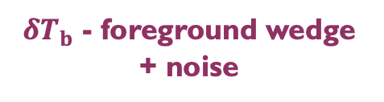


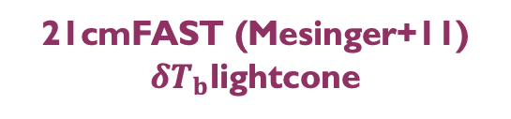
Constraining cosmology with Alcock-Paczynski tests
Bubbles from the future SKA observations of the 21-cm signal?
Kennedy+24
Observations: $δT_{b}$lightcones, which will include foregrounds and noise
Trained Unet on $δT_{b}$lightcones/coeval boxes to recover the binarized $x_{HI}$
Extraction of the bubbles via a watershed algorithm (Lin+16)
21cmFAST (Mesinger+11)
$δT_{b}$lightcone
$δT_{b}$ - foreground wedge
Kennedy+24
$δT_{b}$+ noise
$δT_{b}$ - foreground wedge + noise
9/13

Slide 18
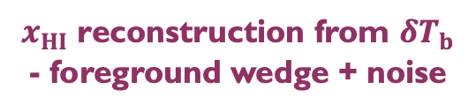
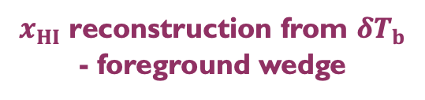

Constraining cosmology with Alcock-Paczynski tests
Bubbles from the future SKA observations of the 21-cm signal?
$x_{HI}$ reconstruction from $δT_{b}$
Observations: $δT_{b}$lightcones, which will include foregrounds and noise
Trained Unet on $δT_{b}$lightcones/coeval boxes to recover the binarized $x_{HI}$
Extraction of the bubbles via a watershed algorithm (Lin+16)
Kennedy+24
$x_{HI}$ reconstruction from $δT_{b}$ - foreground wedge
$x_{HI}$ reconstruction from $δT_{b}$ - foreground wedge + noise
10/13

Slide 19
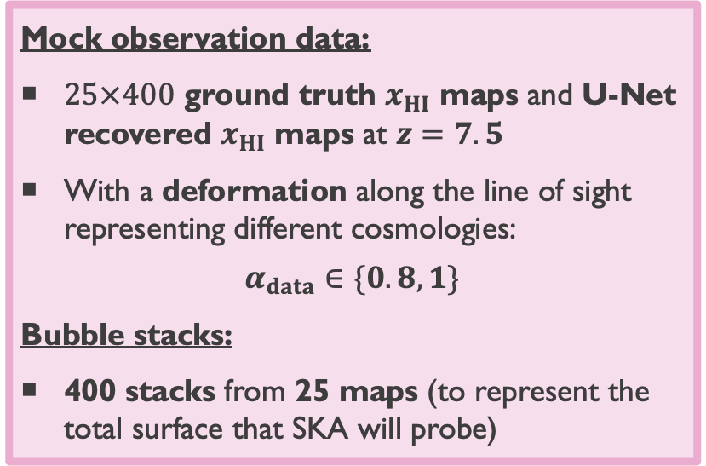
Constraining cosmology with Alcock-Paczynski tests
Mock bubble stacks
Mock observation data:
$25×400$ ground truth $x_{HI}$ maps and U-Net recovered $x_{HI}$ maps at $z=7.5$
With a deformation along the line of sight representing different cosmologies:
$$α_{data}∈\{0.8, 1\}$$
Bubble stacks:
400 stacks from 25 maps (to represent the total surface that SKA will probe)
Thelie+25
11/13

Slide 20
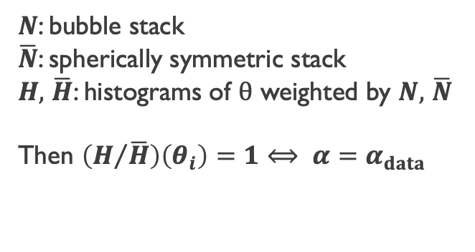
Constraining cosmology with Alcock-Paczynski tests
Sphericity test
Thelie+25
$N$: bubble stack
$\overline{N}$: spherically symmetric stack
$H,$ $\overline{H}$: histograms of $θ$ weighted by $N,$ $\overline{N}$
Then $\left(H/{\overline{H}}\right)\left(θ_{i}\right)=1⟺ α=α_{data}$
12/13

Slide 21



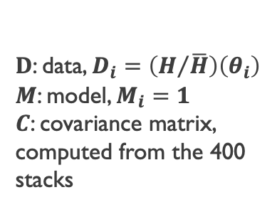

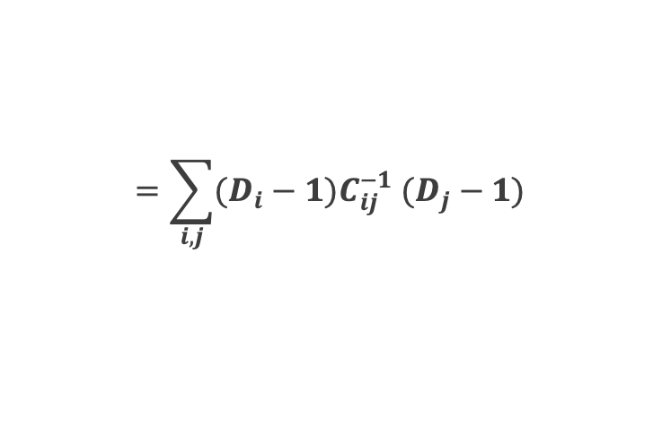

Constraining cosmology with Alcock-Paczynski tests
Making the forecast
Thelie+25
Thelie+25
$N$: bubble stack
$\overline{N}$: spherically symmetric stack
$H,$ $\overline{H}$: histograms of $θ$ weighted by $N,$ $\overline{N}$
Then $\left(H/{\overline{H}}\right)\left(θ_{i}\right)=1⟺ α=α_{data}$
$${0.81}_{−0.01}^{+0.04}$$
$${0.84}_{−0.04}^{+0.01}$$
$$χ^{2}\left(α\right)={\left(D−M\right)}^{T}C^{−1}\left(D−M\right)$$
$$=\sum_{i,j}{(D_{i}−1)C_{ij}^{−1} (D_{j}−1)}$$
$${0.98}_{−0.01}^{+0.04}$$
$D$: data, $D_{i}=\left(H/{\overline{H}}\right)\left(θ_{i}\right)$
$M$: model, $M_{i}=1$
$C$: covariance matrix, computed from the 400 stacks
$${0.98}_{−0.02}^{+0.02}$$
12/13

Slide 22
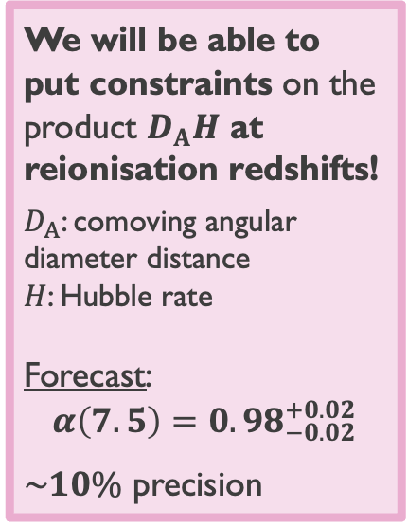
Constraining cosmology with Alcock-Paczynski tests
Forecast
Thelie+25
We will be able to put constraints on the product $D_{A}H$ at reionisation redshifts!
$D_{A}$: comoving angular diameter distance
$H$: Hubble rate
Forecast:
$${α\left(7.5\right)=0.98}_{−0.02}^{+0.02}$$
$\sim 10\%$ precision
13/13

Slide 23
Constraining cosmology with Alcock-Paczynski tests
Forecast
Thelie+25
We will be able to put constraints on the product $D_{A}H$ at reionisation redshifts!
$D_{A}$: comoving angular diameter distance
$H$: Hubble rate
Forecast:
$${α\left(7.5\right)=0.98}_{−0.02}^{+0.02}$$
$\sim 10\%$ precision
Thank you for your attention!
13/13

Slide 24
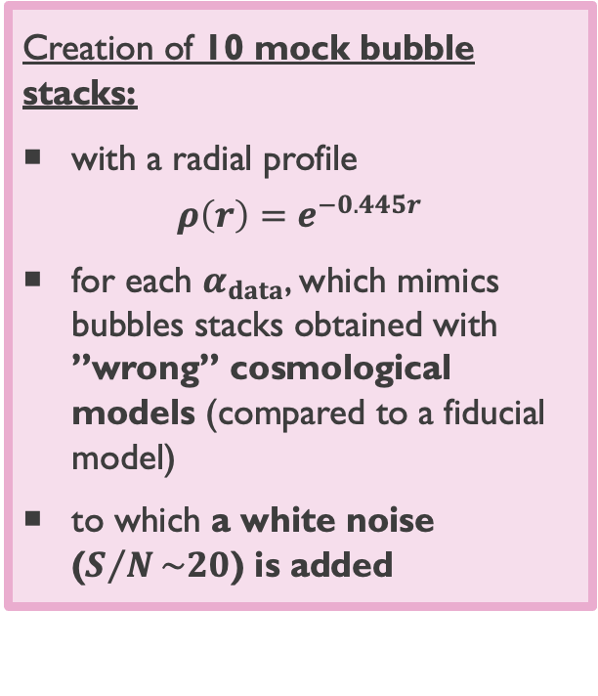
Constraining cosmology with Alcock-Paczynski tests
Toy model
Creation of 10 mock bubble stacks:
with a radial profile
$$ρ\left(r\right)=e^{−0.445r}$$
for each $α_{data}$, which mimics bubbles stacks obtained with ”wrong” cosmological models (compared to a fiducial model)
to which a white noise ($S/N\sim 20$) is added
Thelie+25
14/13

Slide 25
Constraining cosmology with Alcock-Paczynski tests
Toy model
Creation of 10 mock bubble stacks:
with a radial profile
$$ρ\left(r\right)=e^{−0.445r}$$
for each $α_{data}$, which mimics bubbles stacks obtained with ”wrong” cosmological models (compared to a fiducial model)
to which a white noise ($S/N\sim 20$) is added
Thelie+25
14/13

Slide 26
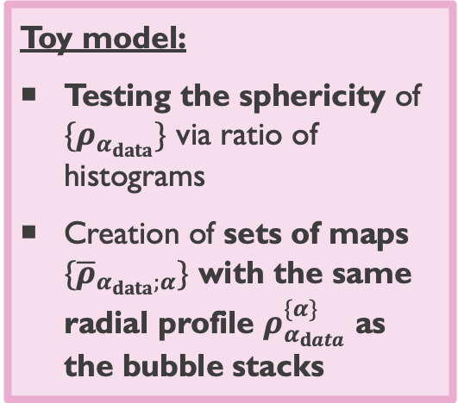
Constraining cosmology with Alcock-Paczynski tests
Toy model
Toy model:
Testing the sphericity of $\{ρ_{α_{data}}\}$ via ratio of histograms
Creation of sets of maps $\{{\overline{ρ}}_{α_{data};α}\}$ with the same radial profile $ρ_{α_{data}}^{\{α\}}$ as the bubble stacks
15/13

Slide 27
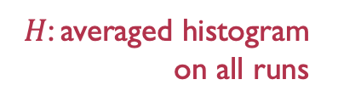
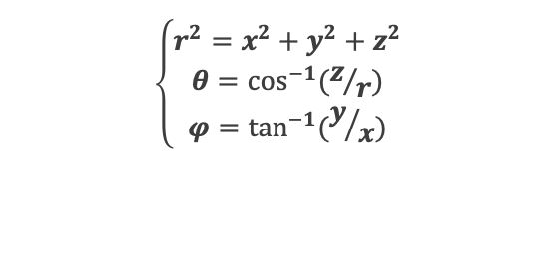
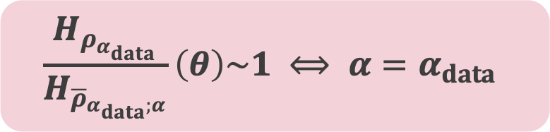


Constraining cosmology with Alcock-Paczynski tests
Toy model
Toy model:
Testing the sphericity of $\{ρ_{α_{data}}\}$ via ratio of histograms
Creation of sets of maps $\{{\overline{ρ}}_{α_{data};α}\}$ with the same radial profile $ρ_{α_{data}}^{\{α\}}$ as the bubble stacks
$$H_{ρ_{α_{data}}}(θ)$$
$$H_{{\overline{ρ}}_{α_{data};α}}(θ)$$
$$\frac{H_{ρ_{α_{data}}}}{H_{{\overline{ρ}}_{α_{data};α}}}\left(θ\right)\sim 1 ⟺ α=α_{data}$$
$$\left\{\begin{aligned}r^{2}=x^{2}+y^{2}+z^{2} \\ θ=\cos^{−1}{(z/r)} \\ φ=\tan^{−1}{(y/x)}\end{aligned}\right.$$
$H$: averaged histogram on all runs
15/13

Slide 28
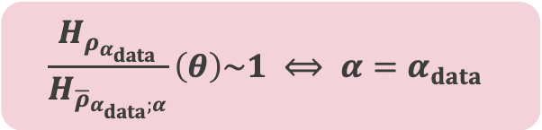
Constraining cosmology with Alcock-Paczynski tests
Toy model
$$\frac{H_{ρ_{α_{data}}}}{H_{{\overline{ρ}}_{α_{data};α}}}\left(θ\right)\sim 1 ⟺ α=α_{data}$$
Thelie+25
16/13

Slide 29
Constraining cosmology with Alcock-Paczynski tests
Toy model
$$\frac{H_{ρ_{α_{data}}}}{H_{{\overline{ρ}}_{α_{data};α}}}\left(θ\right)\sim 1 ⟺ α=α_{data}$$
Thelie+25
16/13

Slide 30
Constraining cosmology with Alcock-Paczynski tests
Toy model
$$\frac{H_{ρ_{α_{data}}}}{H_{{\overline{ρ}}_{α_{data};α}}}\left(θ\right)\sim 1 ⟺ α=α_{data}$$
Thelie+25
16/13

Slide 31
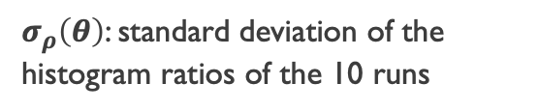
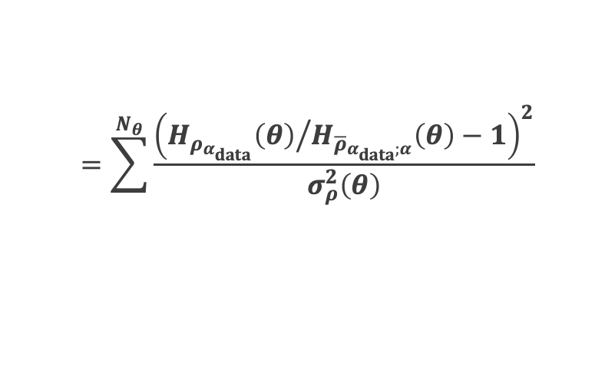
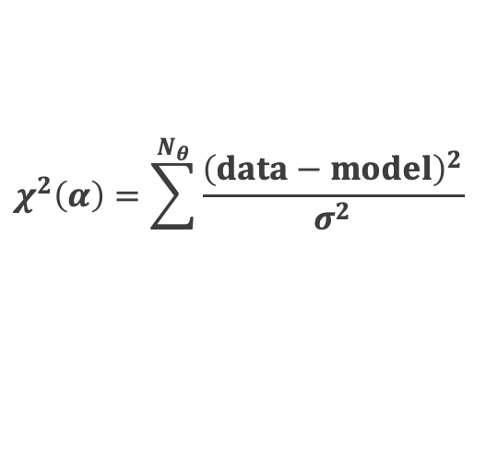

Constraining cosmology with Alcock-Paczynski tests
Toy model
Thelie+25
$$χ^{2}\left(α\right)=\sum^{N_{θ}}{\frac{{\left(data−model\right)}^{2}}{σ^{2}}}$$
$$=\sum^{N_{θ}}{\frac{{\left({H_{ρ_{α_{data}}}\left(θ\right)}/{H_{{\overline{ρ}}_{α_{data};α}}\left(θ\right)}−1\right)}^{2}}{σ_{ρ}^{2}\left(θ\right)}}$$
$σ_{ρ}\left(θ\right)$: standard deviation of the histogram ratios of the 10 runs
We are able to say what is the deformation $α_{data}$ of our mock data for this toy model.
Let’s apply this modelling with mock observation data!
17/13

