Slide 1
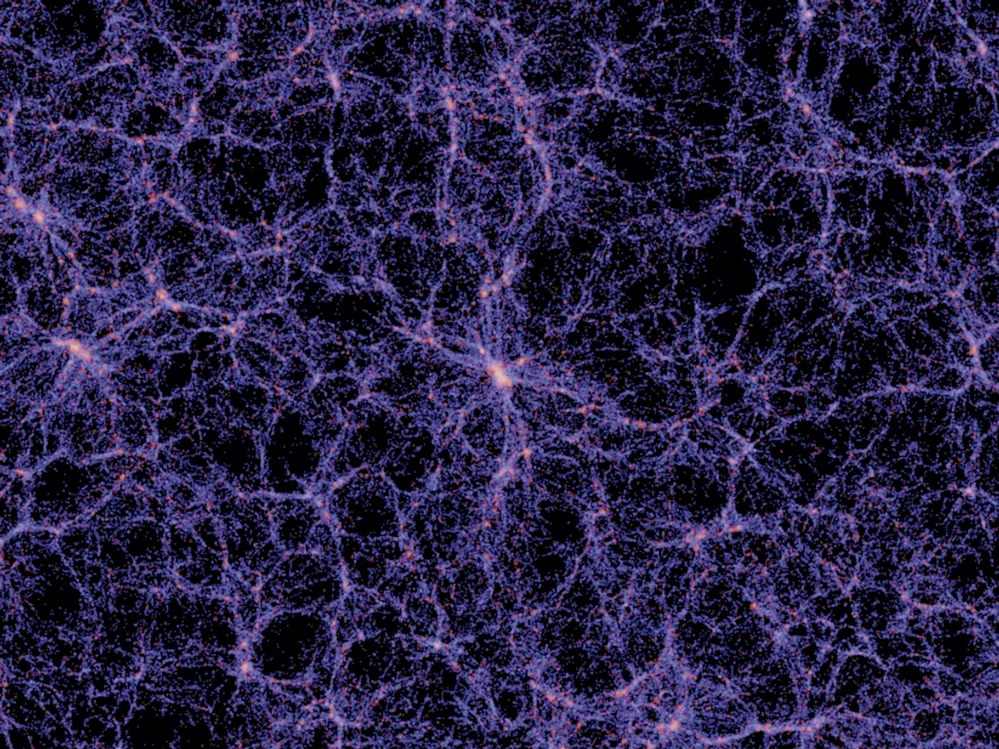
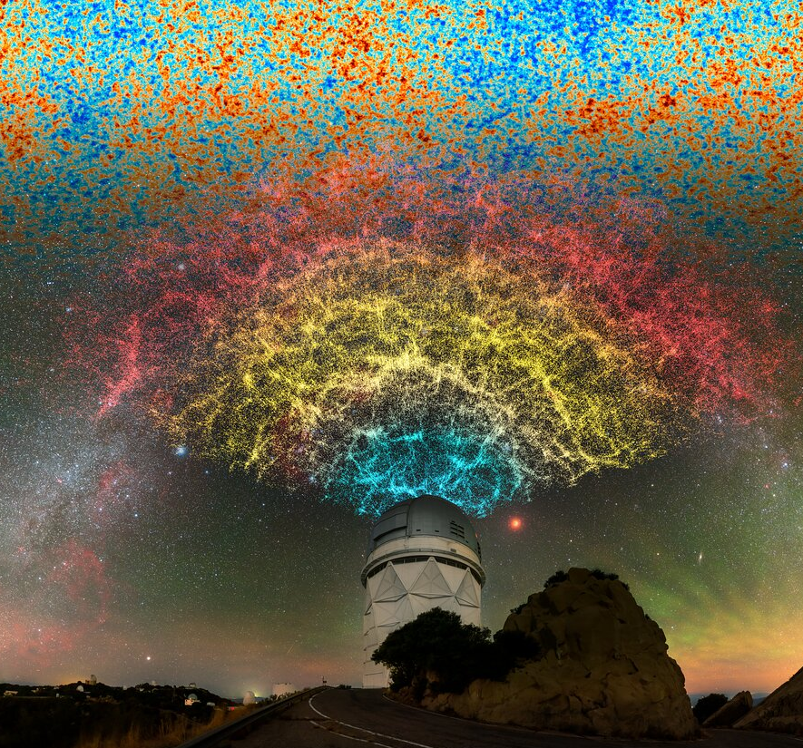

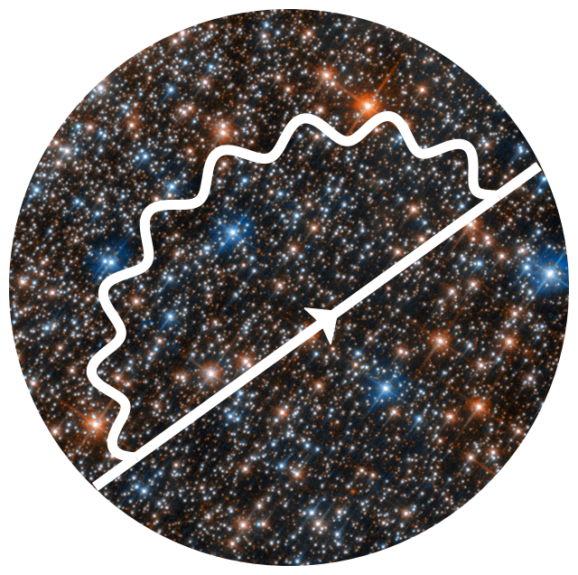
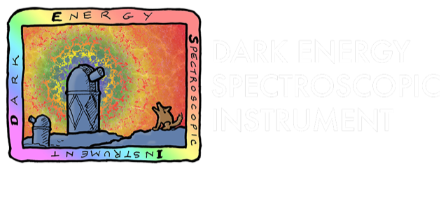
Galaxy-Halo Connection: Fast & Precision mocks for cosmological analysis in DESI
Galaxy-Halo Connection: You can have your cake and eat it too!
Vaisakh Rajeev (Advisor: Robert Kehoe)
PhD Student, Southern Methodist University
TACOS 2025, Sam Houston State University, 13 October 2025
Image credit: DESI/NOIRLab
Notes:
I work on the connection between galaxies and the dark matter halos that host them. In DESI, we need mock universes that are both fast to generate and precise enough for cosmology. Usually you can’t have both — but with our galaxy–halo approach, you really can have your cake and eat it too.

Slide 2
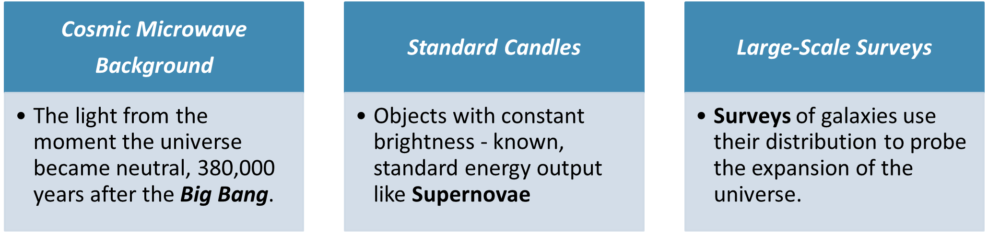
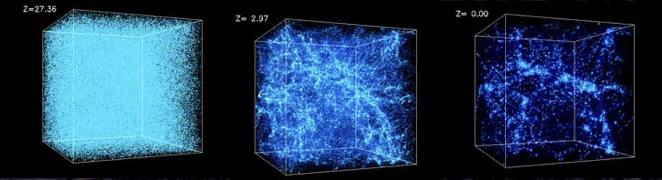
3 Pillars of Modern Cosmological Measurements
Large Scale Structure Surveys
Observe large regions of space to produce galaxy redshift surveys
Growth of LSS gives info about time dependence of Gravity, Dark Energy
Simulation Credit: National Center for Supercomputer Applications by Andrey Kravtsov (U Chicago) and Anatoly Klypin (NMSU).
Cosmic Microwave
Background
The light from the moment the universe became neutral, 380,000 years after the Big Bang.
Standard Candles
Objects with constant brightness - known, standard energy output like Supernovae
Large-Scale Surveys
Surveys of galaxies use their distribution to probe the expansion of the universe.

Slide 3
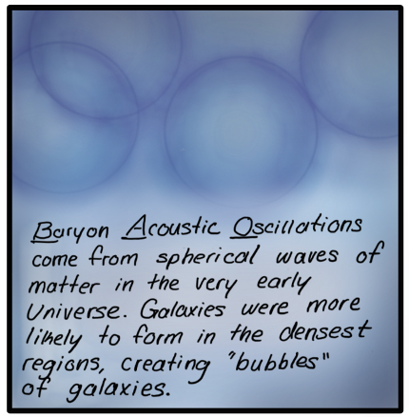
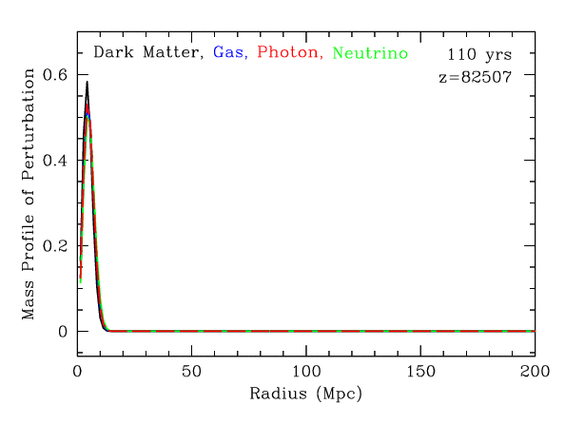
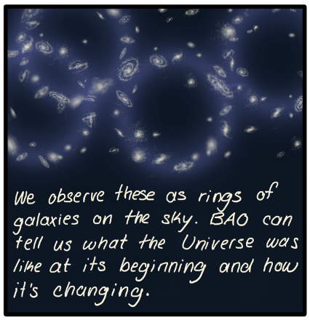
Baryon Acoustic Oscillations (BAO)
Pressure waves emanated from primordial dark matter halos
Travelled rapidly in the early universe
Covering a comoving distance of 150 Mpc (sound horizon r_{d}) between Big Bang and the epoch of recombination.
‘Standard ruler’ for expansion history
Visualizing the origin of the acoustic peak
Credits: Daniel Eisenstein, DESI Member
Credits: Claire Lamann, DESI Member
Notes:
animation illustrating how an initial point-like density perturbation evolves in the early universe, showing the perturbed densities of dark matter, gas, photons, and neutrinos (in a comoving coordinate system) as the sound waves expand and leave an imprint—i.e. visualizing the origin of the acoustic peak.

Slide 4
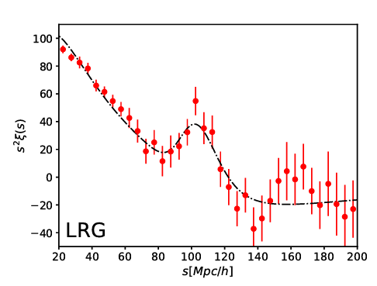
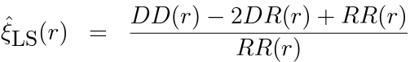
Two-Point Correlation Functions (2PCF)
Excess probability of finding galaxy within given distance of another galaxy
Most common estimator: Landy - Szalay estimator
Data(D) – 3D Position coordinates of Galaxies
Randoms(R) – Position of Galaxies from a Random sample
based on the redshift distribution of the Data
First Detection of BAO signal from early DESI data (Arxiv 2304.08427)
**Another handy tool: Power spectrum – the Fourier transform of 2PCF

Slide 5
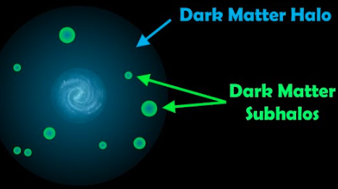
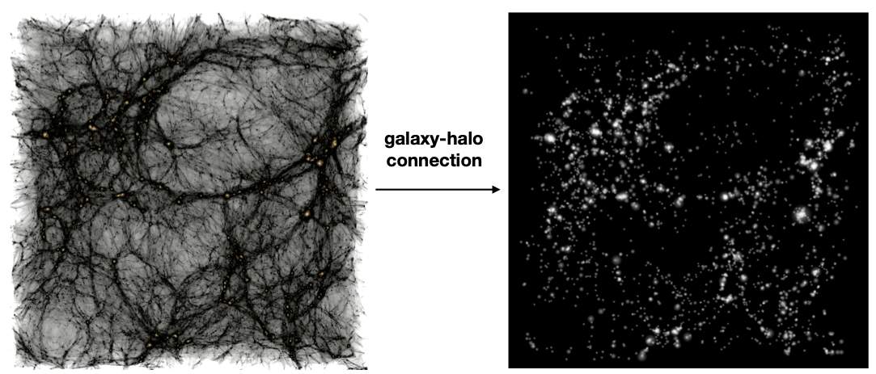
Dark Matter Halos & Galaxies
Dark matter collapses under gravity into dense, ~ spherical structures called halos
Fundamental building blocks of cosmic web
Gravitational anchors, or "cradles”
Characterized by Mass, V_{peak} (Max. circular velocity across accretion history)
Galaxies form and evolve here
Galaxy Bias: Galaxies form in densest regions of DM distribution
Provide a biased view of underlying matter field
Notes:
So, where do galaxies live? They are born and reside within these vast, invisible structures called dark matter halos. You can think of halos as the nodes of the cosmic web—the gravitational anchors that pull in gas and allow galaxies to form. The most important concept to grasp is that the mass of a halo is the primary driver of the types of galaxies we find inside it. This provides us with a physical basis for connecting the two.

Slide 6
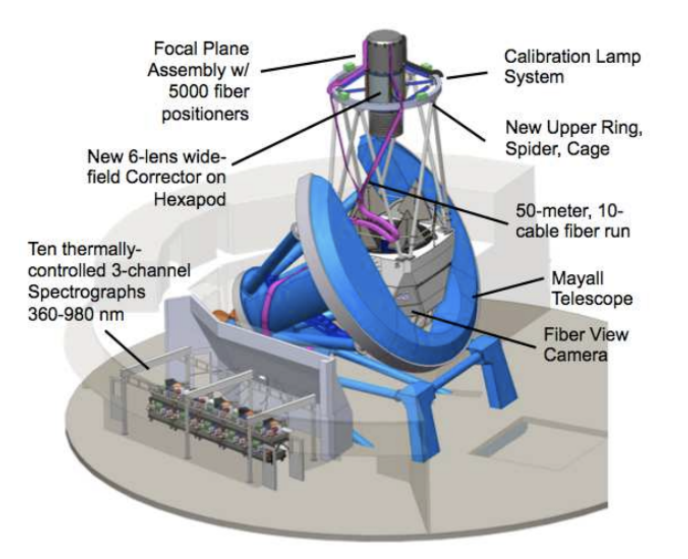
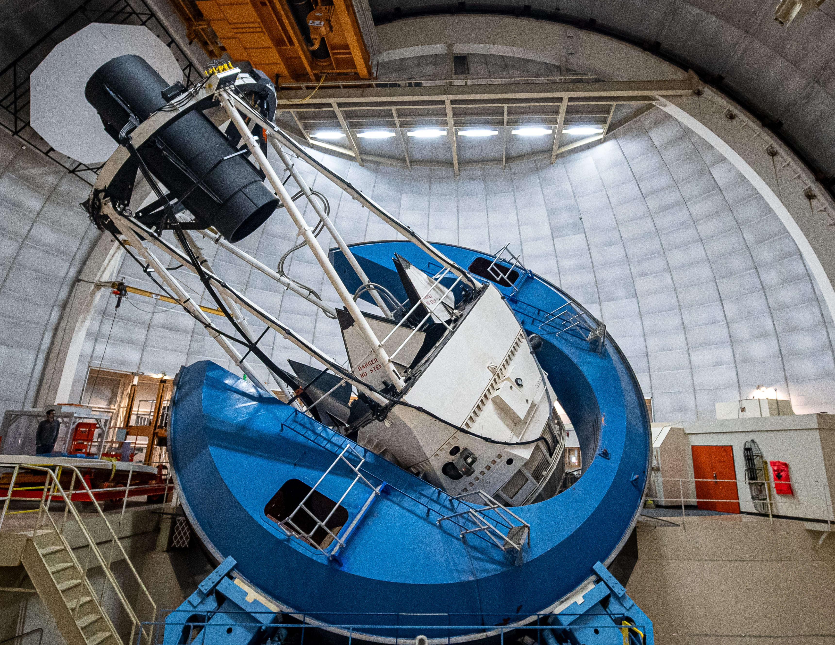
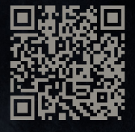
Dark Energy Spectroscopic Instrument (DESI)
Probe expansion history of our Universe
Study the physics of galaxies and quasars
Construct 3D map - from nearby universe out to 11 billion light years
At 4m Mayall Telescope, KPNO, Arizona, USA
Bandpass: 3,600 – 9,800 Å
10 Spectrographs, 3 CCDs each– Blue, Red, and Near IR.
5000 Robotically controlled Positioners (spectra of galaxies, stars)
Scan to know more about the DESI robots!

Slide 7
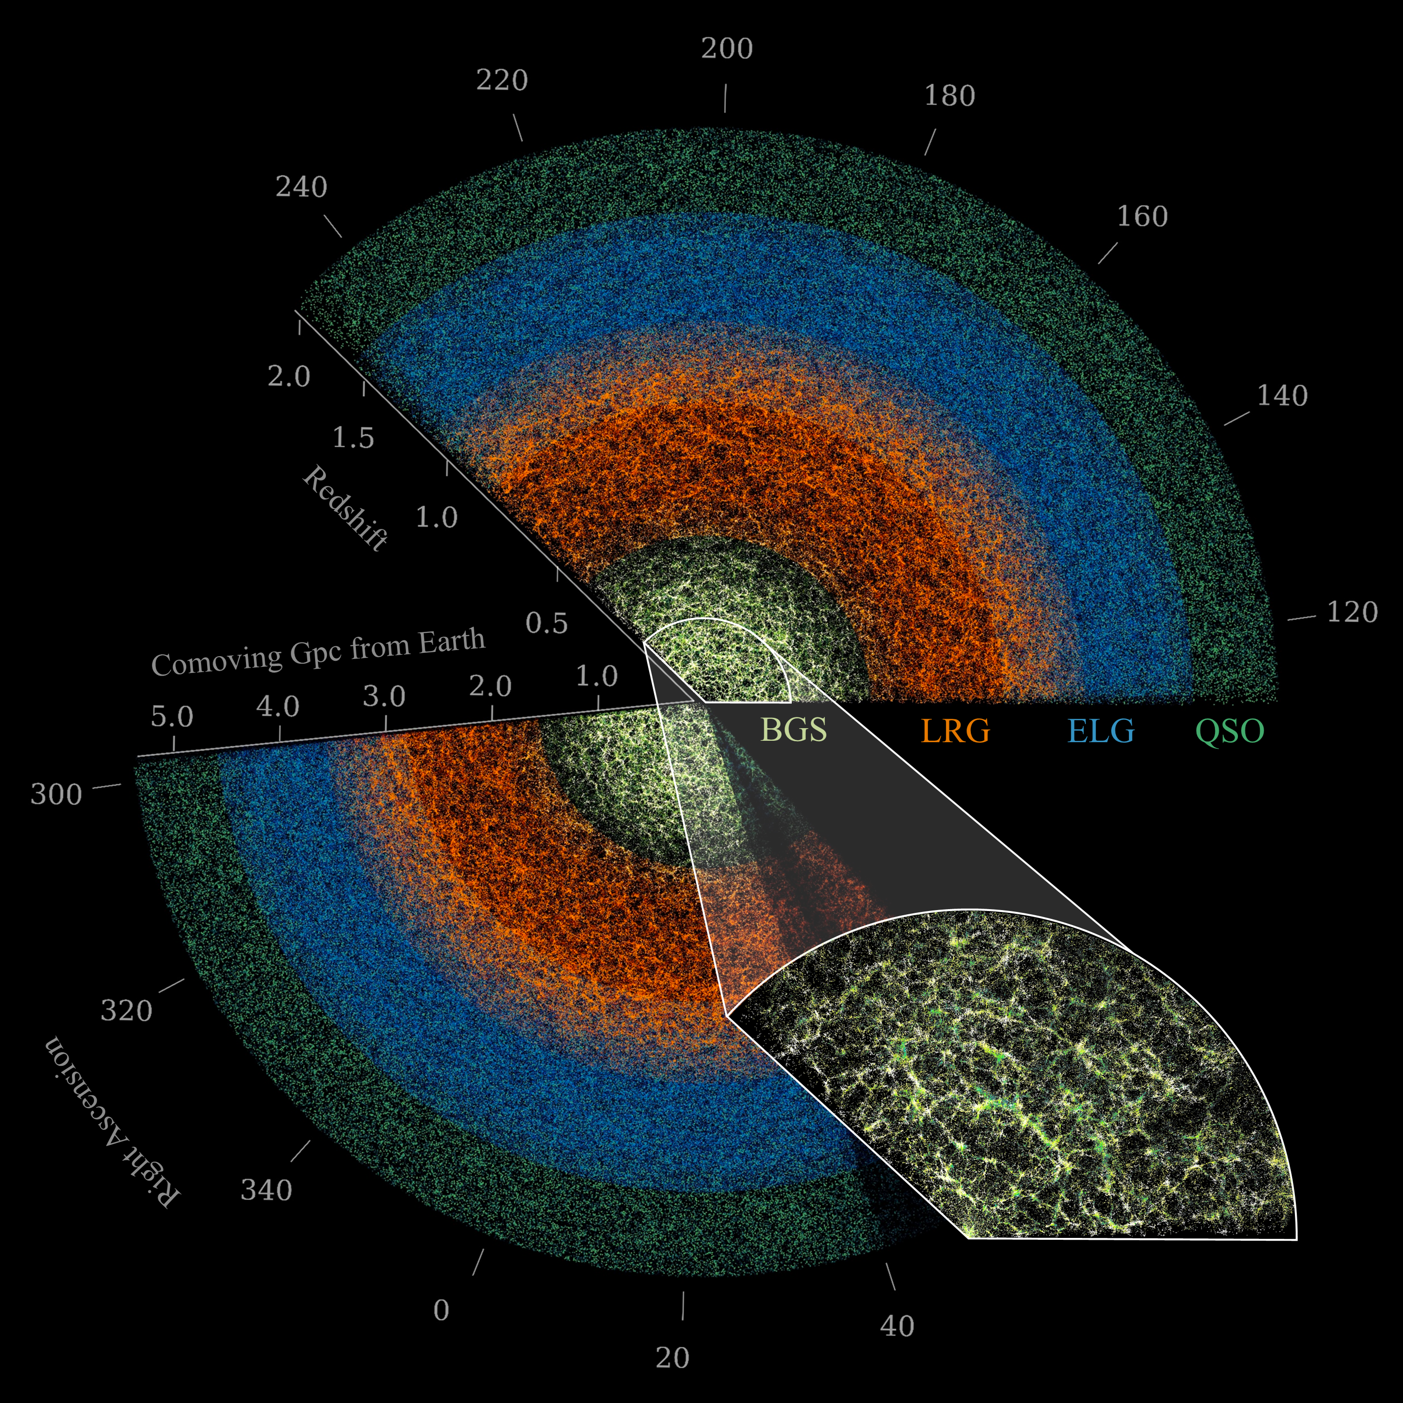
DESI Dark Matter Tracers
DESI Dark Matter Tracers
Quasars (QSOs)
Direct tracers ( z<2.1)
Using Lyman-α absorption features
(2.1 < z < 3.5)
Emission Line Galaxies (ELGs)
0.8 < z < 1.6 (bright forbidden [OII] emissions)
Luminous Red Galaxies (LRGs)
0.4 < z < 1.1 (4000 Å break)
Bright Galaxy Survey (BGS)
0.1 < z < 0.4, magnitude limited
Vaisakh, et al ( in Collab. Review)
Notes:
Direct tracers ( z<2.1)
Using Lyman-α absorption features [clouds of neutral hydrogen between galaxies] at higher z (2.1 < z < 3.5)

Slide 8


Modelling the Galaxy-Halo Connection
Define a mapping : Halo properties Galaxy properties
Hydrodynamic simulations (computationally challenging!)
Large, high-resolution 𝑁-body simulations (e.g., Uchuu)
Resolve substructure down to dwarf galaxies
8 Gpc³ℎ⁻³ cubic box, Multiple snapshots
Simple statistical prescriptions
Halo Occupation Distribution (HOD)
Empirical yet physically-motivated approaches
Subhalo Abundance Matching (SHAM)
Notes:
So, our task is to define a set of rules that maps the properties of simulated halos to the properties of observable galaxies. This mapping is what we call the galaxy-halo connection. Let's explore a couple of popular ways this is done.

Slide 9
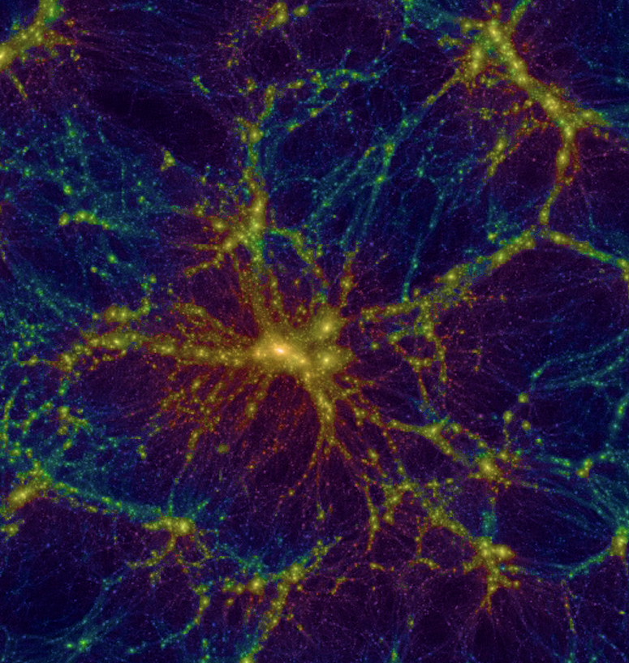
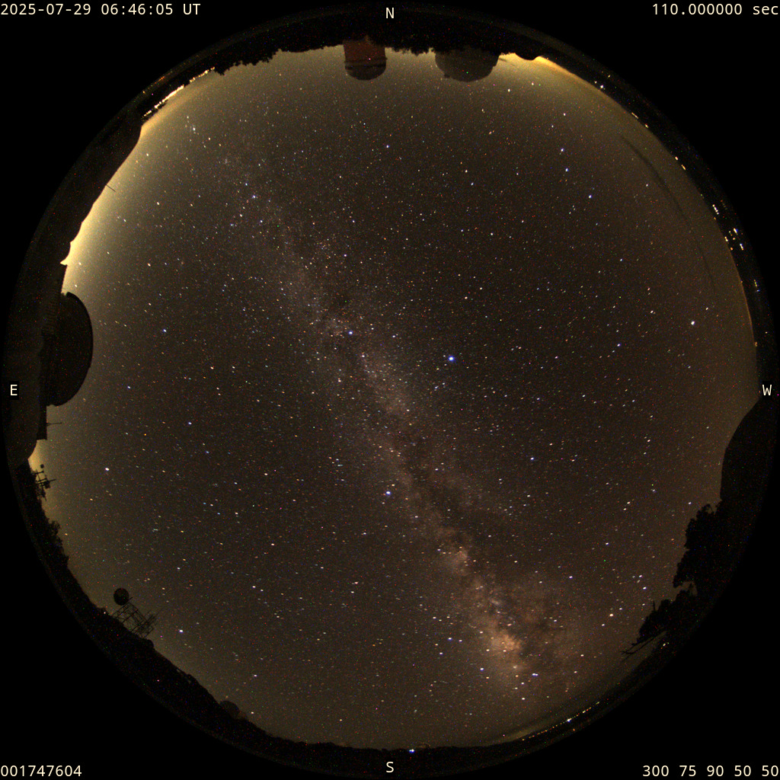

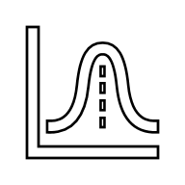
Sequence of Events
Simulations
Survey
Mock Galaxies (Survey Distribution)
Observed Data (Quality Pipeline)
Mock Statistics (2PCF, Power Spectra, 100s–1000s realizations)
Survey Statistics (2PCF, Power Spectra)
Compare Survey vs Mock
Validate Galaxy-Halo Model
Covariance Estimation
Cosmological Interpretation

Slide 10
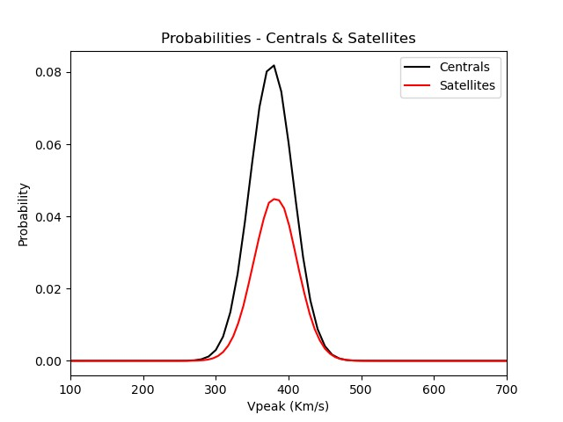
(Sub)halo Abundance Matching (SHAM)
Physically-motivated
Core Assumption: Galaxy property correlated with (sub)halo property
Modified SHAM - accounts for the incompleteness & selection effects
Assume scatter in the V_{peak} between galaxies and DM halos
Gaussian Modeling method:
Quantities of Interest: ‘𝑉_{mean}’ (mean 𝑉_{peak}), ‘f_{sat}’ (Satellite fraction), ‘σ’ (Std. Deviation)
Works remarkably well with very few free parameters
Notes:
This approach is powerful because it relies on a very simple physical assumption and often requires very little tuning to reproduce observations. ELGs (Emission Line Galaxies) & QSOs (Quasars):
These populations are much more incomplete in surveys.
ELG selection depends strongly on star formation activity, emission line detectability, and survey flux limits — you only capture a biased subset of halos that could host them.
QSOs are rare, stochastic, and depend on black hole accretion duty cycles, so not every suitable halo hosts a visible QSO at a given time.
Hence, you need a Modified SHAM to probabilistically assign only a fraction of halos as tracers to reproduce observed densities and clustering

Slide 11
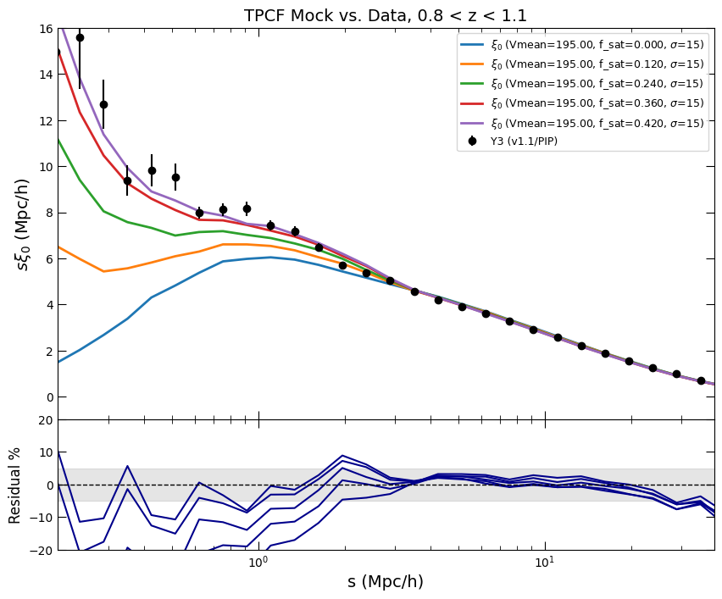
Further modification in SHAM: ELGs
From simulation, select objects
Avoid major mergers
Slower moving satellites as ELGs
Satellites with high peculiar velocity -
Subject to ram pressure
Gas removed from satellite
Star formation quenched
Generate ELG Mocks using a Gaussian V_{peak} distribution

Slide 12
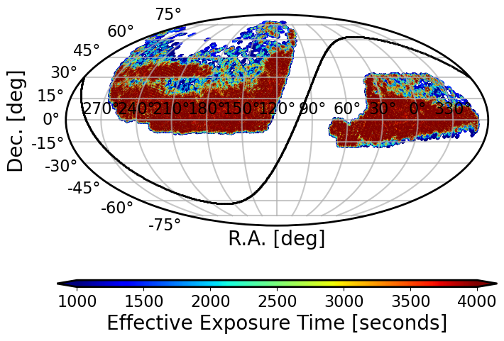
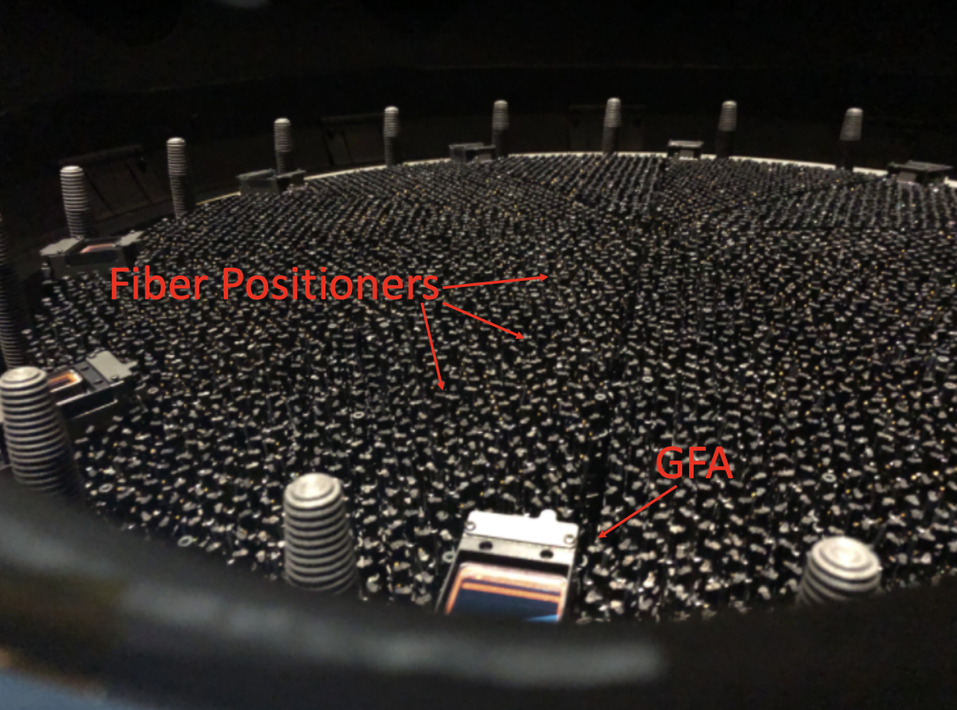
Survey Realism
Must simulate imperfections of real survey
Survey Footprint: Include galaxies in the parts of DESI observed sky
Target Selection: Mimic algorithms deciding which objects are bright enough to be targeted
Fiber Collisions: Robotic positioners can't be placed too close;
We miss some close pairs of galaxies; must be modelled
DESI Y3 footprint
Notes:
But a simulation box represents the universe at only one instant in time. A real survey like DESI sees a 'lightcone'. The further we look, the further back in time we see. To replicate this, we place a virtual observer in our simulation and carve out a wedge. As we go further out in this wedge, we pull halo information from earlier and earlier snapshots of the simulation. This creates a mock catalog that truly represents what a telescope would see.

Slide 13
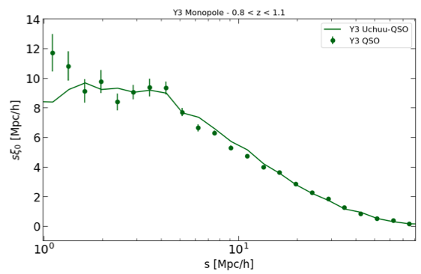
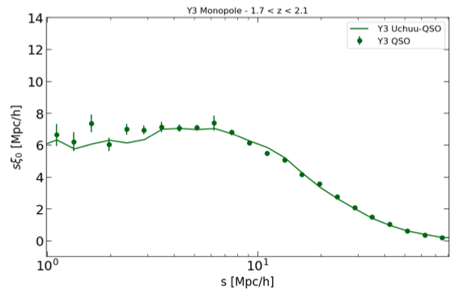
Results: DR2 Reference Mocks - QSOs
Reference Mocks: High Precision simulations
Best estimate of what a given cosmology predicts about clustering properties of DESI tracers
Template for training and testing covariance mocks
~ 1.5M QSOs
Clustering evolution with redshift across z = 0.8 – 1.1, 1.1– 1.4, 1.4 – 1.7, 1.7 - 2.1
Reasonable agreement with Survey data (1 Mpc/h onwards)
ELG Bias
QSO
QSO Bias
Vaisakh, et al ( in Collab. Review)

Slide 14
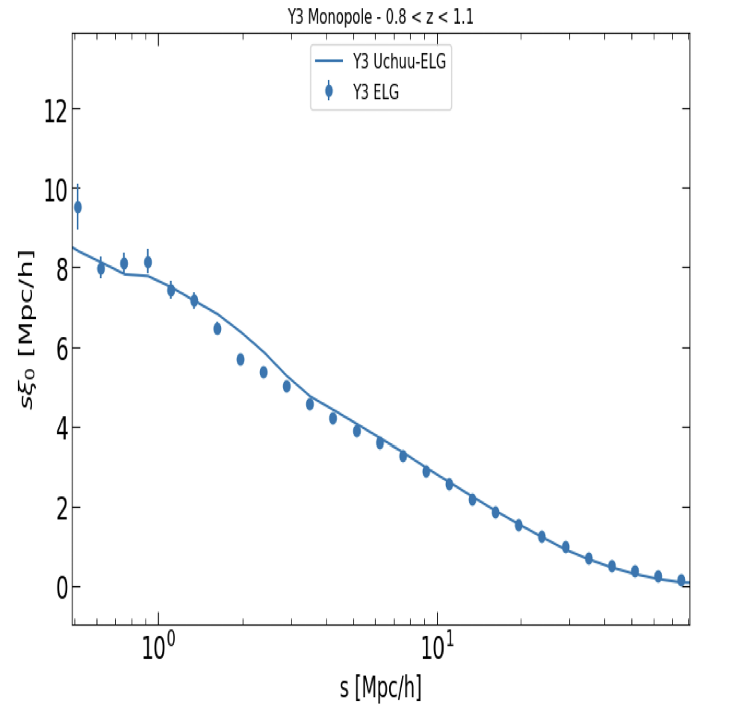
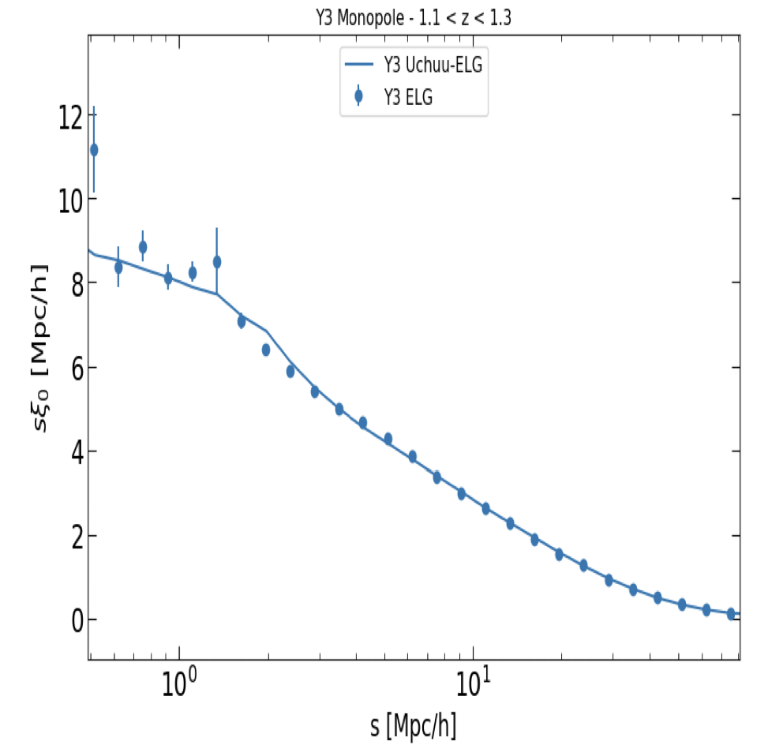
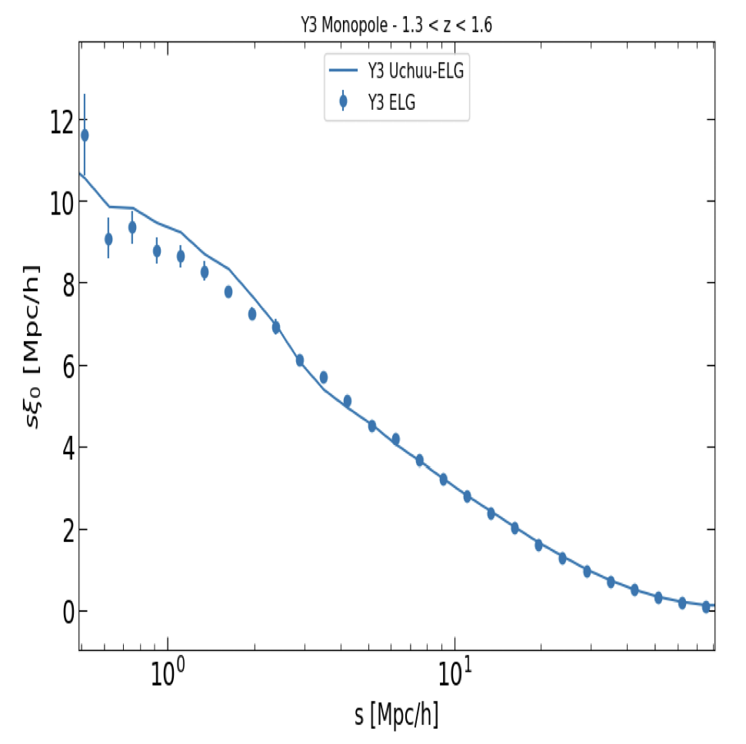
Results: DR2 Reference Mocks - ELGs
~6.5M ELGs
Clustering evolution with redshift across z = 0.8 – 1.1, 1.1– 1.3, 1.3– 1.6
Reasonable agreement with Survey data (0.5 Mpc/h onwards)
ELG
ELG Bias
Vaisakh, et al ( in Collab. Review)
QSO

Slide 15
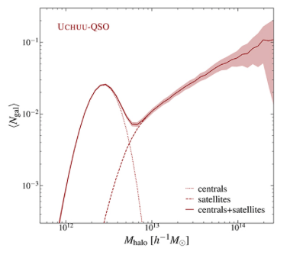
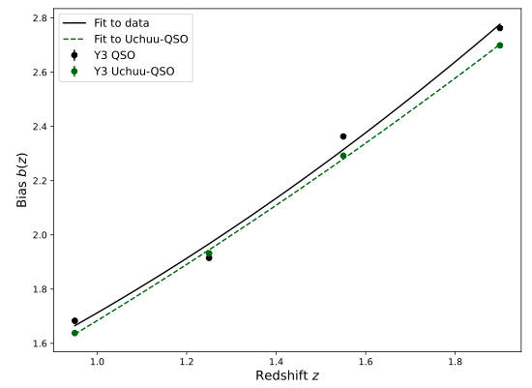
Halo Occupation & Galaxy Bias
Halo Occupation Distribution (HOD)
Galaxy Bias
Halo Model – describes DM distribution in terms of halos
Mass of a gravitationally bound DM halo ↔ Number of galaxies forming in that halo
Mean Halo Mass: 2.5 x 10¹² M_{sun}
Galaxy formation effects cause spatial distribution of baryons to differ from that of DM
Bias b = (ξ_{gal} / ξ_{DM}) ^{1/2}
ELG Bias
Prada et al, A&A, 698 (2025) A170
QSO Bias
Vaisakh, et al ( in Collab. Review)

Slide 16
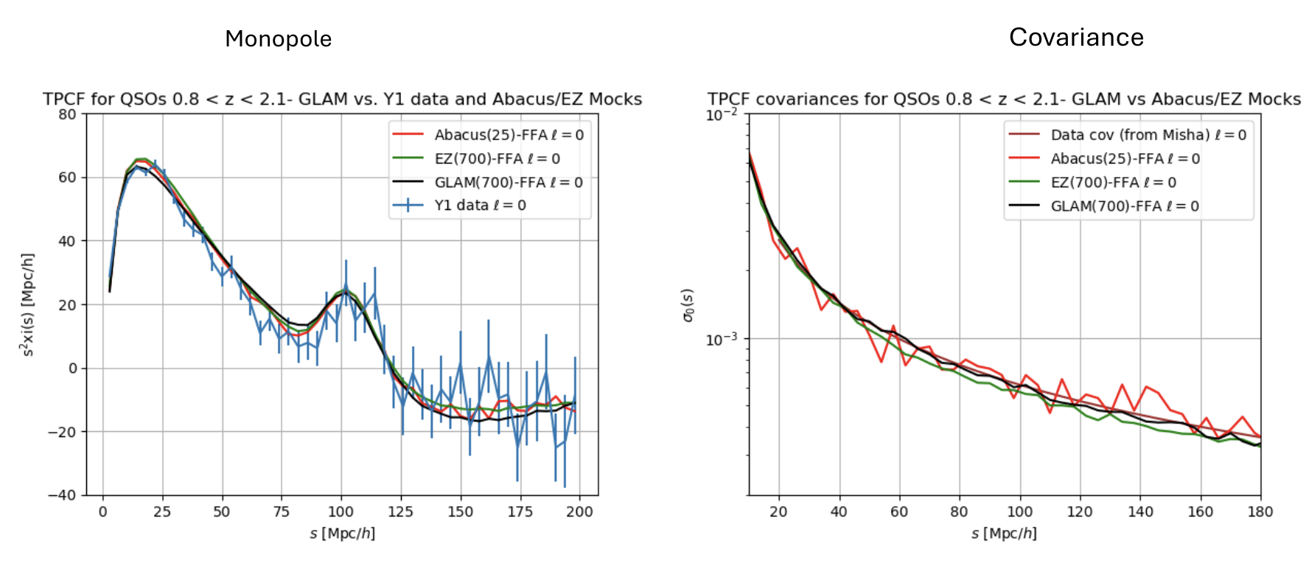
Results: GLAM-Uchuu Covariance Mocks
GLAM (GaLAxy Mocks) Simulation
N-body code by Klypin & Prada,2018
Accurate estimation of covariance errors for N-point clustering
Crucial in BAO analysis
Massive mock production lowers systematic errors
Use Uchuu to tune GLAM mocks for Covariances
1000+ Mocks with different box-sizes and cosmologies
Produced at MANEFRAME3/M3 (SMU), skun6 (Granada) & cosma8 (Durham)
Performance of GLAM-Uchuu mocks against other simulations (AbacusSummit,EZMocks) and survey data
(Theoretical Covariances provided by Misha Rashkovetskyi)

Slide 17
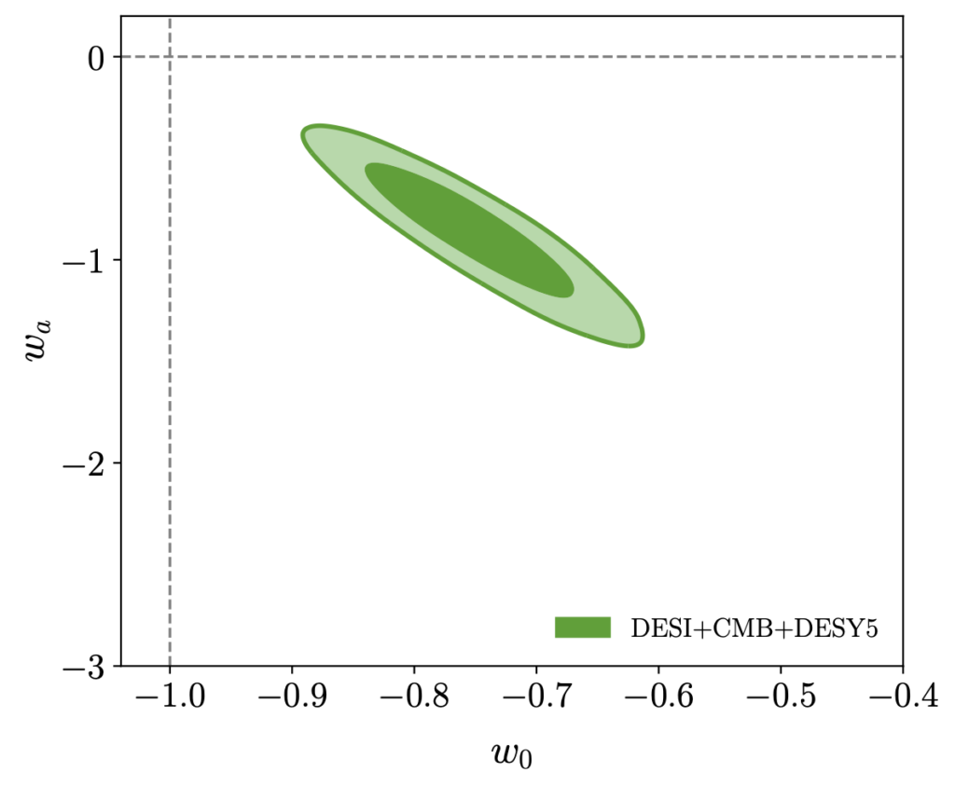
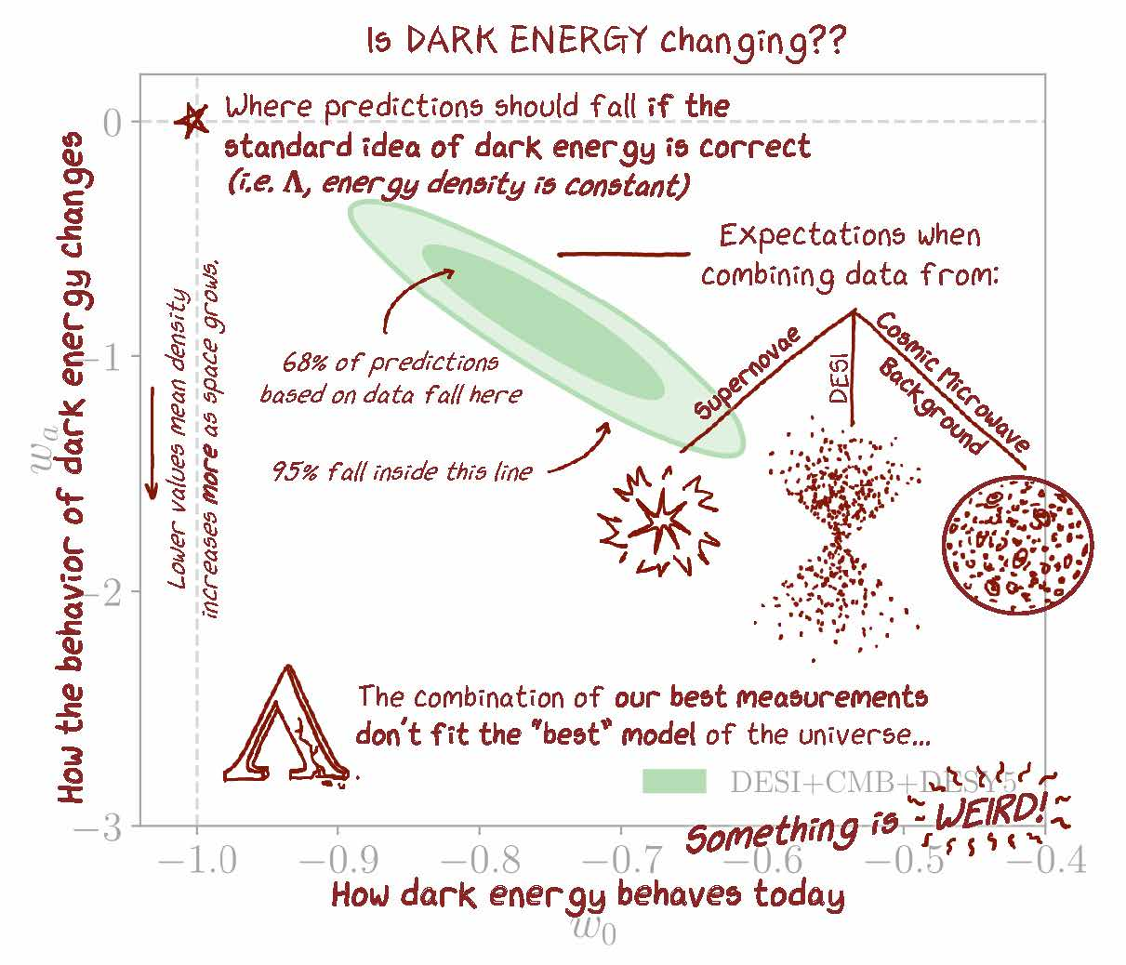
Cosmology Results: DESI DR2
Measured BAO distances from ~15 million galaxies & QSOs across 0.1 < z < 2.1
When combined with external probes (CMB, SNe),
w_{o}w_{a} cosmology : Time-varying dark energy provides a better fit (than LCDM) in some combinations
Preference at ~ 2.8–4.2 σ depending on dataset
Where Mocks come into picture:
Covariance matrices needed to quantify uncertainties
Robust Model Testing under realistic survey conditions
Disentangle cosmological signals from observational or sample variance effects
Notes:
Cosmological signals → the true physics we want to measure, like BAO wiggles, growth of structure, dark energy signatures.
Observational effects → artifacts from the survey itself (e.g. telescope geometry, incomplete sky coverage, redshift errors, fiber assignment).
Sample variance → randomness from only observing one Universe (and a finite volume of it). Even if the physics is the same, different patches of sky would give slightly different clustering patterns.

Slide 18
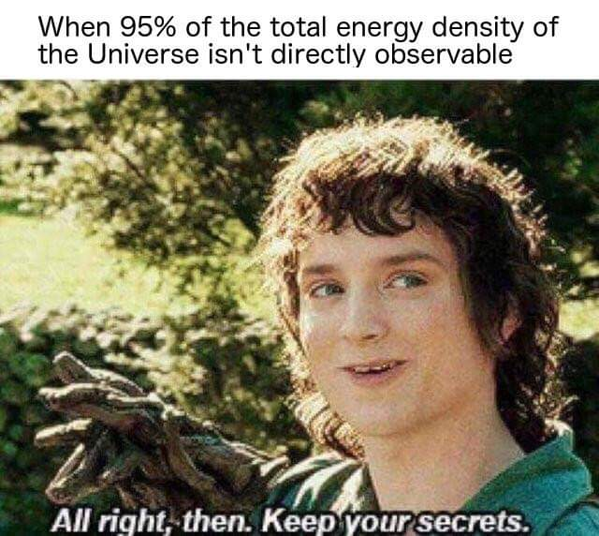
Summary & Future
DESI currently delivering the most precise measurements of our universe's structure
Quality of this data demands an equally sophisticated simulation and modelling infrastructure
Currently producing reasonable results 0.5 Mpc/h onwards
Continued development of mock catalogs is essential for:
Testing theories of gravity
Measuring the mass of the neutrino
Constraining the nature of dark energy with unprecedented precision
The better our simulations, the more we can learn from our observations
No Frodo, let’s unravel the secrets!
Notes:
the DESI survey is a tremendous success, providing a firehose of incredible data. To meet the challenge of analysing this data, our simulations and models must continue to evolve. This ongoing work is what will allow us to push the boundaries of cosmology—to test Einstein's theory of gravity on the largest scales, to weigh the elusive neutrino, and to find new clues about the nature of dark energy. The synergy between observation and simulation is at the heart of modern cosmology, and its future is incredibly bright. Thank you.

Slide 19
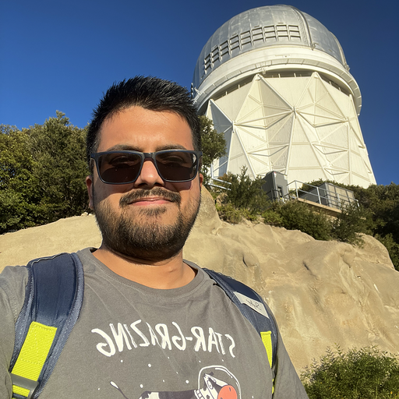

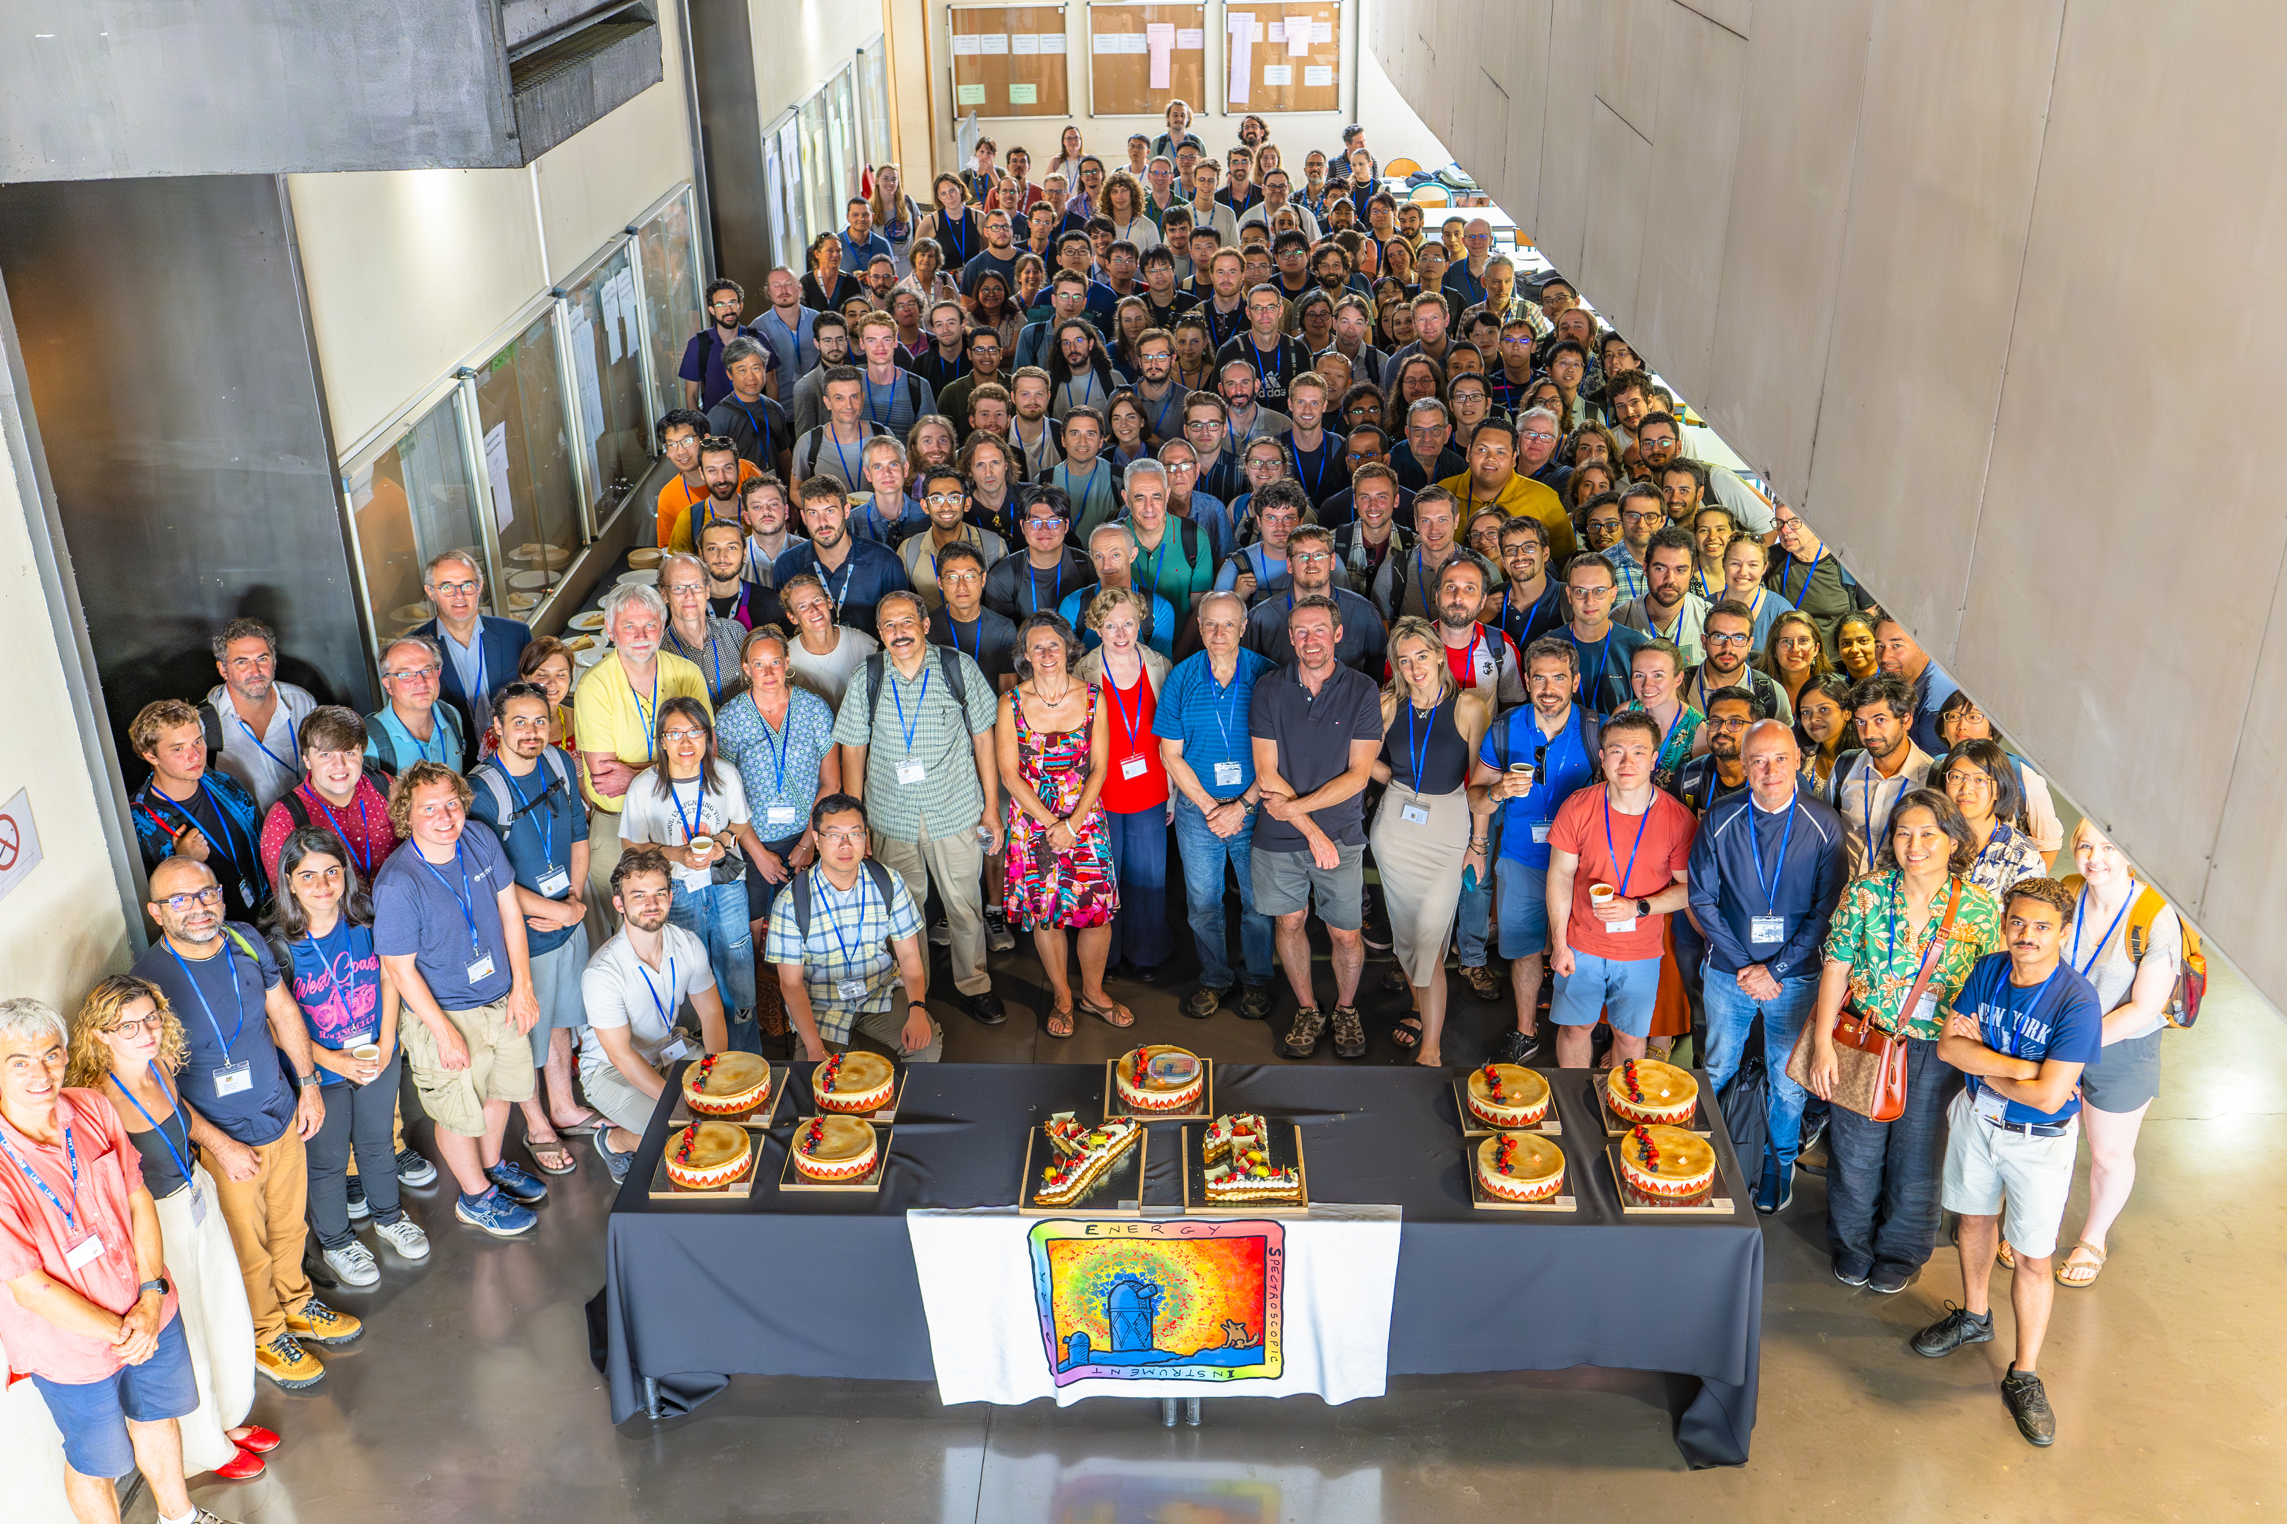
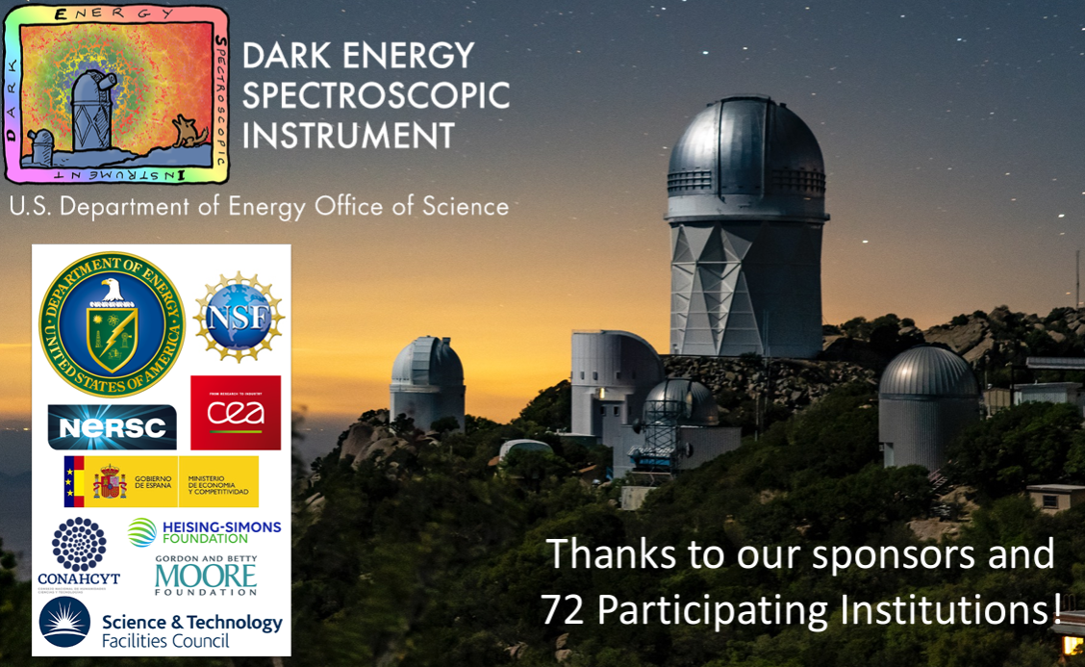
References & Acknowledgements
Prada et al, A&A, 698 (2025) A170
Vaisakh, et al ( in Collab. Review)
Wechsler, R. H., & Tinker, J. L. (2018). The Connection between Galaxies and Their Dark Matter Halos
DESI Collaboration et al. (2025) DESI DR2 Results II: Measurements of Baryon Acoustic Oscillations and Cosmological Constraints
I am looking for Postdoc Opportunities!
For further details and discussions, contact: vvaisakh@smu.edu vaisakh96@gmail.com
Thank You!
Team members: Robert Kehoe, James Lasker, Nabendu Khan, Antone Amalbert (SMU)
Francisco Prada, Elena Fernandez-Garcia (IAA-Spain), Anatoly Klypin (Uva)
The DESI collaboration is honored to be permitted to conduct scientific research on Iolkam Du’ag (Kitt Peak), a mountain with particular significance to the Tohono O’odham Nation.
Special thanks to National Energy Research and Computing Center (NERSC, at LBL, Berkley), CESGA Supercomputing Cluster (IAA, Barcelona, Spain), and SMU HPC – Maneframe III, SMU, Dallas, Texas, for access to their high-performance computing clusters.

Slide 20
Backup

Slide 21
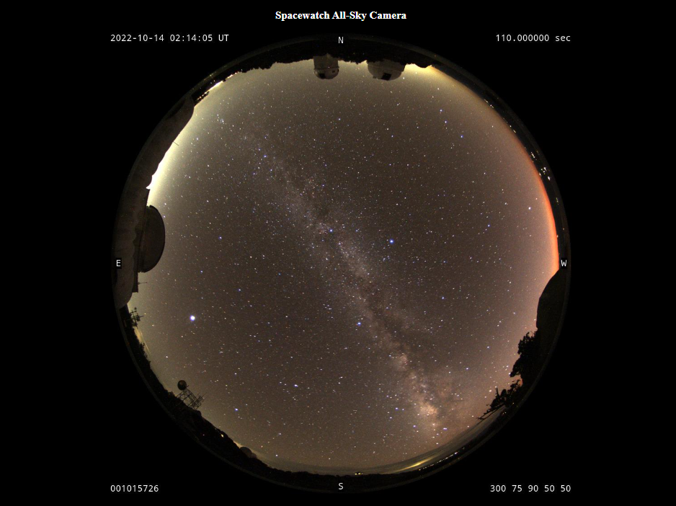
Outline
Introduction
Dark Matter Halos
Galaxy Surveys (DESI)
Galaxy Halo Connection
Modelling
Empirical models
SHAM
Results

Slide 22
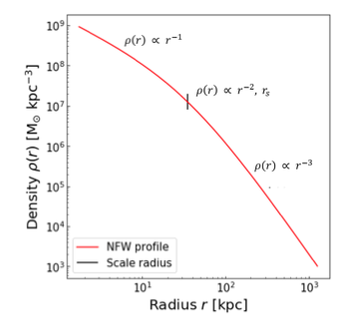

The Dark Matter Halo
Halo Mass Function
Abundance of halos
Density Profile
Halos not uniform spheres
Substructures
Subhalos - remnants that were accreted and tidally stripped
Assembly History
Same mass Halos can have very different histories
Some are early and dense, others late and more diffuse
Host satellites
Exponentially more low-mass halos than high-mass ones!
Peaks at the centre and falls off (see NFW profile)
Notes:
Let's start with the first pillar: the halo itself. As Wechsler and Tinker review, halos are characterized by several key properties. The most important is mass, and theory gives us a precise prediction for how many halos of each mass should exist. They also have a universal density structure, being much denser at their centers. Critically, halos are lumpy, filled with substructure—these are the subhalos that will host satellite galaxies. And finally, a halo's life story, or 'assembly history,' matters deeply.

Slide 23
The Halo Mass Function: A Key Prediction
A cornerstone prediction of the ΛCDM model
(dn/dM​) - number density of halos of a given mass at any cosmic epoch
Tells us how many small halos versus how many rare, giant halos we should expect in each volume of space.
This prediction from simulations is incredibly robust and serves as the foundation for populating our virtual universes
Notes:
One of the most powerful predictions from our simulations is the 'Halo Mass Function'. It's a cosmic census that tells us exactly how many halos of different sizes should exist. There are countless small halos for every one massive, cluster-sized halo. Because this prediction is so solid, we can use it as our starting point. If we know how many halos of each mass exist, our next job is to figure out what kinds of galaxies to put inside them.

Slide 24
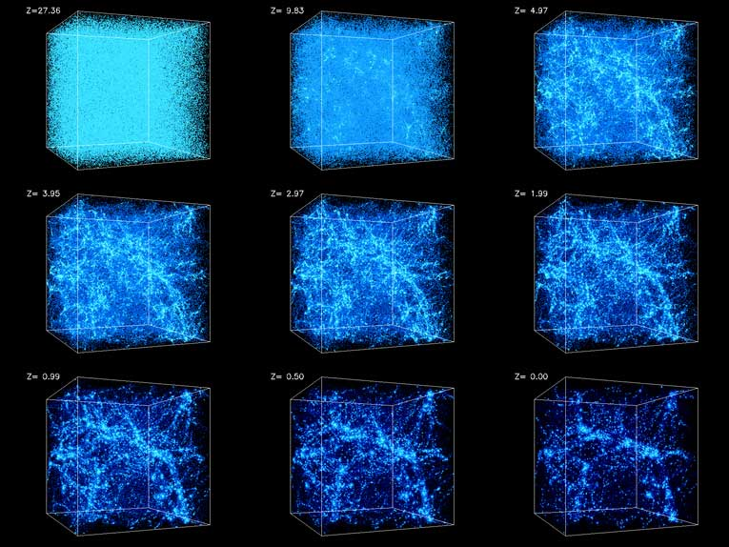
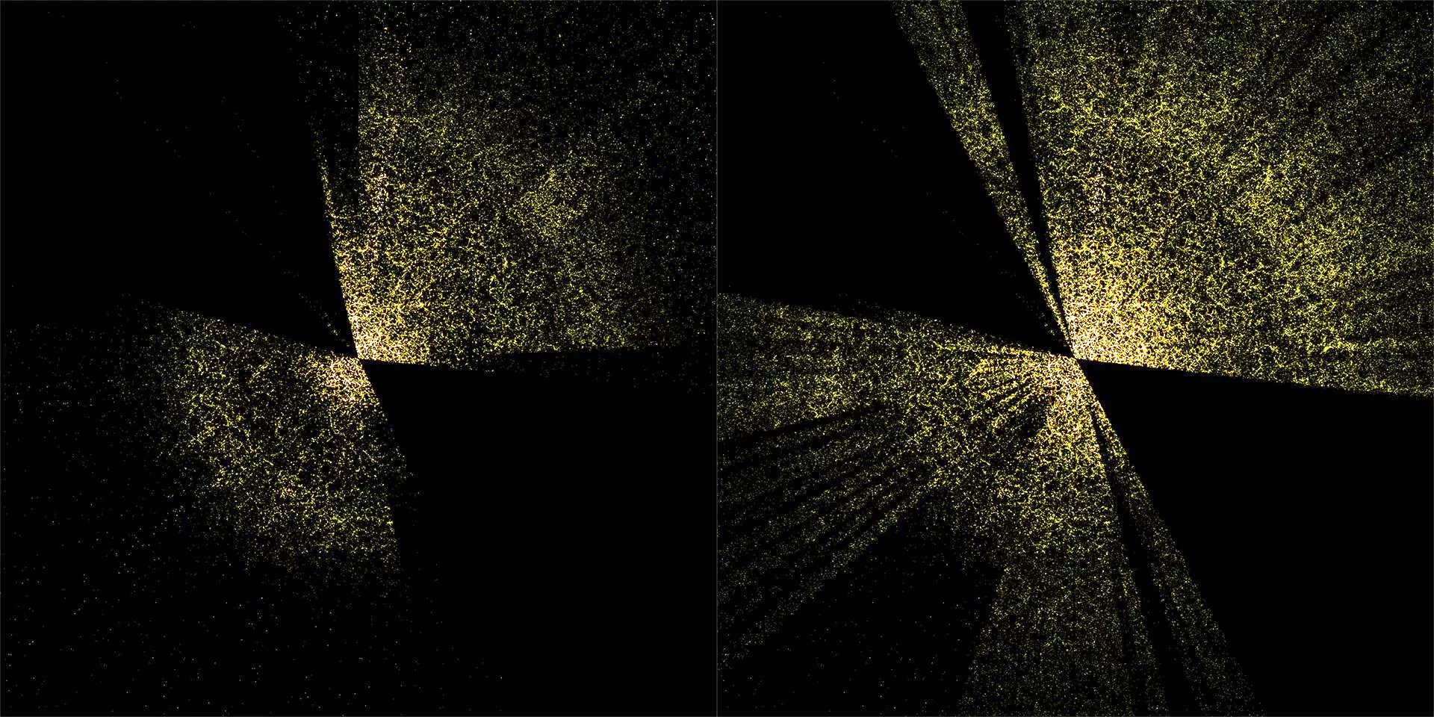
Large Scale Structure Surveys
Observe large regions of space to produce galaxy redshift surveys
Growth of LSS gives info about time dependence of Gravity, Dark Energy
Simulation Credit: National Center for Supercomputer Applications by Andrey Kravtsov (U Chicago) and Anatoly Klypin (NMSU).
Image Credits: DESI Science Outreach; Institute of Space Sciences (ICE-CSIC) Outreach
Sloan Digital Sky Survey (SDSS)
Dark Energy Spectroscopic Instrument (DESI)
Notes:
The earth is at the center, with the furthest galaxies plotted at distances of 10 billion light years. Each point represents one galaxy.

Slide 25
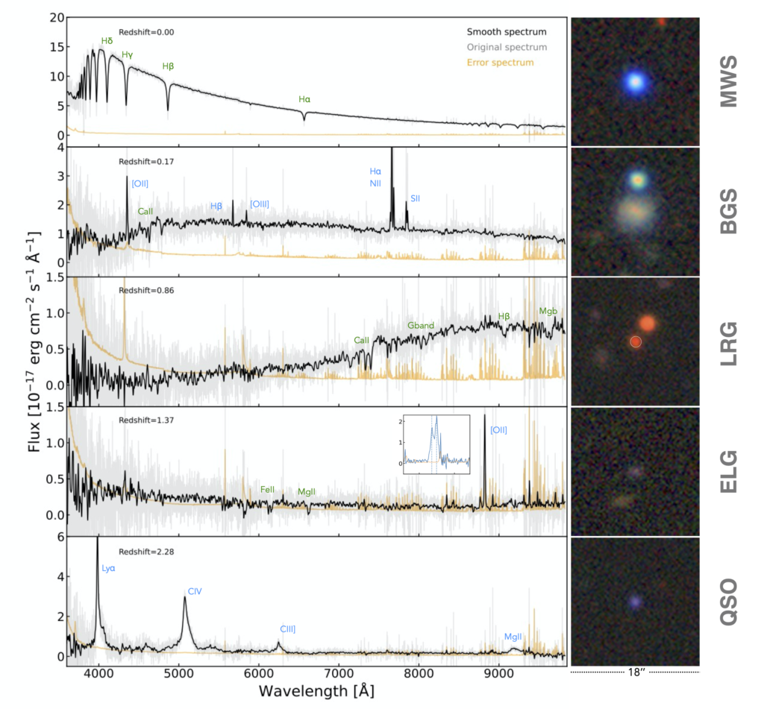
DESI Dark Matter Tracers
DESI uses different types of DM tracers
Milky Way Survey (MWS)
Bright Galaxy Survey (BGS)
Luminous Red Galaxies (LRGs)
up to Redshift z = 1.1 (4000 Å break)
Emission Line Galaxies (ELGs)
up to z = 1.6 (bright forbidden [OII] emissions)
Quasars (QSOs)
Direct tracers ( z<2.1)
Using Lyman-α absorption features (2.1 < z < 3.5)
Stars, z~0
upto z ≈ 0.4
Example spectra for the DESI target classes.
Credit: Ting-Wen Lan, DESI member
Notes:
Direct tracers ( z<2.1)
Using Lyman-α absorption features [clouds of neutral hydrogen between galaxies] at higher z (2.1 < z < 3.5)

Slide 26
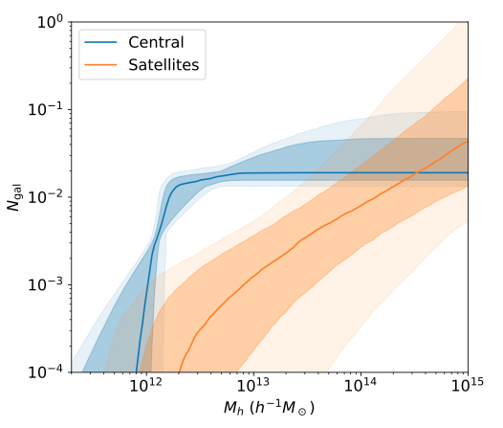
Halo Occupation Distribution (HOD)
A purely statistical framework
P(N∣M) - probability that a halo of mass M hosts N galaxies
Modeled as two separate components:
Centrals: ⟨N_{cen}​⟩ is a step-function
Below a minimum mass, M_{min}​, halos don't host a central galaxy
Satellites: ⟨N_{sat}​⟩ ∝ (M/M1​)^{α}
No. of satellites grows as a power-law with halo mass
Model parameters (few too many) are tuned to match observations
S.Yuan, et al. 2306.06314
Notes:
The Halo Occupation Distribution, or HOD, is a workhorse model in cosmology. It doesn't worry about the complex physics of galaxy formation. Instead, it statistically asks: given a halo of a certain mass, how many galaxies live inside? It splits this into centrals and satellites. The number of centrals is basically a switch—below a minimum mass, there's no galaxy; above it, there's one. The number of satellites then grows with halo mass. We can then adjust these few parameters until our simulated galaxy distribution has the same amount of clustering as the real DESI data.

Slide 27
Bridging the gap: Empirical Models
Halo Occupation Models (HOD)
Halo + galaxy number distribution model (given host halo properties)
Subhalo Abundance Matching (SHAM)
Halos & subhalos + Galaxy-halo connection model
Empirical Forward Modelling
Density Peak evolution + Star formation rates
Semi-Analytic Models
Density Peak evolution + Star Formation/ gas cooling/ Feedback
Hydrodynamical Simulations
Simulate Halos + Gas
Star formation + Feedback
Computationally impossible to simulate the entire universe with full galaxy formation physics
Instead, we use empirical models to statistically connect the halo population (from dark matter-only simulations) to the observed galaxy population.
Empirical Models
Physical Models
Notes:
Because simulating all the complex physics of galaxy formation across the entire universe is computationally prohibitive, we use a clever shortcut: empirical models. These are statistical frameworks designed to bridge the gap between the halo populations we get from simulations and the galaxy populations we see in surveys. The review highlights three major classes of these models.

Slide 28
Closer to how it all began!
Distant Universe
We’re here now!
Nearby Universe
Computer simulations allow us to compare observational results to the theoretical formation of clusters and large-scale filaments in the Cold Dark Matter model with dark energy.

Slide 29

Constructing the Lightcone
Constructing a Lightcone
Surveys don’t see a static cube of the universe
When we look at distant objects, we look back in time: A lightcone mimics this reality
Apply periodic wrapping with the observer at a box centre
Apply periodic replications if shell edges exceed the box size
Adjust number density to match target values and avoid shell interface discontinuities
Cut cubic box into a spherical shell, edges set by comoving distances between snapshots
Convert (x,y,z) to (RA,DEC, Z), including peculiar velocity effects along line of sight
Join spherical shells from successive snapshots to build the lightcone
Notes:
But a simulation box represents the universe at only one instant in time. A real survey like DESI sees a 'lightcone'. The further we look, the further back in time we see. To replicate this, we place a virtual observer in our simulation and carve out a wedge. As we go further out in this wedge, we pull halo information from earlier and earlier snapshots of the simulation. This creates a mock catalog that truly represents what a telescope would see.

