Slide 1



Probing the meV QCD Axion with the SQWARE Quantum Semiconductor Haloscope
TACOS 2025
Jaanita Mehrani, Tao Xu, Andrey Baydin, Michael J. Manfra, Henry O. Everitt,
Andrew J. Long, Kuver Sinha, Junichiro Kono, Shengxi Huang
based upon work in
arXiv:2509.14320
08/05/25
Jaanita Mehrani | Rice University
TACOS 2025
Notes:
Hi everyone my name is Jaanita and I am an Applied physics graduate student from Rice University and today I’ll be talking about my groups recent work that was published on arXiv last month about a new proposed dark matter detector, SQWARE. I actually presented a talkito last year on this project when it used to be called T-RAX, now we have a new name and cool logo!!

Slide 2
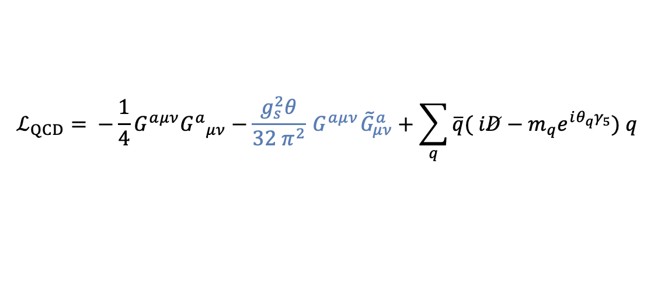
Axions are a promising DM model
85% of matter is dark matter!
Several theoretical models with unique properties like mass, spin, charge, couplings!
Axions could additionally solve the strong charge parity problem in quantum chromodynamics (QCD)
Peccei-Quinn theory:
$$ℒ_{QCD}= −\frac{1}{4}{G^{aμν}G^{a}}_{μν}−\frac{g_{s}^{2}θ}{32 π^{2}}{ G}^{aμν}{\tilde{G}}_{μν}^{a}+\sum_{q}{\overline{q}( iD−m_{q}e^{iθ_{q}γ_{5}}) q }$$
$$ℒ_{a}=\frac{1}{2} {\left(∂_{μ}a\right)}^{2}+\frac{a}{f_{a}}\frac{g_{s}^{2}}{32π^{2}}G\tilde{G}+\frac{1}{4}g_{aγ}^{0} a F\tilde{F}+\frac{∂_{μ}a}{2f_{a}} \overline{q}c_{q}^{0} γ^{μ} γ_{5} q−{\overline{q}}_{L}M_{q}q_{R}+h.c.+…$$
08/05/25
Jaanita Mehrani | Rice University
TACOS 2025
Notes:
We are interested in axions that can additionally solve the strong charge parity problem in QCD. Proposed as a Peccei-Quinn solution by Wilczek and Wienberg almost 50 years ago, the axion is a new particle that can couple to the gluon fields and cancel out the fine-tuning problematic term in the QCD Lagrangian.

Slide 3
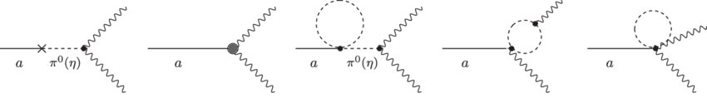
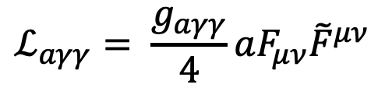



How can we detect axions?
Axions can couple to photons under different models (KSVZ/DFSZ)
which results in the effective interaction Lagrangian
Inverse Primakoff effect
Axions can convert into photons in a magnetic field
γ
$$ℒ_{aγγ}= \frac{g_{aγγ}}{4}aF_{μν}{\tilde{F}}^{μν}$$
$$a$$
$$g$$
$$B$$
08/05/25
Jaanita Mehrani | Rice University
TACOS 2025
Notes:
Because of the axions coupling to gluon fields, axions can couple to photons, through mixing with the neutral pion. Since it’s a new particle, other models can introduce direct couplings with standard model particles. The effective coupling to the photon is given by g a gamma gamma, which realizes the inverse Primakoff effect where axions convert into photons under a strong magnetic field

Slide 4
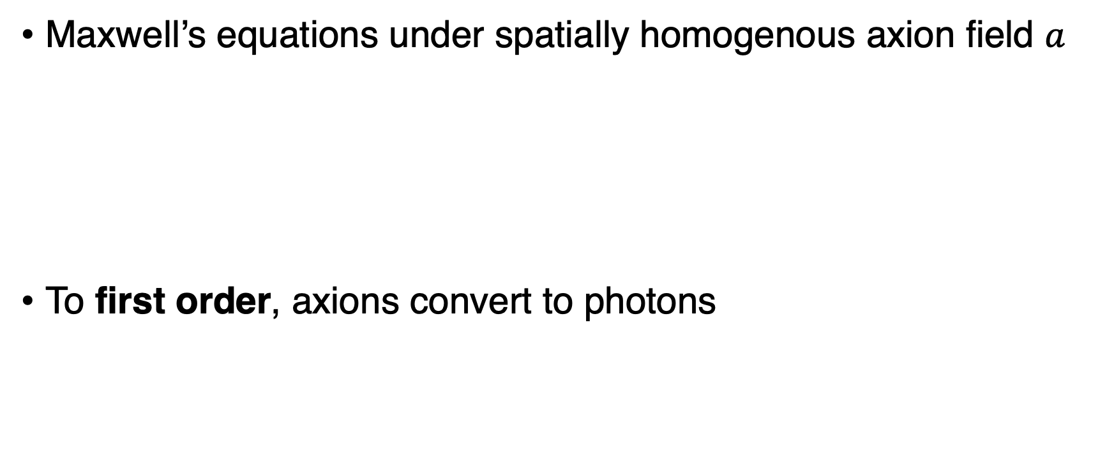

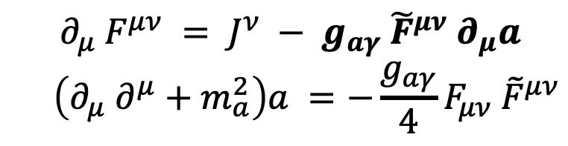
Inverse Primakoff effect
Maxwell’s equations under spatially homogenous axion field $a$
To first order, axions convert to photons
$$∂_{μ} F^{μν} = J^{ν} − g_{aγ} {\tilde{F}}^{μν} ∂_{μ}a$$
$$\left(∂_{μ} ∂^{μ}+m_{a}^{2}\right)a =−\frac{g_{aγ}}{4}F_{μν} {\tilde{F}}^{μν}$$
$$\hat{ϵ}E\left(t\right)=−g_{aγ}B_{e}a_{0}e^{−im_{a}t}$$
08/05/25
Jaanita Mehrani | Rice University
TACOS 2025
Notes:
In the inverse Primakoff effect, maxwells equations are modified under a spatially homogenous time varying axion field a. which generates an effective current. And to first order, this creates an oscillating electric field, proportional to coupling g, magnetic field B, and axion. Importantly, it is also inversely proportional to epsilon, the permittivity. Which In a vacuum would be 1, but can be optimized in materials to generate large fields. Which we will see later

Slide 5
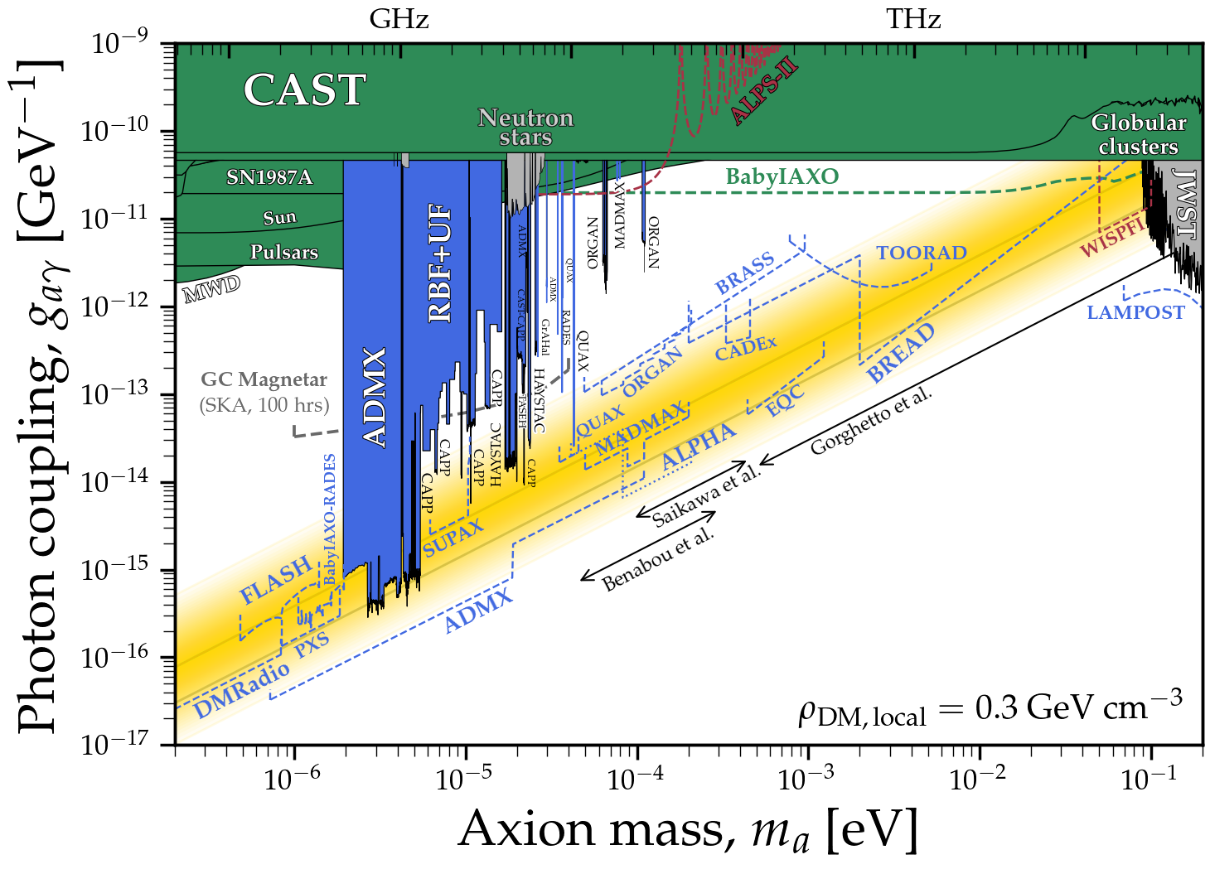
Axion Search Strategies
C. O’Hare
08/05/25
Jaanita Mehrani | Rice University
TACOS 2025
Notes:
Many axion search strategies utilize the Primakoff effect. Here are different proposed and previously running experiments that probe the covering a large QCD axion parameter space, but there still exists a gap in the meV axion or conversely the THz photon frequency range.

Slide 6
Axion Search Strategies
C. O’Hare
08/05/25
Jaanita Mehrani | Rice University
TACOS 2025
Notes:
Before targeting the range, we can categorize the search strategies that get close by how they

Slide 7
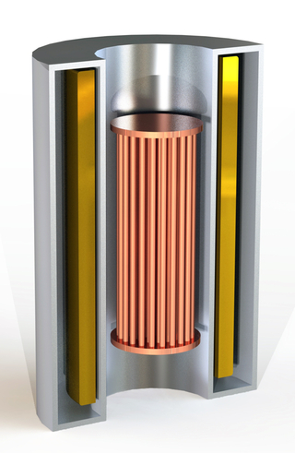
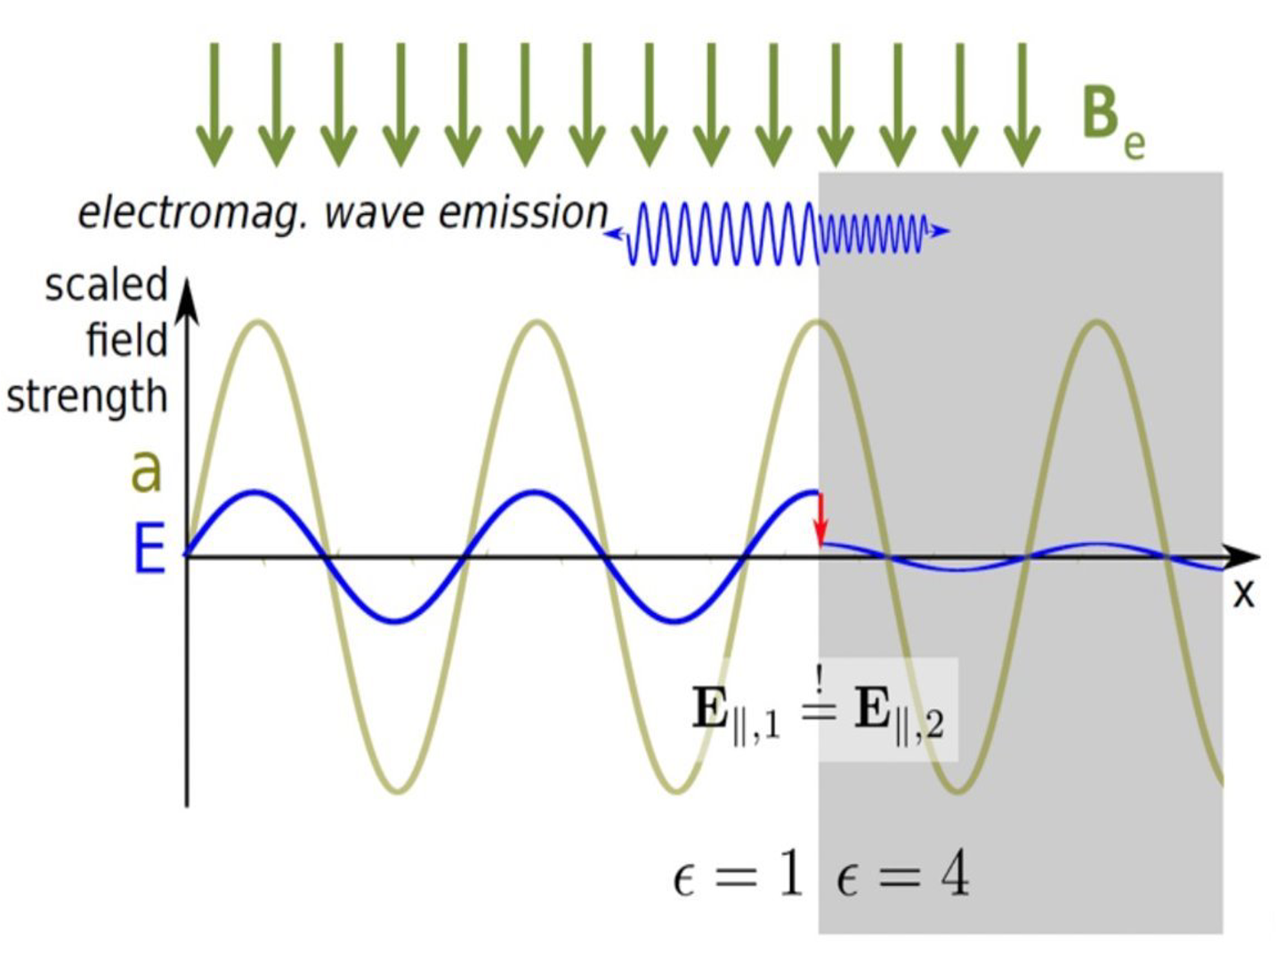
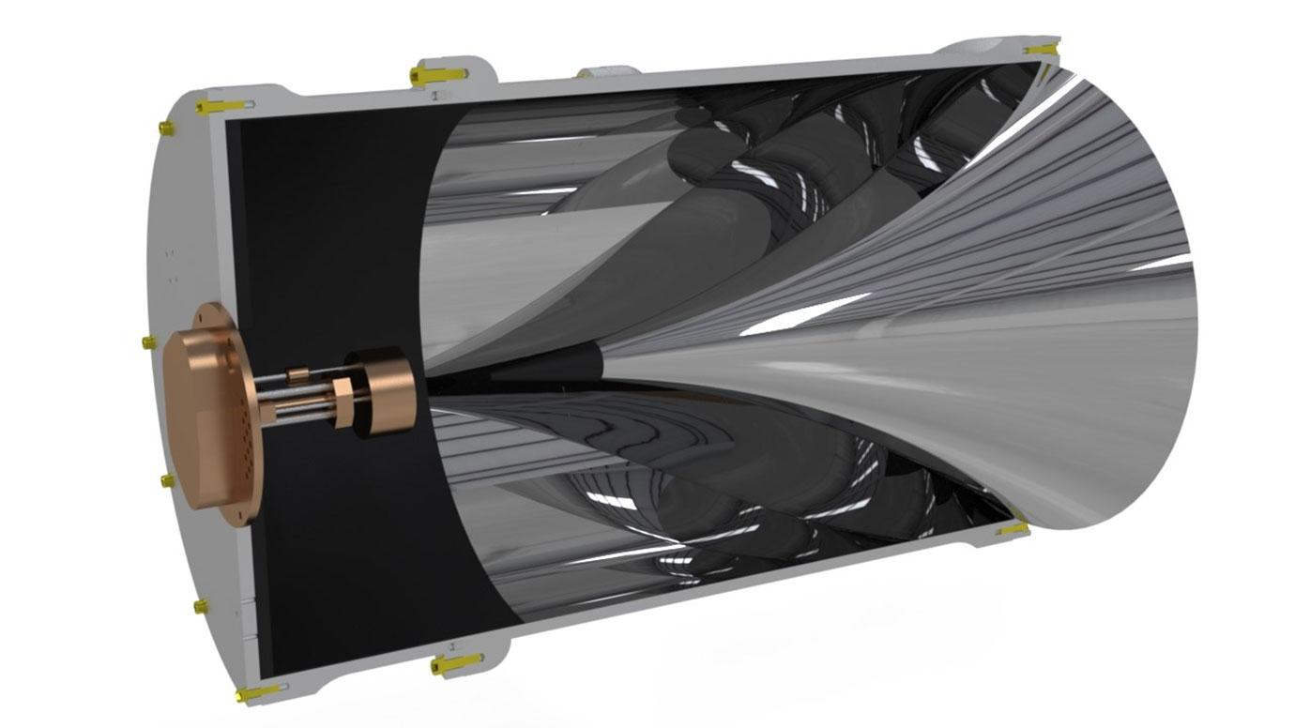
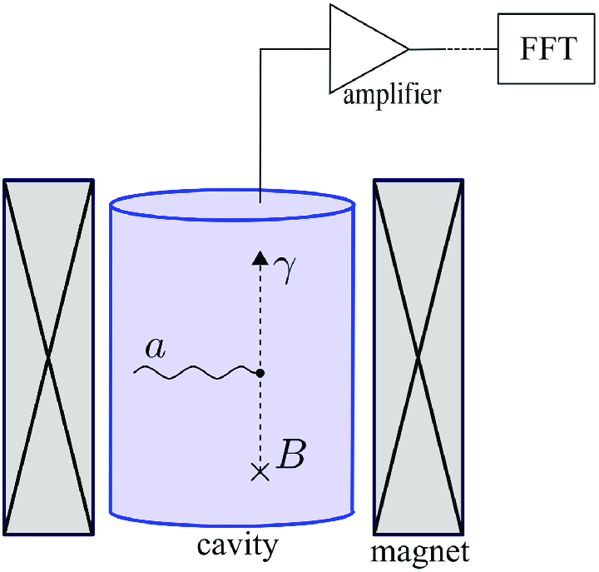
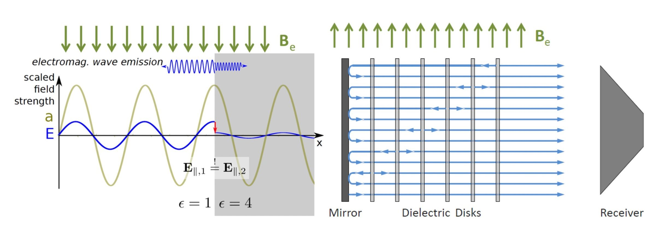
Axion Search Strategies
Axion-Photon Signal Enhancement
Broadband:
focus photons from large volume
Resonant:
cavities resonate at axion mass
Vacuum
- reduced volume
- reduced quality - mechanical tuning (moving rods)
Material
- lack of low-loss
quasiparticle or plasmonic materials
- mechanical tuning (strain or pressure)
Dielectric
- reduced volume
- low structural integrity - mechanical tuning
(moving thin disks)
ALPHA
BREAD
ADMX
MADMAX
C. O’Hare
TACOS 2025
Jaanita Mehrani | Rice University
Notes:
Enhance the axion to photon signal conversion. You can have broadband detectors like BREAD that focus photons from a large volume onto a smaller detection area using a parabolic reflector to enhance the signal flux. Complementary to broadband techniques, are to use cavities that resonate with the axion mass. This includes vacuum cavities like ADMX at lower frequencies. This suffers from reduced volume and quality factor when extrapolating to shorter wavelengths. Dielectric cavities like MADMAX get closer. They utilize dielectric media in vacuum, which generates different axion-induced electric fields, so the dipole at the discontinuity will generate surface radiation that can be coherently detected. They suffer similar problems like smaller structures and difficult mechanical tuning. Finally. you can have inherent resonances in a material, like plasmons, quasiparticles, and phonons, like here in ALPHA or TOORAD which get the closest. But there is a lack of well-studied THz materials in this range. So, this is where we introduce using designer materials

Slide 8
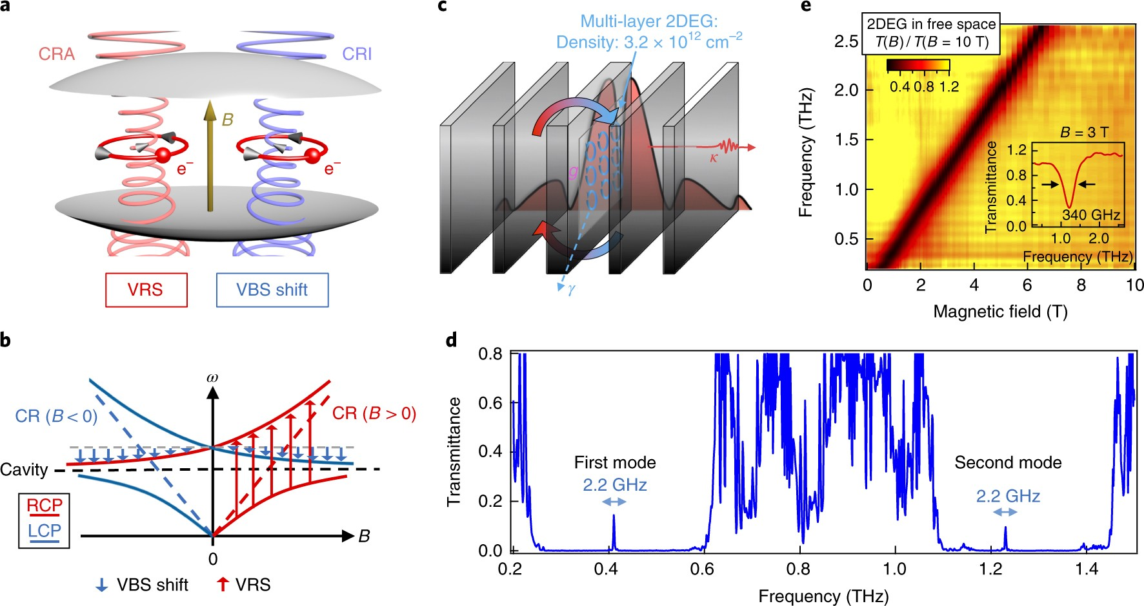
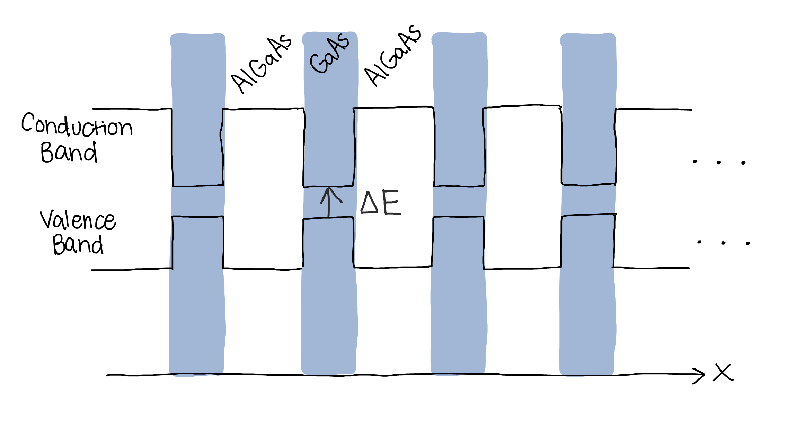
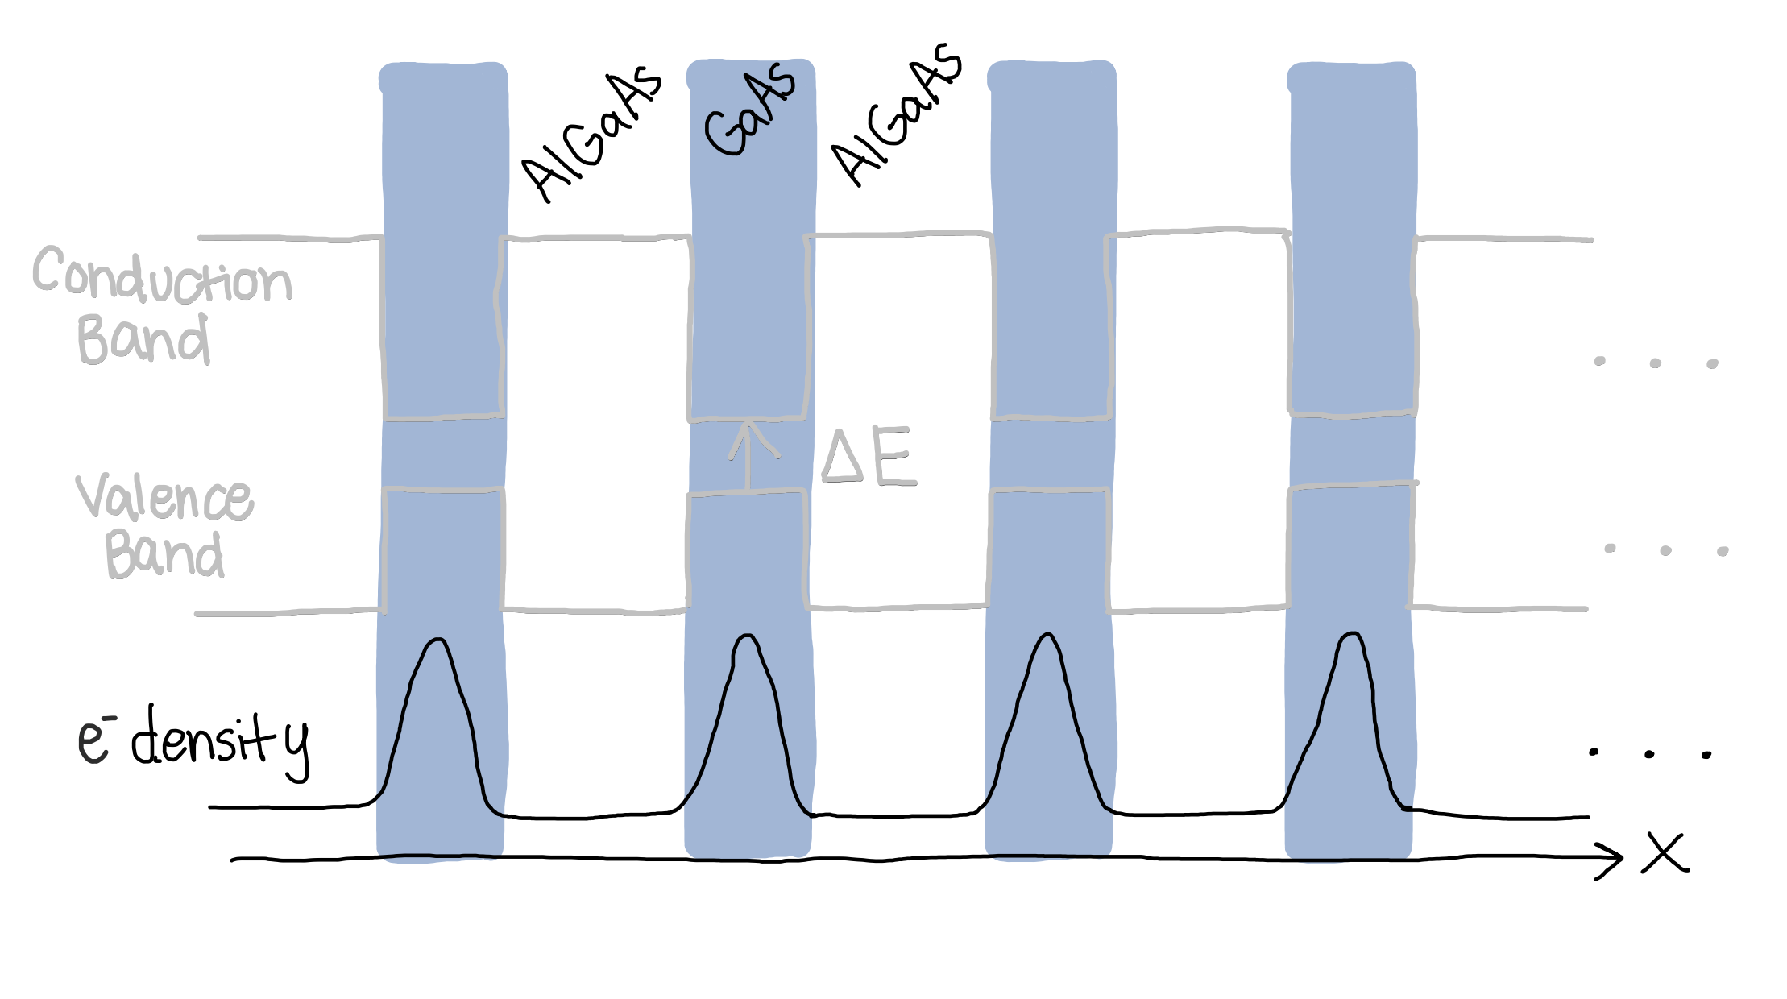
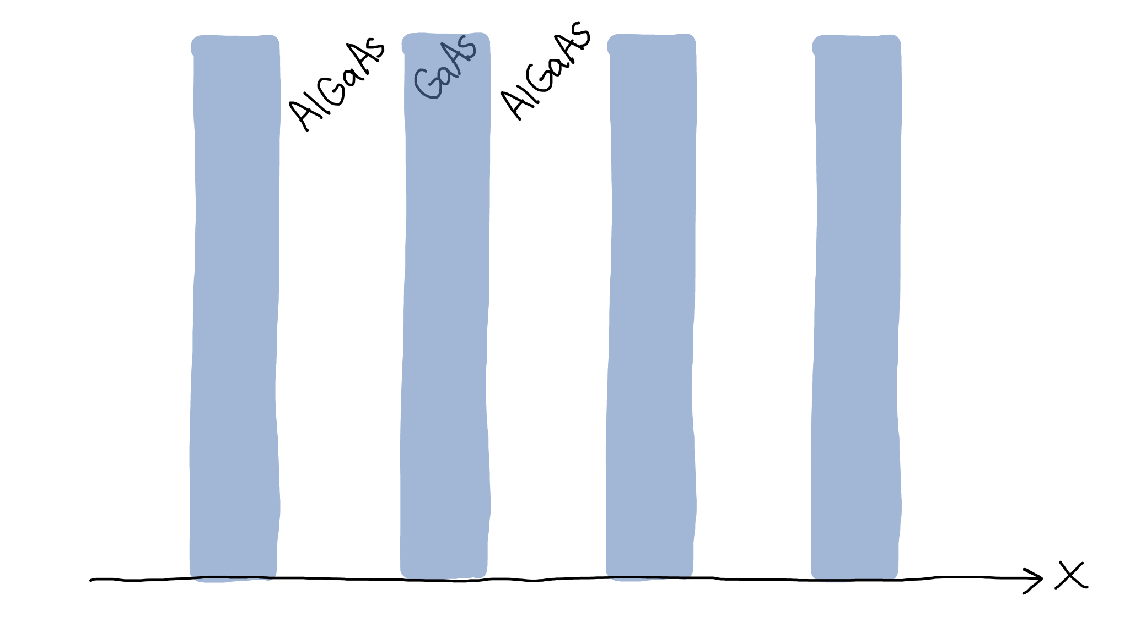
Multiple Quantum Wells (MQW)
Low-loss THz plasmonic resonances that are electromagnetically tunable!
Li, X., Manfra, M., Kono, J., et. al.
Nature Photonics (2018)
08/05/25
Jaanita Mehrani | Rice University
TACOS 2025
Notes:
Specifically multiple quantum wells, that can offer low loss THz plasmonic resonances that are electromagnetically tunable. The wells are doped GaAs 2d electron gases with algaas barriers, here is the energy band and electron density. And here is the resonance tuning sharply with the magnetic field.

Slide 9
Semiconductor- Quantum- Well Axion Radiometer Experiment
logo by Haaniya
08/05/25
Jaanita Mehrani | Rice University
TACOS 2025
Notes:
Our proposal is called SQWARE, which stands for the semiconductor-quantum-well axion radiometer experiment, taking inspiration from dielectric and plasmonic haloscopes like MADMAX and ALPHA.

Slide 10
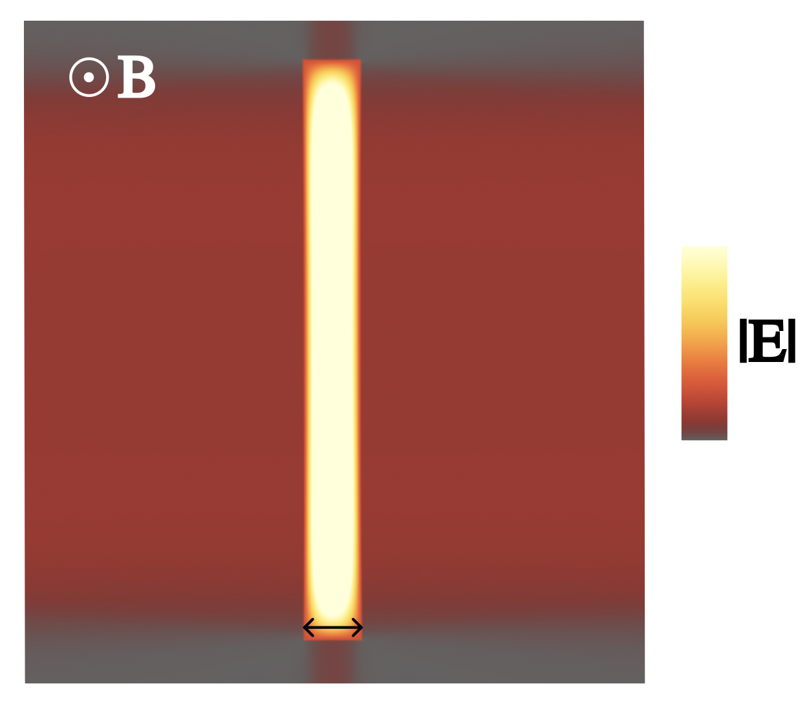
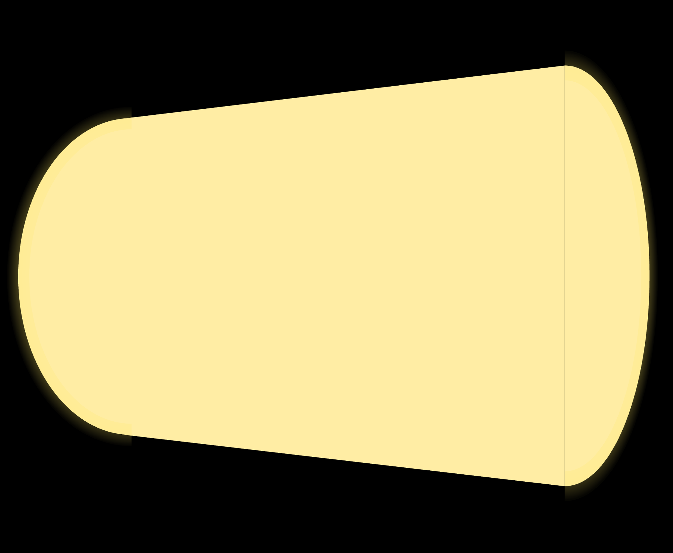
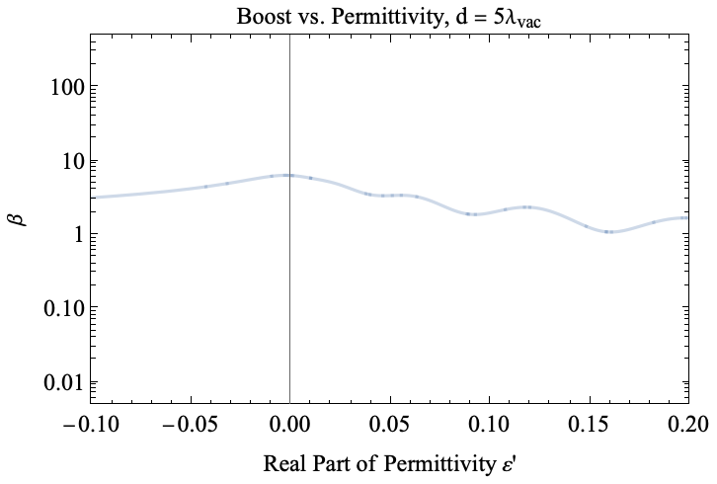
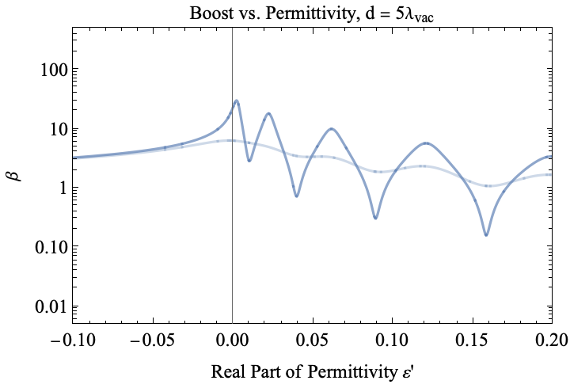
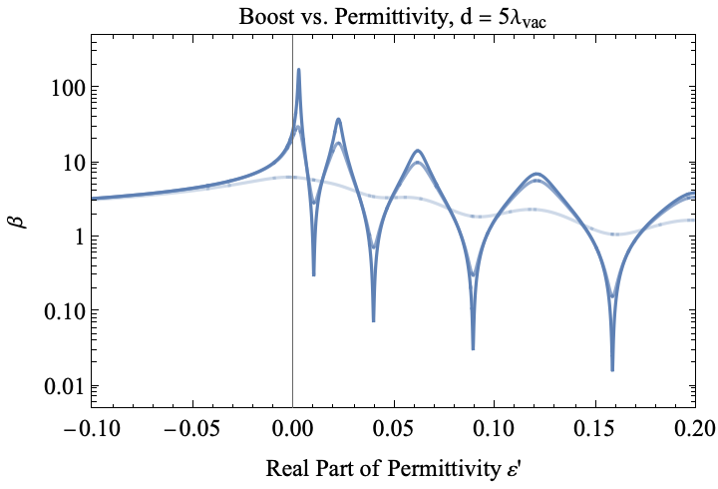
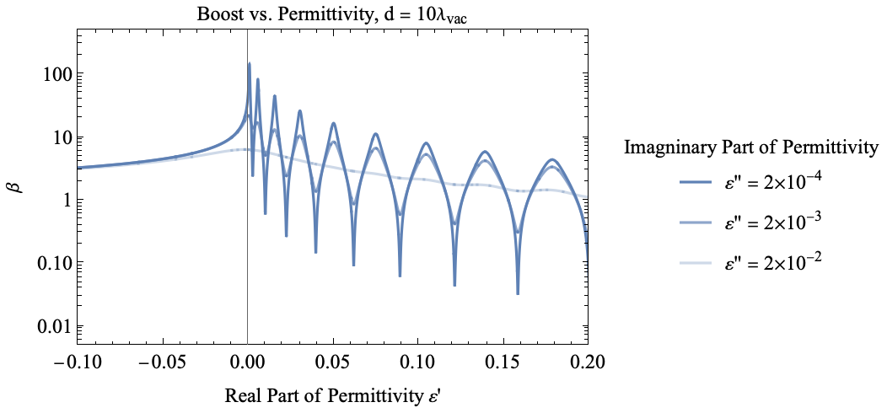



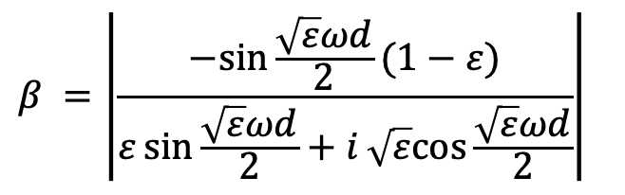


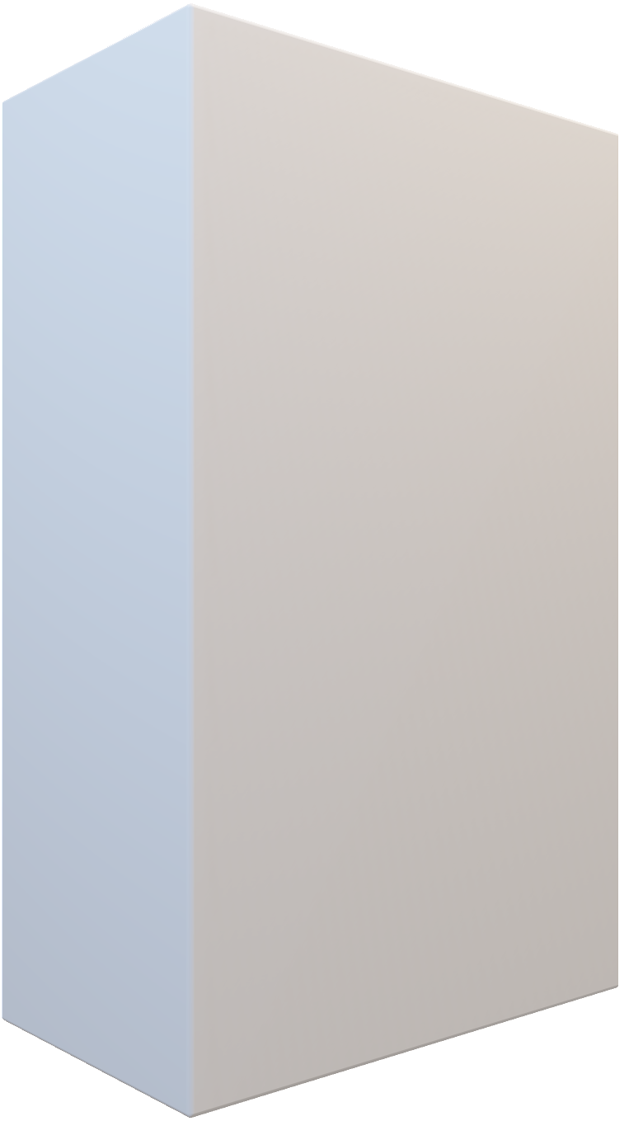
Material’s Plasmonic Response to Axion
Axion-induced electric field
Plasmonic cavities generate surface radiation with boost $β$
$$ε→0$$
$$E_{med}=\frac{E_{vac}}{ε}=\frac{g_{αγ}Ba}{ε}$$
ENZ (ε-near-zero)
$$E_{prop}=βE_{vac}$$
$$β =\left|\frac{−sin{\frac{\sqrt{ε}ωd}{2}(1−ε)}}{ε\sin{\frac{\sqrt{ε}ωd}{2}}+i\sqrt{ε}cos{\frac{\sqrt{ε}ωd}{2}}}\right|$$
d = λ_{med}/2 = λ_{vac}/2$\sqrt{ε}$
COMSOL Simulation
Mehrani, arXiv:2509.14320
08/05/25
Jaanita Mehrani | Rice University
TACOS 2025
Notes:
Now we can go through the details of the mechanism. As before, we have the axion-induced electric field inversely proportional to the permittivity. In a plasmonic material like an MQW, the permittivity can be very small. In a plasmonic cavity, the axion will generate radiation from the surface, just like MADMAX, with boost beta. Which is a function of the permittivity, frequency, and cavity width. Here is a plot of the boost as a function of the real part of the permittivity for selected imaginary part or losses. as the losses get smaller, the boost gets larger. The point at maximum boost is denoted as the epsilon near zero or ENZ point. And here is a different cavity thickness. We also simulate this in 2D in COMSOL and you can see the surface radiation.

Slide 11
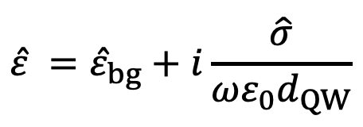
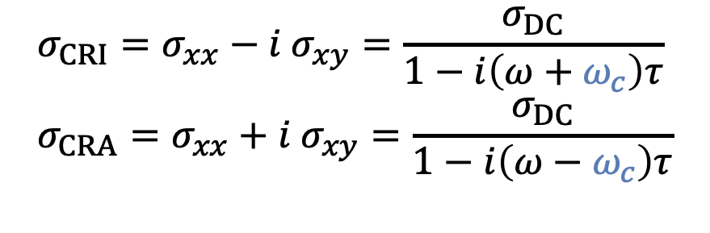

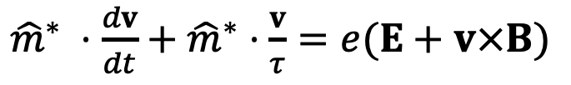
Cyclotron Resonance
A magnetic field tunes ENZ point with cyclotron resonance
Conductivity
Permittivity
${\hat{m}}^{∗} ⋅\frac{dv}{dt}+{\hat{m}}^{∗}⋅\frac{v}{τ}=e(E+v×B)$
$$J=nev=\hat{σ}⋅E$$
$$σ_{CRI}=σ_{xx}−i σ_{xy}=\frac{σ_{DC}}{1−i\left(ω+ω_{c}\right)τ}$$
$$σ_{CRA}=σ_{xx}+i σ_{xy}=\frac{σ_{DC}}{1−i\left(ω−ω_{c}\right)τ}$$
$$\hat{ε} ={\hat{ε}}_{bg}+i\frac{\hat{σ}}{ωε_{0}d_{QW}}$$
Li, X., Kono, J., et. al.
Nature Photonics (2018)
08/05/25
Jaanita Mehrani | Rice University
TACOS 2025
Notes:
The permittivity for the multiple quantum well material that we use is determined by cyclotron resonance, which is tuned with the magnetic field. Here we have the Lorenz equation, and you can solve for the conductivity and permittivity. There are two circular polarizations, CRI and CRA, cyclotron resonance active and inactive.

Slide 12
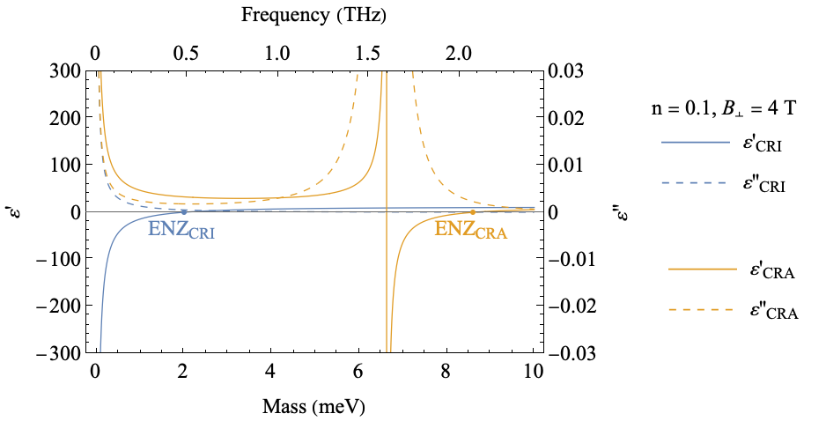
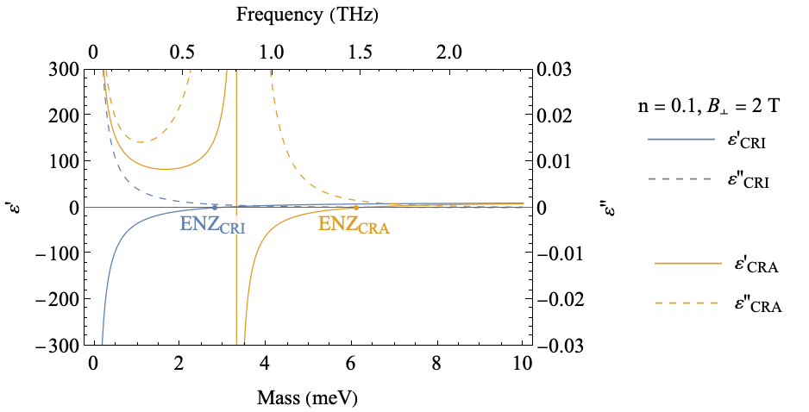
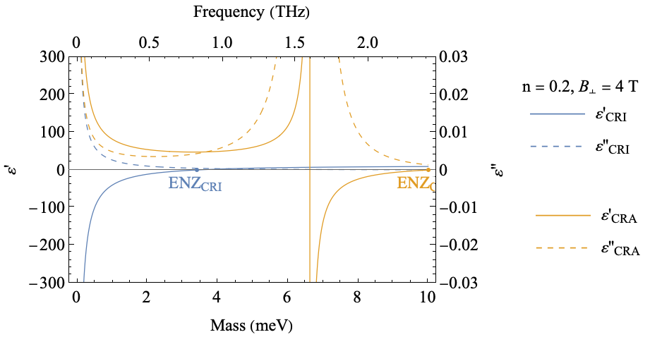

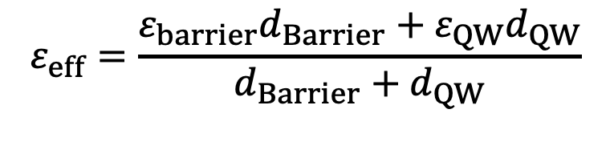
Permittivity
CRI mode is lossless
MQWs use effective medium theory (EMT)
$$β_{CRI}≫β_{CRA}$$
$$ε_{eff}=\frac{ε_{barrier}d_{Barrier}+ε_{QW}d_{QW}}{d_{Barrier}+d_{QW}}$$
Mehrani, arXiv:2509.14320
08/05/25
Jaanita Mehrani | Rice University
TACOS 2025
Notes:
We can plot the permittivity of a single quantum well with frequency, and by tuning the magnetic field or the doping density we can control the ENZ point. For our case, the CRI mode is more important. For MQWs, you can use effective medium theory, which just gives a weighted average of the permittivity of the wells and barriers.

Slide 13

Validate Effective Medium Theory (EMT)
COMSOL simulations of boost validate EMT:
layer thickness << $λ_{med}$
$$ε_{eff}=\frac{ε_{barrier}d_{Barrier}+ε_{QW}d_{QW}}{d_{Barrier}+d_{QW}}$$
Mehrani, arXiv:2509.14320
08/05/25
Jaanita Mehrani | Rice University
TACOS 2025
Notes:
We use COMSOL to validate EMT. Simulating thinner and thicker individual layer thicknesses and comparing with analytical expressions of boost as a function of the permittivity. Essentially, EMT is a good approximation when the thicknesses are smaller than the wavelength,

Slide 14
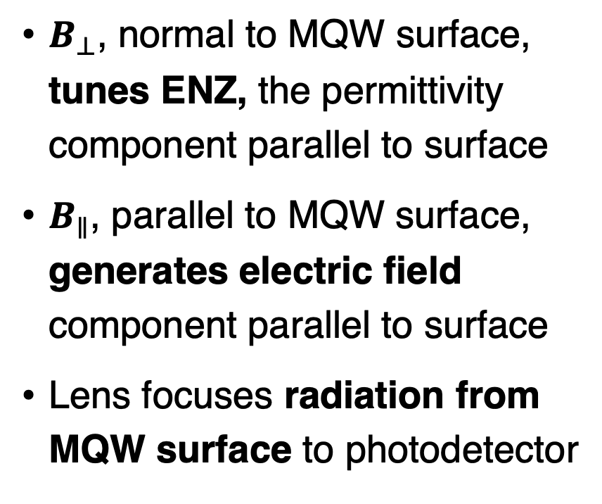
Detection Principle
$B_{⊥}$, normal to MQW surface, tunes ENZ, the permittivity component parallel to surface
$B_{∥}$, parallel to MQW surface, generates electric field component parallel to surface
Lens focuses radiation from MQW surface to photodetector
Mehrani, arXiv:2509.14320
08/05/25
Jaanita Mehrani | Rice University
TACOS 2025
Notes:
Now that we understand the MQW structure we can look at the detector schematic. We have the plasmonic cavity producing surface radiation that is redirected to a photodetector. The magnetic field serves two purposes, the normal component tunes the resonance. And the parallel component tunes the strength of axion-photon conversion. The tuning will be done by simply tilting the structure in the magnetic field.

Slide 15
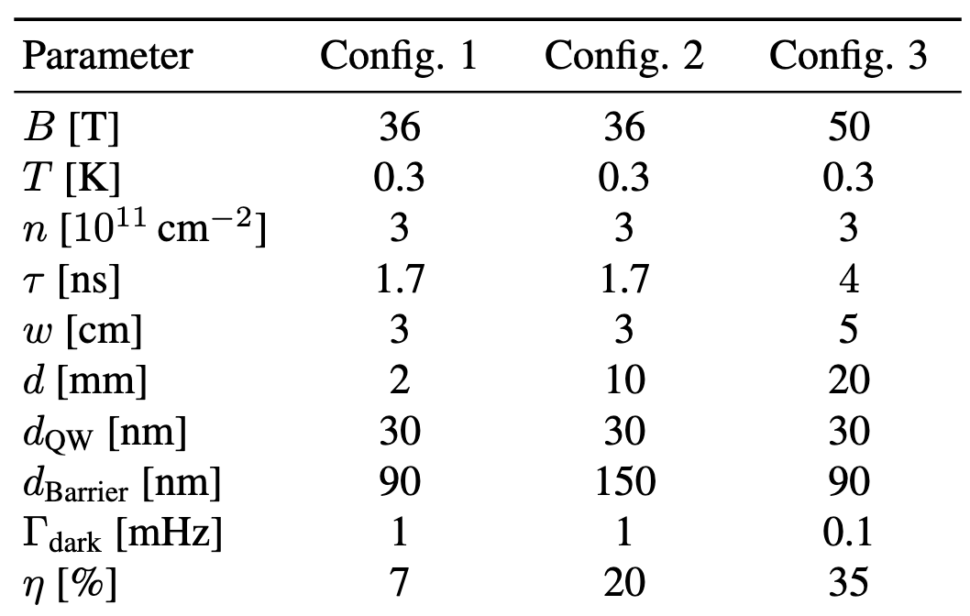
Experimental Parameters
Realistic
Optimistic
Mehrani, arXiv:2509.14320
08/05/25
Jaanita Mehrani | Rice University
TACOS 2025
Notes:
We use three different configurations, ranging from realistic to optimistic parameters depending on how much time and investment we can put in. For example, using thicker and larger MQWs, with longer scattering times (reduced losses). And better photodetector characteristics. Like higher quantum efficiencies and lower dark counts. Magnetic fields and temperatures are kept consistent based on what is experimentally available. Other parameters, like barrier thickness are then optimized.

Slide 16
Axion Proposed Sensitivity
Mehrani, arXiv:2509.14320
08/05/25
Jaanita Mehrani | Rice University
TACOS 2025
Notes:
We can finally plot the sensitivity of our proposed detector, for realistic configurations and more optimistic configurations for the same scan times. And, also some narrow search points for Configs. 1 and 2. which can probe into the theoretically favorable QCD axion parameter space.

Slide 17
Validating Experimental Conditions
Mehrani, arXiv:2509.14320
08/05/25
Jaanita Mehrani | Rice University
TACOS 2025
Notes:
Before concluding, if I have time, we can go through validating experimental conditions to check the feasibility.

Slide 18
Finite Surface Area of MQW
Smaller area leads to reduced collimation and reduced boost
Aspect ratio of ~1.5 leads to a 50% boost
Config. 2
Mehrani, arXiv:2509.14320
08/05/25
Jaanita Mehrani | Rice University
TACOS 2025
Notes:
First, the analytical boost expression is for a 1D structure. When testing in 2D using a finite surface are of the MQW, a smaller area will lead to reduced beam collimation and boost. From the figure, for Config. 2, an aspect ratio of 1.5 will lead to at least a 50% relative boost.

Slide 19
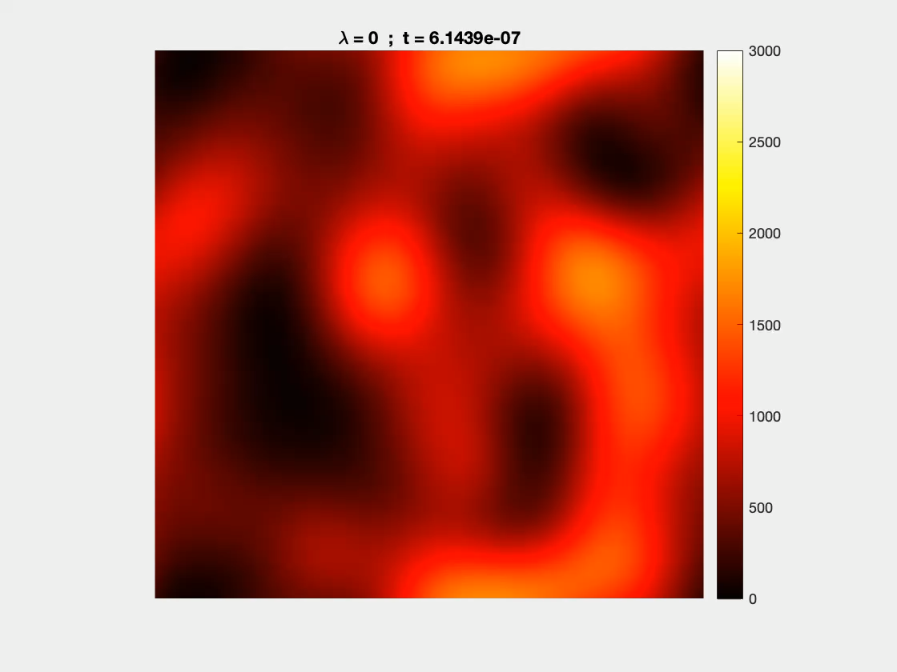
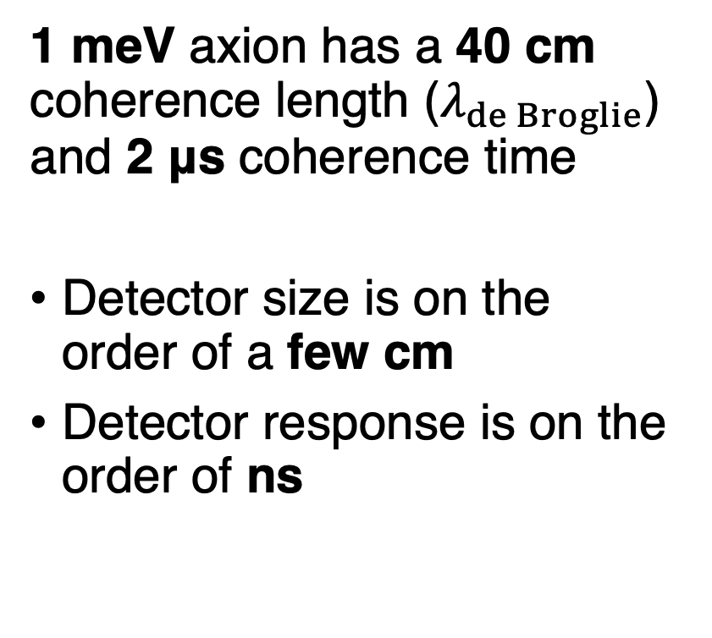
Finite Axion Coherence
1 meV axion has a 40 cm coherence length ($λ_{de Broglie}$) and 2 μs coherence time
Detector size is on the order of a few cm
Detector response is on the order of ns
detector
$$λ_{de Broglie}$$
Config. 2
Axion field code provided by Mudit Jain.
Mehrani, arXiv:2509.14320
TACOS 2025
Jaanita Mehrani | Rice University
Notes:
We also wanted to check the finite axion coherence. So, a 1 meV axion field would have a 40 cm coherence length (which is just the de Broglie wavelength). and a coherence time of 2 microseconds. So here is a video, and in our case, the detector is size is on the order of a few cm, so we can assume spatial homogeneity. And the detector’s plasmonic response is on the order of ns, also shorter than the coherence time. We sweep our detector across a simulated axion field. And show that the boost is largely unchanged.

Slide 20
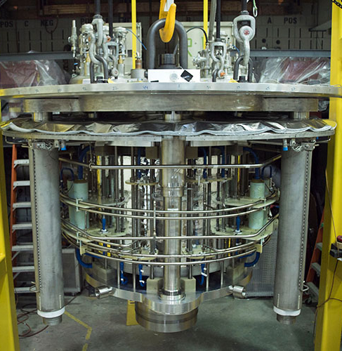
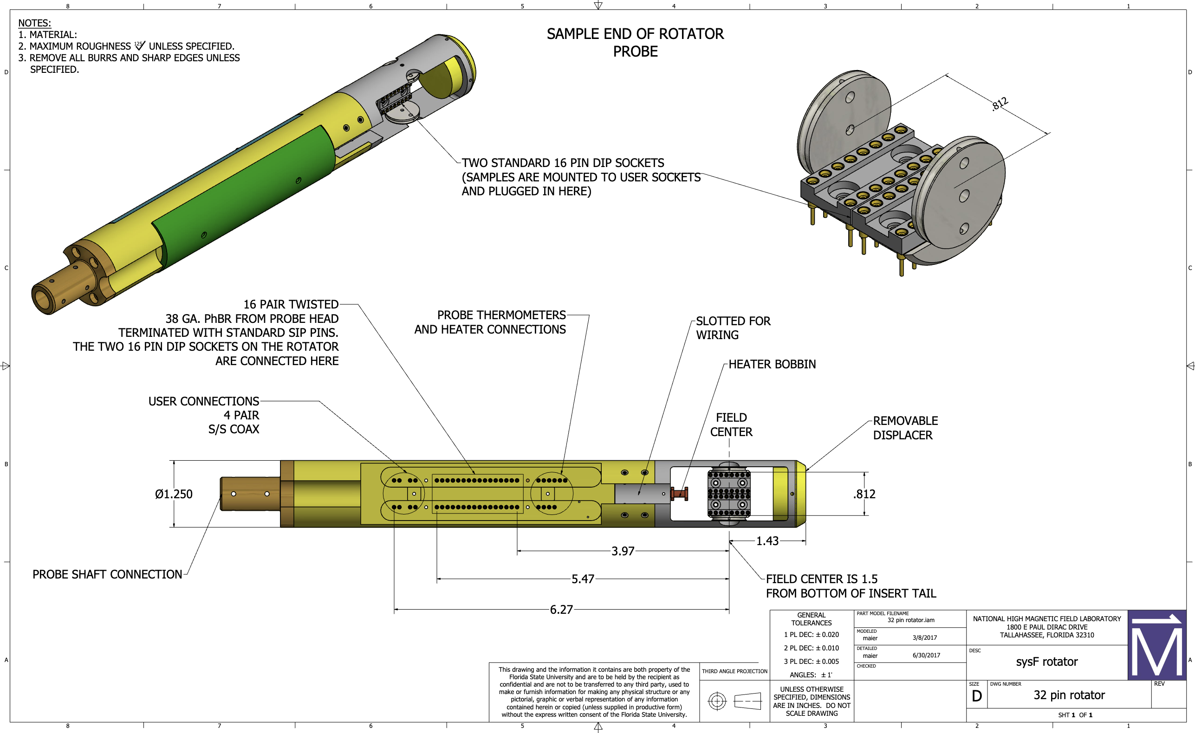
Magnetic Field Inhomogeneity
The boost is extremely sensitive to the magnetic field.
NMR magnets can reach very high homogeneities (1 ppm/cm).
Config. 2
equipped with rotating probe
36 T Magnet at NHMFL
08/05/25
Jaanita Mehrani | Rice University
TACOS 2025
Notes:
The homogeneity of the magnet is also very important, as the MQW permittivity and boost is sharply tuned with respect to normal component of the magnetic field. For us, that means we can use NMR magnets that have 1ppm/cm homogeneity, like the 36 T magnet at NHFML, which is also equipped with a rotating probe for tuning.

Slide 21
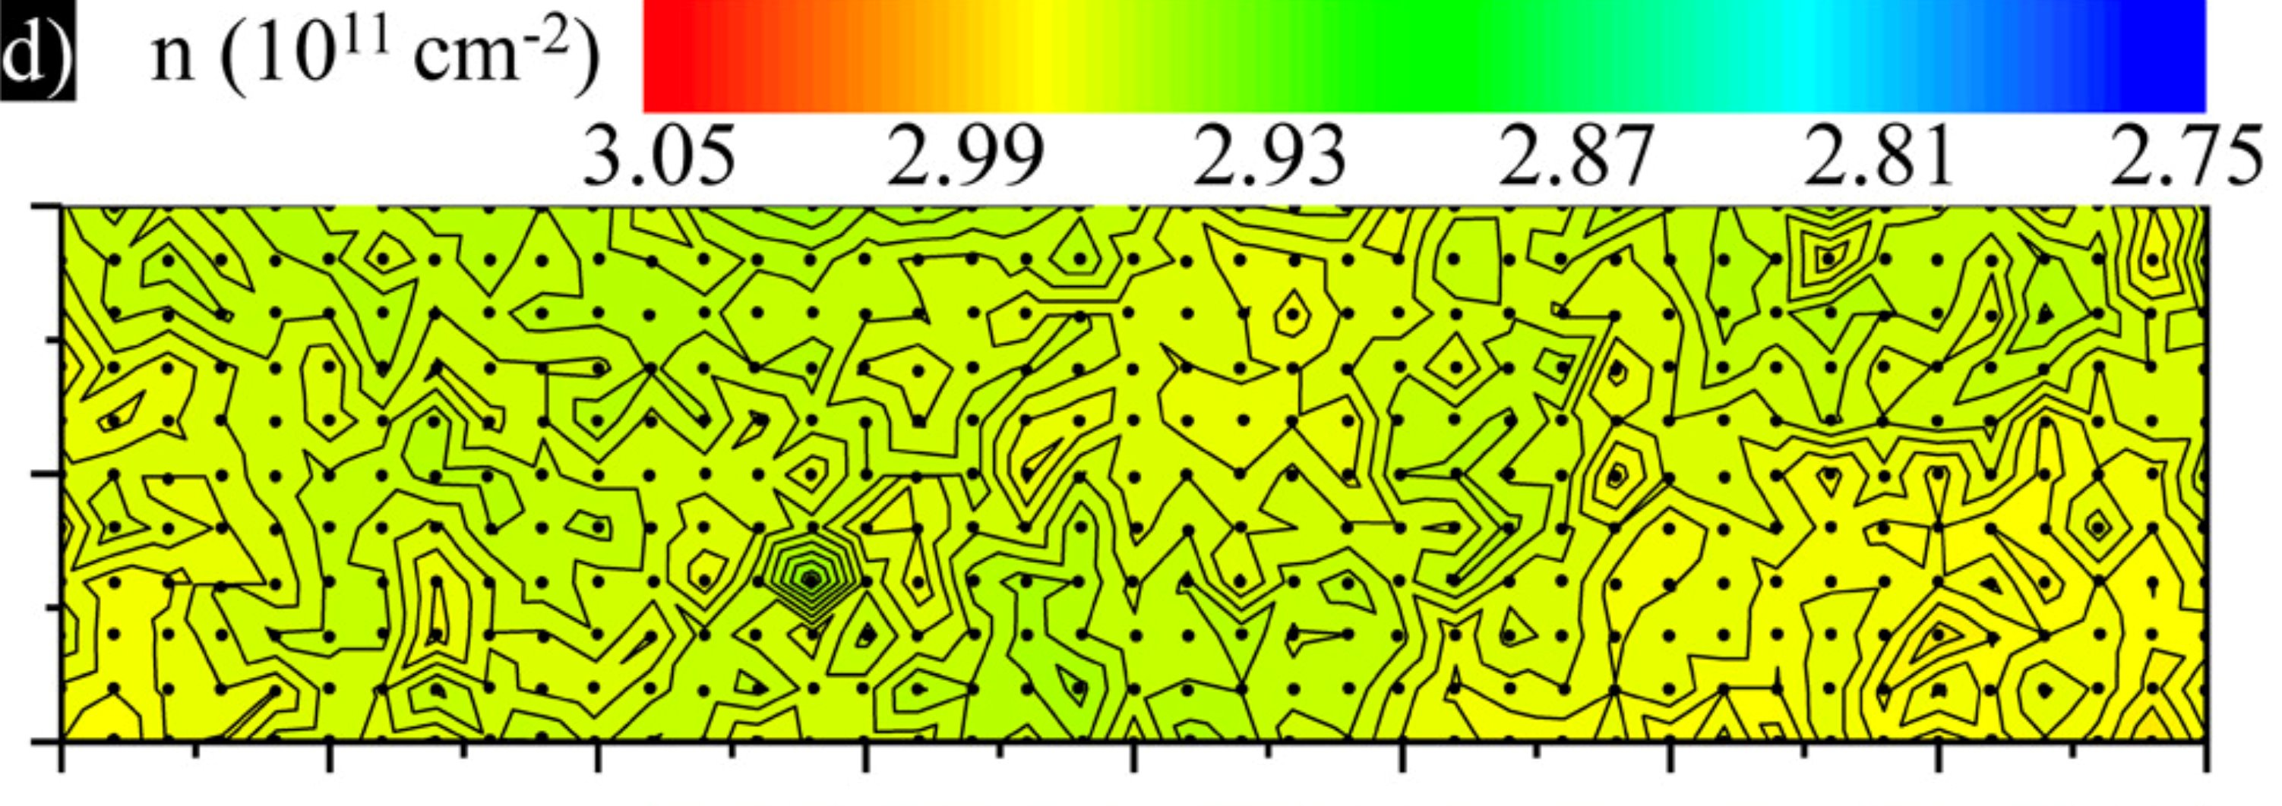
Electron Density Non-Uniformity
The boost is extremely sensitive to the electron density.
Experiments show 0.5%/cm and 1% well-to-well non-uniformity.
~ 0.5%/cm
1 mm
Config. 2
4 mm
Nano Letters 9 3 (2019)
TACOS 2025
Jaanita Mehrani | Rice University
Notes:
Finally, the boost is also sensitive to the electron density uniformity. From experiments, we can expect up to 0.5%/cm density gradient per well and 1 % well to well nonuniformity. This is not good enough, however,

Slide 22
Electron Density Non-Uniformity
EMT comes to the rescue! Randomization across surface and well-to-well maintains boost (“best side” of MQW plotted).
Config. 2
Config. 2
Mehrani, arXiv:2509.14320
TACOS 2025
Jaanita Mehrani | Rice University
Notes:
EMT comes to the rescue! By introducing randomization during MQW fabrication. Random directions of surface gradients and average density from well to well, the boost is maintained. And since there will by some anisotropy through the stacked structure, there will always be a “best side” for the surface radiation, which is plotted for both the surface variation and the well-to-well variation for different random seeds simulated.

Slide 23
Validation Experimental Conditions
Summary: 50% of maximum boost is maintained.
08/05/25
Jaanita Mehrani | Rice University
TACOS 2025
Notes:
In summary, 50 % of the maximum boost is maintained when testing a variety of experimental conditions.

Slide 24
Conclusion
SQWARE is a new tabletop, electromagnetically-tunable, and highly sensitive axion detection scheme that may probe meV axions.
Designer quantum cavities have exciting prospects!!
Mehrani, arXiv:2509.14320
08/05/25
Jaanita Mehrani | Rice University
TACOS 2025
Notes:
In conclusion, SQWARE is a new tabletop, electromagnetically-tunable, and highly sensitive axion detection scheme that may probe meV axions. Designer quantum cavities have exciting prospects!! In the field of dark matter research.

Slide 25
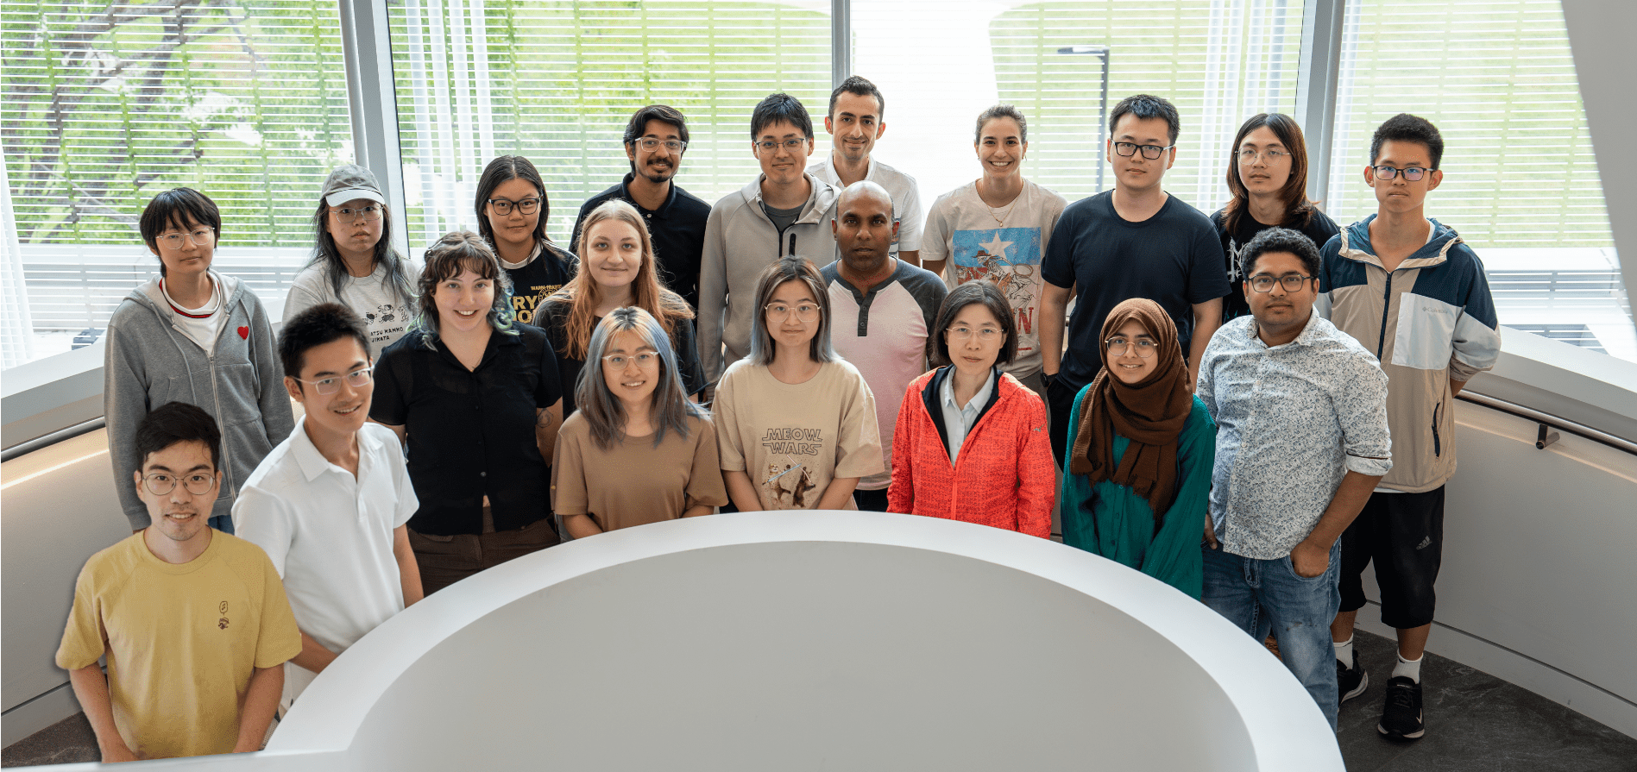
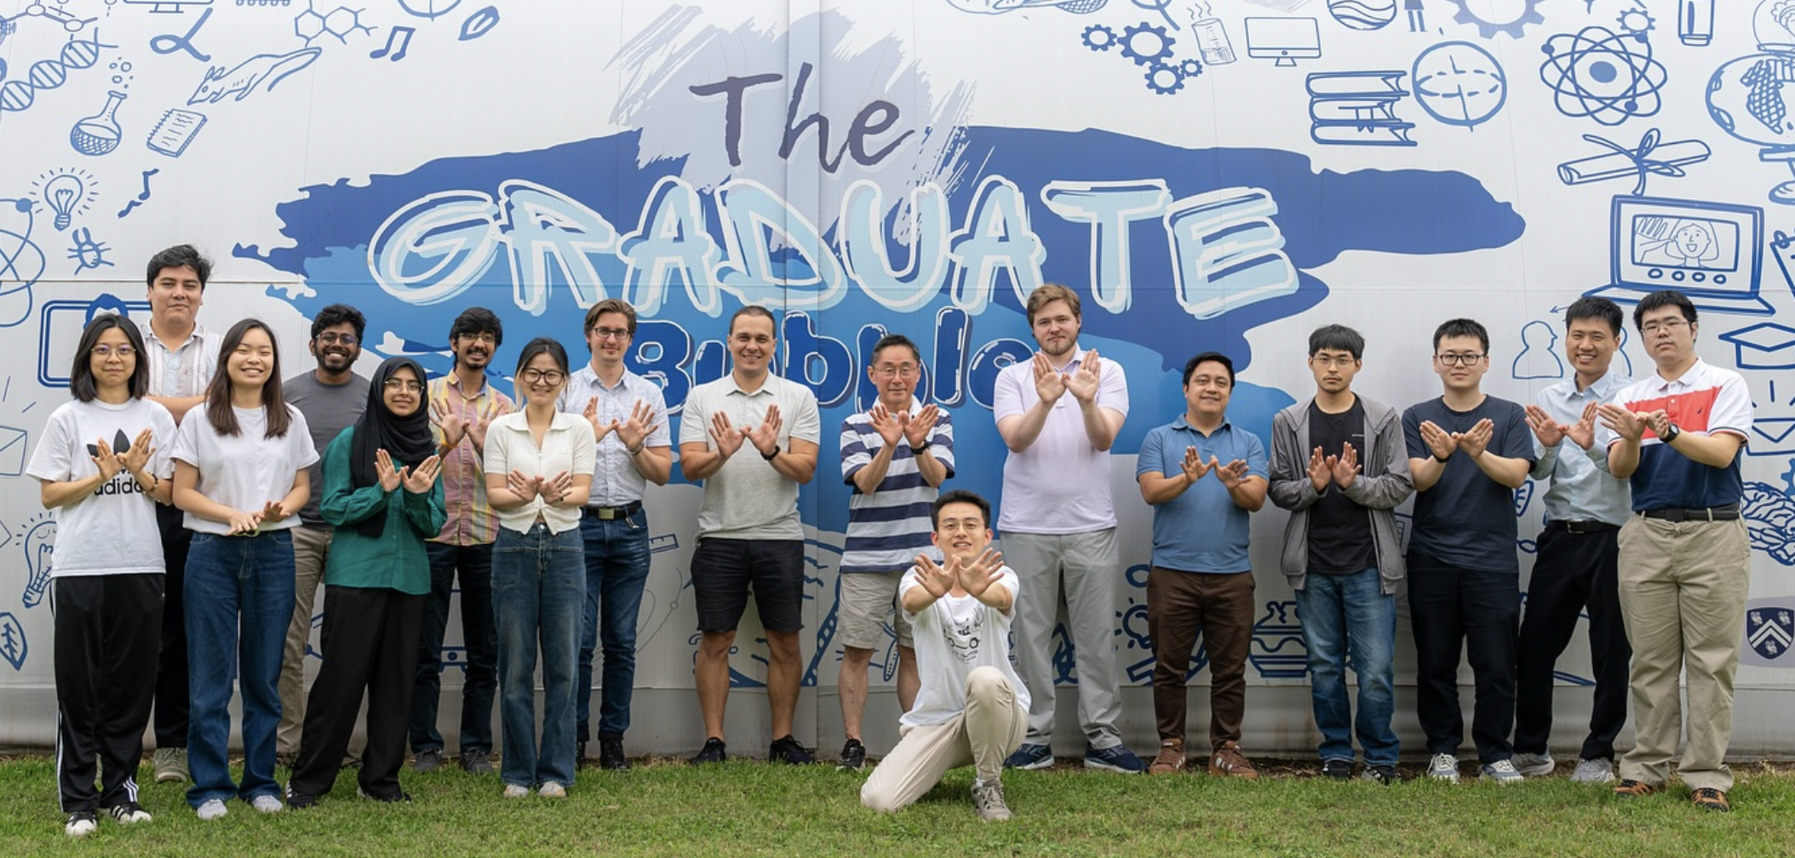
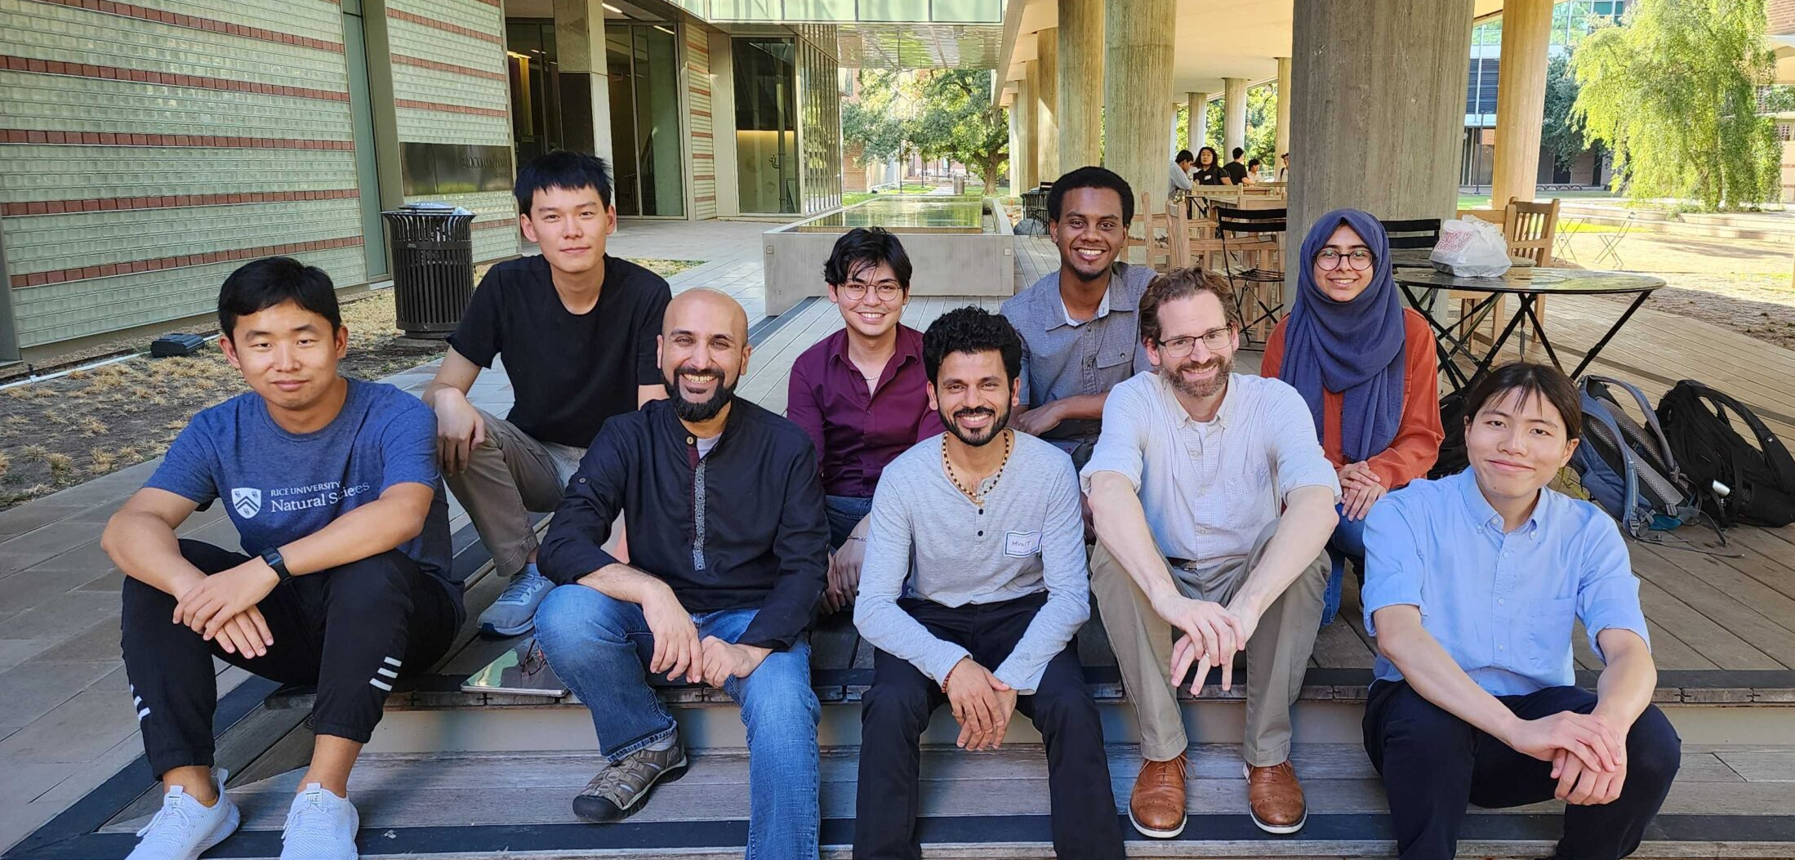

Acknowledgements
Co-authors
Shengxi Huang (advisor), Jun Kono (advisor), Andrew Long, Henry Everitt, Andrey Baydin, Kuver Sinha (met at TACOS 2 years ago!), Tao Xu, Michael Manfra
Helpful discussions!
Alexey Belyanin, Amin Mustafa, Mudit Jain, Dorian Amaral, Asher Berlin, Joseph Tischler, Thirumalai Venkatesan, R. C. Woods
SCOPE + KONO + CAP lab members!
TACOS organizers!!!
08/05/25
Jaanita Mehrani | Rice University
TACOS 2025
Notes:
I’d like to acknowledge. My co-authors. And everyone who provided helpful discussions during our project. As well as my lab members. And most importantly the TACOS organizers for inviting me!!!

Slide 26
Conclusion
T-RAx is a new tabletop, electromagnetically-tunable, and highly sensitive axion detection scheme that may probe meV axions.
Designer quantum cavities have exciting prospects!!
Thank you for listening!
Mehrani, arXiv:2509.14320
08/05/25
Jaanita Mehrani | Rice University
TACOS 2025
Notes:
Thanks for listening and please ask any questions!

Slide 27
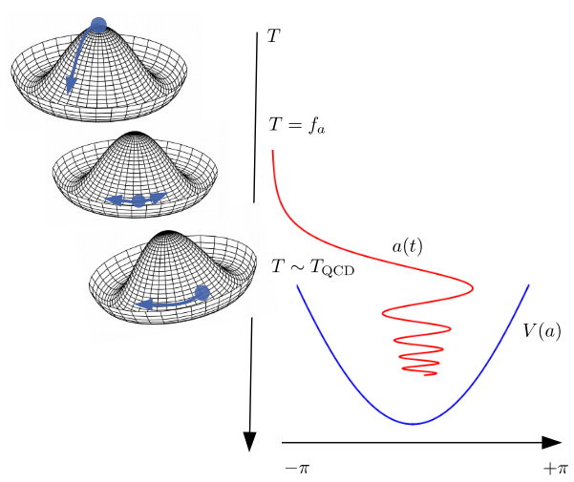
Axion Theory
Peccei-Quinn Symmetry is introduced as a new global symmetry that is spontaneously broken, which generates pseudo-goldstone bosons, called the axion!
Pseudo, since the symmetry wasn’t perfect, as there is some tilt in the potential, related to coupling with the gluon fields.
KIT Andreas Pargner (2019)
08/05/25
Jaanita Mehrani | Rice University
TACOS 2025

Slide 28
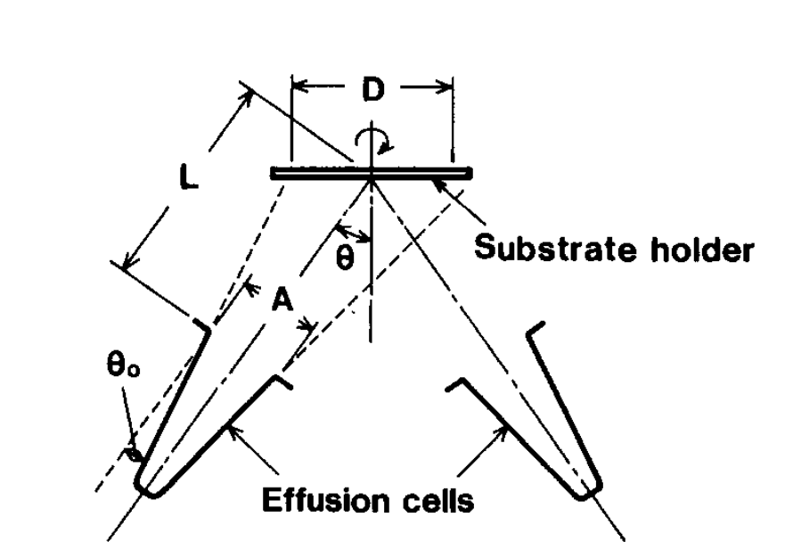
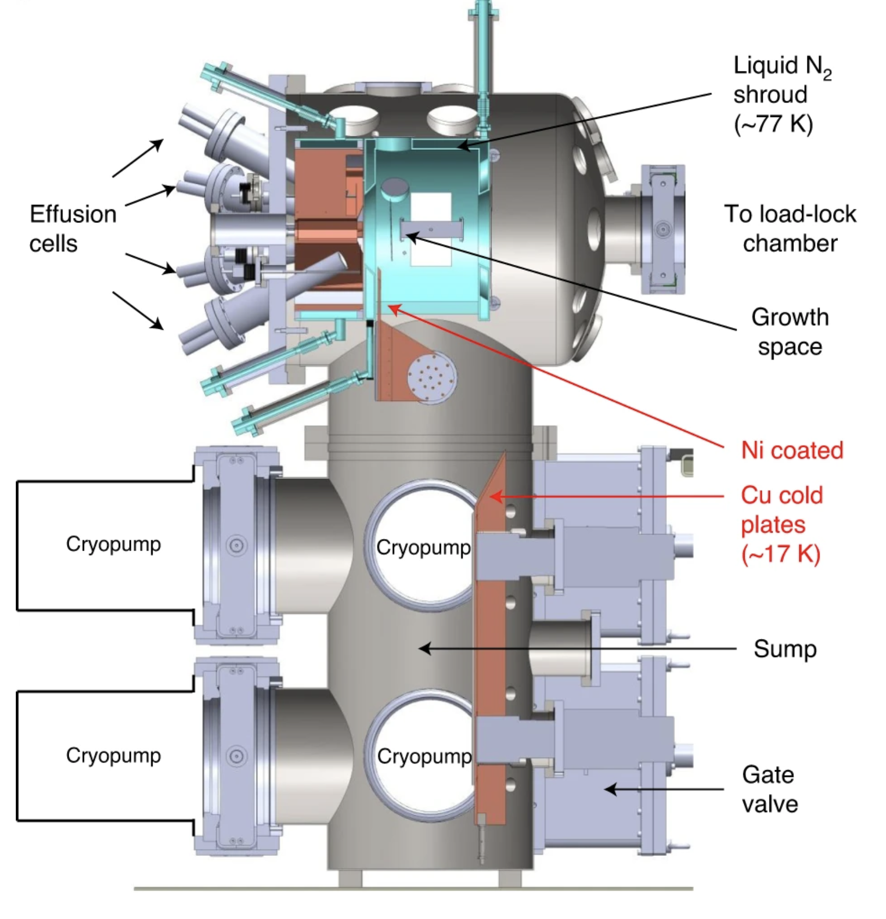
Molecular Beam Epitaxy (MBE)
Journal of Crystal Growth 81 188-192 (1987)
Nature Materials 20 632-637 (2021)
TACOS 2025
Jaanita Mehrani | Rice University

Slide 29

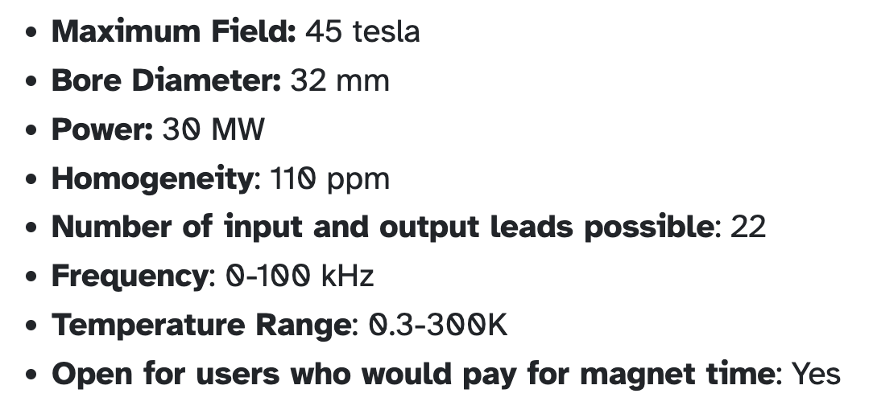
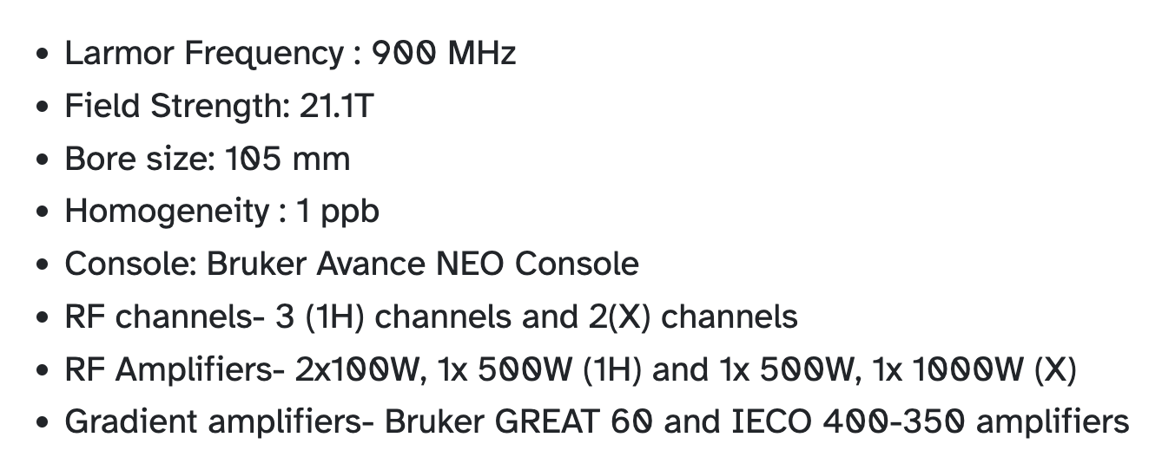
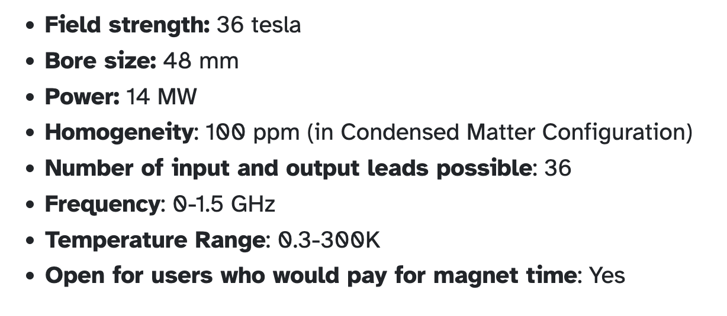
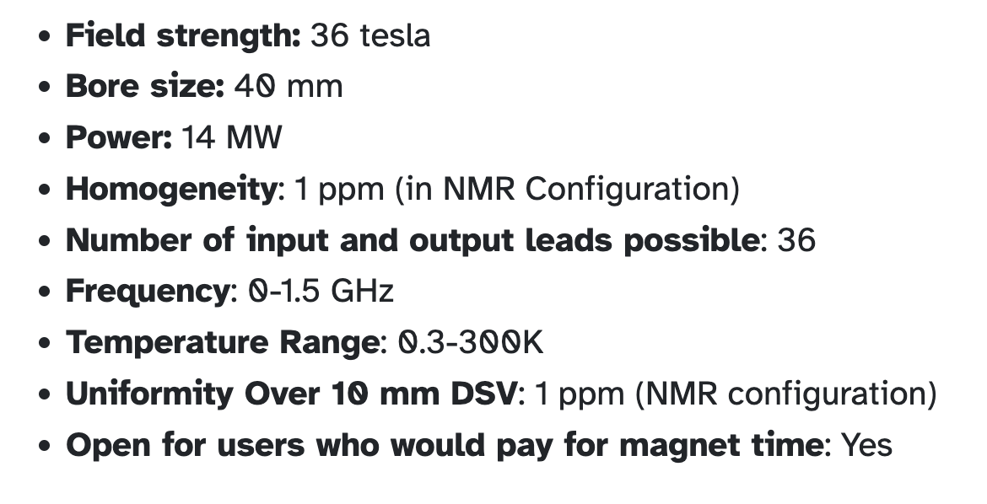
High Field Magnet
08/05/25
Jaanita Mehrani | Rice University
TACOS 2025

Slide 30
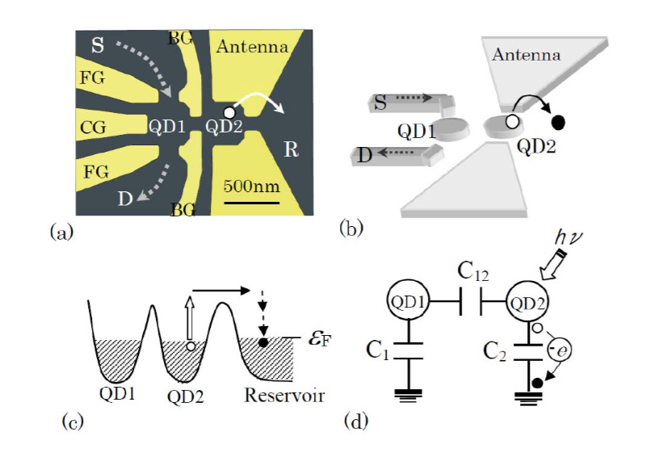
Quantum Dot Photodetector
Tunable resonance using a magnetic field
Some FET measures the electron excitation as a change in charge, capacitance, or current
Experimentally tested at 2 meV and 6 meV resonances
Komiyama S., IEEE Journal of Selected Topics in Quantum Electronics (2011)
TACOS 2025
Jaanita Mehrani | Rice University

Slide 31



Material Response to Axions
Material response ($\hat{ε}$)
Plasmonic material ($\left|ε\right|→0$)
$D_{a}= E_{a}+P_{a}−\frac{i}{ω}J_{a}$
$= E_{a}+\hat{χ}E_{a}−\frac{i\hat{σ}}{ω}E_{a }$
$= \hat{ϵ}E_{a}$ $=−g_{aγ}Ba(t)$
TACOS 2025
Jaanita Mehrani | Rice University

Slide 32
Dark Photon Proposed Sensitivity
Mixing parameter χ instead of coupling g
08/05/25
Jaanita Mehrani | Rice University
TACOS 2025

Slide 33

EMT (1)
08/05/25
Jaanita Mehrani | Rice University
TACOS 2025

Slide 34
EMT (2)
08/05/25
Jaanita Mehrani | Rice University
TACOS 2025

Slide 35
EMT (3)
08/05/25
Jaanita Mehrani | Rice University
TACOS 2025

Slide 36
MQW Permittivity and Boost (Config. 2)
08/05/25
Jaanita Mehrani | Rice University
TACOS 2025

Slide 37
MQW Angle and Boost (Config. 2)
08/05/25
Jaanita Mehrani | Rice University
TACOS 2025

Slide 38
MQW Angle, Quality Factor, and Boost
08/05/25
Jaanita Mehrani | Rice University
TACOS 2025

Slide 39
Surface e⁻ Density Variation
“best side” plotted
08/05/25
Jaanita Mehrani | Rice University
TACOS 2025

Slide 40
Well-to-Well e⁻ Density Variation
“best side” plotted
08/05/25
Jaanita Mehrani | Rice University
TACOS 2025

