Slide 1
Outline
Brief Review of Chapter 1&2
General relativity, gravitational wave
Generation of GWs
Weak field source
Non-relativistic sources(direct integration)
Quadruple formula
Two examples: direct integration v.s. quadruple formula, beyond linearized theory

Slide 2
Brief Review of Chapter 1&2
General relativity
Equivalence principle
physics laws should not depend on choices of frames
(special relativity: physics laws should not depend on choices of inertial frames)
physics laws in terms of quantities that do not depend on choices of frames
Physics laws in terms of tensor equations

Slide 3
Brief Review of Chapter 1&2
General relativity
Tensor
Quantity/Object that stays unchanged under certain coordinate transformation
“what” is a “which kind of tensor” under “what transformation”
Object stays unchanged -> components change

Slide 4
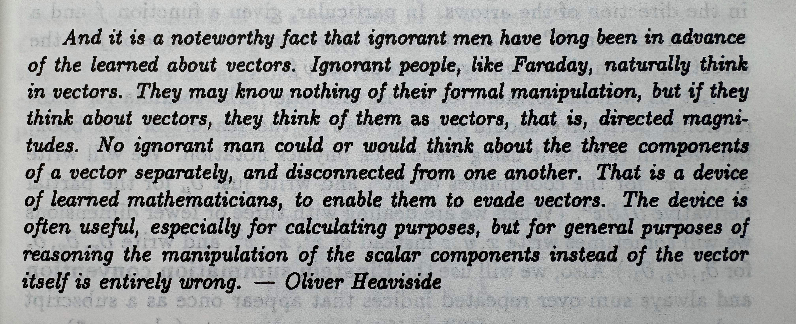
Brief Review of Chapter 1&2
General relativity
Tensor

Slide 5
Brief Review of Chapter 1&2
General relativity
Equivalence principle
physics laws should not depend on choices of frames
(special relativity: physics laws should not depend on choices of inertial frames)
physics laws in terms of quantities that do not depend on choices of frames
Physics laws in terms of tensor equations

Slide 6
Brief Review of Chapter 1&2
General relativity
Equivalence principle
Gravitational wave
Chapter 1(top-down):
From full GR(Einstein’s equation) to linearized gravity
Transverse Traceless(TT) gauge
Energy(energy-momentum tensor) of GWs
Chapter 2(bottom-up):
From linearized gravity to full GR
Gravitons
energy-momentum tensor & angular momentum of GWs

Slide 7
Generation of GWs
Weak field source

Slide 8
Generation of GWs
Weak field source
Non-relativistic sources

Slide 9
Generation of GWs
Weak field source
Non-relativistic sources
Quadruple formula

Slide 10
Generation of GWs
Weak field source
Non-relativistic sources
Quadruple formula
Example 1: circular motion under scalar interaction

Slide 11
Generation of GWs
Weak field source
Non-relativistic sources
Quadruple formula
Example 1: circular motion under scalar interaction
Example 2: circular motion under gravity

