Slide 1

New methods and instrumentation to exploit CNA and CERN synergies in experimental nuclear physics
J. Bartolomé-Sarsa*, G. Auñón, B. Fernández, J. Ferrer, J. García-López, J. Gómez-Camacho, C. Guerrero and A. Vegas
Universidad de Sevilla, 41012 Seville, Spain
Centro Nacional de Aceleradores (CNA), 41092 Seville, Spain
Plan Complementario de Astrofísica y Física de Altas Energías (ASTRO+FAE)
Congreso final en Santander, 25-27 de noviembre de 2025
*Doctoral student funded by MRR ASTRO-FAE @CNA/USevilla

Slide 2
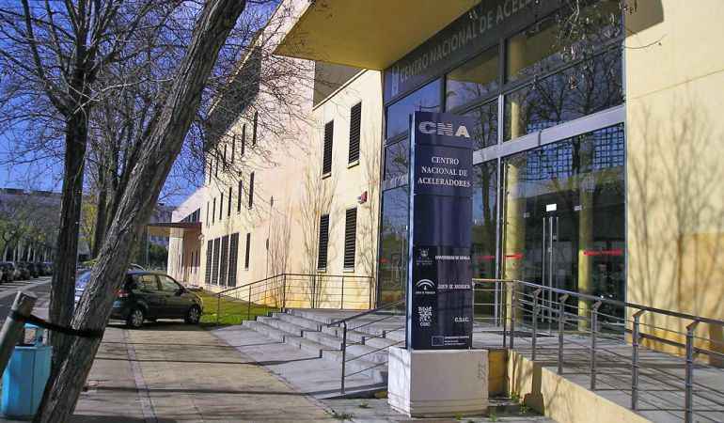
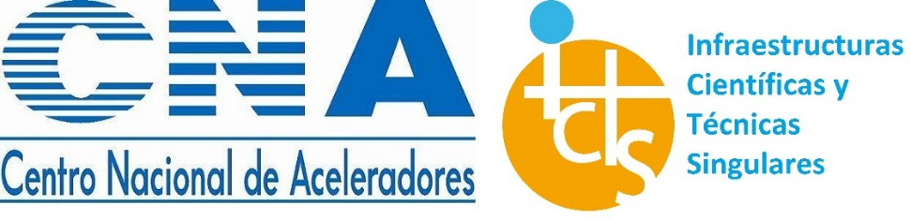



The Centro Nacional de Aceleradores (CNA) in Seville
MiCaDaS
3 MV Tandem
18/9 MeV Cyclotron
PET/TC Scanner
Micro PET and Micro TC scanner (Animals)
1 MV AMS (SARA)
Radiofarmacy Labs
Co-60 Irradiator

Slide 3
Nuclear reactions at CNA and CERN

Slide 4



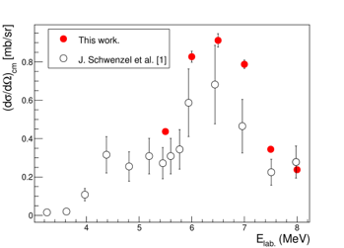
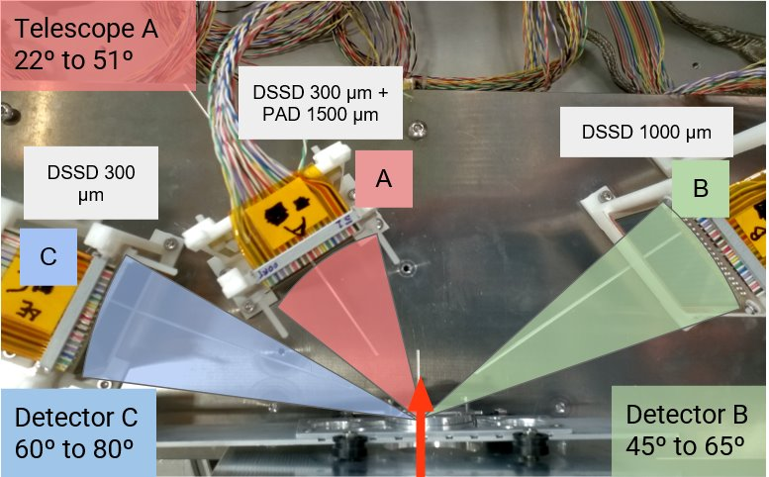
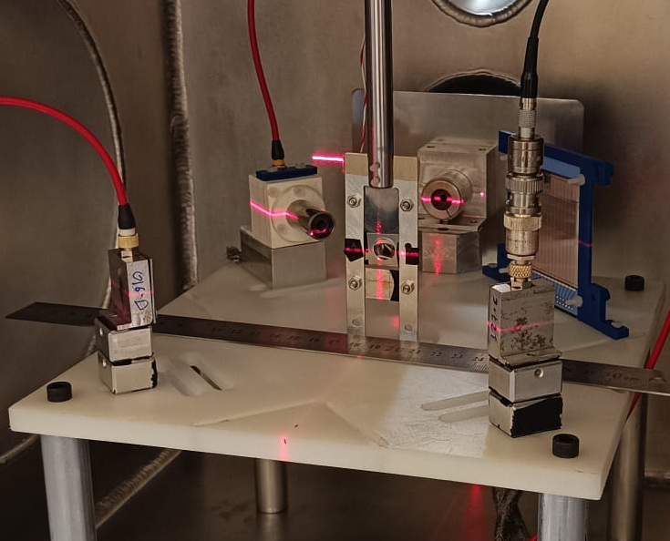
Nuclear reactions at CERN/ISOLDE and CNA/FNB
Light targets nuclear reactions studies at energies around the coulomb barrier V_{b}.
α-scattering on unstable proton-rich tin isotopes for the astrophysical p-process.
^{108,110,112}Sn(α,α) at E_{c.m} = 18.8 MeV in inverse kinematics using “solid” ⁴He targets @ SEC (Scattering Experiments Chamber) of HIE-ISOLDE
+
V_{b}= 4.5 MeV
⁶Li
¹²C
¹⁴N
α
¹²C+¹⁹⁷Au
target
Silicon DSSSD
PIPS detectors
¹²C(⁶Li,α₀)¹⁴N_{g.s}
excitation function

Slide 5
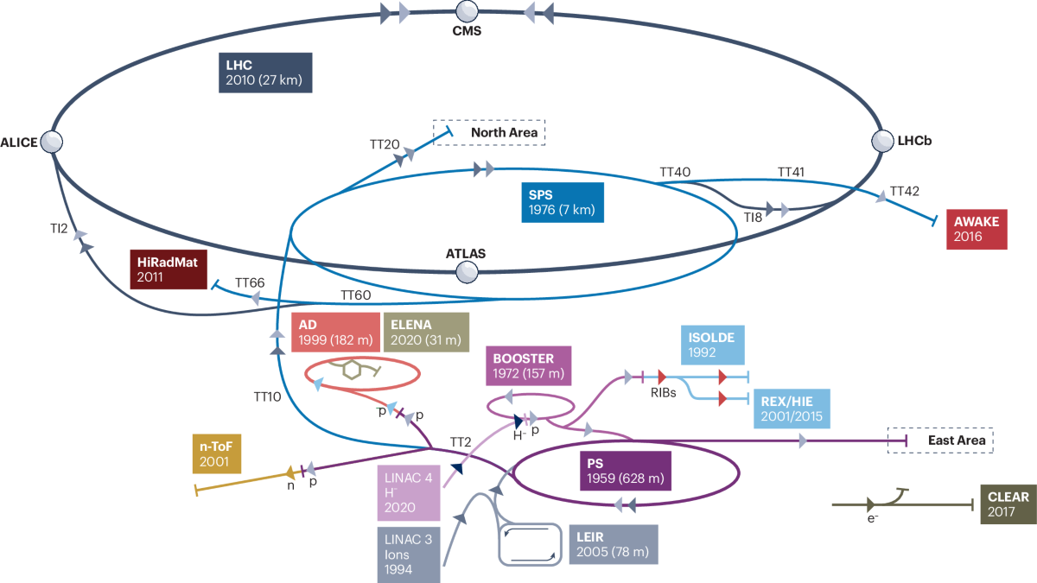

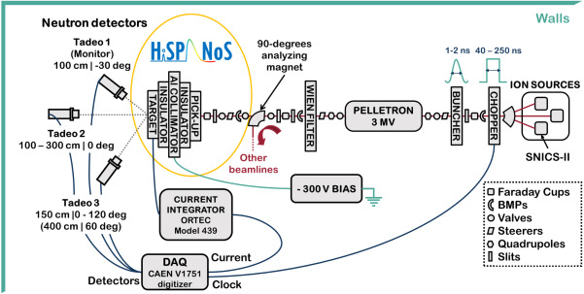

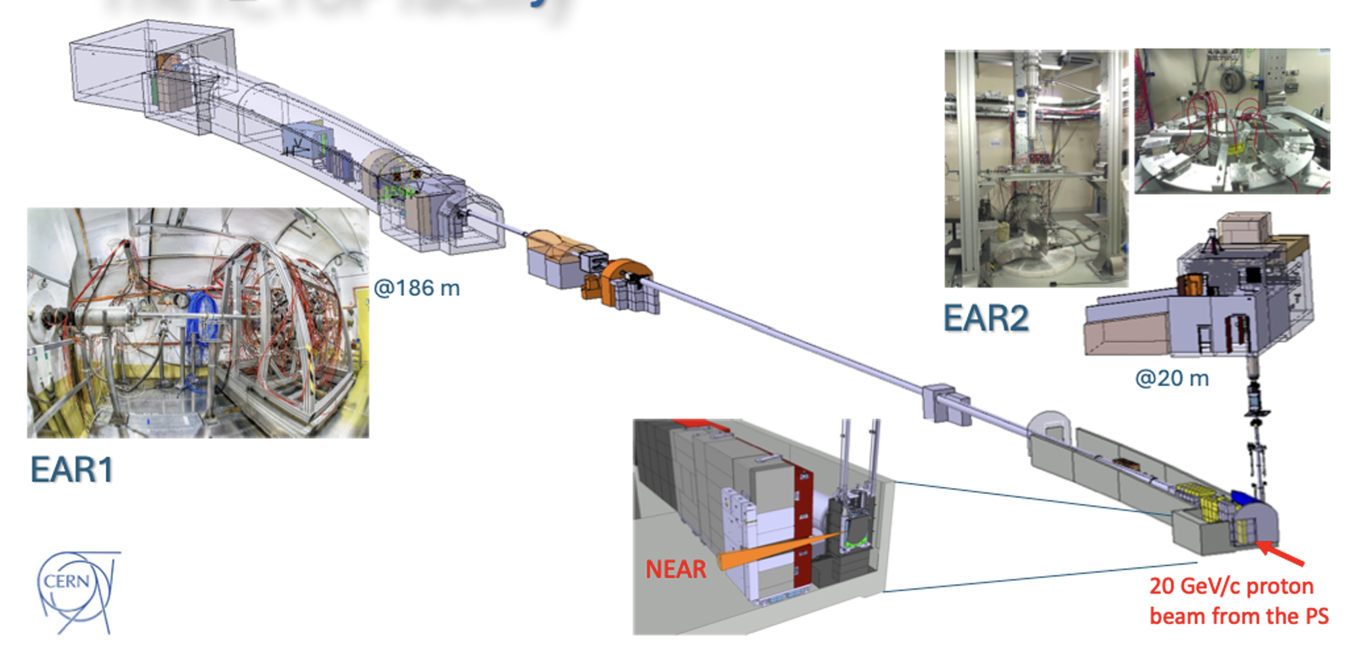
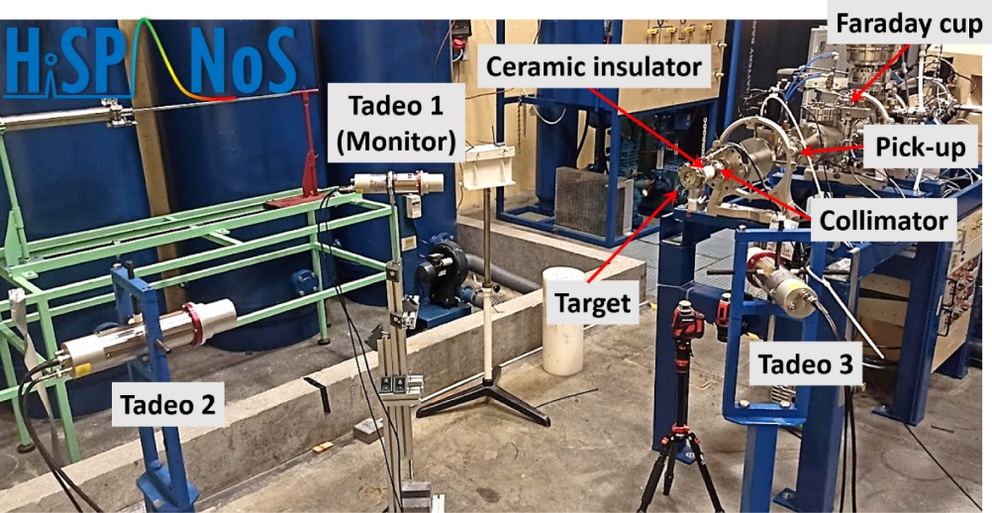
Neutron induced reactions at CERN/n_TOF and CNA/HiSPANoS

Slide 6
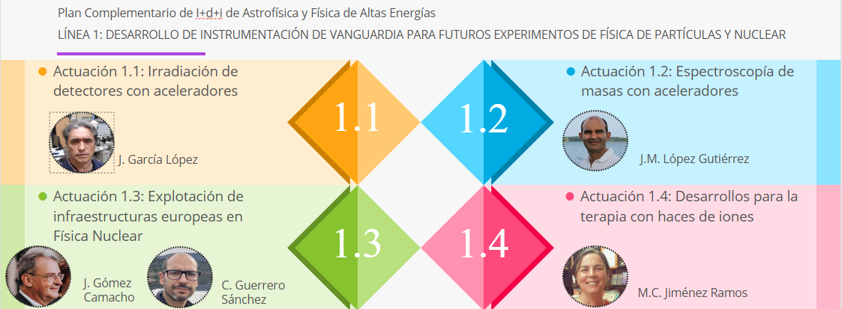
Plan Complementario de I+D+i de
Astrofísica y Física de Altas Energías @CNA

Slide 7
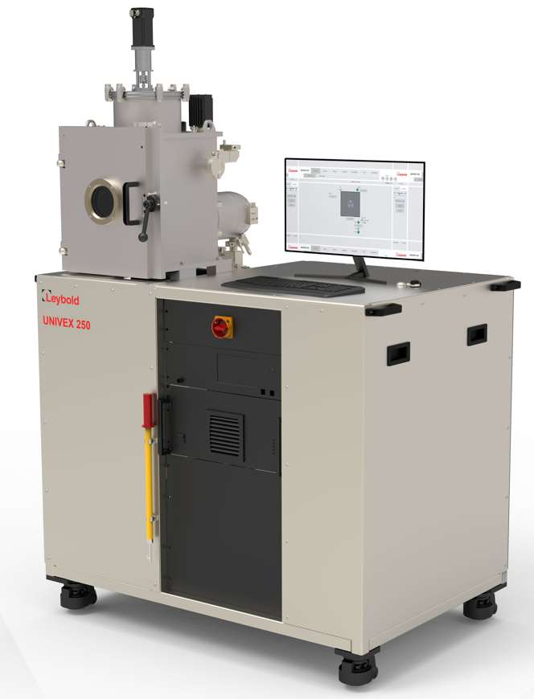
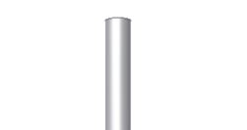
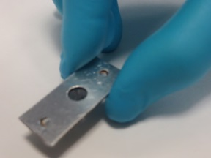
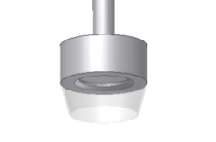
Magnetron-Sputtering to make solid-gas targets for CNA and CERN
Many of the isotopes of interest in nuclear reactions correspond to gaseous elements, which poses a serious problem
=> A solution is to “grow” s samples that incorporate the gas into sustrate in sufficient amounts, which has been demosntrated by our group and now at CNA we will be able to make such targets for nuclear physics experiments at CNA, CERN/ISOLDE, TRIUMPH, LNS, etc.
solid
matrix
Gas
element
Gas
element
Gas
element
Gas
element
MRR ASTRO-FAE:
Magnetron-Sputtering system
Magnetron Sputtering
Industrially well established
Large areas feasible
Wide range of substrates
Control of microstructure
Control of composition
metal _{target}
plasma
5 cm
Sample holder
UNIVEX 250 for RF sputtering
by Leybold
Self supported Si-He target

Slide 8
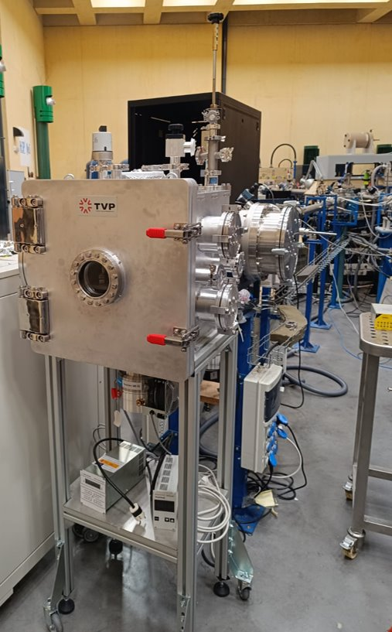
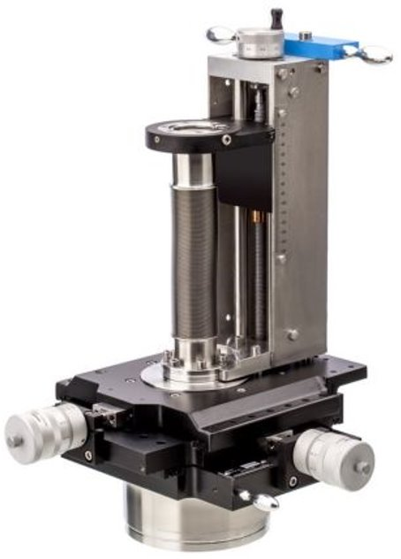
New manipulator for accurate sample positioning at CNA/FNB
Precise target positioning is essential for achieving high-accuracy nuclear reaction measurements: σ(E,θ)
Física Nuclear Básica (FNB) reaction chamber
New manipulator system:
Remote contolled motorized movement
3D positioning with 10 µm precision.
360º rotation
MRR ASTRO-FAE:
Manipulator for CNA/FNB

Slide 9
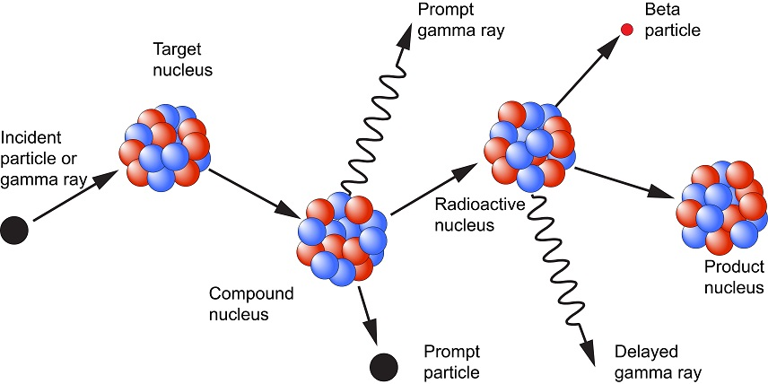
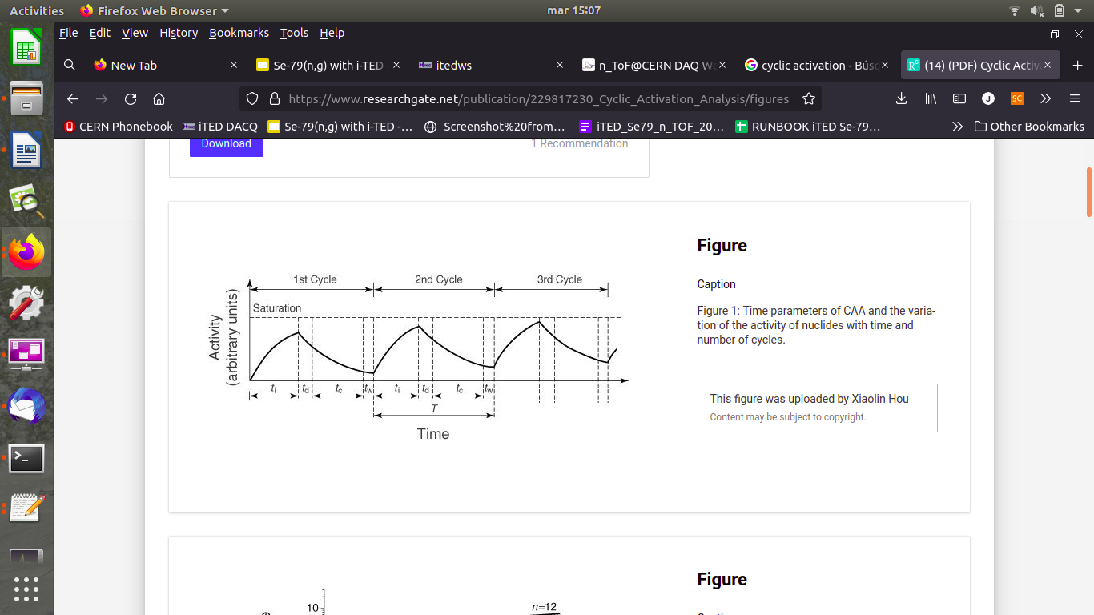

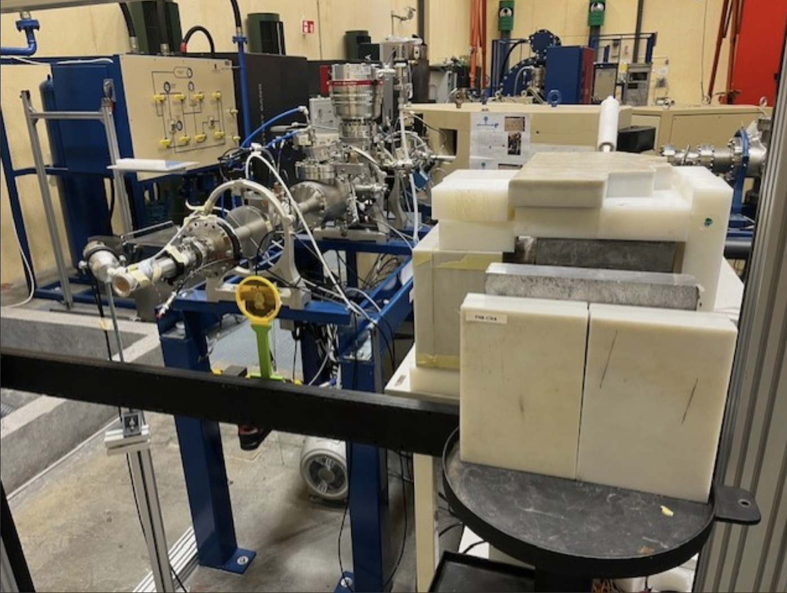

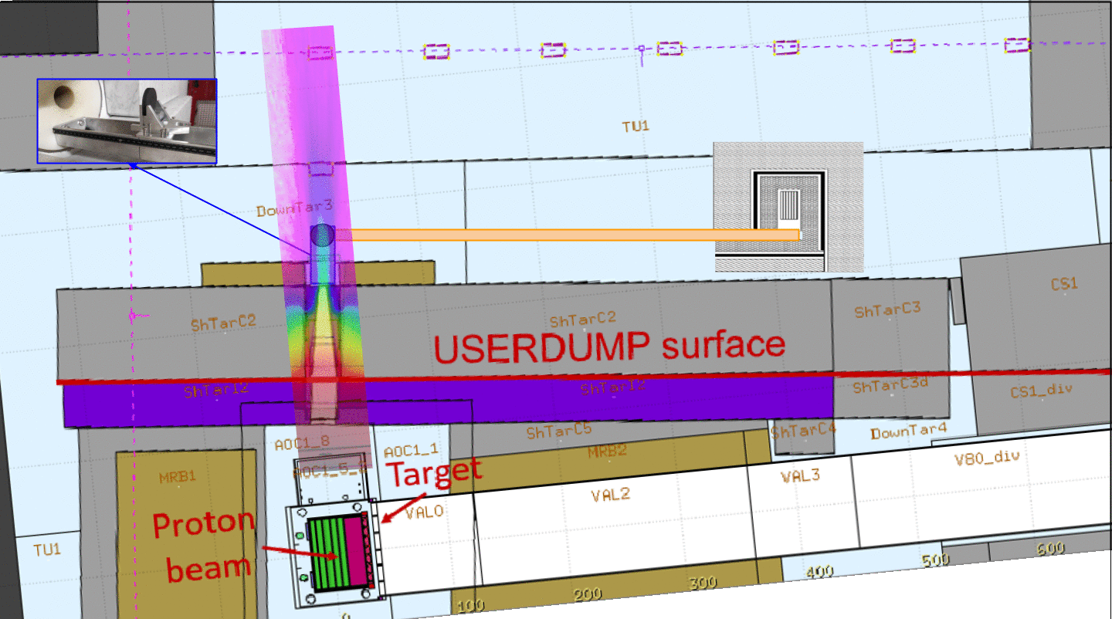
Cyclic neutron activation at CNA/HiPANoS and CERN/n_TOF (short t_{1/2})
Neutron activation is used to measured te integral cross section of recations of intersts, mainly in astrophysics. Often, the product nucleus is short lived and thus cyclic activation is required.
MRR ASTRO-FAE:
Fast Linear Stager at CNA
n-moderator for beam shaping at CNA
Contract student and trips to CERN

Slide 10
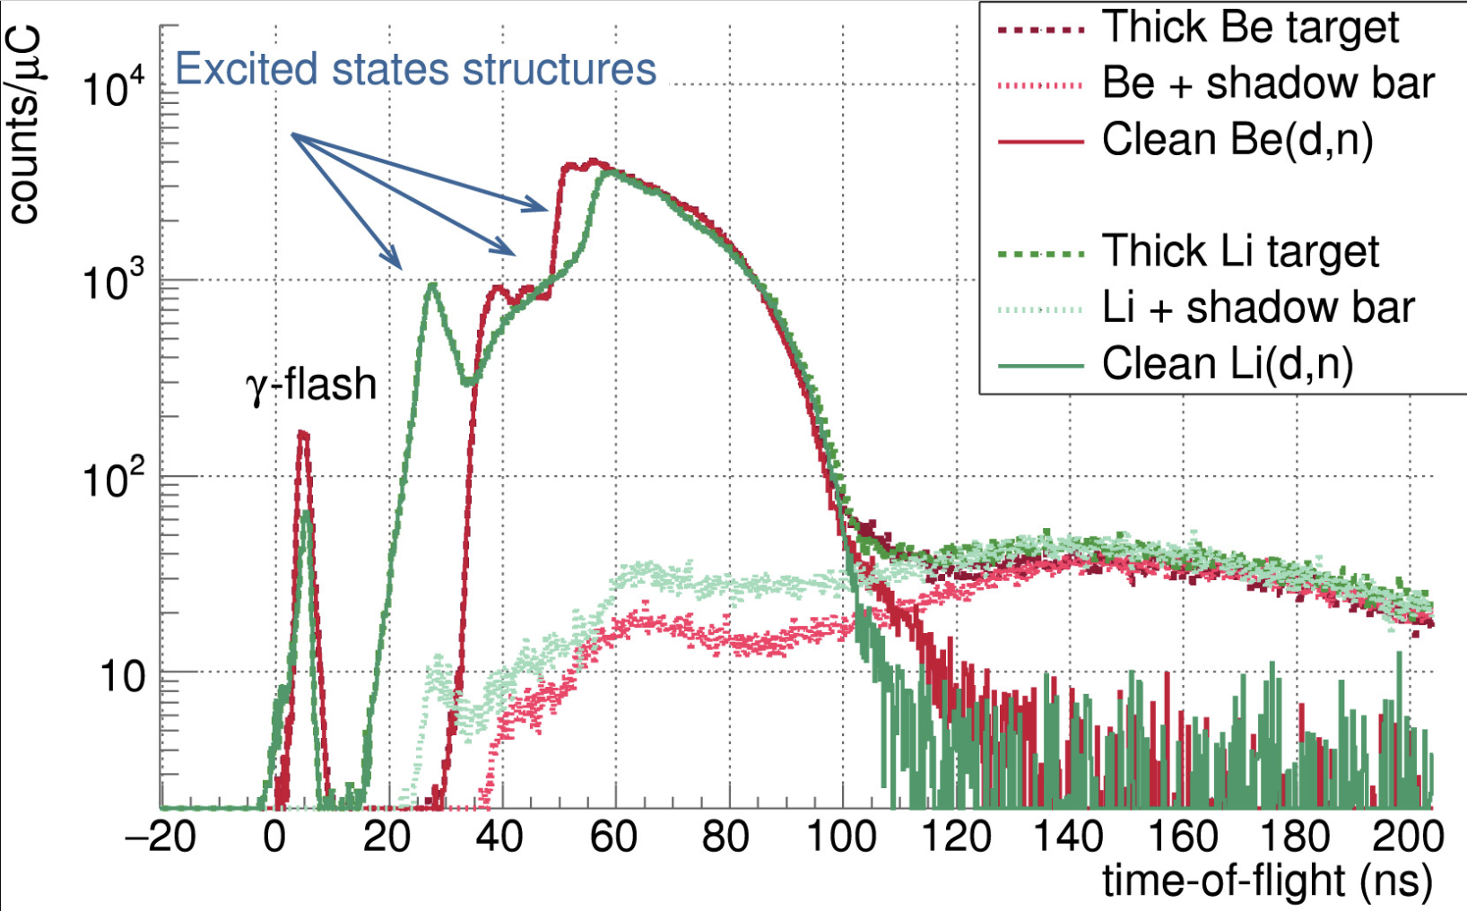
New buncher to measure (α,n) by Time-of-Flight at CNA/HiSPANoS
The MANY Collaboration: Measurements of (A,N) Yields
Renewed interest in measuring (α,n) recations for astrophysics, nuclear Technology, rare-events background assesment.
Current pulsing systems for ToF only for 1H and 2H beams.
In collaboration with NEC:
=> design a unique 3 stage buncher for ¹H, ²H and ⁴He beams to <2ns.
MRR ASTRO-FAE:
Design, construction and installation with NEC of new beam buncher
Contract student

Slide 11
Conclusions
MRR ASTRO-FAE (Actuación 1.3 and part of 1.1):
New Magnetron-Sputtering system for making solid targets of gaseous elements for CNA, ISOLDE, TRIUMPH, …
High precision sample manipulator for nuclear reaction studies at CNA
Fast linear stager and moderator for cyclic neutron activation at CNA/HiSPANoS and CERN/n_TOF-NEAR
New beam buncher for CNA/HiSPANoS suited for ⁴He in addition to ¹H and ²H
24 months contract of doctoral student on the last two topics
This work is part of the ASTRO21/1.3/3 project, funded by the Plan Complementario de I+D+i de Astrofísica y Física de Altas Energías, Plan de Recuperación, Transformación y Resiliciencia (MRR)

