Slide 1
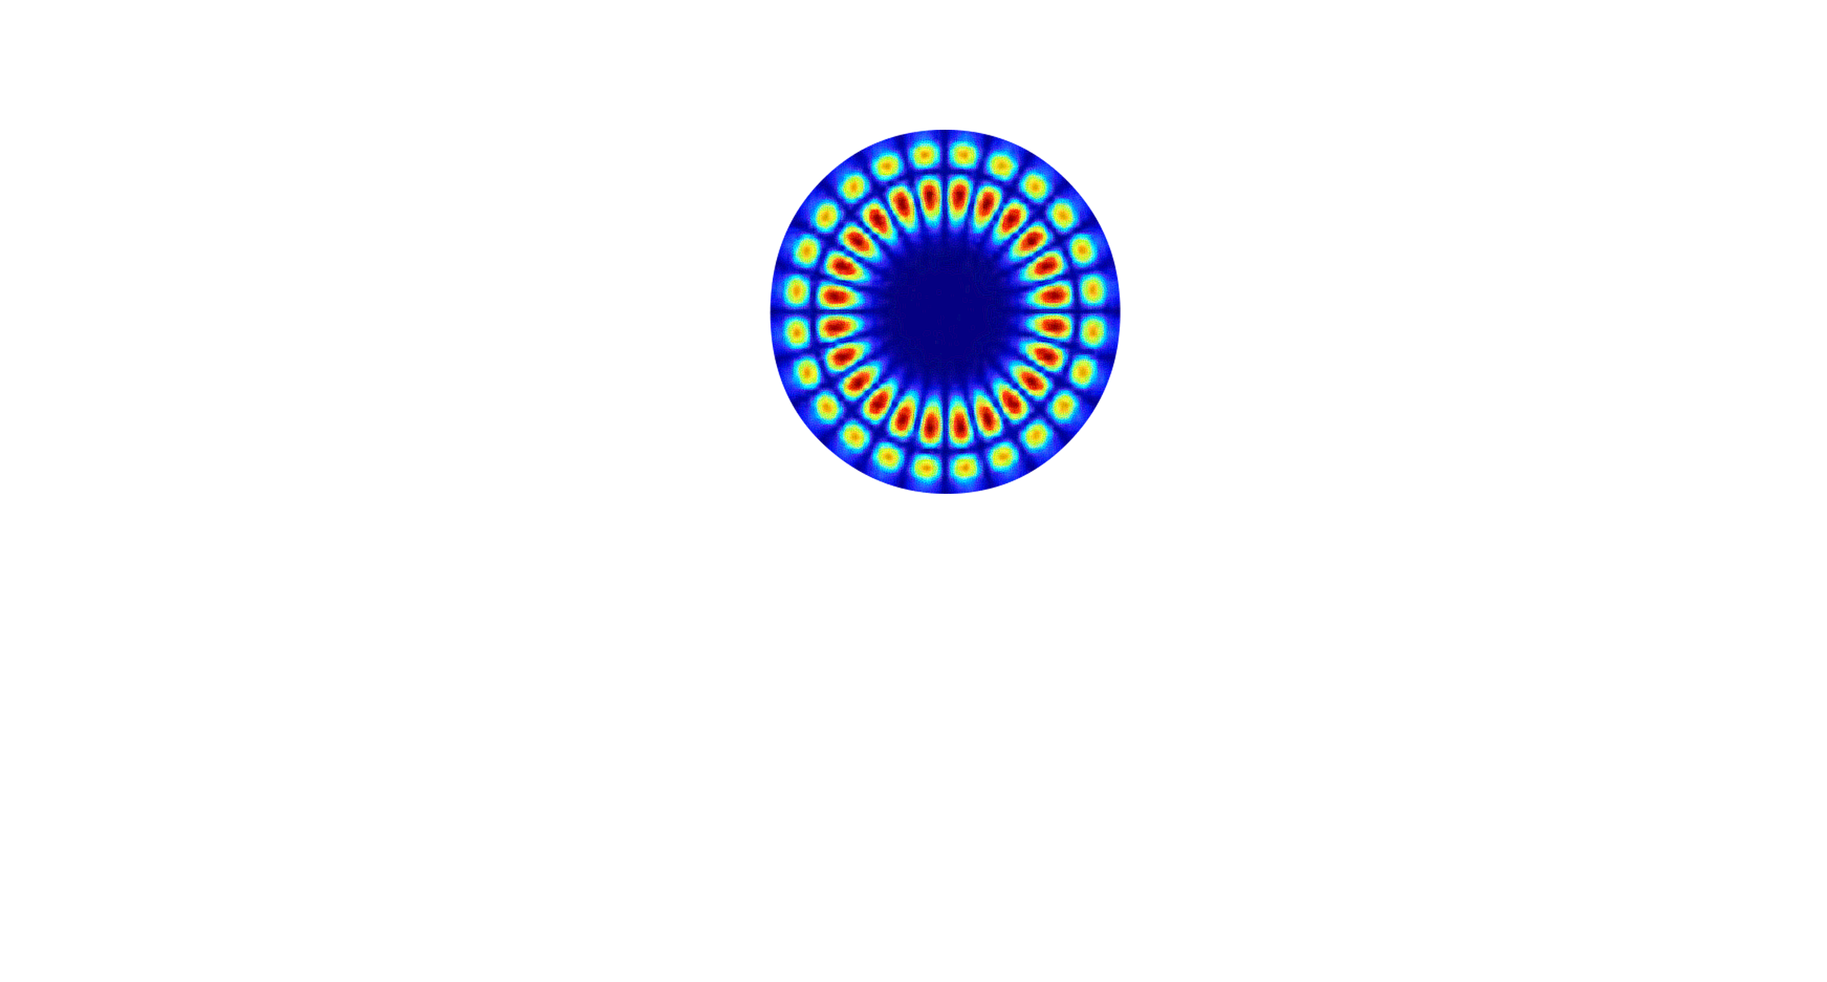




Ultra-high resolution temperature sensing using Whispering-Gallery-Mode resonators.
Vivek Gualani
25th November 2025, Santander.
gualani@ieec.cat …@ice.csic.es

Slide 2

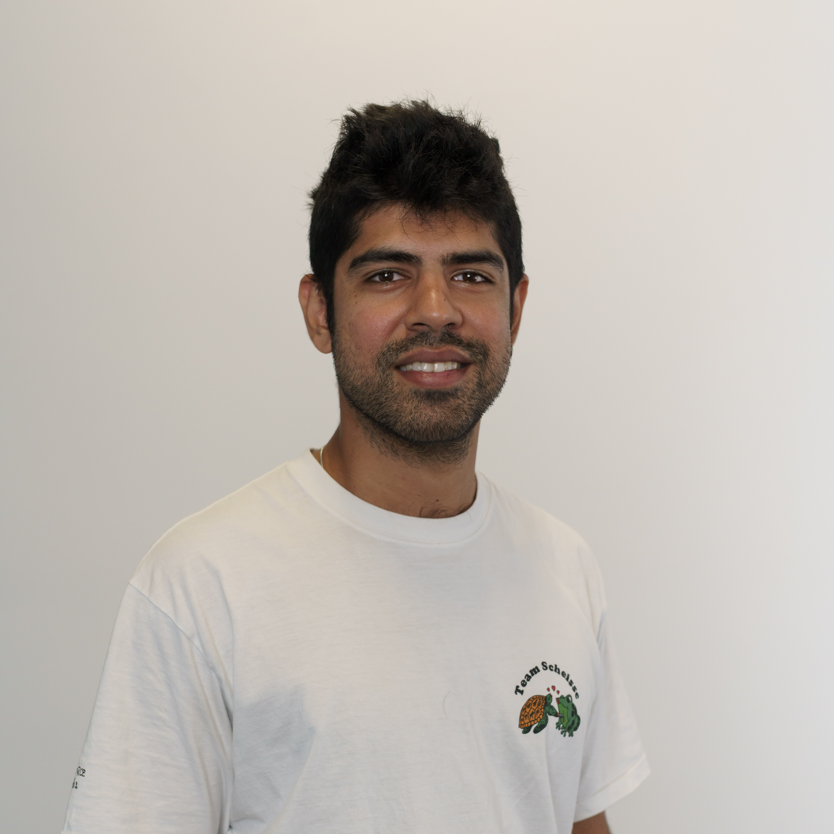
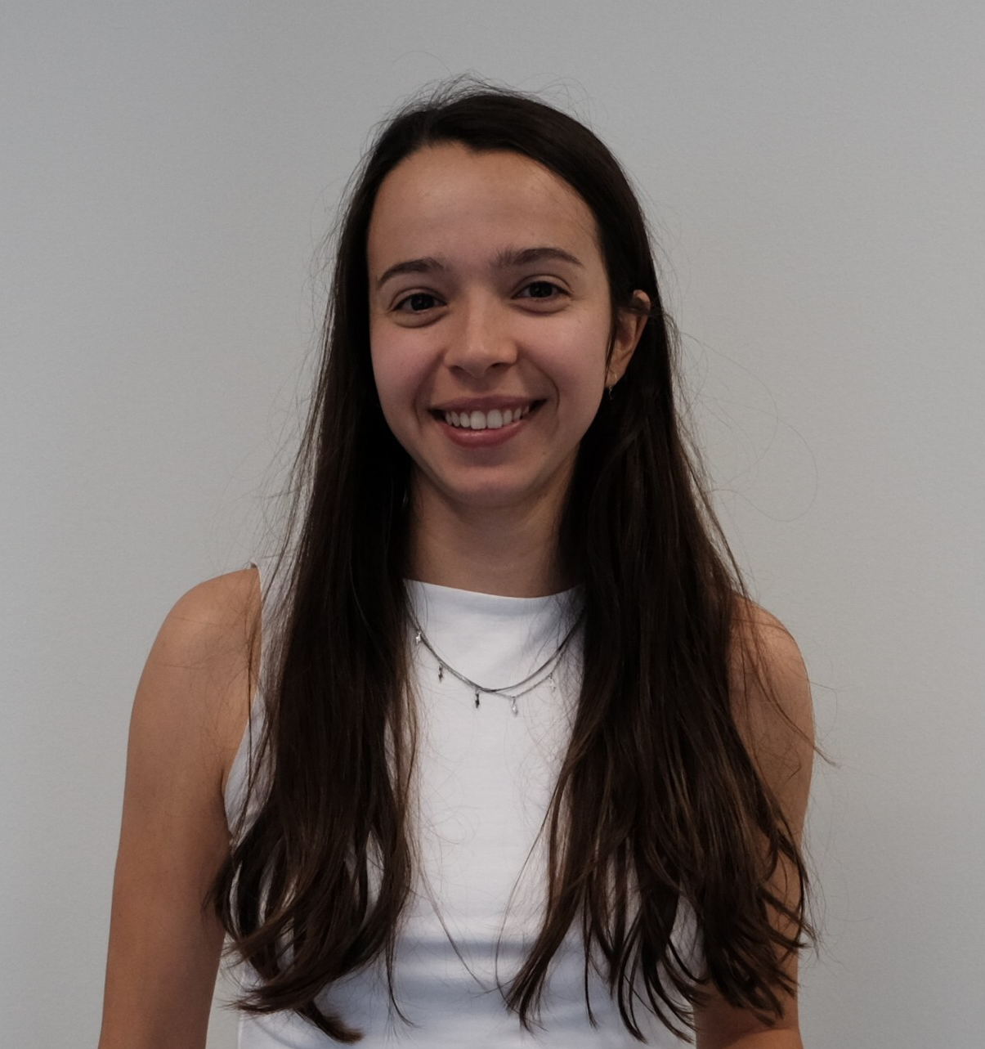

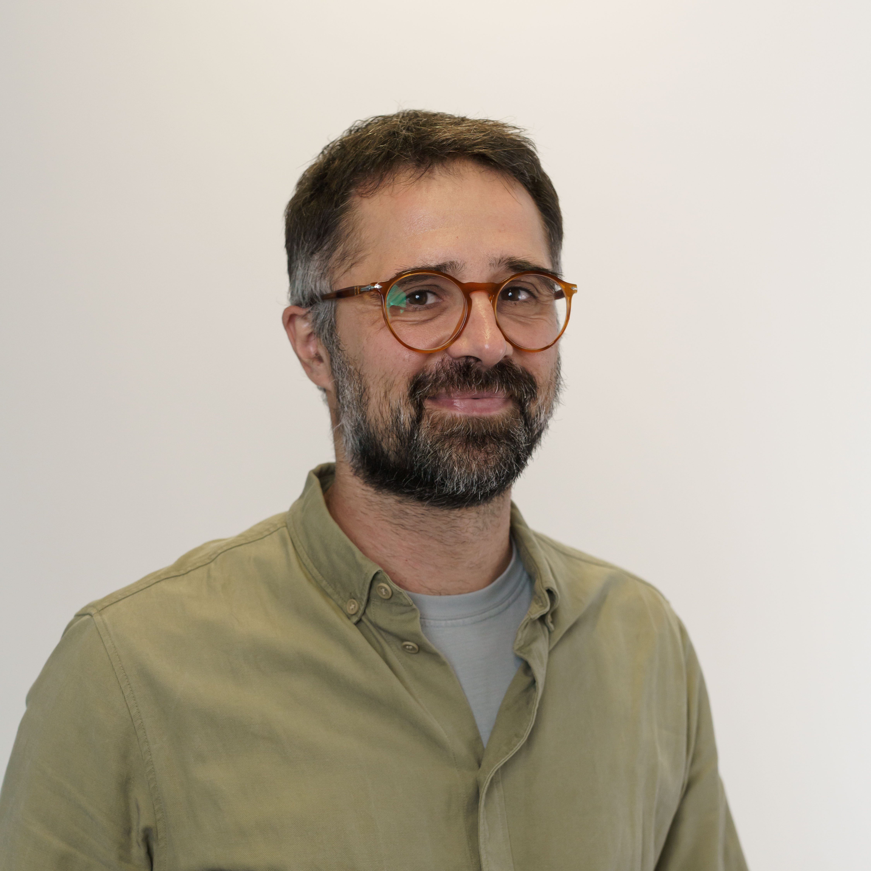
Who are we?
GLOW is a project with the aim of developing ultra-sensitive temperature sensing systems based on Whispering-Gallery-Mode resonators for gravitational wave observatories (i.e. LISA μ𝑲∕√𝑯𝒛 in the 1-100mHz window) GLOW is part of the LISA-Spain group, in charge of the LISA-SDS (Science Diagnostics Subsystem).
Vivek Gualani:
PhD Student (Electronics/
photonics engineer).
Alba Moras:
PhD Student
(Physicist).
Pep Salvans:
Research assistant (Mechanical engineer).
Dr. Miquel Nofrarías:
PI (Physicist)
Bachelor/Masters Students:
Pau Fernandez: Telec. engineer. (UAB, TFG, Jul. 2022)
Juan Garrido: Aerospace engineer. (UAB, TFM, Jun. 2023)
Eloi Fernandez: Physicist (UAB, TFG, Expected Feb. 2024)
Maria Riera: Physicist (UB, internship Feb-Jul.2025)
ice.csic.es

Slide 3
Contents
LISA – low frequency metrology:
LDS – LISA Diagnostics Subsystem
Optical cavities
The Whispering Gallery Mode Resonator
WGMRs as temperature sensors
Goals and Objectives
Lab development
Coupling Mechanics
Low frequency stabilization
WGMR fabrication
Temperature sensing
Final thoughts and conclusions
ice.csic.es

Slide 4
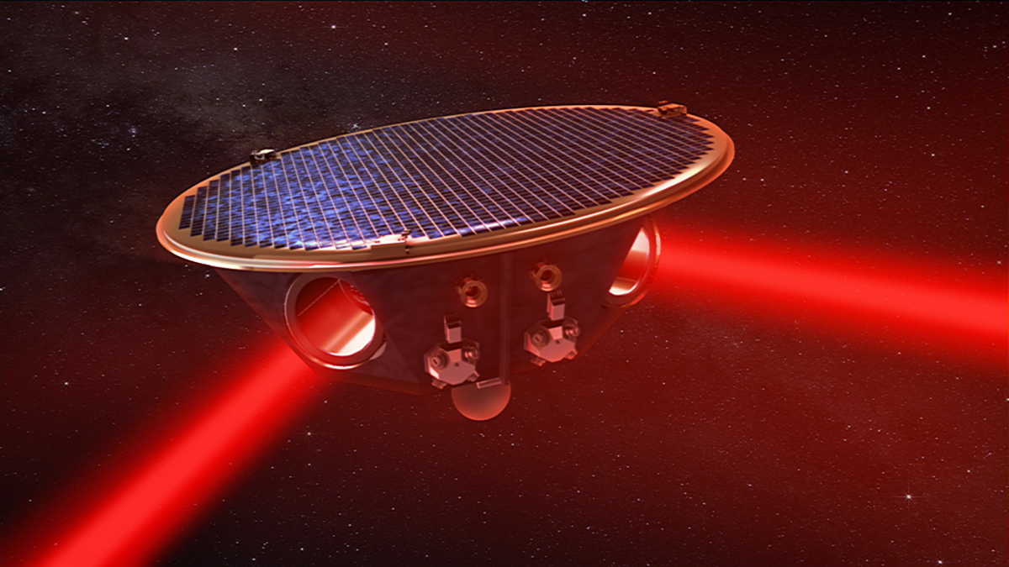
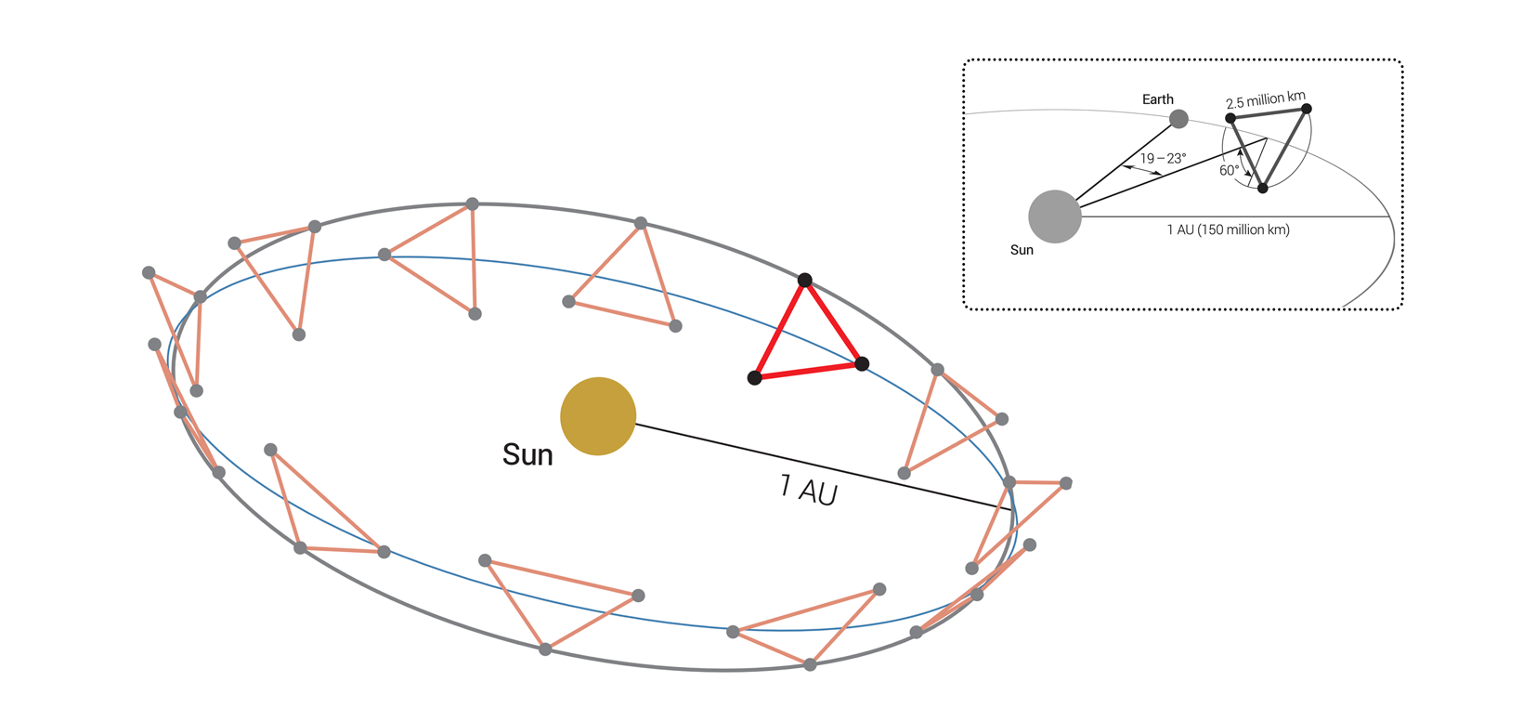

Fig 1. Artists recreation of a Satellite of the LISA-Mission
© Max Planck Institute for Gravitational Physics (Albert Einstein Institute).
LISA
The Laser Interferometer Space Antenna is an L3 class mission from the ESA.
It will be the first space-based gravitational wave observatory.
In contrast to ground based detectors, the detection window will be of lower frequencies (0.1 Hz - 0.1 mHz).
3 Spacecraft constellation, 2.5 million Km apart on a “earth sailing” heliocentric orbit.
Fig 7. WGMR and coupling prism we used in our lab. The third picture corresponds to the same resonator viewed through an IR camera after coupling light into it.
Fig 2. Sketch of the LISA orbit. The three spacecraft form a rotating triangle that follows earth in a heliocentric orbit. Source: LISA consortium.
ice.csic.es

Slide 5
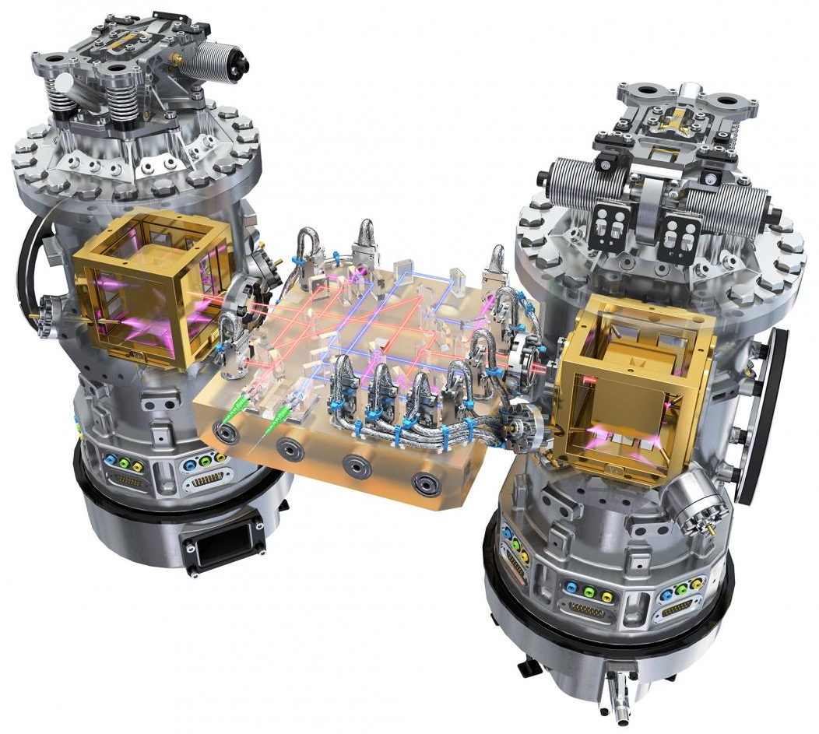
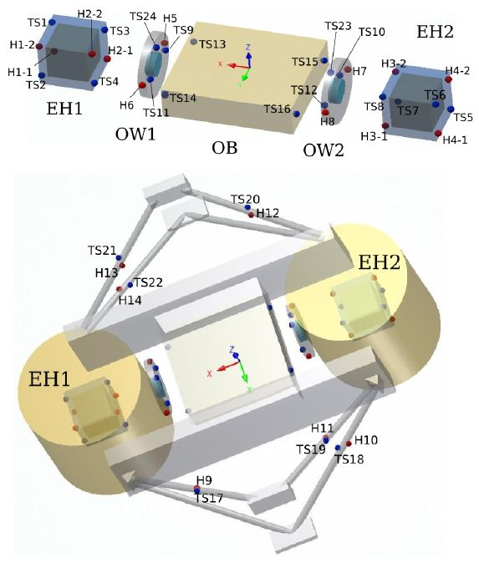
Fig 3. Artist impression of the LISA Technology Package (LTP). Source: ESA/ATG medialab.
LISA Diagnostics subsystem
Magnetometer
Magnetic field sensors
LISA Diagnostics Subsystem
Radiation monitor
Temperature sensors
Temperature fluctuations will play an important role in space-borne gravitational detectors. Typically their most significant contribution is in the sub-milliHertz window.
induced forces on the test mass.
thermoelastic effects
displacement or force
noise effects in LISA
mechanical stress
ice.csic.es
Fig 4. Distribution of temperature sensors and heaters across the electrode housing (EH), optical window (OW), optical bench (OB) and struts. Source: M. Armano et al (2019).

Slide 6
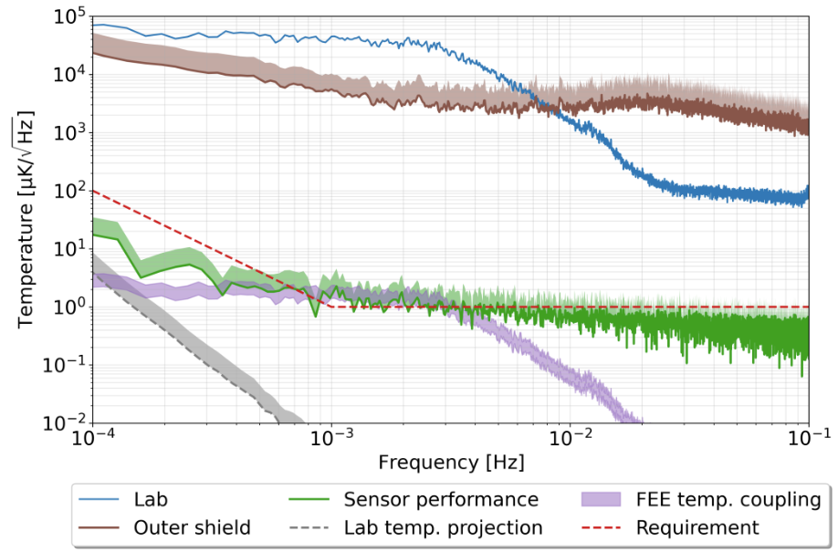
LISA Diagnostics subsystem
LETS – LISA Enhanced Temperature Subsystem (ESA funded contract):
Arsenal of sensors to be placed within the LISA spacecrafts.
NTC Thermistors.
Sensitivity requirement of 1 µK/Hz^{1/2} at 1mHz up to 100 µK/Hz^{1/2} at 0.1mHz. (updated requirement 10 µK/Hz^{1/2} at 1mHz)
The design of the electronic subsystem is already finalized. The first batch of “plug and play” prototypes are already being made to be used for LISA ground support equipment.
Fig 5. Performance of the LISA enhanced temperature subsystem (LETS). It can be seen that the sensors successfully pass the requirement of 1 µK/Hz^{1/2} at 1mHz [1].
Efforts are being made to tackle this challenge, potentially overtaking the sensitivity requirement, using optical technologies.
LIRA (ESA funded contract): Optical fiber micro-kelvin temperature sensor network for sensitive optical payloads
GLOW: Ultra Sensitive thermometry using Whispering Gallery Mode Resonators.
[1] Roma-Dollase, D., Gualani, V., Gohlke, M., Abich, K., … Nofrarias, M. (2022, December 23). Resistive-Based Micro-Kelvin Temperature Resolution for Ultra-Stable Space Experiments. Sensors. MDPI AG. http://doi.org/10.3390/s23010145
ice.csic.es

Slide 7
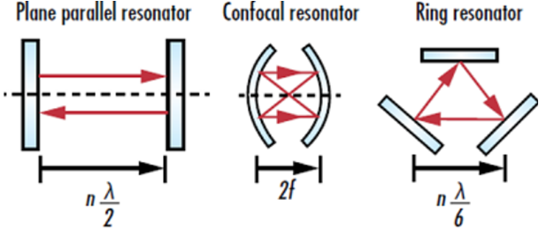
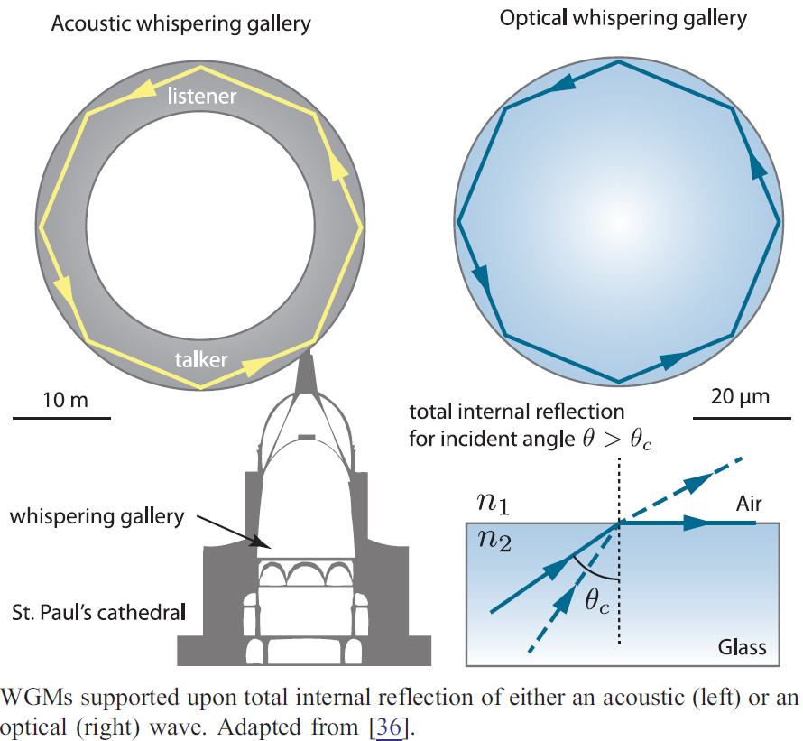
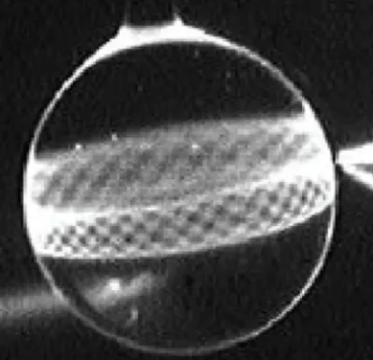
Fig 6. Three types of Laser resonator geometries (edmundoptics.com).
Optical Cavities
The Whispering Gallery Mode Resonator
An optical cavity is an arrangement of mirrors or other optical elements that confine light waves (at a certain wavelength/frequency).
WGMR’s are monolithic, convex shaped structures made of a dielectric material with low light absorption.
WGMRs present either radial or spherical symmetry.
“Whispering-gallery waves” are a kind of wave which is able to travel along and around a physical concave surface, due to total internal reflection.
Fig 7. Comparison of the acoustic and optical WG effect [2].
Fig 8. Intensity of interfering traveling light waves in a selected combination of WGM modes (NASA).
[2] Matthew R. Foreman et. Al., "Whispering gallery mode sensors," Adv. Opt. Photon. 7, 168-240 (2015).
ice.csic.es

Slide 8
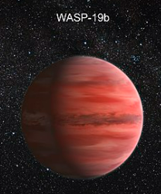
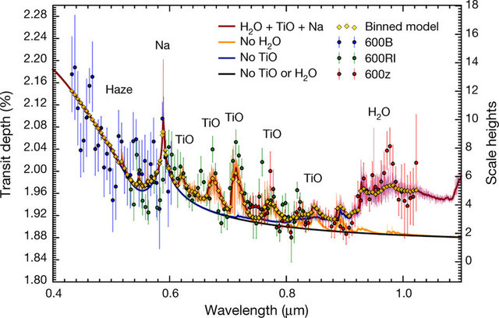
Optical Cavities
The Whispering Gallery Mode Resonator
WGMRs are widely used in the field of optics fulfilling different purposes, the most common being:
Ultra stable frequency reference sources: “Optical clocks”
Non linear crystal: Second Harmonics Generator (SHG), third… and frequency combs.
High sensitivity sensors.
Uses of optical clocks/combs in space involve:
Navigation
Interferometry
Spectroscopy
Fundamental physics experimentation
Astronomical scanning
Others…
Fig 11. (Fig 9. Exoplanet WASP-19b transmission spectrum [3].
[3] Sedaghati, Elyar et al (2017). Detection of titanium oxide in the atmosphere of a hot Jupiter. Nature. 549.
ice.csic.es

Slide 9
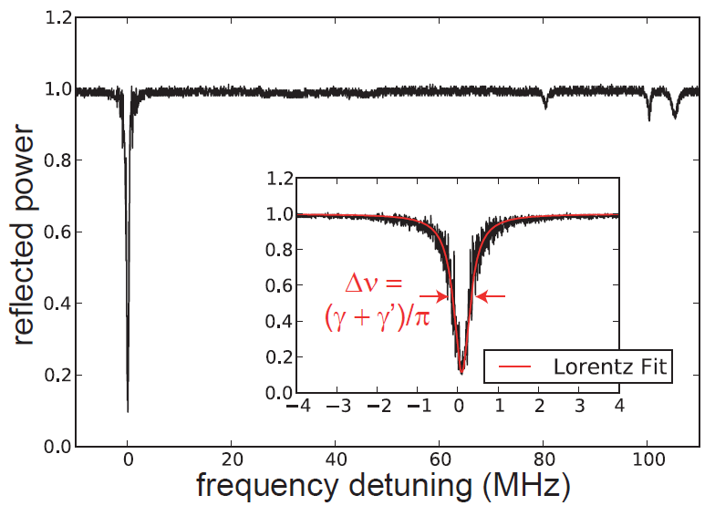
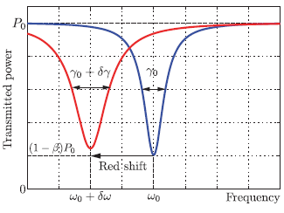
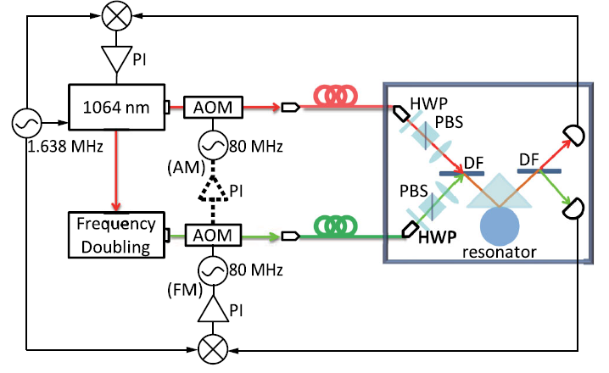
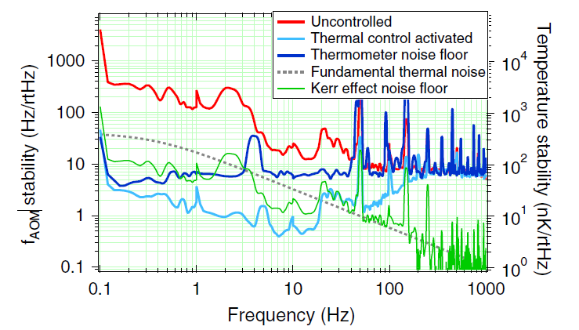
WGMRs as sensors
In stable conditions, the amplitude and width of the resonance peak will remain stable.
Changes in wavelength, refractive medium and geometry of the resonator will shift the resonance frequency, which enables its use as a sensor for [3]:
WGMR’s as temperature sensors have reached a ground-breaking level of sensitivity, where the limit has almost reached the fundamental thermal noise of the sensor itself.
Fig 9. Spectral measurement of reflected optical power of a WGMR [4].
Fig 10. Red shift due to temperature change [2].
Temperature
Pressure and force
Humidity
Acceleration
Biosensors
Fig 11. (Top) Dual wavelength optical layout schematic and (Bottom) temperature readout presented in [5].
Wenle Weng et.al. (2014)[4] achieved a resolution of 80 𝒏𝑲∕√𝑯𝒛 is achieved. (“High” frequencies)
[4] Sedlmeir, Florian. (2016). Crystalline Whispering Gallery Mode Resonators.
ice.csic.es
[5] Weng, Wenle et al. (2014). Nano-Kelvin Thermometry and Temperature Control: Beyond the Thermal Noise Limit. Physical Review Letters. 112. 10.1103/PhysRevLett.112.160801.

Slide 10
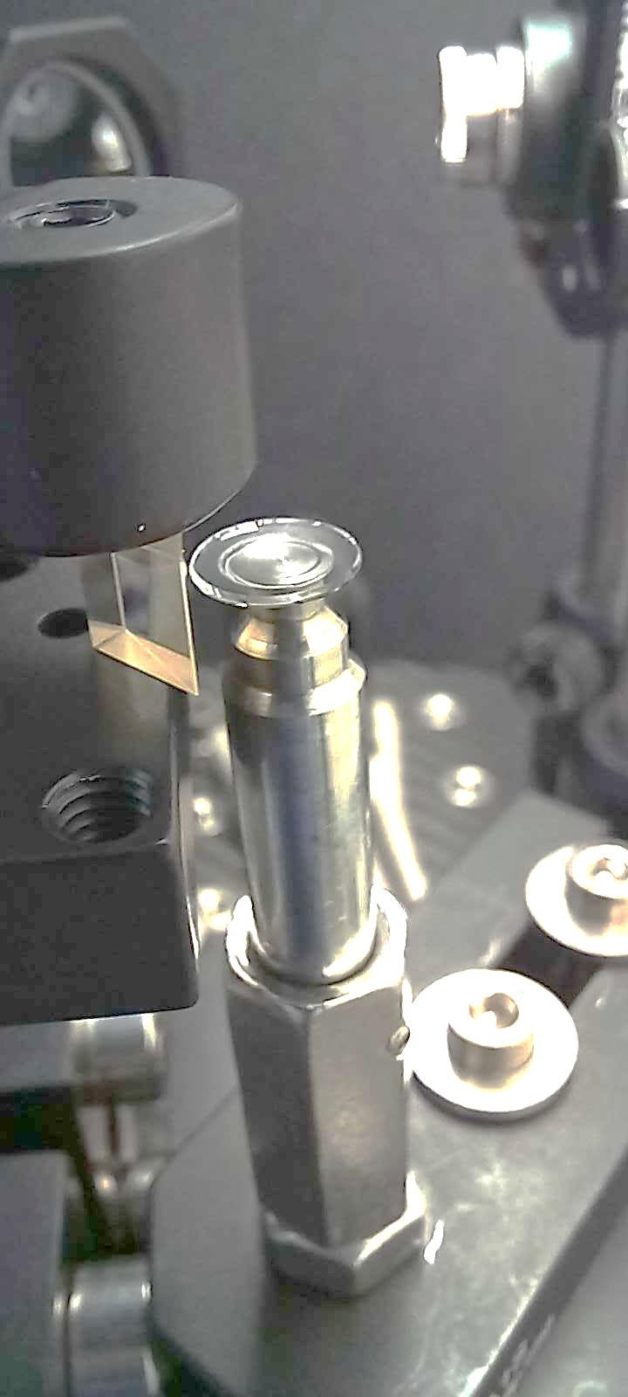
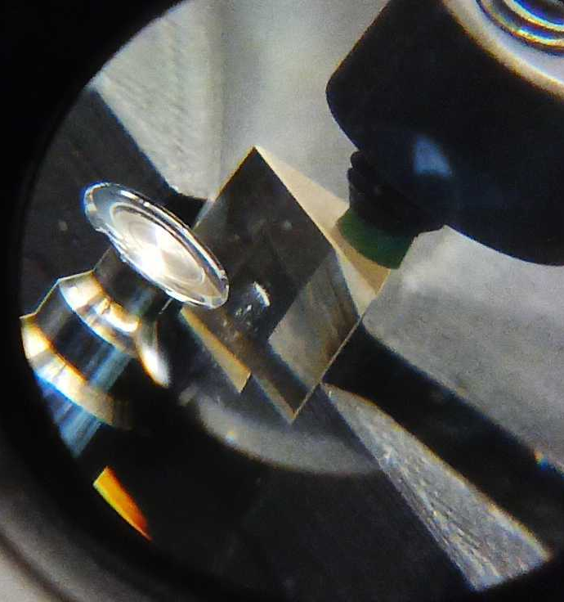
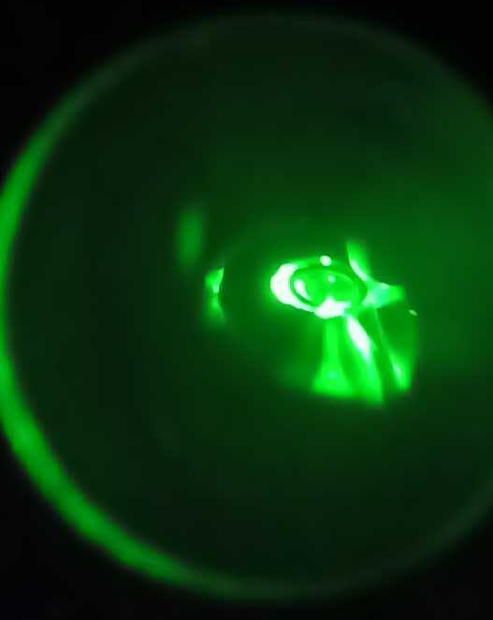
Goals and Objectives
Our primary goal is to in-house know-how on optomechanical resonators and optoelectronic systems, with potential application in different fields of precision measurement, both from ground and in space.
Our first milestone is to use this technology to reach a nK resolution temperature readout system at low frequencies (1-100 mHz) which is the window of interest for space gravitational wave detection, as in LISA.
Fig 12. WGMR and coupling prism we used in our lab. The third picture corresponds to the same resonator viewed through an IR camera after coupling light into it.
ice.csic.es

Slide 11
Contents
LISA – low frequency metrology:
LDS – LISA Diagnostics Subsystem
Optical cavities
The Whispering Gallery Mode Resonator
WGMRs as temperature sensors
Goals and Objectives
Lab development
Coupling Mechanics
Low frequency stabilization
WGMR fabrication
Temperature sensing
Final thoughts and conclusions
ice.csic.es

Slide 12
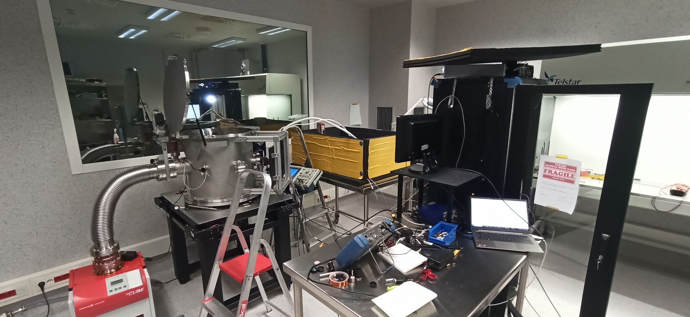
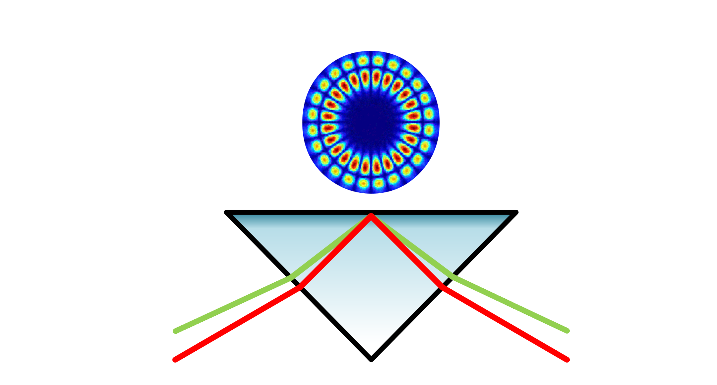
Lab development
Fig 13. Our lab.

Slide 13
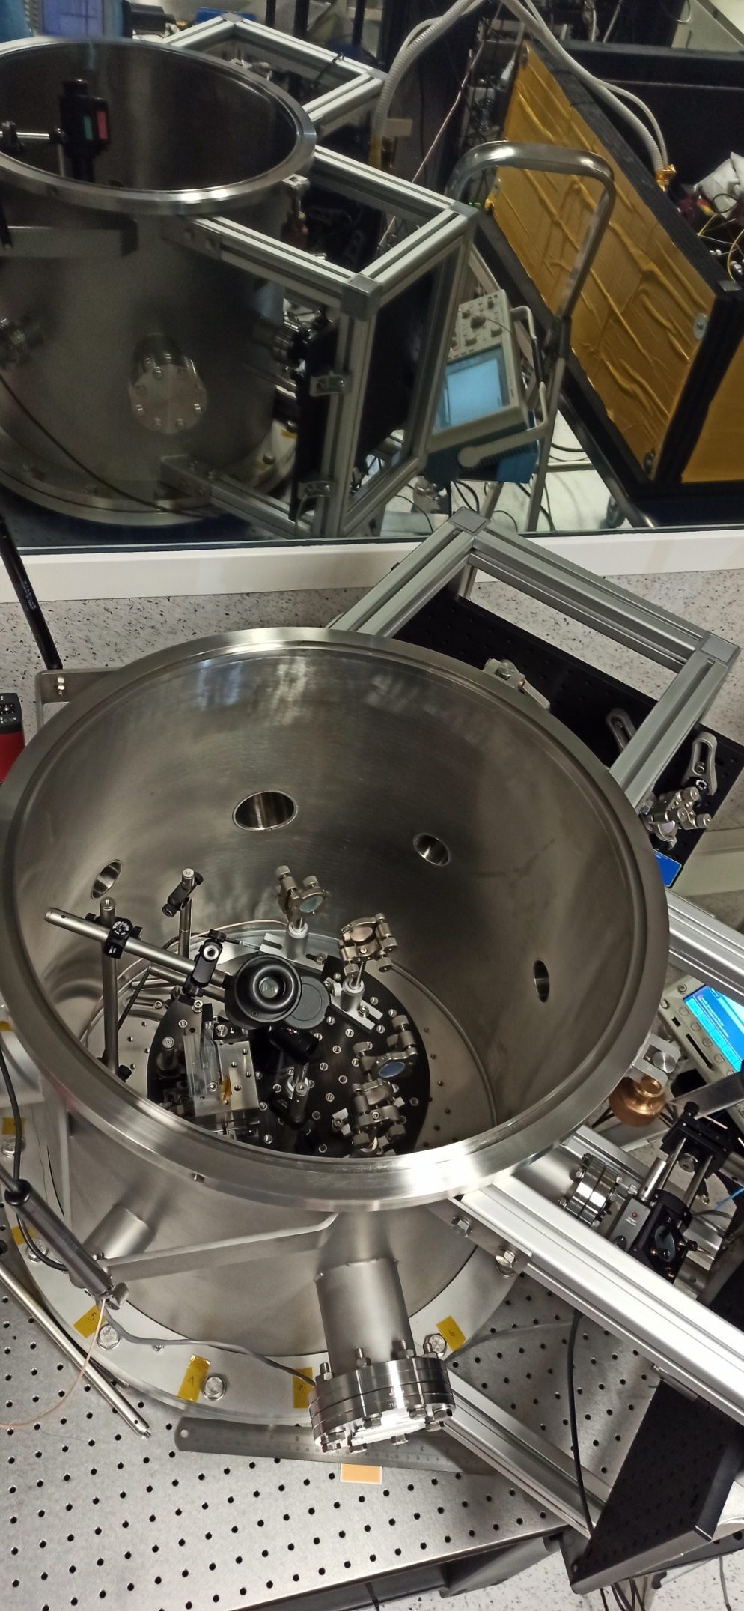
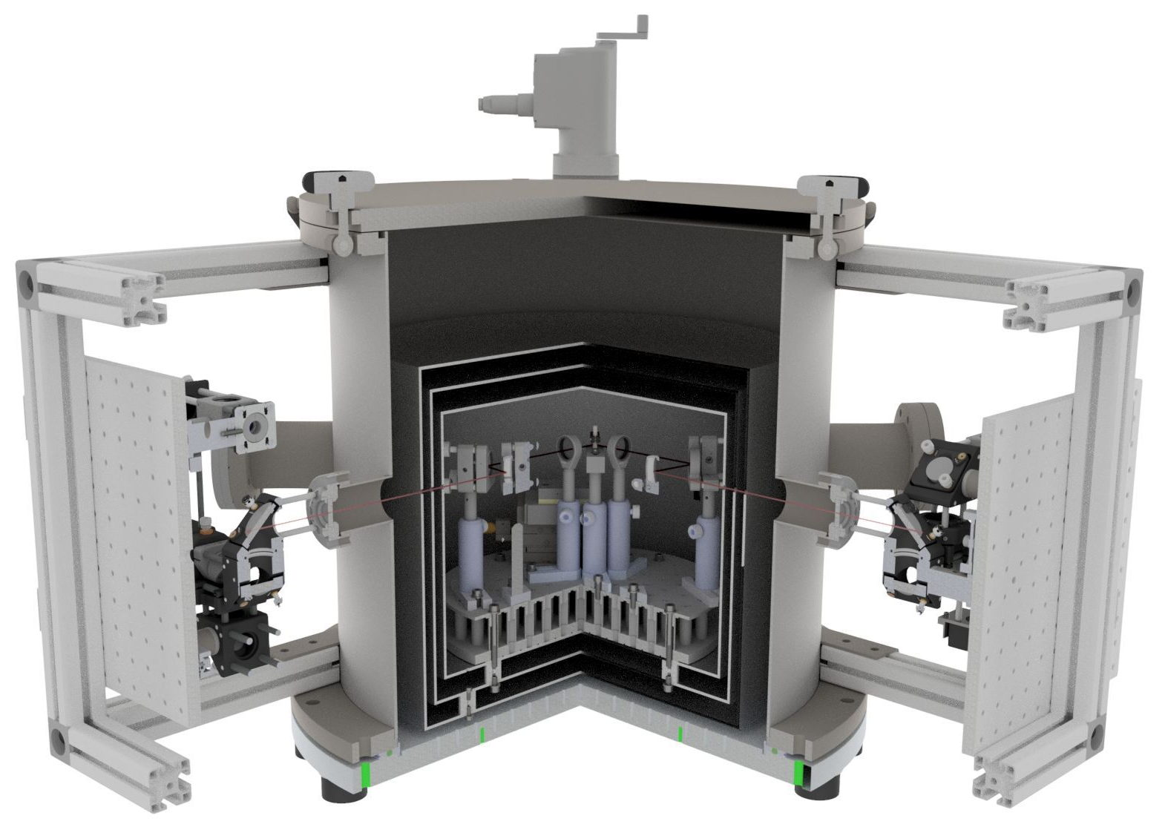
Fig 18. Vacuum chamber and optical benches currently in our lab.
Lab development
Low frequency stabilisation
A thermal vacuum chamber has been built to provide with a thermally stable environment, in the order of 𝒏𝑲∕√𝑯𝒛 .
The WGMR is kept inside and optically coupled from the outside through Optical windows.
Fig 17. 3D rendered sketch of the vacuum chamber, optical breadboards, thermal shields and WGMR/prism mounts.
ice.csic.es

Slide 14
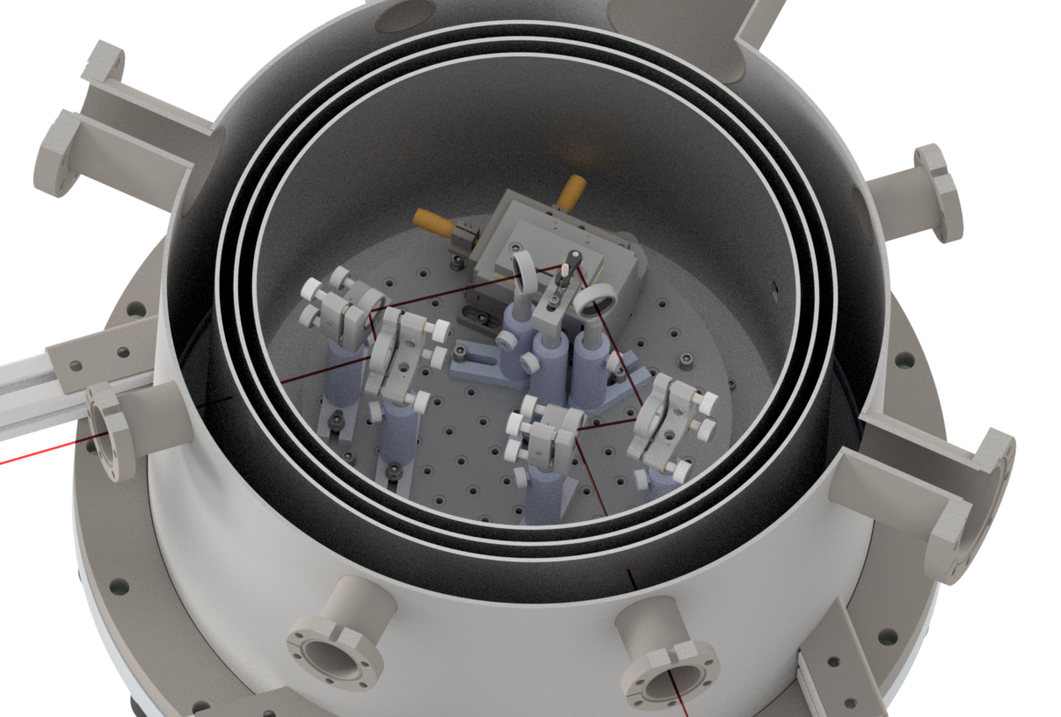
Fig 19. 3D Render, cross section of the Vacuum Chamber, thermal shields and WGMR OBB.

Slide 15
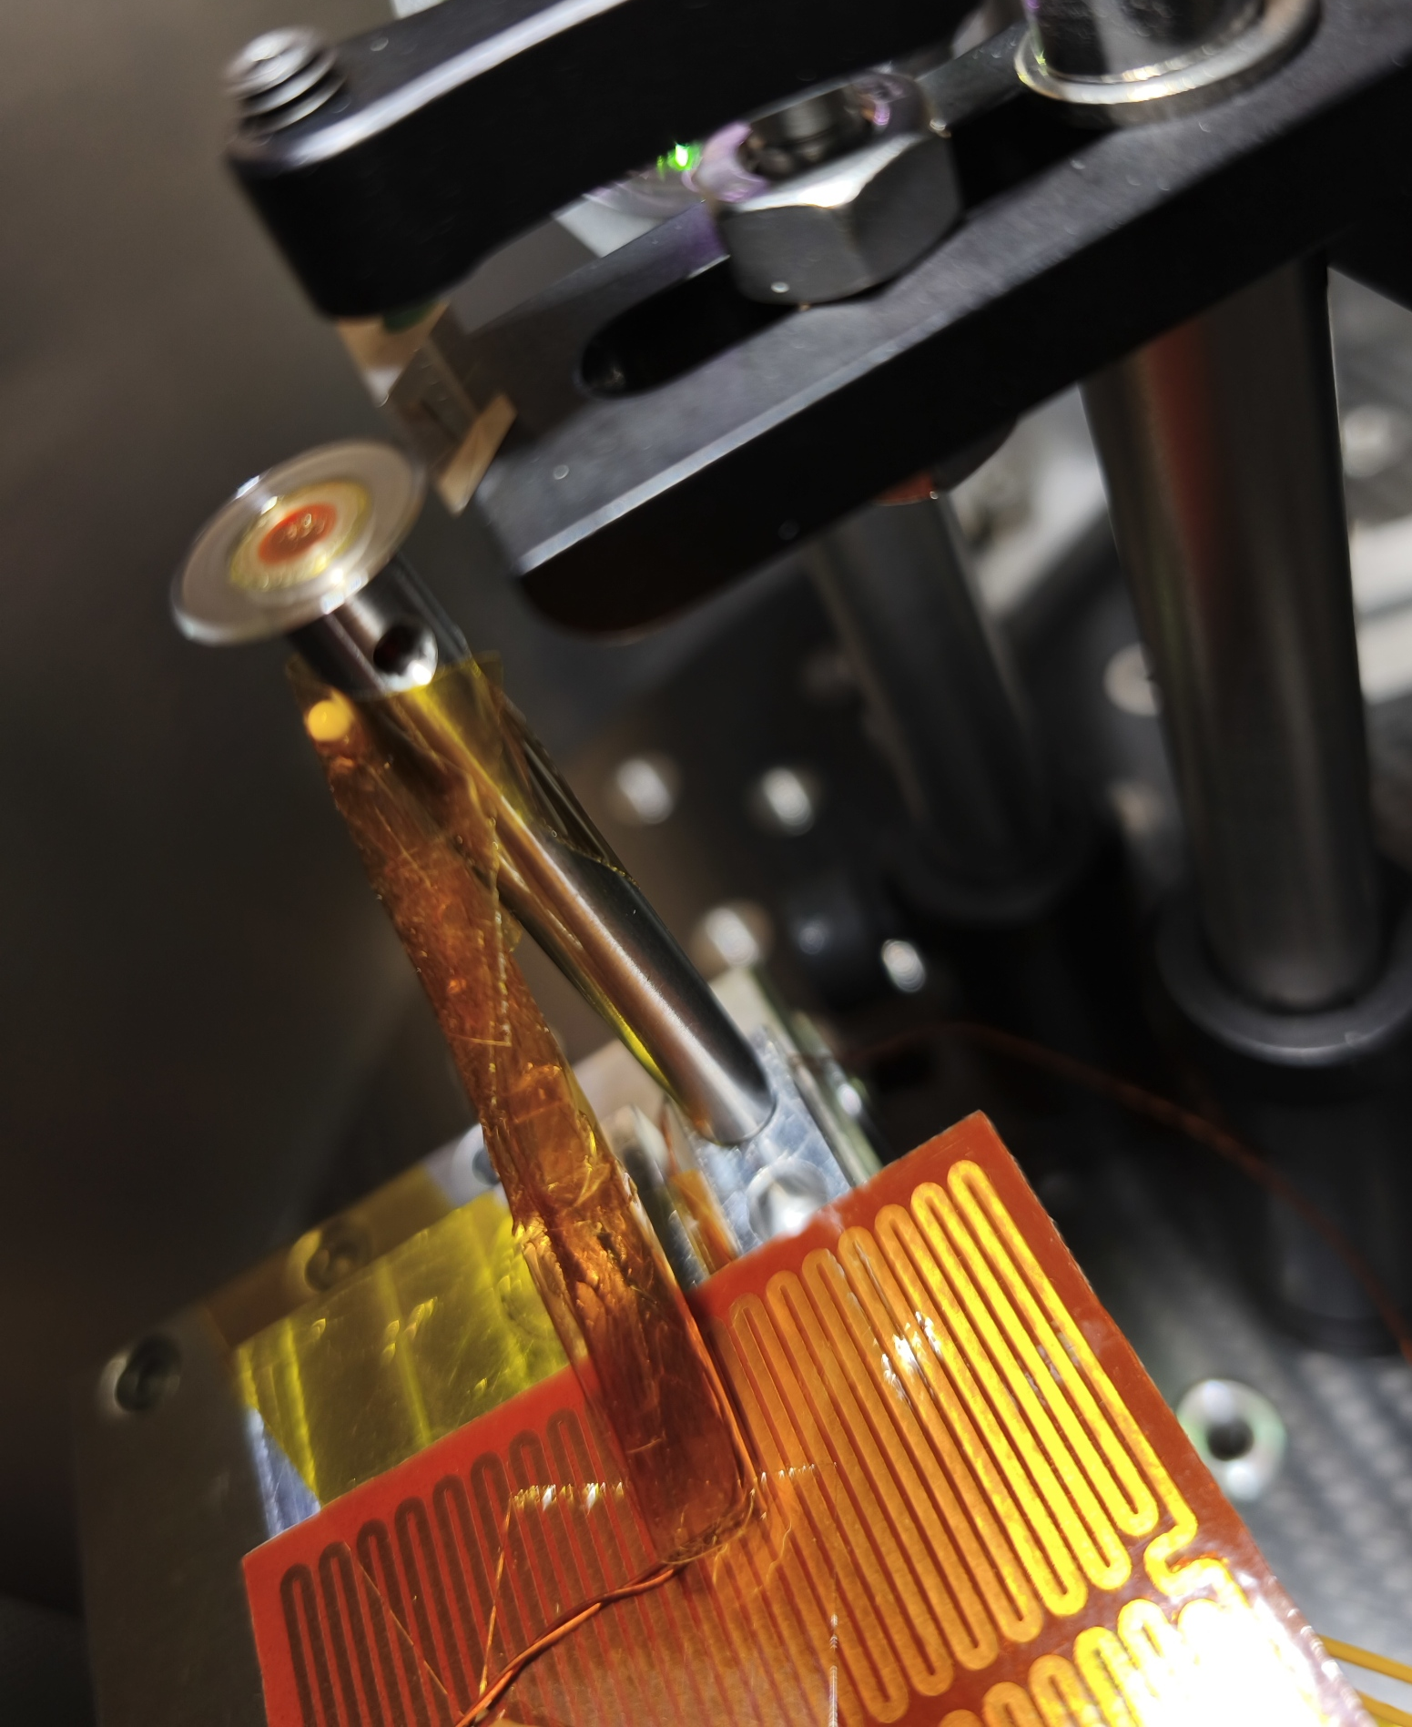
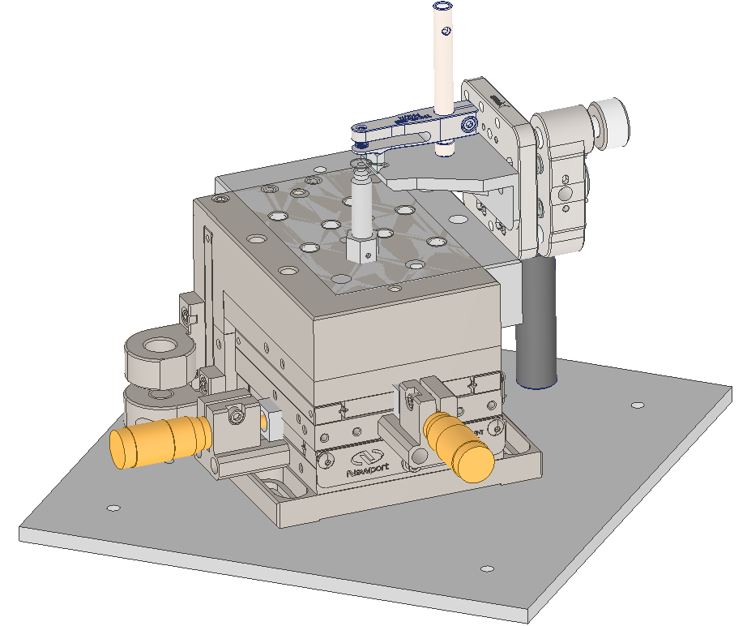
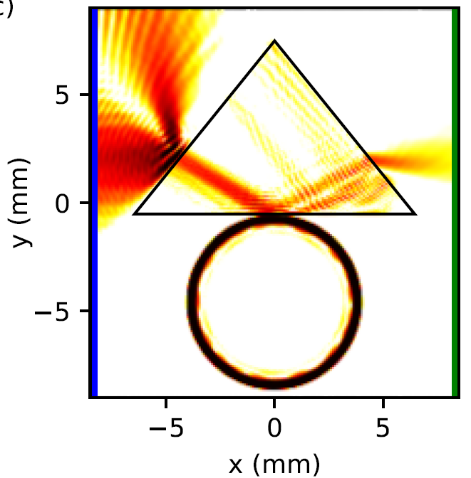
Fig 15. Close-up image of the WGMR and coupling prism in the vacuum chamber. An NTC sensor is attached to the post of the WGMR and a heater to the XYZ platform.
Lab development
Coupling Mechanics: Evanescent Waves
Fig 16. 2D simulation of a Gaussian beam going through FTIR between a Prism and a WGMR [3].
Fig 14. 3D sketch of the WGMR and Prism mounts.
The platforms provide 5 degrees of movement freedom (X, Y, Z, pitch and yaw) to efficiently align WGMR and prism.
ice.csic.es

Slide 16
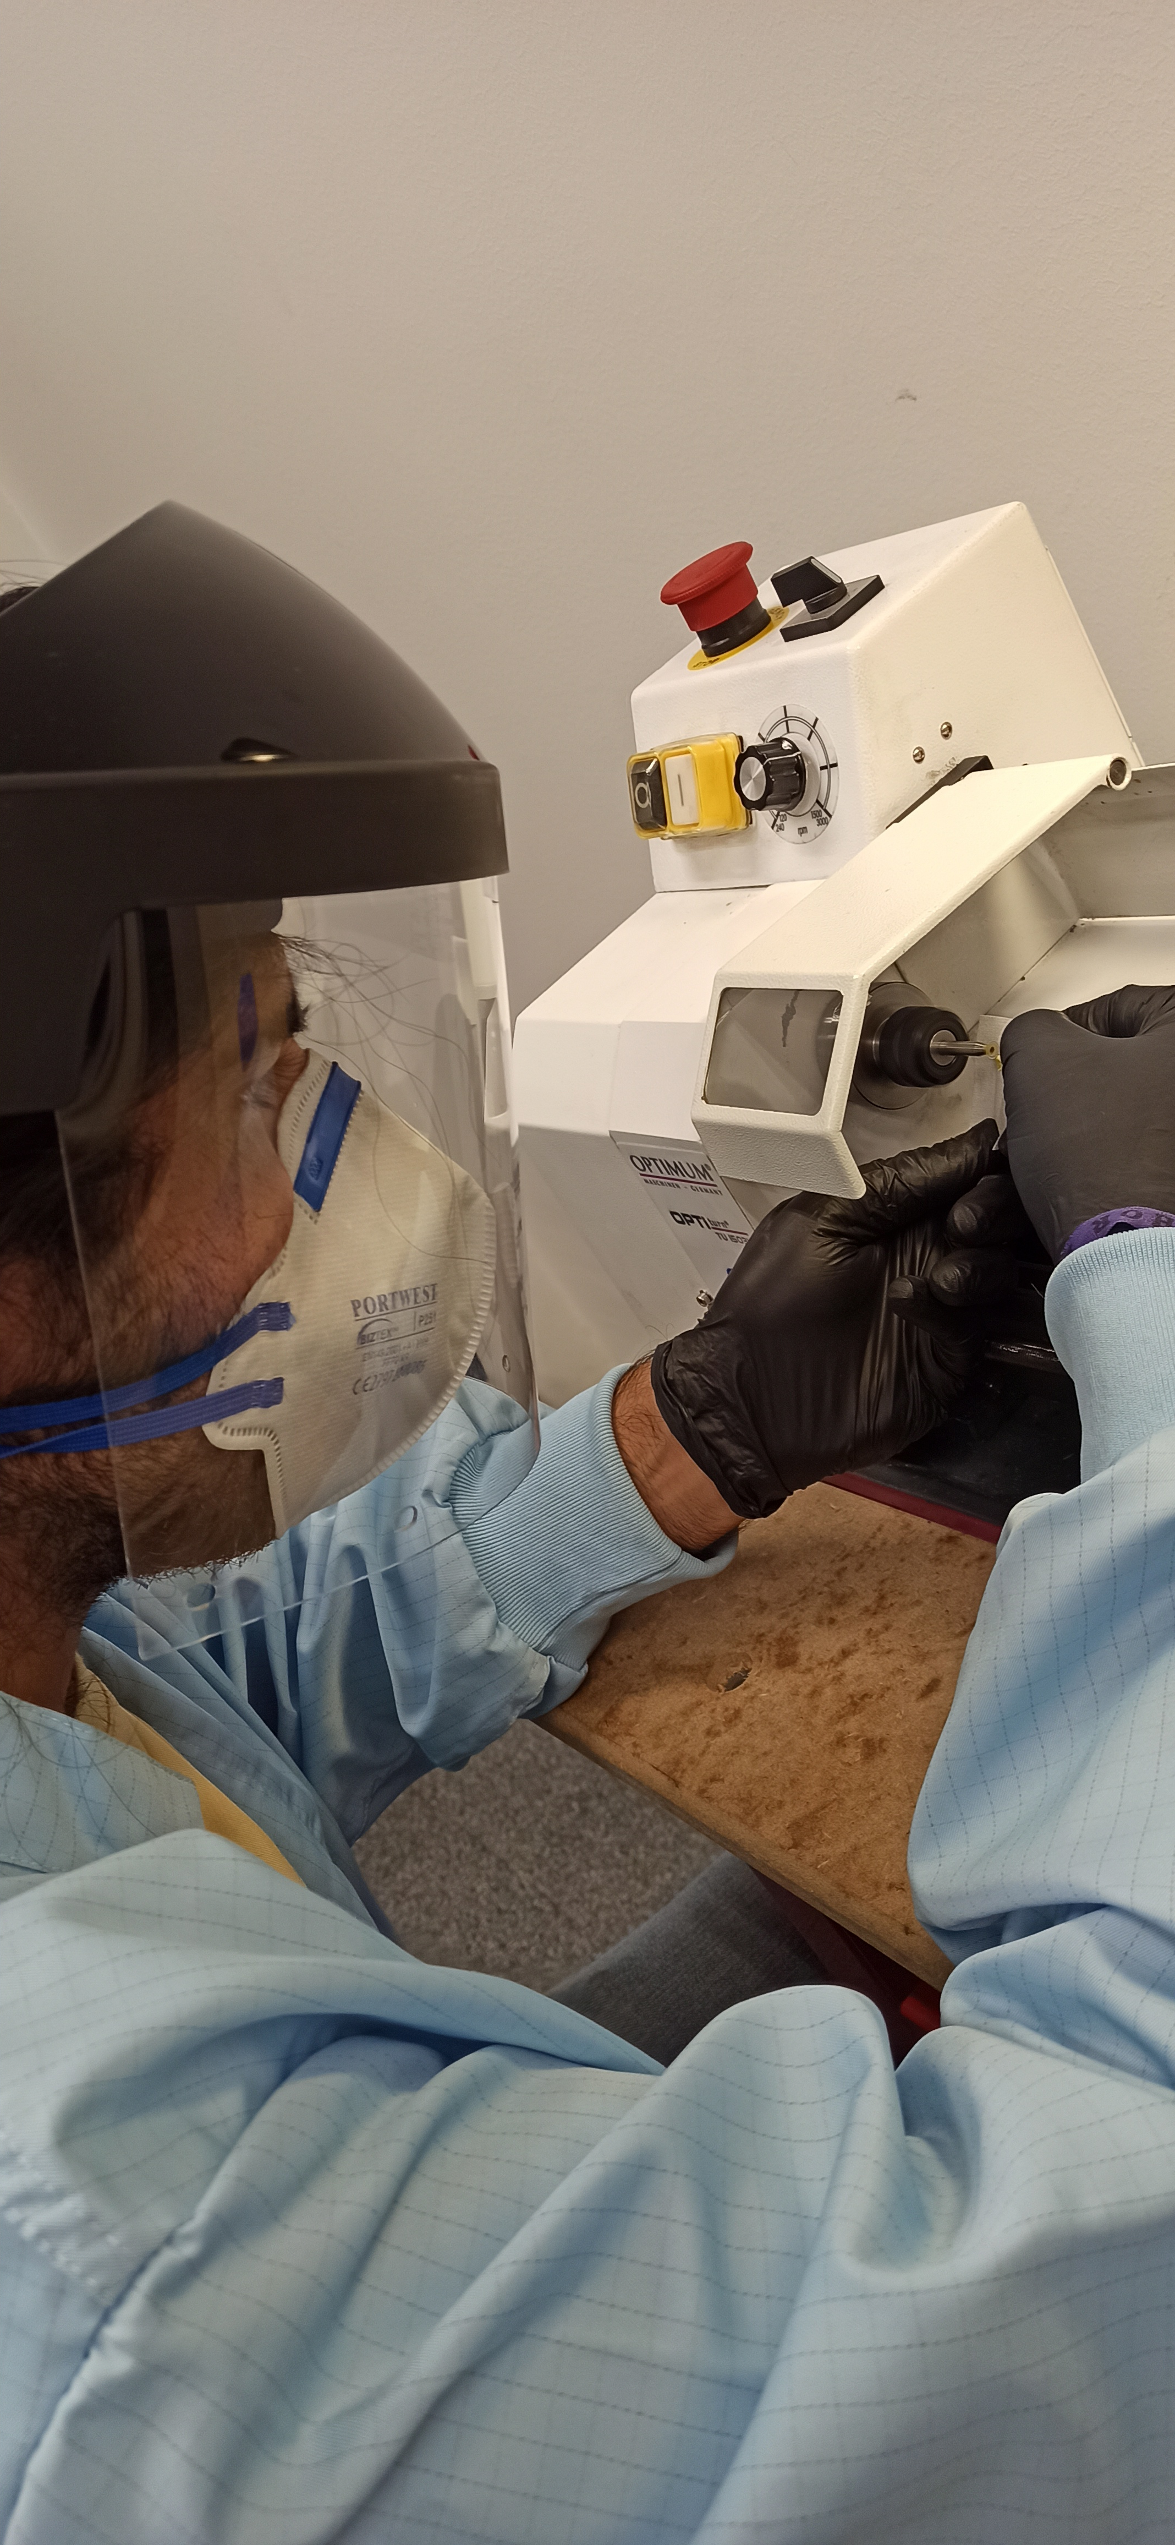
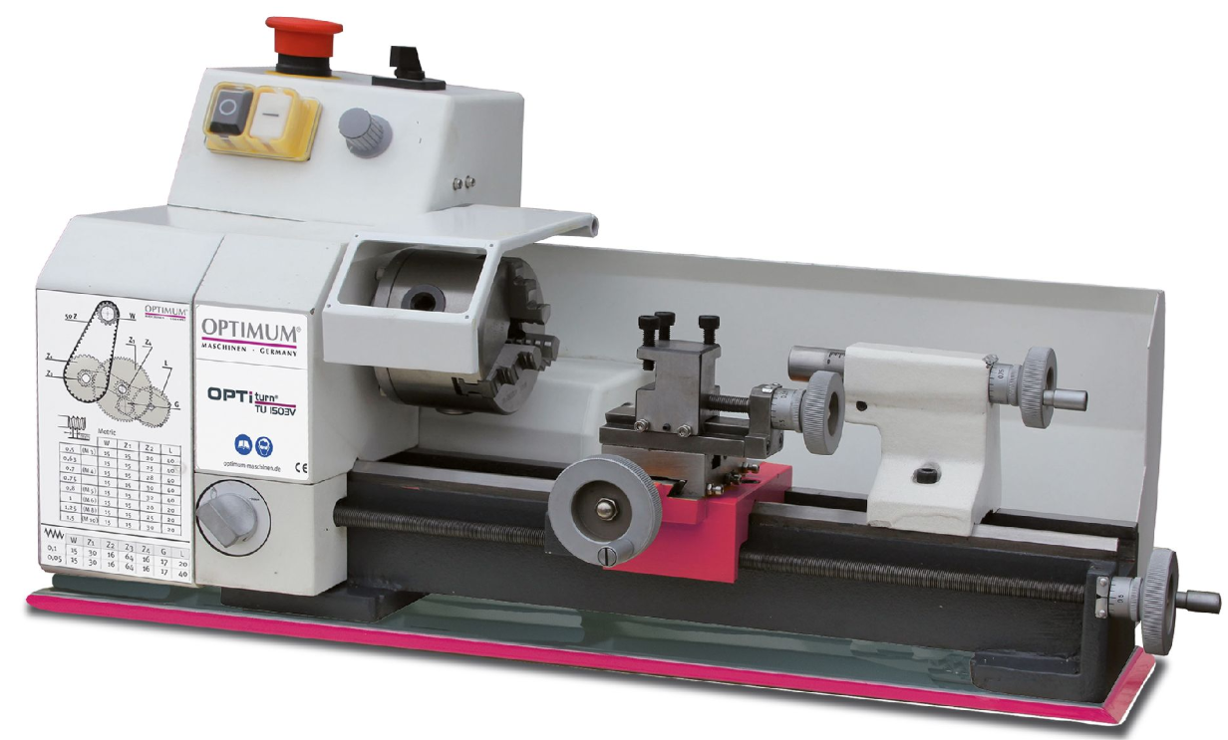
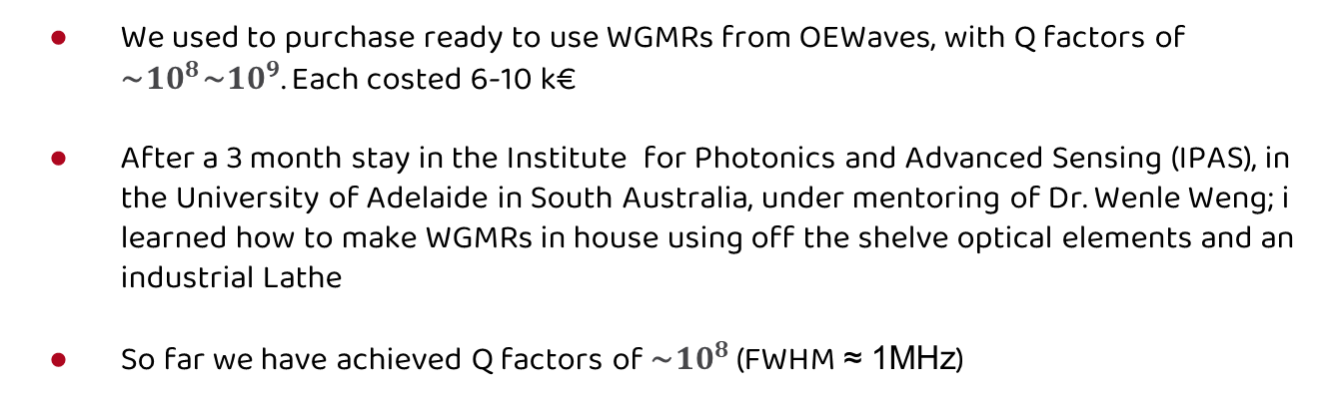
WGMR Fabrication
We used to purchase ready to use WGMRs from OEWaves, with Q factors of ∼${10}^{8}\text{∼}{10}^{9}$. Each costed 6-10 k€
After a 3 month stay in the Institute for Photonics and Advanced Sensing (IPAS), in the University of Adelaide in South Australia, under mentoring of Dr. Wenle Weng; i learned how to make WGMRs in house using off the shelve optical elements and an industrial Lathe
So far we have achieved Q factors of ∼${10}^{8}$ (FWHM ≈ 1MHz)
Fig 21. Me polishing resonators.
Fig 20. Optimum TU 1503 mini-lathe we now have in our workshop.
Fig 8. Our lab.

Slide 17
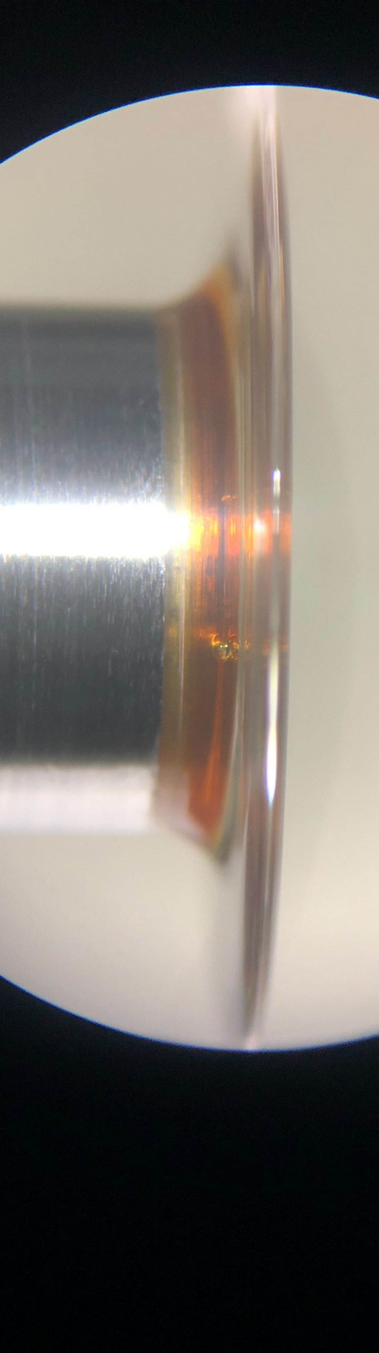
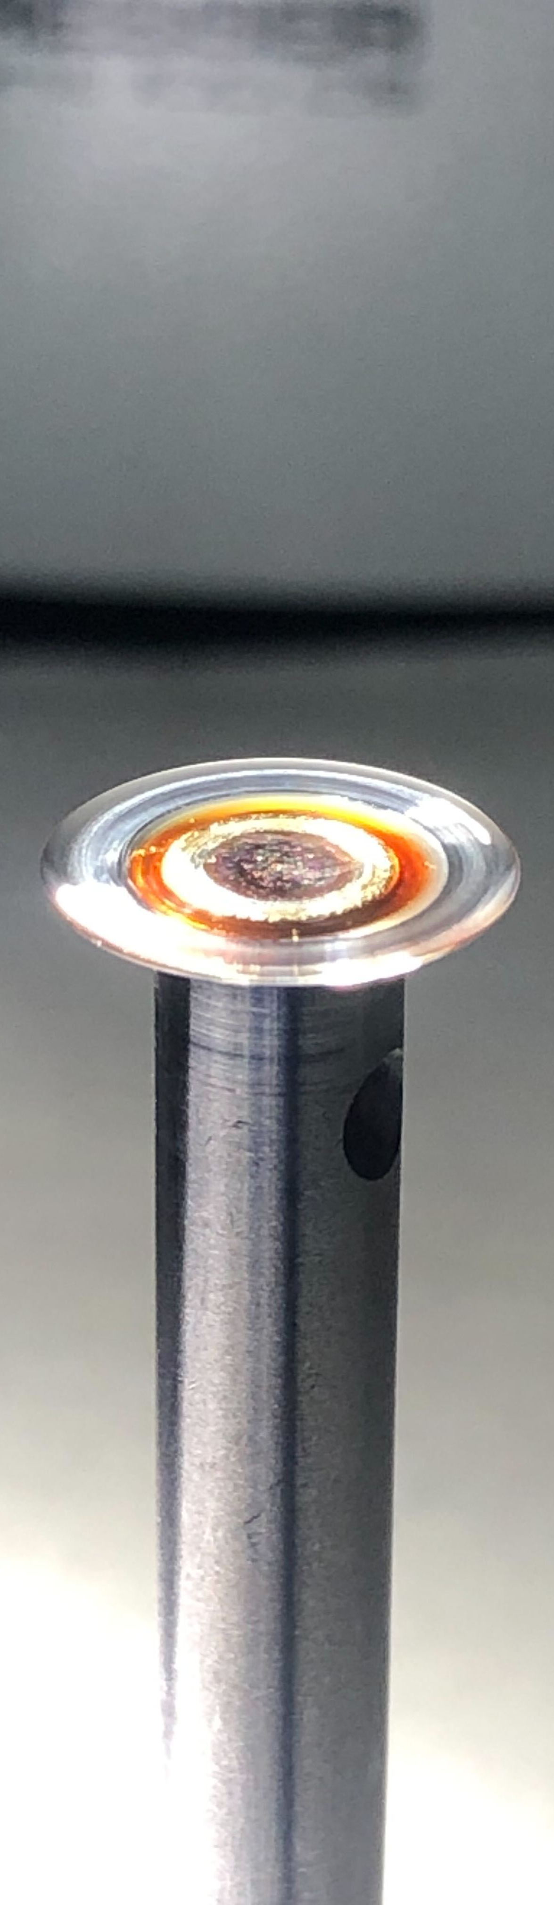
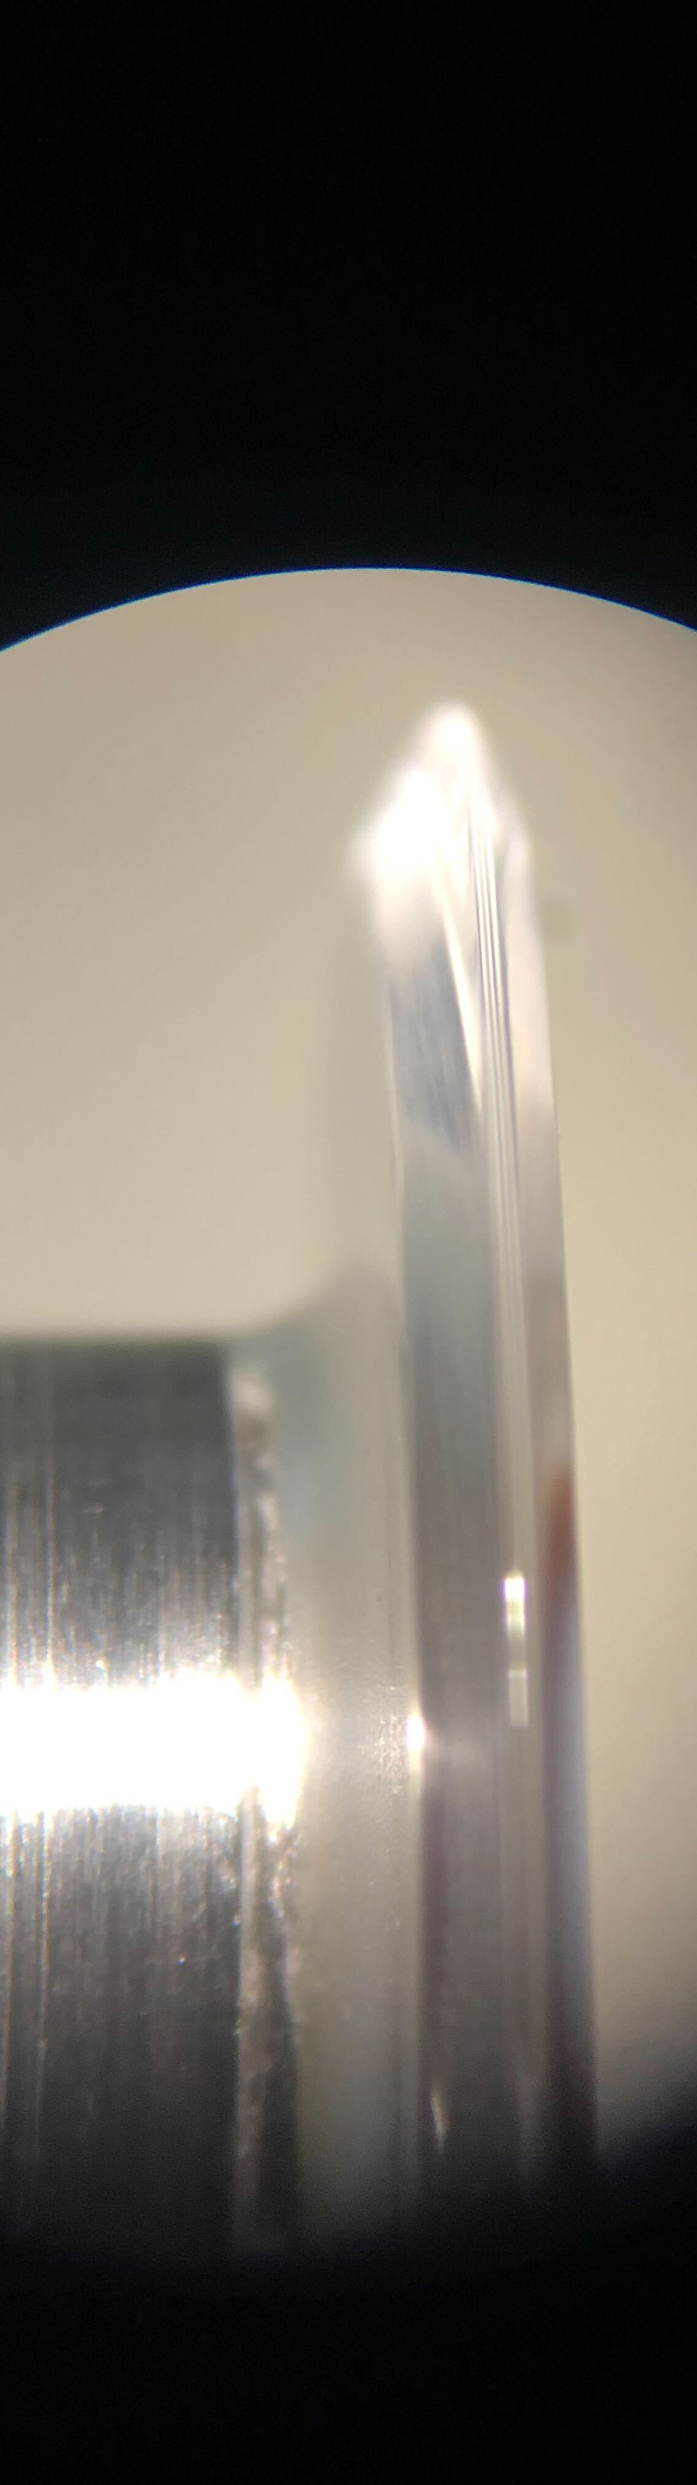
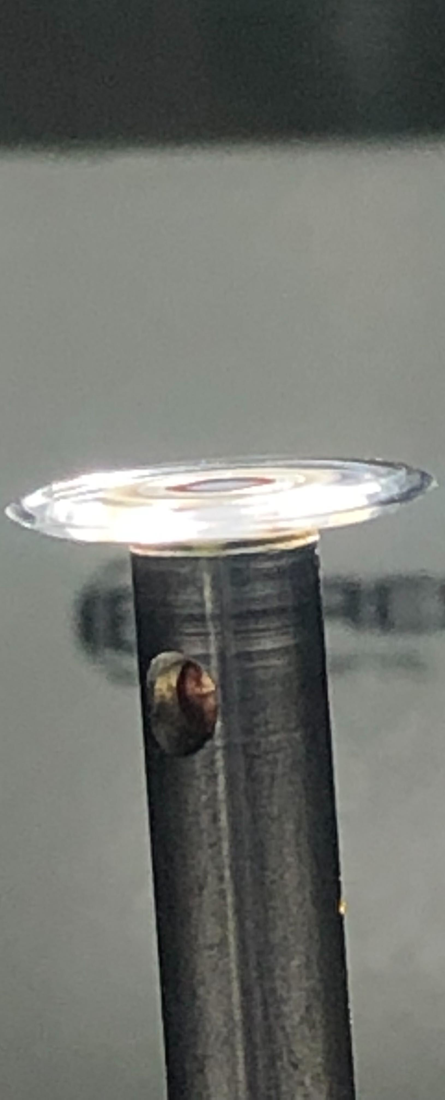
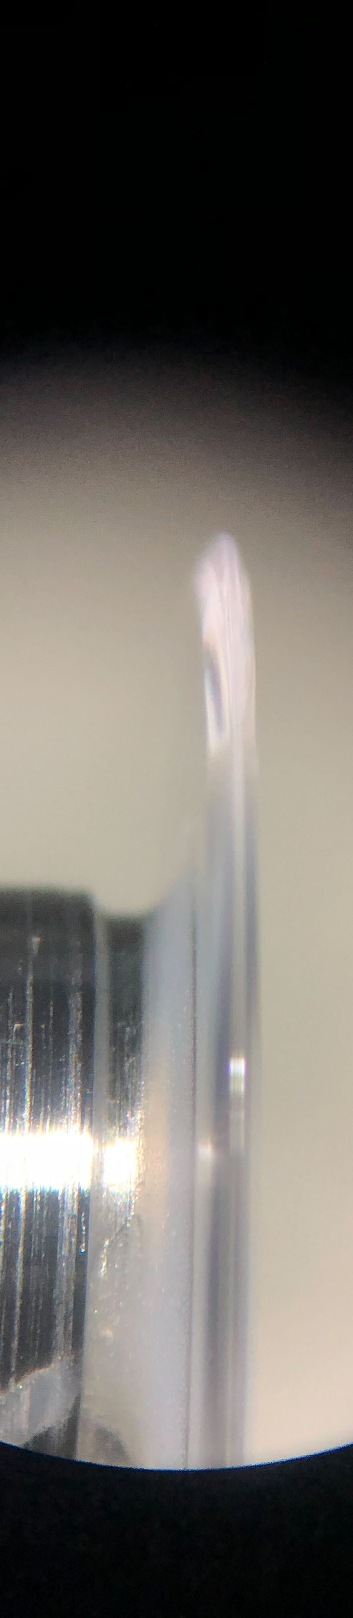
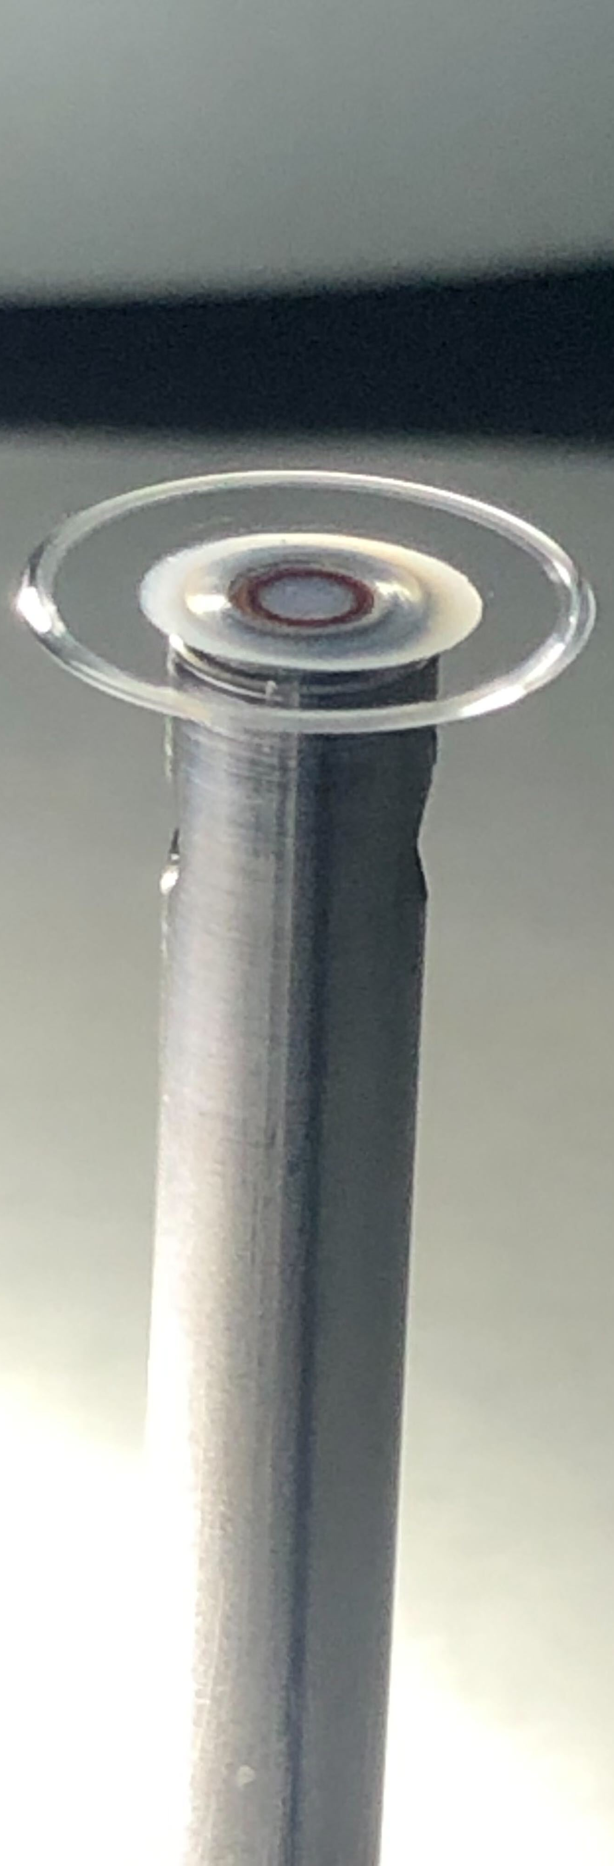
Lab development: WGMR fabrication
WGMR-A
WGMR-B
WGMR-2
WGMR-H2
WGMR-F1
WGMR-H4

Slide 18
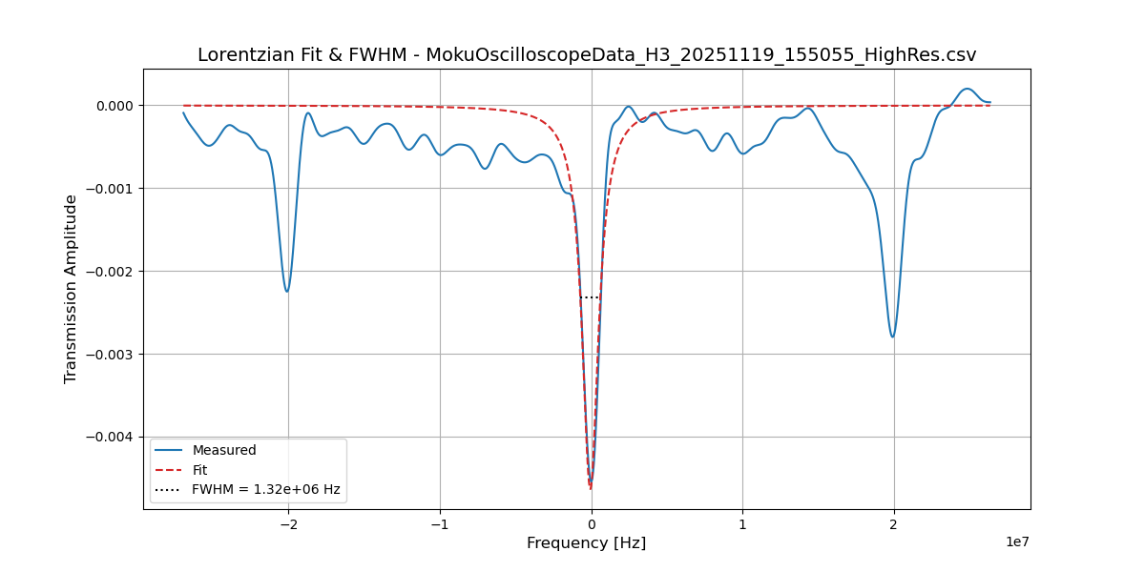
WGMR Fabrication
Fig 22. Mode spectrum and bandwidth of one of our self made WGMRs. The equivalent Q factor is of 2x10^8.
Fig 8. Our lab.

Slide 19
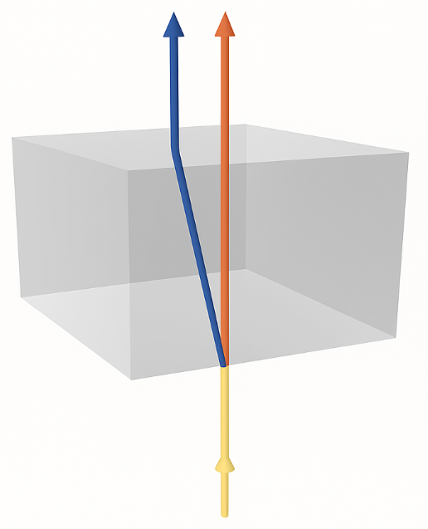
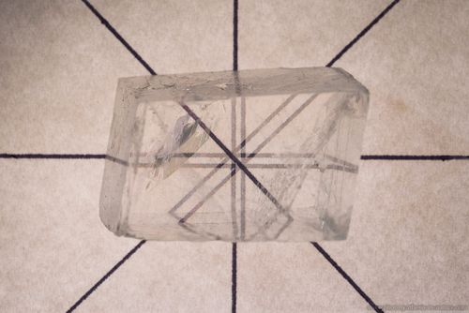

Temperature Sensing
Double cross-polarization lock
Orthogonal polarisations:
Slow axys: $n_{e}$
(extraordinary / Transverse Magnetic - TM)
Fast Axys: $n_{o}$
(ordinary / Transverse Electric - TE)
Birefringence is the optical property of a material having a refractive index that depends on the polarization and propagation direction of light.
Fig 23. Birefringence effect on a Calcite crystal. Source: https://photosynthesis-in-nature.com/
ice.csic.es

Slide 20
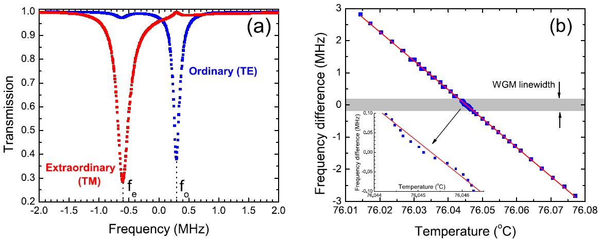

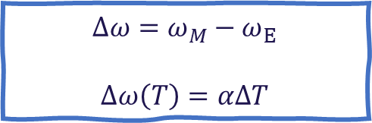
Temperature Sensing
Double cross-polarization lock
Birefringence is the optical property of a material having a refractive index that depends on the polarization and propagation direction of light.
Change in the refractive index of a transparent medium due to temperature variations is known as Thermo-optic effect (α)
Fig 24. (a) A pair of TE and TM modes with small frequency detuning. (b) frequency separation of a pair of TE and TM modes over temperature [6].
$α_{E}=\frac{ⅆn_{E}}{dT}$ $α_{M}=\frac{ⅆn_{M}}{dT}$
$$Δω=ω_{M}−ω_{E}$$
$$Δω\left(T\right)=αΔT$$
ice.csic.es

Slide 21
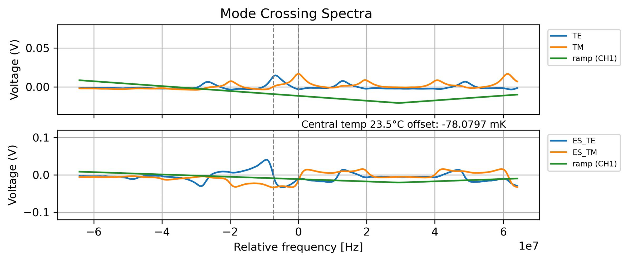
Temperature Sensing
Double cross-polarization lock
ice.csic.es

Slide 22
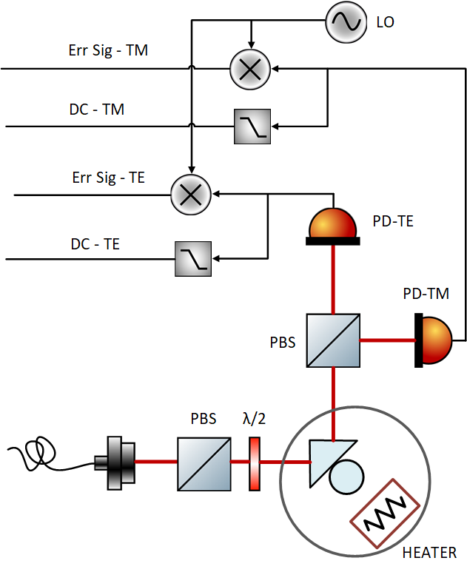
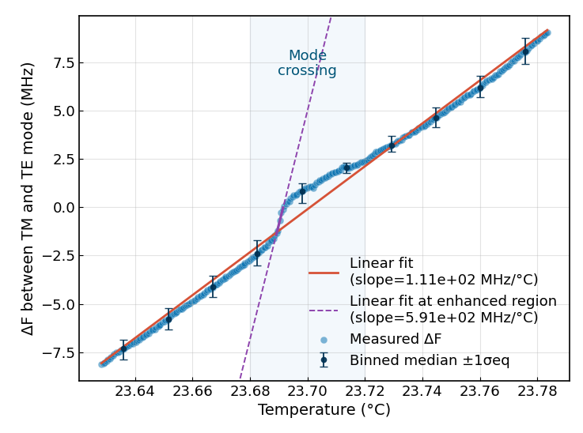

Temperature Sensing
Double cross-polarization lock
A calibration run of our set-up provided an α of 111MHz/K.
It can be seen that the value of α (slope) displays non-linear behaviour during mode crossing and reaches a value of 591 MHz/K.
We use α to describe the thermo-optic coefficient difference between TE and TM modes.
$$ω_{TM}=ω_{TE}+αΔT$$
Fig 25. Simplified layout of the mode-crossing measurement.
Fig 26. Measurement of the frequency difference between TE and TM resonance modes vs temperature change. The shadowed region shows where modes are crossing each other.

Slide 23
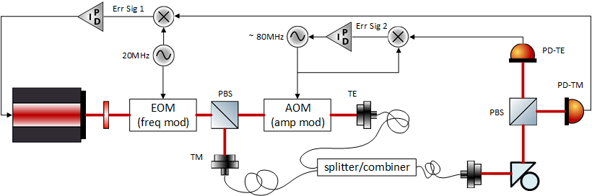
Temperature Sensing
Double cross-polarization lock
Cross-polarization dual lock scheme:
Two beams of opposite polarization are locked to the WGMR.
MgF2 is a birefringent material, thermo-refractive index changes with polarization.
The frequency drift between them will be the temperature measurement.
Fig 27. Simplified schematic of our cross-polarization locking scheme/optical breadboards.
ice.csic.es

Slide 24
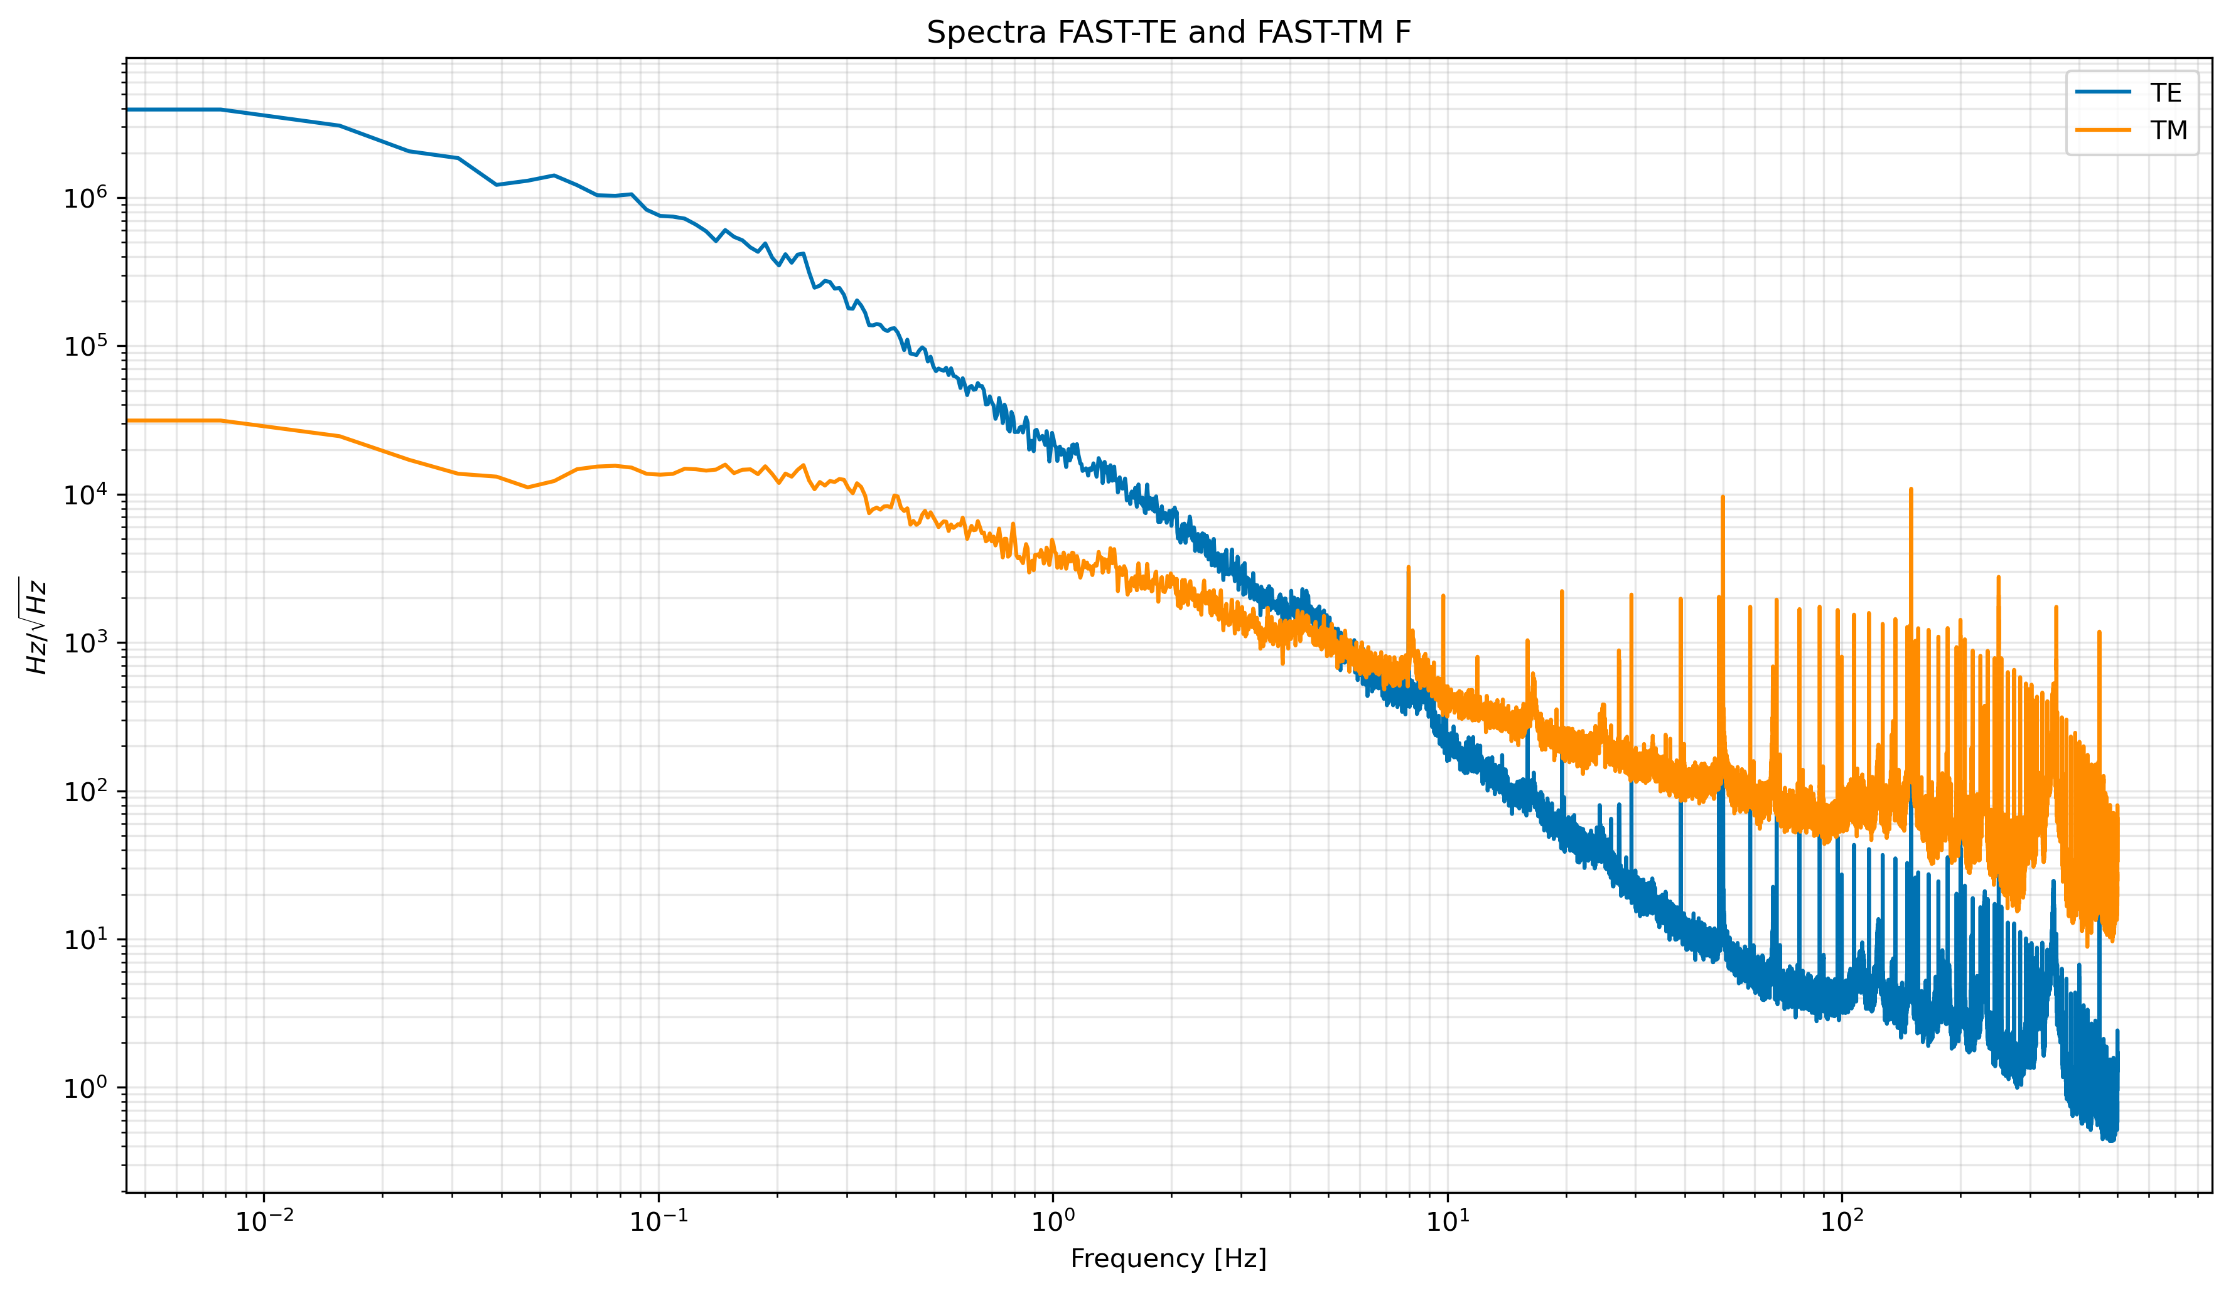
PRELIMINAR
Temperature Measurement scheme:
Double cross-polarization lock
ice.csic.es
Fig 29. PSD of the locking signals of the TE and TM modes.

Slide 25

PRELIMINAR
Temperature Measurement scheme:
Double cross-polarization lock
LISA requirement
ice.csic.es
Fig 30. Equivalent temperature PSD readout.

Slide 26

Final Thoughts and Next steps
Short term milestones
Achieve high resolution temperature readouts:
Introduce thermal shields in the test bench
Optimize locking parameters to execute long runs (hours-days)
Optimize electronic readout noise
Write and defend my thesis
Long term milestones
Integration of whispering gallery mode resonators in photonic chips, in collaboration with CNM (national center of microelectronics)
Experiment different sensing methodologies using WGMRs
Develop magnetic field sensors
ice.csic.es

Slide 27


gualani@ice.csic.es … @ieec.cat
nofrarias@ice.csic.es … @ieec.cat
Thank you very much!
Campus UAB, c. Can Magrans s/n, 08193, Bellaterra, Barcelona
(+34) 937 379 788
ice@ice.csic.es
www.ice.csic.es

