Slide 1



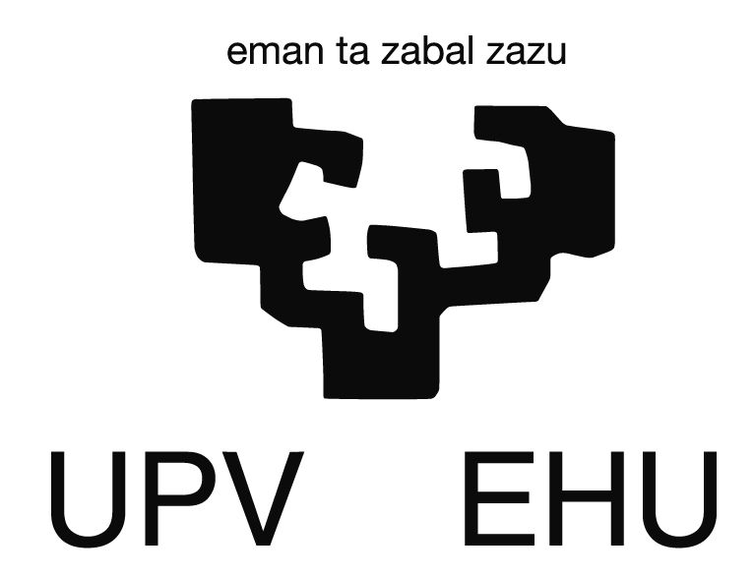
Radiation hardness and radiation-induced charge multiplication in neutron-irradiated SiC p-in-n diodes characterized by TPA-TCT
Planes Complementarios Astro+HEP, Santander, November 25, 2025
J. Duarte, M. Fernández, E. Navarrete, I. Vila Álvarez, D. Rosich,
C. Quintana
Instituto de Física de Cantabria (CSIC-UC)
R. Montero
Universidad del País Vasco

Slide 2
Outline
Method, setup and sample description
Brief recall of previous results
Results from pristine sample
TPA-TCT signal multiplication
Electron and hole lifetimes
Electric field study of the diodes after irradiation
Current studies
Summary

Slide 3
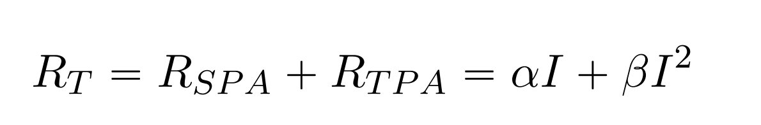
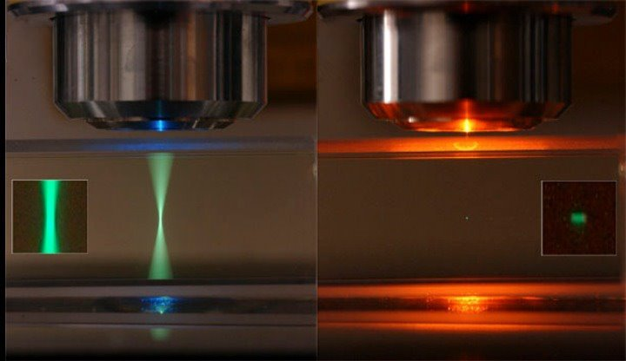
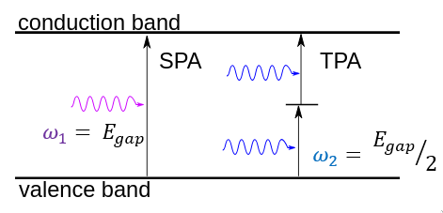
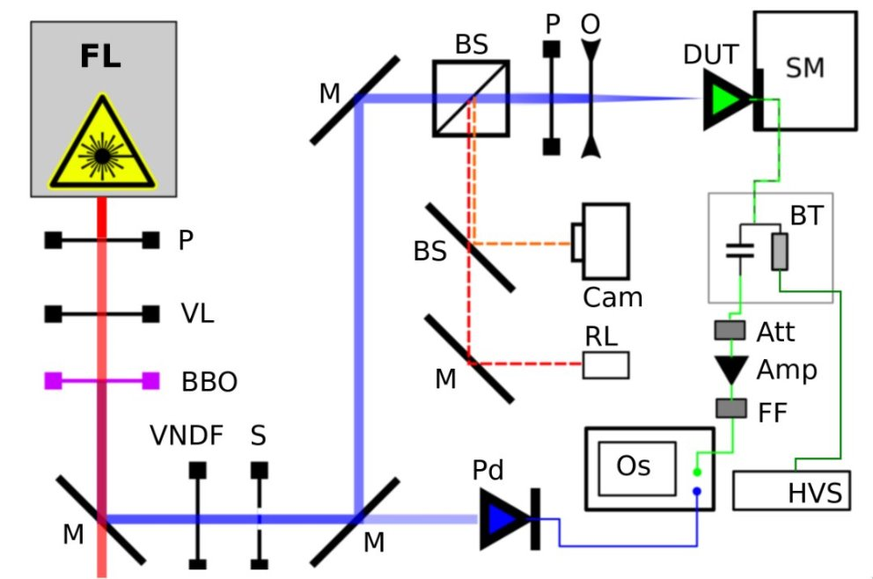
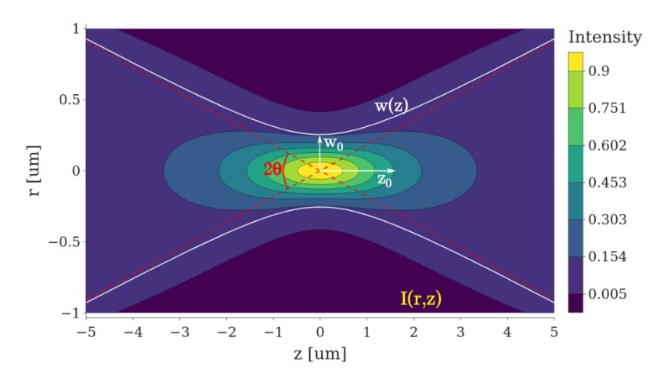
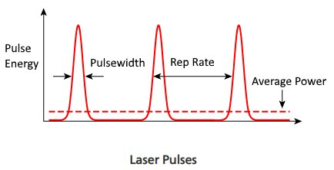
TPA signal generation
Focusing Pulsed operation
TPA-TCT setup

Slide 4

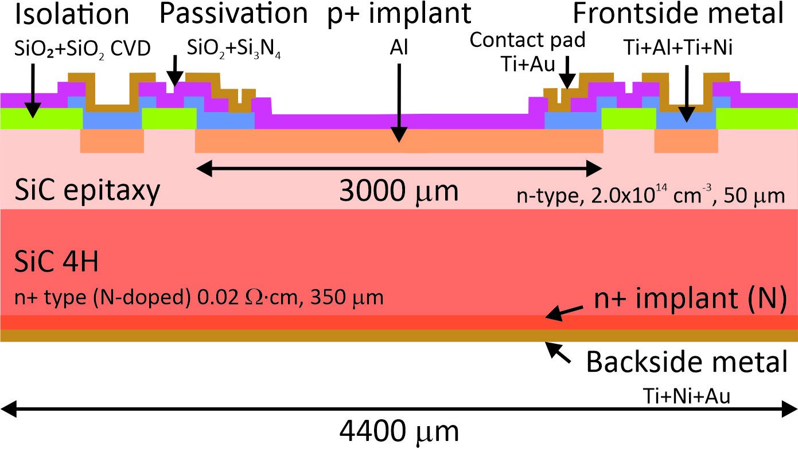

TPA-TCT setup and SiC samples
Samples:
IMB-CNM SiC planar pad diodes P in N
Non metallized top contact for laser illumination
Sample 1MW2 - non-irradiated
Sample F2W1 - 10¹⁵ n_{eq}/cm² at ATI in Vienna
TPA-TCT setup

Slide 5
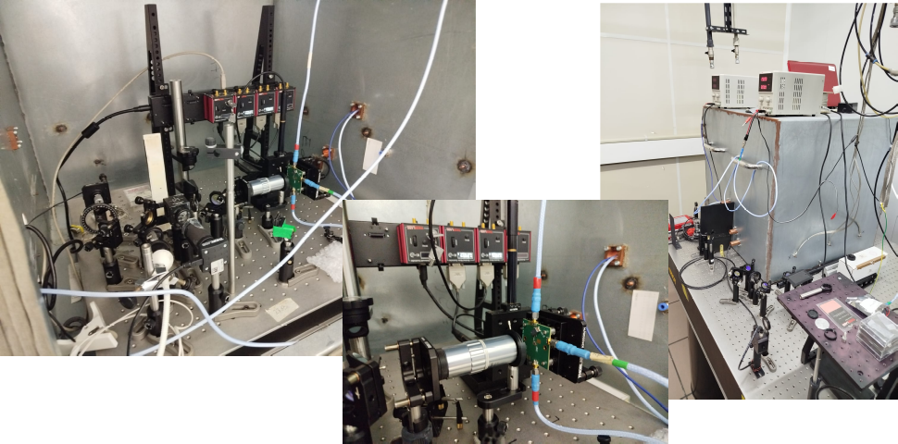
Setup:

Slide 6
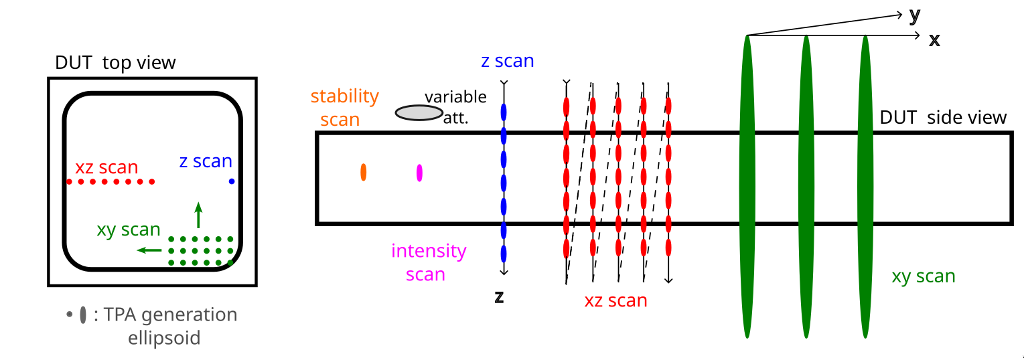
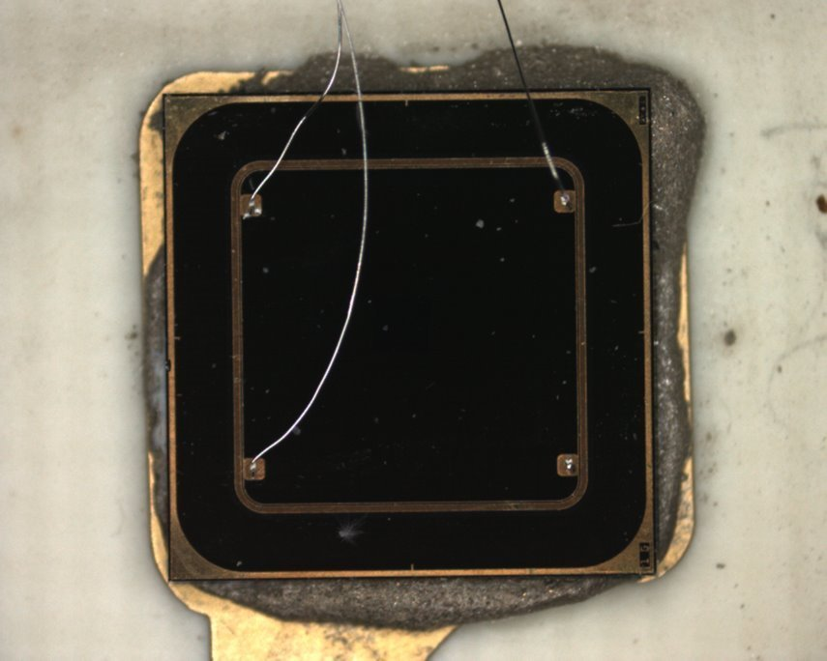
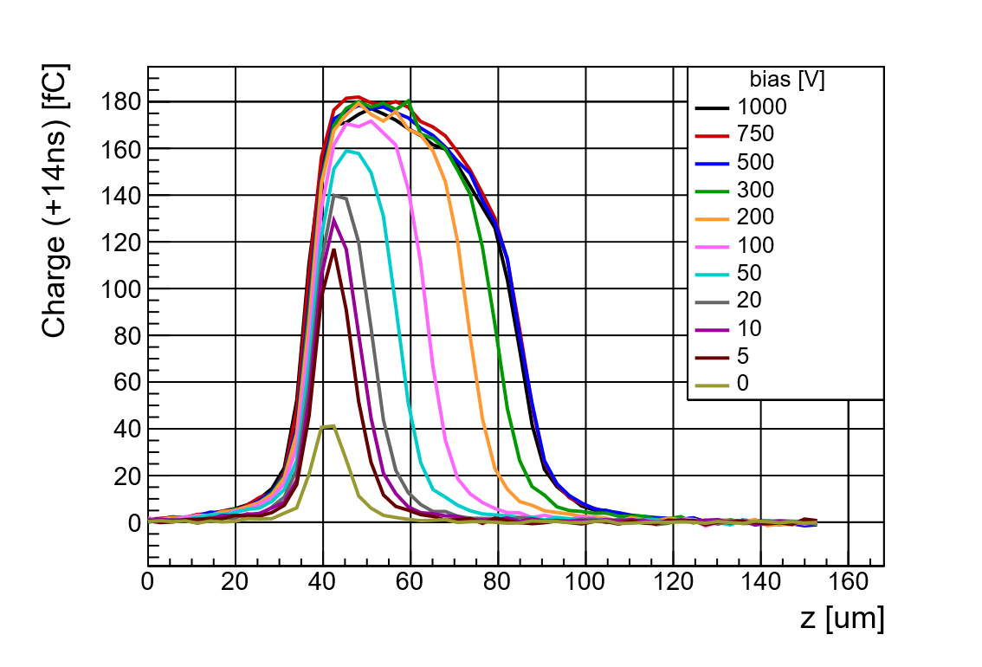
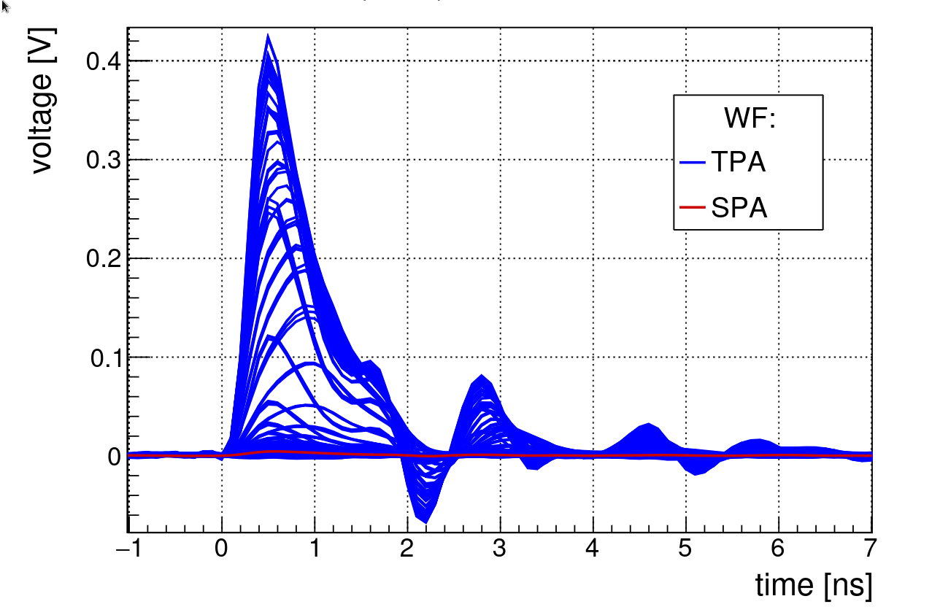
Types of TPA-TCT scans
Z-scan:

Slide 7
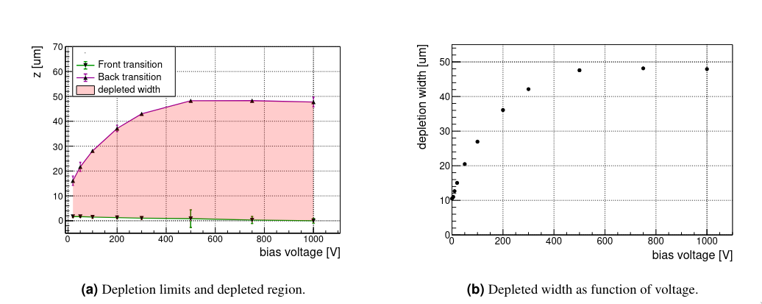
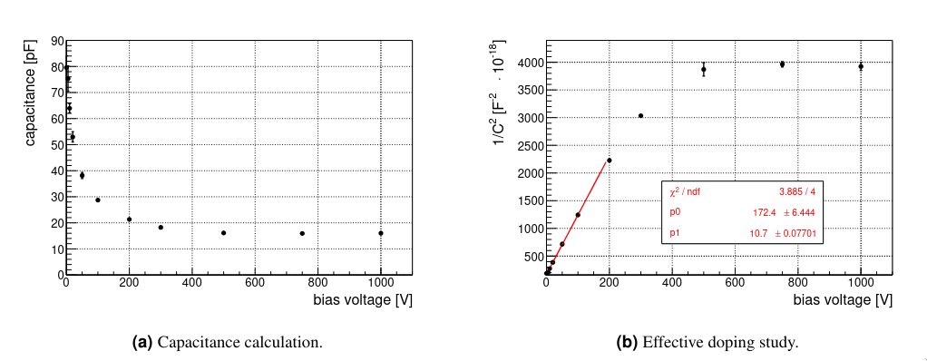
Pristine sample derived studies
Maximun depletion width compatilbe with the nominal width for the epitaxial layer
Capacitance and effective dopping values also compatible with the nominal ones

Slide 8
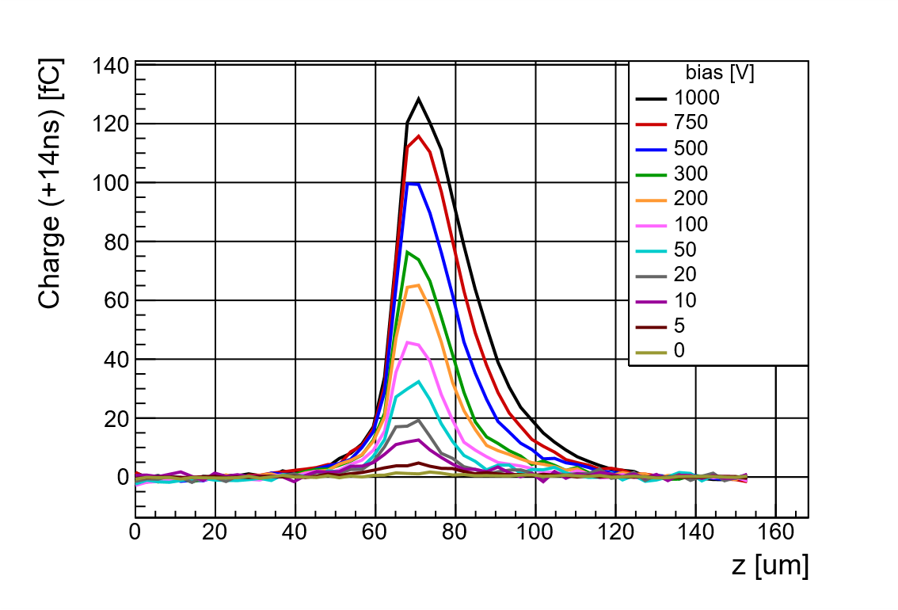
Pristine vs Irradiated SiC sample comparison - zscans
Sample 1MW2 - non-irradiated​
Sample F2W1 – 10¹⁵ n_{eq}/cm²
Irradiated samples show a decrease in the maximum and integrated amount of collected charge
There is no saturation effect in the irradiated samples, they recover more signal as bias voltage is increased
Important leakage current increase, not only after irradiation but during operation in both!

Slide 9
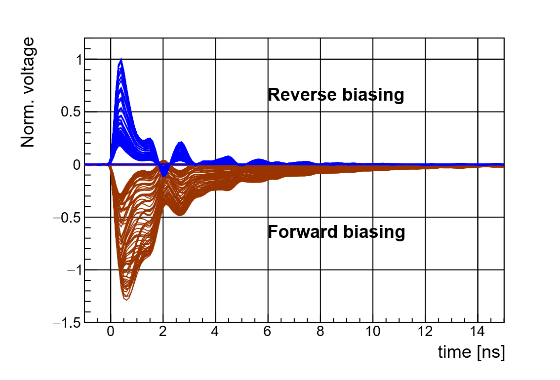
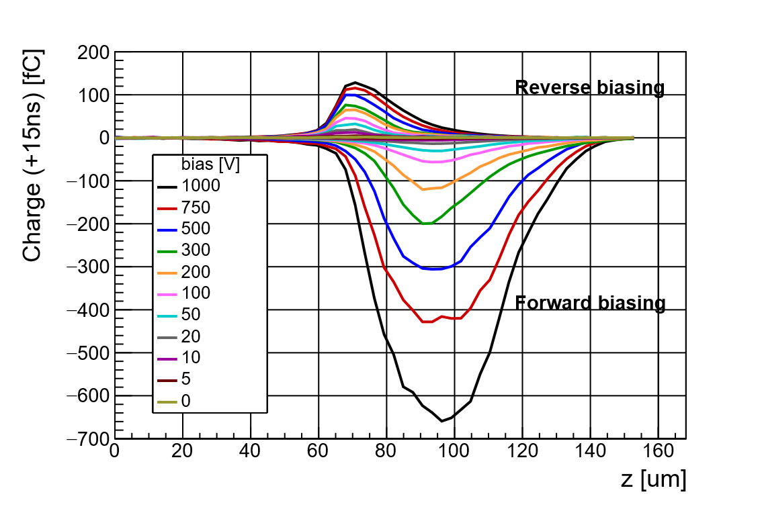
Forwar vs Reverse biasing on irradiated samples
Sample F2W1 – 10¹⁵ n_{eq}/cm²
Bias = 1kV
Under forward biasing, there is a cuantitative increase of the collected charge
Charge collection distribution also changes, the peak of the profile shifts to the back transition of the detector

Slide 10
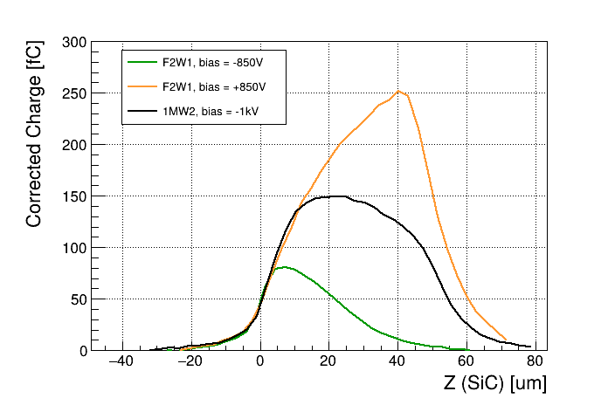
Charge multiplication in forward-biased irradiated sample
TPA-TCT z-scan of fresh and irradiated samples
Charge multiplication
Fully depleted after irradiation
Trapping on irradiated samples
Multiplication
Forward-biased irradiated
Reverse-biased fresh
Reverse-biased irradiated
Diode active thickness

Slide 11
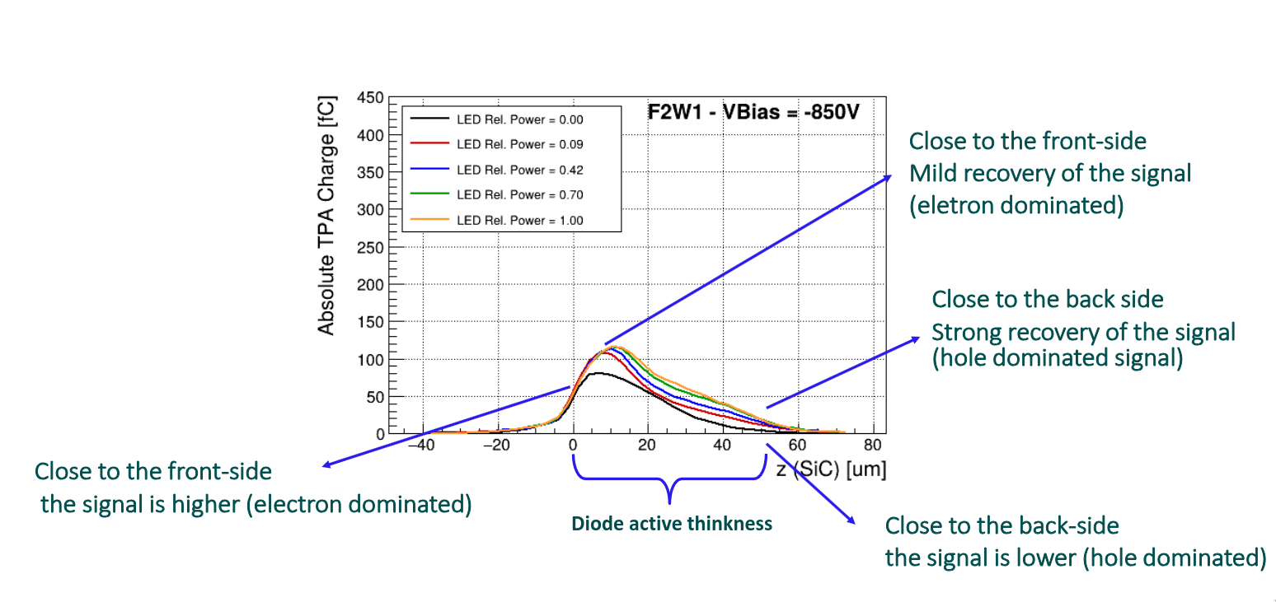
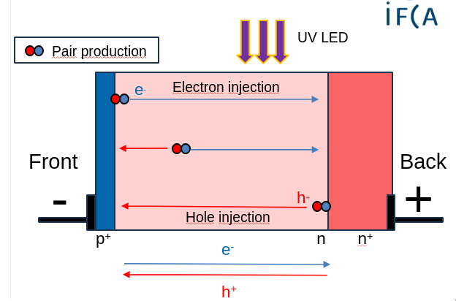
Optical injection in irradiated sample - reverse-biased operation
Irradiation significantly reduces the hole lifetime compared to the electron lifetime

Slide 12
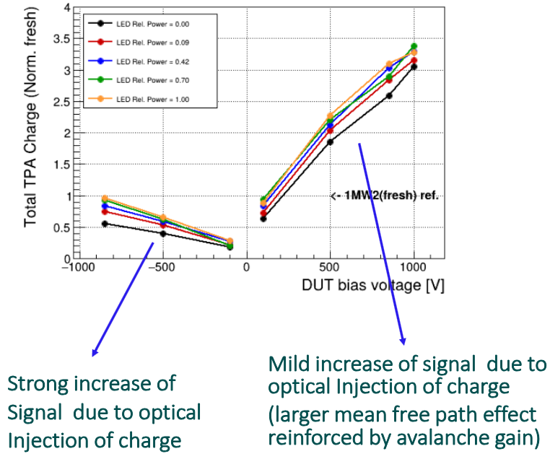
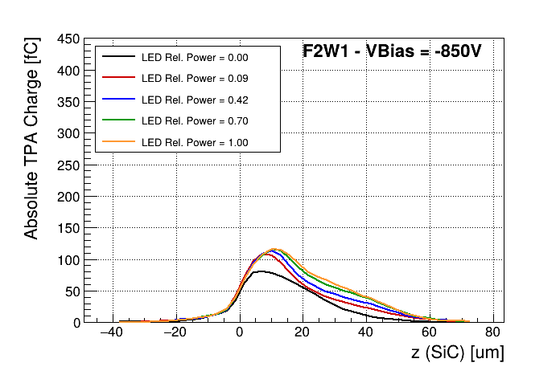
Forward-reverse comparison and signal recovery/multiplication
Hipothesis: Hole traps are to be partially filled by the (large) forward current, dominated by holes. Therefore, the optically injected carriers are not expected to have a significant impact on the signal.

Slide 13
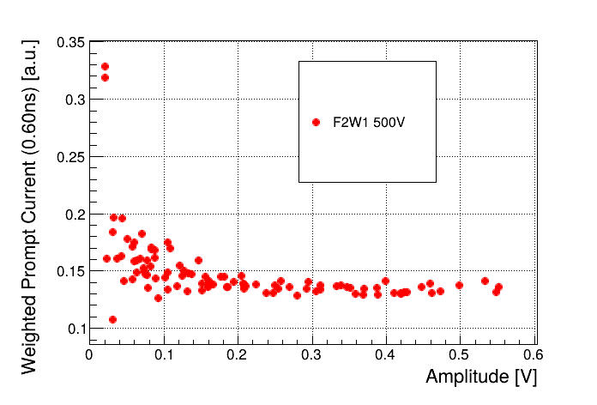
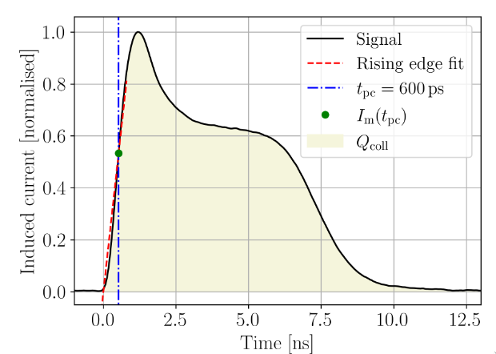
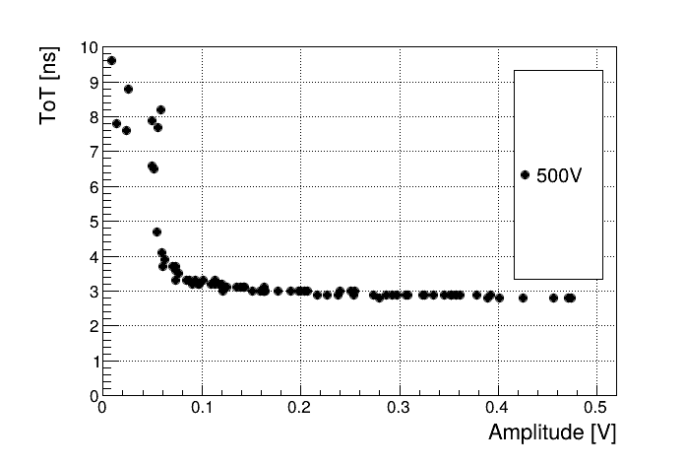

Weighted Prompt Current vs Time Over Theshold as electric field estimators for irradiated samples
Weighted Prompt Current
WPC
ToT
ToT
Sebastian Pape Thesis - "Characterisation of Silicon Detectors Using the Two Photon Absorption – Transient Current Technique"

Slide 14
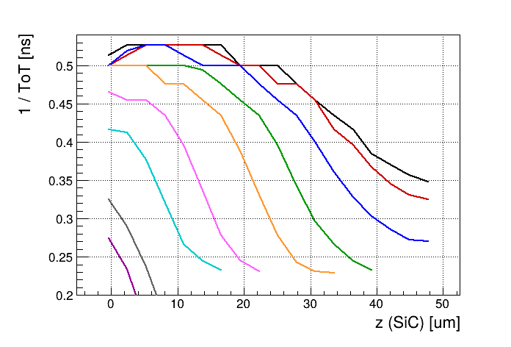
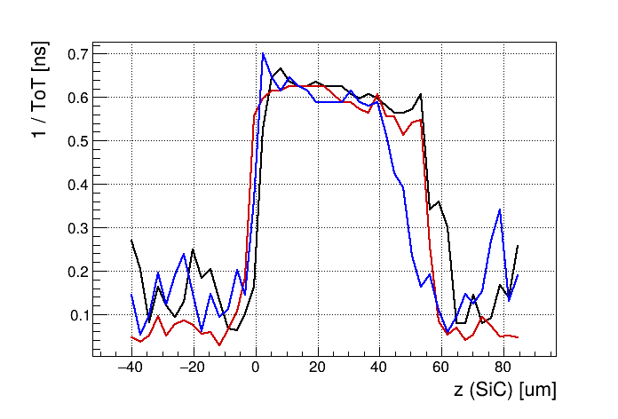
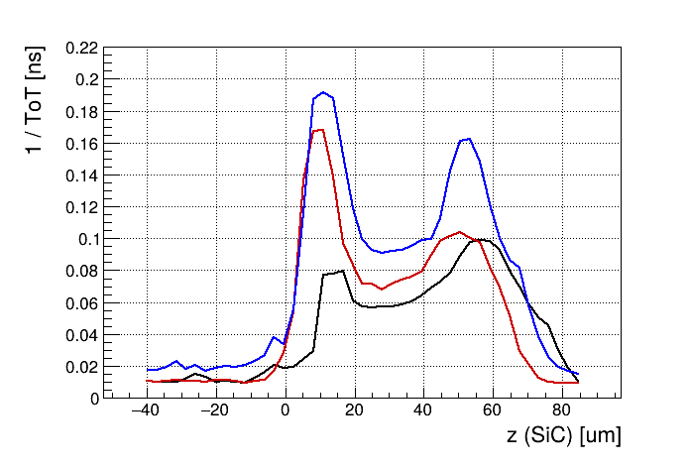


Electric field study
ToT was found to be a better electric field estimator, since the signal profile is compromised by several factors, like noise or signal processing artifacts
Pristine Irradiated(reverse) Irradiated (forward)
The pristine sample was used to cross check of the method
Under reverse biasing, irradiated sample has no clear electric field structure
Under forward biasing, the same sample shows several peaks that may indicate a higher local electric field at the two interfaces

Slide 15
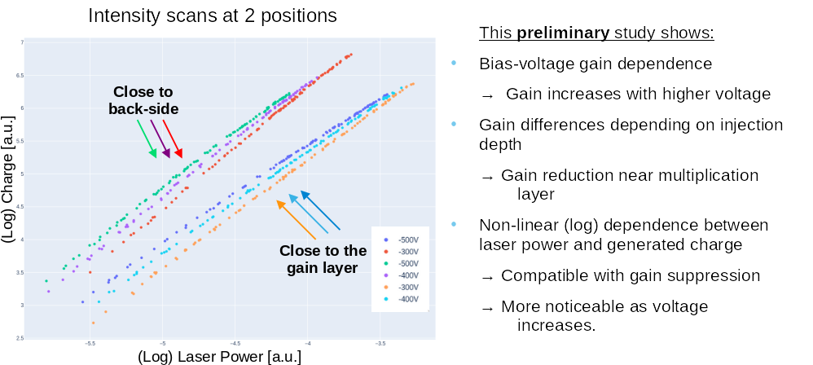
New structures: SiC LGAD gain study
LGAD
gain layer
back-side
26 Nov 2025 Cristian Quintana | cquintan@cern.ch Plan Complementario Astro-HEP

Slide 16
Summary
We carried multiple studies, which includes the characterization of electric field distribution on fresh and neutron irradiated pn SiC diodes to explain the observed signal multiplication
Reverse bias (after irradiation): Presence of a stronger electric field at the front side. Forward bias (after irradiation): Presence of a back side peak whose amplitude relative to the front side peak increases with the bias
We observe an important decrease of the collected charge after irradiation that could be mitigated by the charge multiplication mechanism. There is also an increase of the leakage current of several order of magnitude even on the pristine detector.
Recent measurements are showing promising results, and new device structures are currently under investigation. High-intensity tests indicate gain suppression in LGADs as well as plasma effects in PIN SiC samples.

Slide 17
Backup

Slide 18
Electric field study on irradiated SiC sample: Reverse biasing
Under reverse biasing we have an increase of the electric field at front side
It seems compatible (kind of) with the behavior of a biased dielectric
26 Nov 2025 Cristian Quintana | cquintan@cern.ch Plan Complementario Astro-HEP

Slide 19
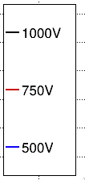
Electric field study on irradiated SiC sample: Forward biasing
Front peak maybe due to an artifact caused by low amplitude pulses
The higher the bias voltage the higher is the peak amplitude at the back side compared with the front side peak
The higher the bias the smaller electric field !!! (longer ToT)
1/ToT shows two peaks, and therir relation changes with bias voltage
As we increase the bias voltage signals seem to become more slower
26 Nov 2025 Cristian Quintana | cquintan@cern.ch Plan Complementario Astro-HEP

Slide 20
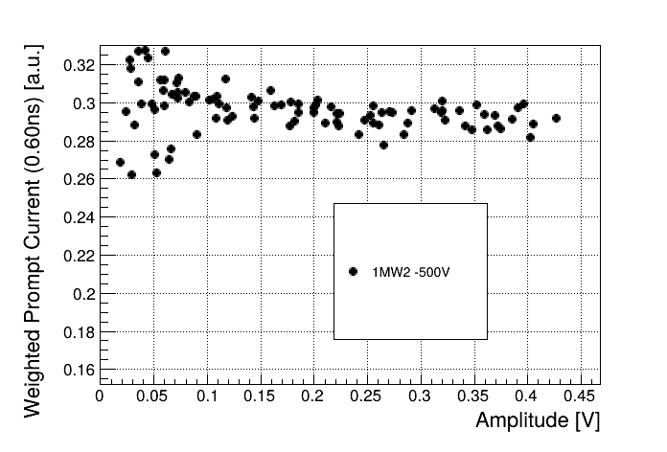
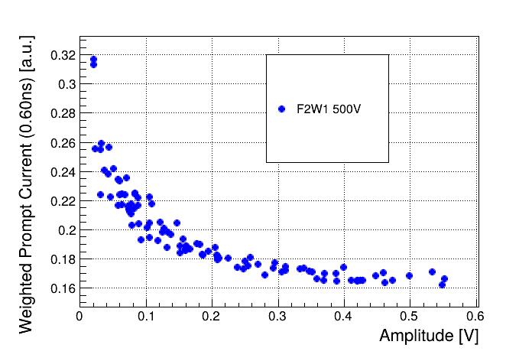
WPC as electric field estimator for irradiated samples
Intensity scan: Laser intensity is changed while focusing at the same depth (inside the sample). At that position the electric field does not change, so we would espect a constant WPC
Fresh Irradiated Irradiated SPA corr.
WPC strongly affected by the SPA component
Residual effects even after the SPA subtraction
26 Nov 2025 Cristian Quintana | cquintan@cern.ch Plan Complementario Astro-HEP

Slide 21
ToT as electric field estimator for irradiated samples
WPC of Irradiated SPA corr. ToT of Irradiated SPA corr.
No microplasma
=
No pulse duration broadening
ToT apears to be more robust than WPC against the changes in the signal amplitude
26 Nov 2025 Cristian Quintana | cquintan@cern.ch Plan Complementario Astro-HEP

Slide 22
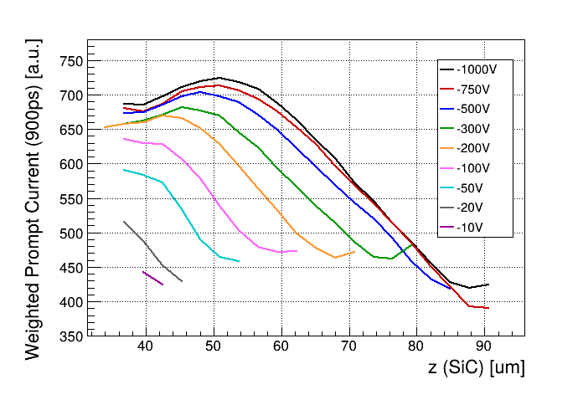
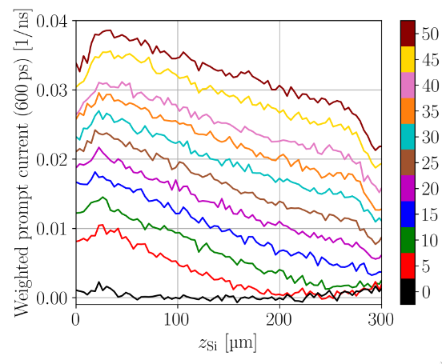
Electric field study on non-irradiated SiC sample
WPC
WPC – Silicon diode
Front side
Drop or maximum shif in the WPC at surface
Extrange saturation effect
^{Sebastian Pape Thesis}
26 Nov 2025 Cristian Quintana | cquintan@cern.ch Plan Complementario Astro-HEP

Slide 23
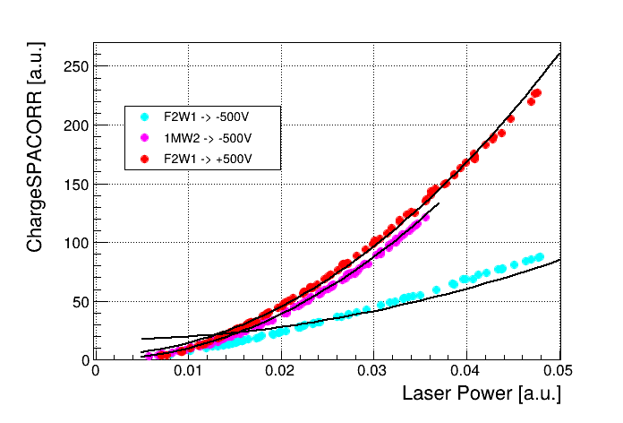
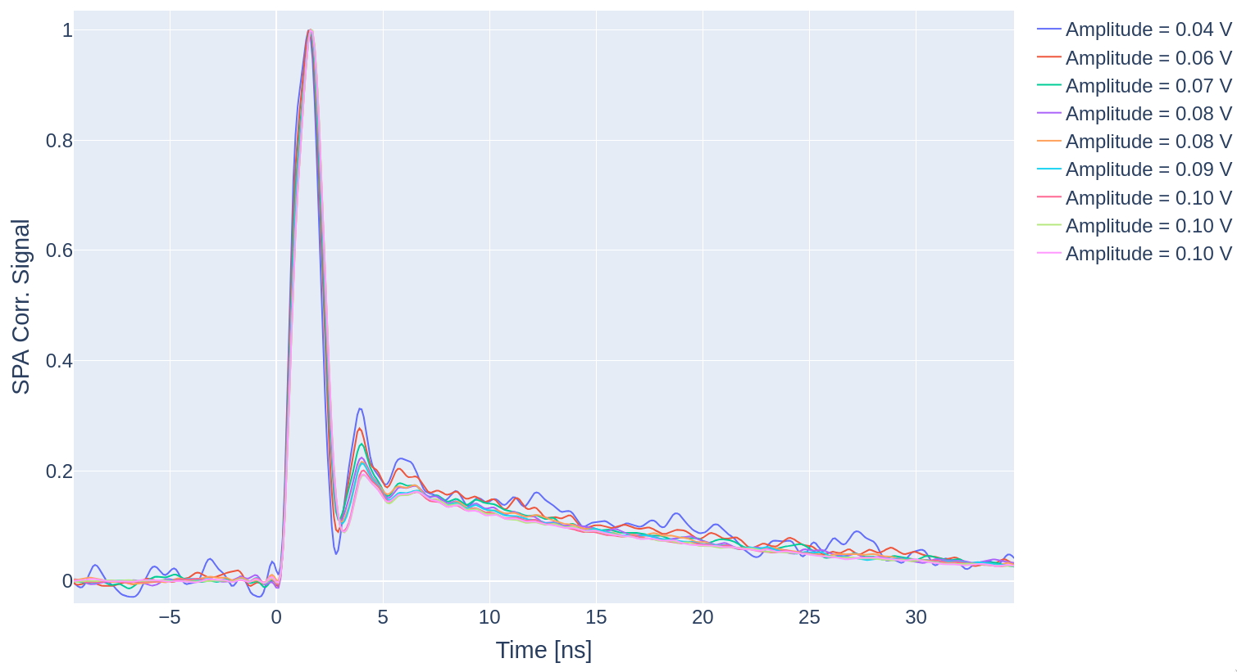
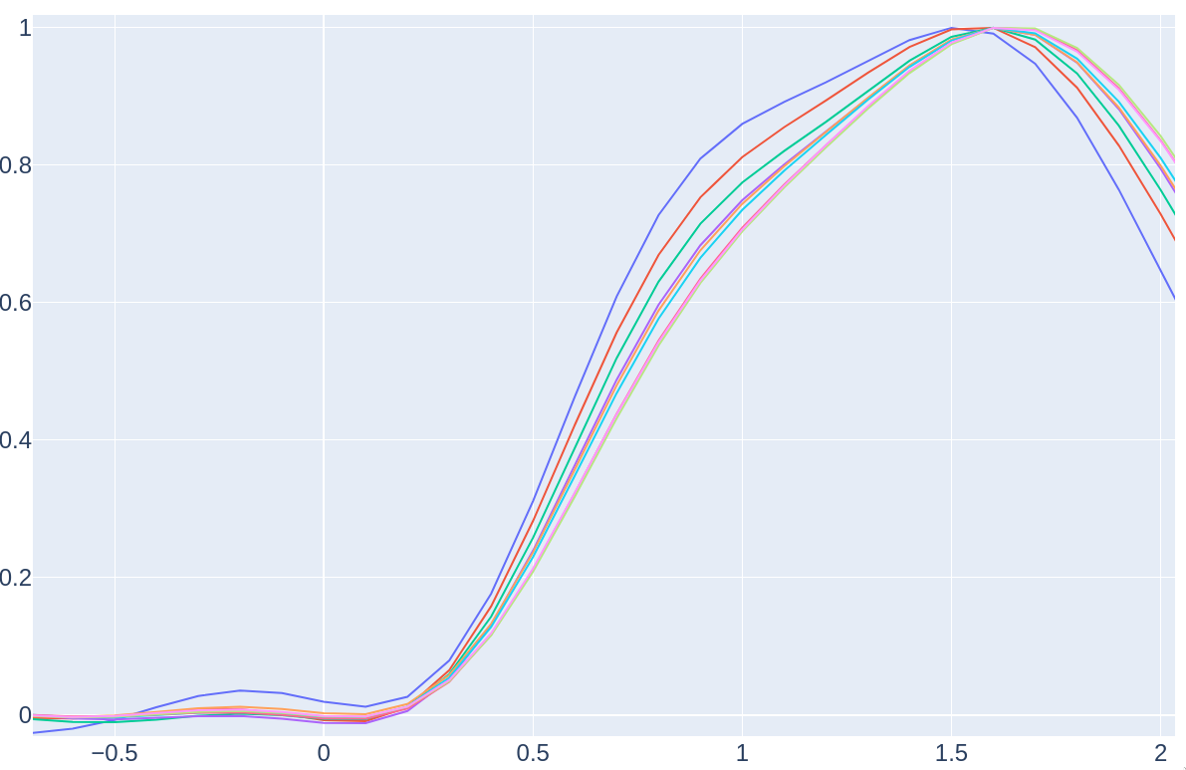
Plasma generation study
Three photon absorption
Two photon absorption
+500V
Pure quadratic fit
Plasma multiplication should decrease at higher electric fields
Irradiation damage should also decrease the plasma generation
Pulse energy should have an impact in the gain
No plasma effects can be appreciated in the signals of both, TPA and 3PA studies, nor in the relation between laser power and charge
No Plasma
26 Nov 2025 Cristian Quintana | cquintan@cern.ch Plan Complementario Astro-HEP

Slide 24
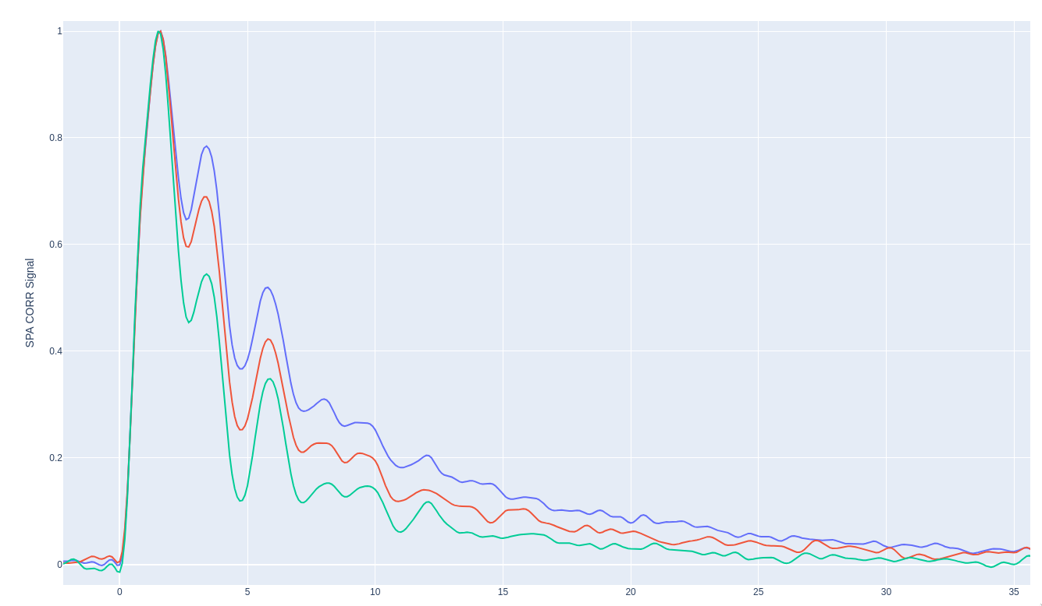
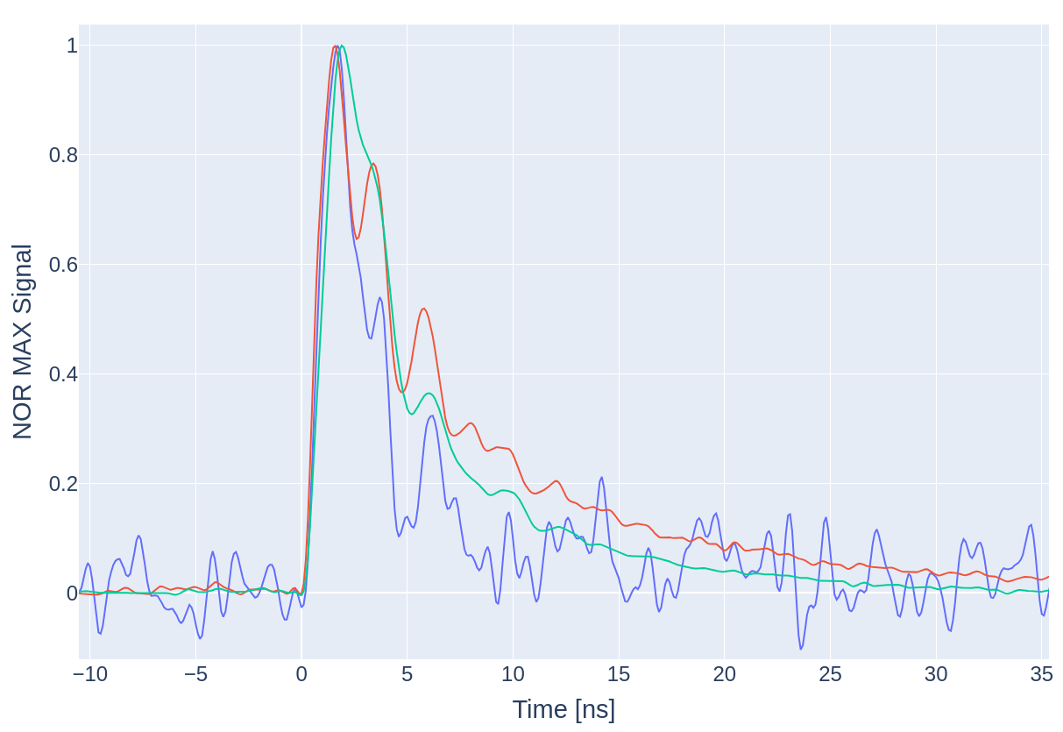
Forward biased irradiated sample WF comparison
Same position (mid) Same bias voltage (+1kV)
Front side
Mid
Back side
+500
+750
+1kV
26 Nov 2025 Cristian Quintana | cquintan@cern.ch Plan Complementario Astro-HEP

