Slide 1
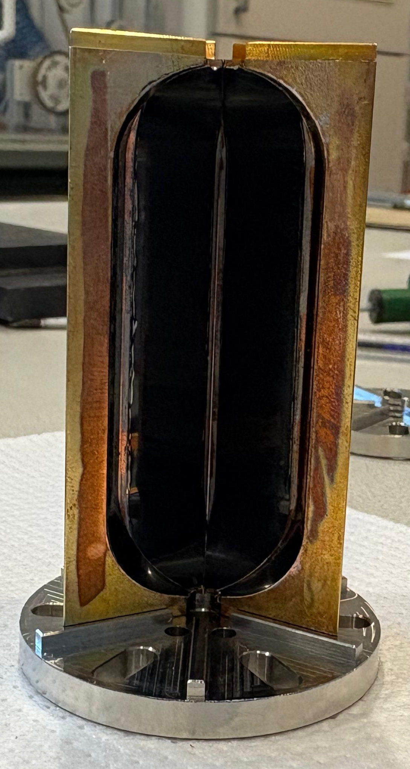
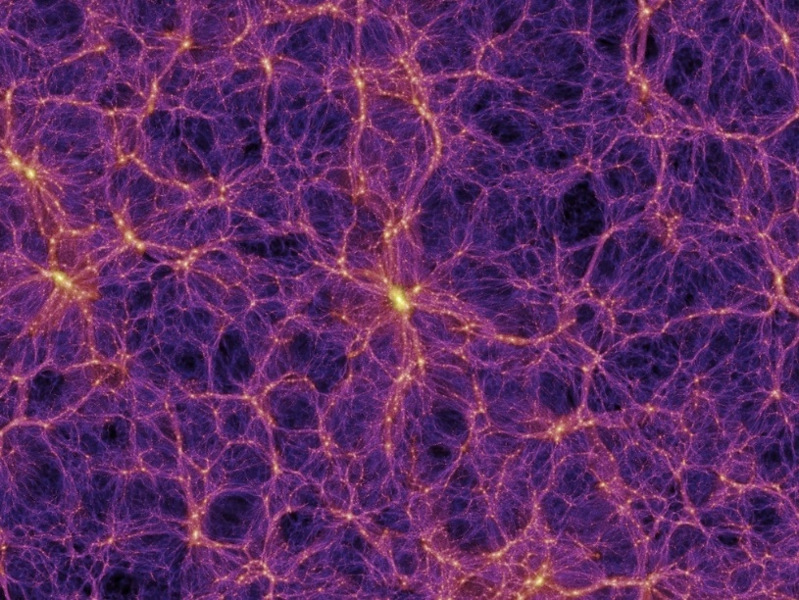


HTS coated conductor coatings in haloscopes for dark matter search
Joffre Gutierrez Royo
V. Springel et al. 2005

Slide 2
Aknowledgements
Guilherme Telles¹, Teresa Puig¹, Ahmed Irfan¹, Neil Lamas¹, Luca Benedetti¹, Xavier Granados¹, Rafael Garcia², Julia Mundet², Jessica Golm³, Walter Wuensch³, Sergio Calatroni³, Alejandro Benedicto Díaz Morcillo⁴, Jordi Miralda Escudé⁵, Babette Dobrich⁶, Igor Irastorza⁷
1- Institut de Ciència de Materials de Barcelona, ICMAB-CSIC, Bellaterra (Spain)
2- Institut de Física d'Altes Energies, IFAE, Bellaterra (Spain)
3- CERN - The European Organization for Nuclear Research, Geneva (Switzerland)
4- Information and Communications Technologies Dept., Technical University of Cartagena (Spain)
5- Institut de Ciencies del Cosmos, ICCUB, Universitat de Barcelona, Barcelona (Spain)
6- Max-Planck-Institut fur Physik, MPP, Garching (Germany)
7- Center for Astroparticles and High Energy Physics (CAPA), Universidad de Zaragoza (Spain)

Slide 3

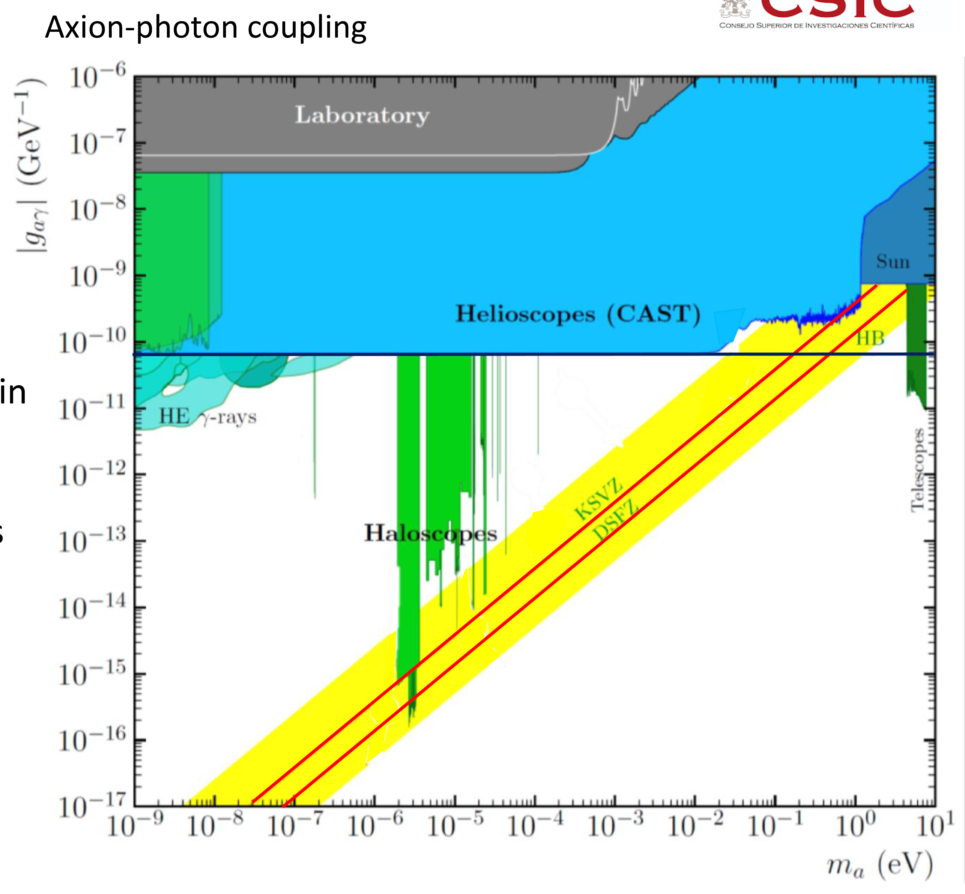
We are trying to detect the AXION, an excellent dark matter candidate
The axion is a hypothetical elementary particle that emerges very naturally when trying to solve the strong CP problem in QCD.
Very light (m_{a})
Extremely weakly interacting
Couples to photons (g_{aγ} ) very feebly.
arXiv:2504.00079 [hep-ph]

Slide 4
We are trying to detect the AXION, an excellent dark matter candidate
The axion is a hypothetical elementary particle that emerges very naturally when trying to solve the strong CP problem in QCD.
Very light (m_{a})
Extremely weakly interacting
Couples to photons (g_{aγ} ) very feebly.
Why axions can be cold dark matter
Axions fit every criterion for cold dark matter:
✔ Produced cold: non-thermal, non-relativistic
✔ Extremely long-lived: > age of universe
✔ Weakly interacting: won’t scatter or dissipate energy
✔ Abundant: natural cosmological production gives the right density
✔ Predictive: oscillating fields, couplings to photons, etc.
arXiv:2504.00079 [hep-ph]
In one stroke axions solves the CP problem and the dark matter mystery

Slide 5
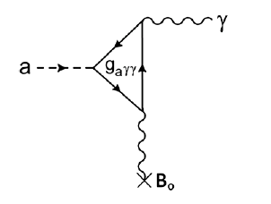
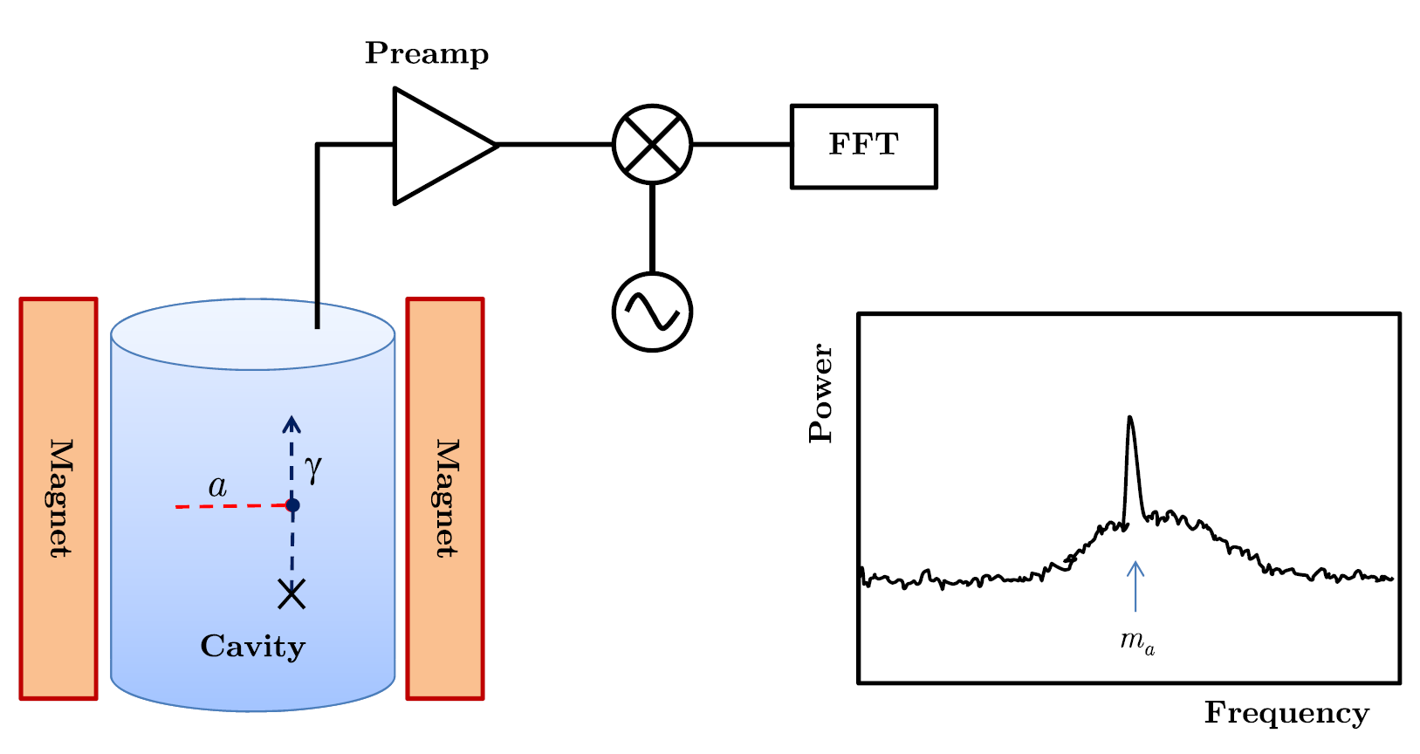

Axions can be detected through the Primakoff effect
$$\left(ν_{γ}∝m_{a}\right)$$
Haloscope’s detection principle
g_{aγ}
P. Sikivie, Phys. Rev. Lett. 52, 695 (1984)
B
I. G. Irastorza & J. Redondo, Prog. Part. Nucl. Phys. 102,89 (2018)

Slide 6
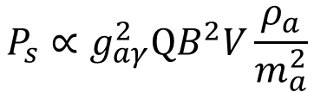
Axions can be detected through the Primakoff effect
$$\left(ν_{γ}∝m_{a}\right)$$
Haloscope’s detection principle
g_{aγ}
P. Sikivie, Phys. Rev. Lett. 52, 695 (1984)
B
Magnetic field
Axion density
$$P_{s}∝g_{aγ}^{2}QB^{2}V\frac{ρ_{a}}{m_{a}^{2}}$$
I. G. Irastorza & J. Redondo, Prog. Part. Nucl. Phys. 102,89 (2018)
Cavity’s quality factor
Cavity’s volume
We want
High-Q (low-R_{s}) cavities under high-B fields
High Temperature Superconductors (HTS) can be ideal materials

Slide 7
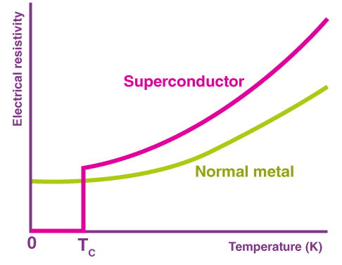
Superconductors are the materials with the lowest resistance $\left(Q∝1/{R_{s}}\right)$

Slide 8
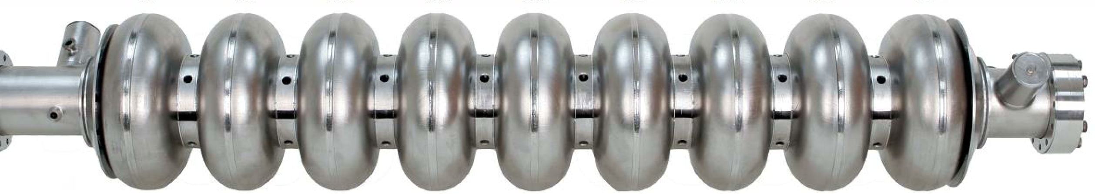
High-purity LTS Nb coated cavities are used due to their very high-Q
Cavity coated with LTS pure Nb
Q₀ ≈ 10¹⁰
But Nb cavities’ Q-factor dramatically decreases in the presence of a few mT

Slide 9
The mixed state in HTS allows
superconductivity to survive up to very high-magnetic fields

Slide 10
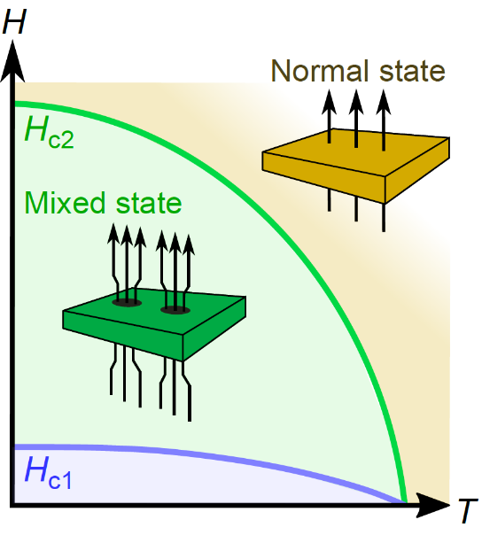

The mixed state in HTS allows
superconductivity to survive up to very high-magnetic fields
Magnetic phase diagram of HTS
In the mixed state quantized magnetic field lines called vortices penetrate the material.
The trade off is the penetration of superconducting vortices which generate dissipation when move
$$\overset{⃑}{E}=\overset{⃑}{v}×\overset{⃑}{B}→R_{s}↑$$

Slide 11

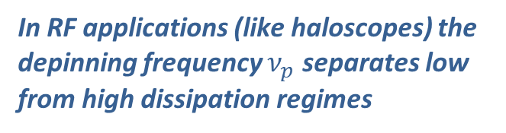
Pinning centers are introduced in the material
to stop (or reduce) the movement of vortices
Some material defects act as pinning centers for vortices
In RF applications (like haloscopes) the depinning frequency $ν_{p}$ separates low from high dissipation regimes
if $ν_{rf}<ν_{p}$ pinning centers can keep R_{s} low

Slide 12
Outline
1 – REBCO HTS and its surface resistance
2 – How we coat surfaces with REBCO
3 – REBCO coated haloscopes for cold DM detection

Slide 13
Outline
1 – REBCO HTS and its surface resistance
2 – How we coat surfaces with REBCO
3 – REBCO coated haloscopes for cold DM detection

Slide 14
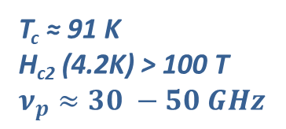
Coated Conductors solve the problem of needing a textured substrate
to obtain high-quality REBCO
Why REBa₂Cu₃O_{7-x}?
T_{c} ≈ 91 K
H_{c2} (4.2K) > 100 T
$ν_{p}≈30 −50 GHz$
but REBCO needs epitaxy

Slide 15






Coated Conductors solve the problem of needing a textured substrate
to obtain high-quality REBCO
Why REBCO?
Ag ~ 2 μm (protection)
T_{c} ≈ 91 K
H_{c2} (4.2K) > 100 T
$ν_{p}≈30 −50 GHz$
Cu ~ 20 μm
(electrical contact)
REBCO HTS ~ 1 – 3 μm
Buffers ~ 0.2 – 1 μm (provide texture)
but REBCO needs epitaxy
Metallic Substrate ~ 30 – 100 μm
(provides flexibility)
CCs are commercially available with different widths in Km length
In collaboration with:

Slide 16
REBCO CCs have lower R_{s} than Cu
ideal materials for low-R_{s} (high-Q cavities) at high magnetic fields
T = 50 K, ν = 8 GHz
T = 10 K, ν = 8 GHz
Cu
Cu
Lower pinning
REBCO CC
Higher pinning
REBCO CC
T. Puig et al, Supercond. Sci. Technol. 32 (2019)
A. Romanov, et al. Scientific reports 10 (2020)
At intermediate and low temperatures, R_{s} of high-pinning REBCO shows a weak magnetic field dependence
The lower the operating temperature, the larger the benefit from using REBCO

Slide 17
Outline
1 – REBCO HTS and its surface resistance
2 – How we coat surfaces with REBCO
3 – REBCO coated haloscopes for cold DM detection

Slide 18
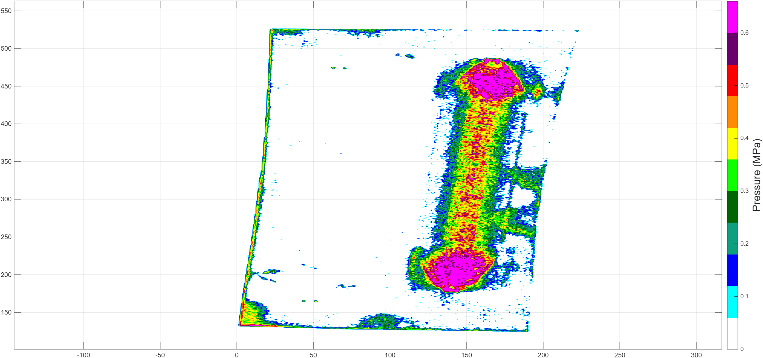
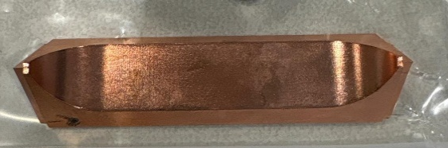
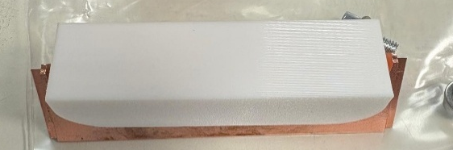
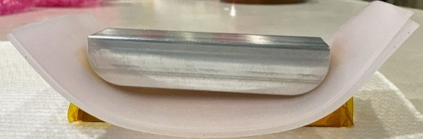
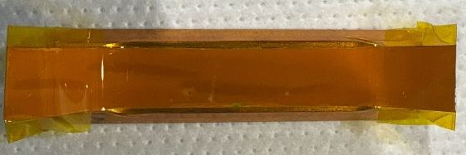
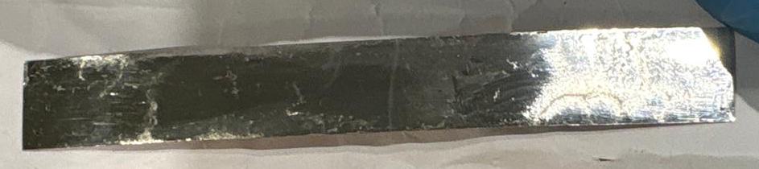
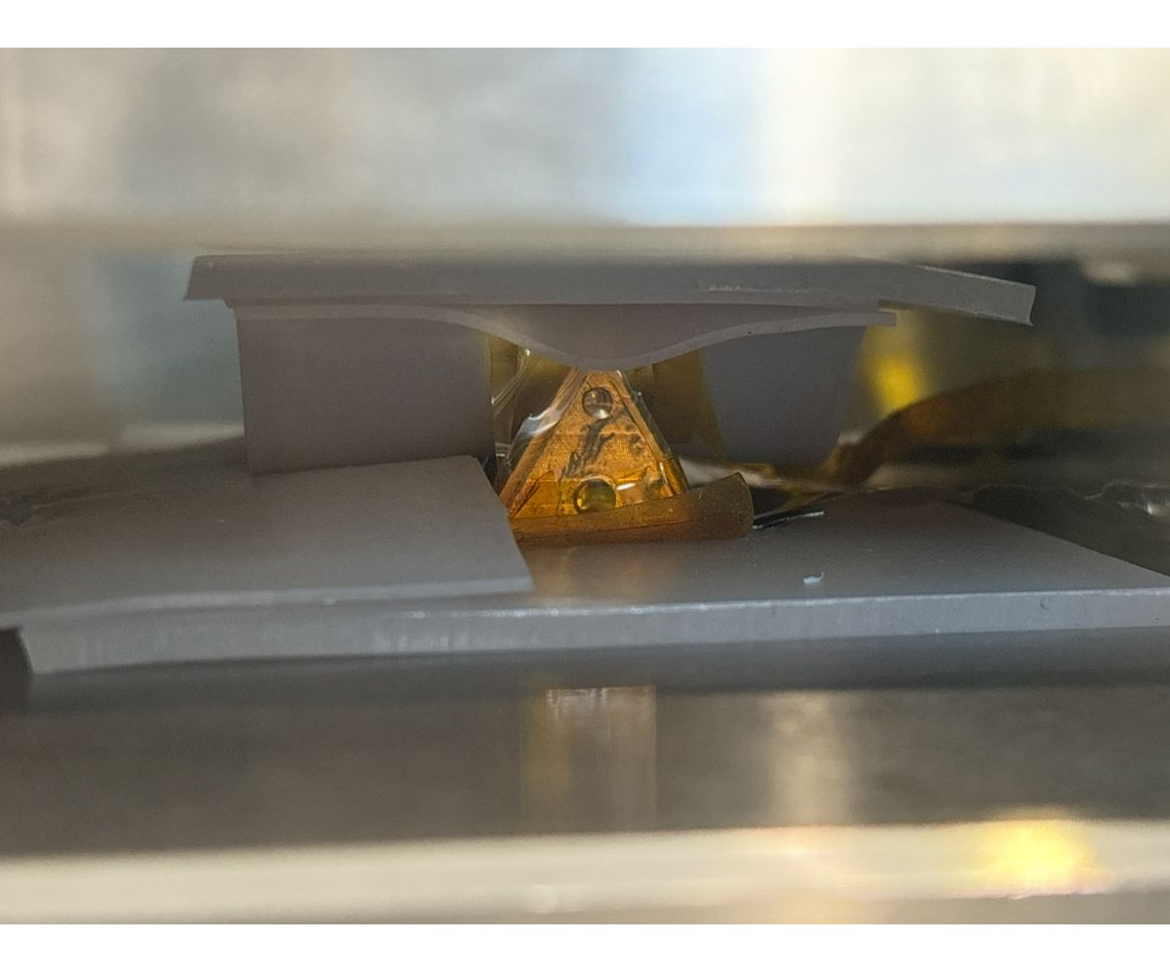
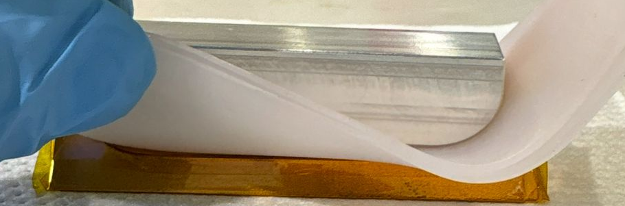
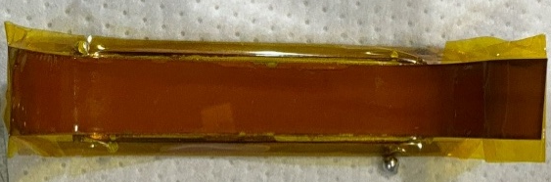
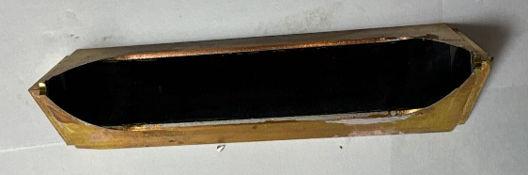
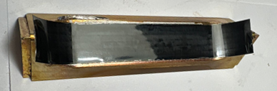
We have developed a scalable CC coating technique for large surfaces
Target
0
1
2
3
Hexagonal cavity component
Design of a custom plastic adapter
Pressure measurements
Custom 3D-printed metallic adapter
6
5
4
Homogenizers and adapter
Placement and protection
Coated conductor preparation
7
8
9
10
Soldering
Soldered coating (excess tin)
Delaminated coating w/ protrusions
Coated component
We have developed technology to automatize all the steps

Slide 19
Outline
1 – REBCO HTS and its surface resistance
2 – How we coat surfaces with REBCO
3 – REBCO coated haloscopes for cold DM detection

Slide 20
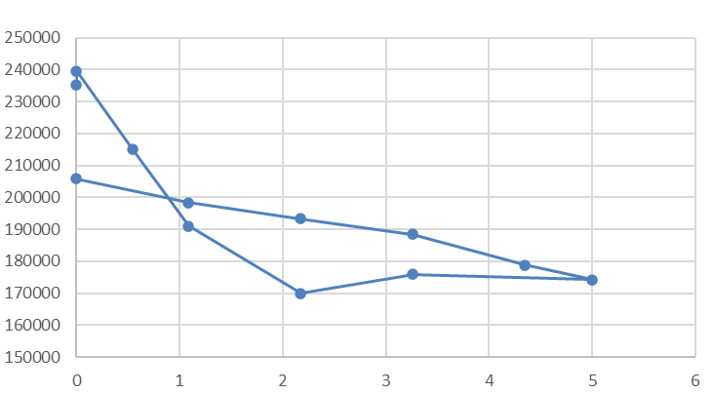
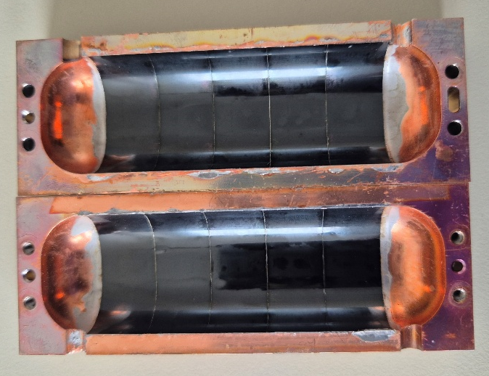
HTS coated haloscopes outperform state of the art Cu haloscopes
Original RADES Cavity
Very low amount of flux used
Factor 4 – 6 better than Cu
Not dettached!
Copper: 40k
Q₀
B-field
Analysed with https://www.arpe.upc.edu/
Progress on HTS Coatings of Cavities and Characterization
13

Slide 21
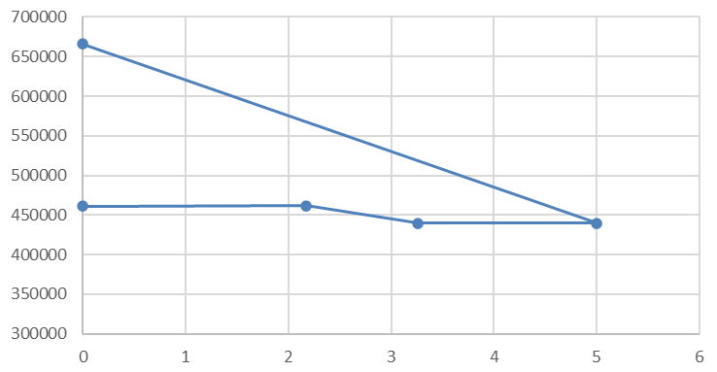
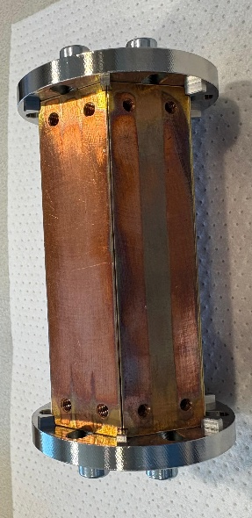
HTS coated haloscopes outperform state of the art Cu haloscopes
Preliminary results!
Hexagonal Cavity
First iteration
Dettachment in 2/6 pieces
High Q-factor preserved
Low field dependence (parallel)
Factor 5 – 8 better than Cu
660k Q if not dettached?
Q₀
Copper: 80k
Original RADES Cavity
Very low amount of flux used
Factor 4 – 6 better than Cu
Not dettached!
Copper: 40k
Q₀
B-field
Analysed with https://www.arpe.upc.edu/
Progress on HTS Coatings of Cavities and Characterization
13

Slide 22
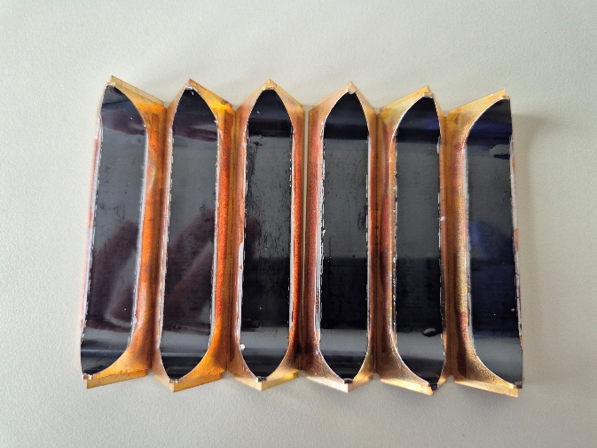
HTS coated haloscopes outperform state of the art Cu haloscopes
Preliminary results!
Hexagonal Cavity
First iteration
Dettachment in 2/6 pieces
High Q-factor preserved
Low field dependence (parallel)
Factor 5 – 8 better than Cu
660k Q if not dettached?
Prediction if not dettached
Q₀
Copper: 80k
Original RADES Cavity
Very low amount of flux used
Factor 4 – 6 better than Cu
Not dettached!
Copper: 40k
Q₀
B-field
Analysed with https://www.arpe.upc.edu/
The geometry of the haloscope has to be adapted to the HTS
Progress on HTS Coatings of Cavities and Characterization
13

Slide 23
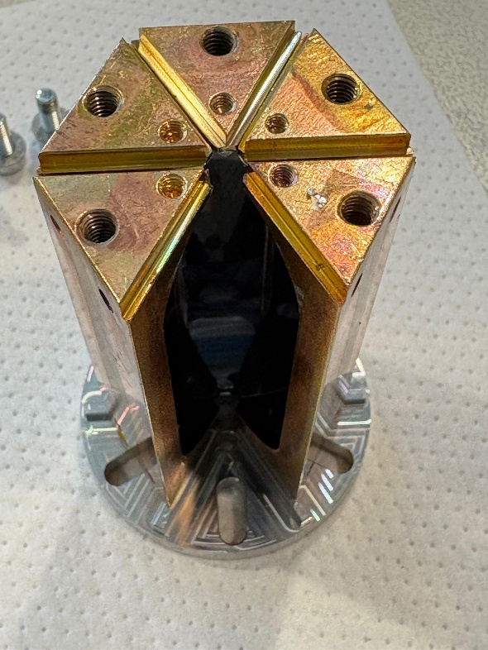
Conclusions
The search for Cold DM Axions is challenging but HTS coated haloscopes can help.

Slide 24
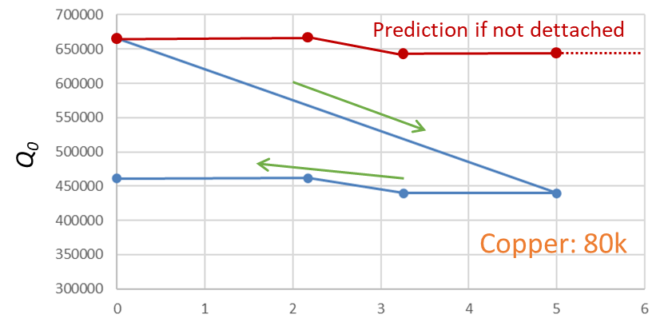
Conclusions
The search for Cold DM Axions is challenging but HTS coated haloscopes can help.
HTS enhances the sensitivity (Q-factor) of resonant cavities and can operate under high magnetic fields.

Slide 25
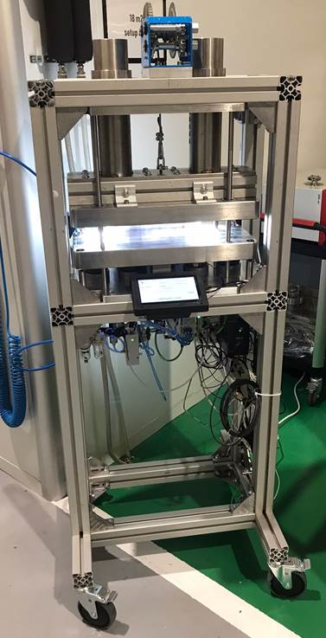
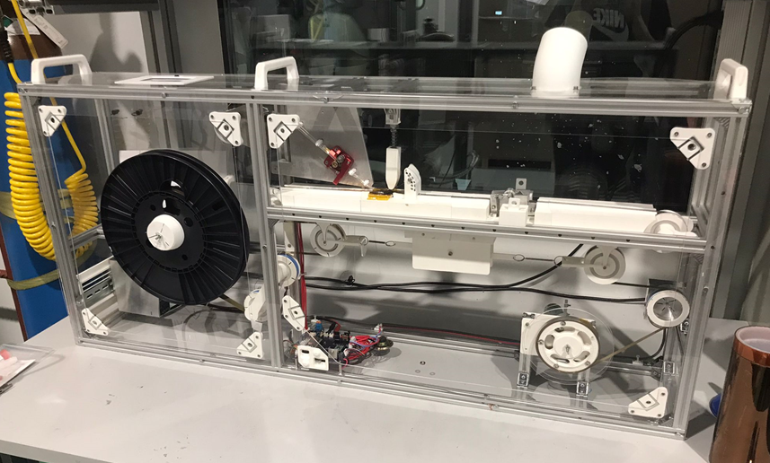
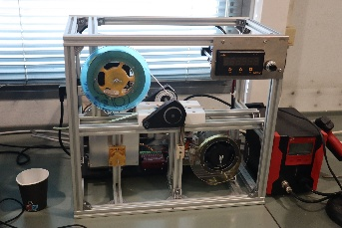
Conclusions
The search for Cold DM Axions is challenging but HTS coated haloscopes can help.
HTS enhances the sensitivity (Q-factor) of resonant cavities and can operate under high magnetic fields.
A robust coating technology adapted to complex surfaces is being developed and automatized.

Slide 26
Conclusions
The search for Cold DM Axions is challenging but HTS coated haloscopes can help.
HTS enhances the sensitivity (Q-factor) of resonant cavities and can operate under high magnetic fields.
A robust coating technology adapted to complex surfaces is being developed and automatized.
Cooperation between HEP and HTS may lead to new leaps in technology.

Slide 27

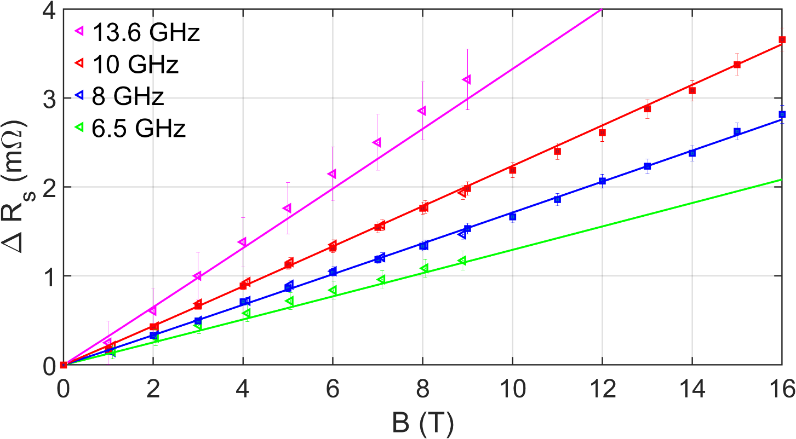




Going to lower frequencies benefits a lot REBCO CC as compared to Cu
Normal conductors:
$$∝^{0.5}$$
(B independent)
T = 50 K
Superconductors:
for ν << ν_{p} and 2B_{c1} < B << B_{c2}
$$R_{s}∝ν^{2}B$$
S. Calatroni and R. Vaglio, IEEE TAS 27, 2017
Experimentally REBCO:
$$∆R_{s}∝ν^{1.3}B$$
In agreement with N. Belk et al. Phys. Rev. B 53 1996
REBCO CCs’ R_{s}(H) shows a stronger $ν$ dependence than Cu
$$ΔR_{s}=G_{s}\left(\frac{1}{Q_{0}\left(B\right)}−\frac{1}{Q_{0}\left(0\right)}\right)$$
N. Tagdulang, Ph.D. Thesis, UPC (2024)

Slide 28


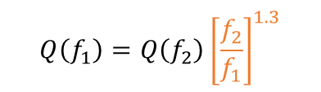
Million quality factor: depends on the frequency
As reported by Jessica Golm
Analysed with https://www.arpe.upc.edu/
Hexagonal Cavity
First iteration
Dettachment in 2/6 pieces
High Q-factor preserved
Low field dependence (parallel)
Factor 5 – 8 better than Cu
6.5e5 Q if not dettached?
Prediction if not dettached
Q0
Copper: 80k
What would our Q-factor be at 2.3 and 5.4 GHz?
CAPP’s 3rd Gen. Cavities
$$Q\left(f_{1}\right)=Q\left(f_{2}\right){\left[\frac{f_{2}}{f_{1}}\right]}^{1.3}$$
$$Q\left(2.3\right)=6.5e5⋅6=3.9e6$$
$Q\left(5.4\right)=6.5e5⋅2$ $=1.3e6$
 | RADES | CAPP
T (K) | 5 | < 1
f (GHz) | 9.2 | 2.3 | 5.4
Q | 6.5e5 | 3.5e6 | 1.3e7
We are already matching CAPP’s 2.3 GHz cavity!
But how can we improve?
Higher REBCO ratio (12 mm tapes in 14 mm facets)
More well-aligned facets
Flux-free solder
Solder vs. Glue
From Dahno Ahn’s presentation at the 18th PATRAS Workshop
Progress on HTS Coatings of Cavities and Characterization
14

Slide 29
Initial study shows that CCs have a weak dependence with the RF power
T = 50 K, ν = 8 GHz
P. Krkotic, et al. Supercond. Sci. Technol. 35 (2022)
Opens the possibility for high-power applications
Medicine: Compact linacs
High-energy physics: Muon collider

Slide 30

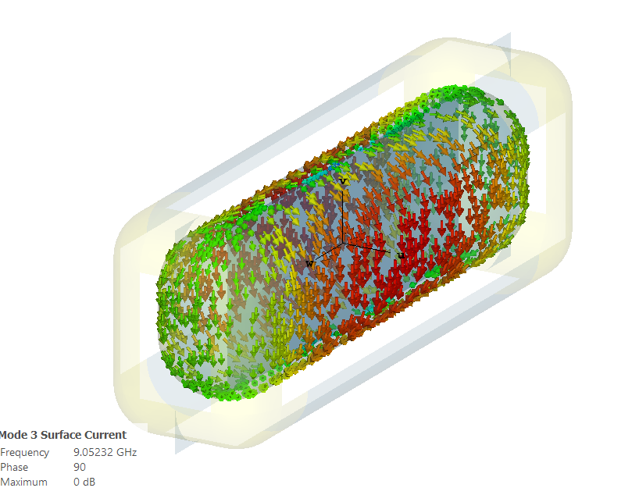
B and E configurations
TE₀₁₀
B
TE₁₁₁
B

Slide 31
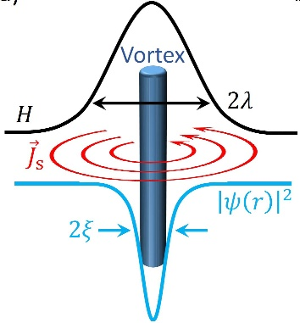
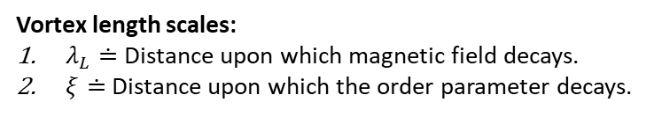

The mixed state in HTS allows
superconductivity to survive up to very high-magnetic fields
Magnetic phase diagram of HTS
Vortex in HTS carries a quantum of flux
Vortex length scales:
$λ_{L}≐$ Distance upon which magnetic field decays.
$ξ≐$ Distance upon which the order parameter decays.
Characterized by mixed state with
quantized magnetic field penetration
called vortices.
When vortices move (due to Lorentz like forces) generate dissipation
$$\overset{⃑}{E}=\overset{⃑}{v}×\overset{⃑}{B}$$

Slide 32
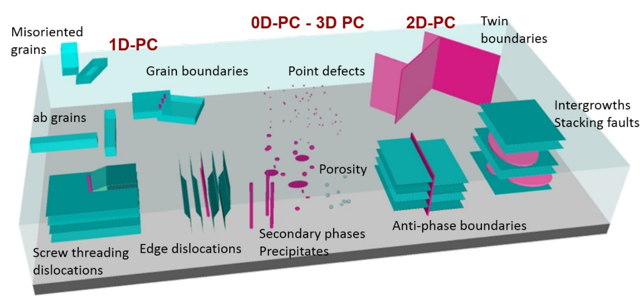

Immobilization of vortices is key for lossless operation
Material defects: Strategy to pin vortices
Some material defects act as pinning centers for vortices
In DC pinning centres provide lossless operation until a certain critical current density
$${\overset{⃑}{F}}_{P}={\overset{⃑}{J}}_{c}×\overset{⃑}{B}$$

Slide 33


The surface resistance of an HTS under B is dominated by vortices
Some material defects act as pinning centers for vortices
if $ν_{rf}<ν_{p}$ pinning centers modulate dissipation
RF
$$R_{s}\left(H_{rf},B,T\right)≅R_{vm}(H_{rf},B,T)$$
A. Romanov, et al. Scientific reports 10 (2020)

