Slide 1



Deep Space Microsatellite Power System Design and Development
ASFAE/2022/021
José Manuel Blanes Martínez
Space Power and Electronics System Group
Universidad Miguel Hernández de Elche
SPES
Reunión Final del Plan Complementario de Astrofísica y Altas Energías
Noviembre 2025, Santander

Slide 2
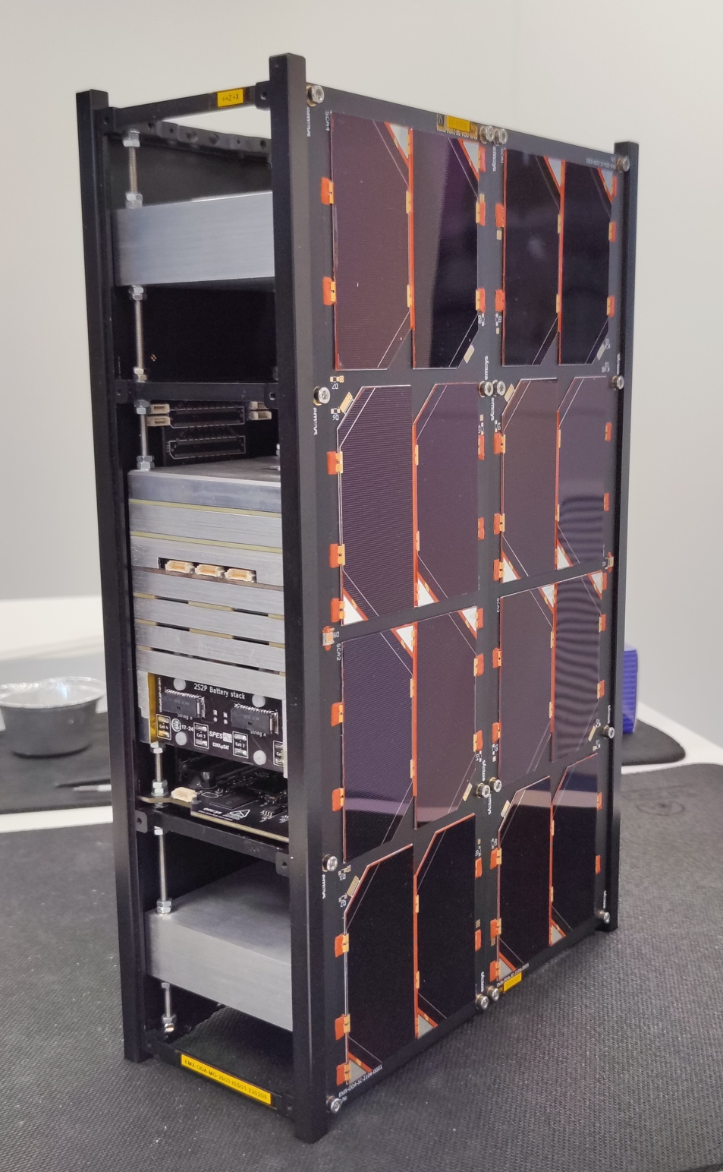

Presentation Outline
Introduction
Project Objectives
SPES PCDU Architecture
Facilities and Equipment Acquired
PCDU Validation and Test Results
Summary and Conclusions
The ASFAE’s research projects acknowledge the financial support from the MCIU with funding from the European Union NextGenerationEU and Generalitat Valenciana.

Slide 3
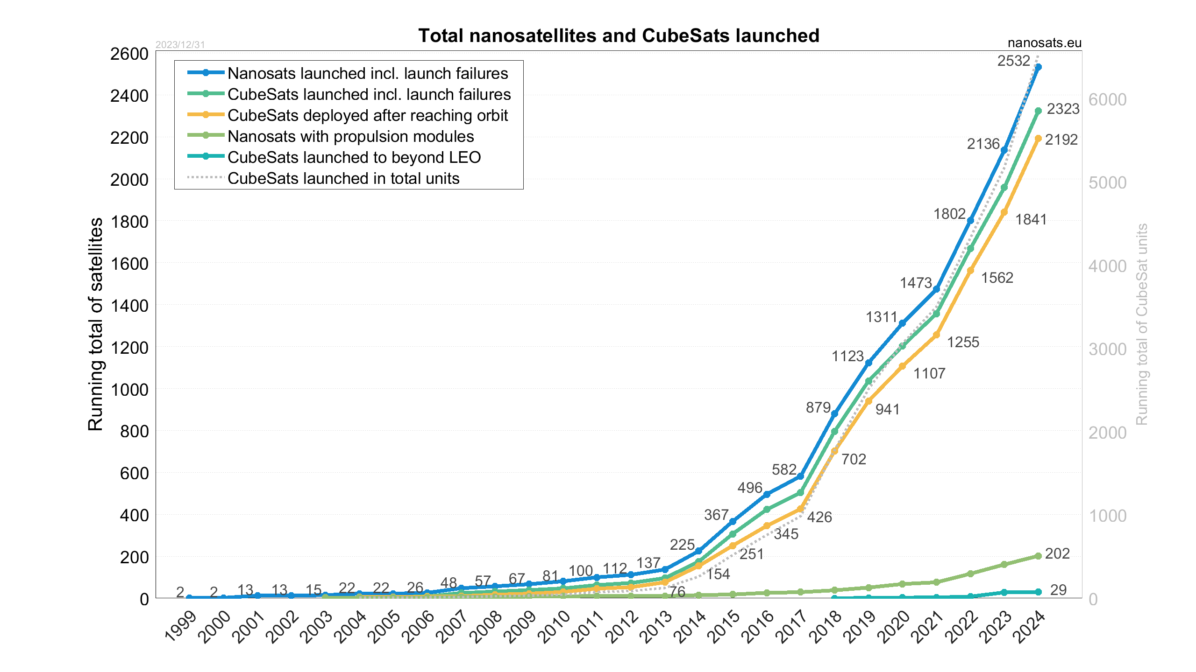
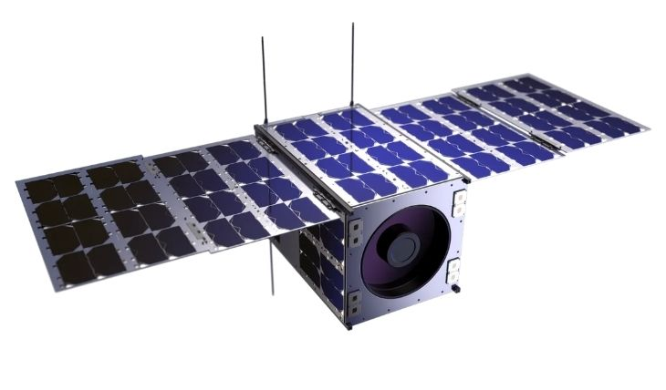
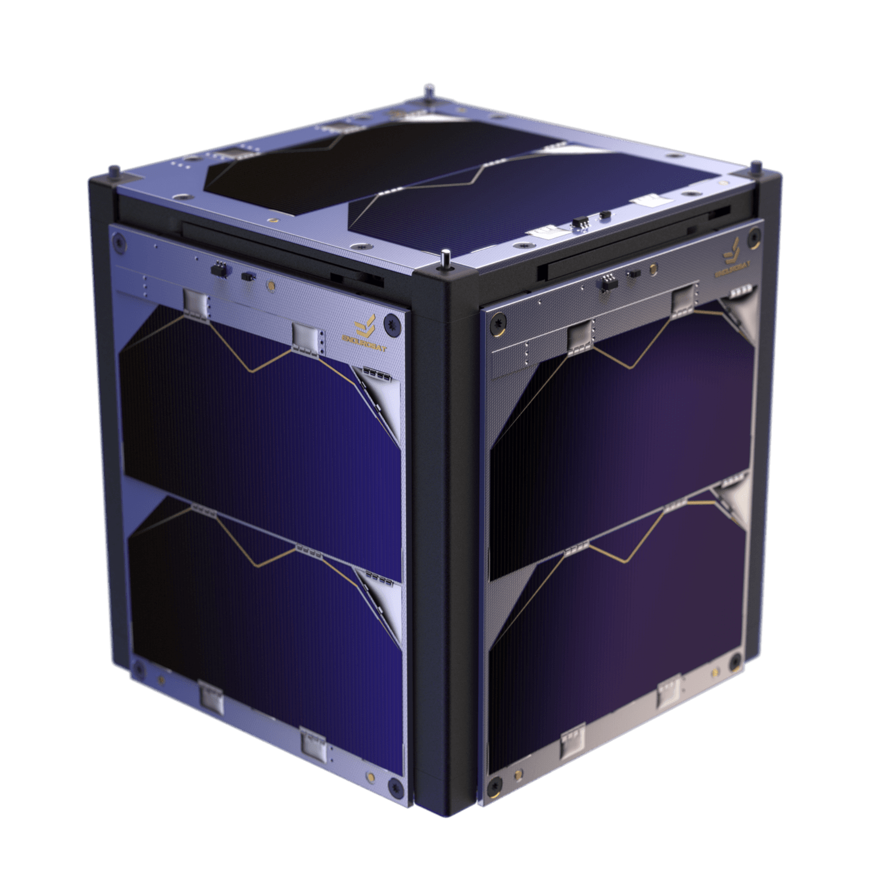
Introduction – Rise of Cubesats
Traditionally used in the past by universities for educational purposes.
Exponential growth in recent years driven by the “New Space” paradigm.
Cost-effective platforms (Reduced Complexity - COTS components).
Faster development cycles.
Reduced complexity but with increased mission risks
1U
12U
The ASFAE’s research projects acknowledge the financial support from the MCIU with funding from the European Union NextGenerationEU and Generalitat Valenciana.

Slide 4
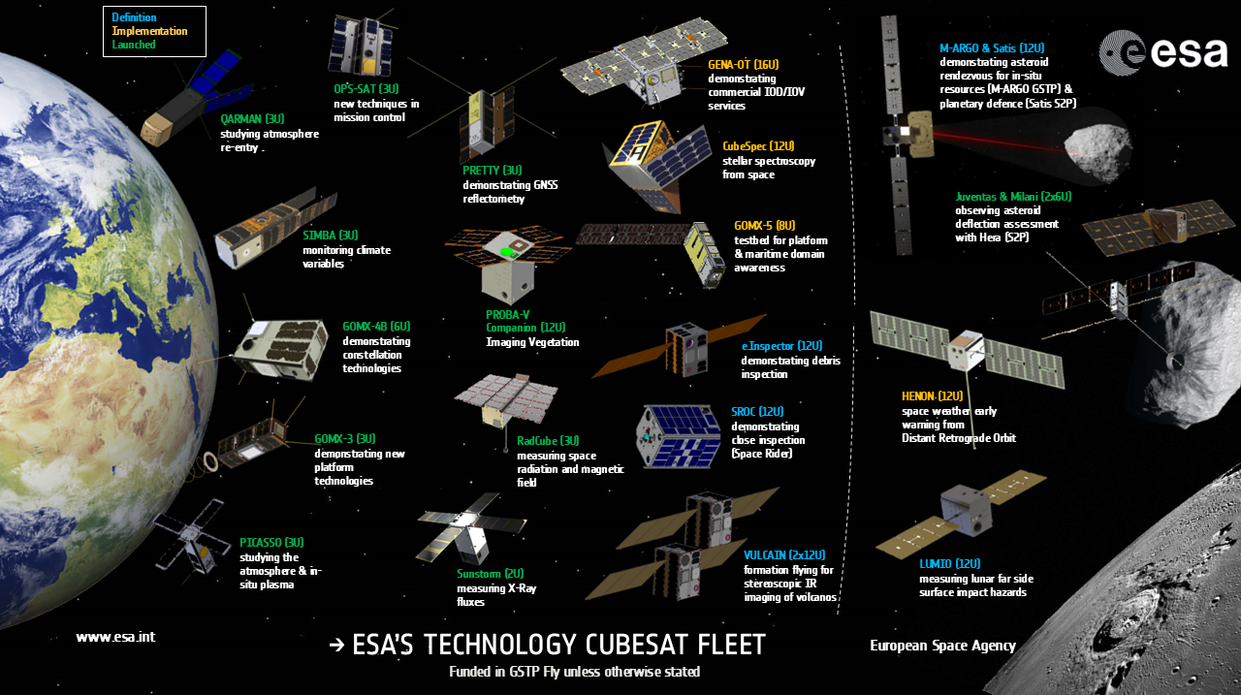
Introduction – Cubesats in Deep Space Missions
Deep Space
The ASFAE’s research projects acknowledge the financial support from the MCIU with funding from the European Union NextGenerationEU and Generalitat Valenciana.

Slide 5
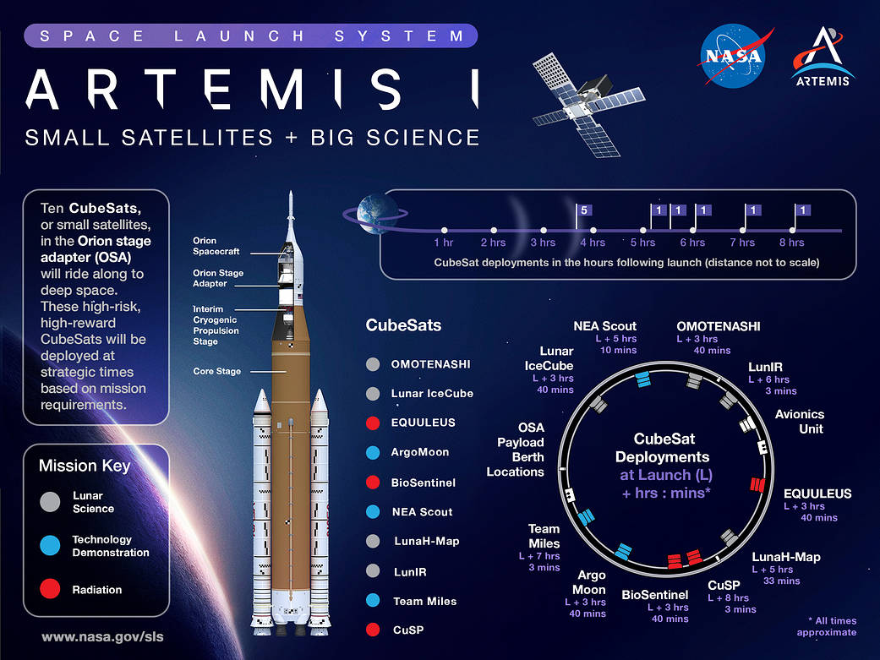




Introduction – Cubesats in Artemis I (Deep Space)
6U Cubesats
BioSentinel
EQUULEUS
Argomoon
LunaHMap
Lunar IceCube
CuSP
LunIR
Omotenashi
Team Miles
NEA Scout
Lessons Learned:
More reliable Cubesats are needed for Deep-Space
High Risk-High Reward
The ASFAE’s research projects acknowledge the financial support from the MCIU with funding from the European Union NextGenerationEU and Generalitat Valenciana.

Slide 6
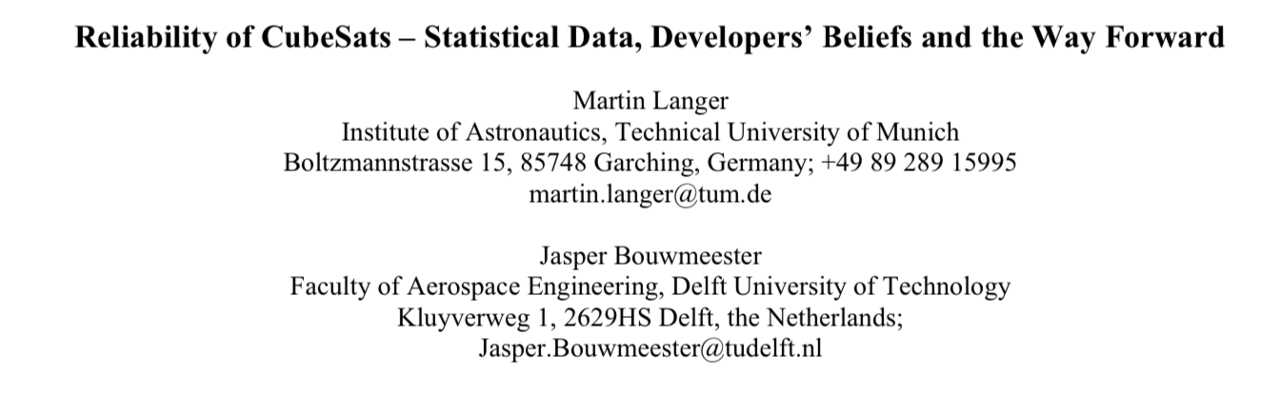
Introduction – Cubesats Failures
Electrical Power Subsystem (EPS) + Unknown Failures > 50 %
Subsystem contribution to Cubesats Failures
More recent reliability studies and state-of-the-art reviews agree that improving the robustness of the EPS is essential for Deep-Space Cubesats.
The ASFAE’s research projects acknowledge the financial support from the MCIU with funding from the European Union NextGenerationEU and Generalitat Valenciana.

Slide 7
Project Objectives
Deep Space Exploration Microsatellite PCDU system development.
  Very low temperature .
  Harsh Radiation Environment.
  Use of commercial components (COTS)
    Identify electronic components and battery cells.
    ”Careful COTS approach” - System level design
  High reliability
    Protections and Redundancy for critical functions.
    Optional Rad-Hard version of critical components in the same PCB.
Validation System development.
The ASFAE’s research projects acknowledge the financial support from the MCIU with funding from the European Union NextGenerationEU and Generalitat Valenciana.

Slide 8
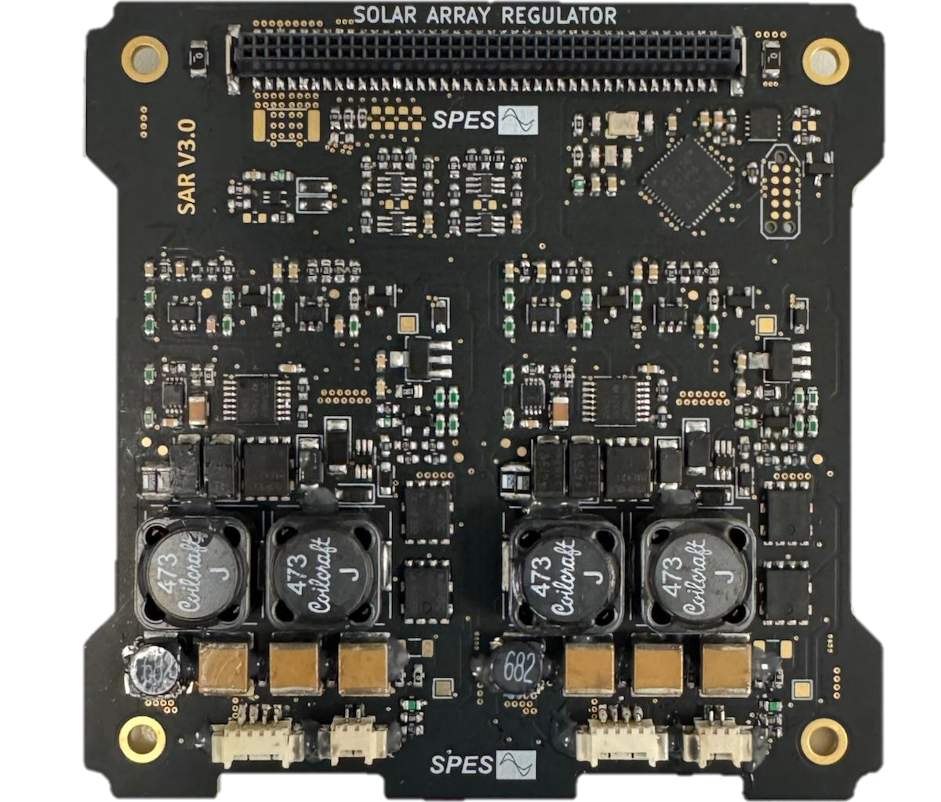
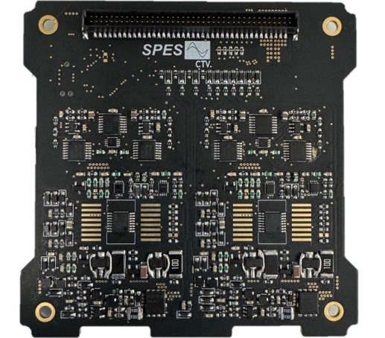
PCDU Architecture – Solar Array Regulator (SAR)
COTS: Extended temperature range automotive qualified components
Analog MPPT
Integrated PWM controller (rad hard version option)
Double control loop
µController (rad tol version available)
Redundancy and Protections
C. Torres, J. M. Blanes, A. Garrigós, D. Marroquí and J. A. Carrasco,
"High-Reliability Solar Array Regulator for Deep Space Exploration Micro-Satellites" in IEEE Access, vol. 11, pp. 94138-94147, 2023
Fault-Free Operation TID > 70 kRads
Fault-Free Operation TVAC -40ºC-60ºC
The ASFAE’s research projects acknowledge the financial support from the MCIU with funding from the European Union NextGenerationEU and Generalitat Valenciana.

Slide 9
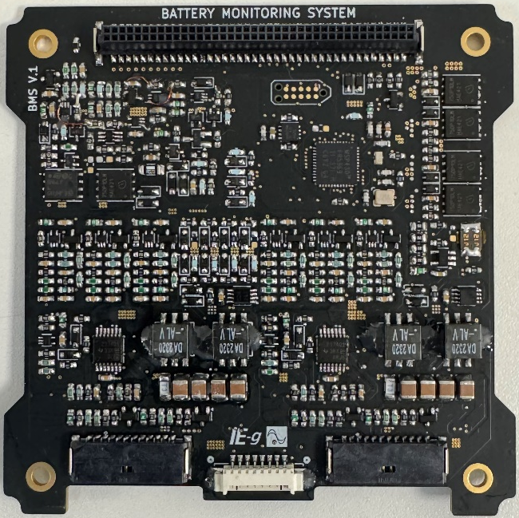
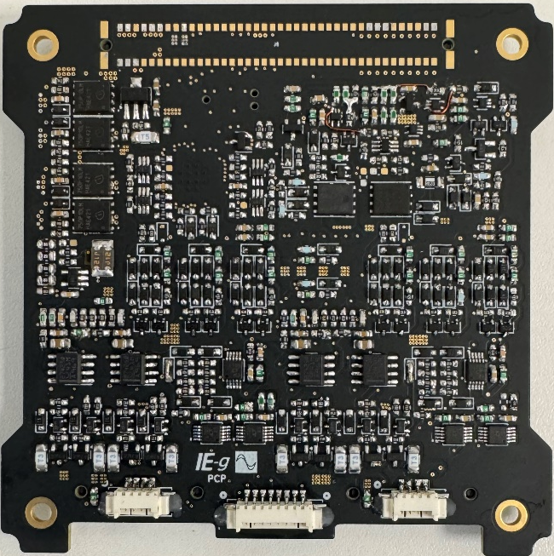
PCDU Architecture – Battery Management System (BMS)
COTS: Extended temperature range automotive qualified components
Single Point Failure Free
Battery Cell Thermal Management
Cell Balancing - Switched Capacitors Equalizers (SCE)
OV + OC protection
Remove Before Flight + Deployment Switches
µController (rad tol version available)
Fault-Free Operation TID > 70 kRads
Fault-Free Operation TVAC -40ºC-60ºC
Casado, P.; Blanes, J.M.; Garrigós, A.; Marroquí, D.; Torres, C. “COTS Battery Charge Equalizer for Small Satellite Applications”. Appl. Sci. 2025, 15, 8228. https://doi.org/10.3390/app15158228
The ASFAE’s research projects acknowledge the financial support from the MCIU with funding from the European Union NextGenerationEU and Generalitat Valenciana.

Slide 10
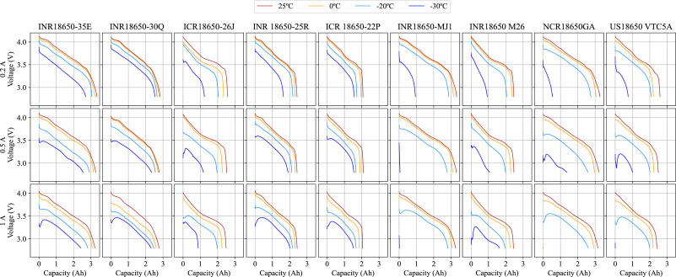
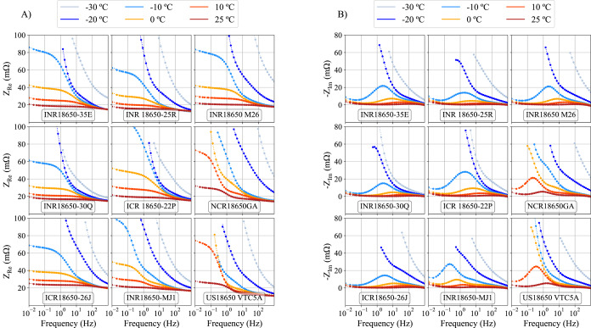
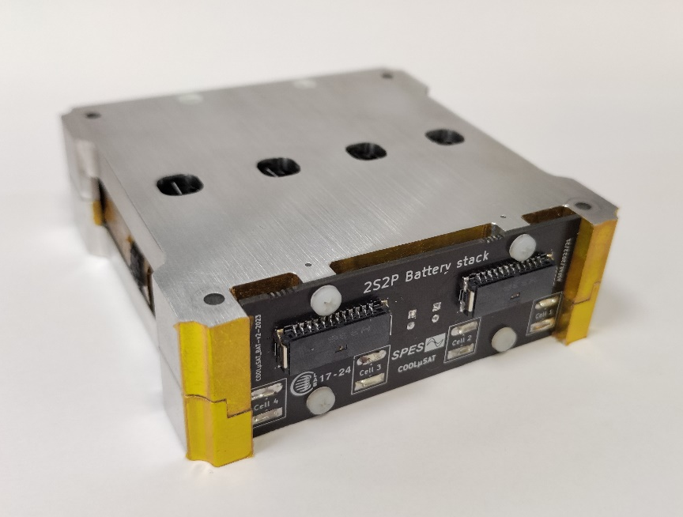
PCDU Architecture – Battery Pack
COTS: Extended temperature range automotive qualified components
Li-ion Commercial 18650 cells
4 Independent Heaters
4 Cell temperature sensors
2S2P (other conf: 2 x 1S1P+1S1P, 4S1P)
Over temperature protection
Fault-Free Operation TID > 70 kRads
Fault-Free Operation TVAC -40ºC-60ºC
P. Casado, J.M. Blanes, A. Garrigós, D. Marroquí, C. Torres,
“Evaluation of commercial Li-Ion 18650 battery cells for deep space applications”,
Journal of Power Sources, Volume 638, 2025
The ASFAE’s research projects acknowledge the financial support from the MCIU with funding from the European Union NextGenerationEU and Generalitat Valenciana.

Slide 11
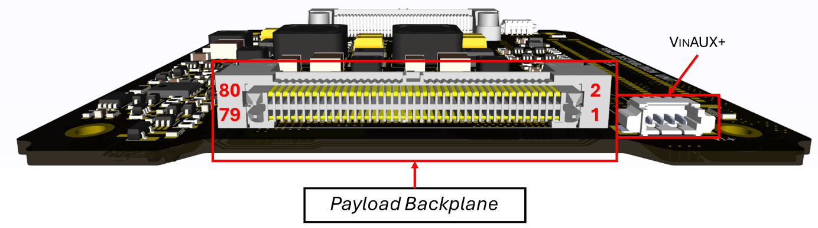
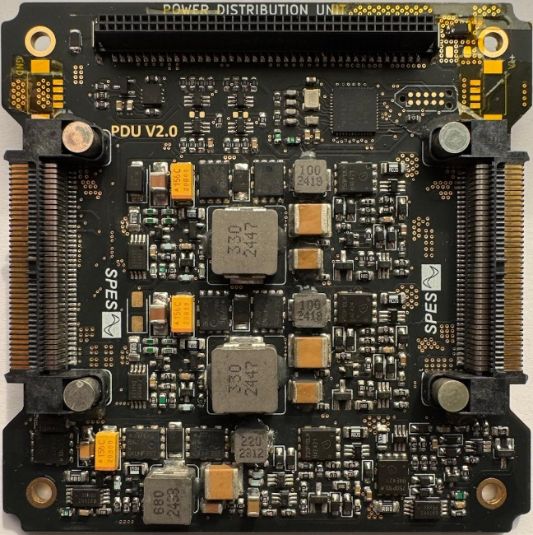
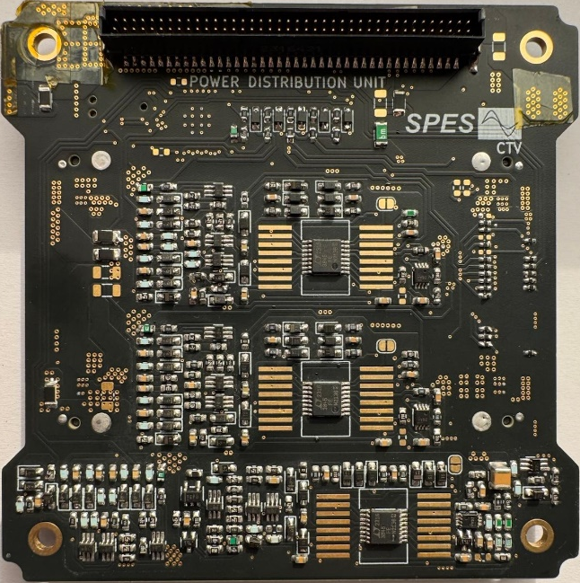
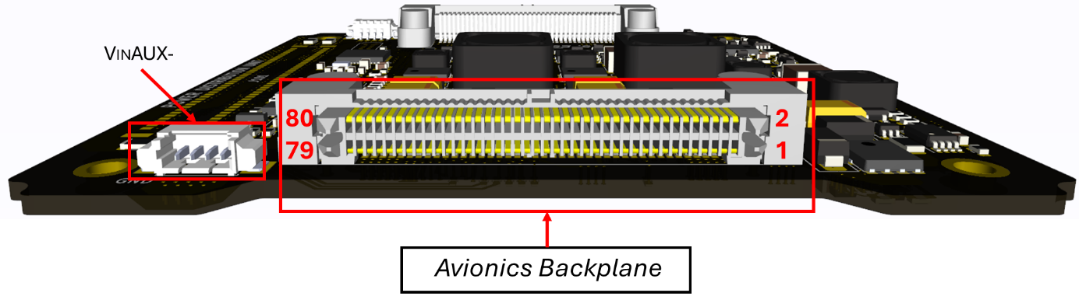
PCDU Architecture - Power Distribution Unit (PDU)
COTS: Extended temperature range automotive qualified components
PCDU Payload/Avionics backplane connection
Outputs: Vbat, 5V, 3.3V outputs
OC and UV protections (LCL)
OBC dedicated supply lines
Integrated PWM controller (rad hard option)
µController (radtol version available)
Fault-Free Operation TID > 70 kRads
Fault-Free Operation TVAC -40ºC-60ºC
The ASFAE’s research projects acknowledge the financial support from the MCIU with funding from the European Union NextGenerationEU and Generalitat Valenciana.

Slide 12
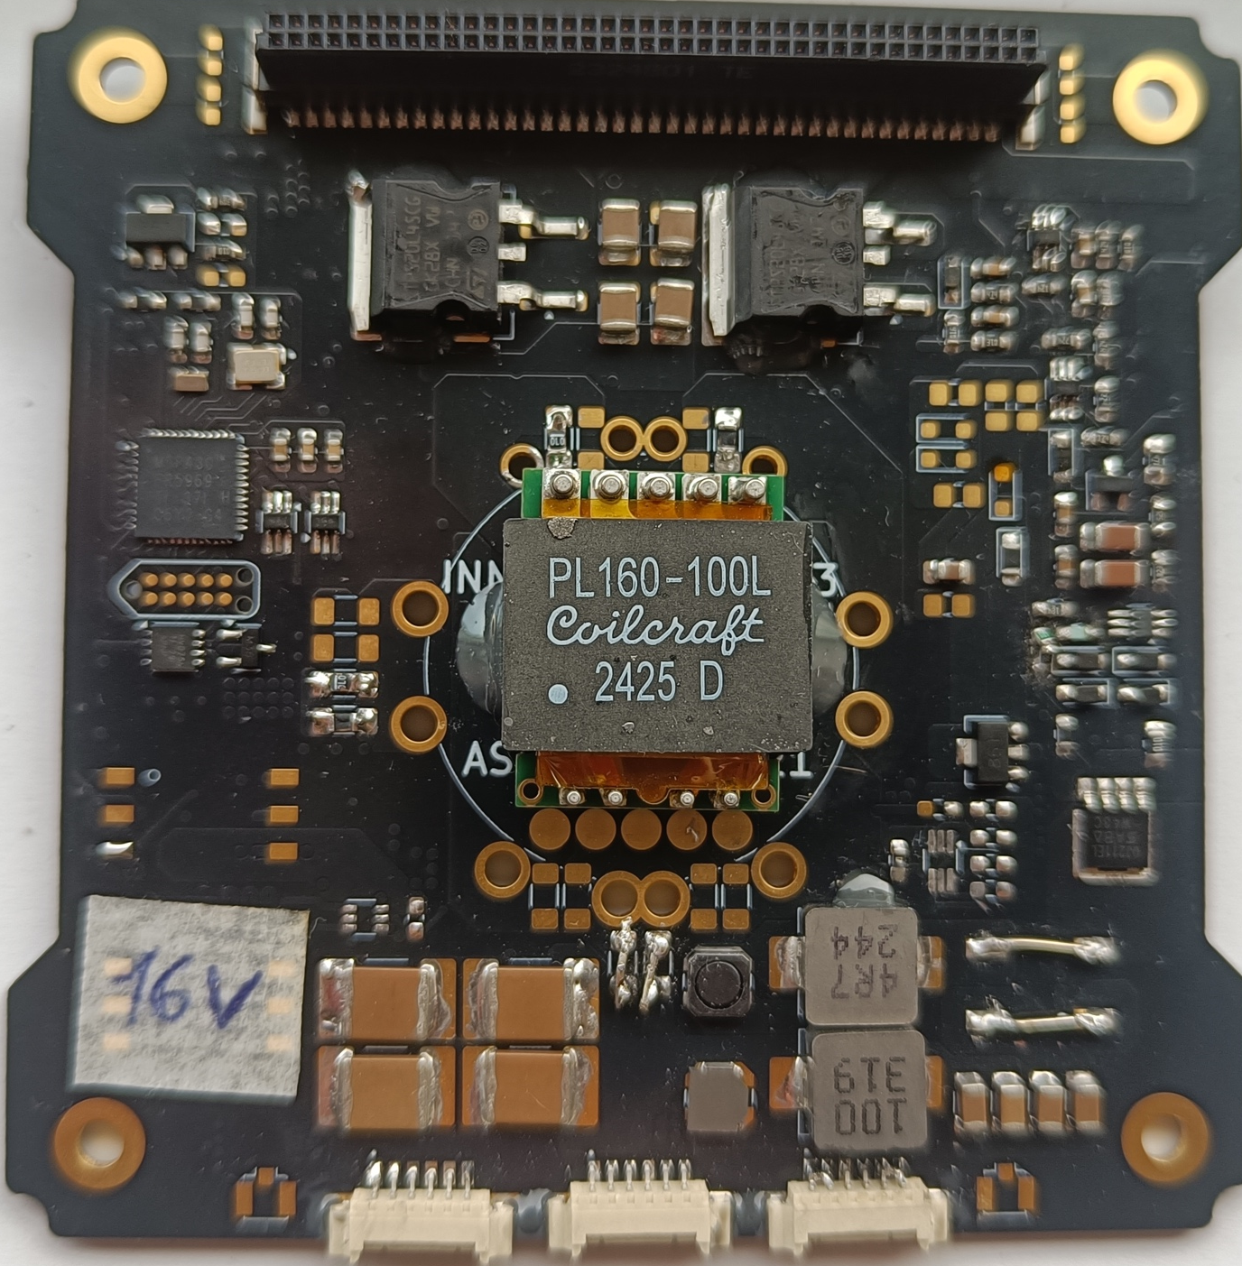
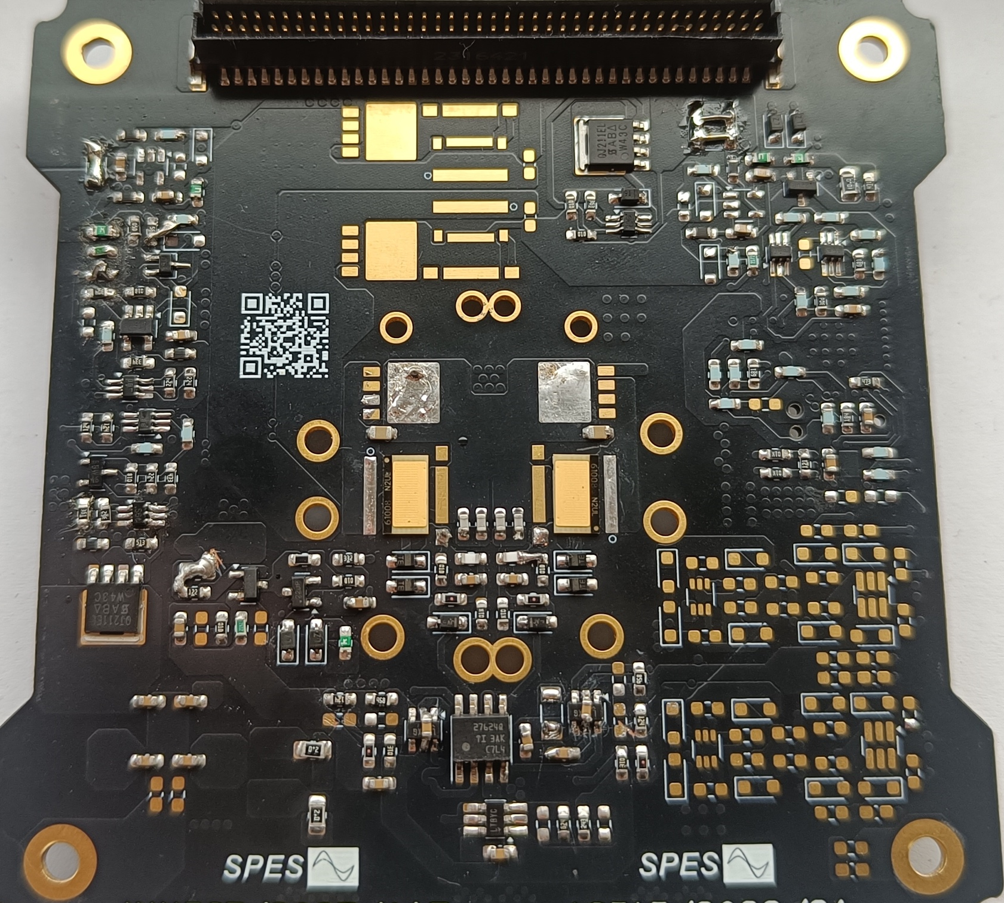
PCDU Architecture - DC Transformer (DCX)
COTS: Extended temperature range automotive qualified components
EMI filter
Planar transformer - Isolated outputs
Si MOSFET or GaN FETs
Zero voltage and zero current switching
µController (radtol version available)
OC and UV protections (LCL)
Fault-Free Operation TID > 70 kRads
Fault-Free Operation TVAC -40ºC-60ºC
The ASFAE’s research projects acknowledge the financial support from the MCIU with funding from the European Union NextGenerationEU and Generalitat Valenciana.

Slide 13
PCDU Architecture – Modular Design
4.DCX
1.SAR
5.PDU
3.BMS
6.PDU
0.BAT
2.SAR
7.DCX
The ASFAE’s research projects acknowledge the financial support from the MCIU with funding from the European Union NextGenerationEU and Generalitat Valenciana.

Slide 14
selecting, testing, and designing around the commercial components.
PCDU Architecture – Modular Design
4.DCX
1.SAR
2.BMS
0.BAT
3.PDU
The ASFAE’s research projects acknowledge the financial support from the MCIU with funding from the European Union NextGenerationEU and Generalitat Valenciana.

Slide 15
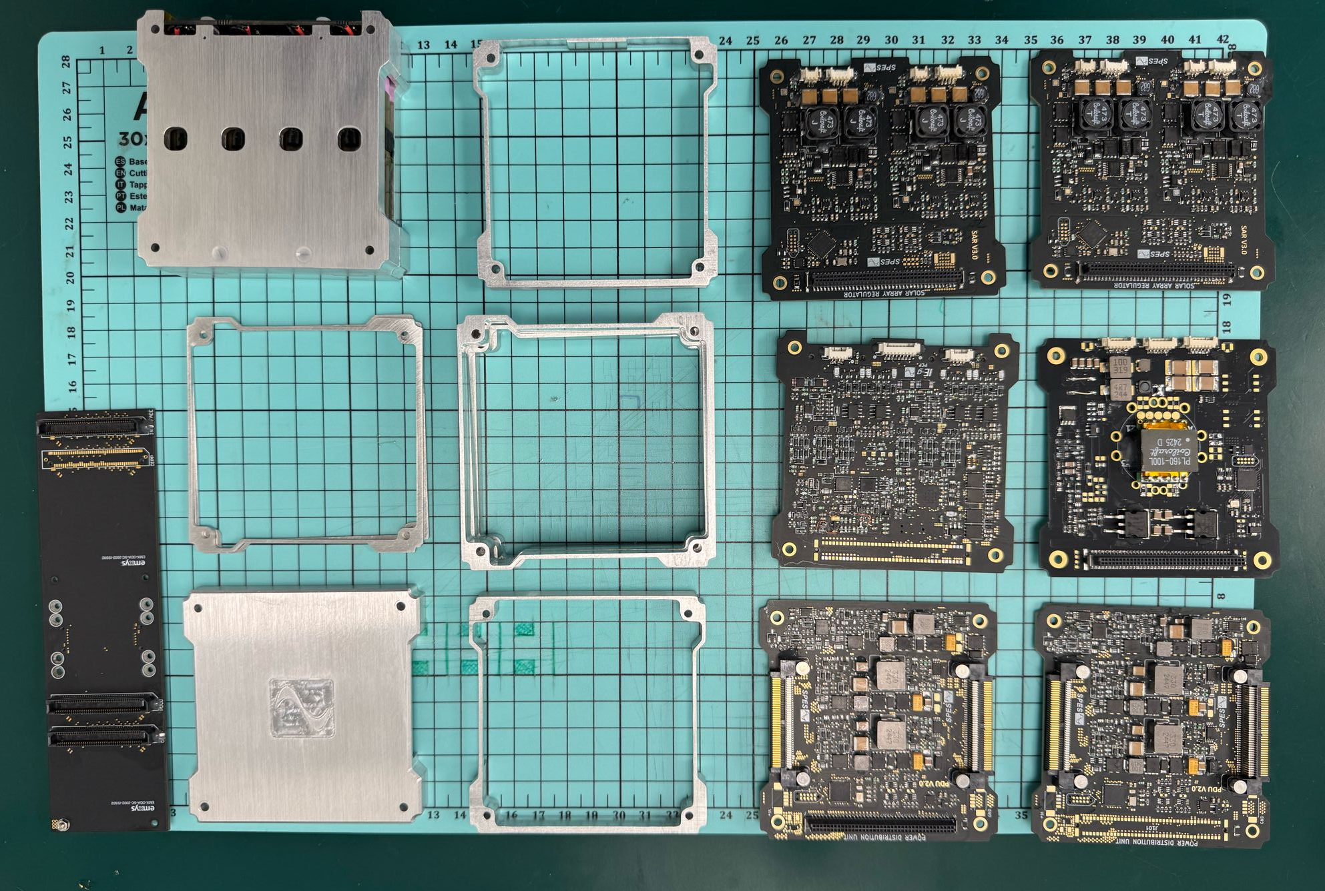
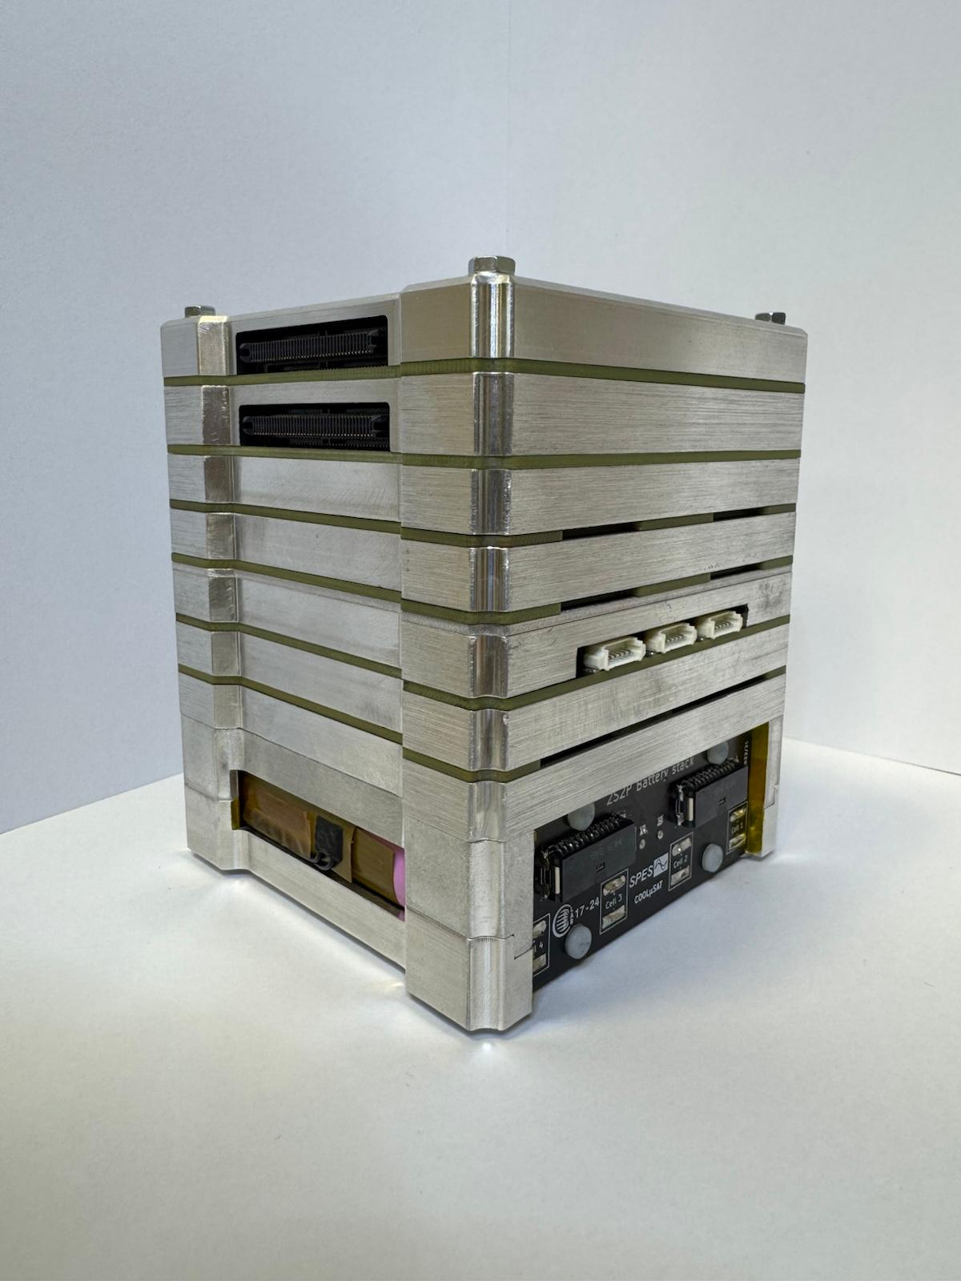
PCDU Architecture - Integration
PCDU – Aluminium Enclosure
The ASFAE’s research projects acknowledge the financial support from the MCIU with funding from the European Union NextGenerationEU and Generalitat Valenciana.

Slide 16
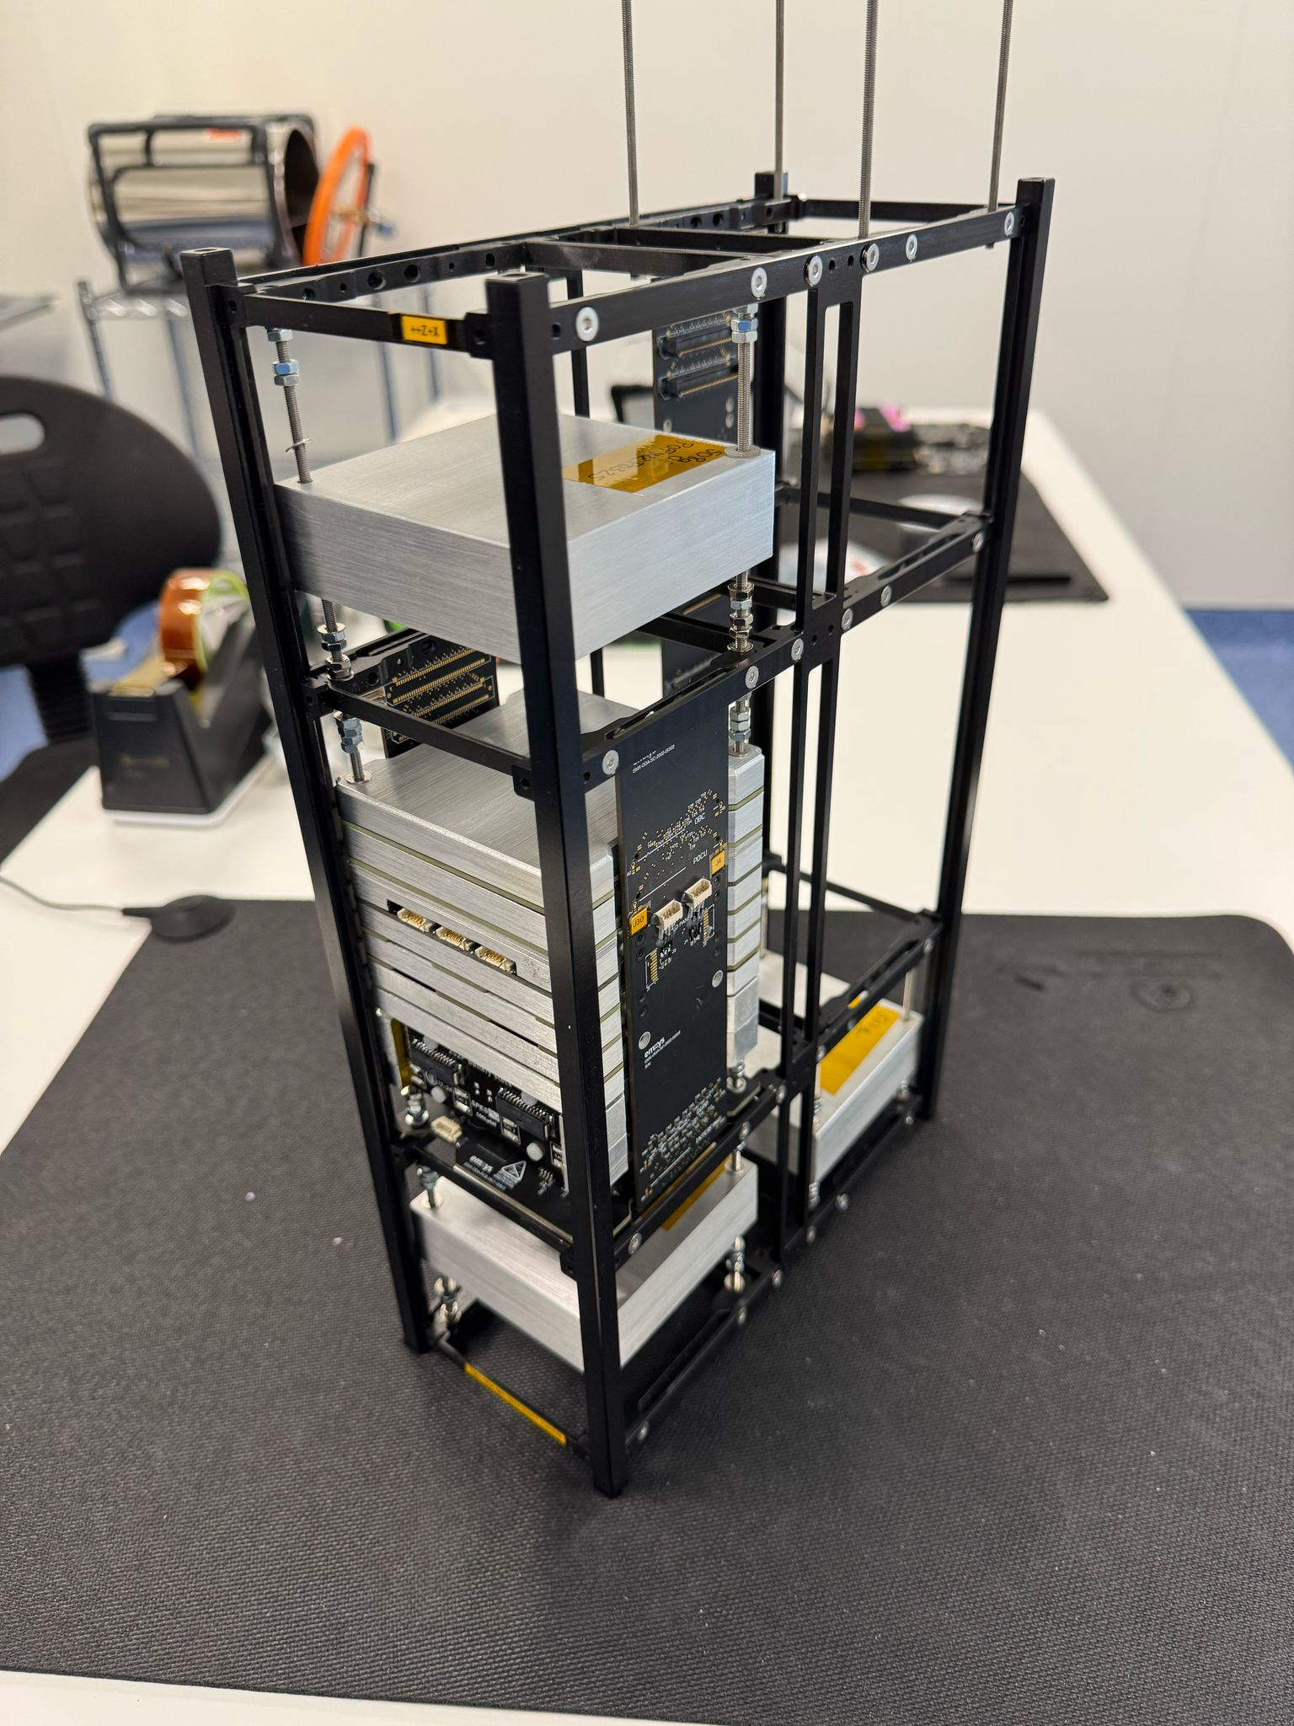
PCDU Architecture – Structure Integration
6U Cubesat Structure
4x8S1P – SAS
Cesi CTJ30-SCA
The ASFAE’s research projects acknowledge the financial support from the MCIU with funding from the European Union NextGenerationEU and Generalitat Valenciana.

Slide 17
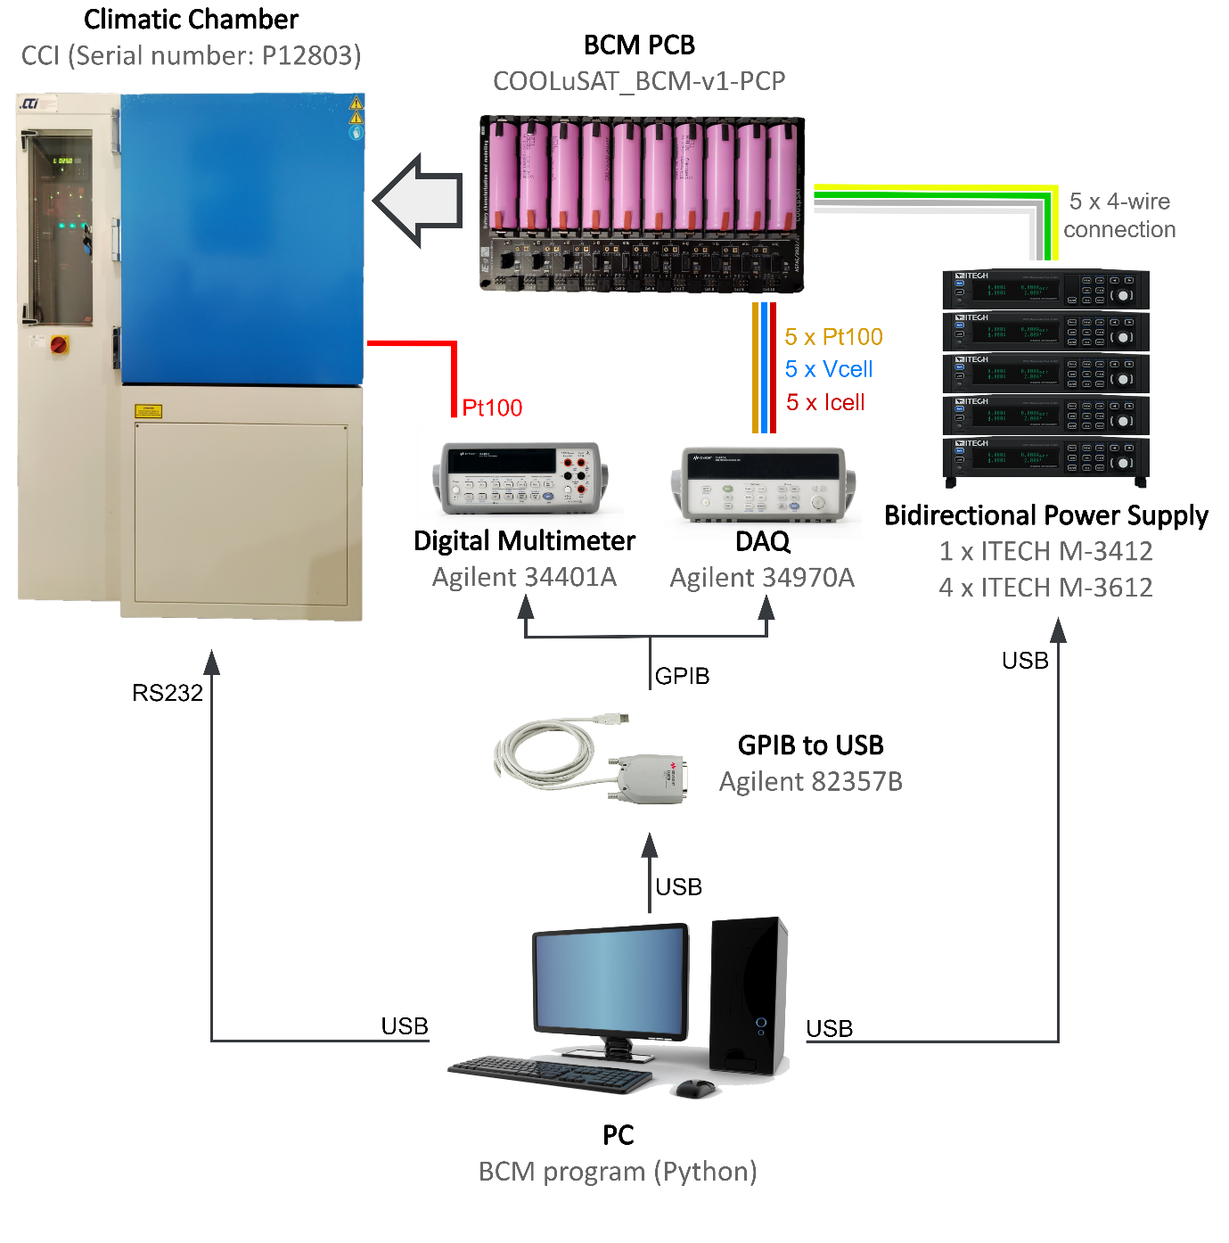
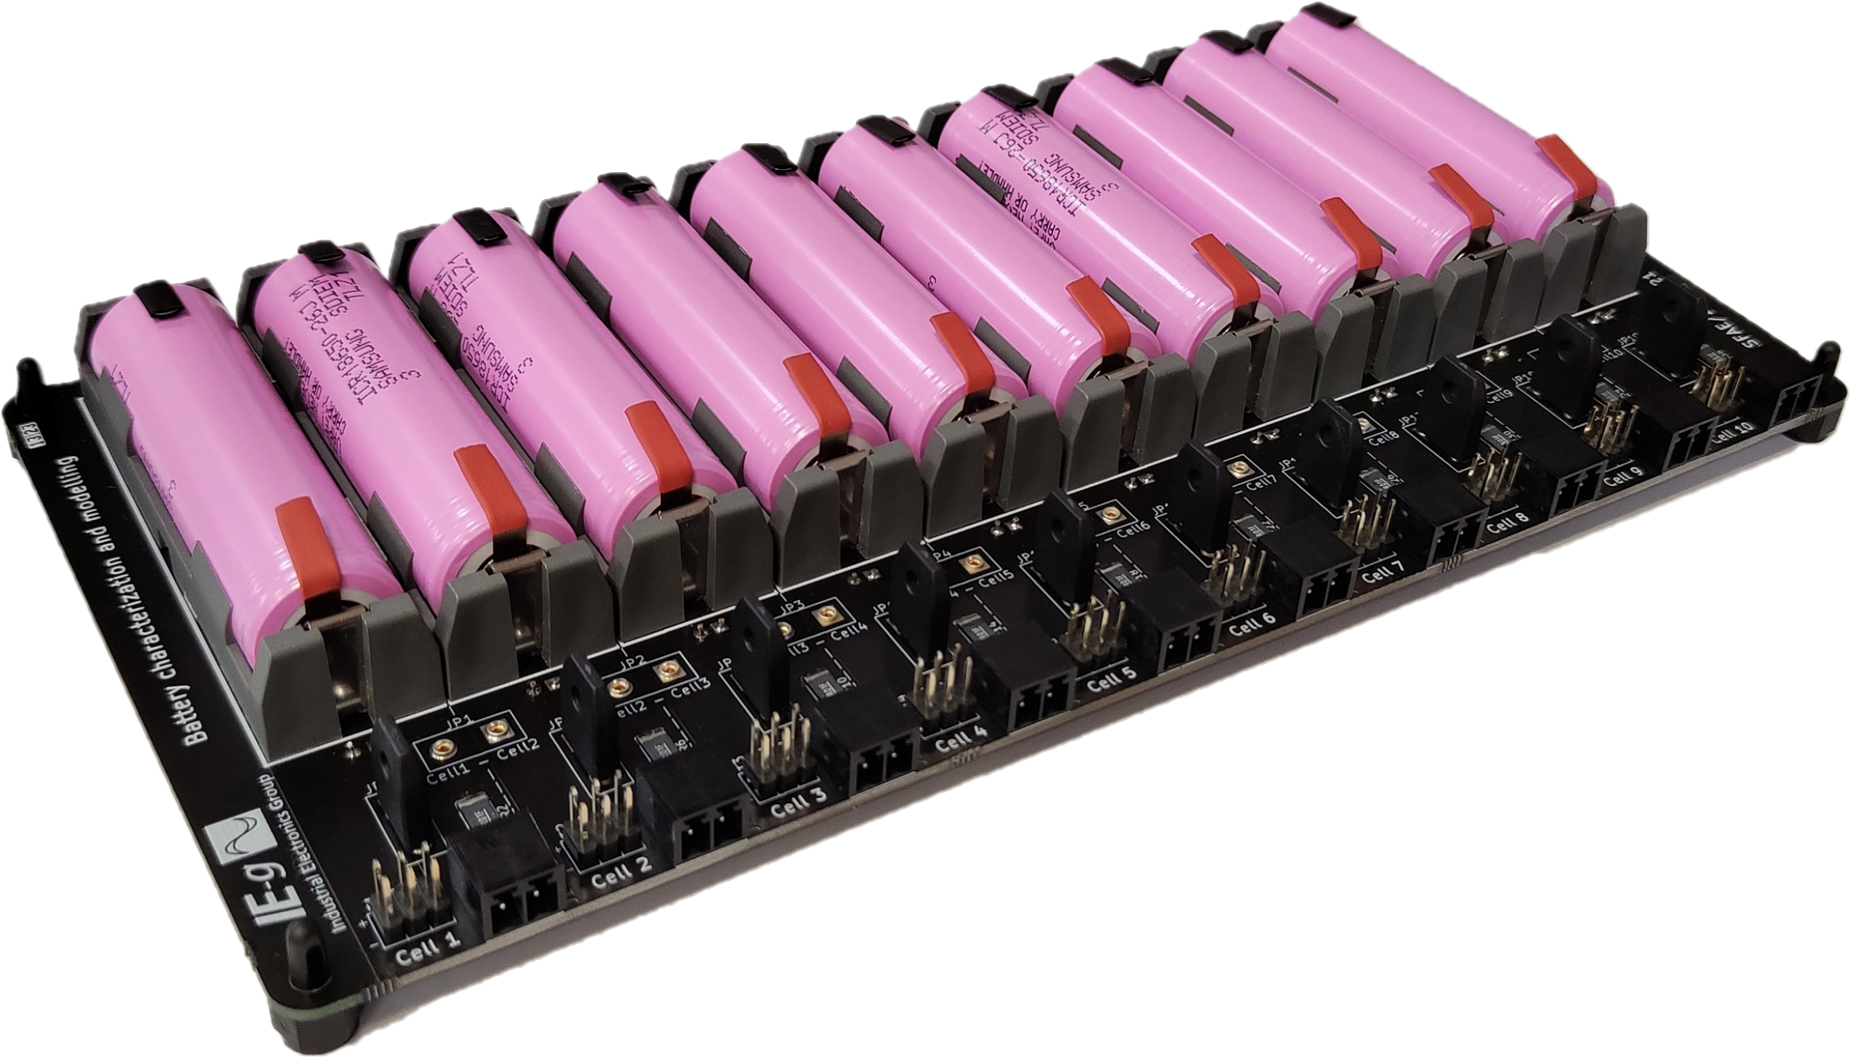
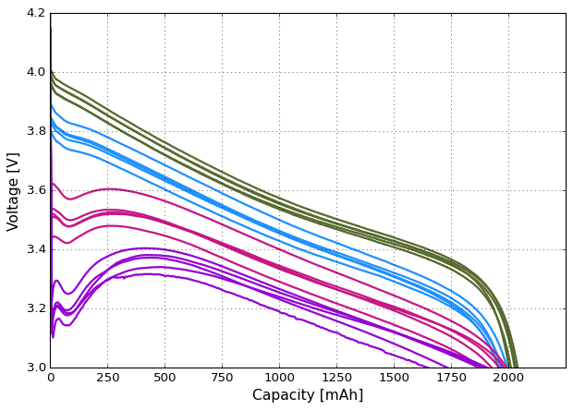
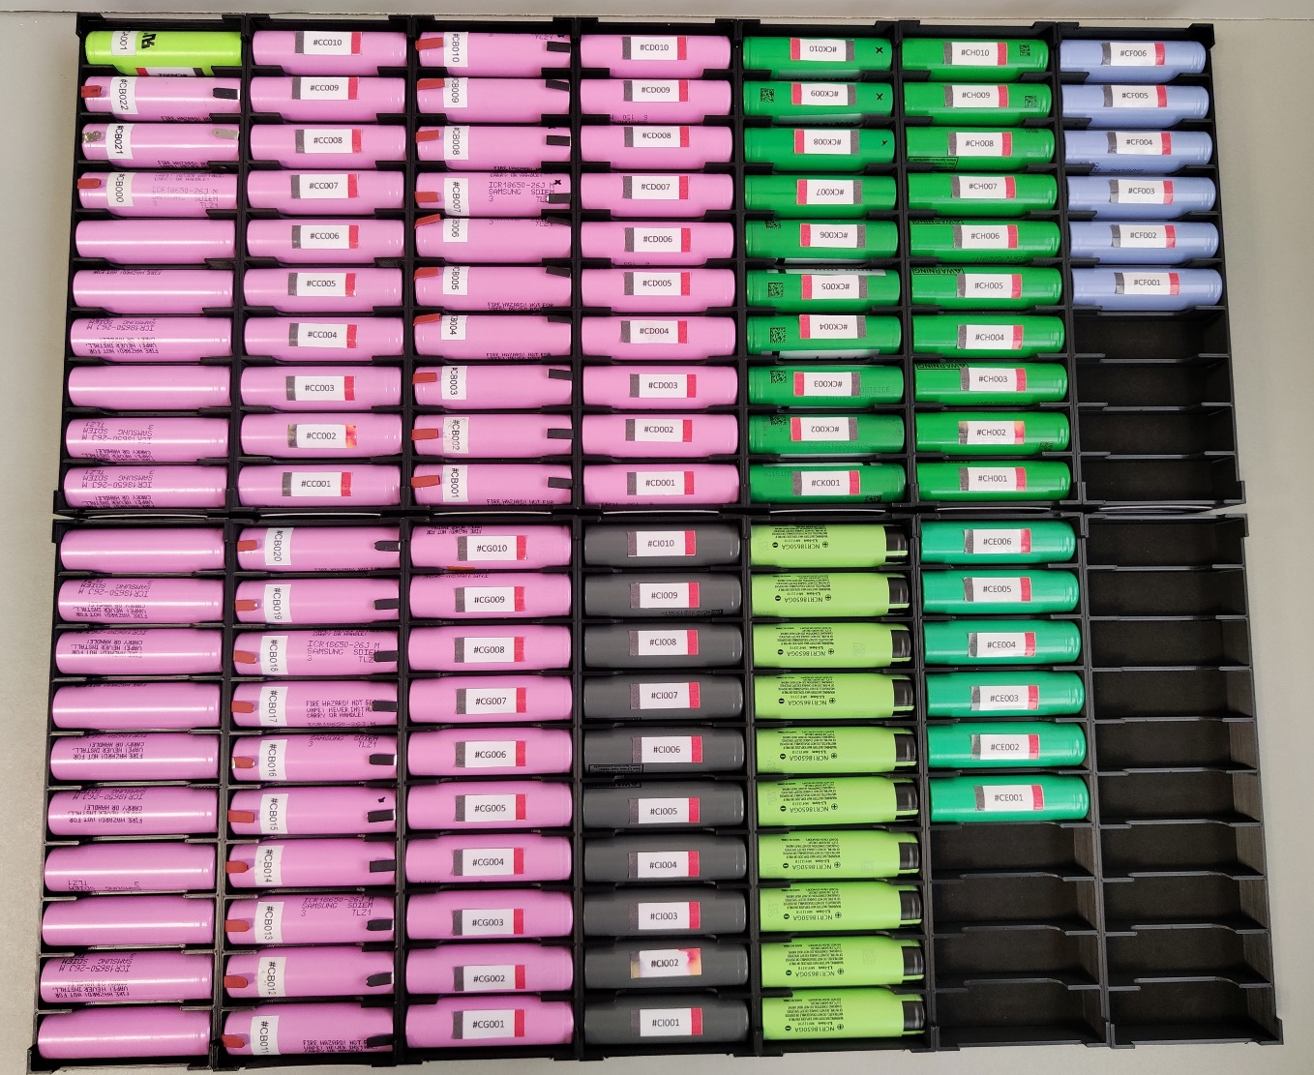
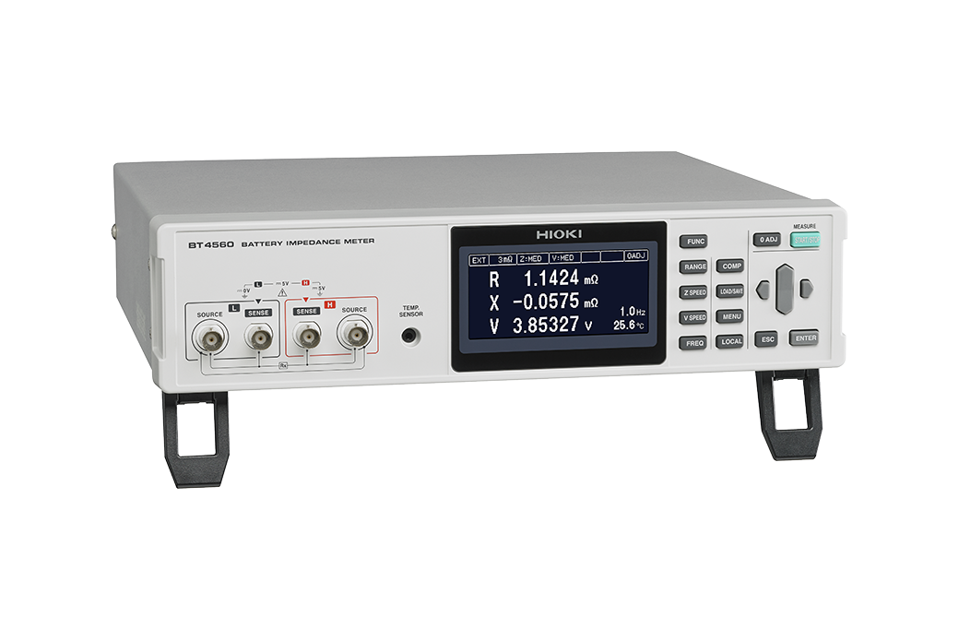
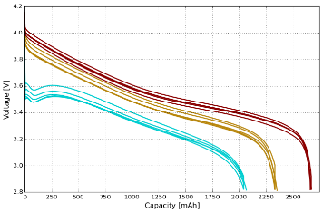
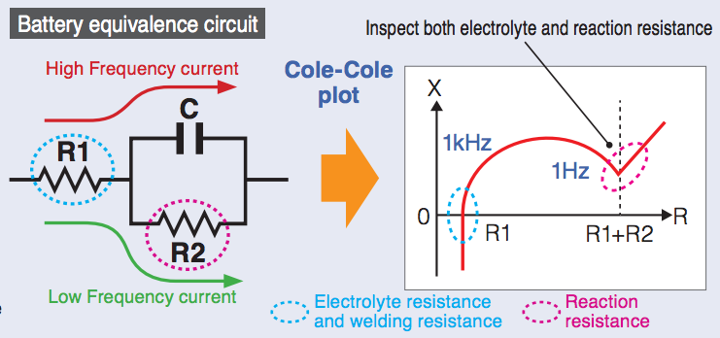
Facilities – Battery Characterization System
12 different battery cells characterized
Hioki BT4560
Battery Impedance Meter
June 2024
The ASFAE’s research projects acknowledge the financial support from the MCIU with funding from the European Union NextGenerationEU and Generalitat Valenciana.

Slide 18
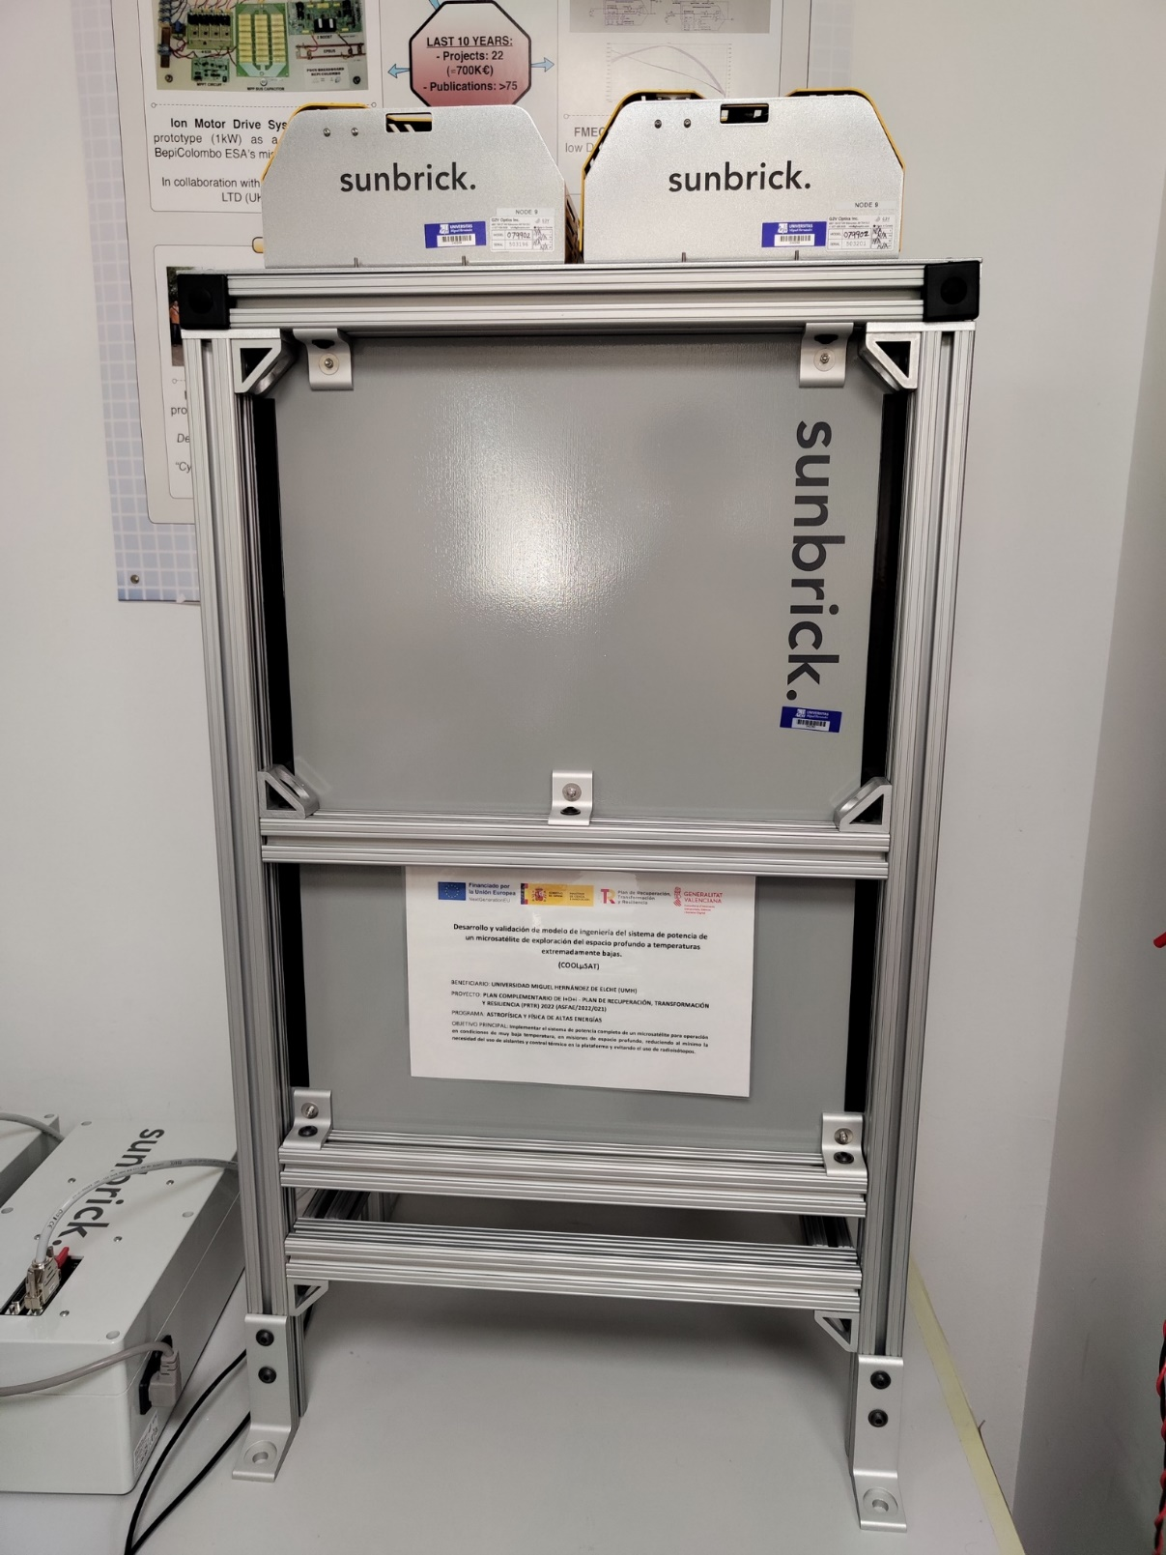
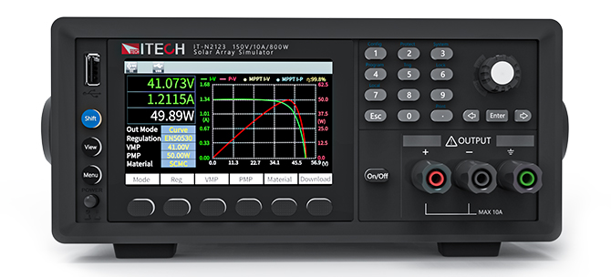
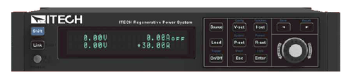
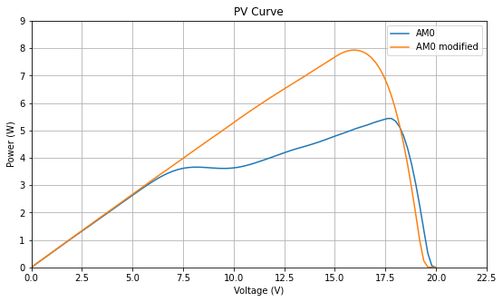
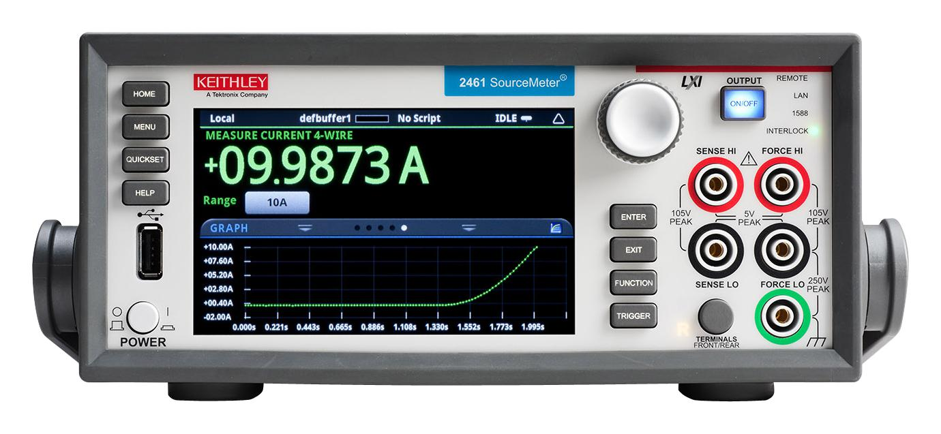
Facilities – SAS, Bat & Sun Simulator
SUN SIMULATOR
G2V SUNBRICK
SOLAR ARRAY SIMULATOR
4xSAS ITECH IT2100
BATTERY SIMULATOR
4xBat ITECH M3612
SOURCE MEASUREMENT UNIT
SMU KEITHLEY 2461
LED LARGE AREA SOLAR SIMULATOR 25x50 cm2
32 Channels
The ASFAE’s research projects acknowledge the financial support from the MCIU with funding from the European Union NextGenerationEU and Generalitat Valenciana.

Slide 19
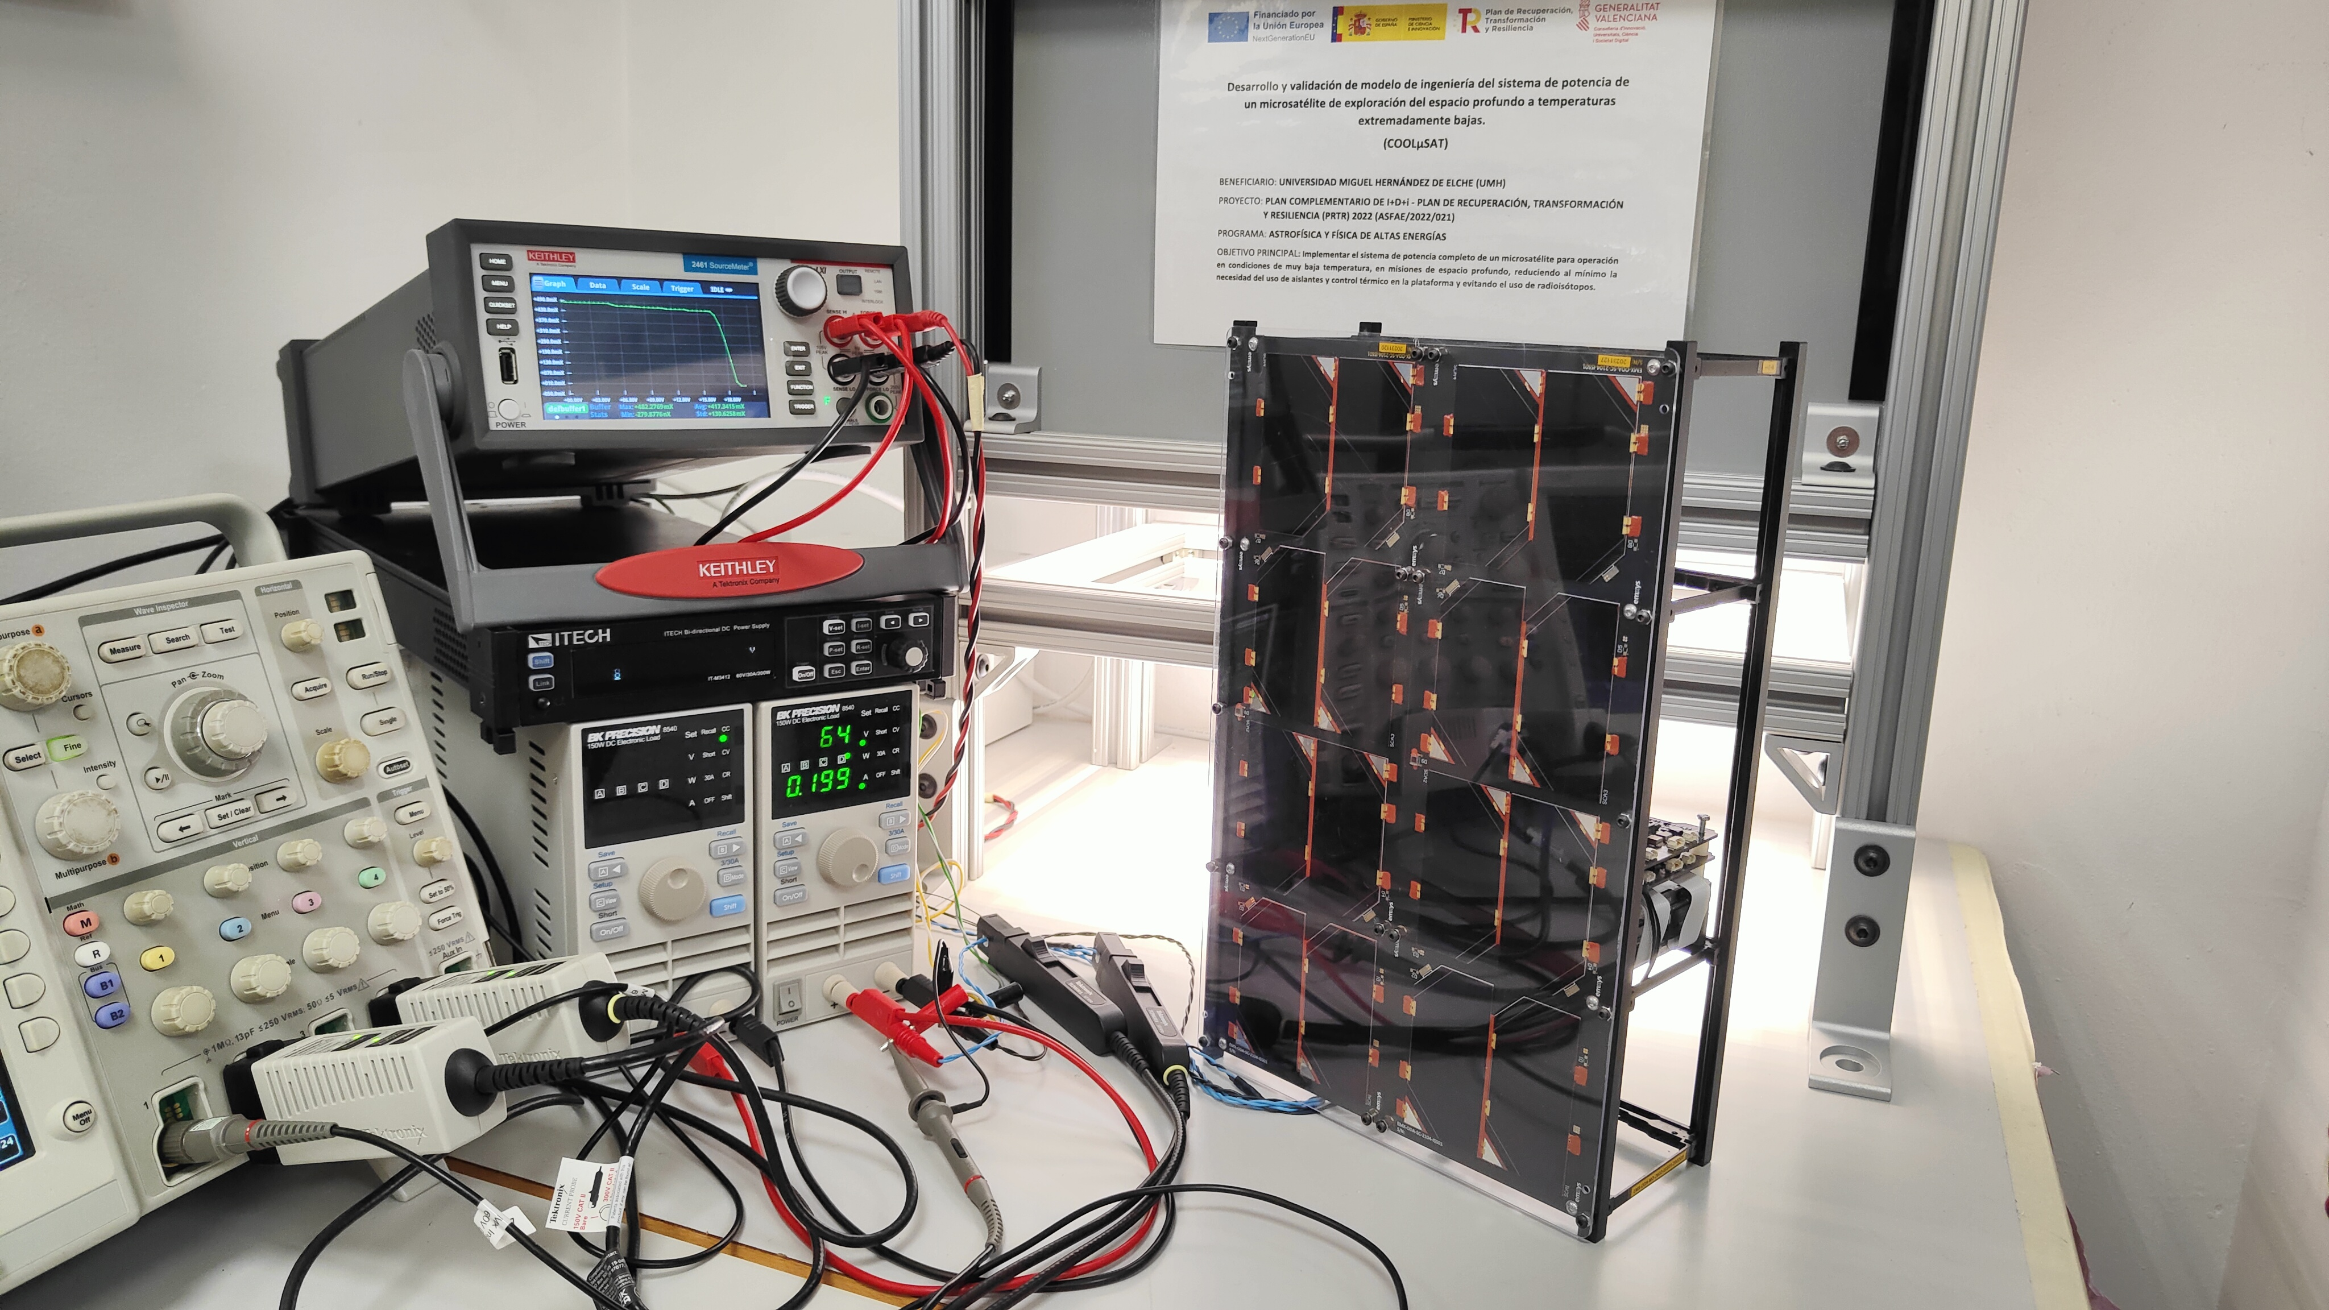
PCDU Validation – In-House Functional Tests - OK
The ASFAE’s research projects acknowledge the financial support from the MCIU with funding from the European Union NextGenerationEU and Generalitat Valenciana.

Slide 20

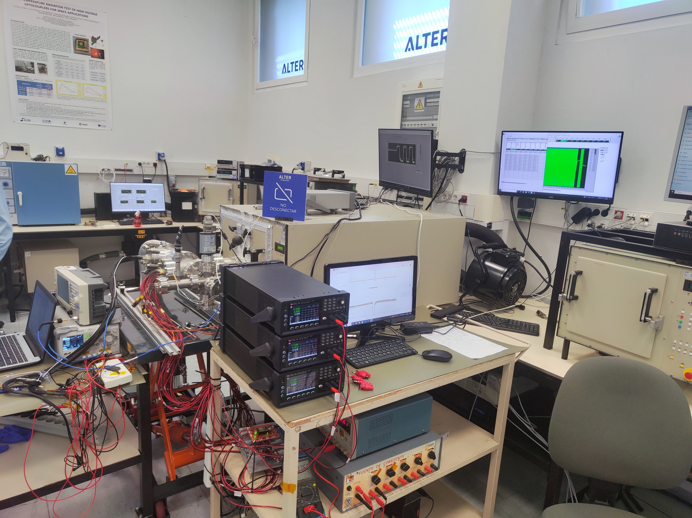
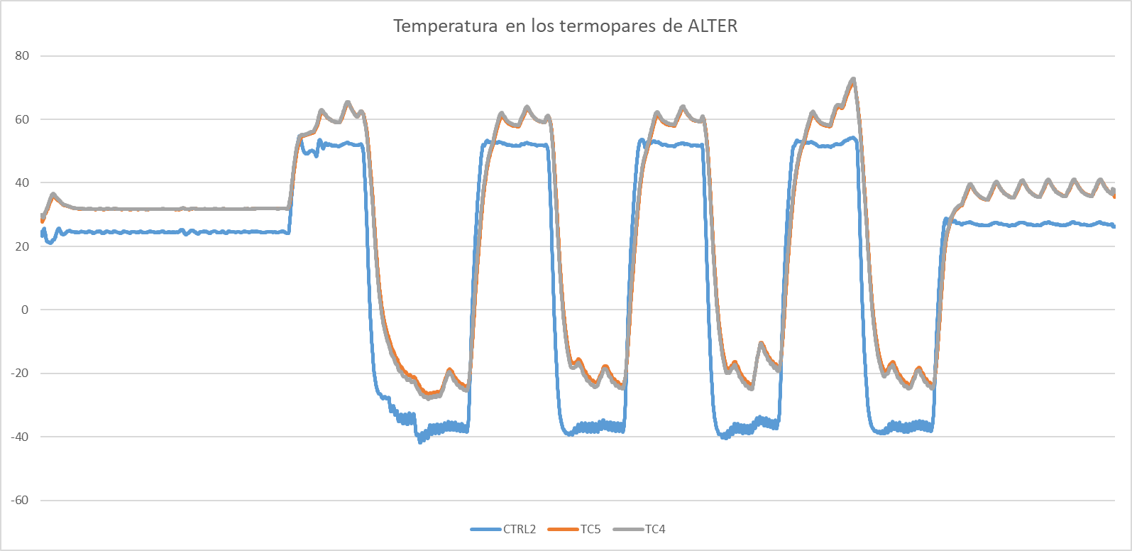
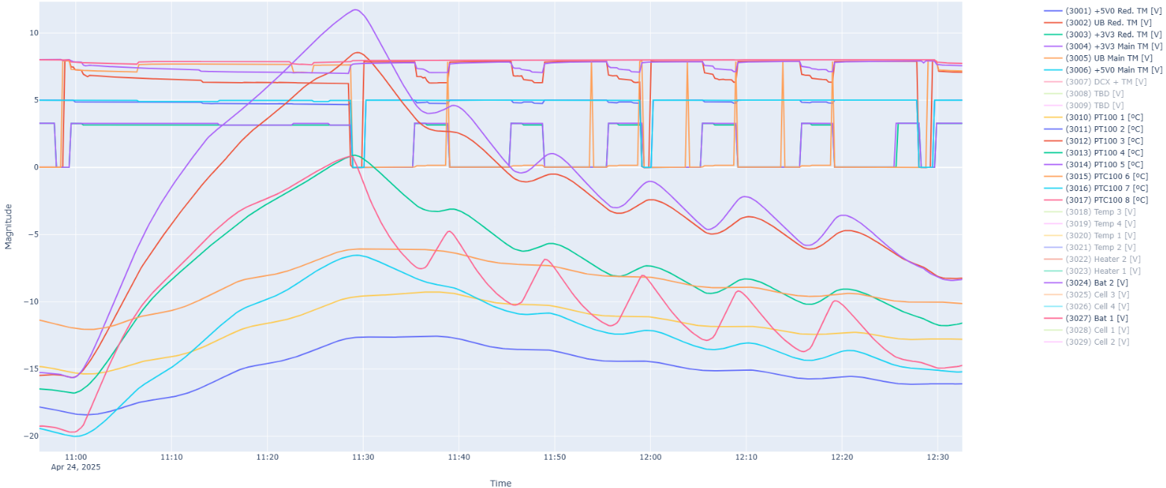
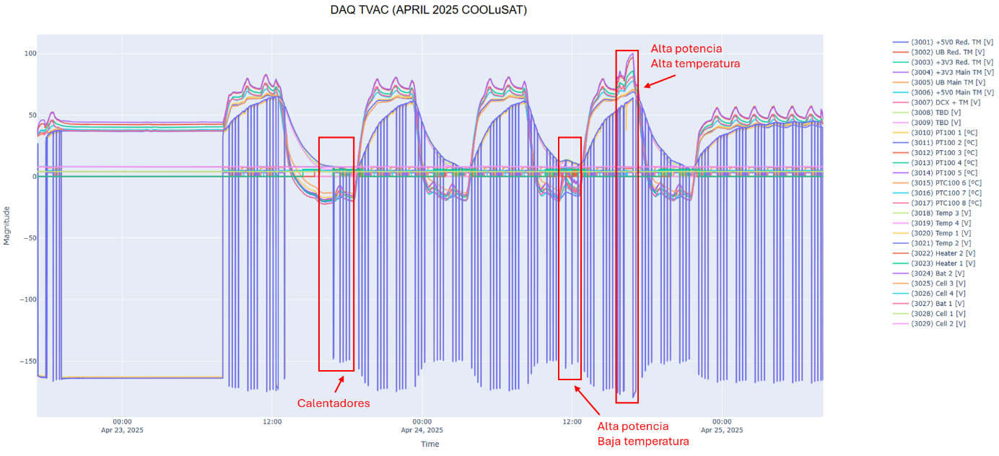
PCDU Validation – Thermal Vacuum Chamber (TVAC) Tests
Fault Free Operation TVAC -40ºC-60ºC
The ASFAE’s research projects acknowledge the financial support from the MCIU with funding from the European Union NextGenerationEU and Generalitat Valenciana.

Slide 21
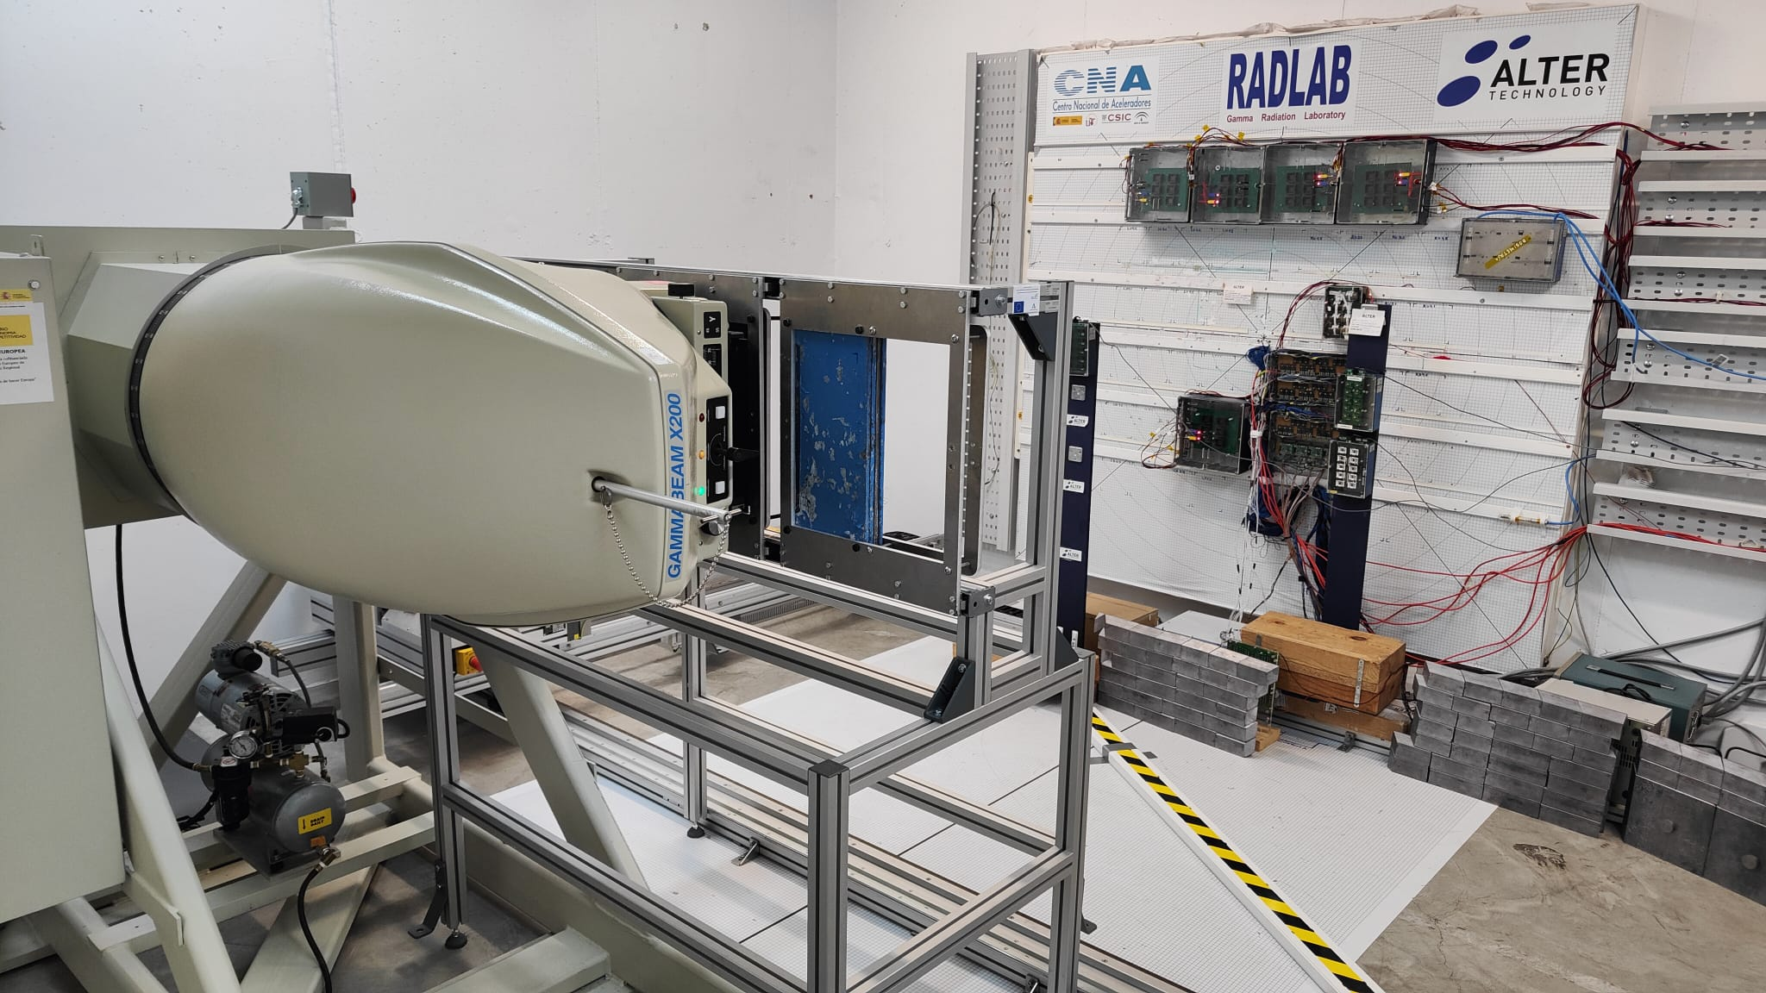

PCDU Validation – Total Ionizing Dose (TID) Radiation Tests
Fault Free Operation TID > 70 kRads
The ASFAE’s research projects acknowledge the financial support from the MCIU with funding from the European Union NextGenerationEU and Generalitat Valenciana.

Slide 22
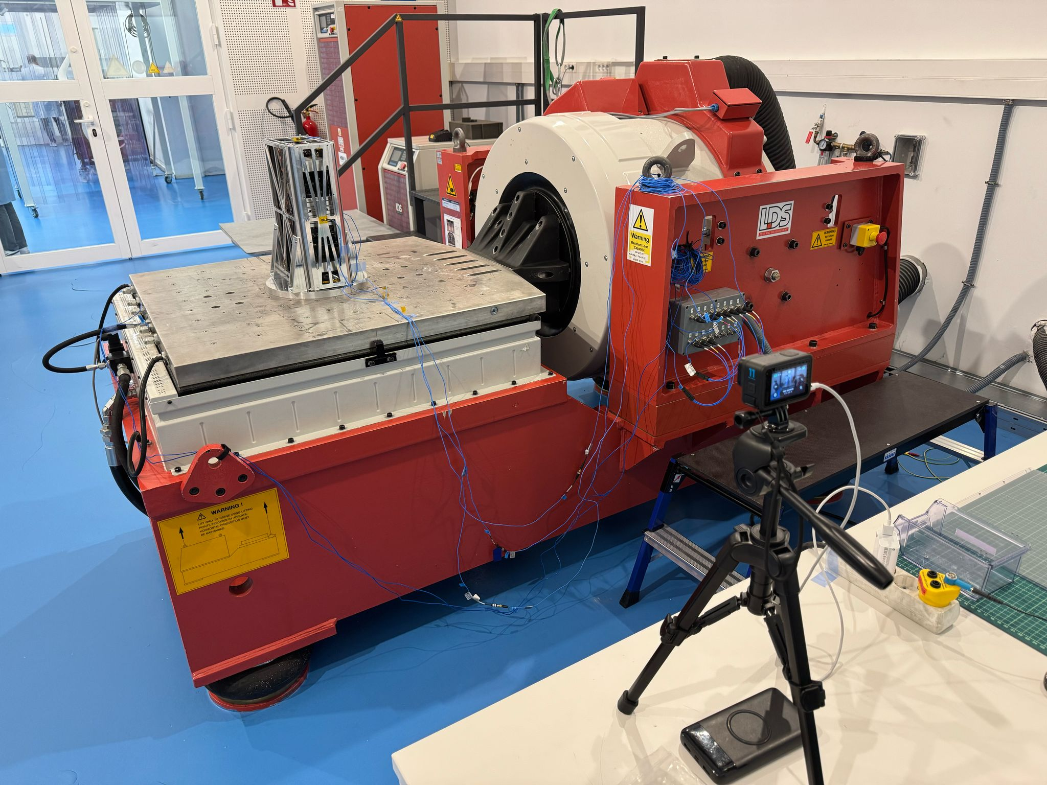
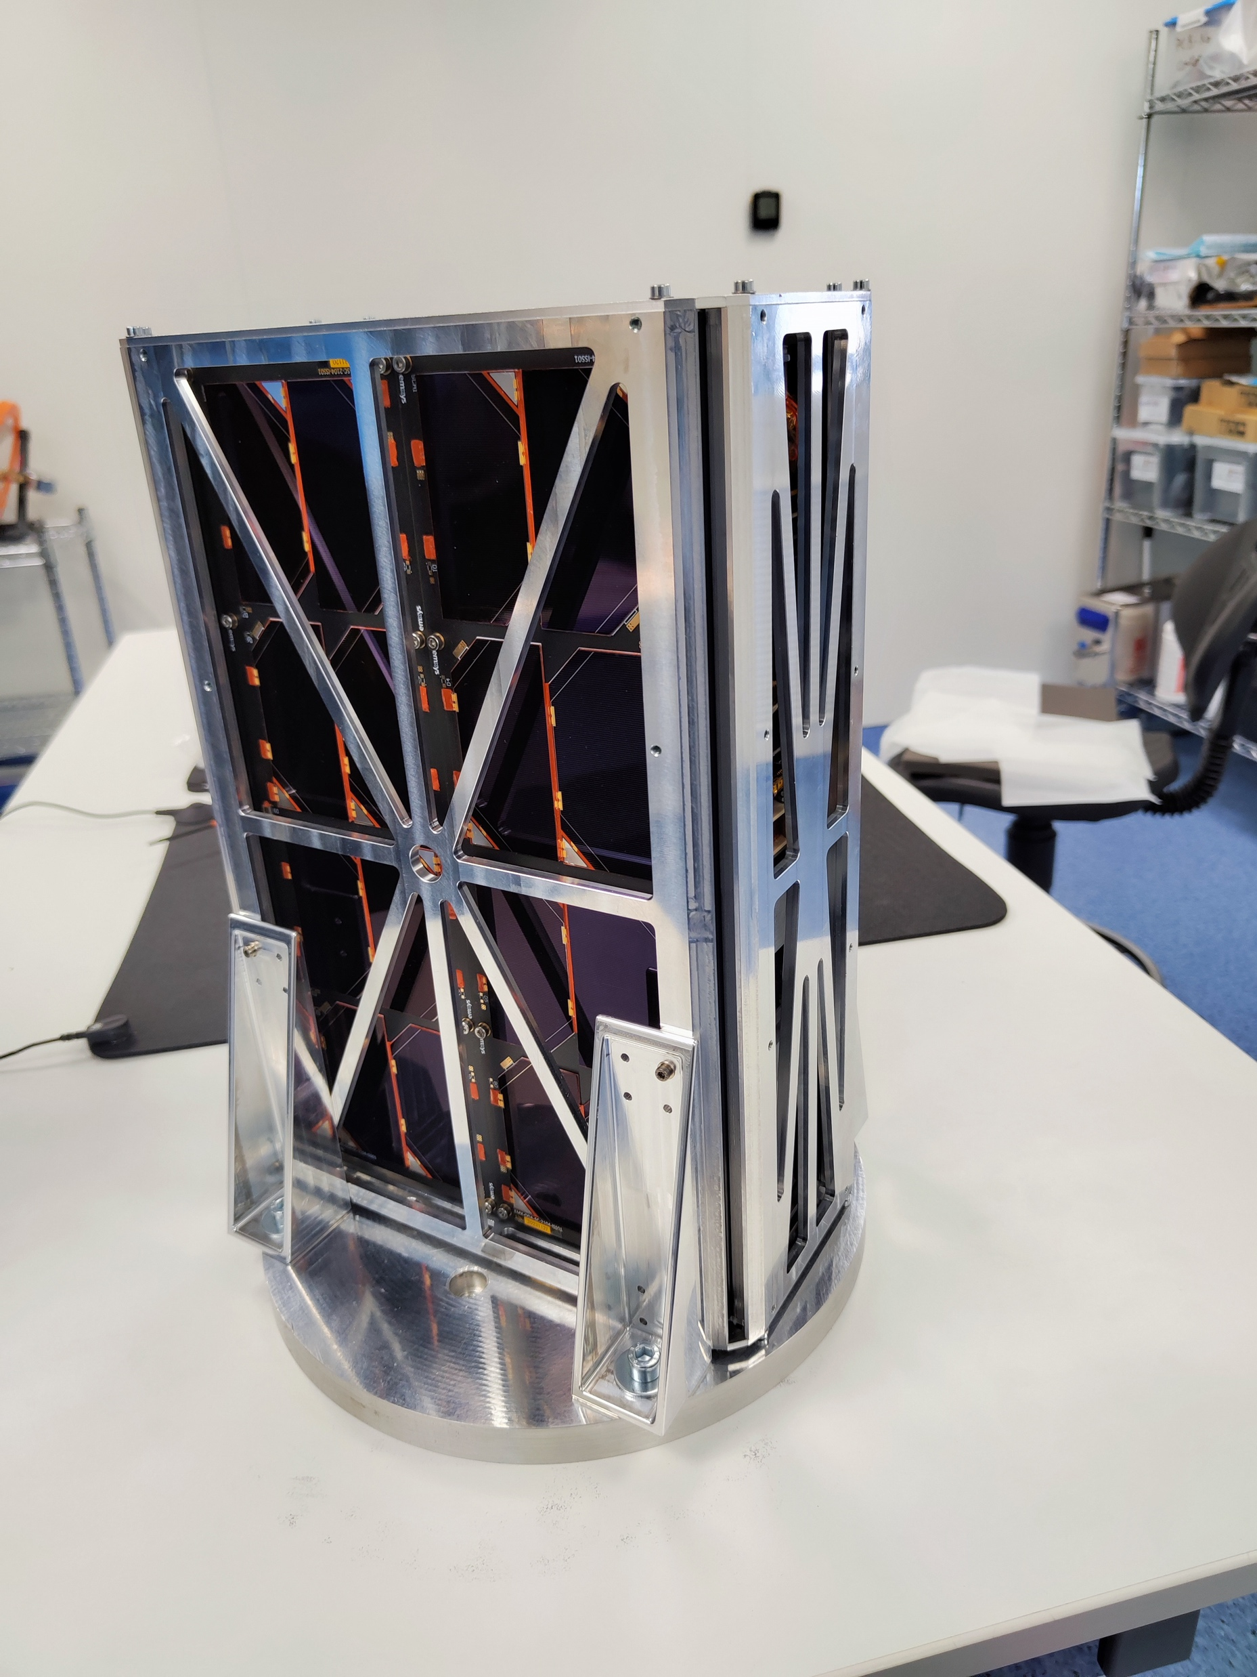
PCDU Validation - Vibration Tests
PASSED
The ASFAE’s research projects acknowledge the financial support from the MCIU with funding from the European Union NextGenerationEU and Generalitat Valenciana.

Slide 23
Conclusions
6U Modular/Scalable HiRel PCDU ready – TRL 6
Technology ready for integration in future space missions.
Validated advanced “Careful COTS” and “New Space” methodologies for power conversion and distribution.
Consolidated a technological capability in high-reliability satellite power systems within the Valencian Community.
Research group specialized in power systems for space applications.
Facilities and Know-How for Space Power Electronics.
The ASFAE’s research projects acknowledge the financial support from the MCIU with funding from the European Union NextGenerationEU and Generalitat Valenciana.

Slide 24
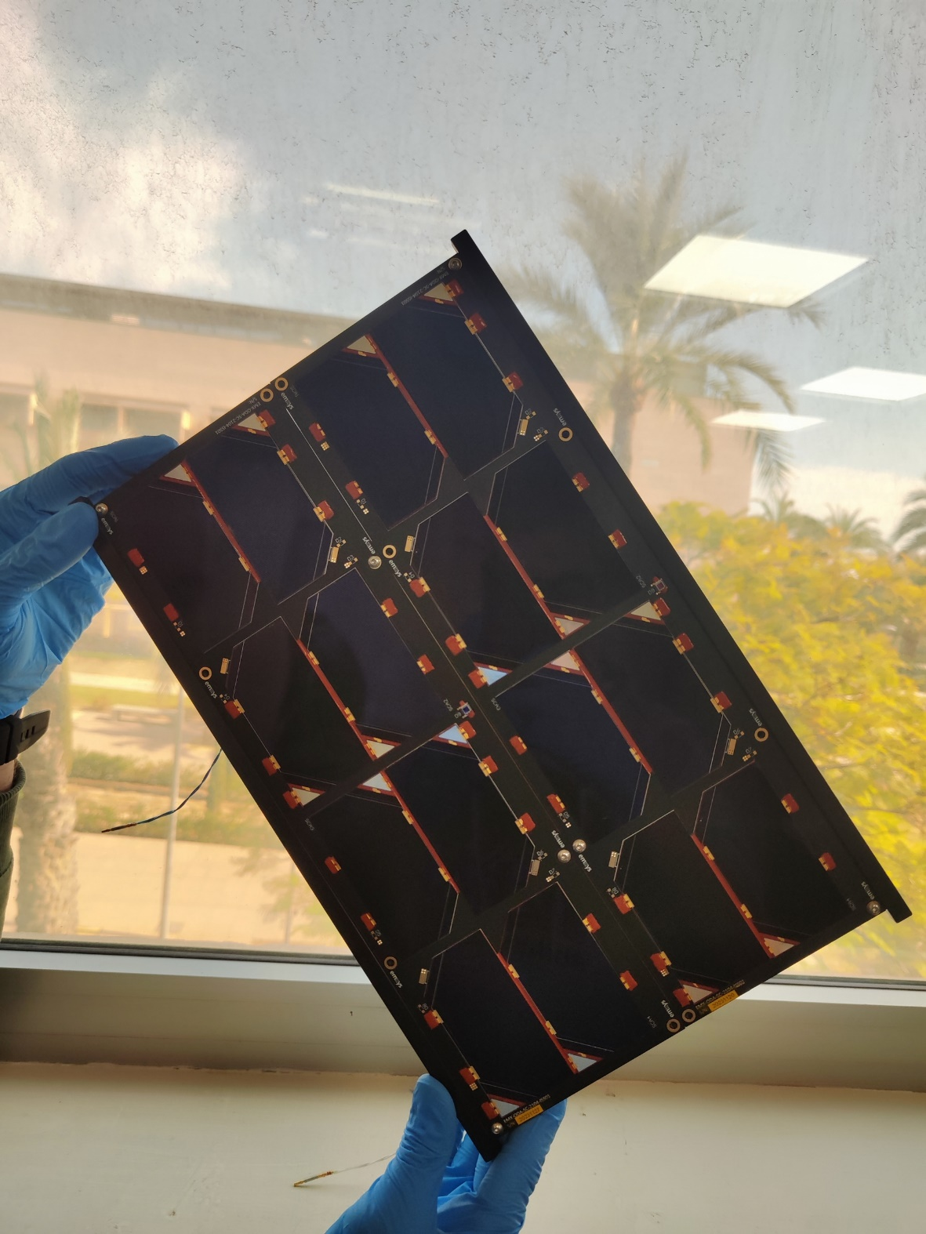
Deep Space Microsatellite Power System Development
ASFAE/2022/021
José Manuel Blanes Martínez
Space Power and Electronics System Group
Universidad Miguel Hernández de Elche
SPES
Reunión Final del Plan Complementario de Astrofísica y Altas Energías
Noviembre 2025, Santander

Slide 25
Backup Slides – ASFAE 2022/21 Results
1 Post-Doctoral researcher hired
1 Pre-Doctoral researcher hired
1 PhD Thesis on-going
5 Papers in indexed Journals
7 Conferences Proceedings
1 Private company collaboration
Consolidated a technological capability in high-reliability satellite power systems within the Valencian Community.
The ASFAE’s research projects acknowledge the financial support from the MCIU with funding from the European Union NextGenerationEU and Generalitat Valenciana.

