Slide 1
A novel Scintillator Tracker for the HK ND280++ Upgrade
Thorsten Lux

Slide 2

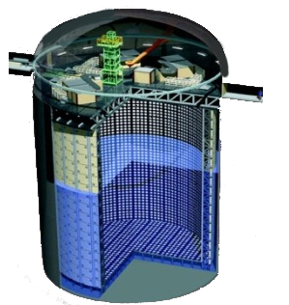
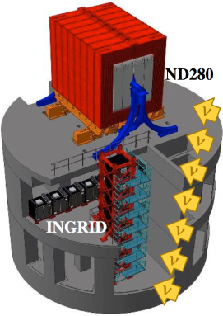
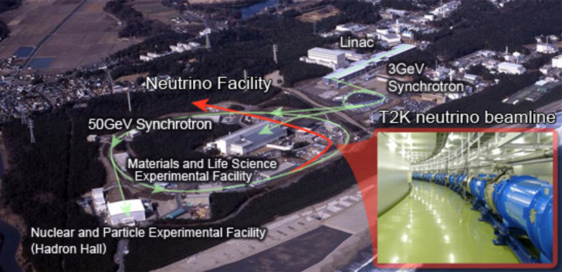
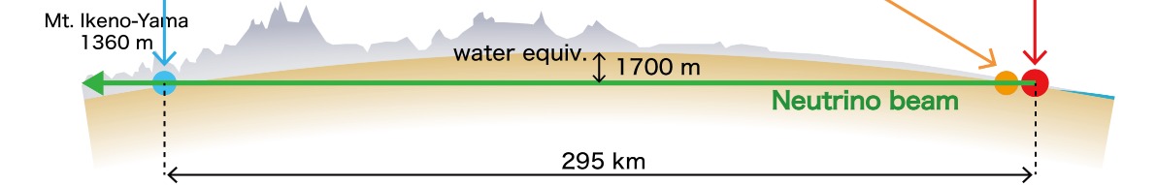
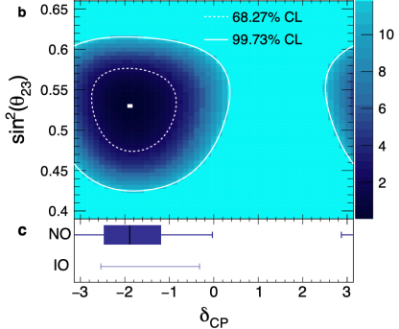
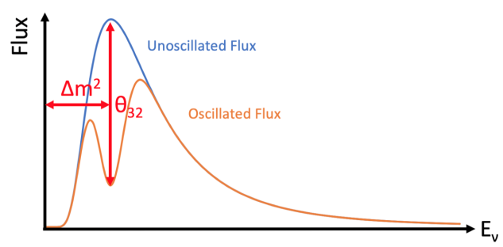
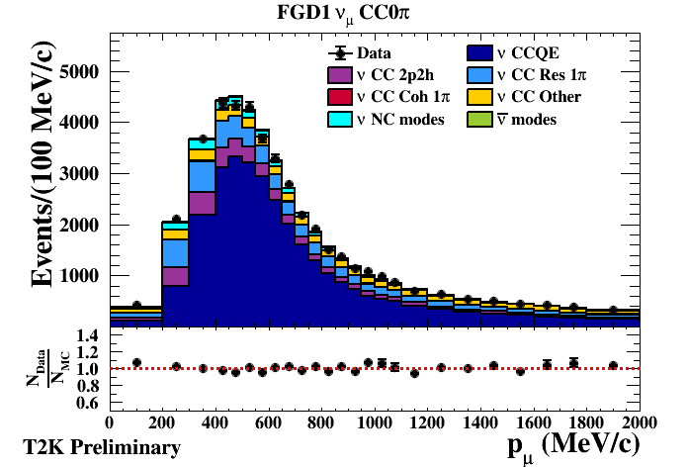
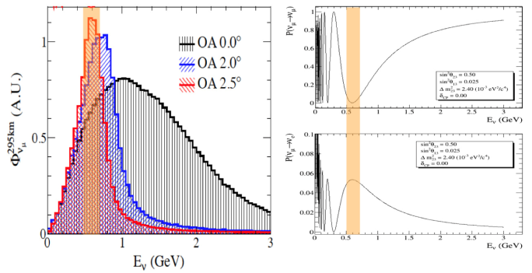




The Tokai-to-Kamioka ( ) experiment
Far detector
Super Kamiokande
Near detector
complex
J-Parc
Neutrino Beam
@SK
@ND280
@J-PARC
Measure oscillated beam
Characterize beam and $ν$ interactions
Create Neutrino’s off-axis beam
$ν_{μ}$ or ${\overline{ν}}_{μ}$
$ν_{μ}$ $→$ $ν_{μ}$
$ν_{μ}$ $→$ $ν_{e}$

Slide 3
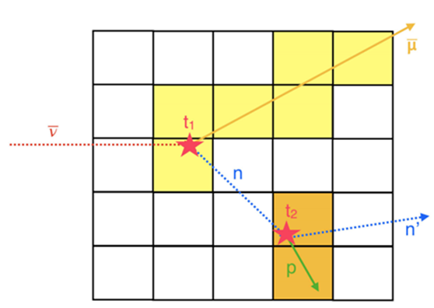
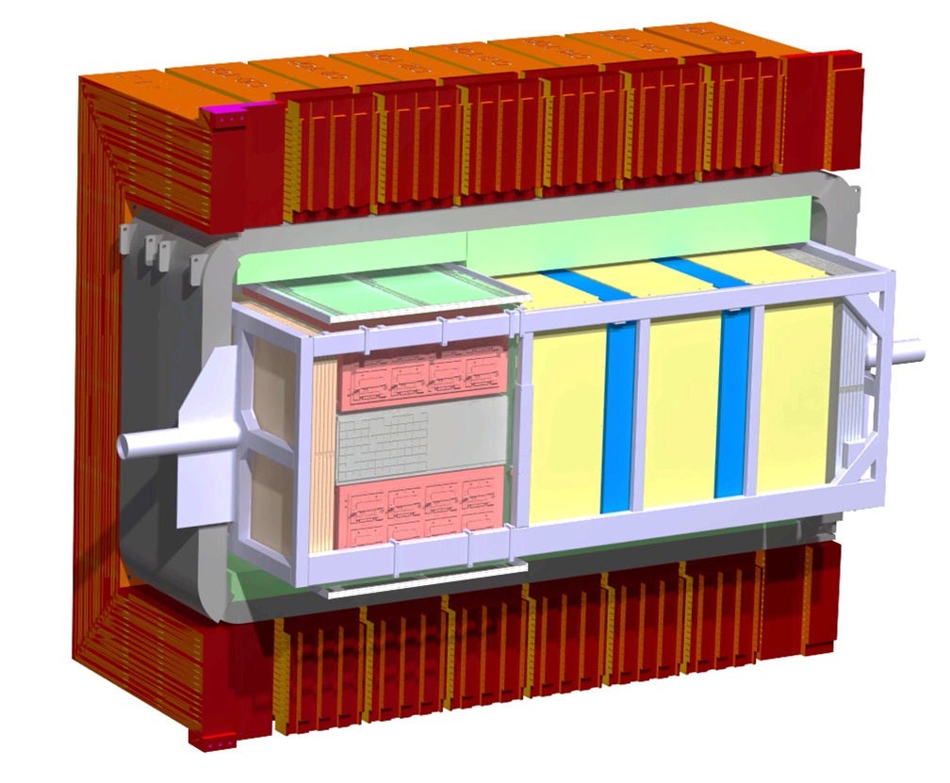
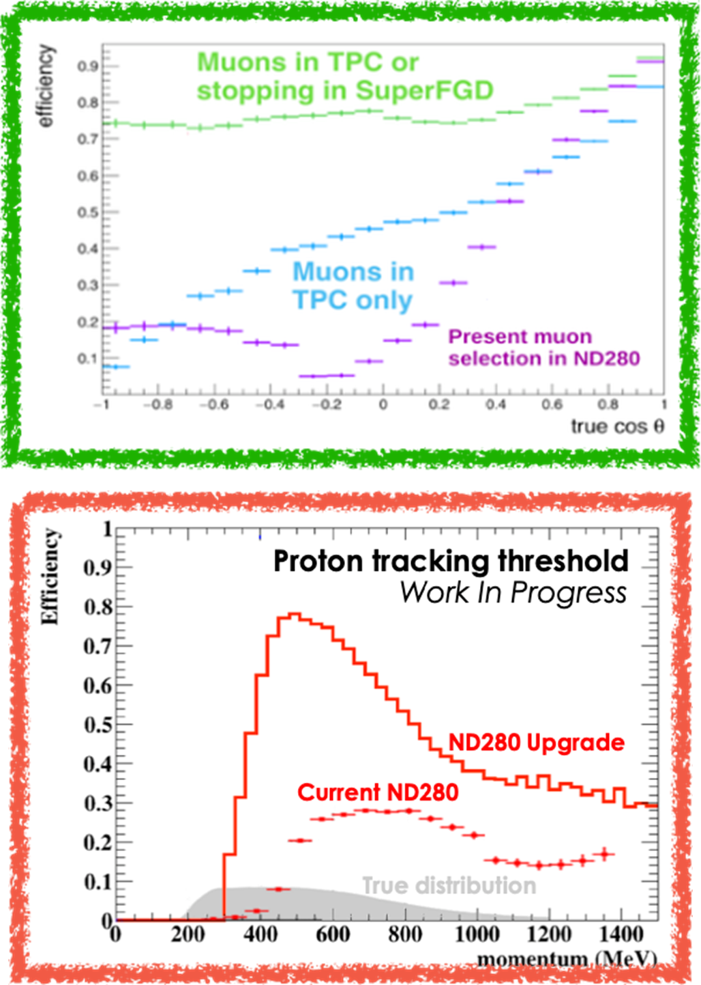
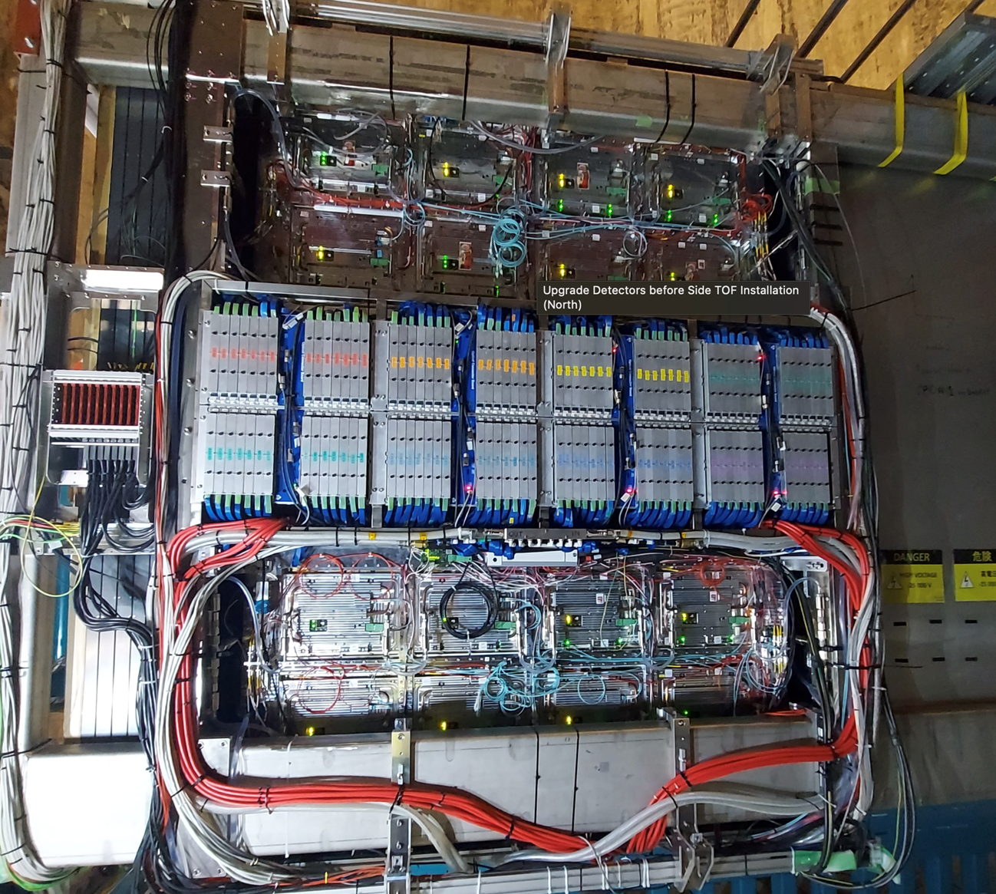
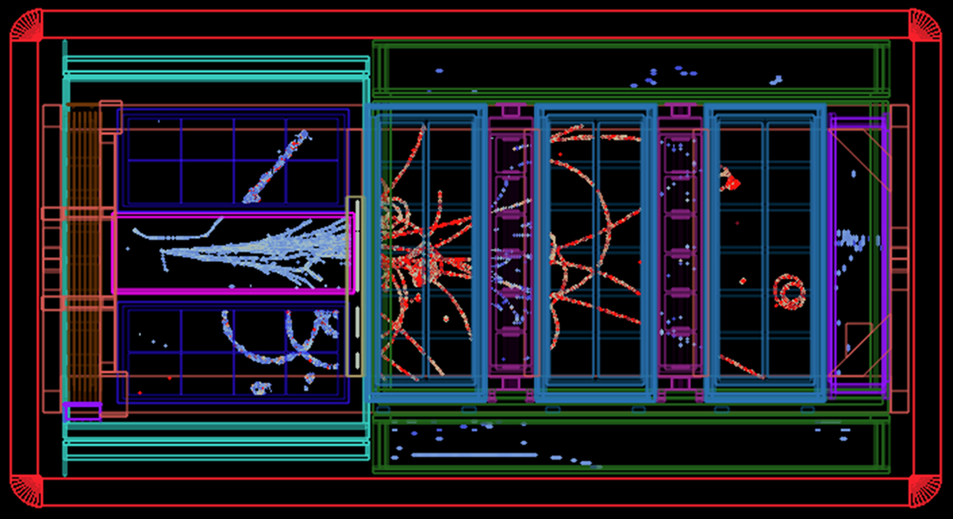
Upgraded ND280
Upgraded ND280 (2017-2024)
ND280 is the near detector of T2K
Recently underwent upgrade to improve some features
Now how detection efficiency in 4pi
Much lower detection threshold and higher efficiency
Added capability to detect neutrons
Installation completed in May 2024 and taking neutrino data since then
Installation completed May 2024
Notes:
-) Considerations started in 2016 to upgrade ND280 for T2K run before HK
-) And to use upgraded ND280 later for HK
-) More than 120 persons from 30 institutions from 11 countries, including CERN involved
-) Replace POD by some novel detectors
-) Installation completed in May 2024 and operation started very smoothly
-) not a typical event but very nice to show how new and old detectors work together
-) Taking beam data since then and work on analysis has started

Slide 4
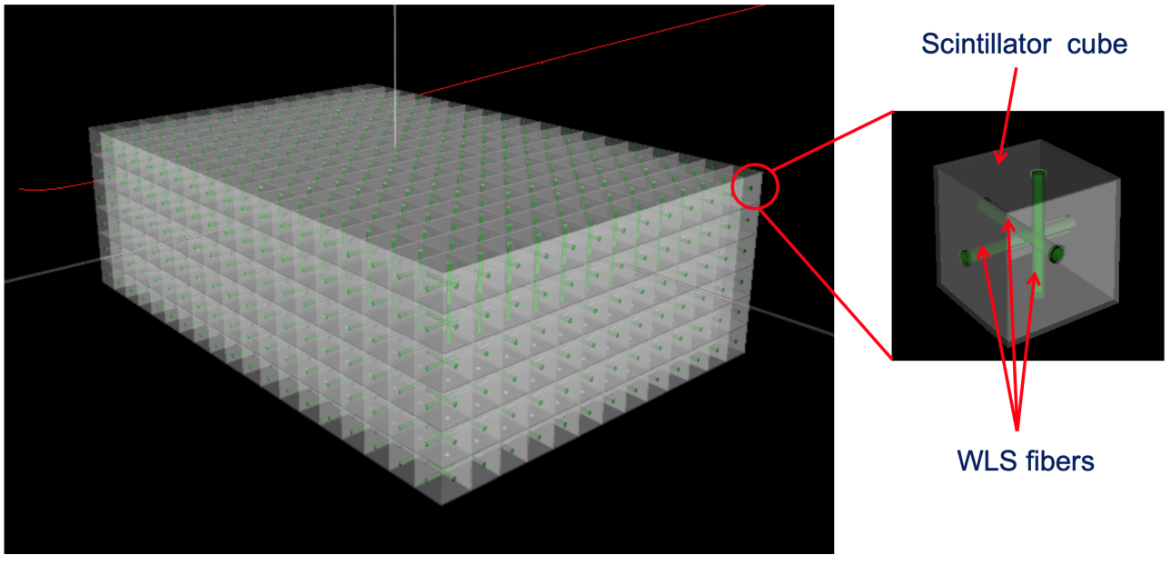
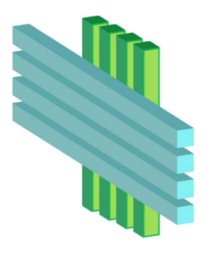
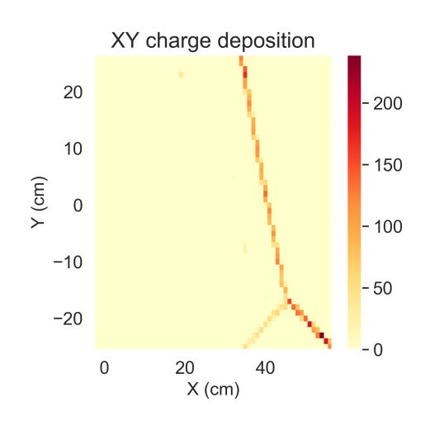
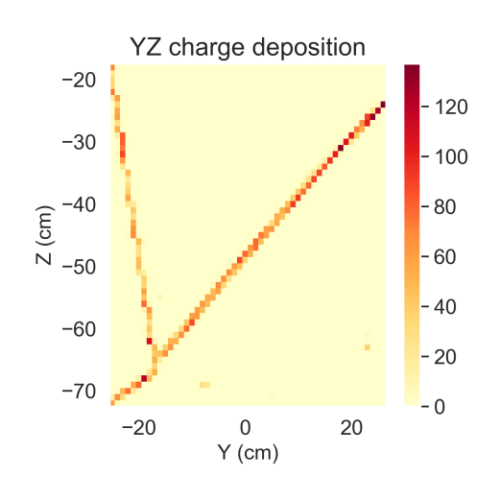
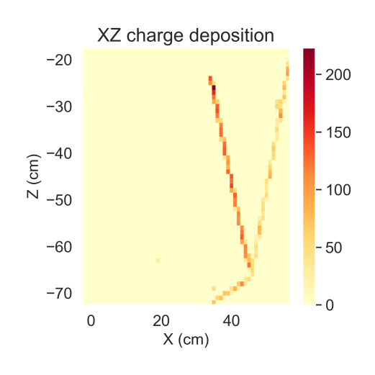
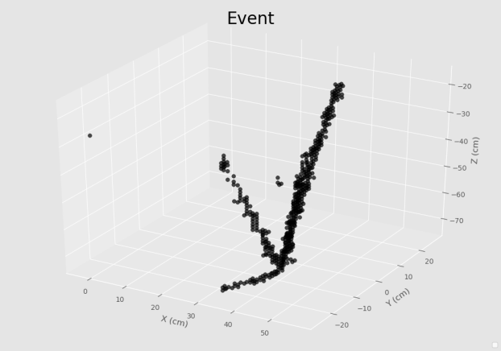
A new scintillator tracker concept (SuperFGD)
To improve the granularity the new active target will be a novel 3D tracking technology
Testbeam event
SuperFGD concept
FGD concept
1cm³
182 cm
192cm
56cm
JINST 13, P02006 (2018)

Slide 5
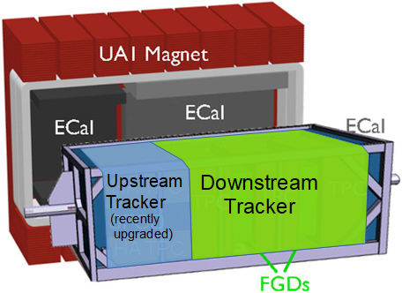
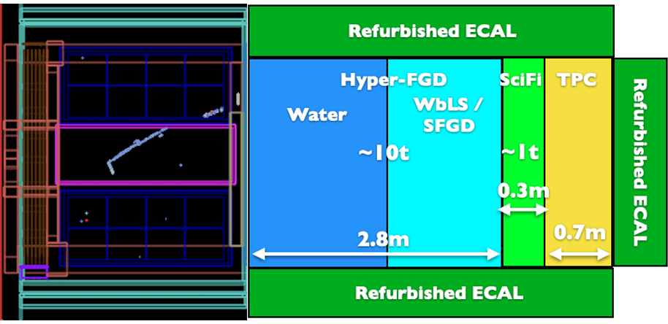
HK ND280++
While T2K data taking will end beginning of 2028
But ND280 will live on as part of Hyper-Kamiokande (HK)
We will start with “T2K ND280” but studies towards new upgrade, ND280++, have started
Motivation:
Measure σ(νe)/ σ(νe)
High detection efficiency for neutrons with TOF
Lower detection threshold with high efficiency
=> We need multi-tonne detectors with high granularity!
-
Upgraded ND280
ND280++ (under study)

Slide 6
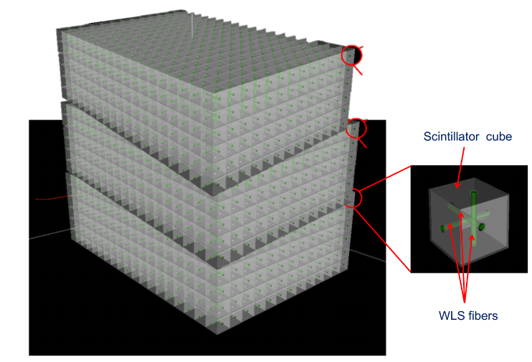
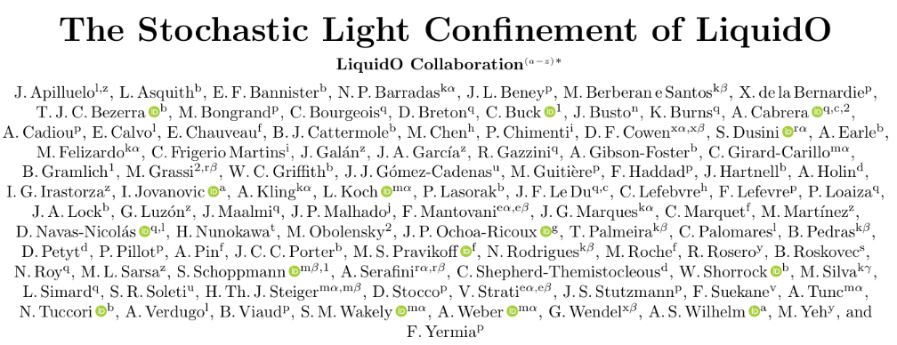
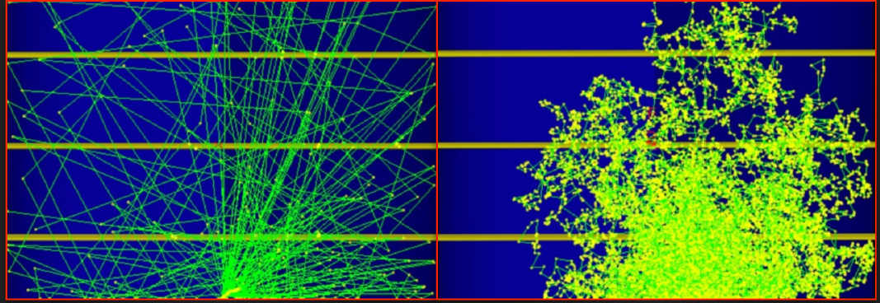
Why not simply scaling up SFGD?
You do not want to handle 10M 1x1x1 cm3 and drill 30M holes!
Segmentation is the problem, so let us get rid of it!
But then we lose a lot of photons …
Let us use opaque scintillator => stochastic confinement of the photons!
=> LiquidO Concept (https://liquido.ijclab.in2p3.fr/)
Transparent medium
Opaque medium
Experimentally proven!
https://arxiv.org/abs/2503.02541

Slide 7
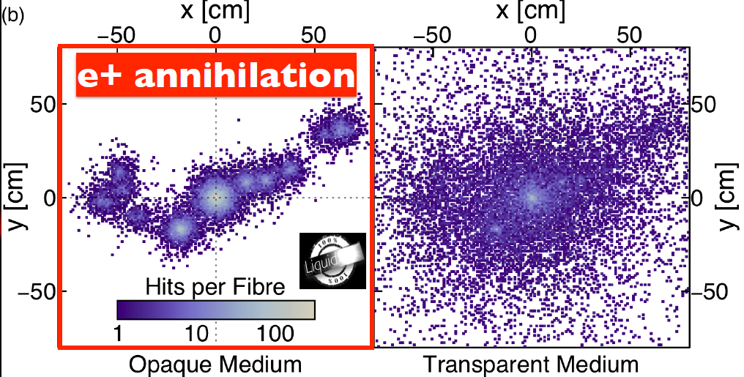
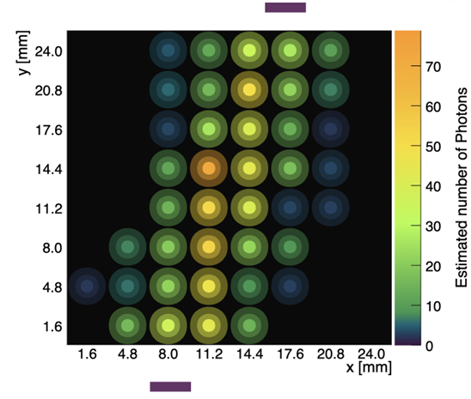
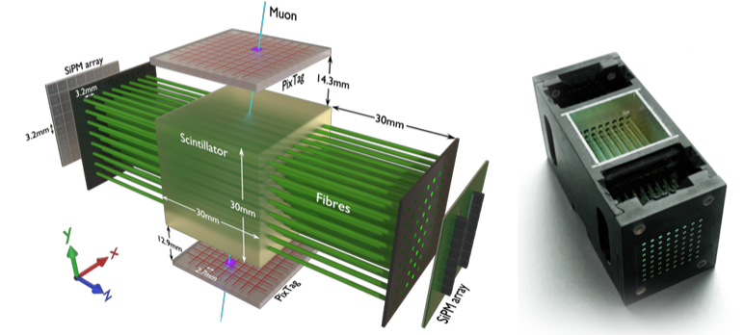
LiquidO
Confinement of light reveals event structure
2 key parameters:
Absorption length: several metres => more light
Scatter length: few mm (ideal seems to be 1/30 of fibre pitch) => defines size of structures to be reconstructed
Group from Univ. Sussex built first prototype
Demonstrating tracking capabilities using muons
https://arxiv.org/abs/2507.13864

Slide 8
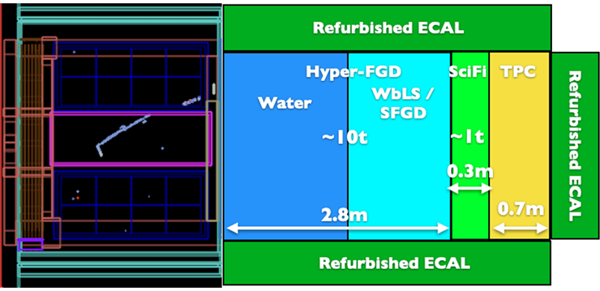
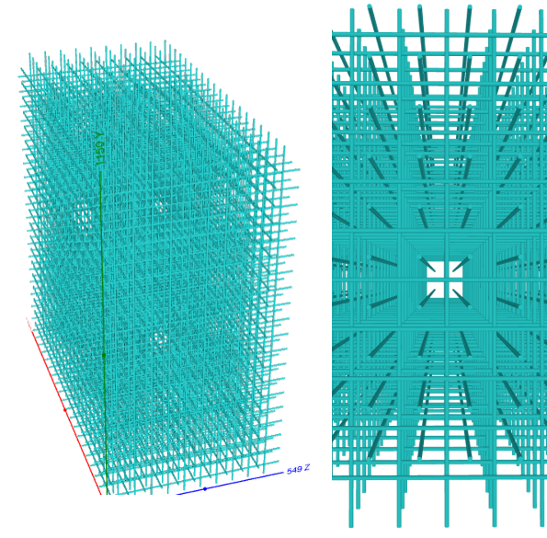
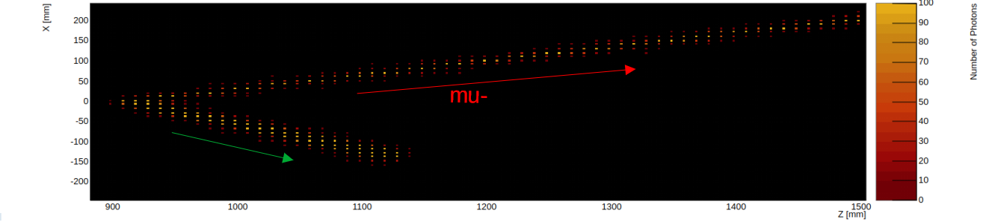
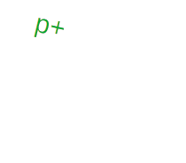
LiquidO-FGD (LFGD) in ND280++
Simulate ND280++ geometry (using the official ND280 software)
1 cm pitch between 1mm fibres (as SFGD)
Scintillator: 1 mm scatter, 5 m absorption
Fibre attenuation + photon detection efficiency included but not electronics
Simulate particle gun and neutrino MC events
Simulating 1 event takes 1.5 hours => not the best for statistical analysis ….

Slide 9
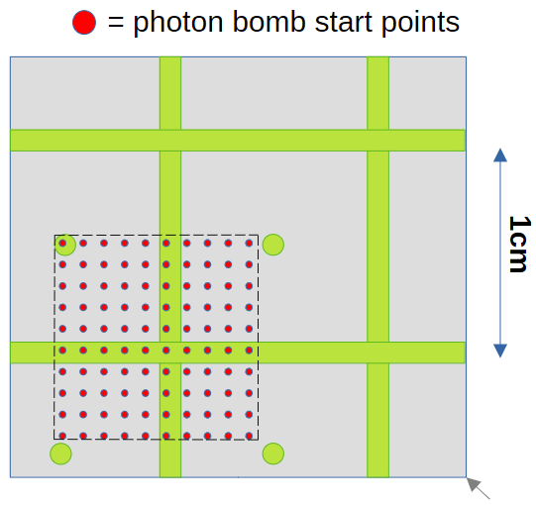
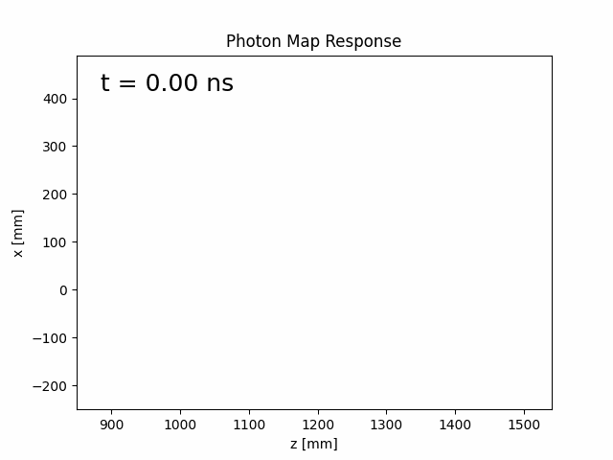
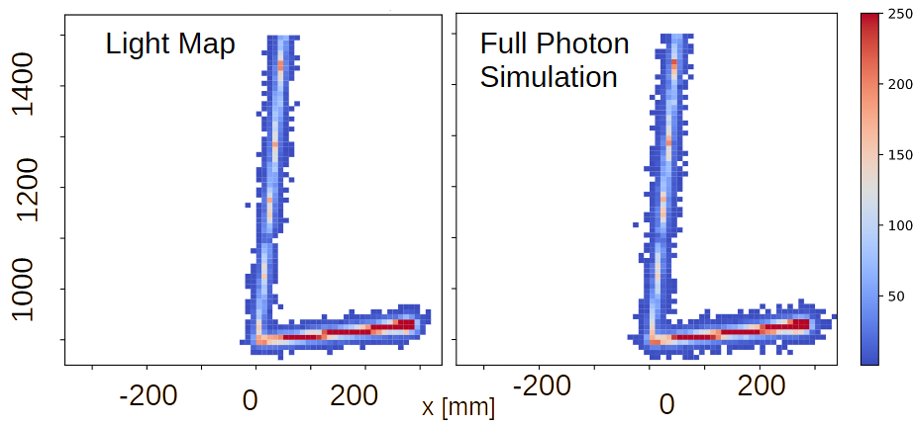
Light Map
Introduced light map approach
Simulate 1000 photo bombs in base cell (1x1x1 cm3)
Measure fraction of photons recorded at each fibre
Create look up table and include in simulations
1.5 h/event => ~0.1 s/event (5000 in 10 min)
Time now also included

Slide 10
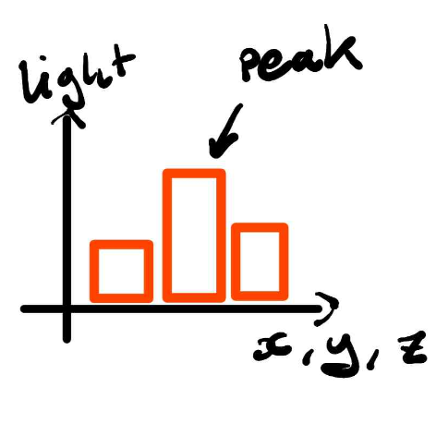
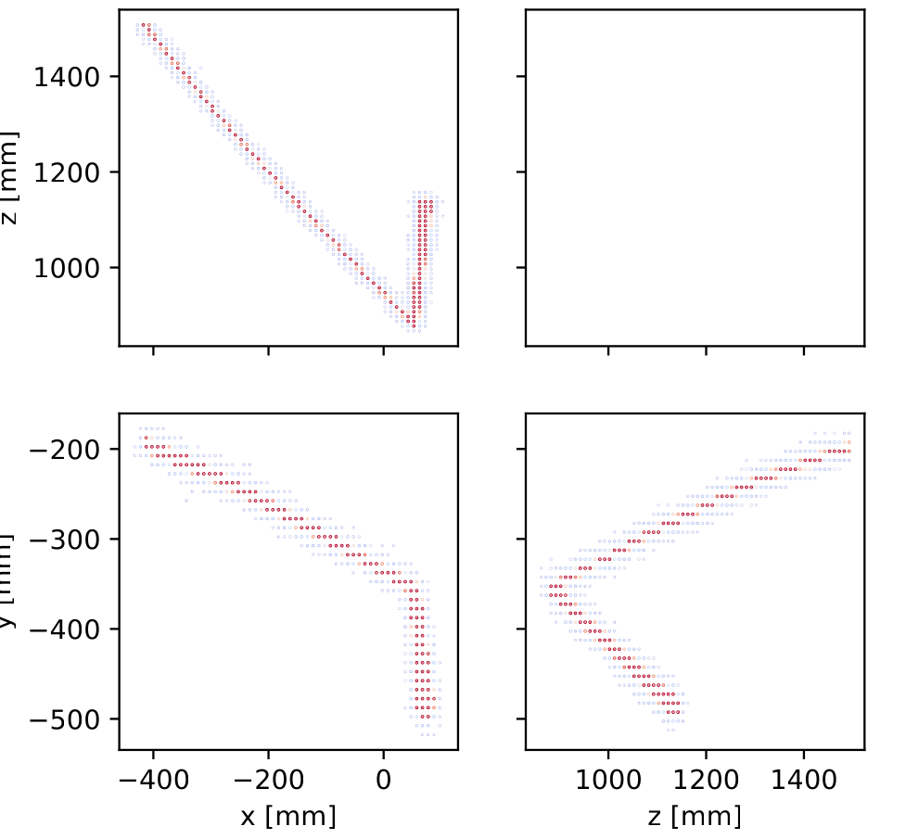
Reconstruction
Now able to generate large number of events
Particle gun and NEUT MC
But we need to develop a new reconstruction algorithm
SFGD: signal in 1 fibre vs LFGD: light spread over few fibres
LFGD much better point resolution thanks to this feature (< pitch/sqrt(12))
Simple peak finder approach currently: use weighted average of 3 nearest neighbours
Potential improvement: use “light response funtion” similar to “pad response function” in TPCs

Slide 11
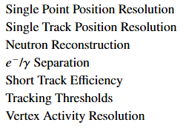
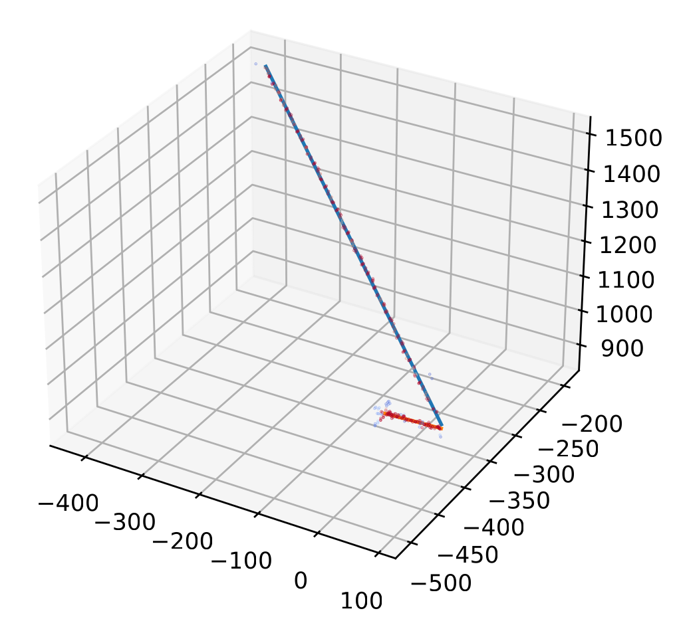
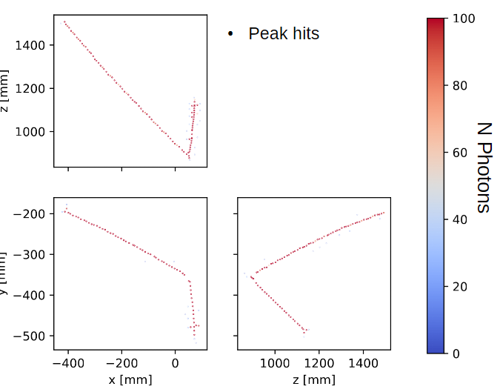
Reconstruction
Peak finder provides hit position per row
Reconstruct from three 2D points, one 3D point
Fit line/helix to 3D points
Start to analyse => we are here!
With reconstruction ready, we can use ND280 software analysis tools

Slide 12
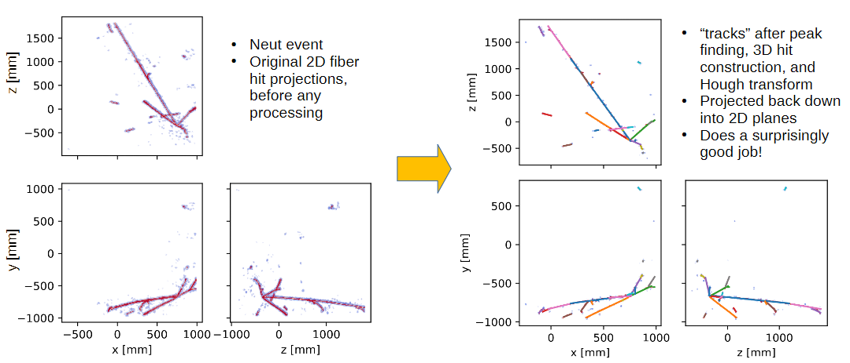
NEUT MC Event

Slide 13
Summary
The T2K ND280 detector was successfully upgraded and will be used for HK
It will help to reduce the systematic uncertainties for deltaCP measurements
An additional upgrade, ND280++, is under consideration
Aim will be larger target masses and fine(r) granularity
LiquidO-concept is an interesting option as active target (LFGD)
LFGD simulation was implemented and reconstruction algorithm developed
In process to start statistical analysis but until now promising results
Looking for funds to build small prototype (8x8x8 fibres)

Slide 14
Backup Slides

Slide 15
Summary
Funds received: 150.000 Euro including overheads for personnel
Personnel hired:
PhD Student
PostDoc
Objective: Feasibility study of a novel scintillator tracker
Results:
Detector simulated
Optimization of MC simulation performed
Basic event reconstruction developed
Full integration in ND280 software including physics analysis tools
Ongoing: Physics studies using neutrino MC
Publication should be ready by mid 2026

