Slide 1
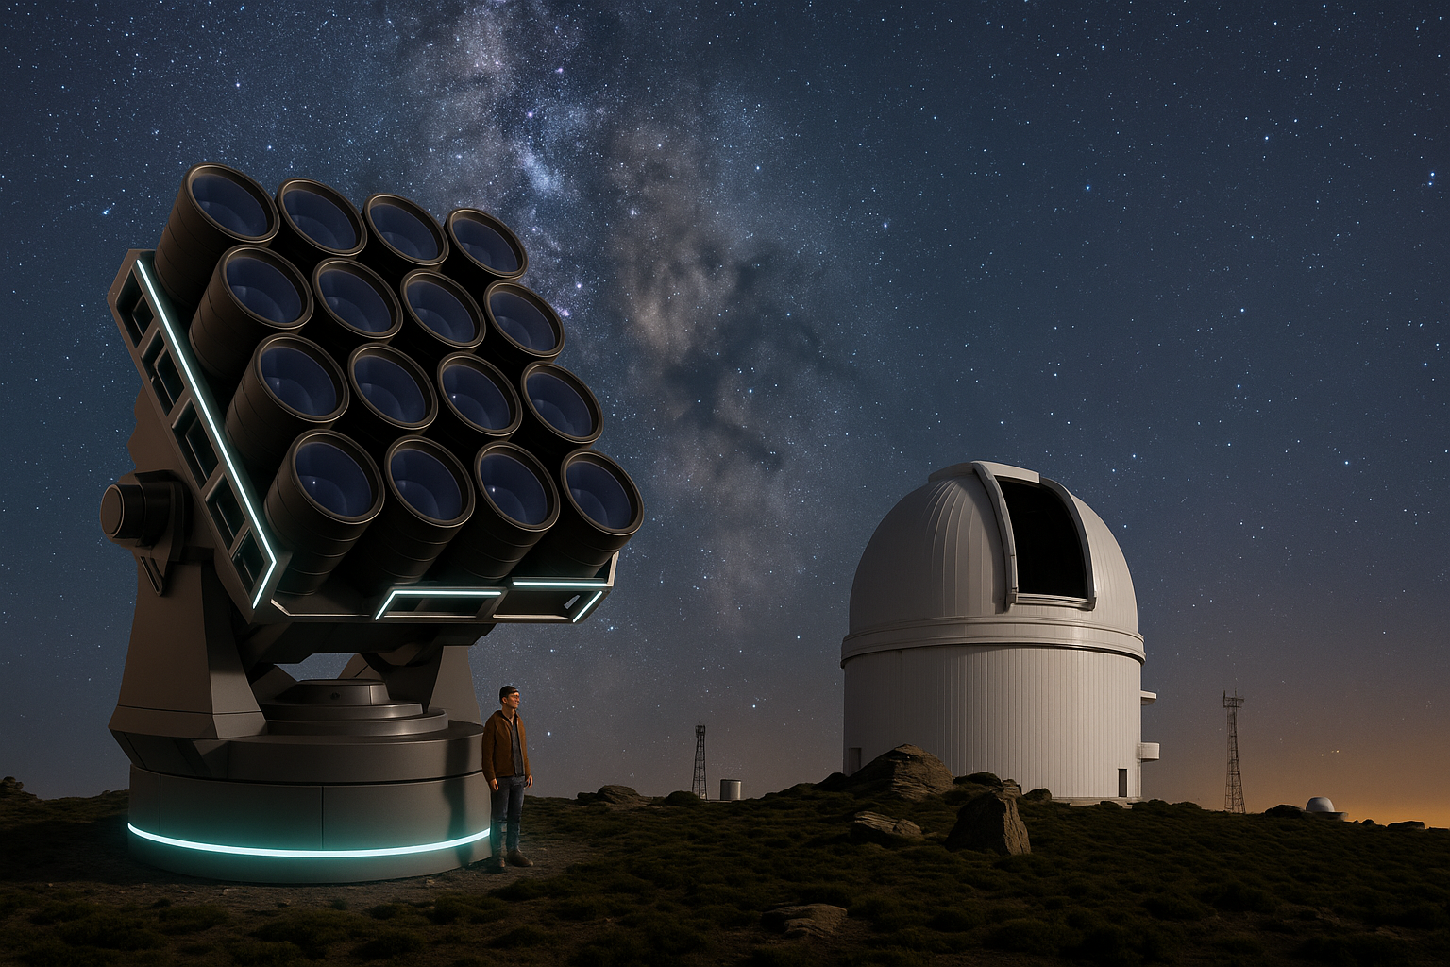





European Multiarray of Combined Telescopes. E-MARCOT
Conceptual design of E-MARCOT. AI generated.
Jesús Aceituno (CAHA), Pedro Amado, Marina Centenera IAA-CSIC, Santander, Nov 26, 2025.

Slide 2


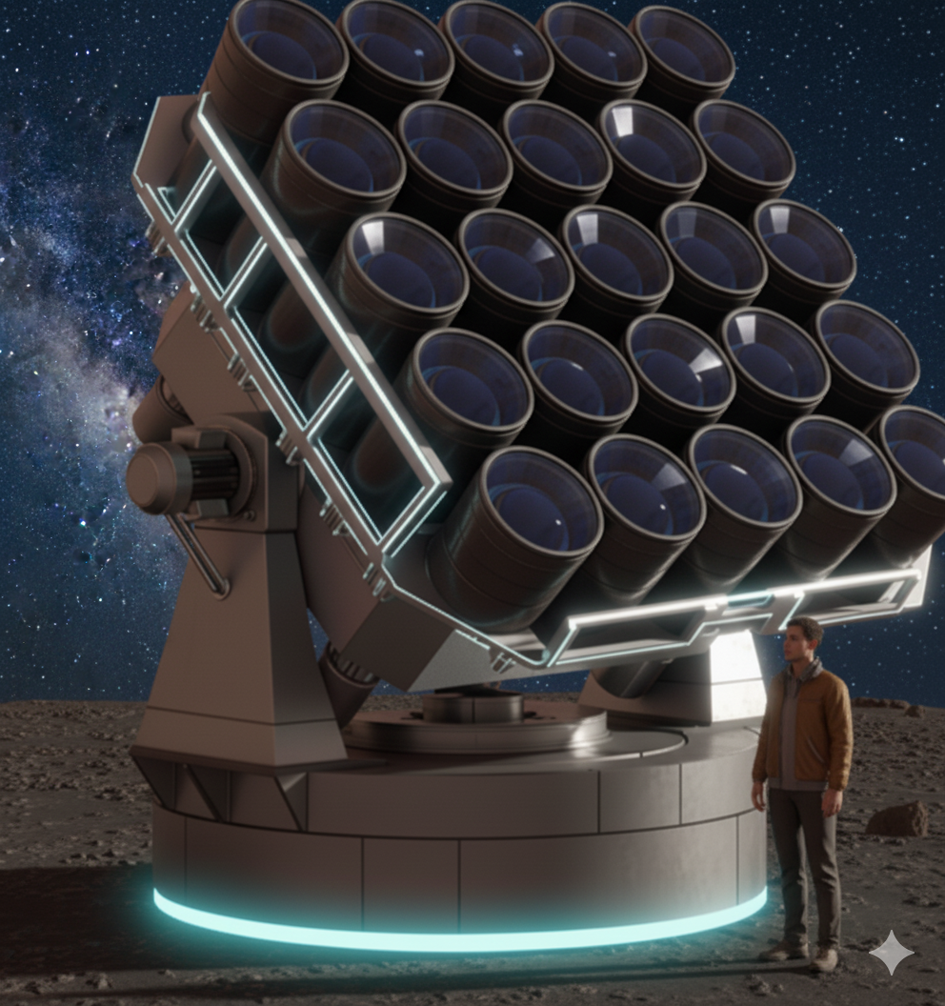
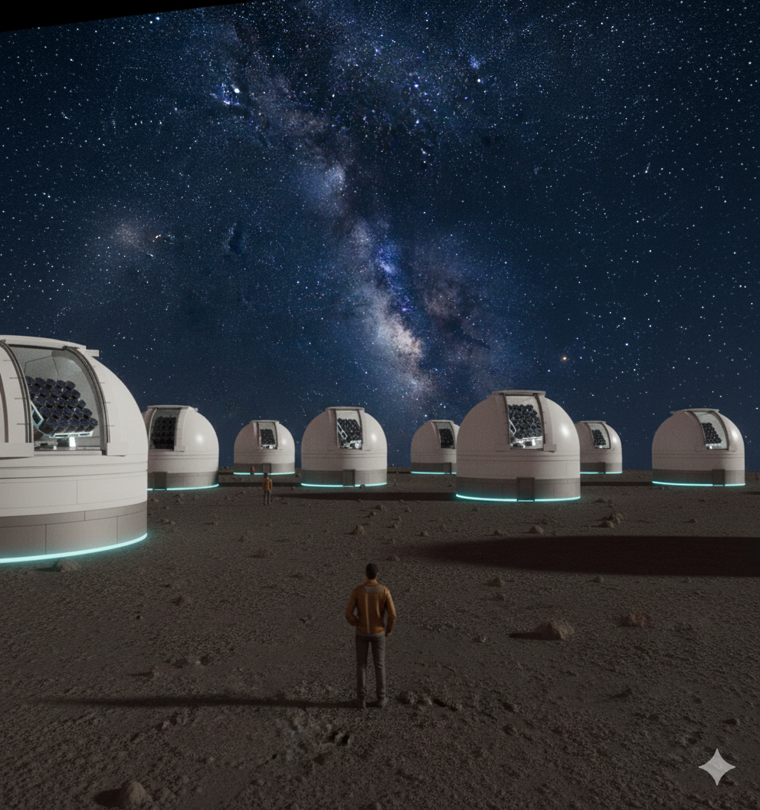
E-MARCOT: The Concept
Main aim: Create the conceptual design and roadmap for building a next-generation European telescope with a large effective aperture.
Combination of multiple identical optical elements (OTA) resulting in a new infrastructure facility with a large effective aperture.
  Spectroscopic mode. The photons are collected by individual optical fibers attached to each OTA, which are finally combined by a novel multimode photonic lantern into a single fiber, which feeds a high-resolution spectrograph.
  Imaging mode. Each OTA is equipped with an acquisition and guiding system. (reprojecting & stacking pipelines).
Advantages:
large field of view and high dynamic range imaging
sub-arcsec spatial resolution
Hig res spec mode MM-PL
Low cost (ongoing study of cost/size/#OTAs)
Modular and scalable
Image: J. Flores

Slide 3
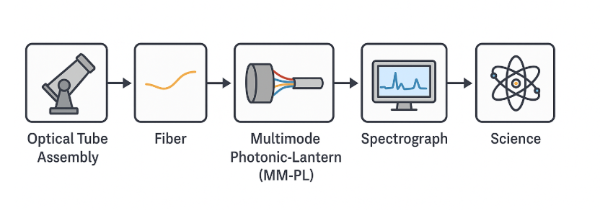
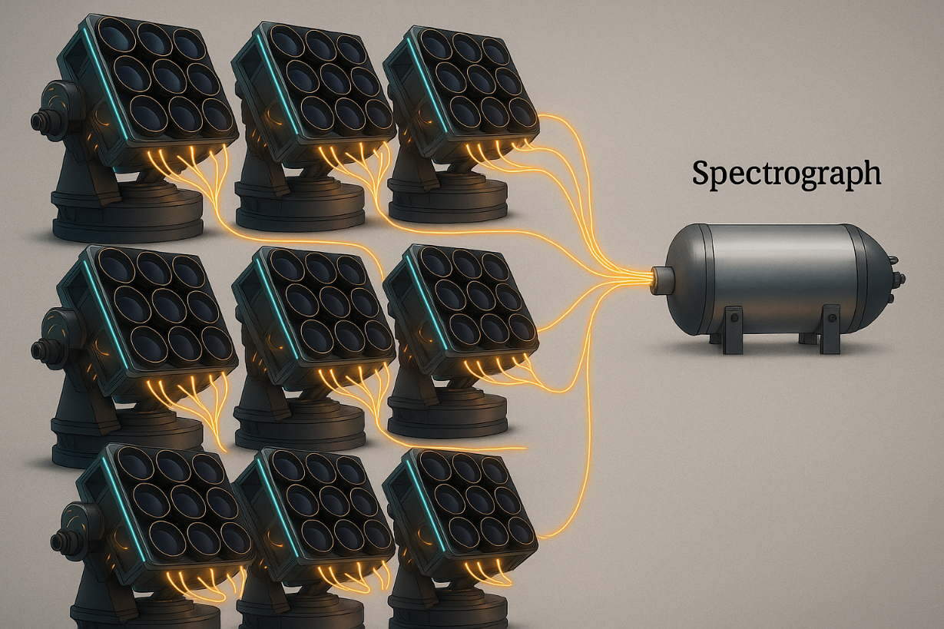
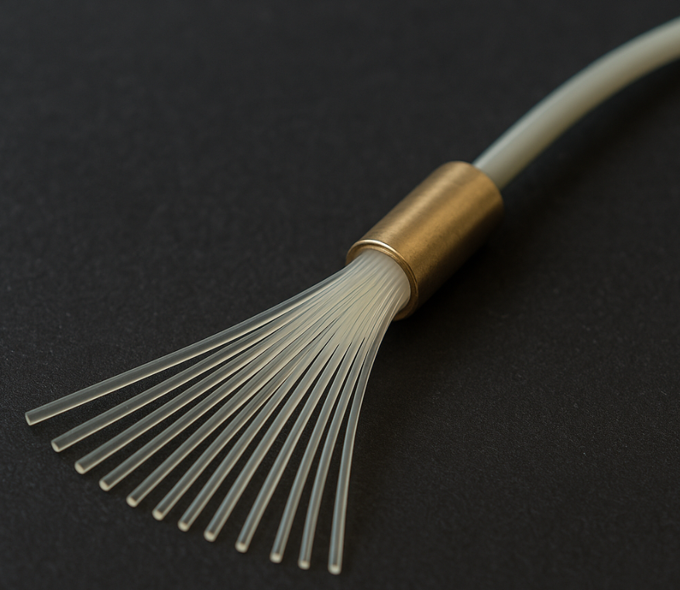
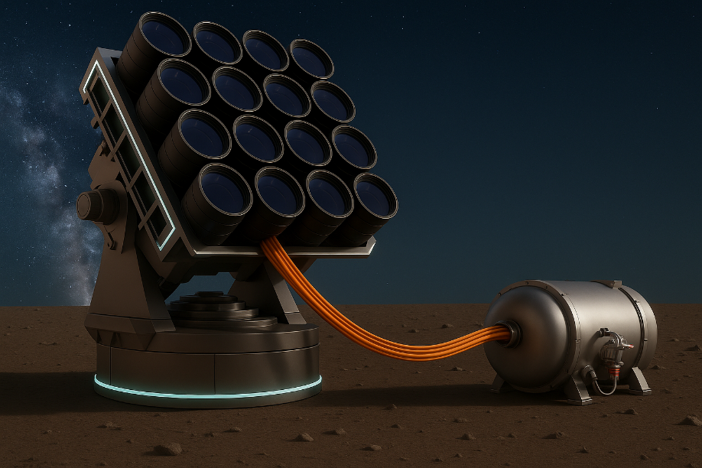
2. MARCOT Concept
The light collected by the modules through the individual optical fiber feed of each OTA is optically injected into a novel multi-mode photonic lantern (MM-PL), which can either directly feed the astronomical instrument attached to the telescope or, feed a second stage MM-PL that can combine the light from a cascade of several MARCOT modules.
Photonic lantern
EMARCOT-5m. 1 module of 5m plugged to a CARMENES
spec. AI generated.
EMARCOT-15m. 9 modules of 5m equivalent to 15m, plugged to a
CARMENES-like spec. AI generated.

Slide 4



Why E-MARCOT? The Case for a New Generation of Telescopes
A scalable path to precision astronomy, beyond the limits of monolithic designs.
The Challenge
  Large telescopes are reaching practical and financial limits.
  High-precision spectroscopy demands stability and distributed architectures.
  Exoplanet characterization needs long-term observations and dedicated facilities.
The Opportunity
  Modern photonics and control systems now allow for modular arrays.
  Multi-aperture designs offer high étendue at a fraction of the cost.
  Flexible platforms for both imaging and spectroscopy, adaptable to evolving science goals.
The E-MARCOT Vision
  From a telescope… to a network of light collectors.
  Light from multiple telescopes is efficiently combined using multimode photonic lanterns, producing a stable, integrated input for high-resolution spectroscopy.
  MARCOT is a strategic development for the Calar Alto Observatory, leveraging existing infrastructure to implement a next-generation modular and scalable astronomical platform..

Slide 5
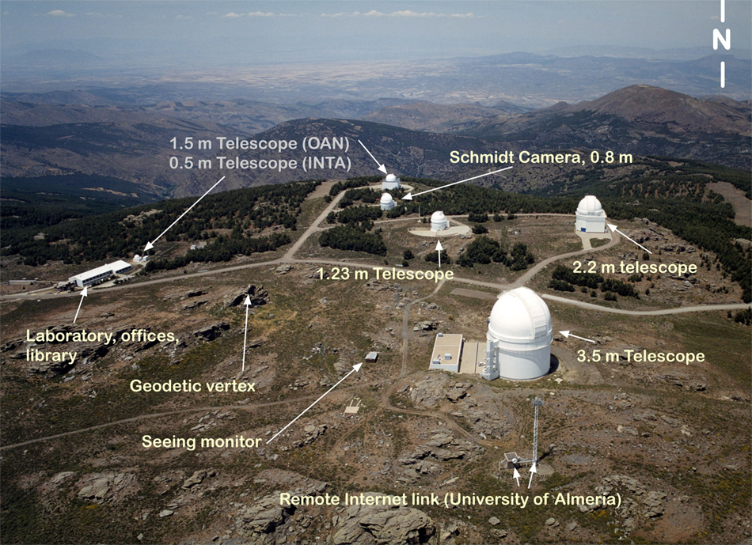
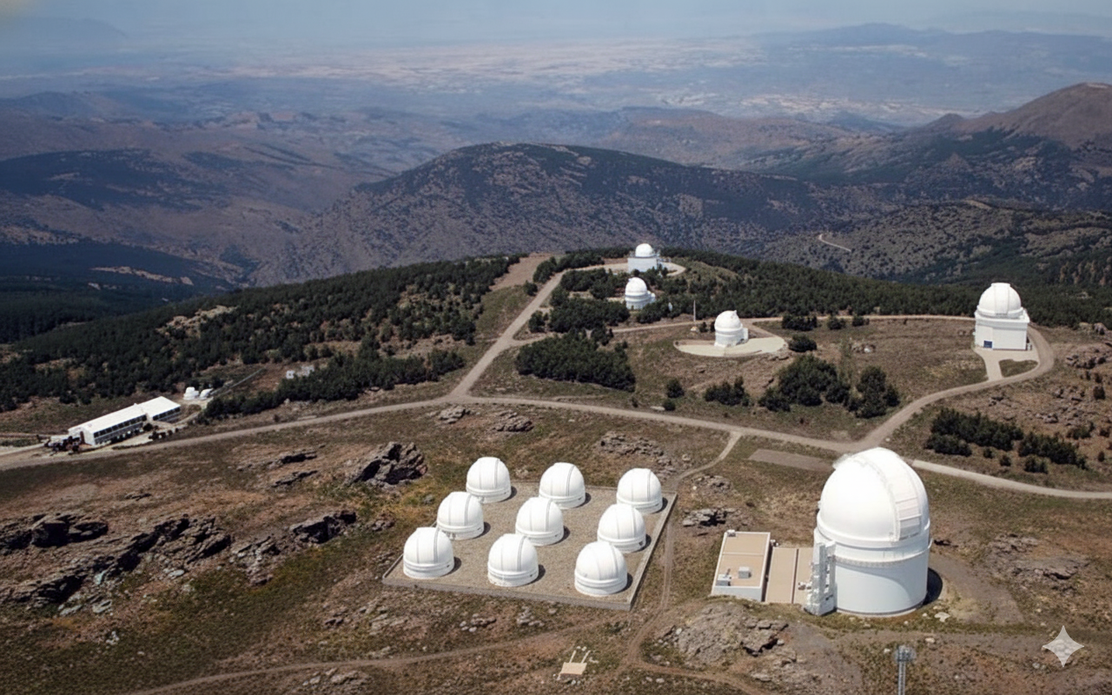
Where?... In Calar Alto Observatory
CAHA. Joint venture CSIC-Junta de Andalucía. Institutional stability.
Existing observatory platform and infrastructure in operation for 50+ years.
  Very effective observatory =>130pp/years and less 4millons of yearly budget.
  Well trained staff, less than 3% of technical time lost.
Legacy and continuity of MARCOT Pathfinder
Suitable site conditions (seeing, darkness, extinction)
A lot of available space for new developments in a mainland platform.
Expertise in high-resolution spectroscopy (e.g., CARMENES)

Slide 6
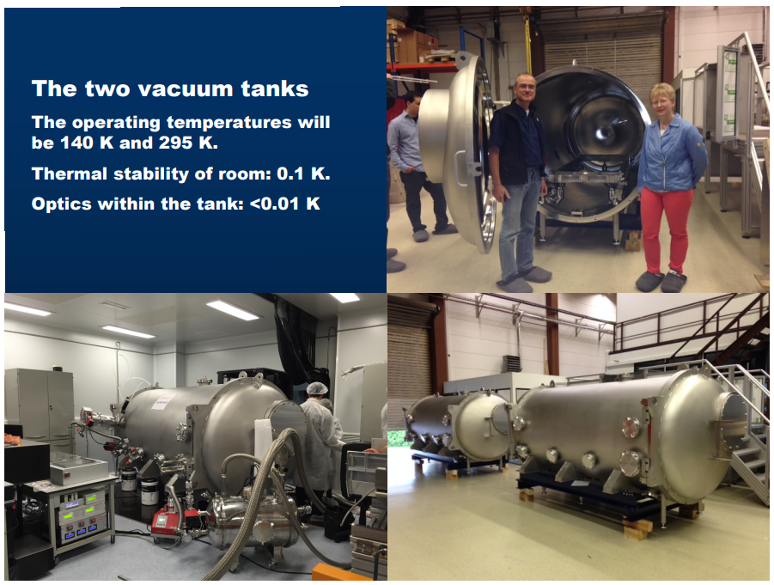
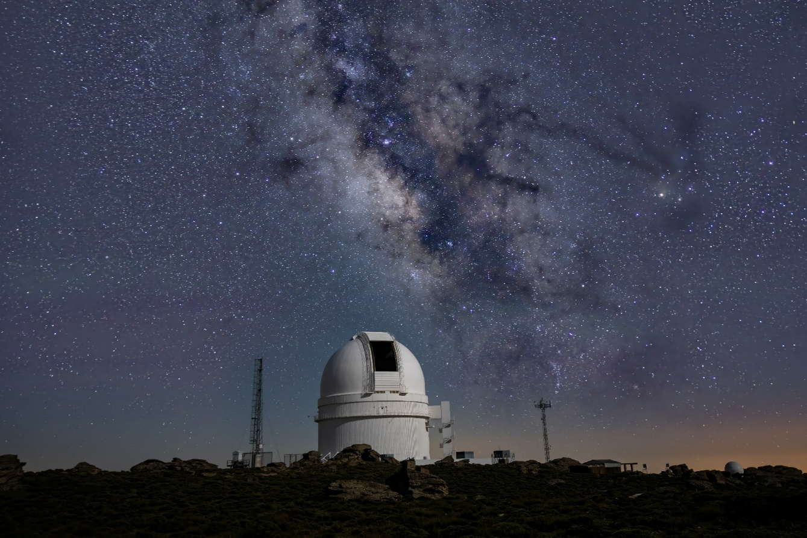
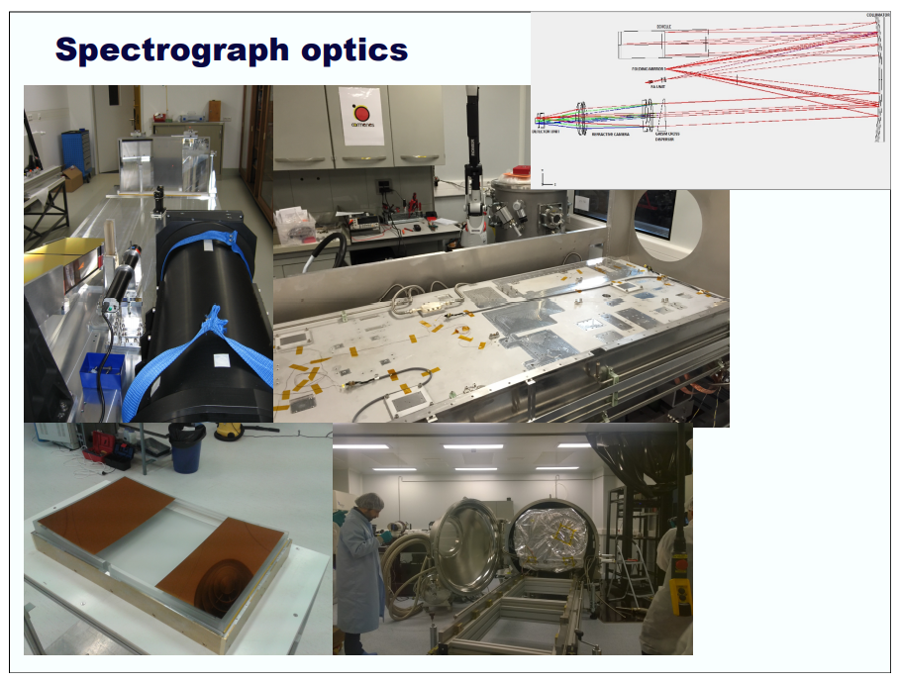

CARMENES
https://carmenes.caha.es/

Slide 7
E-MARCOT: Science Case & Motivation
CARMENES Science Case:
populating the Mass-Radius Diagram
6036 Exoplanets (as of July, 2025). 2.5% d. with precision >20%
https://exoplanets.nasa.gov/
Rather than going on an extensive ‘blind RV search’ (survey) for planets, the optimal approach for MARCOT is to target systems with already known transiting candidate planets for which planetary radii have already been estimated from ground- and space-based observations
3.5m
(338)
5m
(800)
15m
(2200)
Exoplanet discovery and characterization
Refining the architecture of the most nearby stars and brown dwarfs
Exoplanet atmospheres
30…. 100 RV samples per exoplanet needed
© AIP/P. Weilbacher

Slide 8
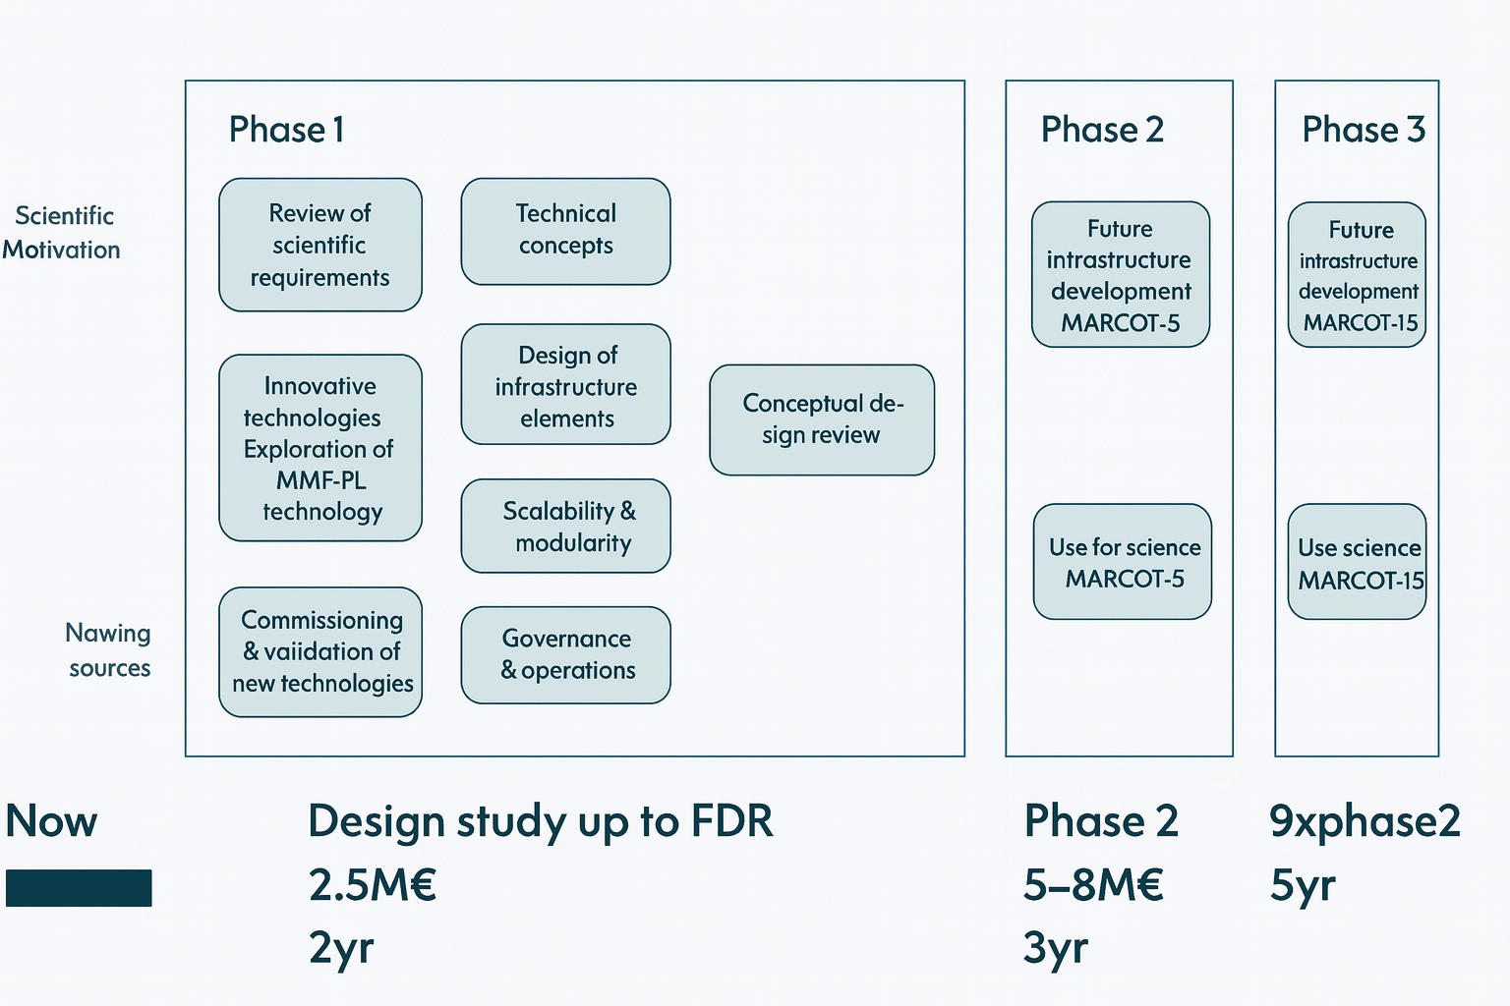
E-MARCOT: Status. Roadmap
Fund raising: ongoing, new partners welcome!!!

Slide 9
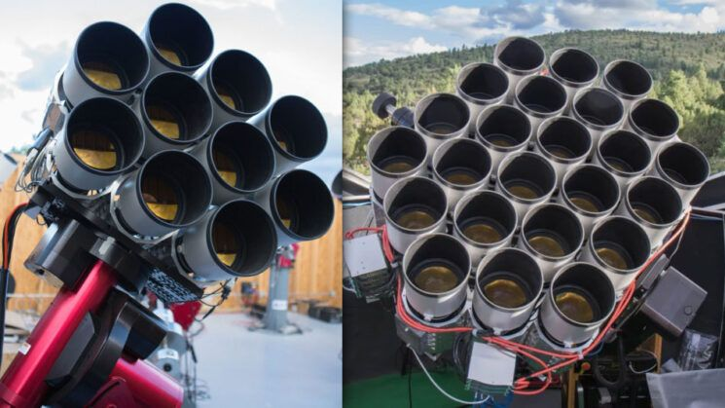
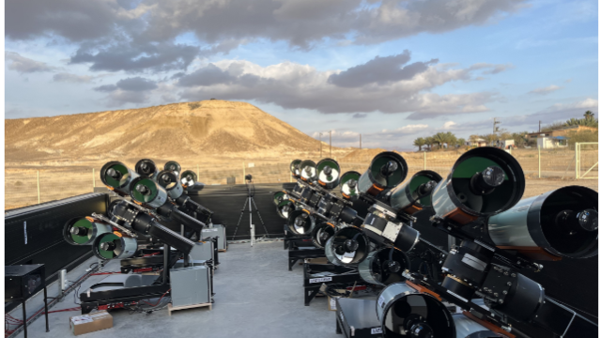
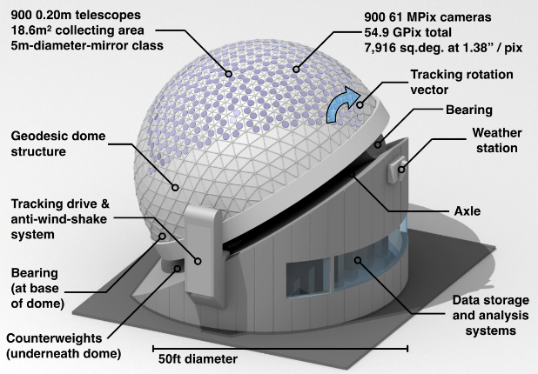
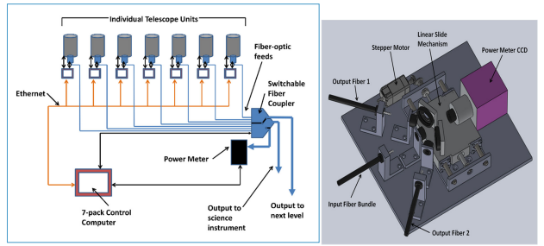
Comparative Overview of MARCOT vs Other Multi-Telescope Initiatives
Project | Imaging | Spectroscopy | Fiber Optics | AO Required | Modularity | Development Stage
MARCOT | Yes | High-precision | Multimode (MM) | No | High | In development
Dragonfly | Yes | No | No | No | Medium | Operational
ARGUS | Yes | No | No | No | Very High | Conceptual
PolyOculus | Partial | High-precision | Single-mode (SM) | Yes | High | Prototype
LAST | Yes | No | No | No | High | Operational
MAST | No | High-throughput | Yes | No | High | Proposed (2024)

Slide 10


E-MARCOT Resources
Current Grants | Action | Budget
SOMM17_5208_IAA | Development of MARCOT PL | 120.000€
C17.I01.P02.S17.SI01 Andalucía-Astrofísica & Física de Altas Energías | Acquisition of a PL machine Virtualization system expansion | 190.735€ 205.511€
EQC-2024 | Focal post-unit, spectrograph adapter, OTAs support control unit. | 283.000€
PRE2022-104799 | Subprograma Estatal de Formación. FPI | 111,758€
Partners contributions | Detectors, tools, accesories | 100.000€
Future Plans
ERDF of ICTS (Dec-2025) | Phase A of MARCOT-5M | 1.500.000€
EQC-2025 (submitted) | Astrophotonic Laboratory | 262,280€

Slide 11
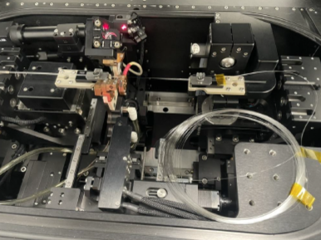
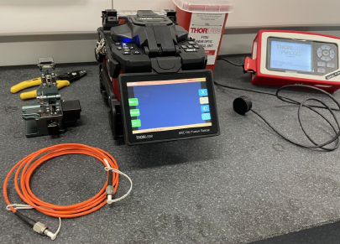

E-MARCOT Resources
Acquisition for the PL Manufacturing Machine (LIC-2025-004)
General Objective
To establish the necessary infrastructure for the manufacturing and development of Photonic Lanterns (PL) within the future astro-photonics laboratory, in collaboration with the IAA-CSIC.
Main Laboratory Lines
  Manufacturing
  • Implementation of the new machine for PL production
  • Prototype development and process optimization
  Characterization
  Evaluation of optical performance, stability, efficiency, validation of PL.
  Theoretical Studies and Analysis
  • Design modelling
  • Simulation of photonic behavior and integration into MARCOT systems
C17.I01.P02.S17.SI01 Andalucía-Astrofísica & Física de Altas Energías
Budget 190.735€. Expected delivery time: Dec 2025.

Slide 12
E-MARCOT Resources
Virtualization System Expansion (LIC-2025-005)
Since its installation at the end of 2018, the virtualization system has performed exceptionally well, clearly surpassing expectations. Over time, and due to growing project demands, CPU, memory and storage consumption have increased far beyond the original projections.
Compute and memory resources are becoming insufficient.
The current storage system (~130 TB) is close to its operational limit.
To ensure continuity and future growth, an upgrade of both the server farm and the storage system is necessary.
C17.I01.P02.S17.SI01 Andalucía-Astrofísica & Física de Altas Energías
Budget 205.511,97€ Expected delivery time: Jan 2026.

Slide 13
E-MARCOT Resources
Virtualization System Expansion (LIC-2025-005)
General Objective
The upgrade includes a new high-performance server and a new SSD storage array, designed to meet current and upcoming requirements.
New Server:
  24 additional CPU cores (Intel Xeon Gold 6542Y @ 2.9 GHz)
  +512 GB RAM (8 × 64 GB RDIMM)
  Network: 4×10 Gb + 2×1 Gb BaseT
  Internal RAID1 storage (2×480 GB)
  iDRAC9 remote management and redundant power supplies
New Storage Array:
  14 × 30 TB QLC SSDs (≈300 TB net SSD storage)
  Connectivity: 8×10 Gb BaseT + 4×100 Gb Ethernet
  Dual controllers and redundant 1600 W power supplies
C17.I01.P02.S17.SI01 Andalucía-Astrofísica & Física de Altas Energías
Budget 205.511,97€ Expected delivery time: Jan 2026.

Slide 14
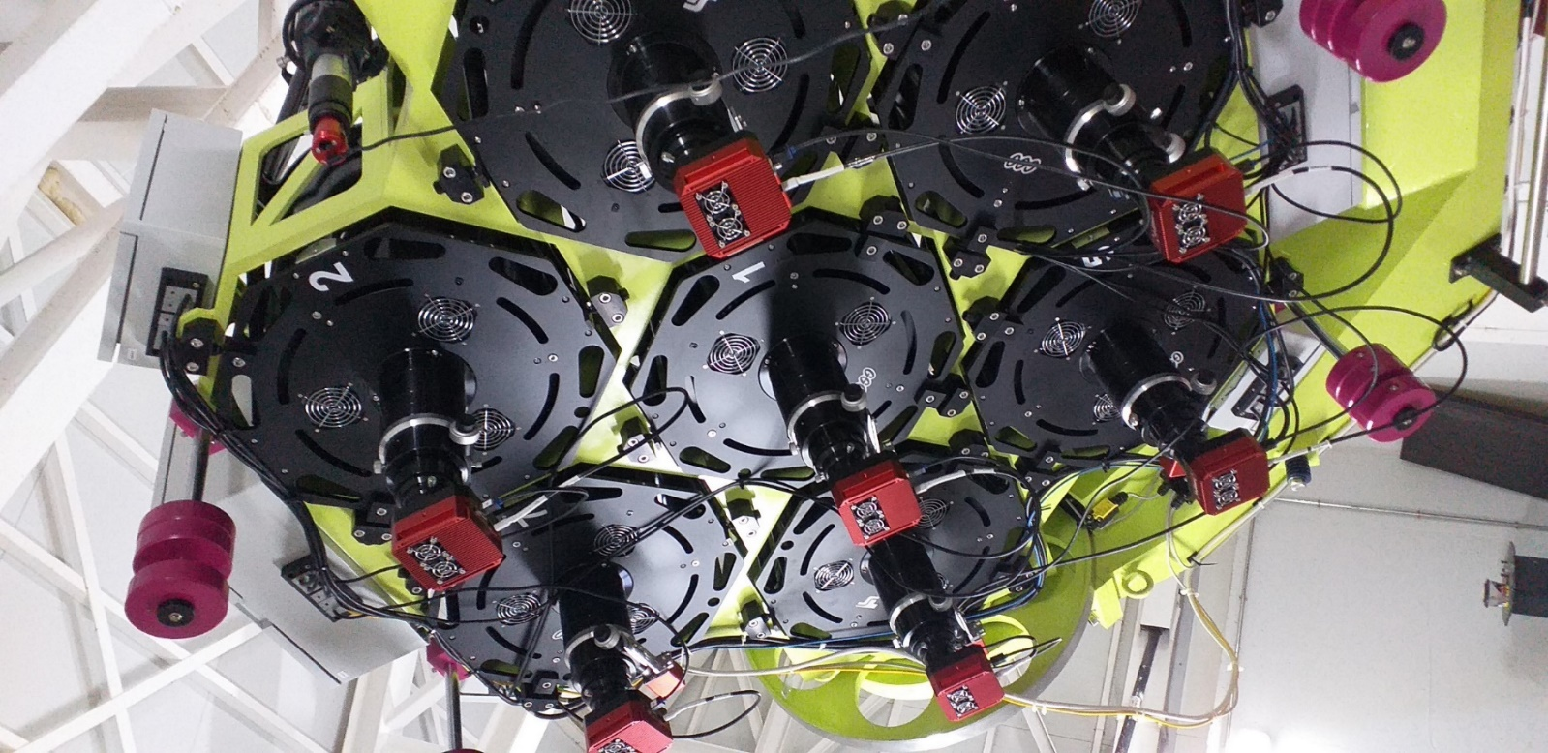
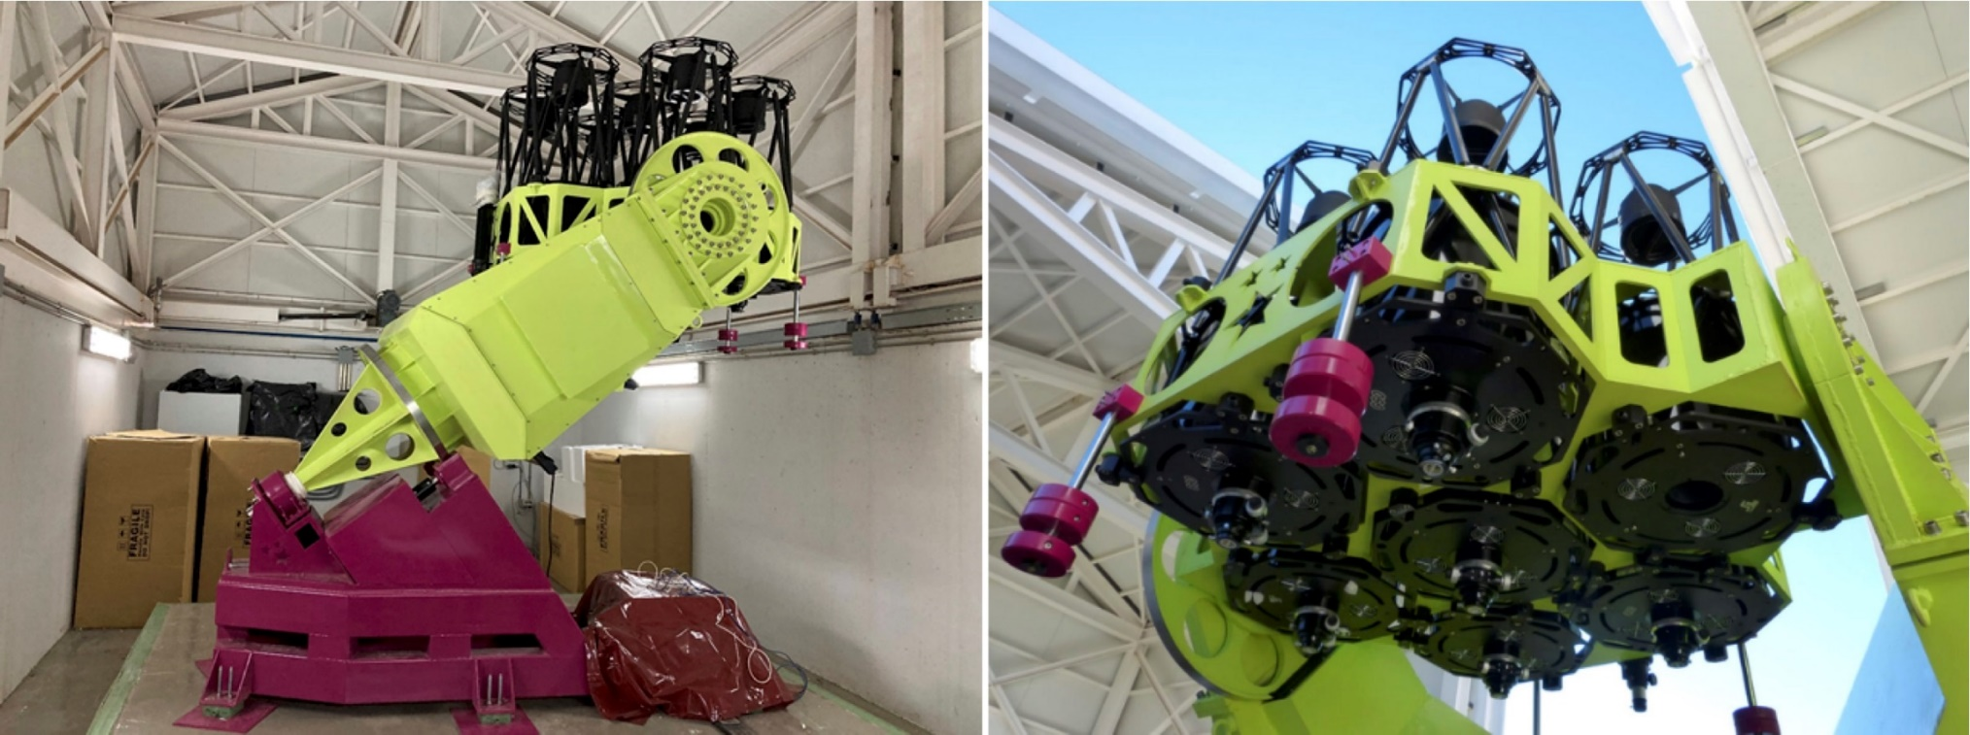
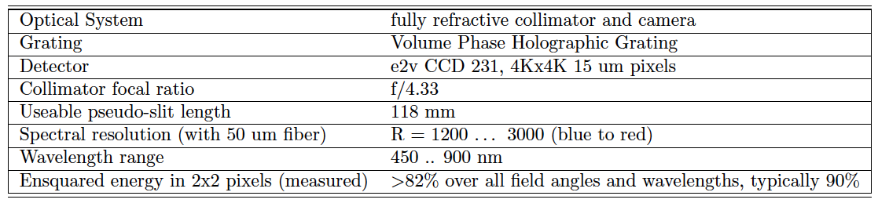
E-MARCOT- Pathfinder PF
MARCOT Pathfinder at Calar Alto progress report", Proc. SPIE 12182, Ground-based and Airborne Telescopes IX, 121820M (2022); https://doi.org/10.1117/12.2629901
Moralejo, B., Roth, M. M., Godefroy, P., Fechner, T., Bauer, S. M., Schmälzlin, E., Kelz, A., Haynes, R. 2016. The Potsdam MRS spectrograph: heritage of MUSE SPIE 9912, 991222
© AIP/P. Weilbacher
SOMM17_5208_IAA

Slide 15
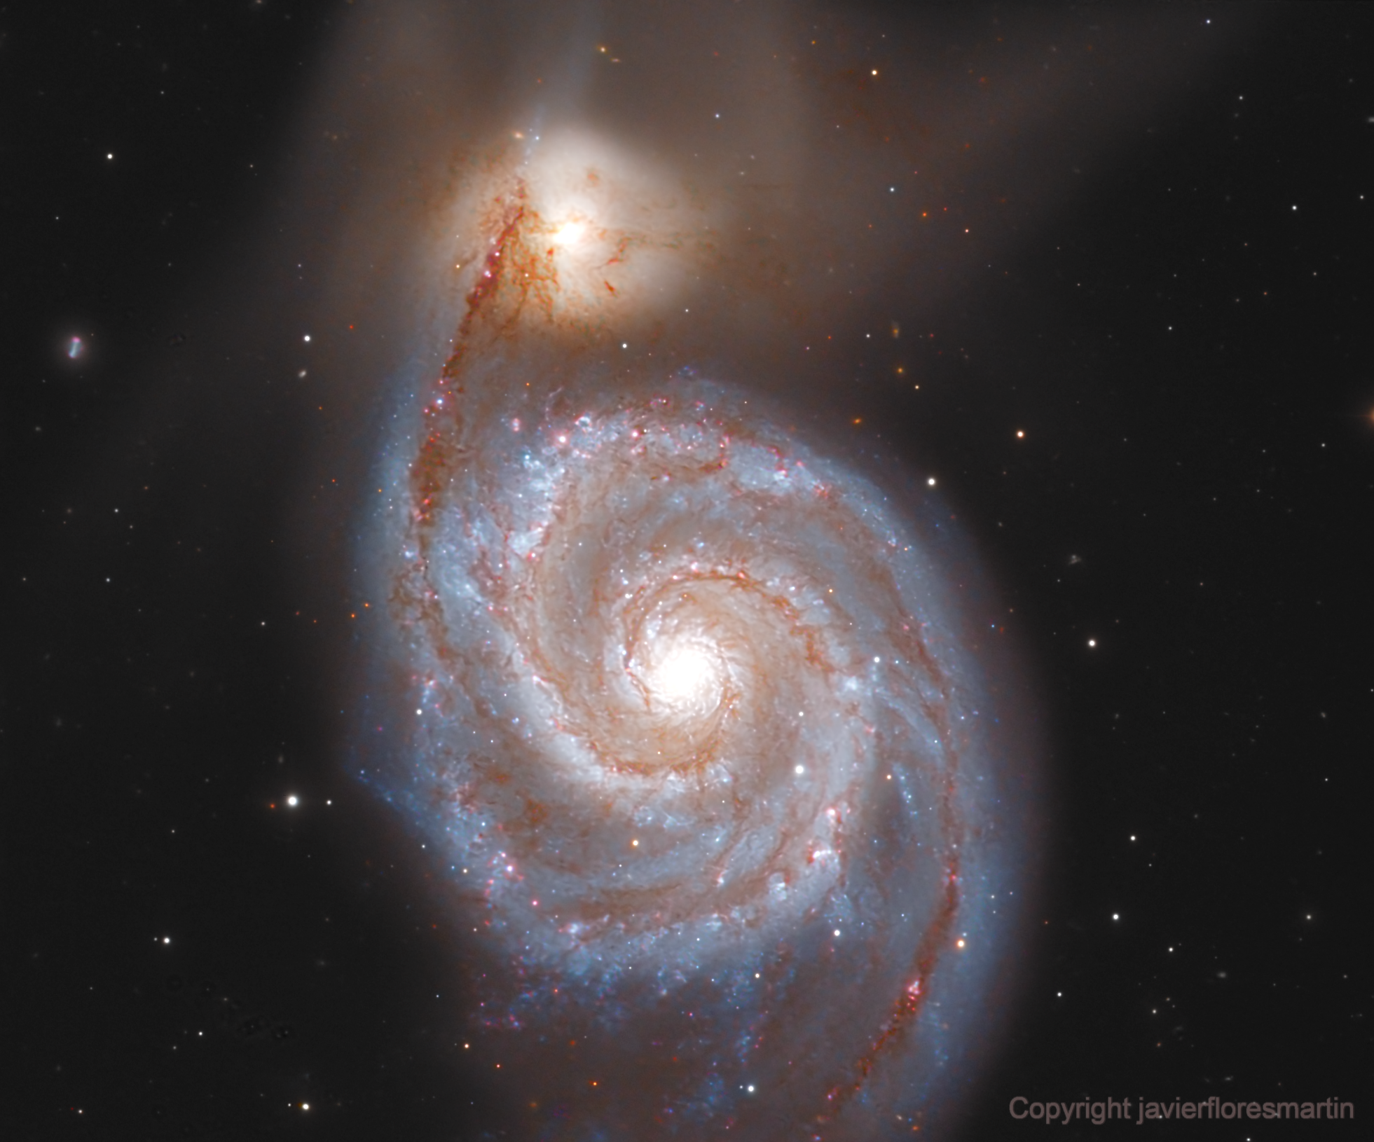
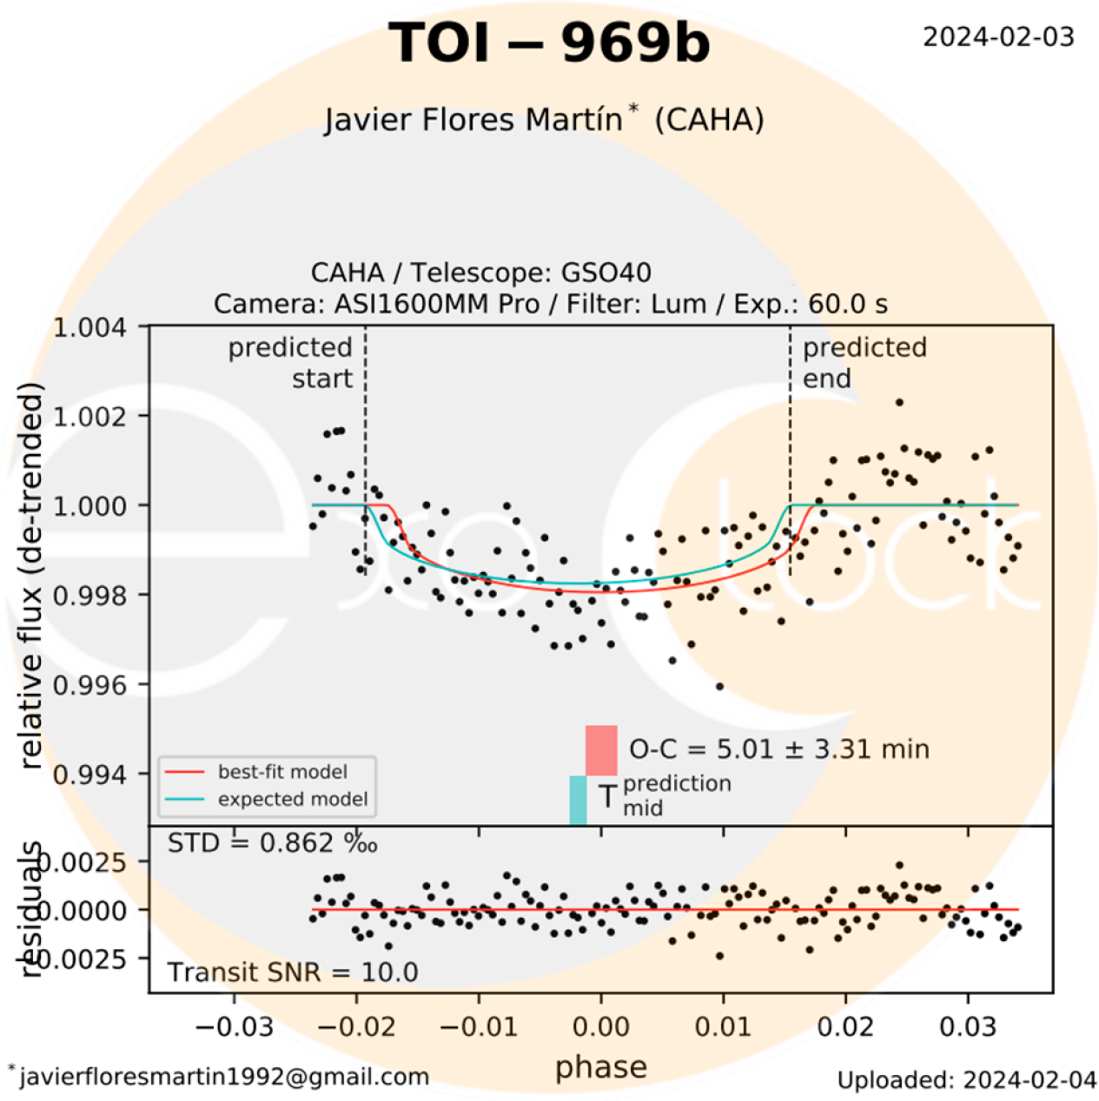
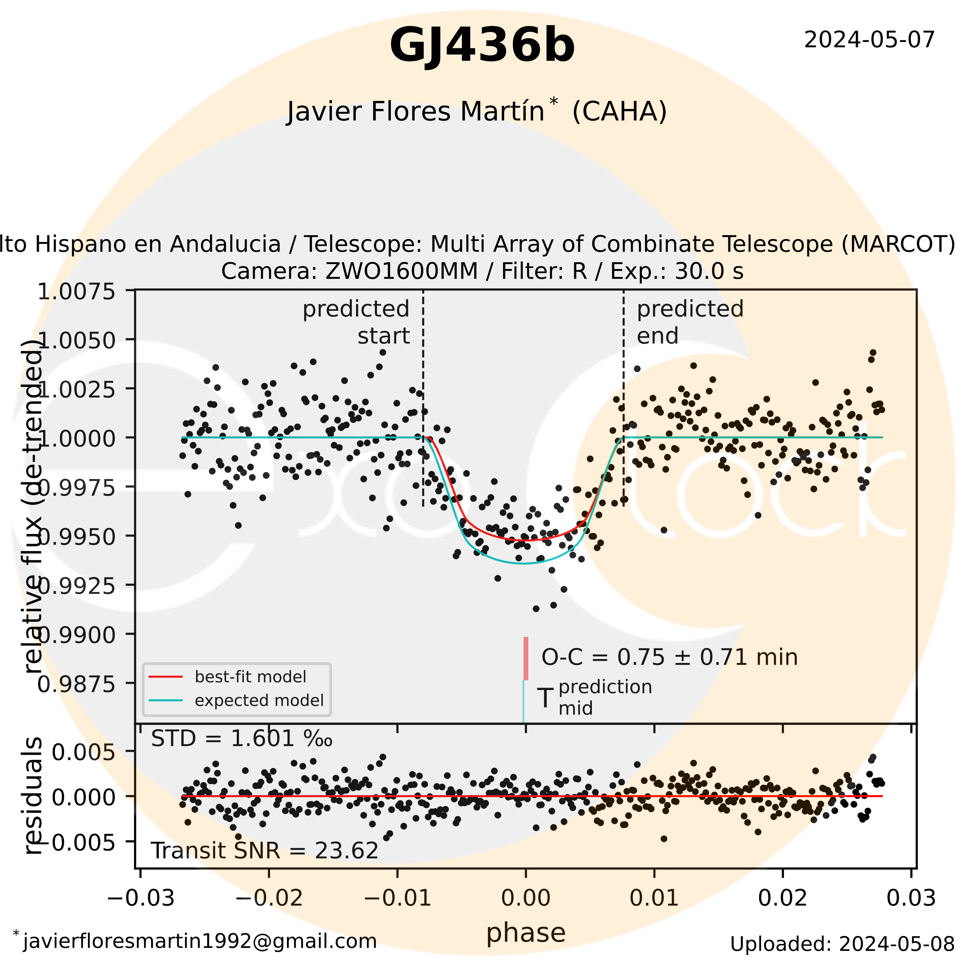
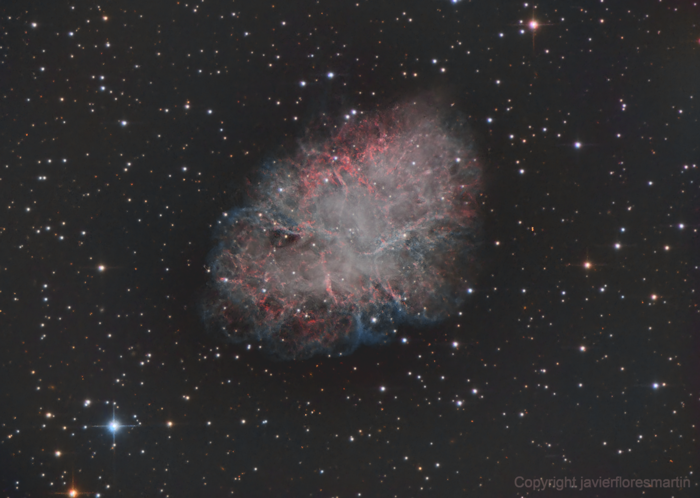
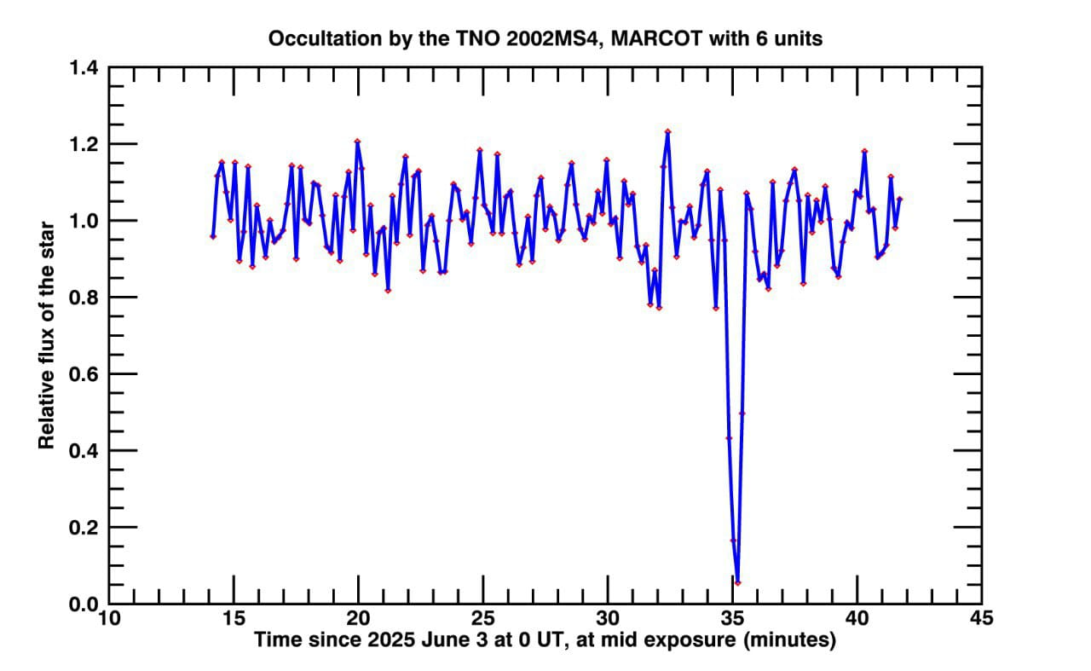
MARCOT PF observations – Imaging mode
Currently ongoing observations in imaging mode
Exoplanet transit photometry (over 30 transit LCs published)
Asteroid occultations (ongoing program with IAA)
Asteroid/NEO photometry & astrometry (ongoing program with IAA)
Astrophotography (for validation purposes and pipeline tests)
Credits. J. Flores (CAHA)
9 / 13

Slide 16
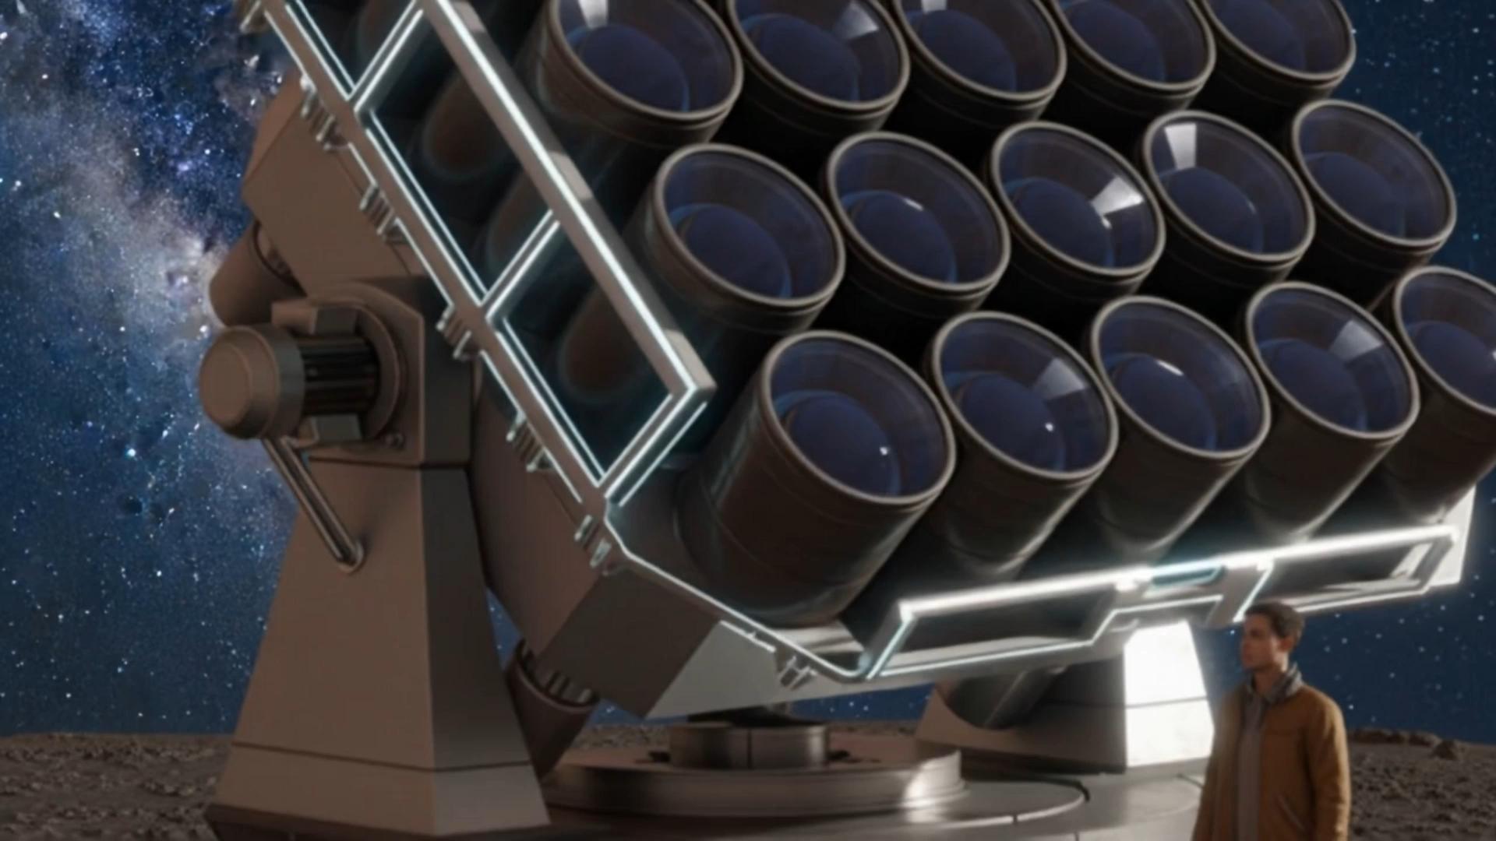
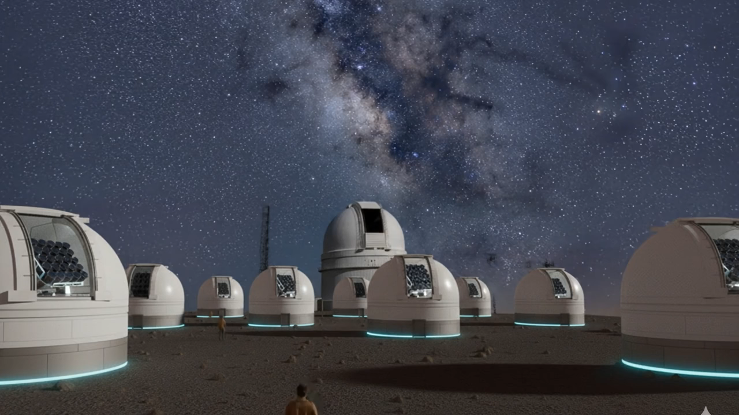
Conclusions
This is not just a telescope. It’s a new way of thinking instrumentation.
We are actively seeking partners for co-development and science use cases.
E-MARCOT PIs: Jesús Aceituno (aceitun@caha.es)
Pedro Amado (pja@iaa.csic.es)

