Slide 1

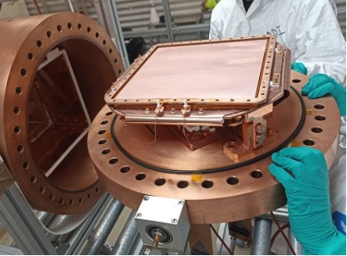
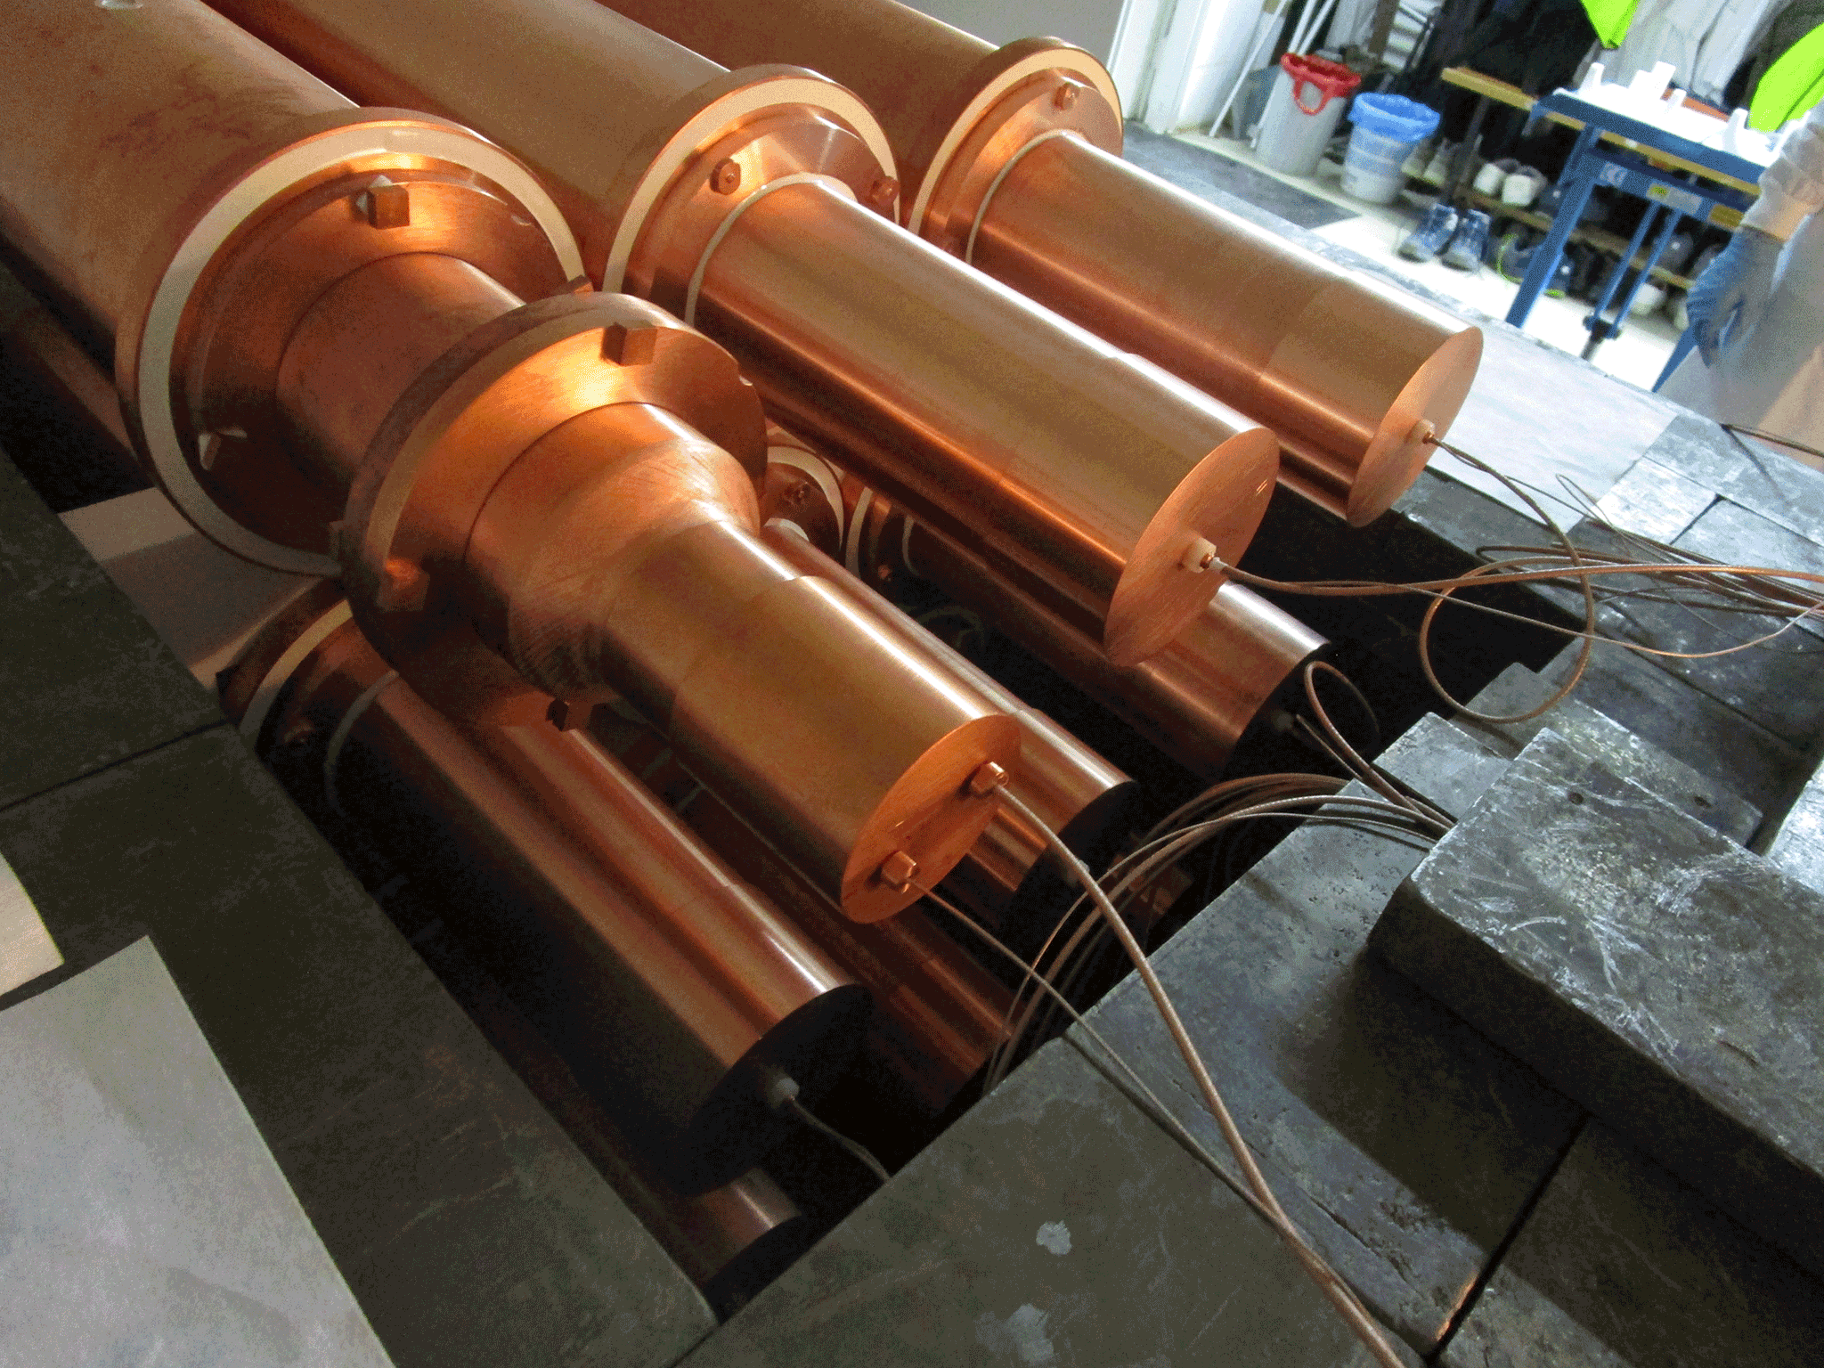
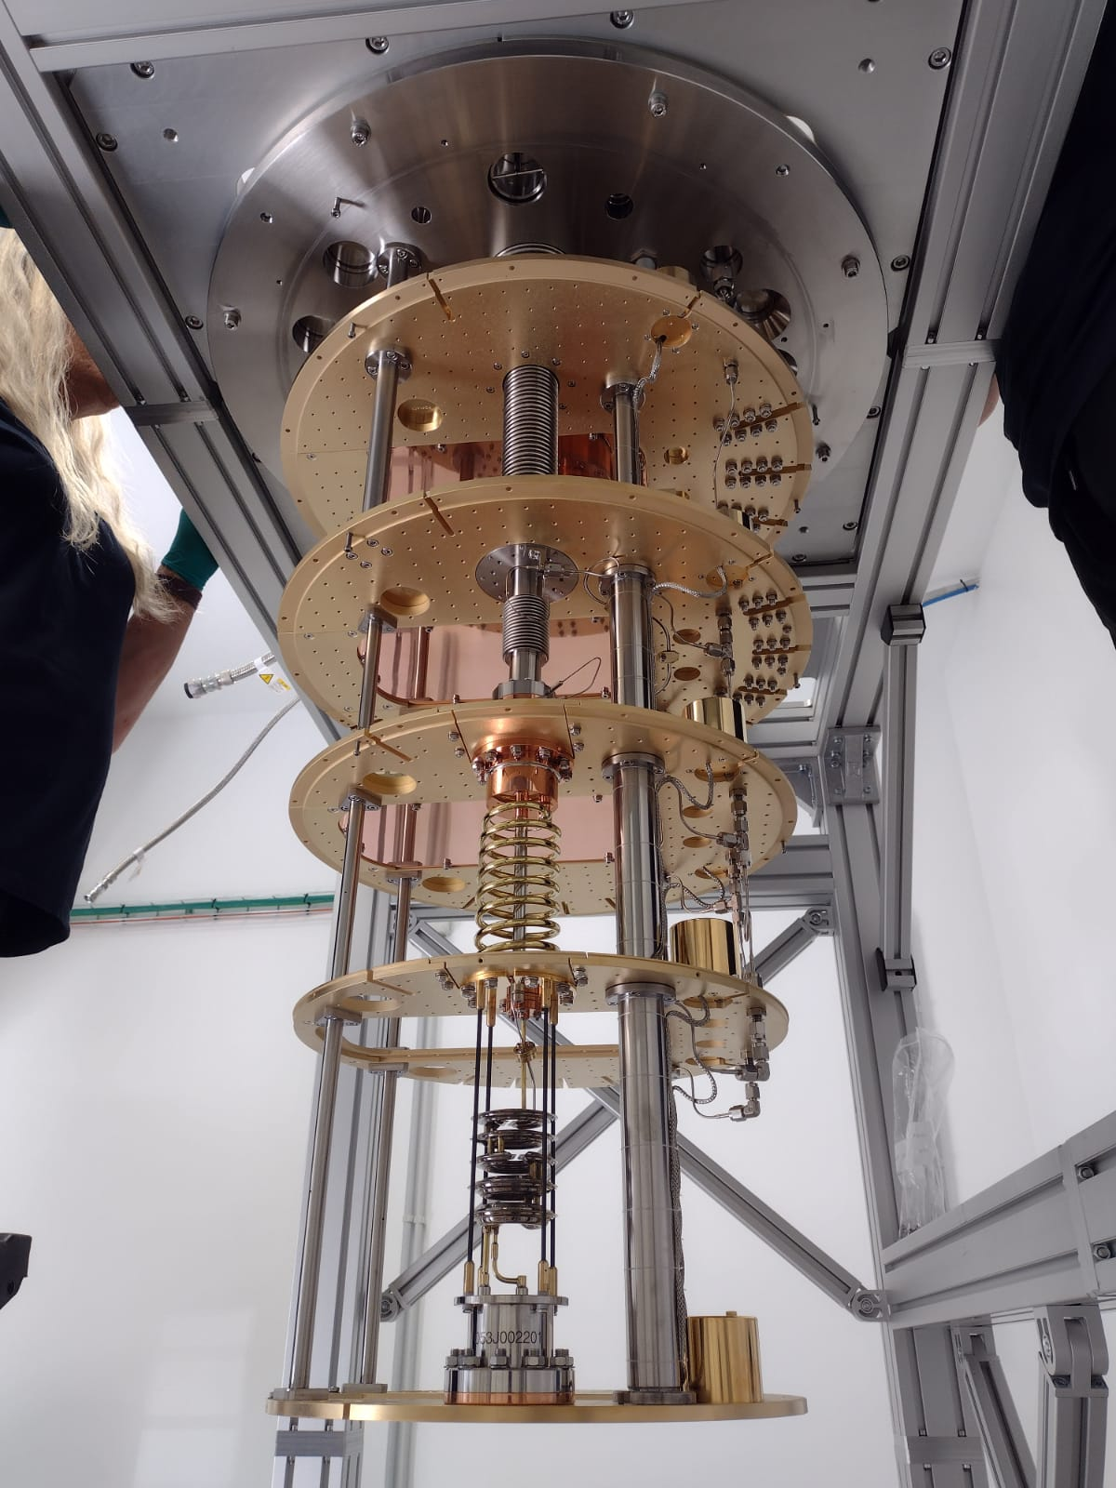
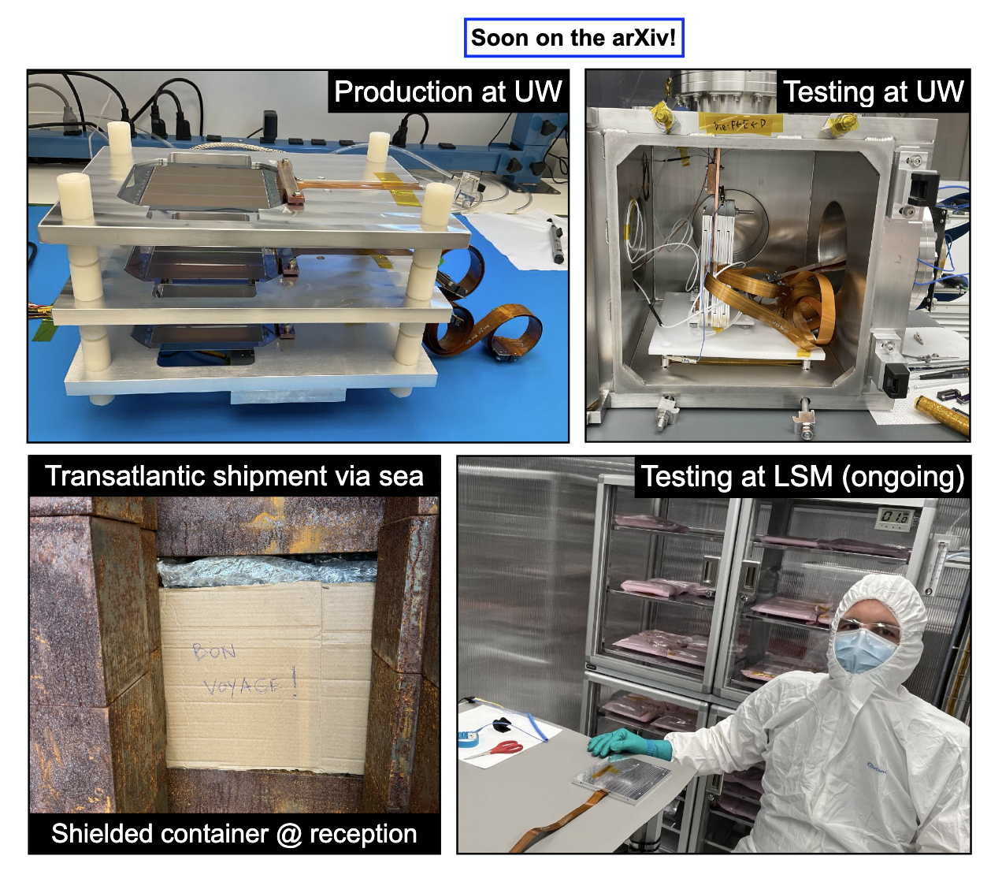
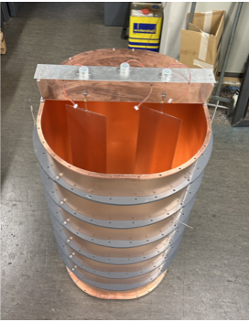
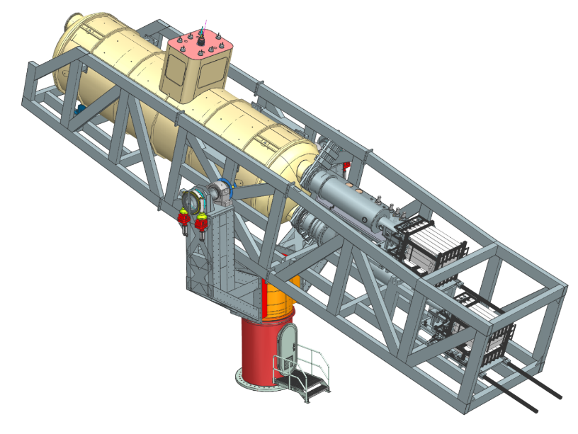
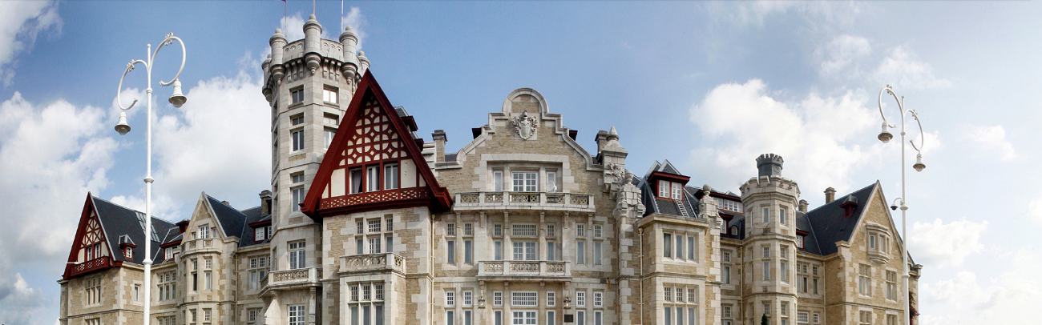
Introduction and highlights of
LIA5: Direct searches for Dark Matter
Igor G. Irastorza (CAPA/UNIZAR)
Reunión Final del Plan Complementario de Astrofísica y Altas Energías, November 2025

Slide 2
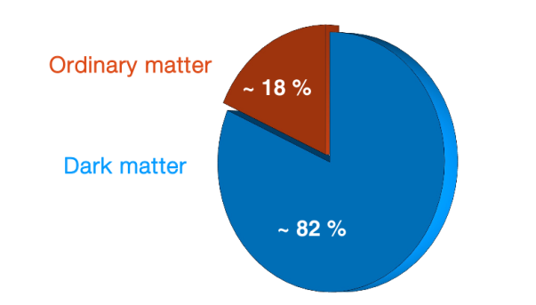
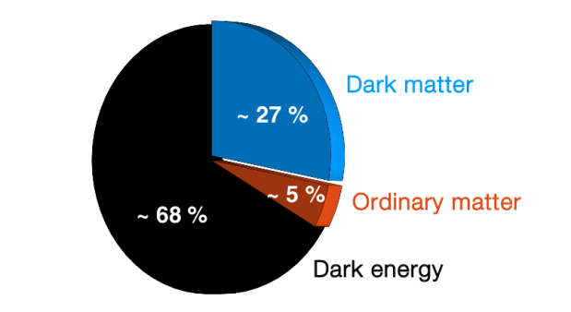
The Dark Matter problem
Matter content of the Universe
Strong evidence for existence of Dark Matter:
Not accounted for by Standard Model particles
4-5 times more abundant than ”ordinary” matter
Supporting evidence from different scales & types
Strongest observational evidence for physics beyond the Standard Model (SM)
How to extend the SM? Many hypothesis in the market, Best motivated options those which solve other problems.
WIMPs and Axions ← Main paradigms
Large international effort to find these particles
Matter-energy content of the Universe

Slide 3
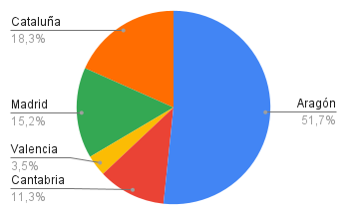
The LIA5 in the PPCC
The objective of this line is to carry out a series of experimental, technological-development, and phenomenological activities aimed at the direct detection of dark matter over a wide mass range, from the μeV axion to the 100-GeV WIMP.
A large part of the experimental activity in this LIA is carried out at the Canfranc Underground Laboratory (LSC) in Aragón, a landmark ICTS in the national and international HEP community.
Axions: strengthen Spanish leadership and weight in consolidated (BabyIAXO/IAXO) or emerging (RADES) collaborations, and kick-off new initiatives (CADEX)
WIMPs: strengthen Spanish experiments (or Spanish contributions to international ones) in a complementary LSC-centered effort: ANAIS, TREX-DM, DAMIC-M
See summary talks by J. Miralda (axions) and B. Kavanagh (WIMPs)
~4 M€

Slide 4










RADES - Relic Axion Detector Exploratory Setup
12 PM (STUDENT, CAPA)
12 PM (STUDENT, IFIC)
12 PM (STUDENT, ICMAB) 24 PM (STUDENT, ICMAB) 24 PM (POSTDOC, ICMAB)
24 PM (INGENIERO, ICCUB)
1.214 K€

Slide 5


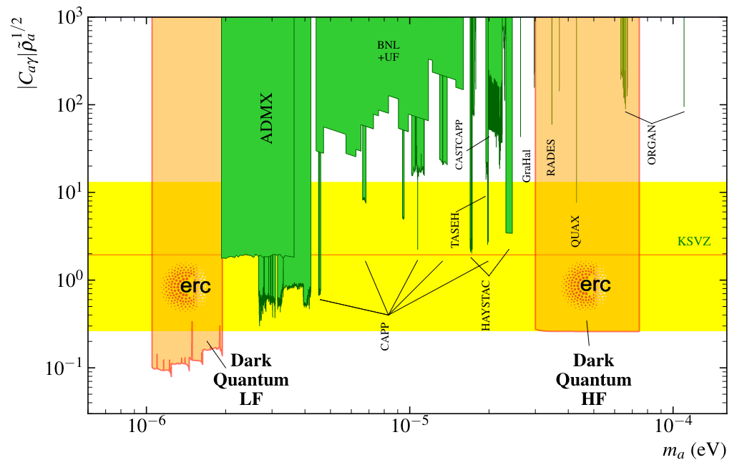
RADES – Highlights
Award of DarkQuantum ERC-SyG 2023 → connection with quantum technologies
CAPA (coord), also ICMAB, UPCT.
Also QRADES Quantera project (+IFAE)
RADES-HF: axion haloscope with single photon counter → beyond SQL!
Development of qubit-based (transmon) single photon detector
Eventually to LSC? (EoI in 2024)
RADES-LF: Large cavities eventually inside BabyIAXO magnet
Prototype could be used at M1 magnet at CERN to get very competitive physics already in 2027. LoI submitted to SCSC last September.

Slide 6
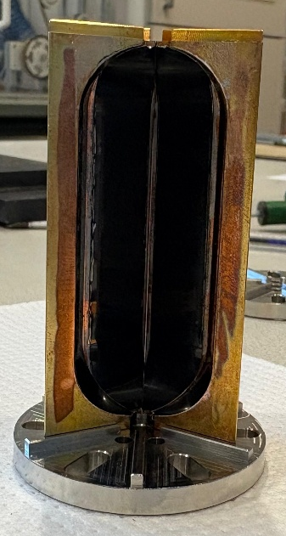
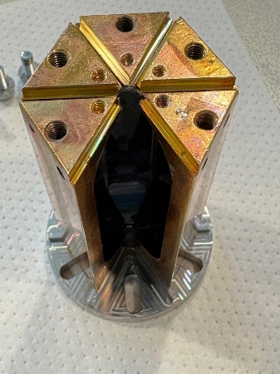
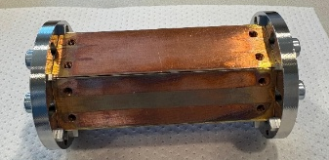
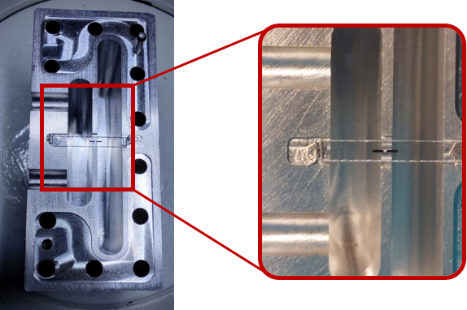
RADES – Highlights
High-Temperature superconductor coatings for the RADES cavities → increase of Q (ICMAB)
RF cavity design, new geometries, magnetic tuning, etc… (UPCT)
Related phenomenology, sensitivity to HFGW, directionality, … (IFIC, ICCUB)
Also (with international partners):
Tailored cryogenic solutions
Tuning systems
Magnetic resilient qubits
Quantum sensing, and quantum control

Slide 7

BabyIAXO/IAXO – international Axion Observatory
12 PM (POSTODOC; CAPA)
12 PM (ESTUDIANTE, CAPA)
24 PM (INGENIERO, CAPA)
12 PM (Técnico, CAPA)
24 PM (INGENIERO, ITA)
6 PM (ESTUDIANTE, IFIC)
860 K€

Slide 8
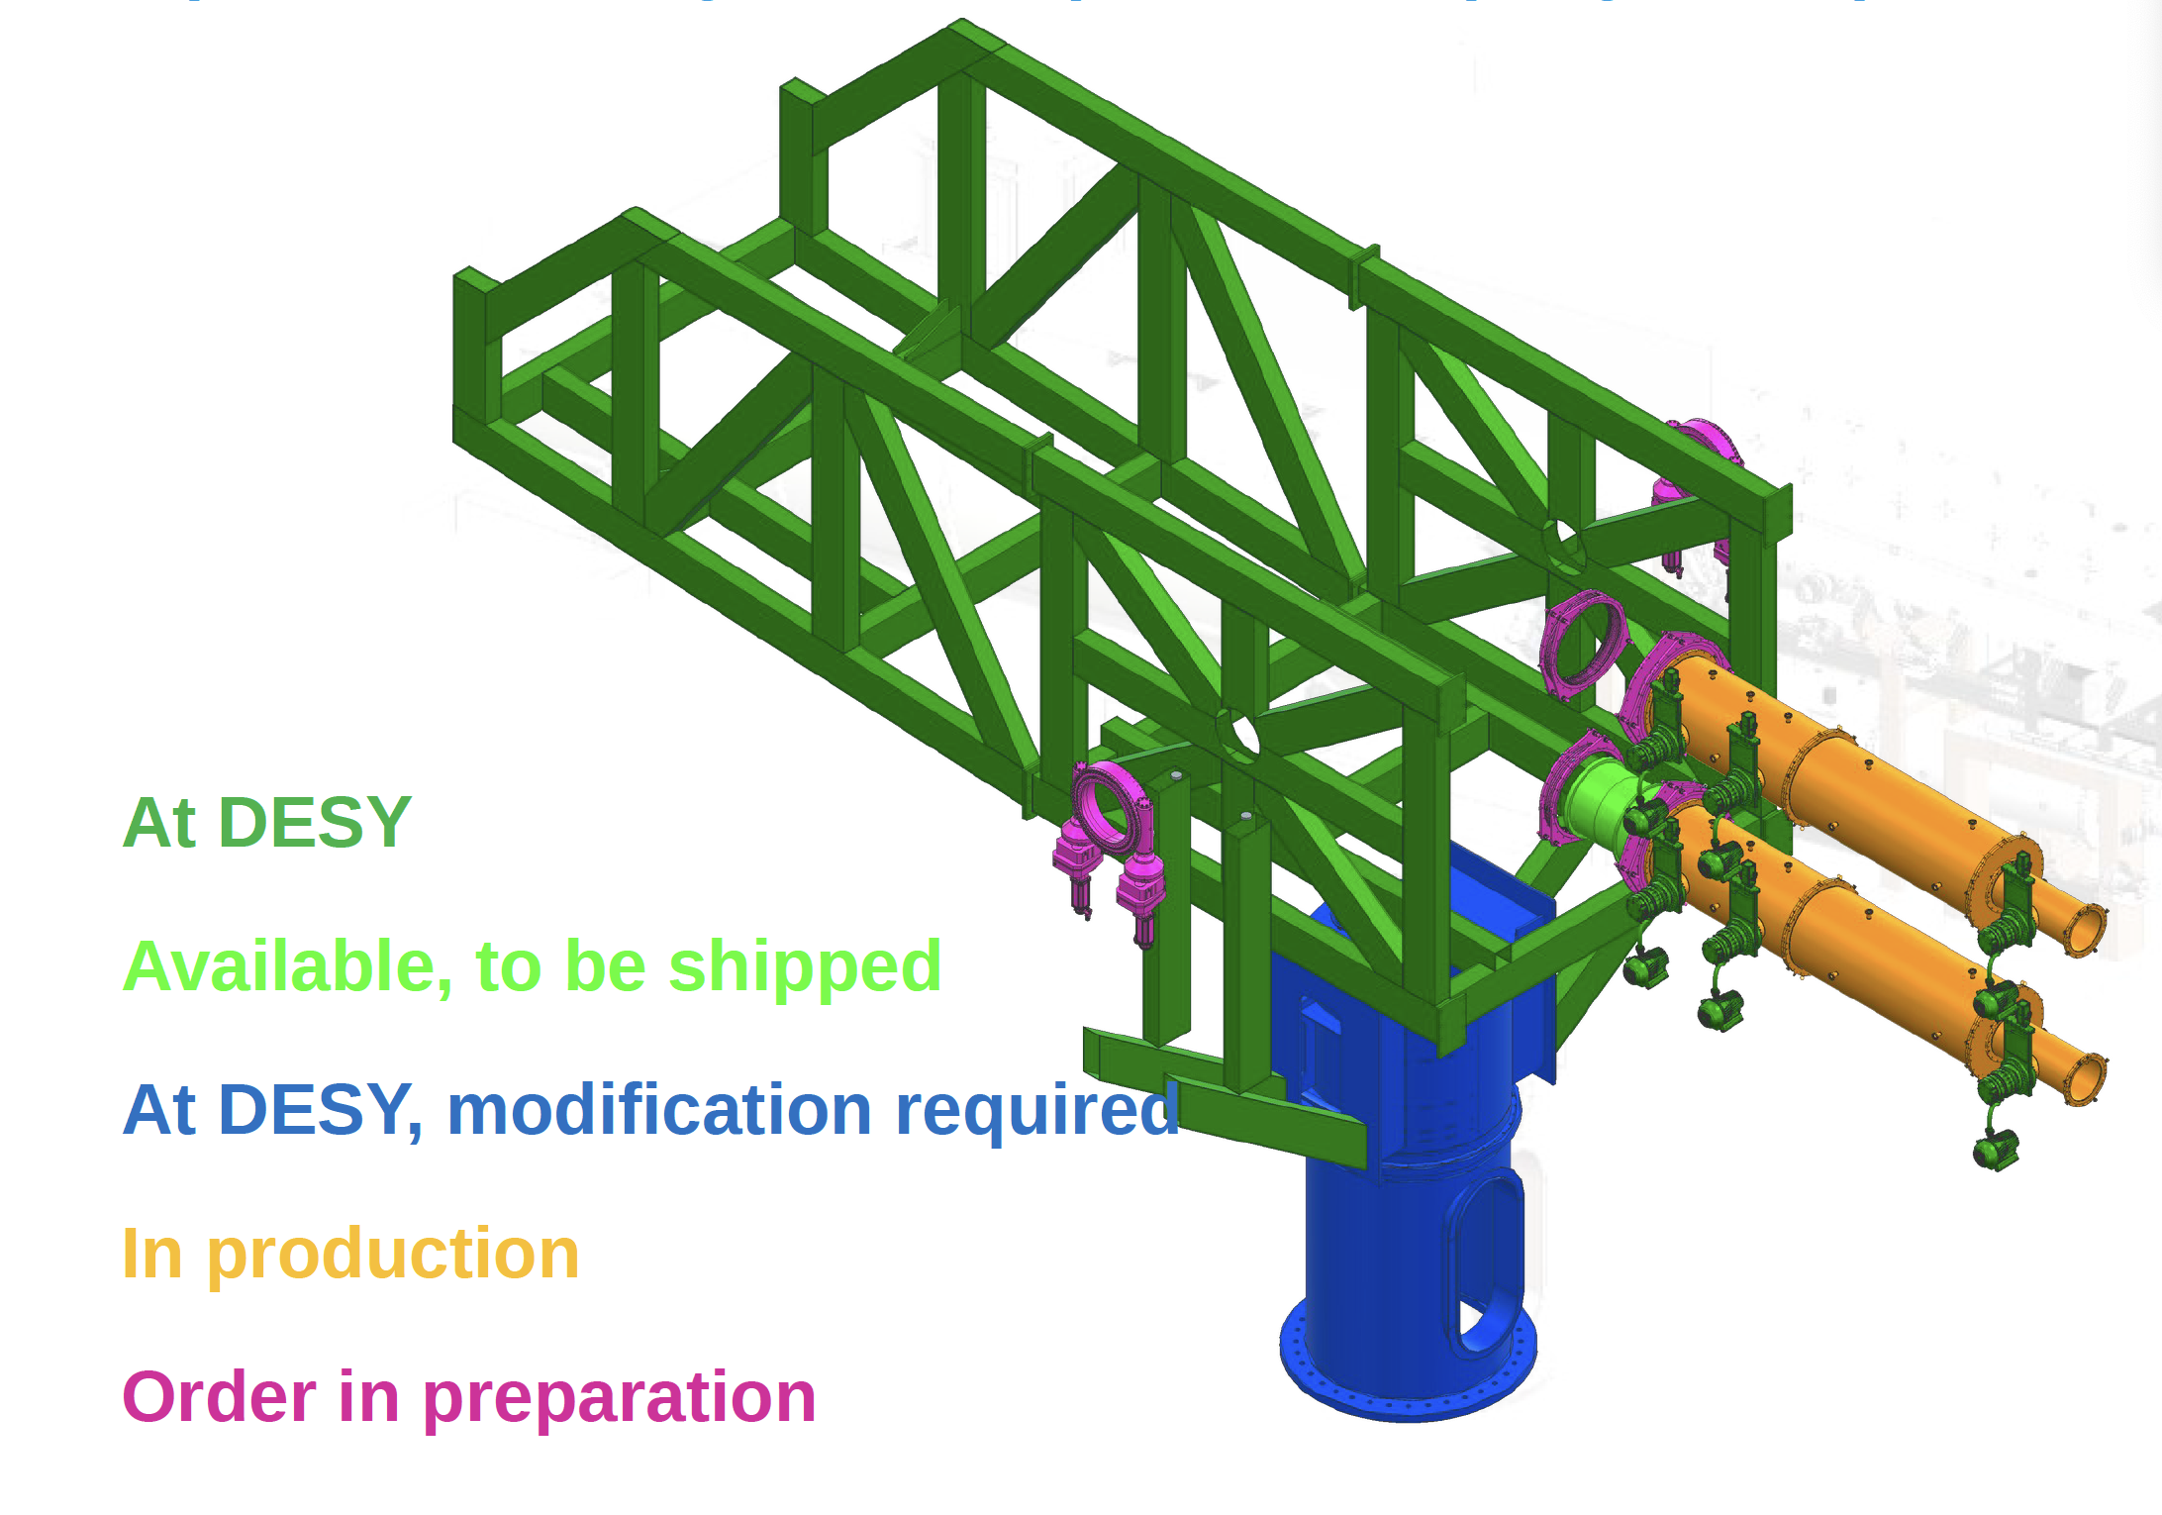
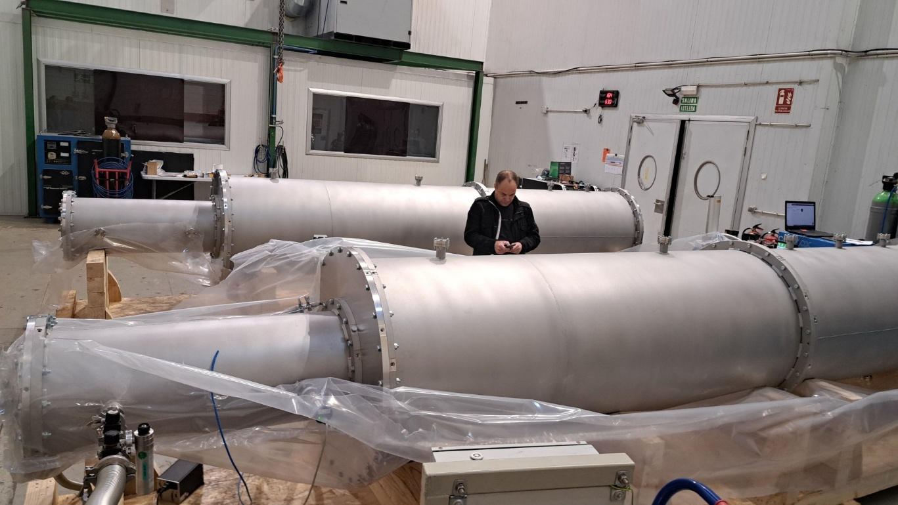
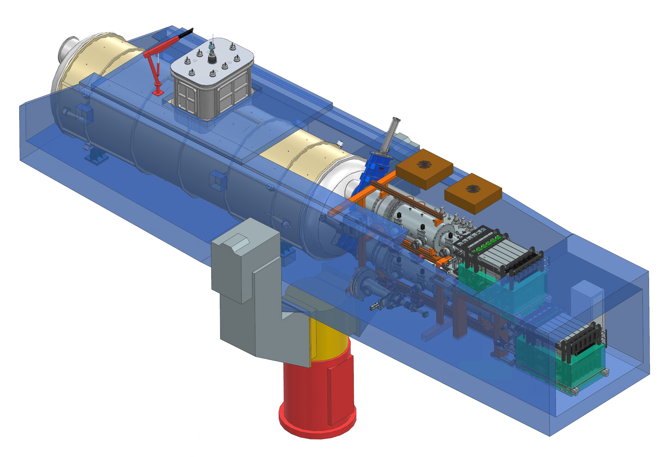
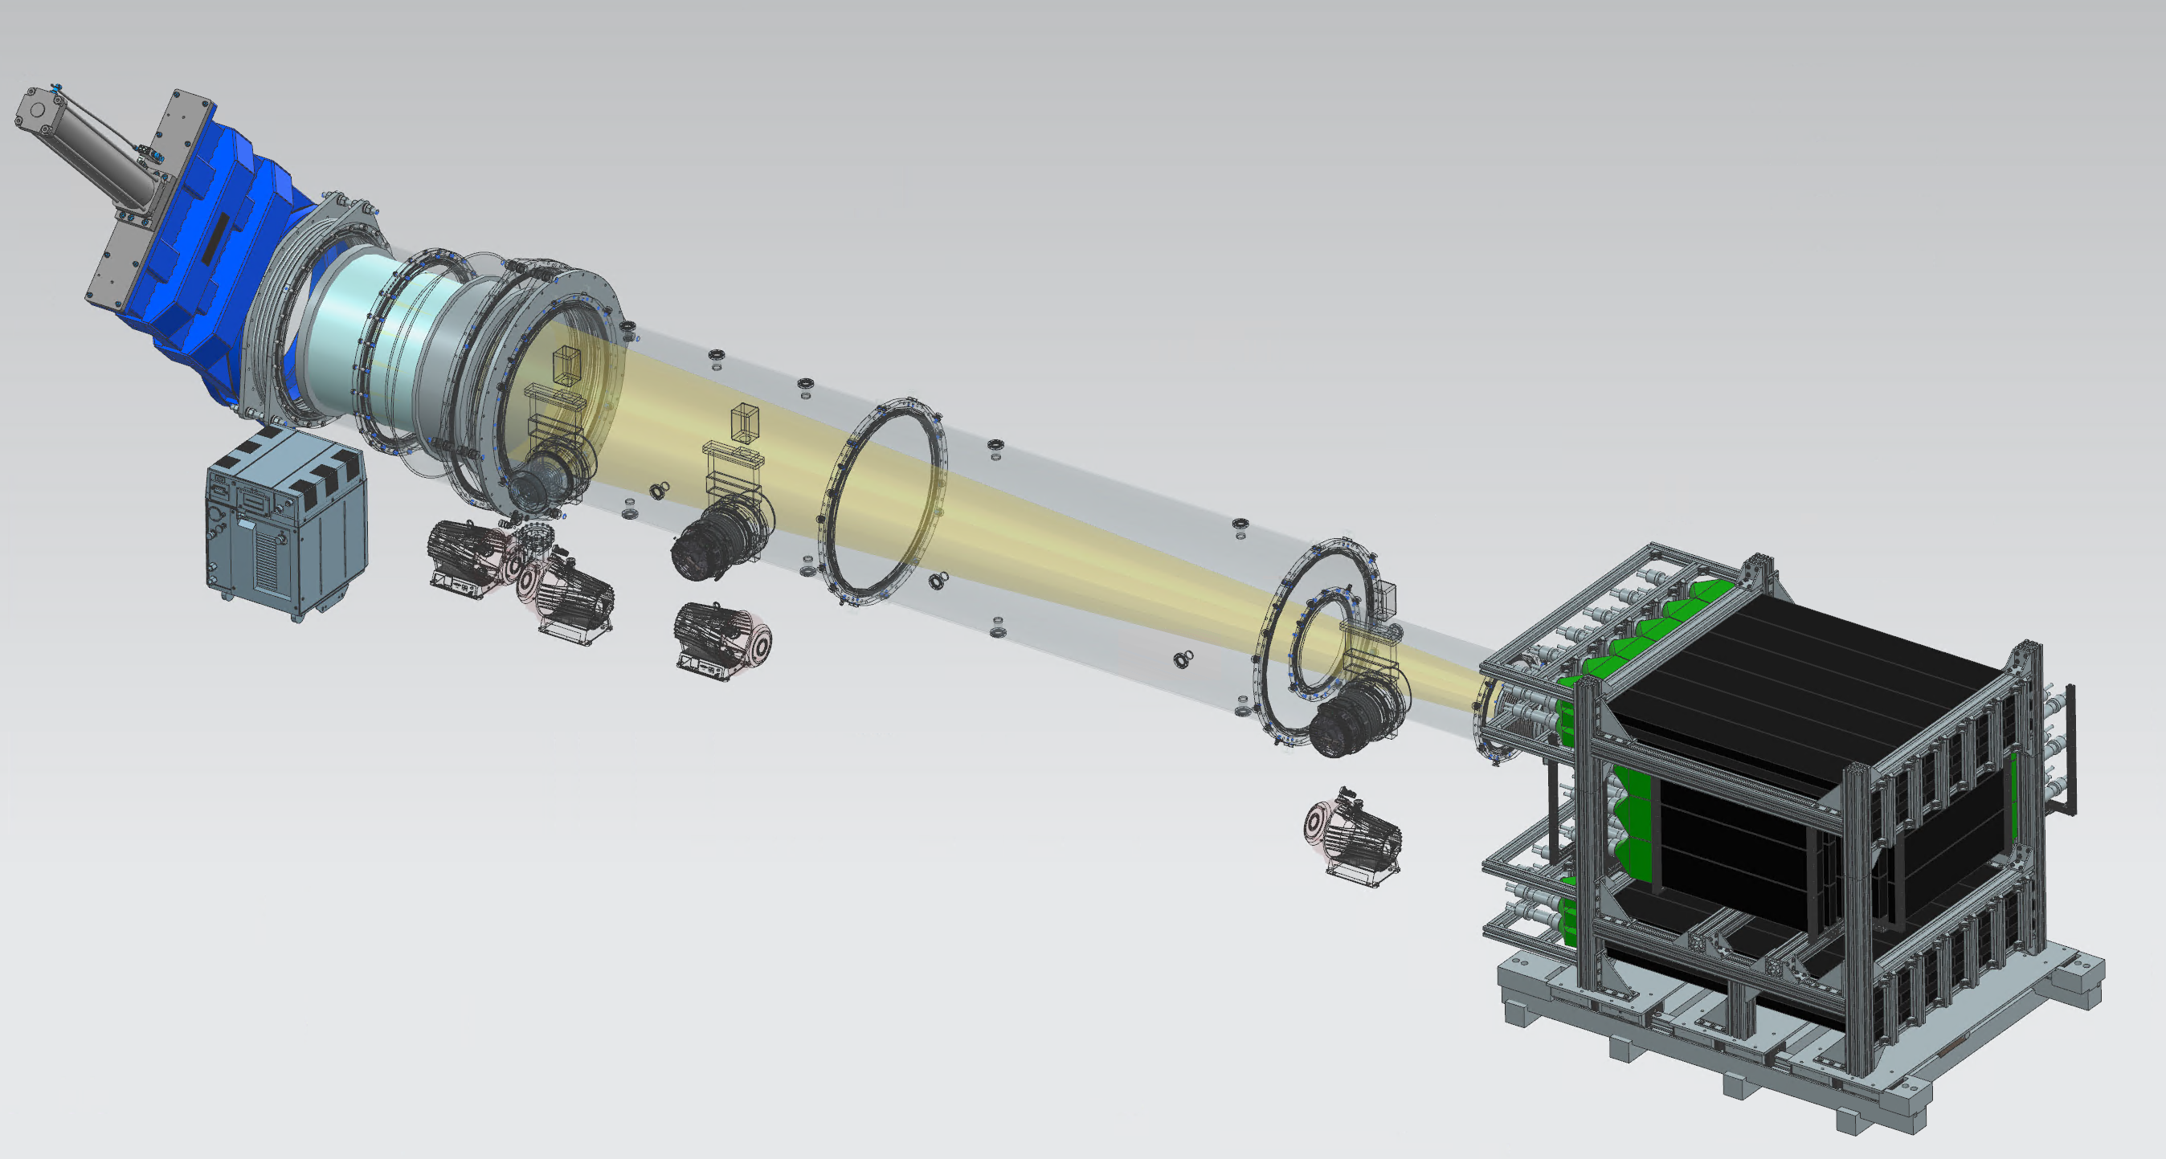
BabyIAXO – Highlights
BabyIAXO fully into construction mode. Many components already at DESY
Beamlines just produced (largely funded by PPCC)
X-ray Optics
The X-ray beam from the Optics to the detector
Detector

Slide 9
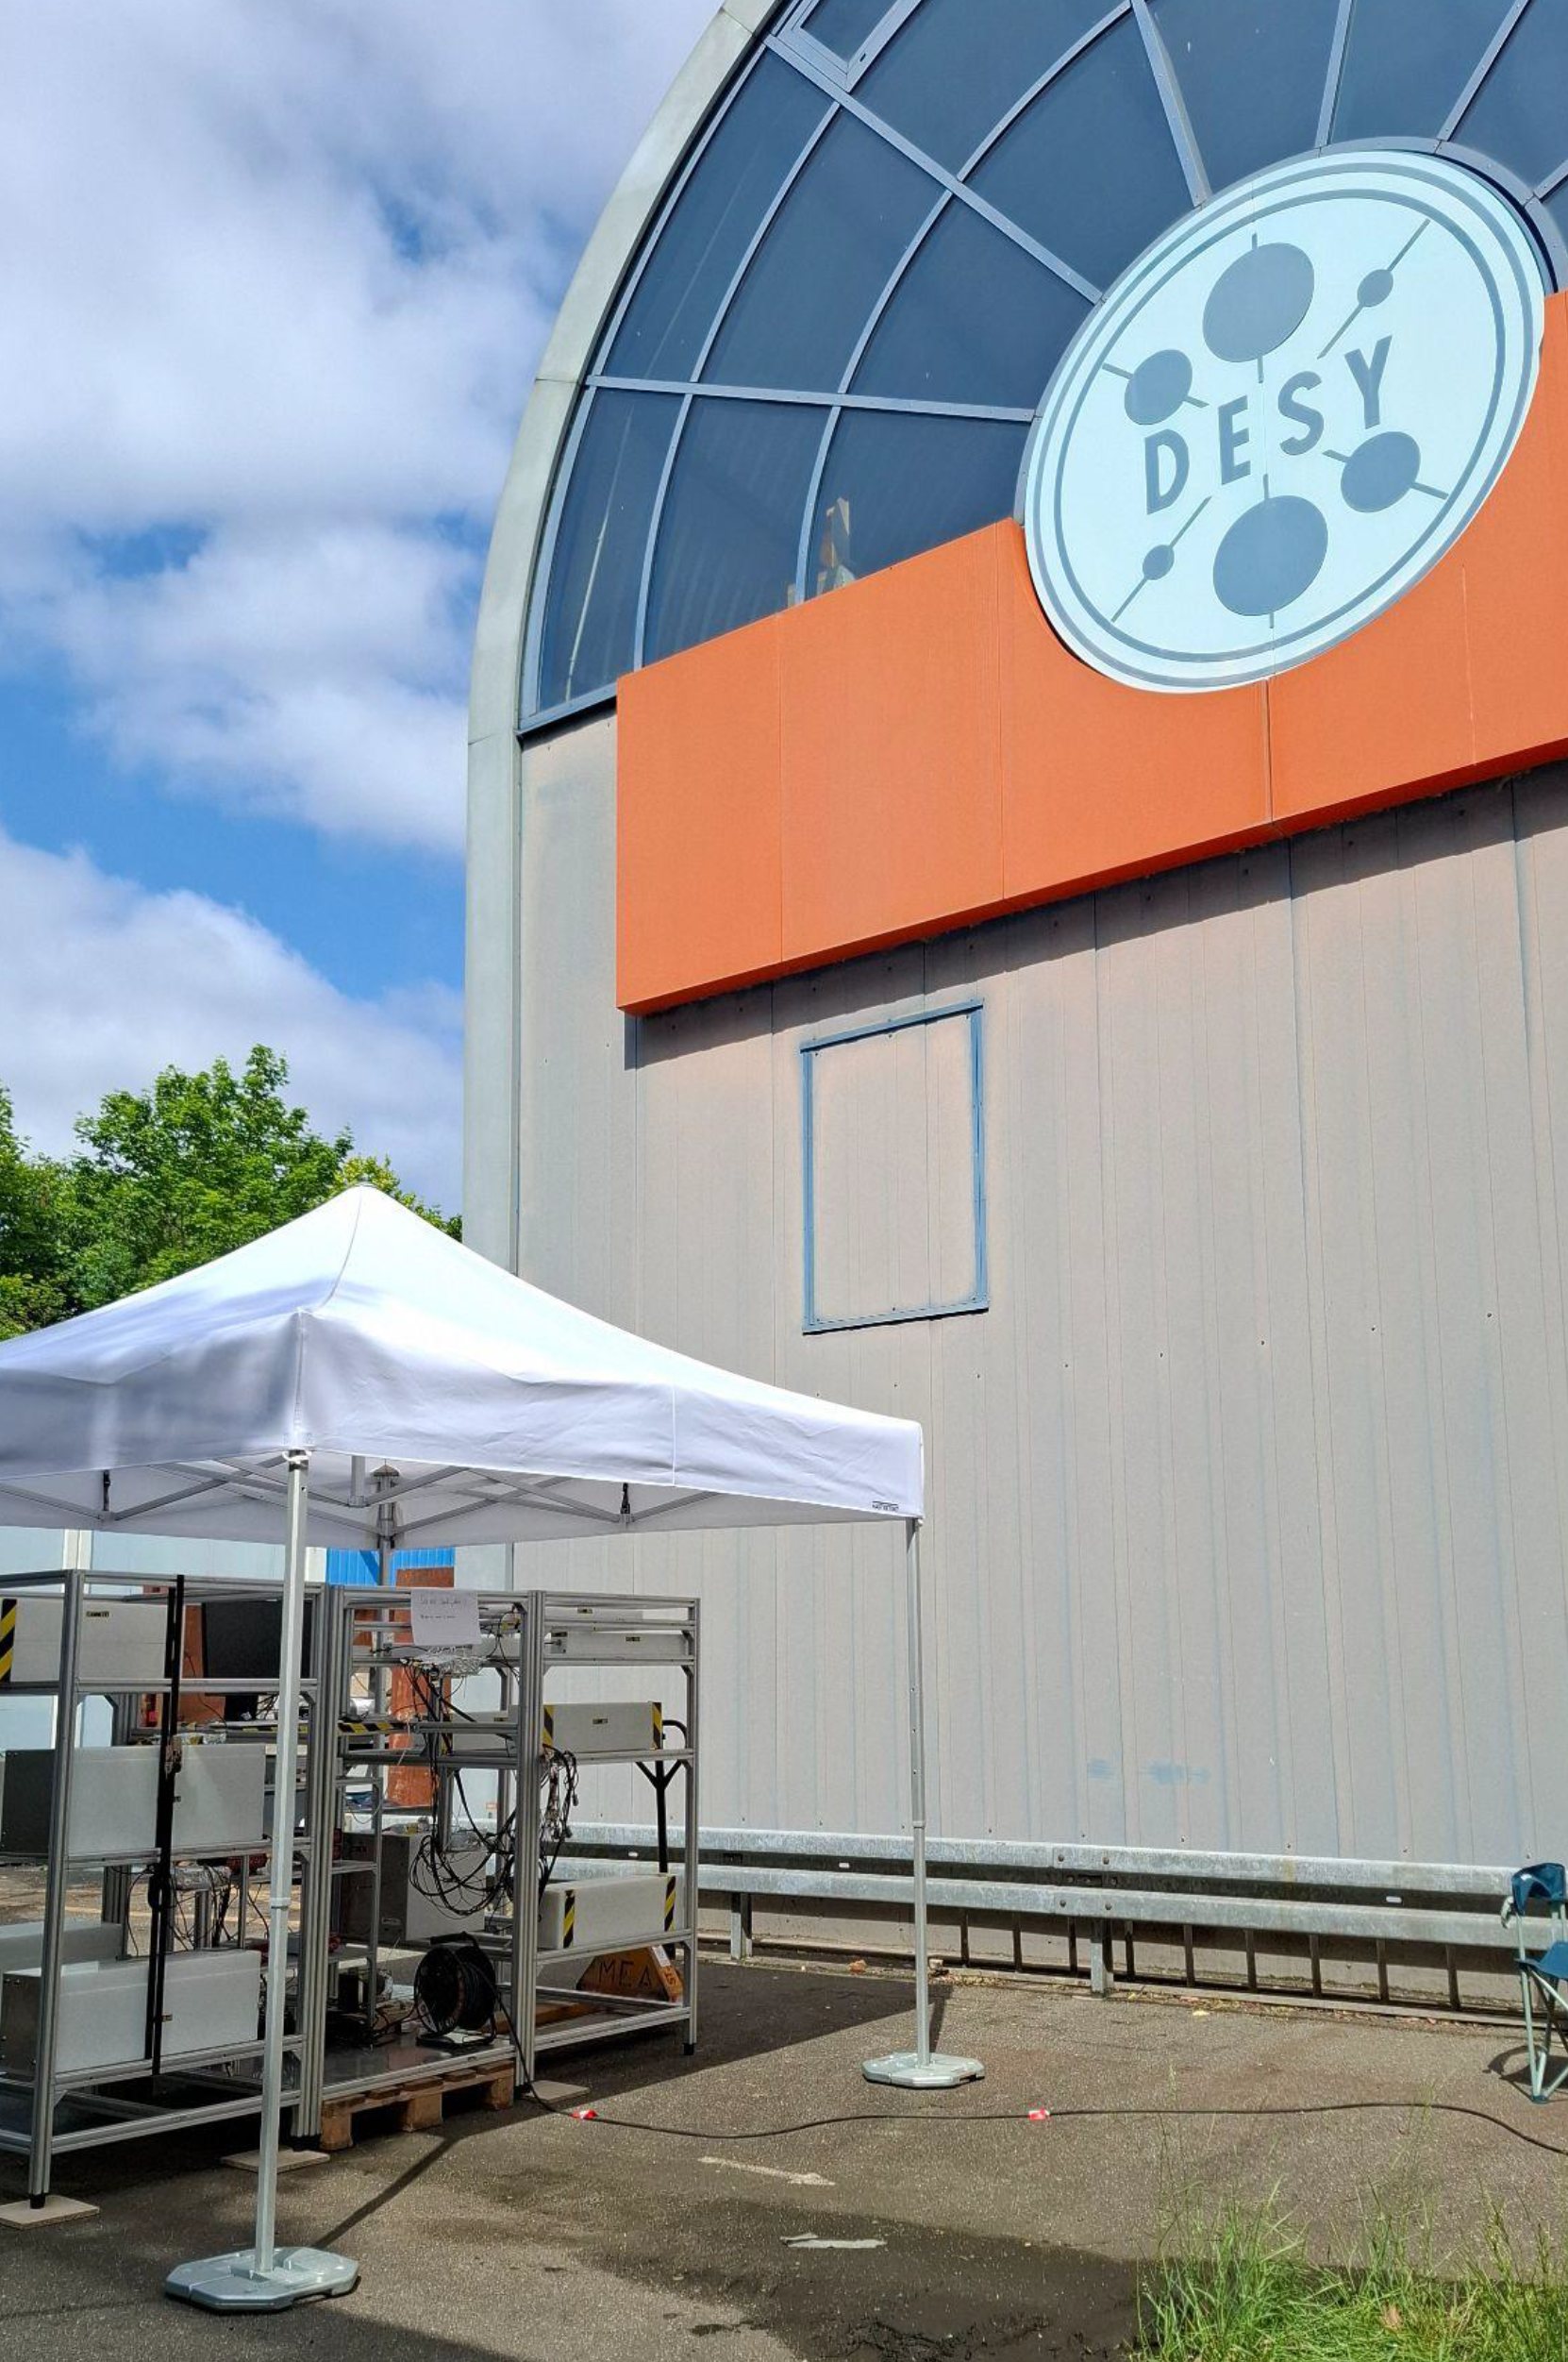
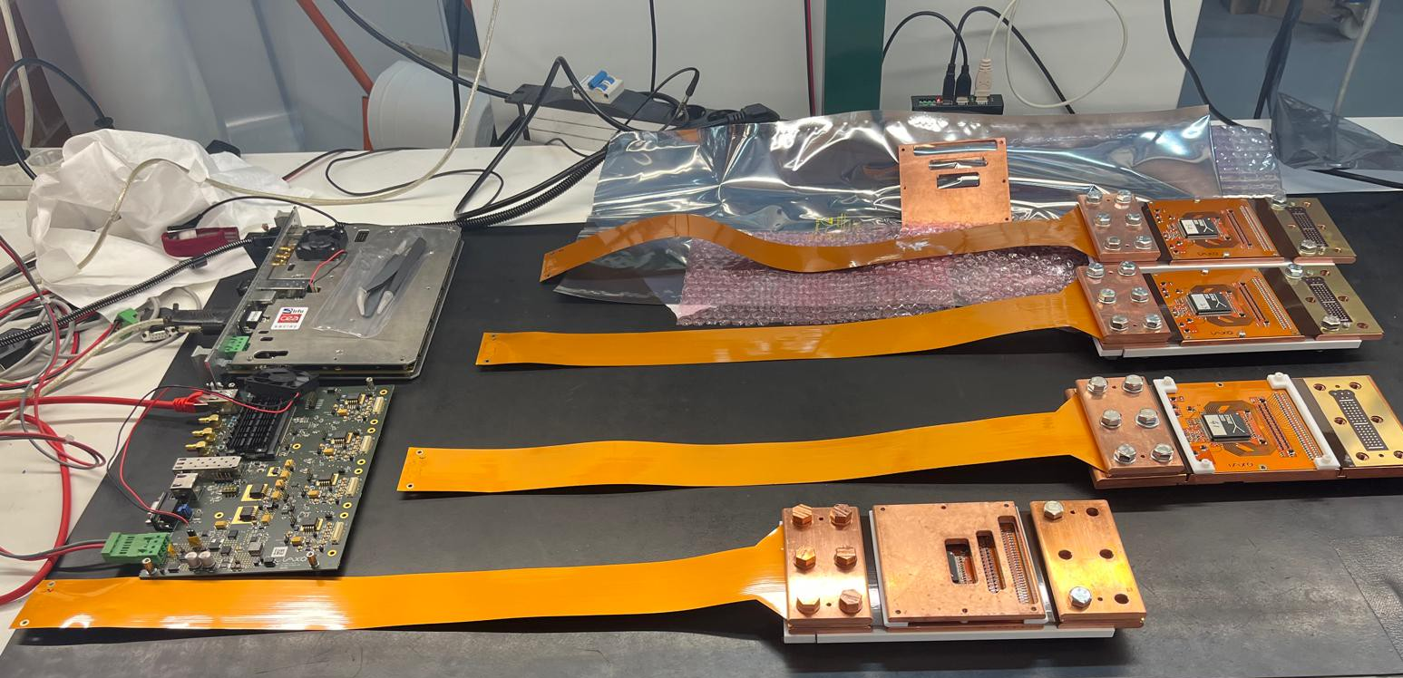
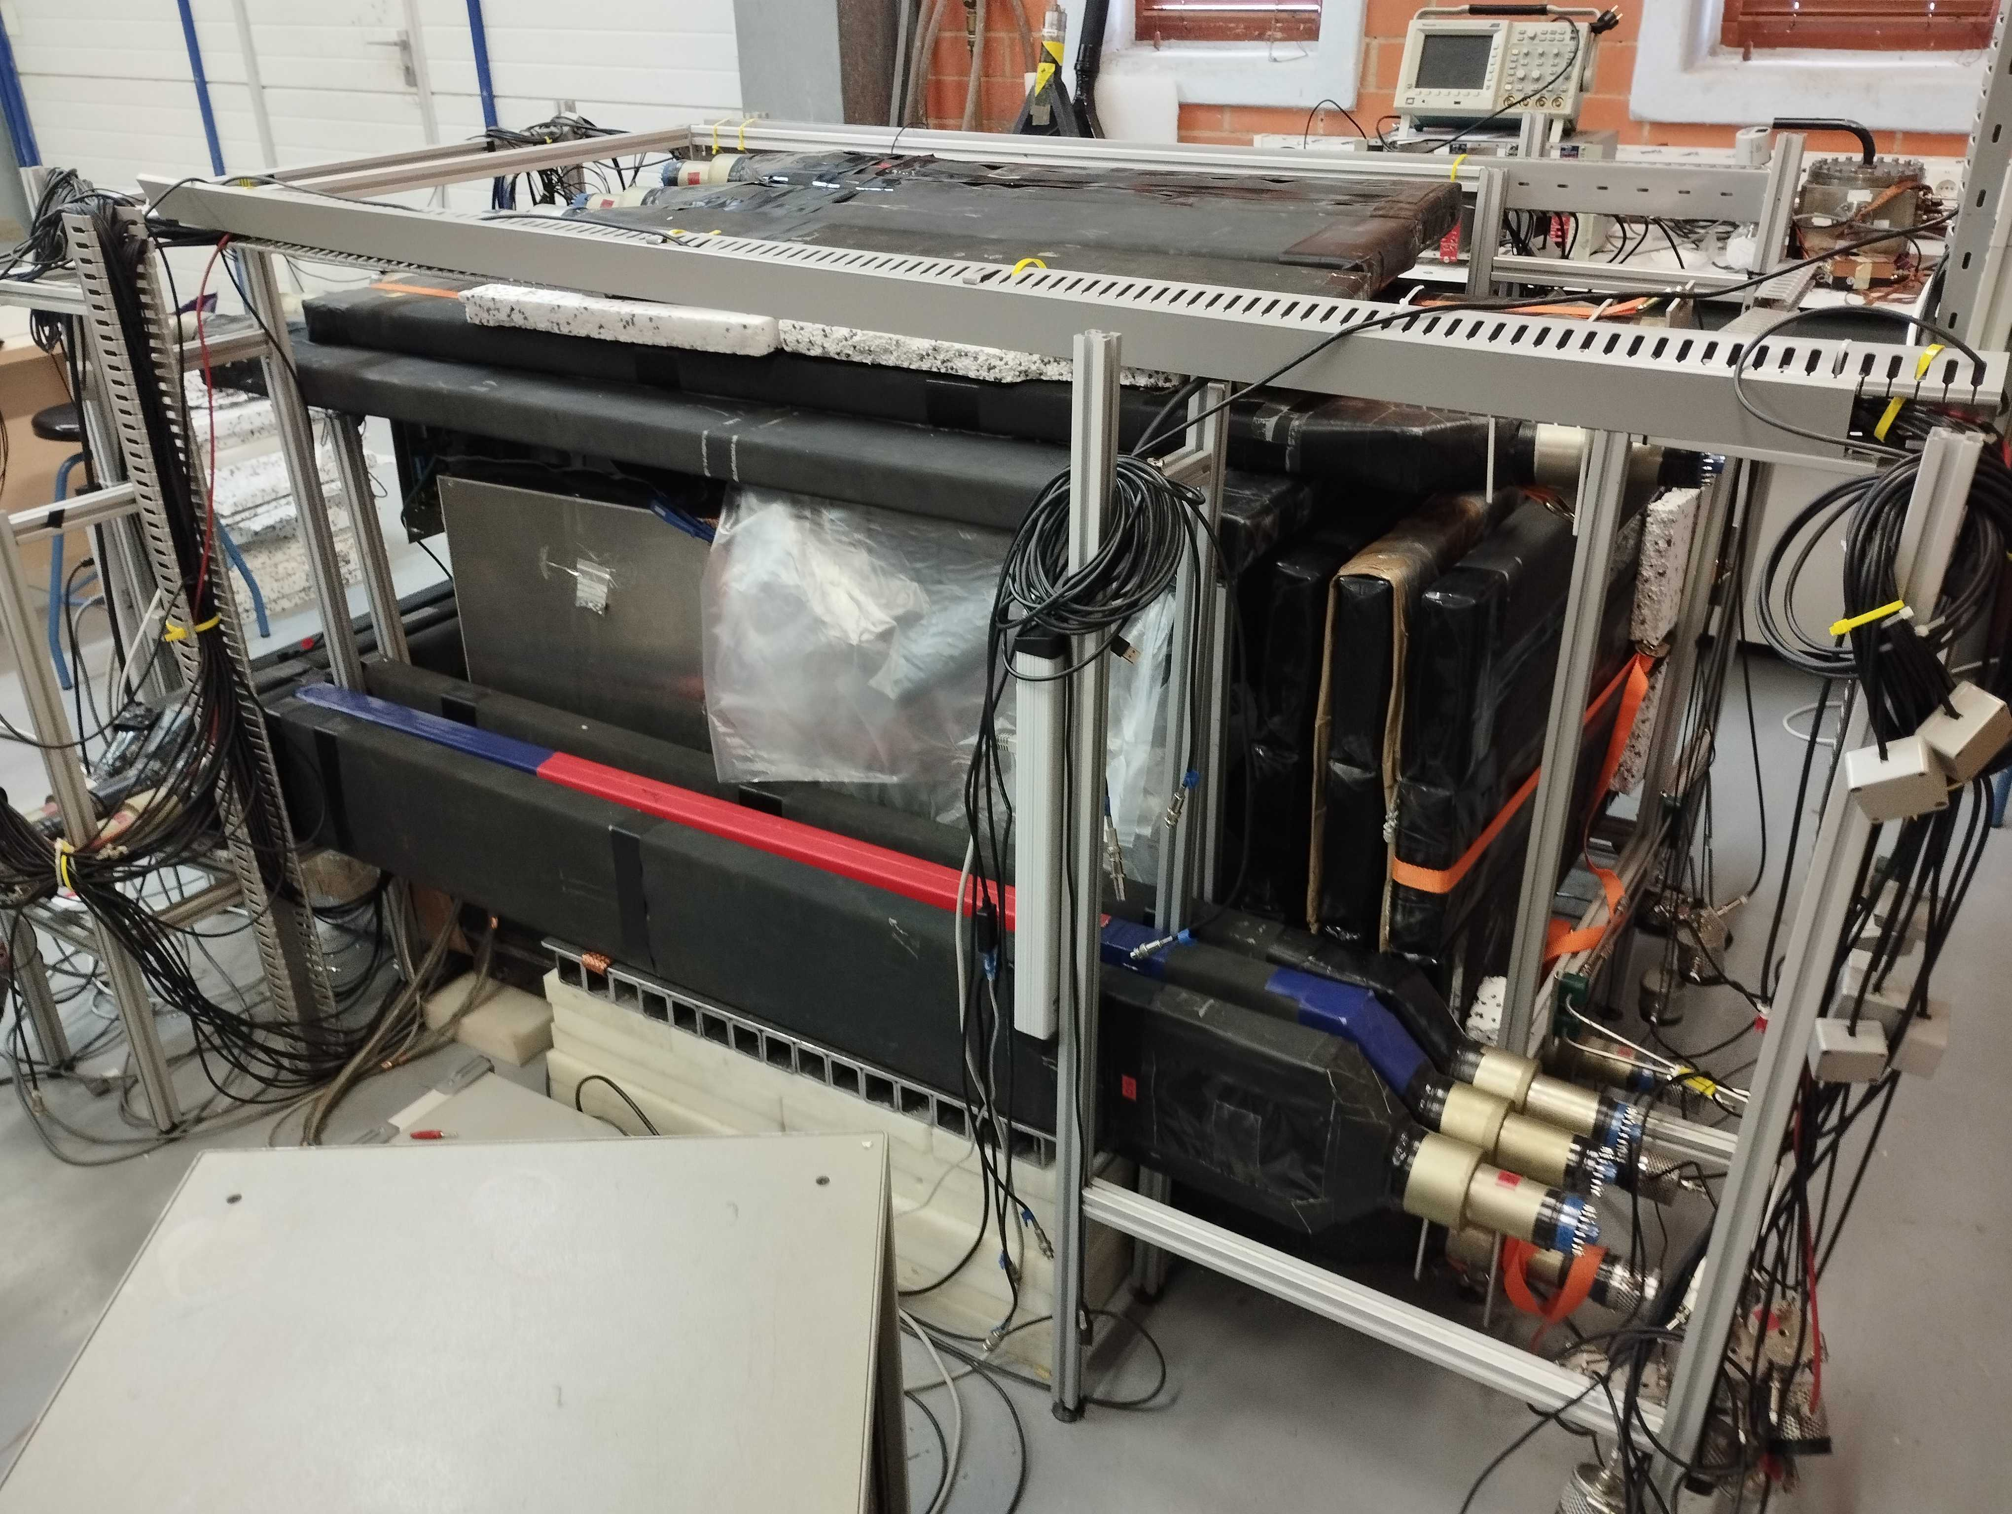
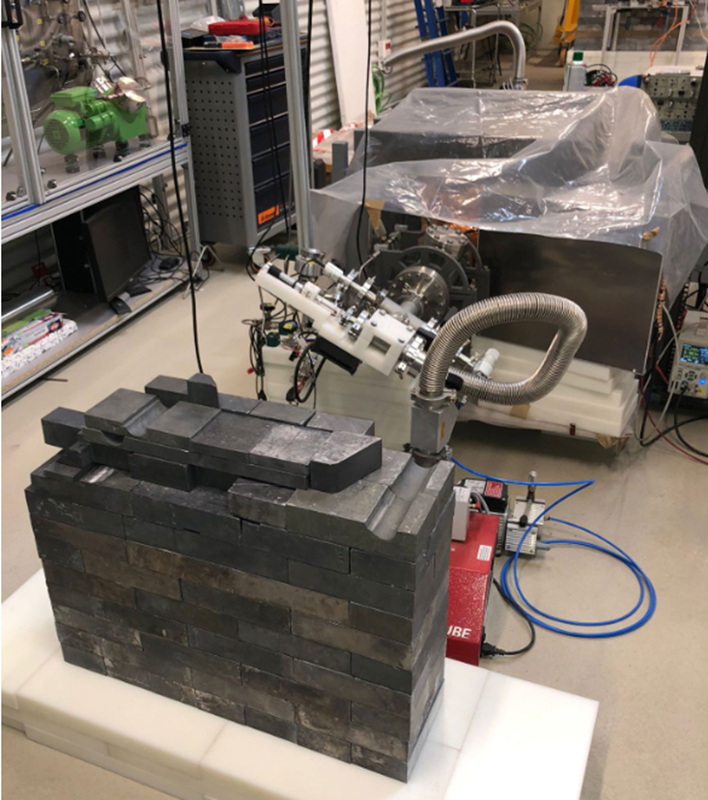
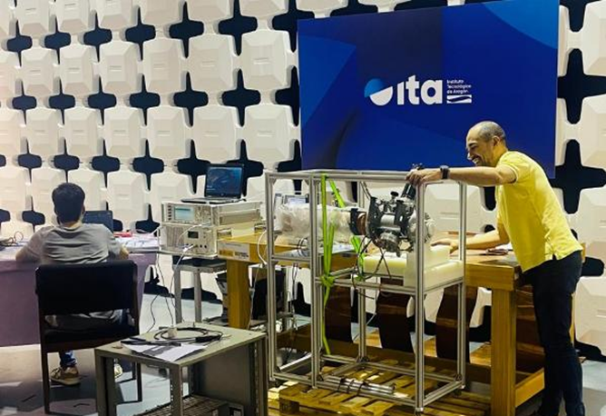
BabyIAXO – Highlights
HENSA @DESY
BabyIAXO Micromegas x-ray detectors built
Intense background study campaigns:
Simulations (CAPA), screening (LSC, CAPA), neutrons (HENSA, measurements @ CAPA, DESY)
Radiopure electronics (ICCUB)
Detectors ITA radiopure electronics, HENSA,…
Radiopure DAQ @ ICCUB
BabyIAXO EMC test campaign (ITA)
IAXO-D1 @CAPA
IAXO-D1 @LSC

Slide 10



CADEX - Canfranc Axion Detector Experiment
14 PM (POSTDOC; CAB)
6 PM (ESTUDIANTE; IFIC )
12 PM (POSTDOC, IFCA)
740 K€

Slide 11
CADEX - Highlights
Proposed axion haloscope experiment to search for QCD axion Dark Matter (DM) in the W-band (80-110 GHz) - well-motivated but so far unexplored region of parameter space (m_{a} = 330-460 μeV)
Spanish collaboration with experiment to eventually be hosted at Canfranc Underground Lab (LSC)
Synergetic activity within IFCA - participation from both Particle Physics and Cosmology groups and with other groups from the Plan Complementario (CAB @ Madrid).
IFCA leads the Science Working Group
IFCA equipping a laboratory CRYOLAB to demonstrate the integration of the core technologies: Cryostat acquisition, installation and operation. Demonstration of key technology (magnet haloscope, detectors,…) this activity is partially funded the Plan Complementario
Dilution
Refrigerator
at Cryolab (IFCA)
11

Slide 12


ANAIS - Annual modulation with NaI Scintillators
3 PM (STUDENT, CAPA)
31 PM (POSTDOC, CAPA)
327 K€
PPCC meeting, Santander, 26/11/25

Slide 13
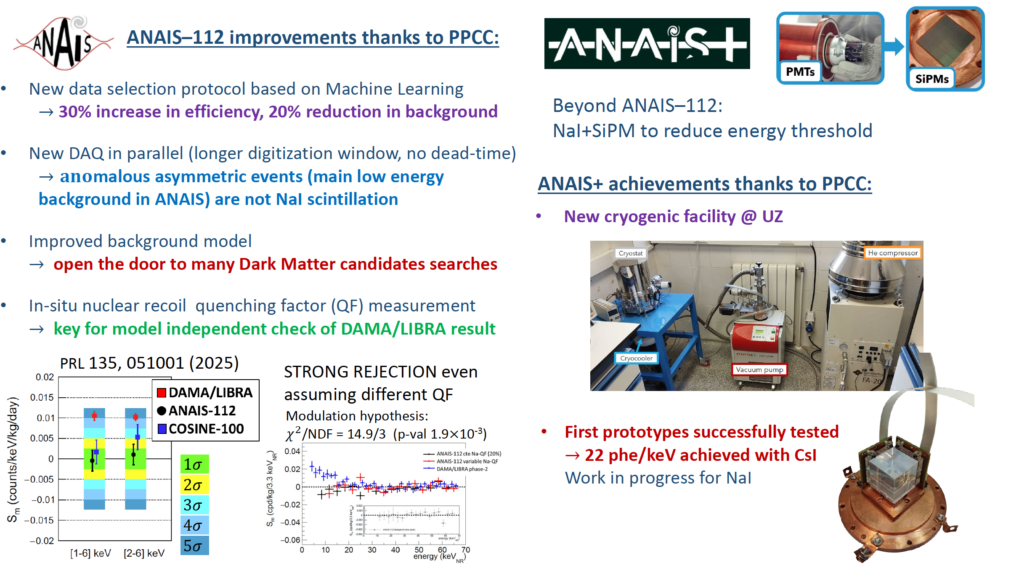
13

Slide 14

DAMIC-M – Dark Matter in CCD at MODANE
IFCA
12 PM (STUDENT, IFCA)
50 K€

Slide 15

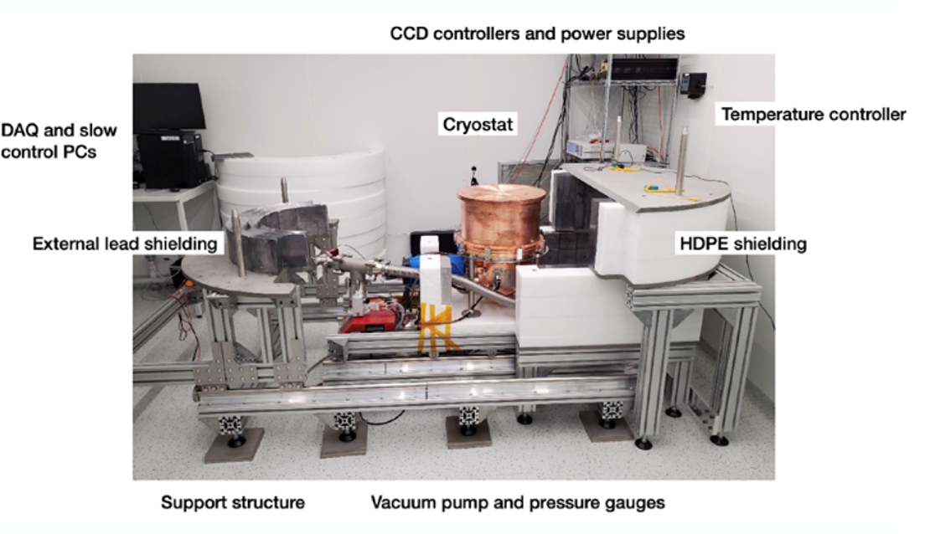
DAMIC-M – Highlights
The DAMIC-M experiment at Modane Underground Laboratory focuses on the search for light DM candidates, between eV up to a few GeV
The sensing technology based on skipper CCDs with single electron resolution, that will improve by orders of magnitude the existing limits on DM for a range of different models.
Low Background Chamber (LBC) First operational prototype of the DAMIC-M detector:
LBC validates the final detector concept: background levels, noise performance, stability, and sub-eV signal response and platform to optimize readout electronics and skipper acquisition algorithms.
IFCA Contributions (Plan Complementario Context)
Key participation in LBC validation and operation (2023–2025).
Development of data-quality monitoring and background/noise analysis tools.
Skipper CCD characterization: noise, stability, performance.
Contribution to internal detector components and ultra-pure copper handling (LSC, ESS-Bilbao, Idresa).
15

Slide 16
TREX-DM - TPC for Rare Event eXperiments-DM
22 PM (STUDENT, CAPA) 24 PM (ENGINEER, ITA)
340 K€

Slide 17
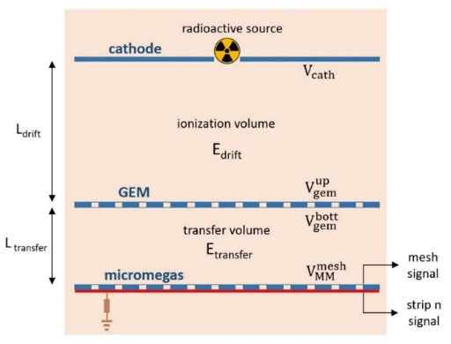
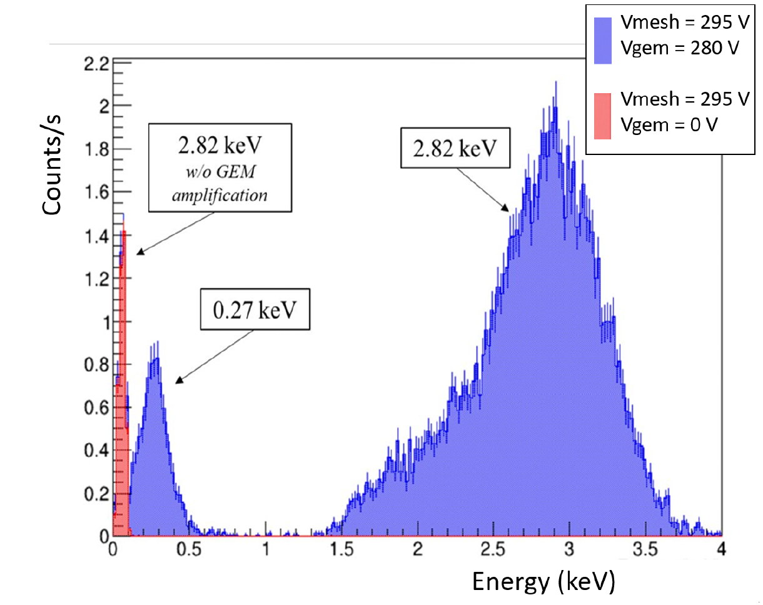
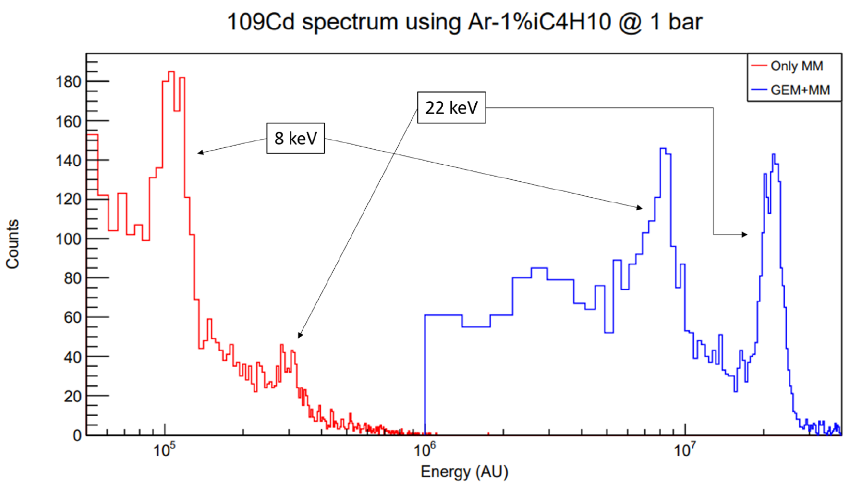
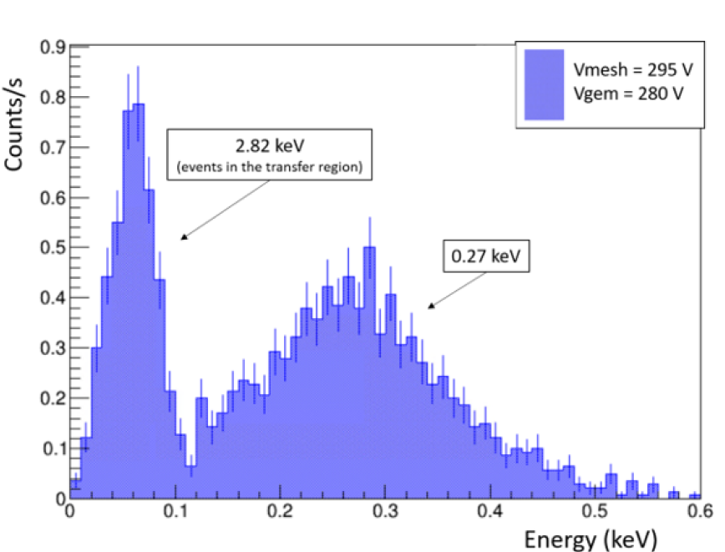
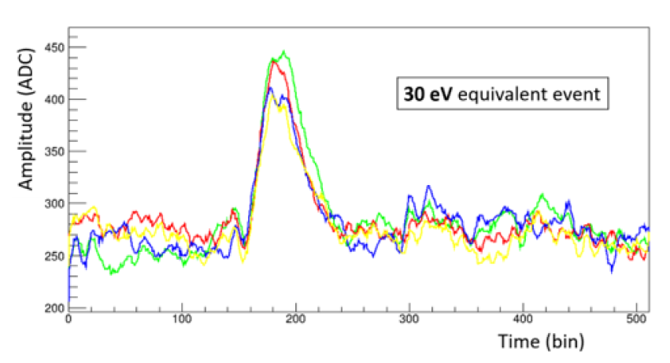
TREX-DM – Highlights
New Micromegas readout with GEM preamplification → dramatic improvement in E threshold
Special lwo energy ⁴⁷Ar gaseous source develop via irradiation of Ca with neutrons at CNA;
37Ar Gas source: distribution in all volume; 2.8 keV (90%), 0.27keV (9%).
Experiment entering now data taking phase
~30 eV event!
x80
Big microbulk mM @1bar
Example of low-energy events

Slide 18
Conclusions
Successful implementation of PPCC in LIA5. In general resources have helped to strengthen the community in a complementary way to standard capabilities
Consolidate Spanish leadership in large international projects: BabyIAXO well into construction phase at DESY
Supporting proper physics exploitation from consolidated projects: ANAIS new physics results, TREX-DM in operation
Enabling further fundraising successes: Award of DarkQuantum ERC-SyG in RADES.
Enabling new emerging projects: new window in axion mass CADEX, earlier physics from RADES-LF (CERN proposal),…
Exploiting synergies and creating network among Spanish groups

Slide 19

Thank you for your attention
Acknowledgements to the “European Union NextGenerationEU/PRTR” (Planes complementarios, Programa de Astrofísica y Física de Altas Energías), co-funded by Gobierno de Aragón

Slide 20
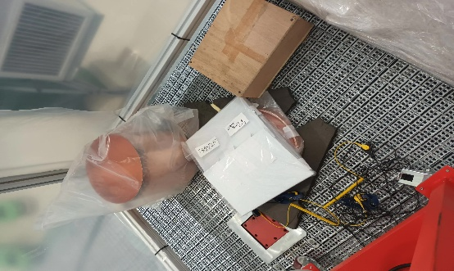
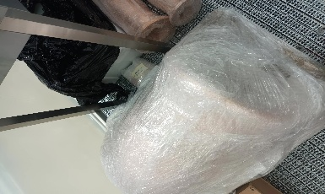
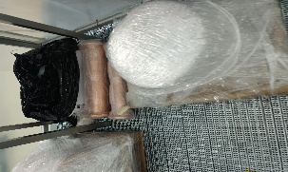
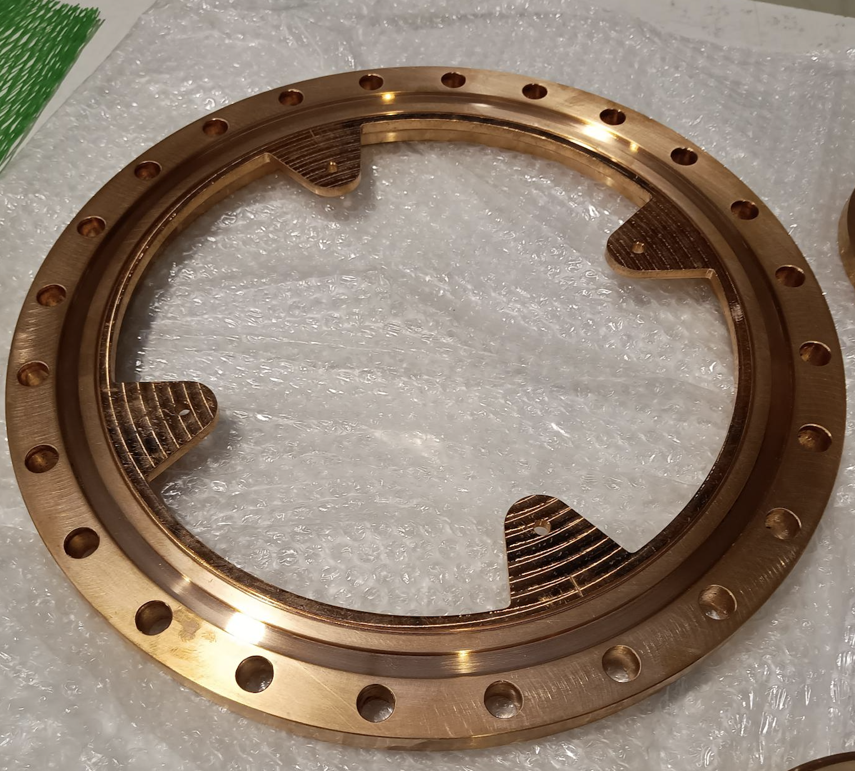
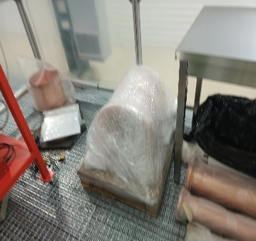
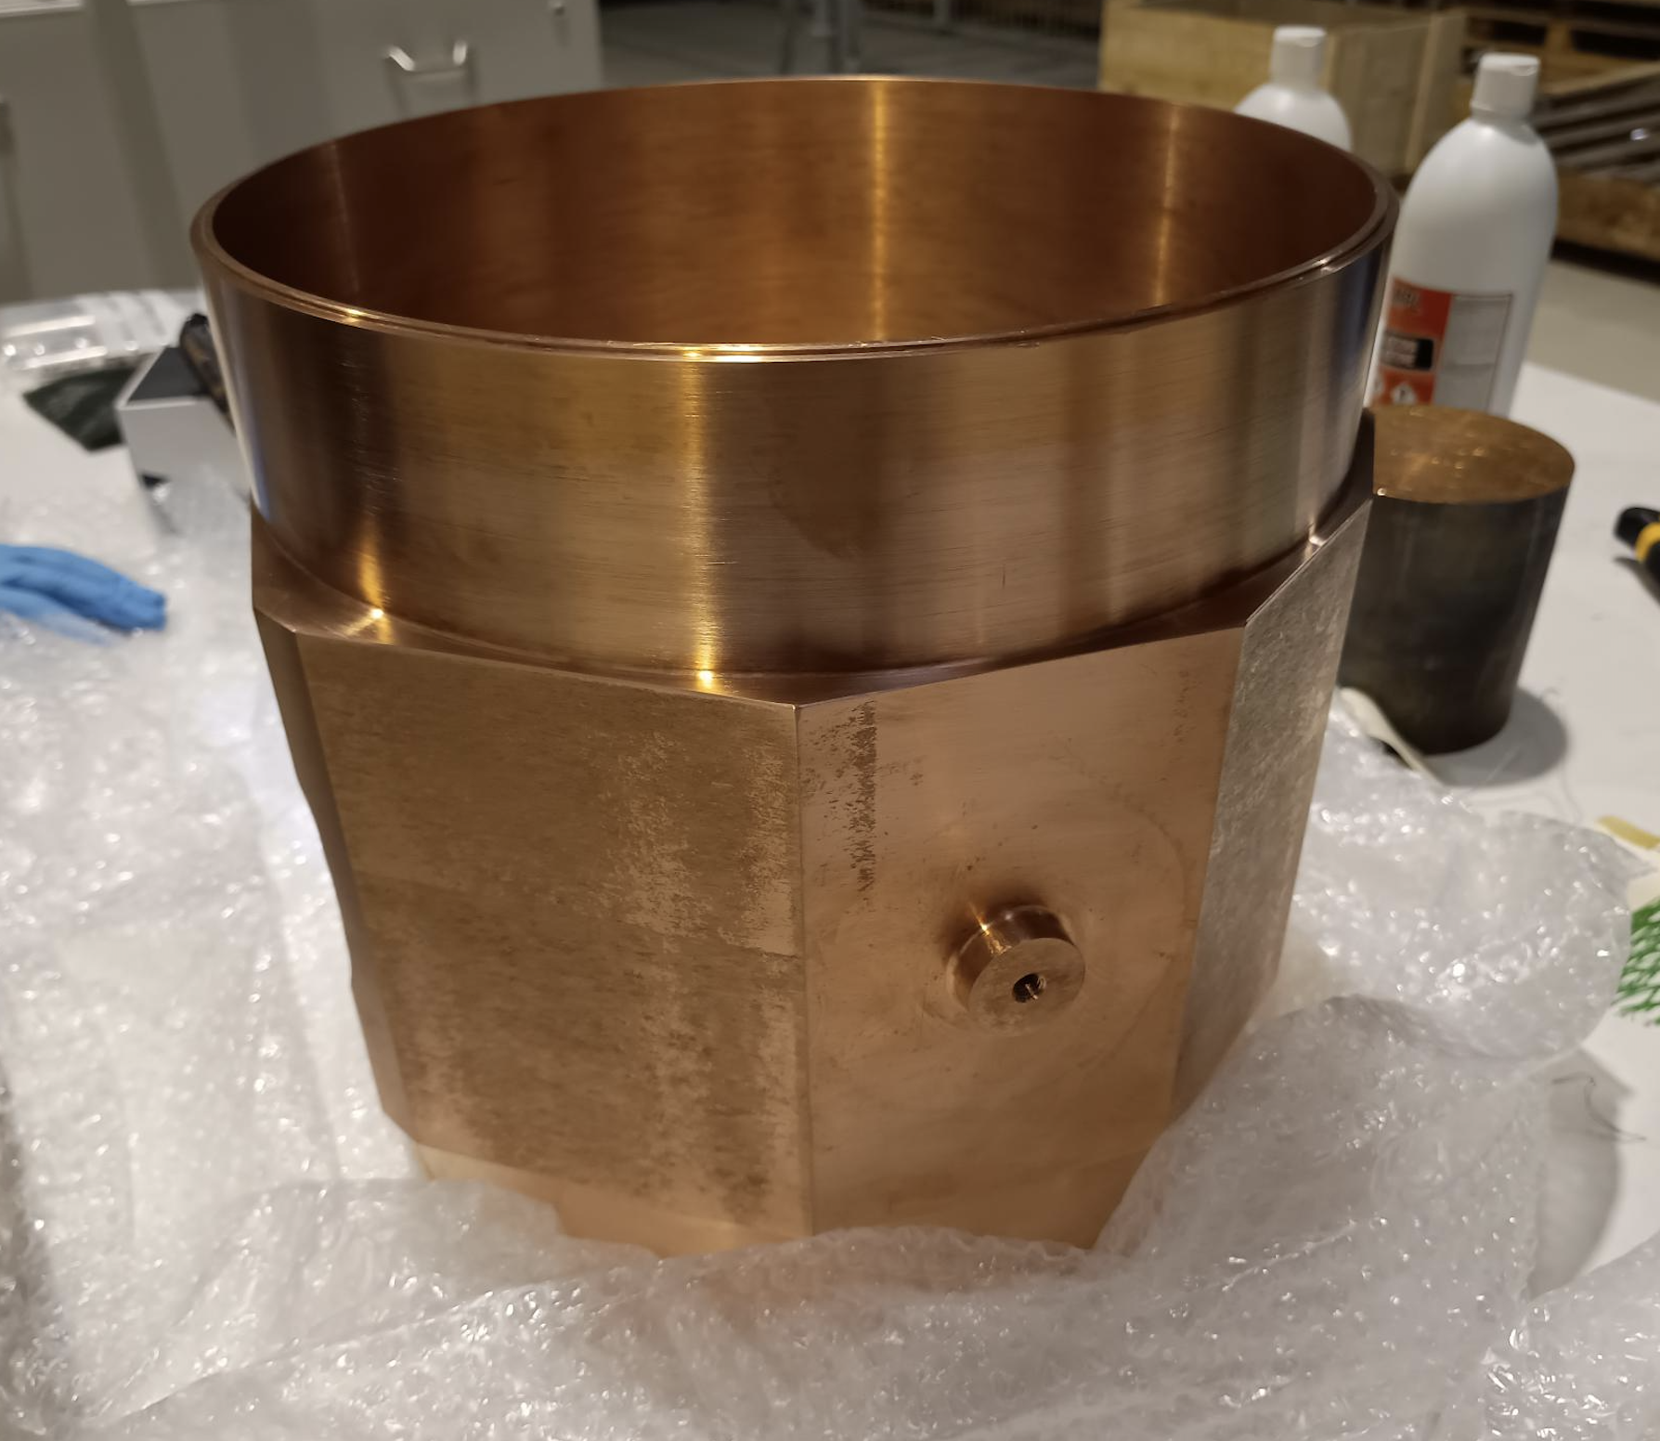
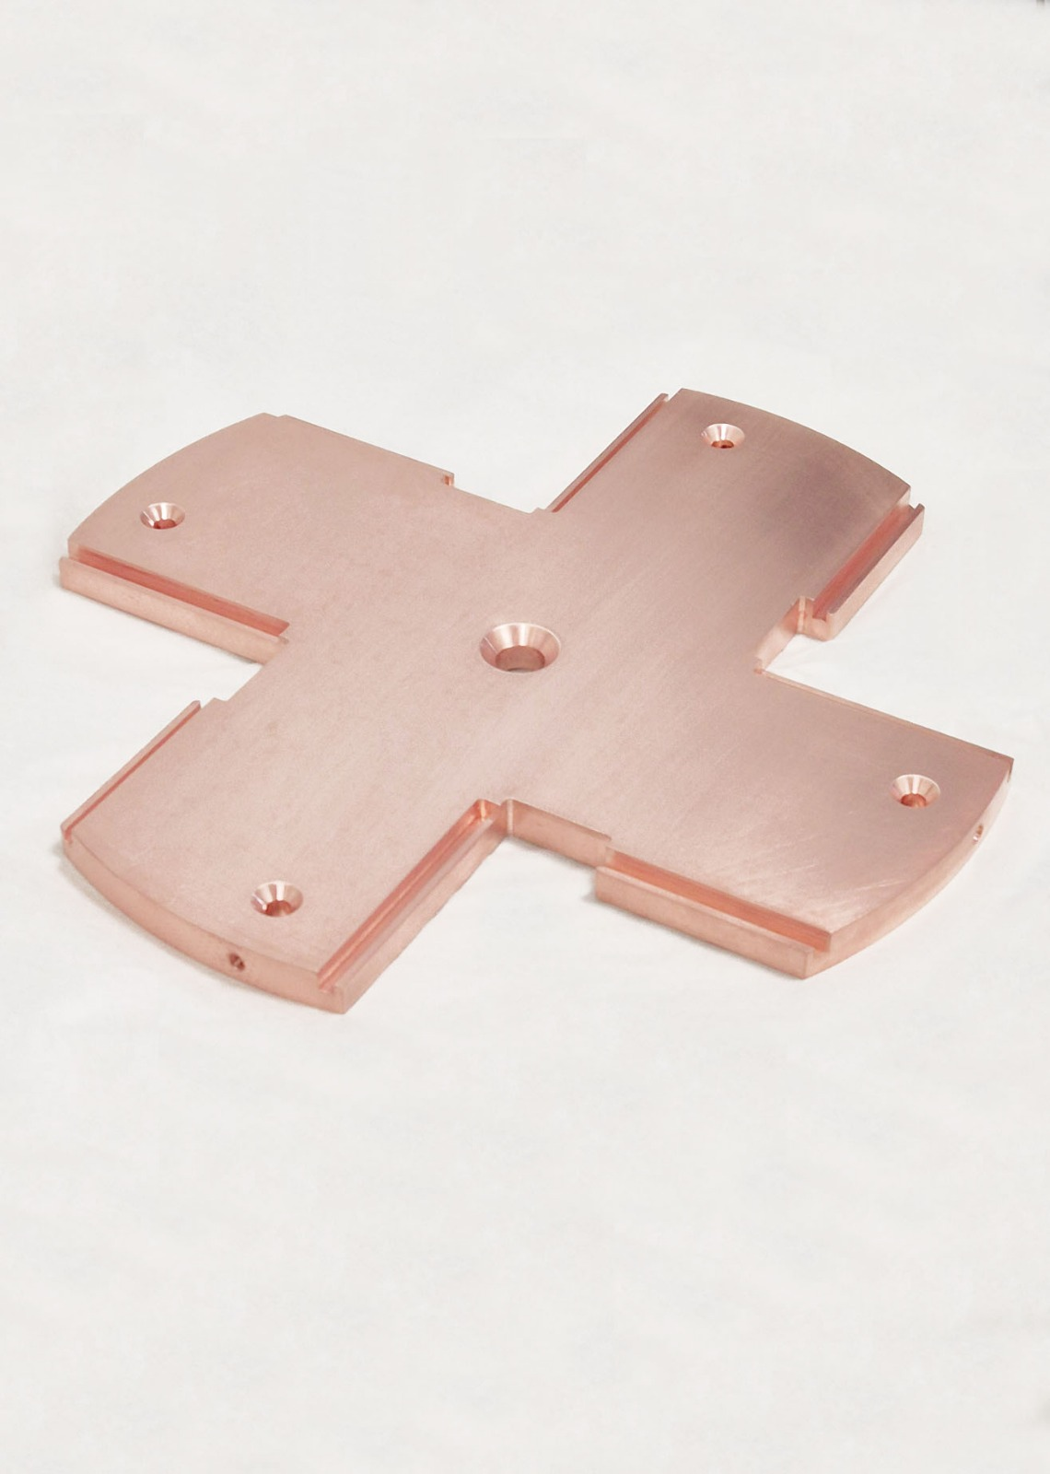
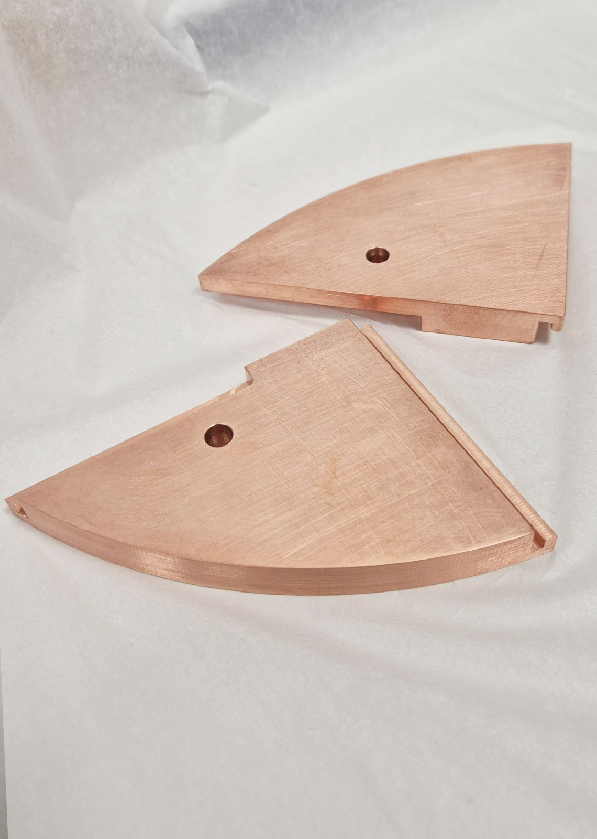
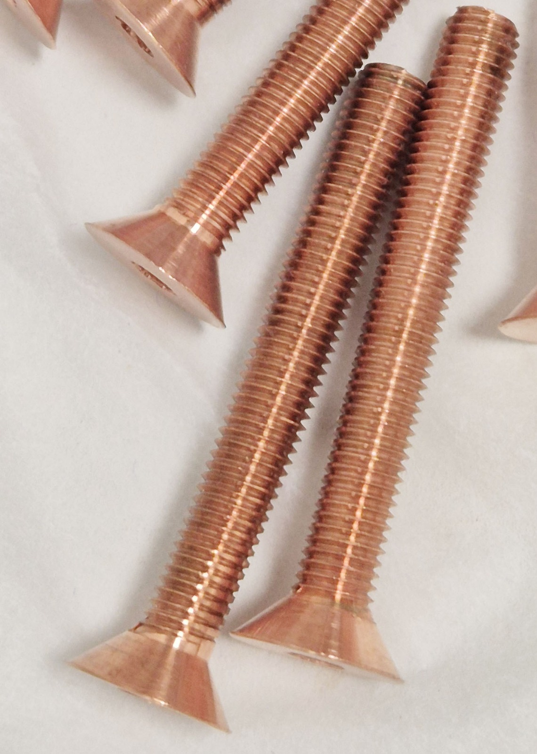
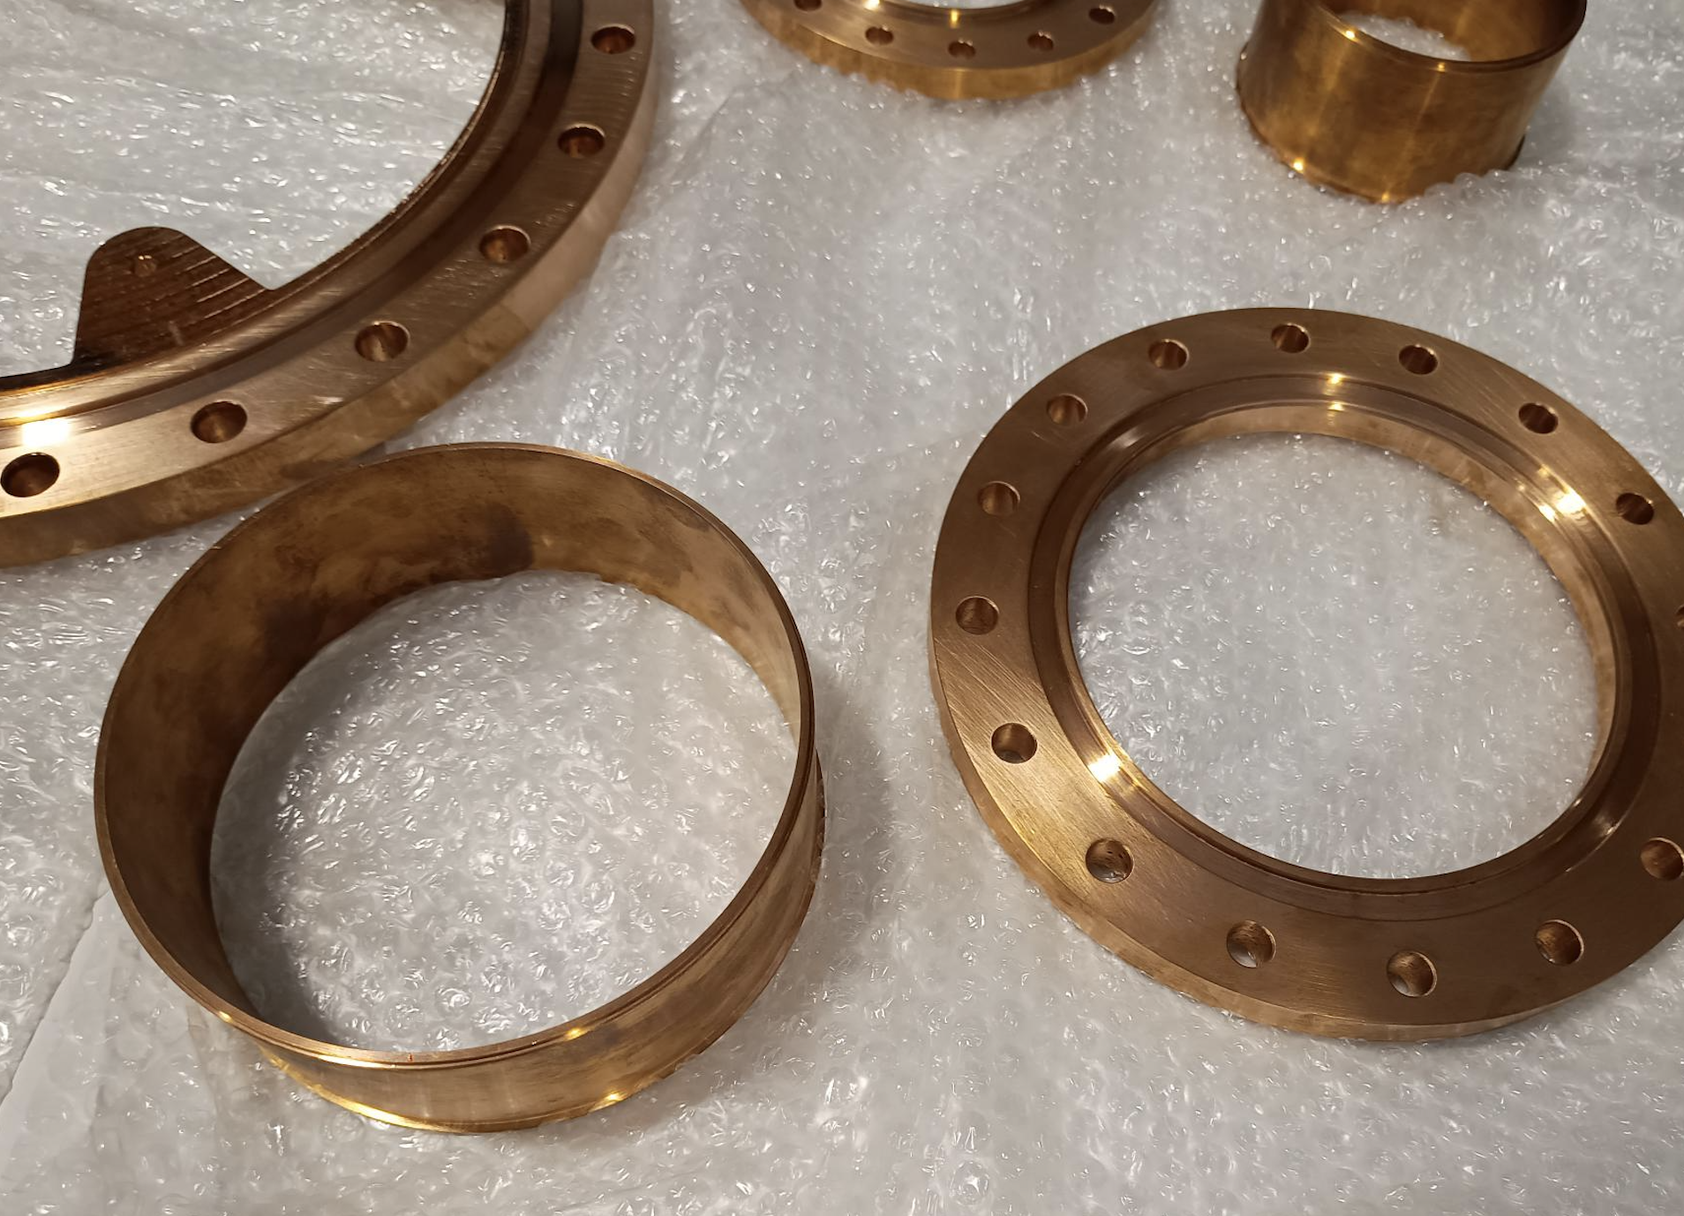
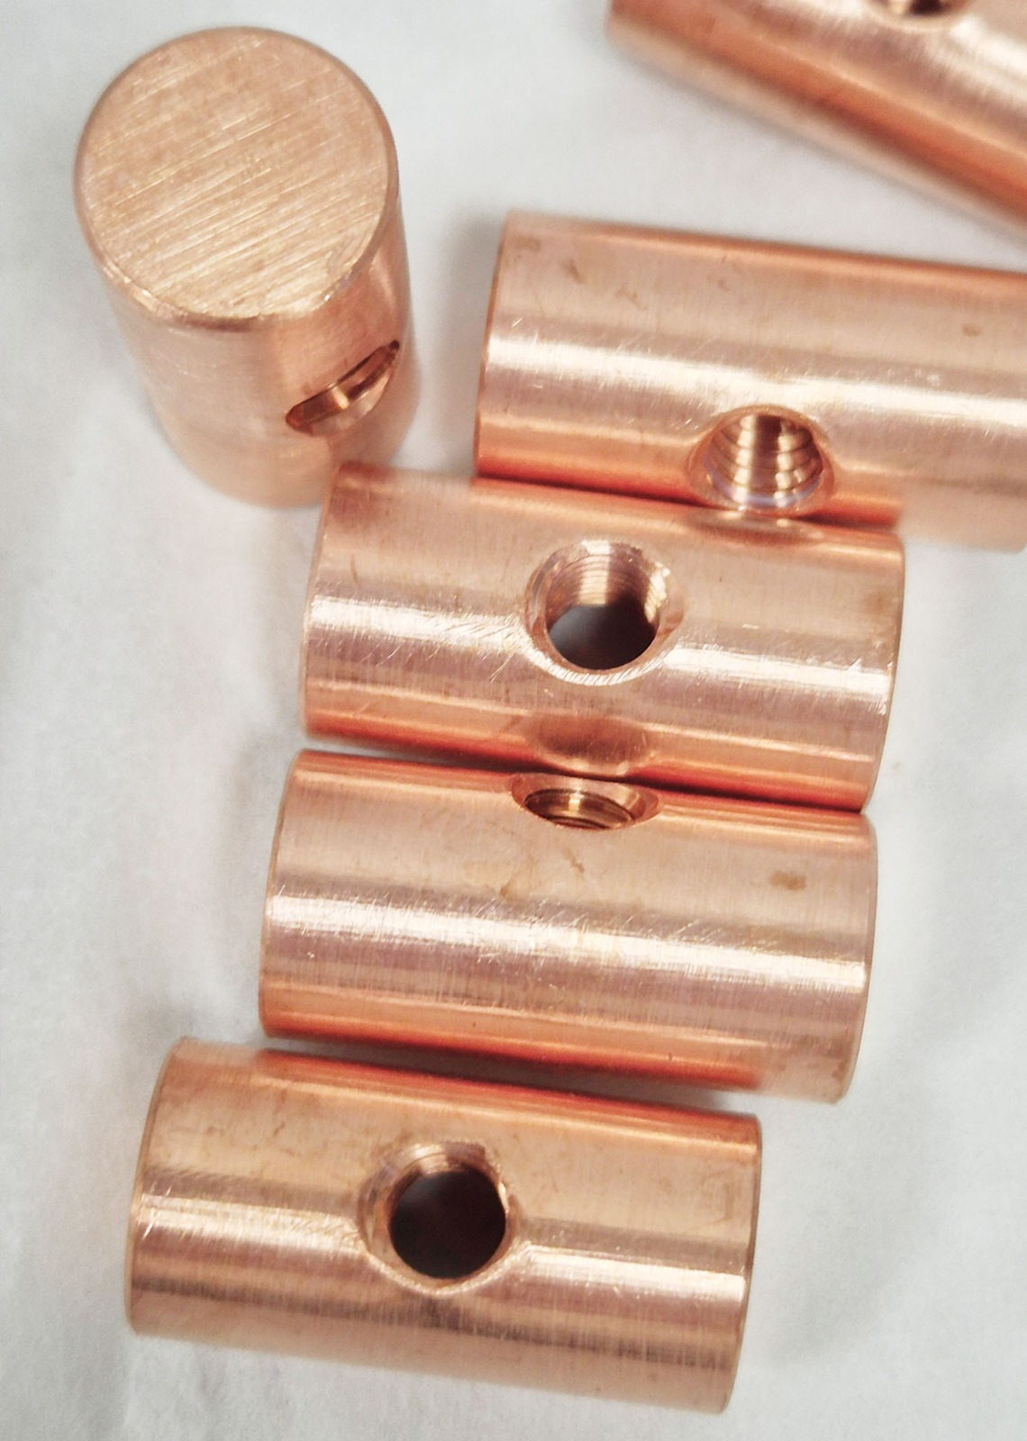
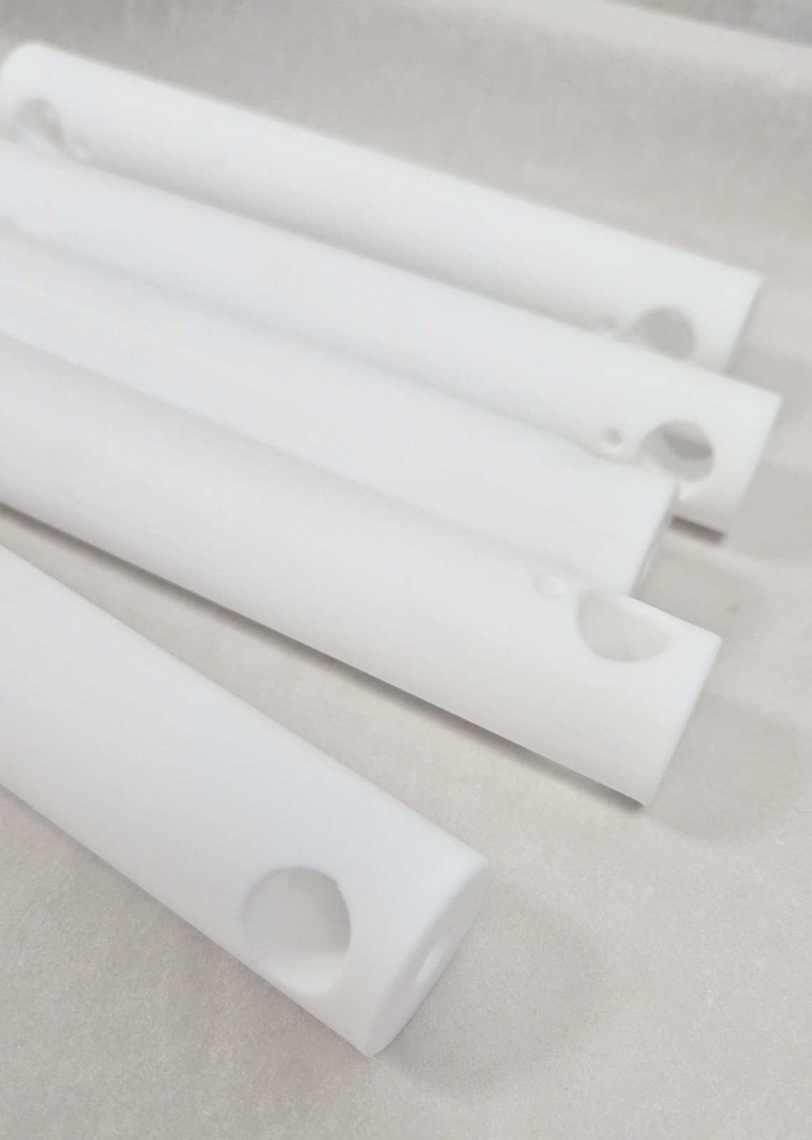
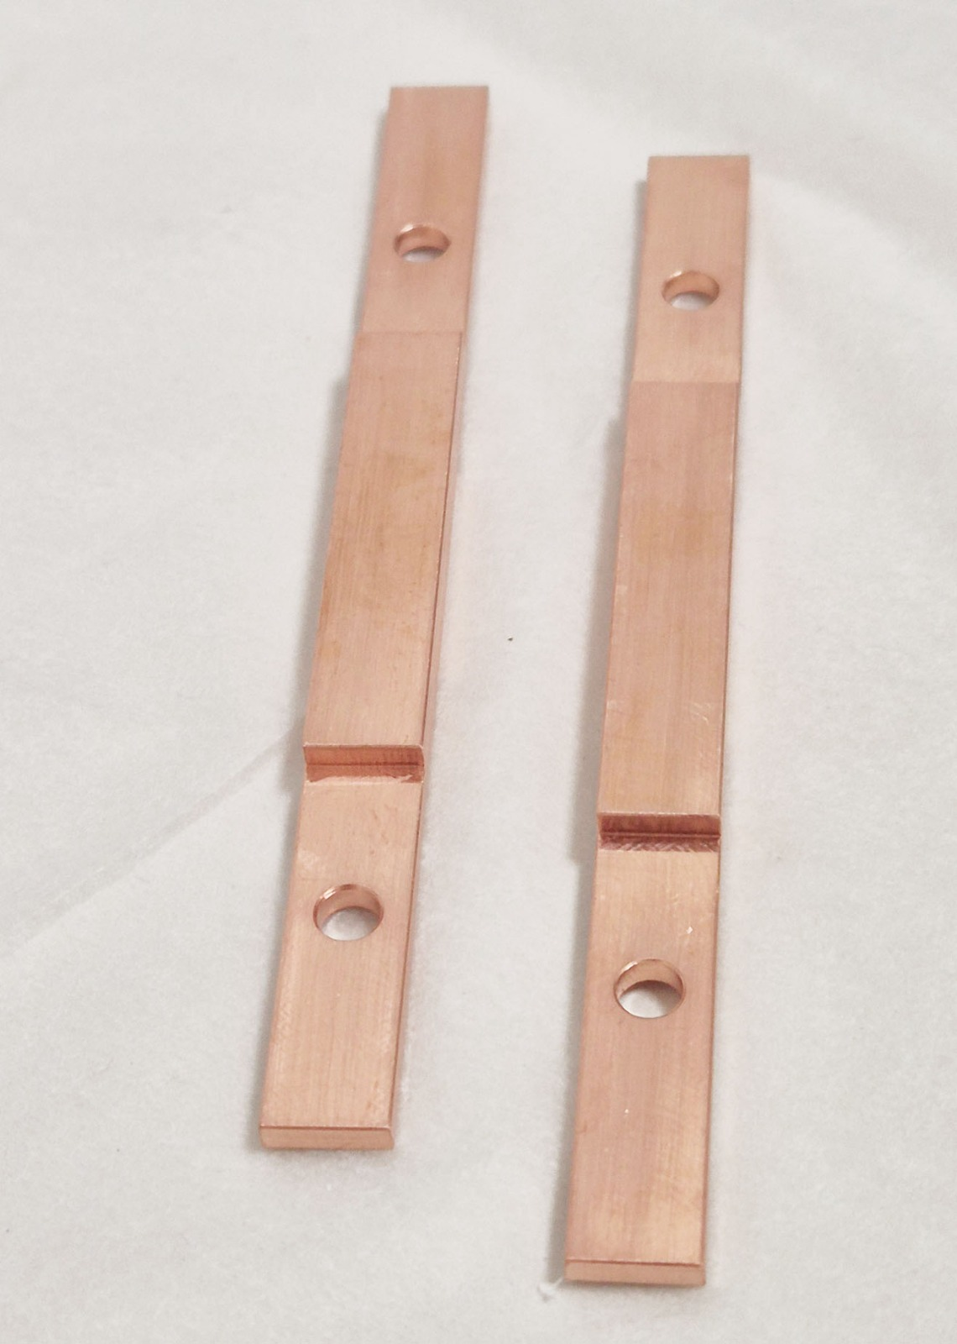
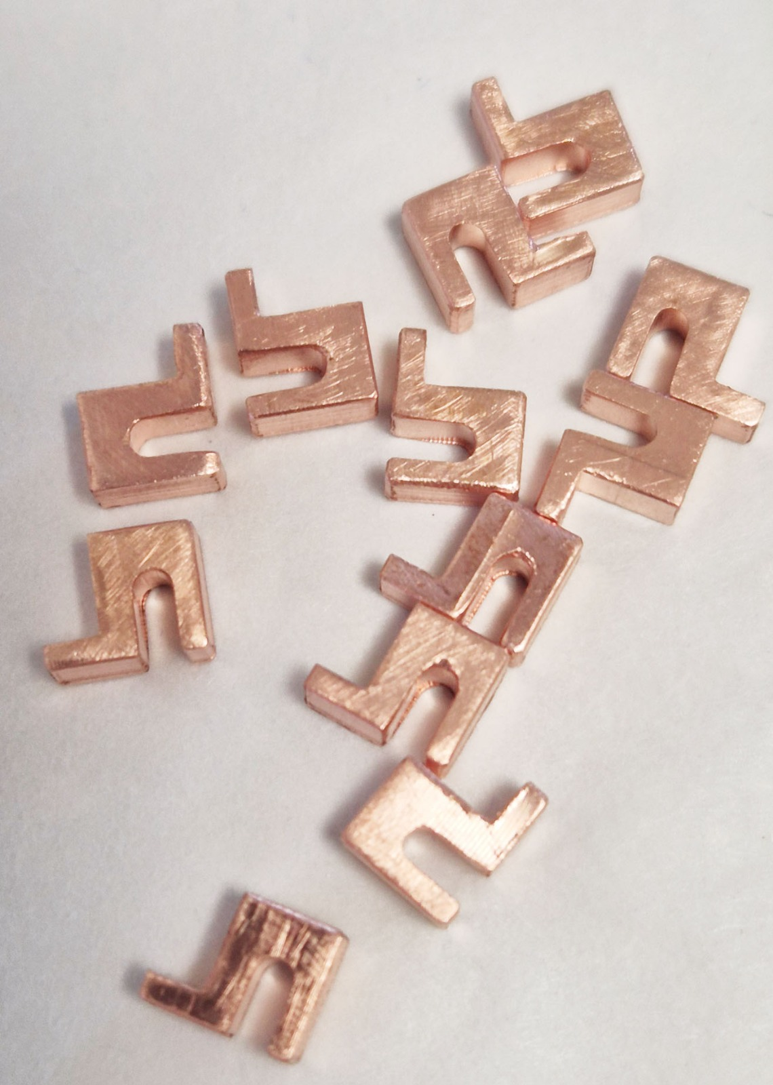
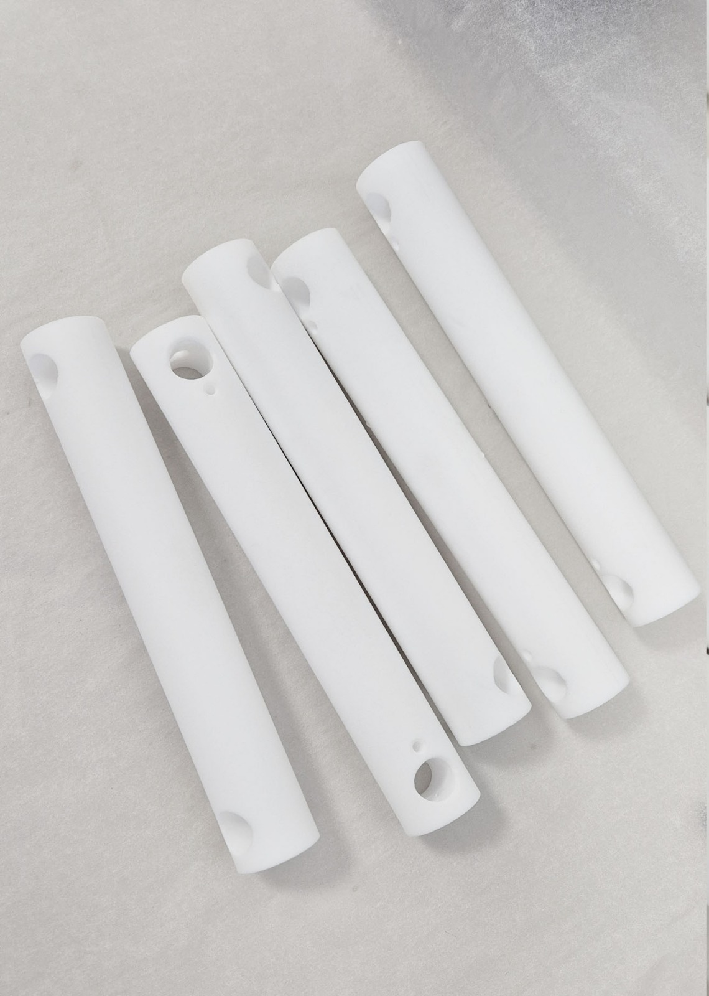
DAMIC-M – Highlights
CCD module production at UW completed (late 2024):
➡ LSM Underground characterization before array assembly (ongoing NOW).
➡ Production electronics testing ongoing
➡ Copper machining ongoing, lead and poly shield ready.
Inner parts of DAMIC-M (Vessel, cross, CCDs array, IR shield,..) are made of Copper (OFHE and EFC. Machined at national companies (Idresa and ESSBilbao)
These pieces stored at LSC -> LSC key to keep the background level propose by DAMIC-M
PPCC funding (Phd student) contributed to all these actions

