Slide 1
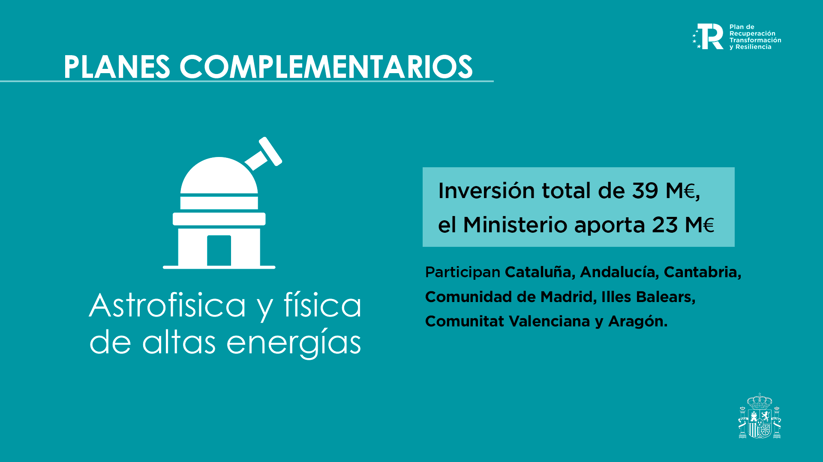
THE PHOTSAT MISSION
Big science with a small satellite
LIA7
Josep Manel Carrasco
Project Scientist
Ignasi Esteva
Project Manager
Josh Wilkinson
Systems Engineer
Ignasi Ribas
PI
Guillem Anglada-Escudé
co-PI

Slide 2





INTRODUCTION
Objectives
All-sky monitoring of the 40 million brighter stars and other astrophysical objects, mainly to support high-precision programmes of all kinds (exoplanets, stellar physics, Solar System, cosmology, transients)
Develop the capability of executing science experiments from scratch, including preliminary design, construction, launch, and operations; using off-the-shelf #newspace technologies
PhotSat is the first astrophysical satellite developed from design to operations by the IEEC and the local industrial ecosystem

Slide 3
IN A NUTSHELL…
The payload
The mission
Parameter | Value
Telescopes | 1 Visible + 1 Ultraviolet
Diameters | 70 mm
WIDE passband | 500 – 840 nm
RED passband | 670 – 840 nm
UV passband | 245 – 310 nm
Detectors | 2 x EHD GSENSE2020BSI (2048x2048 pixels)
Exposure time | 3.125 seconds (frames) 50 seconds (coadded)
Pixel size | 14 arcsec/pix (6.5 μm)
Parameter | Value
Launch | 2026
Lifetime | 2 – 3 years
Full sky scan | 2 – 3 days
Field of view | 8 deg x 8 deg
Orbit | LEO SSO (>500 km)
Ground stations | Montsec & Svalbard
Cubesat | 16U
Number of observations | 100 - 1000 obs/source/yr

Slide 4
SCIENTIFIC JUSTIFICATION
SCIENCE CASES
UV coverage – not accessible from a ground-based telescope
Homogeneous full-sky coverage – not accessible from a single ground-based telescope with a single instrument
High-cadence time-domain monitoring of bright sources – not observable with larger telescopes (saturation)
Broad wavelength coverage of all stellar types (white dwarfs, red giants, emission line stars, …)
Balmer jump measurement – not accessible from ground
Transient events: Supernovae, stellar flares, gamma-ray bursts, AGN, …
Periodic events: Pulsating stars, stellar activity, eclipsing binaries, ...
Solar System: Asteroids and near-Earth objects
Complete catalog of celestial objects in UV and VIS
Space debris: Monitoring MEO/LEO satellites

Slide 5
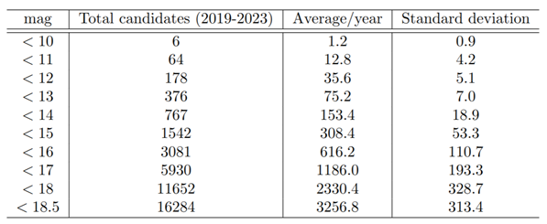
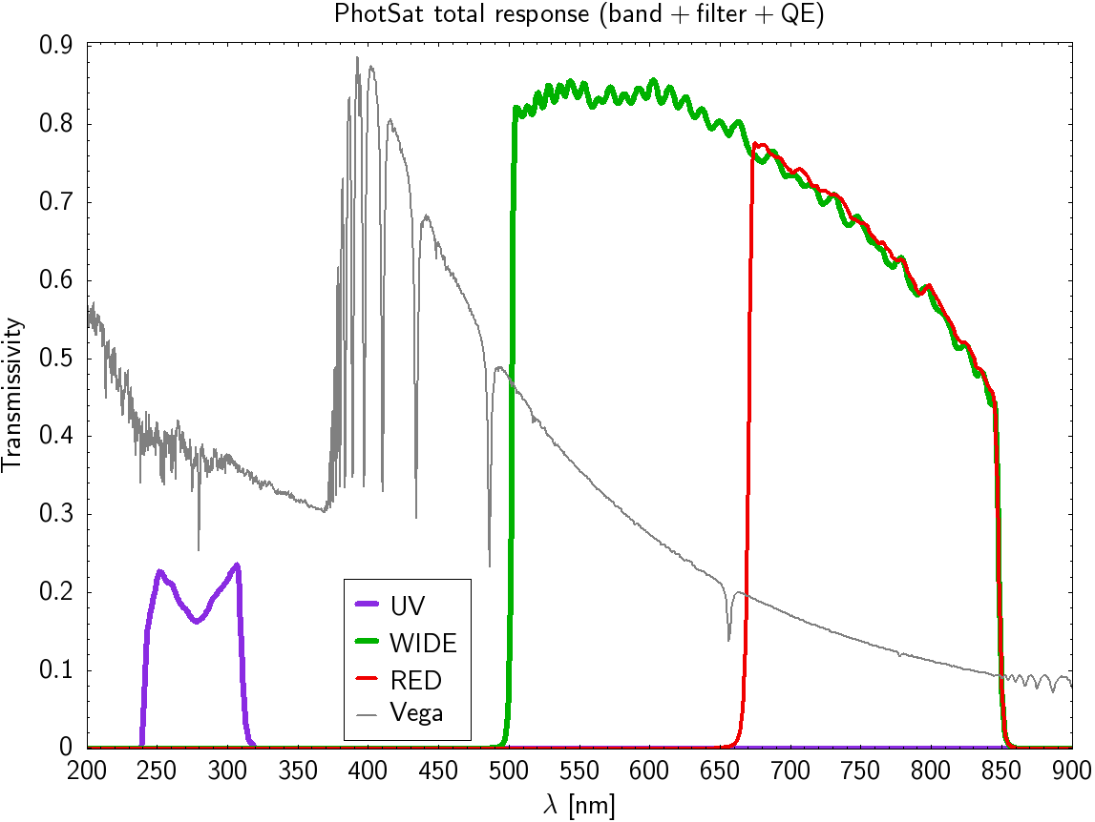
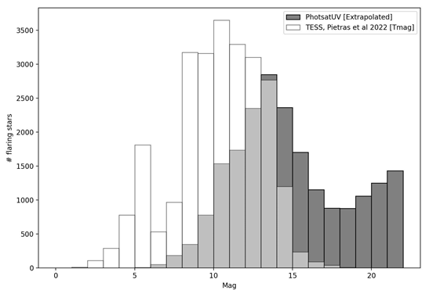
SCIENCE CASES
Expected number of transient events
Balmer jump for an A-type star
Stellar flares

Slide 6
PHOTSAT FOR SST
PhotSat has great potential for debris and artificial satellite studies:
Large field of view (FoV=8º x 8º → 11.3º diagonal)
Full sky scan every 2 – 3 days (except 32º around the Sun)
Sources at the anti-Sun position observed every orbit (∼90 min)
All sources brighter than 14 – 15 mag
One full FoV observed during 50 seconds (16 frames of 3 s)
Half of the FoV observed again the following 50 seconds
Follow-up observations from IEEC telescopes at Montsec observatory (TRAC, TFRM, TJO)
Pathfinder to test methodology and improvements for a future fully-devoted SST satellite?

Slide 7
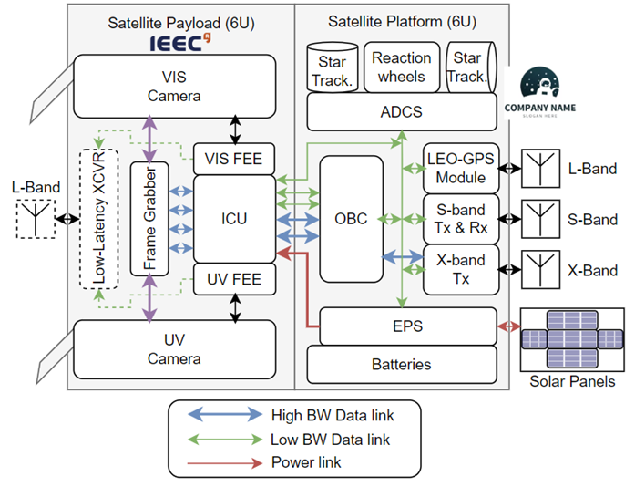


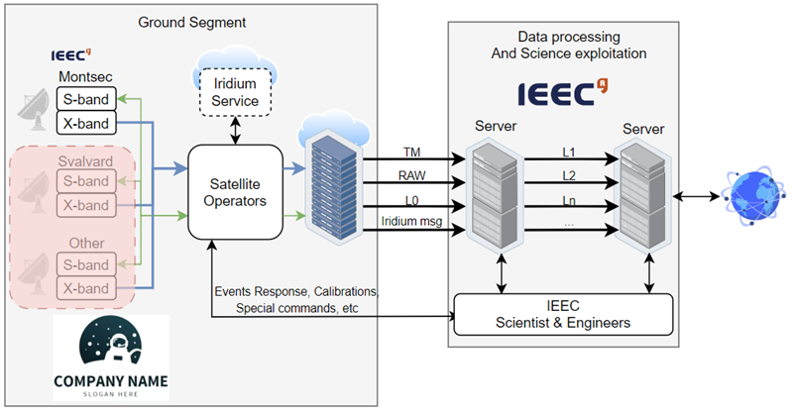







SYSTEM DEVELOPMENT

Slide 8
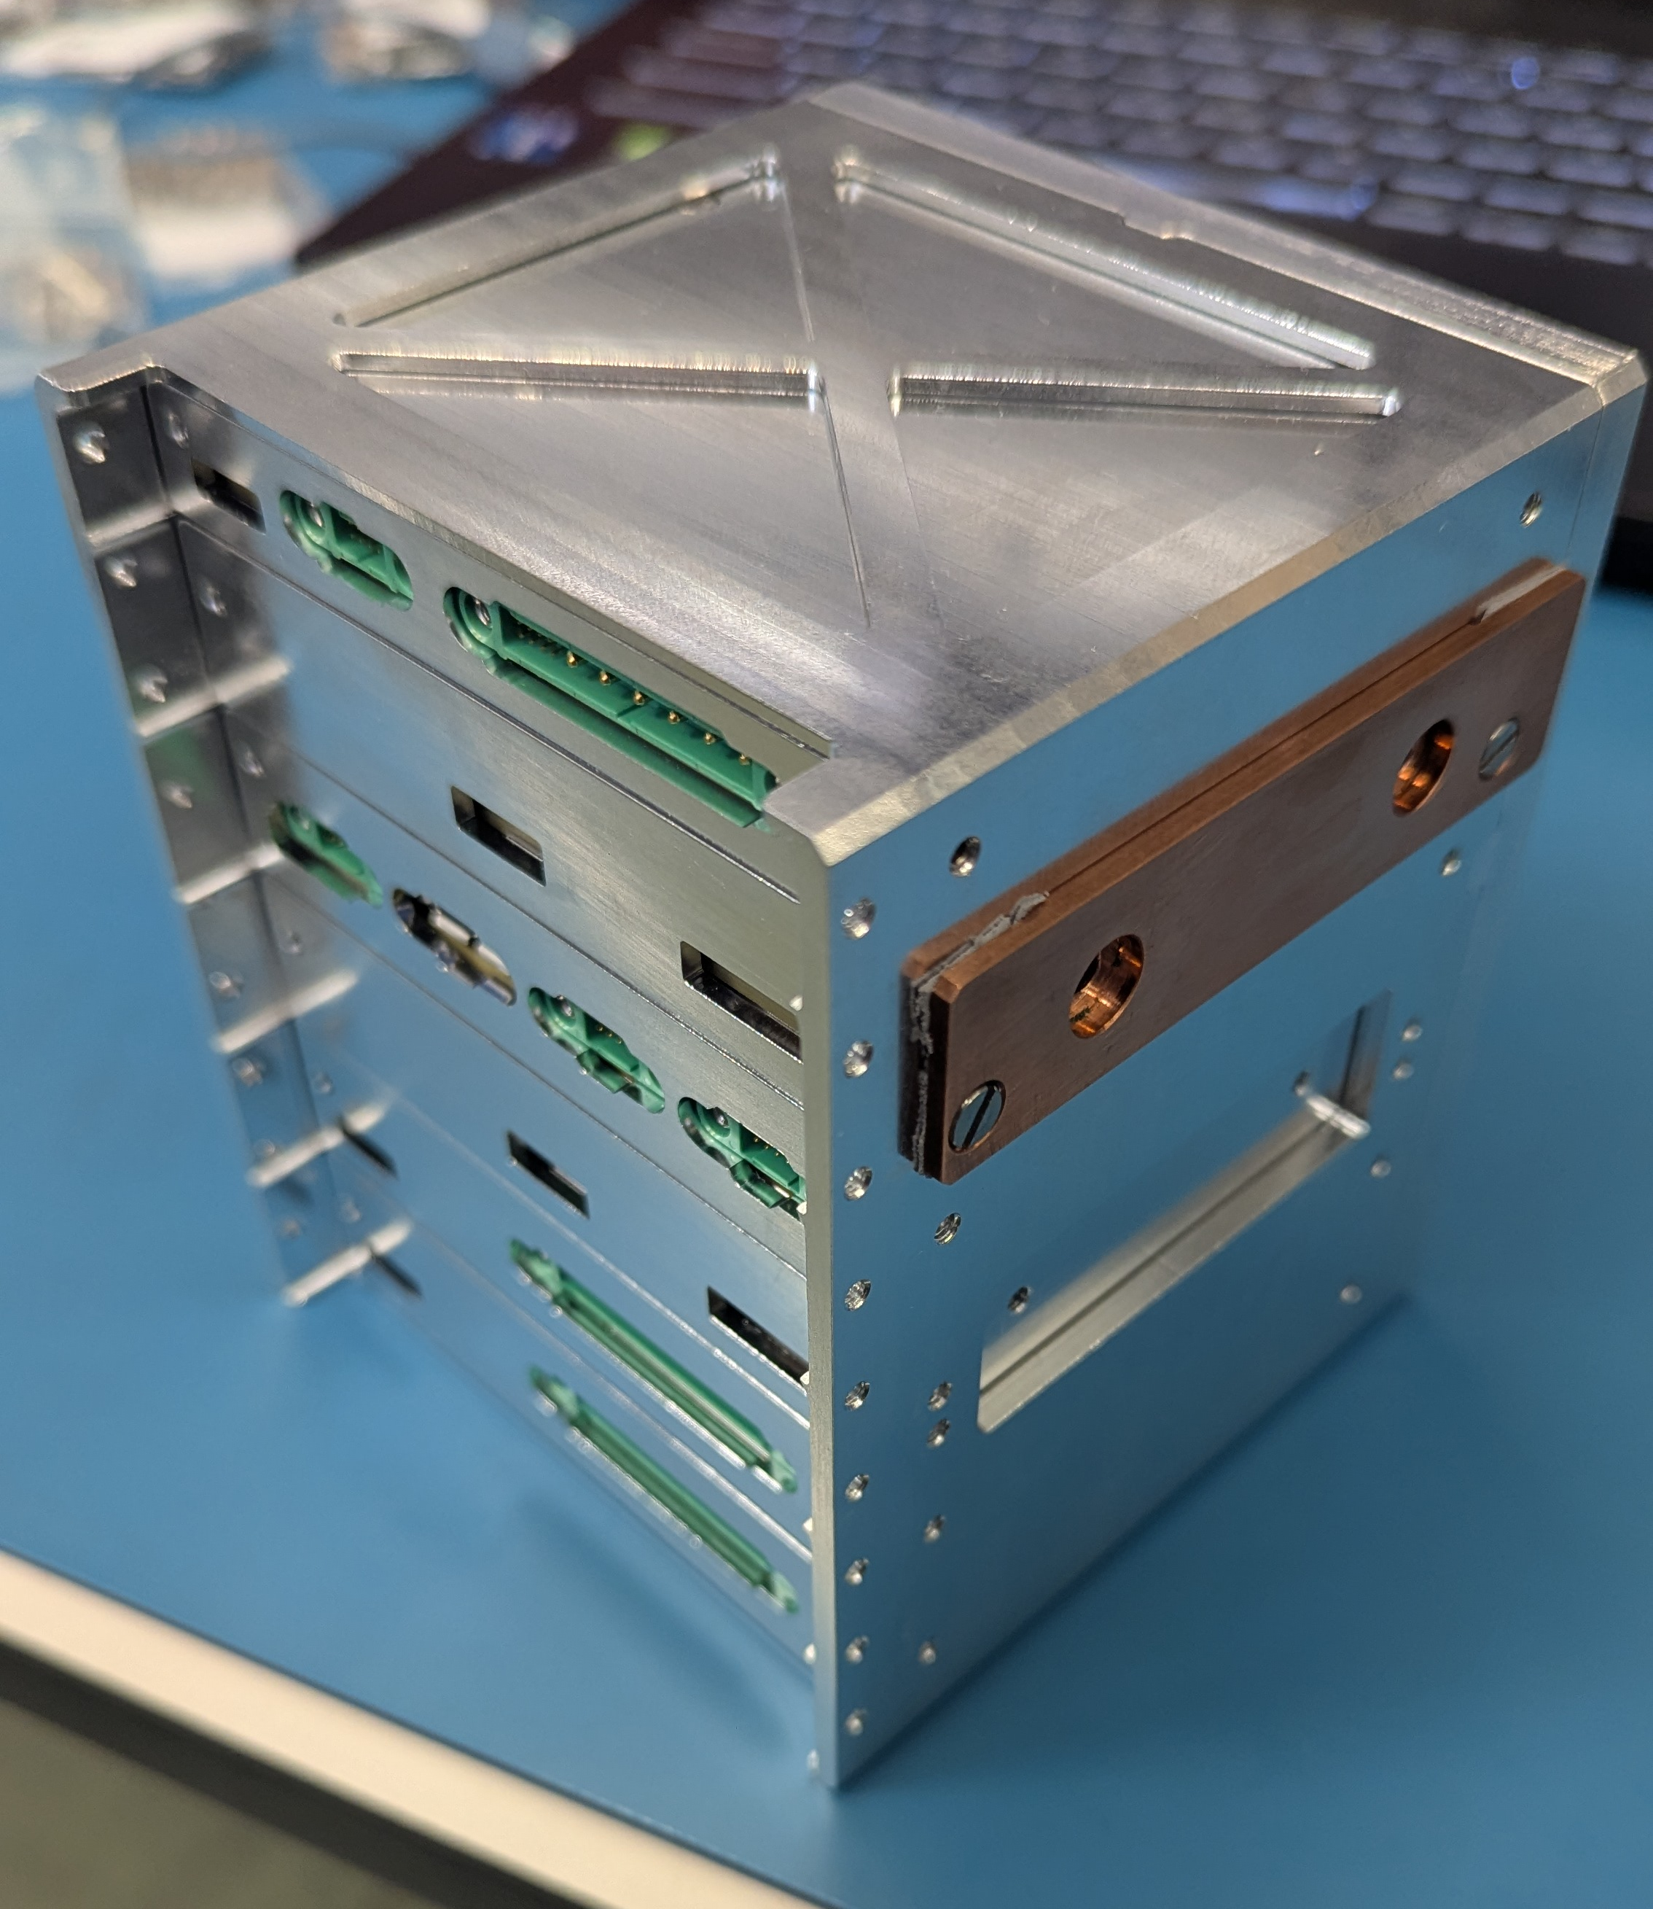
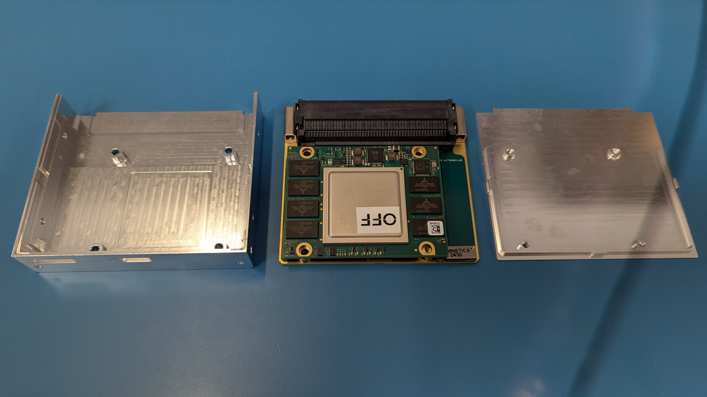
PAYLOAD INSTRUMENT CONTROL UNIT (ICU)
ICU based on a backplane with cards that follow the VNX+ standard

Slide 9
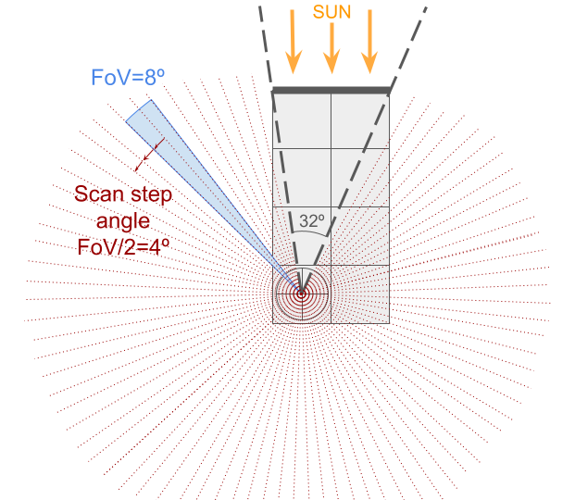
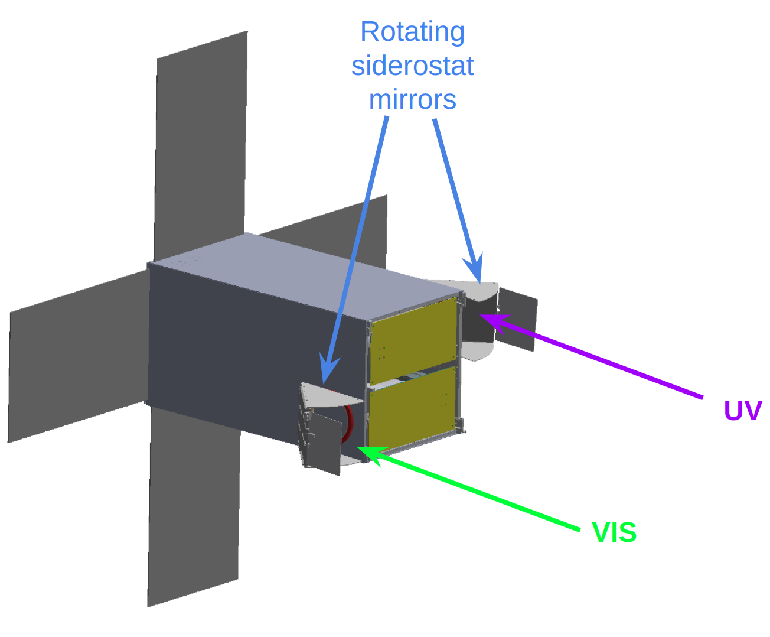
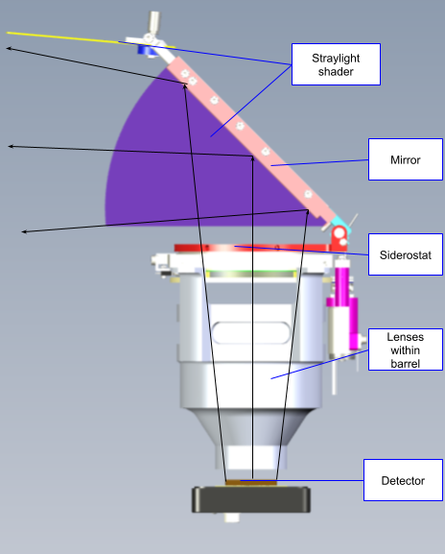
Scanning of a given
great circle
SIDEROSTAT
Foldable solar panels

Slide 10
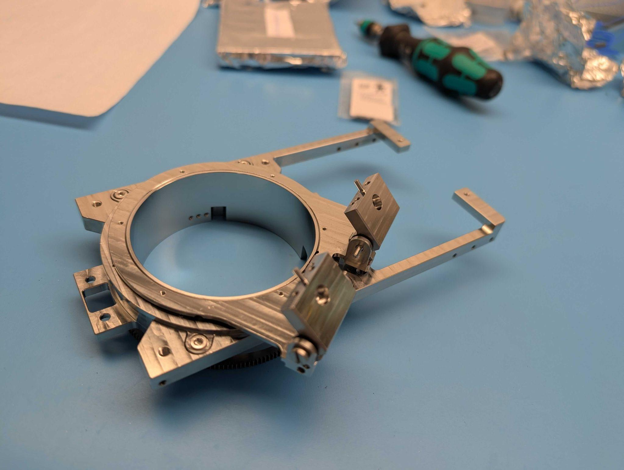
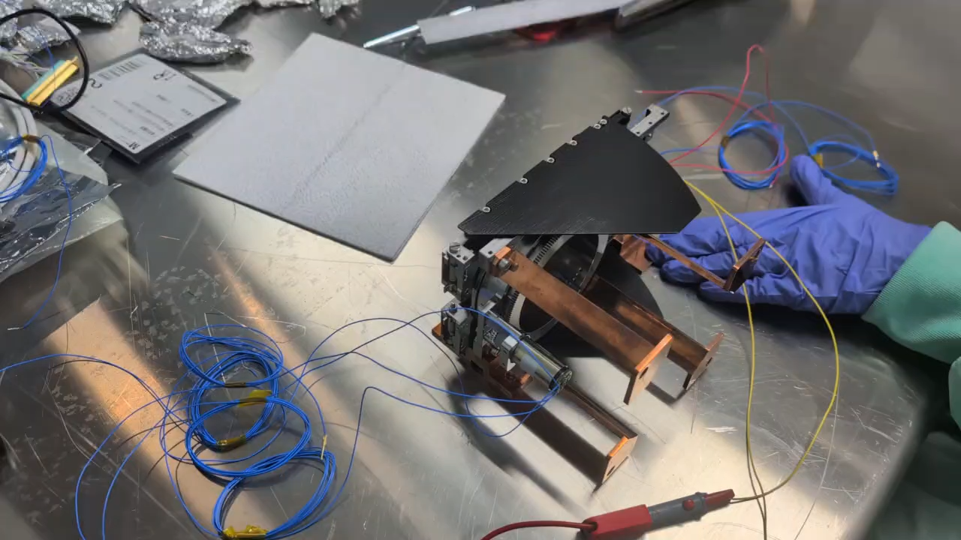
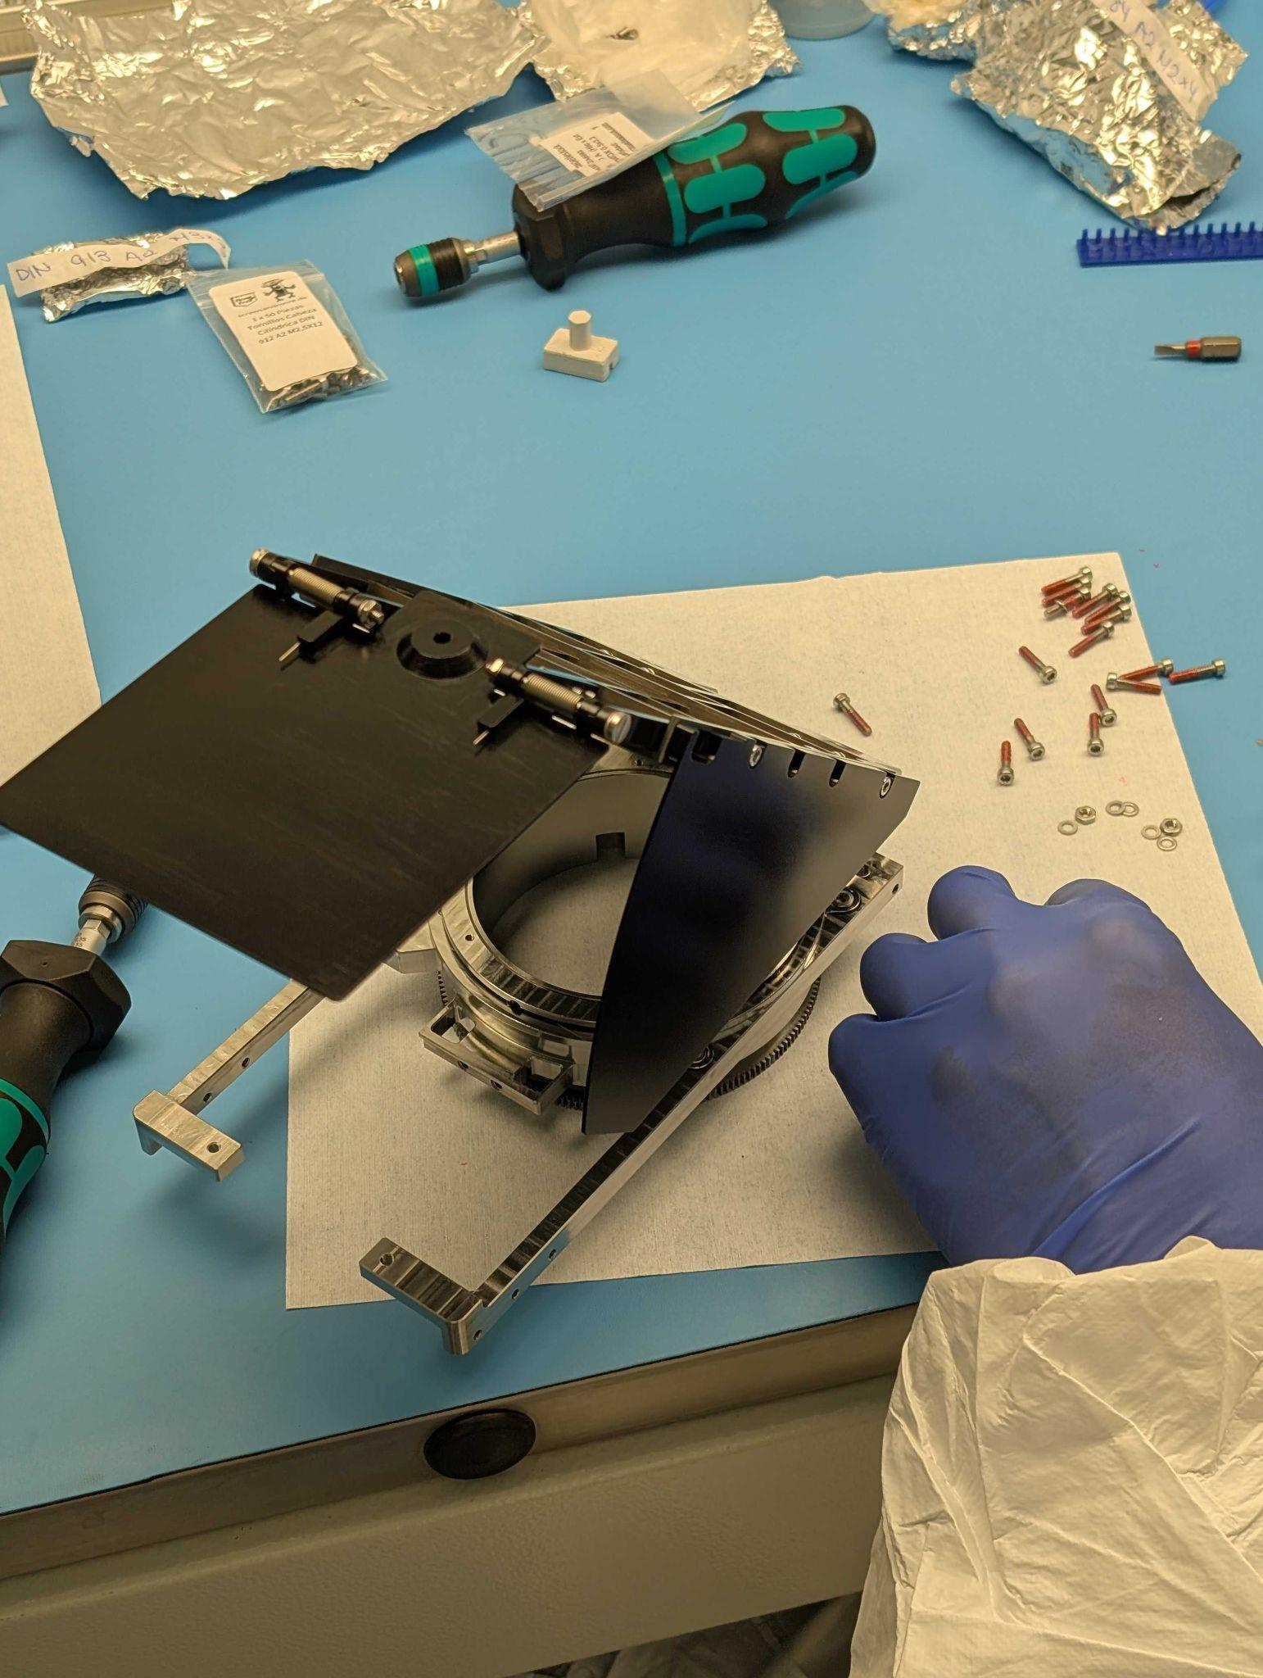
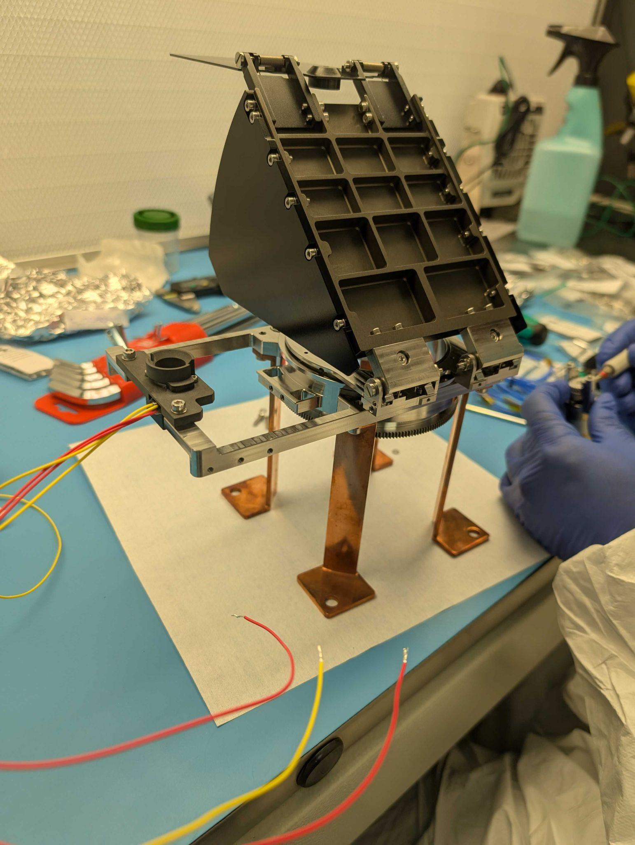
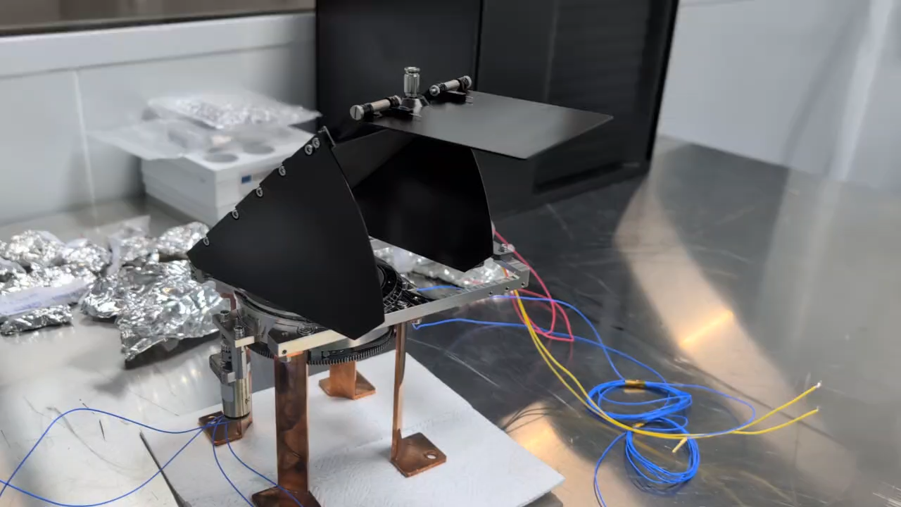
SIDEROSTAT
Qualification campaign
(Sep/Oct 2025)

Slide 11
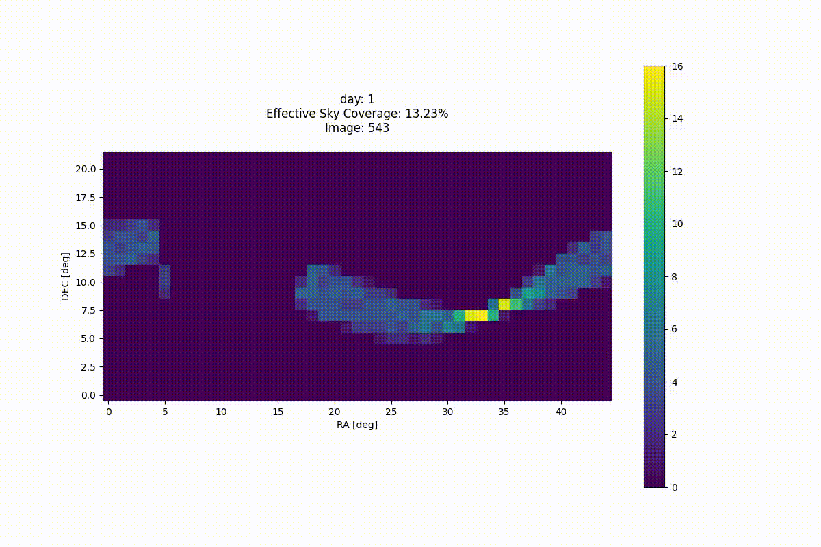
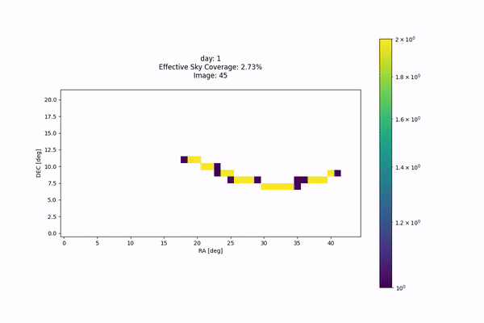
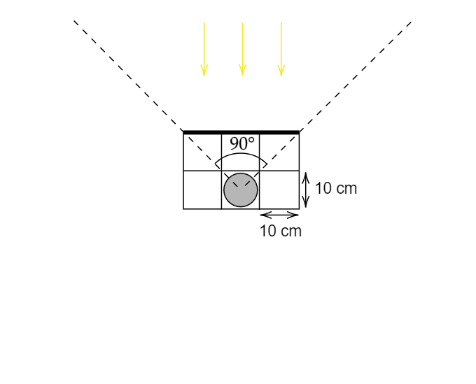
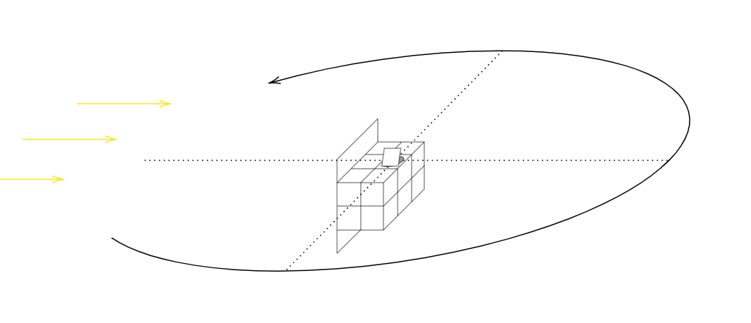
SCANNING LAW
First days of mission
One year of mission
1 year of survey

Slide 12
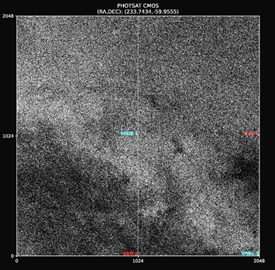
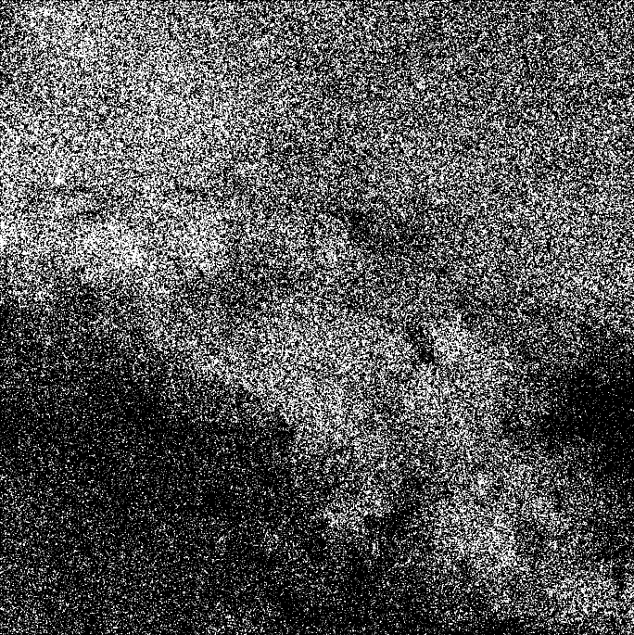
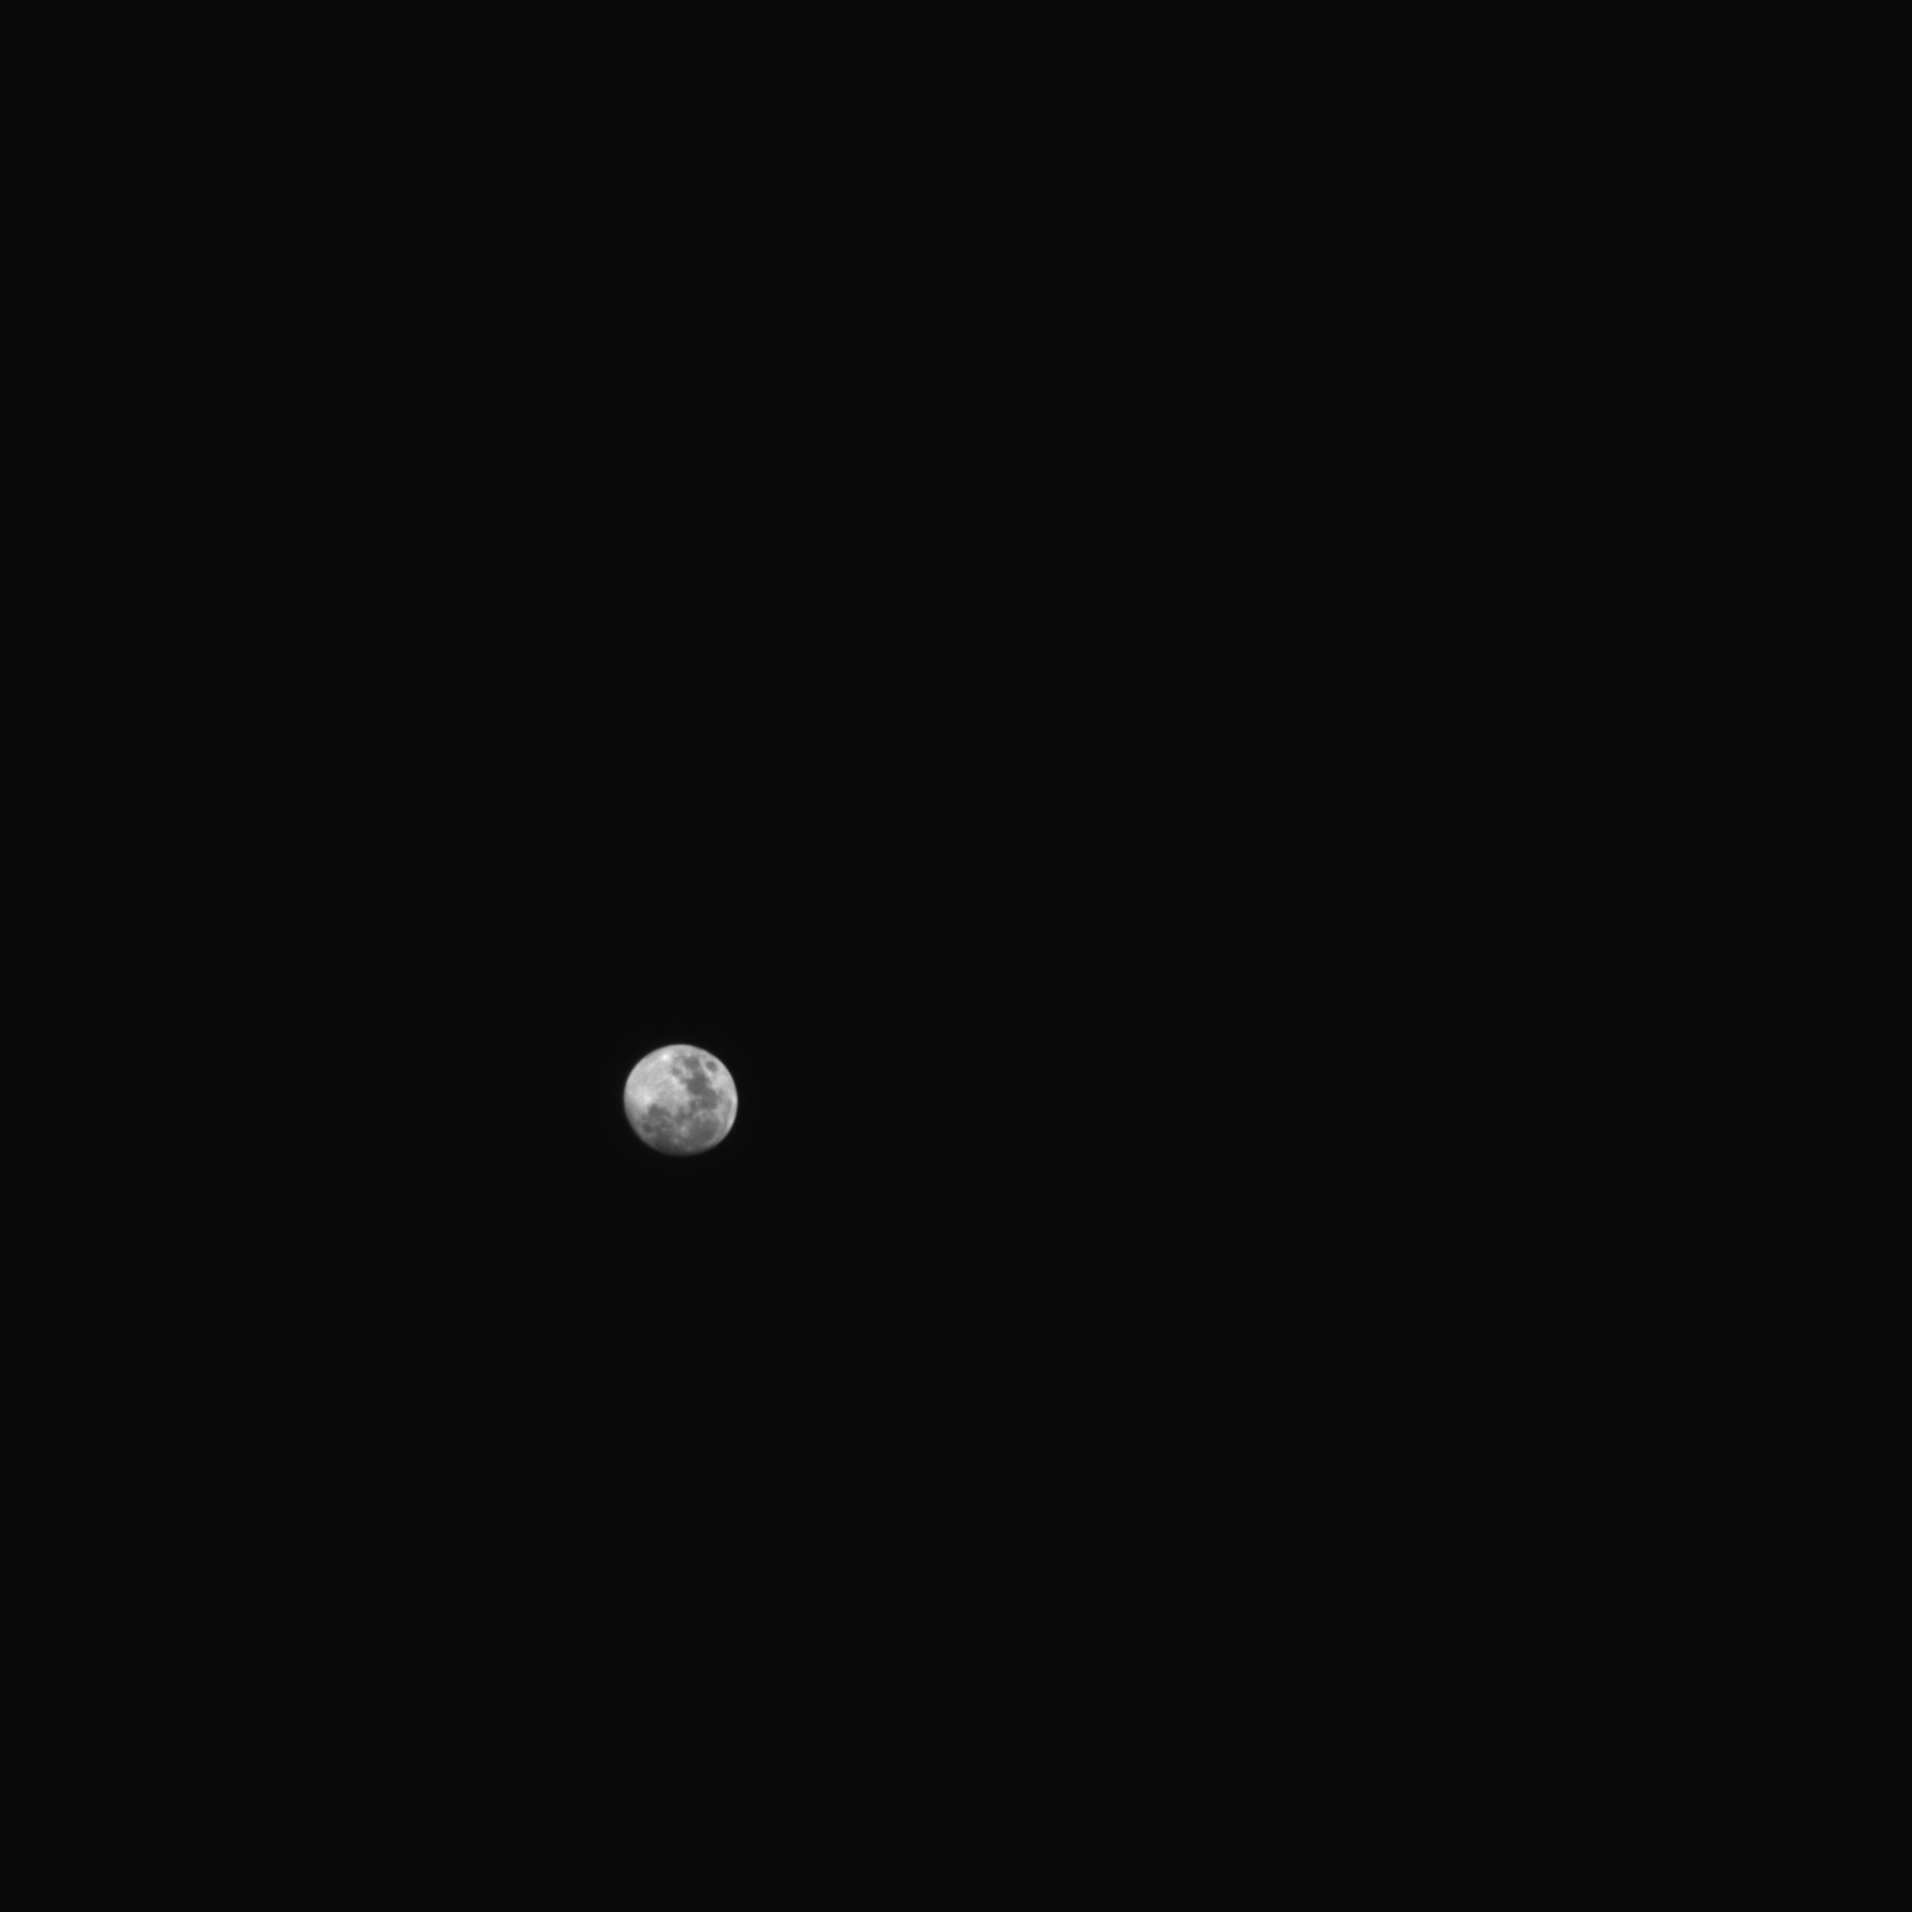
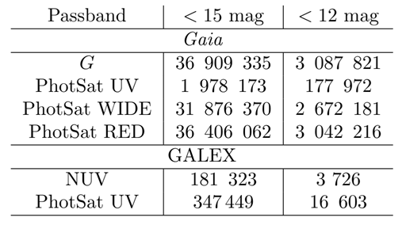
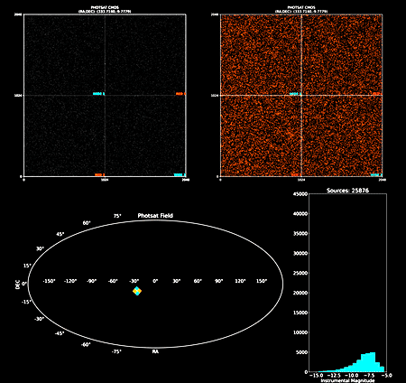
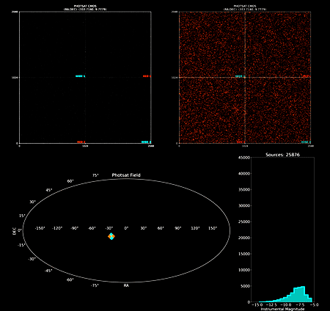
OBSERVABLE SOURCES
Crowded field
Moon
FoV = 8º
Moon size comparison
(FoV = 8º = 16 x Moon)
Image from Montsec Observatory using PhotSat detector (Mar 2025)

Slide 13
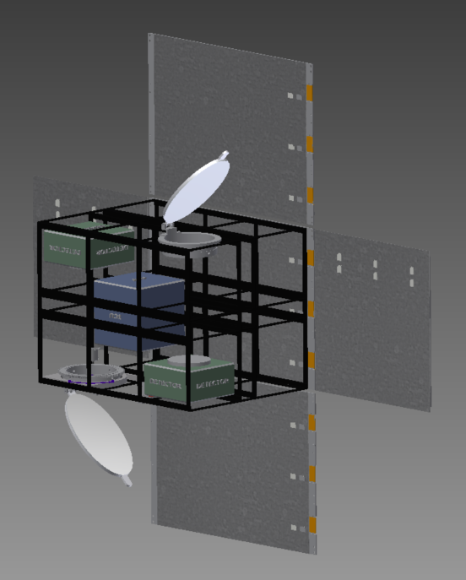
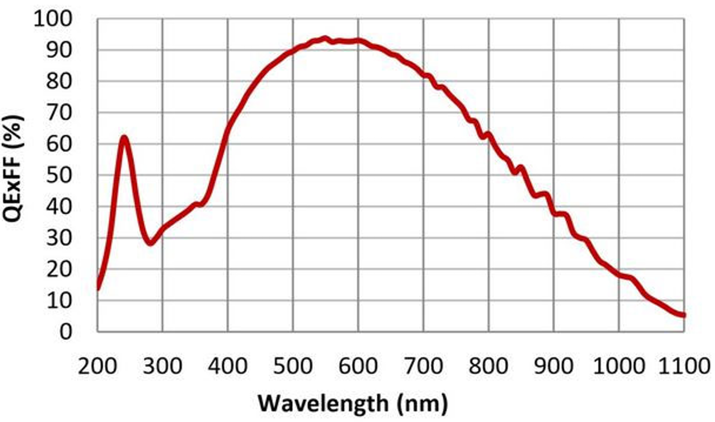
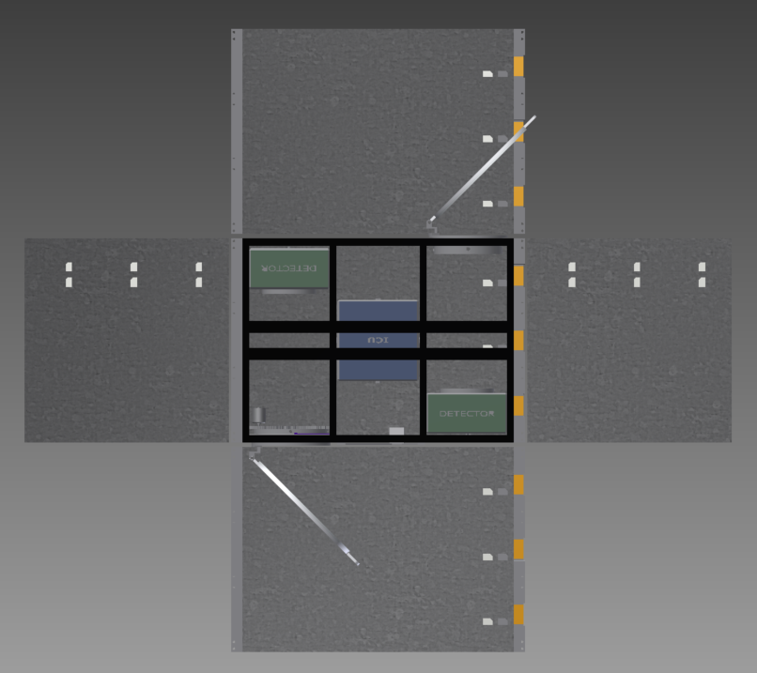
INSTRUMENT CONCEPT
CMOS detectors
VIS
WIDE
RED
RED
WIDE
UV
VIS
UV
VIS2
WIDE
500–840 nm
UV
245–310 nm
RED
670–840 nm
UV

Slide 14


Slide 15
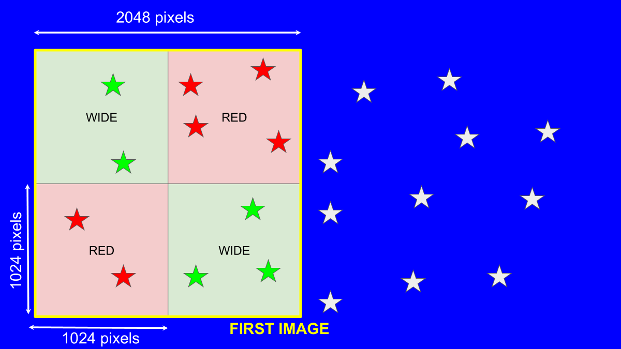

Slide 16
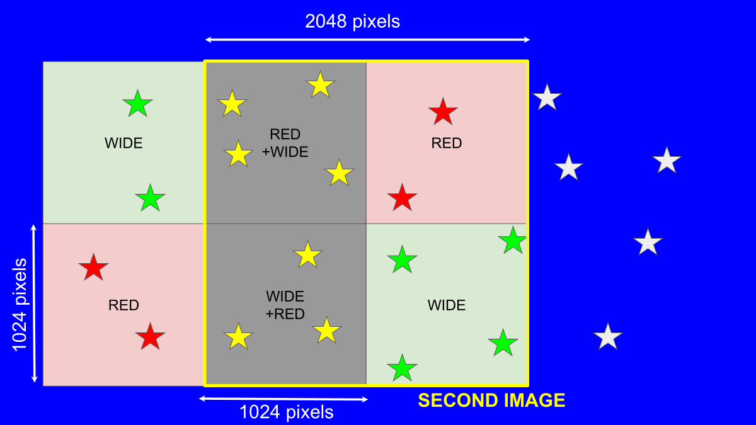

Slide 17
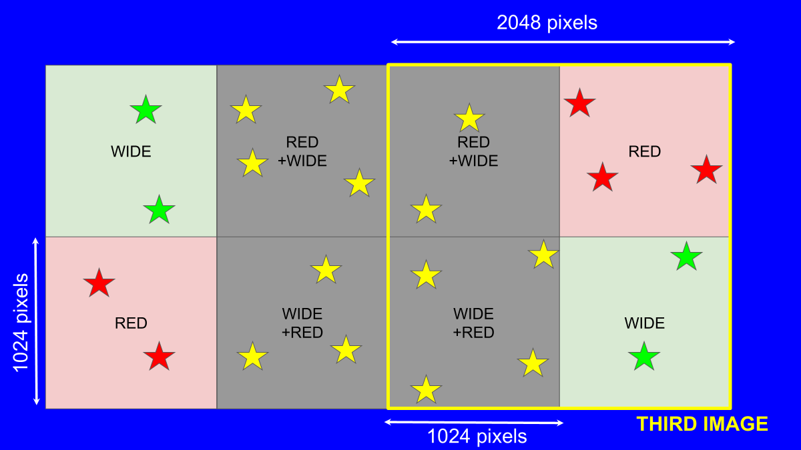

Slide 18
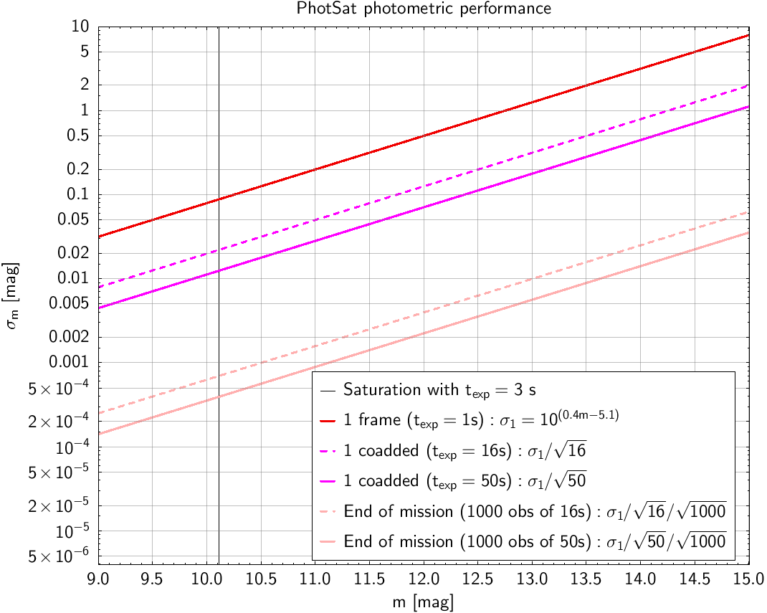
PHOTSAT PHOTOMETRIC PERFORMANCE

Slide 19
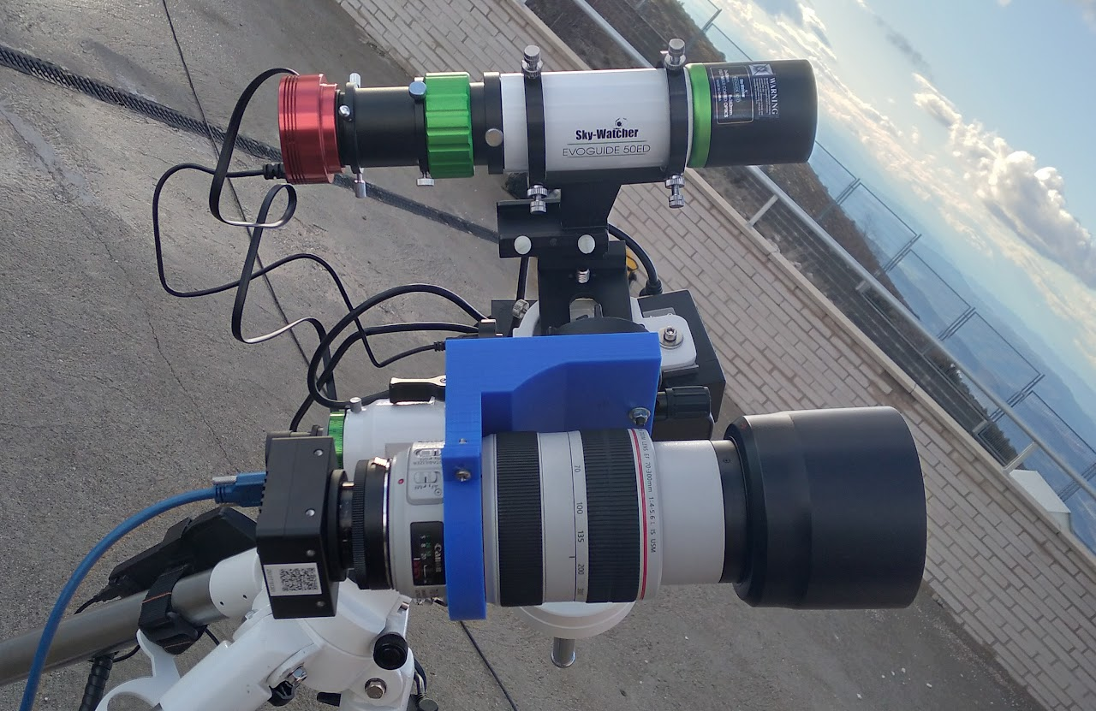
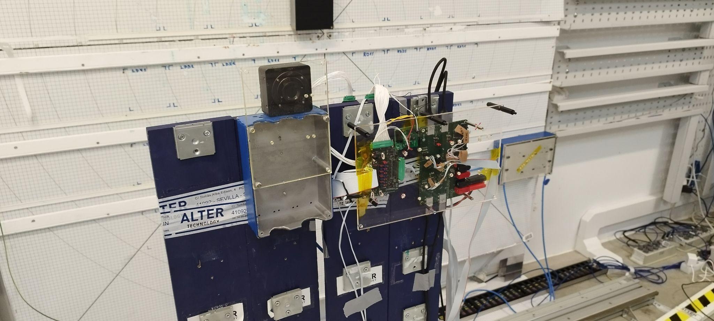
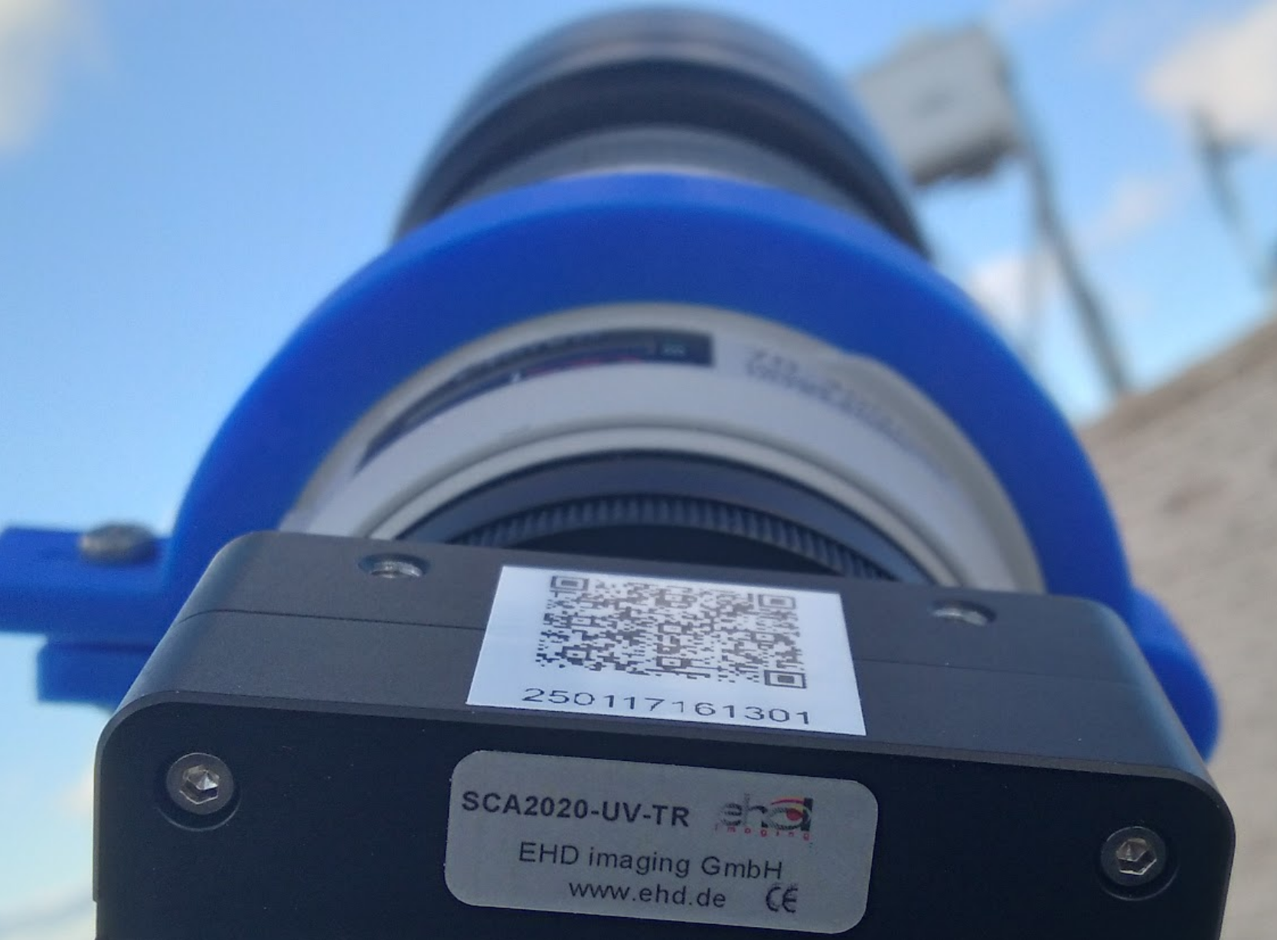
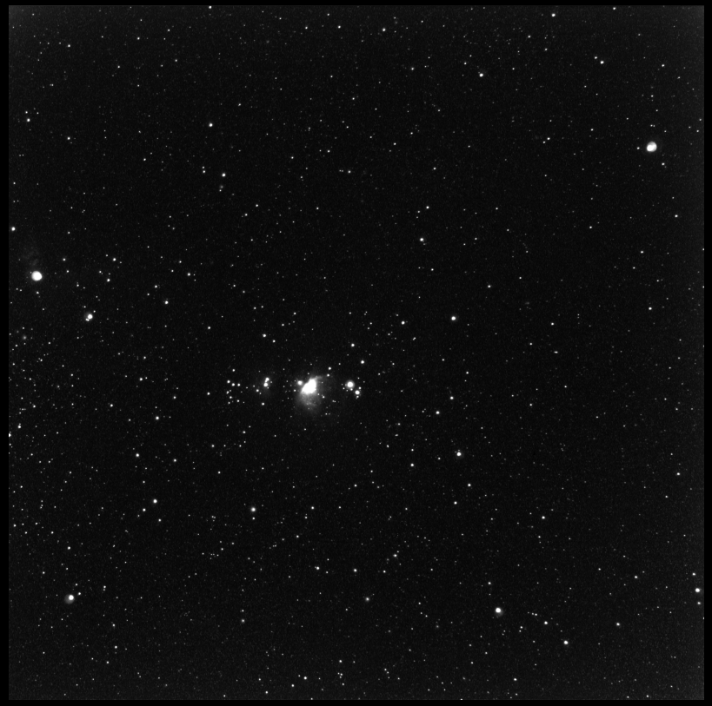
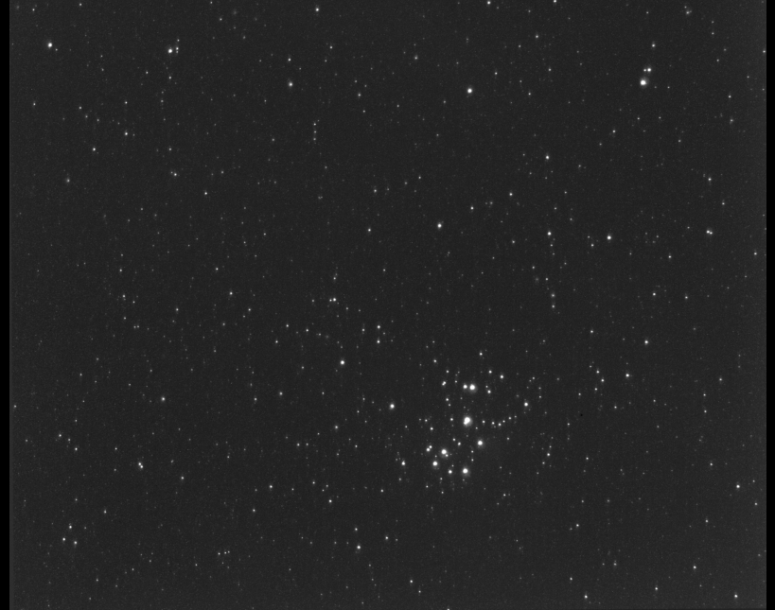
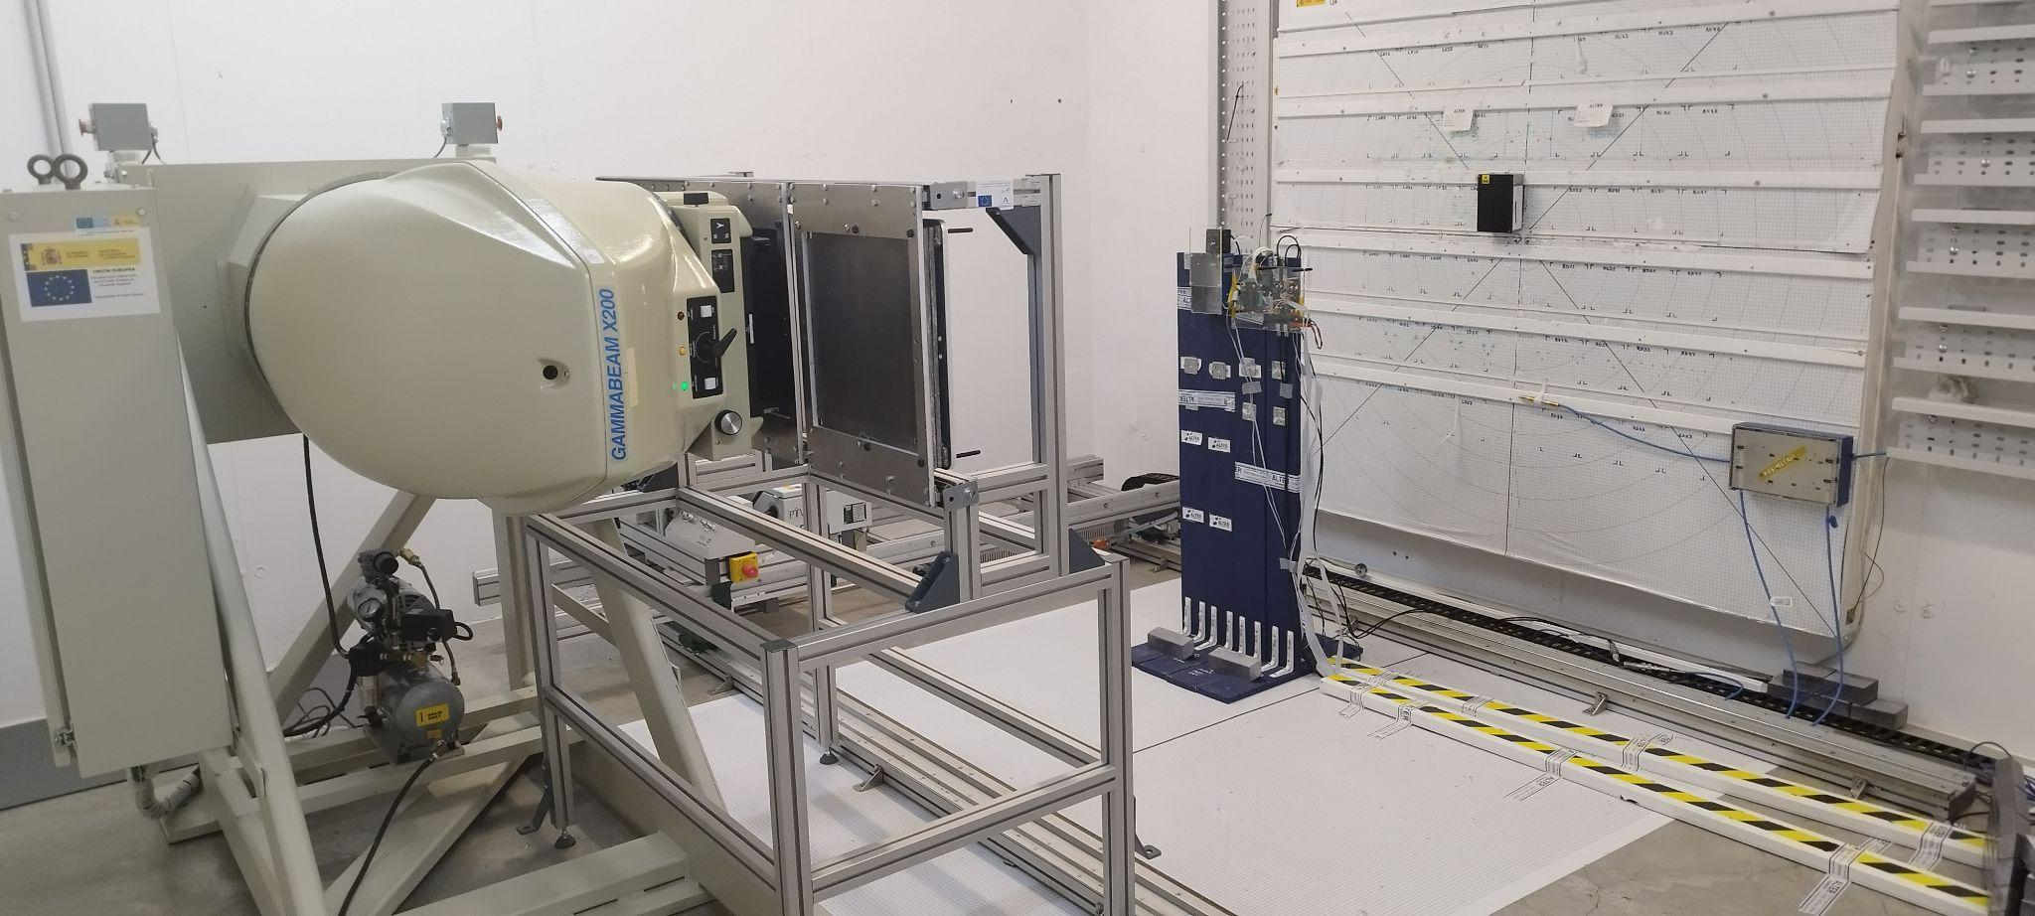
ON-GROUND TESTS
EHD SCA2020-UV-TR detector
Detector tests (Obs. Montsec, March 2025)
Radiation campaign (Sevilla, April 2025)
Centro Nacional de Aceleradores (CNA)
Orion nebula (left) and Pleiades (right)

Slide 20
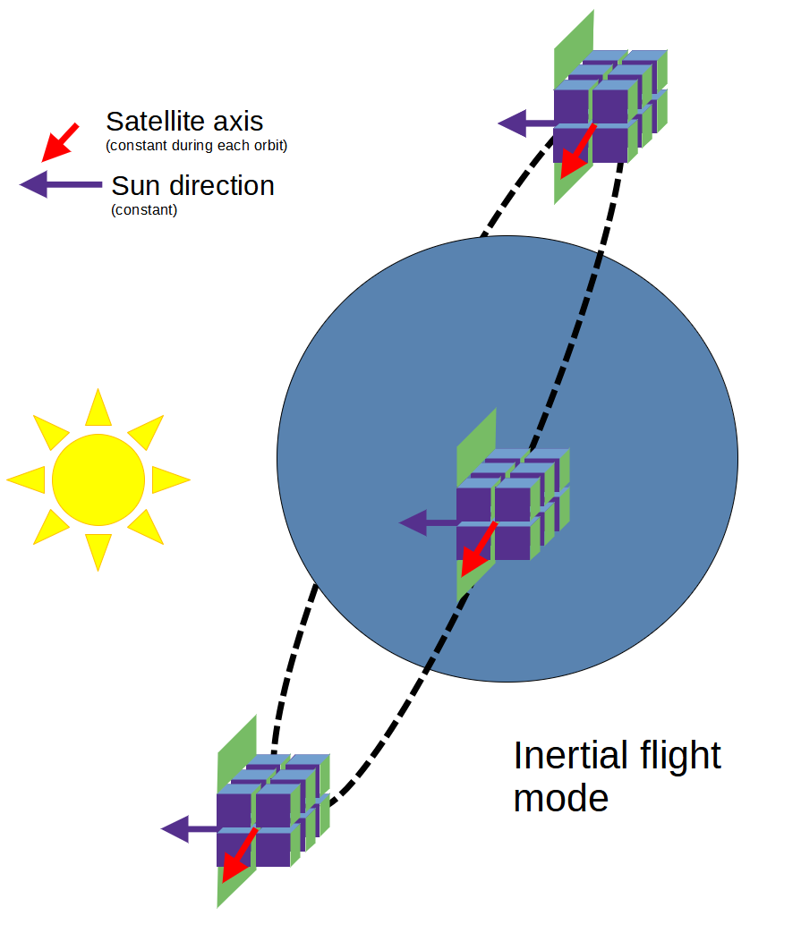
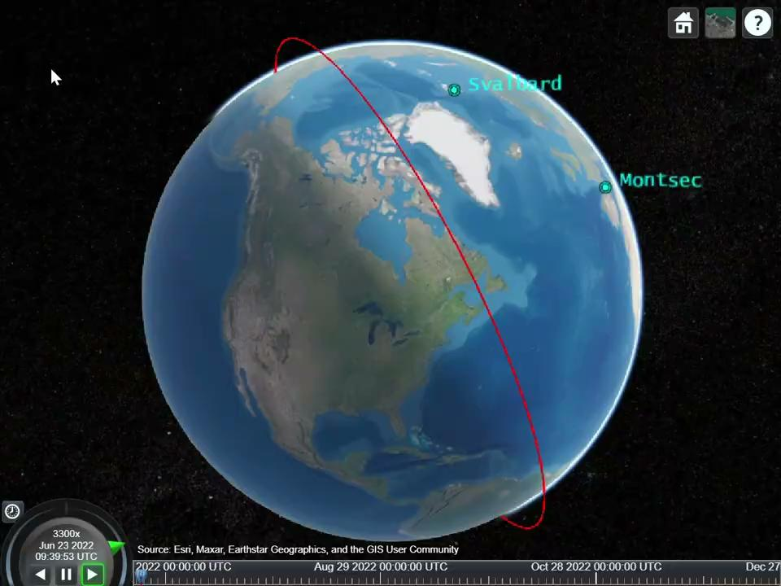
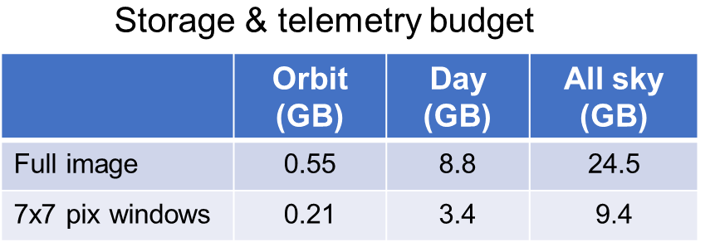
ORBIT & COMMUNICATIONS
Download (X band) ∼9 GB/pass

Slide 21
PHOTSAT OPERATIONS
Operations concept being defined ➔ Funding challenge
Ground station at Montsec (Sant Esteve de la Sarga Teleport) and Svalbard for redundancy
Science exploitation – The PhotSat catalog
Data policy still TBD
Most likely all data to be public either immediately or after short period
Catalog published in VO/TAP (like Gaia)
First prototype based on GAVO DaCHS using simulated data already available

Slide 22
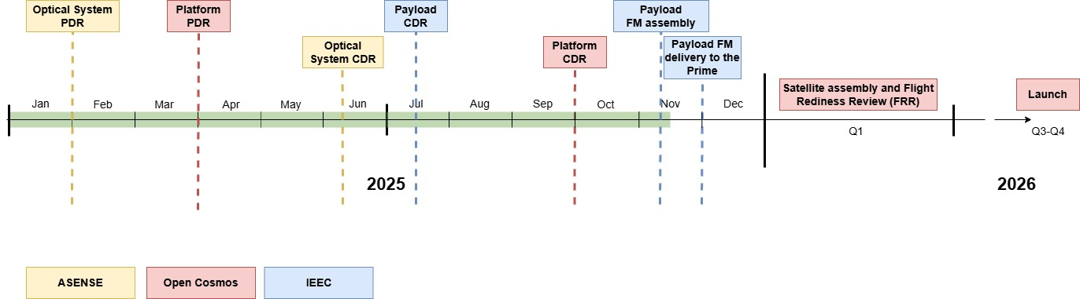
PROJECT STATUS

Slide 23

FUTURE SPIN-OFF MISSION?
GAUDI mission concept submitted to ESA as mini-F
PI: Josep Manel Carrasco (ICCUB & IEEC)

Slide 24


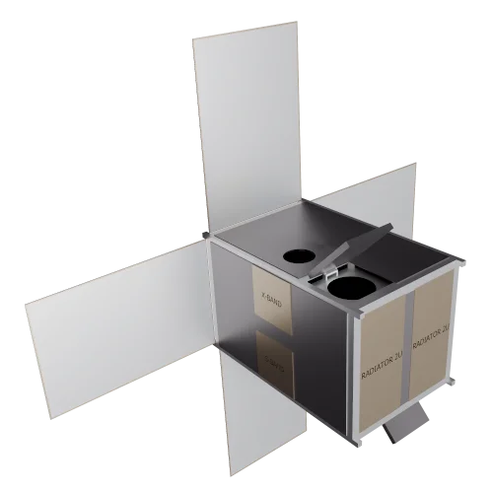

THANK YOU
Contact: ribas@ieec.cat
https://photsat.ieec.cat/
showcase/photsat/
@photsat-mission.bsky.social
@photsat_mission
photsat_mission

Slide 25
PhotSat for SST
In 50 seconds, even LEO satellites are caught without leaving the FoV
60% of LEO satellites (about 4000) are observable with PhotSat
Also some MEO and GEO are observable
From PhotSat, LEO satellites are 1.7 magnitudes brighter than from ground
Orbit | Maximum distance to PhotSat (km) | Magnitude difference m_{ground}-m_{PhotSat} (mag) | FoV crossing time (s) | Number of satellites with V<15 mag | Observable satellites (illuminated by the Sun)
LEO | 9787 | 1.7 | 254.68 | 6768/6768 | 3926 (58%)
MEO | 27264 | 0.67 | 709.41 | 85/143 | 8 (5%)
GEO | 42721 | 0.38 | 1111.60 | 590/590 | 77 (13%)

Slide 26
INSTRUMENT AND OPERATIONS CONCEPT

Slide 27
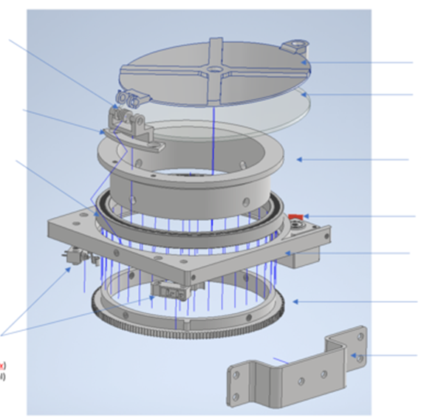
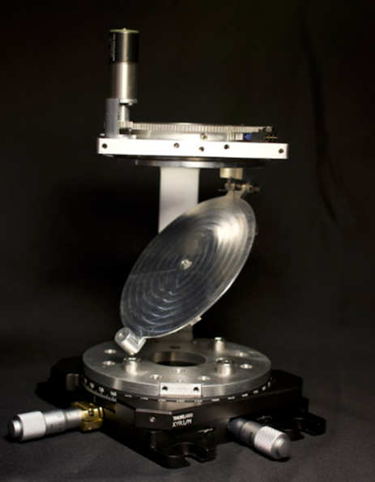
SIDEROSTAT
Spring (2N·mm/deg in rest at 60º)
Mirror cover
Mirror rotation axis
Mirror
Bearing
Rotation axis coupling (mirror+gear)
Nanorelease Nut mechanism
Gears
Microswitch
Reducer assembly support

Slide 28
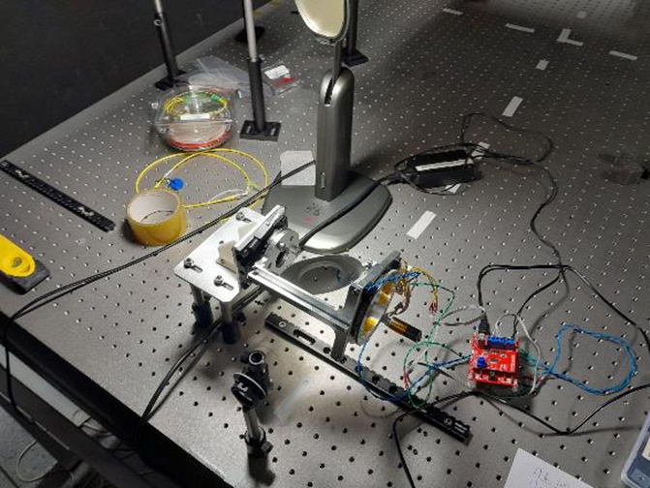
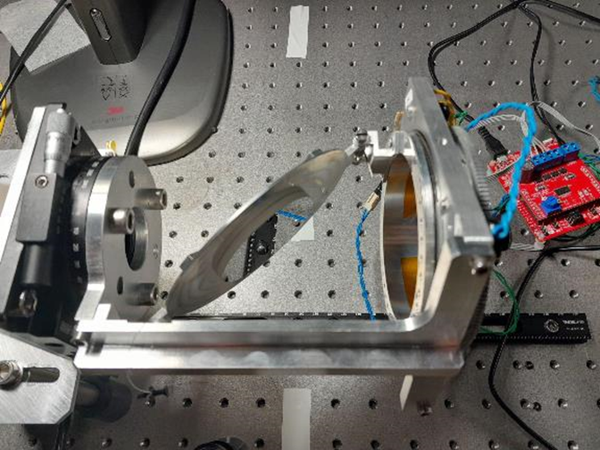
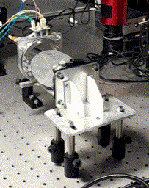
SIDEROSTAT: prototype
10 deg rotation test

Slide 29
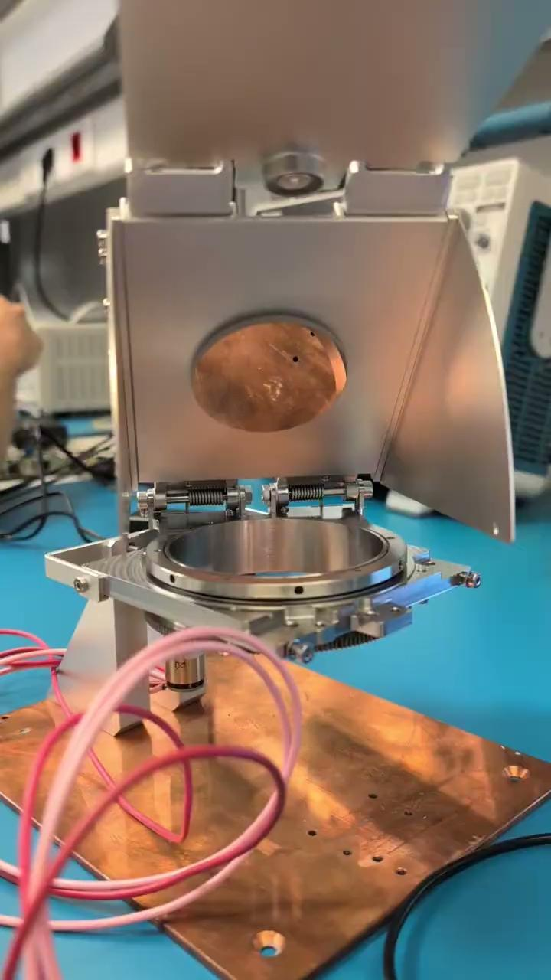

SIDEROSTAT: prototype

Slide 30

SCANNING LAW
Scanning of a given
great circle
Great circle orientation change

Slide 31


OPTICAL SYSTEM

Slide 32


Slide 33
THE PHOTSAT CONSORTIUM

Slide 34

PHOTSAT CONSORTIUM

Slide 35

PHOTSAT CONSORTIUM

Slide 36




PHOTSAT CONSORTIUM
PhotSat consortium
Mission definition, payload
Science modes and products
Senior Board - IEEC (PI), +5 members ICE/CSIC, UAB, ICCUB, UPC
Project Office - IEEC, Project manager (full time), Systems Engineers (full time), Project Scientist (part time), communication, admin & legal
Science exploitation team - ICE, UB, UPC, UAB (+ partners, funding for operations)
Engineering development & advisory - IEEC, UPC, UAB, ICCUB
Payload assembly and QA - IEEC, IFAE, terms & contract to be negotiated
Contractor
Main contractor - Mission architecture, platform, launch, commissioning, operations, ground segment, with advice from consortium
Minor contracts for payload subsystems - Optics
PhotSat Exploitation Consortium
Science exploitation - pipelines, alerts, cosmic rays, compression, archival and dissemination- Institutes, not fully funded : national/international partners
Operations - IEEC (not fully funded). Requests to infrastructure support funding Gen.Cat & intl partner contributions.
2023
2024
Contractor
Mission architecture and platform & minor
PhotSat Exploitation Consortium
Operations and science exploitation (open to international partners)
2025
2026+

Slide 37

PROJECT STATUS

