Slide 1

Challenges for the Future Circular Collider
Leon van Riesen-Haupt for LPAP

Slide 2
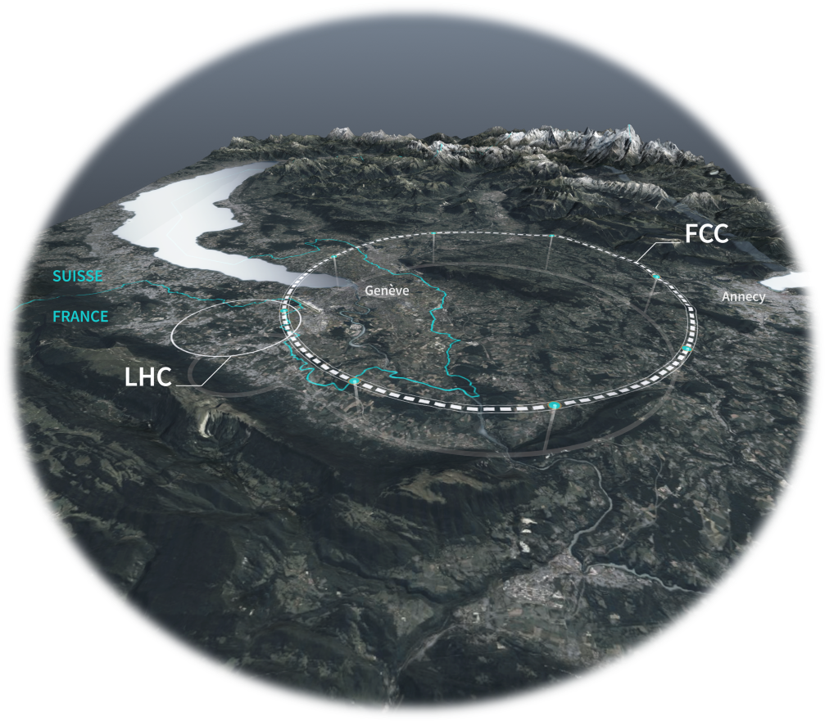
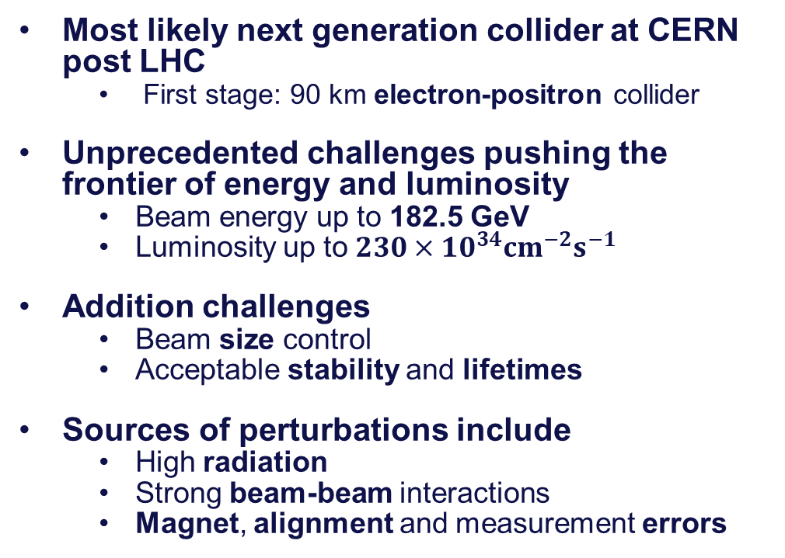
FCC Overview
Most likely next generation collider at CERN post LHC
  First stage: 90 km electron-positron collider
Unprecedented challenges pushing the frontier of energy and luminosity
  Beam energy up to 182.5 GeV
  Luminosity up to $230×{10}^{34}{cm}^{−2}s^{−1}$
Addition challenges
  Beam size control
  Acceptable stability and lifetimes
Sources of perturbations include
  High radiation
  Strong beam-beam interactions
  Magnet, alignment and measurement errors

Slide 3
Goals LPAP is Contributing to
Accurate models describing FCC with strong synchrotron radiation and effects from high luminosity
Compute key performance metrics in full detail indicating
  Beam size
  Luminosity
  Lifetime
Scan metrics for different design parameters and perturbations
  Optimise performance and set design tolerances
  Explore faster metrics to streamline optimisation

Slide 4
Background

Slide 5

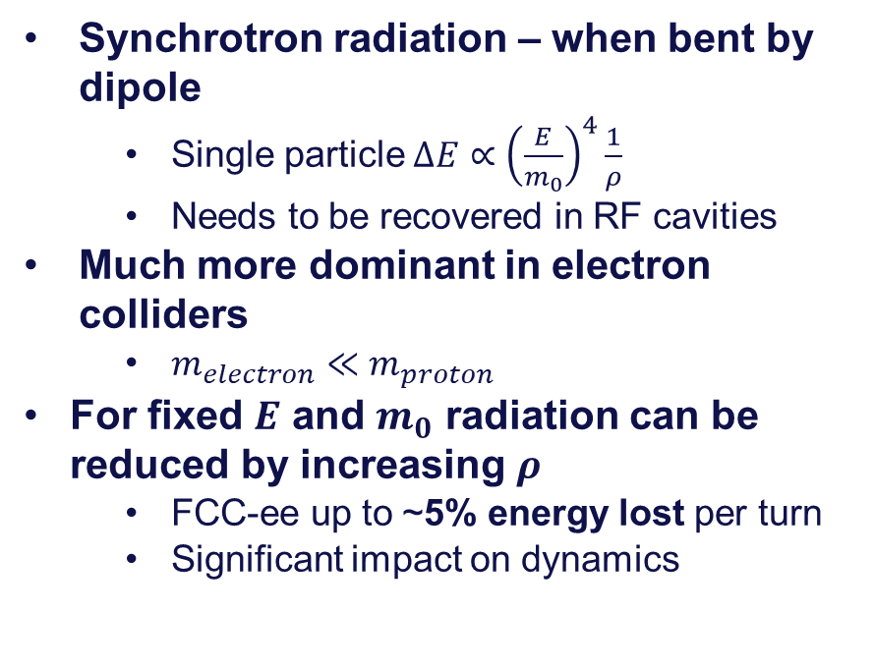

Synchrotron Radiation
Synchrotron radiation – when bent by dipole
  Single particle $ΔE∝{\left(\frac{E}{m_{0}}\right)}^{4}\frac{1}{ρ}$
  Needs to be recovered in RF cavities
Much more dominant in electron colliders
  $m_{electron}≪m_{proton}$
For fixed $E$ and $m_{0}$ radiation can be reduced by increasing $ρ$
  FCC-ee up to ~5% energy lost per turn
  Significant impact on dynamics
N
$$B_{dipole}$$
photons
$$ρ$$
S

Slide 6
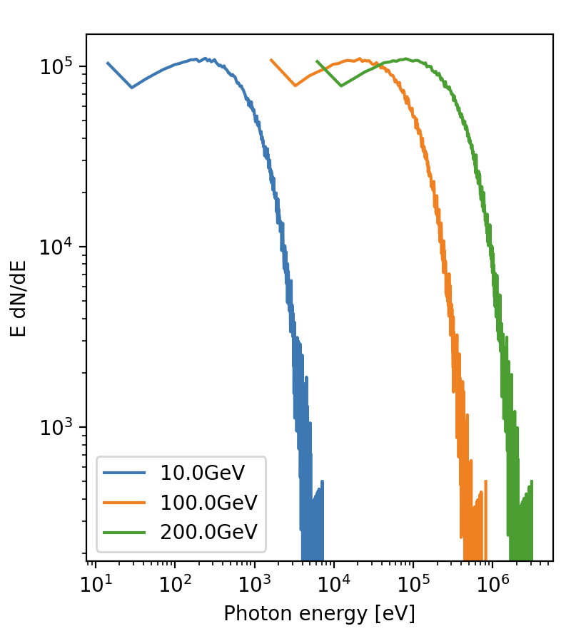
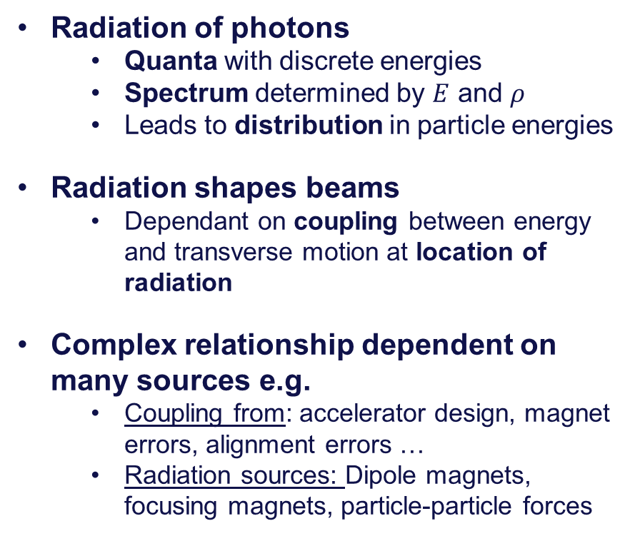
Radiation Shaping Beams
Radiation of photons
  Quanta with discrete energies
  Spectrum determined by $E$ and $ρ$
  Leads to distribution in particle energies
Radiation shapes beams
  Dependant on coupling between energy and transverse motion at location of radiation
Complex relationship dependent on many sources e.g.
  Coupling from: accelerator design, magnet errors, alignment errors …
  Radiation sources: Dipole magnets, focusing magnets, particle-particle forces

Slide 7

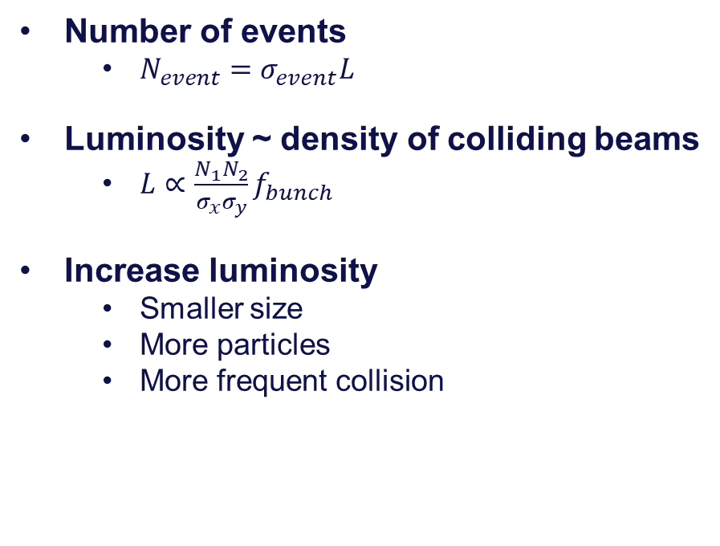



Event Rate – Luminosity
$$σ_{x}$$
$$N_{1}$$
$$N_{2}$$
Number of events
  $N_{event}=σ_{event}L$
Luminosity ~ density of colliding beams
  $L∝\frac{N_{1}N_{2}}{σ_{x}σ_{y}}f_{bunch}$
Increase luminosity
  Smaller size
  More particles
  More frequent collision
$$σ_{y}$$

Slide 8
Beam Size
Beam size roughly split into:
Local beam size
  Manipulated with higher order magnets
Global beam size
  Dependant on global impact from radiation and coupling
N
S
S
N

Slide 9
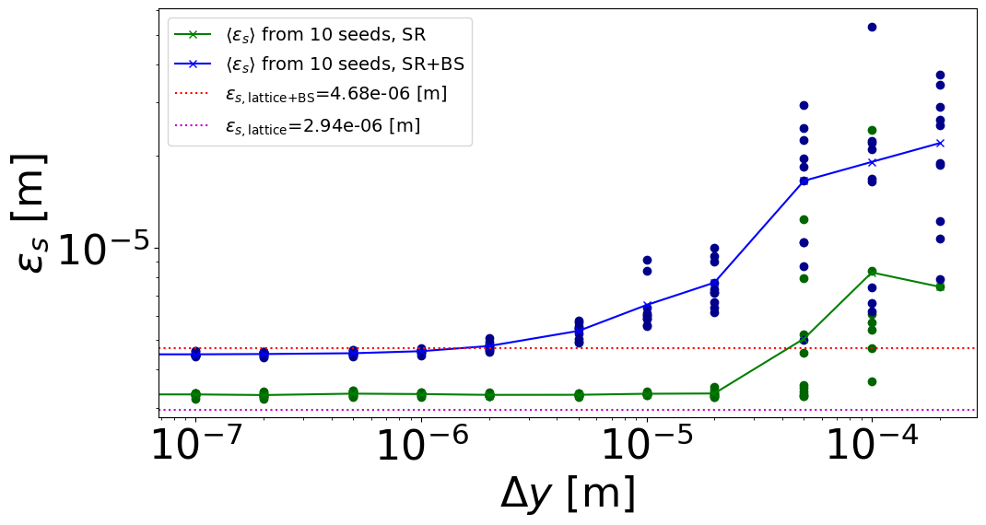
Number of Particles
Number of particles limited by particles interacting with:
    Particles in the same bunch
    Particles in other bunches
    Colliding bunch – beam-beam
    Electrons in the vacuum
    The beam pipe and instruments
    …
Beam-beam forces
  Electromagnetic interaction between particles in colliding bunches
  Perturbs particle dynamics
  Source of addition radiation
Beam size² / m
Average Magnet Misalignment / m

Slide 10
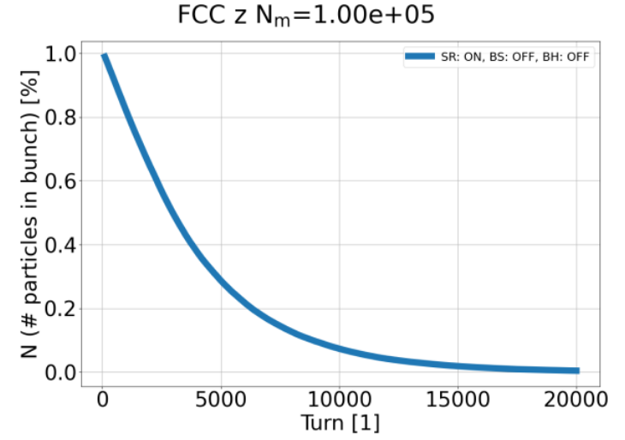
Lifetime
Lifetime important property of collider
  How long particles can expect to stay in collider
  Low lifetime = fast drop in luminosity
Particles lost for various reasons e.g.:
  Chaotic non-linear behaviour at large amplitudes
  Beam size due to high energy photons
  in magnets
  Strong transverse kick from interaction with colliding beam
  Strong radiation from interaction with colliding beam
Magnets
Beam-beam

Slide 11

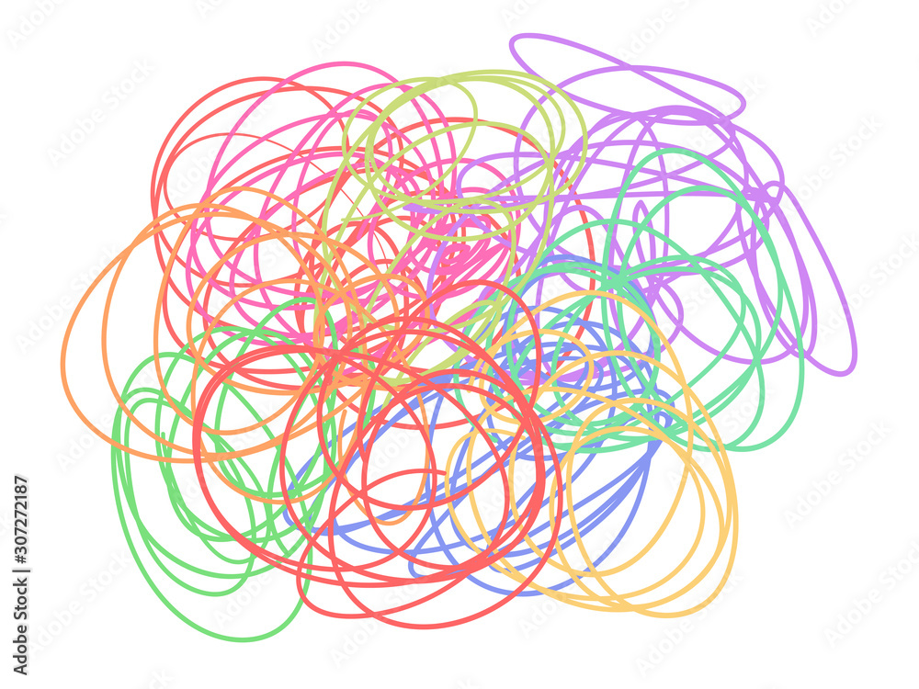

Detailed Simulations
errors &
misalignments
Image credit: P. Kicsiny
Multiple effects governing dynamics in accelerator
  Often software and experts focusing on single/few aspects
  Simulations done in parallel
Model interplay of effects
  More important as designs get more complex
  Made possible through modern resources
Compute collider performance
  Define and compute performance indicators
  Understand impact of interplay on performance
magnet
configurations
experiment
solenoid
Beam size
forces between
beams
radiation
nonlinearities
Luminosity
Stability

Slide 12
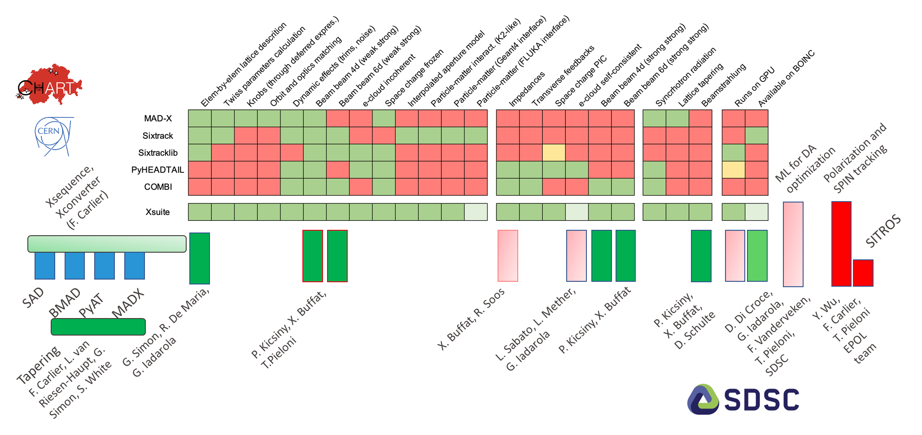
Xsuite as Software Framework

Slide 13
Beam Sizes

Slide 14
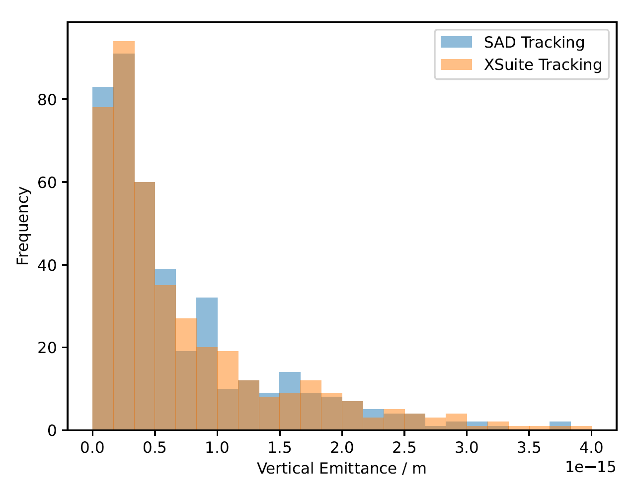
Beam Size from Synchrotron Radiation
Various effects contribute to beam size
Introduce individual effects in Xsuite under controlled conditions
  Benchmark to results from established codes
  Understand contributions from individual sources
  Eventually understand interplay
E.g. Magnet alignment errors:
  Study with 500 randomly generated misaligned FCC-ee models
  Same average misalignment – different error “seed”
  Compare to legacy code – SAD

Slide 15
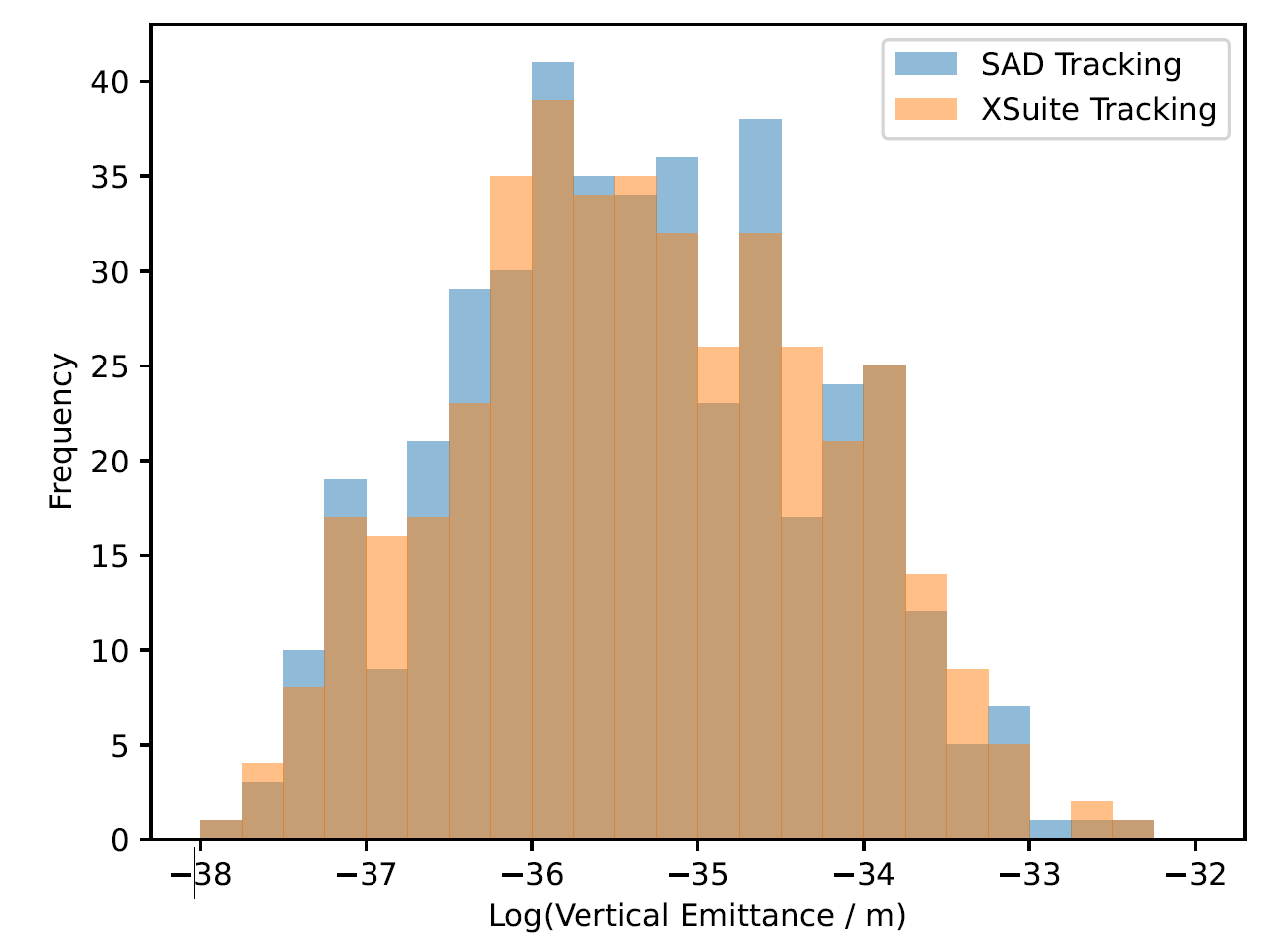
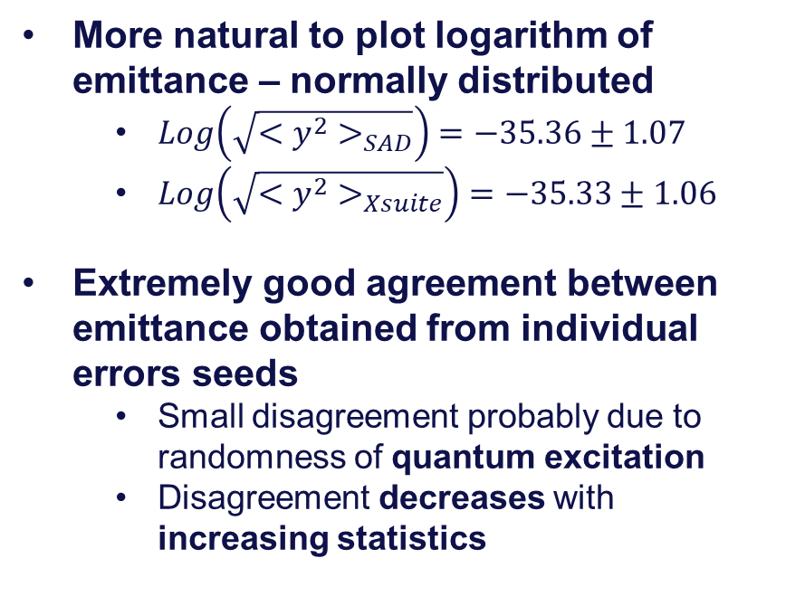
Beam Size from Synchrotron Radiation
More natural to plot logarithm of emittance – normally distributed
  $Log\left(\sqrt{<y^{2}>_{SAD}}\right)=−35.36±1.07$
  $Log\left(\sqrt{<y^{2}>_{Xsuite}}\right)=−35.33±1.06$
Extremely good agreement between emittance obtained from individual errors seeds
  Small disagreement probably due to randomness of quantum excitation
  Disagreement decreases with increasing statistics

Slide 16
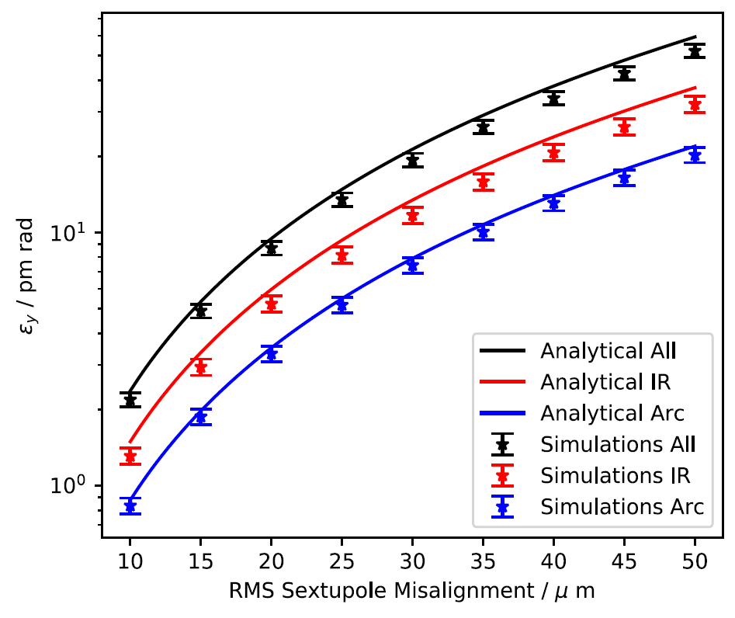
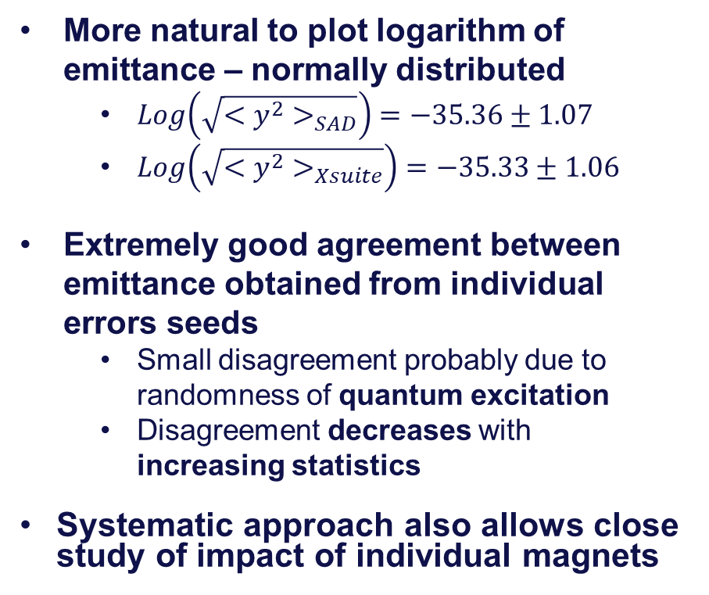
Beam Size from Synchrotron Radiation
More natural to plot logarithm of emittance – normally distributed
  $Log\left(\sqrt{<y^{2}>_{SAD}}\right)=−35.36±1.07$
  $Log\left(\sqrt{<y^{2}>_{Xsuite}}\right)=−35.33±1.06$
Extremely good agreement between emittance obtained from individual errors seeds
  Small disagreement probably due to randomness of quantum excitation
  Disagreement decreases with increasing statistics
Systematic approach also allows close study of impact of individual magnets

Slide 17
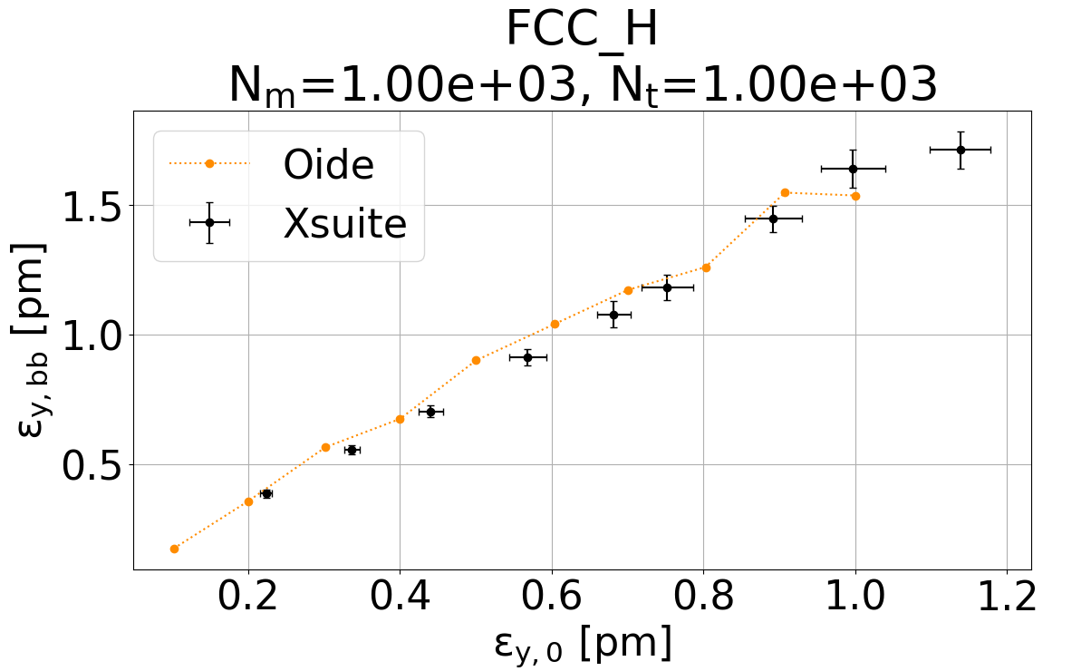
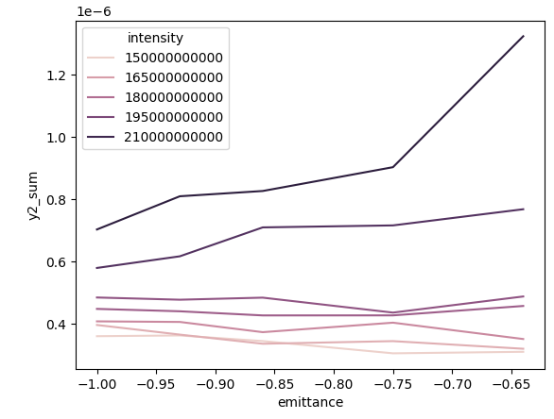
Multiple Factors: Lattice and Beam-beam
Xsuite allows simulation of multiple effects
  E.g. Radiation and coupling from magnets and from beam-beam
Study how much beam size increases due to beam-beam
  For different beam sizes due to magnets
  Benchmark with legacy codes
  Set targets for corrections without beam-beam
Allow for detailed and extensive parameter scans
  Tolerances from magnets and number of particles (Intensity)
Beam size² / m
- Beam size without BB / Target beam size

Slide 18
Luminosity

Slide 19
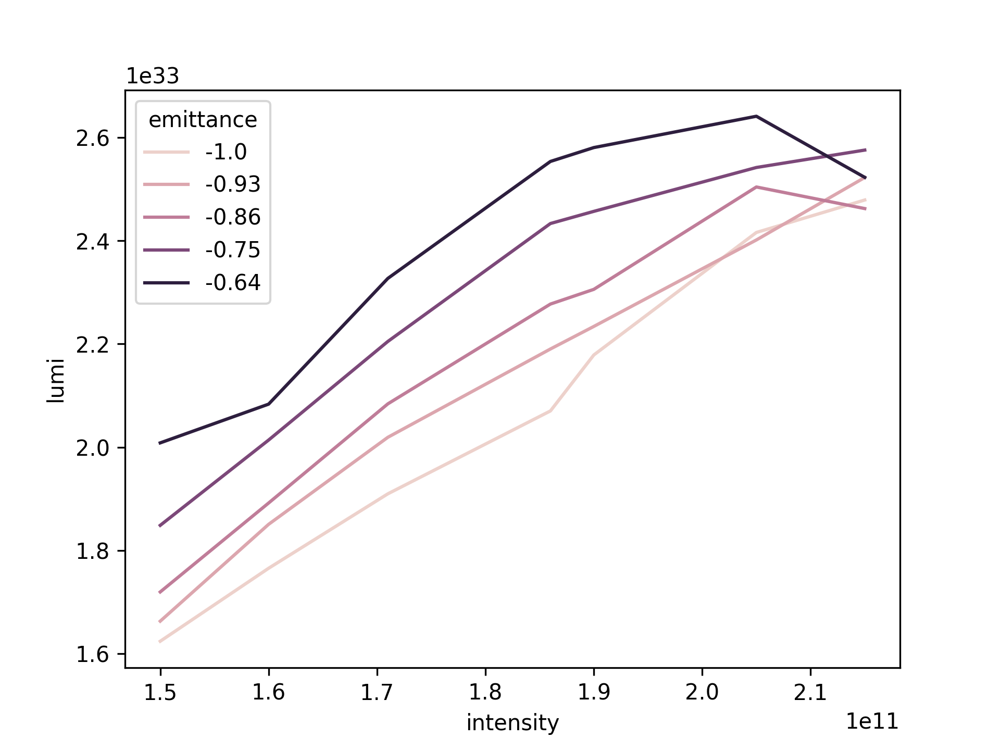

Luminosity – Number of Particles
Small beam size important for luminosity
Full Picture of luminosity more complicated
  Impact of collective effects of colliding particles
  Needs to be computed using numerical integration – LPAP contribution to Xsuite
Complex and computationally intensive parameter scans
  Optimise beam size, number of particles and number of colliding bunches
  Optimisation together with simulations with electron clouds L. Sabato (LPAP)
-Beam size/default
Luminosity/collision
${10}^{11}$Particles/ bunch

Slide 20
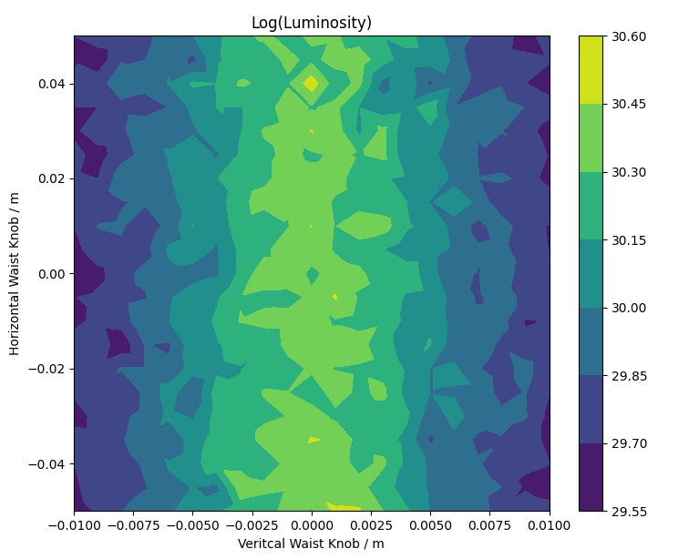
Luminosity – IP Perturbations
Luminosity highly dependent on beam size control at interaction point
  Offset location of beam size minimum compared to second beam
  Important tolerance input for error tolerances and correction strategies
Compute luminosity using numerical integration
Very high sensitivity in control in vertical plane
Similar studies performed to determine other tolerances

Slide 21
Lifetime

Slide 22
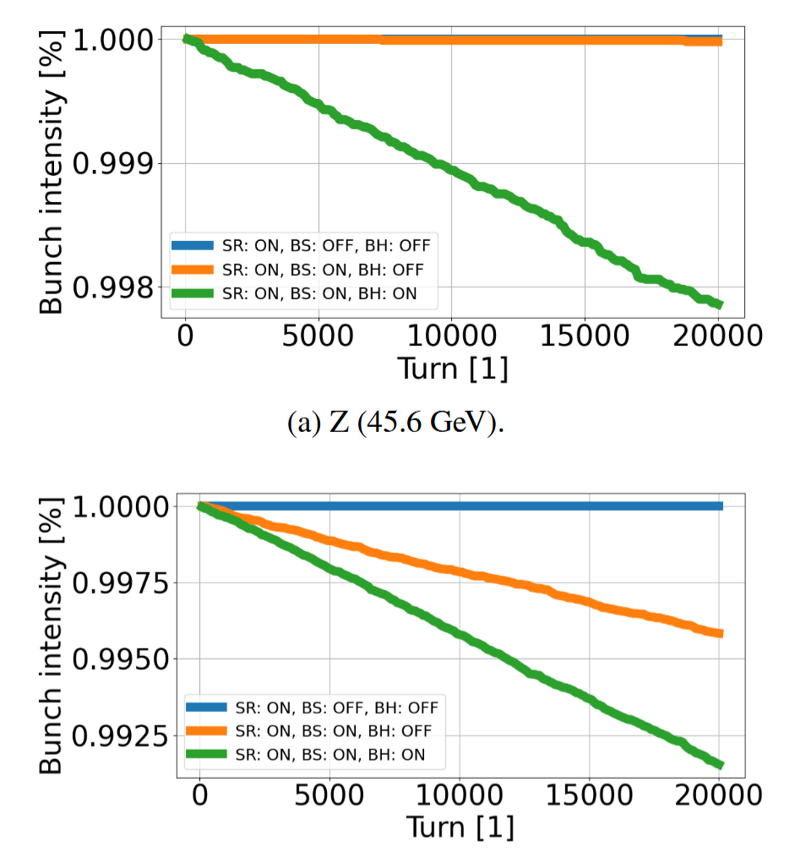
Lifetime and Stability
Lifetime studies with magnets and beam-beam effects possible in Xsuite
  Benchmarked to legacy models
Xsuite enables more detailed simulations
  E.g. with specific errors and/or corrections
  Addition of other effects
Lifetime simulations extremely computationally intensive
  Track 100,000 particles’ trajectory for thousands of turns
  Sufficient loss events required

Slide 23
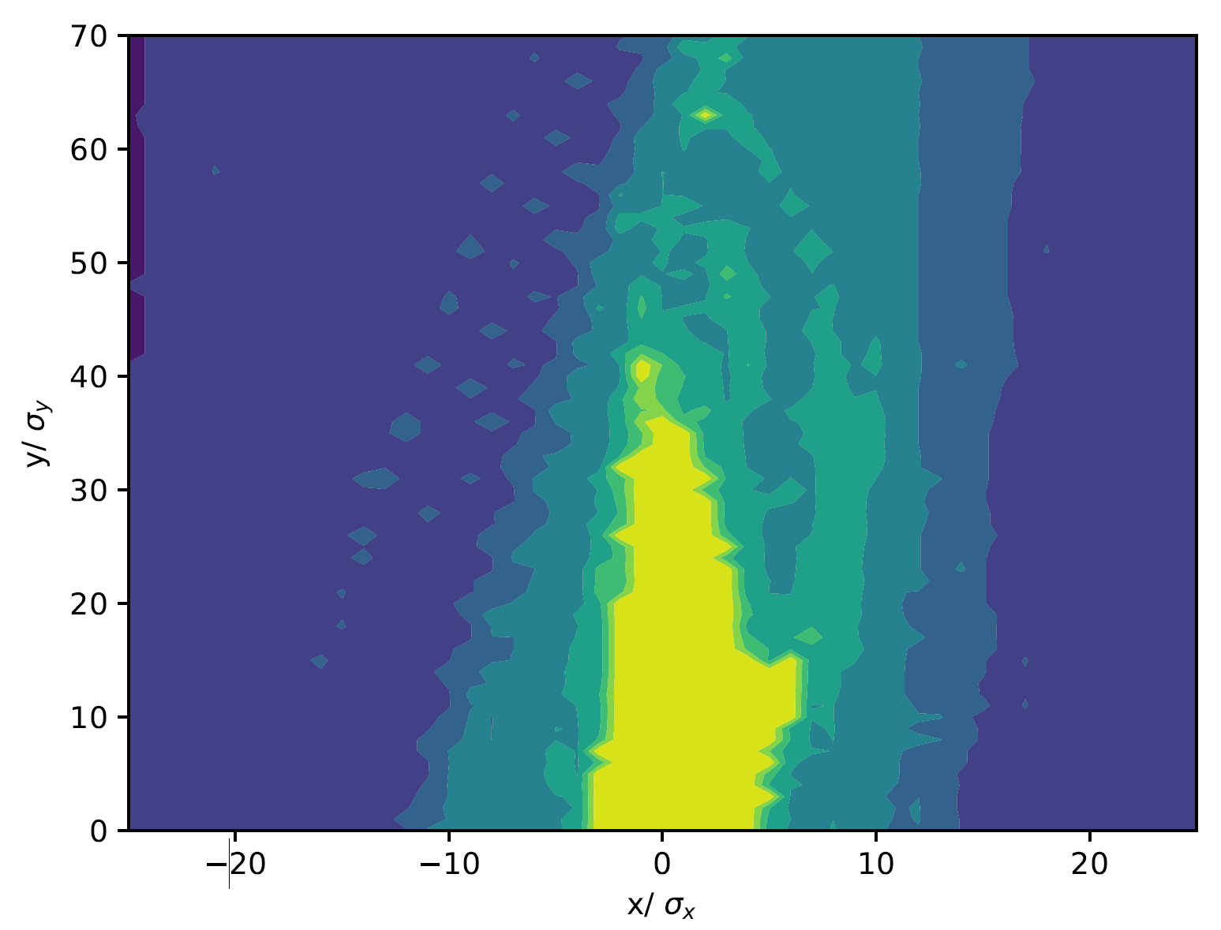
Dynamic Indicators
Often use other indicators to optimise lifetime
Many traditional indicators tested and implemented
  Models set up in XSuite
  Benchmarked against other models
Indicators studied (and benchmarked)
  Optics
    Linear approximation of motion
  Beam size
  Dynamic aperture
    Stable transverse phase space
  Momentum acceptance
    Off-momentum dynamic aperture
  Lifetime
  Luminosity

Slide 24
Rough Overview of Timescales
Simulation | Number of Particles | Number of Turns
Optics | ~1 | ~few
Beam Size – Matrix | ~1 | ~few
Dynamic Aperture | ~100 | ~few damping times (50-5000)
Beam Size – Tracking | ~1k | ~few damping times (50-5000)
Momentum Acceptance | ~10k | ~few damping times (50-5000)
Luminosity | ~10k | ~few damping times (50-5000)
Lifetime | ~100k | ~20k

Slide 25
Limits of Indicators
Many indicators designed for accelerators with less radiation
  Lower energy or hadrons
  Often inadequate at describing radiation dominated motion
    Faster but bad correlation with actual performance
Indicators often qualitative
Drive to develop robust quantitative indicators
  Numerical figure of merit for optimisation problems and scans
  Take into account effects of radiation
  Fast and accurate estimate of performance

Slide 26


Improved Indicators: Radiation Dominated Motion
Dynamic aperture – stable region in phase space
  Typically computed by:
  Creating particles in a grid with different horizontal and vertical amplitudes
  Track around the accelerator until motion is damped
  Identify amplitudes of stable and lost particles
$$N_{y}σ_{y}$$
$$N_{x}σ_{x}$$

Slide 27
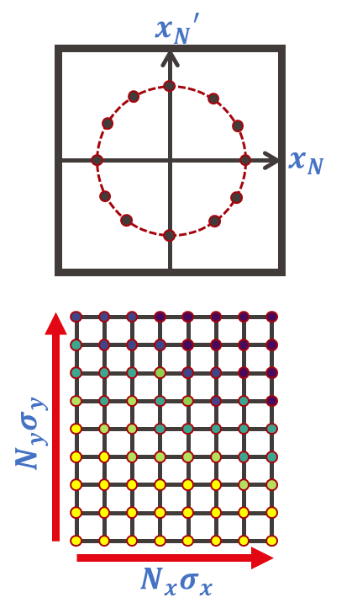
Improved Indicators: Radiation Dominated Motion
Dynamic aperture – stable region in phase space
  Typically computed by:
  Creating particles in a grid with different horizontal and vertical amplitudes
  Track around the accelerator until motion is damped
  Identify amplitudes of stable and lost particles
Due to fast damping sensitive to location in accelerator where particles were initiated
  New method developed, creating particles transverse coordinate and diversion

Slide 28
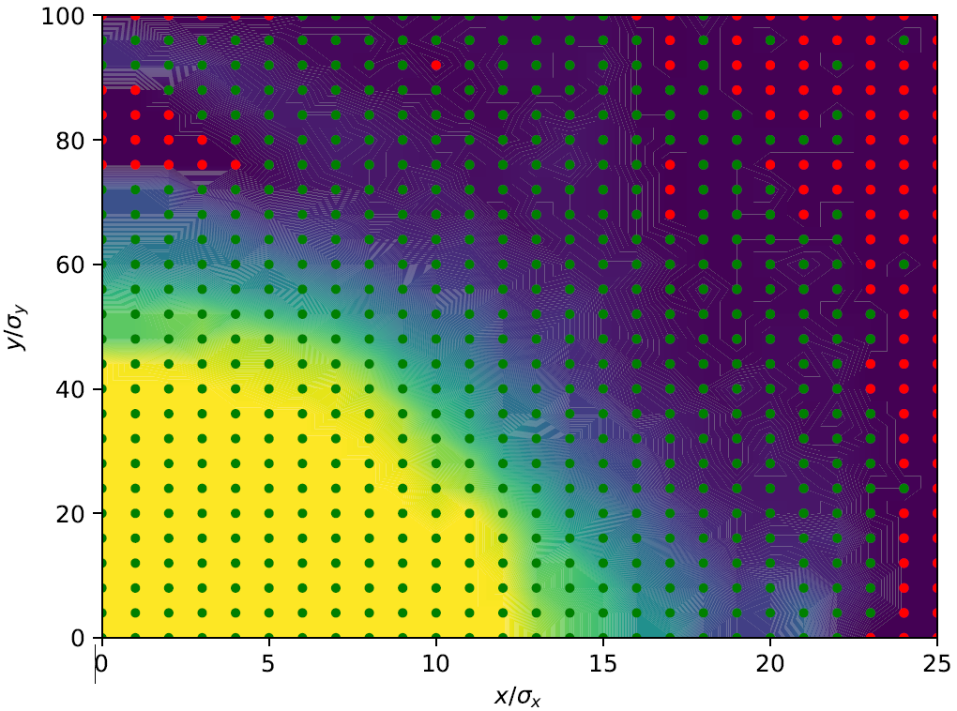
Improved Indicators: Radiation Dominated Motion
Dynamic aperture – stable region in phase space
  Typically computed by:
  Creating particles in a grid with different horizontal and vertical amplitudes
  Track around the accelerator until motion is damped
  Identify amplitudes of stable and lost particles
Due to fast damping sensitive to location in accelerator where particles were initiated
  New method developed, creating particles transverse coordinate and diversion
  Better indicator of stable amplitudes
Traditional: stable unstable
New: stable unstable

Slide 29
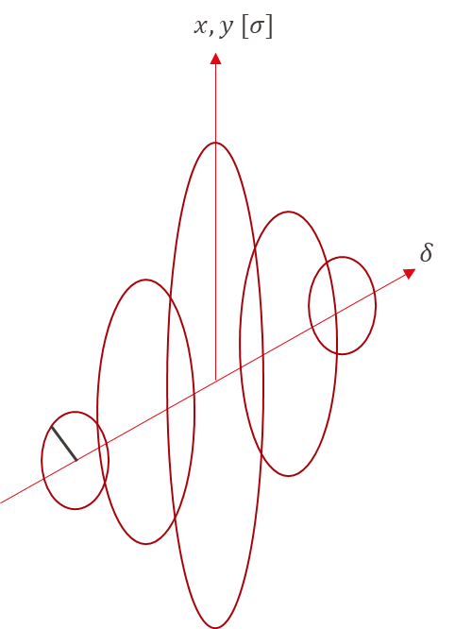
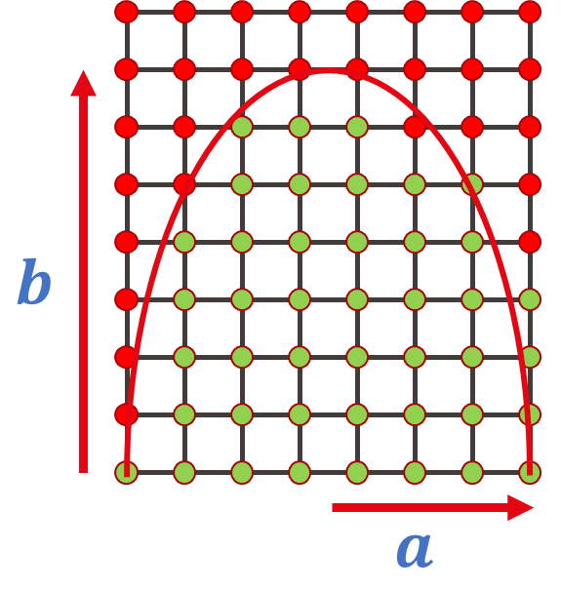
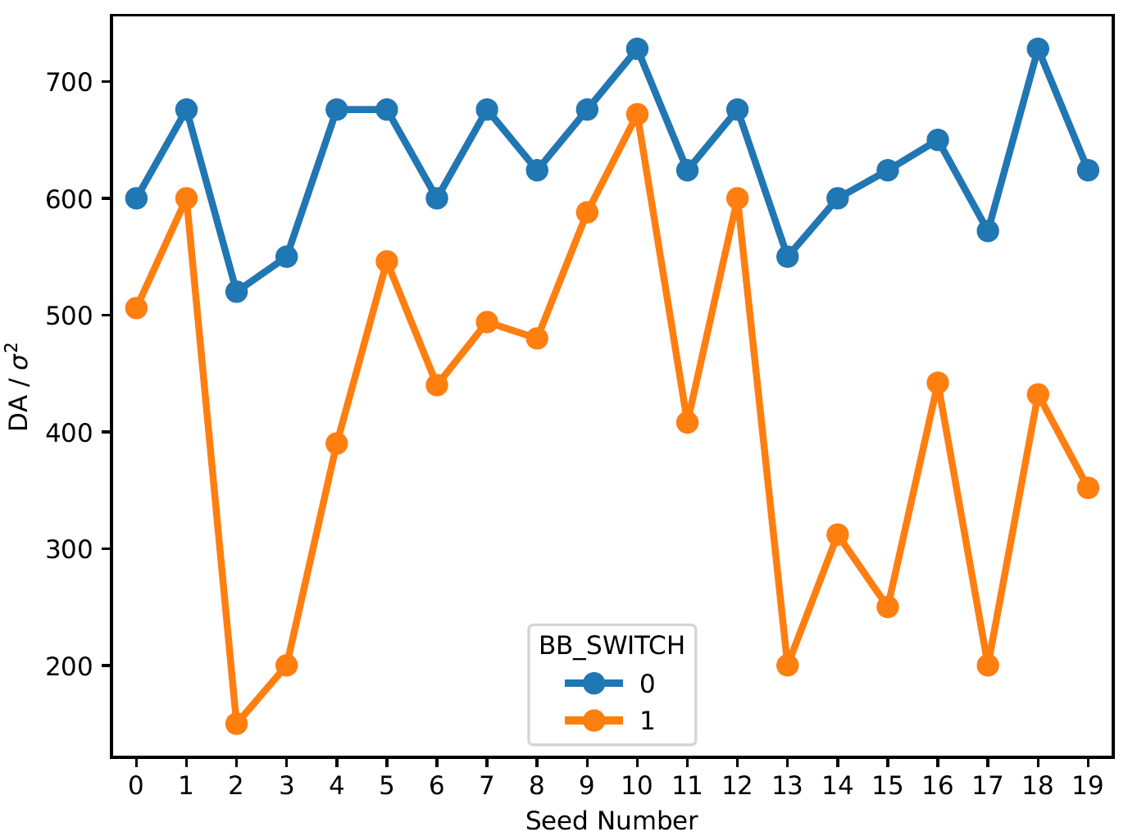
Quantitative Indicators
Efforts to create quantitative indicators
  Numerical value
  Indicative of result from more detailed simulation
Use these to
  Help drive FCC-ee design and optimisation
  Understand behaviour in scans and interplay
Example: Area of ellipse containing stable particles
  Can be extended to momentum acceptance
  Use case: impact of beam-beam on stability with alignment errors
    Understand error interplay and target corrections

Slide 30
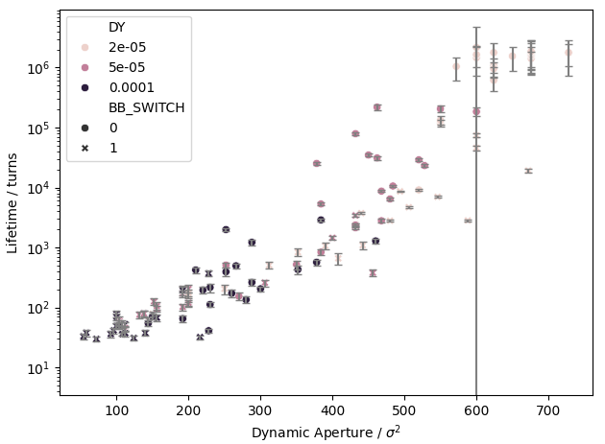
Correlations
Dynamic aperture as lifetime indicator
  Plot fast(er) quantitative stability indicators vs. lifetime
  With magnet misalignments, with and without beam-beam effects
  Computed using improved method
Clear trend between DA and lifetime
  Additional variance by an order of magnitude
  Additional or better indicators needed to fully describe lifetime
Next goals
  Understand source of variance
  Define new and improve existing indicators

Slide 31
Conclusions
Contributed to the creation of accurate models simulating FCC in its complexity
  Carefully benchmarked individual aspects to established models
  Introduced simulations with multiple effects
Able to compute performance
  Detailed performance described by beam size, luminosity and lifetime
  Explored other indicators
    Refined for FCC-ee requirements
    First work to understand predictive power
Perform scans and tolerance studies to drive design
  Set clear targets
  Understand interplay to inform designs and correction strategies

