Slide 1




Update from the McDonald Institute
Joint IPP/CINP Meeting
CAP Congress
June 26th / 2026
By Tony Noble
tony.noble@mcdonaldinstitute.ca

Slide 2
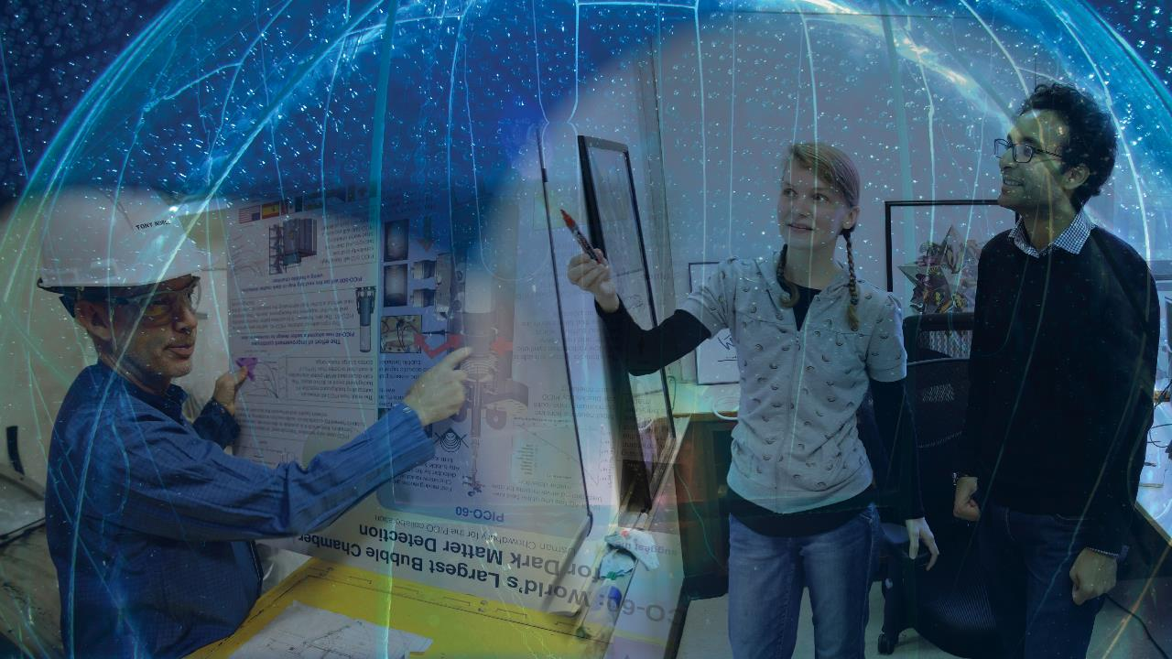
The McDonald Institute is Canada's network for astroparticle physics research, uniting scientists, engineers, and technical experts within one Pan Canadian Partnership
We strive to be:
A globally recognized centre for research and learning, coalescing Canadian and international expertise in underground astroparticle physics.

Slide 3



















Now a partnership of 11 Universities and 6 institutes>
New

Slide 4
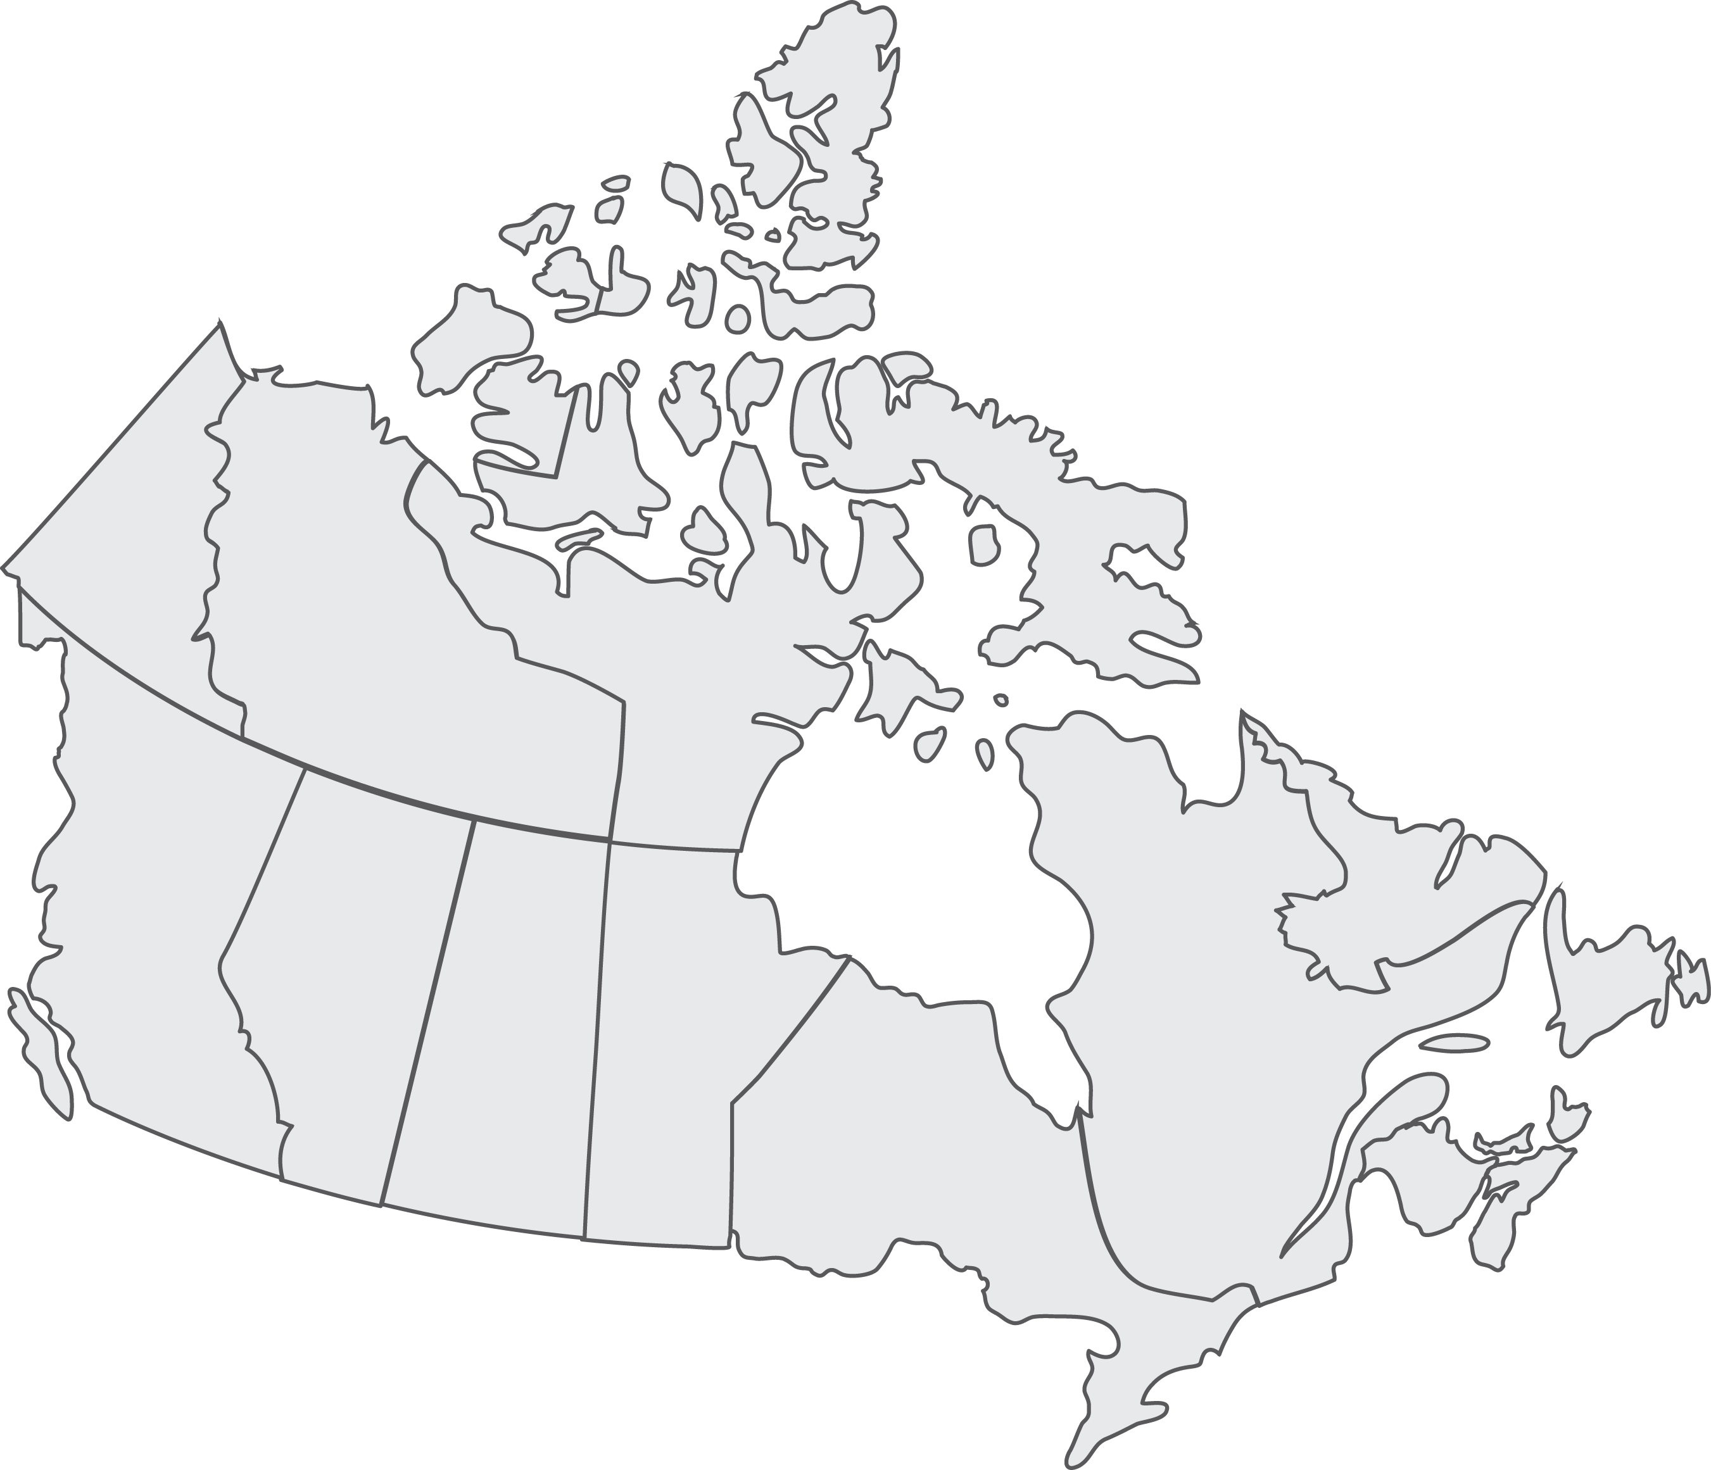
A Pan-Canadian Partnership
SNOLAB – Premier facility in the world
Pan-Canadian scientific effort
leveraging world-class facilities
Partnerships:
11 Universities
Alberta
Carleton
Laurentian
McGill
Montreal
Queen’s
Sherbrook
Simon Fraser
Toronto
UBC
Victoria
6 Institutes
CIFRA
CITA
IPP
PI
SNOLAB
TRIUMF
Collaborators
McMaster
Regina
Saskatchewan
Waterloo
Winnipeg
York
SNOLAB
Queen’s
Notes:
SNOLAB is considered the premier facility in the world by virtue of the lowest backgrounds
We involve all institutions in Canada, and the only such institution known with a national agenda
Large international collaborations

Slide 5
CFREF Funding Complete:
NSERC-MRS Funding Ramping UP:
Scientific Capacity Building:
Addressing the Gaps:
15 new Faculty in cross-disciplinary positions hired by McDonald Institute. Now University supported.
This spawned about 12 more faculty positions to build on these groups.
New faculty members developed interest in astroparticle physics. Over 80 faculty have had significant engagement with MI during the CFREF period.
Initiated substantial growth in astroparticle physics theory
Many hundreds of HQP supported across Canada
Substantial support for key projects via faculty, HQP, engineering and technical resources.
Community support & Network development
Significant new engineering, and technical support through an MRS like “Integrated Project Delivery Office”. Hubs strategically placed across Canada with 17 FTE personnel supported.
Pool of talent will include mechanical, structural, cryogenic, electrical, project management…
Allocated through Prioritization Board.
Strong continued support for research programs through HQP, other personnel
New partnership with Sherbrooke, Simon Fraser, Victoria and CITA
Technology development

Slide 6
Funding Situation
CFREF completed: All spending complete. Accounts closed. Final annual reports due to CFREF Sept 2026
NSERC-MRS In progress:
  First two years (18.2 M$) received. Nominally April 2024 – March 2026 but with extra year spend down at NSERC we are budgeting this April 2024 – March 2027
  Final three years (27.3 M$) has also been reviewed, approved and received. Budgetted ~ April 2027 – March 2030 including the one year spend down.
 | 2024-25 | 2025-26 | 2026-27 | 2027-28 | 2028-29 | 2029-30
First 2 years | 0 | 9.1 | 9.1
Final 3 years |  |  |  | 9.1 | 9.1 | 9.1
Notes:
`

Slide 7
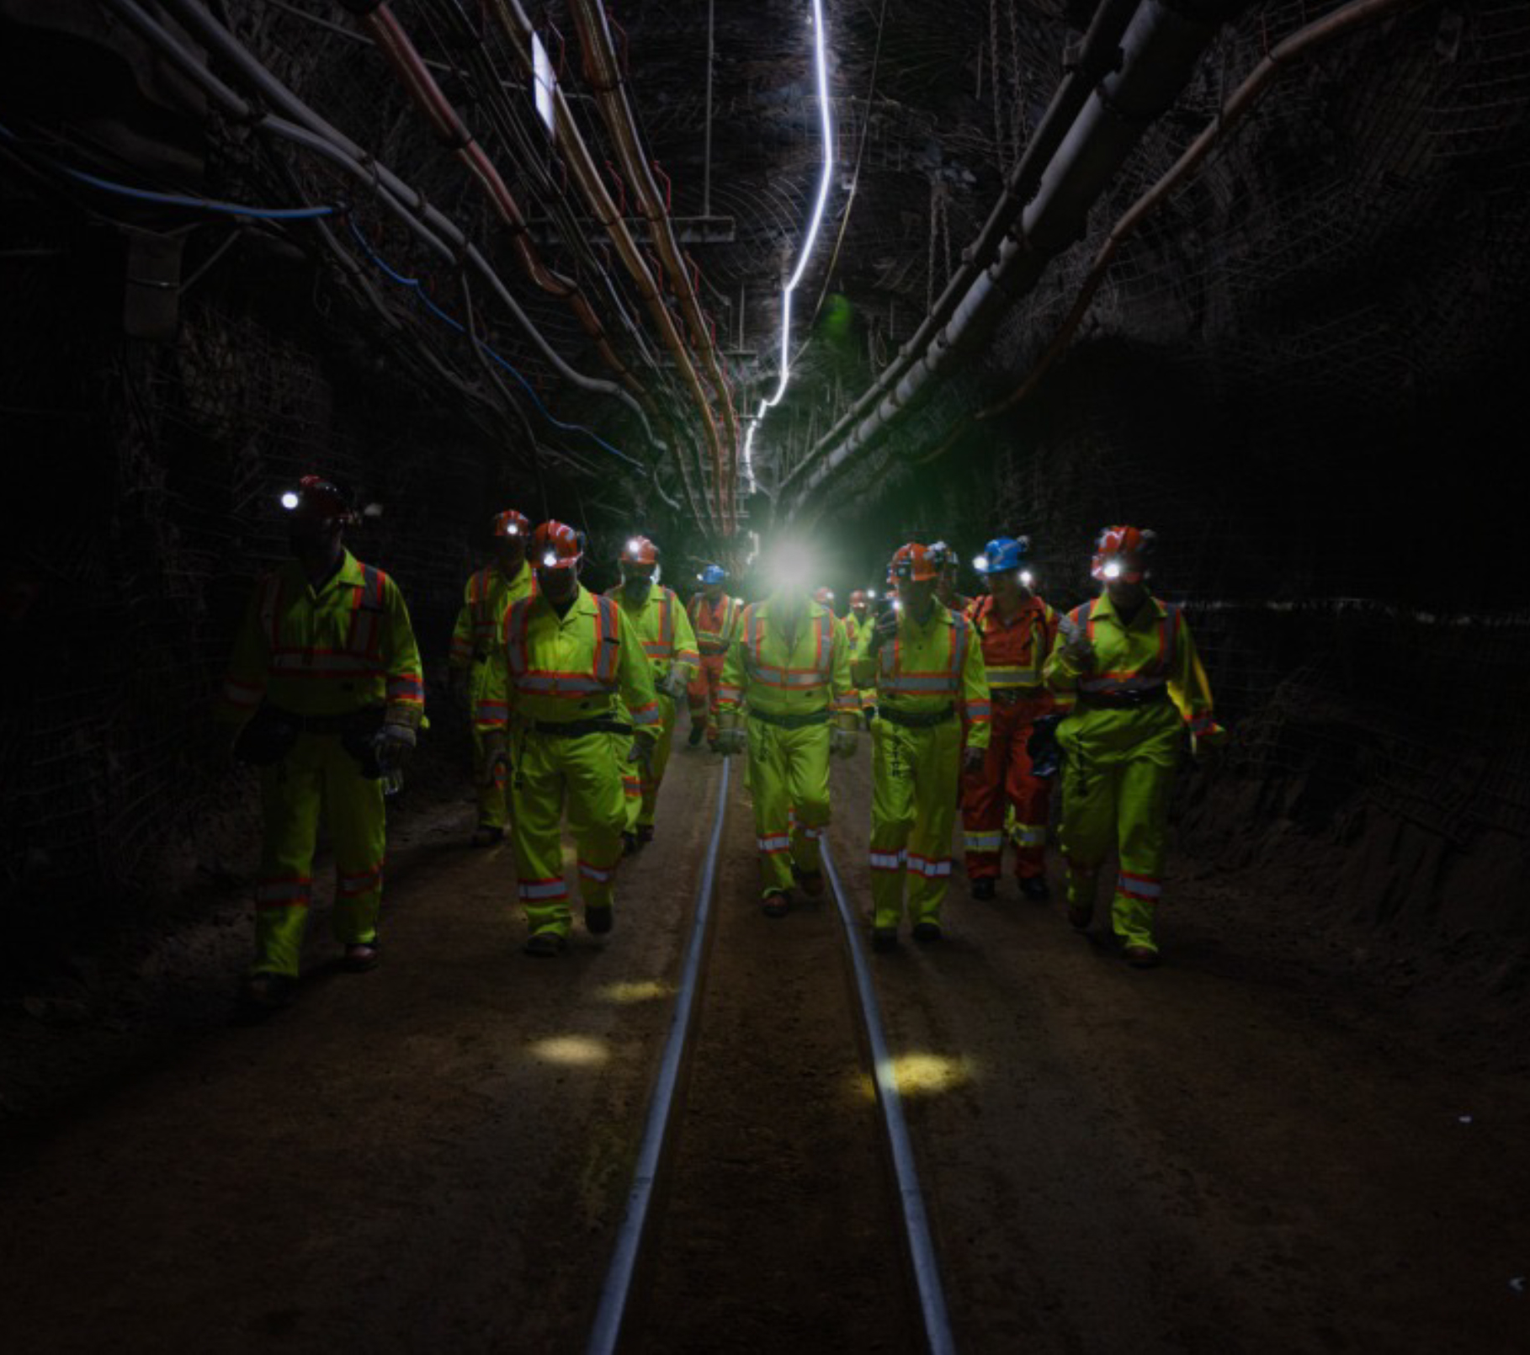
Scope: The Institute is providing support for the initial research & development of projects and for the ongoing science delivery, primarily at the Universities where the initial R&D is occurring.
Focus: The Institute was initially created with a focus on ensuring Canadian scientists were leading in the science that benefits from having the premier underground facility, SNOLAB, in their backyard.
Physics objective focus on:
  Dark Matter
  Fundamental Properties of neutrinos
  Neutrinoless double beta decay
  Multi-messenger Physics
In addition to SNOLAB we also now benefit from the underwater facilities at Ocean Networks Canada.

Slide 8








Delivering the Science:
McDonald Institute
Integrated Project
Delivery Office
Education and outreach
Catalyzing critical
innovations
HQP professional training, and ECR development
MI
Enhancing accessibility
and scientific training
EDII integration in all activity/governance
Disruptive research:
cross-disciplinary approach
Facilitating
knowledge translation
Notes:
An integrated project delivery office To enable Canada to attract and lead major elements of international experiments at the 500M$ scale by providing the engineering and technical resources required.
Catalyze Innovation: For projects and novel new applications.
Providing the “Complete Package” on behalf of the community. As required for big science programs.

Slide 9
Integrated Project Delivery Office
A well identified gap in the Canadian astroparticle physics ecosystem is the lack of engineering and technical resources at the Universities. Such a resource:
Will enable Canadian researchers to take on major leadership responsibilities within large international collaborations to deliver significant components of those projects. Hence elevating the stature of the Canadian contributions.
Will provide a blend of technical skills accessible by the entire community where having all those skills locally would be impossible.
Allows the community to retain the expertise in underground physics while the various projects move through the typical life cycles of design, fabrication, and commissioning where significant engineering resources are most needed.

Slide 10
Managing the IPDO
Relevant proposals are first reviewed by a “Project Feasibility Committee” with appropriate engineering and technical expertise to evaluate the technical feasibility of the request. This may involve some iteration with the proponents.
The “Resource Allocation Committee” evaluates the scientific merit and alignment of feasible proposals and makes a recommendation on the appropriate level of support.
Notes:
`

Slide 11
Engineering and Technical Staff in the IPDC
Queen’s Koby Dering P.ENG Mechanical, Structural, Process, PM, Technical Director
Jonathan Corbett P.ENG Cryogenic, Mechanical
Mackenzie Dean Mechanical
Armin Mir Mechanical
Nicholas Moss Mechanical
Jeff Kingma Machinist
Robert Gagnon Research Technologist
Carleton Farrokh Rad P.ENG Project Management
Ryan Crampton P.ENG Design Engineer
John Sosiak Lab Management
Alberta Michael Rangen Electronics Technologist
Steve Perricone Mechanical
McGill Naman Walia Mechanical, Cryogenic
Montreal Mathieu Lauren ++ Research Scientist
UVIC Sam de Jong Detector Technologist
SFU Chris Ng Mechanical
TRIUMF++ Leanne Beet Facility Manager
Roger Brammall Electronics Engineer in Training
Benjamin Smithers Detector Scientist
James Nikkel Research Scientist

Slide 12
Rough base line of activity prior to fully launching IPDC
Fractions are % FTE working on project
TRIUMF and Montreal not reporting hours yet
Several entries based on a few weeks only so not that representative.
Notes:
`

Slide 13
HQP Recruitment through Pooled Funding Programs
Pooled Funding Competitions:
Graduate Student Competition: Round 1 17 (11 MSc, 6 PhD)
Graduate Student Competition: Round 2 14 (2 UG, 9 MSc, 3 PhD)
Postdoc Competition: Expt: Round 1 5
Postdoc Competition: CITA: Round 1 3
Postdoc Competition: Theory: Round 1 5
Postdoc Competition: Theory: Round 2 3
Total: 47 (2 UG, 20 MSc, 9 Phd, 16 Pdf)
Notes:
`

Slide 14
Basic Program support
Program | UG | MSc | PhD | PDF | RS | Eng/tech | EIT | Admin | Total
Theory | 2 | 2 |  | 1 |  |  |  |  | 5
PICO |  |  |  | 1 |  |  |  |  | 1
HK |  |  | 1 |  |  |  |  |  | 1
SuperCDMS |  | 1 |  | 7.7 | .75 |  |  |  | 9.45
Tech Dev |  |  |  | 1 |  | 4 |  |  | 5
IPDC |  |  |  |  |  | 22 |  |  | 22
LAr | 1 |  | 1 | 1 | 2 | 5.7 |  | 2 | 12.7
SBC |  |  |  | 1 |  | .5 |  |  | 1.5
P-ONE |  |  |  |  |  | .5 |  |  | 0.5
SNO+ |  |  |  |  |  | .3 | 2 |  | 2.3
Sensei |  | 1 |  |  |  |  |  |  | 1
XLZD | 1 |  | 3 |  |  |  |  |  | 4
CUTE |  |  |  |  | .25 |  |  |  | .25
Ricochet | 2 |  |  |  |  |  |  |  | 2
LIGO |  |  |  | 1 |  |  |  |  | 1
Mathusla |  |  |  | .3 |  |  |  |  | .3
Other |  |  |  |  |  | 2 |  | 4 | 6
Total | 6 | 4 | 5 | 14 | 3 | 35 | 2 | 6 | 75
Notes:
`

Slide 15
Current Support Summary
47 HQP supported through pooled funding program so far. New competitions on the way.
75 HQP supported through funds to partner Institutions
Plus, 9 administrative support positions funded through the indirects (not the main NSERC-MRS grant.
Plus 4 HQP working on astroparticle physics related STEM curriculum development in Faculty of education
A total of 135 positions currently being supported, with good coverage of the program, particularly SuperCDMS and the LAr program (mostly Darkside)
Strong engineering and technical support through the IPDC

Slide 16
Highest MI Priorities (in no particular order)
XLZD/nEXO2.0 amalgamation.
  Potentially best of both worlds if 0νββ comes together with dark matter.
  First phase will give world leading DM result at large scale and 0νββ at similar sensitivity to nEXO without isotopic enrichment (exact sensitivity to be determined).
  Excellent potential home at SNOLAB. (But other labs are interested too)
  Ready made second phase with xenon enrichment.
  Capturing imagination of scientists, and agencies are willing to explore.
  Still a long row to hoe to get fully funded/designed etc. A developing concept. PandaX is a competitor.
SNO+
  So close to being able to load with Te. (The main focus of MI support for SNO+).
  Still very competitive.
SuperCDMS
  In the process of commissioning. Reached temperature. Chasing usual sources of noise, thermal leaks….
  After decades of effort, on the verge of exciting new physics results. A must complete
Darkside 20
  Enormous Canadian investment to construction phase. Follows from successful DEAP program in Canada. Excellent PSD demonstrated.
Theory
  Modest amounts of support leads to big impact, connected vibrant community. Elevates community “into the conduction band”.

Slide 17
Near top MI Priorities
P-ONE
  Great enthusiasm for neutrino telescope in Canada using ONC infrastructure
  Adds to the global community, overall sensitivity, complementary sky coverage
  Important to have P-ONE and KM3Net for multi-messenger astronomy with transient events where opacity of earth to high energy neutrinos can be a limitation.
  Technology is generally understood for vanilla detector (to be refined and optimized based on pathfinder strings).
  MI support generally focused on support for getting first strings built and deployed.
  Less well aligned to MI mandate. (Originally focused on the connection to SNOLAB)
  No clear path yet to fully funded km³ array.

Slide 18
Breadth
Experiments which are at the smaller/earlier stage. Important, but feasibility or ability to implement a next step needs to be demonstrated. MI willing to provide modest support in the short term. Next phase to be determined based on success at this level. Otherwise, these projects may be sun-set in the eyes of MI.
PICO
  Imperative that PICO 500 is completed. At this stage construction in nearly complete. Only operational support required.
  No clear next generation scaleup
  Possible interest in swapping fluids to push to lower mass WIMP
SBC
  Small scale demonstrator needs to run its course
  Possible coalescence of community (PICO/SBC merger) if promise of SBC can be demonstrated.
NewsG
  Needs to finish operations at SNOLAB. Next phase is 3-m SPC at Boulby. Less connected to MI
Deap’/DSLM
  Extensions to DEAP (isotope spikes, ARGO tests and Darkside Low Mass (DSLM) are interesting ideas.
Super Fluid Helium: Some interesting developments in using superfluid He as low mass DM detector should be explored

Slide 19
Lower Priorities
Experiments which have limited footprint in Canada, are less well aligned with MI, or not really needing the sorts of resources available from MI. These currently get limited or no funding from MI
Legend: Small footprint in Canada. LNGS siting. SNO+ then Xe based 0νββ are priorities.
Halo: Minimal resources needed.
DEAP 3600: Important to finish but completion of DEAP has minimal or no resource cost to MI
KDK+: Fundamental measurement of K decay, but not requiring SNOLAB, underground resources.
DUNE: Longer time scale than HK, less Canadian footprint, not so well aligned with MI
Skipper CCDs: Very interesting project, but no real footprint in Canada as yet (Potentially changing when Ana Botti arrives at UdeM).
Mathusla: Not well aligned with MI for deep underground low background expt. No clear path to funding required. Limited existing support internationally.

Slide 20
Other Priorities
Experiments which have a high scientific impact but are less well aligned with MI and are not using Canadian facilities will be supported strategically to boost Canadian opportunities to lead on some of the scientific output.
Hyper-Kamiokande: A very exciting, accelerator based, neutrino oscillation experiment in Japan. Very likely to be operation in the next couple of years and with Juno should make defining measurements of neutrino/PMNS matrix parameters, (mass hierarchy, CP phases, precision mixing angles….). Very strong Canadian contributions. Should be a key element of the SAP LRP but not so well aligned to MI mandate. A natural follow on from SNO, T2K etc. Modest support to help maintain Canadian Ledership.
LIGO/LISA GW: Interesting to MI (not of relevance to SAP LRP) as a global success story with connections to multi-messenger physics. Modest support to amplify Canadian contributions

Slide 21
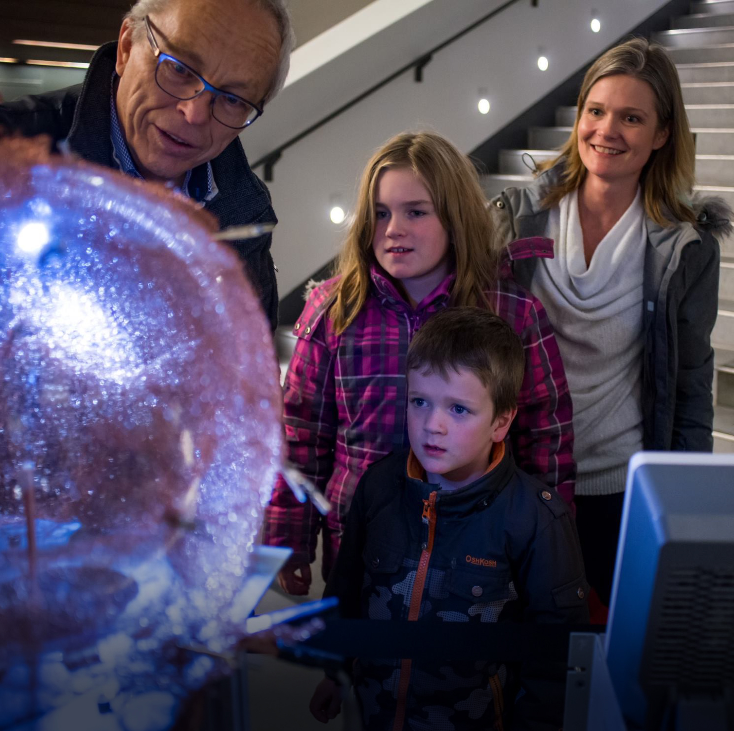

Thank-You tony.noble@mcdonaldinstitute.ca
Thank You

