Slide 1

James Chow^{1,2}
  ¹University of Toronto
  ²University Health Network
From Minutes to Seconds:
Hybrid AI–Monte Carlo Dose Calculation for Real-Time Radiotherapy
Artificial Intelligence in Radiotherapy Symposium
CAP Congress – Ottawa, Canada (June 2026)

Slide 2
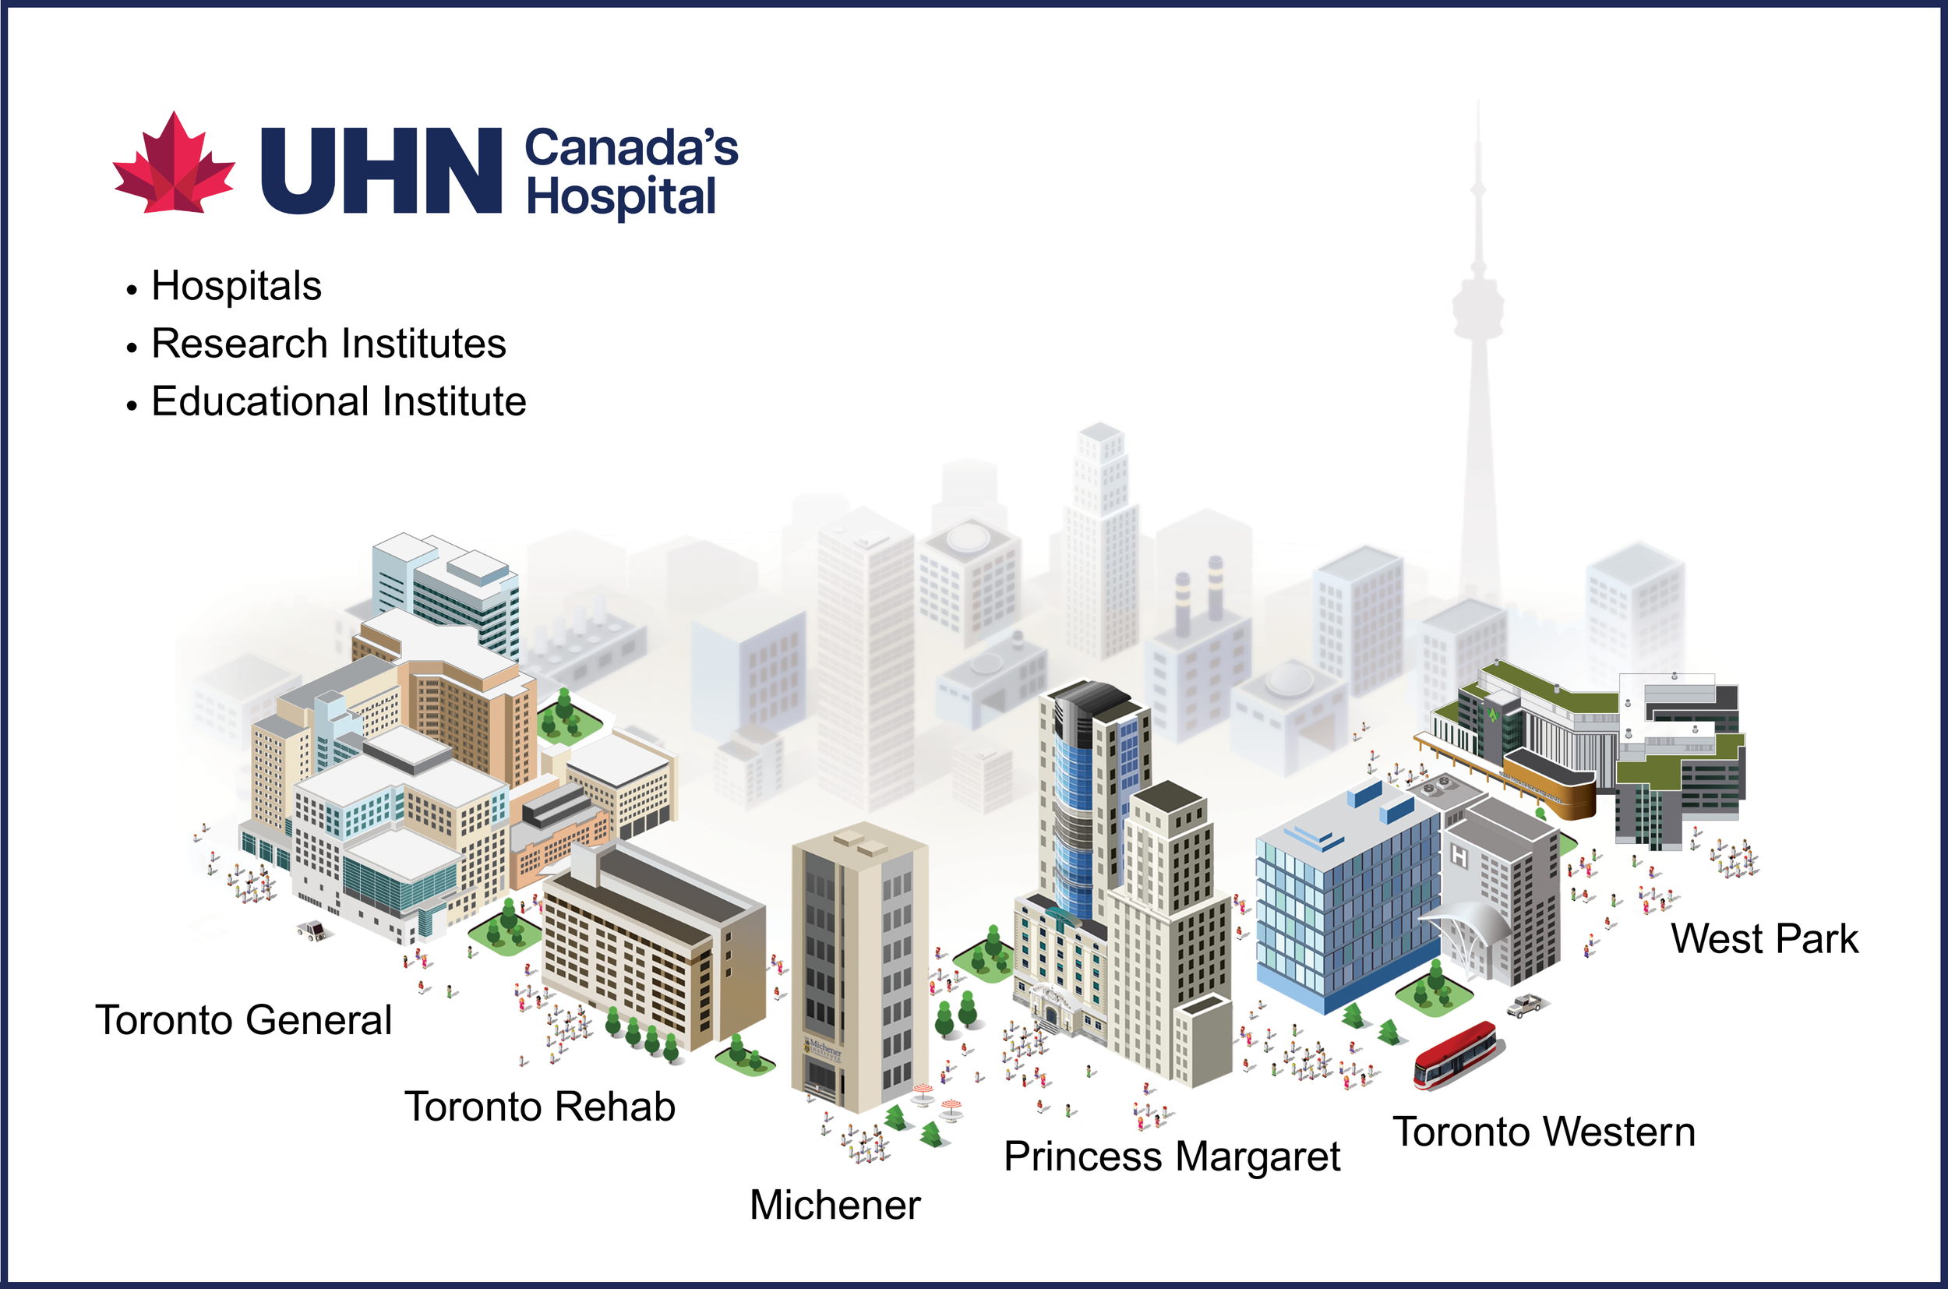

University Health Network (UHN)
#1 research hospital in Canada (since 2011)
~$599M annual research spending
UHN hospitals include #2 ranked hospital worldwide (2026)
~24,000+ staff and 2,000+ physicians
https://www.uhn.ca/corporate/AboutUHN/Pages/uhn_at_a_glance.aspx
https://www.uhnresearch.ca/news/12-04-2025/uhn-is-canadas-1-research-hospital

Slide 3
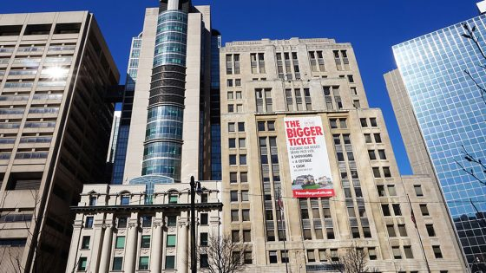
Princess Margaret Cancer Centre (PM)
Top 10 globally in oncology (Newsweek World’s Best Specialized Hospitals 2026)
#1 cancer centre in Canada
~20,000 new cancer patients/year
~279,000 clinic & virtual visits/year
~$298M annual research funding
https://www.uhn.ca/corporate/News/PressReleases/Pages/canadian-hospital-now-ranked-2-in-the-world.aspx
https://www.uhnresearch.ca/news/12-04-2025/uhn-is-canadas-1-research-hospital

Slide 4
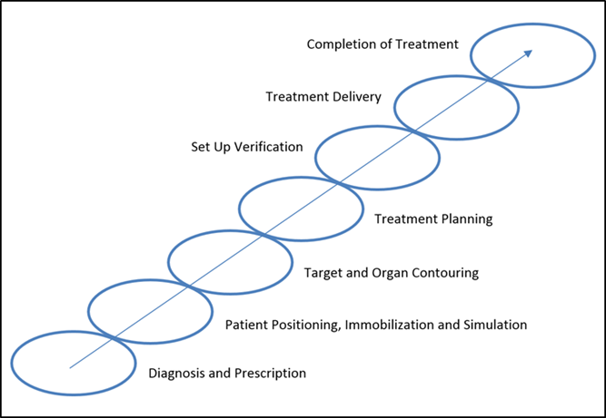
Radiotherapy Chain
Chow JCL. Recent Progress of Gold Nanomaterials in Cancer Therapy. In Handbook of Nanomaterials and Nanocomposites for Energy and Environmental Applications. Springer Nature, Cham, pp. 1-30. 2020. DOI
https://doi.org/10.1007/978-3-030-11155-7_2-1.
A radiotherapy chain showing different steps in the radiation treatment process.

Slide 5
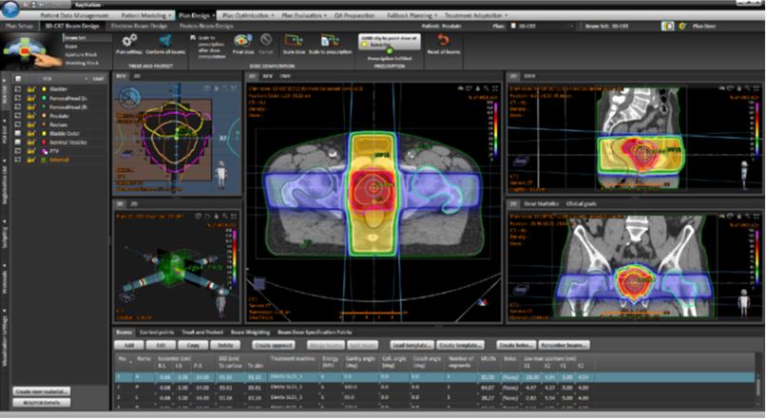
Radiation Treatment Planning
In radiotherapy, radiation treatment planning is the process in which a team of Radiation Oncologists, Radiation Therapists, Medical Physicists and Medical Dosimetrists plan the appropriate external beam radiotherapy or internal brachytherapy technique for a cancer patient.
https://en.wikipedia.org/wiki/Radiation_treatment_planning

Slide 6
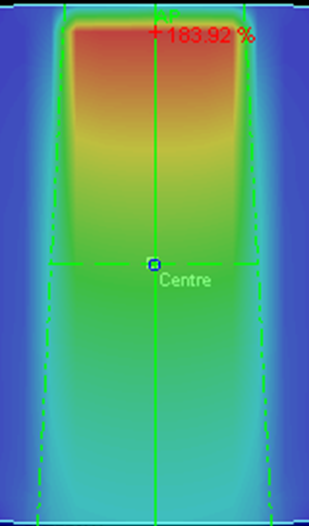
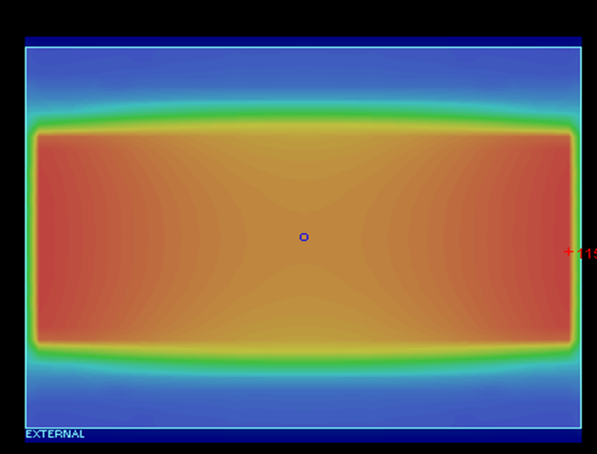
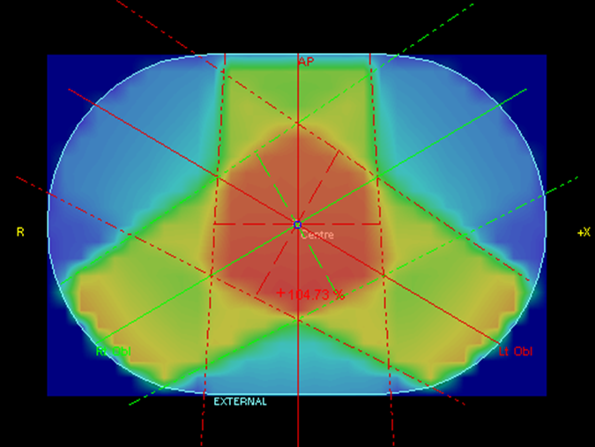
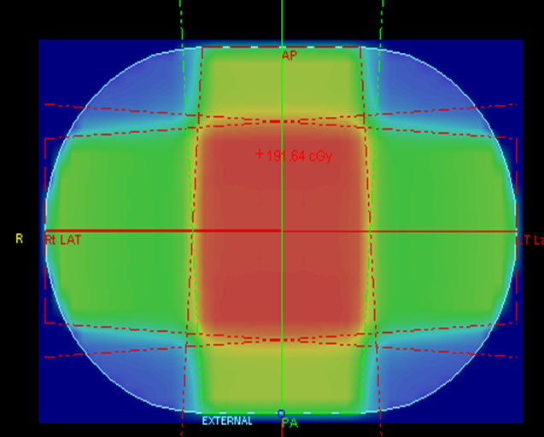
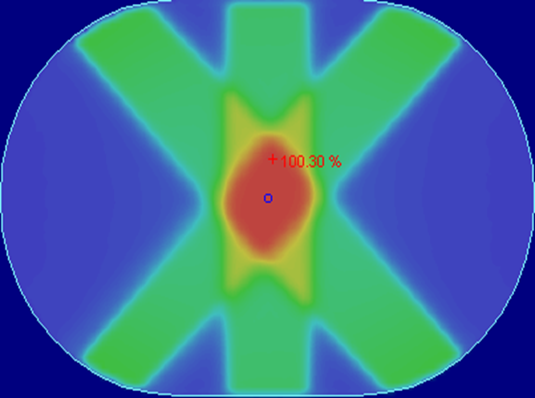
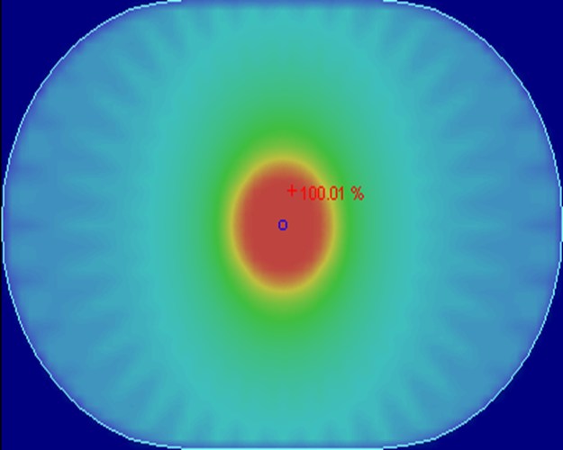
Dose Distribution
2 beams
3 beams
1 beam
4 beams
6 beams
Arc

Slide 7
Dose Calculation – Monte Carlo vs. Treatment Planning System (Pencil beam/Convolution–superposition)
Monte Carlo vs. Collapsed Cone Convolution (CCC) vs. Adaptive Convolution (AC) vs. …
Monte Carlo (MC) simulation is widely regarded as the most accurate radiation dose calculation method.
However, this high level of accuracy comes at the cost of long computation times, as the precision of the results depends on the number of particle histories simulated.

Slide 8
Monte Carlo methods (or Monte Carlo experiments) are a broad class of computational algorithms that rely on repeated random sampling to obtain numerical results. They are often used in physical and mathematical problems and are most useful when it is difficult or impossible to use other mathematical methods.
Monte Carlo methods are mainly used in three distinct problem classes: optimization, numerical integration, and generating draws from a probability distribution.
R Harrison. Introduction to Monte Carlo Simulation. AIP Conf Proc. 2010;1204:17-21

Slide 9
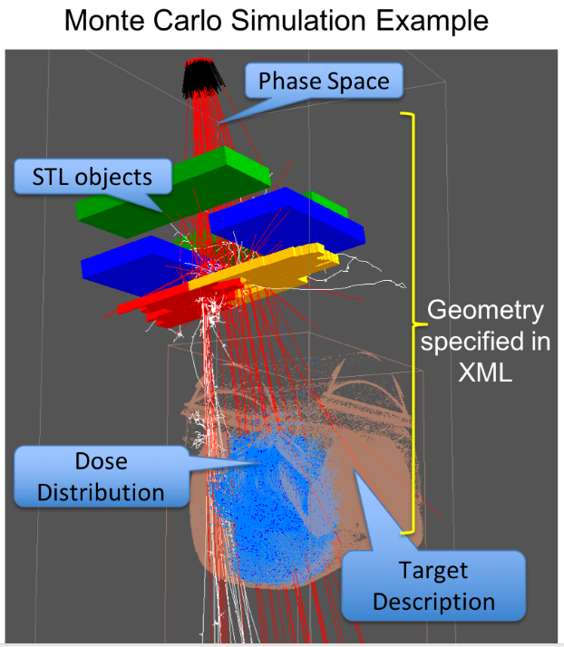
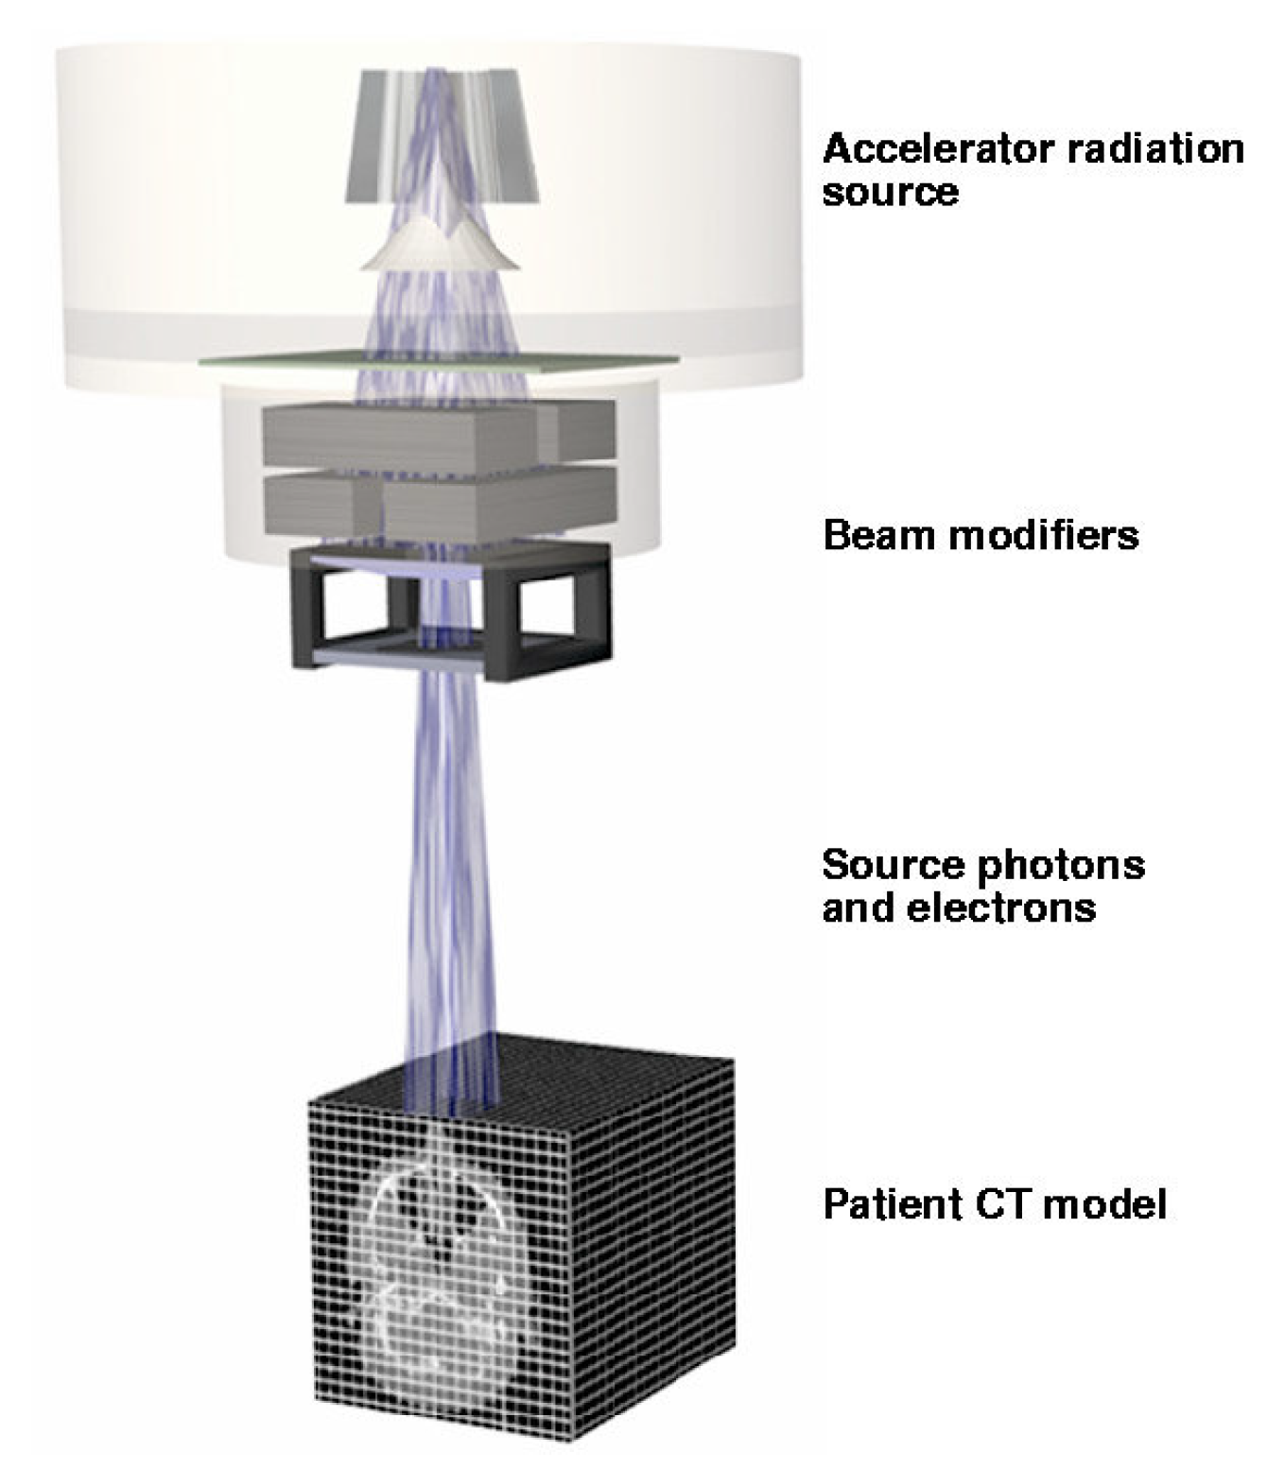
https://www.preprints.org/manuscript/202509.2179
https://radyalis.com/monte-carlo-3/monte-carlo-dose-simulator/

Slide 10
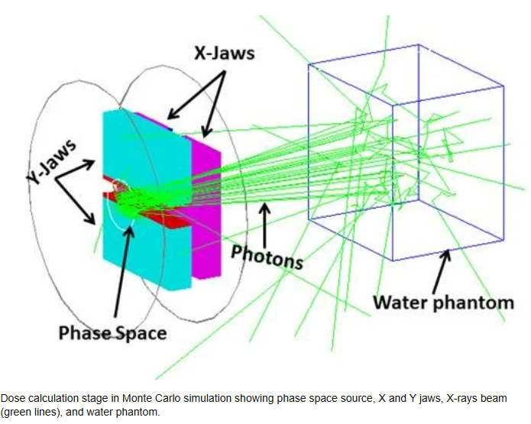
Monte Carlo: Gold Standard
Physics-based modeling
Handles heterogeneity
Reference for validation
https://www.researchgate.net/figure/Dose-calculation-stage-in-Monte-Carlo-simulation-showing-phase-space-source-X-and-Y_fig2_344953788

Slide 11
Why Dose Calculation Still Matters
Accurate dose is central to treatment quality
Precision radiotherapy depends on reliability
The Core Problem
Monte Carlo: accurate but slow
Analytical and semi-analytical models (PBC, CCC, AAA, AXB): fast but approximate
Persistent trade-off

Slide 12
Limitations of Monte Carlo
High computational cost
Minutes per calculation
Not suitable for real-time workflows
Limited in adaptive radiotherapy

Slide 13
Adaptive Radiotherapy
Adaptive radiotherapy (ART) adjusts the treatment plan during therapy.
It accounts for changes like tumor shrinkage or patient anatomy.
Imaging is used to monitor changes and update the plan.
This helps deliver radiation more accurately while protecting healthy tissue.

Slide 14
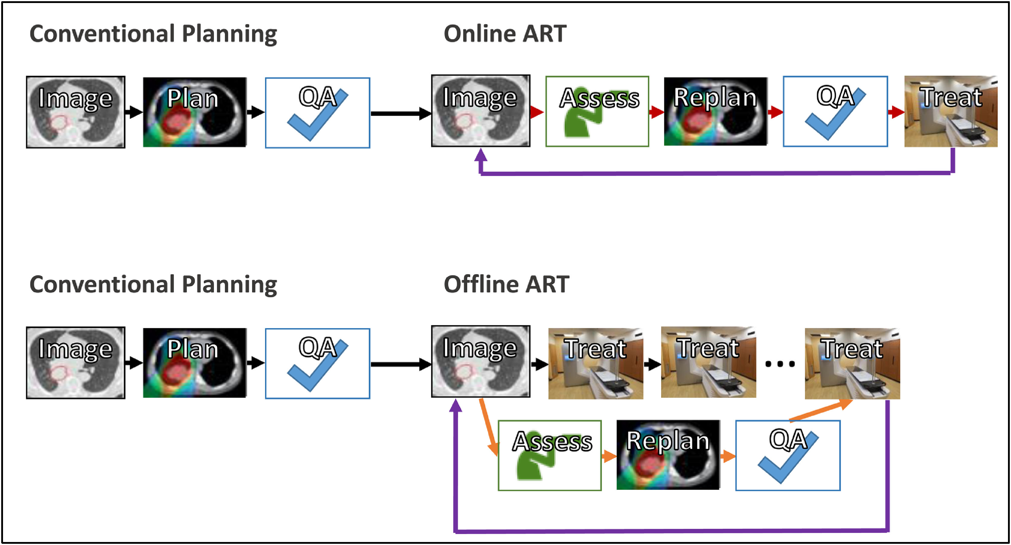
ART Workflow
https://doi.org/10.1016/j.semradonc.2019.02.004

Slide 15
Clinical Need: Speed
Adaptive radiotherapy (online) requires real-time decisions
Patient on couch: limited time window
https://health.economictimes.indiatimes.com/news/health-it/american-oncology-institute-hyderabad-launches-ai-driven-ethos-radiotherapy/101491205

Slide 16
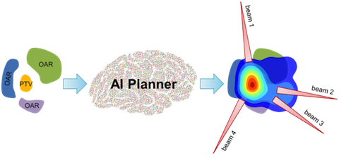
Enter AI
Learns dose patterns from data
Predicts dose in seconds
Enables rapid workflow
https://labs.utsouthwestern.edu/maia-lab/research/treatment-planning

Slide 17
AI for Dose Prediction
Deep learning models (e.g., U-Net)
Input: CT + beam
Output: 3D dose

Slide 18
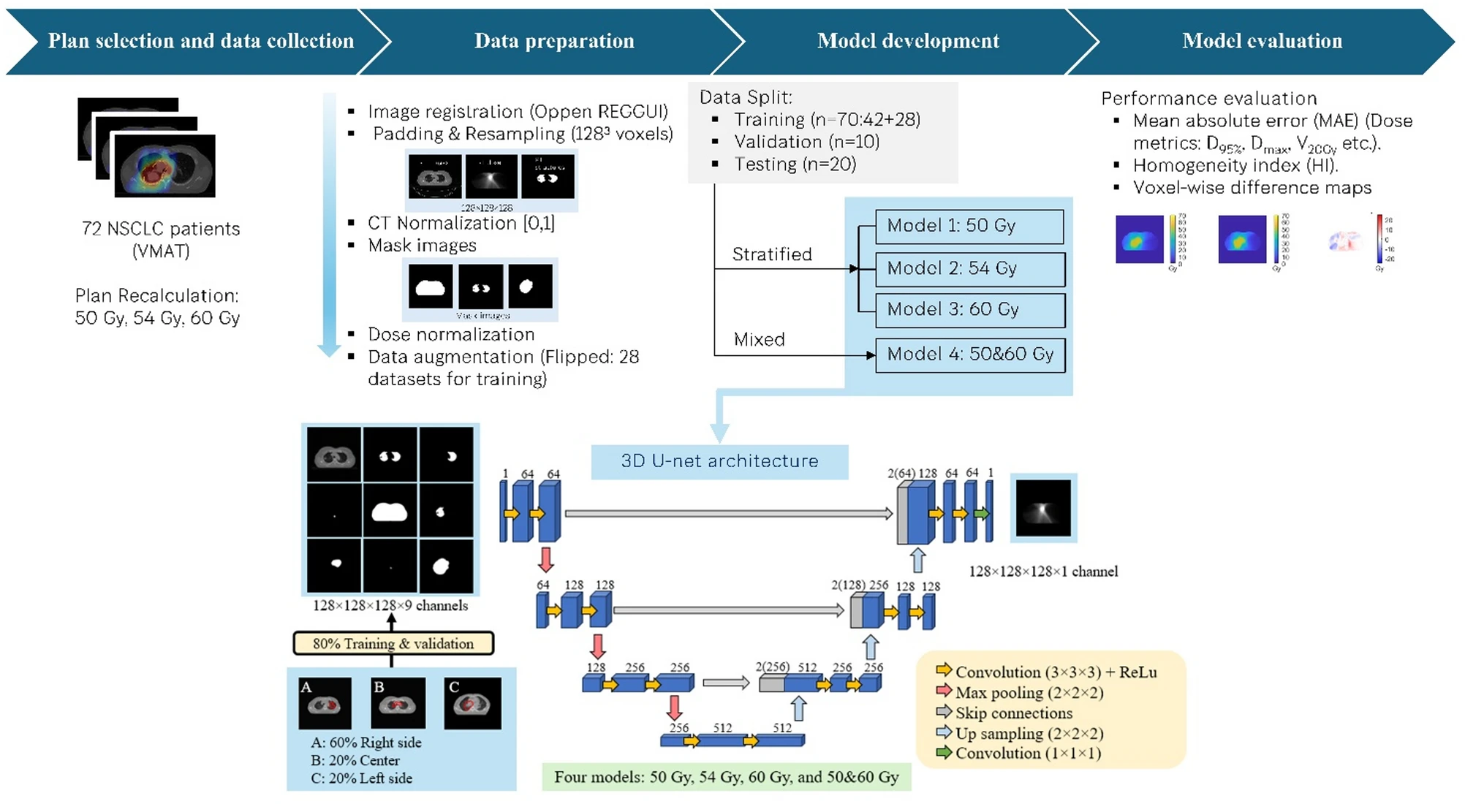
https://link.springer.com/article/10.1038/s41598-026-43192-6/figures/1

Slide 19
AI Performance
Fast inference
Reasonable accuracy
Useful for planning support

Slide 20
Limitations of AI
Generalization issues
No direct physics
Uncertainty in new cases

Slide 21
Key Idea
Not AI or MC
But AI + MC

Slide 22
Hybrid AI–MC Framework
AI: fast full dose
MC: selective verification
Combined accuracy and speed

Slide 23
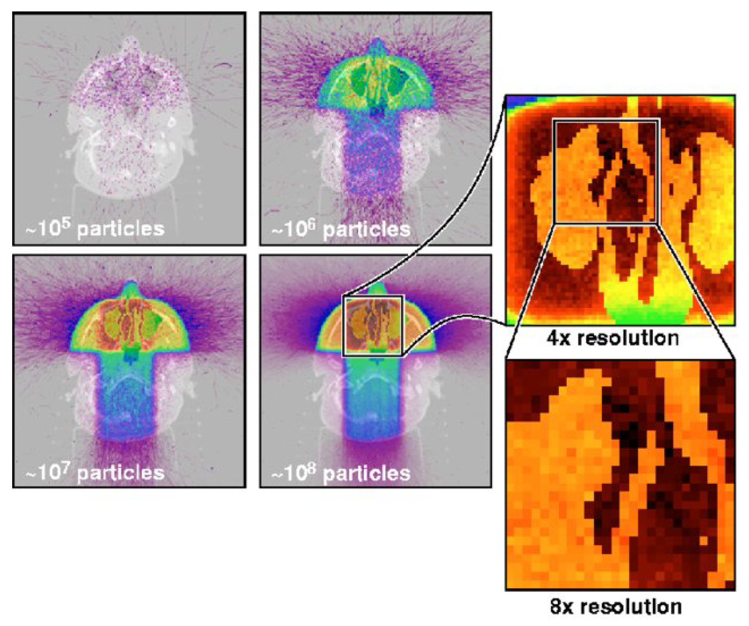
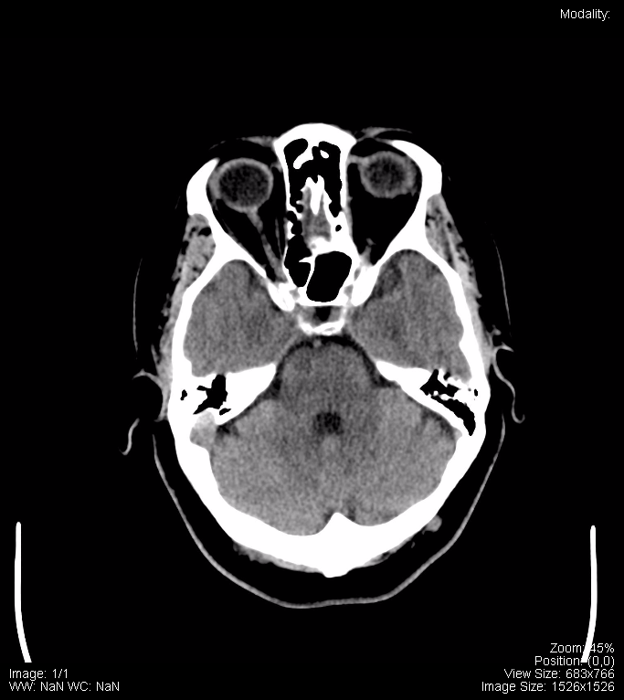
Workflow
Imaging → AI dose prediction → identify critical regions → MC refinement
https://www.preprints.org/manuscript/202509.2179

Slide 24
From Minutes to Seconds
AI enables rapid estimation
MC used only where needed
Significant time reduction

Slide 25
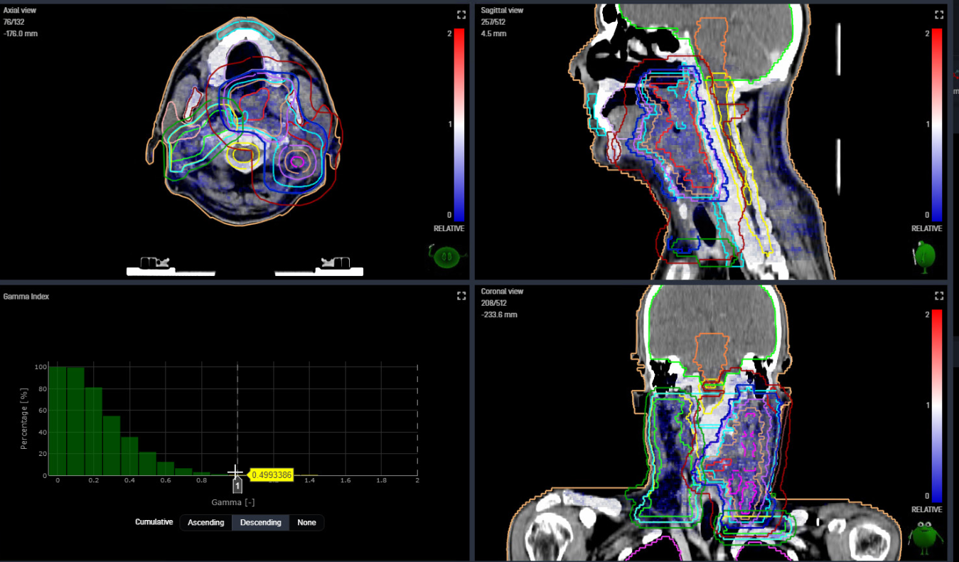
Clinical Scenario
On-couch adaptive radiotherapy
AI gives instant estimate
MC confirms critical regions
https://www.iba-dosimetry.com/product/myqa-ion-radiation-therapy

Slide 26
Applications
Adaptive radiotherapy
Treatment planning
Quality assurance

Slide 27
Uncertainty & Safety
AI: uncertainty estimation
MC: ensures reliability
Hybrid: improves confidence

Slide 28
Key Advantage
From minutes to seconds
Maintain physical accuracy

Slide 29
Limitations & Challenges
Data dependence
Domain shift
  Differences in anatomy, imaging characteristics, treatment setups and materials properties
Model maintenance

Slide 30
Future Directions
Physics-informed AI
Proton therapy
Real-time adaptive workflows

Slide 31
Take-Home Messages
MC = accuracy
AI = speed
Hybrid = future

Slide 32

Acknowledgment
We are grateful to the Natural Sciences and Engineering Research Council of Canada (NSERC) Discovery Grant Program for funding this project.

