Slide 1

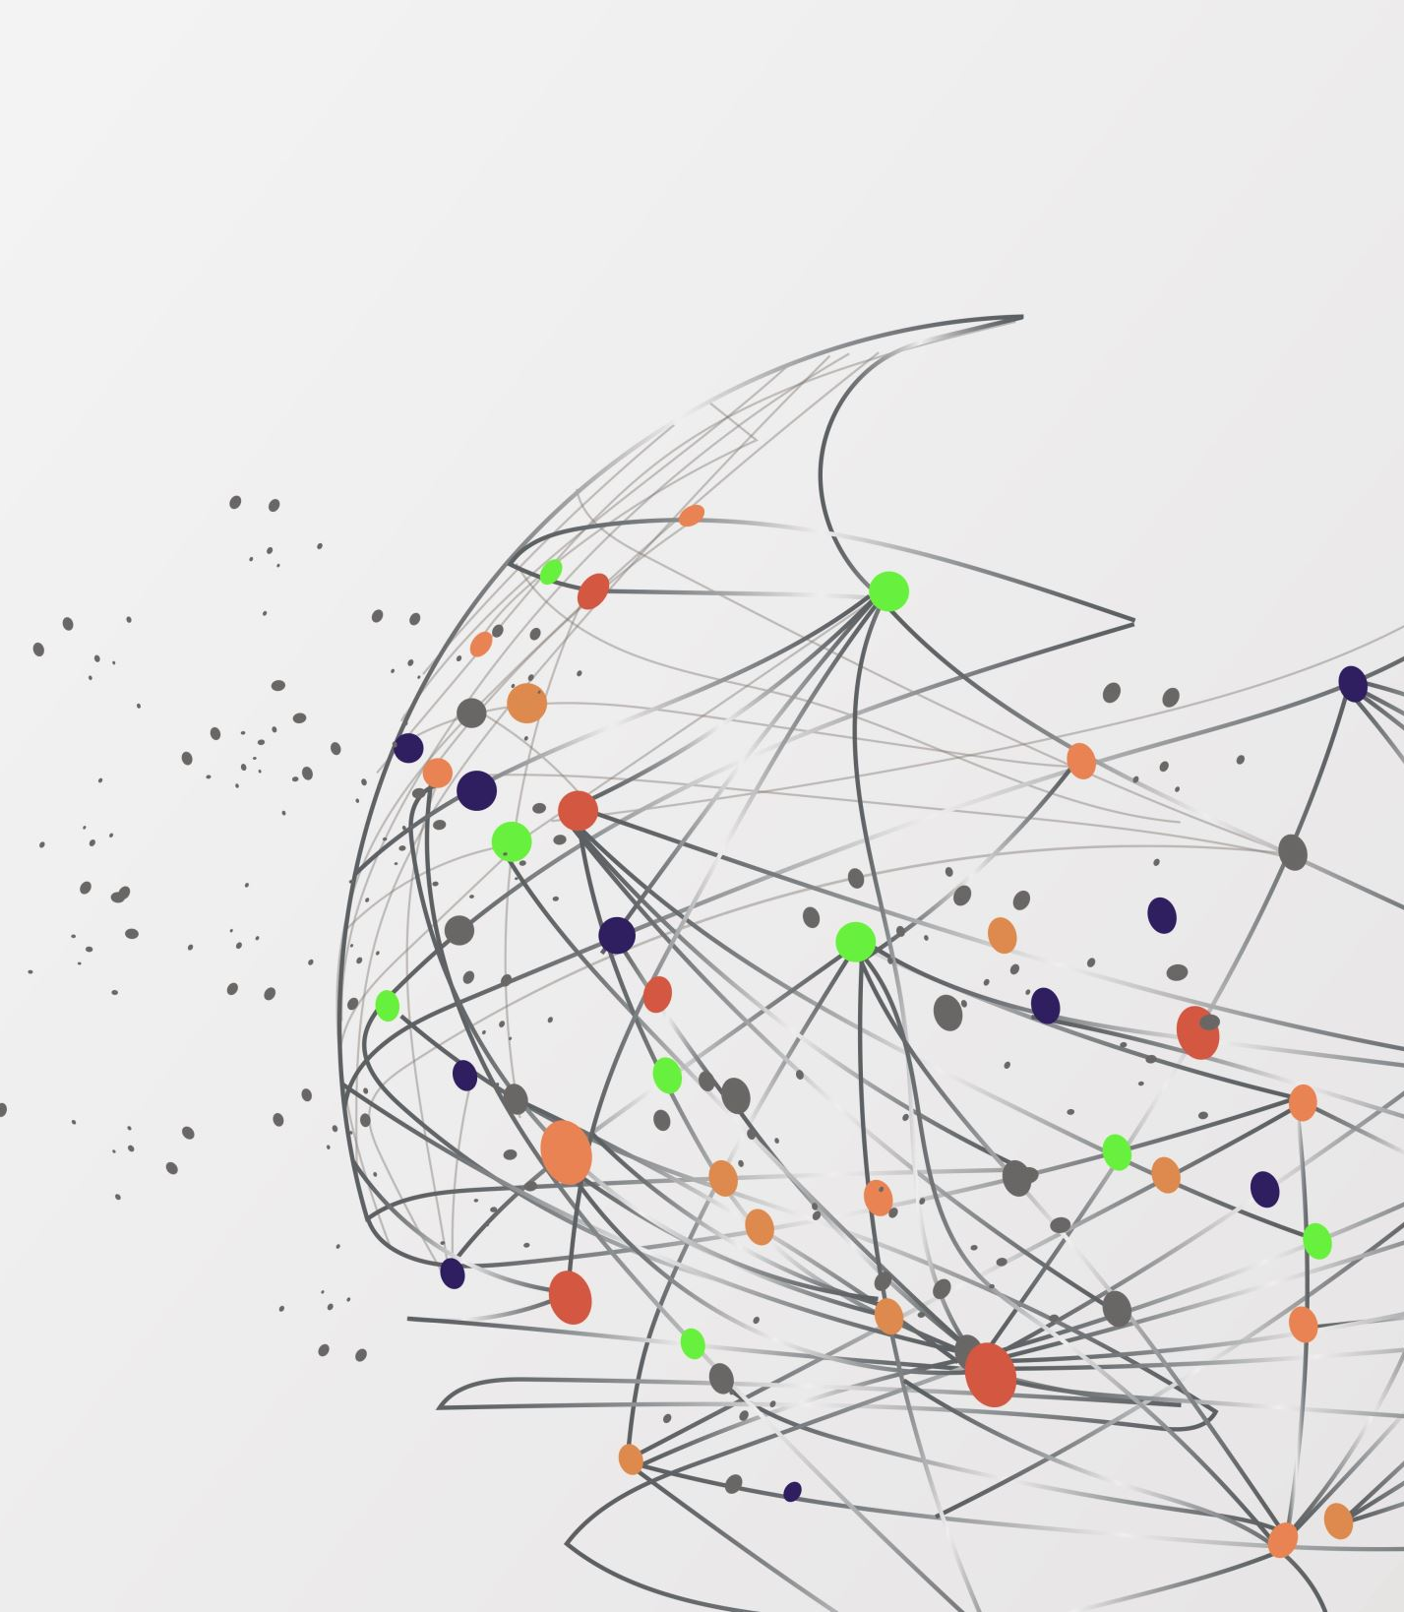

PICO-40L thermal model
2026 CAP Congress
June 23rd

Slide 2
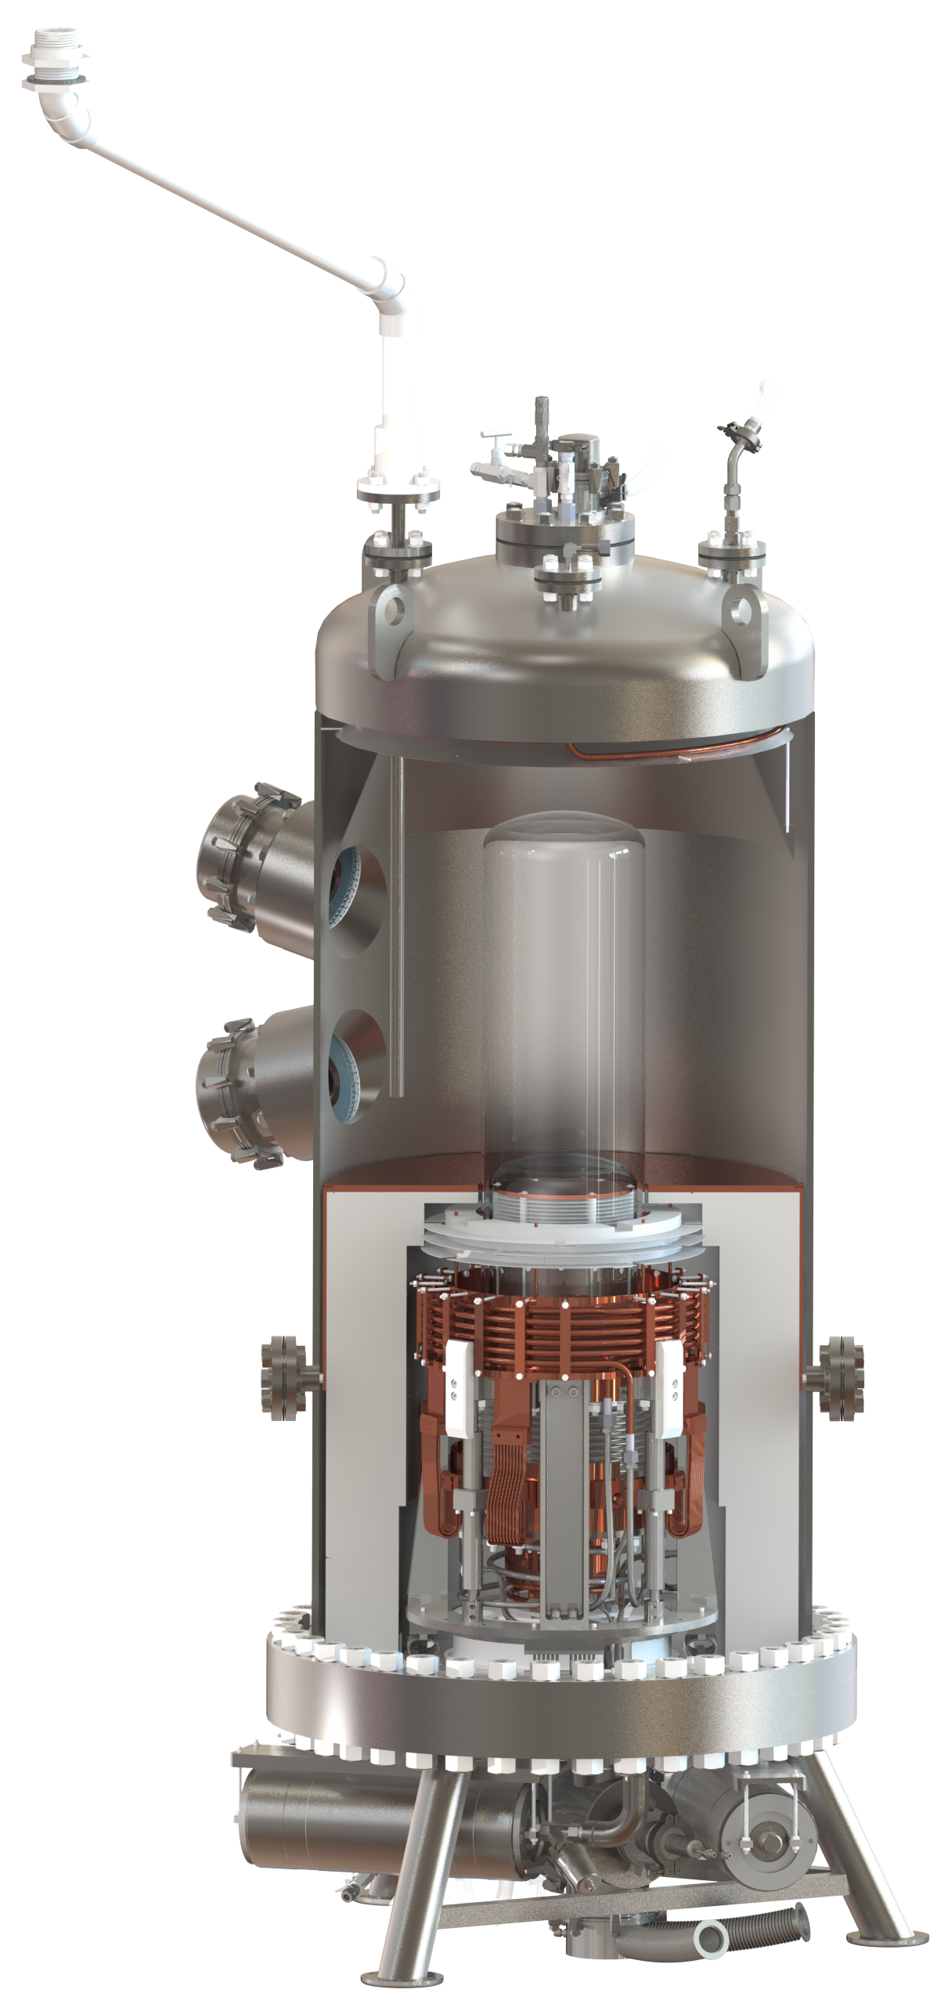
Outline
Intro
Motivation
Thermal model
Threshold
Conclusion

Slide 3
PICO-40L Experiment
Top
Instrumentation
Flange
Cameras
Bubble chamber detector
  C3F8 as the active fluid → Metastable (superheated, ⇣ P)
  Interaction: particle-nucleus→ nuclear recoil →bubble(s)
  Seitz model : localized energy deposit → threshold
Collaboration: technological achievement
  Background rejection : insensitive to electron & gamma
    less localized than nuclear recoils→ protobubble collapses immediately
  Acoustic discrimination: Piezo→ distinct sign.; 𝛼 vs neutron
Oil
C3F8
Heating
Plate
Cooling
Coil
HDPE

Slide 4
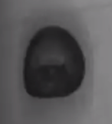

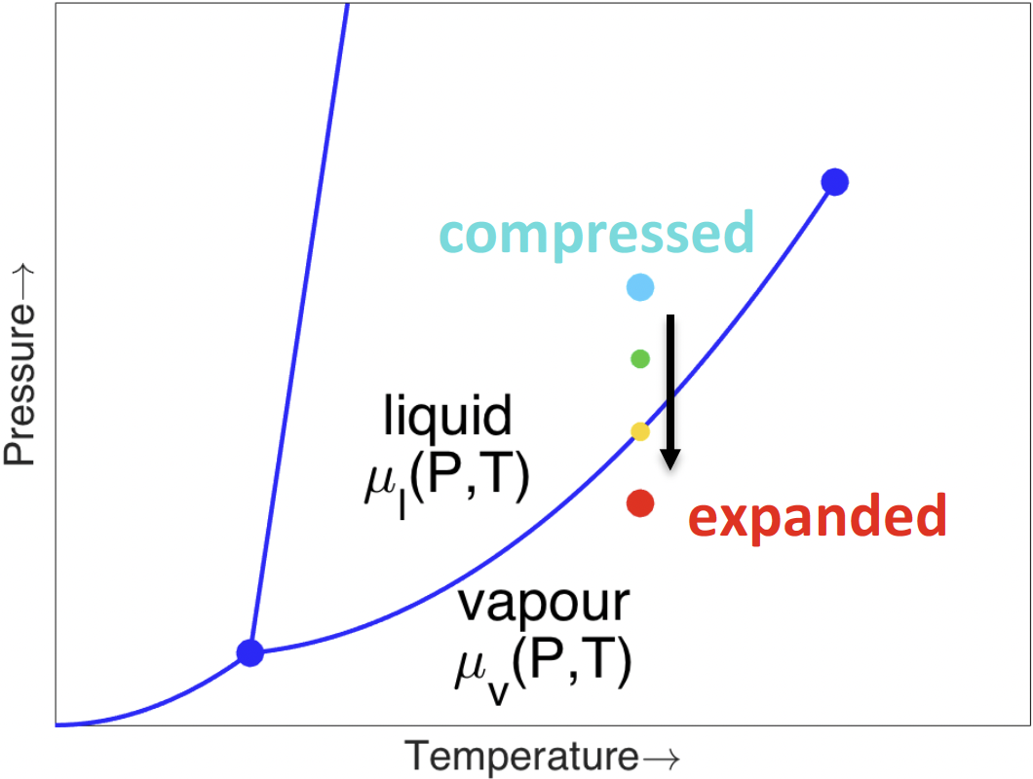
PICO-40L Experiment
  Camera
    Primary trigger
    Bubble position reconstruction
  Fast pressure transducer : dytran
    Secondary trigger
    Bubble multiplicity
    Event type: bulk vs wall
Oil
C3F8
Piezos

Slide 5
Thermal concept
Warm region: water bath → regulate T
Transition region: imperfect
  HDPE sheets & Heater plates
  Thermal simulation & RTD to understand
Cold region: Cooling coil
Need for a cold and warm region: why?
  C₃F₈ in contract with the bellows
  Nucleation sites: Bellows (presence) vs Glass (~ absence)
Warm region
~ 13 ∘C
Cold region
~ - 25 ∘C

Slide 6
Thermal concept
Question that needed to be answered
  P & T∘ : profile along the Z-axis
  Threshold → Q(P,T)
  No RTDs in the active fluid
COMSOL simulation vs RTD data
  Which model best describes reality
Warm region
~ 13 ∘C
Cold region
~ - 25 ∘C

Slide 7
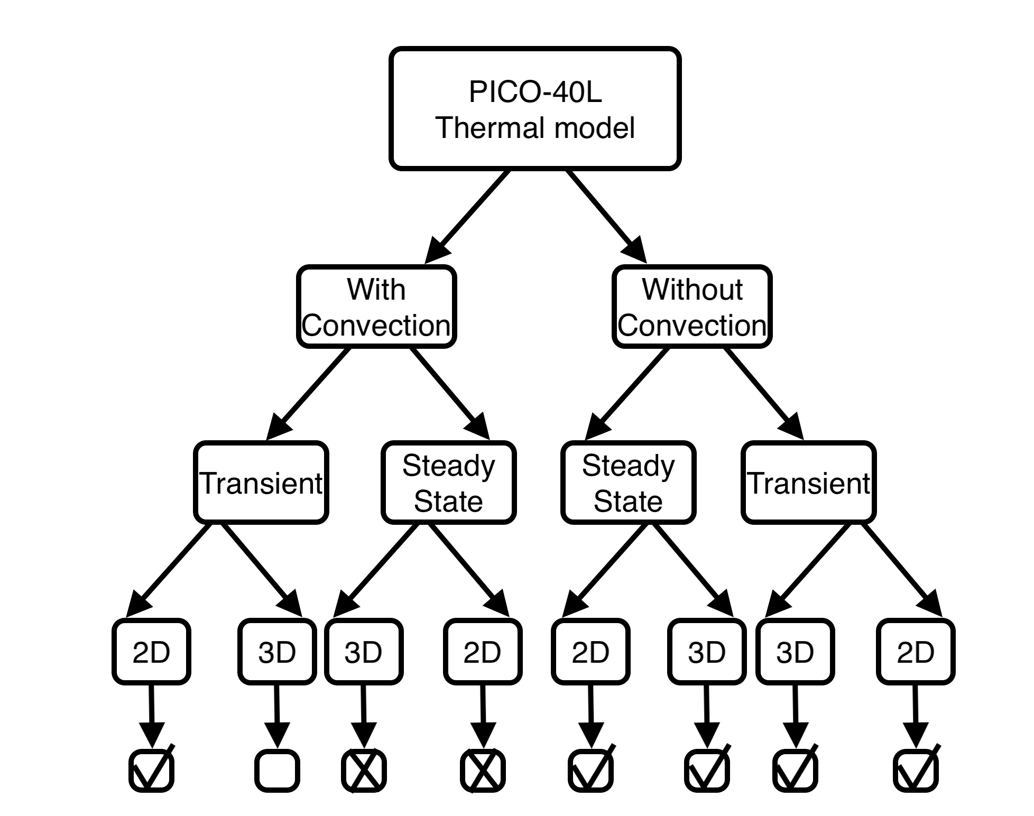
Thermal model : diagram
Convection
  More realistic regarding the time needed to reach a steady state
  Boussinesq approximation : velocity field of the fluid
No convection
  When the system stabilizes, it is possible that the convective flow can be neglected.
  Maximum time to reach equilibrium

Slide 8
Thermal model : diagram
Transient
  T over time: COMSOL vs RTD
  Compression and expansion cycle
Steady state
  When the system reaches stability
2D
  Reduce computation time but constitutes a simplification
3D
  Limits possible errors due to the use of symmetry (2D)

Slide 9
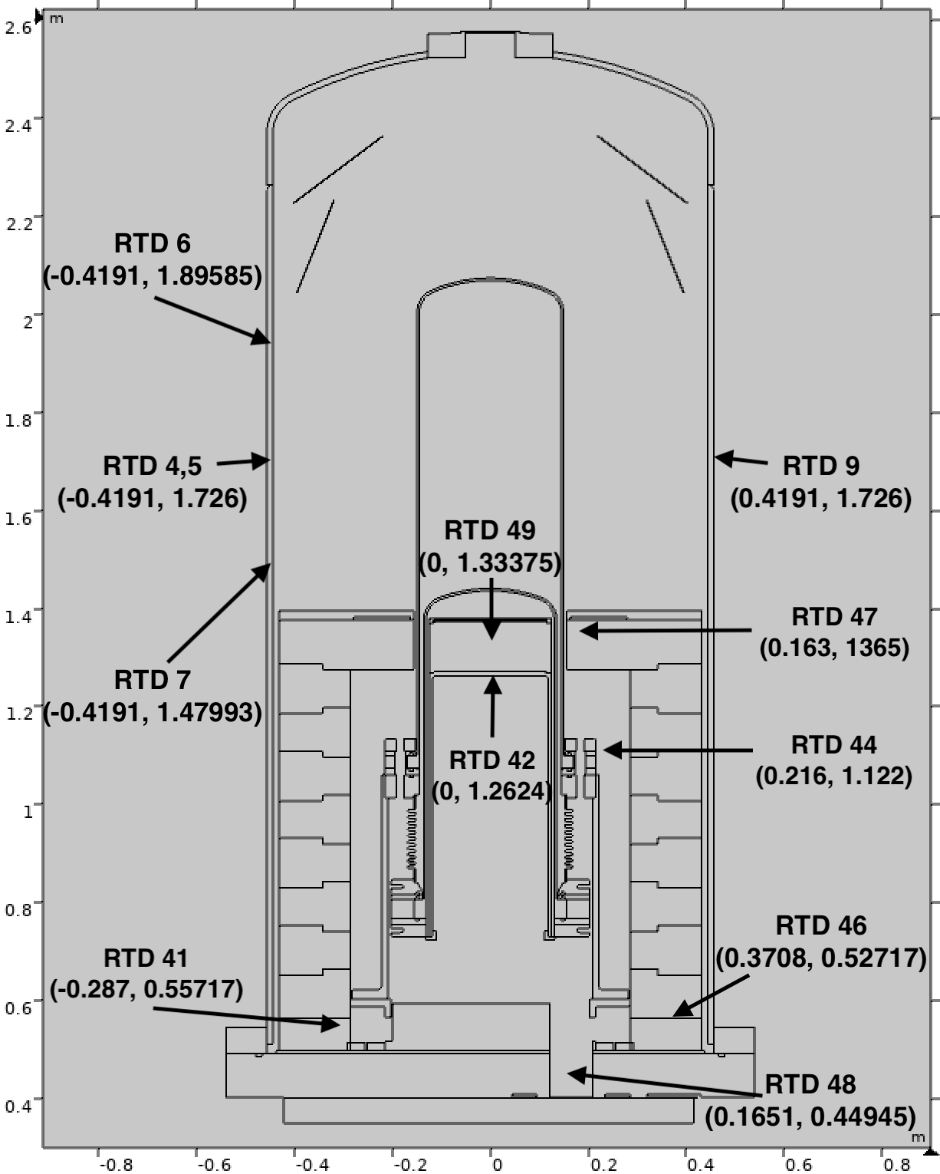
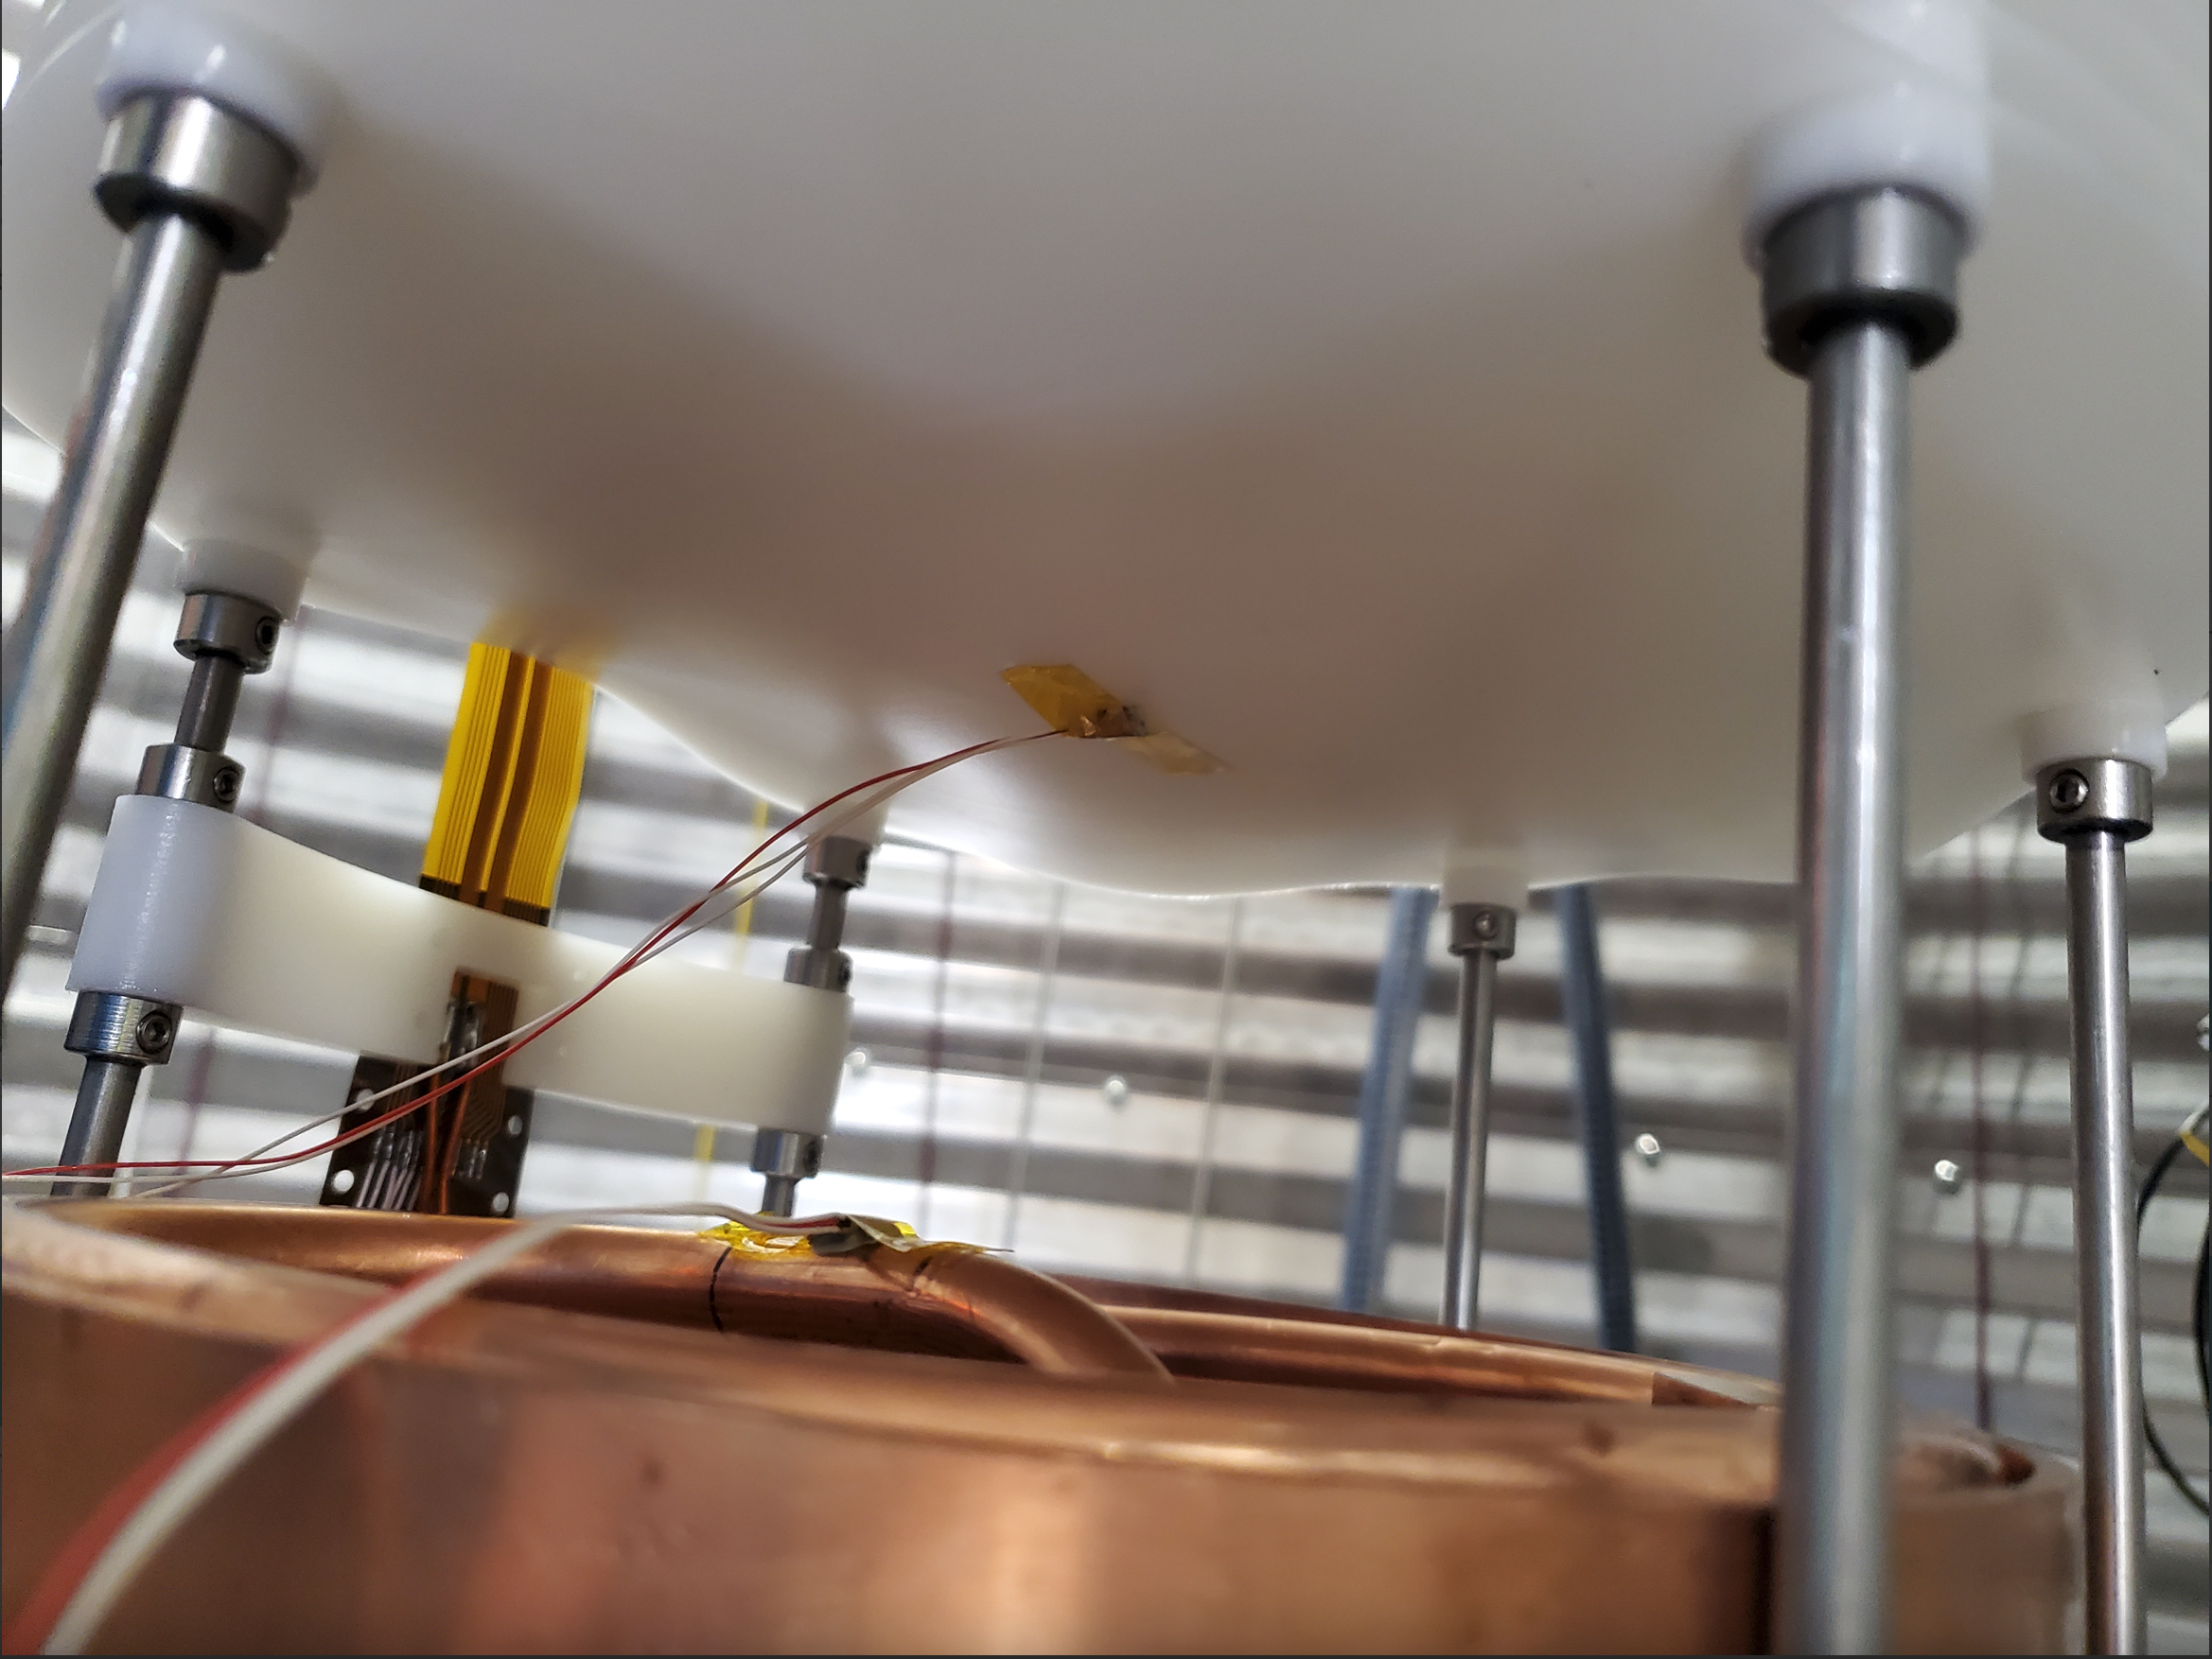
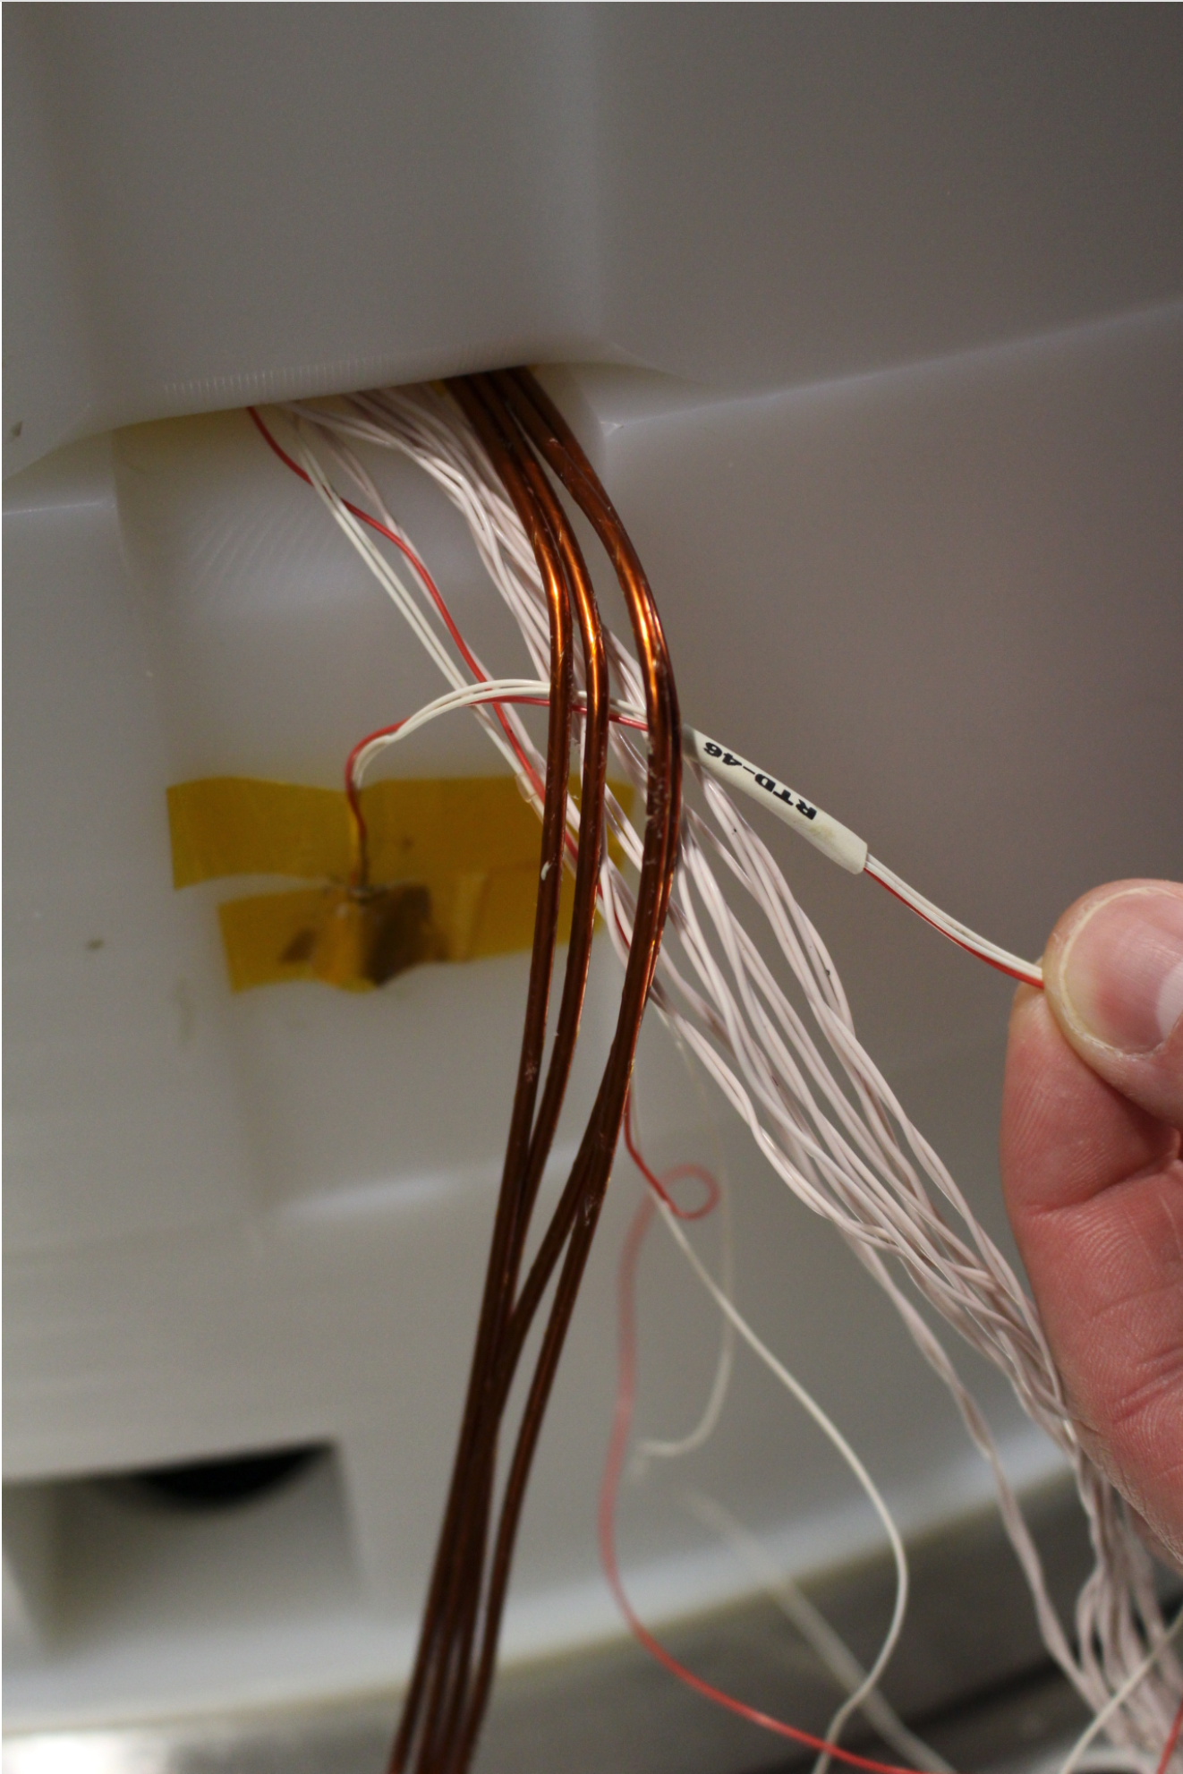
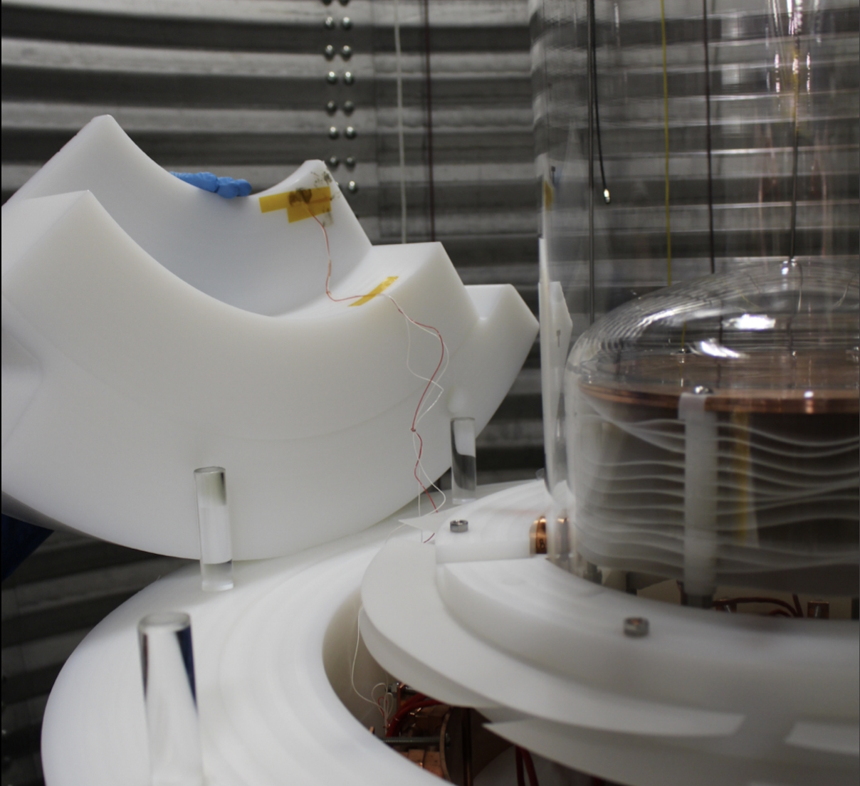
RTDs : positions
RTD 42
RTD 46
RTD 47

Slide 10
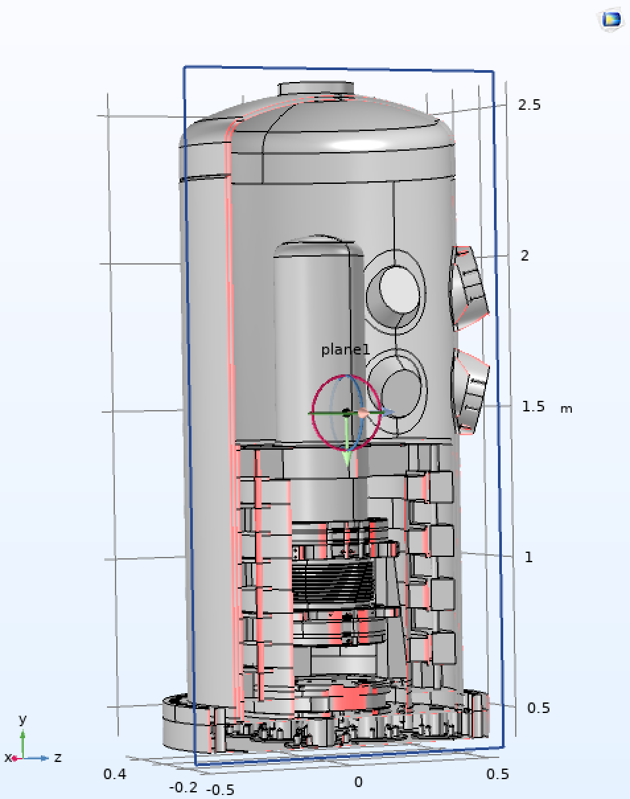
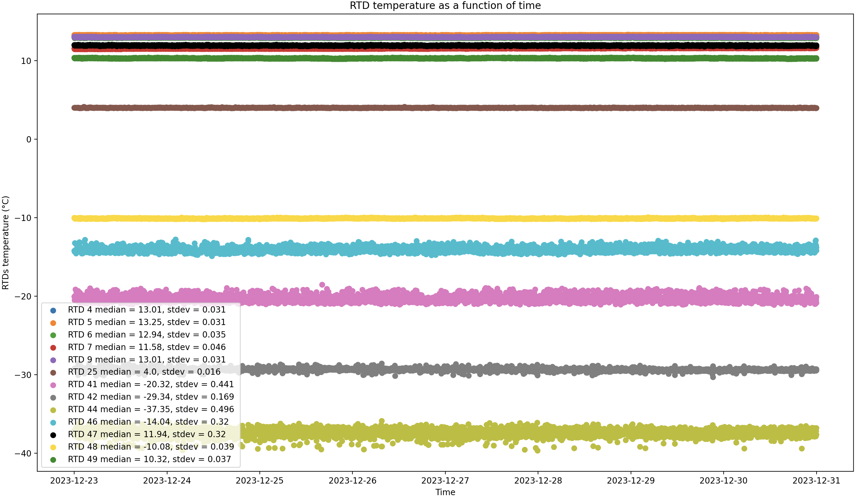
RTDs: steady-state data

Slide 11
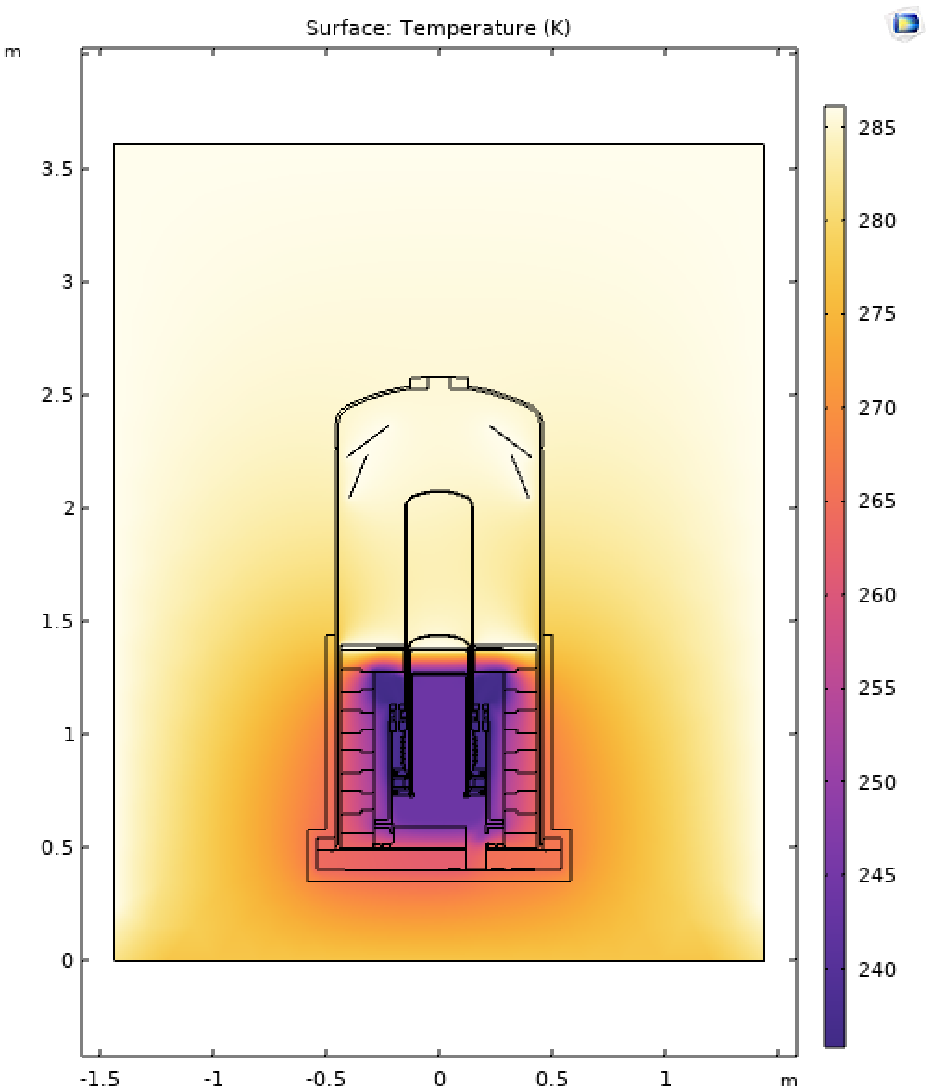
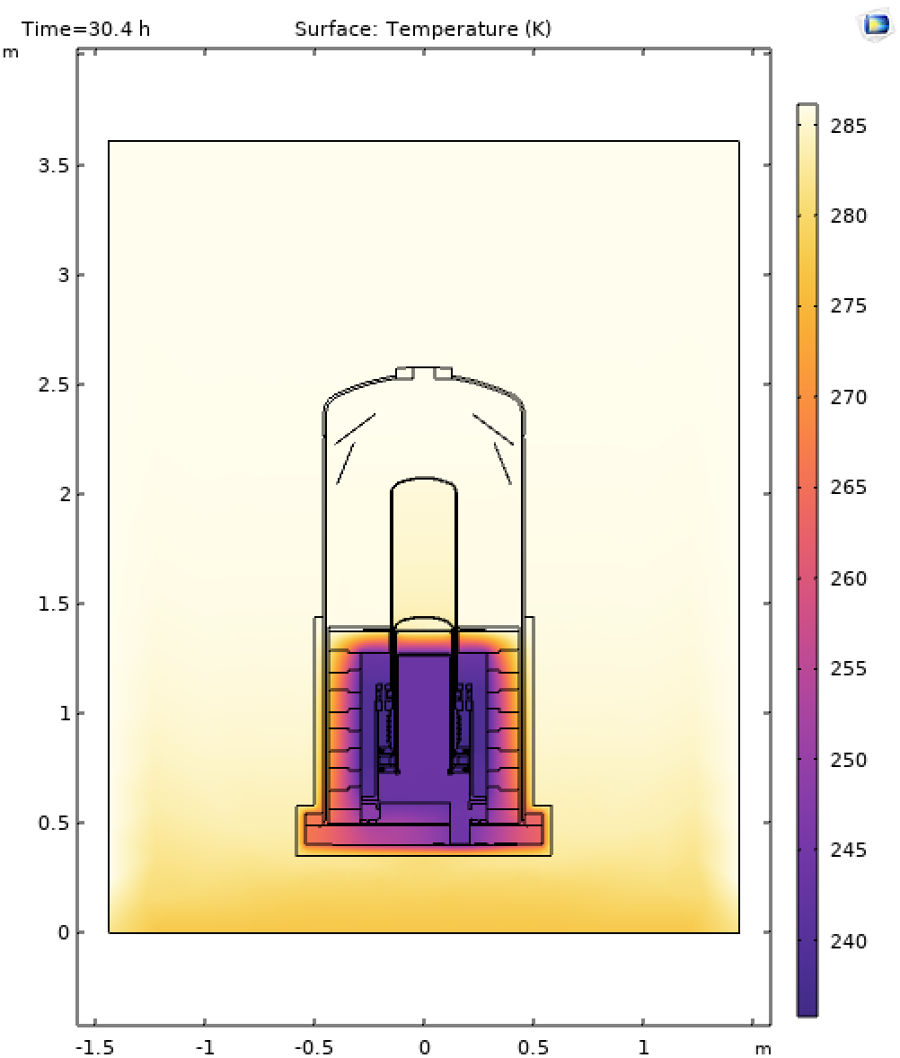
RTD vs COMSOL data
Slight temperature difference near the wall and the bottom of the PV.
The bottom of the PV is colder when convection is taken into account.
SS No convection vs Convection trans
*** Heat transfer occurs from the oil to the glass wall since the oil is warmer. ***

Slide 12
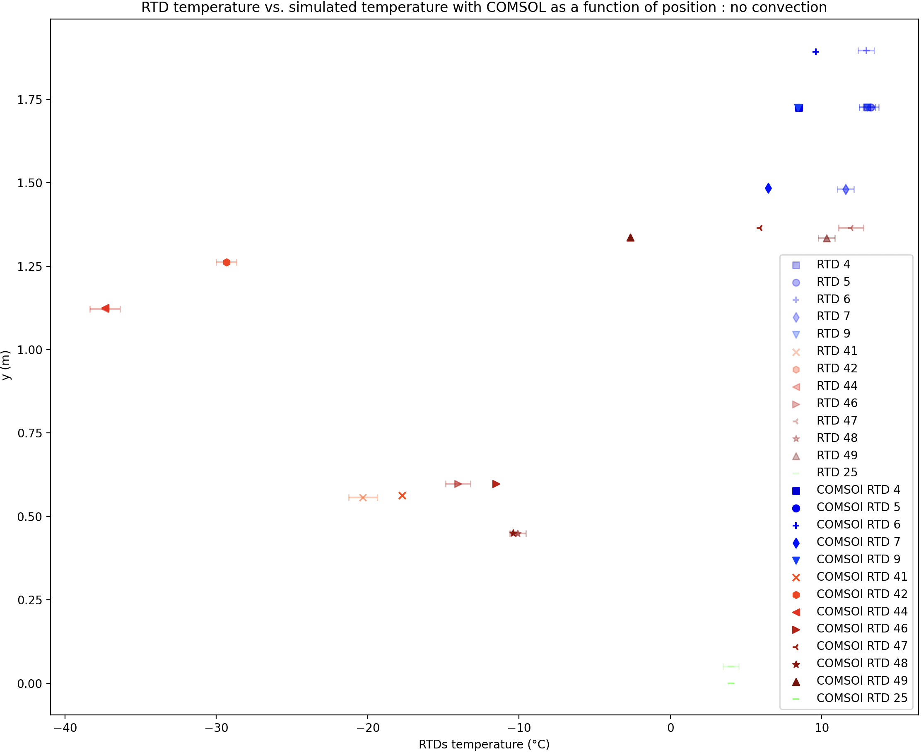
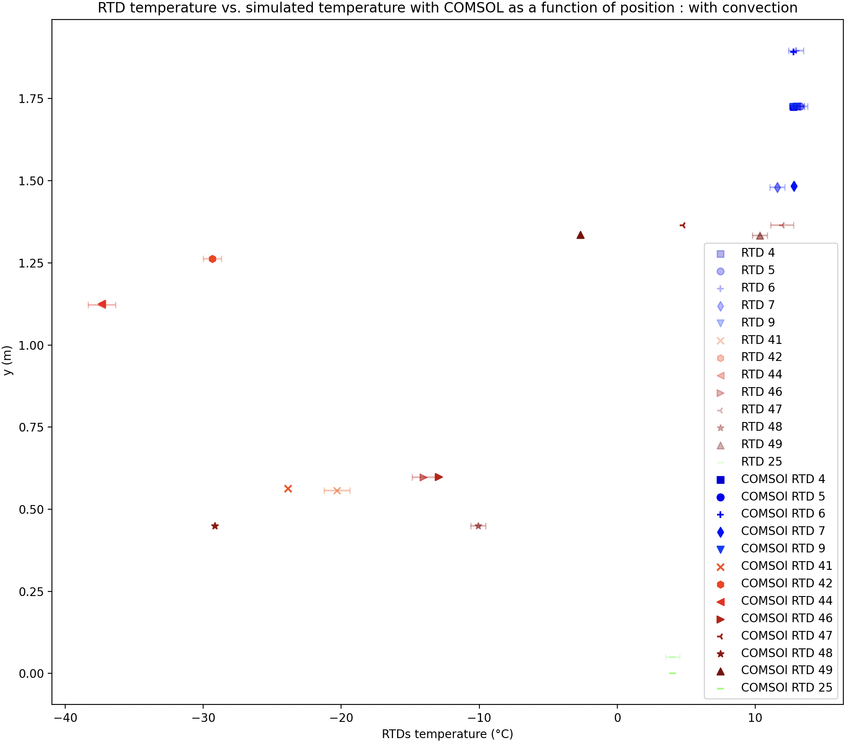
RTD vs COMSOL data

Slide 13
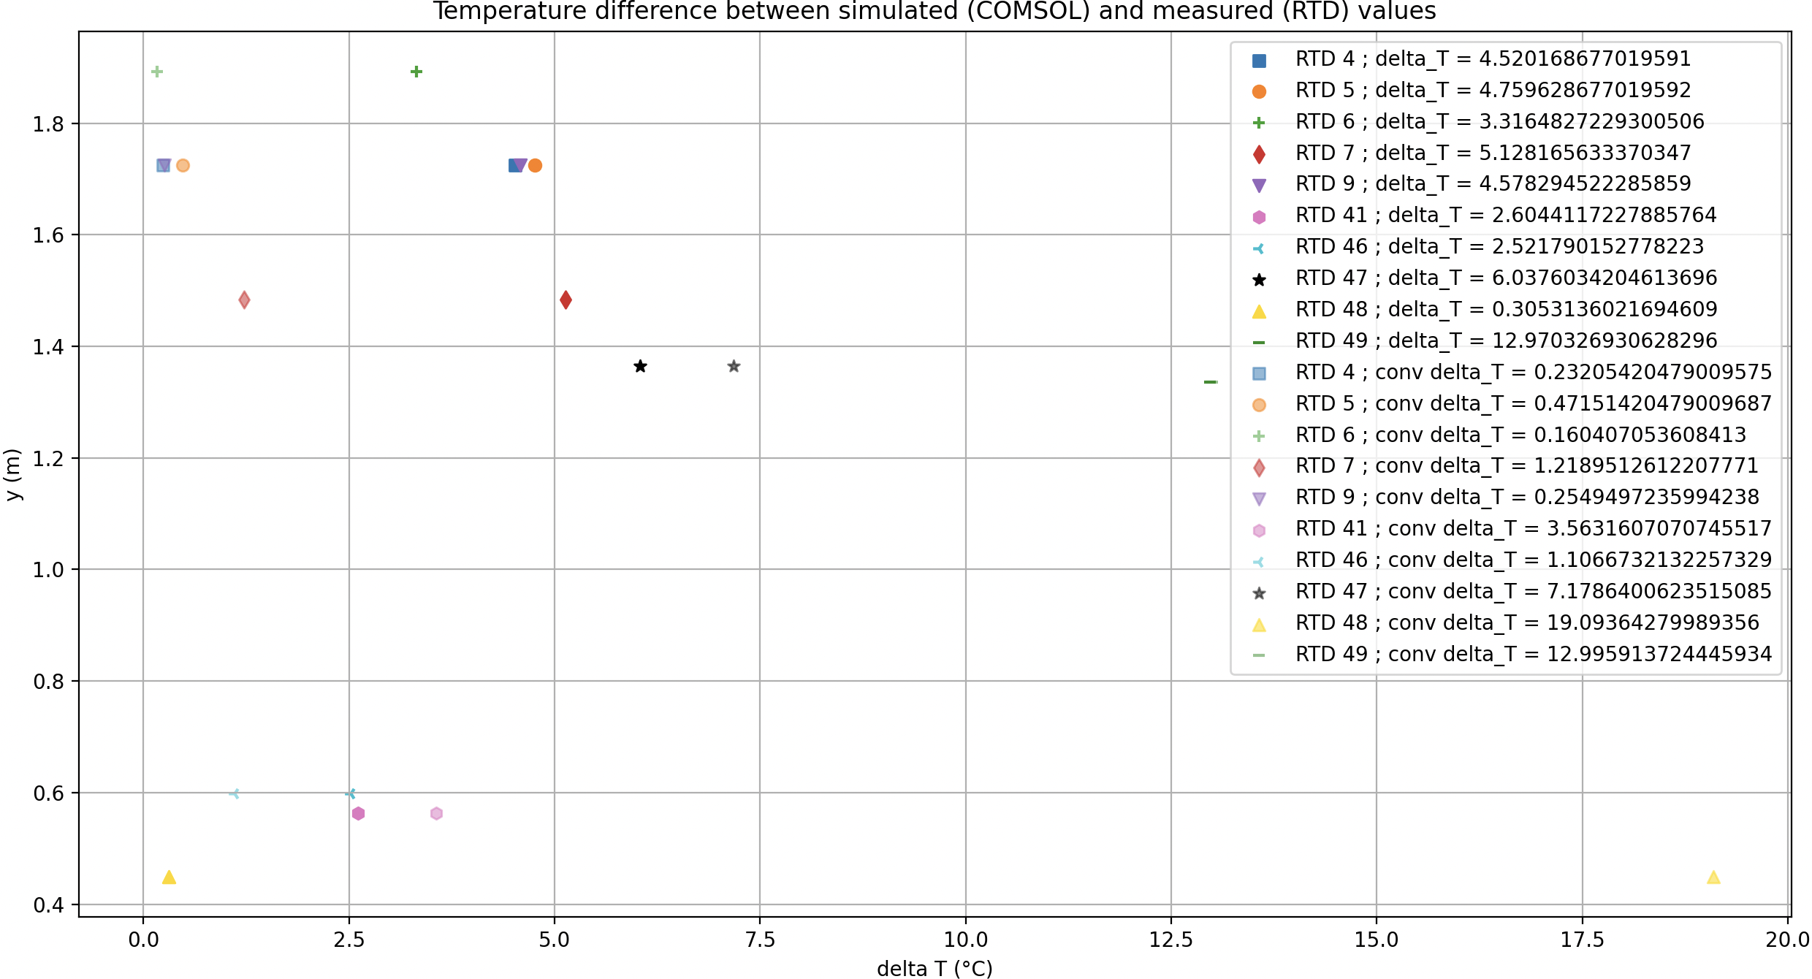
Temperature difference between models
The model that takes convection into account best describes reality.
Significant change in T with a slight spatial shift : RTD47, RTD49

Slide 14
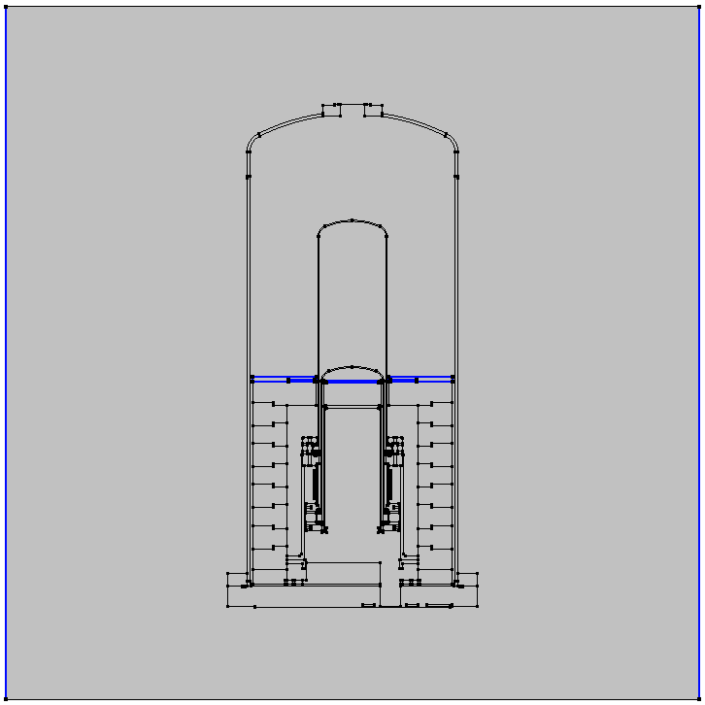
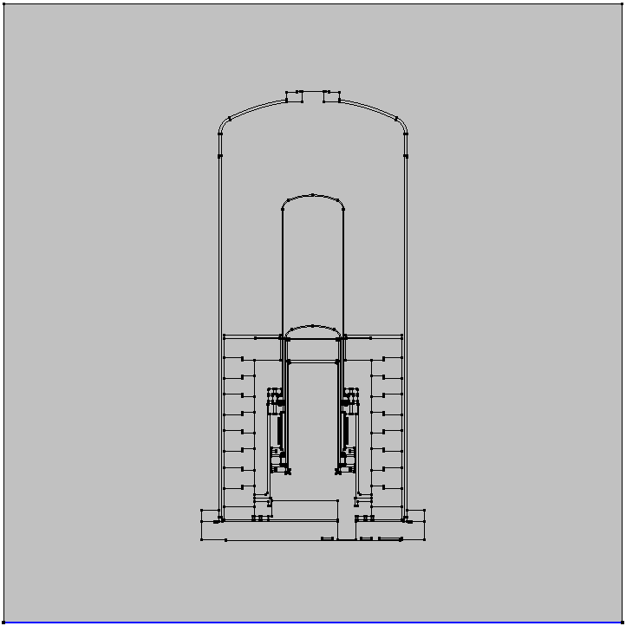
Initial & Boundaries condition
Water Tank Wall & Heater plate
286.15 K. ; 13 ⁰C
Water Tank Floor
277.15 K. ; 4 ⁰C
Ti =293.15 K

Slide 15
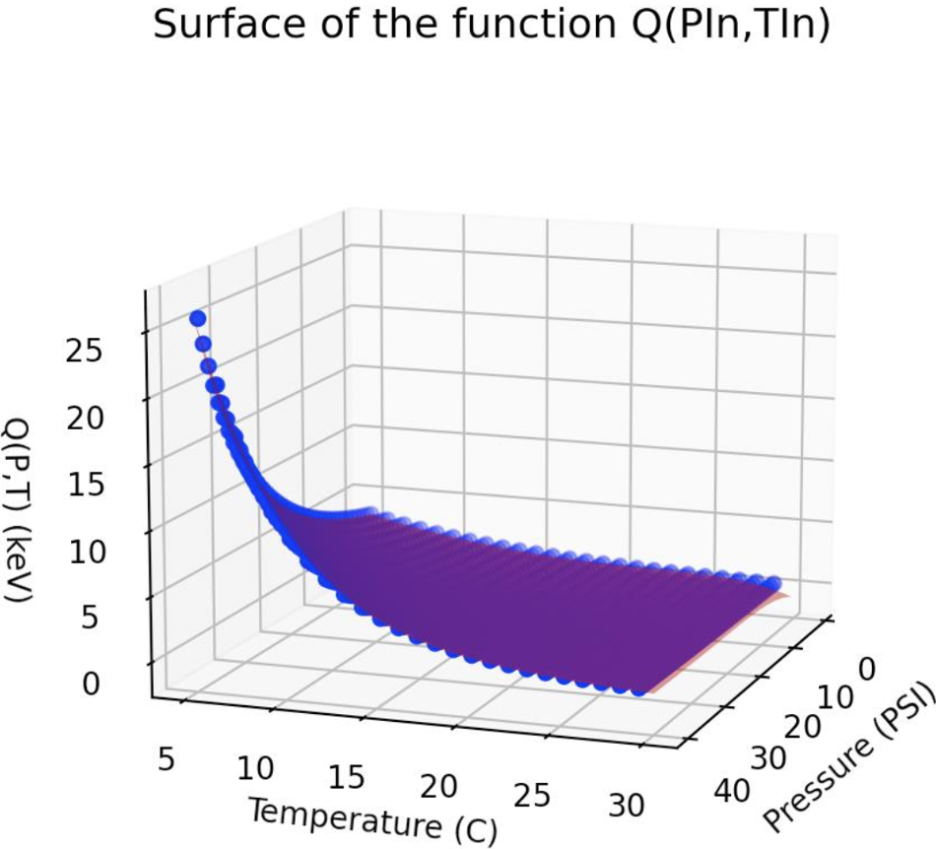
Seitz Threshold : C₃F₈
Q(P,T) = 5.7447 + 0.2538*P -0.7725*T + 0.0086*p^2 + 0.0695*T^2 -0.0468*p*T -0.0018*p^2*T+0.0047*p*T^2 + 0.0002*p^3 -0.0046*T^3 +0.0002*p^2*T^2 -0.0002*p*T^3 -4.1545e-05*p^3*T+ 3.9234e-06*p^4 + 0.0002*T^4 + 4.7669e-06*x*y**4 -4.5610e-07*p^4*T -4.0602e-06*p^2*7^3 + 1.8094e-06*p^3*T^2 + 6.3598e-08*p^5 -2.4525e-06*p^5

Slide 16
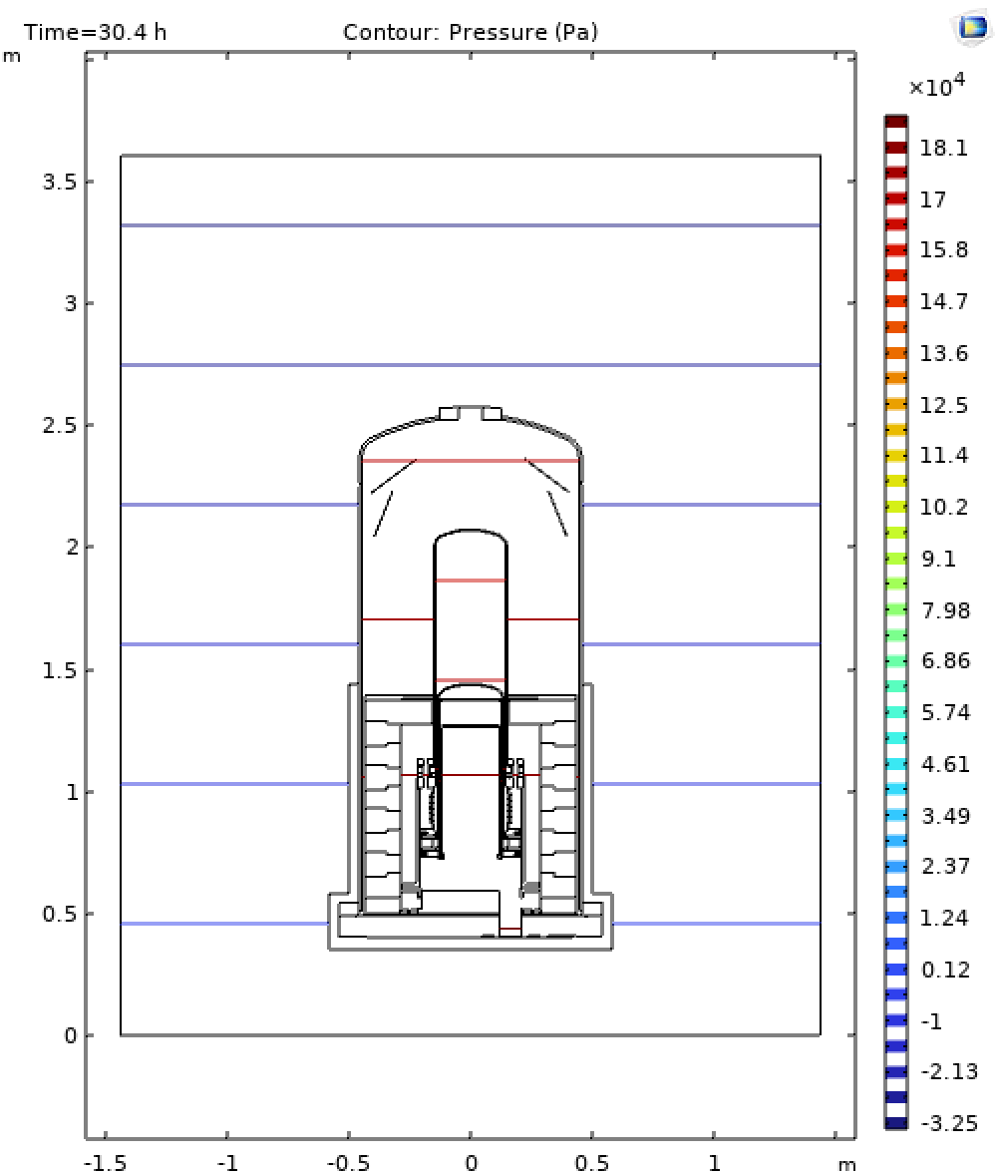
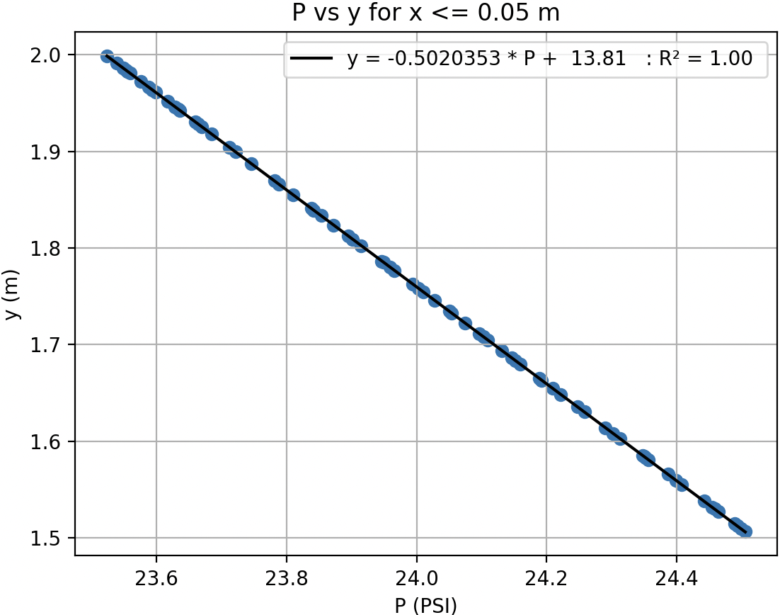
Pressure
Water Bath
Pressure Vessel
Fused Quartz

Slide 17
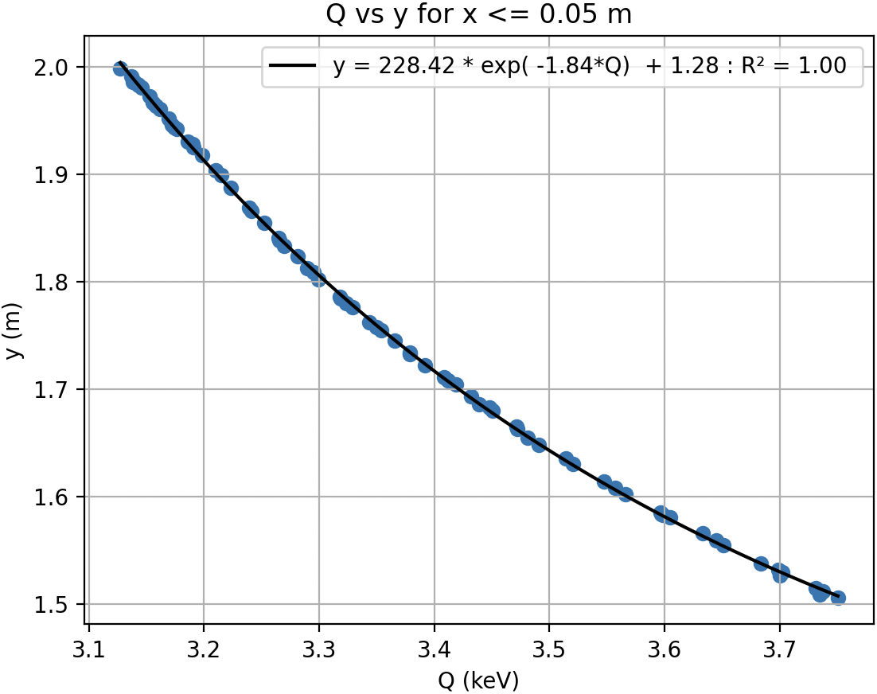
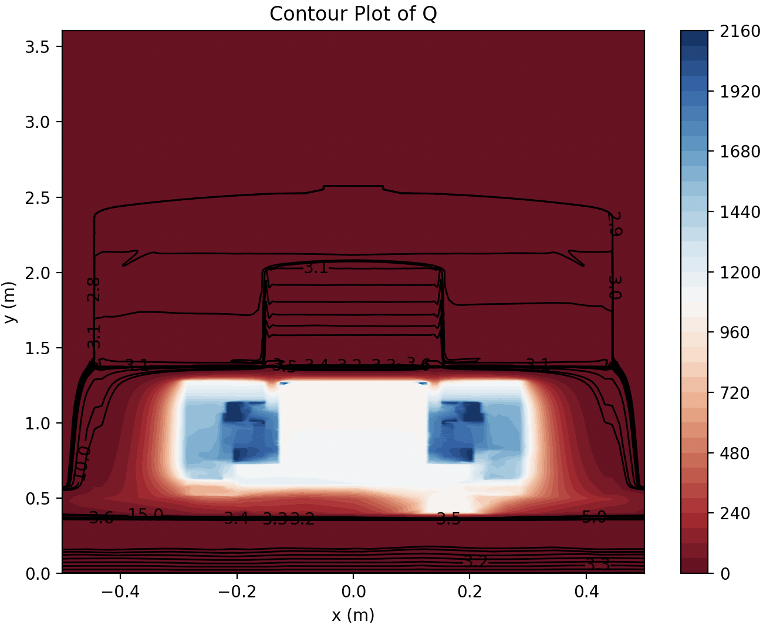
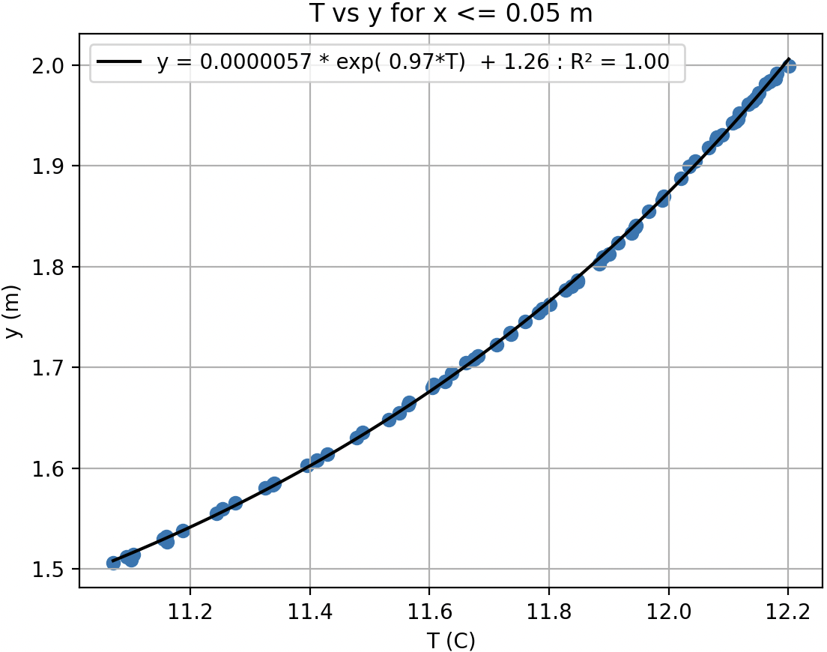
Threshold
The correction on T and Q(P,T), in C₃F₈, is defined by the equations

Slide 19
Conclusion
Done
Models considered: with and without convection ; Steady state and transient
Strong correlation between simulated and real RTDs
Need to be done
Final check : values implemented → pressure, temperature

Slide 20
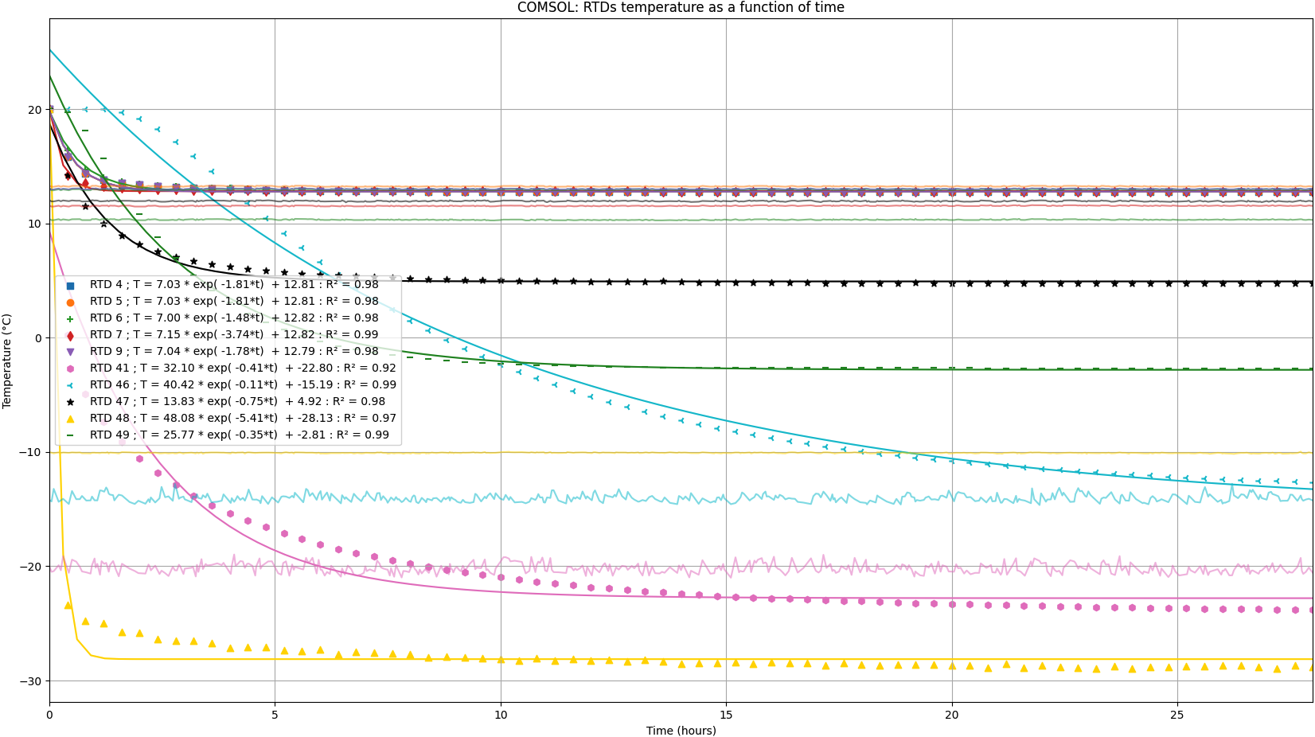
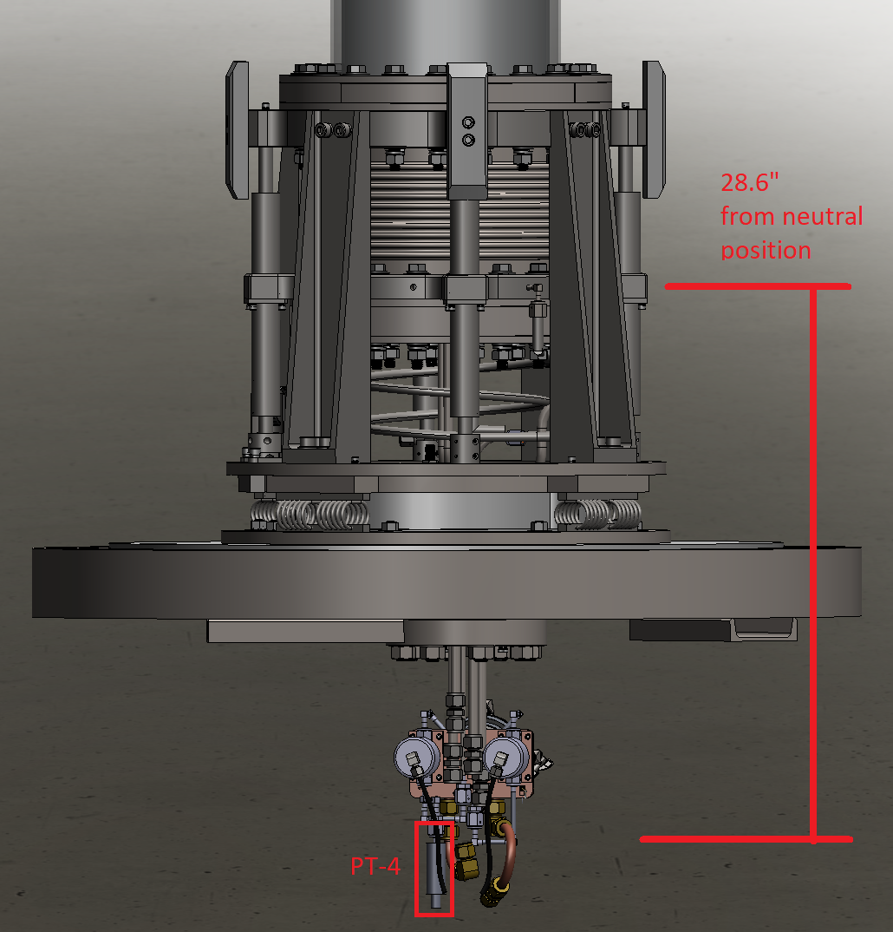
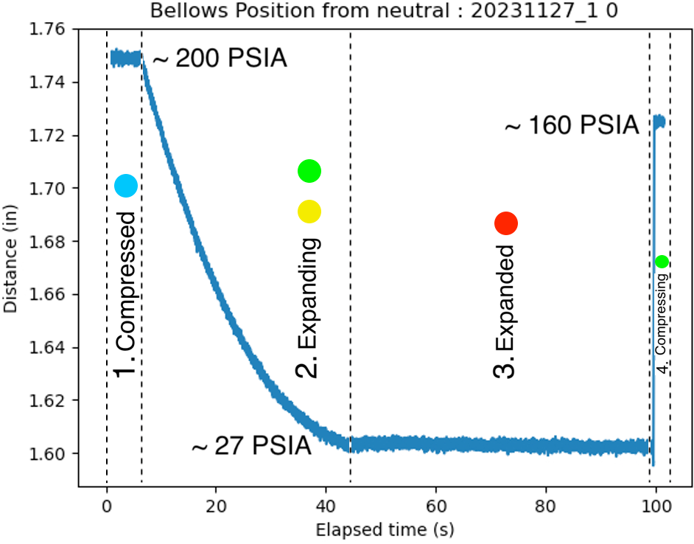
Annex
Bellows
Bellows & cycle
T vs t

Slide 21

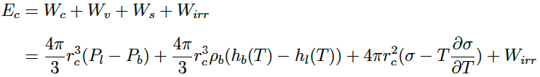
Annex : Seitz model
Conditions for nucleation (Q_s > = W_min)
  W_min = 4 pi /3 * sigma * r_c^2
  E_r > Q_s
  Energy must be deposited within r_c ~ 25 nm at 30 psia and 13 C
Q_s
  Contain three principal terms
  W_c : combat the pressure of the liquid to allow the protobubble to expand
  W_v : to evaporate the liquid and transform it into gas
  W_s : Energy to form the surface of the critical sphere
  W_irr : irreversible processes such as acoustic wave emission (about 2%)

Slide 22

Annex : heat transfer → advection-diffusion equation
Conduction
Advection
Generation
Transient
$\frac{1}{r}\frac{∂T\left(r, z,t\right)}{∂r}+\frac{∂^{2}T\left(r, z,t\right)}{{∂r}^{2}}+\frac{∂^{2}T\left(r, z,t\right)}{{∂z}^{2}}−\frac{ρC_{p}v_{r}}{k}\frac{∂T\left(r, z,t\right)}{∂r}−\frac{ρC_{p}v_{z}}{k}\frac{∂T\left(r, z,t\right)}{∂z}+\frac{\dot{g}}{k}=\frac{ρC_{p}}{k}\frac{∂T\left(r, z,t\right)}{∂t}$
where${ v}_{r} and v_{z}$ are given by the Boussinesq approximation of the Navier-Stokes equations;
  Where, $C_{p}$ is the Heat capacity
  $ρ$ the density
  $k$ the thermal conductivity
  $\dot{g}$ heat generation term
  $v_{r}$ and $v_{z}$ are the velocity components
  T the temperature
The velocity $\vec{u} (v_{r}$,$v_{z})$ is given by the Navier-Stokes (N-S) equation or the approxi. choosen
Ignored terms
  Friction $μφ$, ~ dilatation $βT\frac{∂p\left(r, z,t\right)}{∂t}$ and compressibility fluid $βTv∙∇p$, radiation term

Slide 23
