Slide 1


High Temperature Superconductor (HTS) magnets for particule accelerators
Prof. Frédéric Sirois and collaborators
Laboratory of Superconductivity and Magnetism (LSM)
Polytechnique Montréal, Montréal, QC, Canada
CAP Conference, Ottawa, June 21-26, 2026

Slide 2
Introduction
Particle accelerators: essential tool in modern physics research
Magnets (copper or superconductor): essential components of particle accelerators
High-energy beams require high-field magnets for reasonable accelerator footprint
  Low Temperature Superconductor (LTS) technology has nearly reached its limits
    NbTi technology: fully mature and industrialized, rely on LHe, field <8 T
    Nb₃Sn technology: mature but limited industrialization, rely on LHe, field <16 T
  High Temperature Superconductor (HTS) technology
    REBCO* tape technology: industrialization ramping up, magnet technology still in its infancy
    Immense potential for very high-field magnets (>16 T) and LHe-free magnets
Energy efficiency and helium supply are key aspects to consider in future projects
* REBCO = Rare-Earth-Barium-Copper-Oxide

Slide 3
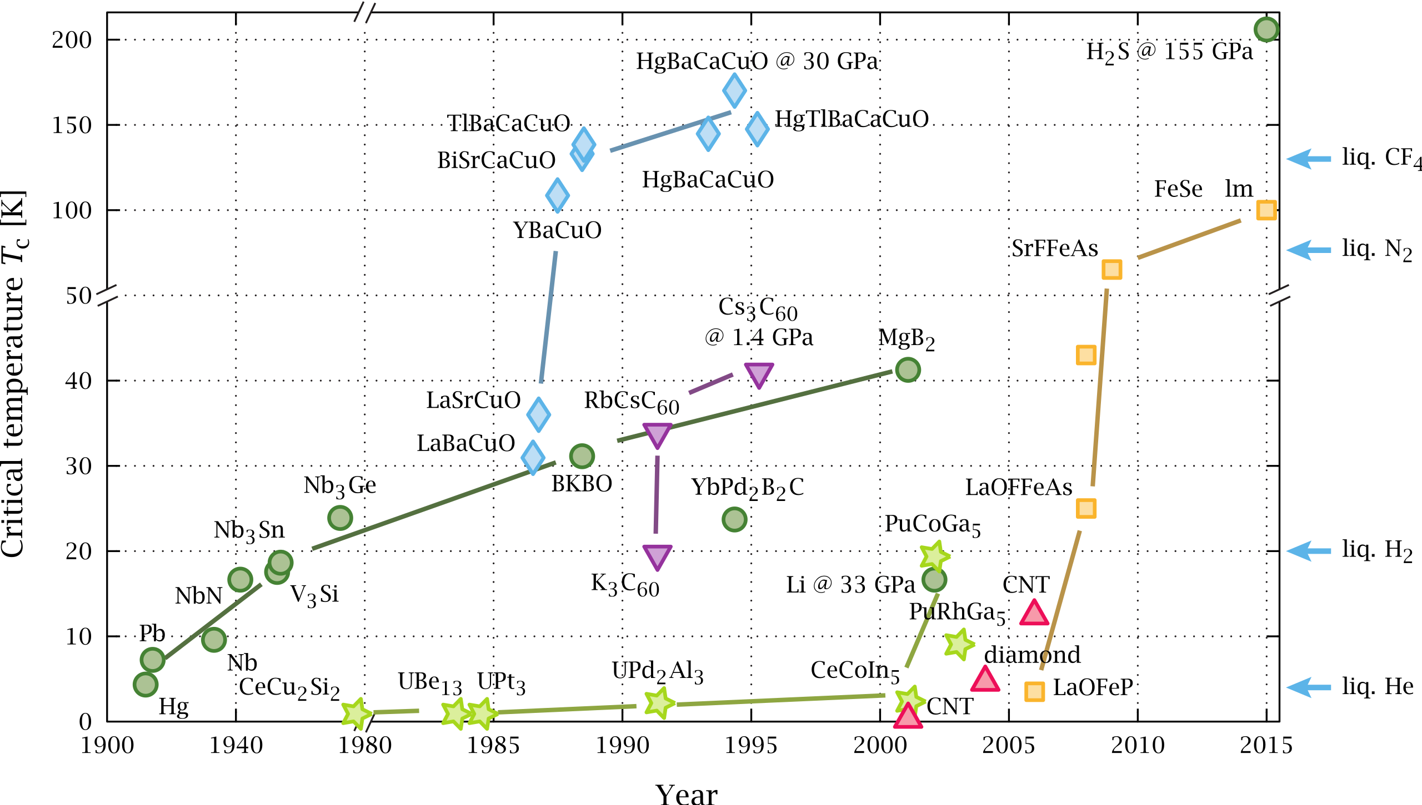
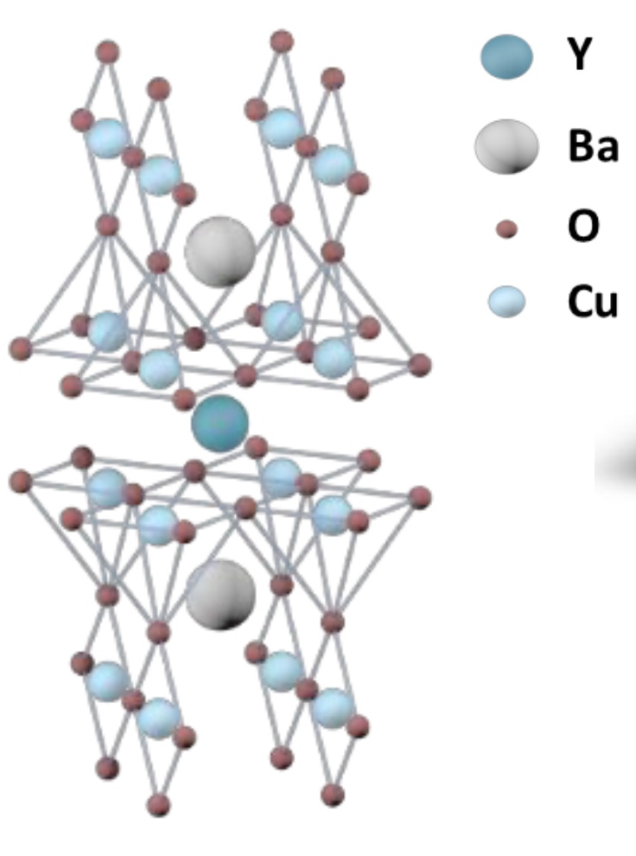
Families of superconductors
Source: https://commons.wikimedia.org/wiki/File:Timeline_of_Superconductivity_from_1900_to_2015.svg
Cuprates
HTS
→ REBCO
(77 K)
Conventional superconductors
LTS
Ti
RE: Rare Earth (Y, Sm, Dy, Gd, …)
(4.2 K)
LTS/HTS: Low/High Temperature Superconductor

Slide 4
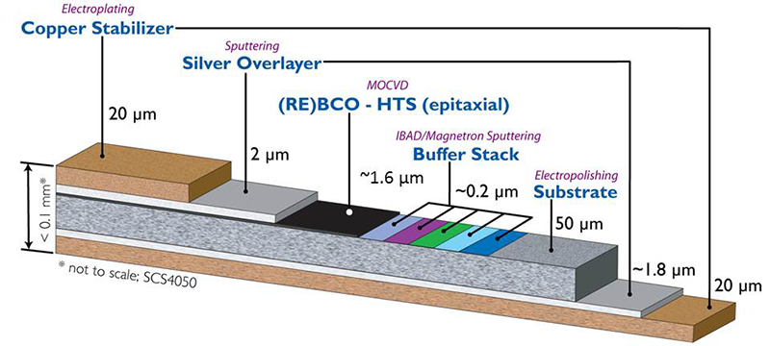
Superconducting wires: how do they look like?
REBCO technology (HTS tapes)
NbTi technology (LTS wires)
  Flexible multifilamentary metallic wire
  Produced by conventional drawing methods
  Flexible but anisotropic ribbon
  Sophisticated thin film deposition techniques (PLD, MOCVD, …)
Source: http://hyperphysics.phy-astr.gsu.edu/hbase/Solids/scmag.html

Slide 5
Critical surfaces (J_{c} = critical current density)
Superconductivity is lost when
  T > T_{c} (this is what everyone knows)
  B > B_{c2} (B_{c} = flux density, B_{c2} = upper critical field)
  J > J_{c} (reality is more subtle than that)
Note that
  J_{c} = f(B,T)
    → J_{c} decreases with B and T
  B dependence of REBCO is very anisotropic
  → angle between B and J matters
HTS
LTS

Slide 6
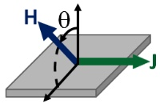
J_{c}(B) for different superconductor materials at 4.2 K
B
B⊥
B∥
Tape
Intrinsic properties
of REBCO tapes:
- Far superior to that of any other superconducting material
- Possible to go beyond 20 T with high J_{c}
- Better than Bi-2212 (Ag-based isotropic round HTS wire)
Source: NHMFL
(https://nationalmaglab.org/magnet-development/applied-superconductivity-center/plots)

Slide 7
Defects in epitaxially growth HTS layer
Typical defects in REBCO tapes (some of them are beneficial if well controlled)

Slide 8
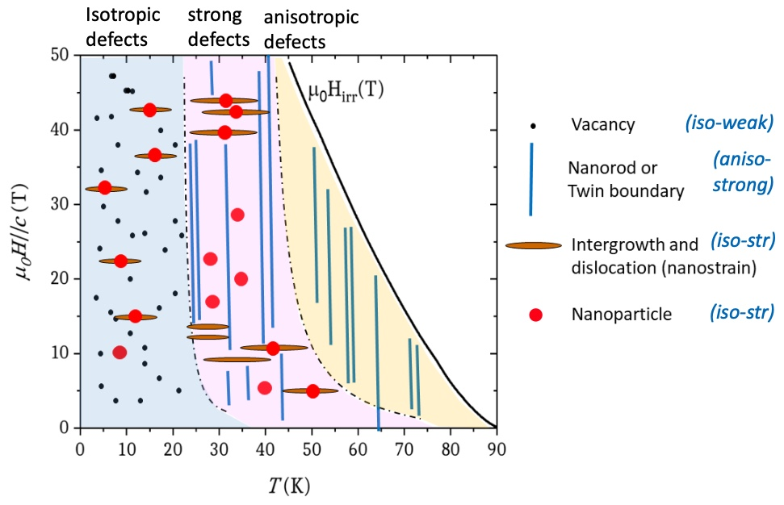
Defect engineering: the art to tailor J_{c}(B)
B
T. Puig et al., Nature Physics Reviews 6, 132-148, 2024.
Tape
F. Valles et al., Comm Mat 3, 2022.

Slide 9
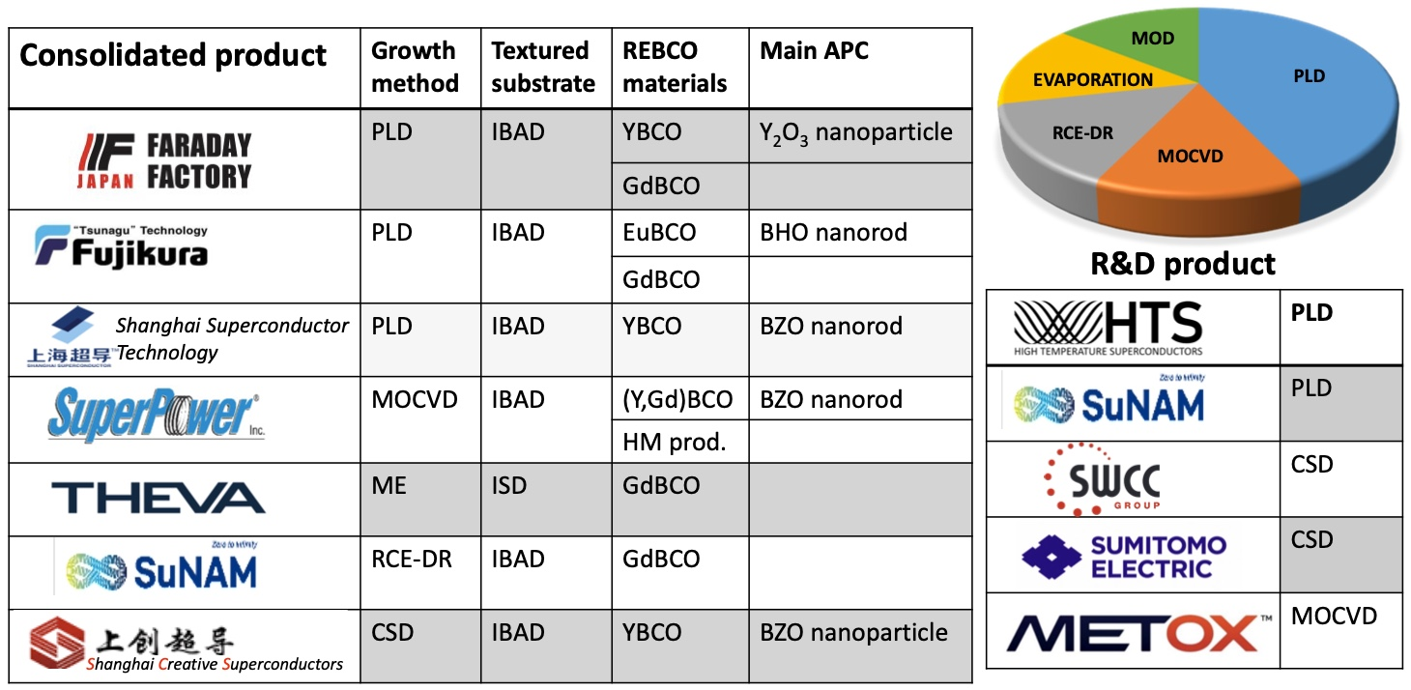
REBCO tape manufacturers (a dozen worldwide, nonE in Canada)
Source: X. Obradors, Applied Superconductivity Conference, Salt Lake City, Sept. 2024

Slide 10
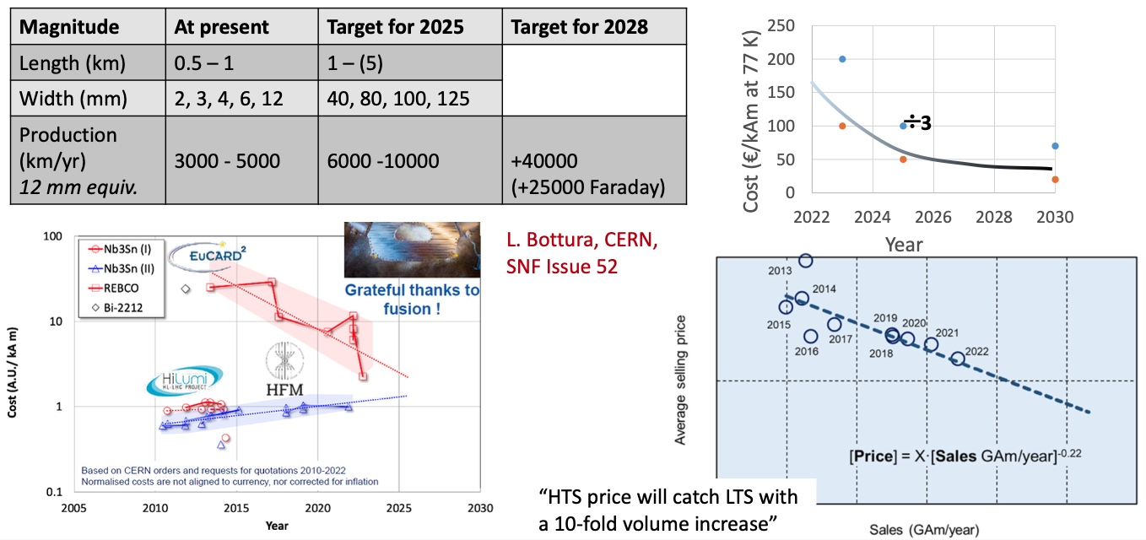
Production rate vs. cost of REBCO tapes (x2 every year)
REBCO price will catch up with LTS price shortly: and it might be soon lower!
Source: X. Obradors, Applied Superconductivity Conference, Salt Lake City, Sept. 2024

Slide 11
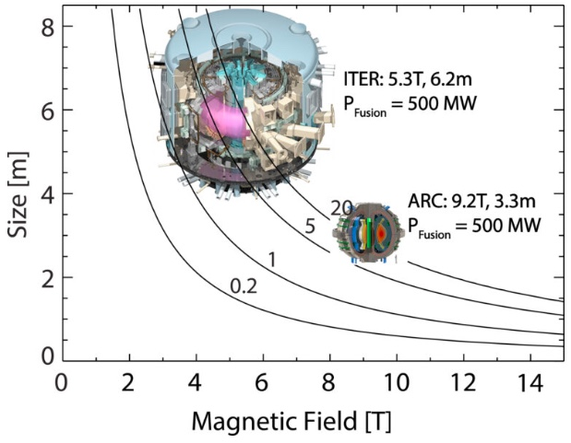
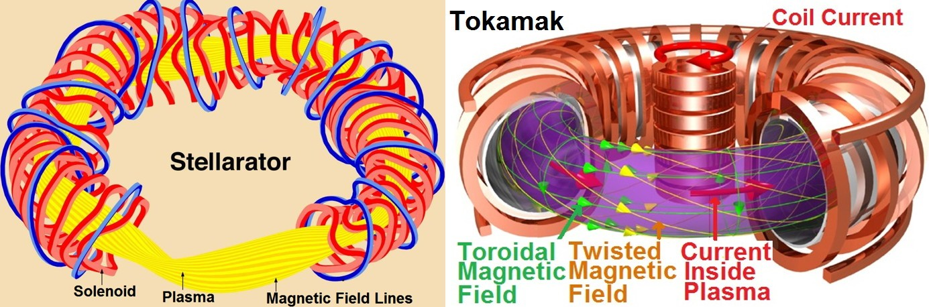
Why is the world production of REBCO tapes booming?
Fusion reactors require many huge high-field magnets (~10 T at 20 K)
~12 private fusion companies worldwide based on REBCO tape technology
Fusion is THE DRIVER for REBCO tapes (>90% of world purchases)
Two types of magnetic confinement fusion reactors

Slide 12
Back to HTS accelerator magnetS...
Some challenges to overcome to develop REBCO-based magnet technology
  Anisotropy of REBCO tapes to make cables and coils
  Understand the behaviour of REBCO under various types of radiations
  Higher magnetic fields = high forces and new types of mechanical failures under
  Completely new magnet designs: lots of experience to acquire + lots of models to produce
Two very fundamental questions to address in the short term
  How to deal with magnetization currents and their impact on field homogeneity?
  How to handle quench protection, provided that
    Higher-field magnets store a lot of magnetic energy
    REBCO tapes have a very different thermal behaviour than LTS wires (slower hot spot propagation)

Slide 13
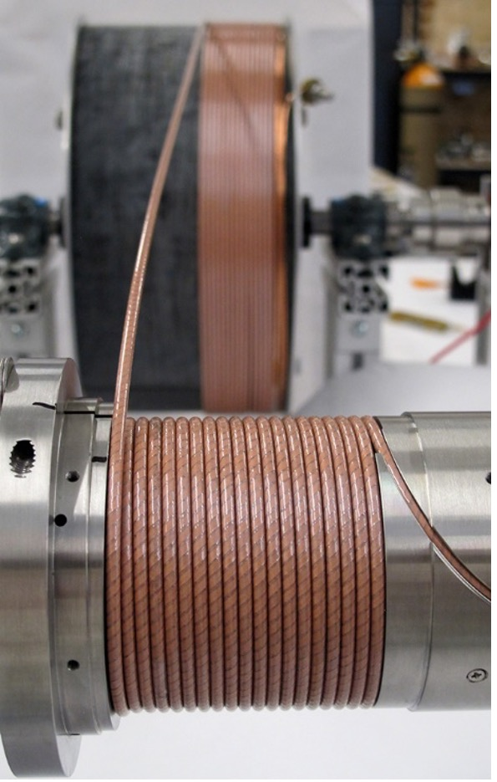
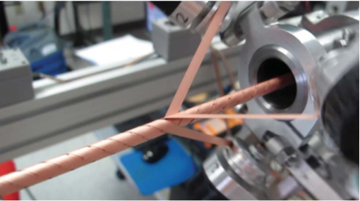
Example of cable and coil winding
Conductor On Round Core (CORC) cables and coils
  Allow making kA-class REBCO cables (below)
Source: https://www.advancedconductor.com

Slide 14
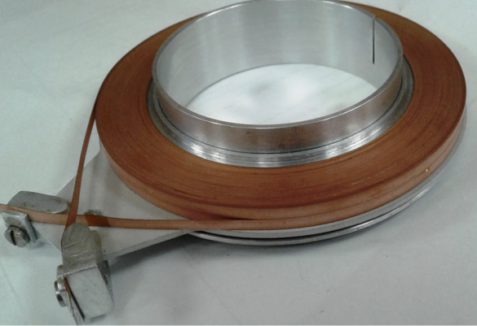
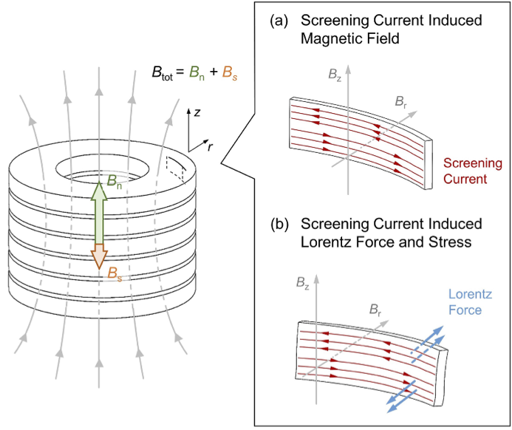
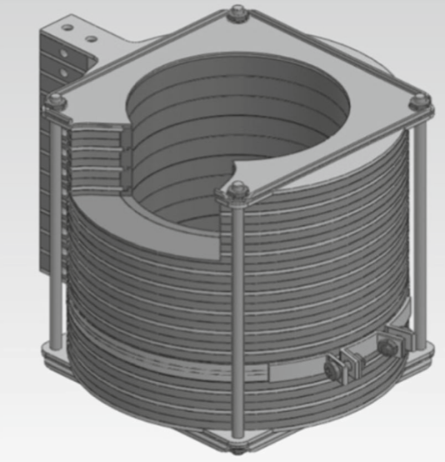
Magnetizing (screening) currents and field quality
Screening currents create a net demagnetization field (B_{s}), affecting field quality
Top: example of HTS pancake coil (top)
Right: solenoid made by stacking pancake coils
Y. Yan et al., Supercond. Sci. Technol. (2022), 35:014003
E. P. Krasnoperov et al., Electrical Engineering (2020), 102:1769–1774

Slide 15
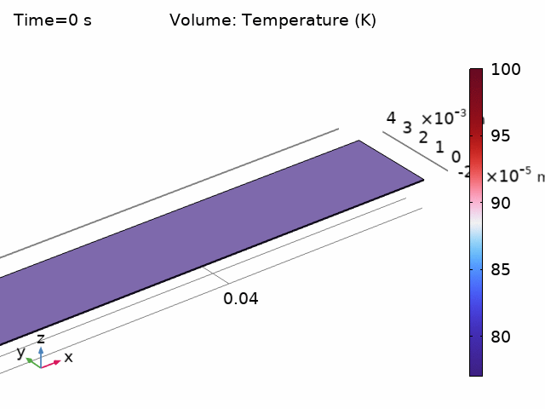
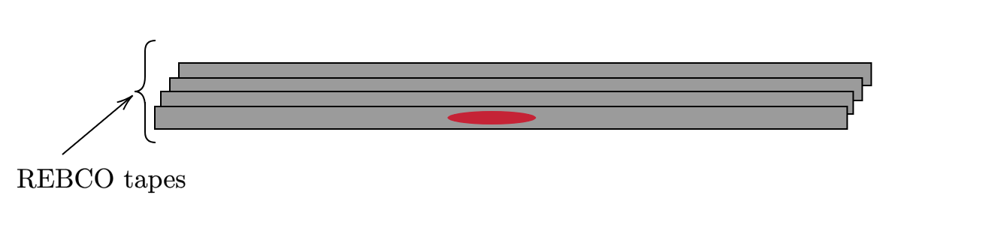
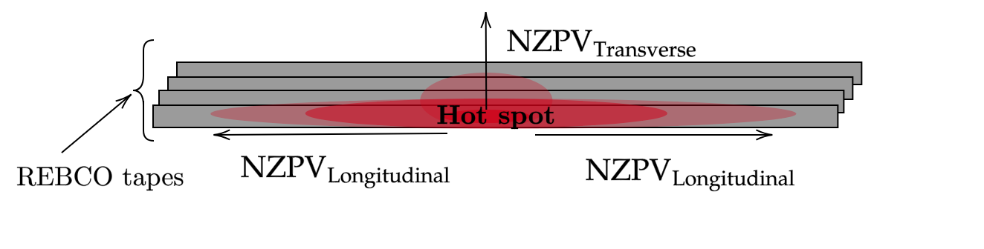
Quench protection of REBCO-based magnets
REBCO-based devices are prone to HOT SPOTS and QUENCH PROPAGATION
  A hot spot can destroy a 2 M$ magnet in a matter of seconds!
Hot spots in REBCO tapes propagate up to 2 orders of magnitude slower than in LTS devices → Much harder to detect
Finding robust quench protection systems is currently THE PRIMARY CONCERN of the HTS magnet community → Many strategies under test
Hot spot nucleation and quench propagation
Finite element simulation
(NZPV – Normal Zone Propagation Velocity)

Slide 16
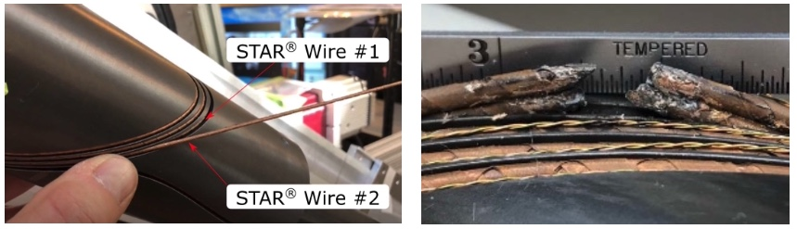
Quench protection of REBCO magnets
Subscale model of an REBCO accelerator magnet (CCT dipole) damaged by a quench
Courtesy of Lawrence Berkeley National Lab – Project carried out within the U.S. Magnet Development Program

Slide 17
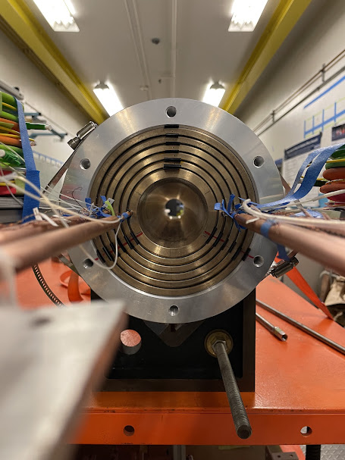
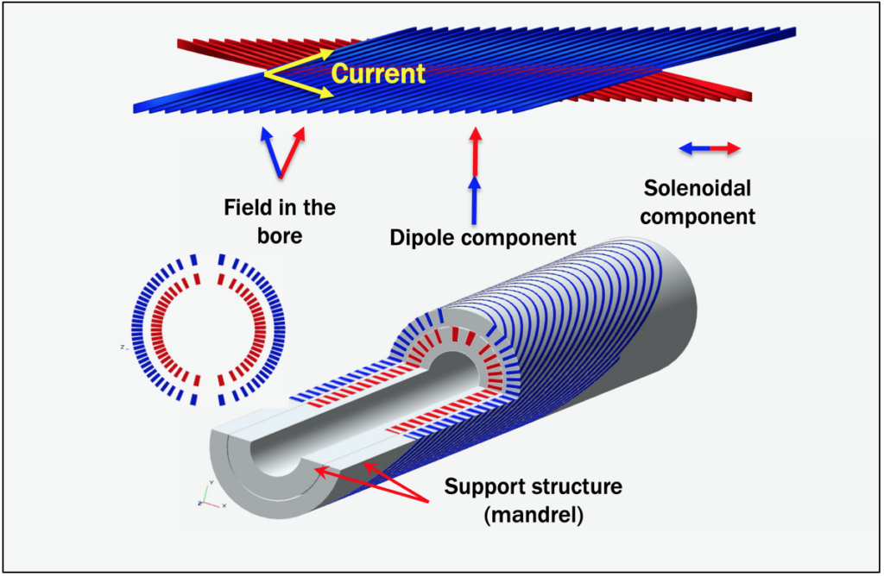
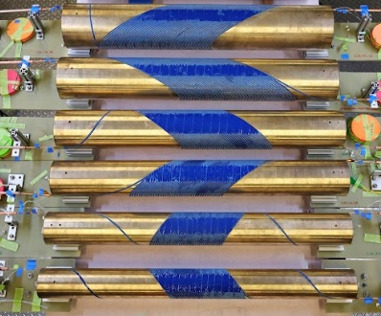
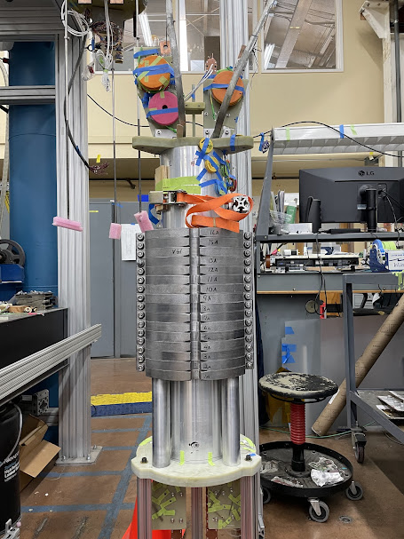
C3 magnet: a 6 T REBCO magnet (65 mm aperture)
Schematic first 2 layers
Right: Complete magnet assembly
Picture of the whole 6 layers
Source: https://atap.lbl.gov/news/a-blueprint-for-more-powerful-superconducting-magnets
Courtesy of Lawrence Berkeley National Lab Project carried out within the U.S. Magnet Development Program

Slide 18
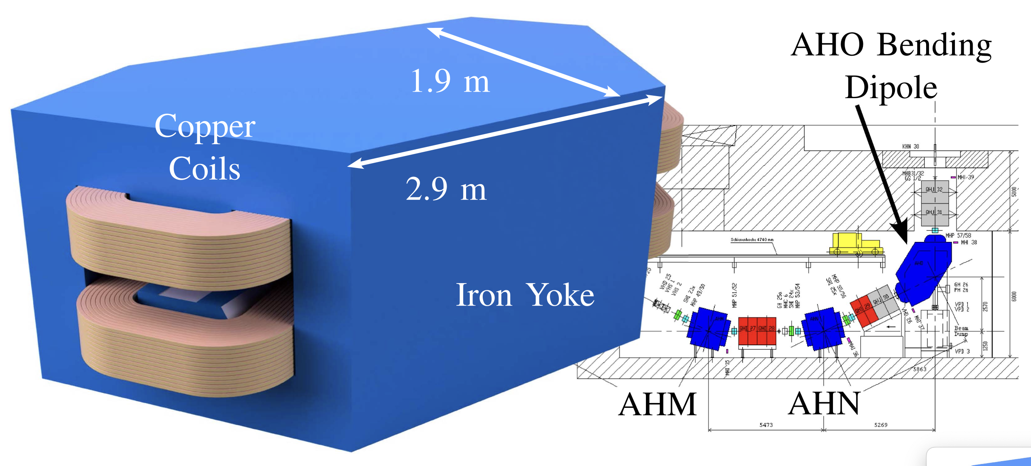
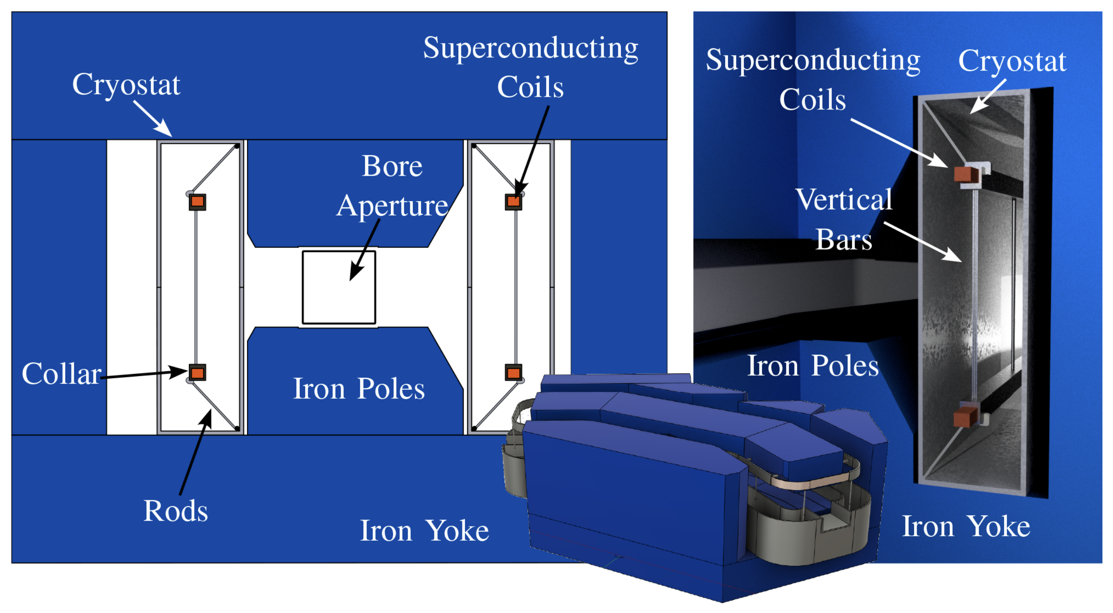
Is there room for low-field REBCO magnetS? (with no Lhe)
Concept of retrofit HTS magnet to replace a copper dipole at PSI (Paul Scherrer Inst.)
  T_{op}=50 K (low cryogenic cost) → Power: from 190 kW to 6 kW (3-year payback)
Applicable to any beamline using copper magnets (In Canada: TRIUMF, CLS)
NSERC SAP Discovery project awarded (April 2026, Poly-TRIUMF-UVic)
S. Mariotto et al., IEEE Trans. Appl. Supercond. (2025), 35(5):4605305

Slide 19
Conclusion → Towards A Canadian Magnet Strategy?
HTS (REBCO) magnets can benefit many sectors
  Accelerators, Fusion reactors, Medical magnets, High-field research magnets, etc.
REBCO magnet technology is still in its infancy, but it is here to stay
  U.S.A., Europe, Japan, China, Korea, etc.
Canada has missed the LTS magnet technology…
  … but it is still time to catch the train of HTS magnets (REBCO technology)
Exchanges between stakeholders are required to establish a Canadian Magnet Strategy
Canadian efforts should be coupled with other national/international efforts, e.g.
  The US Magnet Development Program (US MDP)
  Various Horizon 2020 European projects (now that Canada is an associated member of EU)
  etc.

Slide 20

Thank you for your attention!

