Slide 1
Photo-detector R&D in the FCC era
Fabrice Retiere (TRIUMF) on behalf of the DRD4 collaboration
Although very much a personnal selection

Slide 2
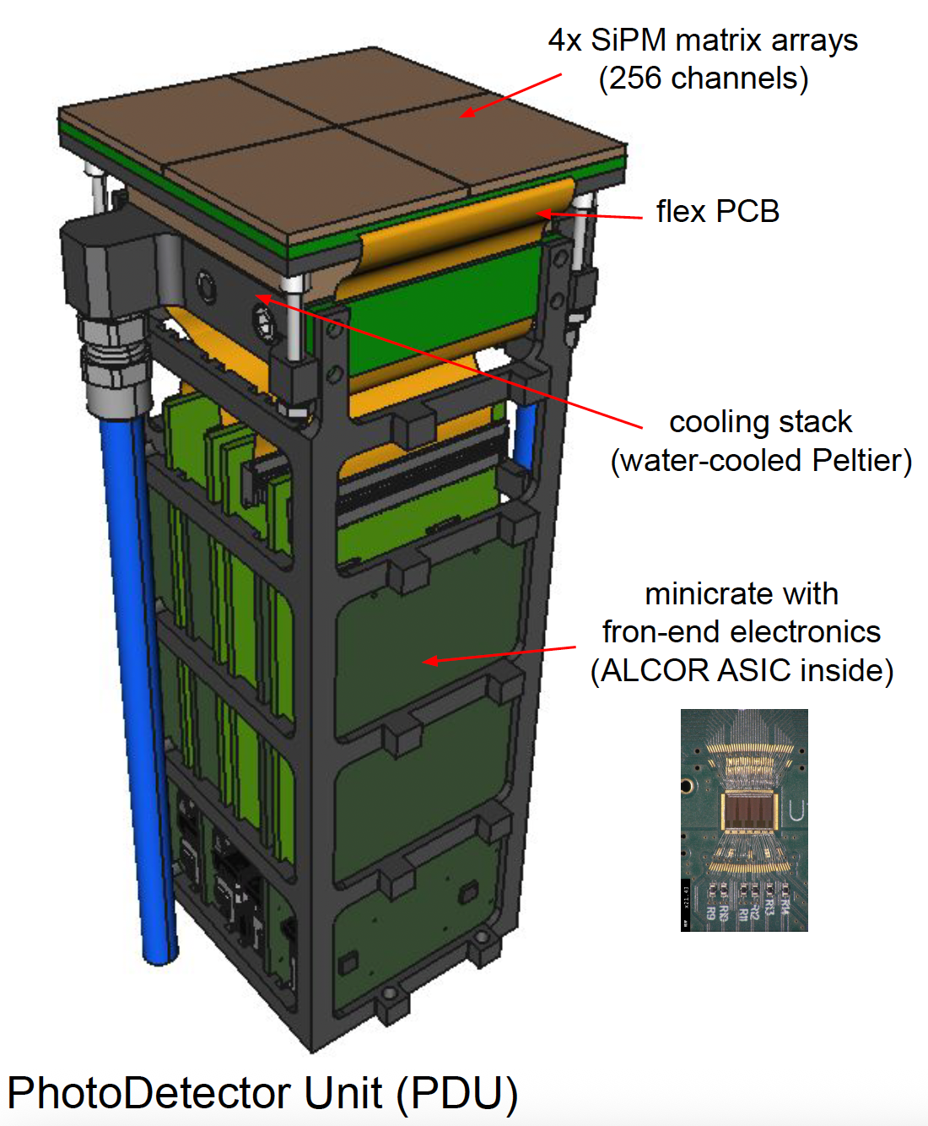

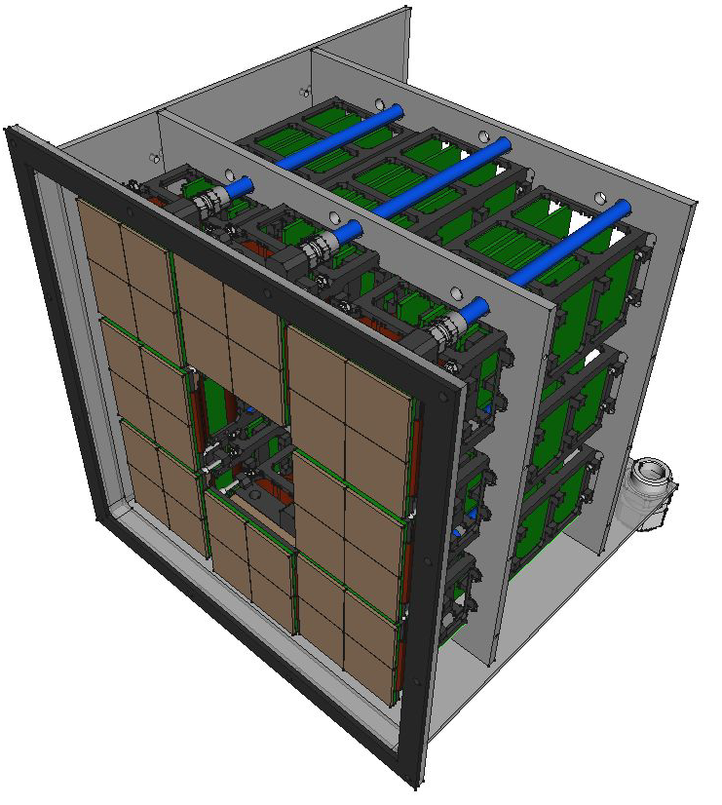
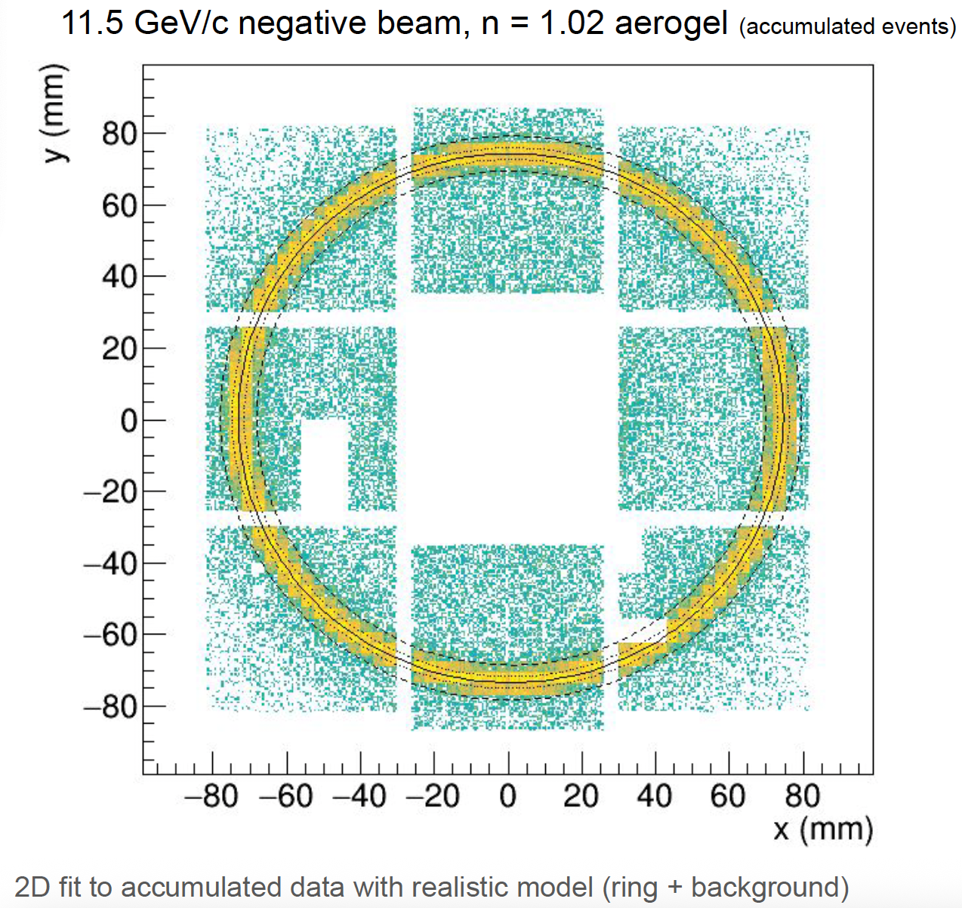
State of the art Ring Imaging Cerenkov
Preamble
Dual RICH (dRICH) detector with SiPM for ePIC (EIC)
  2 radiators: aerogel (n ~ 1.02) and C2F6 (n ~ 1.0008)
  4× matrix Hamamatsu (8×8 S13361
  Read-out board with front-end chip (ASIC), FPGA, and cooling
  Single-photon detection inside high B field (~ 1 T)
  Advanced design and prototype tests
R. Preghenella (INFN Bologna)
CAP 2026 · DRD4 photodetector R&D for the FCC

Slide 3
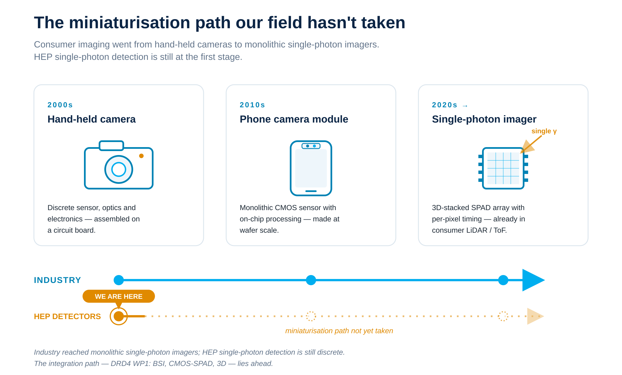
State of the art?
Preamble

Slide 4
ORGANISATION
Working Groups and Work Packages
Six WGs are open R&D forums; five WPs are funded, milestone-driven projects mapped to the ECFA roadmap — the same roadmap that defines detector needs for the FCC.
Spokesperson: M. Fiorini (INFN Ferrara), deputy spokesperson: F. Retiere (TRIUMF)
WORKING GROUPS
WORK PACKAGES
open forums · no committed resources
funded projects · goals, milestones, deliverables
WG1 Photon Detectors Retière, TRIUMF
Writing a 400 pages compendium about single photon detectors
WG2 Particle ID Easo, RAL
WG3 Technological activities Tessarotto, Trieste
WG4 Software Martinelli, Milano-Bicocca
WG5 SciFi & TR detectors Jakobsen, CERN
WG6 Novel / far-future R&D Özkorucuklu, Istanbul
WP1 Solid-state photodetectors Pestotnik, Ljubljana
WP2 Vacuum-based photodetectors Laktineh, Lyon
WP3 RICH & imaging detectors Cardinale, Genova
WP4 Time-of-Flight detectors Lapington, Leicester
WP5 SciFi tracking & TR Leverington, Heidelberg
CAP 2026 · DRD4 photodetector R&D for the FCC
Notes:
WGs share know-how, samples, infrastructure; WPs carry the funded commitments. Note the leadership map. Canadian point: TRIUMF leads WG1. ~1 min.

Slide 5
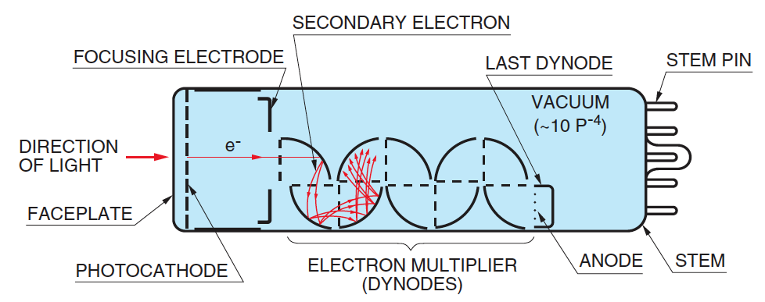
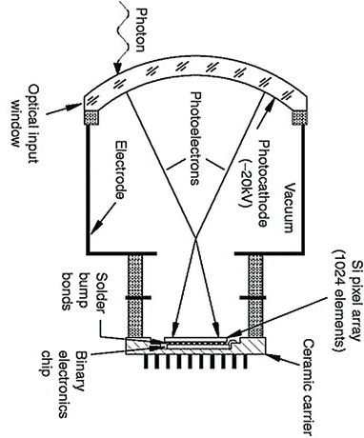
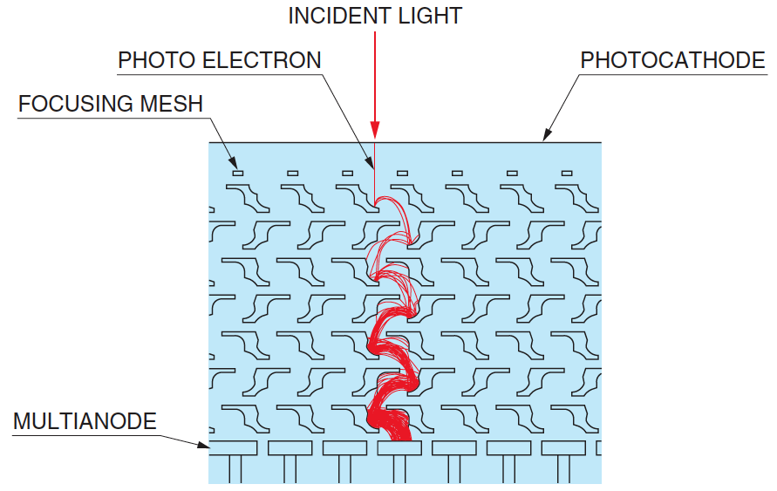
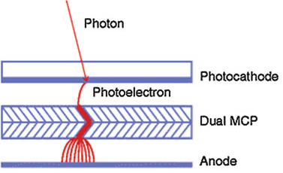
Vacuum Photo-Detector
WP2/WG1 – silicon photo-detector foundation
Conventional PMT
Pros
  High gain and low dark noise
  Excellent timing resolution for MCP
  Good efficiency
Cons
  Specialized manufacturing
    Limited suppliers
  Fragile
  Bulky
Hybrid-Photodetector
Multi-Anode PMT
Micro-channel plates

Slide 6
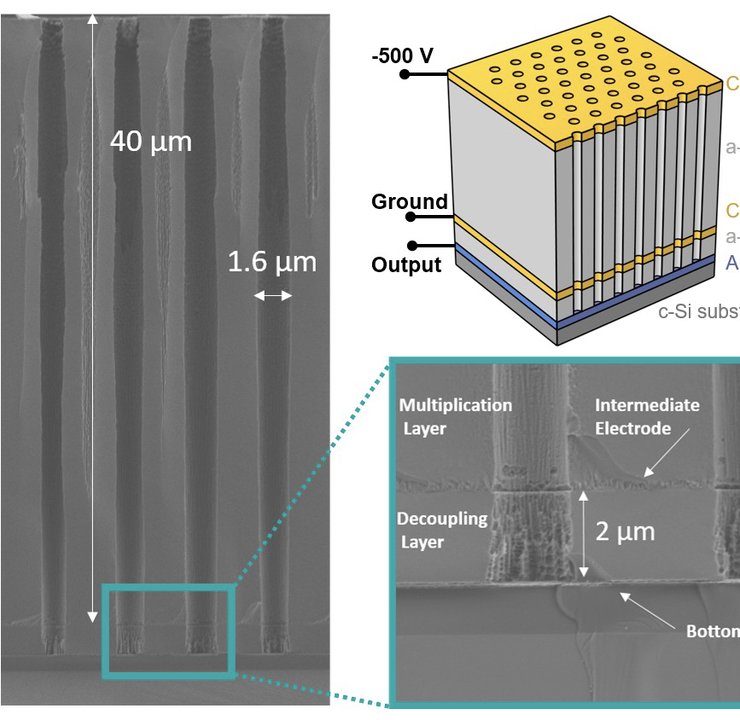
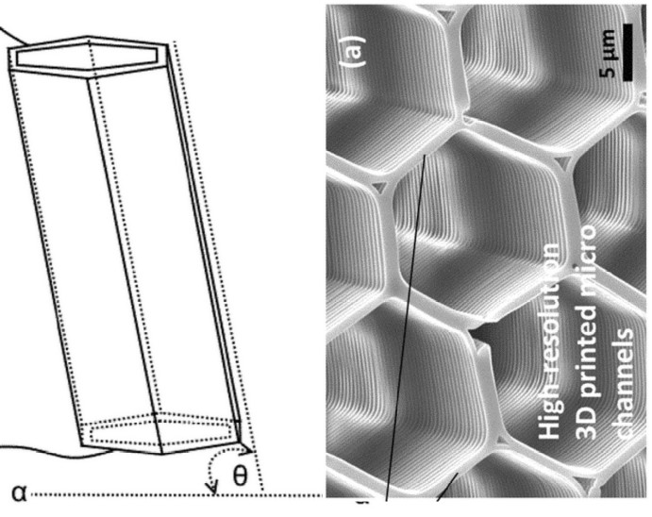
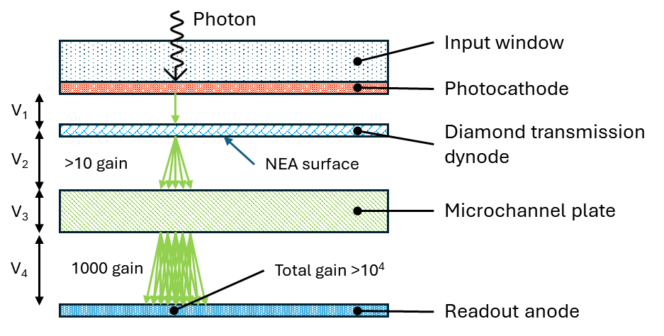
Vacuum photo-detector moving towards enhanced integration
WP2/WG1 – silicon photo-detector
MCP fabrication over silicon substrate
3D printed MCP
Transmission dynode
All these technique enables integration with CMOS – TimePiX4, PICMIC
J. Lapington (RICH 2025)
C. Ertley (Proc. of SPIE Vol.13093, 130935S)
S. Frei (IEEE TNS Vol.70 No. 9 2226, 2023)
6

Slide 7
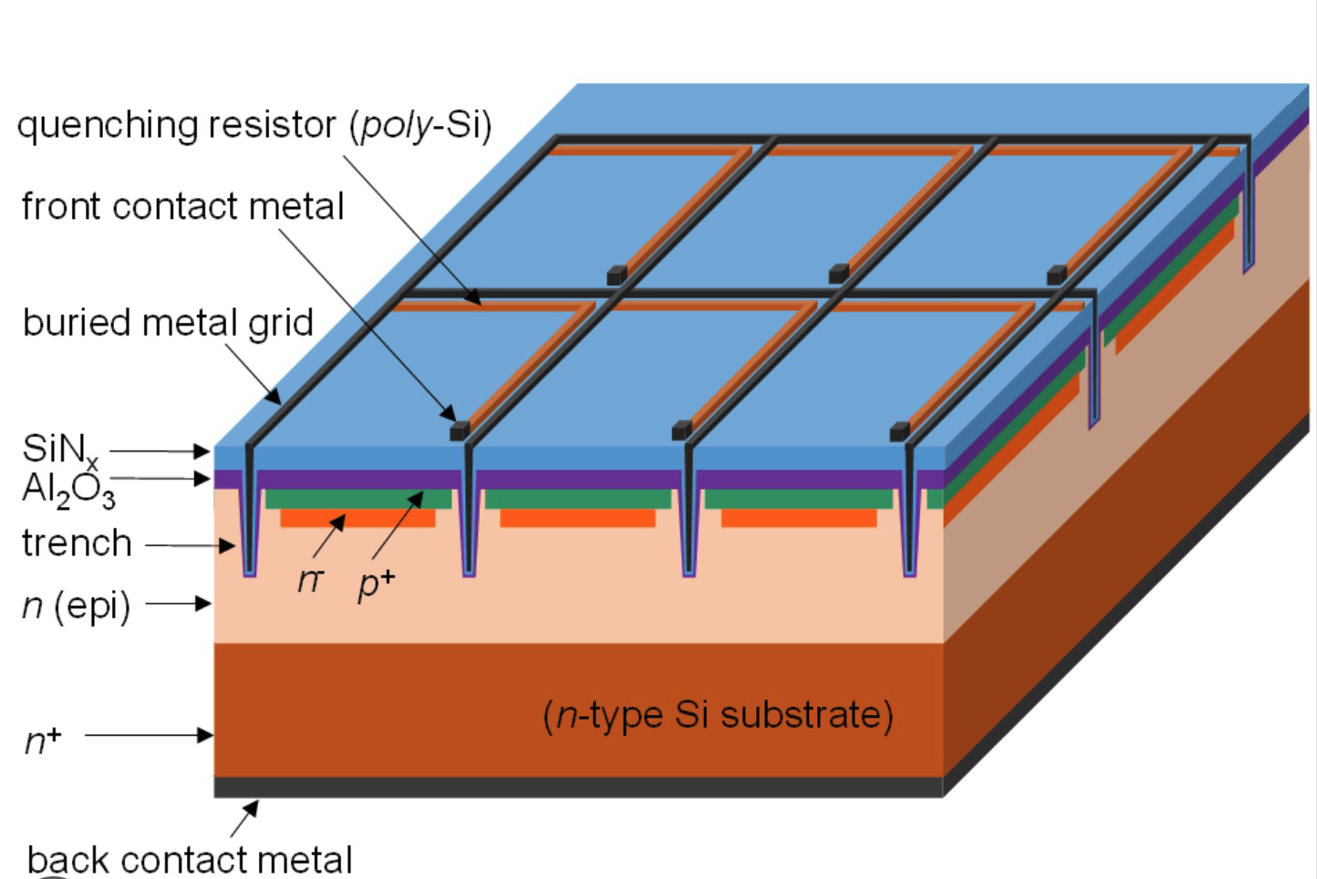
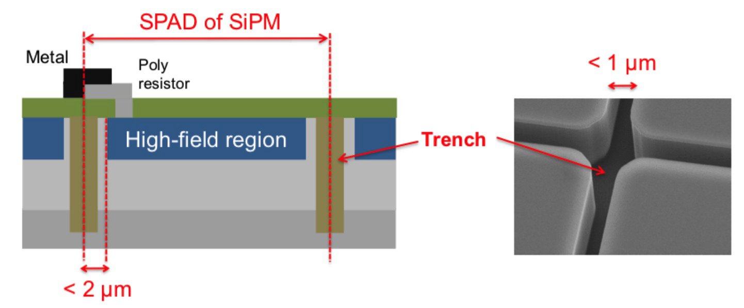
Single Photon Avalanche Diode Arrays (SiPMs)
WP1/WG1 – silicon photo-detector foundation
Pros:
  High gain (~10⁶) and single photon separation
  Excellent time resolution
  Good granularity
  Insensitive to magnetic fields; low V operation
  Compact
Cons:
  High dark count rate. typ. ~100 kHz/mm²
  correlated avalanches (afterpulse, crosstalk) & emits light
  Very sensitive to neutrons and ionizing particles
Notes:
Dark counts are produced by thermal generation of carriers, trap assisted tunnelling or band gap tunnelling.
Optical cross-talk produced when photons emitted in avalanche initiate signal in neighbouring cell, reduced by screening – trenches.
After-pulses produced by trap-release of carriers or delayed.

Slide 8
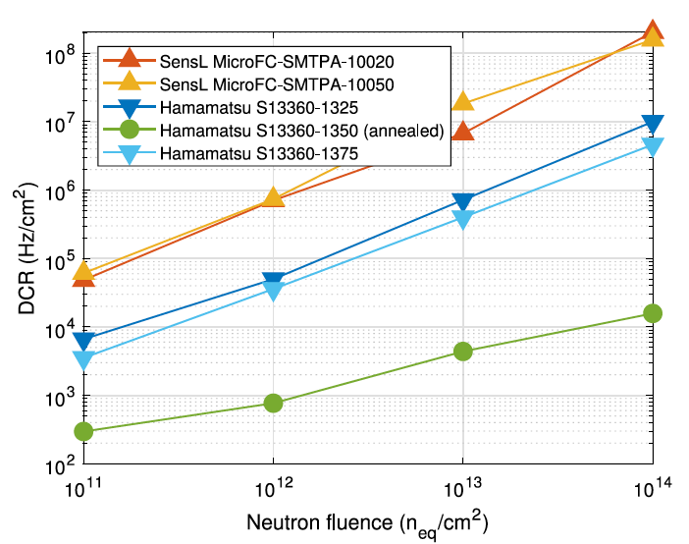
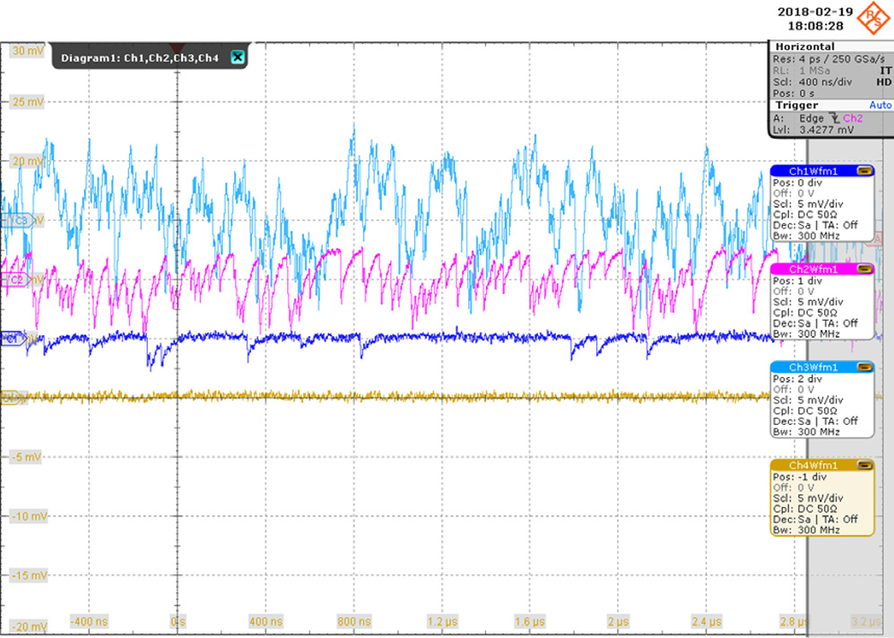
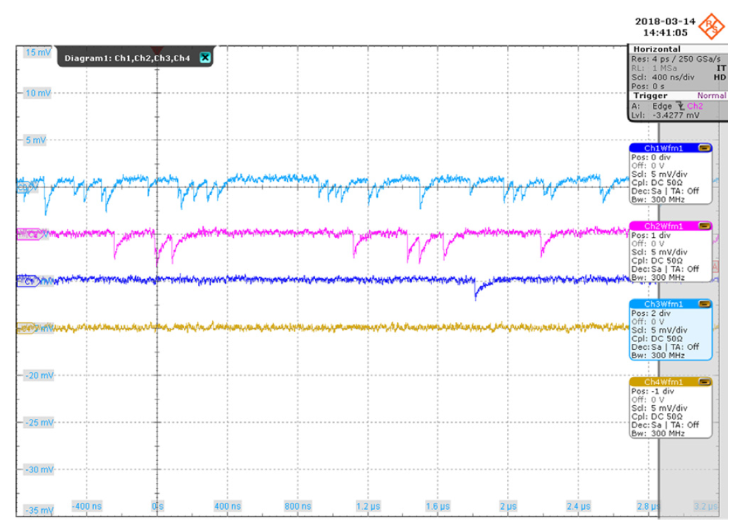
WP 1, task 3 radiation hardness
WP1/WG1 – silicon photo-detector radiation damage
Liquid nitrogen (77 K)
DCR highly depends on temperature and irradiation
Can be mitigated by cooling (and annealing after irradiation)
M. Calvi (NIM A 952 161788, 2020)
10¹³ n_{eq}/cm²
10¹² n_{eq}/cm²
10¹¹ n_{eq}/cm²
non irradiated
Hamamatsu S13360-1350CS, -30°C
-30°C, after annealing
Notes:
Baselines of the same devices just after irradiation, and after 600 h of annealing up to 175 ◦C: operation in single photon regime is possible, but only for fluences up to 10^11 neq/cm^2.
Devices were then cooled down to 77 K: for Hamamatsu SiPMs of any cell size, a DCR of about 10 MHz∕cm2 was measured, which would allow single photon operation.
The device that was annealed shows an even lower DCR of about 10 kHz∕cm2, comparable to that of vacuum devices like MaPMTs and MCP-PMTs.

Slide 9

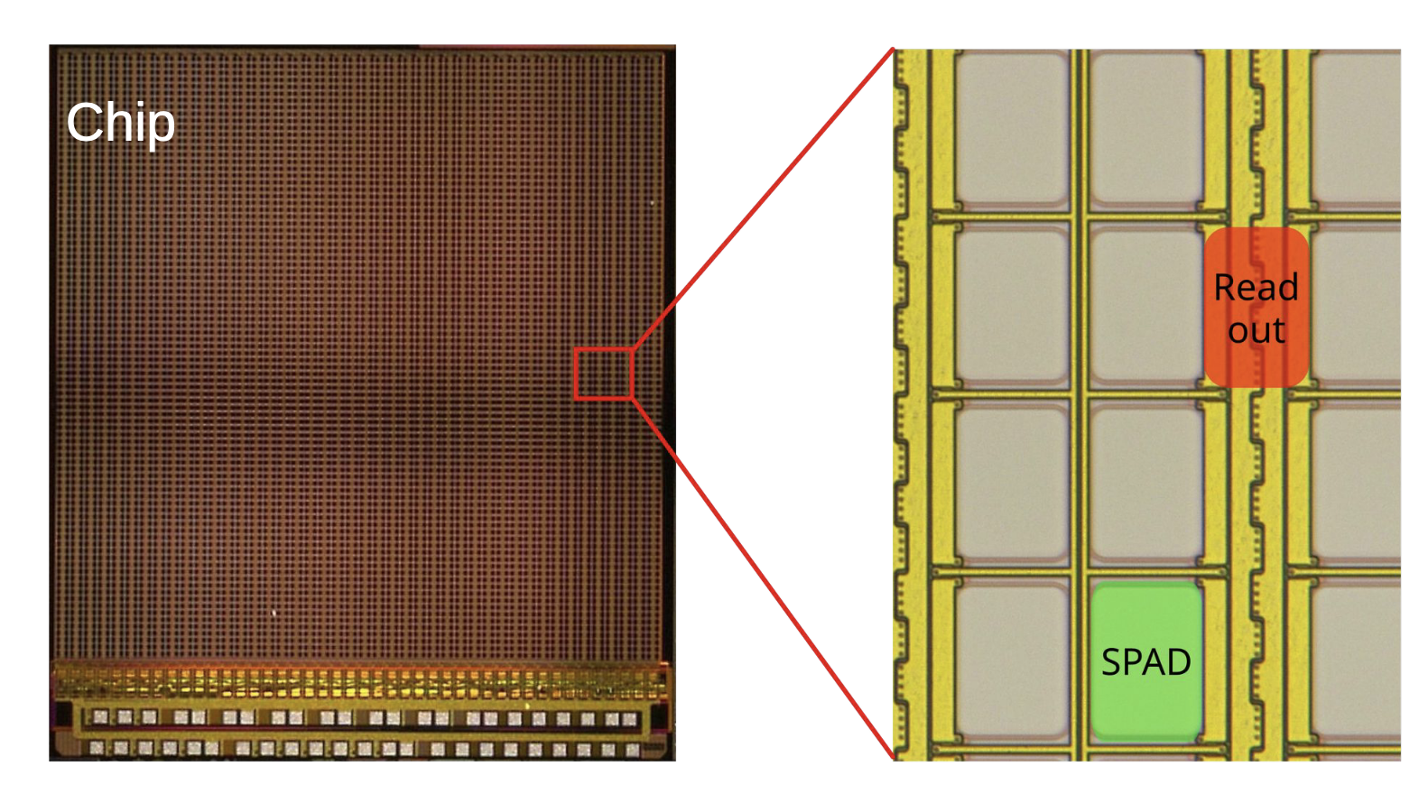
CMOS SPAD
WP1/WG1 – silicon photo-detector electronics integration
Pros
  “no” power dissipation when idling
  Tailor performances to needs. E.g. dynamic range, timing, imaging,…
  Less complex at system level
  Lower dark noise by SPAD elimination
Cons
  In 2D, some efficiency loss
  More complex at chip level
  Mass production not demonstrated (by HEP)

Slide 10
CMOS SPAD within DRD4
WP1/WG1 – silicon photo-detector electronics integration
PLATON (EPFL, ETHZ – D. Sgalaberna)
  Scintillating fibres as active neutrino target
  Towards dedicated dSiPM: 272x192 SPAD pixels, per-cluster TDCs (200-800 ps LSB), low data rate (1-2 LVDS connections sufficient per chip)

Slide 11
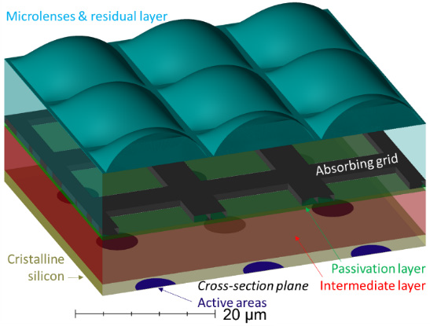
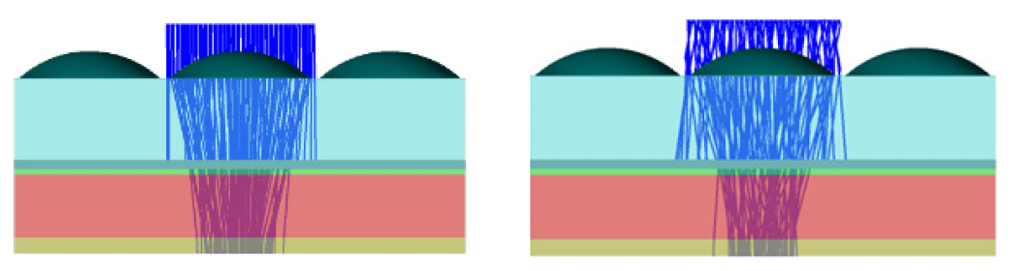
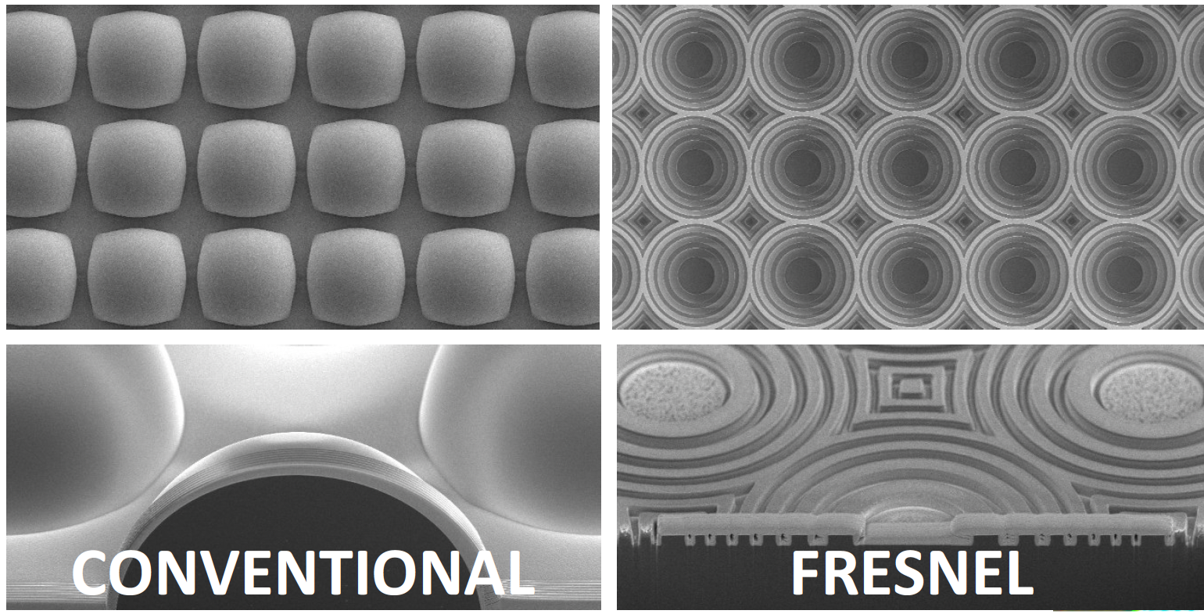
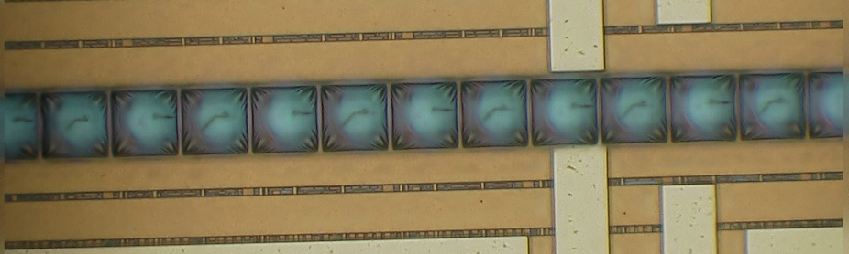
Leveraging the nano-optics revolution
WP1/WG1 – silicon photo-detector optics
C. Bruschini

Slide 12
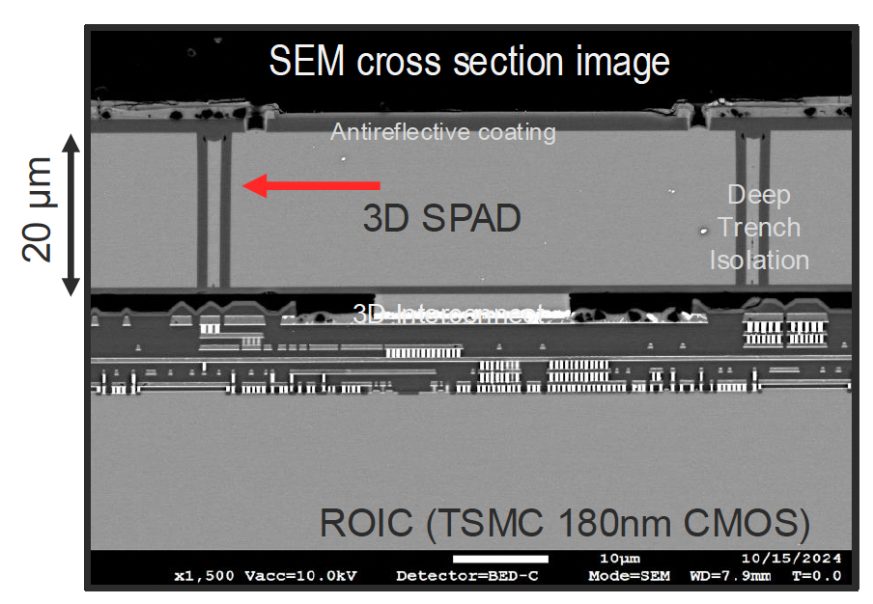
3D integration
WP1/WG1 – silicon photo-detector electronics integration
Industry is leading:
  CANON, SONY for single photon imager
  STMicroelectronics and smaller companies for LIDAR
In HEP, University of Sherbrooke, Canada (S.Charlebois, J.-F. Pratte) is leading with Photon to Digital Converter
  Development driven by astro-particle physics, nEXO, ARGO
  SPAD array and CMOS readout 3D-stacked to form a single heterogeneous detector chip
  Made in Canada: SPAD array and 3D integration in Teledyne MEMS, Bromont, Quebec
S. Charlebois (PD 2025)
Notes:
NEXT: Search for neutrino-less Double Beta Decay

Slide 13
Back-side illumination is the next step for versatility
WP1/WG1 – silicon photo-detector electronics integration
p+
p
p-epi
p-epi
Even dark matter search
n+
n
Poly
SiO2
100-500 um
Electron trajectories
Geiger mode avalanche
Hole trajectories
Linear avalanche
VUV – Blue photon
Charged particle
Neutron or dark matter
5-50um
Un-depleted
depleted
80um
5-20um
CMOS
CMOS
CMOS
CMOS
Front side avalanche diode
Back side avalanche diode
Extended
Ultra-thick

Slide 14
Canada FCC and photo-detectors
Conclusion - outlook
Canadian effort can no longer be sustained only by astro-particle physics
Both TRIUMF and Sherbrooke are drifting to applied projects
  Neutron imaging. Sherbrooke - ORNL
  Air analysis. TRIUMF – SenseNet
  Neutron spectrometry. TRIUMF – General Fusion
  Expansion through non NSERC SAP grants
Canada photo-detector effort needs FCC interest
  DRD4 is LHCB biased. About 50% of the community
  And DRD4 is also fibers, optics,…
Canada has very strong industrial assets in photonic
  Teledyne-MEMS
  And broad industry
Strong opportunity to catch up with industry if we can create critical mass

Slide 15
Merci / Thank you

