Slide 1
TRIUMF Accelerator Capabilities and Contributions
Bob Laxdal
Deputy Director – Accelerator Division
W1-1 SYMPOSIUM; Future Particle Physics Energy Frontier Facilities
CAP June 24-25, 2026

Slide 2
TRIUMF is Canada's particle accelerator centre
UBC Campus
TRIUMF

Slide 3
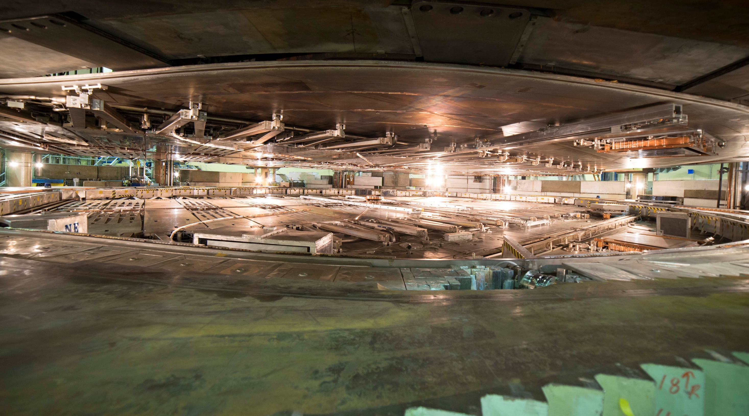
TRIUMF has five decades of experience in building a rich particle accelerator infrastructure that enables cutting-edge research and supports accelerator R&D.

Slide 4
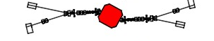
TRIUMF accelerator complex
ISAC-II
High energy
Primary beam driver (1974):
500 MeV Cyclotron, 300 μA, H⁻
Produces rare isotopes, neutrons and muons
Isotope Separator and Accelerator facility – ISAC (1996)
ISAC-I: Normal conducting-linac
  0.15-1.8 MeV/u (2000)
ISAC-II: Superconducting-linac
  1.5-16.5 MeV/u (2006)
Advanced Rare Isotope Laboratory – ARIEL (in progress)
Superconducting electron linac
  30 MeV, 10 mA, cw (2019)
4 (+1) Cyclotrons for medical isotope production – TR30 and TR13 designed by TRIUMF
ARIEL
ISAC-I
Low and
medium
energy
Isotope Cyclotrons
elinac
500 MeV Cyclotron and BL1A
IAMI

Slide 5
A wide variety of accelerator technologies populate the campus.
Our strategy is to use internal projects and external collaborations as springboards to expand core competencies or gain new ones.
Competencies include:
Superconducting radio-frequency
Beam physics of electrons and hadrons
Secondary beam production
Cyclotrons and linear accelerators
Beam diagnostics
High power targets
Remote handling
ISAC-II
High energy
ARIEL
ISAC-I
Low and
medium
energy
Isotope Cyclotrons
elinac
520 MeV
Cyclotron

Slide 6
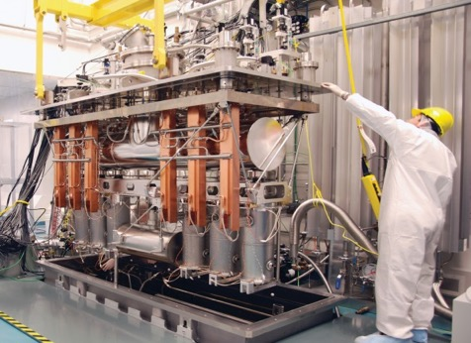
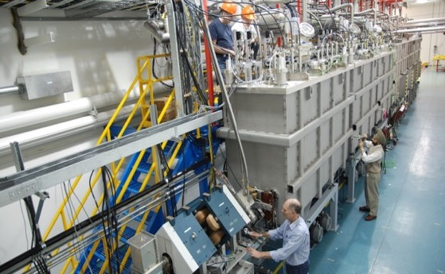
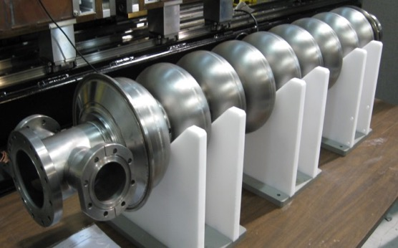
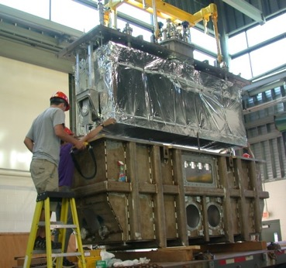
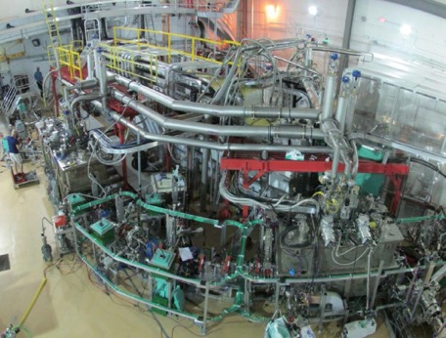
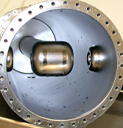
Example: SRF Technology at TRIUMF since 2001 –> In house linear accelerators
40MV ISAC-II SRF heavy ion linac
@ 106 and 141 MHz
in operation since 2006
30MV ARIEL SRF 10mA electron linac
@ 1.3 GHz
first beam 2014

Slide 7
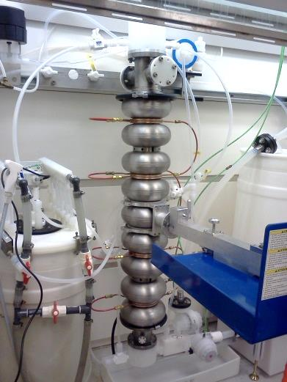
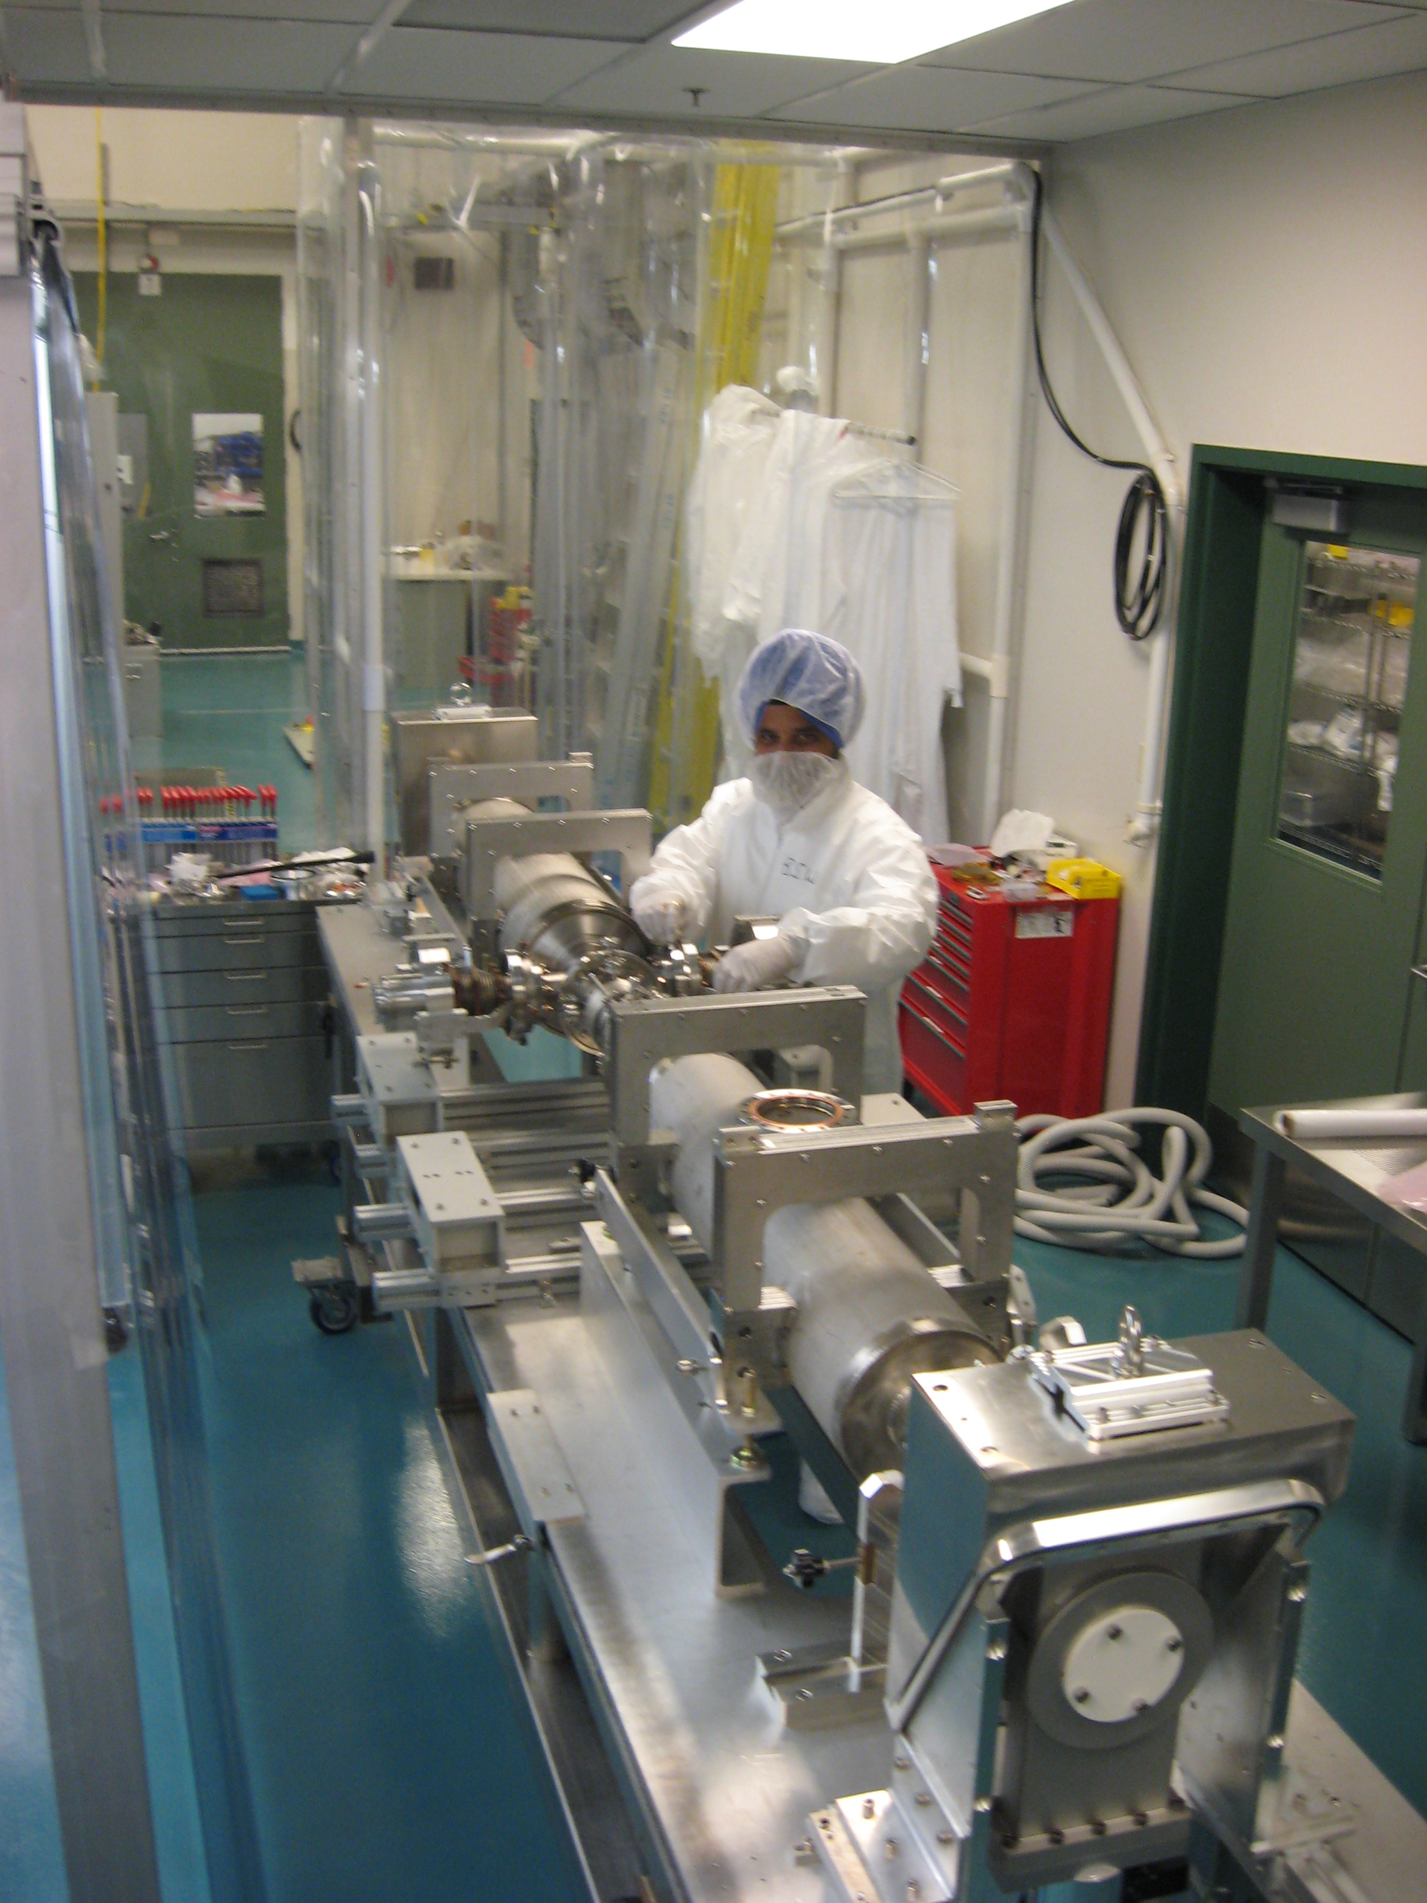
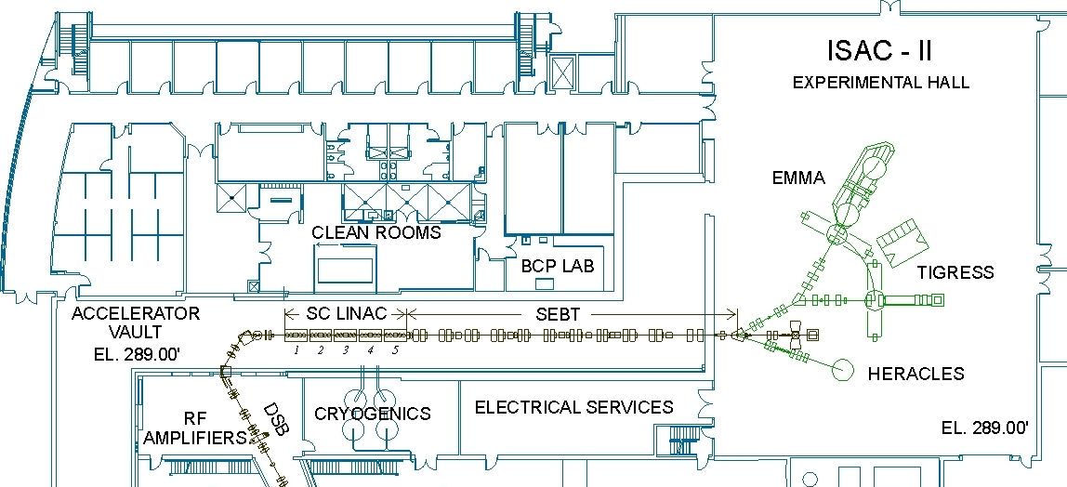
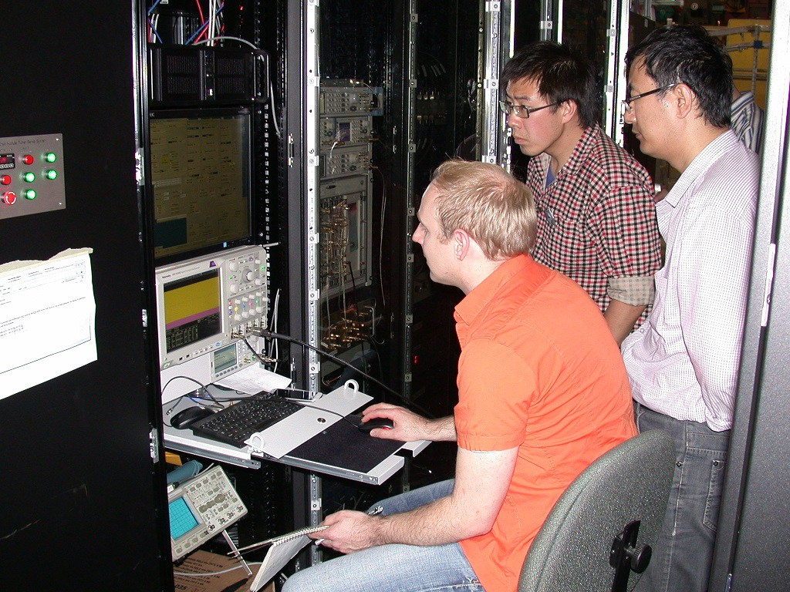

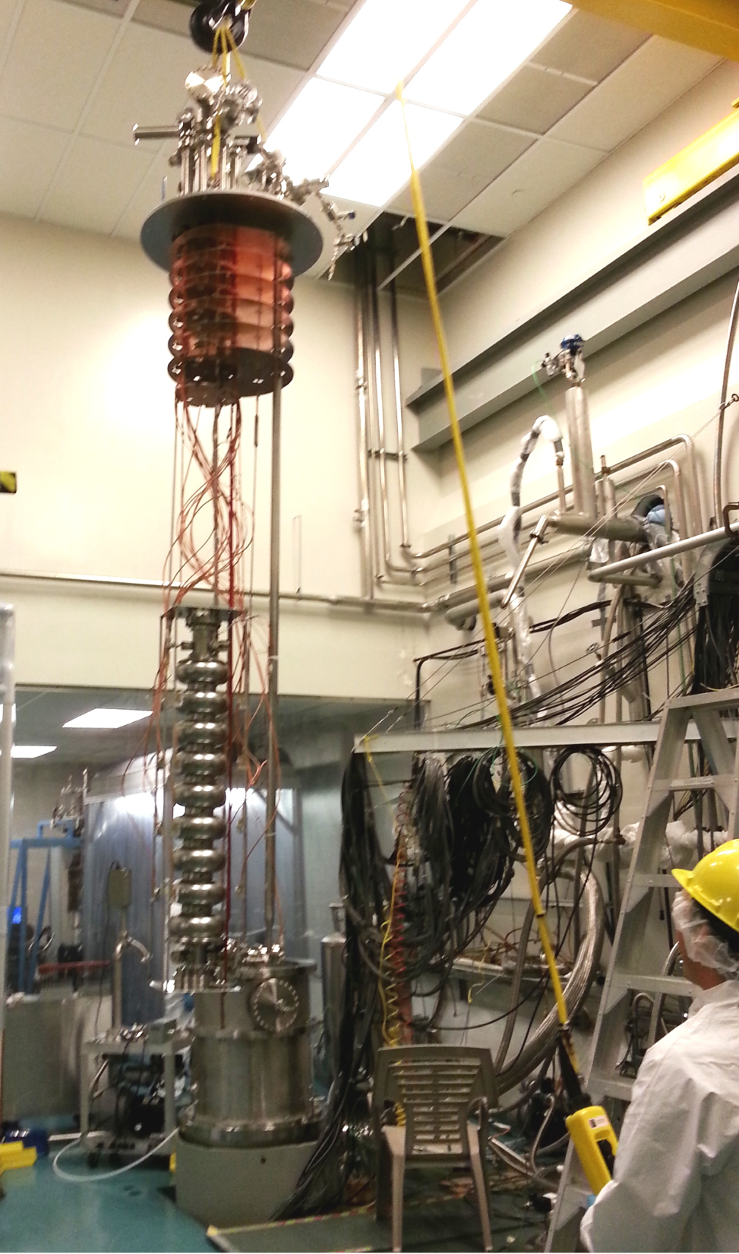
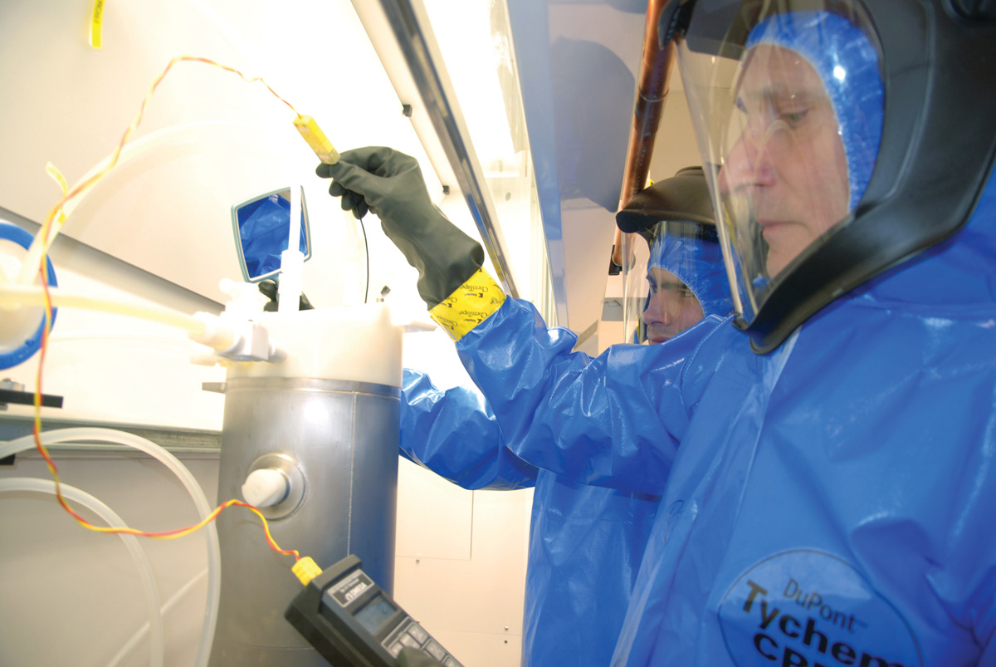
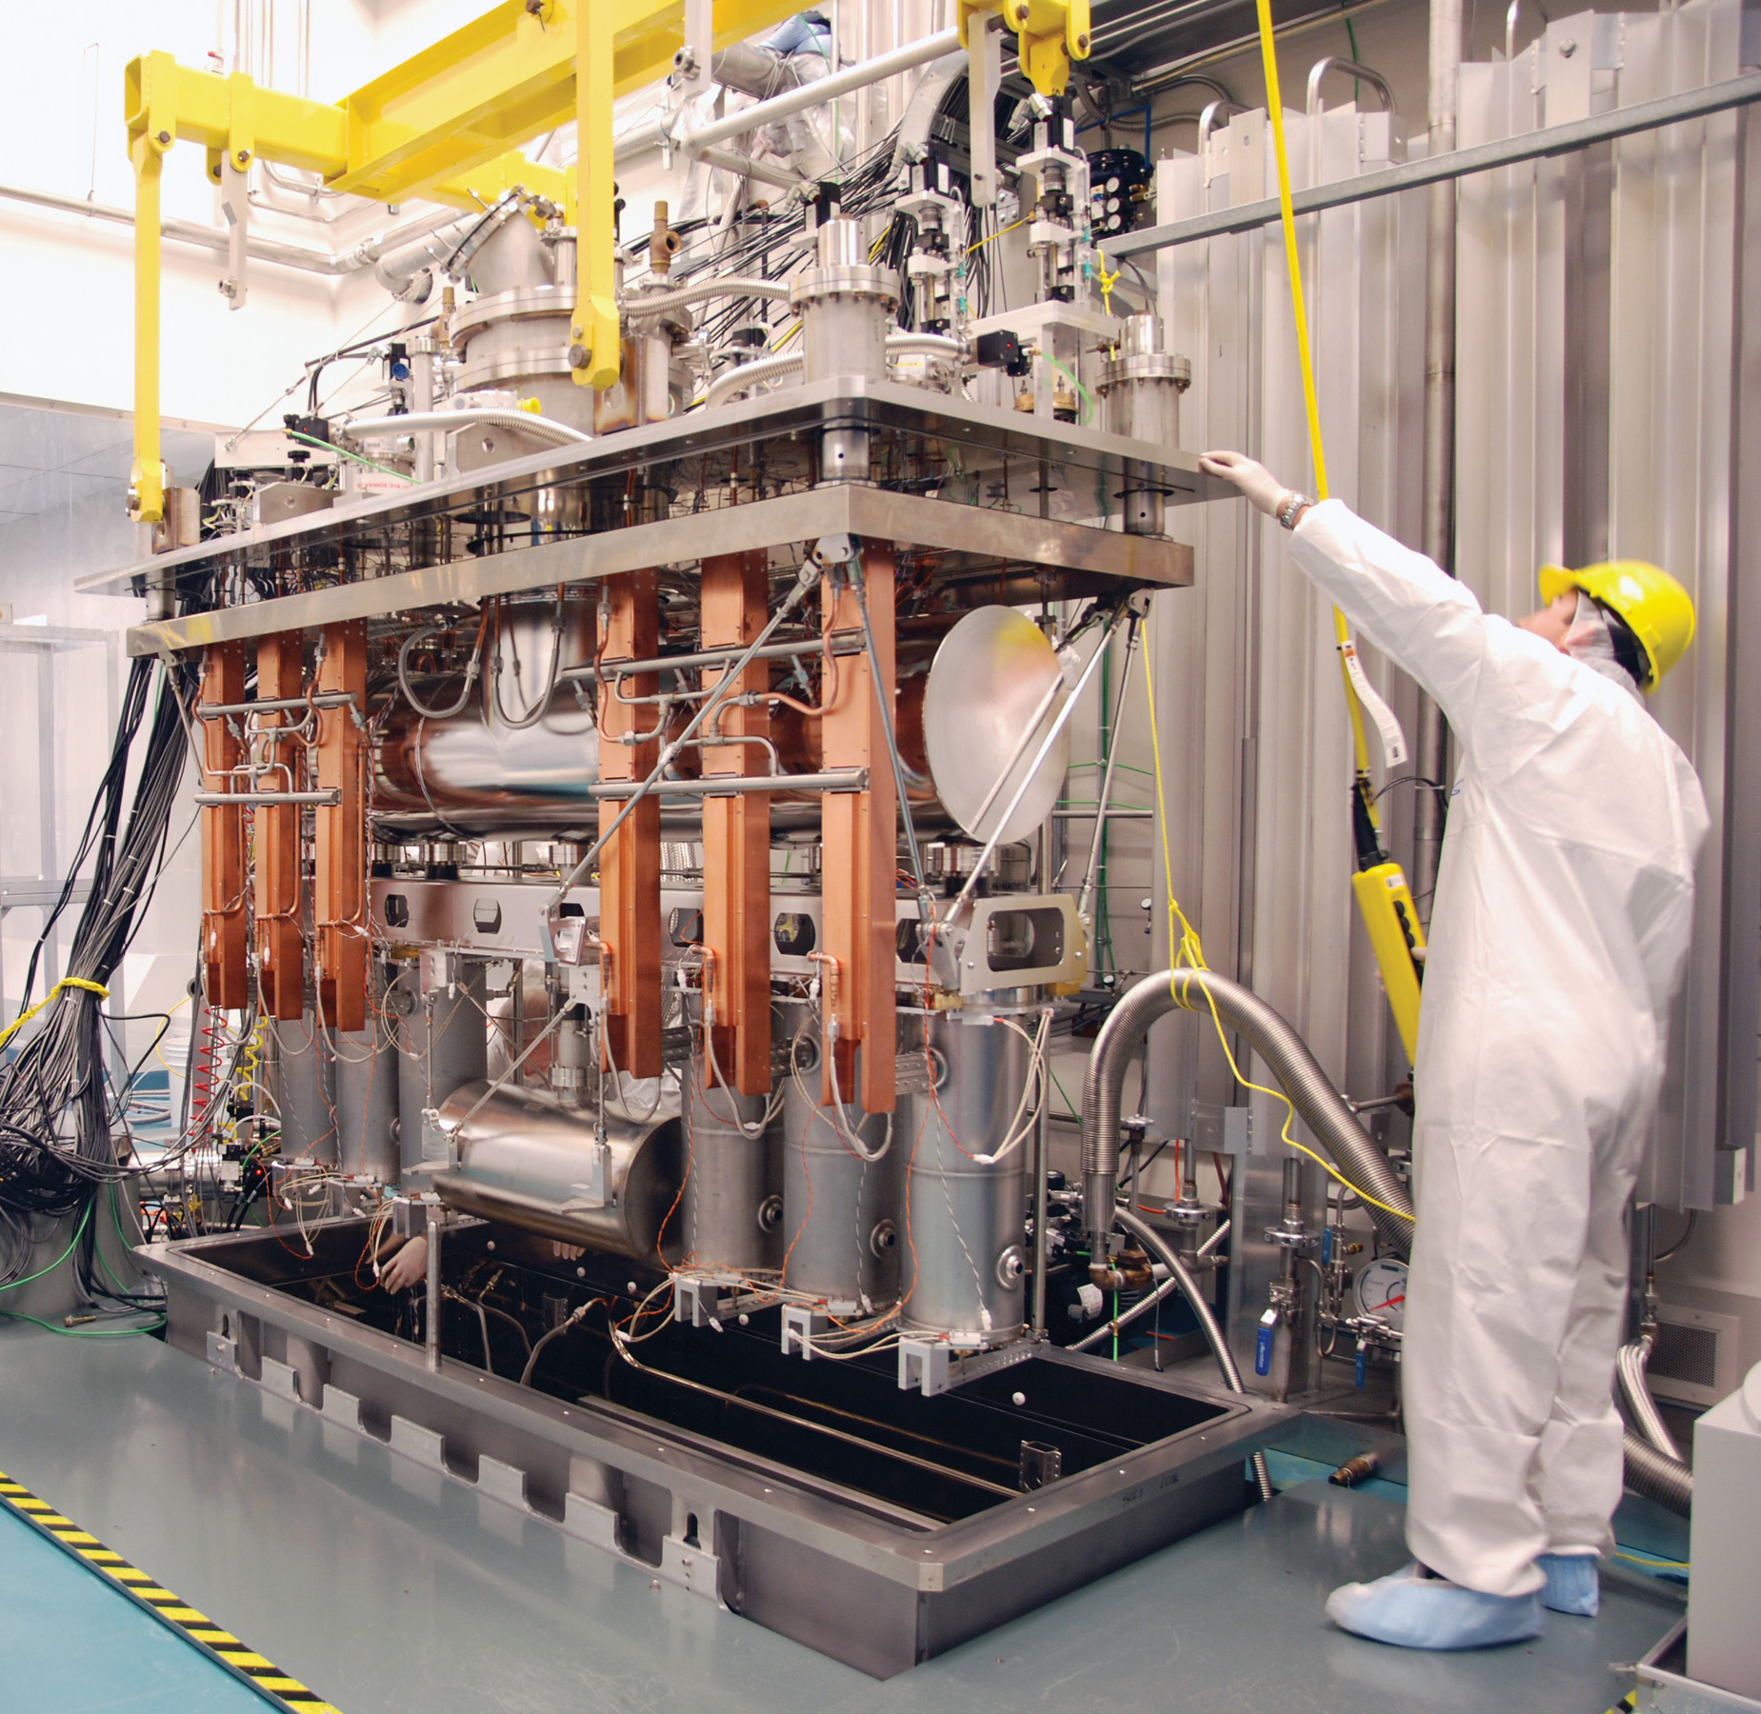
SRF Facilities
The SRF lab supports the in-house accelerator program, SRF research, work for others and external collaborations
Dirty assembly
Clean room
RF
HPWR
Prep room
Cryo-testing
Clean assembly
BCP

Slide 8
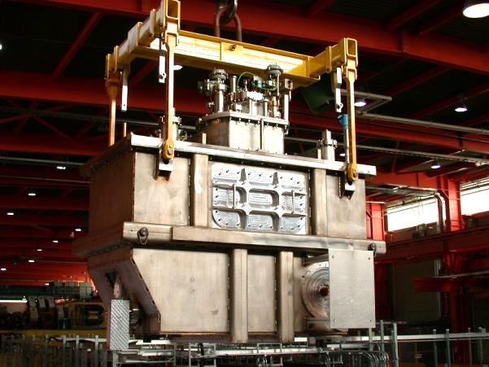
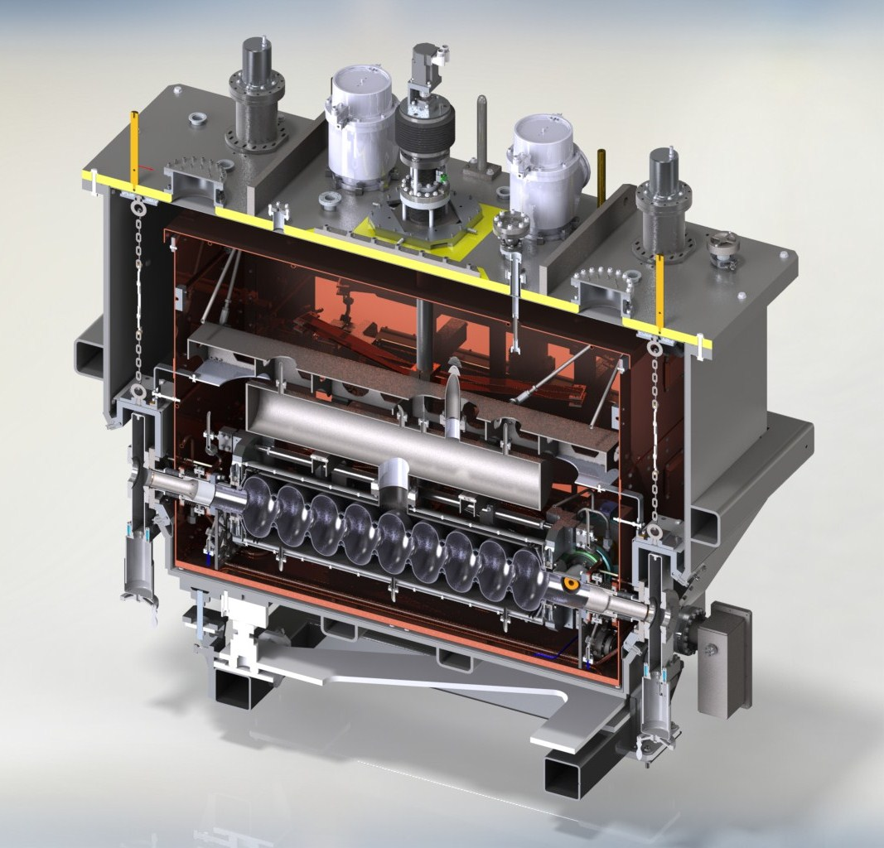
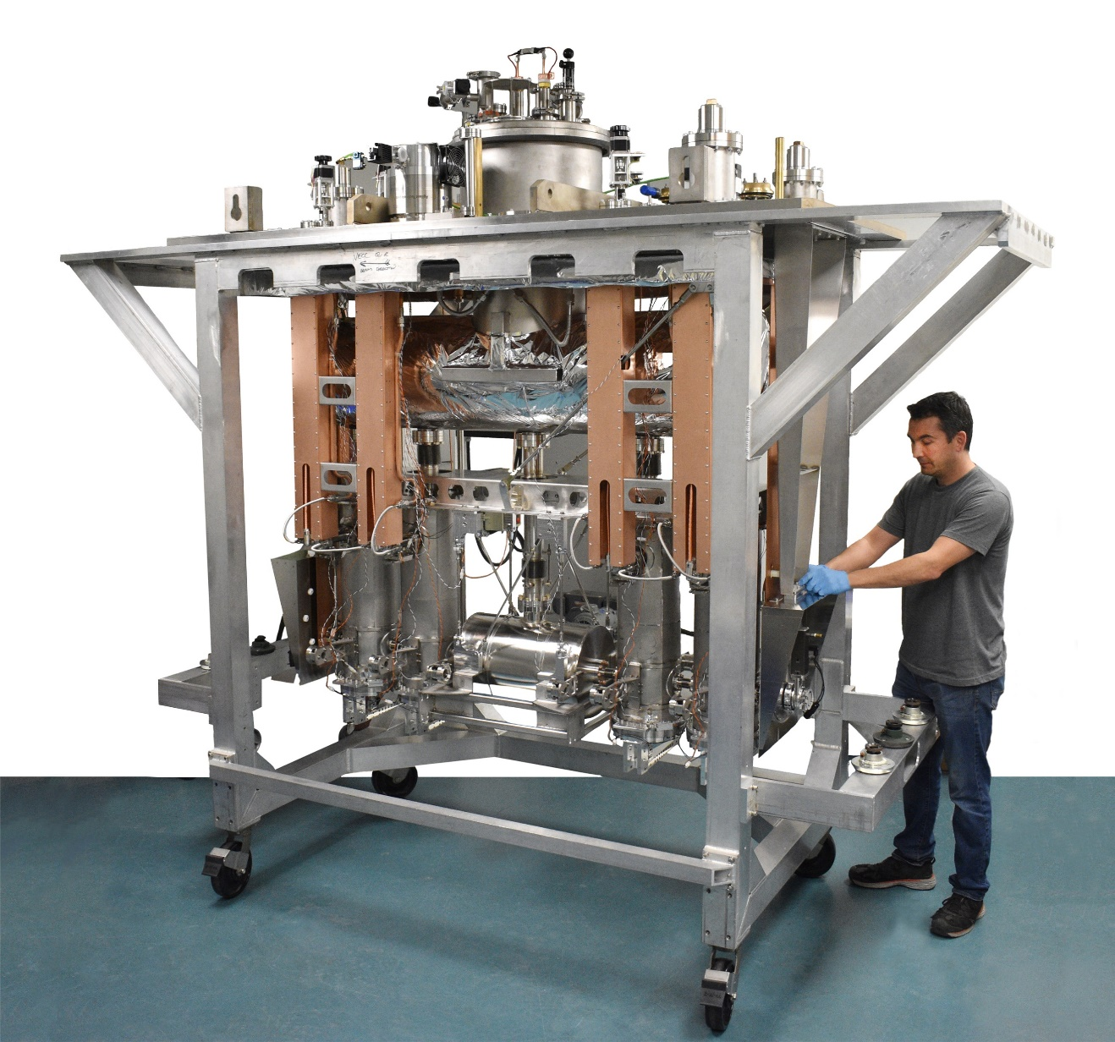
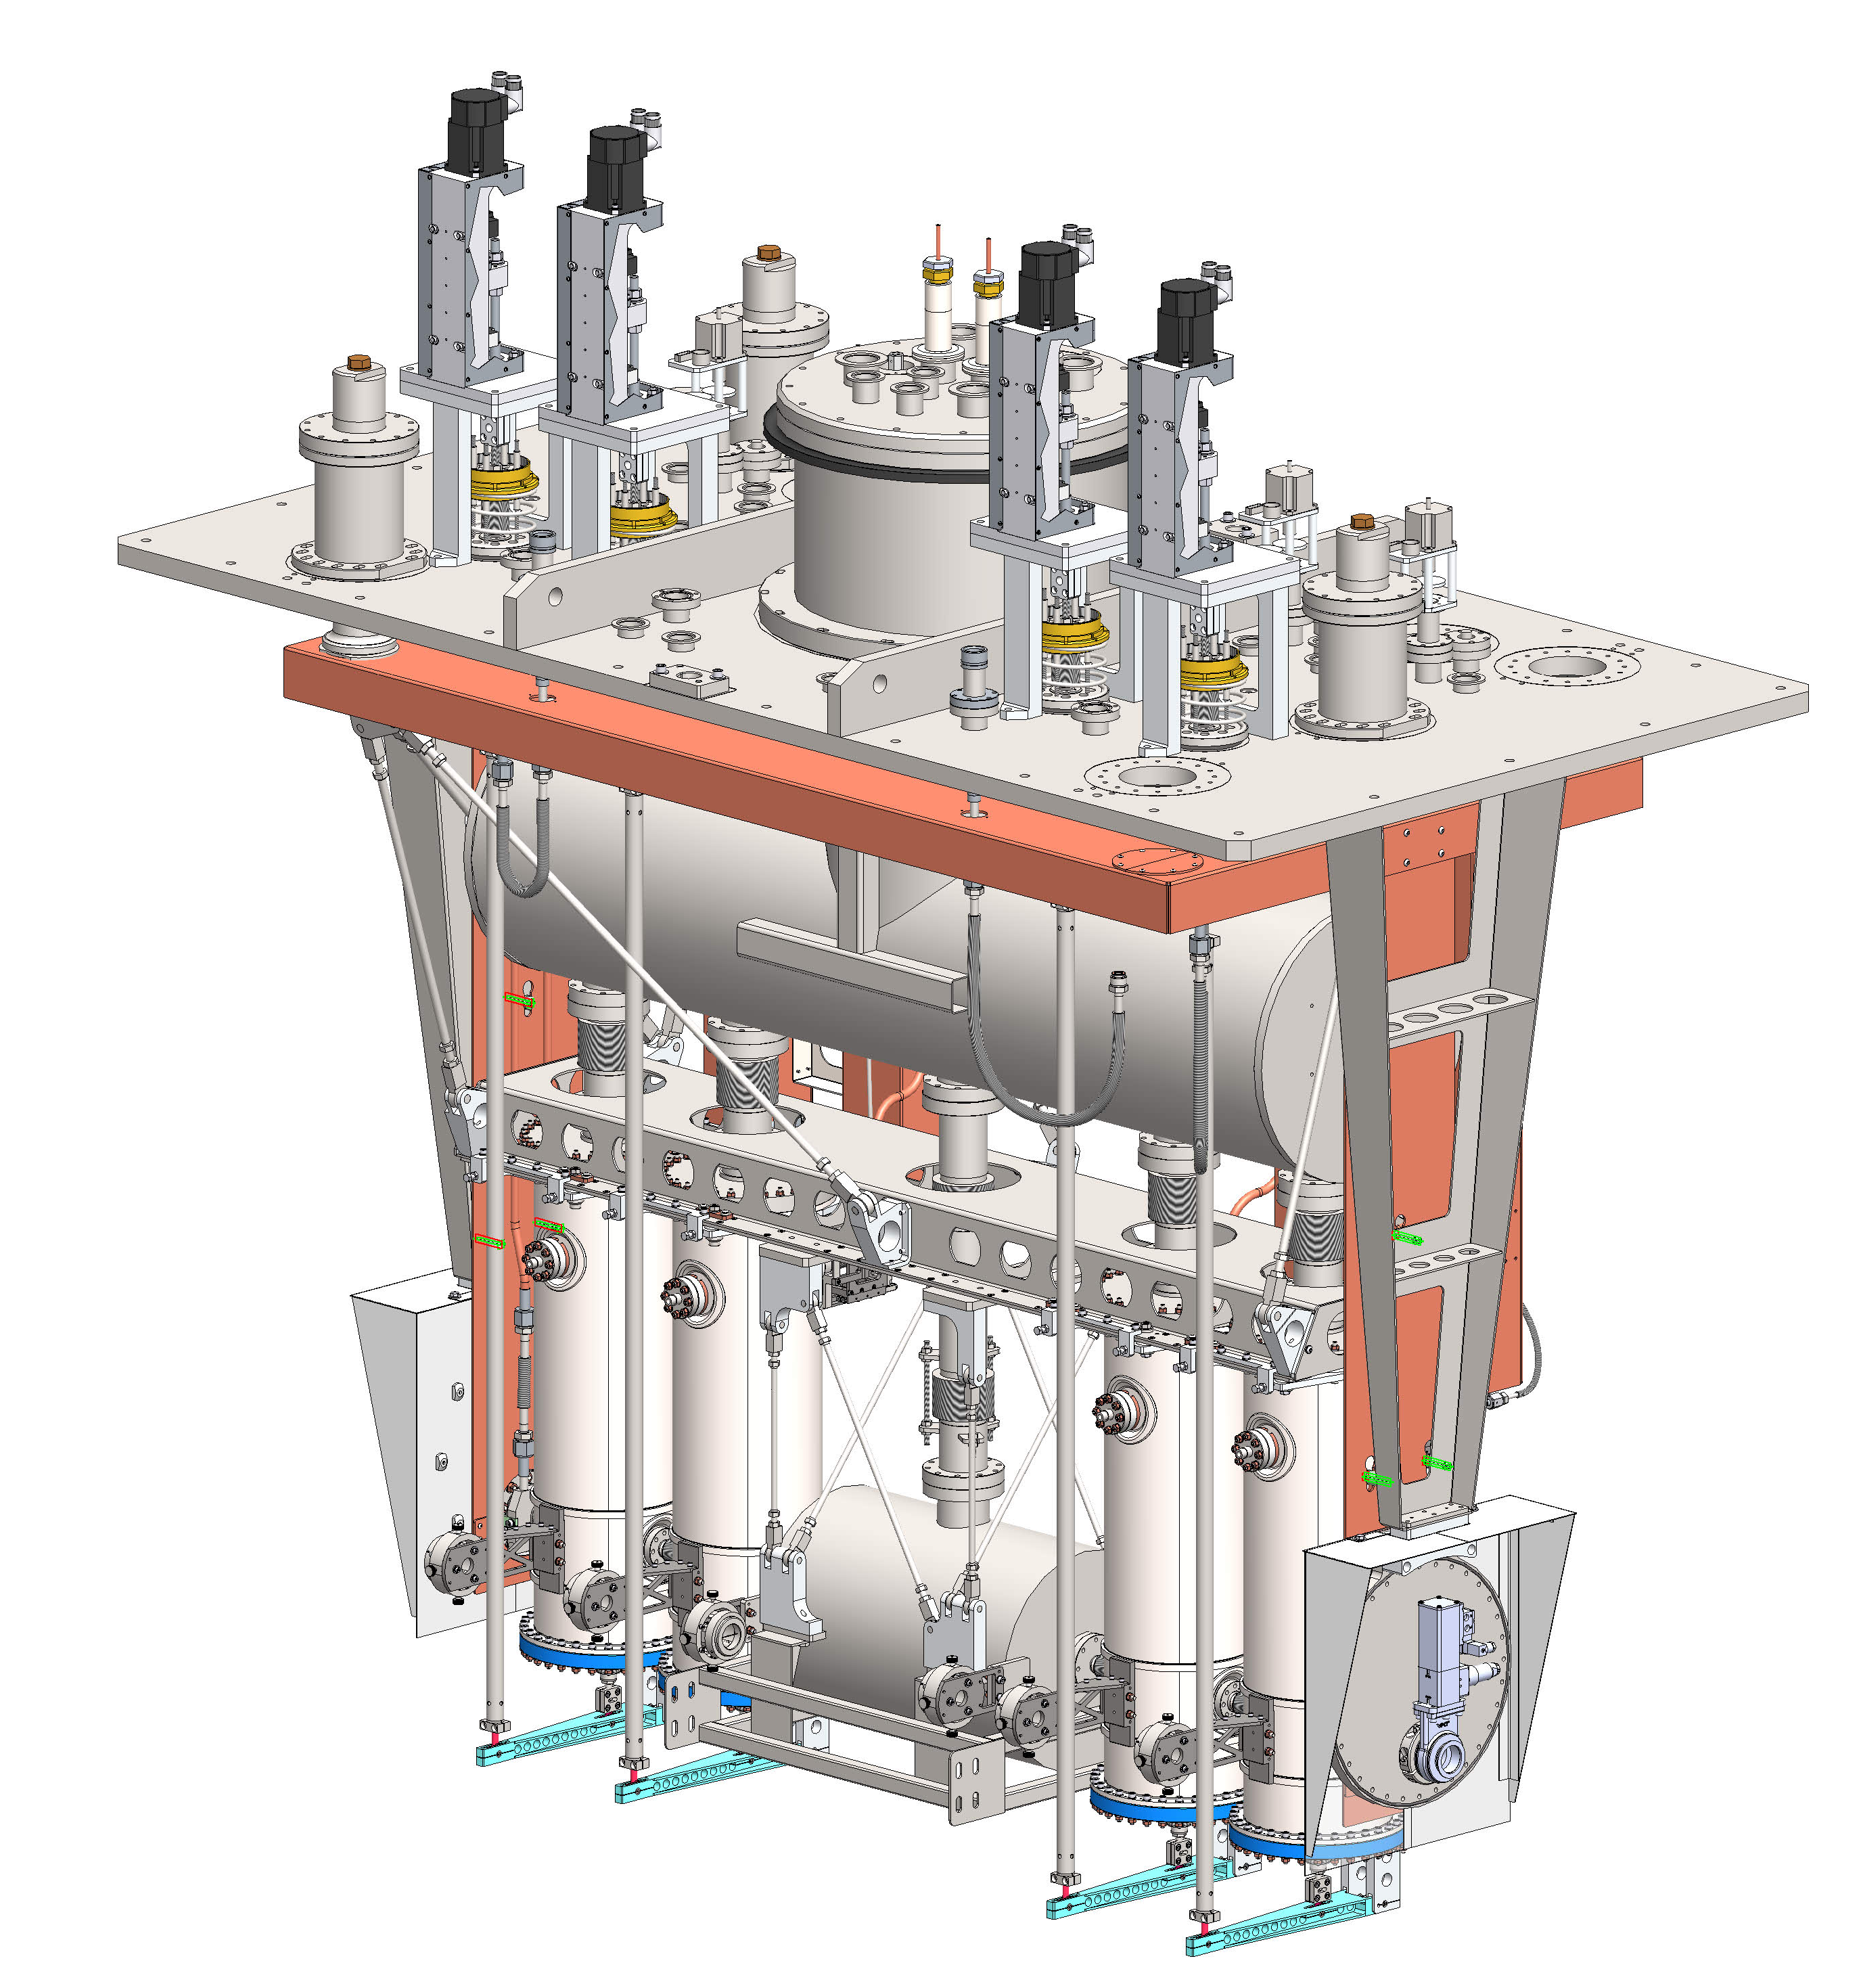
TRIUMF Work for Others ---------VECC (India)
TRIUMF SRF group designed, fabricated and delivered
2018 - A1.3GHz SRF cryomodule for accelerating electrons
2022 - A 110MHz SRF cryomodule for accelerating heavy ions

Slide 9
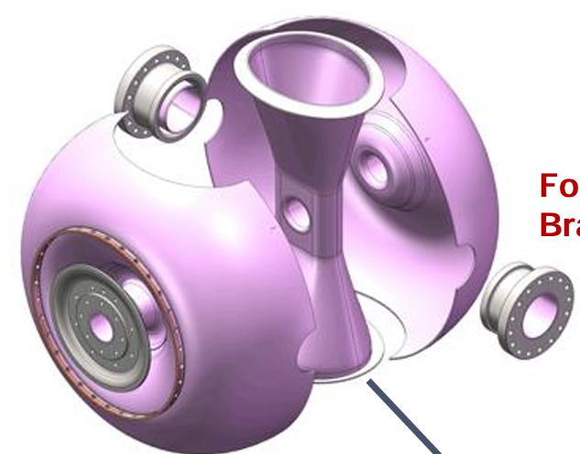
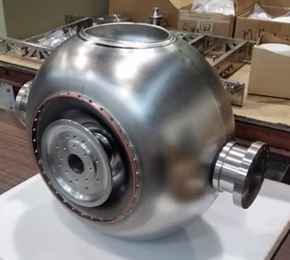
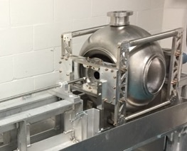
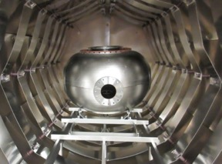
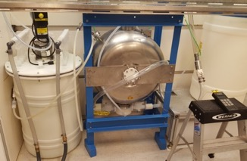
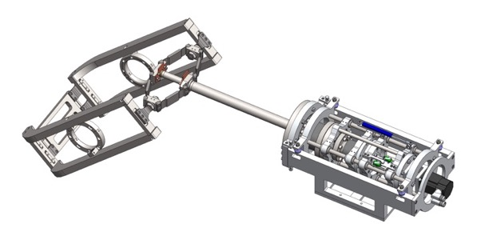
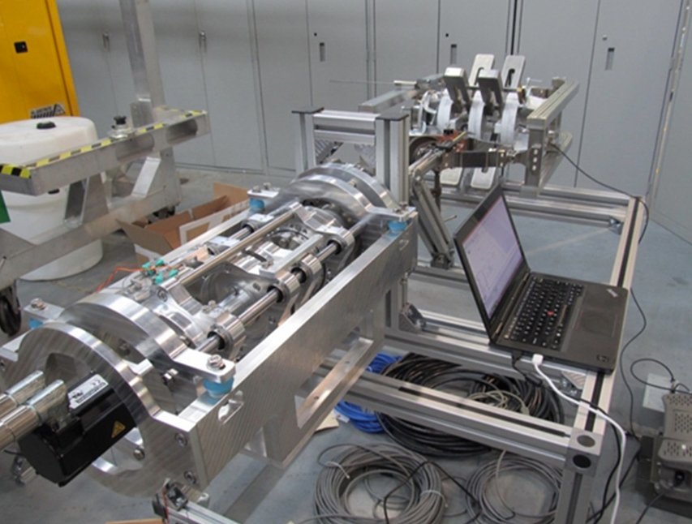
TRIUMF Work for Others ---------RISP (S. Korea)
TRIUMF SRF group designed, fabricated and delivered
two prototype SRF single spoke resonator (SSR) cavities at 325 MH
Prototype rf frequency tuner for SSR cavity

Slide 10
TRIUMF and External Collaboration

Slide 11
Value of external collaborations
The TRIUMF Accelerator Division has a long tradition of international collaboration to provide Canadian contributions to particle physics projects abroad.
Enhance expertise: - Collaborations strengthen and expand core competency and broaden our expertise in accelerator physics and technology.
National resilience: The collaborations draw Canadian industry into world-class projects, building national resilience in cutting edge technologies.
Develop HQP: The collaborations also provide opportunities to students and young researchers enriching knowledge and experience in critical technologies.

Slide 12
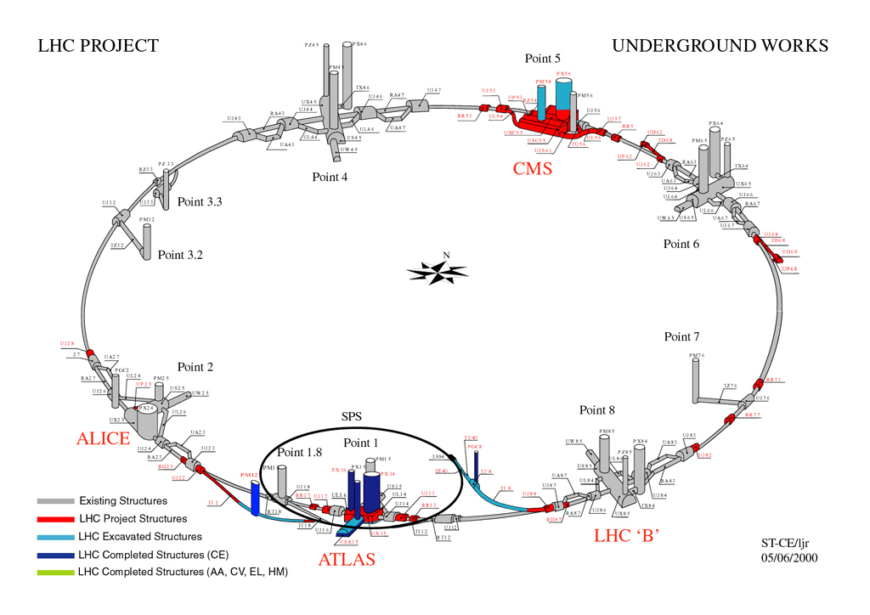
TRIUMFs Contributions to LHC (1995-2005)
1995-2005 - $41.5M
TRIUMF was given the mandate to act as Canada's main connection with CERN and to develop and construct components for the Large Hadron Collider.
Contributions included beam physics support and hardware including magnets, beam instrumentation, rf systems, kickers
>80% Canadian industry involvement
8-10 FTEs from TRIUMF per year

Slide 13
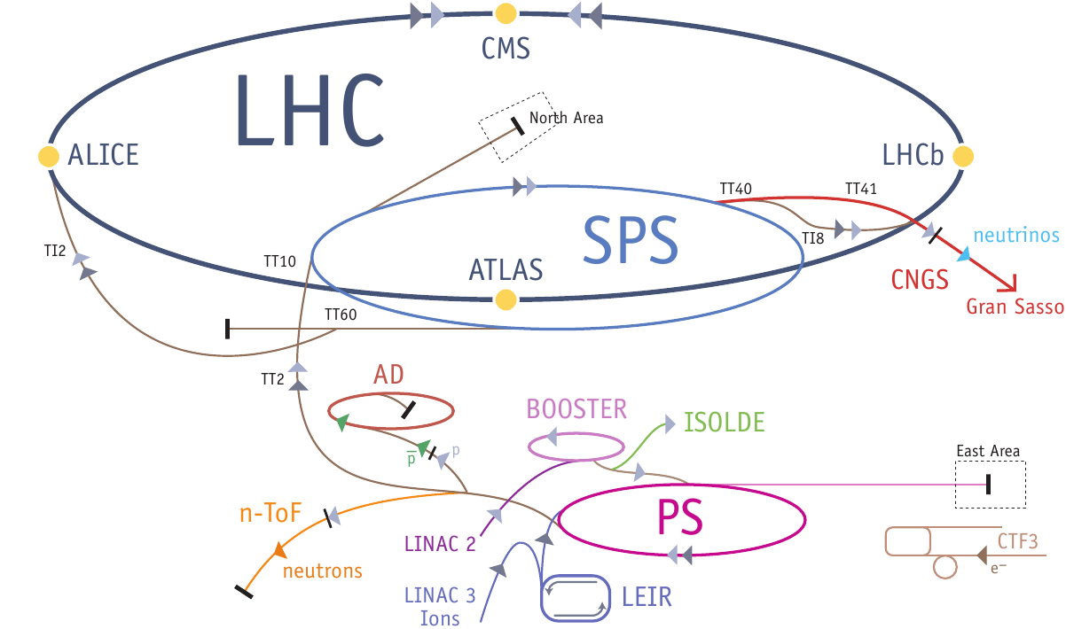
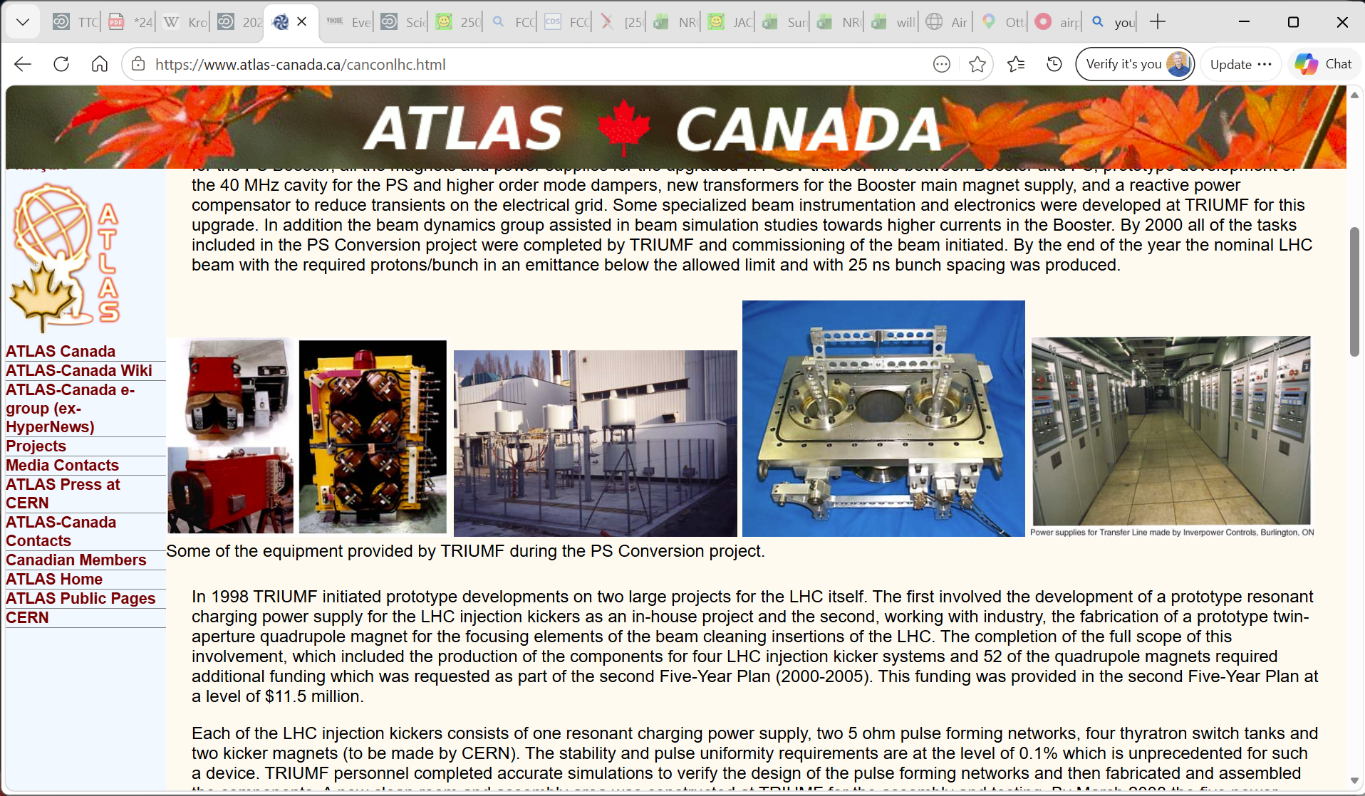
TRIUMFs Contributions to LHC – Phase 1 (1995-2000)
1995-2000 – Phase I - $30M – Proton synchrotron conversion
upgrades to the injector synchrotrons - double beam brightness, control emittance, and modify bunch spacing for LHC operation.
TRIUMF contributions in beam dynamics, instrumentation, power supplies, magnets and RF.
  four first-harmonic rf cavities for the PS Booster
  development of a 40 MHz cavity for the PS plus higher order mode (HOM) dampers
  magnets and power supplies for the upgraded 1.4 GeV transfer line between Booster and PS
  new transformers for the Booster main magnet supply

Slide 14
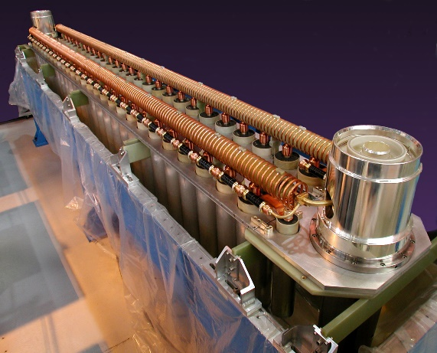
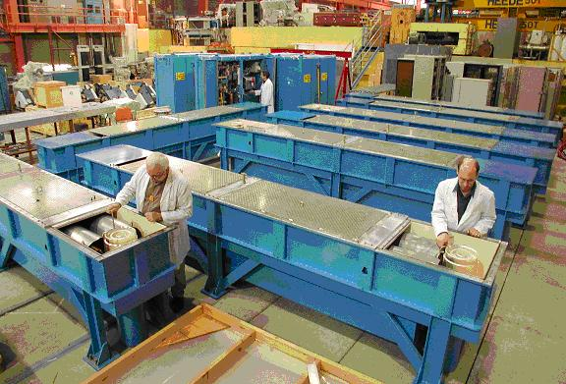
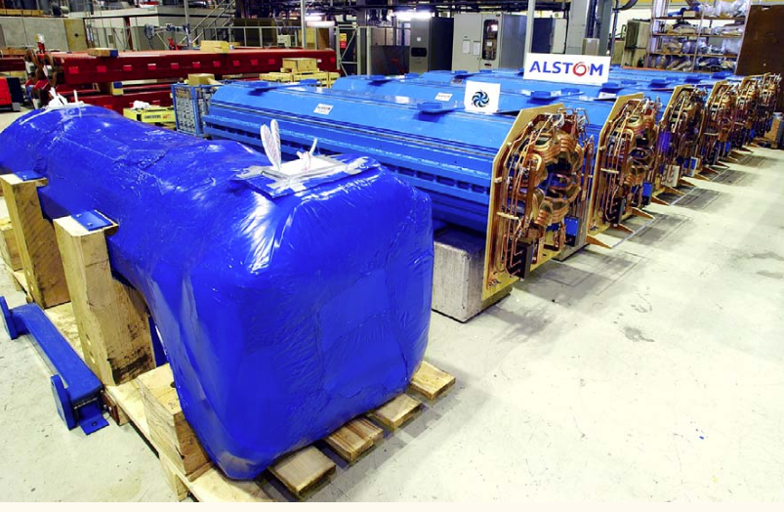
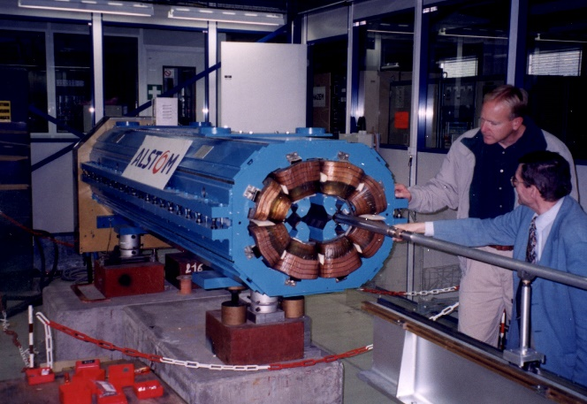
TRIUMFs Contributions to LHC - Phase 2 (2000-2005)
2000-2005 - $11.5M
TRIUMF - production of the components for four LHC injection kicker systems
  Pulse forming networks, power supplies, thyratron switches and kicker magnets.
  A new clean room and assembly area was constructed at TRIUMF for production and testing
ALSTOM (Quebec) - Production of 52 twin aperture quadrupole magnets in Canadian industry
PFNs for Kickers
Twin-Aperture Quads

Slide 15
TRIUMF / CERN beam physics towards LHC
TRIUMF has a long-standing collaboration with CERN on beam physics.
The beam dynamics group assisted in beam simulation studies towards higher currents in the Booster.
  specification of multi-stage collimation system and optics design
LHC beam-beam simulations:
  Simulating beam cleaning efficiency of the collimation system, halo dynamics, and multi-turn losses
  full 3D beam-beam solutions including longitudinal variation of beam sizes and finite crossing angle

Slide 16
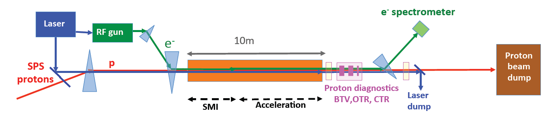
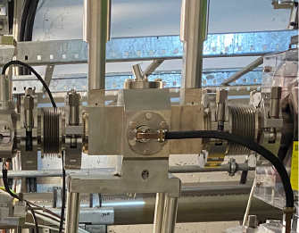
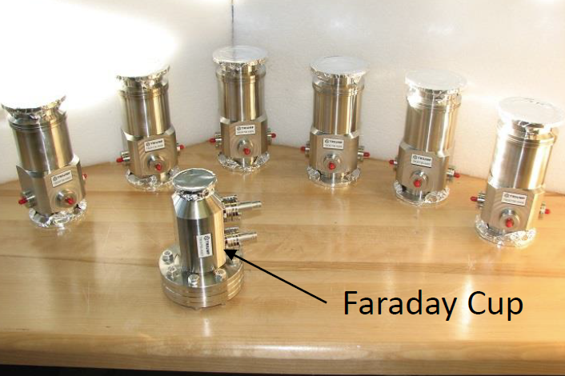
TRIUMF @ AWAKE at CERN
TRIUMF was a collaboration
partner in the Advanced
Wakefield Experiment
(AWAKE) at CERN
R&D experiment at CERN towards developing accelerator technologies for future accelerators → Exploits acceleration by plasma waves driven by a high energy proton beam
400 GeV protons from the CERN Super Proton Synchrotron (SPS) → 10 m long Rubidium plasma channel (plasma generated by the laser)
  electrons accelerated from 20MeV to 2 GeV – 200MV/m
TRIUMF provided beam diagnostics
for the electron beams
(beam position and current)
Beam position monitor
Faraday cups

Slide 17
Hi-Lumi @ CERN

Slide 18
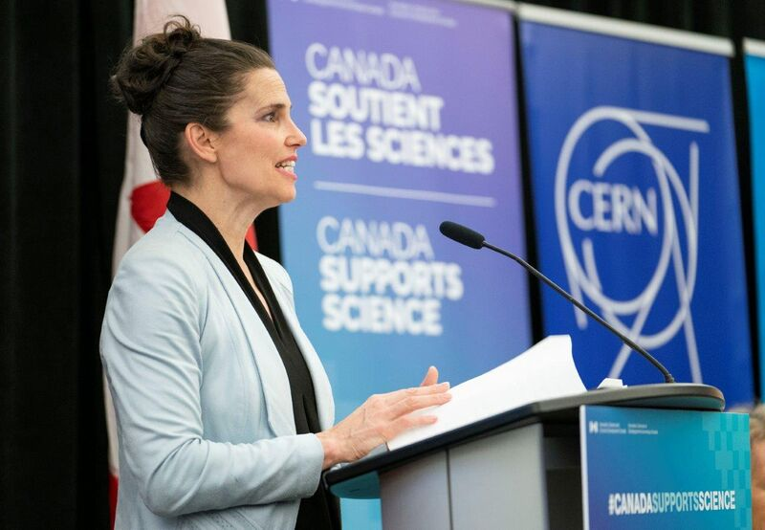
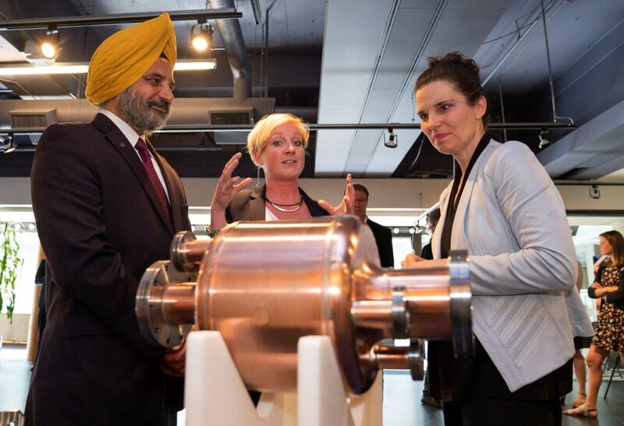



June 25, 2018
“Great science knows no borders.” Minister Kirsty Duncan
Canadian Minister of Science and Sport Kirsty Duncan announces 10M$ support for TRIUMF to build 5 Hi Lumi LHC RFD Crab Cavity Cryomodules
Working with the Canadian research community and industry, TRIUMF will lead the production of the cryomodules with a $2 million in-kind contribution for a total project value of $12 million.

Slide 19

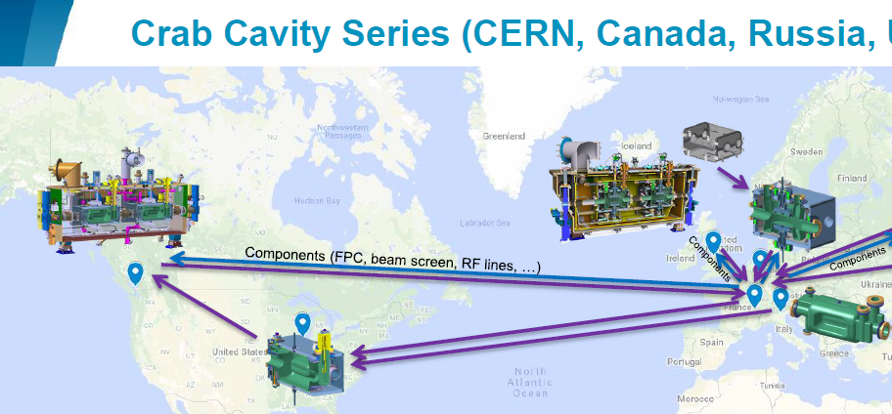

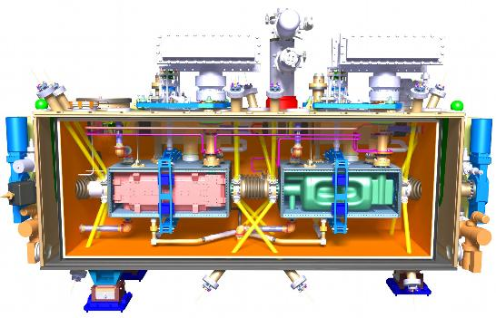
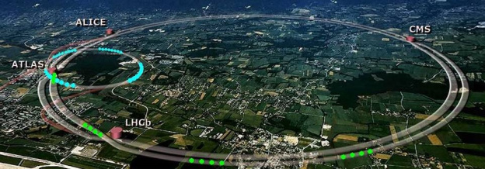
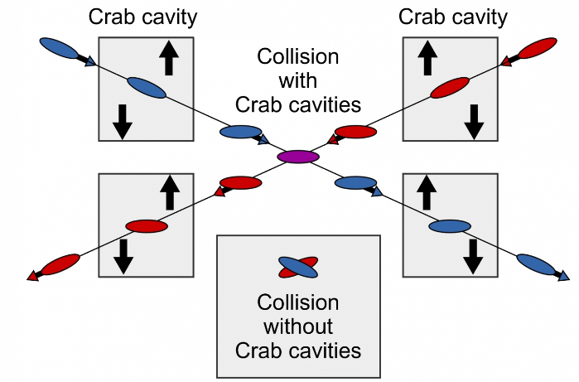
TRIUMF is part of global collaboration (CERN, US, UK) that will deliver 5 RFD Crab Cavity modules as a Canadian contribution to HL-LHC

Slide 20
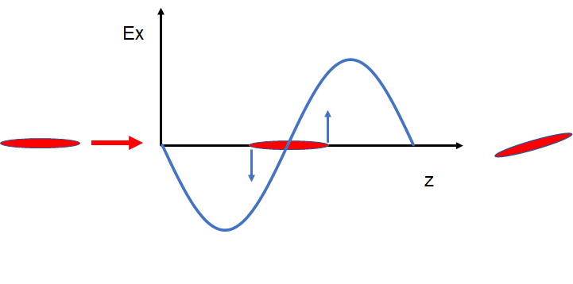
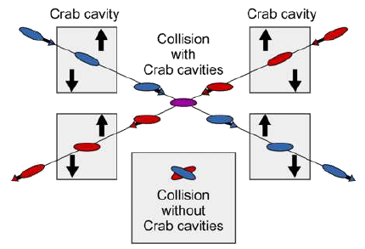
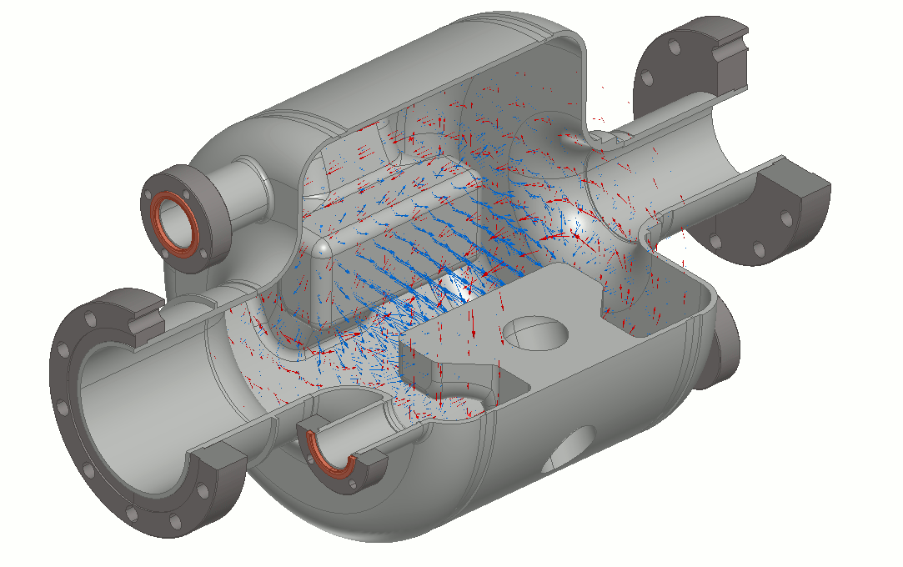
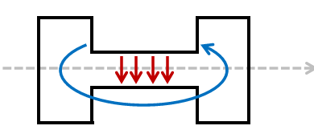
What is a crab cavity?
A crab cavity is designed to produce a deflecting (rather than accelerating) electro-magnetic rf field.
A charged particle bunch passing through the cavity at the zero-crossing will experience a transverse skewing (crabbing) so the bunch is rotated to be at an angle with respect to the beam path
This skewing compensates for the crossing angle at the collision point and increases the probability of collision (luminosity)

Slide 21
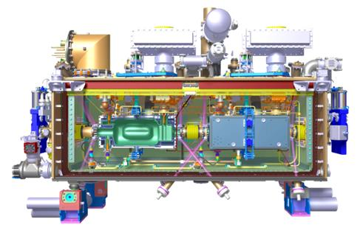
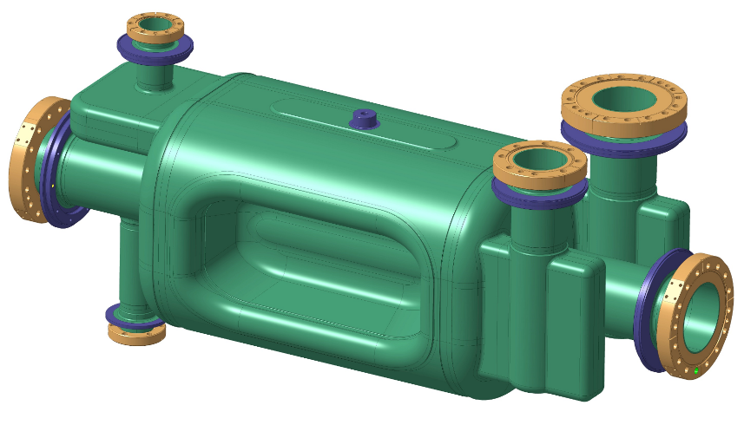
TRIUMF @ HL-LHC
TRIUMF will receive 10 RF Dipole crab cavity resonators from US-Accelerator Upgrade Project (AUP)
Cavities will be re-qualified (cold tested in a dewar) and assembled into five cryomodules.
TRIUMF to qualify the cryomodules through testing at TRIUMF before packaging and shipping to CERN
RF-dipole crab cavity

Slide 22
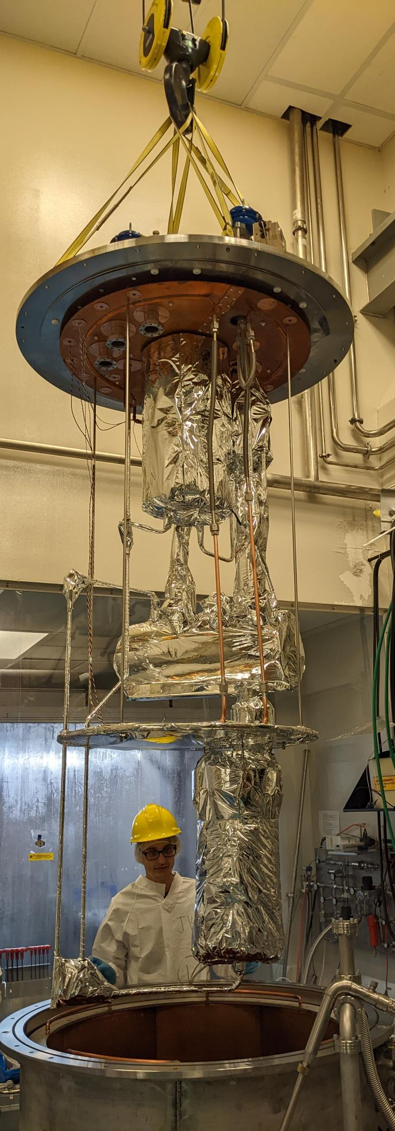
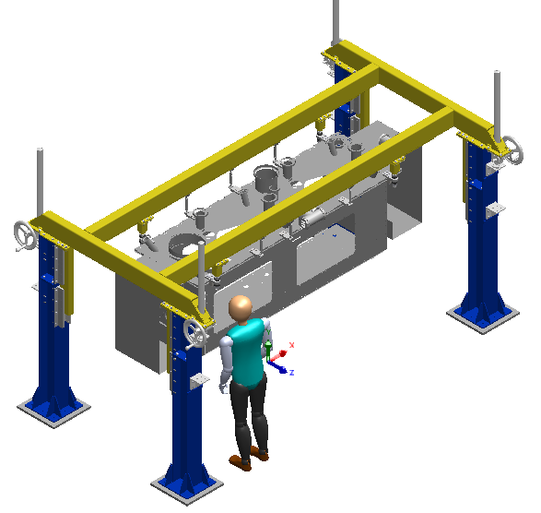





Infrastructure at TRIUMF
Major tooling and infrastructure including new clean room and cavity test cryostat are in hand.
Test cryostat
Top assembly frame
New SRF clean room
String assembly cart

Slide 23





Status
Mock string assembly in progress in the clean room
Vacuum chamber and major components are in hand

Slide 24


First cavity received from US Collaboration
First cavity received and tested at TRIUMF - Meets rf specification
2nd cavity expected in Aug. 2026 and First string assembly by end of 2026
2K curve
10W power & Spec.

Slide 25




TRIUMF @ Hi-Lumi - Beam-Beam Long-Range compensation
Beam-beam interactions in the LHC near interaction regions can degrade beam quality leading to beam loss, loss of luminosity and loss of dynamic aperture
→ TRIUMF beam physics is contributing key insight into this problem
Wires can be added at strategic location in LHC to reduce beam-beam effects
TRIUMF has interest in supplying hardware
for the wire compensation
P. Bélanger
IPAC’ 24 paper (Belanger et al) documenting the improved simulation model that predicts LHC losses due to beam beam effects
Topological formulation of beam dynamics : a study of quasiperiodic motion in Hamiltonian systems – P. Belanger – UBC PhD Thesis

Slide 26


Electron Ion Collider
The EIC at Brookhaven will be the next international discovery machine.
TRIUMF is working with EIC-Canada on a CFI project to deliver in-kind contributions.
TRIUMF’s SRF group has started work on the design of the 394 MHz crab cavity – similar size to HL-LHC 400 MHz crab cavity
394 MHz RF Dipole Cavity

Slide 27
Future: EIC CRAB Cavities
The performance of the crab cavities is critical to the success of EIC – they increase luminosity by a factor of 10
The EIC requires crab cavities on both the hadron storage ring (HSR) and the electron storage ring (ESR)
HSR – long bunch, high rigidity
  requires eight 197MHz crab cavities and four 394MHz cavities to linearize the deflection
ESR – short bunch, low rigidity
  requires two 394 MHz cavities
Our proposal keys on the 394 MHz cavities as the Canadian contribution
 | Voltage/cavity Vt (MV) |  | No. of cavities
System | HSR | ESR | HSR | ESR
197 MHz | 8.5 | - | 8 | -
394 MHz | 2.4 | 2.9 | 4 | 2
25 mrad
394MHz
197MHz

Slide 28


Beyond EIC – FCC-ee at CERN?
Realization of the FCC will require a significant international participation.
FCC-ee has huge synchrotron radiation losses, requiring large installed rf voltage. Development is required for
More efficient acceleration systems
SRF materials, more efficient klystrons
Canada, through TRIUMF, is well poised to make significant in-kind contributions in
Beam physics
SRF – cavity/material development
RF Systems and power supplies
Beam instrumentation
Kickers
Superconducting magnets

Slide 29




Example: FCC-ee SRF Cavities and Cryomodules
Conceptual & preliminary designs
Z, W, H
ttb, booster
X 856
X 264
400 MHz
Niobium thin film on Copper
Operation at 4.5 Kelvin
E_{acc} = 13.2 MV/m
Quality factor Q₀ = 3.3 x 10⁹
800 MHz
Bulk Niobium (Nb₃Sn possibly)
Operation at 2 Kelvin
E_{acc} = 24.5 MV/m
Quality factor Q₀ = 3.8 x 10¹⁰
LEP
Opportunity for collaboration and contribution
A key will be high performance – new treatments and new materials – higher Tc
1.5 m long
1.5 m long

Slide 30

Summary
Summary
  Accelerator science at TRIUMF provides Canada with a world-class platform in beam physics and instrumentation, secondary particle production, and SRF technologies.
  TRIUMF has a long tradition of international collaboration in support of Canadian contributions to large particle physics projects.
Collaborations contribute to Canadian and International projects with critical components and expertise while maintaining and developing national resilience in cutting edge technologies

Slide 31
Thank you, Merci

