Slide 1



Study of Li-ion diffusion in Li-Mg, Li-Zn, and Li-Sn alloys using transition path sampling in MLACS
Hoan Tran-Van¹
Co-author
Prof. Gabriel Antonius¹
Prof. François Allard^{1,2}
¹Département de Chimie, Biochimie et Physique, Institut de Recherche sur l’Hydrogène, Université du Québec à Trois-Rivières, Trois-Rivières, Québec, Canada
²INRS-UQTR Joint Research Unit in Materials and Technologies for Energy Transition
Ottawa, 2026/6
1

Slide 2
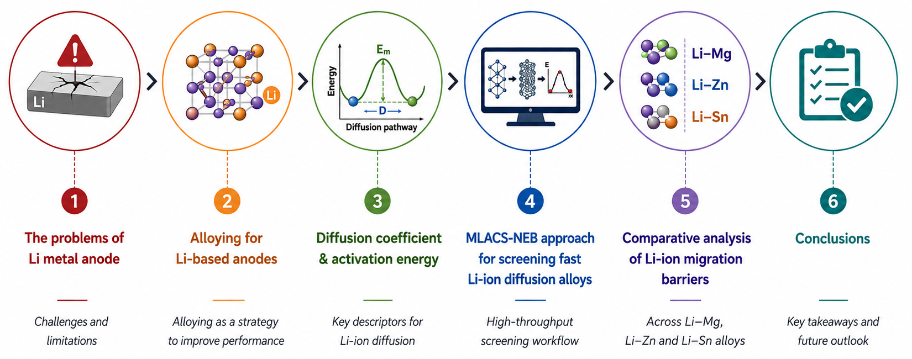
Outline
Hoan Tran-Van
Study of Li ion diffusion in Li-Mg, Li-Zn, and Li-Sn alloys using transition path sampling in MLACS
2

Slide 3

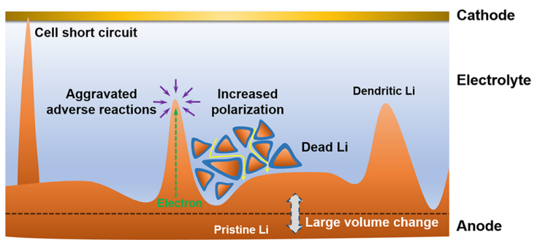
1. The problems of Li metal anode
All-solid-state Li-ion batteries
  High energy density, safety, recyclability
  EV demand: > 300 km + fast charging [1]
Challenges of Li metal anode
  Dendrite growth → short circuit, safety risk
  Dead Li and void formation → capacity loss
  Unstable SEI → side reactions, low efficiency
  Volume change → interface degradation
Why Li metal anode?
  High theoretical capacity: 3860 mAh g⁻¹
  Lowest electrochemical potential: −3.04 V vs SHE
  Lowest density: 0.534 g cm⁻³
Critical limitations of Li metal anodes [2]
EV - Electric Vehicles
SHE - Standard Hydrogen Electrode
SEI – Solid electrolyte interphase
Li diffusion is a critical factor influencing the stabilization
[1] M.M. Islam et al., Phys. Chem. Chem. Phys., 17, 3383-3393 (2015)
[2] X.B. Cheng et al., Chem. Rev. 117 (2017) 10403–10473
Hoan Tran-Van
Study of Li ion diffusion in Li-Mg, Li-Zn, and Li-Sn alloys using transition path sampling in MLACS
3
Notes:
+ The development of high energy density batteries is becoming increasingly important, particularly for applications such as electric vehicles, where continuous power supply over long driving ranges is required. In this context, safety, energy storage capacity, and recyclability are key factors that must be improved.
+ All-solid-state lithium-ion batteries (ASSLBs) have emerged as a promising solution to meet these requirements. Among various anode candidates, lithium metal exhibits the highest theoretical capacity, which is approximately ten times greater than that of conventional graphite anodes. However, the practical application of lithium metal anodes remains challenging due to their poor stability. Issues such as dendrite growth, unstable solid electrolyte interphase (SEI), dead lithium formation, void generation, and significant volume changes severely limit their performance and safety
+ Therefore, stabilizing the anode is crucial for improving the performance of solid-state lithium batteries. In this regard, lithium diffusion plays a critical role, as it strongly influences the structural stability and electrochemical behavior of the anode.

Slide 4
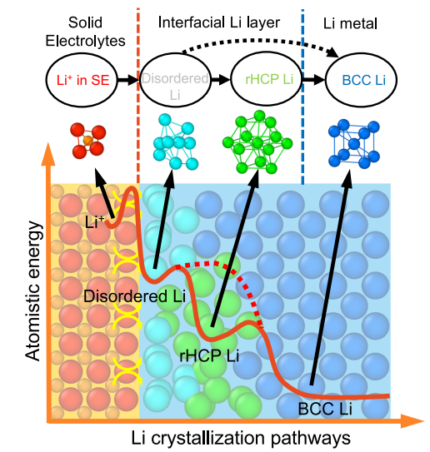
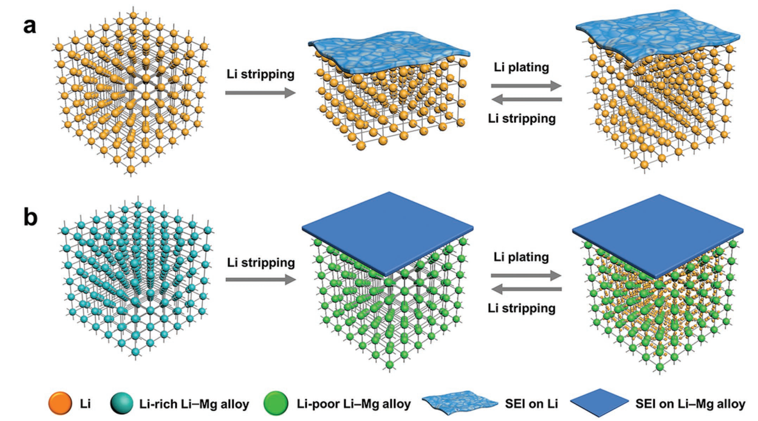
2. Alloying for Li-based anodes
Mg can form a conductive framework
A diagram illustrating the multi-stage process of Li crystallization [3]
(a) Li and (b) Li–Mg anode structures, bulk & surface, during stripping/plating [4]
[3] M. Yang et al., Nat. Commun., 14, 2986 (2023)
[4] L. L. Kong et al., Adv Funct Mater., 29(13), 1808756 (2019)
Predict how alloying effectively changes diffusion and stability?
Hoan Tran-Van
Atomistic Investigation of Li-Ion Diffusion in Lithium Alloy Anode Materials: Li-Mg alloys
4
Notes:
Interface instability causes problems with lithium metal batteries such as dendrite, void, dead Li, etc.
Li alloying is a useful solution to increase interface stability.

Slide 5
2. Alloying for Li-based anodes
Li diffusion coefficients D_{Li}
Li-Mg
Li-Zn
Phase | Li Im-3m | Li-Mg (70-90 at%Li)
D_{Li} (cm² s⁻¹) | 1.6×10⁻¹⁰ [7] | 1.4-2.6×10⁻¹⁰ [7]
Low Li diffusion
Structural integrity
→ uniform Li deposition [4]
Faster Li diffusion than Li
Low capacity [6]
Buffer/protection layer for Li metal → uniform Li deposition [6, 8]
Phase | LiZn Fd-3m | Li₇Sn₃ P2₁/m
D_{Li} (cm² s⁻¹) | 8.8-37×10⁻¹⁰ [5] | 3-5×10⁻⁷ [5]
Li-Sn
Alloy anode
Alloy as a buffer layer
Faster Li diffusion than Li
Volume change [9]
Uniform transportation of the Li ions [9]
Electrolyte
Electrolyte
SEI
SEI
Li-M alloy
Li-M alloy
Li metal
[5] Y. Huang et al., J. Mater. Chem. A, 10, 12350 (2022)
[6] X. Gu et al., Engineering Reports, 2021;3:e12339.
[7] M. Siniscalchi et al., ACS Energy Lett., 7, 3593 (2022)
[8] Q. Chen et al., ACS Appl. Mater. Interfaces, 13, 9985−9993 (2021)
[9] A. Serikkazyyeva et al., J. Alloys Compd., 965, 171381 (2023)
Enhanced Li diffusion can contribute to suppressing void and dendrite formation.
Hoan Tran-Van
Atomistic Investigation of Li-Ion Diffusion in Lithium Alloy Anode Materials: Li-Mg alloys
5
Notes:
Li-Al: excellent mechanical properties, Li–Al alloy shows the highest compressive strength among all
the alloys
Ex

Slide 6
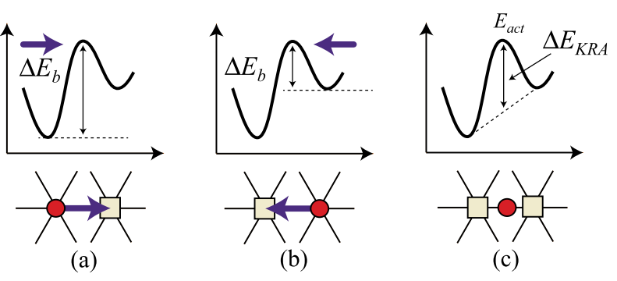
3. Diffusion coefficient & activation energy
The diffusion coefficient:
Kinetically resolved activation (KRA) barrier [10]
The activation energy:
D₀: the pre-exponential factor
E_{m}: the migration energy for hopping
E_{f}^{vac} : the Li vacancy formation energy
E_{a}: the effective activation energy for Li diffusion
Forward hop
Reverse hop
ΔKRA = E_{m}
can be obtained from DFT calculations
can be obtained from NEB method
Focus on migration barrier E_{m}
DFT - Density Functional Theory
NEB – Nudged Elastic Band method
[10] A. Van der Ven et al., Chem. Rev., 120, 14, 6977–7019 (2020)
Hoan Tran-Van
The Li ion diffusion in Li-M alloys for anode application
6

Slide 7
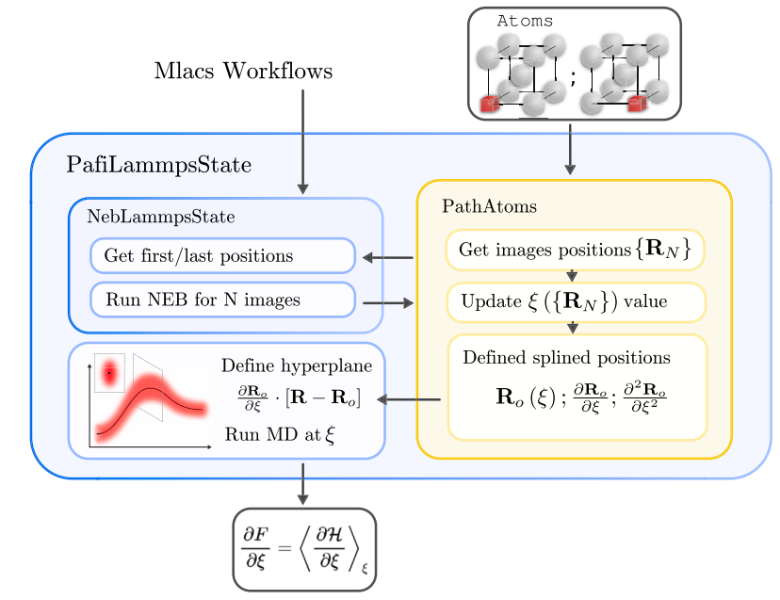
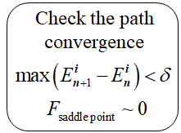
4. MLACS-NEB approach for screening fast Li-ion diffusion alloys
MLIPs address the trade-off issue
DFT-NEB
Higher accuracy
Higher computational costs for large supercell
MD-NEB
Accuracy limited by interatomic potential
Lower computational costs for large supercell
Remove in NEB
MD – Molecular Dynamics method
MLIPs - Machine-learning interatomic potentials
MLACS - Machine Learning Assisted Canonical Sampling
MLACS-NEB workflow [11]
[11] A. Castellano et al., Comput. Phys. Commun., 316,109730 (2025)
Hoan Tran-Van
The Li ion diffusion in Li-M alloys for anode application
7

Slide 8
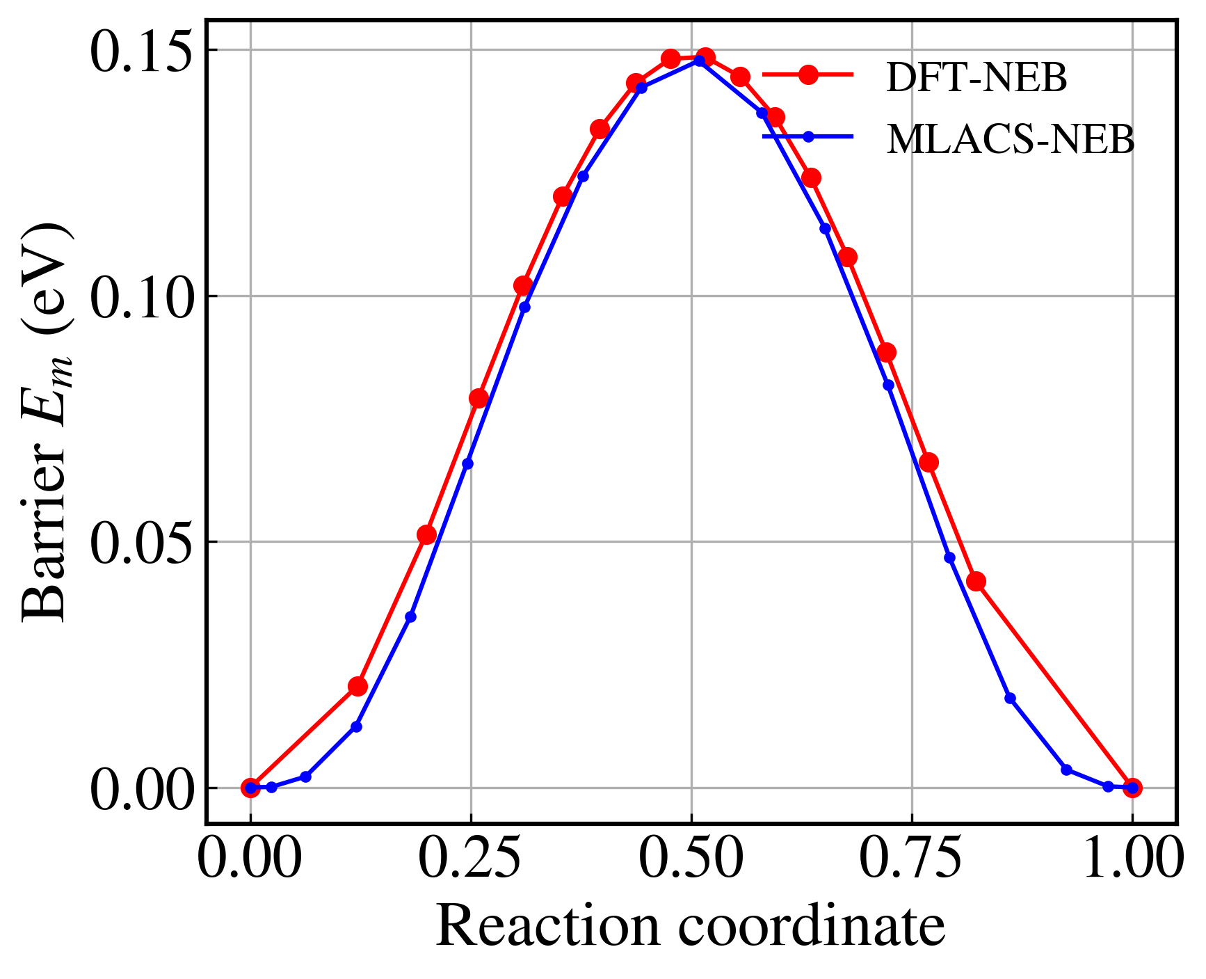
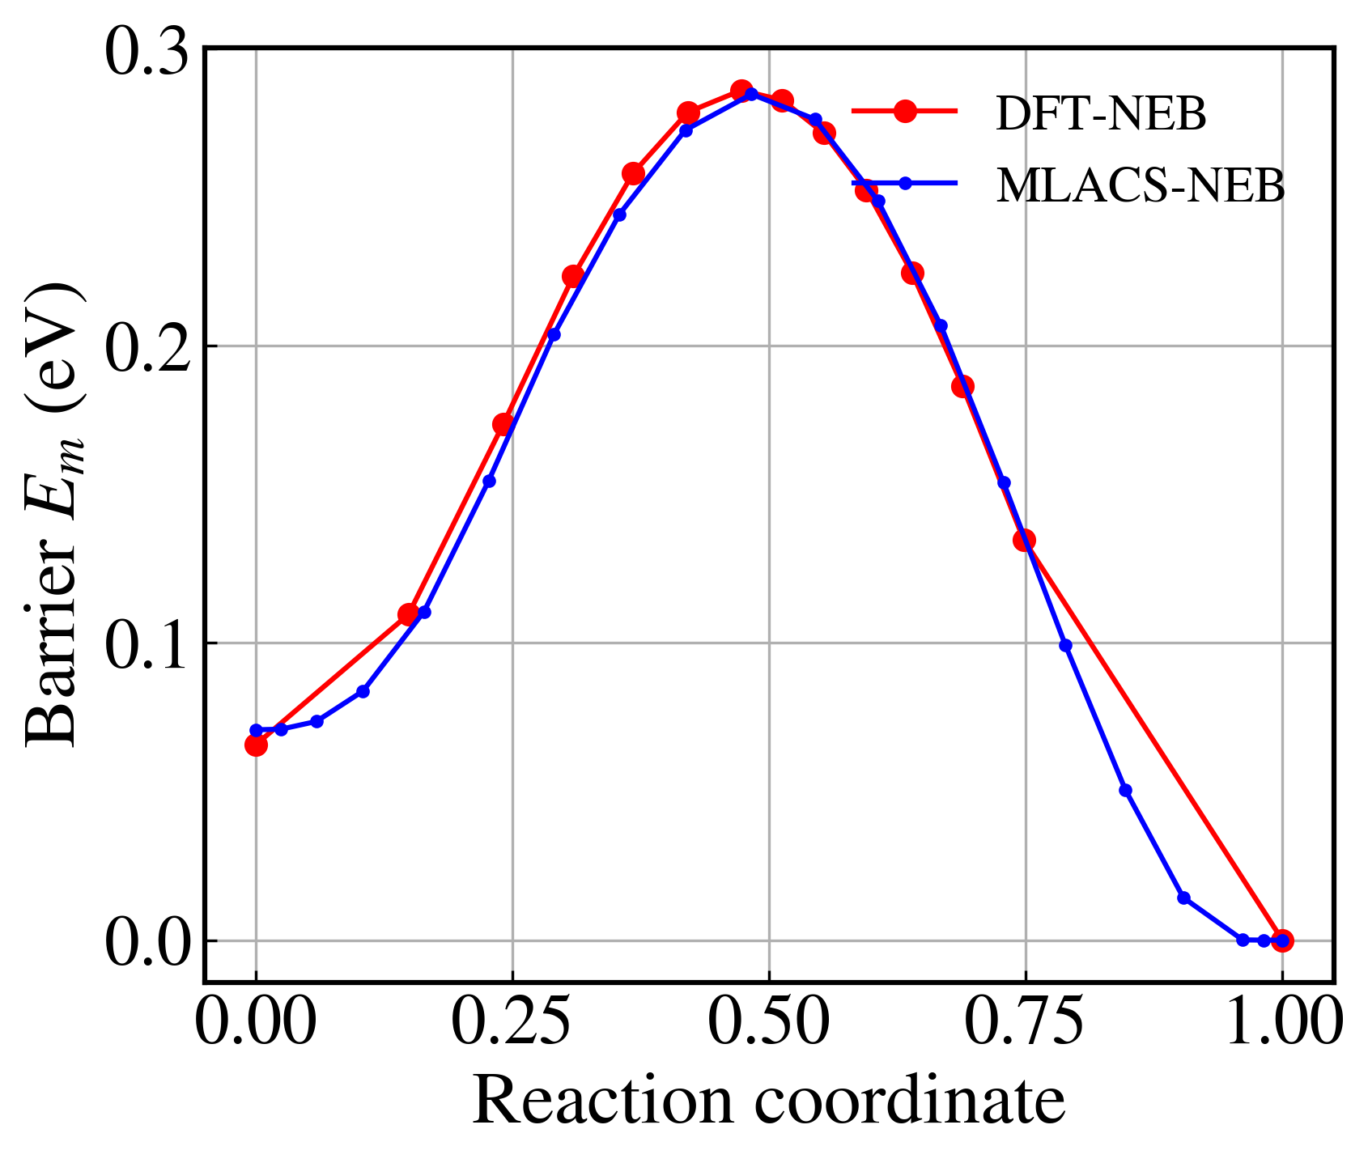
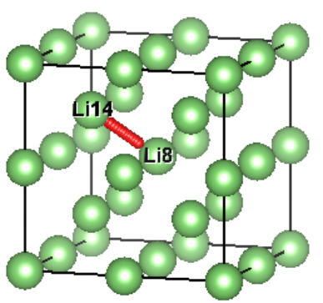
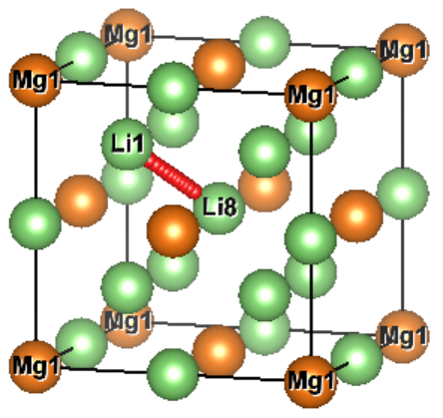
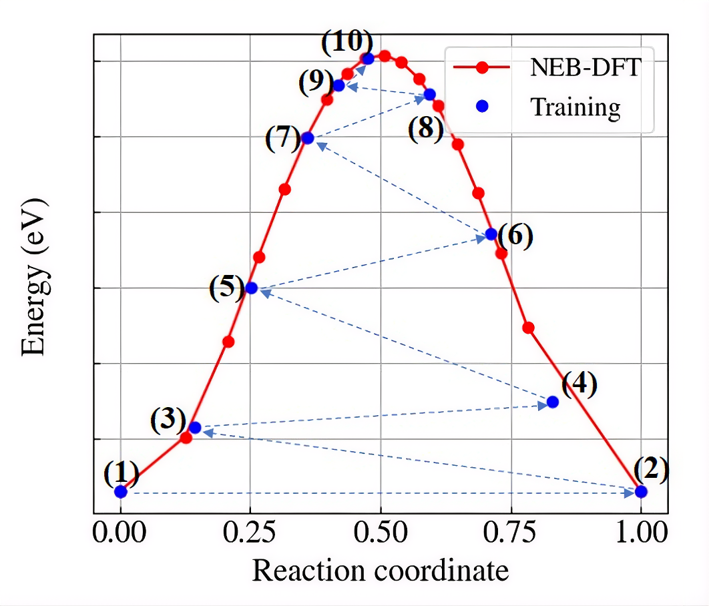
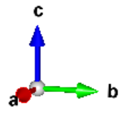
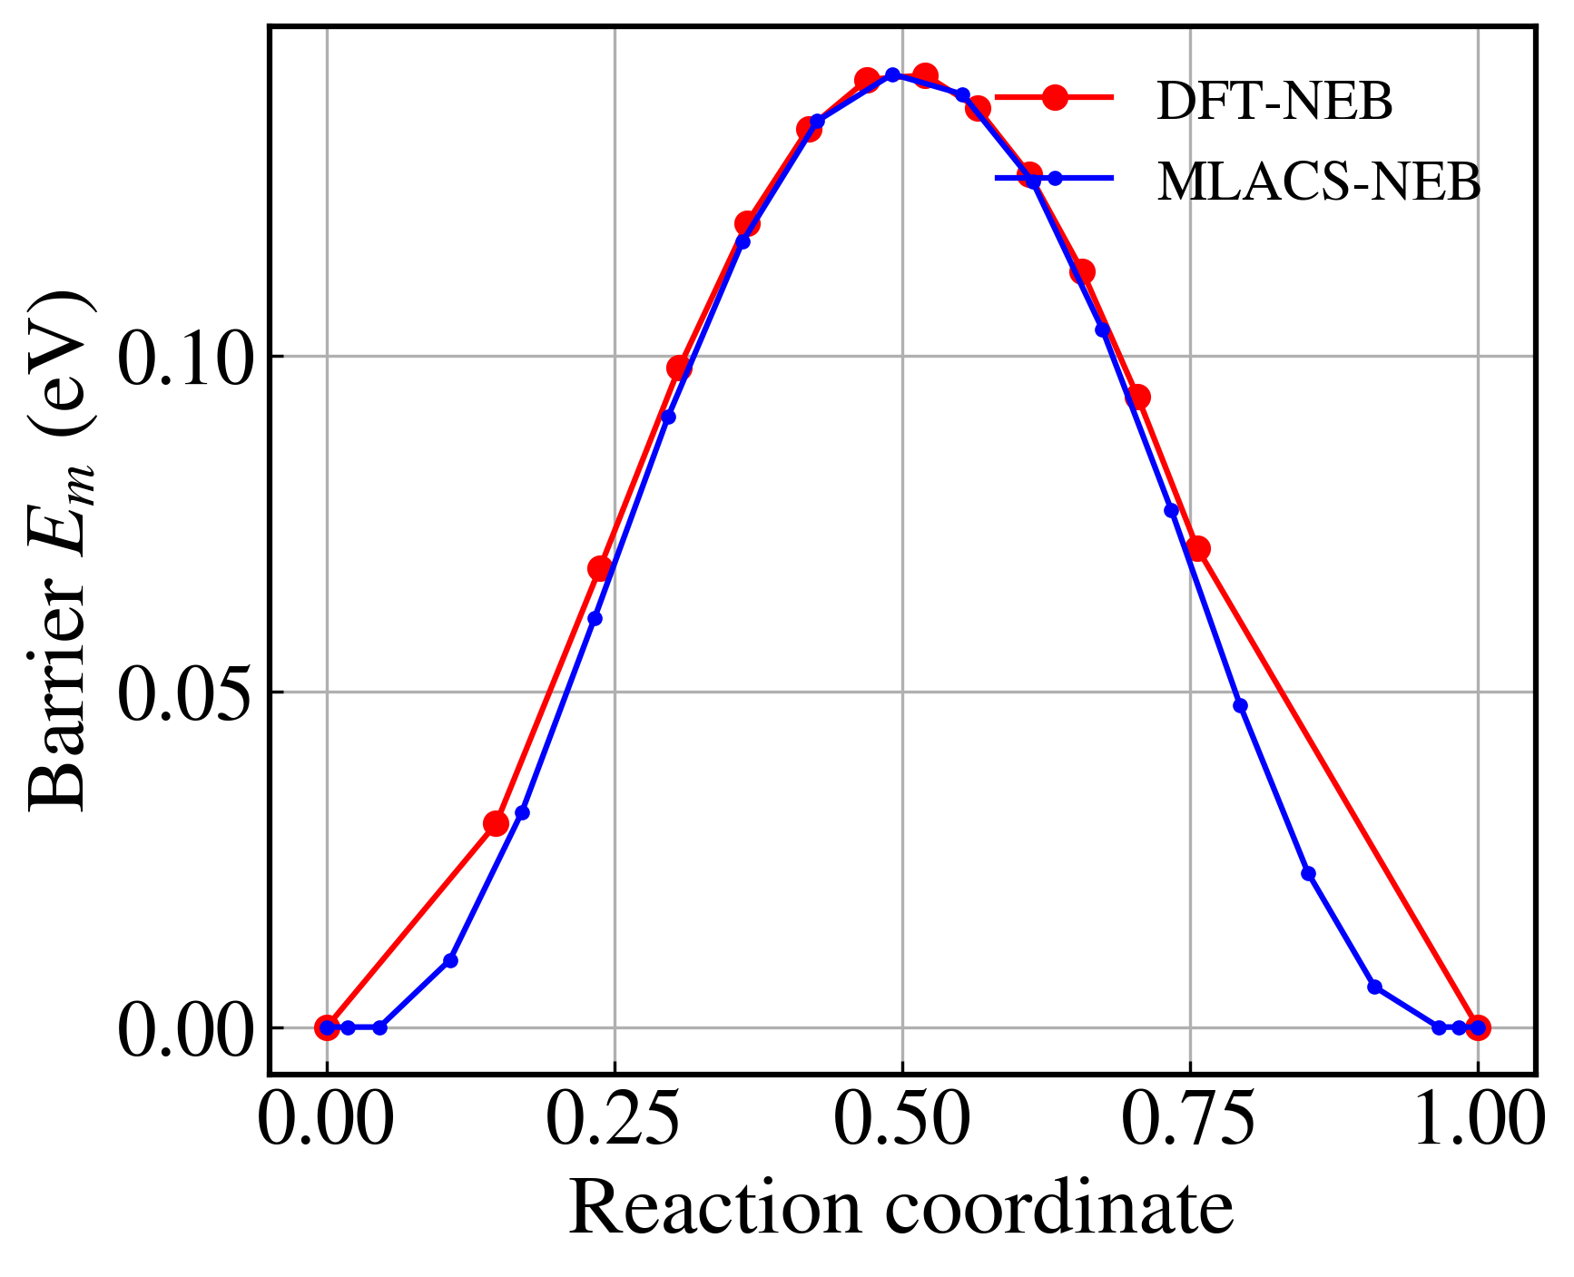
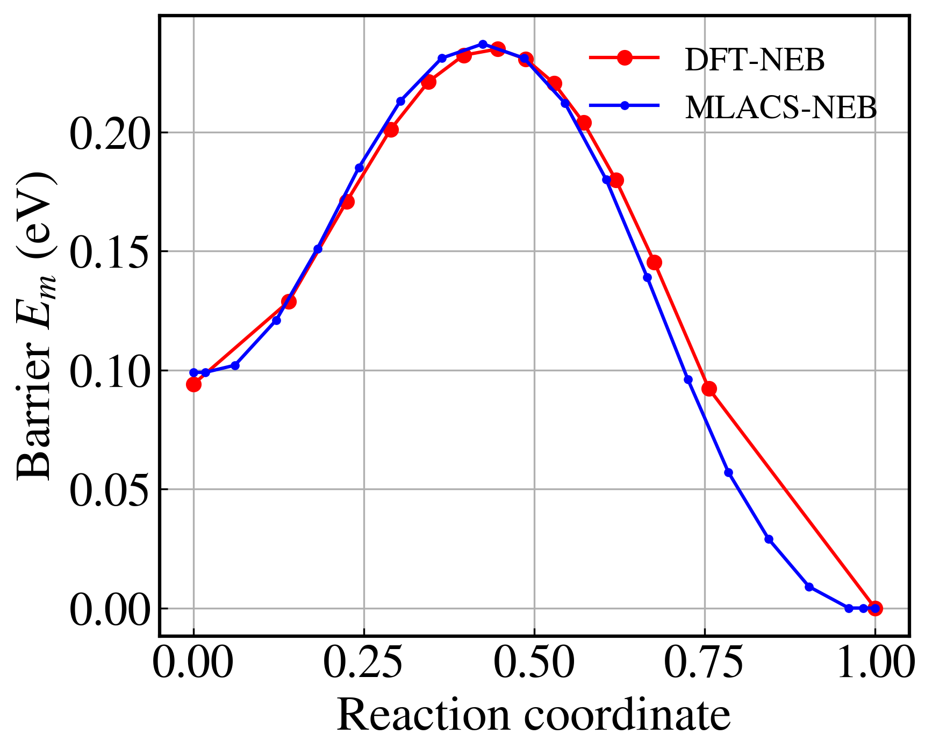
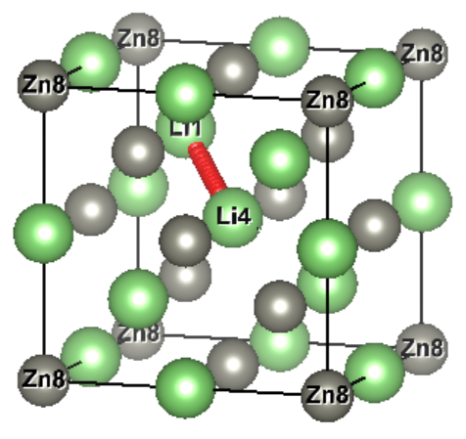
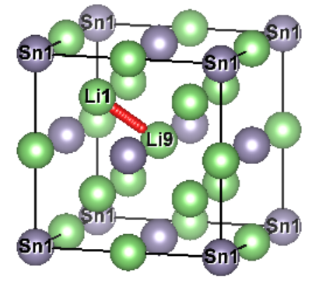
4. MLACS-NEB approach for screening fast Li-ion diffusion alloys
Li, Im-3m, |ΔE_{m}|= 8.17×10⁻⁴ eV
Li₃Mg, Fm-3m, |ΔE_{m}|=1.29×10⁻³ eV
10-30 training configurations
Linear SNAP
10–100× speed-up compared to DFT-NEB
LiZn, Fd-3m, |ΔE_{m}|= 1.34×10⁻⁴ eV
Li₃Sn, Fm-3m, |ΔE_{m}|= 2.14×10⁻³ eV
Sampling process and energy profile of training configurations for MLIP in the MLACS workflow.
Hoan Tran-Van
The Li ion diffusion in Li-M alloys for anode application
8

Slide 9
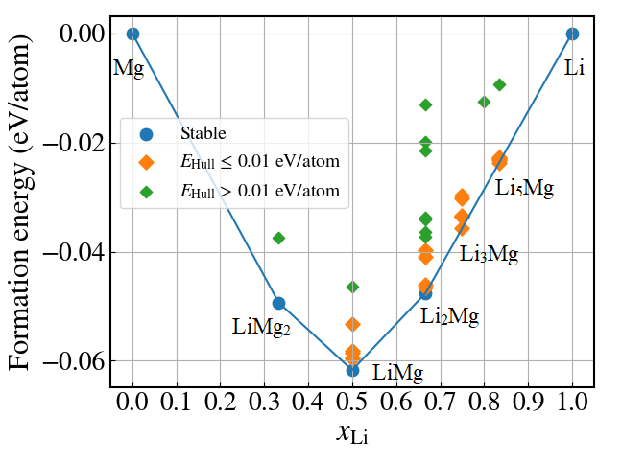
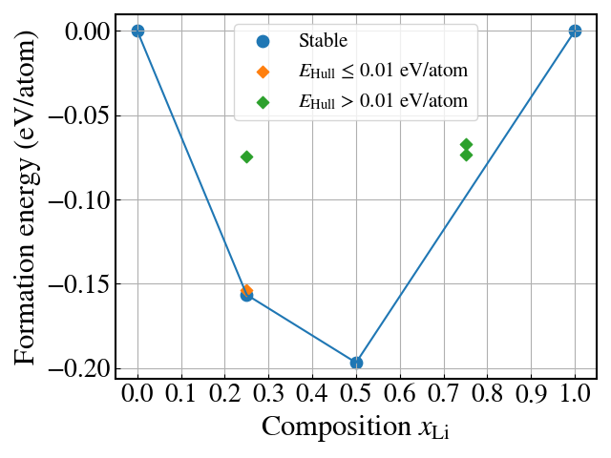
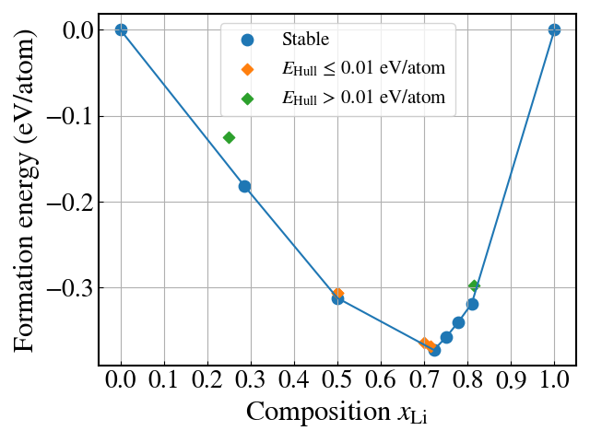
5. Comparative analysis of Li-ion migration barriers
Convex hull and calculated structures
Convex hull of formation energies
Zn
Li
Sn
Li
LiSn₃
LiZn₃
LiSn
Li₁₇Sn₄
Li₇Sn₂
LiZn
Li₁₃Sn₅
Li₃Sn
LiMg (x_{Li} = 0.5): 6 polymorphs
Li₂Mg (x_{Li} = 0.667): 5 polymorphs
Li₃Mg (x_{Li} = 075) .: 6 polymorphs
Li₅Mg (x_{Li} = 0.833): 5 polymorphs
LiZn (x_{Li} = 0.5): 1 polymorphs
Li₇Sn₂ (x_{Li} = 0.778): 1 polymorphs
Li₃Sn (x_{Li} = 0.75): 1 polymorphs
Li₅Sn₂ (x_{Li} = 0.714): 1 polymorphs
LiSn (x_{Li} = 0.5): 2 polymorphs
Near-degenerate structures
→ Boltzmann-weighted average
Hoan Tran-Van
The Li ion diffusion in Li-M alloys for anode application
9

Slide 10


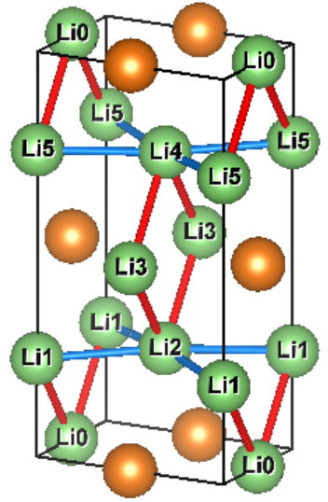
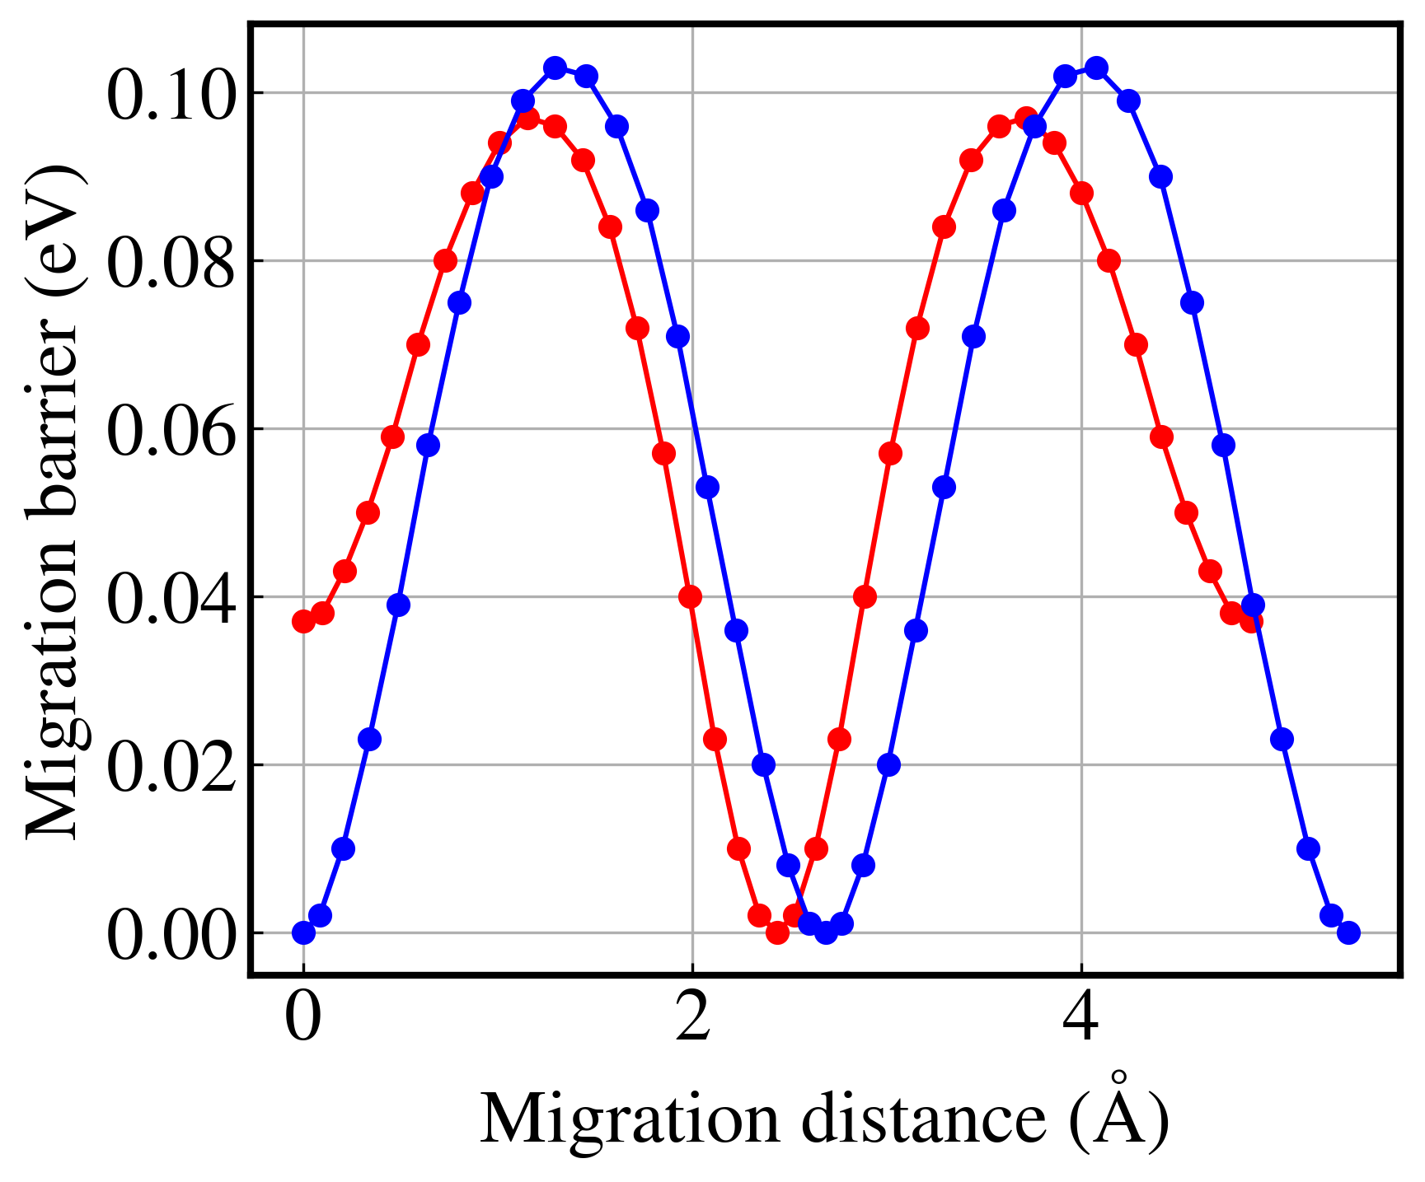
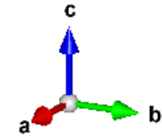
5. Comparative analysis of Li-ion migration barriers
The Li effective migration barrier
Path (1)
Diffusion pathway selection
Path (2)
Li transport prefers lowest-energy migration path
d1 = 2.910 Å
d2 = 2.988 Å
Li3
Li3
Li5
Li4
Li4
Li5
Li₃Mg Imm2
Conventional cell structure of Li₃Mg (Imm2) with vacancy formation energies and MEP from MLACS-NEB.
Hoan Tran-Van
The Li ion diffusion in Li-M alloys for anode application
10

Slide 11
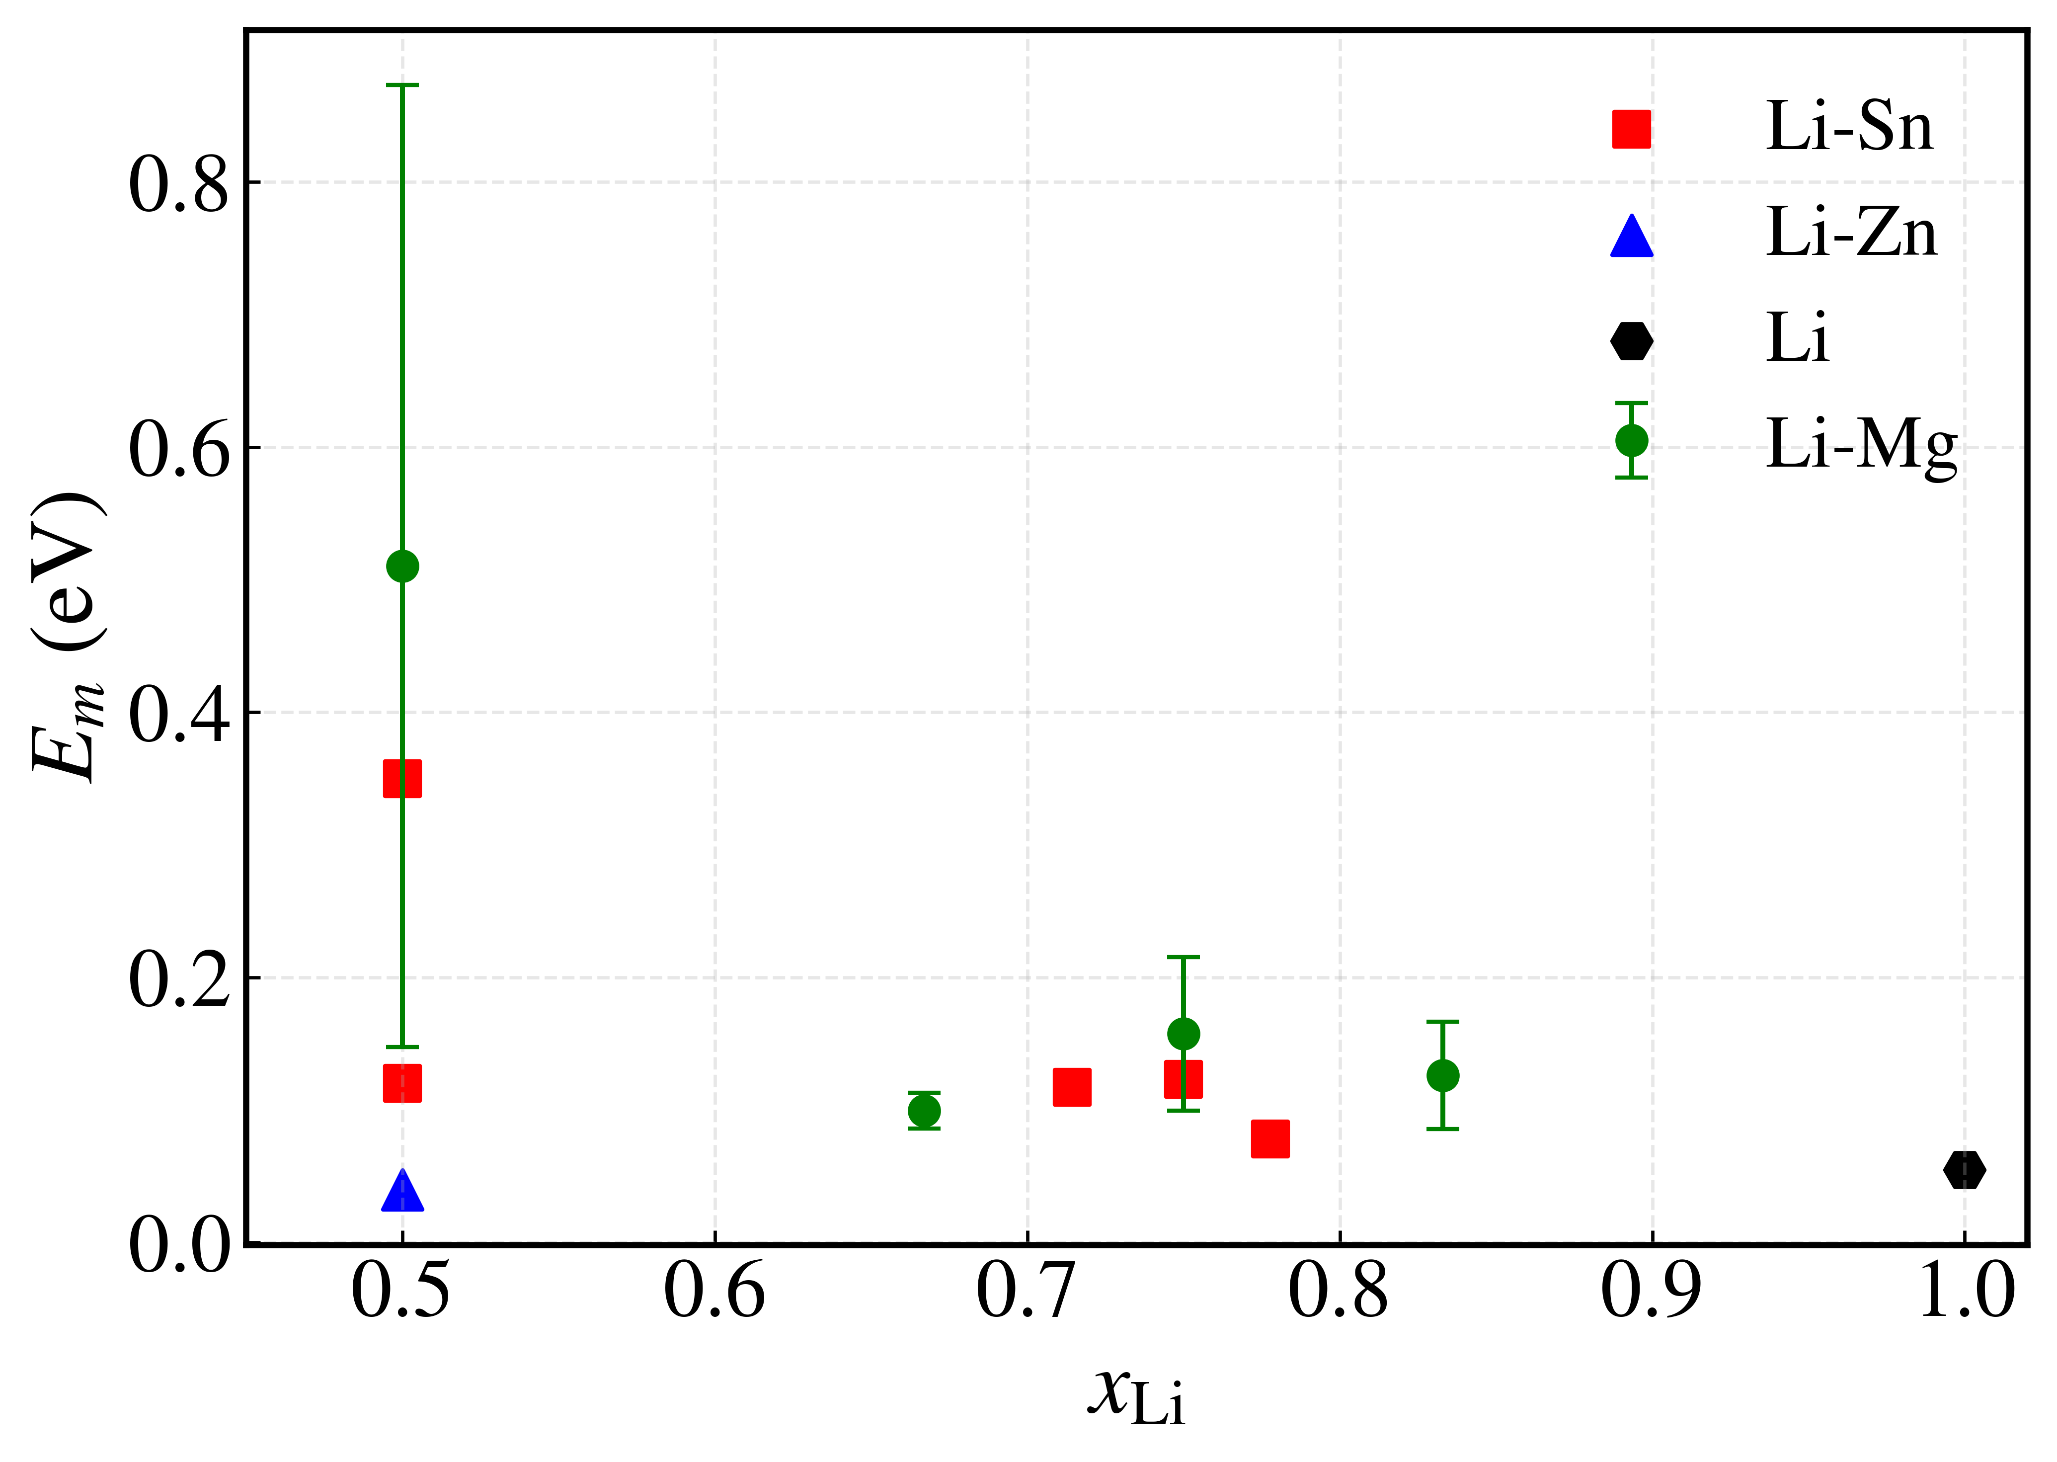
5. Comparative analysis of Li-ion migration barriers
The Li effective migration barrier
Eₘ vs x_{Li}
Minimum Eₘ in Li–Mg, Li–Sn, and Li–Zn systems
Phase | x_{Li} | E_{m} (eV)
Li₂Mg (mixed phase) | 0.667 | 0.099
Li₇Sn₂ (Cmmm) | 0.778 | 0.077
LiZn (Fd-3m) | 0.5 | 0.040
LiMg
LiSn (P2/m)
Very low E_{m} (0.04–0.1 eV) are accessible in Li–Mg, Li–Sn, and Li–Zn phases
E_{m} is strongly structure-dependent
No universal correlation between E_{m} ​and x_{Li} is observed.
Li₅Sn₂
Li₃Mg
LiSn (I4₁/amd)
Li₅Mg
Li₃Sn
Li
LiZn
Li₂Mg
Li₇Sn₂
Error bars indicate the Boltzmann-weighted standard deviation
Supercells contain 108–256 atoms, satisfying the shortest vac-vac distance > 10 Å.
Linear SNAP with 2J_{max} = 8 and r_{cut} = 5 Å.
Hoan Tran-Van
The Li ion diffusion in Li-M alloys for anode application
11

Slide 12
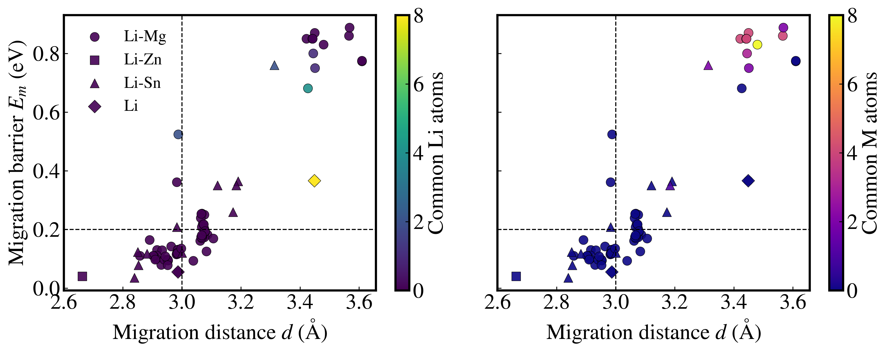
5. Comparative analysis of Li-ion migration barriers
Factors governing migration barriers
Coordination-Controlled Migration Barriers
Radius cutoff = 3.1 Å to determine coordination
Low d → low E_{m} ​ (baseline regime)
Coordination overlap → barrier amplification
Hoan Tran-Van
The Li ion diffusion in Li-M alloys for anode application
12

Slide 13
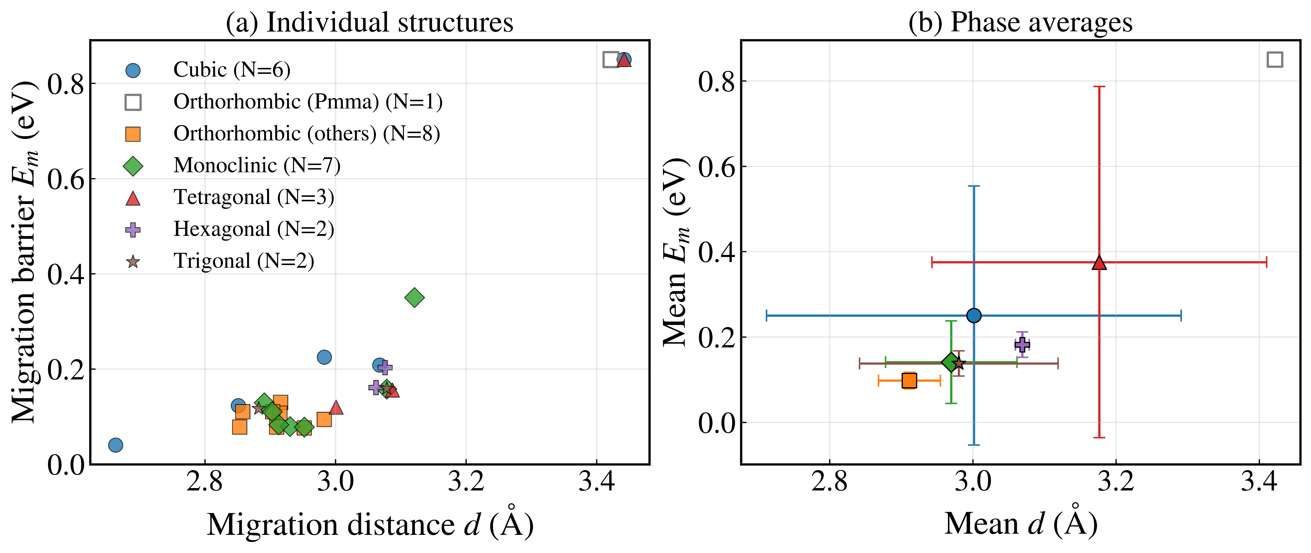
5. Comparative analysis of Li-ion migration barriers
Factors governing migration barriers
Phase-dependent relationship between d and E_{m}
Orthorhombic/monoclinic cluster at low d and low E_{m}.
Phase indirectly reflects diffusion topology.
Hoan Tran-Van
The Li ion diffusion in Li-M alloys for anode application
13

Slide 14

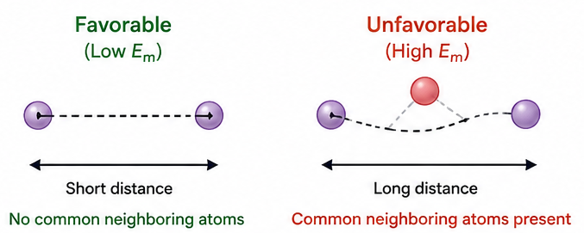
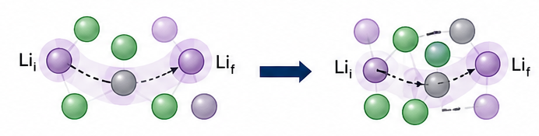
6. Conclusion
The obtained results
1
MLACS-NEB efficiently screens Li-ion migration barriers
2
Li₂Mg, Li₇Sn₂ and LiZn exhibit low Li migration barriers (E_{m} < 0.1 eV)
3
Low E_{m} is favored by short migration distance and the absence of common neighboring atoms
Future work
1
Complete NEB calculations with other crystal structures
2
Perform calculations with Li–Mg solid solution
3
Evaluate vacancy formation energy
Hoan Tran-Van
The Li ion diffusion in Li-M alloys for anode application
14

Slide 15




Thank you
Hoan Tran-Van
The Li ion diffusion in Li-M alloys for anode application
15

