Slide 1
Monte Carlo evaluation of energy deposition for a novel system for microdosimetry and cell radiation response
Prarthana Pasricha¹, S. Khilji² ,C. McNairn¹, B. Muir³, E. Cassol¹, V. Chauhan², S. Dang¹, A. Jirasek⁴, JL. Andrews⁴, S. Murugkar¹, RM. Thomson¹​
¹Carleton University, ²Health Canada.​ ³National Research Council of Canada, ⁴University of British Columbia,

Slide 2
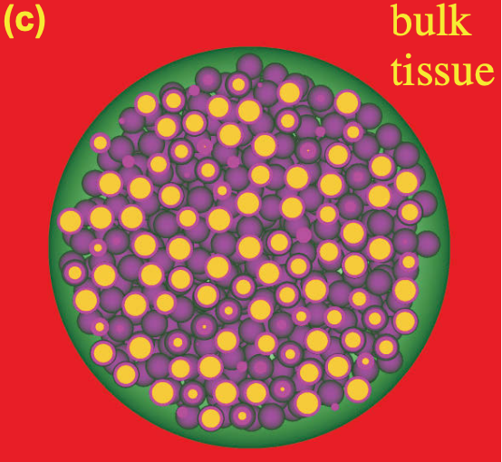

Motivation
ECM
Overarching goal: To understand the relationship between energy deposition in populations of cells and its biological response to radiation.
This knowledge is essential for
      Precision medicine
      Cancer therapy
      Radiation safety
cells

Slide 3
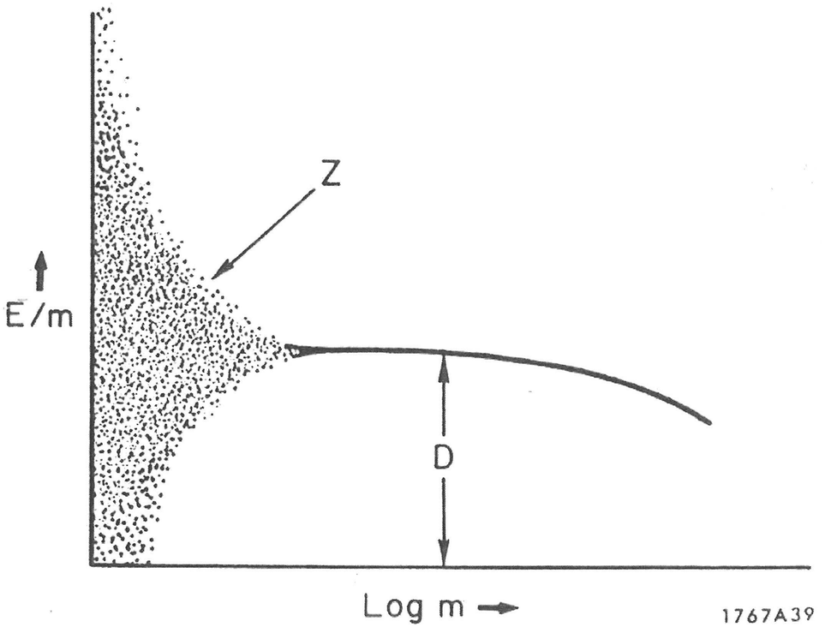
Why Microdosimetry?
Microdosimetry characterizes the stochastic distribution of energy deposited by radiation at microscopic sites
Conventional dosimetry reports average dose
Variability seen in specific energy (z = E/m) at low doses & small targets
Biological response at low doses remains poorly understood
z
Variation of the specific energy with size (mass) of a microscopic target (Rossi H., Microdosimetry and its Applications)

Slide 4



Dose vs specific energy
Cookie 2:🍫🍫
Cookie 3:🍫🍫 🍫🍫🍫🍫🍫🍫🍫 🍫🍫🍫🍫
Cookie1:🍫🍫🍫 🍫🍫🍫🍫
Average chips per cookie (dose): 7.3
Variation in chips distribution (microdosimetric spread)
Notes:
Just to make sure we understand the concept of dose vs specific energy, I baked some choco chip cookies. And because am great at baking each cookie ended up with different amount of choco chips.
Considering cookies as cells, specific energy tells you how many chocolate chips ended up in each cookie; absorbed dose tells you the average recipe and the variation in choco chips distribution across cookies is called the microdosimetruic sprad

Slide 5


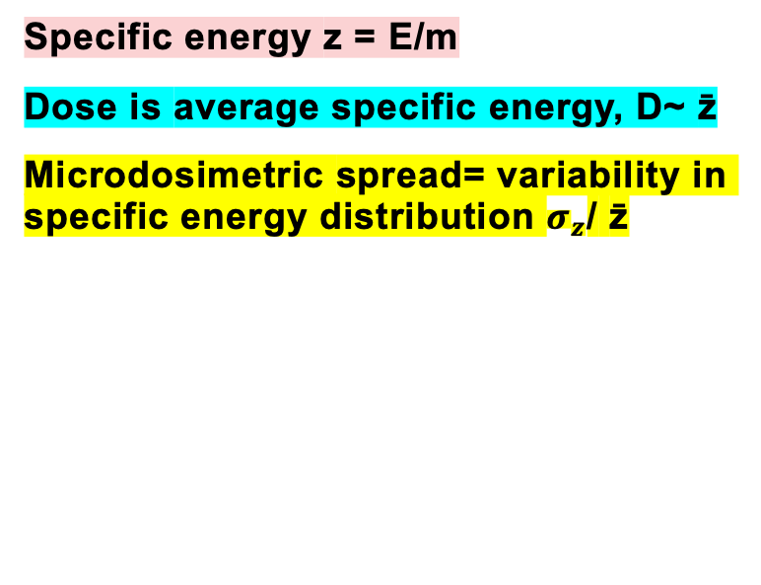
Specific energy z = E/m
Dose is average specific energy, D~ z̄
Microdosimetric spread= variability in specific energy distribution $σ_{z}$/ z̄
4

Slide 6
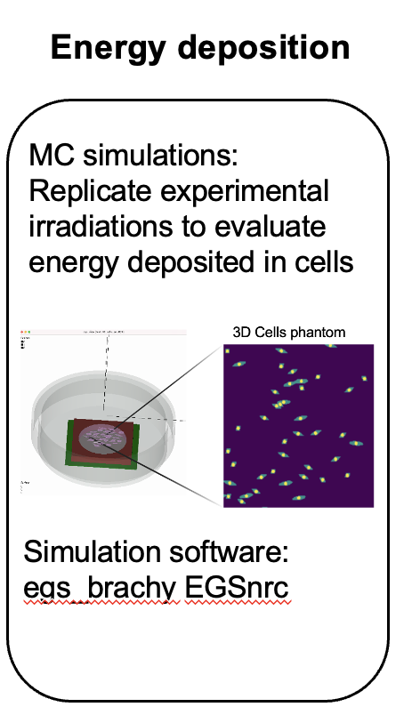
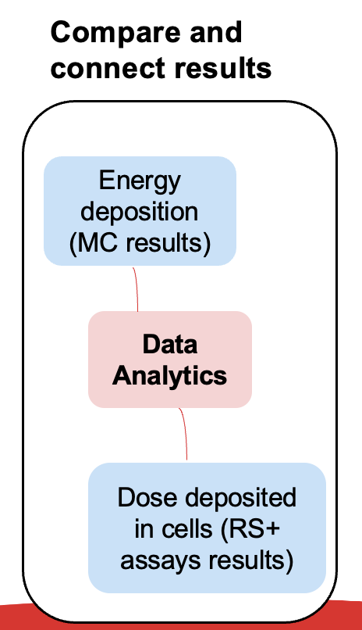
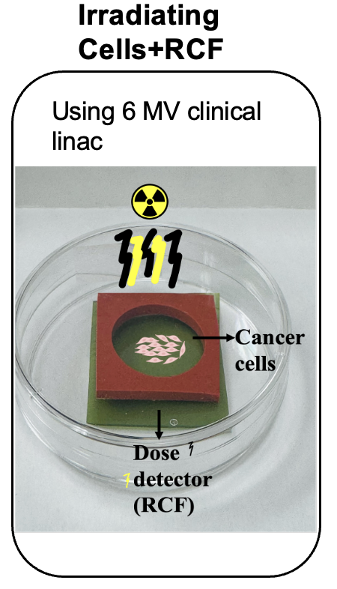
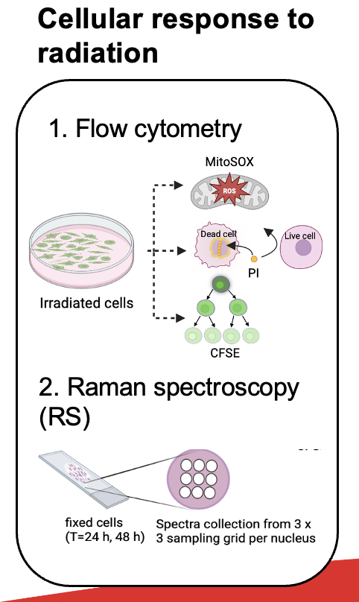
A novel system for micron-scale evaluation of radiation dose deposition and cellular response

Slide 7
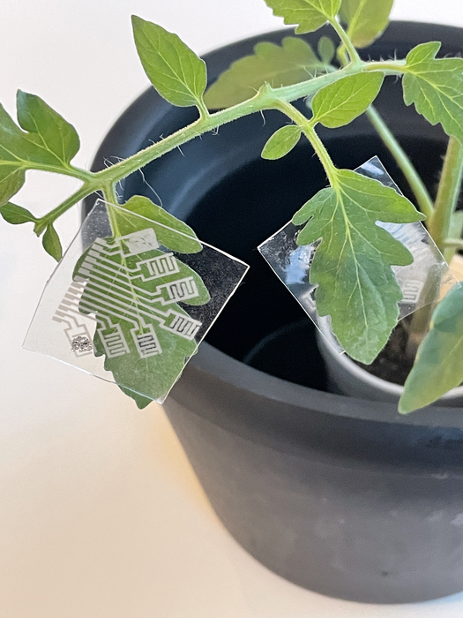
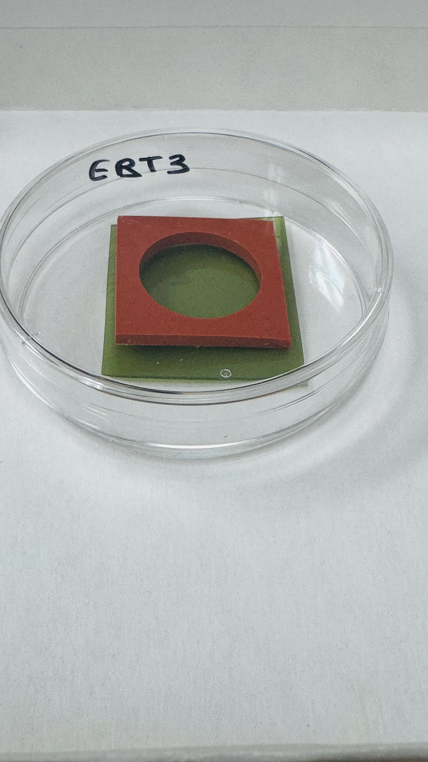


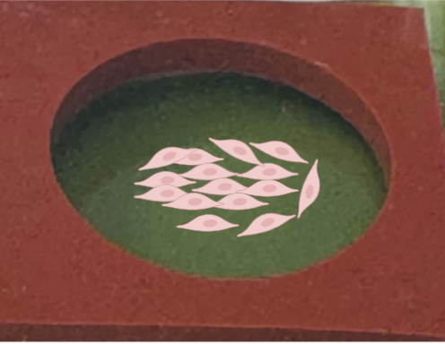
Leaf
(5 cm)
Cancer cell
(0.002 cm)
Storm detector
Dose detector

Slide 8
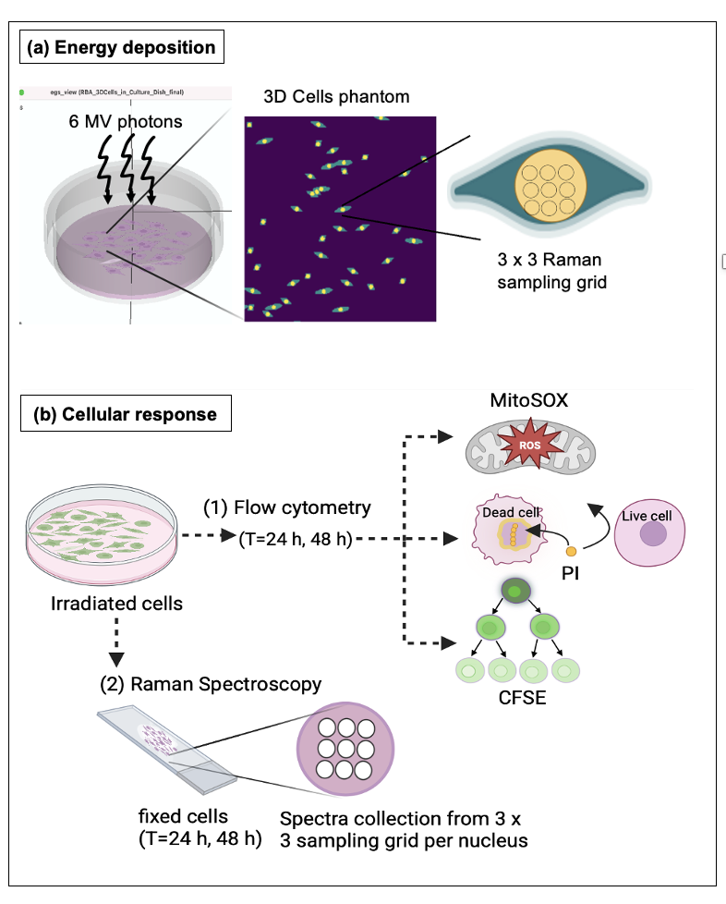

Characterizing the MC38 cells in a Petri-dish

Slide 9
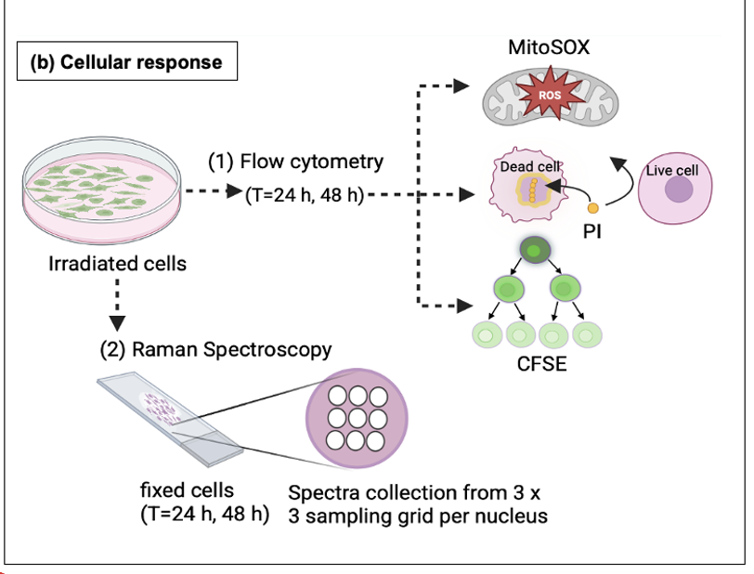
Characterizing the MC38 cells
Irradiating cells in a petri dish to 6 MV photons (0-10 Gy)
MC simulations used to model and evaluate energy deposited in cells using realistic 3D cells phantom
Radiation response characterized using:
  Flow cytometry: to assess mitochondrial superoxide generation, cell membrane integrity and proliferation.
  RS: to measure radiation induced biochemical changes in cell nuclei.

Slide 10

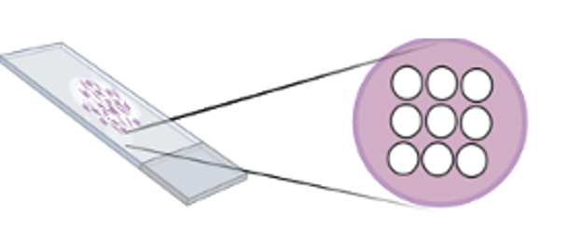
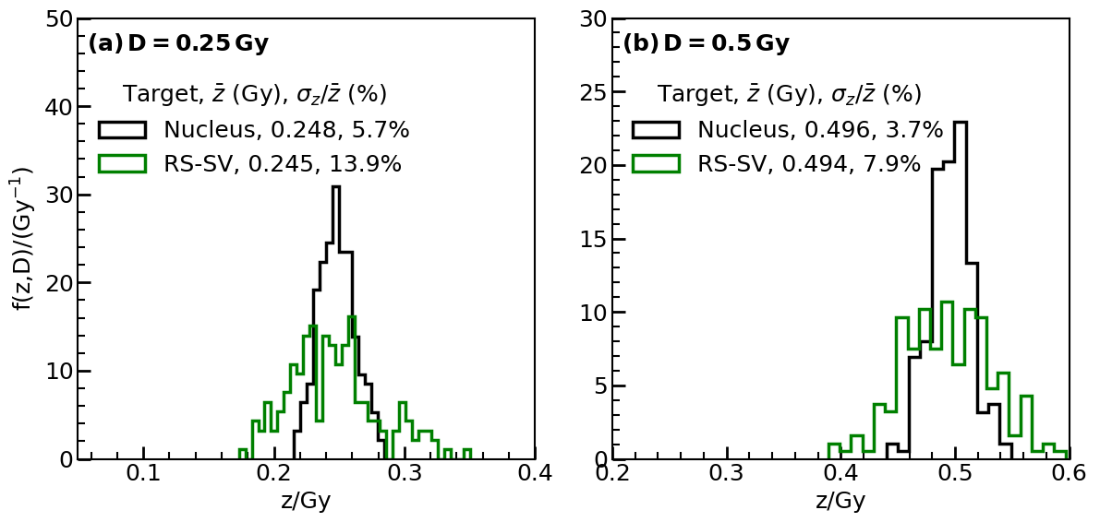

Results: MC obtained specific energy distributions from cells in a petri dish
RS-SV
Nucleus
Variability in energy deposition in cells decreases with increasing dose
Sampling only part of the nucleus may exaggerate variability in observed cellular response compared with entire nucleus.

Slide 11
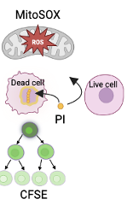
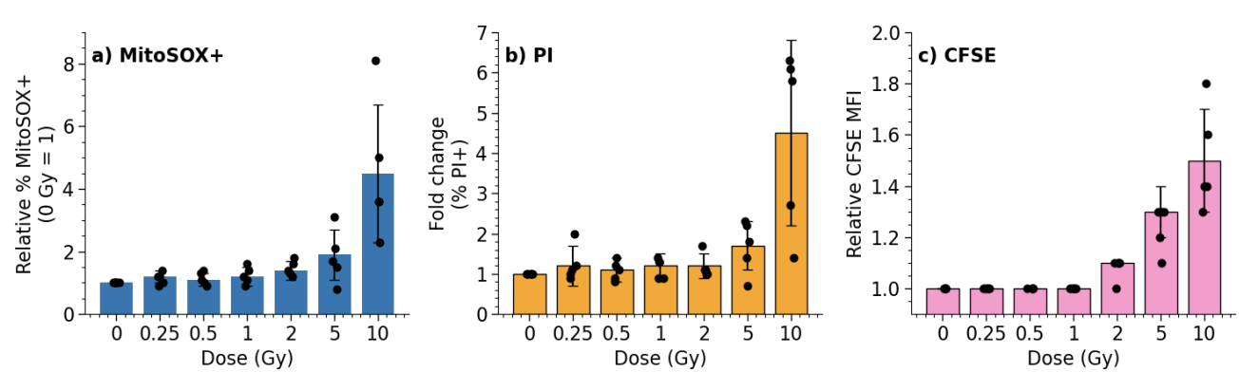

Results: Cellular response using flow cytometry
Increased membrane damage
= decreased viability
Increased fluorescence
= decreased proliferation
Increased oxidative stress
Decreased proliferation and viability emerge at 48h for doses ≥5 Gy.

Slide 12
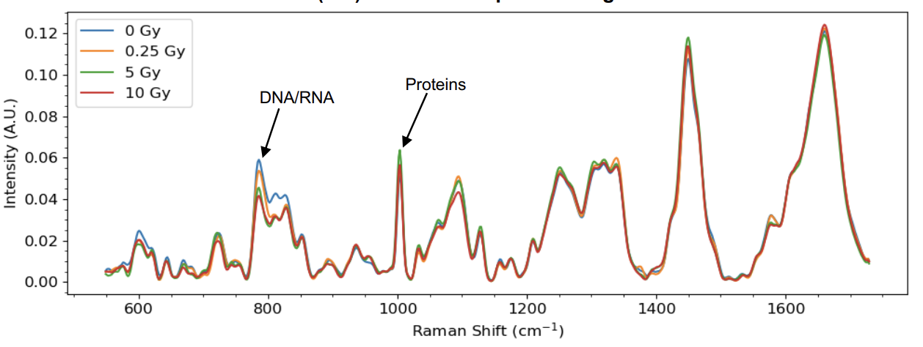
Results: Cellular response using Raman spectroscopy
Reductions up to 30% in DNA/RNA-associated bands and increases of up to 20% in protein-associated bands for doses ≥5 Gy.

Slide 13

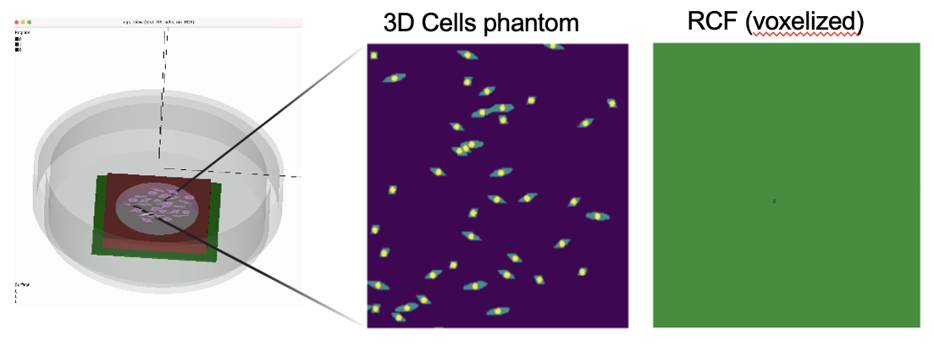
Cells+RCF setup (Ongoing)

Slide 14
Feasibility test: Cells+RCF setup
Cells are grown directly on RCF and co-irradiated (0-10 Gy).
Allows simultaneous measurement of physical dose and biological response (cells).
Feasibility test: cells+RCF studied using MC simulations to evaluate correlations between energy deposition in cells and in RCF.
Is RCF closely registering the dose deposited in cells?

Slide 15
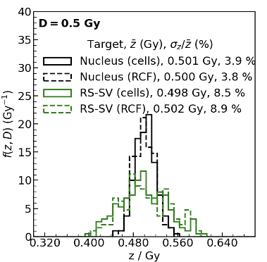
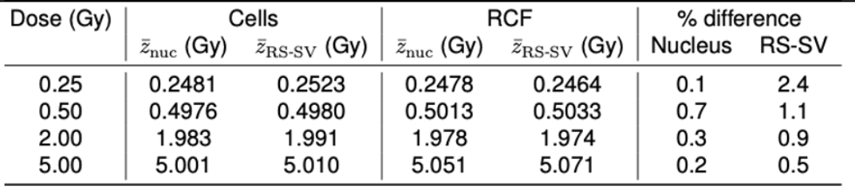
MC results: cells + RCF feasibility test
MC simulations of cells+RCF show agreement between mean specific energy deposited in nuclei and in the RCF, with differences <2% across all doses.

Slide 16


Summary: Insights from MC simulations
  Reveals large variations in energy deposition at low doses and small target sizes.
  Partial nuclear sampling can overestimate cellular response variability at low doses.
  3. Supports the feasibility of the cell+RCF system for microdosimetry.
  Future works: RS measurements from the integrated system and use of ML to correlate energy deposition to radiation response in cells.

Slide 17






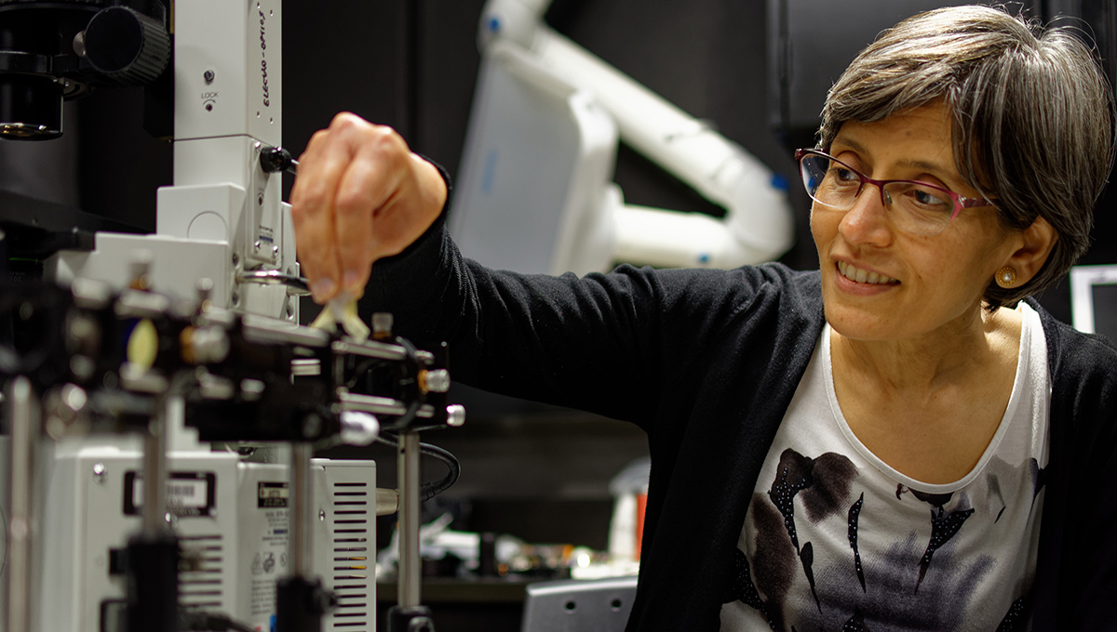


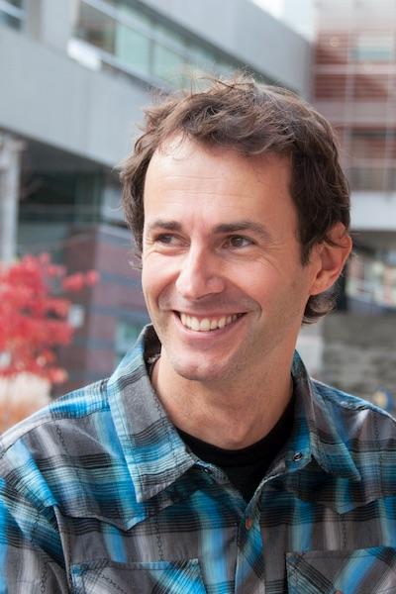
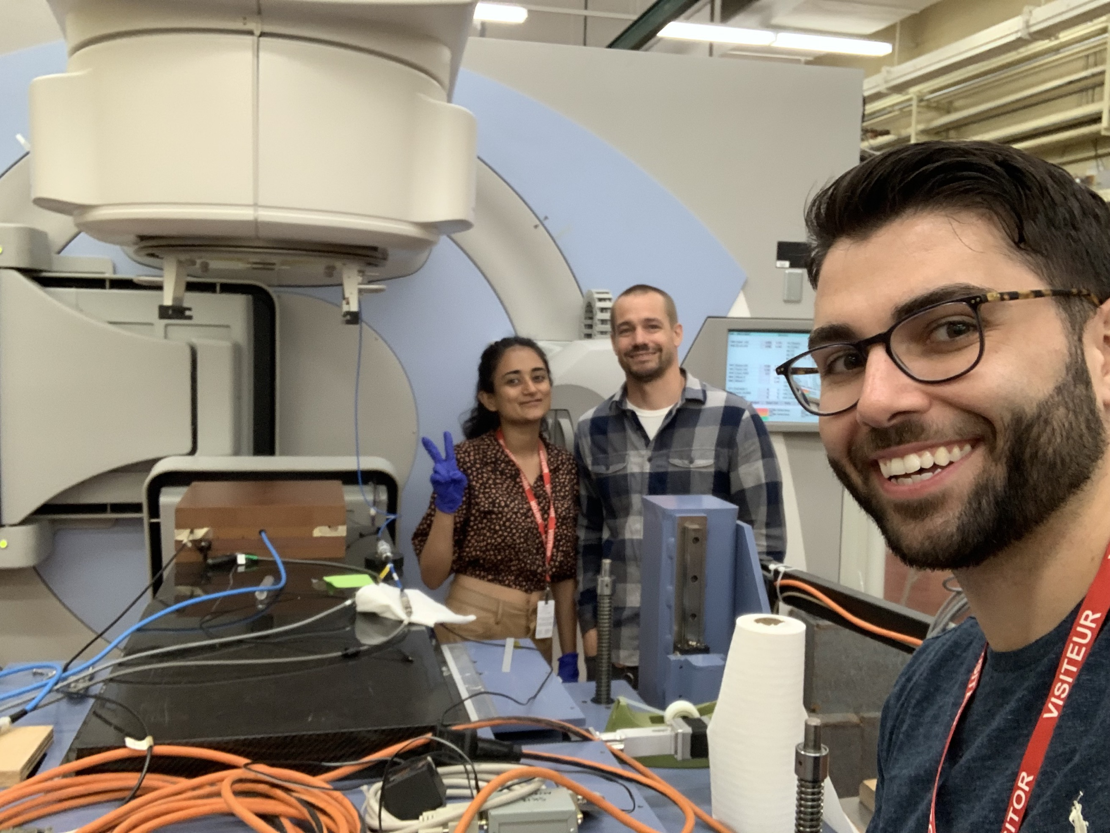



This research is supported by the Government of Canada’s New Frontiers in Research Fund, NSERC, BRIGHT-Canada Scholarship and Radiobiology training program.
Thank you!
Physicists
Data Scientists
Biologists

