Slide 1
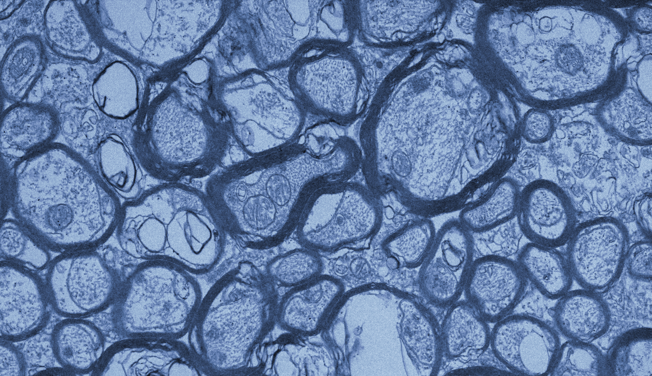







Automatic vs manual segmentations for electron microscopy images in a male mouse
Jessica de Kort ^{1,2}, Daniel Girard ², Madison Chisholm ², Melanie Martin ²
¹ University of Manitoba, Winnipeg, ² The University of Winnipeg, Winnipeg
June 21-26, 2026

Slide 2
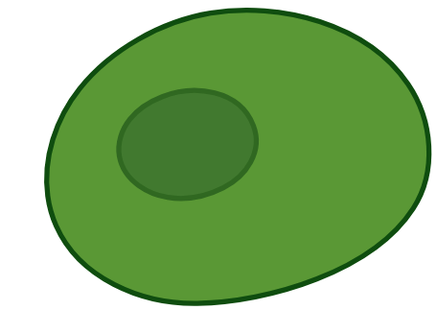
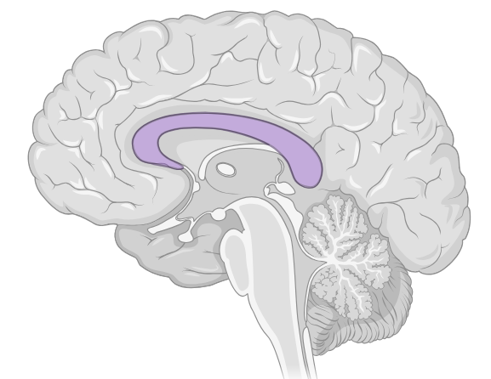
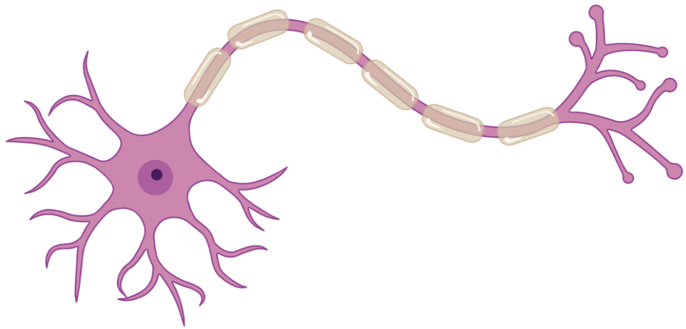

Neurons & Axons
Largest white matter structure is in the corpus callosum
Neurons (cells in the brain) propagate neuronal signals
Axons conduct signals
Myelin sheaths aid with conduction
Other cells surround neurons
Neuron
Axon
Corpus Callosum
Myelin
Sheath
Axon Terminal
Other Cells
Cell Body
Images made in BioRender
2

Slide 3
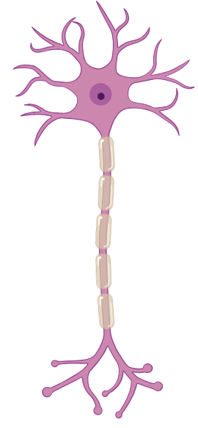
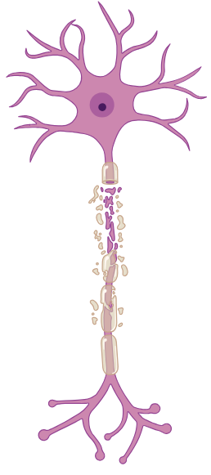
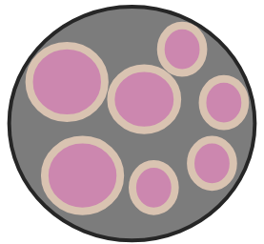
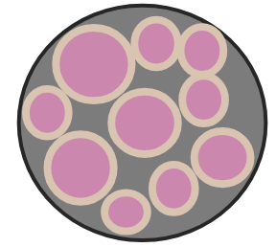
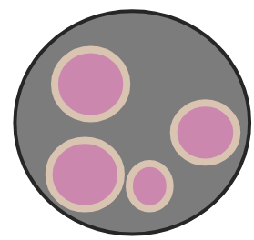
Past Literature
Postmortem studies suggest axon diameters and fibre tract densities change with various neurological conditions
Healthy
Multiple Sclerosis
Autism
Spectrum
Disorders
Schizophrenia
Images made in BioRender
3

Slide 4
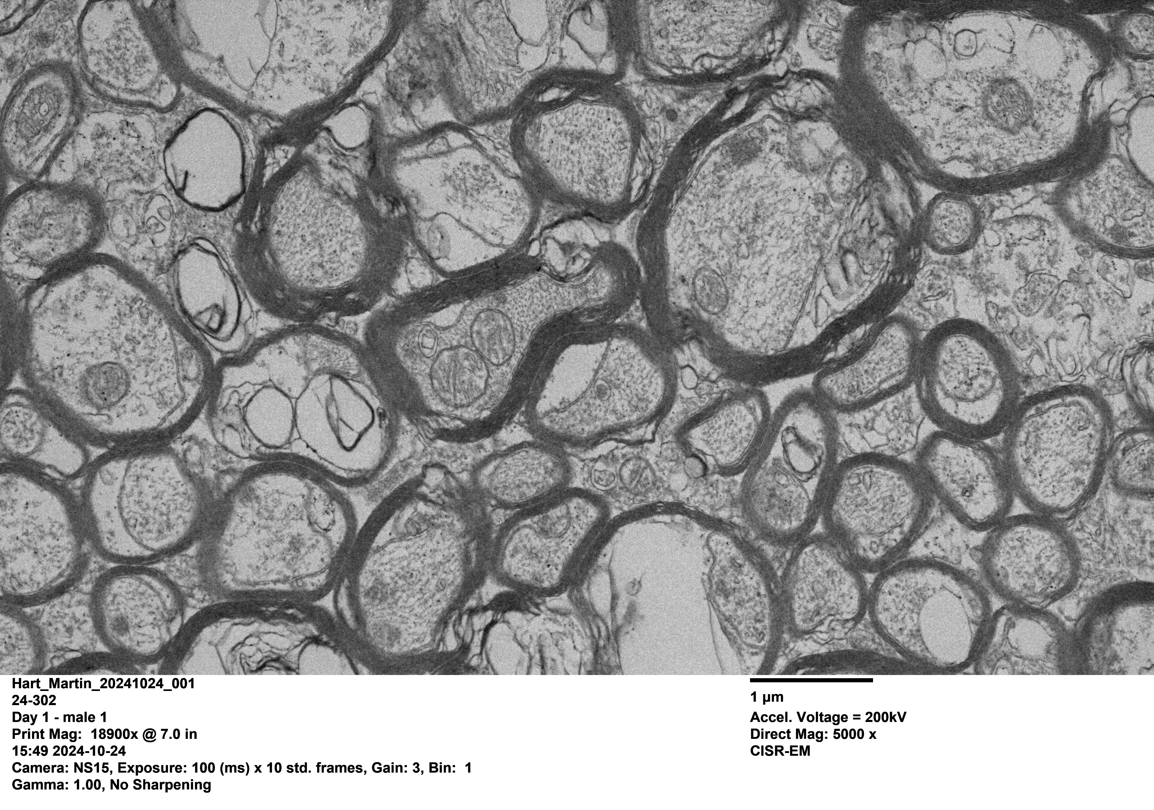
Electron Microscopy (EM) Imaging
Current gold standard
High resolution
Performed ex vivo
Manual segmentations (summer 2025, 2026)
Calculate many packing fractions (f)
  Intra-axonal area, myelin sheaths, other cells
4

Slide 5
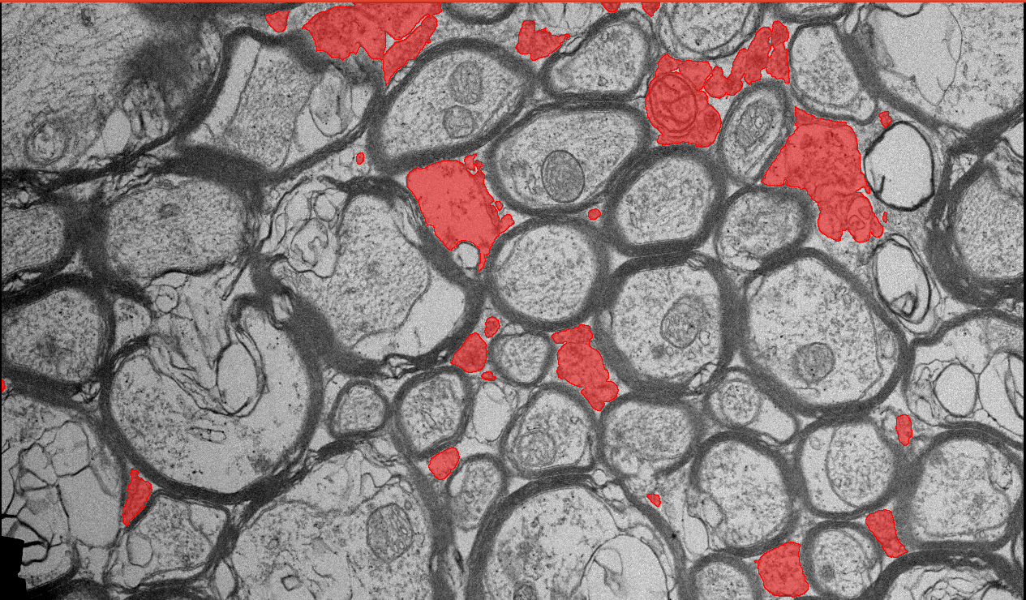
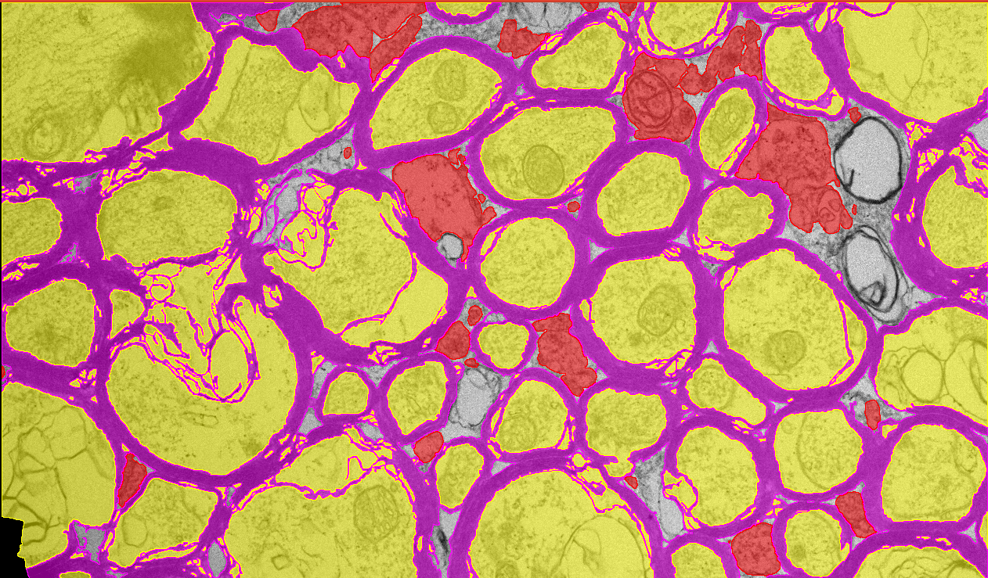
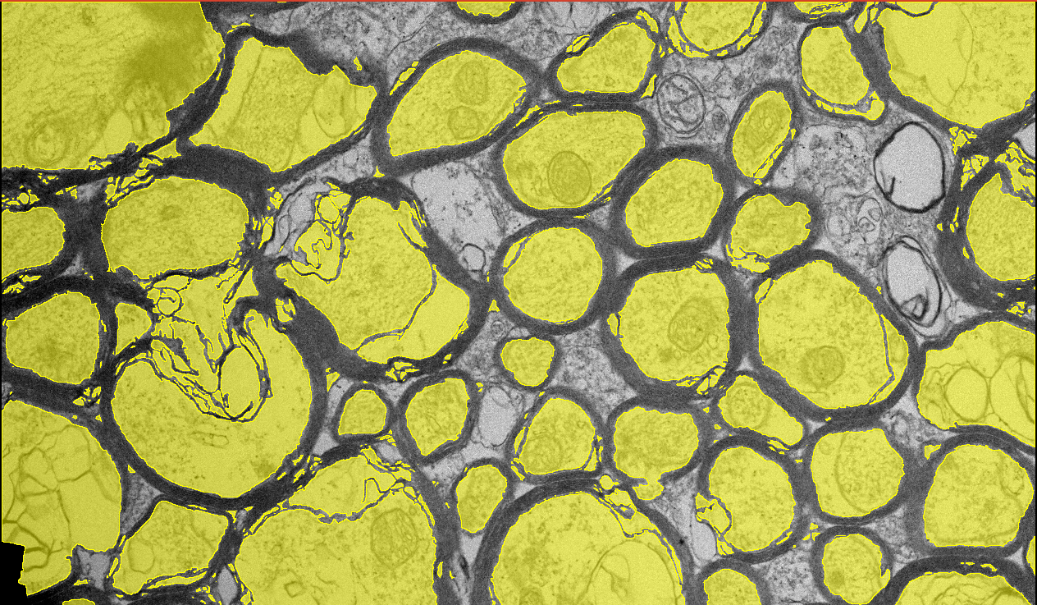
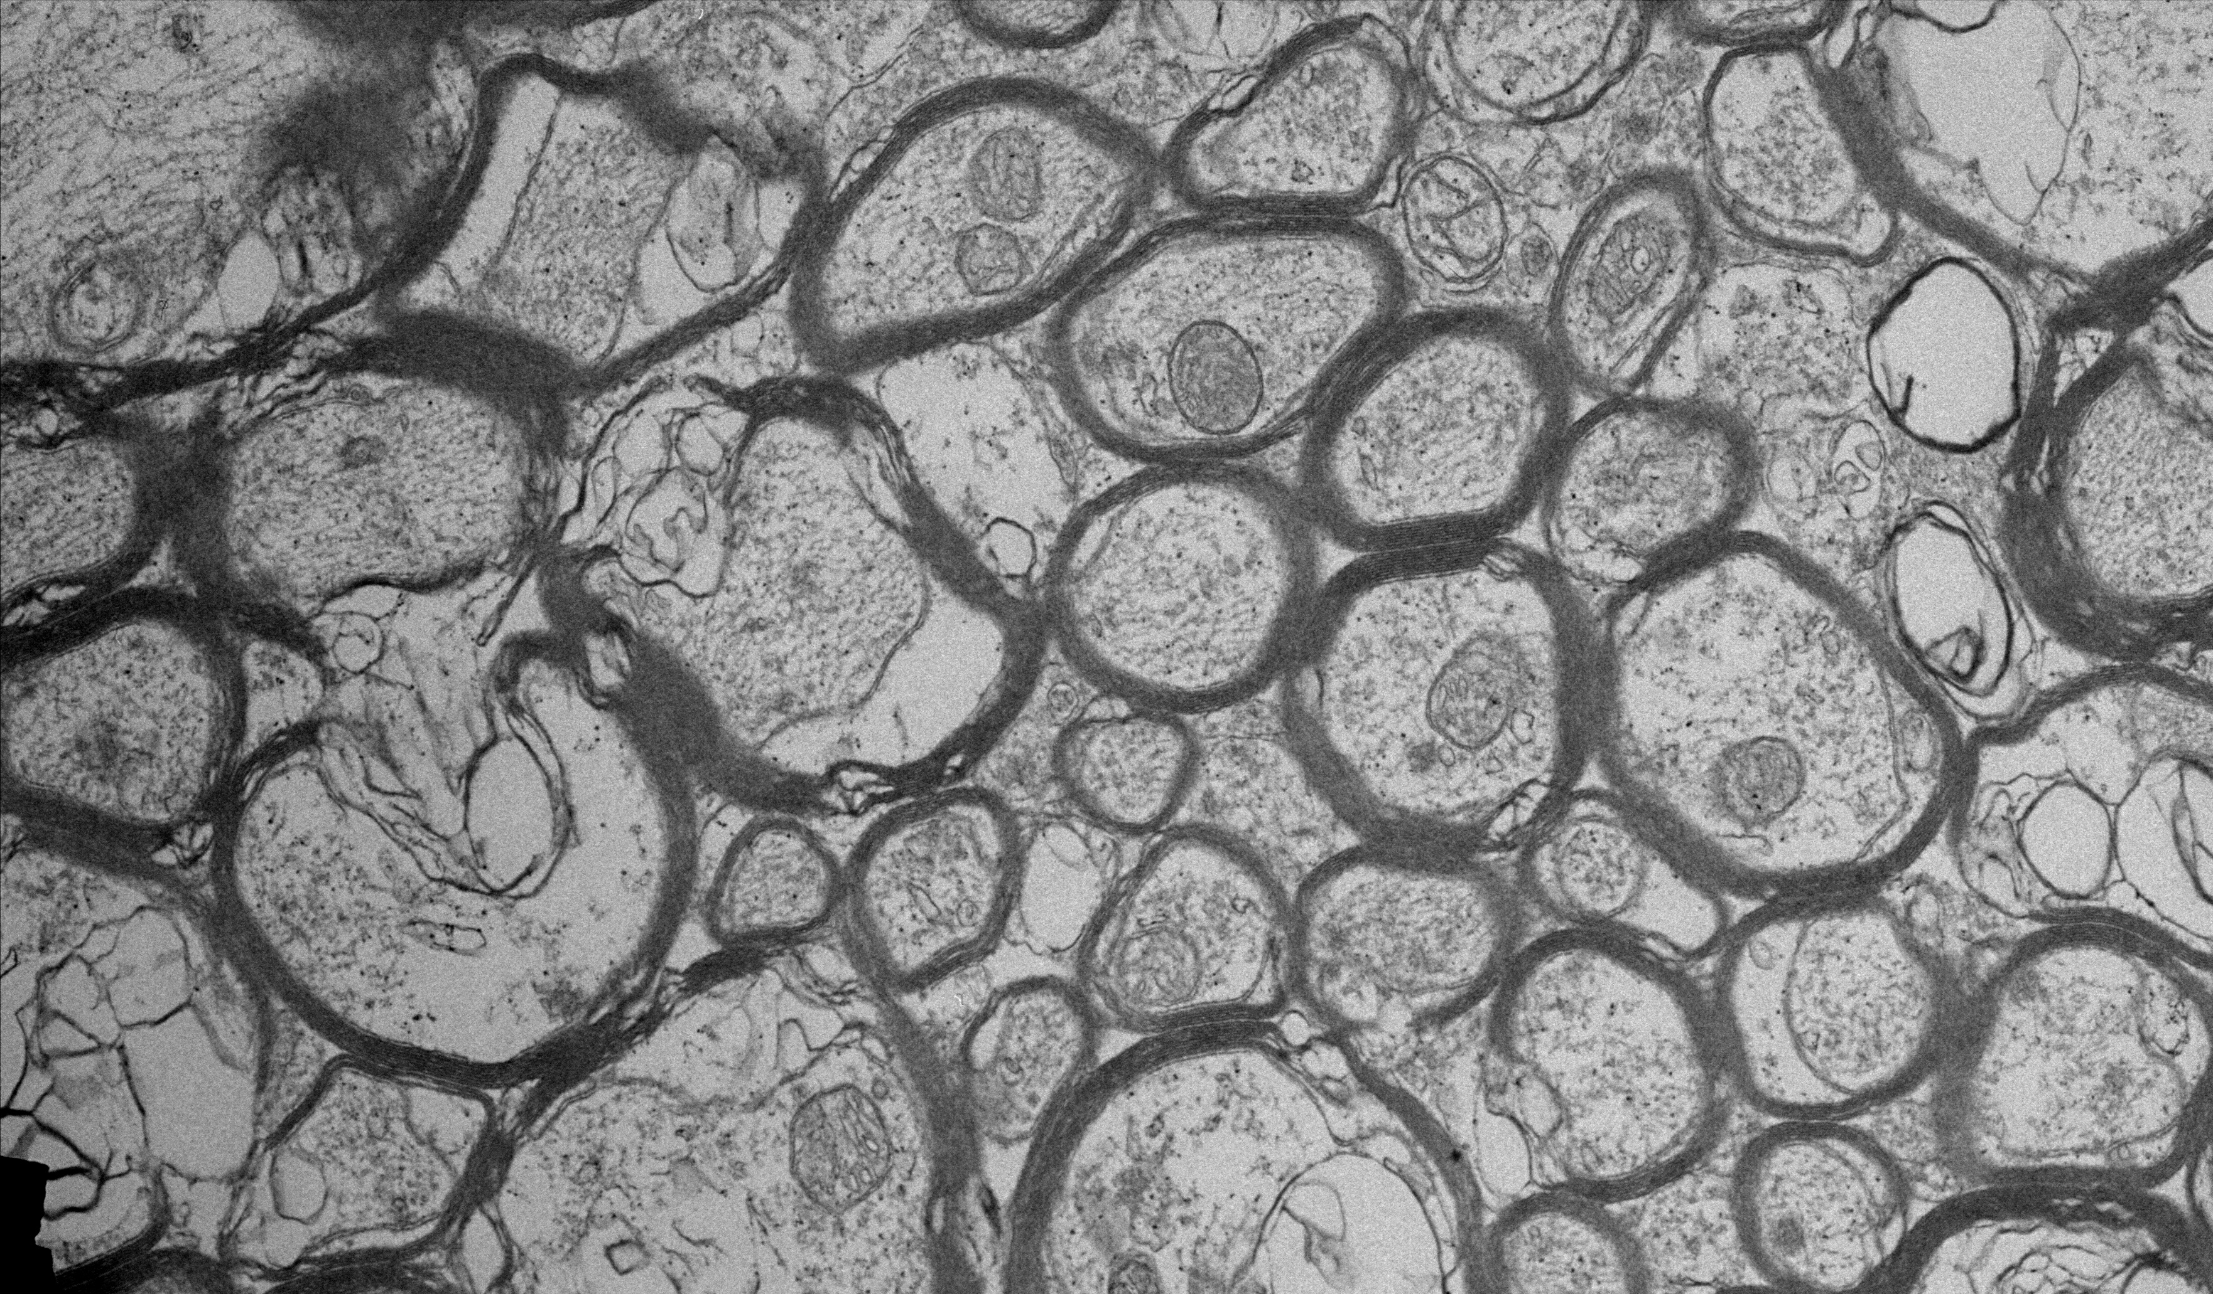
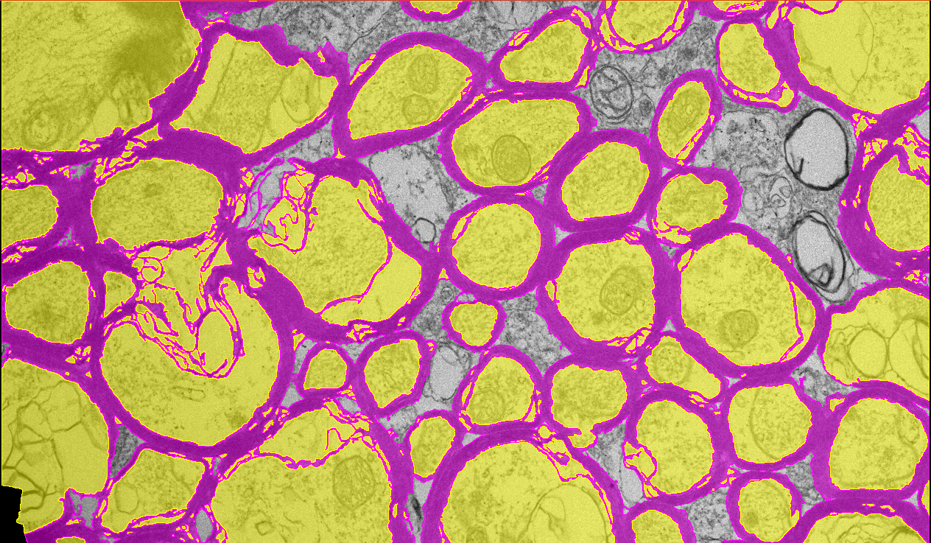
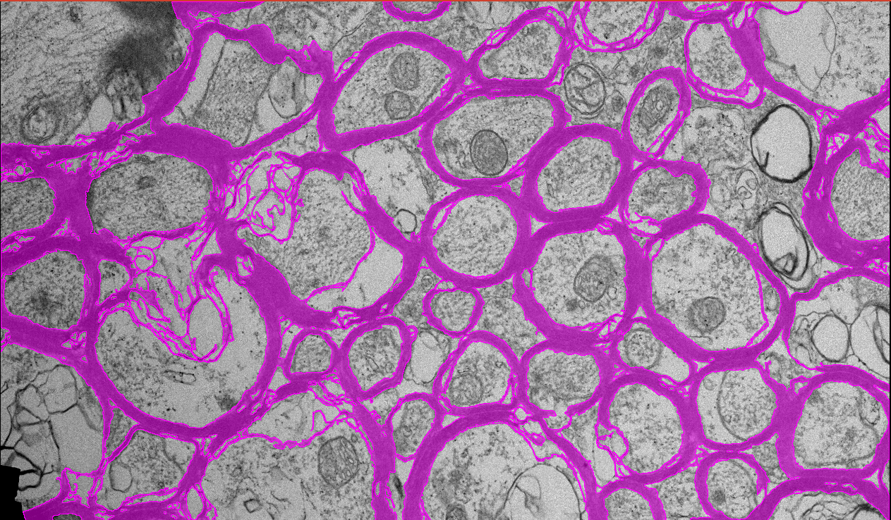
Manual Segmentation
Performed by Daniel Girard (summer 2025, 2026)
Manually segmented 8 EM slices from a male mouse
Time to segment:
~ 42 hours/image
Courtesy of Daniel Girard
5

Slide 6
Packing Fractions (f)
Ratio of a specific area of tissue to the total area of tissue
To understand when, how, why axon sizes change over time
Intra-Axonal Area
Myelin Area
Other Cell Area
f_{ax}
,
f_{m}
,
f_{c}
Total Area
Total Area
Total Area
f_{ax+m}
f_{ax}
f_{m}
Courtesy of Daniel Girard
6

Slide 7

Honours Thesis Objective
Compare manual segmentations to those of an automated segmentation model.
  Using 8 EM images from a male mouse
  Using Segment Anything for Microscopy (micro_sam)
7

Slide 8
micro_sam Models
Models = same deep-learning architecture, trained on different segmentations
Test two models:
1. Electron microscopy (EM) model
      Trained to segment mitochondrion and nuclei
2. Light microscopy (LM) model
      Trained to segment cells and nuclei
Nuclei
*
*
* A. Archit, L. Freckmann, S. Nair, et al. Segment anything for microscopy. NatureMethods, 22:579–591, 2025
Images made in BioRender
8

Slide 9
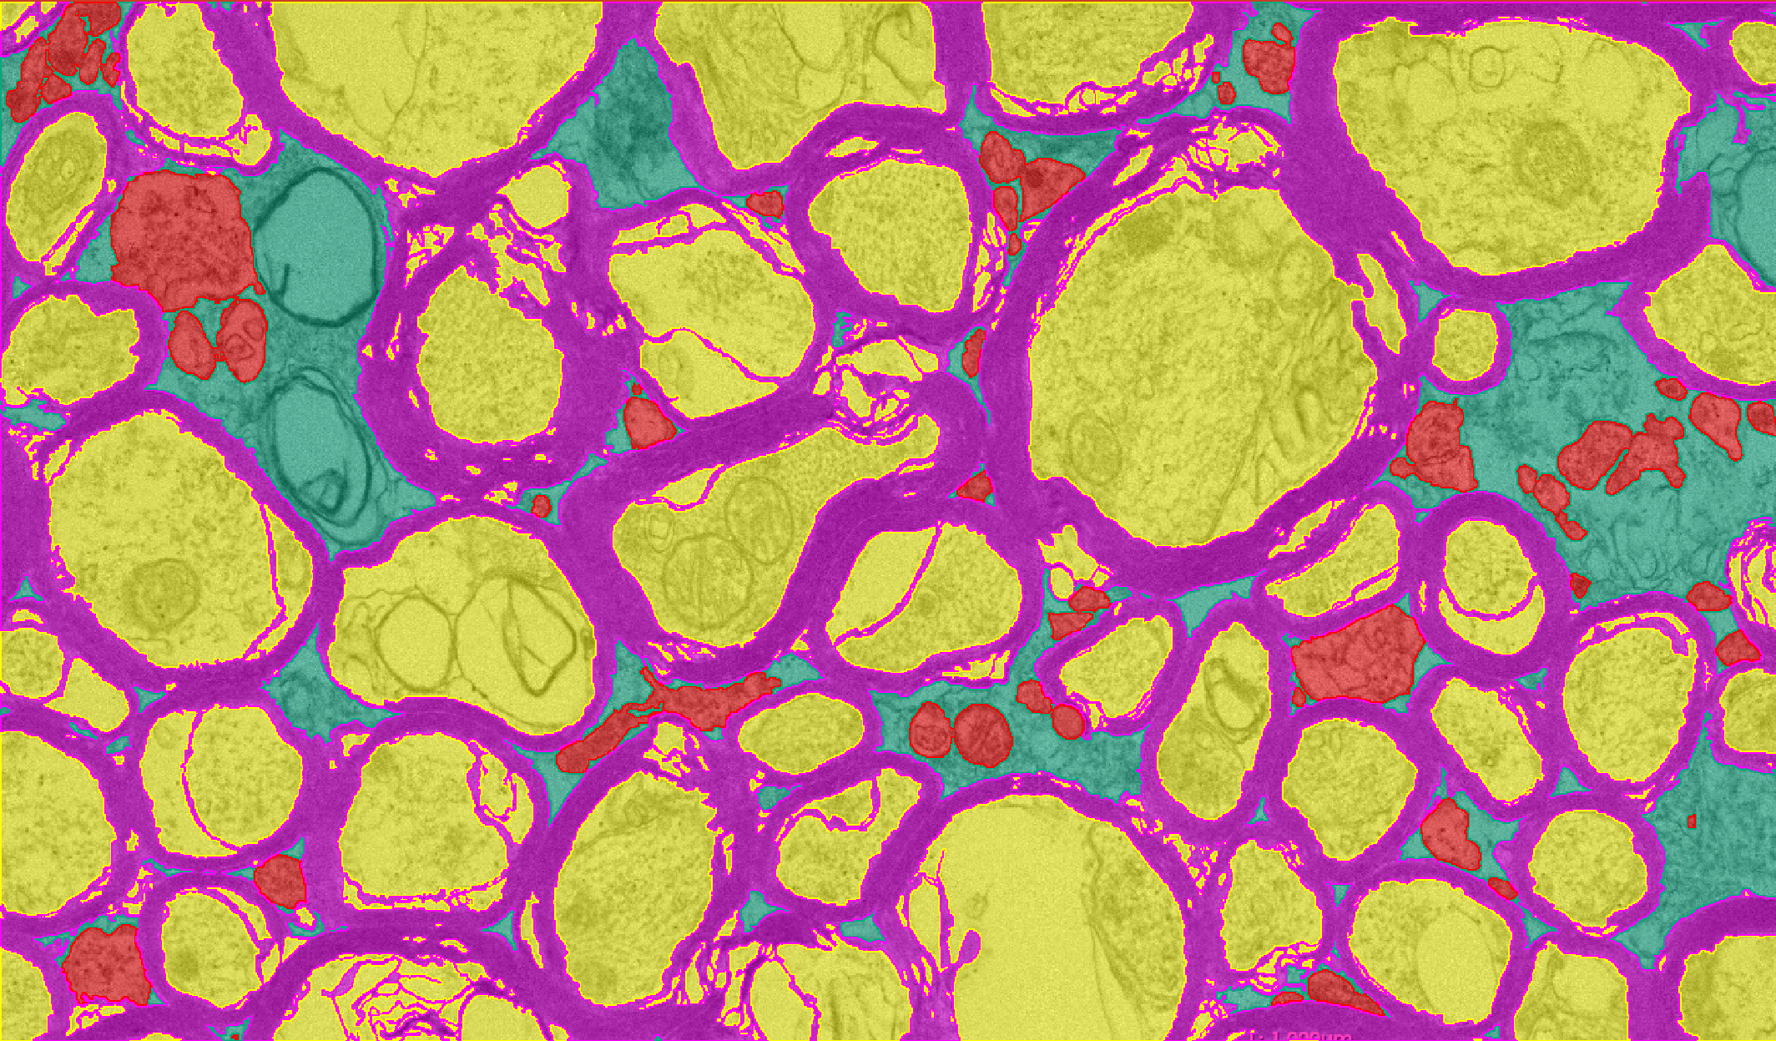
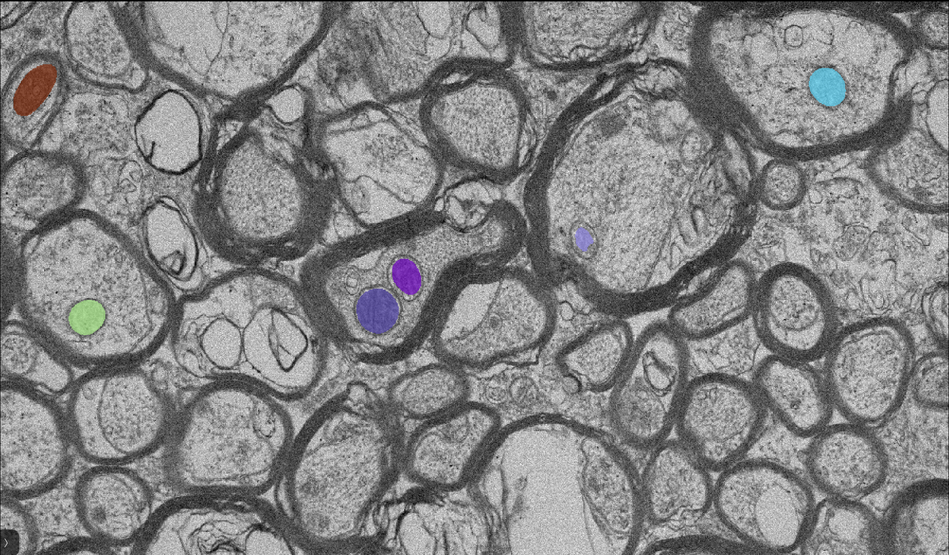
Segmentations
Manual EM Model
Time to segment:
~ 42 hours/image
Time to segment:
1.5 ± 0.2 seconds/image
9

Slide 10
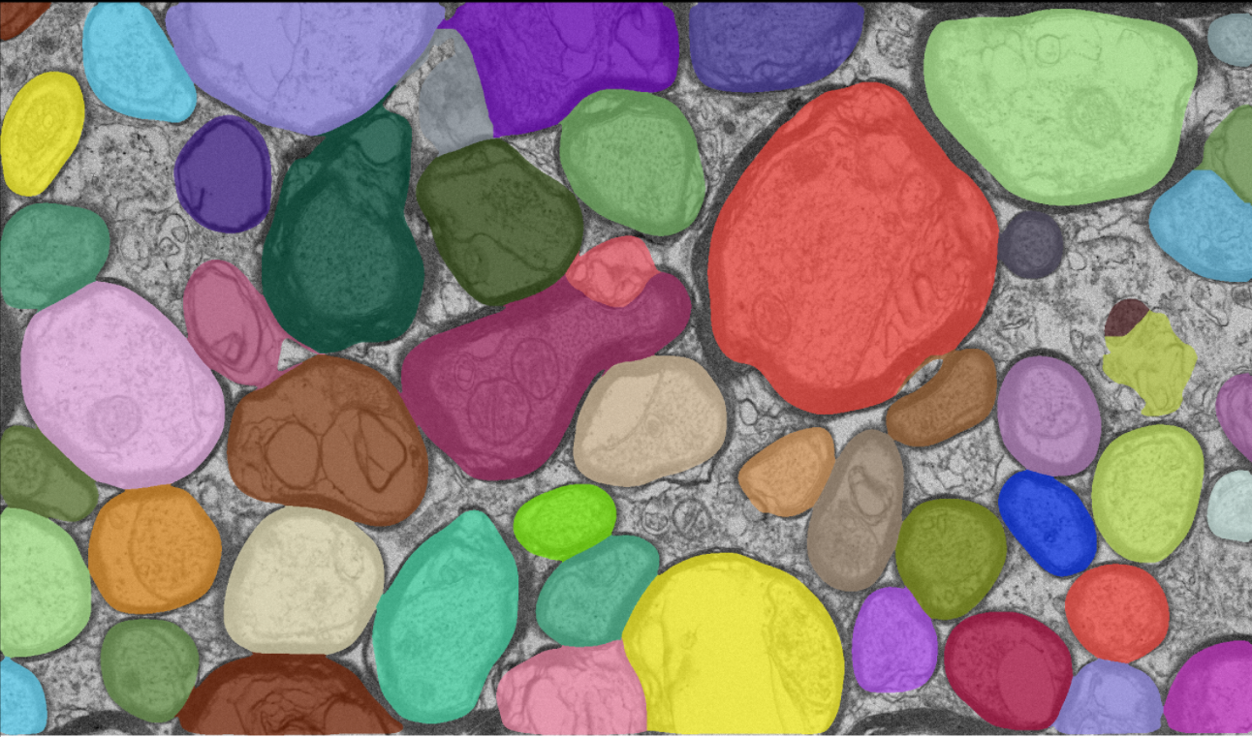
Segmentations
Manual LM Model
Time to segment:
~ 42 hours/image
Time to segment:
4.0 ± 0.2 seconds/image
10

Slide 11
Measurements
Convert to binary segmentation maps
Find the metrics
Dice similarity coefficient (DSC)
Precision
Accuracy
Find the f
- Segmented pixels divided by total pixels
Sum the segmented pixels and divide by total number of pixels per image to find f values
Compare each pixel to respective ground truth to find the metrics
Perform t-tests to find the p-values to see if there are any statistically significant differences
11

Slide 12



Metrics
True Negative (TN)
True Positive (TP)
Dice Similarity Coefficient (DSC):
Precision:
Accuracy:
Average ± Standard Deviation
False Negative (FN)
False Positive (FP)
$$\frac{\text{2 }\text{TP} }{\text{2 }\text{TP}\text{ + }\text{FN}\text{ + }\text{FP} }$$
$$\frac{\text{TP} }{\text{TP}\text{ + }\text{FN} }$$
$$\frac{\text{TP}\text{ + }\text{TN} }{\text{TP}\text{ + }\text{TN}\text{ + }\text{FN}\text{ + }\text{FP} }$$
Ground Truth (manual) Segmentation
Predicted (automated) Segmentation
12
Notes:
DSC assesses how much overlap is between the prediction and ground truth
Precision assesses for over predictions
Accuracy assesses for under prediction

Slide 13
Metric Results
EM Model
Metrics | Intra-Axonal Space | Myelin | Intra-Axonal Space & Myelin | Other Cells
DSC | 0.06 ± 0.02 | 0.0002 ± 0.0003 | 0.04 ± 0.01 | 0.05 ± 0.05
Precision | 0.9 ± 0.1 | 0.002 ± 0.002 | 0.9 ± 0.1 | 0.1 ± 0.1
Accuracy | 0.51 ± 0.03 | 0.67 ± 0.03 | 0.19 ± 0.05 | 0.91 ± 0.03
LM Model
Metrics | Intra-Axonal Space | Myelin | Intra-Axonal Space & Myelin | Other Cells
DSC | 0.77 ± 0.03 | 0.42 ± 0.02 | 0.91 ± 0.02 | 0.05 ± 0.03
Precision | 0.63 ± 0.04 | 0.29 ± 0.02 | 0.93 ± 0.05 | 0.02 ± 0.02
Accuracy | 0.70 ± 0.03 | 0.36 ± 0.03 | 0.85 ± 0.03 | 0.17 ± 0.02
13

Slide 14
f Results
What do these values mean?
Are they statistically different from one another?
Can the uncertainty be quantified?
Model | f | f_{ax} | f_{m} | f_{ax + m} | f_{c}
Manual | - | 0.51 ± 0.04 | 0.32 ± 0.03 | 0.82 ± 0.05 | 0.08 ± 0.03
EM | 0.020 ± 0.007 | - | - | - | -
LM | 0.79 ± 0.02 | - | - | - | -
14

Slide 15
Two-Sample T-Test
p-value > .006 = no significant difference
p-value < .006 = significant difference
f Comparison | p-Value
f_{EM} vs f_{ax} | < .0001
f_{EM} vs f_{m} | < .0001
f_{EM} vs f_{c} | .0001
f_{EM} vs f_{ax+m} | < .0001
f Comparison | p-Value
f_{LM} vs f_{ax} | < .0001
f_{LM} vs f_{m} | < .0001
f_{LM} vs f_{c} | < .0001
f_{LM} vs f_{ax+m} | .1374
15

Slide 16
Conclusion
micro_sam greatly reduces segmentation time
  Automated < manual segmentation time
  Trade-off for less detail
micro_sam’s LM model performs better compared to EM model
  From observing all metrics
  From f values & p-values
micro_sam’s LM model successfully segments axons & myelin
16

Slide 17
Next Steps
Increase dataset for manual segmentations
  More male mice
  Include female mice
  Test on human EM images
Adjust/train micro_sam on our manual segmentations
  Not enough manual segmentations
Test & compare other deep-learning segmentation applications
17

Slide 18



Acknowledgements
Supervisor
Melanie Martin
Committee Members
Esmat Elhami
Murray Alexander
Co-Authors
Daniel Girard
Madison Chisholm
Huge thank you to Bibek Dhakal (Vanderbilt University Institute of Imaging Science) for his help in providing access to the diffusion-weighted spin echo pulse sequence and Zou Yue (Vanderbilt University Institute of Imaging Science) for her help in the perfusion-fixating the mice brains. Thank you to Madison Chisholm for imaging the mice and Daniel Girard for manually segmenting the EM images.
18

Slide 19
Thank you!
dekortj@myumanitoba.ca
Automatic vs manual segmentations for electron microscopy images in a male mouse
Jessica de Kort ^{1,2}, Daniel Girard ², Madison Chisholm ², Melanie Martin ²
¹ University of Manitoba, Winnipeg, ² The University of Winnipeg, Winnipeg
June 21-26, 2026

Slide 20
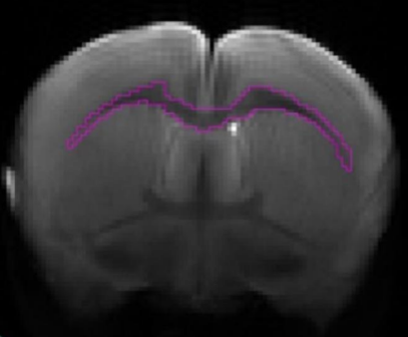
Magnetic Resonance Imaging (MRI)
Low resolution
Performed in vivo
Custom automated model
Produces one packing fraction (f)
Uncalibrated
*
* M. Chisholm, “Assessing the precision of magnetic resonance imaging axon diameter inferences using oscillating gradient spin echo pulse sequences in a 15 T system”, May 5, 2025. doi: 10.36939/ir.202505051532
20

Slide 21
EM Image
Axon
Myelin sheath
Bubble
Extra-cellular matrix
21

Slide 22
Manual Segmentations
Intra-axonal space
Myelin sheath
Other cells
Courtesy of Daniel Girard
22

Slide 23
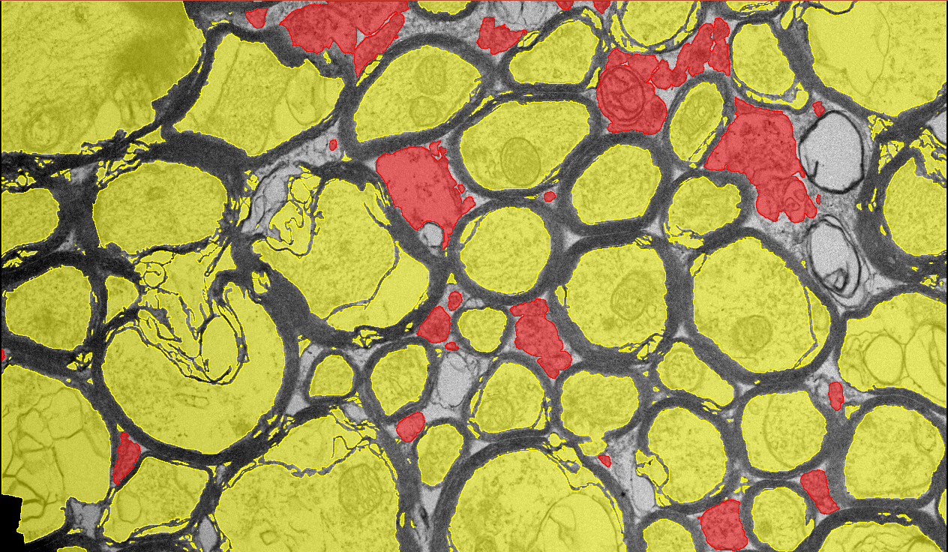
Packing Fractions (f)
The ratio of a specific area of tissue to the total area of tissue
Intra-Axonal Area
Myelin Area
Other Cell Area
f_{ax}
,
f_{m}
,
f_{c}
Total Area
Total Area
Total Area
f_{ax+m}
f_{ax}
f_{m}
f_{ax+c}
f_{ax}
f_{c}
f_{ax+m+c}
f_{ax}
f_{m}
f_{c}
Courtesy of Daniel Girard
24

Slide 24
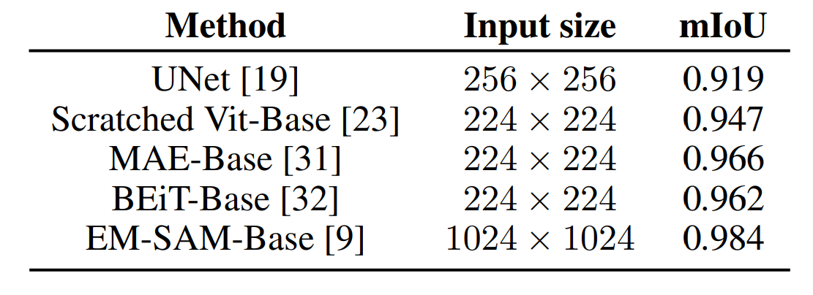
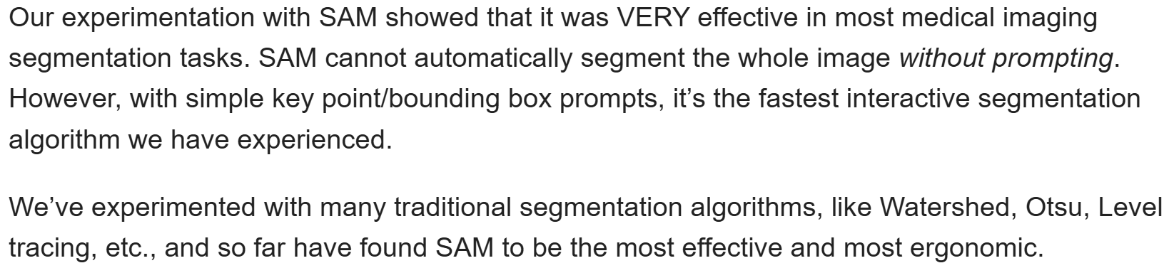
Why micro_sam?
***
“Identifying objects in microscopy images, such as cells and nuclei in light microscopy (LM) or cells and organelles in electron microscopy (EM) …”
“Improved models for LM and EM segmentation that perform considerably better than the default SAM models in their respective domains”
“… μSAM is more versatile because its pretrained models cover both LM and EM, covering a wide range of segmentation tasks”
“… napari plugin for interactive and automatic segmentation”
*
**
* A. Cheng, G. Zhao, L. Wang, and R. Zhang, “AxonCallosumEM dataset: Axon semantic segmentation of whole corpus callosum cross section from EM images,” arXiv preprint arXiv:2307.02464, Jul. 6, 2023. [Online]. Available: https://arxiv.org/pdf/2307.02464.
** S. Sharma, "Integration of 'Segment Anything Model'?", 3D Slicer Community, Apr. 10, 2023. [Online]. Available: https://discourse.slicer.org/t/integration-of-segment-anything-model/28787/13.
*** A. Archit, L. Freckmann, S. Nair, et al. “Segment Anything for Microscopy”. Nat Methods 22,579–591 (2025). https://doi.org/10.1038/s41592-024-02580-4.
23

Slide 25
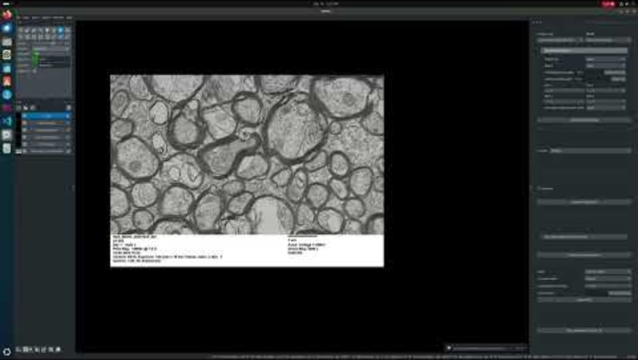
micro_sam
24

Slide 26
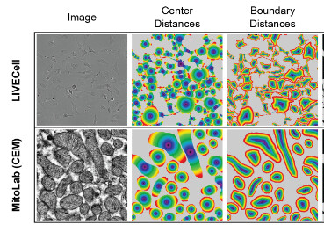
Parameters
Grid overlaid onto the image
Estimate seeds
Observe center distance threshold and boundary distance threshold to find the seeds
Center distance threshold [0,1]:
      Number of rings added onto the seed to find the distance to the center
Boundary distance threshold [0,1]:
  Distance from the boundary to the seed to find the distance to the boundary
Minimum object size [0, ∞):
  “Minimal object size in the
segmentation result”
*
**
* Automatic Segmentation Settings in micro_sam. image.sc. (2026, January 18). https://forum.image.sc/t/automatic-segmentation-settings-in-micro-sam/118602.
** A. Archit, L. Freckmann, S. Nair, et al. “Segment Anything for Microscopy”. Nat Methods 22,579–591 (2025). https://doi.org/10.1038/s41592-024-02580-4.
25

Slide 27
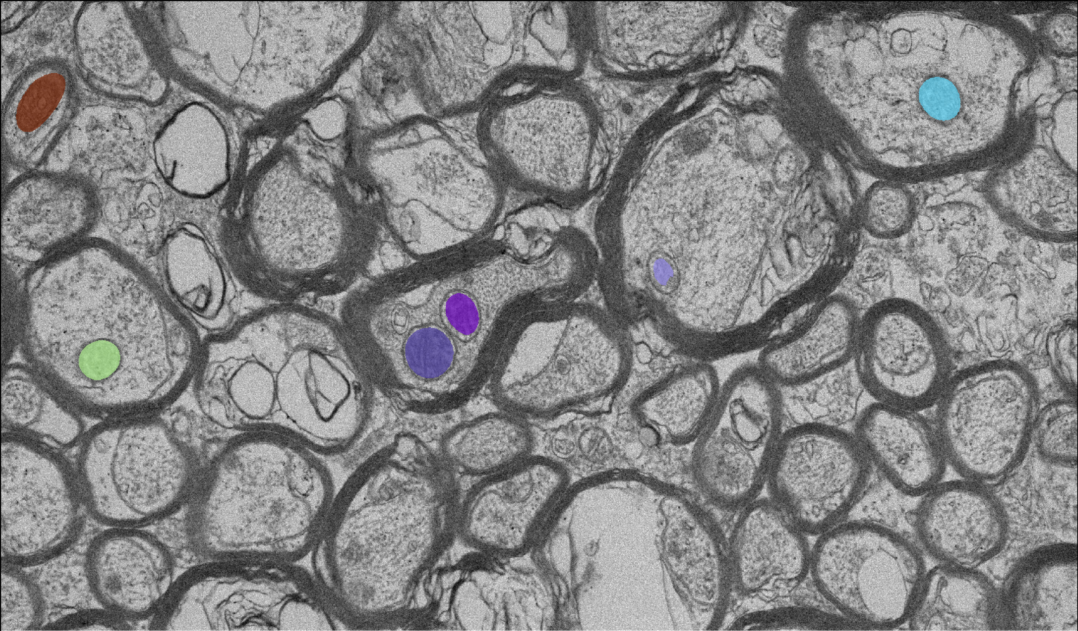
Manual vs EM Automatic Segmentation
Parameters: 0.75, 0.75, 1
Time to segment:
~ 42 hours/image
Time to segment:
1.2 ± 0.2 seconds/image
26

Slide 28
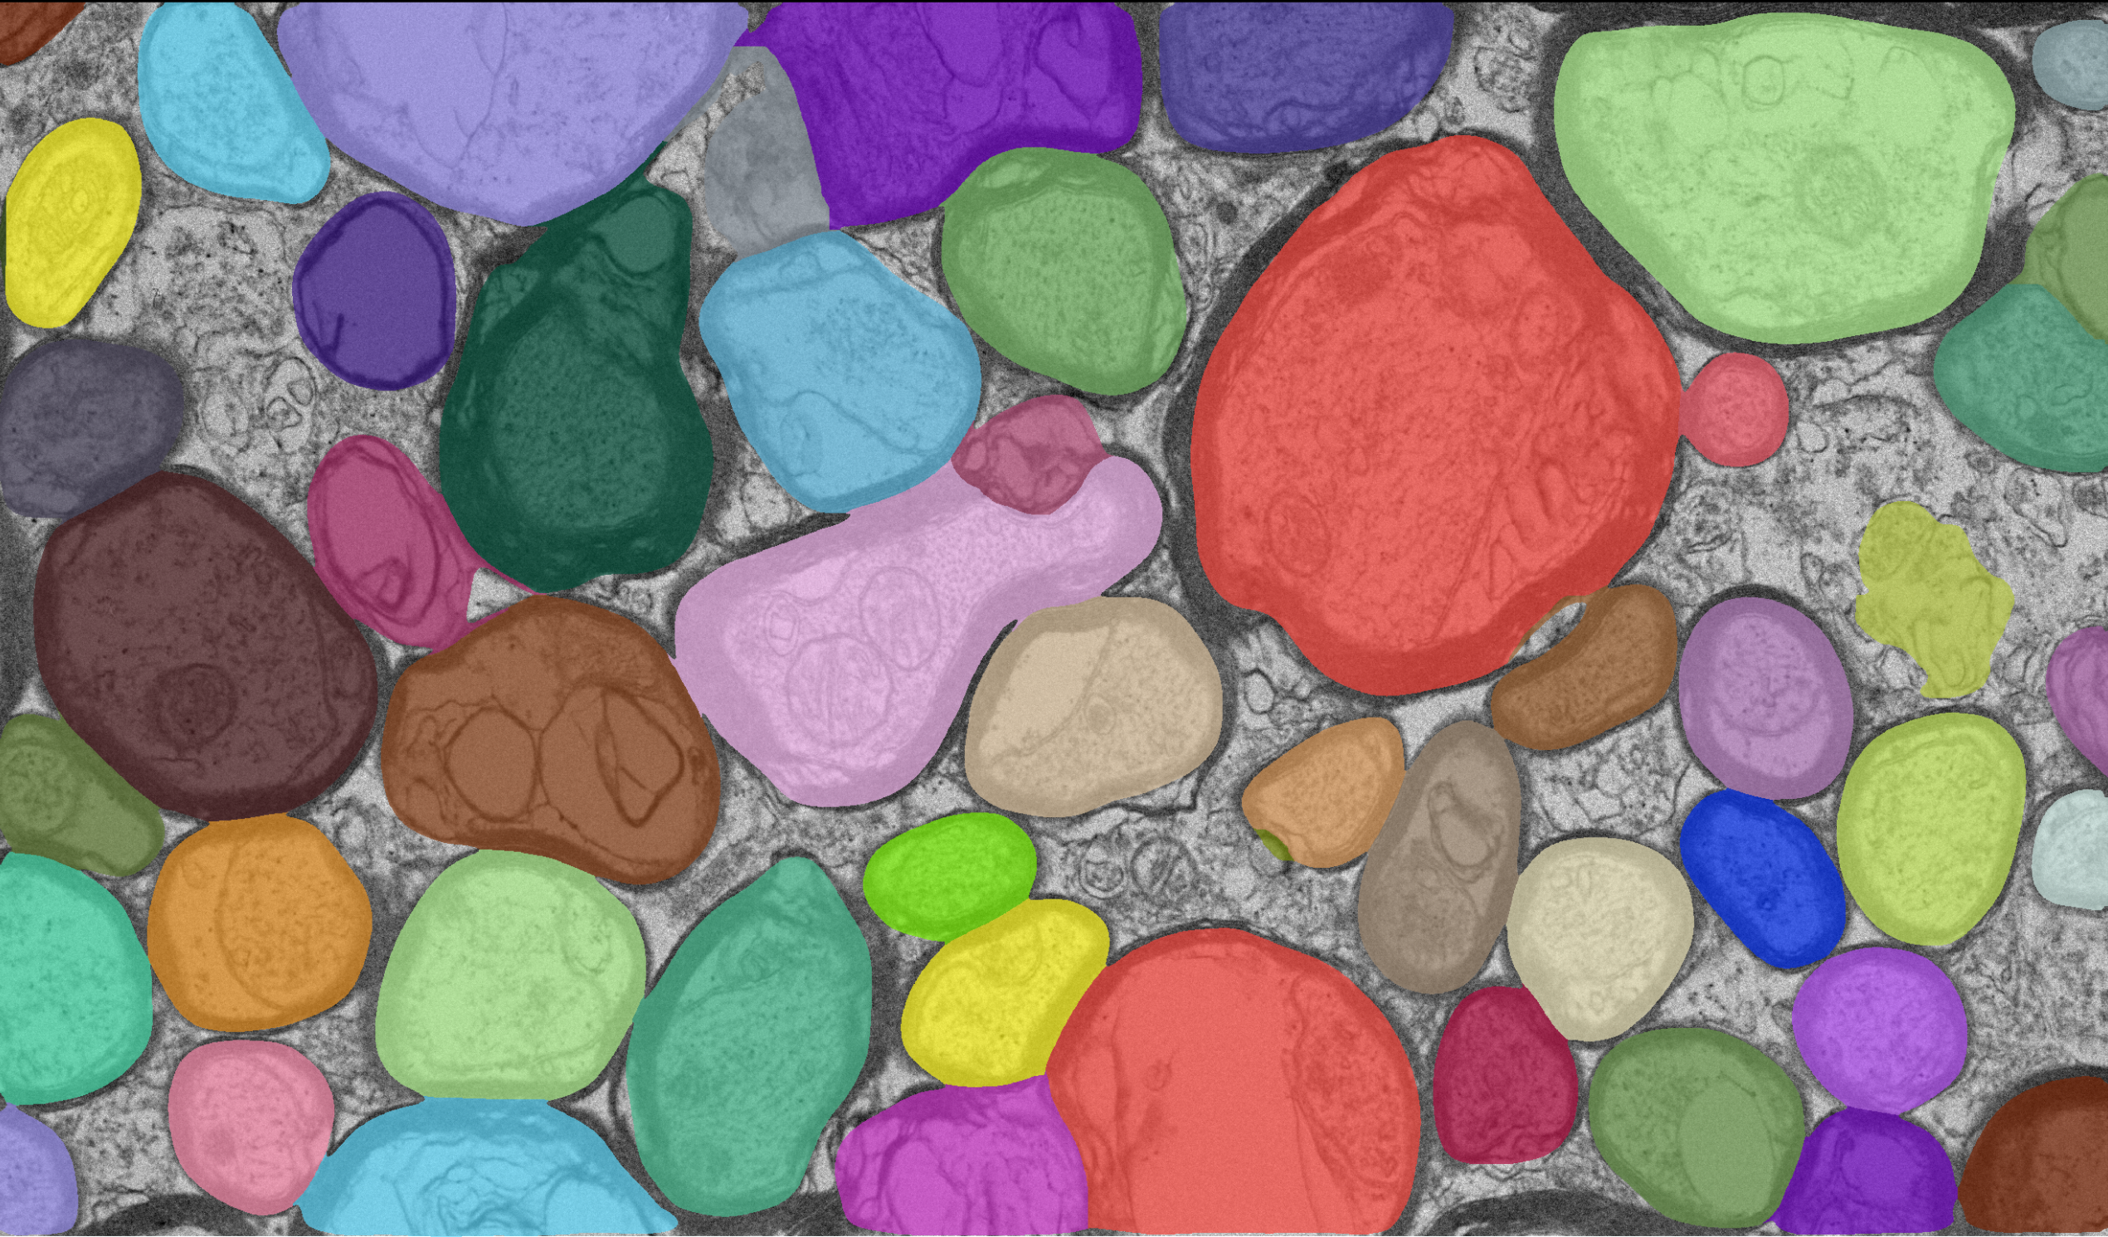
Manual vs LM Automatic Segmentation
Parameters: 0.75, 0.75, 1
Time to segment:
~ 42 hours/image
Time to segment:
5.5 ± 0.3 seconds/image
27

Slide 29
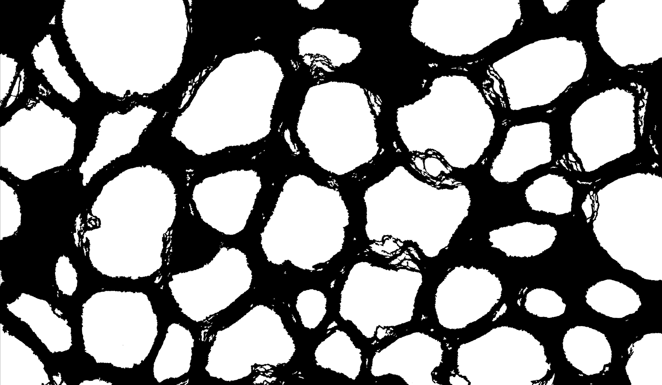
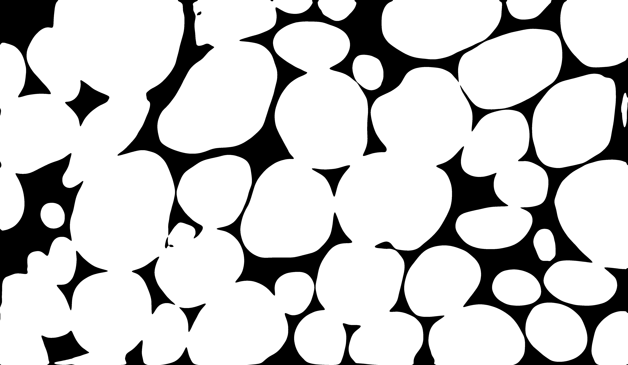
Binary Map Comparison
Intra-axonal space vs LM model
28

Slide 30
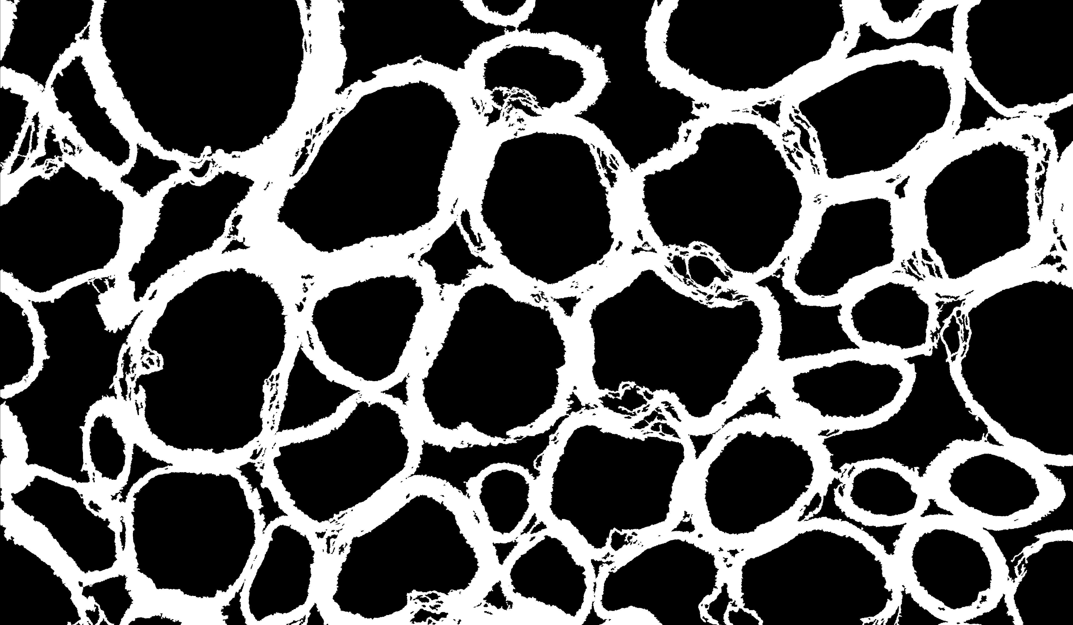
Binary Map Comparison
Myelin vs LM model
0
29

Slide 31
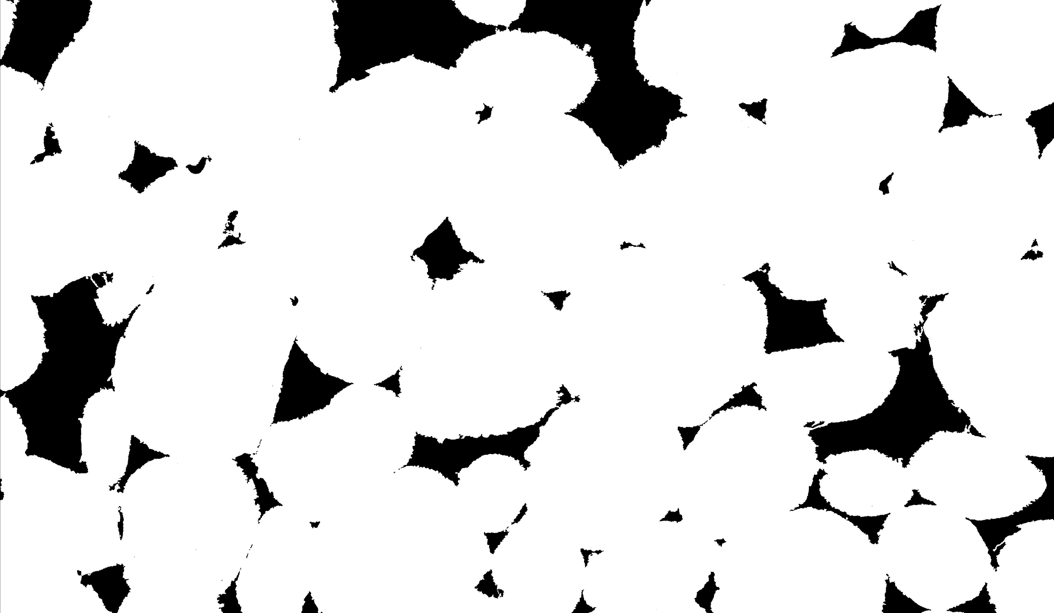
Binary Map Comparison
Intra-axonal space and myelin vs LM model
30

Slide 32
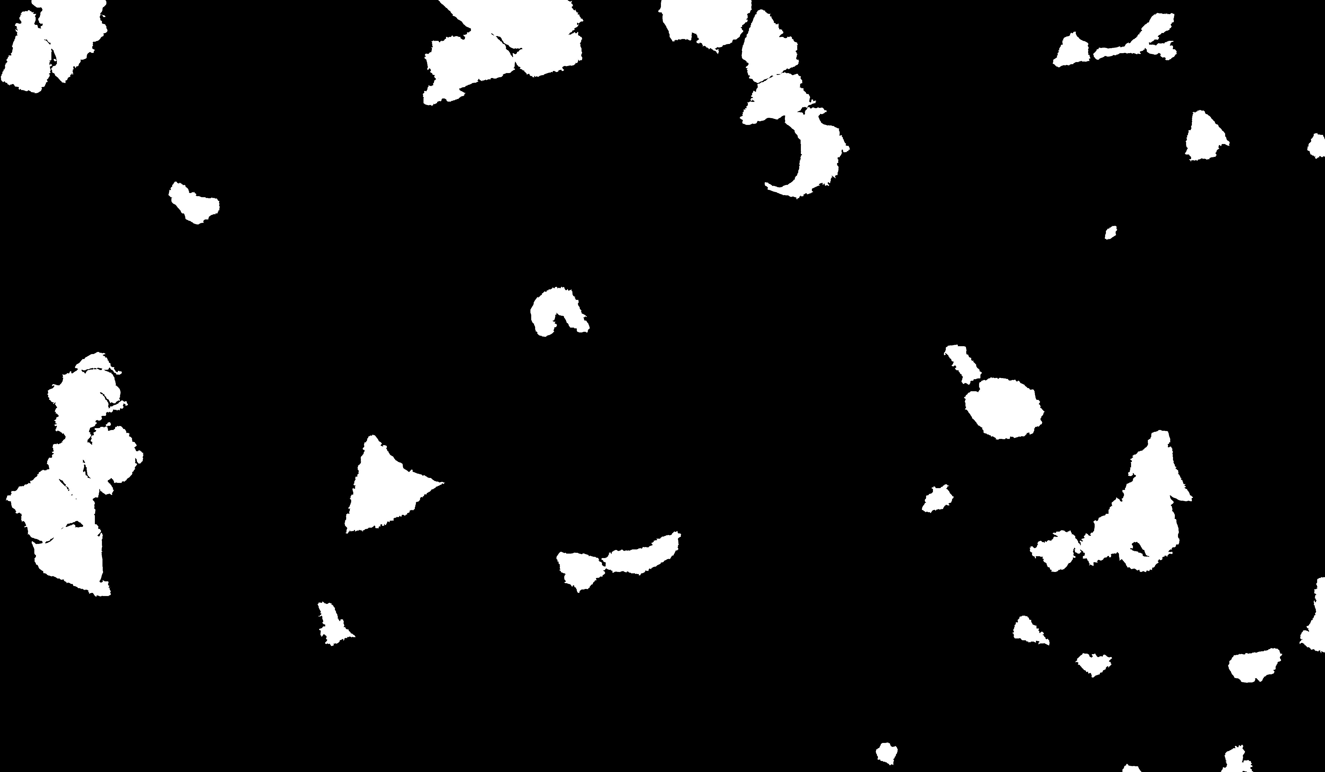
Binary Map Comparison
Other cells vs LM model
31

Slide 33
f Results
Are they statistically different from one another?
Can the uncertainty be quantified?
Model | f | f_{ax} | f_{m} | f_{ax + m} | f_{c}
Manual | - | 0.51 ± 0.04 | 0.32 ± 0.03 | 0.82 ± 0.05 | 0.08 ± 0.03
EM | 0.020 ± 0.007 | - | - | - | -
LM | 0.79 ± 0.02 | - | - | - | -
MRI | 0.3 ± 0.2 | - | - | - | -
32

Slide 34
Metric Results
Parameters: 0.75, 0.75, 1
EM Model
Metrics | Intra-Axonal Space | Myelin | Intra-Axonal Space & Myelin | Other Cells
DSC | 0.06 ± 0.01 | 0.0002 ± 0.0003 | 0.04 ± 0.01 | 0.05 ± 0.05
Precision | 0.9 ± 0.1 | 0.002 ± 0.002 | 0.9 ± 0.1 | 0.1 ± 0.1
Accuracy | 0.51 ± 0.03 | 0.67 ± 0.03 | 0.19 ± 0.05 | 0.91 ± 0.03
LM Model
Metrics | Intra-Axonal Space | Myelin | Intra-Axonal Space & Myelin | Other Cells
DSC | 0.77 ± 0.03 | 0.42 ± 0.02 | 0.91 ± 0.02 | 0.05 ± 0.03
Precision | 0.63 ± 0.04 | 0.29 ± 0.02 | 0.93 ± 0.05 | 0.02 ± 0.02
Accuracy | 0.70 ± 0.03 | 0.36 ± 0.03 | 0.85 ± 0.03 | 0.18 ± 0.02
33

Slide 35

Two-Sample T-Test
Statistical method that compares two means:
Can find p-value
  Probability of measuring the result
  p-value > .05/n = no significant difference
  p-value < .05/n = significant difference
$$t−test value= \frac{\left|\left(\overline{x_{A}}−\overline{x_{B}}\right)\right|}{\sqrt[2]{\frac{σ_{A}^{2}}{n_{A}}+\frac{σ_{B}^{2}}{n_{B}}}}$$
34
Notes:
Move to extra slides

Slide 36
Two-Sample T-Test
p-value > .05/n = no significant difference
p-value < .05/n = significant difference
n = 10
f Comparison | p-Value
f_{EM} vs f_{ax} | < .0001
f_{EM} vs f_{m} | < .0001
f_{EM} vs f_{c} | .0001
f_{EM} vs f_{ax+m} | < .0001
f_{EM} vs f_{MRI} | .0014
f Comparison | p-Value
f_{LM} vs f_{ax} | < .0001
f_{LM} vs f_{m} | < .0001
f_{LM} vs f_{c} | < .0001
f_{LM} vs f_{ax+m} | .1374
f_{LM} vs f_{MRI} | < .0001
35
Notes:
Maybe get rid of the MRI

Slide 37
Two-Sample T-Test
Parameters: 0.75, 0.75, 1
p-value > .05/n = no significant difference
p-value < .05/n = significant difference
n = 10
f Comparison | p-Value
f_{EM} vs f_{ax} | < .0001
f_{EM} vs f_{m} | < .0001
f_{EM} vs f_{c} | .0001
f_{EM} vs f_{ax+m} | < .0001
f_{EM} vs f_{MRI} | .0014
f Comparison | p-Value
f_{LM} vs f_{ax} | < .0001
f_{LM} vs f_{m} | < .0001
f_{LM} vs f_{c} | < .0001
f_{LM} vs f_{ax+m} | .1677
f_{LM} vs f_{MRI} | < .0001
36

Slide 38
Daniel’s f Results
Calculated using a module in 3D Slicer after segmenting
No differences from using binary map to compare
Model | f | f_{ax} | f_{m} | f_{ax + m} | f_{c}
Manual | - | 0.51 ± 0.04 | 0.32 ± 0.03 | 0.82 ± 0.05 | 0.08 ± 0.03
MRI | 0.3 ± 0.2 | - | - | - | -
f = packing fraction
f_{ax} = intra-axonal packing fraction
f_{m} = myelin packing fraction
f_{ax + m} = intra-axonal and myelin packing fraction
f_{c}= intracellular packing fraction of other cells
37

Slide 39
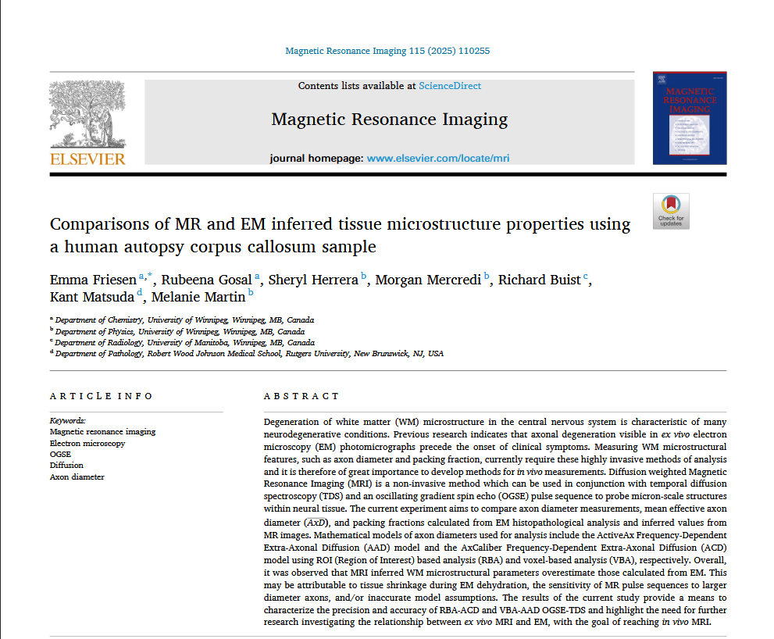
Human f
*
*
f_{ax} | f_{m} | f_{c}
0.12 ± 0.03 | 0.23 ± 0.06 | 0.32 ± 0.08
Courtesy of Daniel Girard
* E. Friesen, R. Gosal, S. Herrera, M. Mercredi, R. Buist, K. Matsuda, M. Martin, “Comparisons of MR and EM inferred tissue microstructure properties using a human autopsy corpus callosum sample”, Magnetic Resonance Imaging, Jan. 2024. [Online]. Available: \url{https://www.sciencedirect.com/science/article/pii/S0730725X24002364}.
38
Notes:
Targeting humans vs mice cells, (use Emma’s results, human fax was so small). We should analyze humans more in details. Myelin decays too fast (T2), can’t use alone (Nicole will do this)

Slide 40
Female Mouse Results
One slice from one female mouse
No manual segmentations ∴ no metric calculations
Model | f Value
EM | 0.013081
LM | 0.581809
39

Slide 41
Human Results
One slice from one human EM image
No manual segmentations ∴ no metric calculations
Variable | Value
Time | 3.74 s
f_{LM} | 0.27514
40

