Slide 1


Seeing Beyond the Limits of Dark Matter Searches: Mineral Detection of Heavy Dark Matter
Jennika McIntosh
Mcdonald Institute & Queen’s University graduate student
Canadian Association of Physics Conference,
University of Ottawa 2026
Notes:
Hi, my name is Jennika McIntosh. I’m a graduate student with the McDonald Institute and at Queen’s University. Today I going to discuss a method of detecting heavy dark matter with ancient earth minerals. The fluxes of these particles today would be too low to be detectable in direct detection experiments on human timescales.

Slide 2
Why Are We Poking Around in The Dark?
Visible matter alone cannot account for the gravitational pull needed to explain the universe's large-scale structure. The missing mass is Dark matter (DM).
1
2
3
Galactic
rotation
curves
Galactic
rotation
curves
Gravitational lensing
Cosmic
Microwave
Background
Notes:
Visible matter alone, extending to planets, stars and galaxies, cannot account for the gravitational pull needed to explain the universe's large-scale structure. This missing mass is dark matter, making up over 25% of the known universe while standard matter, everything that we see, is only 5%. The standard assumption is that our DM candidate does not interact with the electromagnetic field and therefore cannot be detected or seen through photon interactions. But through its gravitational interactions we have observational evidence — such as galactic rotation curves.

Slide 3
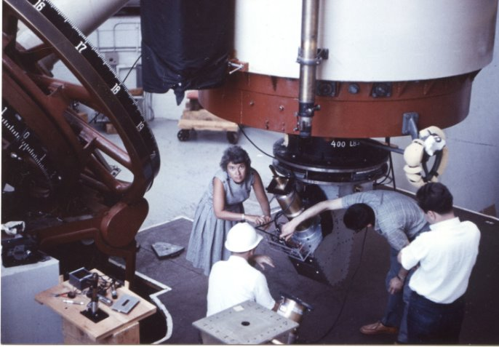
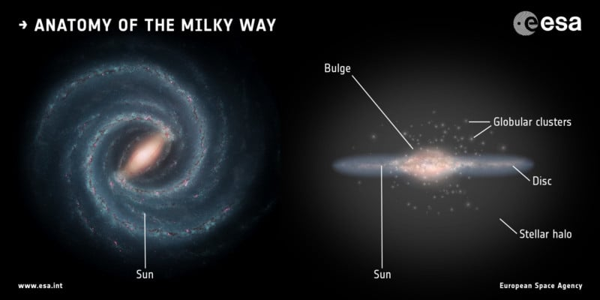
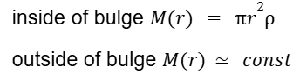
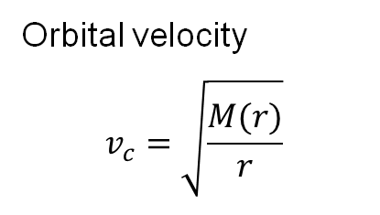

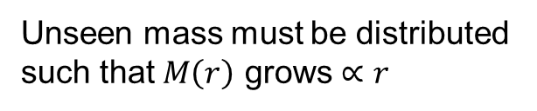

Why Are We Poking Around in The Dark?
1
2
3
Galactic
rotation
curves
Galactic
rotation
curves
Gravitational lensing
Cosmic
Microwave
Background
Credit: Carnegie Institution, Vera Rubin, 1965
observed
expectations
rendering from the European space Agency https://www.esa.int/ESA_Multimedia/Images/2016/09/Anatomy_of_the_Milky_Way
Rotation speed $v_{c}$ (km/s)
Orbital velocity
$$v_{c}=\sqrt{\frac{M(r)}{r}}$$
0 100 200 300
Unseen mass must be distributed such that $M\left(r\right)$ grows $∝r$
0 10 20 30 40 50
Radius from Center $r$ (kpc)
Notes:
The expectation, due to most of the visible mass being located within the galactic bulge, is that objects near the edge of the galaxy should orbit slower to remain gravitationally bound. But Vera Rubin's original optical observations of starlight showed rotation curves staying flat or even rising slightly at larger radii, rather than declining as Keplerian motion would predict. Implying the presence of unseen mass that is distributed such that the mass continues to increase proportional to r, preventing galaxies from flying apart.

Slide 4
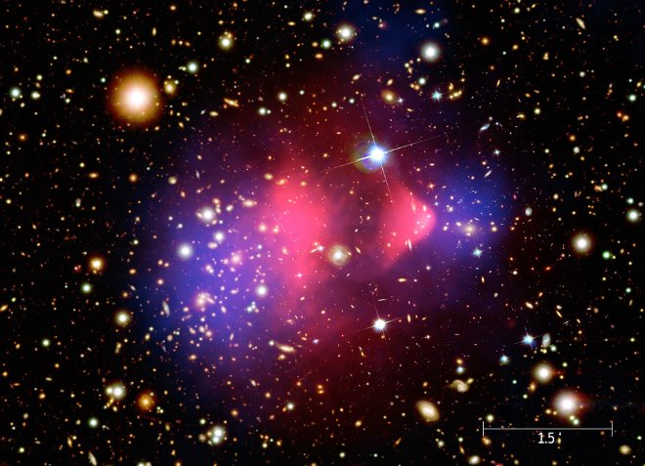
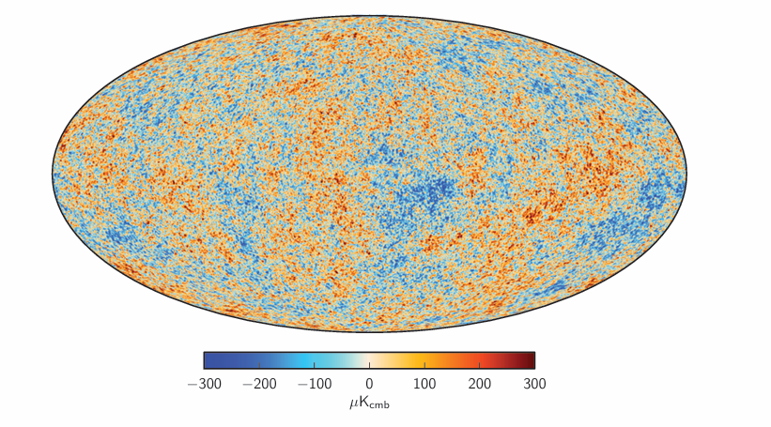
Why Are We Poking Around in The Dark?
1
2
3
Galactic
rotation
curves
Cosmic
Microwave
Background
Galactic
rotation
curves
Gravitational lensing
Cosmic
Microwave
Background
Gravitational lensing
Image Credit: ESA/Hubble & NASA
Notes:
Other evidences include gravitational lensing, curve spacetime and bend path of light. CMB temperature variation is only precisely fit when a dark matter model is used. So you ask why are we poking around in the dark? Without dark matter, we cannot fully explain how galaxies formed, how the universe evolved, or what it is ultimately made of — nor the fundamental laws of physics that govern our own existence, including the gravitational scaffolding that allowed the conditions for life on Earth to form.
CMB: 3000k, photons had last scattering event, nucleons now bound, free streaming and red shifting.
Before recombination, ordinary matter was tightly coupled to photons (via Thomson scattering), small density fluctuations (seeded by quantum fluctuations during inflation), drive gravitational collapse which photon radiation pushes against –creating oscillation, literally sound waves propagating through the early universe plasma. These are called baryon acoustic oscillations (BAO).But dark matter doesn't interact with photons; DM clumps could grow continuously, creating gravitational wells that baryons eventually fall into (after recombination, once photon pressure decouples) — and the size/timing of these competing effects sets the precise pattern of peaks seen in the power spectrum today.

Slide 5


What sets the DM signal?
DM
DM
Standard Halo Model (SHM)
Direct detection
$$ρ_{0}≈0.3\frac{GⅇV}{cm^{3}}$$
Local DM density
Dark matter speed
$$v_{x} \sim {10}^{−3}c$$
SM
SM
We search for composite DM of heavy enough mass to produce a measurable nuclear recoil that would melt the mineral
Notes:
non-gravitational interactions with standard model matter remain undetected, and its fundamental nature unknown. The standard halo model describes the dark matter as a gravitationally bound, roughly spherical distribution of mass encompassing a galaxy (smooth, virialized, isothermal sphere) One candidate is composite dark matter, made up of bound states of more fundamental constituents, typically held together by a new confining 'dark' force analogous to QCD. Because the dark matter particle is itself a composite object (like a nucleus), its interactions with the Standard Model can exhibit coherent, form-factor-suppressed scattering. So we may not see the DM particle come in, but we look for this rare nuclear recoil scattering event.
setting a local density ρ₀ ≈ 0.3 GeV/cm³, with particle velocities following a Maxwell-Boltzmann distribution centered around a characteristic speed (σ ≈ 220 km/s), derived from the galactic rotation curve via the virial theorem.
In the Standard Halo Model, the local DM density comes from subtracting the known baryonic mass from the total mass inferred from the galactic rotation curve, then evaluating the leftover (dark) mass distribution at the Sun's location. The local velocity dispersion is set by assuming the halo is an isotropic (same in every direction), isothermal (every r has same temp) (Maxwellian) sphere, with its characteristic speed tied to the local circular rotation speed (~220 km/s)
*what sets density
*what sets speed

Slide 6

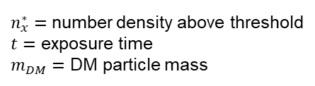


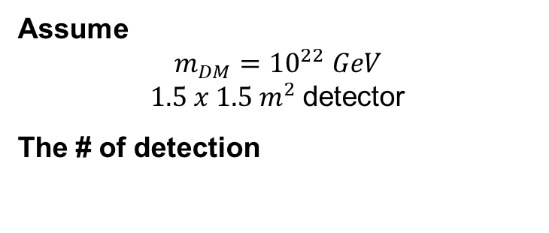
The exposure problem
$$Signal=Area × n_{x}^{∗}v_{x}t$$
Mass
$$n_{DM}$$
$$n_{DM}=\frac{ρ_{0}}{m_{DM}}$$
$n_{x}^{∗}=$number density above threshold
$t=$ exposure time
$m_{DM}=$ DM particle mass
Assume
$$m_{DM}={10}^{22} GeV$$
$1.5 x 1.5 m^{2}$detector
The # of detection
t
5 events in 10 000 years
500 000 events in exposure time
t
5
Notes:
The signal of this event depends on the detector area and the time in which the detector is exposed to DM flux.

Slide 7
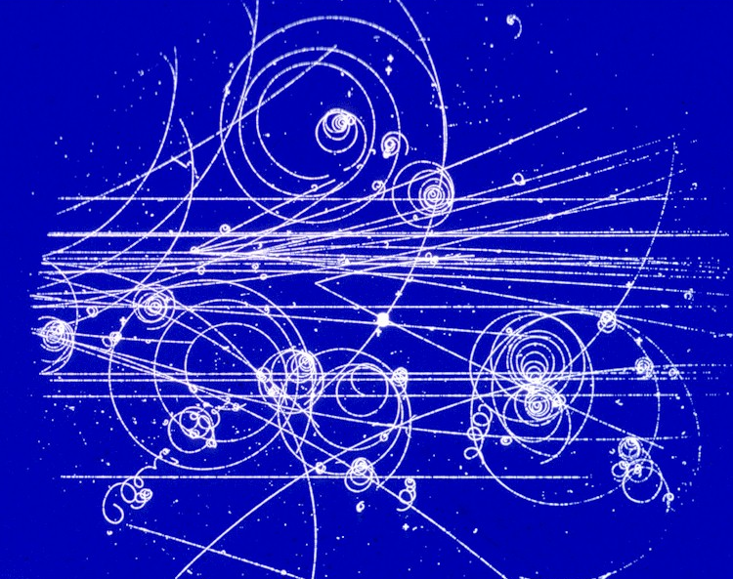

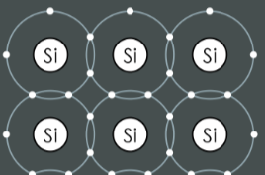
Current direct detection experiments
+
-
Scintillation in NaI(Tl) crystal
Scintillation in noble gases (Xenon, Argon)
Nucleation in bubble chamber
Axion to photon conversion
Nuclear and electronic recoils in semiconductor crystals
Notes:
Scintillators detect light from electronic excitation; some combine this with ionization charge for better discrimination. Bubble chambers use thermodynamic nucleation. Semiconductor detectors split by recoil type — nuclear recoils for traditional WIMP masses, electron recoils for sub-GeV DM. All face backgrounds from radioactive contamination and cosmic rays. Sensitivity range is set by threshold at low mass, exposure/event-rate at high mass.

Slide 8
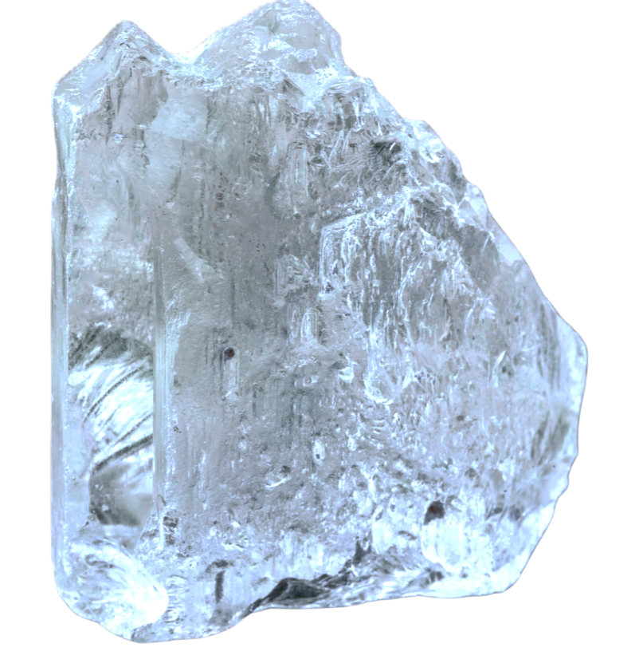
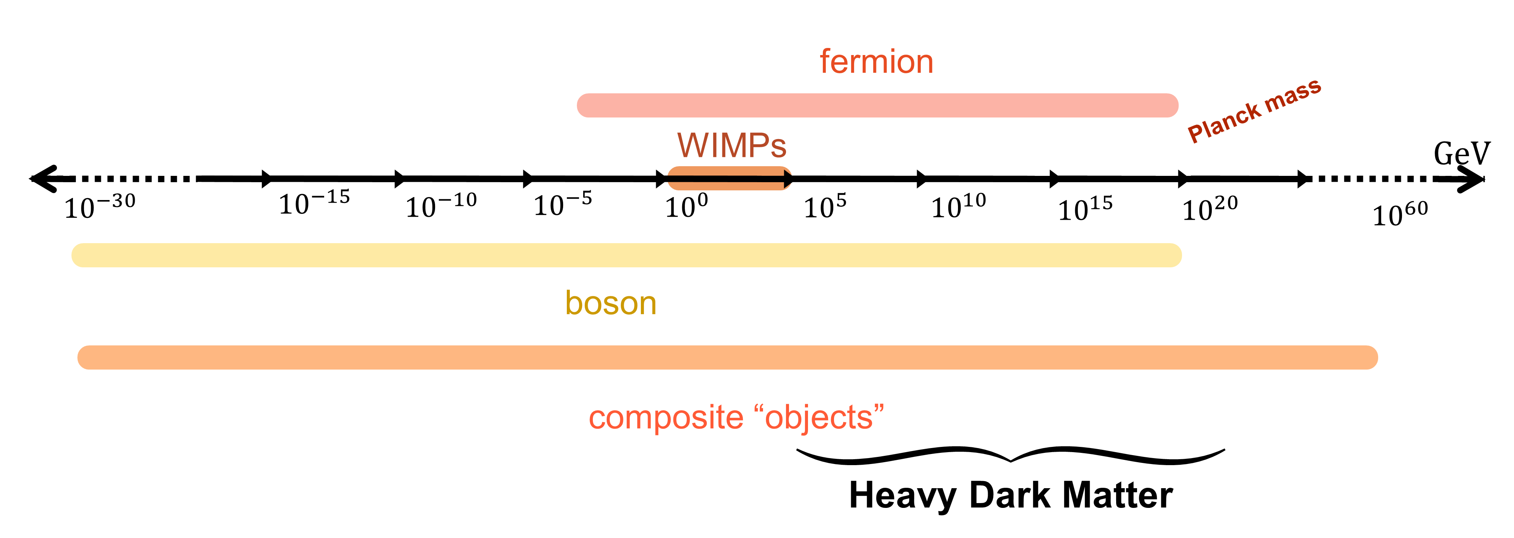
Current direct detection experiments
t
t
They all face backgrounds.
Cost ineffective to scale
+
-
Notes:
WIMPs are a leading dark matter candidate because, remarkably, weak-scale mass and weak-scale interaction strength alone naturally predict a relic abundance matching what we observe today — the so-called "WIMP miracle." (depends on annihilation cross section) Despite decades of dedicated searches across the experiments we've discussed, no confirmed WIMP detection has emerged, motivating exploration of complementary mass ranges.
microgram(∼10¹⁸GeV), falls below one particle per year.
paleo-detection's enormous exposure time pushes the upper mass limit dramatically higher than any lab experiment could reach in a few years.
(DEAP-3600, at Planck-mass sensitivity, would expect only about 1 event every 6 years — illustrating why such ultraheavy composite dark matter searches benefit enormously from the geological timescales paleo-detection provides.)
none of these reach the heavy composite regime

Slide 9
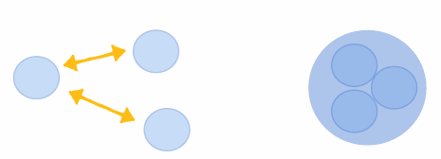
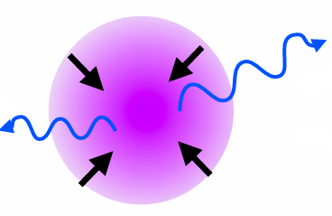
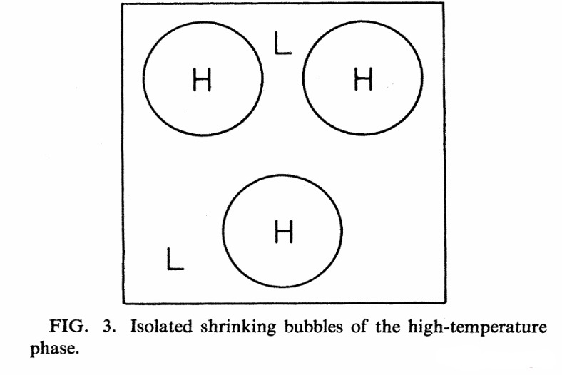
How can we get heavier dark matter?
Production from False Vacuum Bubbles
Dark Nucleosynthesis
Dissipative Processes
Witten ‘84
Boukhtouchen ‘24
Bramante et al ‘24
Naturally predict heavier mass scales
SHM properties apply identically to composite dark matter, since its internal structure doesn't affect bulk halo kinematics
Notes:
Among many dark matter candidates is composite dark matter bound states of dark particles. This changes the detection signature fundamentally, not just the mass. It may scatter multiple times as it crosses a detector. It may have an internal form factor, suppressing or modifying the interaction cross-section depending on momentum transfer. Depending on formation mechanism, it predicts very different mass scales — some pushing well beyond what WIMP searches were ever designed for.
The first mechanism, from Witten's 1984 work, is that as the universe cools through the QCD phase transition, pockets of the old high-temperature phase get trapped and shrink, compressing the particles inside into a single heavy composite.
Dark nucleosynthesis works like Big Bang nucleosynthesis — if the dark sector has its own confining force, dark quarks bind together as the universe cools into composite dark states.
And dissipative collapse happens when dark matter can radiate away kinetic energy, causing it to clump and bind together, just like ordinary gas cools and collapses into stars.

Slide 10
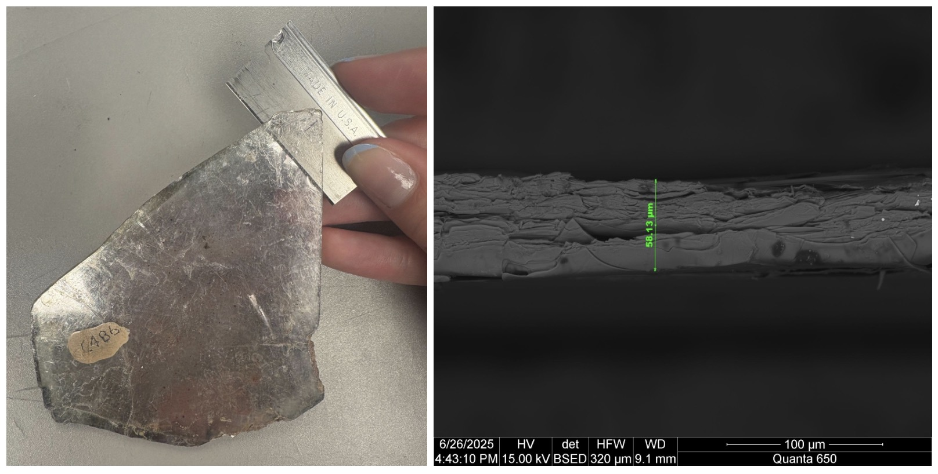
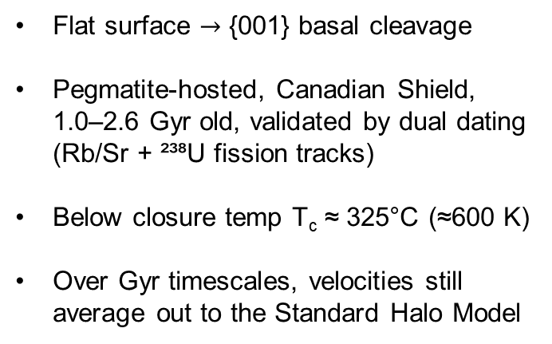
Mineral Detector: Muscovite Mica
Flat surface $→$ {001} basal cleavage​
Pegmatite-hosted, Canadian Shield, 1.0–2.6 Gyr old, validated by dual dating (Rb/Sr + ²³⁸U fission tracks)
Below closure temp T_{c} ≈ 325°C (≈600 K)
Over Gyr timescales, velocities still average out to the Standard Halo Model
Alex Queen’s University
Muscovite Mica:
KAl₂(AlSi₃O₁₀)(OH)₂
Notes:
We chose mica because it has a layered silicate structure that lets us cleave it into large, flat sheets using nothing more than a razor blade or adhesive tape. We also source our samples from pegmatite deposits in the Canadian Shield, which have been tectonically stable for up to 2.6 billion years and have a track retention temperature of around 325°C (isotopes can no longer diffuse out of crystal). This means any damage track produced in that time is still there, waiting to be read out.

Slide 11



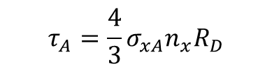
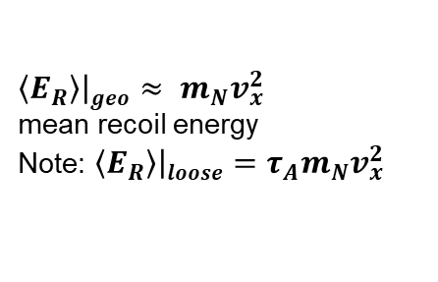

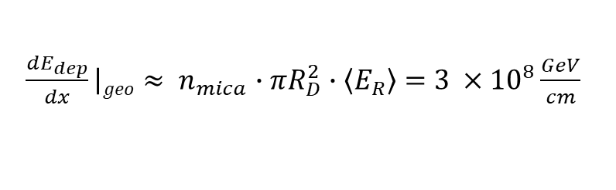
DM creates a melt signature in Mica
$R_{D} →$ transverse scale of $E_{dep}$
Lattice displacement E (~10-30 eV) Enthalpy $H_{f}$ of melt (~0.1 eV per atom)
Opaque limit $R_{D}$ = dm radius
Everything in its cross-section $σ_{geo}=πR_{D}^{2}$ scatters.
$\frac{dE_{dep}}{dx}\left|geo\right.≈ n_{mica}∙πR_{D}^{2}∙\left\langle E_{R}\right\rangle =$ $3 ×{10}^{8}\frac{GeV}{cm}$
Diffuse limit: composite is loosely bound; constituents interact via per-nucleon cross-section. Mean scatters is:
$$τ_{A}=\frac{4}{3}σ_{xA}n_{x}R_{D}$$
Both regimes deposit energy on the transit timescale $tdep \sim RD/vx$ ​
$\left\langle E_{R}\right\rangle \left|geo\right.≈ m_{N}v_{x}^{2}$
mean recoil energy
Note: $\left\langle E_{R}\right\rangle \left|loose\right.=τ_{A}m_{N}v_{x}^{2}$
Notes:
In the opaque (Geometric limit), the composite’s interaction strength scales with its full physical size.
number of interactions the particle undergoes with traversing a certain path
allows the deposited energy per site to range from well below to well above the melt threshold as the composite’s column density is varied. In this work we focus on the parameter space where Edep is sufficient to produce a detectable melt track,
geometric-limit physics is somewhat coupling-structure agnostic — it cares about the cross-section being large enough to saturate the geometric limit, not the detailed Lorentz structure of the underlying interaction, unlike standard WIMP searches which are very sensitive to exactly this scalar vs. spin-dependent distinction.

Slide 12
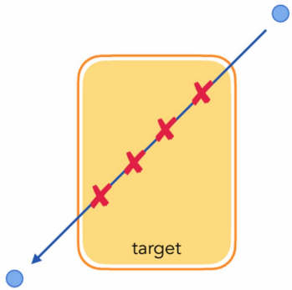


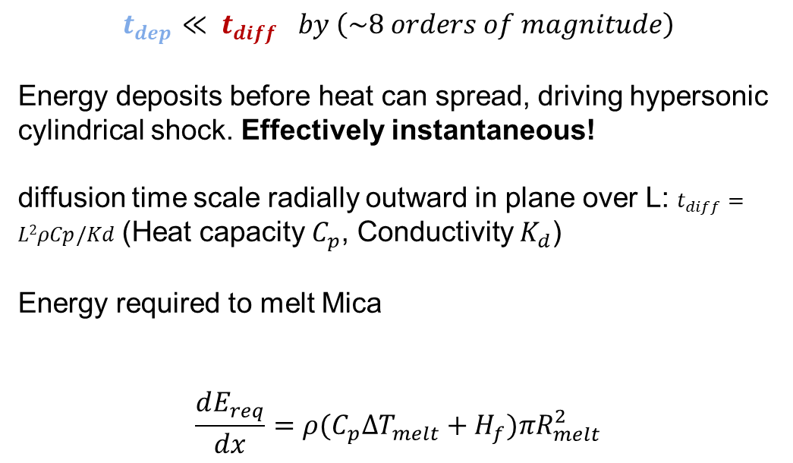
What does the melt trail look like?
$$t_{dep}≪ t_{diff} by \left(\sim 8 orders of magnitude\right)$$
Energy deposits before heat can spread, driving hypersonic cylindrical shock. Effectively instantaneous!
diffusion time scale radially outward in plane over L: $t_{diff}=L2ρCp/Kd$ (Heat capacity $C_{p}$, Conductivity $K_{d}$)
Energy required to melt Mica
$$\frac{dE_{req}}{dx}=ρ(C_{p}ΔT_{melt}+H_{f})πR_{melt}^{2}$$
specific latent heat, goes into displacing nuclei
T increase to melt point
$$ρ=n_{mica}{\overline{m}}_{N}$$
Notes:
In the opaque (Geometric limit), the composite’s interaction strength scales with its full physical size. Here the energy deposition per unit path length is determined by the geometric cylinder of rock swept out
allows the deposited energy per site to range from well below to well above the melt threshold as the composite’s column density is varied. In this work we focus on the parameter space where Edep is sufficient to produce a detectable melt track,
geometric-limit physics is somewhat coupling-structure agnostic — it cares about the cross-section being large enough to saturate the geometric limit, not the detailed Lorentz structure of the underlying interaction, unlike standard WIMP searches which are very sensitive to exactly this scalar vs. spin-dependent distinction.

Slide 13
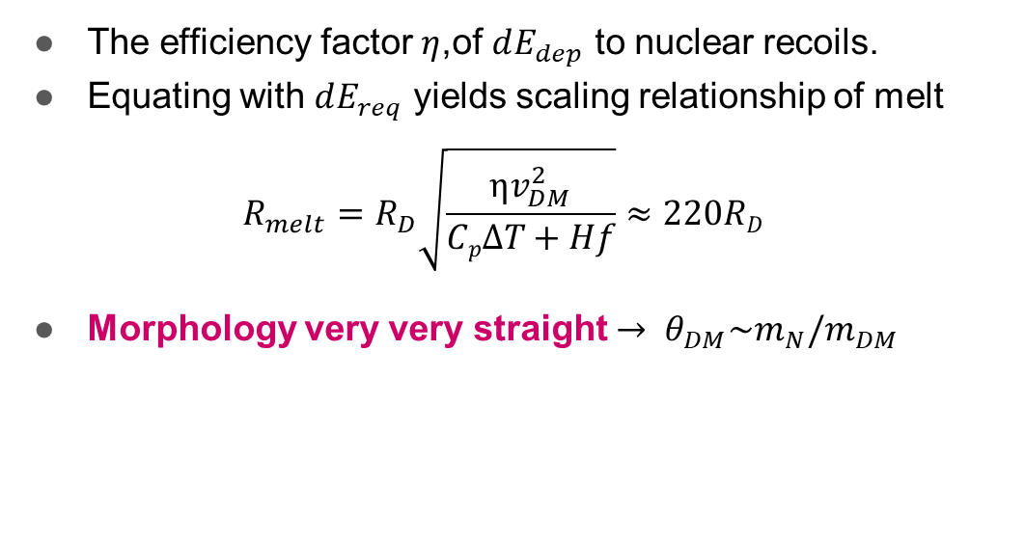
What signal are we looking for?
Deposited Energy
#1: Electronic stopping/ionization
#2: Nuclear recoil/
phonon
The efficiency factor $η$,of $dE_{dep}$ to nuclear recoils.
Equating with $dE_{req}$ yields scaling relationship of melt
$$R_{melt}=R_{D}\sqrt{\frac{ηv_{DM}^{2}}{Cp∆T+Hf}}≈220RD$$
Morphology very very straight $→ θ_{DM}\sim m_{N}/m_{DM}$
Notes:
No known Standard Model process produces a continuous, straight-line damage feature that would extend centimeters through mica sheets: spontaneous fission tracks terminate within ∼ 10 µm and alpha-recoil tracks anneal on ∼Myr timescales. A heavy composite transit is, to our knowledge, the only physical process that can produce a single, contiguous ≳cm-long damage track at the depths and exposure ages relevant to this work.

Slide 14
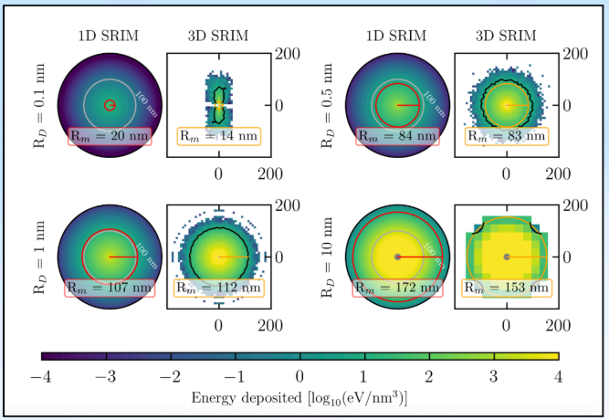
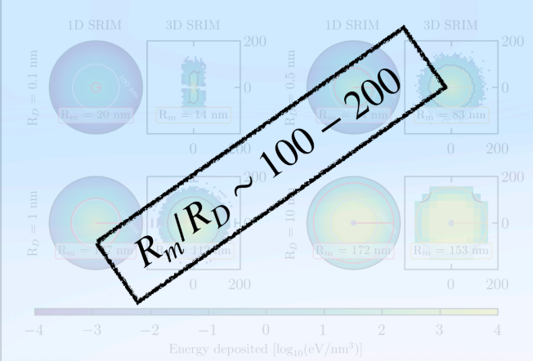
How we expect DM to behave
From SRIM (stopping and range of Ions in Matter) Simulation - http://www.srim.org/
For a target nucleus of mass mN, the mean recoil energy in the elastic, heavy-composite Limit (MD ≫ mN) is $\left\langle E_{R}\right\rangle =m_{N}v_{D}^{2}=$
Notes:
validates the analytic melt-radius model using SRIM/TRIM simulations, numerical tools that track individual nuclear recoil cascades and uses them to calibrate the phonon efficiency factor η.
The setup: when a composite transits the mineral, it knocks loose "primary knock-on atoms" (PKAs), which then cascade, colliding with and displacing further atoms. SRIM simulates this cascade for each element in muscovite, tracking how the PKA's energy splits between nuclear collisions (displacing atoms, the actual damage), phonons (lattice heating), and ionization (electron excitation).
paper conservatively assumes ionization energy never converts to lattice heating. So η is just the fraction of total deposited energy that goes into nuclear collisions + phonons (the parts that actually heat/melt the crystal): n = 0.75
SRIM gives 1D depth profiles per PKA; reconstruct a full 3D picture by assuming PKAs emerge radially outward from the composite's surface, distributing energy accordingly (with phonon data approximated by following the same spatial pattern as nuclear scatters, since SRIM only outputs phonon data in 1D).
shows good agreement for R_D ~ 0.1–1 nm (melt radii 20–200 nm). Below R_D < 0.05 nm, composites are too small/rare to produce continuous tracks at all. They'd just leave isolated point defects. Above R_D ~ 1 nm, SRIM's assumption of an undisturbed lattice breaks down (up to 50% of atoms get displaced near the cascade core), causing SRIM to underestimate the melt radius. So the analytic geometric model takes over as the trusted approach for the larger composites relevant to the rest of the paper.
since the experimental readout technique (XRF mapping, introduced next) is only sensitive to tracks from composites with R_D ≳ 0.1 μm, well above the validated SRIM range, the paper uses the analytic geometric estimate, calibrated with η = 0.75 from this SRIM study, for all subsequent sensitivity calculations.

Slide 15
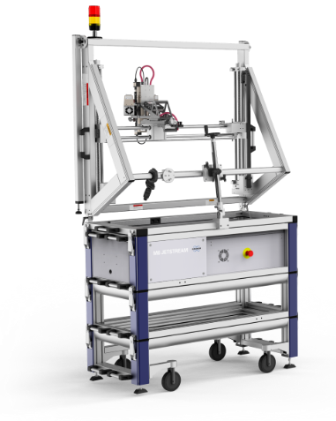

Readout mechanism: X-Ray Fluorescence Mapping
Copper-backing method​
Cleave mica along its {001} basal
X-ray fluorescence maps elemental composition across the cleaved surface
Localized melt features appear as distinct X-ray emission signatures
50 micron melt region
Mica
Copper substrate

Slide 16
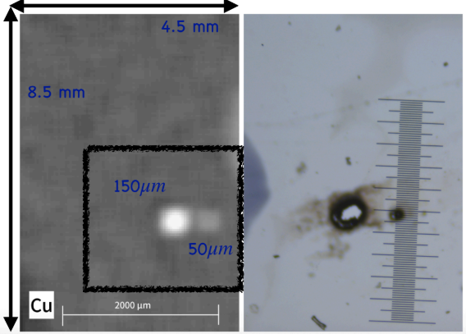
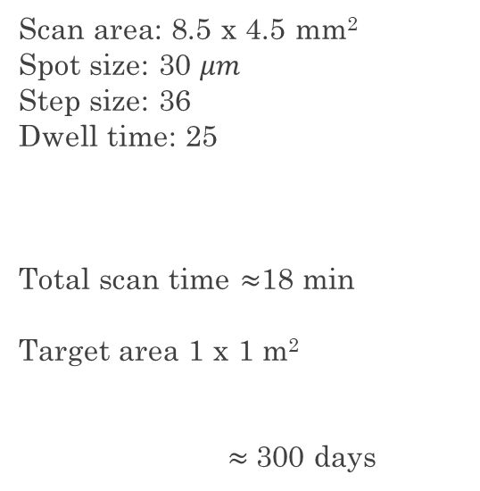
Current calibration results
Scan area: 8.5 x 4.5 mm²
Spot size: 30 $μm$
Step size: 36
Dwell time: 25
Total scan time $≈$18 min
Target area 1 x 1 m²
$≈$300 days
Laser ablated melt regions: 150 µm and 50 µm diameter — proxies for DM tracks

Slide 17
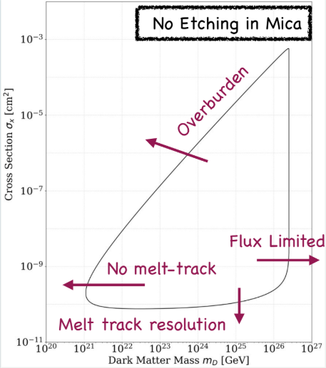
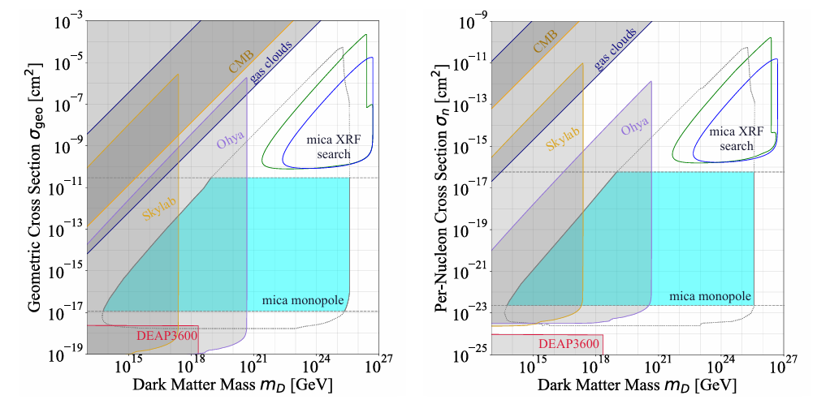
Old and New projected Sensitivities with Mica search
Boukhtouchen 26’
Mineral detection turns geological time into detector time
Need careful treatment of track annealing and readout sensitivity
Future directions: scale search to 1 m²
Notes:
Previous mica searches used optically clean samples with no visible damage
Relied on naturally occurring alpha-recoil tracks as a calibration/reference scale
Alpha tracks anneal on Myr timescales, but the exposure time assumed is Gyr

Slide 18
THANK YOU!
New Windows on Heavy Dark Matter: Mineral Melt
Modelling and X-Ray Readout for Muscovite Mica
arXiv:2606.02579v
Yilda Boukhtouchen, Joseph Bramante, Andrew Buchanan, Alex Hayes, Matt Leybourne, Jennika McIntosh, Aaron Shugar

Slide 19
Sodium iodide crystals, doped with thallium. After many layers of background rejection, they search for flashes of light as their dark matter signal — produced when DM causes nuclear recoil, recoiling SM particles deposits energy, exciting electrons from the valence band into the conduction band. As these excited states relax at the thallium activator sites, light is emitted. PMTs on each end of the crystal read out this flash as electronic pulses, with coincidence measurements between the two PMTs further reducing noise.
Current direct detection experiments
dark matter moves a bound valence electron to the conduction band, creating an electron-hole pair. The electron drifts due to voltage applied across the silicon via embedded electrode structures (gates) built into the CCD itself; the hole appears to move as a positive charge in the opposite direction, as neighboring electrons fill the vacancy it leaves behind. drifts into an isolated storage/sense node at the edge of the CCD, where it sits as a stable, tiny stored charge packet. measures the voltage that this stored charge creates — without removing or destroying it, Each individual read carries some random electronic noise, but the true signal stays the same across reads while the noise is random and uncorrelated. Averaging N independent reads reduces the noise by √N, while the real signal remains fixed.
+
-
Scintillation of noble gas, LZ Dm scatters off xenon nucleus, recoil energy excites atoms and prompts scintillation light (S1), recoil also ionizes some atoms freeing electrons. A strong E is applied via electrodes at top and bottom, drifts free electrons upward. At liquid gas interface there’s even stronger E. once pulled into gas layer they collide gas xenon atoms, exciting them producing secondary flash (S2). Time delay gives 3d reconstruction. Deap 3600 in Argon only has S1 step.,
Scintillation in NaI(Tl) crystal
Scintillation in noble gases (Xenon, Argon)
Nucleation in bubble chamber
Axion to photon conversion
Nuclear and electronic recoils in semiconductor crystals
SuperCDMS stands for Superconducting Cryogenic Dark Matter Search. Cryogenic refers to holding detectors at temperatures just above absolute zero. SuperCDMS detectors are designed with the primary function of detecting the minute crystal lattice vibrations (phonons) and ionization (charge) generated within the detector crystal — germanium and silicon semiconductors — by elastic collisions between detector atomic nuclei and dark matter particles. The energy deposited in a detector by an interacting dark matter particle may be as low as a few tens of electron volts (eV). Event detection at such energy levels requires a very sensitive experimental apparatus: phonons are read out using superconducting Transition Edge Sensors (TES), thin superconducting films held precisely at their transition point, where even a minute heat deposit causes a measurable change in resistance.
All face backgrounds. Radioactive contamination, cosmic rays, neutron-induced nuclear recoils, alpha decays. Each mechanism targets a different dark matter mass range, set by detector threshold (lower mass limit) and event rate over R exposure time (upper mass limit).
Bubble chamber, uses a superheated liquid held in a metastable state, just above its boiling point. DM particle scattering off a nucleus deposits its energy densely over a very short track length, providing enough localized energy to nucleate a bubble. Electron recoils from gammas and betas spread their energy over a much longer track, with lower energy density, and generally fail to trigger bubble formation at the chosen threshold making the detector naturally blind to most electromagnetic background. The main residual backgrounds that can still mimic a genuine signal are neutron-induced nuclear recoils and alpha decays.
Axion to photon conversion. Super conducting magnet generates a strong B field that allows axion to photon conversion. Inside is a microwave cavity with two tuning rods to change frequency. Don’t know mass of DM so have to change frequency for set exposure time. Some experiments have done 25 minutes at a frequency, mostly depends on noise accumulation. An axion interaction with virtual photon and produces photon, who’s energy is deposited in electric field.. Signal collected by antenna and read as an induced tiny voltage/current.
Notes:
Scintillators detect light from electronic excitation; some combine this with ionization charge for better discrimination. Bubble chambers use thermodynamic nucleation. Semiconductor detectors split by recoil type — nuclear recoils for traditional WIMP masses, electron recoils for sub-GeV DM. All face backgrounds from radioactive contamination and cosmic rays. Sensitivity range is set by threshold at low mass, exposure/event-rate at high mass.

Slide 20
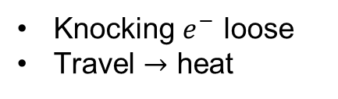
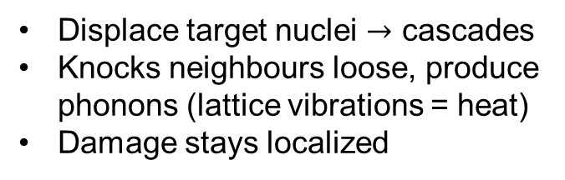
What is the Efficiency? How heat spreads out
Goal: Derive expected melt radius as a function of RD for both composite models.
Deposited Energy
#1: Electronic stopping/ionization
#2: Nuclear recoil/
phonon
Knocking $e^{−}$ loose
Travel $→$ heat
Displace target nuclei $→$ cascades
Knocks neighbours loose, produce phonons (lattice vibrations = heat)
    Damage stays localized
The efficiency is $η$, the fraction of $E_{dep}$ that goes to pathway #2
For standard low-velocity nuclear recoils in insulators η ≈ 0.75

