Slide 1




Developing Scalable Readout Electronics for Directional Sensitivity of the NEWS-G Dark Matter Experiment
Julia Redinger
University of Alberta
Supervisor: Dr. Marie-Cécile Piro
Globie
2026 CAP Congress
June 23, 2026

Slide 2
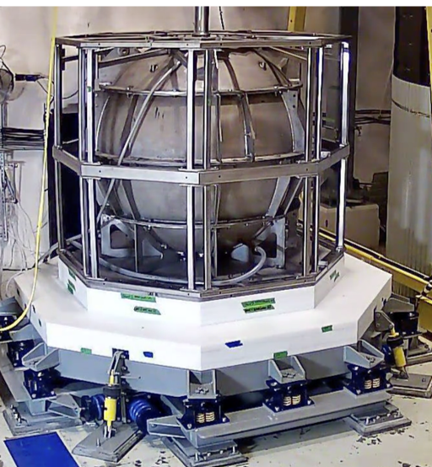
NEWS-G
(New Experiments with spheres – gas)
[1]
Searching for light Dark Matter
NEWS-G assumes the WIMP model
  Weakly Interacting Massive Particle
We know it’s there, but we don’t know what it is!
Notes:
Focuses on ionization detection method.
WIMP miracle – WIMPs match relic density very well!

Slide 3
Detection Goals and obstacles
NEWS-G focuses on the smaller mass region (less than ~5 GeV)
WIMP experiments will soon reach the neutrino floor!
  Experiments will also detect the neutrinos
  For NEWS-G, CE𝜈NS (Coherent Elastic Neutrino Nucleus Scattering) from the sun
  Looks the same as WIMPs, can’t be shielded
→ How can we distinguish between these
signals?
[2]
Neutrino Floor
Directionality!

Slide 4
Directionality
Take advantage of “WIMP Wind”!
  Apparent flux of dark matter as the sun
  moves through the galaxy
Dark matter will come from a particular direction in the detector
→ Need detector to determine direction of
incoming particles
[3]
Notes:
Paper?

Slide 5
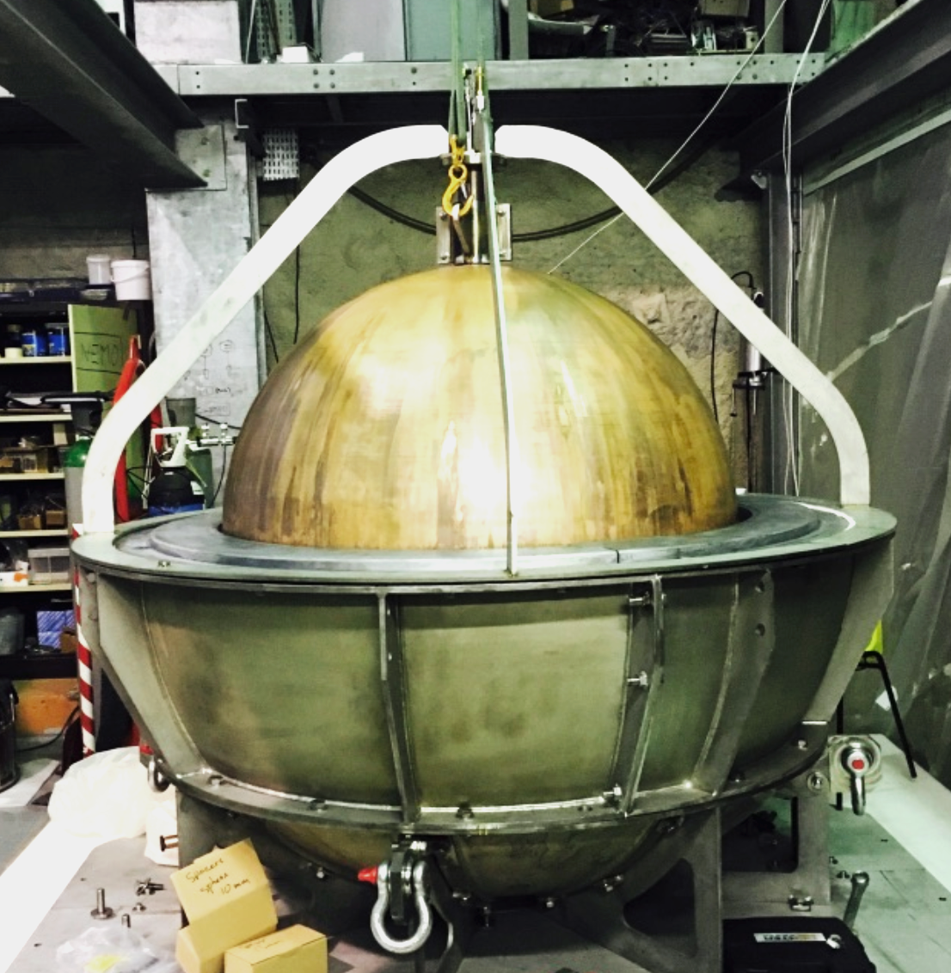
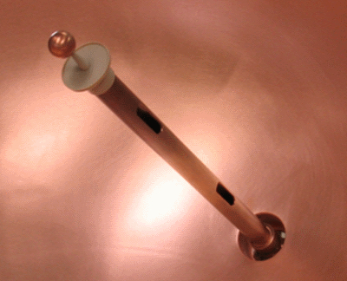
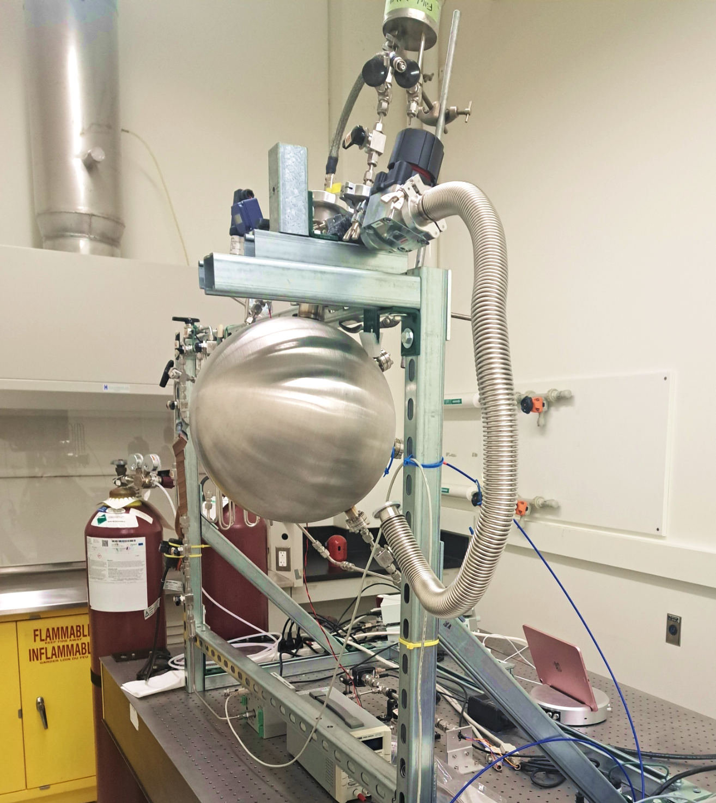
Spherical proportional counter (SPC)
[1]
Copper spherical vessel, filled with noble gas
High voltage anode in center allows charge
to be read out
Different spheres for data taking and R&D!
  The U of A has a 30 cm diameter sphere
Notes:
Noble, low A gas - higher sensitivity to low mass DM
S30: Argon

Slide 6
Detector operation
1. Incident particle interaction
  Primary ionization
2. Electron drift towards anode
3. Secondary electron/ion pair creation
  Townsend avalanche
4. Signal formation on sensor
  Current is induced by secondary ion drift
e-
ions
Notes:
Current induced by secondary ions drifting away from the anode
Cathode: sphere walls

Slide 7
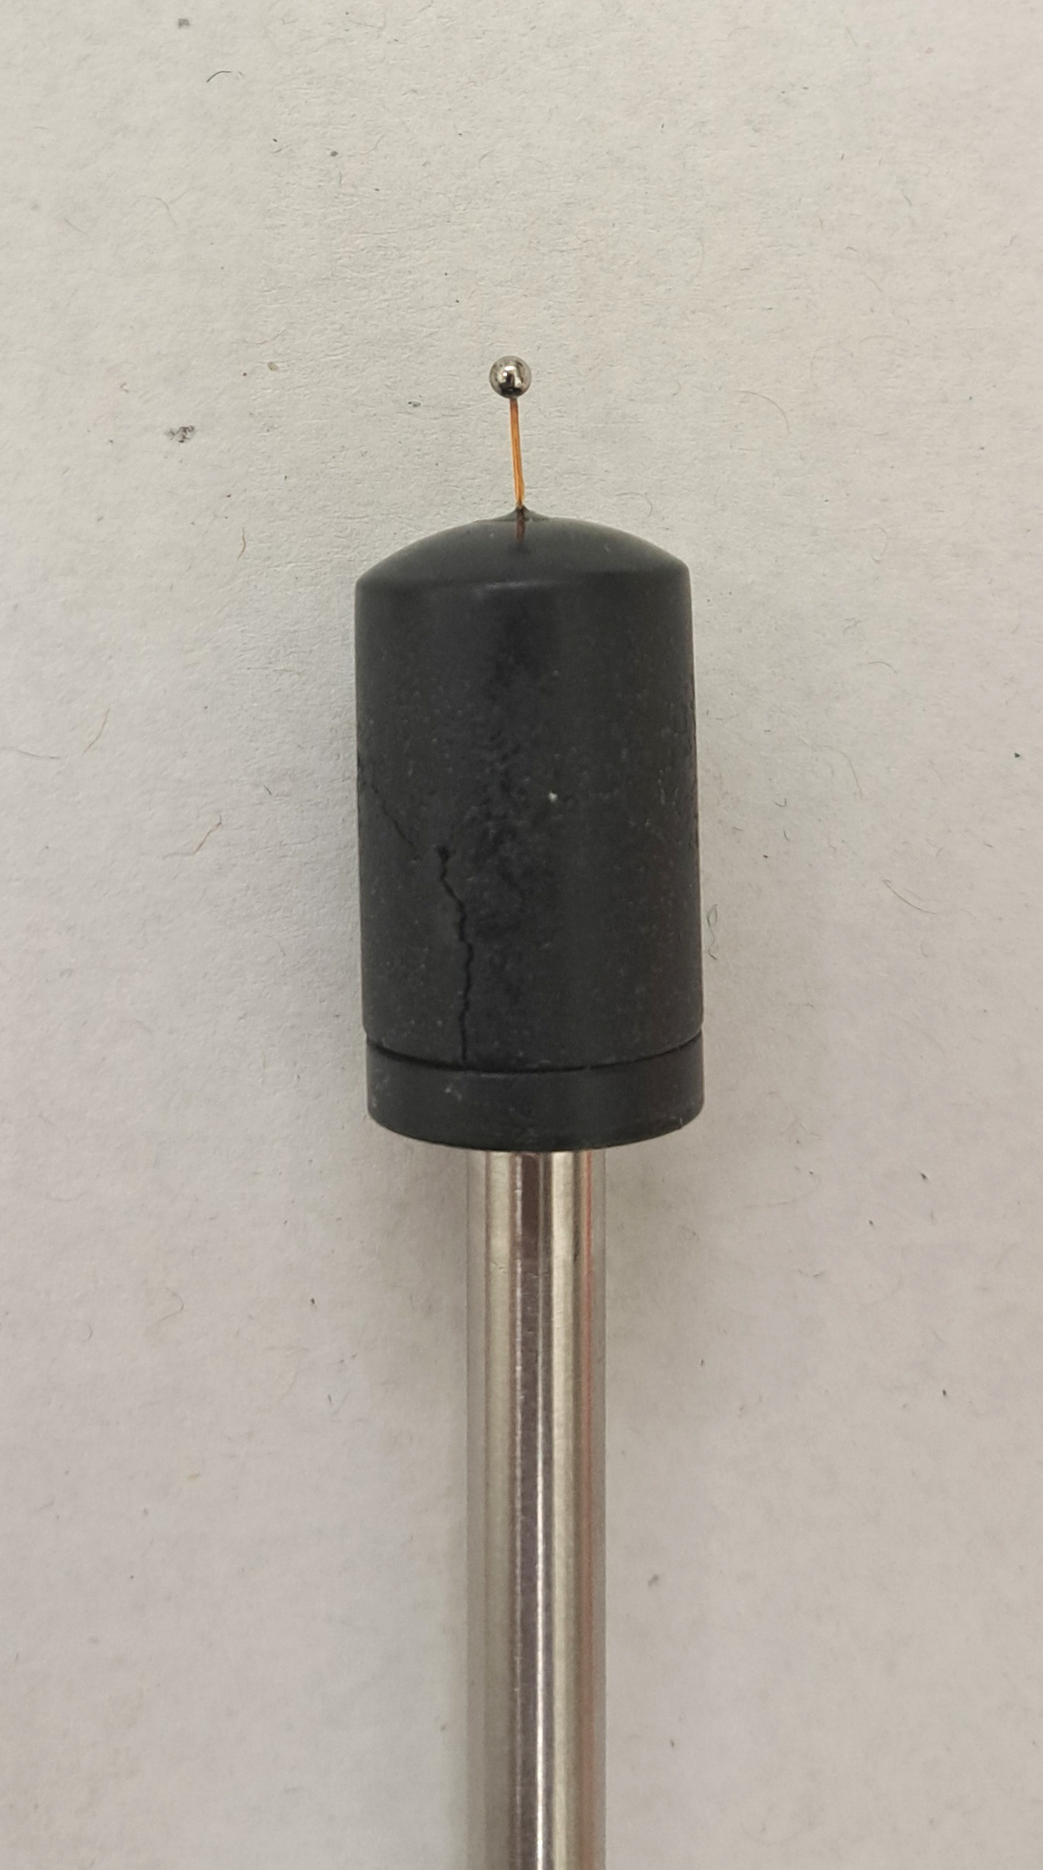
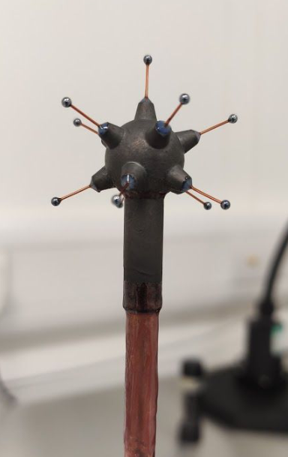
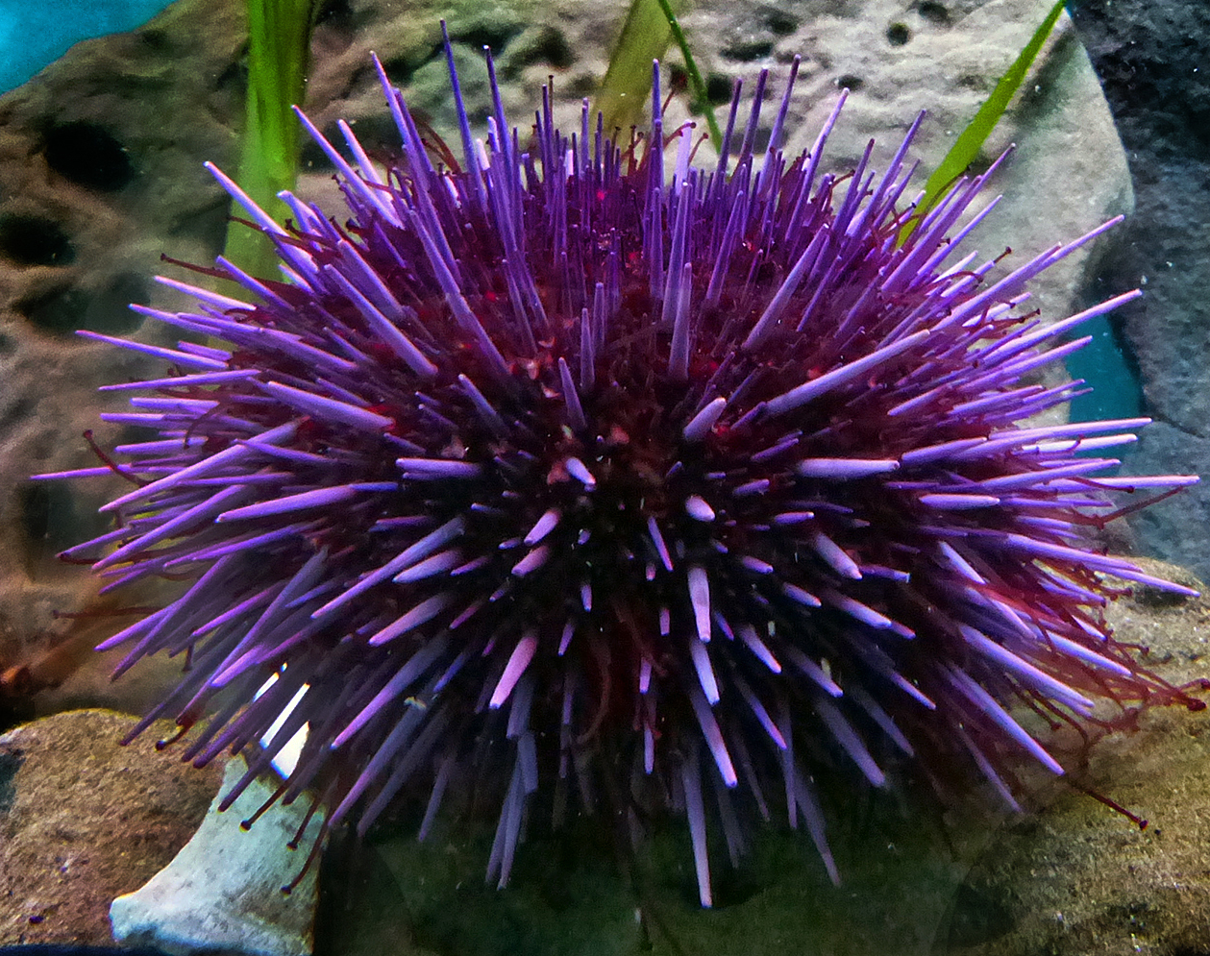
Sensor Anode
[1]
ACHINOS:
11 anodes instead of 1!
Means “sea urchin” in Greek
[4]

Slide 8
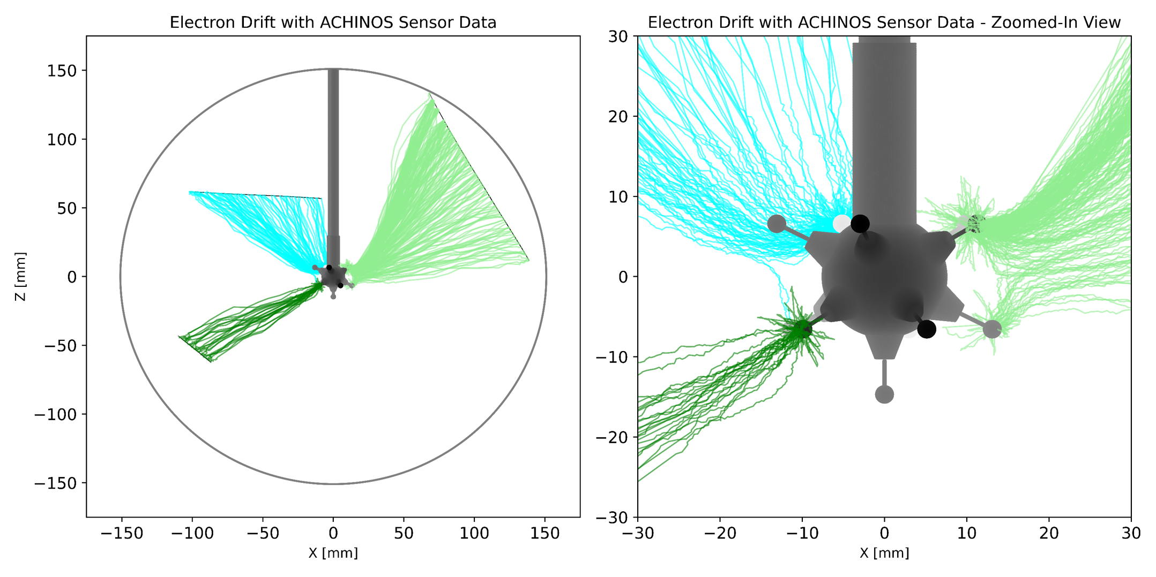
Directionality
Electrons from particle tracks will induce a signal on different anodes → provides directional information!
Requires individual anode readout
Simulations done by Keiran Nicholson:
Poster at 6 pm!
[5]
Notes:
Plan: take data and compare

Slide 9
Goal: Develop 11 Channel Readout System For ACHINOS!

Slide 10
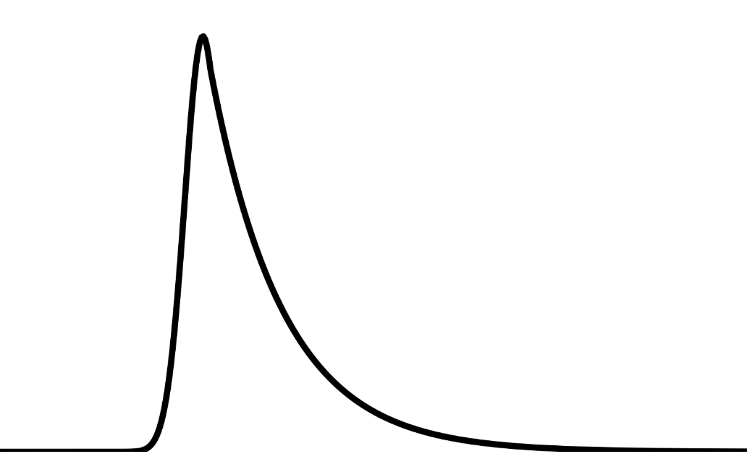
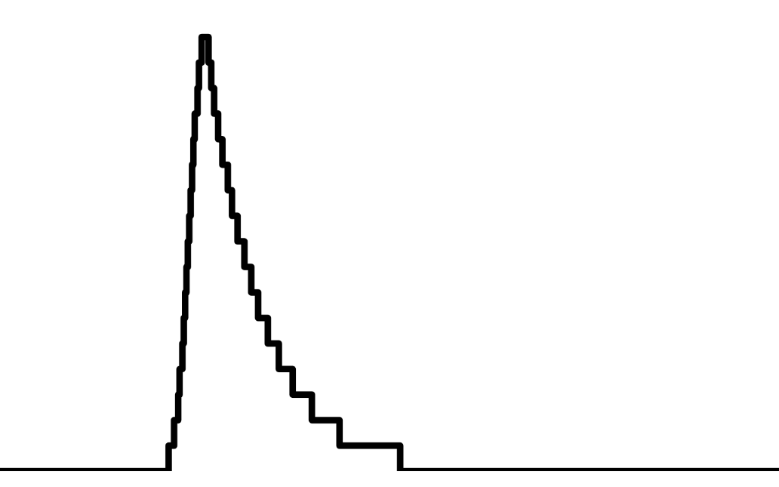

Signal Processing
(single anode)
High Voltage Bias
DAQ (Data Acquisition)
Pre-amplification
Digitization
Dispatching
Analysis & Storage

Slide 11
Single Anode S30 Setup

Slide 12
Single anode S30 Setup
High Voltage Bias
DAQ (Data Acquisition)
Pre-amplification
Digitization
Dispatching
Analysis & Storage
Single anode currently installed!
S30

Slide 13
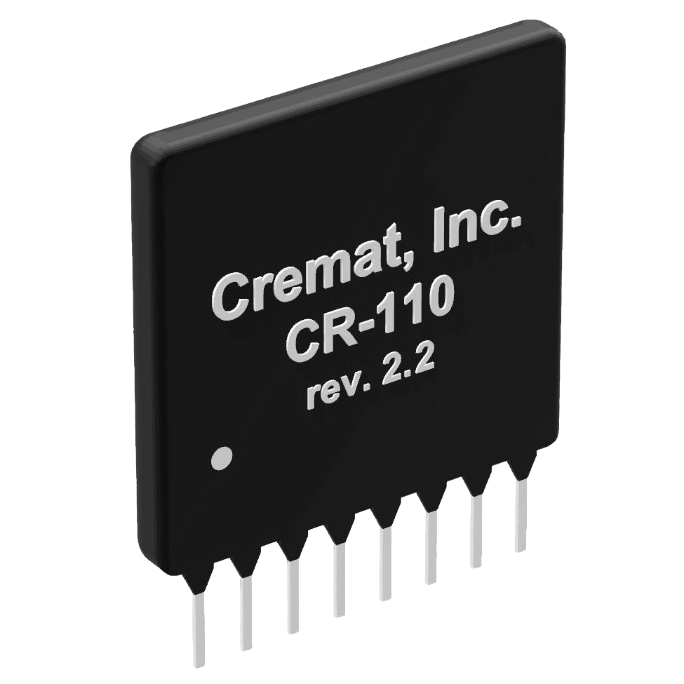
High Voltage Bias
Pre-amplification
Digitization
Dispatching
Analysis & Storage
DAQ (Data Acquisition)
[6]
Cremat charge-sensitive pre-amplifier
Commercially available
More expensive
Breakout board discontinued
S30

Slide 14
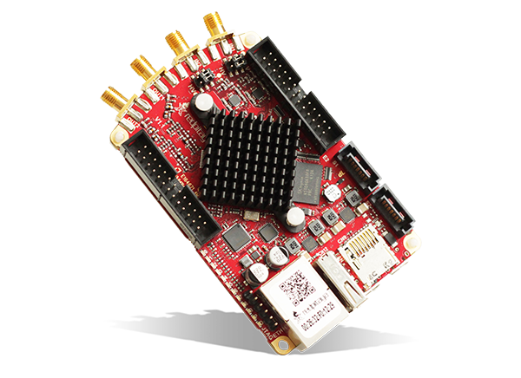
High Voltage Bias
Pre-amplification
Digitization
Dispatching
Analysis & Storage
DAQ (Data Acquisition)
Red Pitaya STEMlab 125-14
Commercially available
Features…
  an ADC (Analog to Digital Converter) for digitization
  an FPGA (Field Programmable Gate Array)
  for processing and dispatching
S30
[7]

Slide 15
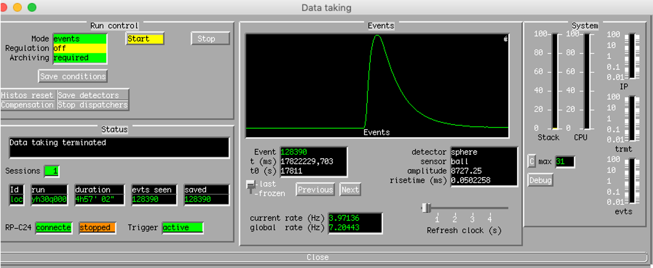
High Voltage Bias
Pre-amplification
Digitization
Dispatching
Analysis & Storage
DAQ (Data Acquisition)
Samba
Custom software used for the NEWS-G detector signals
Manages triggers/cuts and data storage

Slide 16
Eleven Anode S30 Setup
[1]

Slide 17
Eleven anode S30 Setup
High Voltage Bias
DAQ (Data Acquisition)
Pre-amplification
Digitization
Dispatching
Analysis & Storage
To be completed this summer!
Need to install ACHINOS!
S30
S30

Slide 18
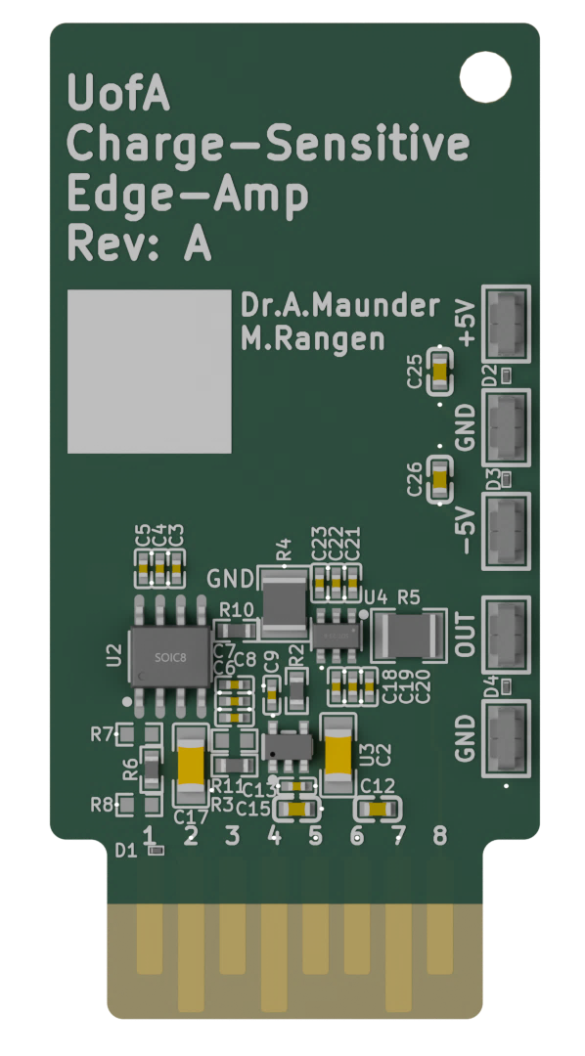
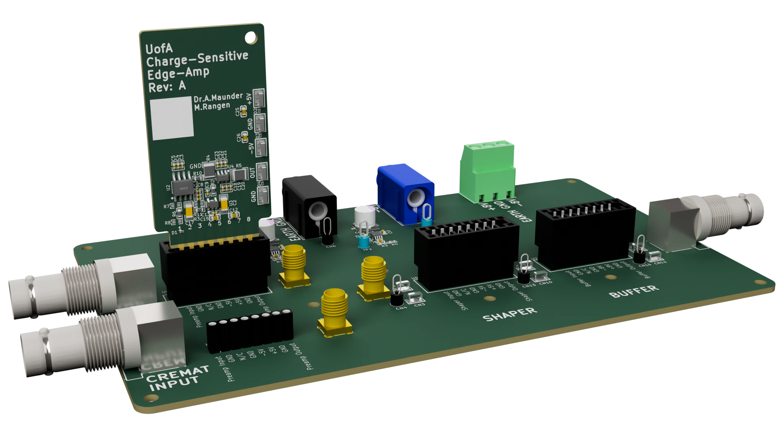
High Voltage Bias
Pre-amplification
Digitization
Dispatching
Analysis & Storage
DAQ (Data Acquisition)
Edge Amp
Designed in-house
Cheaper
Custom carrier board
Multi-channel carrier board to be completed this summer!
Design by Dr. Adam Maunder and Michael Rangen

Slide 19
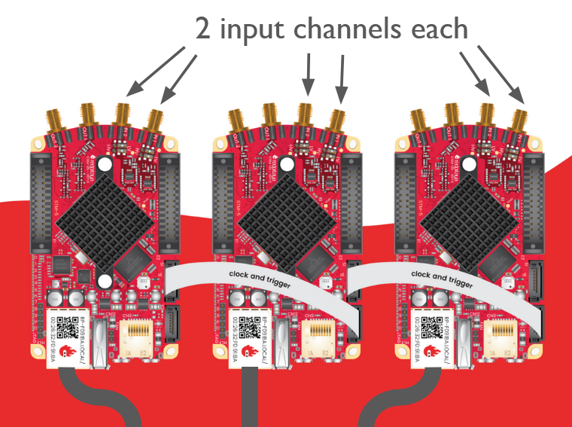
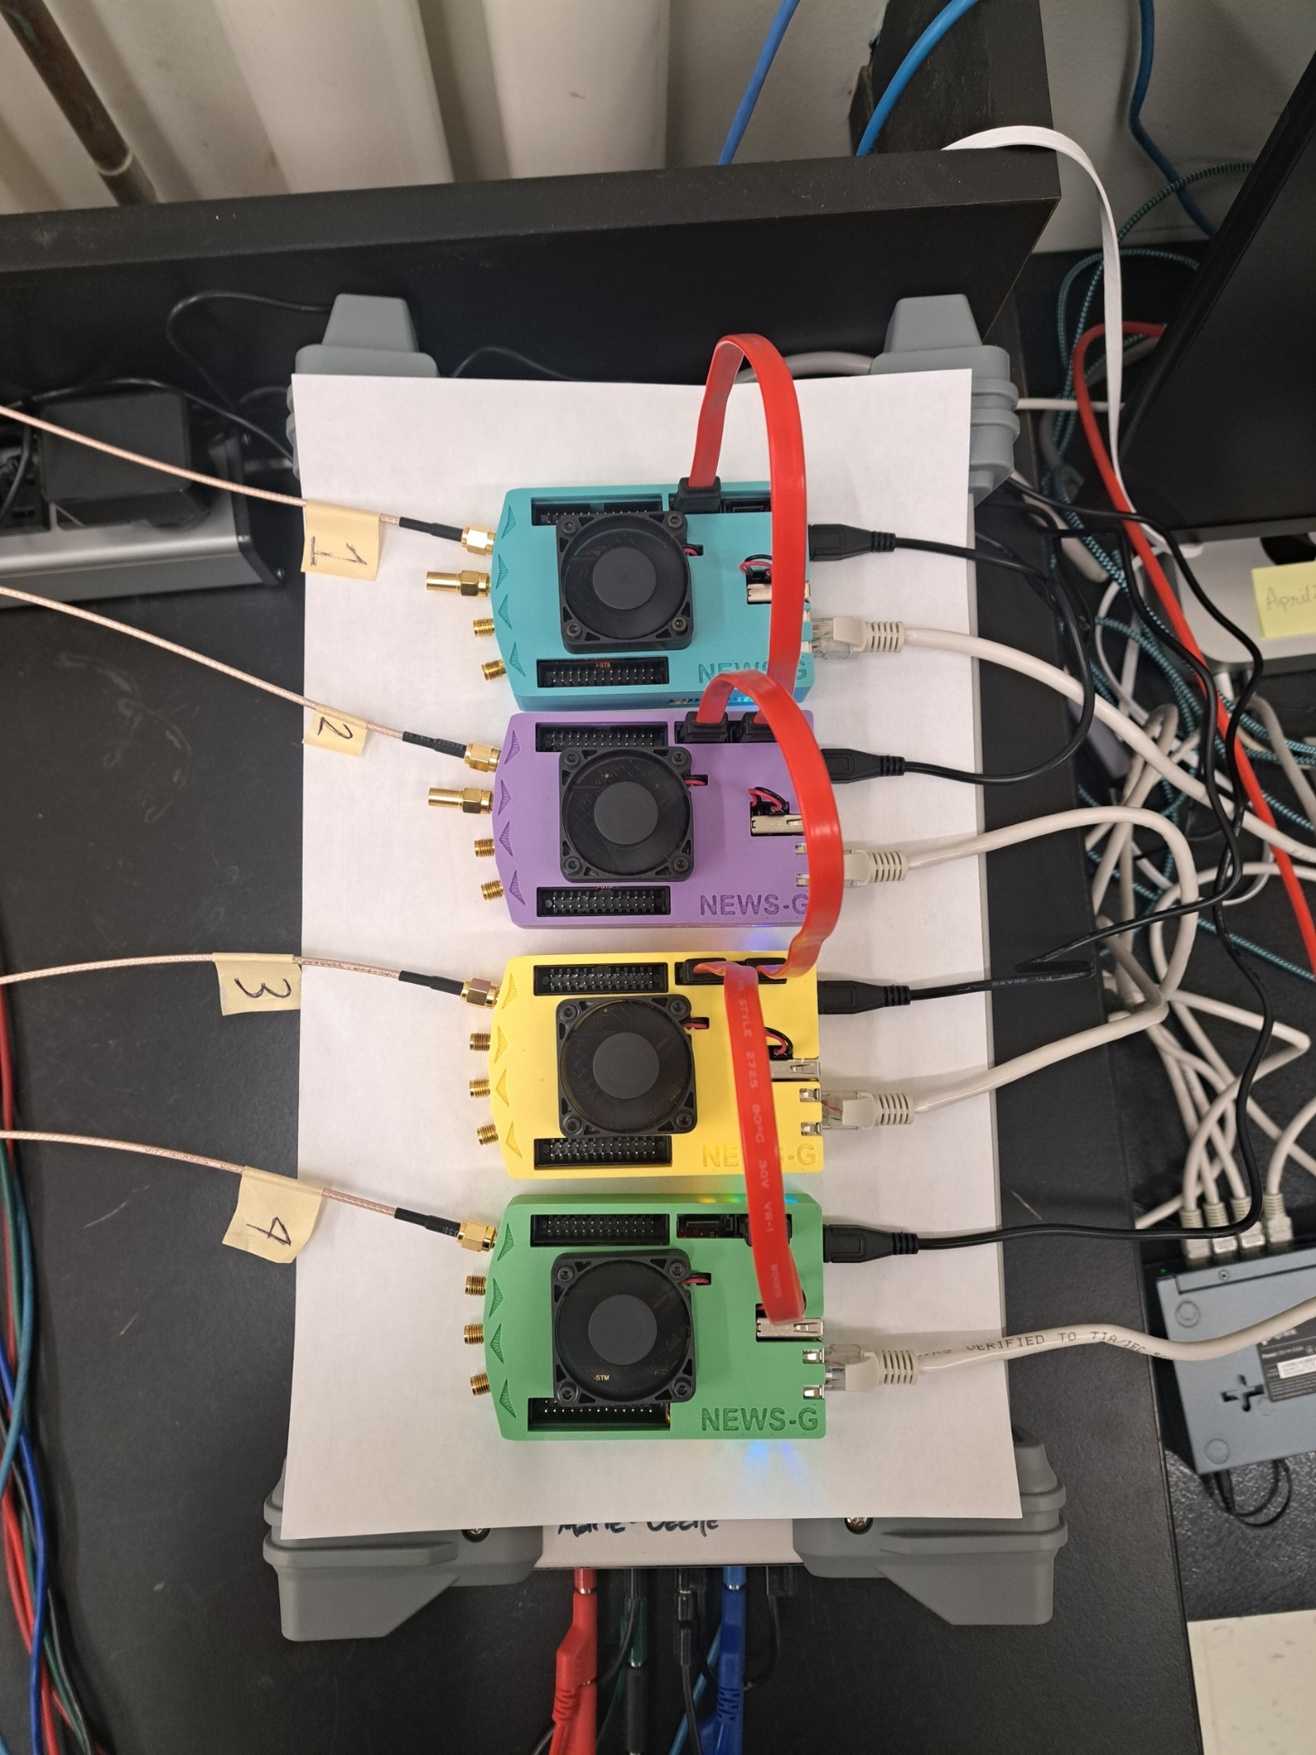
High Voltage Bias
Pre-amplification
Digitization
Dispatching
Analysis & Storage
From Edge Amps
DAQ (Data Acquisition)
Red Pitaya Chaining
Two input channels per board
Chained for clock synchronization
  Allows synchronized data collection
Successful 4 channel test complete
Ethernet output cables

Slide 20
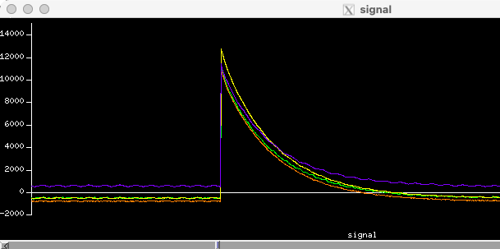
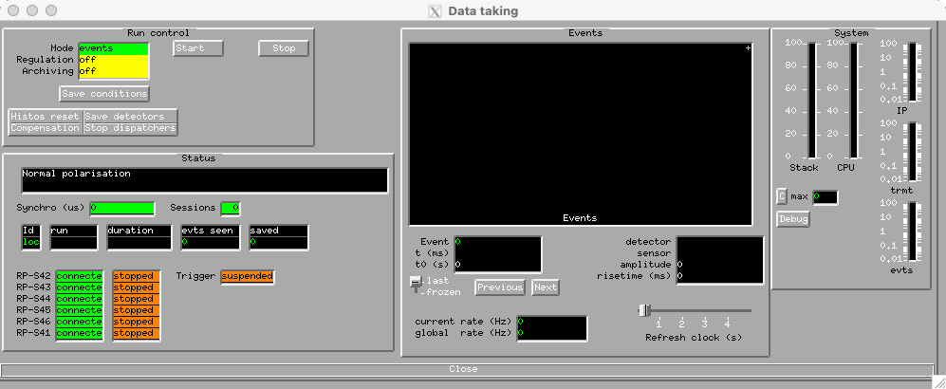
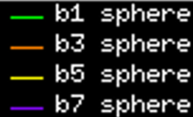
High Voltage Bias
Pre-amplification
Digitization
Dispatching
Analysis & Storage
DAQ (Data Acquisition)
Samba Updates
Eleven channel functionality added
4 channel test results: perfect synchronization in time!
Many thanks to Michel Gros

Slide 21
Conclusions
Development of 11-channel readout system in progress
  Enables directional information to be read out, to distinguish WIMPs from CE𝜈NS
Successful preliminary tests with 4 channels
Future work this summer:
  Install the ACHINOS!
  Design circuit board for 11 channel pre-amps
  Design the electronics enclosures
  End of summer 2026: Test full eleven channel readout with S30 signals!
  Thanks! Questions?
NEWS-G S30 mascot!
Globie
Notes:
Photos?

Slide 22
References
[1] M.-C. Piro, “Searching for Light Dark Matter with the NEWS-G Experiment”, Nov. 2025, https://indico.ijclab.in2p3.fr/event/11699/contributions/39006/attachments/26615/39485/MCPiro_Astrosymposium_2025.pdf (accessed Jun. 5, 2026).
[2] J. Billard et al., “Direct Detection of Dark Matter—APPEC Committee Report,” Reports on Progress in Physics, vol. 85, no. 5, p. 056201, Apr. 2022. doi:10.1088/1361-6633/ac5754
[3] Quantum diaries, https://www.quantumdiaries.org/2012/03/16/une-conference-qui-laisse-songeur/wimp-wind-3/ (accessed Jun. 15, 2026).
[4] D. Young, “Purple sea urchin,” vic high, https://vichighmarine.ca/purple-sea-urchin/ (accessed Jun. 5, 2026).
[5] K. Nicholson, Directionality Simulations
[6] “CR-11X charge sensitive preamplifier modules,” Cremat Inc, https://www.cremat.com/home/charge-sensitive-preamplifiers/ (accessed Jun. 5, 2026).
[7] STEMlab 125-14 4-input starter kit - red pitaya | mouser, https://www.mouser.com/new/red-pitaya/red-pitaya-stemlab-125-14-kit/ (accessed Jun. 5, 2026).
Notes:
Maybe do summary and combine with this? Photo of sphere and achinos??

