Slide 1


Superposed quantum evolutions across regular and chaotic regimes
arXiv:2603.13209
CAP 2026
Amit Anand
Anne-Catherine de la Hamette, Robert Mann and Shohini Ghose
Institute for Quantum Computing
Physics and Astronomy Department
University of Waterloo
June 23, 2026

Slide 2
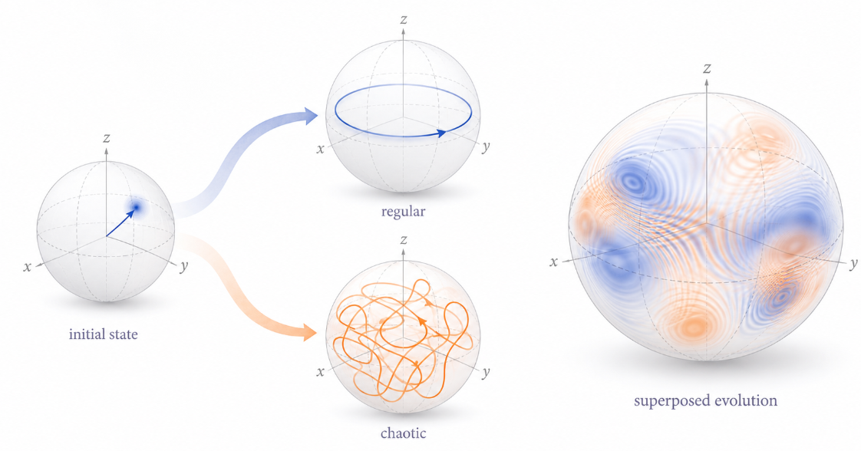
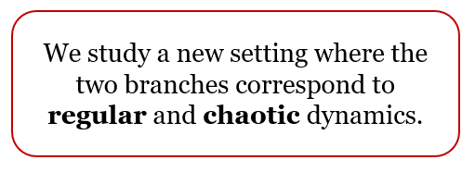
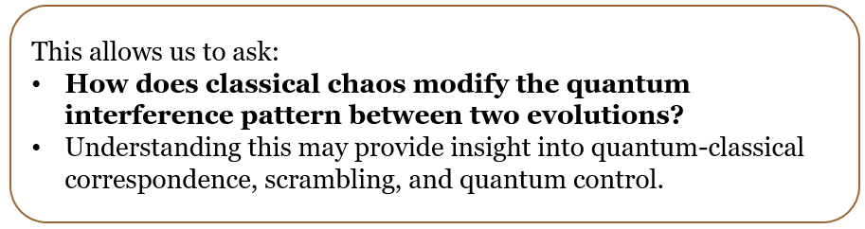
Question: What happens when a quantum state evolves through a coherent superposition of two different dynamics?

Slide 3
Flow of the talk
Introduction of kicked top
Quantum and classical dynamics
Mach-Zehnder setup with kicked top evolutions
Post selection and classical mixture
Entropy generation and observations
3

Slide 4
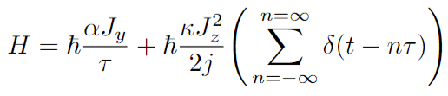
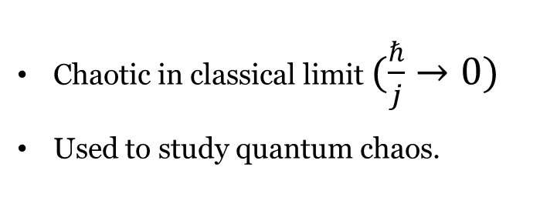

Quantum kicked top
A finite dimensional system with fixed total spin (angular momentum) $j$.
Periodically driven system
precession about y-axis
periodic impulsive non-linear twists
Chaotic in classical limit $(\frac{ℏ}{j}→0)$
Used to study quantum chaos.
$$j$$
deep quantum regime semi-classical regime classical

Slide 5
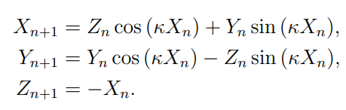
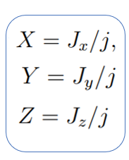

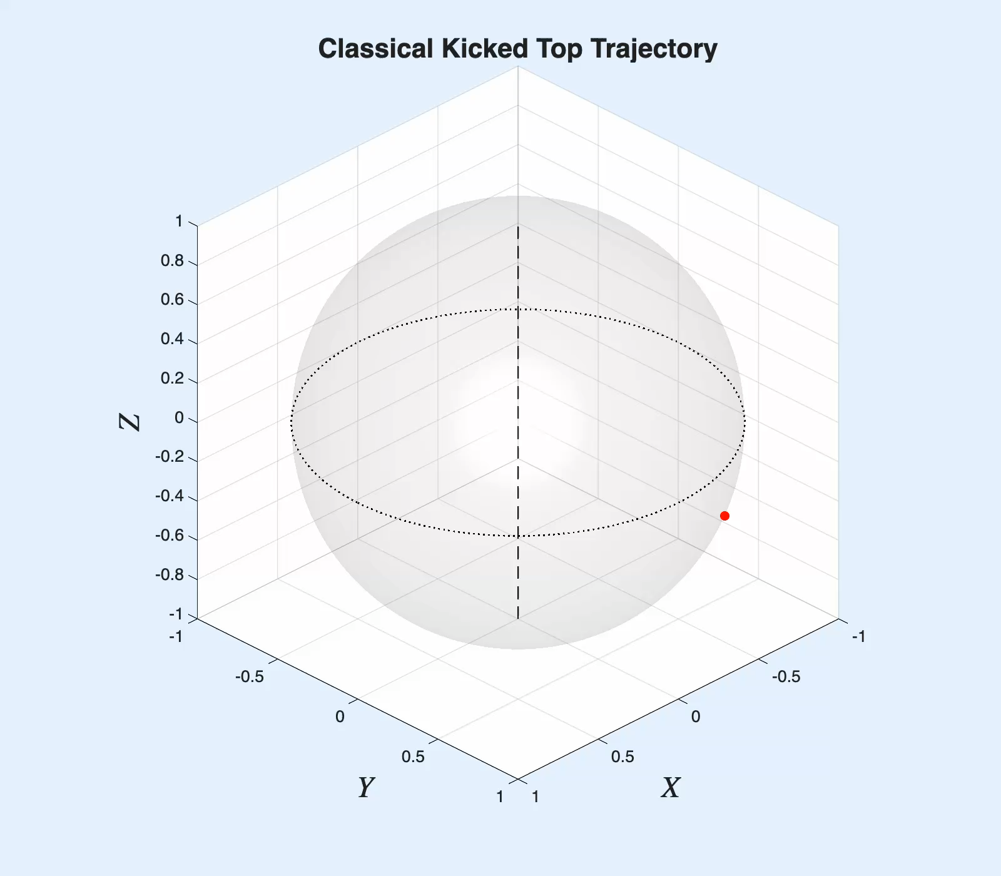
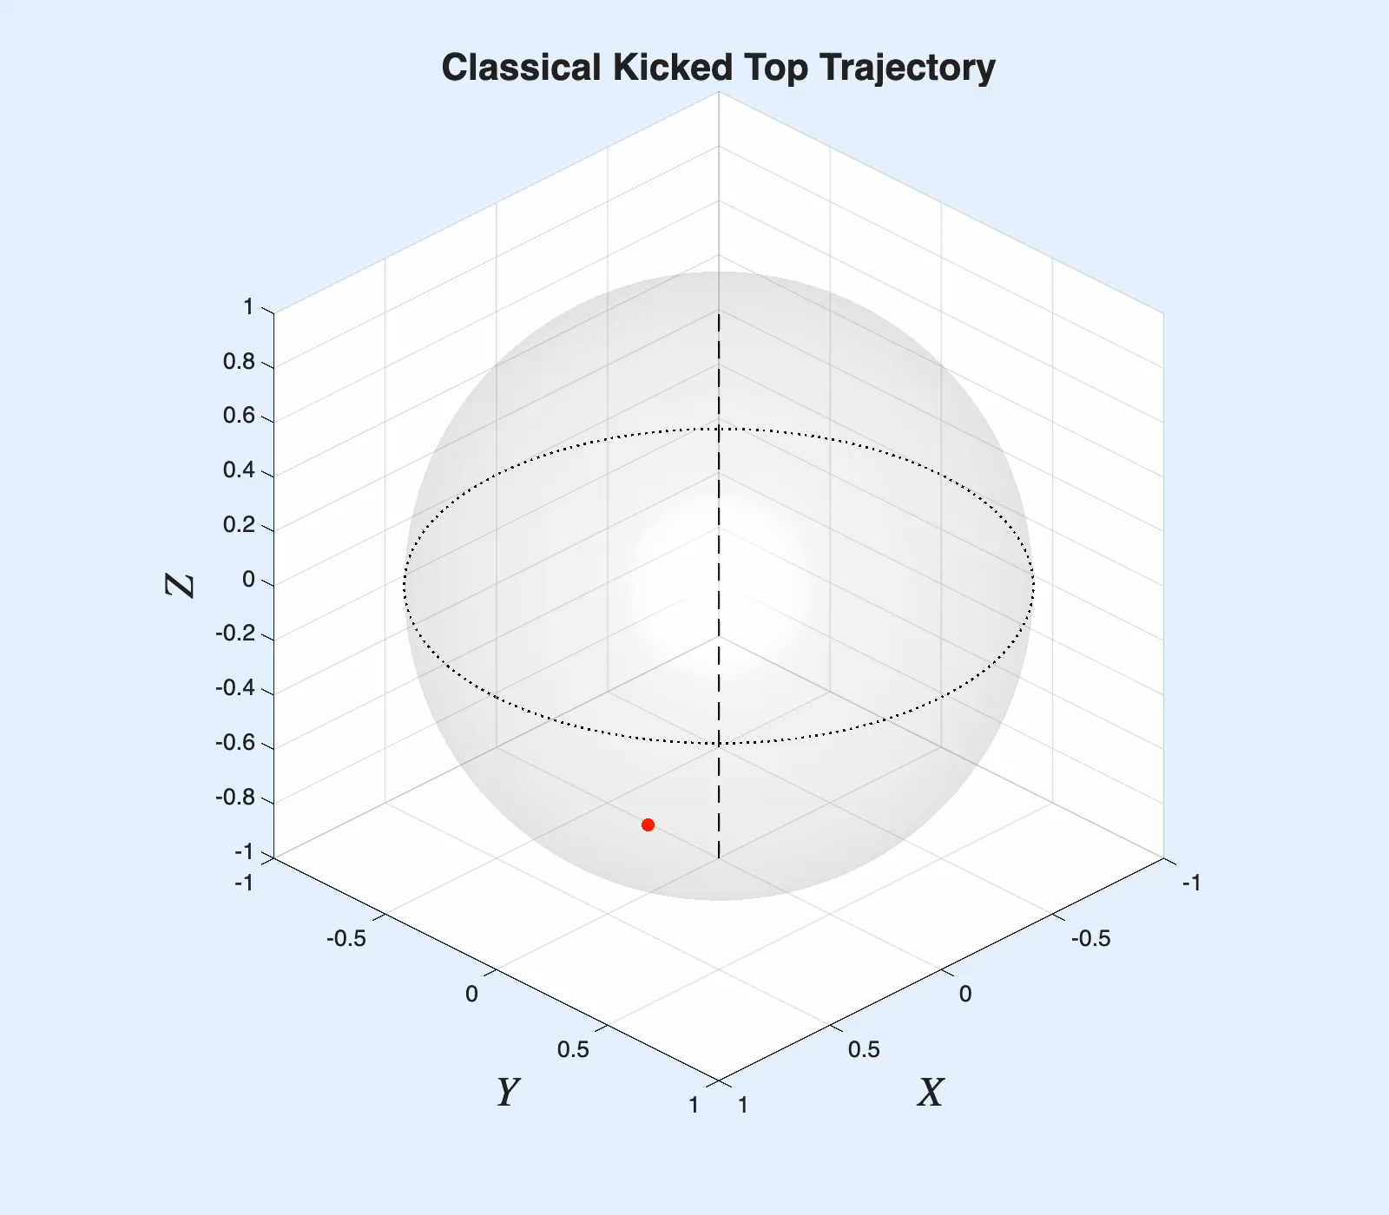
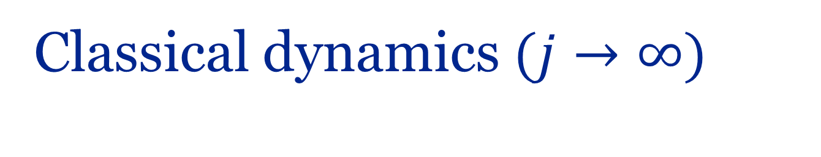
Classical dynamics $(j→∞)$
Haake, Z. Physik B - Condensed Matter 65, 381–395 (1987)

Slide 6
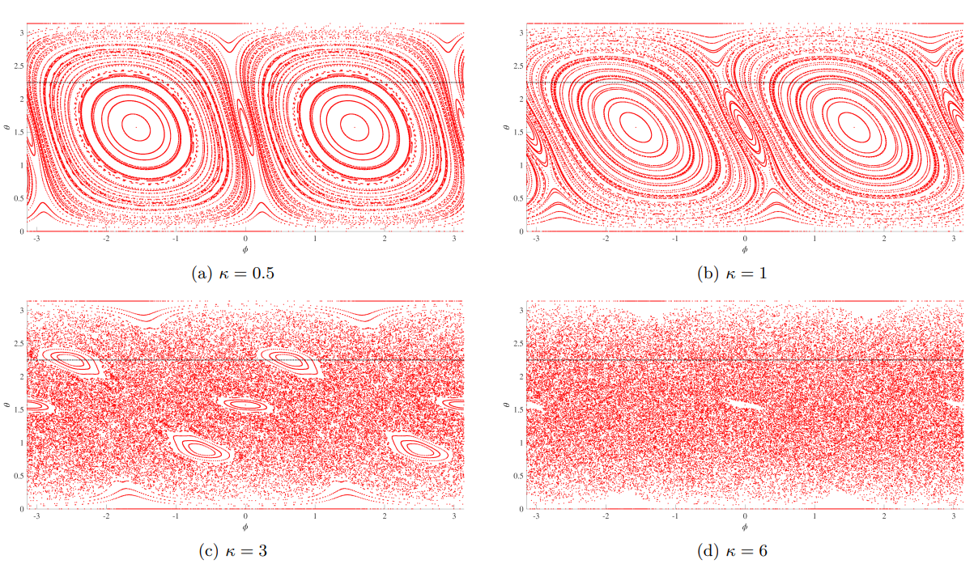
Stroboscopic phase space

Slide 7
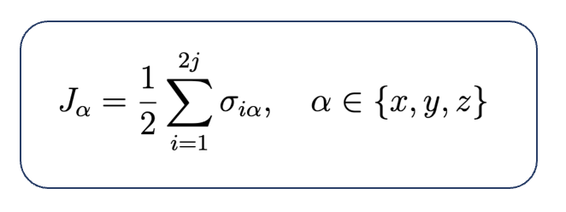
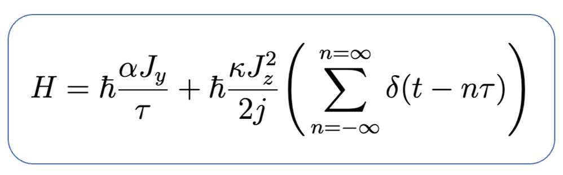
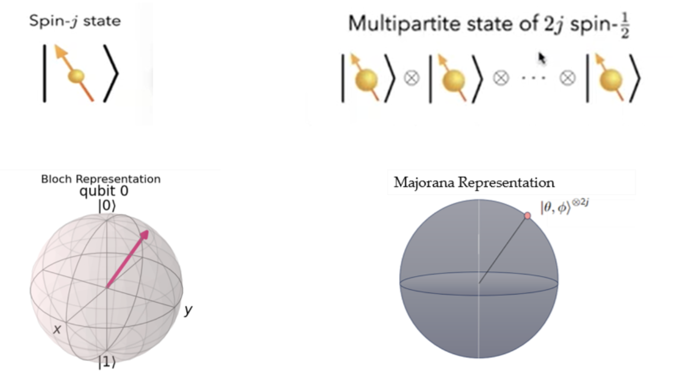
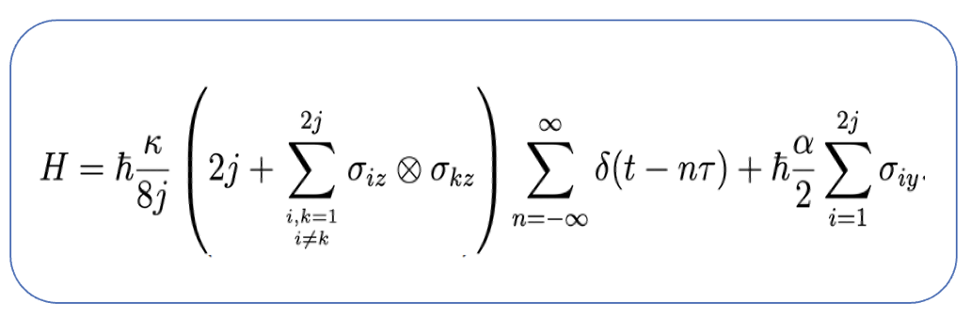

Quantum kicked top
The QKT system with spin j can be considered as an $N = 2j$qubit state lying in the symmetric subspace.
Qubit representation is useful to study entanglements in Kicked Top.
Majorana, E.: Nuovo Cimento 9, 43 (1932)

Slide 8
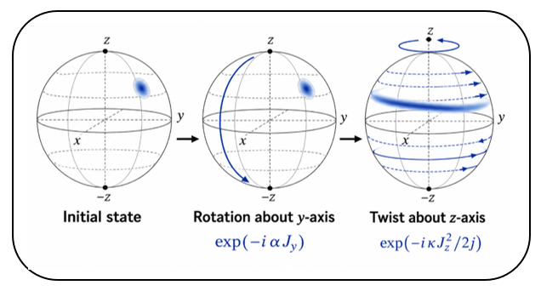
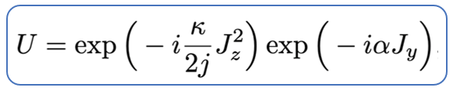
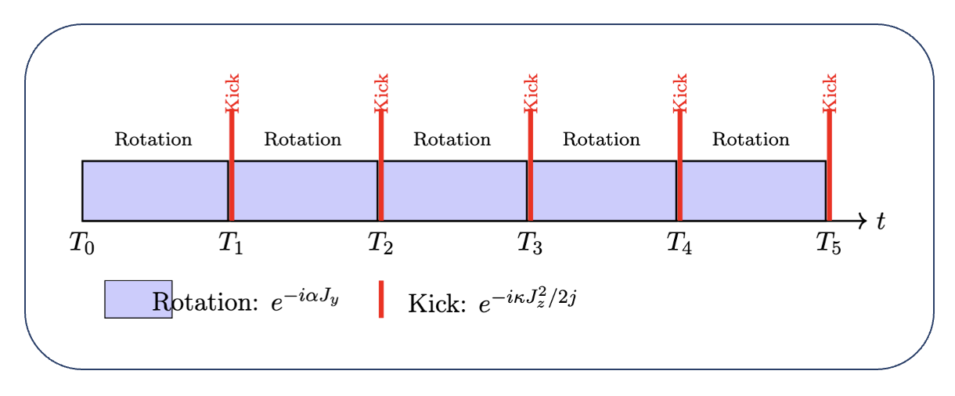
Quantum dynamics
Floquet unitary operator for one kick -

Slide 9
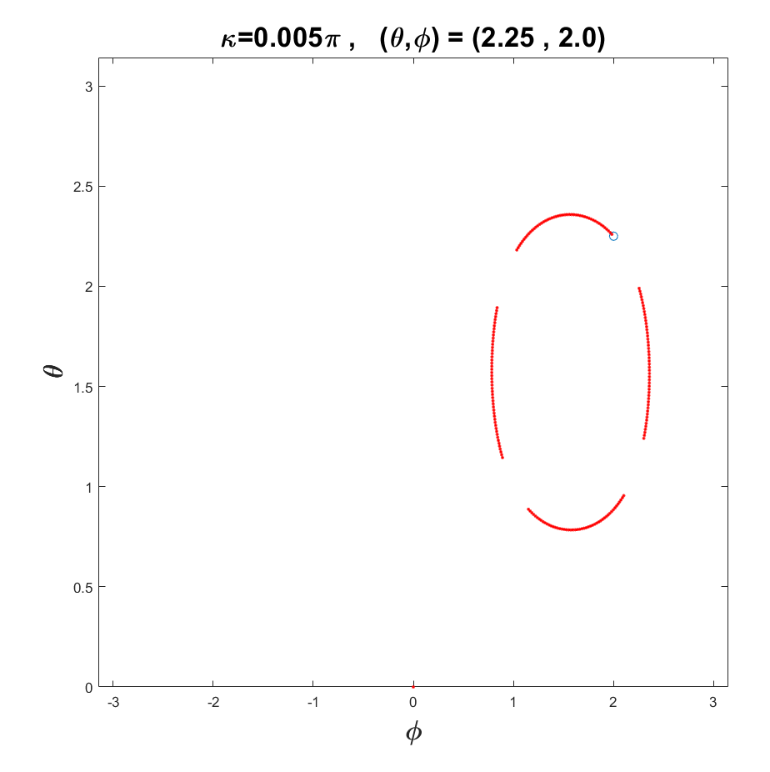
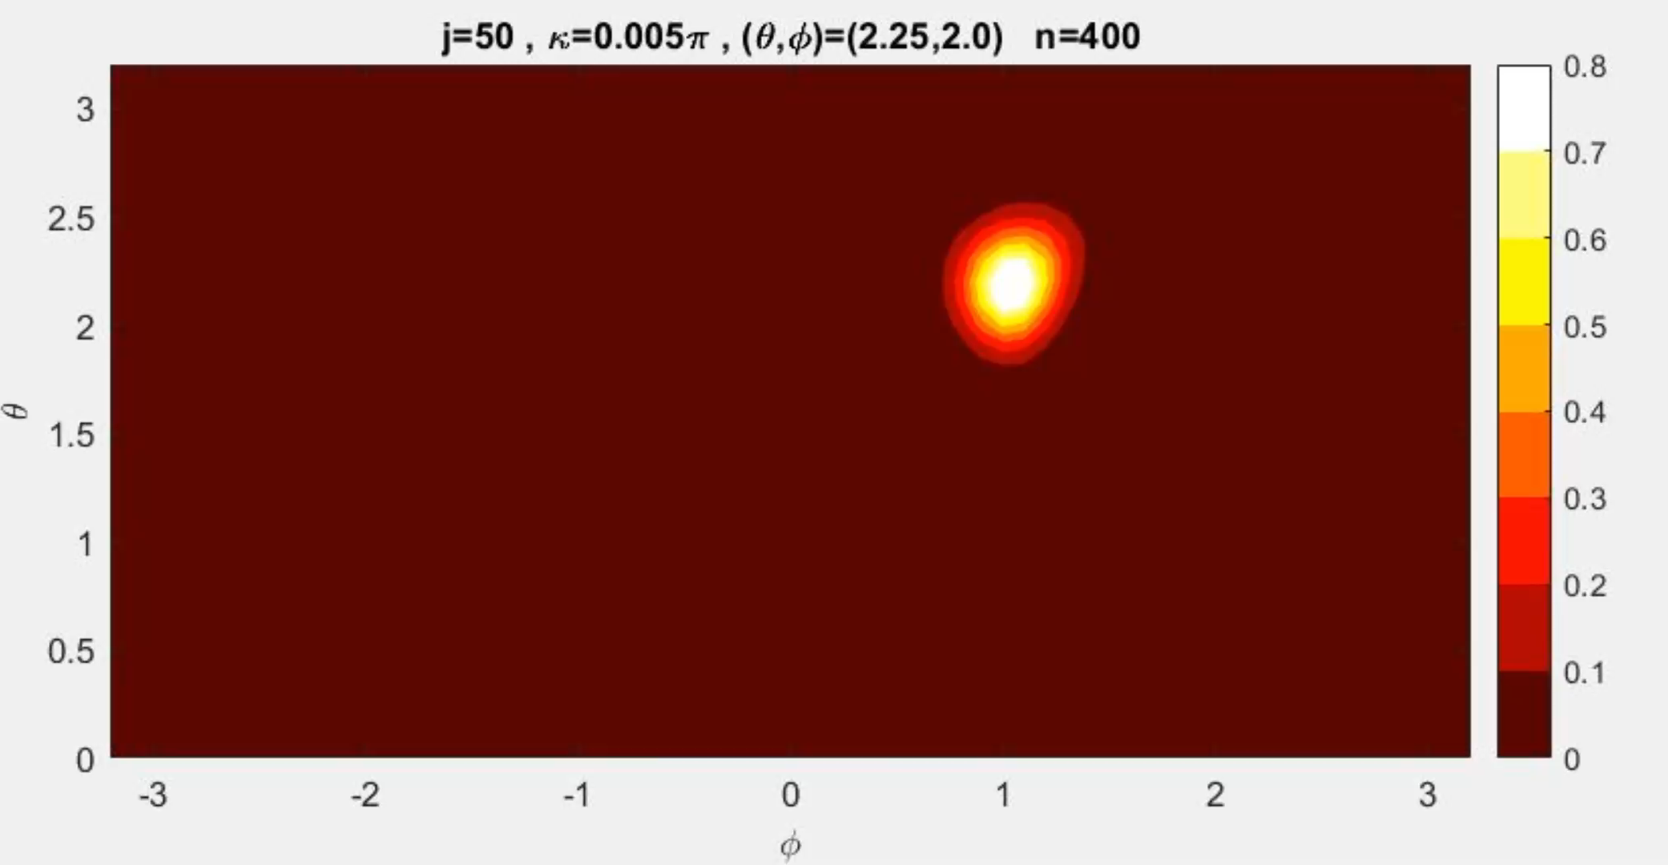
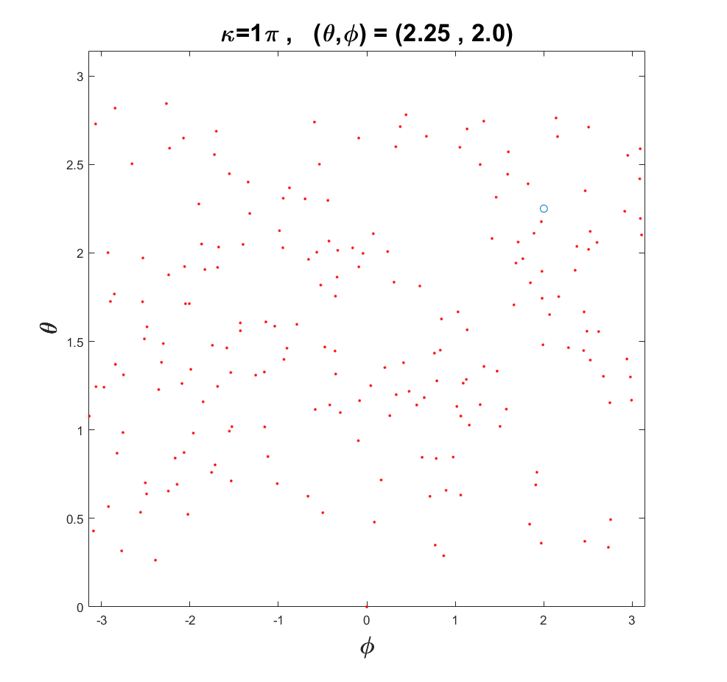
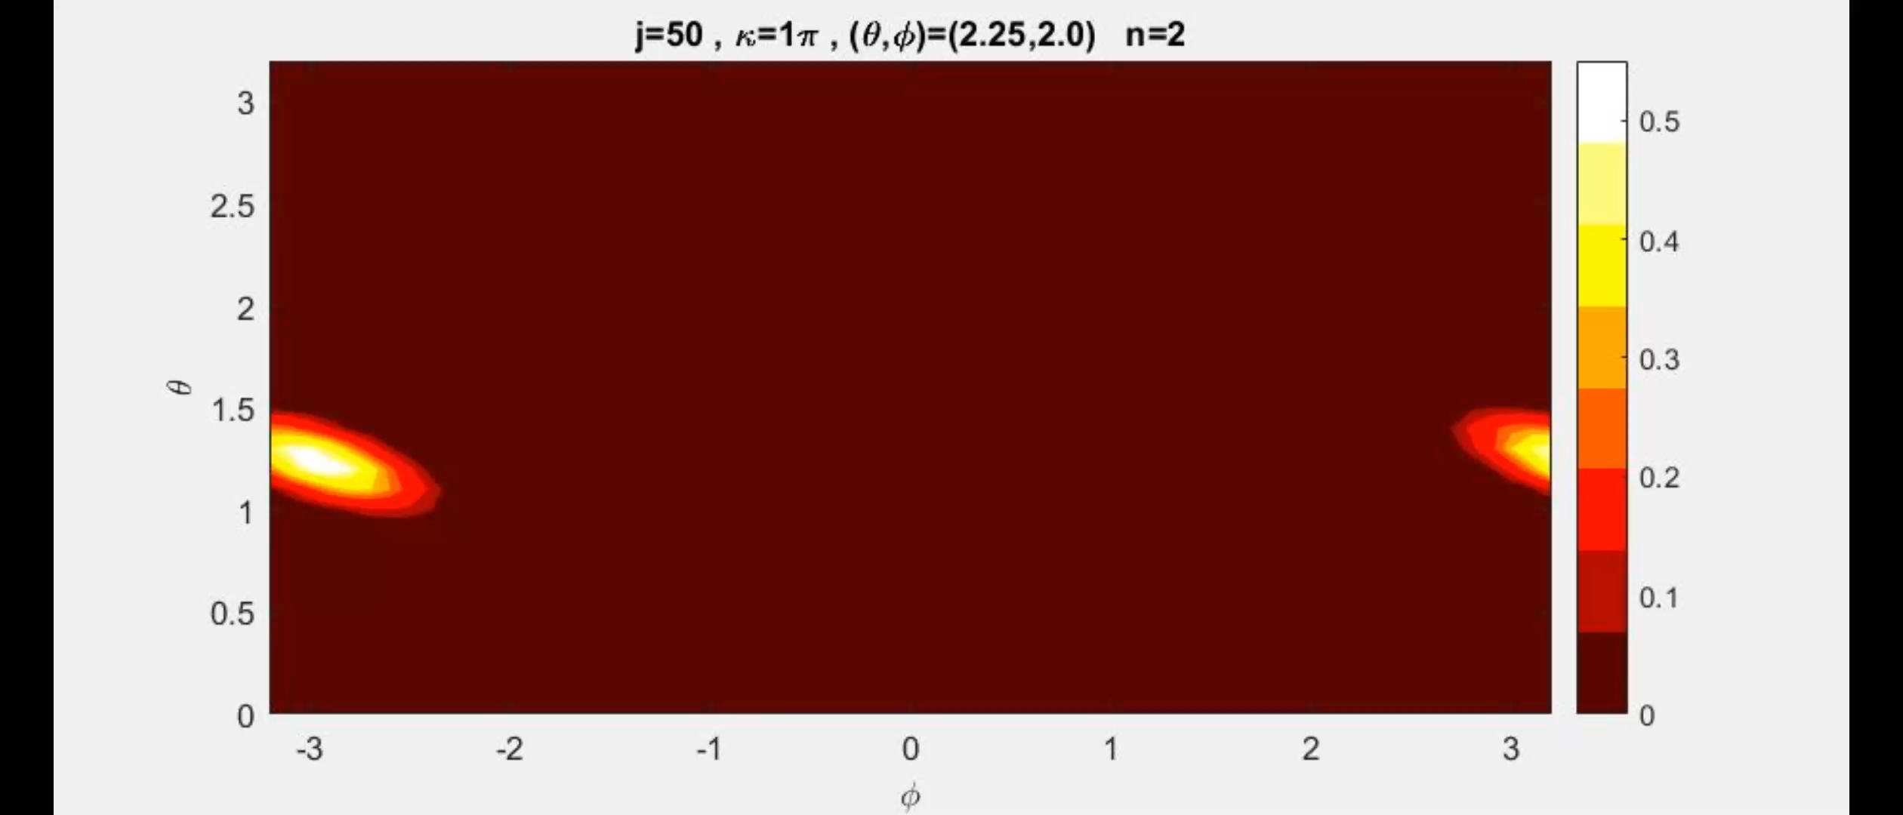

Comparison with classical dynamics
$1$ corresponds to SCS.

Slide 10
Question: what happens when we superposed two chaotic evolution?

Slide 11
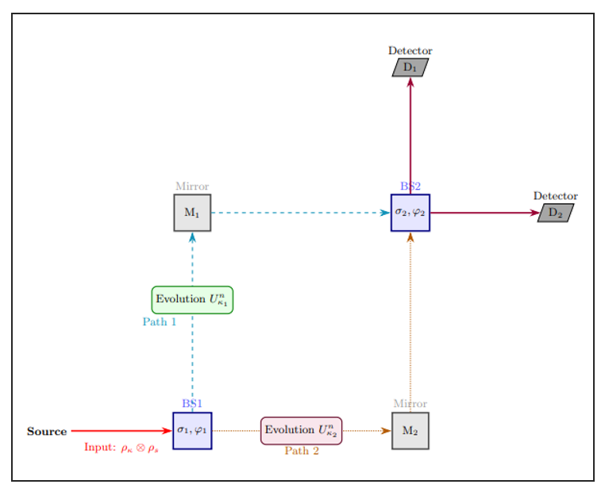
Quantum kicked top in the Mach-Zender interferometer

Slide 12
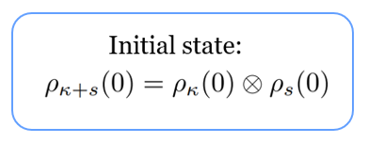
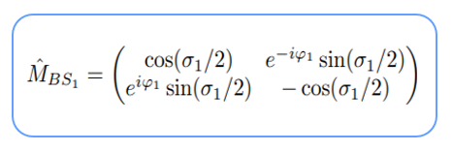
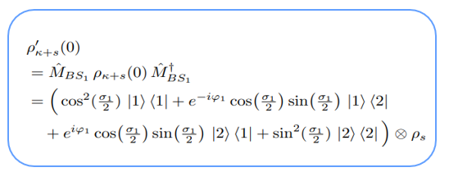
Quantum kicked top in the Mach-Zender interferometer

Slide 13
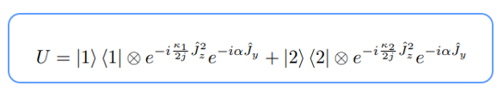
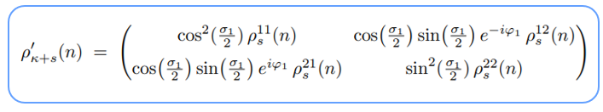
Quantum kicked top in the Mach-Zender interferometer

Slide 14
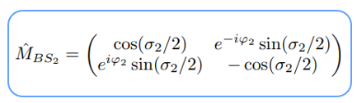
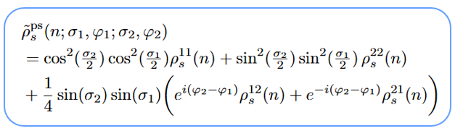
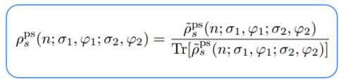
Quantum kicked top in the Mach-Zender interferometer

Slide 15
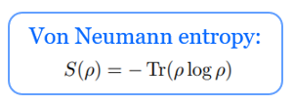
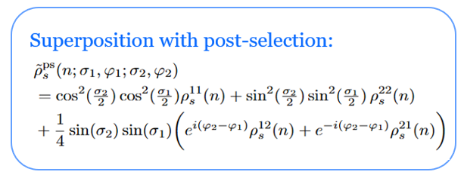
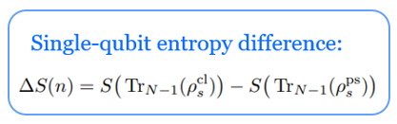
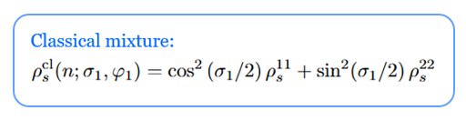
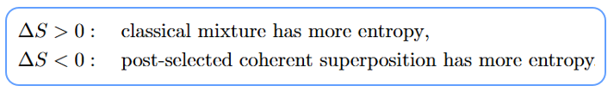
Entropy difference

Slide 16
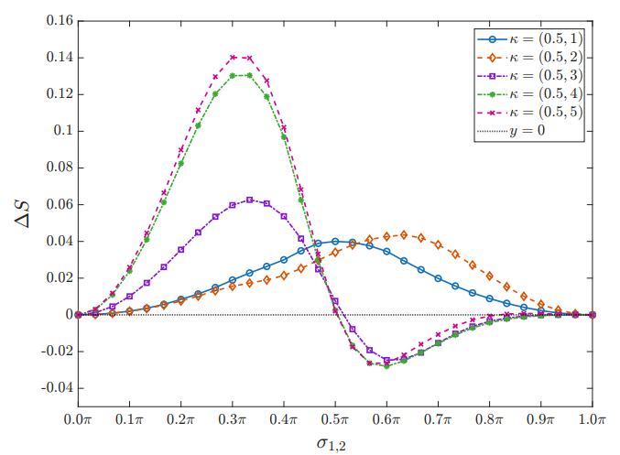
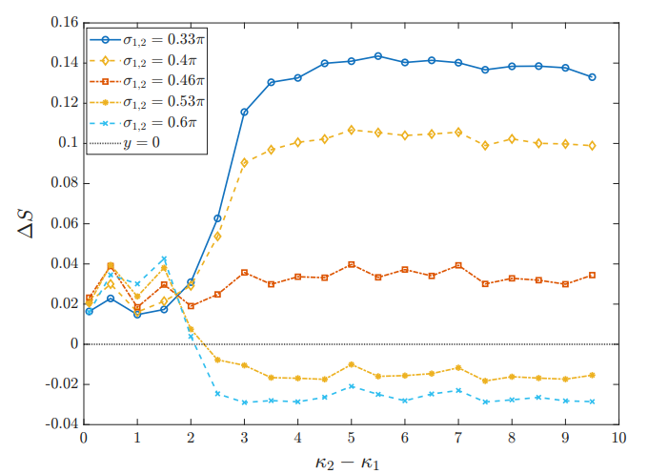
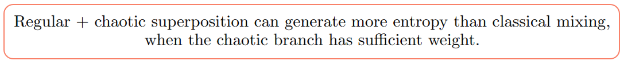
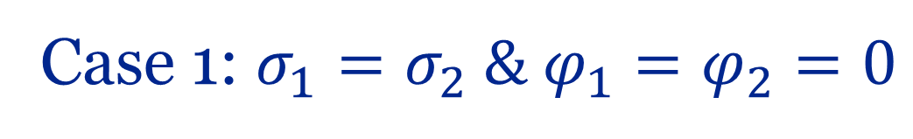
Case 1: $σ_{1}=σ_{2} \& φ_{1}=φ_{2}=0$

Slide 17
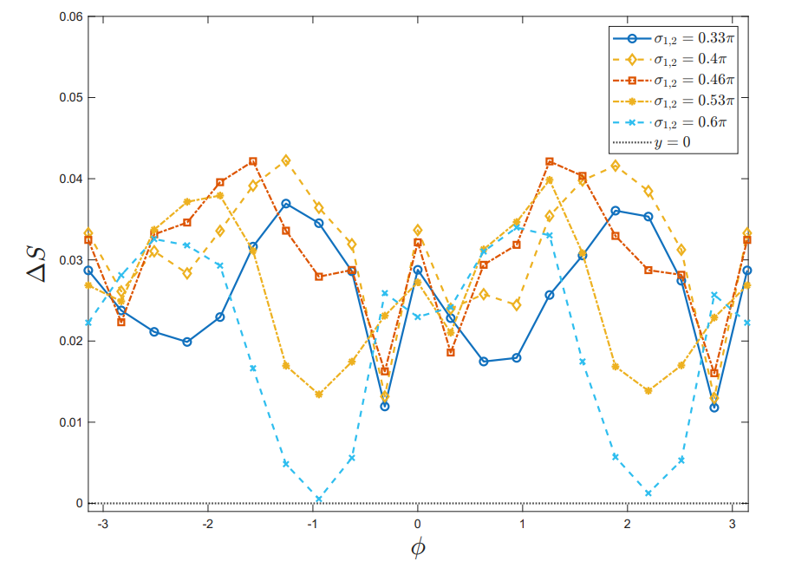
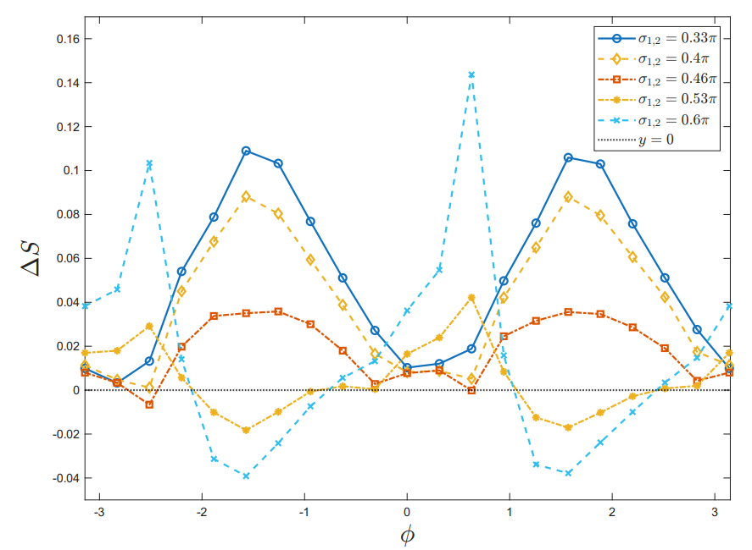
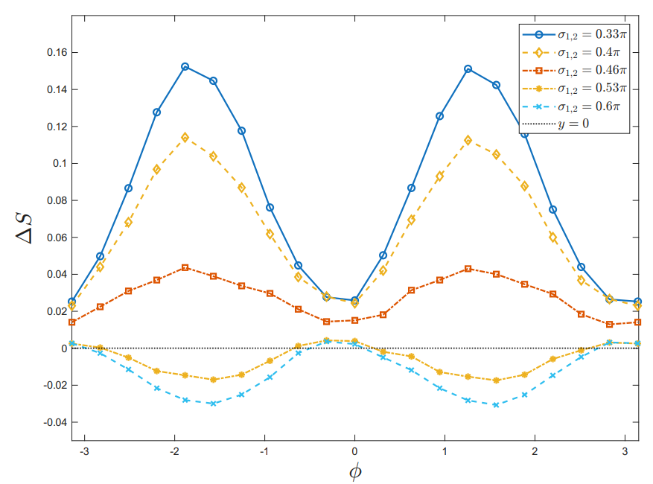
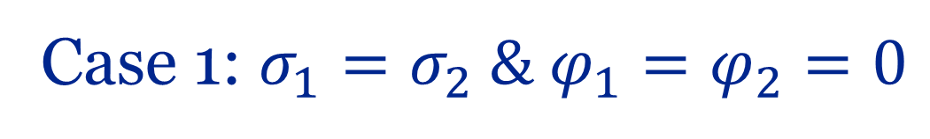
Case 1: $σ_{1}=σ_{2} \& φ_{1}=φ_{2}=0$

Slide 18
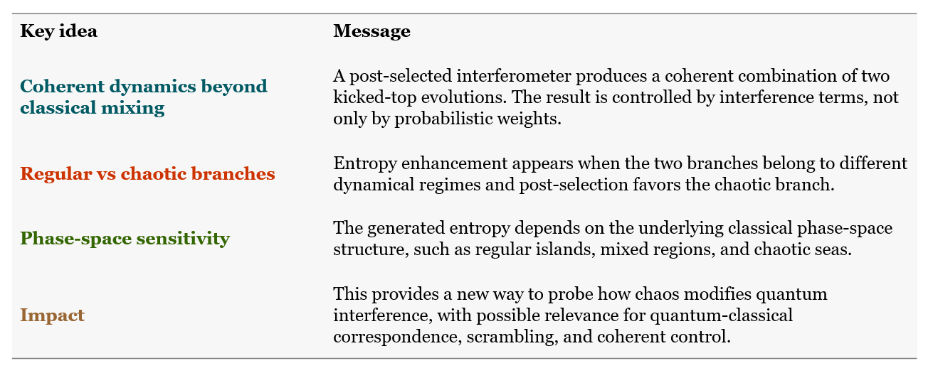
Summary

Slide 19


Slide 20
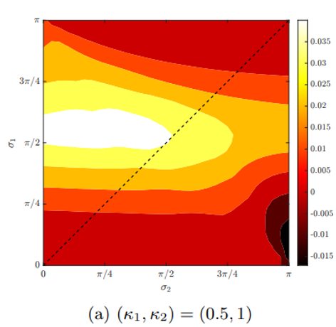
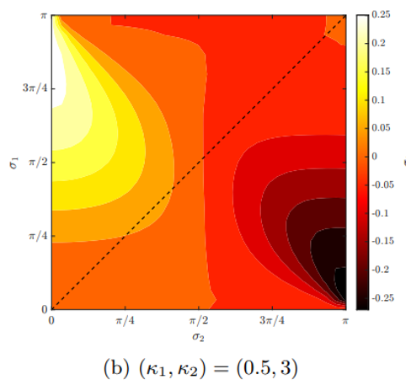
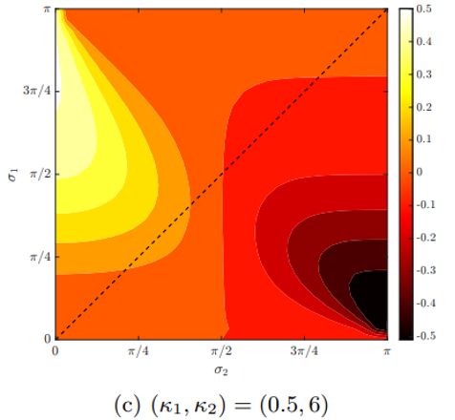
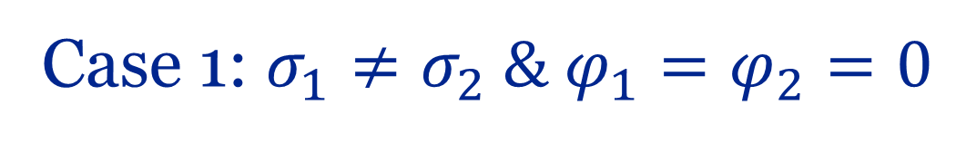
Case 1: $σ_{1}≠σ_{2} \& φ_{1}=φ_{2}=0$

Slide 21




Spin coherent State
Initial state
Coherent states are minimum-uncertainty states
Husimi probability distribution for $j=4$ and $j=50$ and max value $1$ corresponds to SCS.

Slide 22

Classical mixture vs superposition

Slide 23


Classical mixture vs superposition

Slide 24

Classical mixture vs superposition

Slide 25

Classical mixture vs superposition

