Slide 1
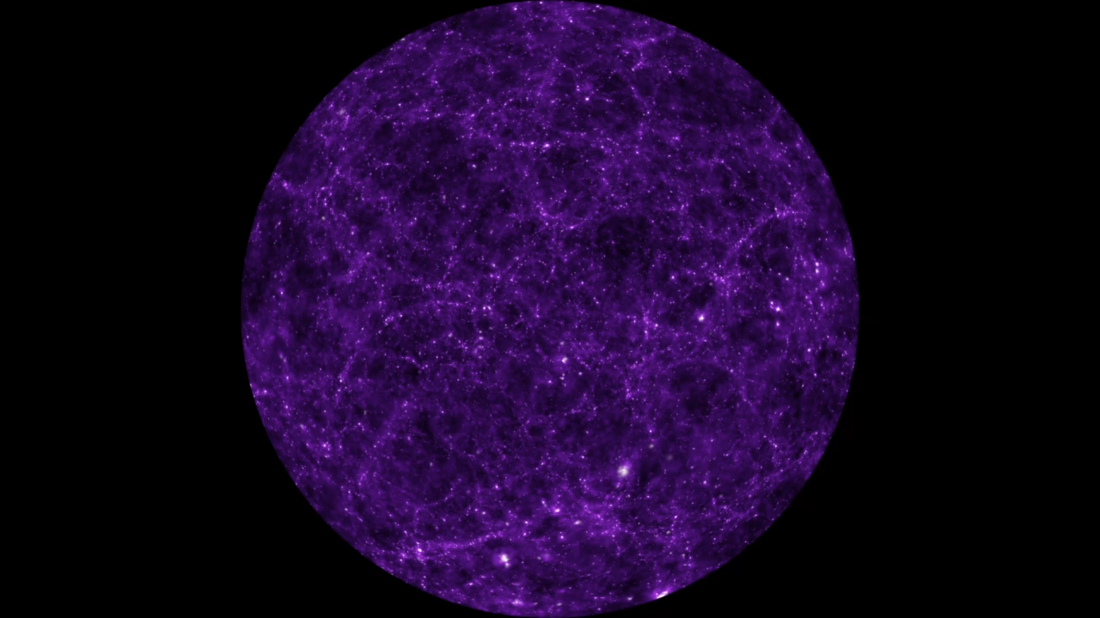
Jeans Model for the Shapes of Self-Interacting Dark Matter Halos
Adam Smith-Orlik
York University
CAP 2026

Slide 2

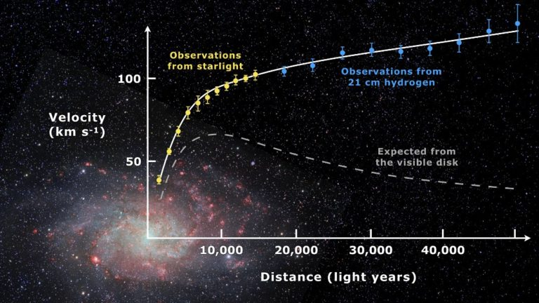
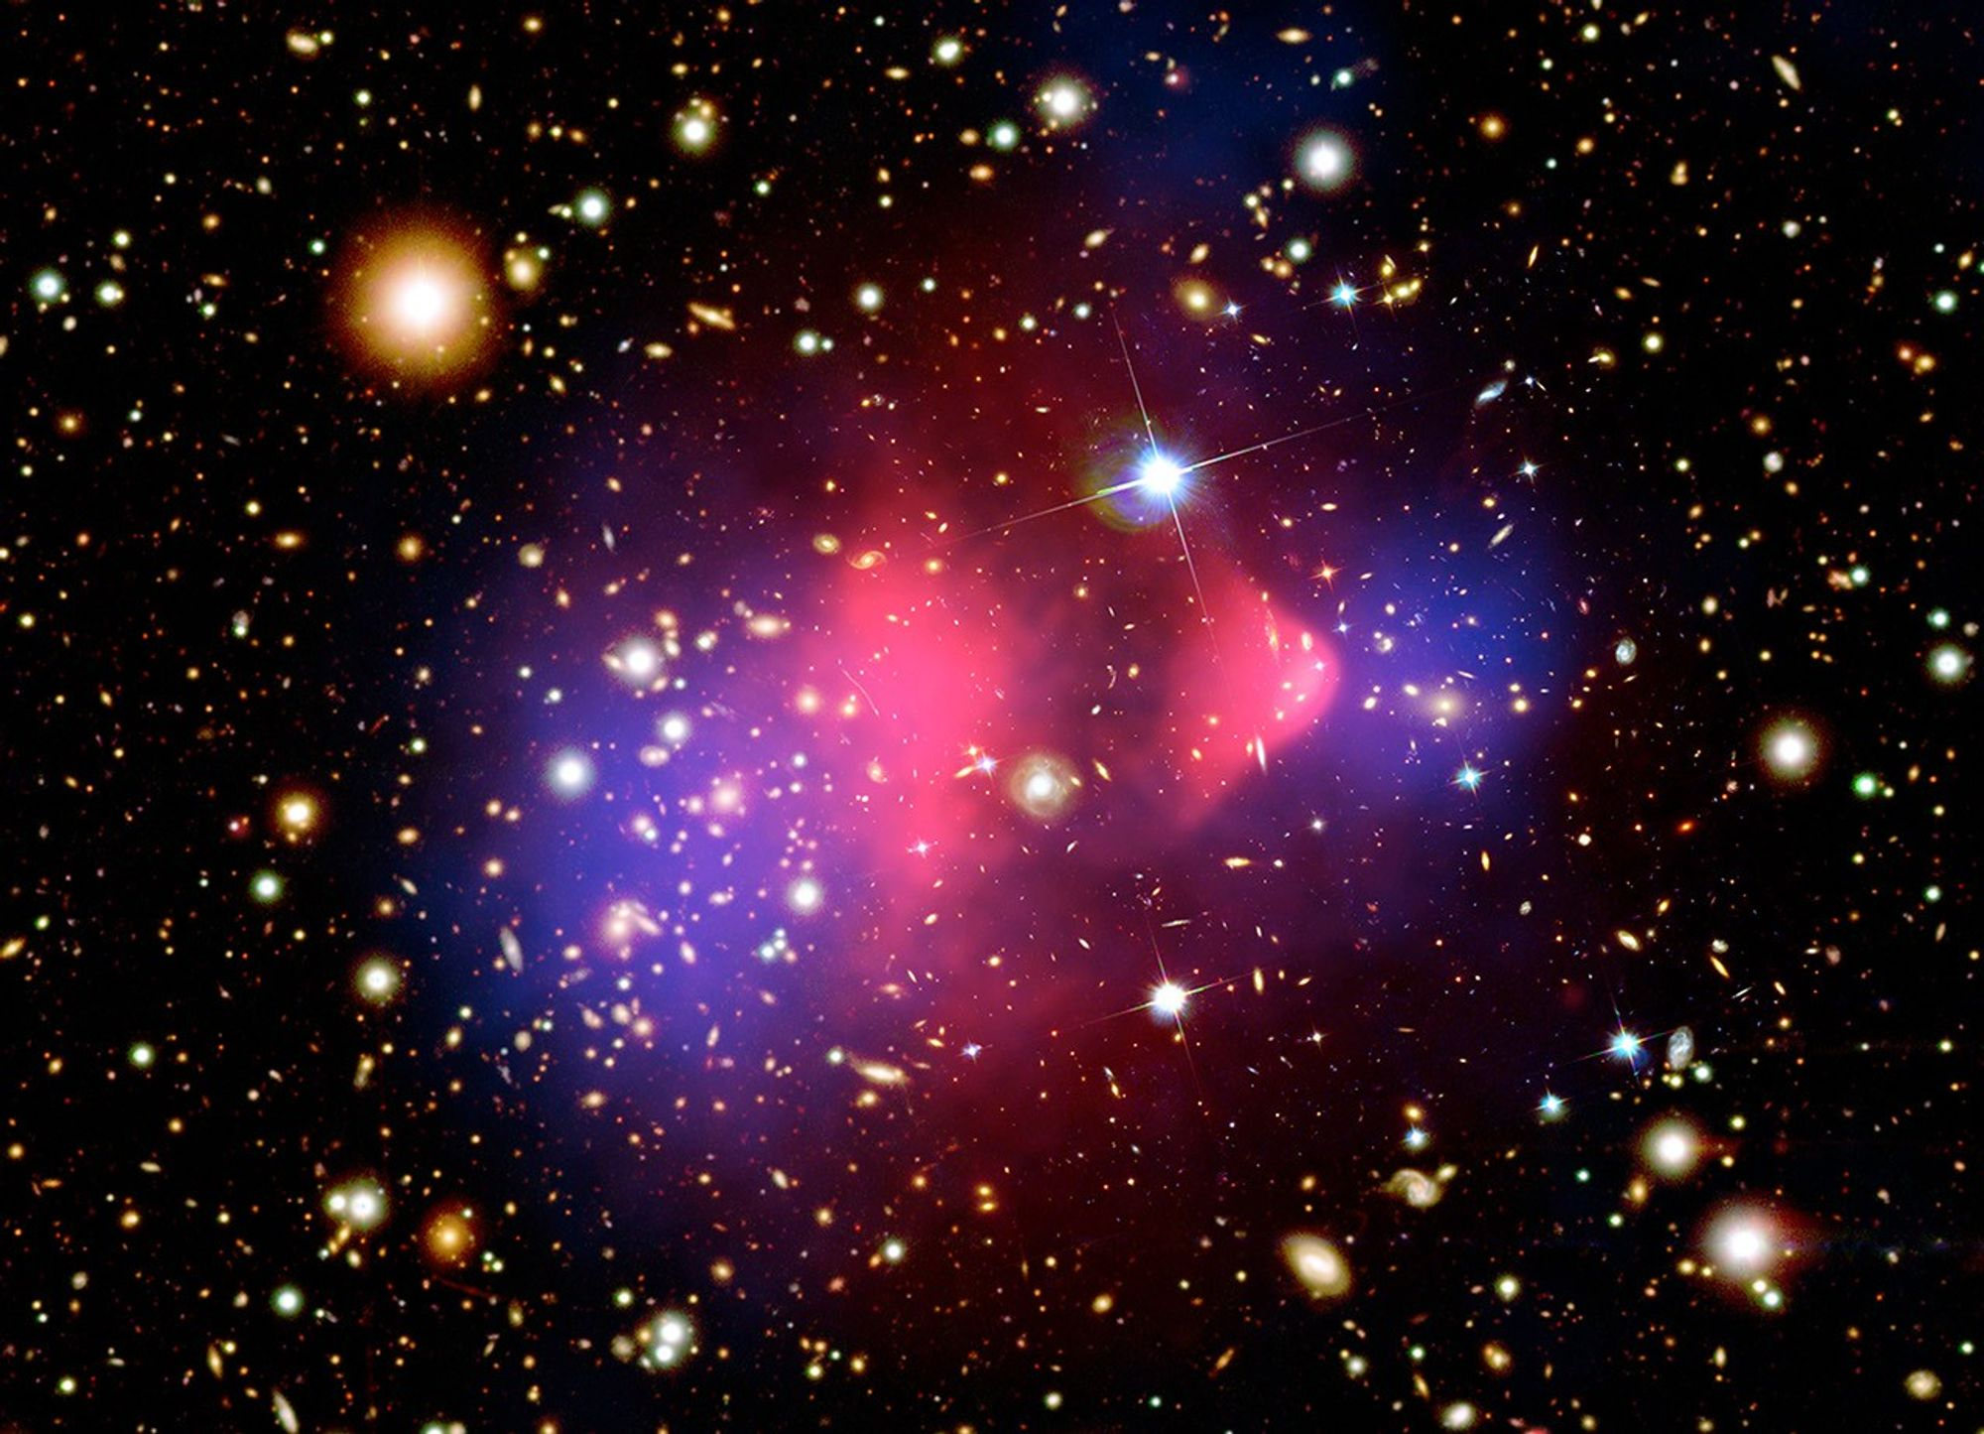
Dark Matter Background
EVIDENCE
CANDIDATES
Gravitational
Cluster velocity dispersions – Zwicky, 1933
Galaxy rotation curves – Rubin, 1970
Cluster X-ray emission – Forman et al., 1972
Gravitational lensing – Walsh et al., 1979
Bullet Cluster – Clowe et al., 2006
Cosmological
BBN – Wagoner et al., 1967
CMB anisotropies – COBE, 1992
Large-scale structure – Various, 2000s
And more…
Particle Candidates
WIMPs
Axions
Sterile neutrinos
Hidden sector…
Compact objects
Primordial black holes
MACHOs
Q-balls
Quark nuggets
Physics
MOND
Fig 1: Galaxy rotation curve example.
Fig 2: Bullet Cluster. Baryon and dark matter mass maps from X-ray observations. [NASA]

Slide 3
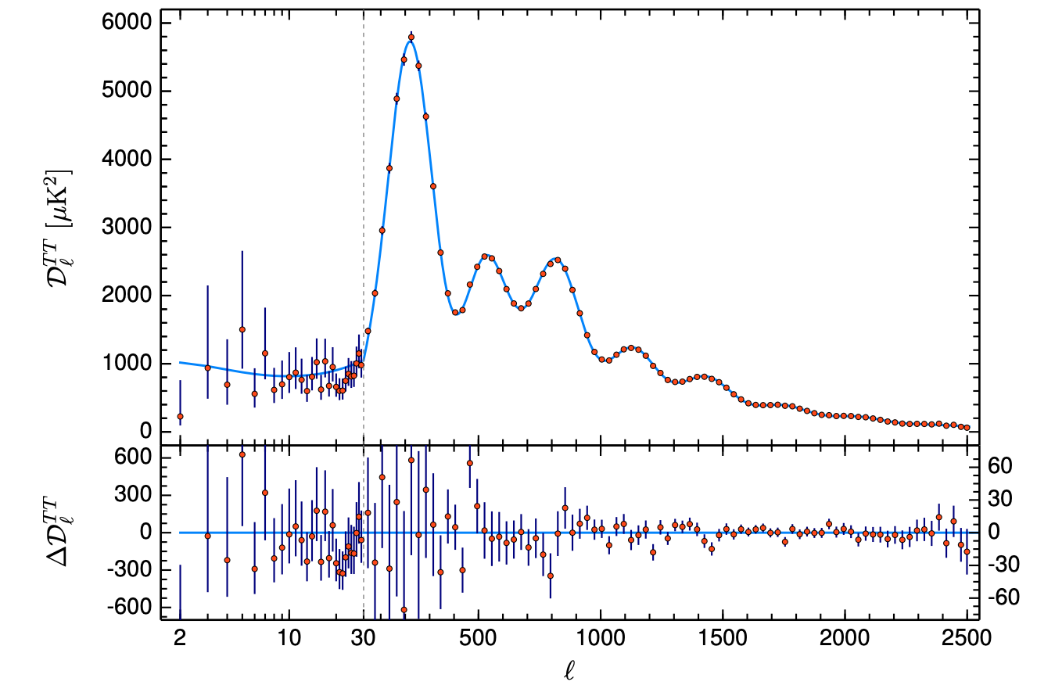
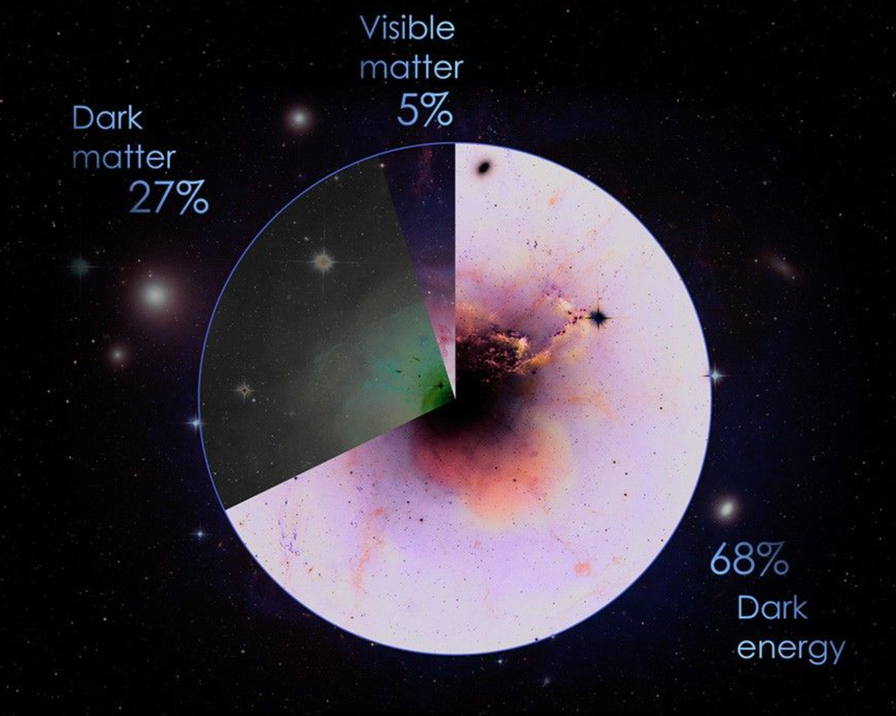

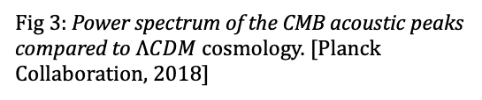
Dark Matter Background
$ΛCDM$ SUCCESS
CMB
Power spectrum
Cosmological parameters
Large-Scale Structure
Matter power spectrum
BAO
Cosmic Web
Structure Formation
Hierarchical mergers
Halo mass function
Density profiles
Cosmological observations
BBN
And more…
Cosmological Constant
Collisionless Dark Matter
Fig 3: Power spectrum of the CMB acoustic peaks compared to $ΛCDM$ cosmology. [Planck Collaboration, 2018]
Fig 4: Components of the Universe. [NASA]

Slide 4
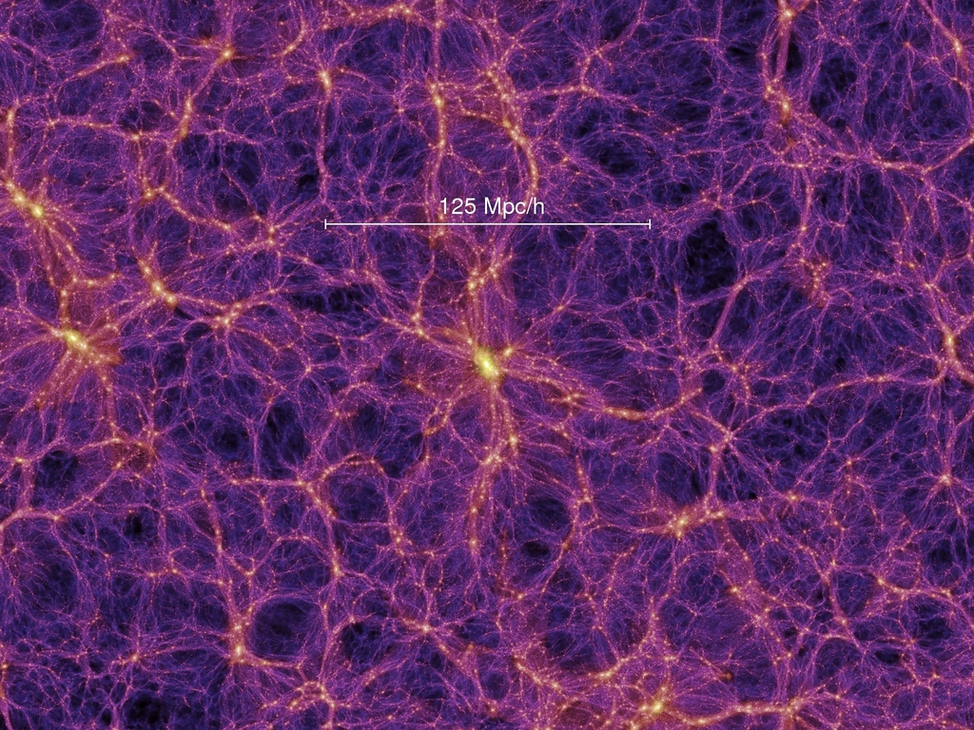

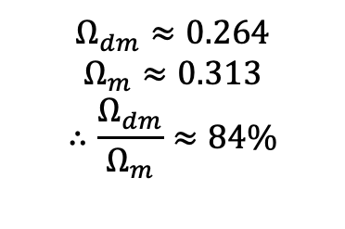
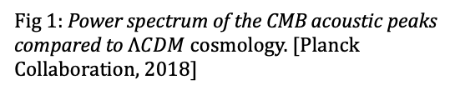
Dark Matter Background
$ΛCDM$ SUCCESS
CMB
Power spectrum
Cosmological parameters
Large-Scale Structure
Matter power spectrum
BAO
Cosmic Web
Structure Formation
Hierarchical mergers
Halo mass function
Density profiles
Cosmological observations
BBN
And more…
Cosmological Constant
Collisionless Dark Matter
Fig 1: Power spectrum of the CMB acoustic peaks compared to $ΛCDM$ cosmology. [Planck Collaboration, 2018]
Fig 2: Components of the Universe. [NASA]
$$Ω_{dm}≈0.264$$
$$Ω_{m}≈0.313$$
$$∴\frac{Ω_{dm}}{Ω_{m}}≈84\%$$
Fig 5: Cosmic web simulation. [Springel et al., 2005]

Slide 5

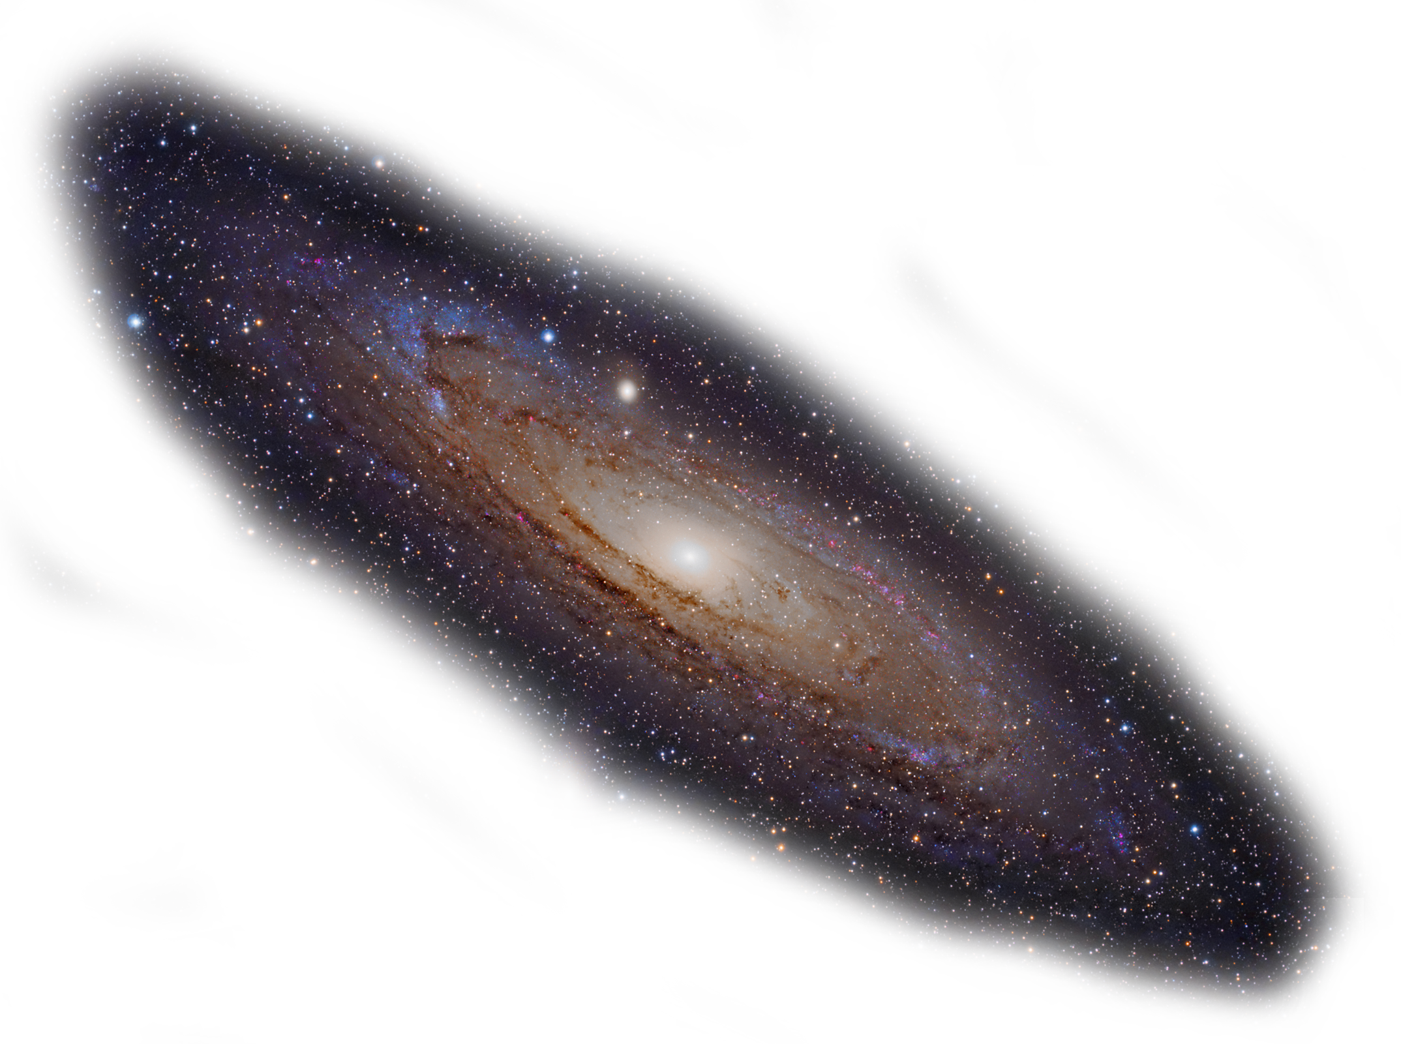

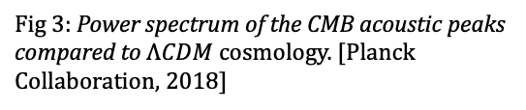
Dark Matter Background
Dark matter
halo
$ΛCDM$ SUCCESS
CMB
Power spectrum
Cosmological parameters
Large-Scale Structure
Matter power spectrum
BAO
Cosmic Web
Structure Formation
Hierarchical mergers
Halo mass function
Density profiles
Cosmological observations
BBN
And more…
R
10R
Fig 3: Power spectrum of the CMB acoustic peaks compared to $ΛCDM$ cosmology. [Planck Collaboration, 2018]
Fig 4: Components of the Universe. [NASA]
Fig 5: Cosmic web simulation. [Springel et al., 2005]

Slide 6
Dark Matter Halos
Dark matter
halo
CDM HALOS
Universal density profile (NFW)
Triaxial shape profile
Maxwell-Boltzmann velocity distribution

Slide 7
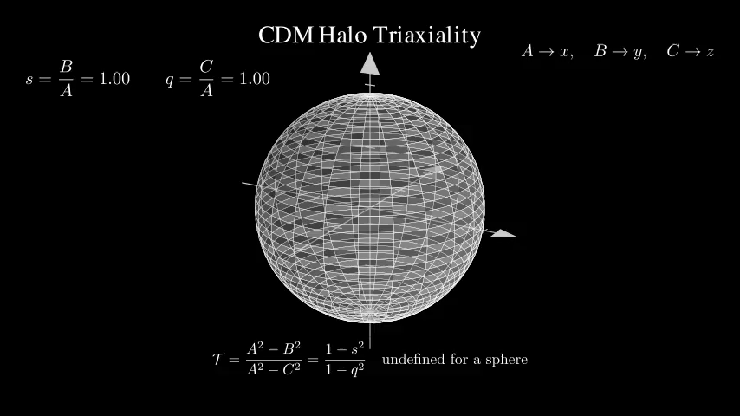

Slide 8
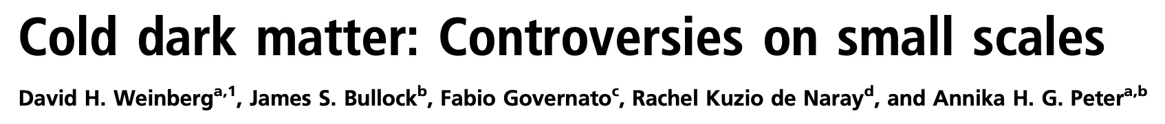


Dark Matter Halos
$$SMALL−SCALE$$
$$TENSIONS$$
CDM HALOS
$$OBSERVED HALOS$$
Universal density profile (NFW)
Triaxial shape profile
Maxwell-Boltzmann velocity distribution
Cored profiles
Diverse inner slopes of rotation curves
Core-Cusp Problem
Diversity Problem
Early DM-only simulations
Dwarf and LSB galaxies

Slide 9
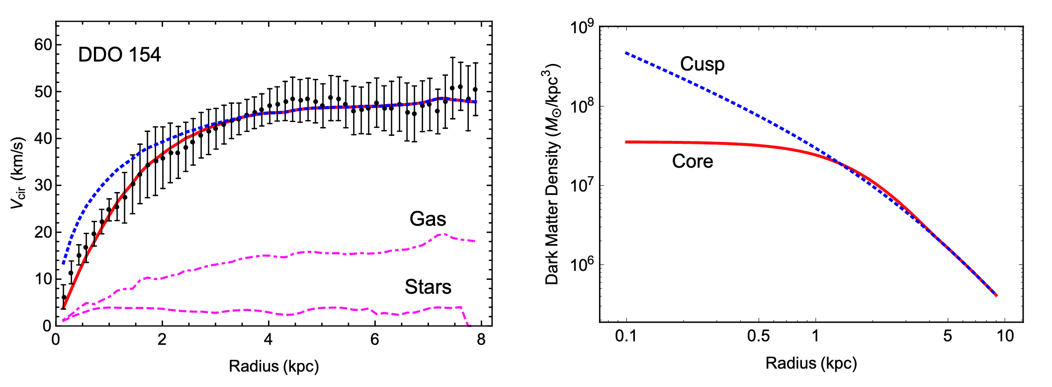
Dark Matter Halos
Fig 1. Observed rotation curve for dwarf galaxy DD0 154 compared to NFW (blue dotted curve) and cored profile (red solid curve). [Tulin & Yu, 2018]

Slide 10


Dark Matter Halos
BARYONS
$$SMALL−SCALE$$
$$TENSIONS$$
Supernova feedback
AGN/Black hole feedback
Gas
Subgrid physics
Diversity problem?
CDM HALOS
$$OBSERVED HALOS$$
Core-Cusp Problem
Diversity Problem
TBTF Problem
Missing Satellite Problem
Universal density profile (NFW)
Triaxial shape profile
Maxwell-Boltzmann velocity distribution
Cored profiles
Diverse inner slopes of rotation curves
SIDM
Self-interactions
Heat-transfer
Retains CDM success
Diversity problem!
Predictions…

Slide 11
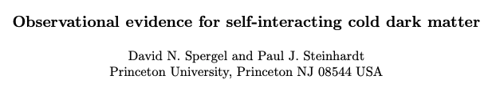



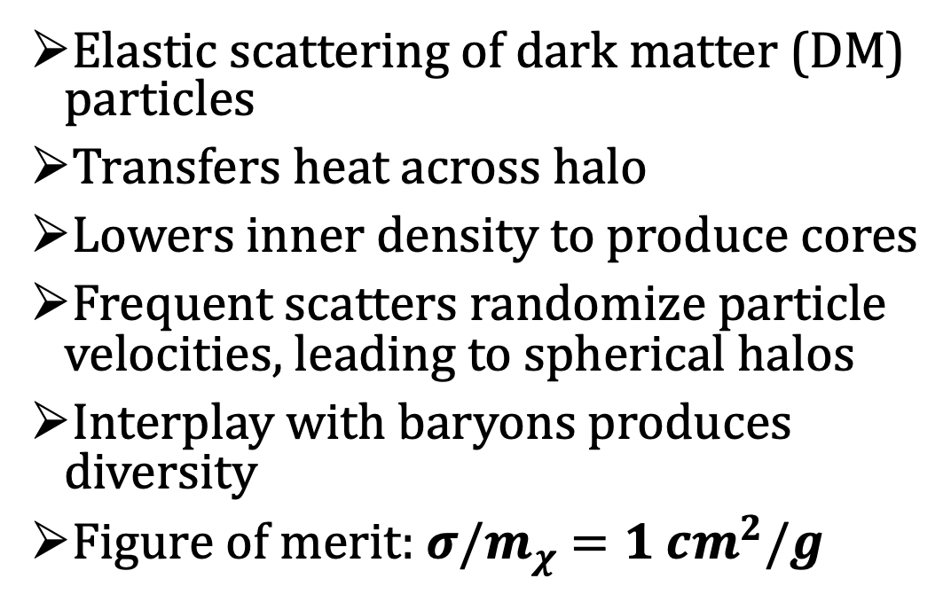
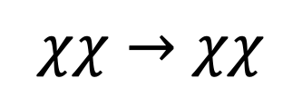
Self-Interacting Dark Matter
$$χ$$
Elastic scattering of dark matter (DM) particles
Transfers heat across halo
Lowers inner density to produce cores
Frequent scatters randomize particle velocities, leading to spherical halos
Interplay with baryons produces diversity
Figure of merit:$σ/m_{χ}$ $=1 cm^{2}/g$
$$χχ→χχ$$
Dwarf tension range: $\frac{σ}{m}∼0.5−50 cm^{2}/g$
$$χ$$

Slide 12


Self-Interacting Dark Matter
Elastic scattering of dark matter (DM) particles
Transfers heat across halo
Lowers inner density to produce cores
Frequent scatters randomize particle velocities, leading to spherical halos
Interplay with baryons produces diversity
Figure of merit:$σ/m_{χ}$ $=1 cm^{2}/g$
$$χχ→χχ$$
$$χ$$
$$χ$$
Dwarf tension range: $\frac{σ}{m}∼0.5−50 cm^{2}/g$

Slide 13

Self-Interacting Dark Matter
$$χ$$
Elastic scattering of dark matter (DM) particles
Transfers heat across halo
Lowers inner density to produce cores
Frequent scatters randomize particle velocities, leading to spherical halos
Interplay with baryons produces diversity
Figure of merit:$σ/m_{χ}$ $=1 cm^{2}/g$
$$χχ→χχ$$
Dwarf tension range: $\frac{σ}{m}∼0.5−50 cm^{2}/g$
$$χ$$

Slide 14
The Jeans Model for SIDM
N-BODY SIMULATIONS
JEANS MODELLING
Pros
Fully dynamical
Realistic evolution
First-principles approach
Cons
Computationally expensive
Cannot fix the final state
One cross section at a time
Large volume space to find analogues
Pros
Computationally cheap
Large parameter scans fast
Non-dynamical (can model final states)
Cons
Non-dynamical (consistency)
Assumes relaxed, steady-state systems
Assumptions that are known not to hold exactly

Slide 15
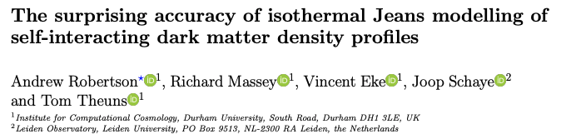
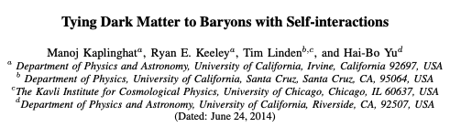
The Jeans Model for SIDM
The 1D isothermal Jeans model is surprisingly accurate for modelling SIDM halos
Non-spherical effects from initial collapse and asymmetric baryon components are important

Slide 16

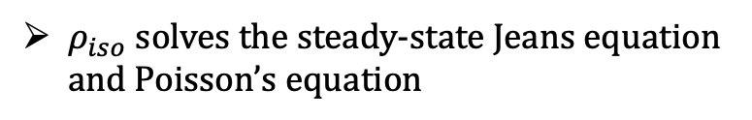

The Jeans Model for SIDM
The Jeans model stitches together an inner isothermal profile with an outer CDM (NFW) profile
$$r_{m}$$
$ρ_{iso}$ solves the steady-state Jeans equation and Poisson’s equation
$ρ_{cdm}$ is the NFW profile
Isothermal ideal gas in hydrostatic equilibrium

Slide 17

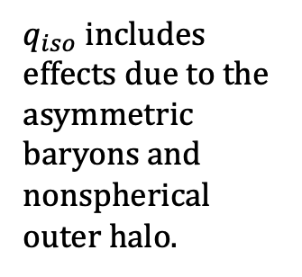
The Squashed Jeans Model for SIDM
We model the nonspherical 2D SIDM halo by “squashing” iso-density spheres into iso-density spheroids of equal volume
Where the effective radius is defined implicitly by
And the shape function $q(r)$ from kinetic theory arguments (collisional Boltzmann equation)
$q_{iso}$ includes effects due to the asymmetric baryons and nonspherical outer halo.
$$\sqrt{2}/5$$

Slide 18


Slide 19
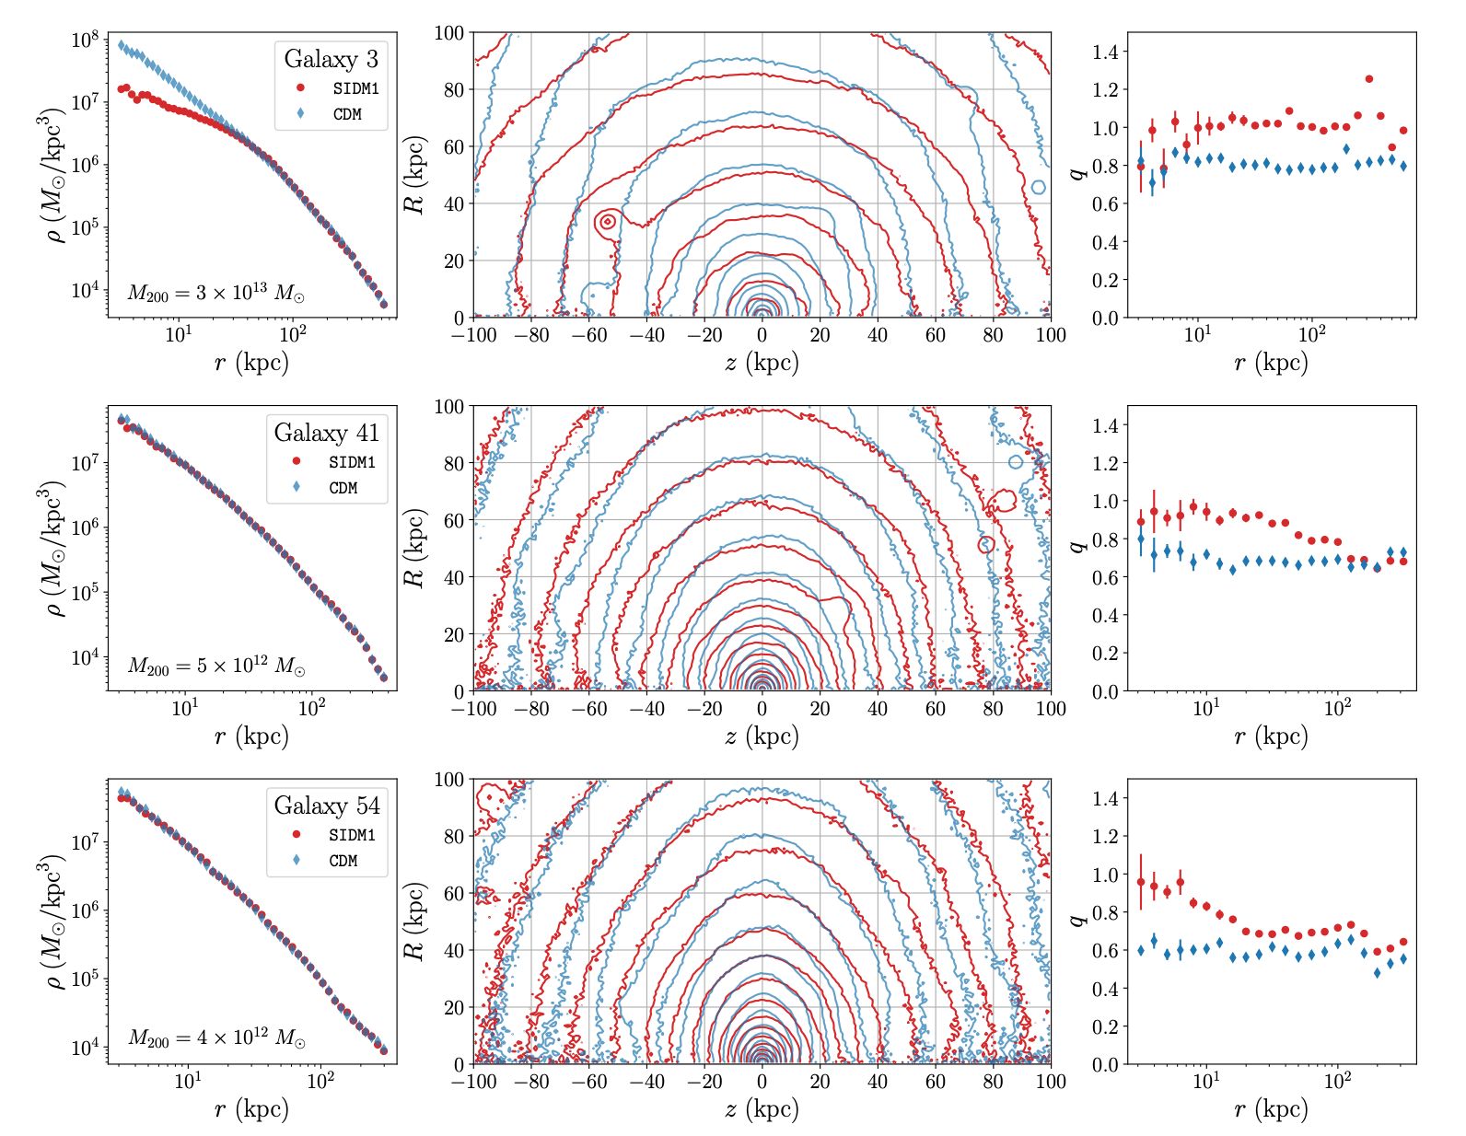

Validation with EAGLE-50 Simulations
IMPORTANT MOTIVATION
Intermediate mass halos–$M_{200}∈\left[{10}^{12},{10}^{13}\right] M_{⊙}$ have indistinguishable spherical density profiles
But, they have different shape profiles!
Can shape information be used to discriminate between SIDM and CDM?
Fig 2. Spherical density profile, 2D density contours, and shape profile respectively, for three example halos from the SIDM1b and CDMb EAGLE-50 simulations. [Bautista et al. 2025]

Slide 20
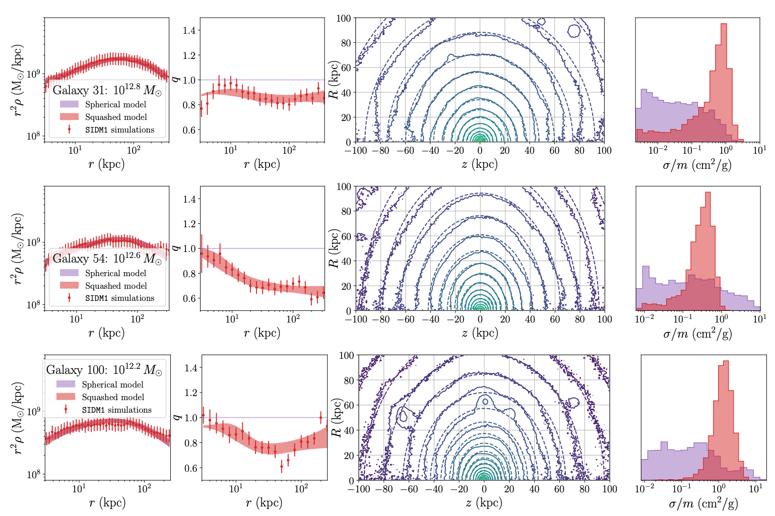
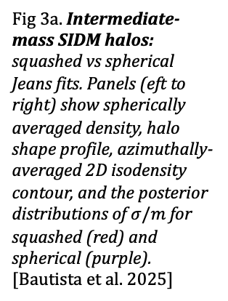
Validation with EAGLE-50 Simulations
Fig 3a. Intermediate-mass SIDM halos: squashed vs spherical Jeans fits. Panels (eft to right) show spherically averaged density, halo shape profile, azimuthally-averaged 2D isodensity contour, and the posterior distributions of $σ/m$ for squashed (red) and spherical (purple). [Bautista et al. 2025]

Slide 21
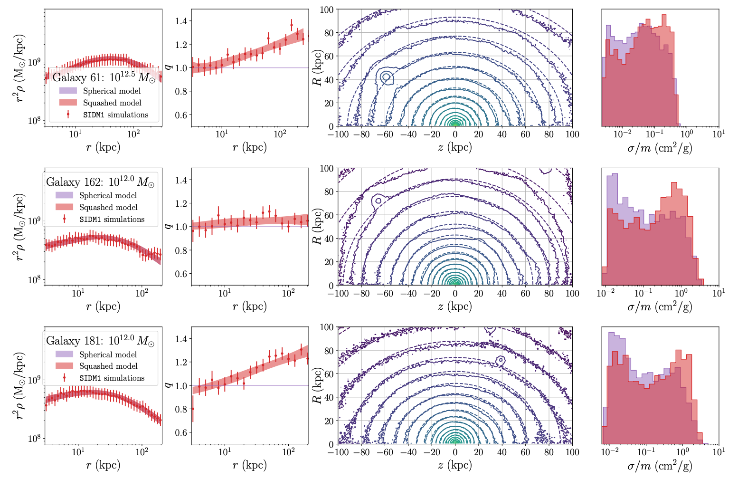
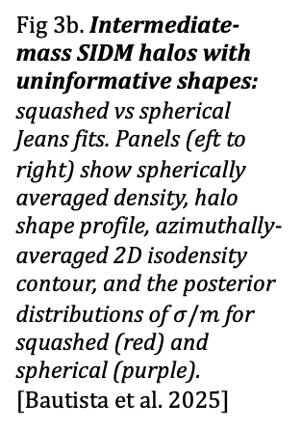
Validation with EAGLE-50 Simulations
Fig 3b. Intermediate-mass SIDM halos with uninformative shapes: squashed vs spherical Jeans fits. Panels (eft to right) show spherically averaged density, halo shape profile, azimuthally-averaged 2D isodensity contour, and the posterior distributions of $σ/m$ for squashed (red) and spherical (purple). [Bautista et al. 2025]

Slide 22
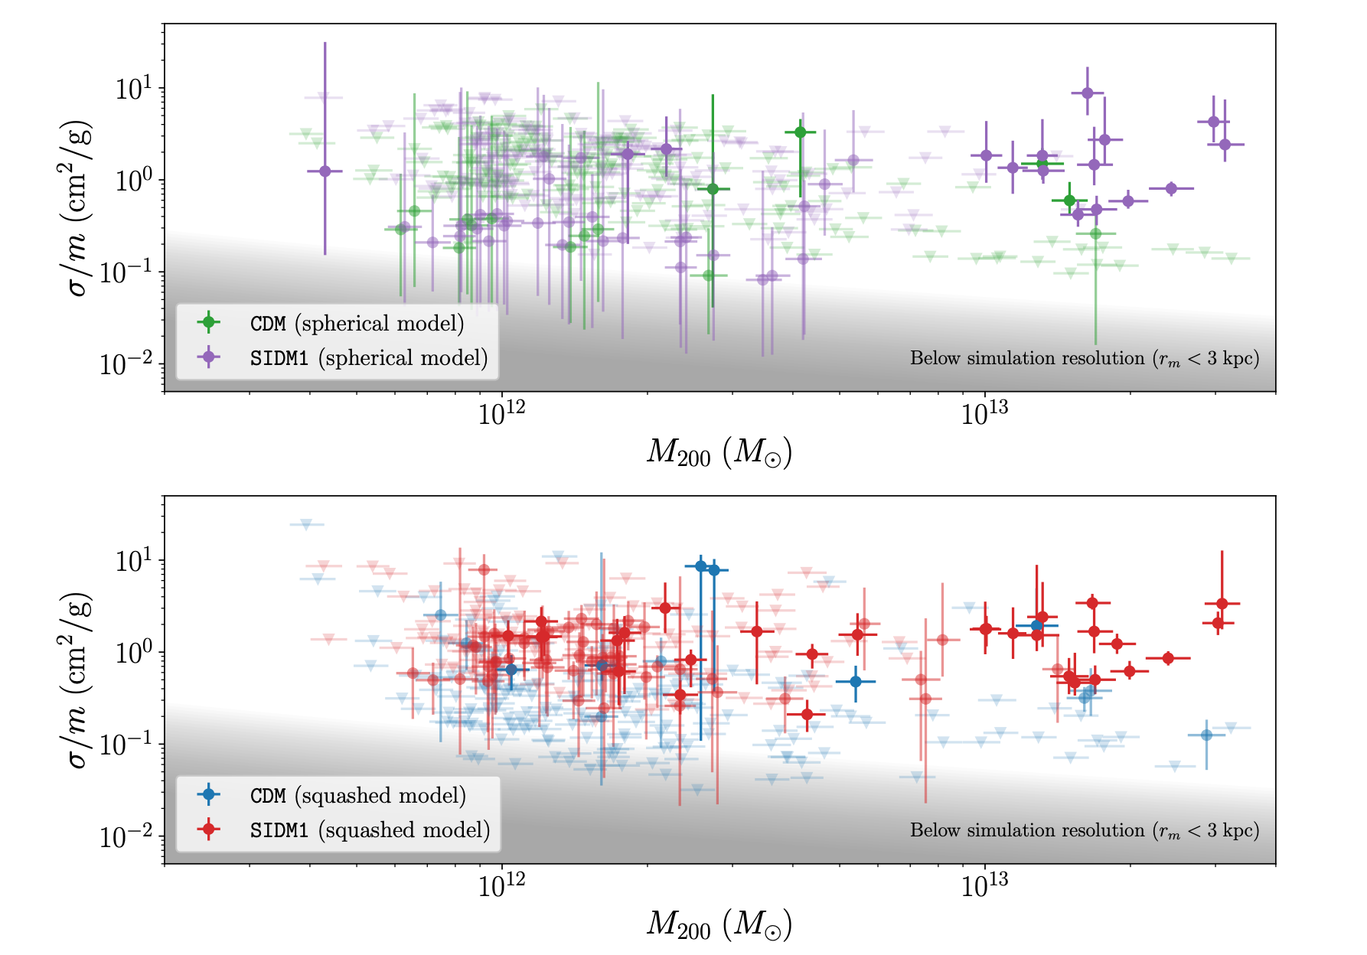
Validation with EAGLE-50 Simulations
Fig 4: Inferred SIDM cross section vs. halo mass from Jeans modelling. Top: spherical Jeans model fit for relaxed SIDM1b (purple) and CDMb (green) halos. Bottom: squashed Jeans model fir for relaxed SIDM1b (red) and CDMb (blue) halos. Points show median with 68% credible intervals. Weak inferences are faint points and downward arrows are 90% upper limits. [Bautista et al. 2025]
Strong inference
Weak inference
Upper limit
Improves strong and weak SIDM inferences and reduces CDM false positives.

Slide 23
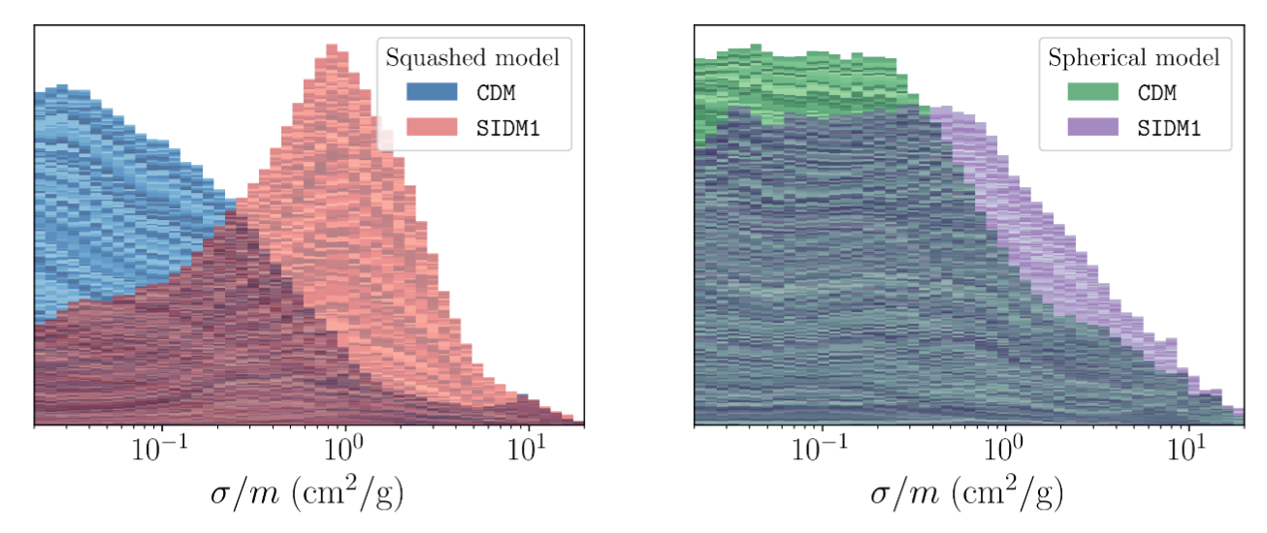
Validation with EAGLE-50 Simulations
Fig 9: Stacked histograms for intermediate mass halos. Left panel: stacked histogram for posterior distributions for $σ/m$ for all SIDM1b (red) and CDMb (blue) for the squashed Jeans model. Right panel: stacked histogram for posterior distributions for $σ/m$ for all SIDM1b (purple) and CDMb (green) for the spherical Jeans model. [Bautista et al. 2025]

Slide 24
Squashed Model Summary
Developed a fast semi-analytic framework, the squashed Jeans model, to describe shapes of SIDM halos
Successfully modelled shapes of SIDM and CDM halos over a wide range of halo masses
Showed that shape information can break the spherical Jeans model degeneracy and improve cross section inferences
Shapes can be used as a discriminant between SIDM and CDM when spherically averaged density profiles are indistinguishable

Slide 25
Future/Ongoing Work
Generalize shape analysis for a velocity-dependent cross section (writing paper now!)
Apply to the MW rotation curve and shape data to constrain the SIDM cross section (no projection needed due to stellar streams; in progress)
Apply to observations from gravitational lensing or X-ray shape measurements (caveat: projection, observed radial shape profiles are difficult reconstruct)
Generalize squashed Jeans model to 3D (ellipsoids rather than spheroids)

Slide 26
QUESTIONS?

Slide 27
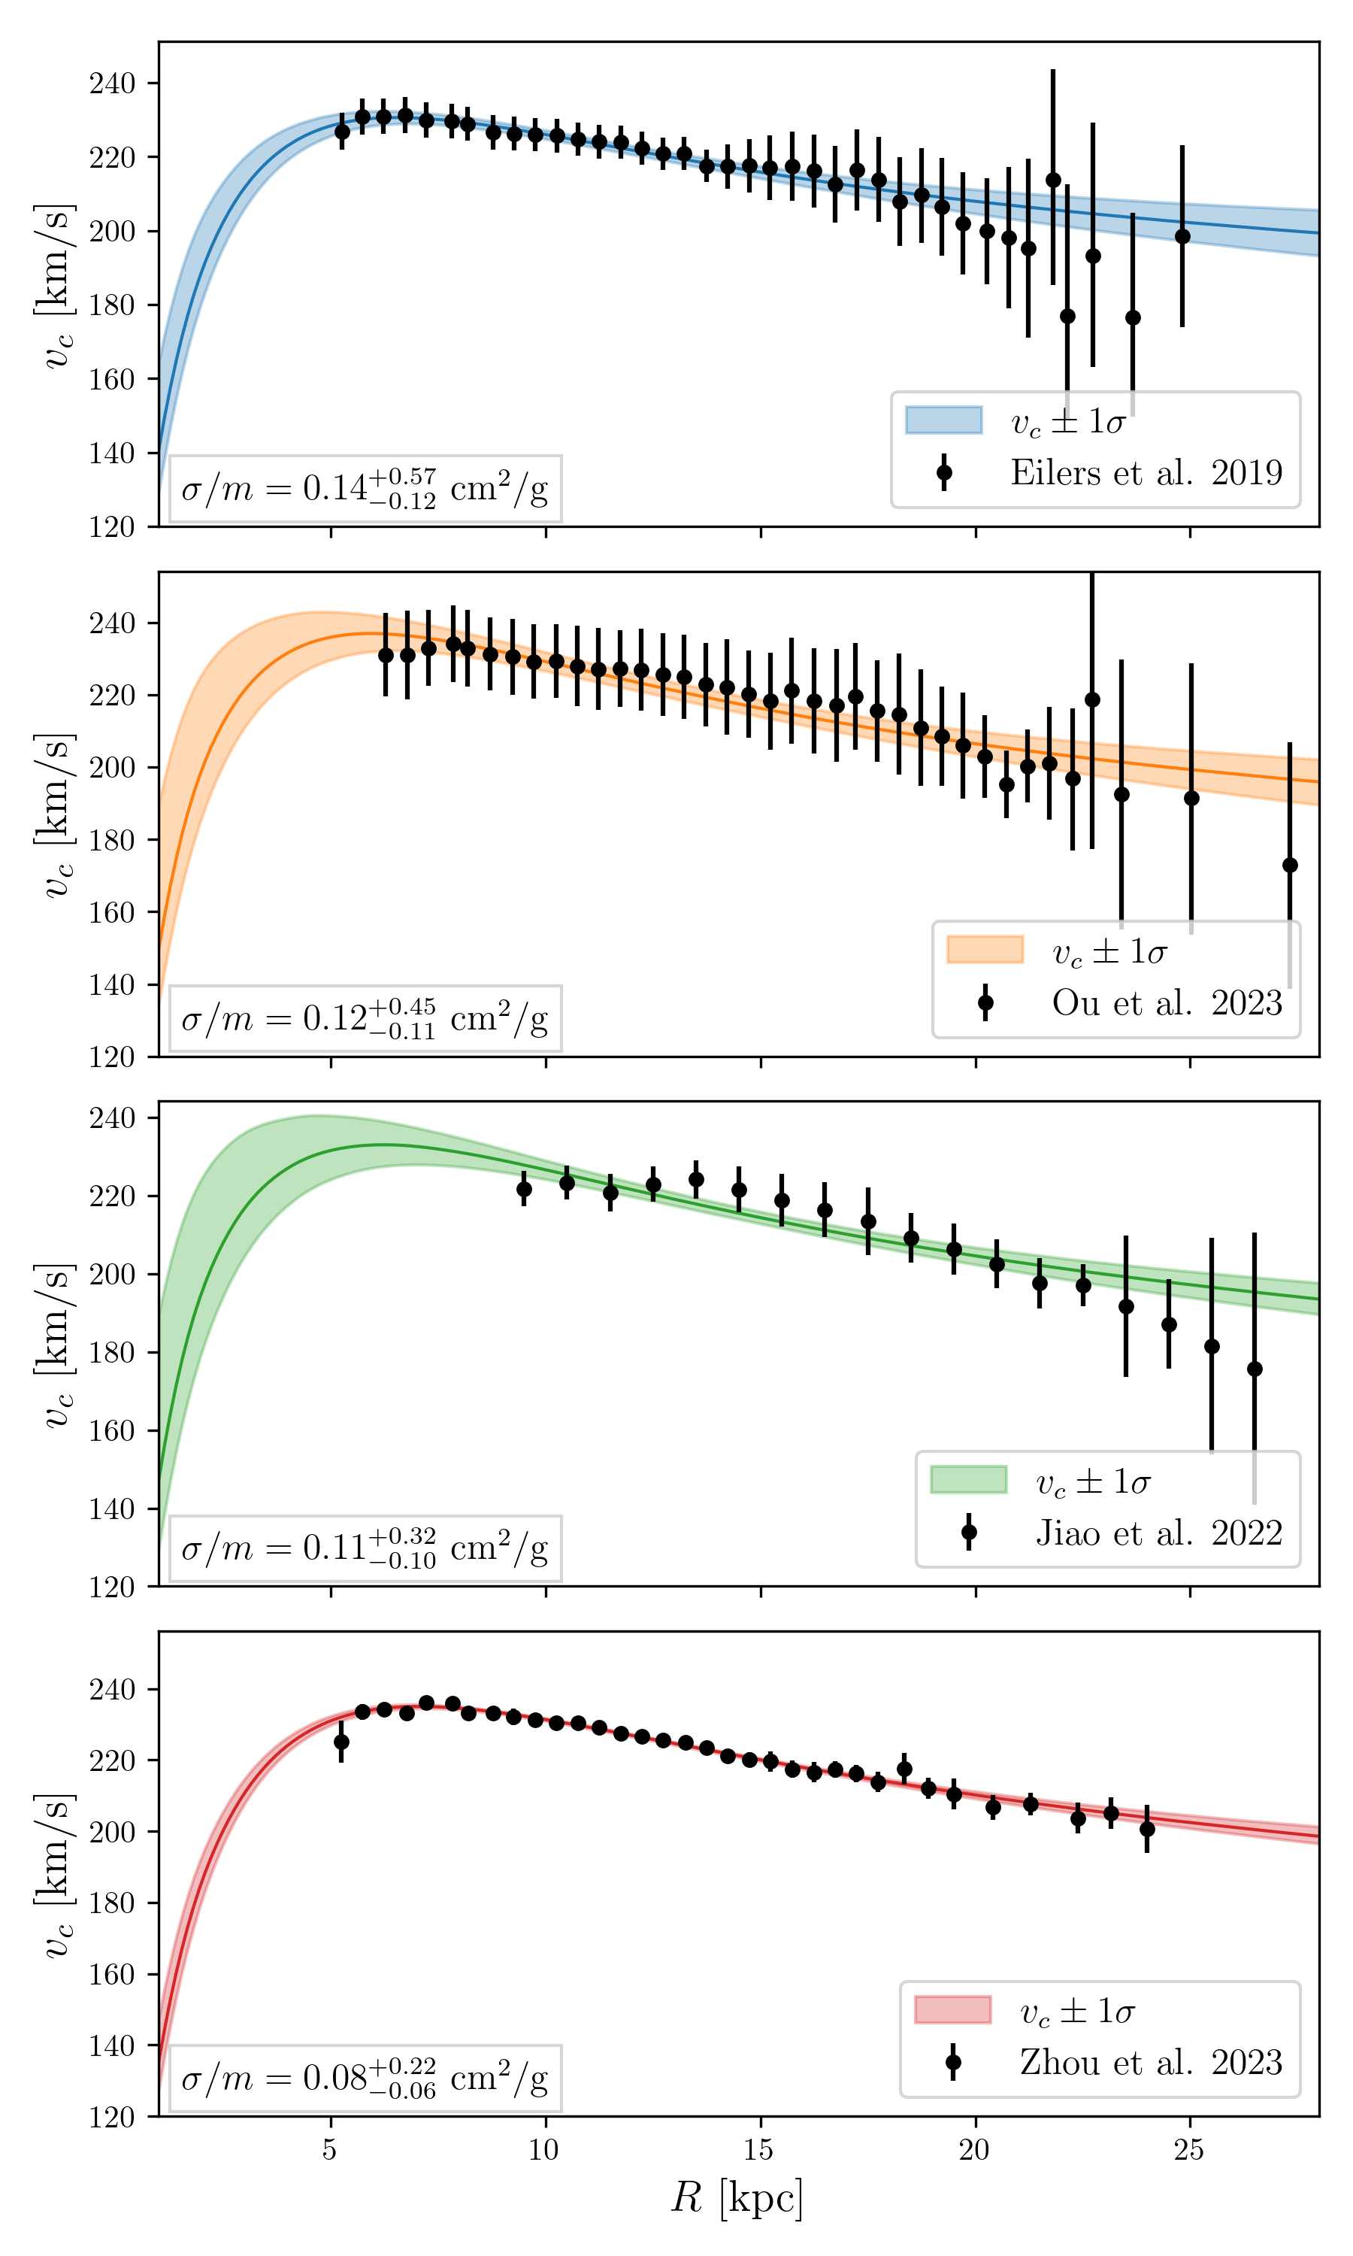
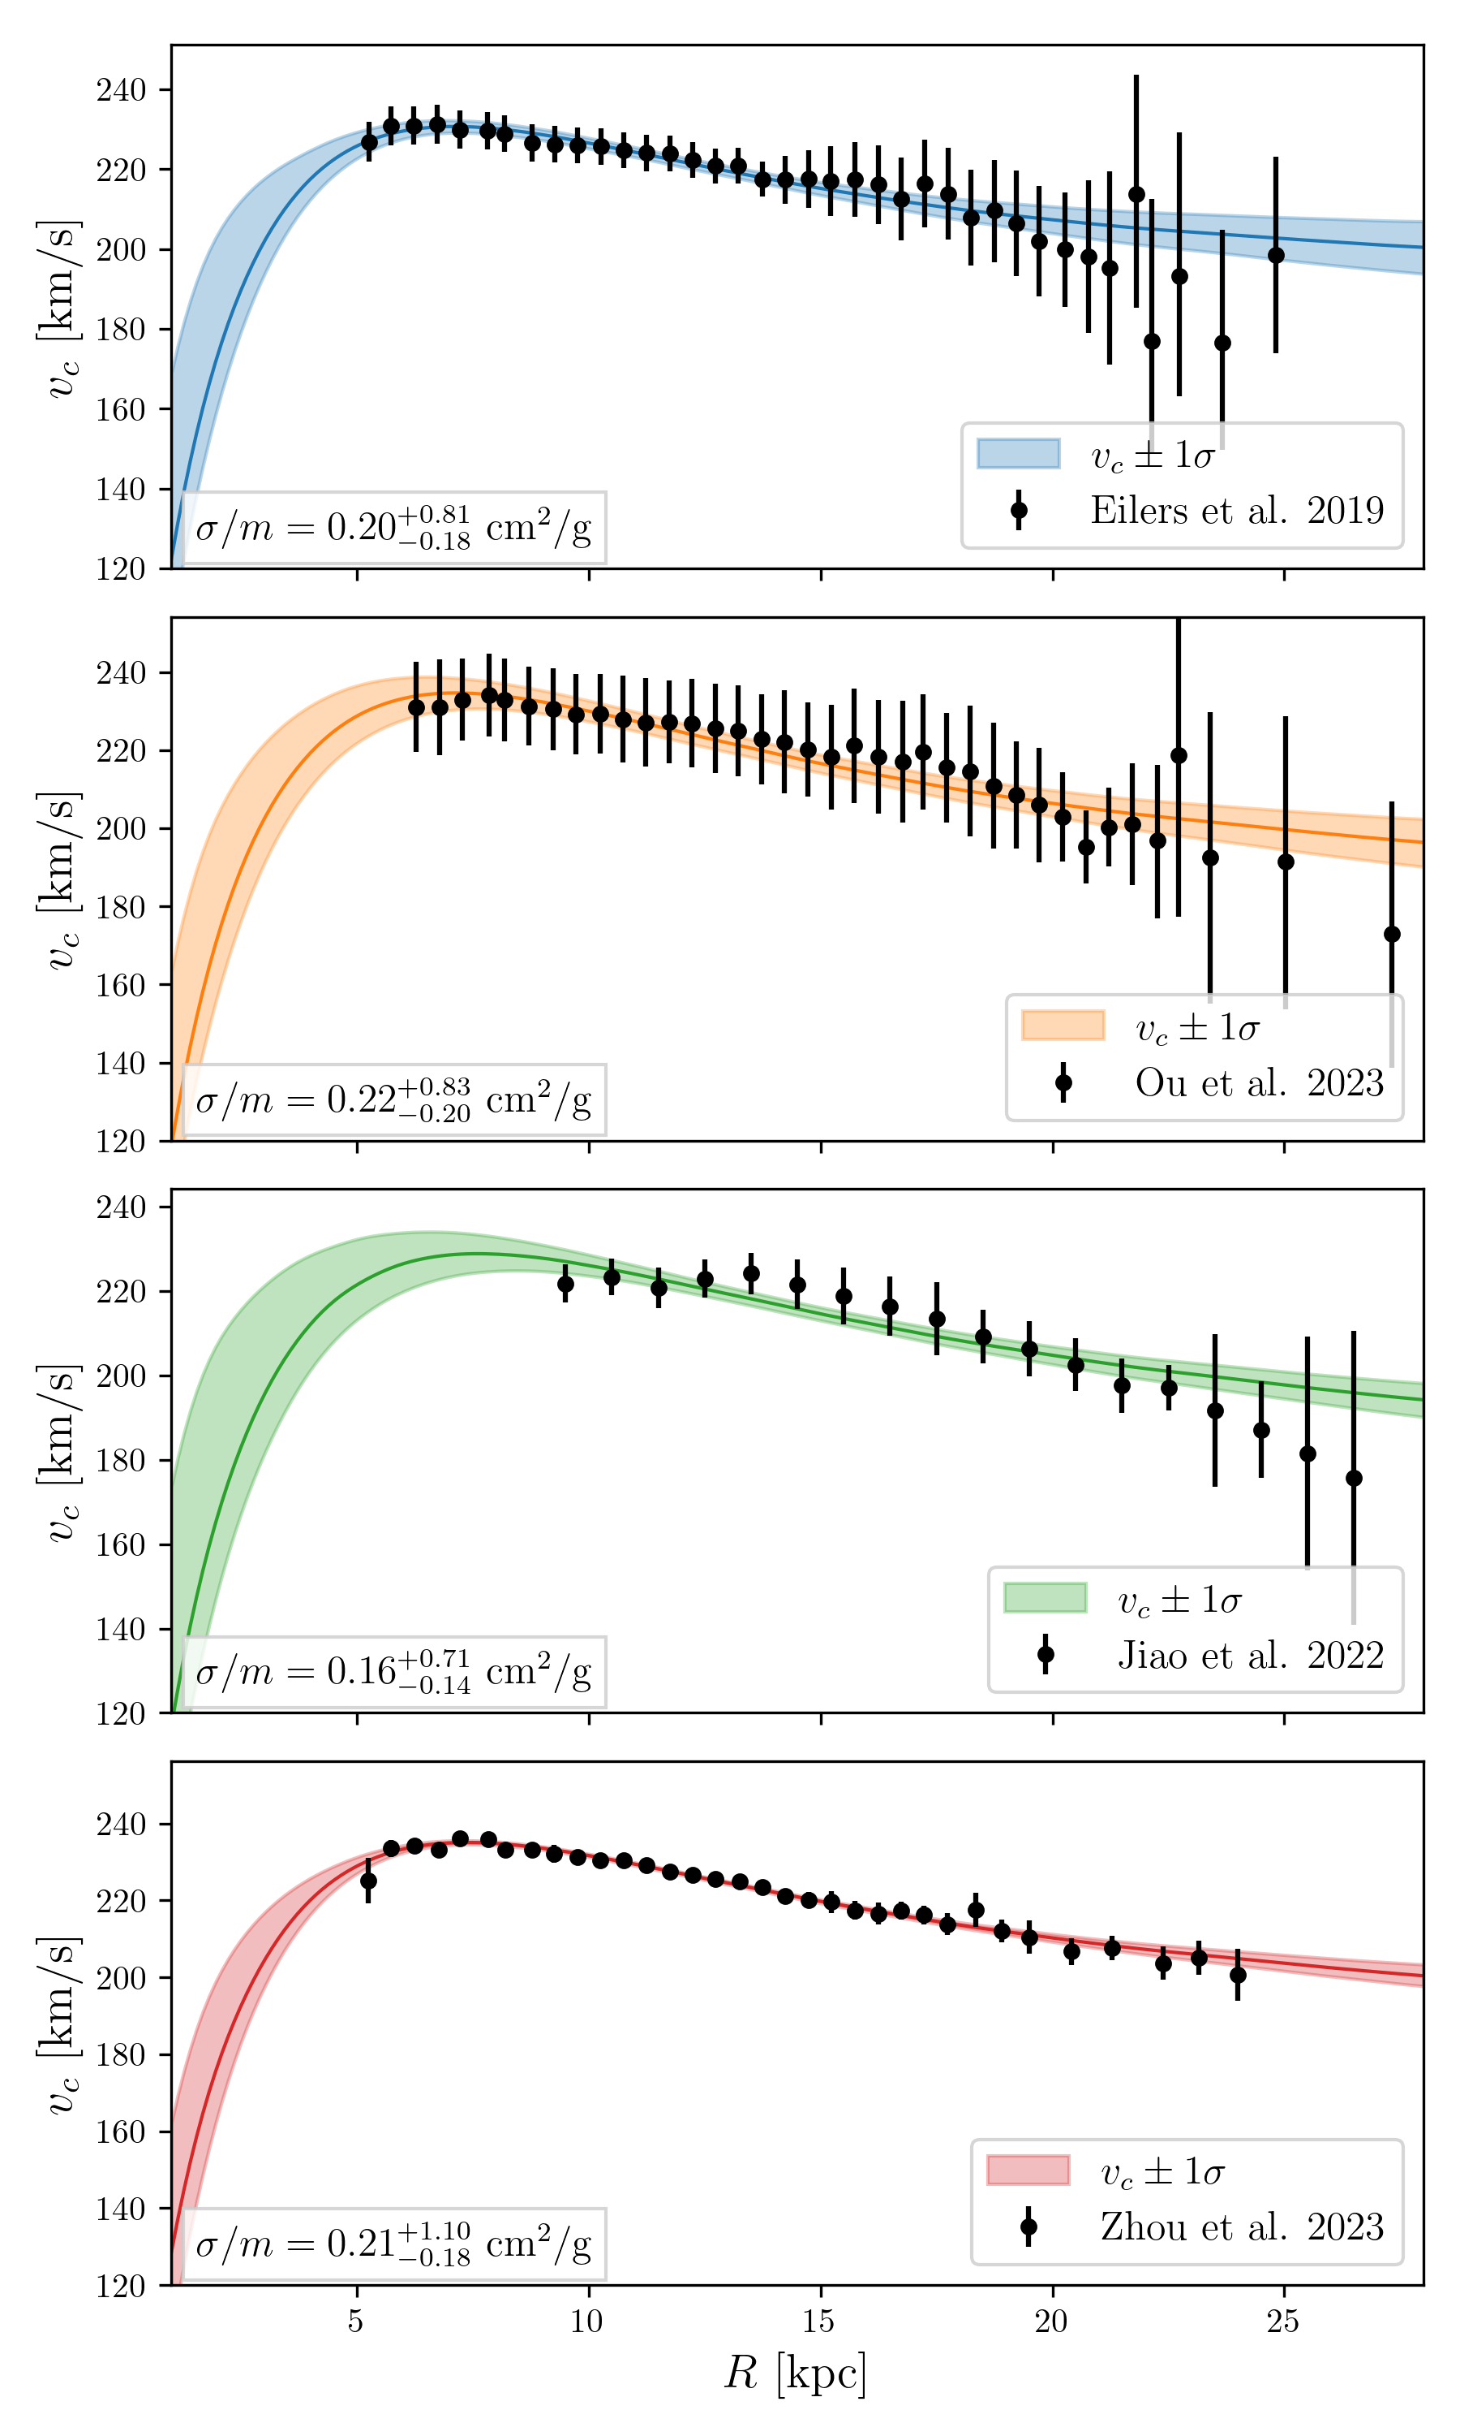
Backup Slides: MW Rotation Curves
Fig 10: Spherical (left panel) and squashed (right panel) Jeans model 80% credible intervals to the rotation curve for (top-to-bottom rows) Eilers et al., Ou et al., Jiao et al., and Zhou et al. The median cross section is labeled in the bottom left corner of each plot.
PRELIMINARY

Slide 28

Backup Slides: Kinetic Theory Argument
Maxwell-Boltzmann population
Define anisotropy parameter assuming axisymmetry
Solve the Collisional Boltzmann equation
Expand around $q≈1$, to leading order

Slide 29
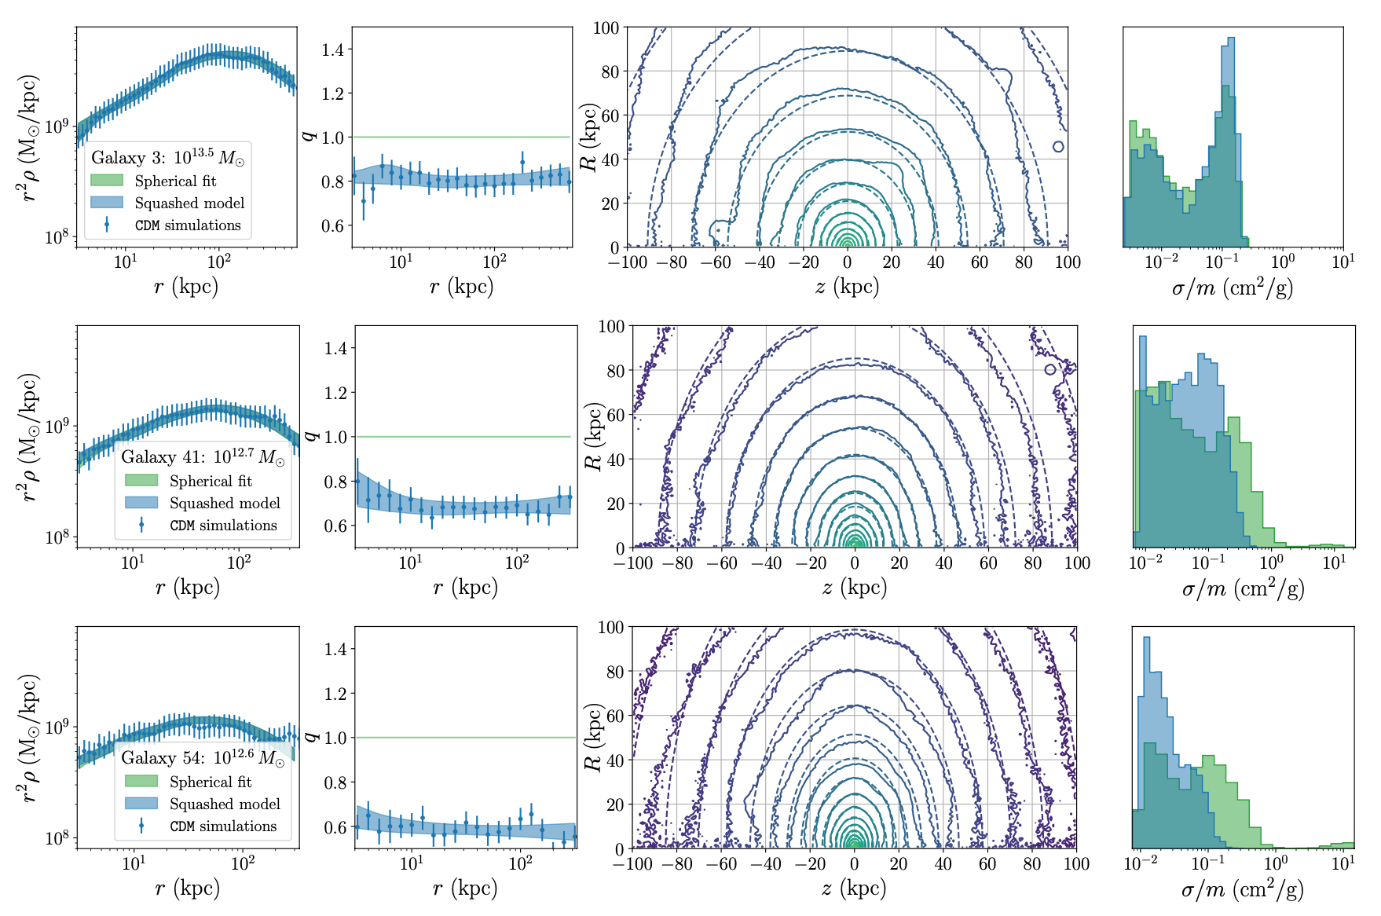
Backup Slides: CDM Fits

Slide 30
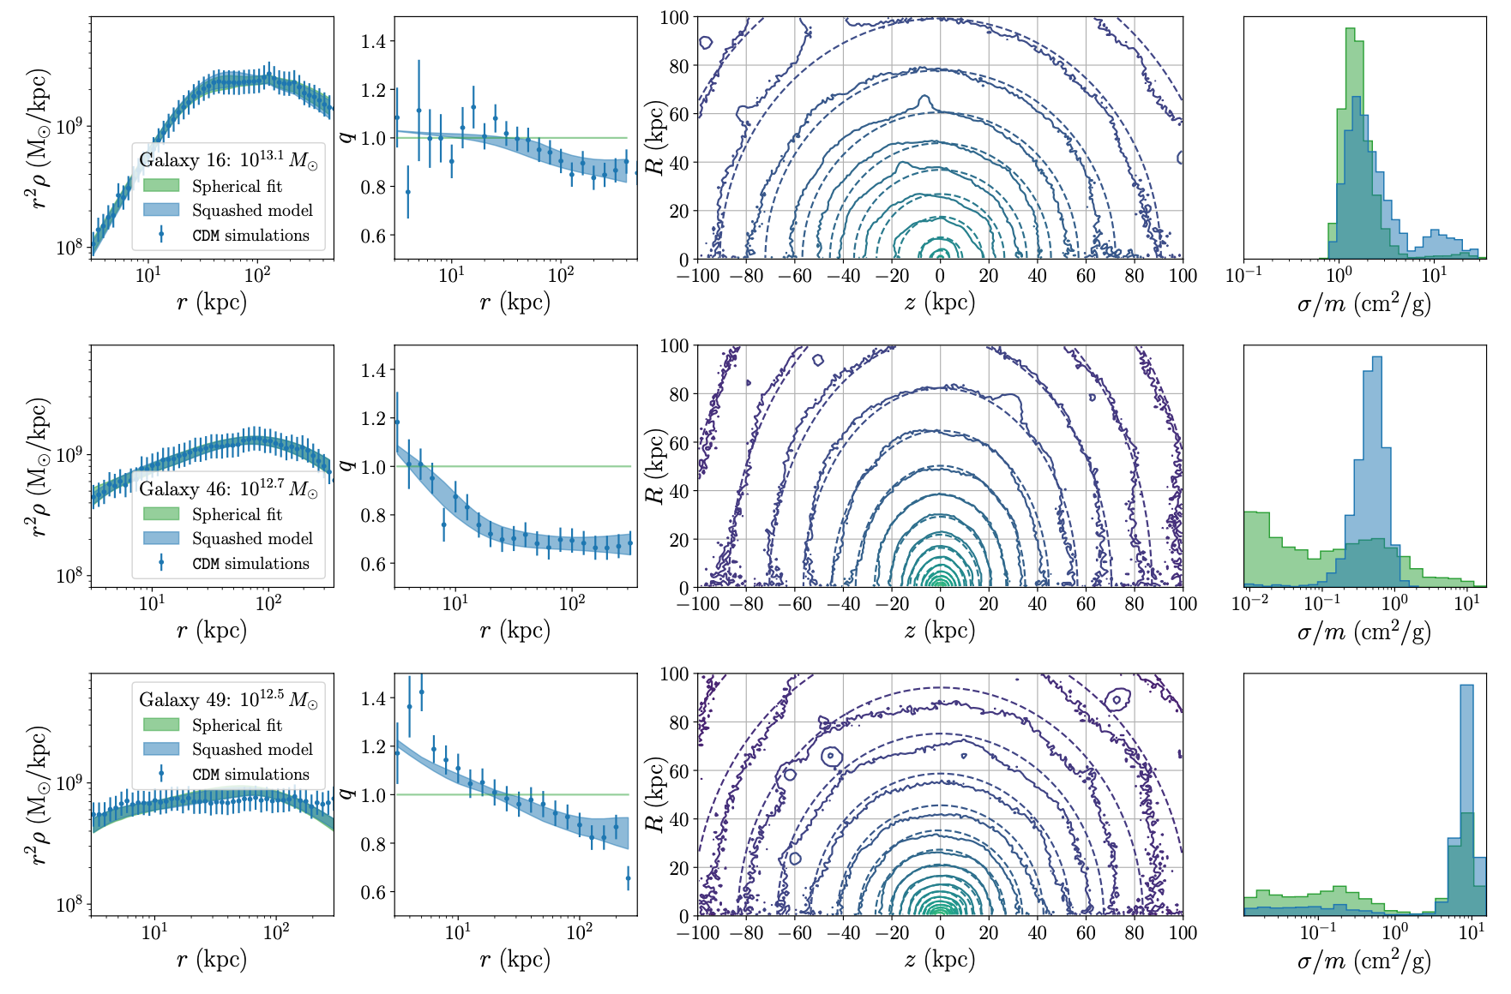
Backup Slides: CDM Fits

Slide 31
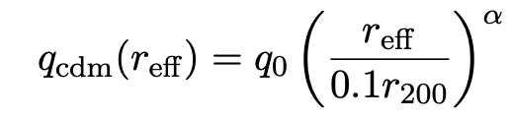
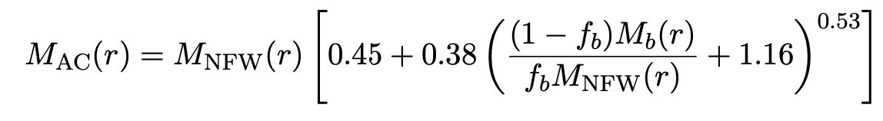
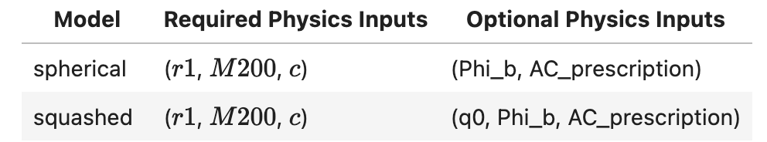
Backup Slides: Miscellaneous
CDM shape power law function
Adiabatic contraction (Cautun et al. 2019)

Slide 32
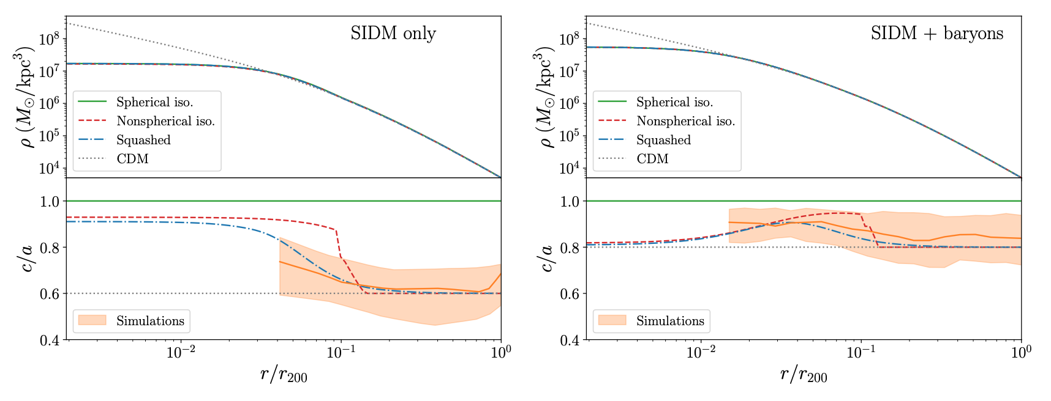
Backup Slides: Miscellaneous

Slide 33
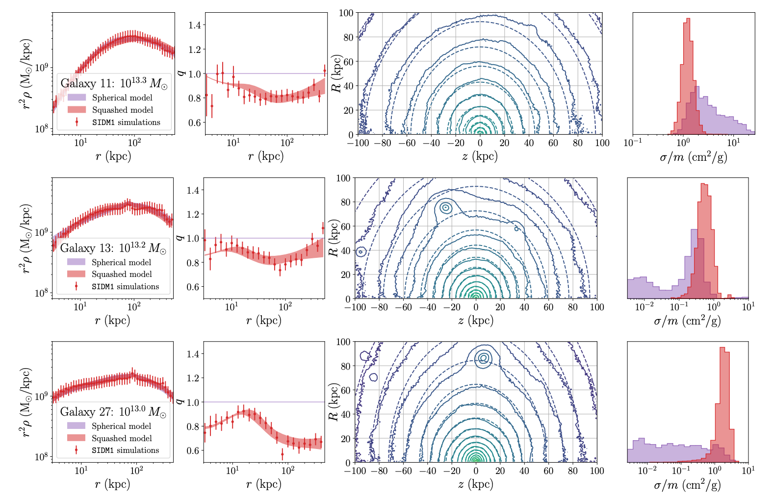
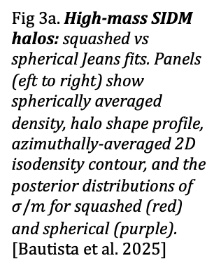
Validation with EAGLE-50 Simulations
Fig 3a. High-mass SIDM halos: squashed vs spherical Jeans fits. Panels (eft to right) show spherically averaged density, halo shape profile, azimuthally-averaged 2D isodensity contour, and the posterior distributions of $σ/m$ for squashed (red) and spherical (purple). [Bautista et al. 2025]
Notes:
The goal is to determine to what extent Jeans modelling can infer the “true” self-interaction cross section, and whether the inference is improved by shape information.

Slide 34
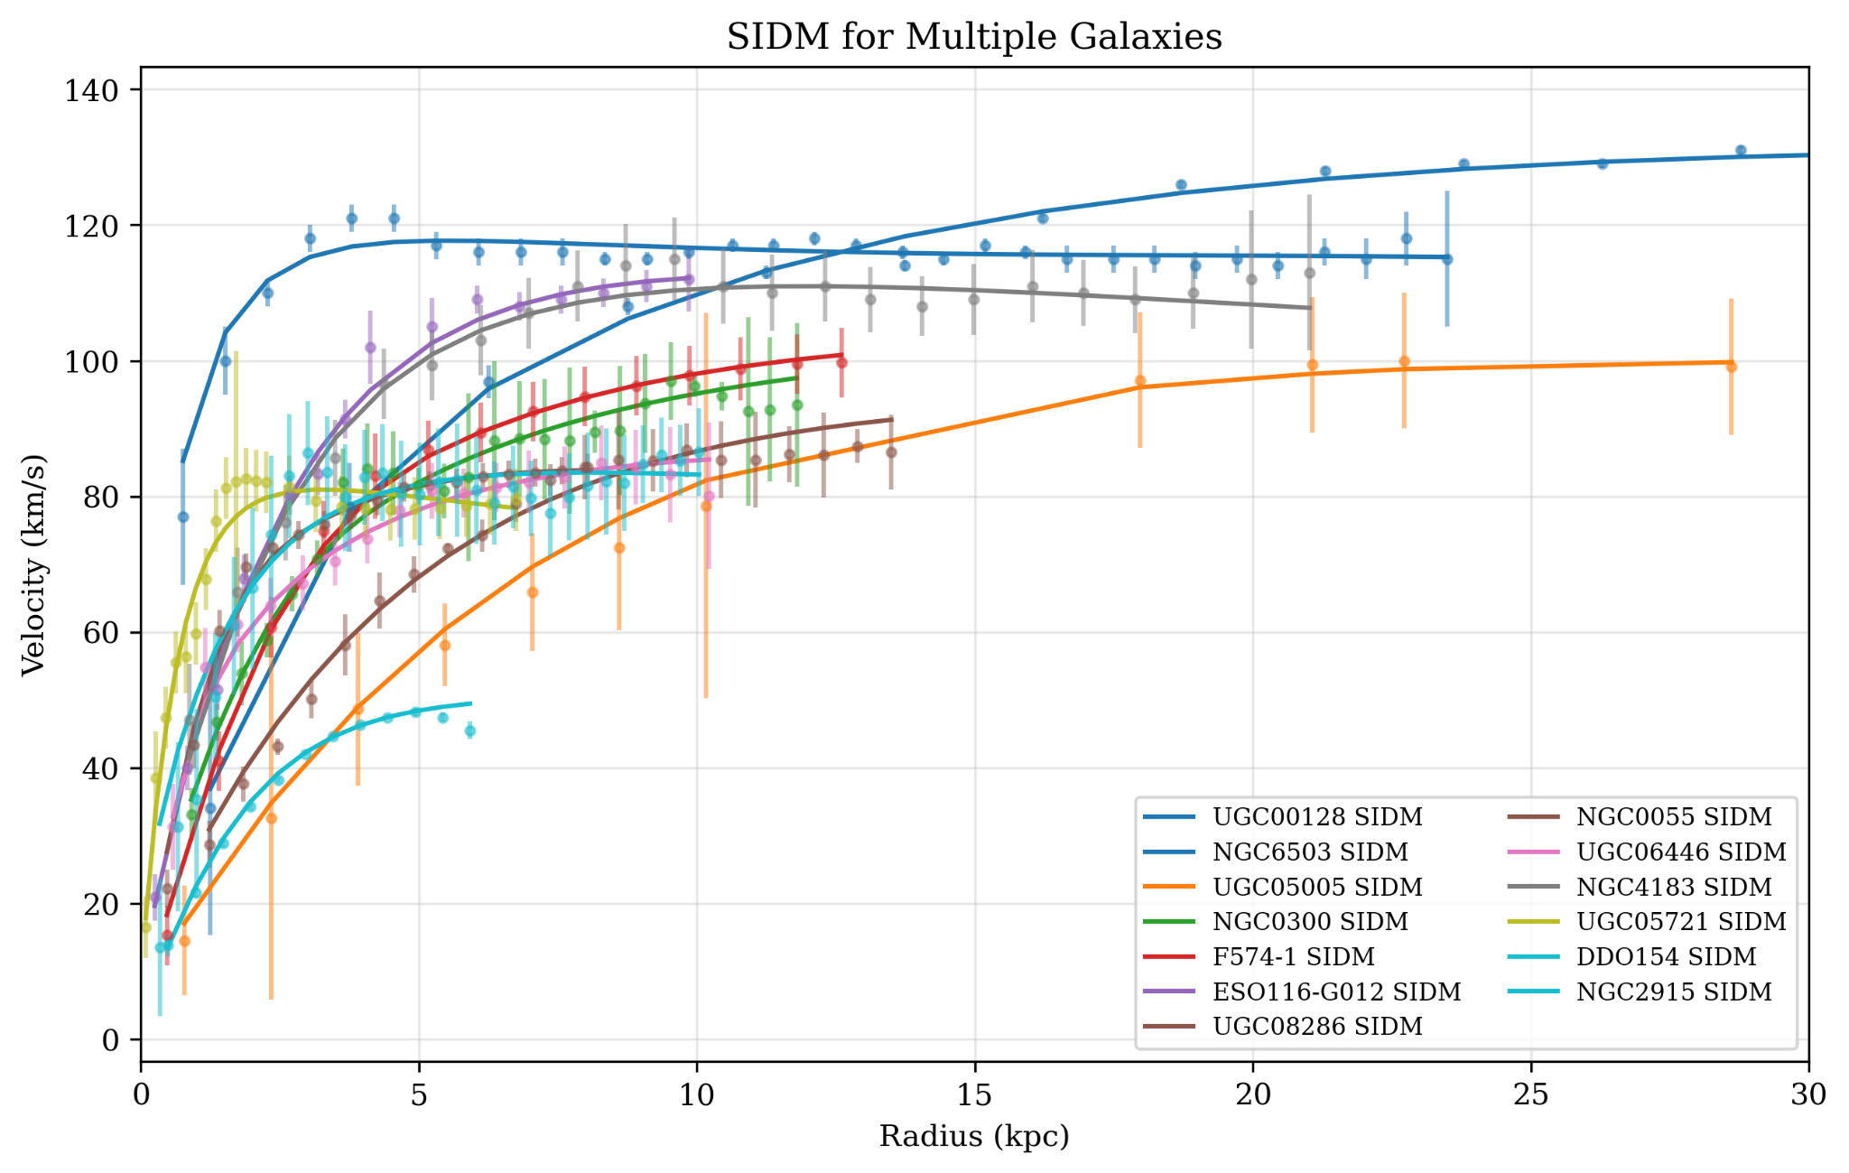
Backup: SPARC Diversity
Spherical Jeans model best fit rotation curves for a subset of SPARC rotation curves illustrating a large diversity in their inner slopes. [EXPLORE, 2026]

