Slide 1
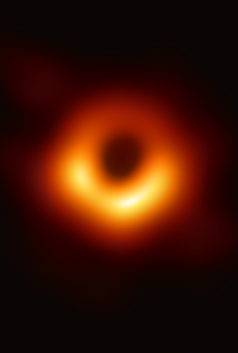

Observationally Excluding Accretion Powered Photospheres in Supermassive Black Hole Candidates
${Ekin Oran}^{1}$, ${Kiana Salehi}^{1,2,3} ,{Avery Broderick}^{1,2,3}$
1. Department of Physics and Astronomy, University of Waterloo, 200 University Avenue West, Waterloo, ON, N2L 3G1, Canada
2. Perimeter Institute for Theoretical Physics, 31 Caroline Street North, Waterloo, ON, N2L 2Y5, Canada
3. Waterloo Centre for Astrophysics, University of Waterloo, Waterloo, ON N2L 3G1 Canada
EHT, 2019
Notes:
Put eht collabarotation 2019, put the affiliations also

Slide 2
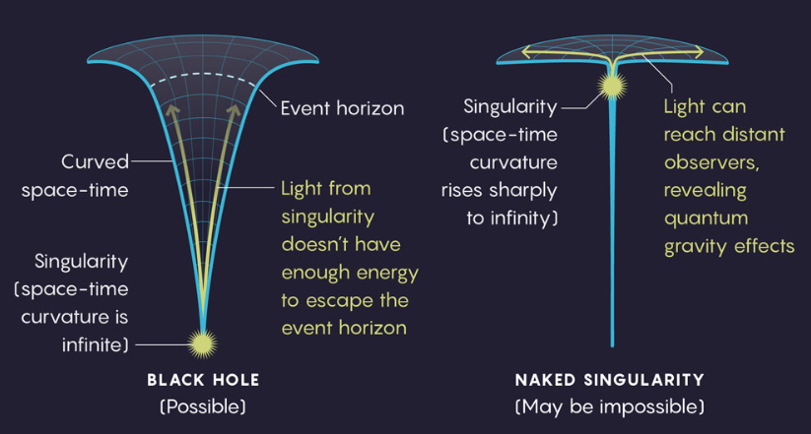

Motivation
In GR, supermassive black holes (SMBH) power AGNs
Most observations focus on gravitational potential rather than the existence of an event horizon
In GR, there are solutions where singularities are unhidden, behaving like a horizonless compact object
  Ie. Naked singularities, boson stars, fermion stars, or gravastars
For a horizonless compact object, accreting matter’s potential energy would turn into kinetic energy
The infalling baryonic gas would collide with previous infalling matter, thermalize and radiate like a blackbody
In SED, accretion powered photosphere would exhibit a rise in flux
Goal: To test the existence of photosphere in AGN by comparing observational spectra with predicted thermal surface emission
Image source: Quanta Magazine (2017), “Where Gravity Is Weak and Naked Singularities Are Verboten” quanta.sc/2017-naked-singularities
Notes:
As a consequence of not having an event horizon, we get photosphere, put early on what you need to detect such a signal, add more ref that goes back in time

Slide 3
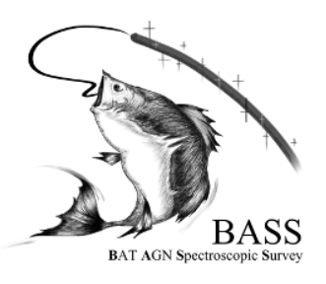
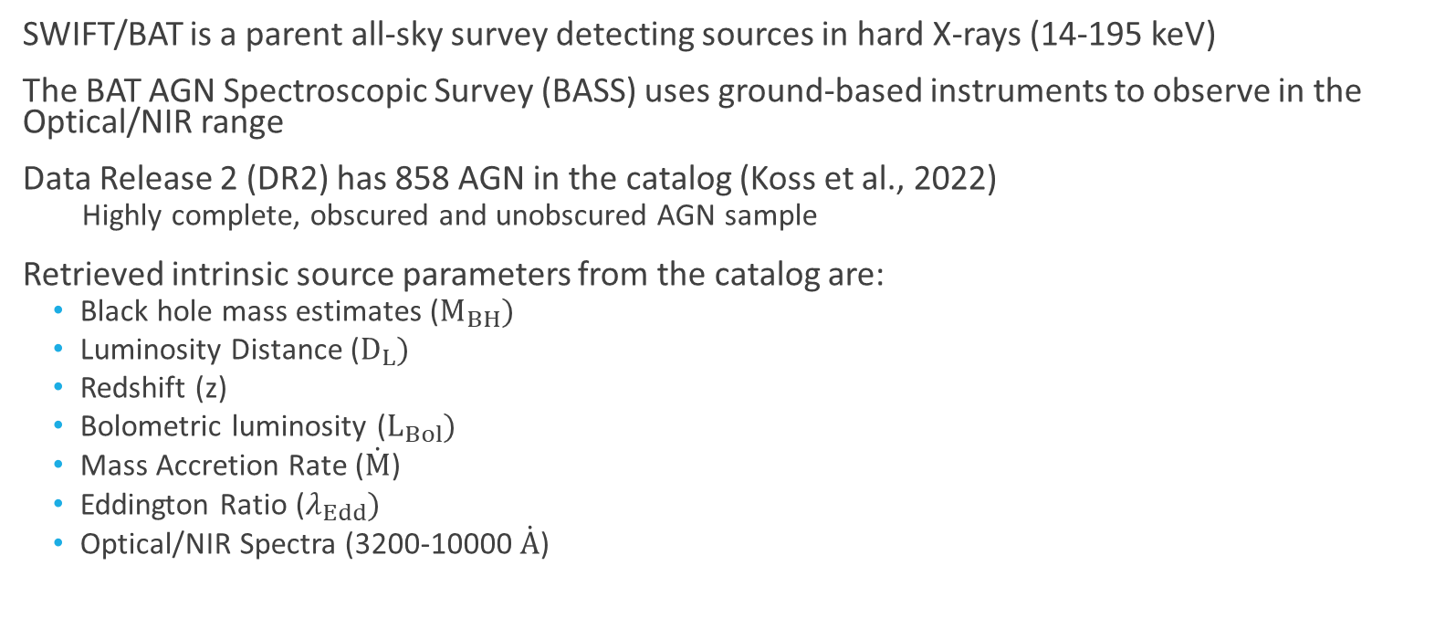
BAT AGN Spectroscopic Survey (BASS)
SWIFT/BAT is a parent all-sky survey detecting sources in hard X-rays (14-195 keV)
The BAT AGN Spectroscopic Survey (BASS) uses ground-based instruments to observe in the Optical/NIR range
Data Release 2 (DR2) has 858 AGN in the catalog (Koss et al., 2022)
  Highly complete, obscured and unobscured AGN sample
Retrieved intrinsic source parameters from the catalog are:
  Black hole mass estimates ($M_{BH})$
  Luminosity Distance ($D_{L})$
  Redshift (z)
  Bolometric luminosity ($L_{Bol})$
  Mass Accretion Rate ($\dot{M}$)
  Eddington Ratio ($λ_{Edd})$
  Optical/NIR Spectra (3200-10000 $\dot{A}$)
Notes:
Swift: fast to change directions, done by the swift telescope (parent)

Slide 4
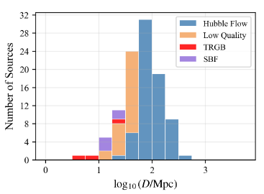
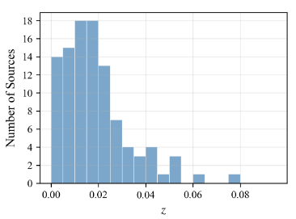
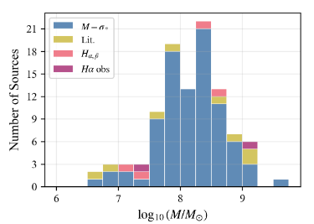
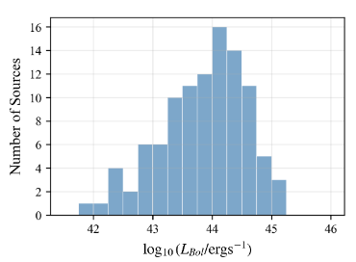



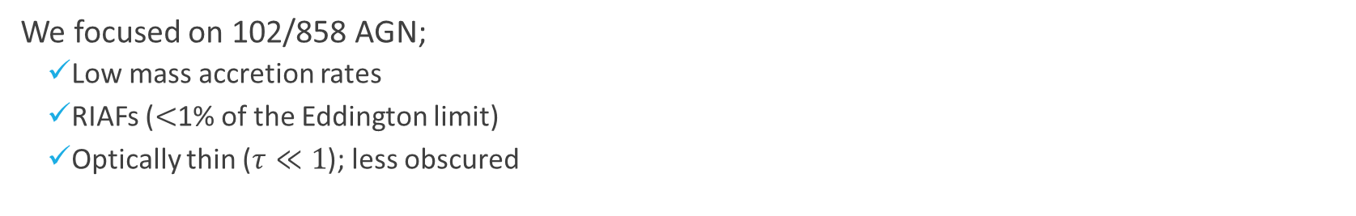
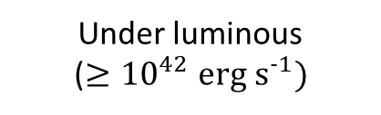
Sample Selection
We focused on 102/858 AGN;
  Low mass accretion rates
  RIAFs ($<$1% of the Eddington limit)
  Optically thin ($τ≪1$); less obscured
Nearby AGN ($<$300 Mpc)
Low redshift ($<$0.1)
Average Mass (${≥10}^{6}M_{⨀}$)
Under luminous (${≥10}^{42}erg s^{-1})$

Slide 5
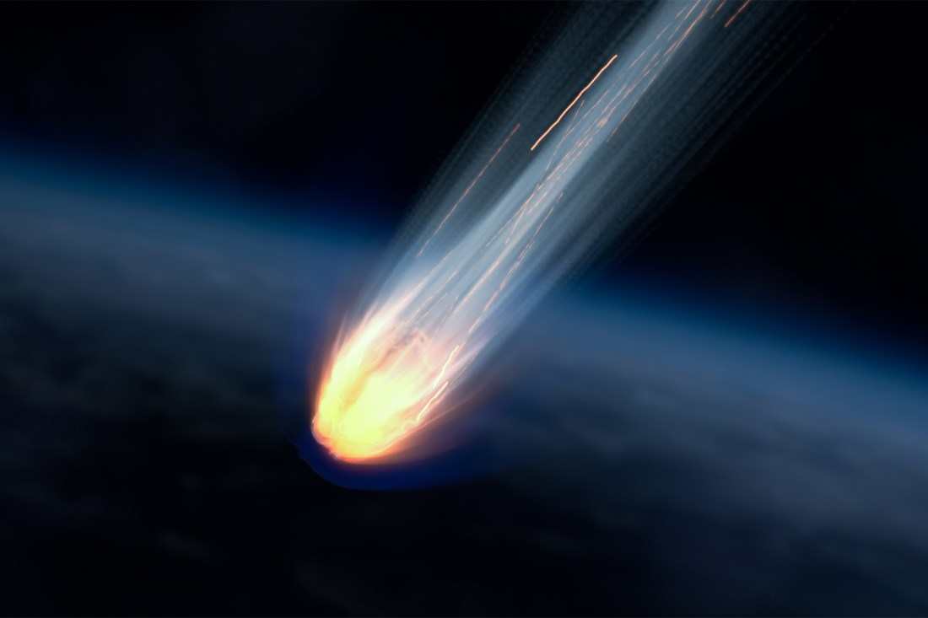
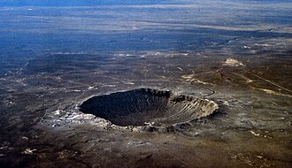
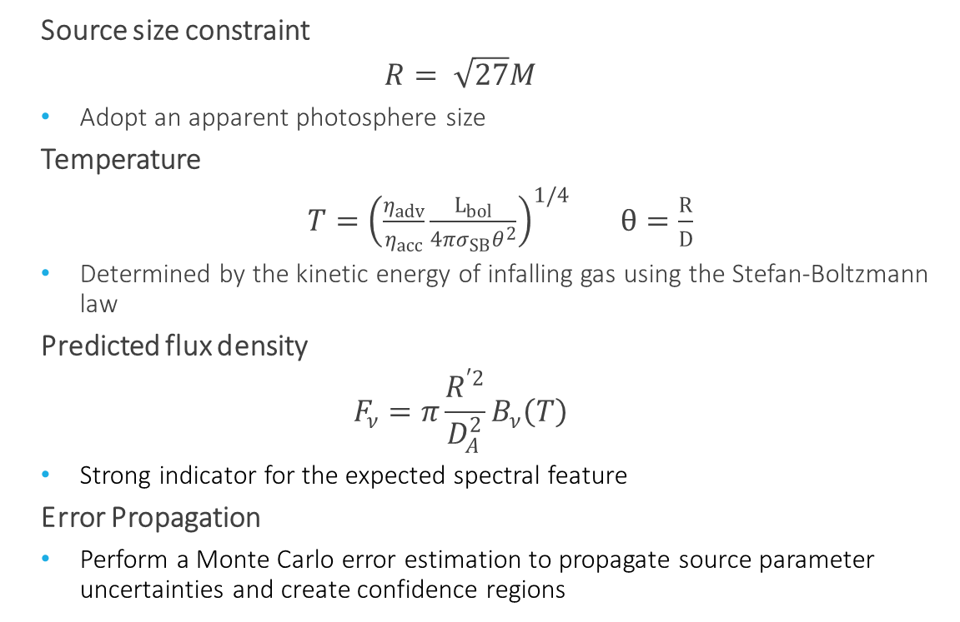
Construction of Thermal Surface Emission
  Source size constraint
  $$R= \sqrt{27}M$$
  Adopt an apparent photosphere size
  Temperature
  $T={\left(\frac{η_{adv}}{η_{acc}}\frac{L_{bol}}{{4πσ}_{SB}θ^{2}}\right)}^{1/4}$ $θ=\frac{R}{D}$
  Determined by the kinetic energy of infalling gas using the Stefan-Boltzmann law
  Predicted flux density
  $$F_{ν}=π\frac{R^{′2}}{D_{A}^{2}}B_{ν}\left(T\right)$$
  Strong indicator for the expected spectral feature
  Error Propagation
  Perform a Monte Carlo error estimation to propagate source parameter uncertainties and create confidence regions
Notes:
Mention size! Meteor=agn, crater = surface, temp determined by the kinetic energy of infalling gas, f_nu makes a strong indicator for the spectral feature, why monte carlo? Bcz src parameters aren’t perfectly known, there are huge errors, we perform MC to get a range

Slide 6
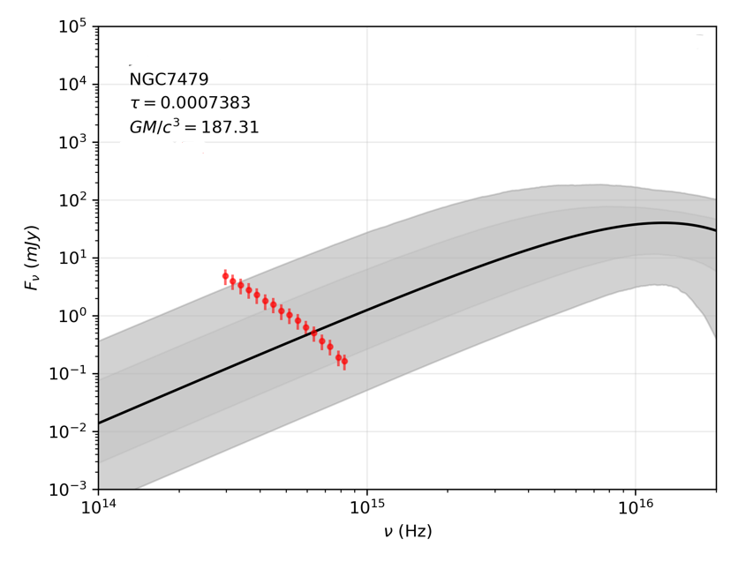

Spectral Energy Density
Constructed thermal surface emission feature
Observed spectrum obtained from BASS
Monte Carlo estimates: 1$σ$, 2$σ$

Slide 7
Results

Slide 8
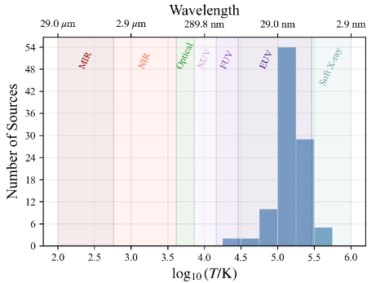
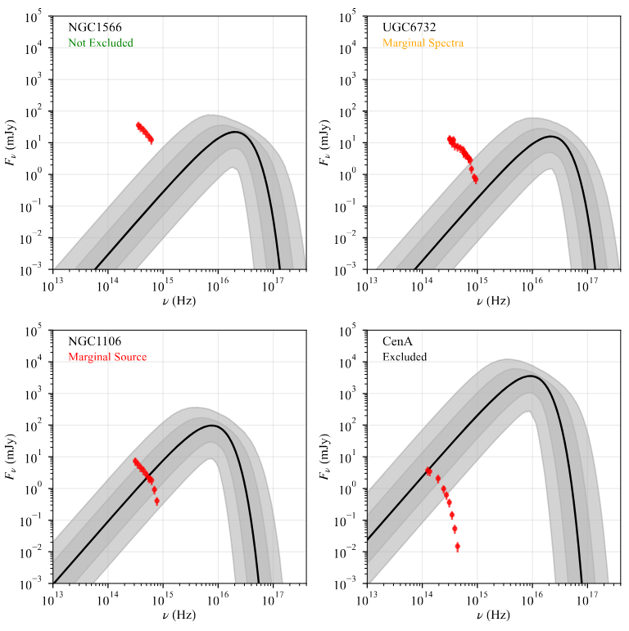
No thermal surface emission was detected!
All sources exhibit a decline in flux, rather than a rise
Predicted thermal surface emission peaks mostly in UV
Sources were classified into four categories:
  Excluded (38/102)
  Observed spectrum falls below the thermal surface emission, and the lower bound of 95th percentile
  The emission is too dim; excluding accretion powered photosphere
  Marginal Source (50/102)
  Observed spectrum falls within the confidence regions
  Better source parameter constraints needed
  Marginal Spectra (13/102)
  Observed spectrum sits on the emission feature and/or within the upper bound of confidence intervals
  Additional observations are needed
  Not Excluded (1/102)
  Observed spectrum lays significantly above the surface emission
  The spectral coverage was limited to draw a firm conclusion
Notes:
We are excluding the accretion powered photosphere, evidently consistent with event horizon

Slide 9
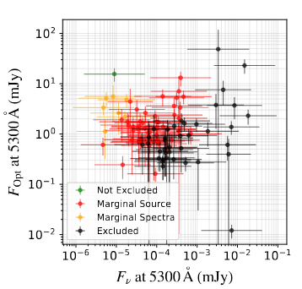
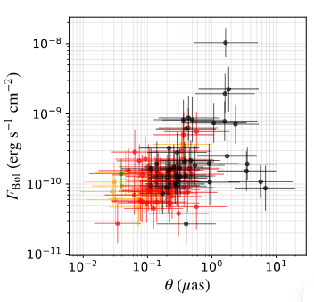
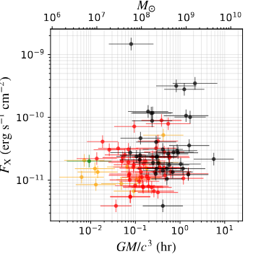
Implication for Future Observations
Sources with lower optical fluxes and higher predicted thermal emission are Excluded. Future space-missions like CASTOR and UVEX in UV regime would improve source classification
Sources with larger angular sizes and higher bolometric fluxes are Excluded. Future observations from Event Horizon Telescope collaboration will significantly enhance sensitivity in this direction and turn that assumption on source to measurement
X-ray bright sources with longer gravitational timescales are Excluded. Future follow ups on X-ray mission could focus on sources with similar characteristics
Notes:
Eht makes that assumption a measurement on source size

Slide 10
Summary
No thermal surface emission was detected!
Predicted thermal surface emissions peaked in the UV and soft X-ray
38/102 AGN are consistent with the existence of an event horizon
Angular size is important in source classification, rather than mass or distance;
  Sources with larger angular sizes were Excluded from having accretion powered photospheres
Better source parameter estimates and space-based missions in UV/Soft X-ray are needed

