Slide 1

Can Gravitational Waves Alter Binary Inspirals?
Emily Spence
Dr. Daniel Stolarski

Slide 2
01
Motivation & Research Goals

Slide 3
Motivation & Big Question
Compact binaries = strongest natural GW sources.
Their radiation causes inspiral and merger.
New question: can external GWs change this?
Could spacetime itself drive, halt, or reverse the process?

Slide 4
Research Goals
03 External GW …..Interaction
05 Conclusion
Identify conditions for measurable effect.
Add external GW forcing; compute orbital response.
02 Intrinsic Binary ….. …..Evolution
Derive circular‑binary GW emission in linearized GR.
04 System Dependence
Apply to two regimes:
– PSR B1913+16 (NS binary)
– OJ 287 (supermassive BH binary)

Slide 5
02
Intrinsic Binary Evolution

Slide 6
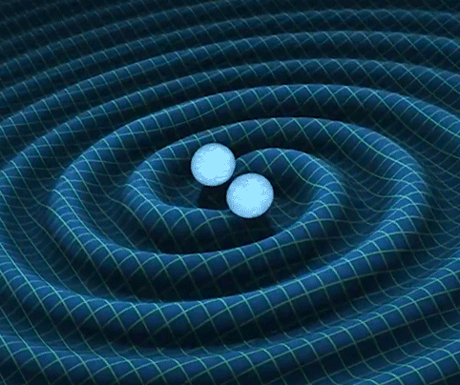


Framework: Linearized GR
Weak-field spacetime: small perturbation of flat space.
Gravitational waves = ripples in spacetime curvature
External signal: monochromatic sinusoidal wave
Radiation sourced by changing quadrupole moment.
Weak-field metric: $g_{αβ}=η_{αβ}+h_{αβ}, \left|h_{αβ}\right|≪1$
[Animation: NUSTEM]
Radiated power: $P=\frac{G}{5c^{2}}\left\langle \overset{⃛}{I_{ij}}\overset{⃛}{I^{ij}}\right\rangle$

Slide 7
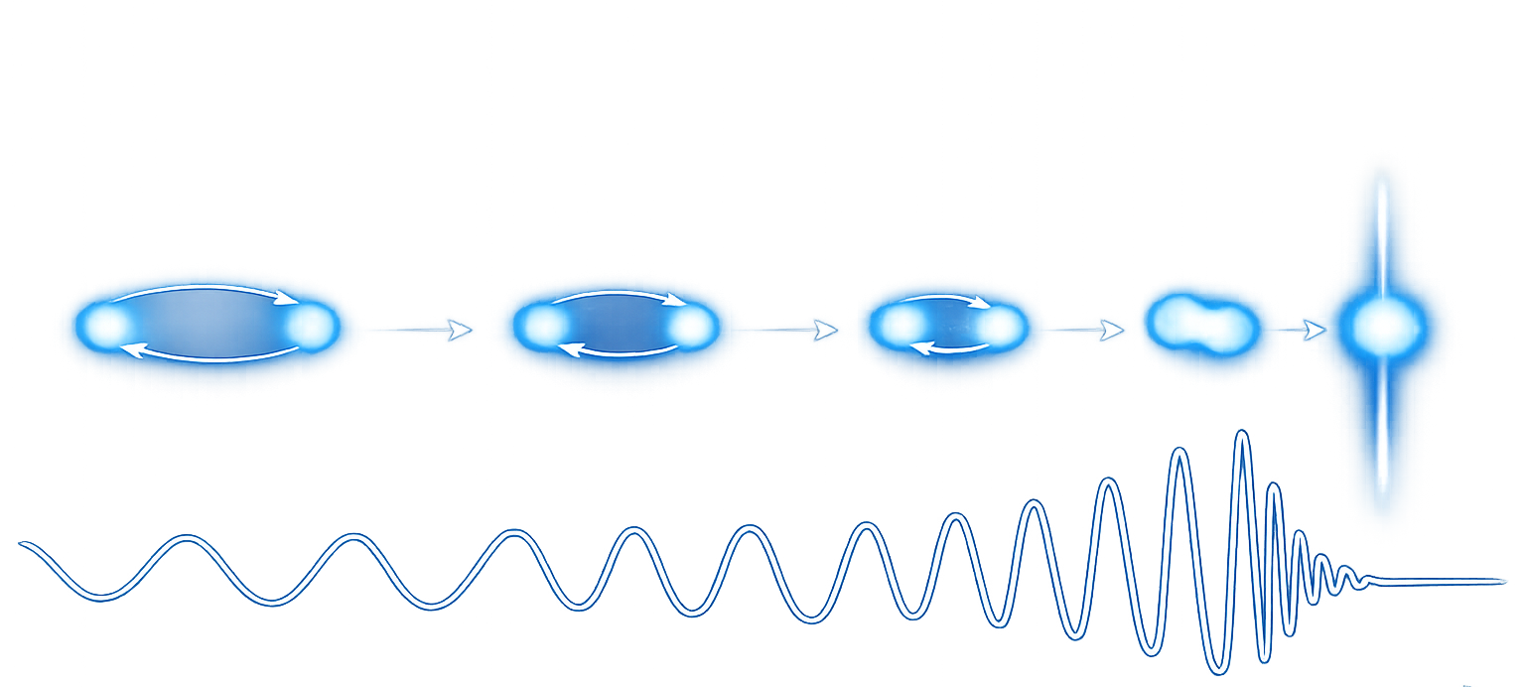


Circular Binary Baseline
For two masses $m_{1}, m_{2}$ in circular orbit:
[Adapted image: Nature]
$$P\left(ν\right)∝ν^{\frac{10}{3}}, \left|\frac{dE}{dν}\right|∝ν^{−\frac{1}{3}}, h\left(ν\right)∝ν^{\frac{2}{3}}$$
Radiated power rises rapidly as orbit tightens.
GW frequency and amplitude increase together (“chirp”).
Late inspiral = strongest, fastest, loudest stage.

Slide 8
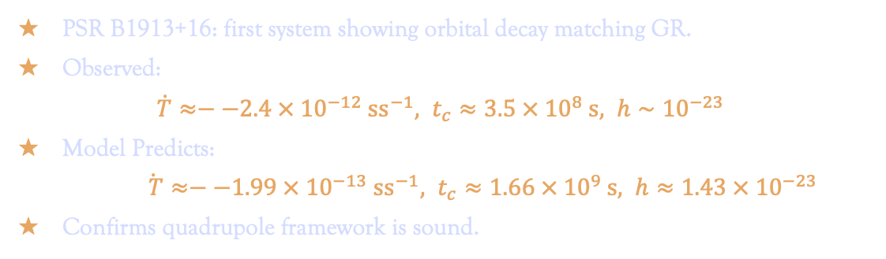
Testing the Model: Hulse–Taylor Pulsar
PSR B1913+16: first system showing orbital decay matching GR.
Observed:
  $\dot{T}≈−−2.4 × 10^{−12} ss^{−1}, t_{c}≈3.5 × {10}^{8} s, h∼10^{−23}$
Model Predicts:
$\dot{ T}≈−−1.99 × 10^{−13} ss^{−1}, t_{c}≈1.66 × {10}^{9} s, h≈1.43 × 10^{−23}$
Confirms quadrupole framework is sound.

Slide 9
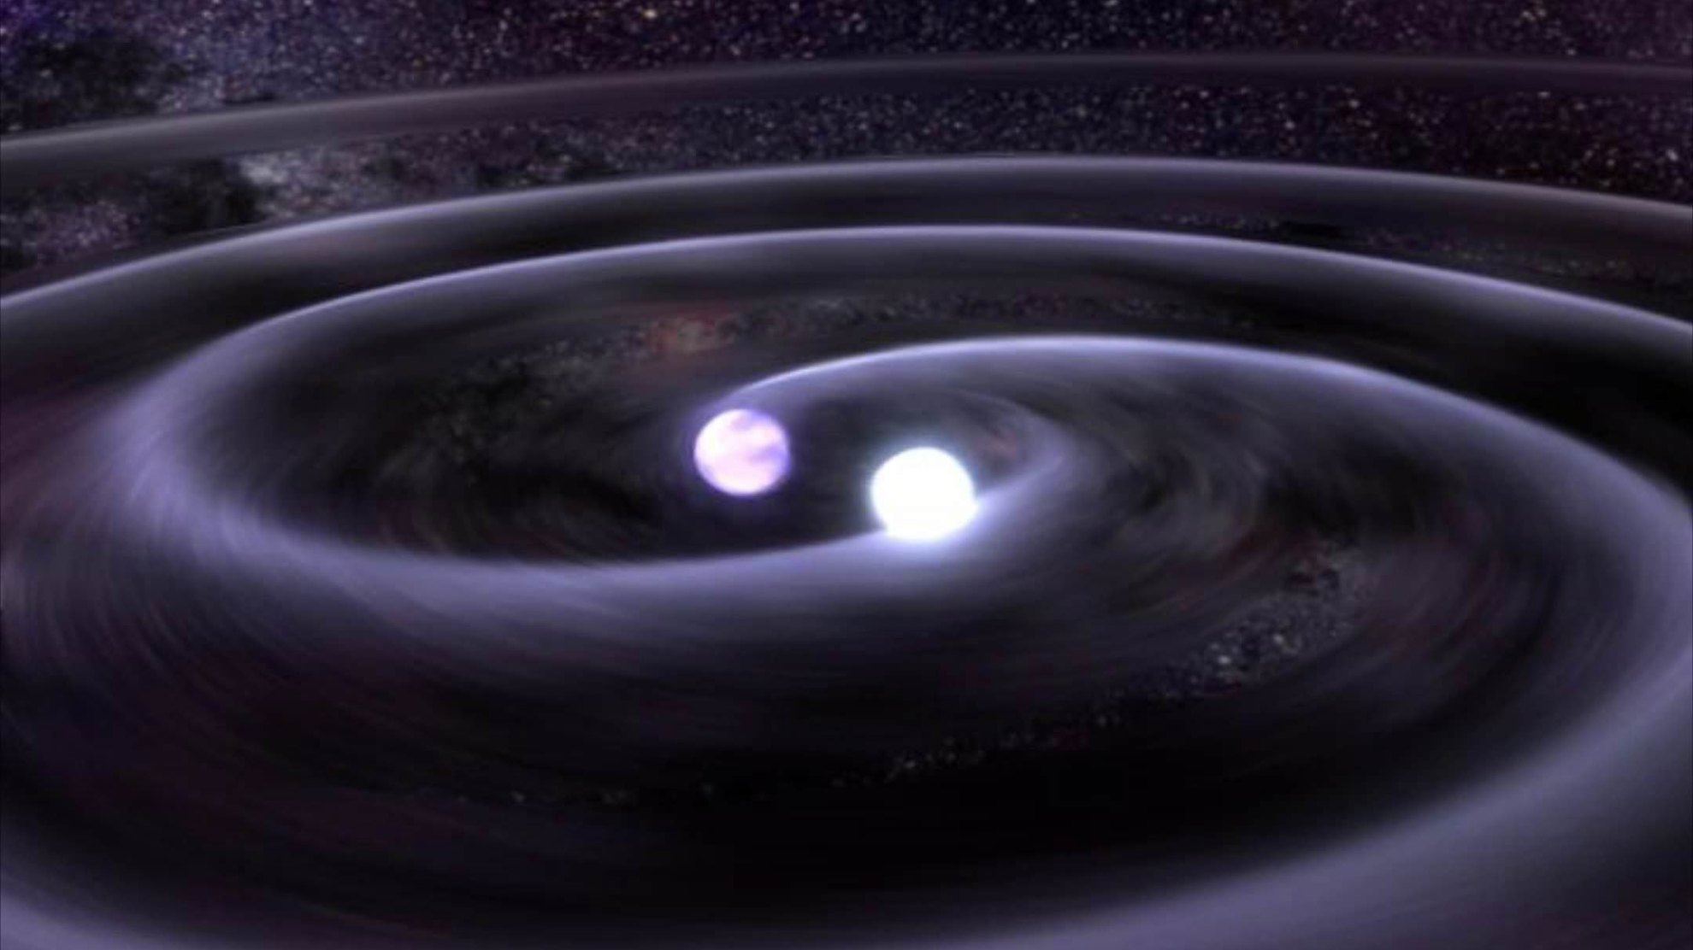
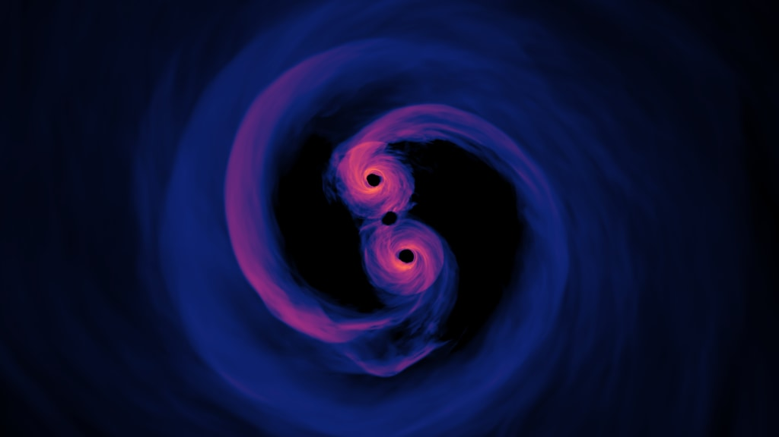
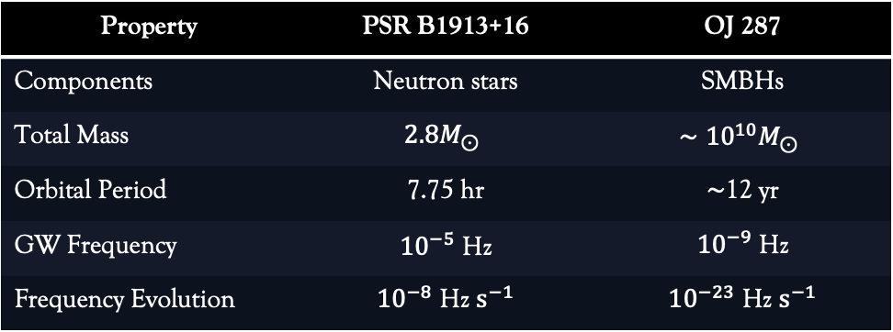
Two Binary Regimes: Stellar vs Supermassive
[Image: AAS Nova]
[Image: AAS Nova]
Property | PSR B1913+16 | OJ 287
Components | Neutron stars | SMBHs
Total Mass | $$2.8M_{⊙}$$ | $$∼{10}^{10}M_{⊙}$$
Orbital Period | 7.75 hr | $∼$12 yr
GW Frequency | $10^{−5}$ Hz | $10^{−9}$ Hz
Frequency Evolution | $10^{−8}$ Hz $s^{−1}$ | $10^{−23}$ Hz $s^{−1}$

Slide 10
External GW Interaction
03

Slide 11
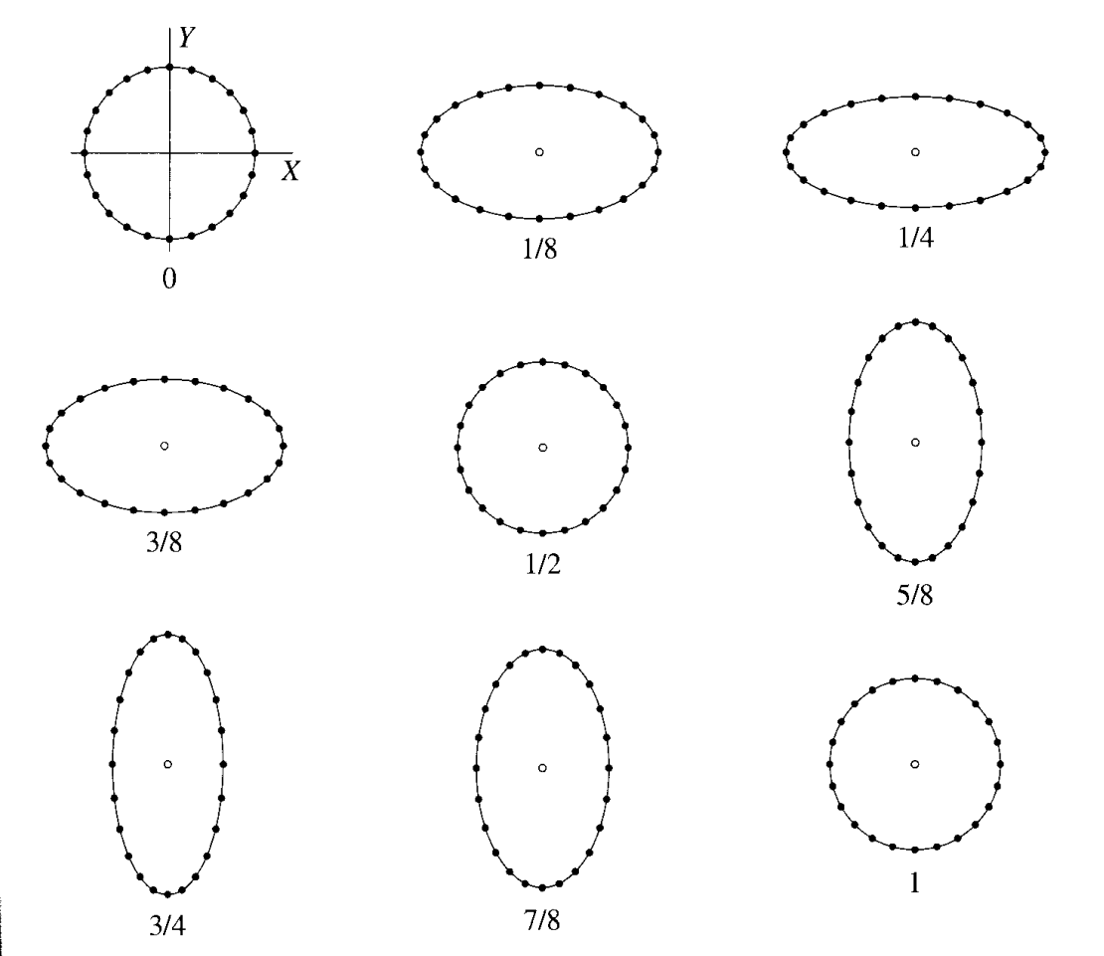
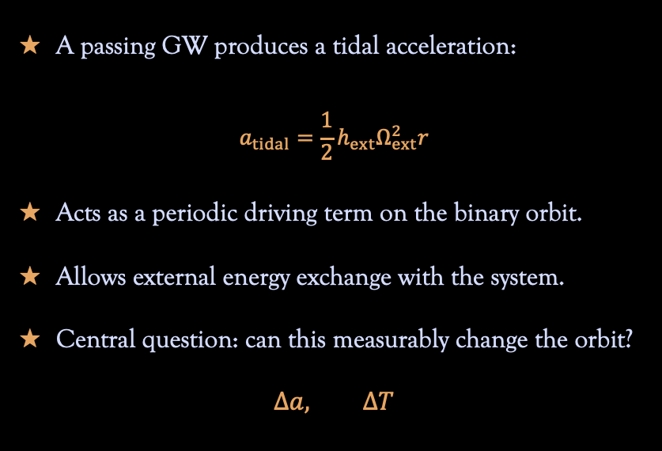
Adding an External GW
Driven Binary Response
A passing GW produces a tidal acceleration:
$$a_{tidal}=\frac{1}{2}h_{ext}Ω_{ext}^{2}r$$
Acts as a periodic driving term on the binary orbit.
Allows external energy exchange with the system.
Central question: can this measurably change the orbit?
$$Δa, ΔT$$
[Adapted from Hartle (2003)]

Slide 12
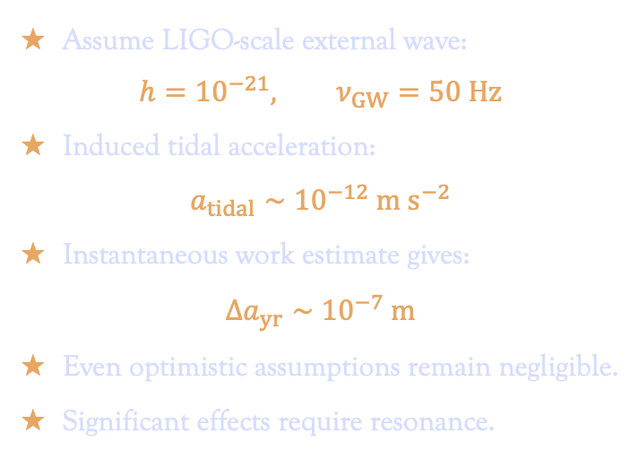
Order-of-Magnitude Estimate
Assume LIGO-scale external wave:
$$h=10^{−21}, ν_{GW}=50 Hz$$
Induced tidal acceleration:
$$a_{tidal}∼10^{−12} m s^{−2}$$
Instantaneous work estimate gives:
$$Δa_{yr}∼10^{−7} m$$
Even optimistic assumptions remain negligible.
Significant effects require resonance.

Slide 13
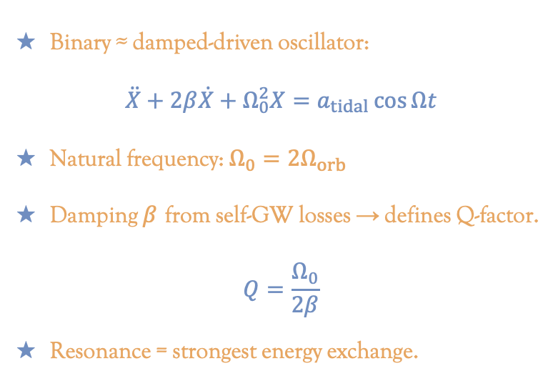
Resonant Oscillator Model
Binary ≈ damped‑driven oscillator:
$$\ddot{X}+2β\dot{X}+Ω_{0}^{2}X=a_{tidal}\cos{Ωt}$$
Natural frequency: $Ω_{0}=2Ω_{orb}$
Damping $β$ from self‑GW losses → defines Q‑factor.
$$Q=\frac{Ω_{0}}{2β}$$
Resonance = strongest energy exchange.

Slide 14
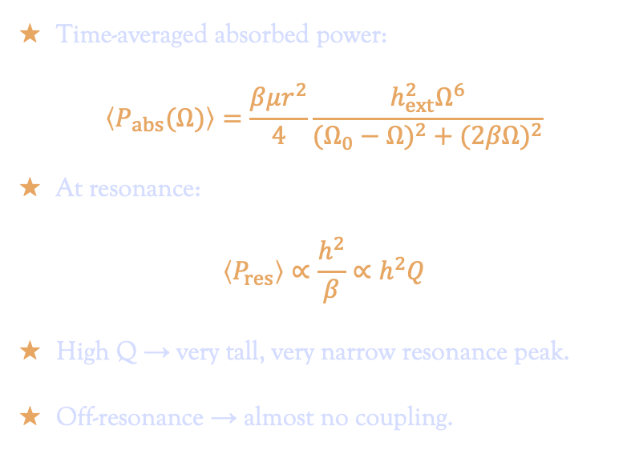
Energy Absorption & Q-factor
Time-averaged absorbed power:
$$\left\langle P_{abs}(Ω)\right\rangle =\frac{βμr^{2}}{4}\frac{h_{ext}^{2}Ω^{6}}{(Ω_{0}−Ω)^{2}+(2βΩ)^{2}}$$
At resonance:
$$\left\langle P_{res}\right\rangle ∝\frac{h^{2}}{β}∝h^{2}Q$$
High Q → very tall, very narrow resonance peak.
Off‑resonance → almost no coupling.

Slide 15
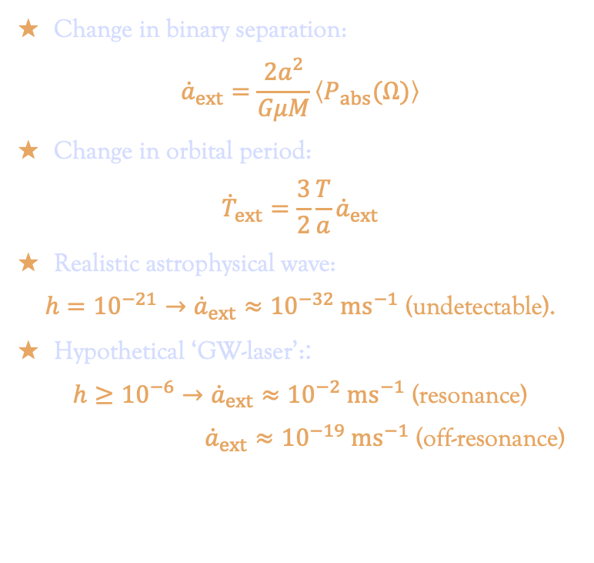
Numerical Illustrations
Change in binary separation:
$${\dot{a}}_{ext}=\frac{2a^{2}}{GμM}\left\langle P_{abs}(Ω)\right\rangle$$
Change in orbital period:
$${\dot{T}}_{ext}=\frac{3}{2}\frac{T}{a}{\dot{a}}_{ext}$$
Realistic astrophysical wave:
$h={10}^{−21}→{\dot{a}}_{ext}≈{10}^{−32} ms^{−1}$ (undetectable).
Hypothetical ‘GW-laser’::
$h≥{10}^{−6}→{\dot{a}}_{ext}≈{10}^{−2} ms^{−1}$ (resonance)
${\dot{a}}_{ext}≈{10}^{−19} ms^{−1}$ (off-resonance)

Slide 16
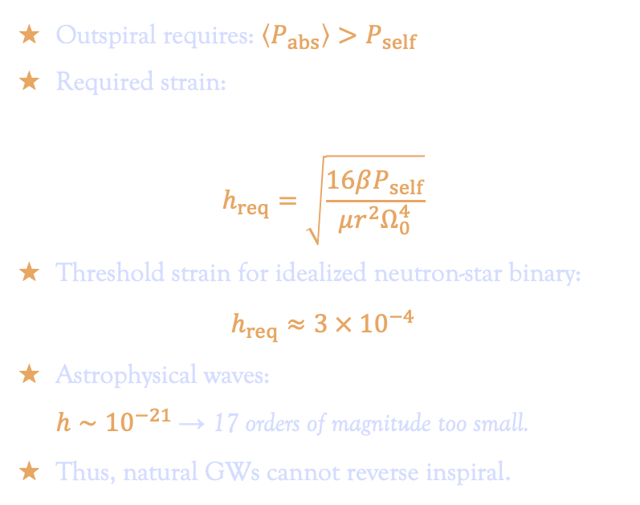
Can Inspiral Be Reversed?
Outspiral requires: $\left\langle P_{abs}\right\rangle >P_{self}$
Required strain:
$$h_{req}=\sqrt{\frac{16βP_{self}}{μr^{2}Ω_{0}^{4}}}$$
Threshold strain for idealized neutron‑star binary:
$h_{req}≈3 × {10}^{−4}$
Astrophysical waves:
$h∼{10}^{−21}$→ 17 orders of magnitude too small.
Thus, natural GWs cannot reverse inspiral.

Slide 17
04
System Dependence

Slide 18
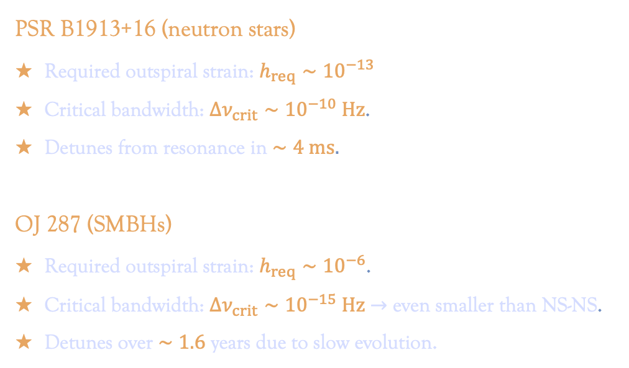
Real System Comparisons
PSR B1913+16 (neutron stars)
Required outspiral strain: $h_{req}∼10^{−13}$
Critical bandwidth: $Δν_{crit}∼{10}^{−10} Hz$.
Detunes from resonance in $∼4 ms.$
OJ 287 (SMBHs)
Required outspiral strain: $h_{req}∼10^{−6}$.
Critical bandwidth: $Δν_{crit}∼{10}^{−15} Hz$ $→$ even smaller than NS-NS.
Detunes over $∼1.6$ years due to slow evolution.

Slide 19
05
Conclusions

Slide 20
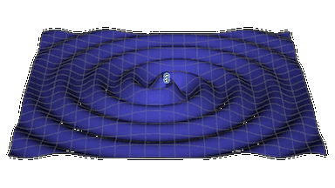
Physical Interpretations
External GWs act via tidal curvature, not a local force.
Effective coupling requires:
  In practice: impossible; in principle: allowed by GR.
                extremely strong waves,
  extreme frequency accuracy,
  continuous chirping.
[Animation: Caltech]

Slide 21
Key Takeaways
External GWs do not affect binary inspirals in nature.
Resonant coupling exists but is ultra‑fine‑tuned.
Compact binaries are robust dynamical systems.
Thank You!

