Slide 1
Gravitational-wave Observations as Astrophysical Probes
Aditya Vijaykumar
CAP Congress 2026, Ottawa

Slide 2
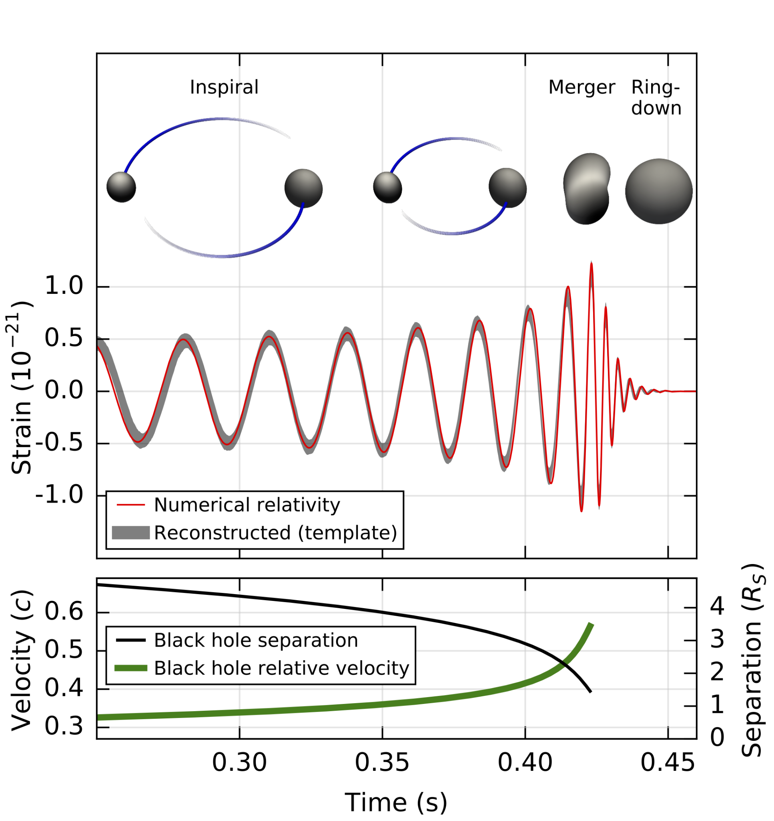
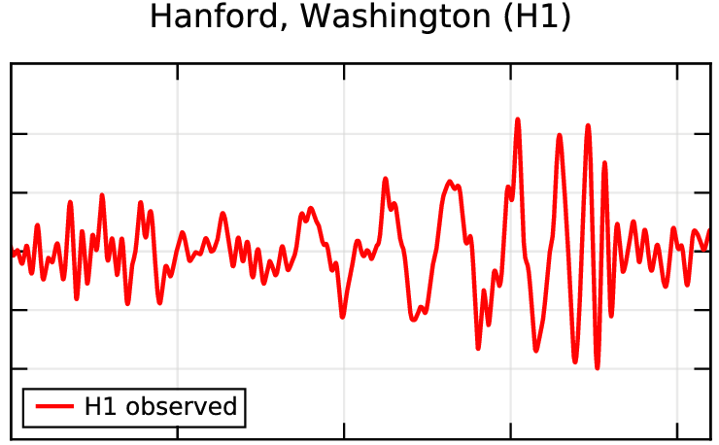
GW150914: The First Detection
Abbott+ 2016, arXiv:1602.03837, arXiv:1602.03840

Slide 3
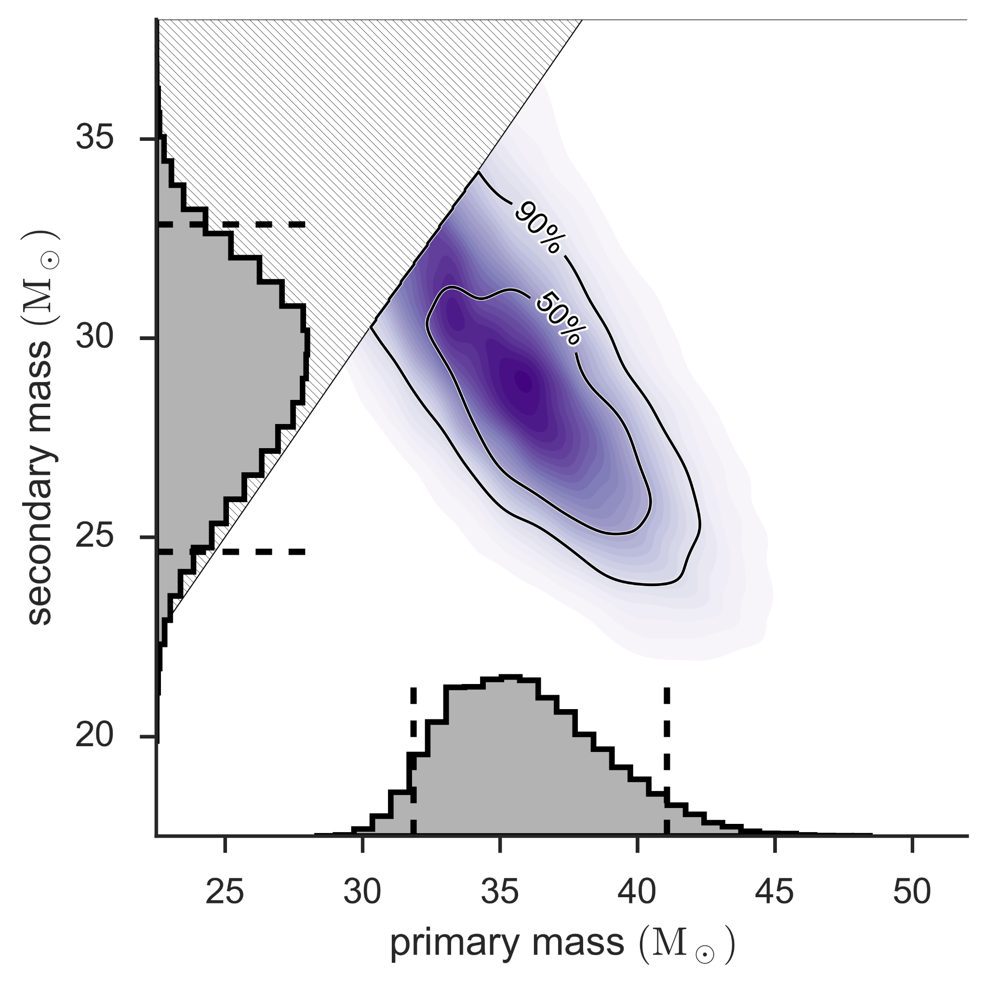
GW150914: The First Detection
Abbott+ 2016, arXiv:1602.03837, arXiv:1602.03840
Measurement of Parameters
(Posterior Distribution)
Showed us that massive merging black holes exist in the Universe.

Slide 4
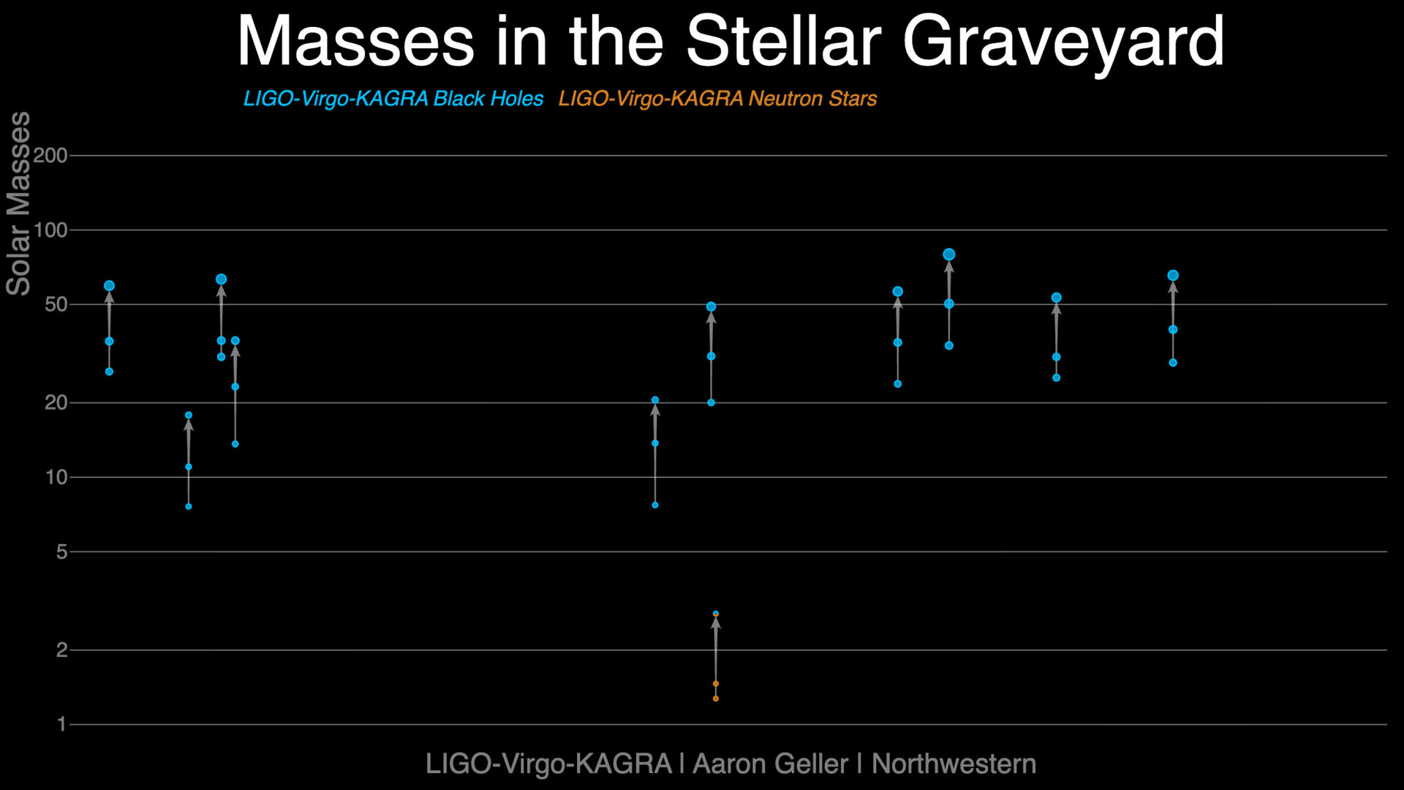
Each signal contains information about masses, spins, redshift, sky location, etc., although measurement precision varies.
Brand new catalog (GWTC-5.0) out now!
arXiv:2605.27225
arXiv:2605.27226
We now have a large population of binary black holes!

Slide 5
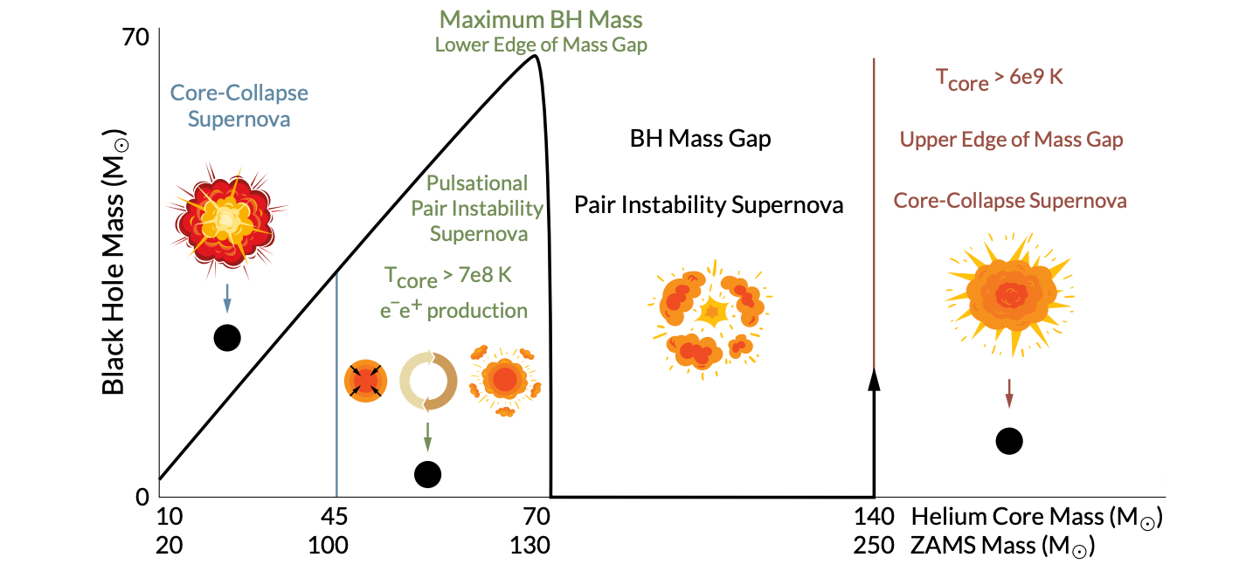
Population Properties Encode Astrophysics
Inferred Population

Slide 6
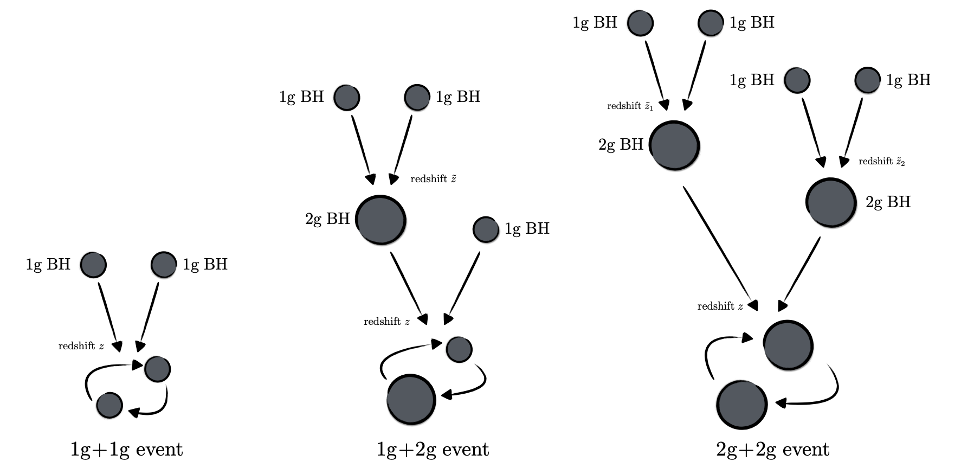
Population Properties Encode Astrophysics
Inferred Population
Are our observed BHs made up of smaller BHs?
Natural by-product of BH assembly in dense environments.

Slide 7
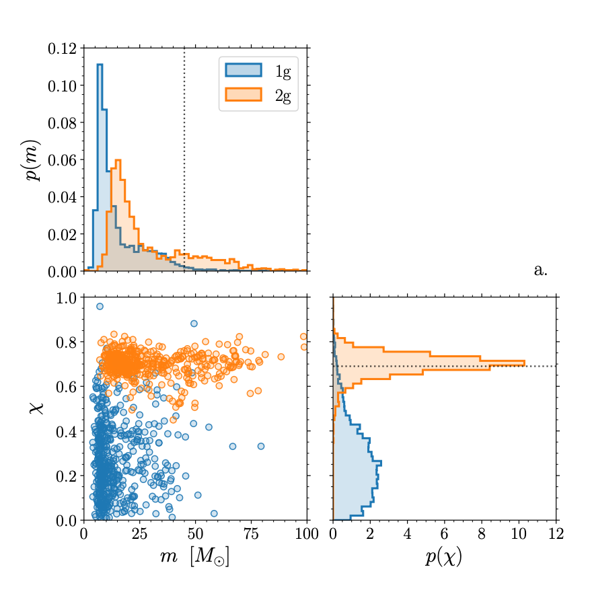
Population Properties Encode Astrophysics
Inferred Population
2G BHs should have higher maximum mass than 1G black holes.
Predictions of 2G BH population.
Gerosa & Fishbach 2021
arXiv:2105.03439
2G BHs should have spins concentrated around 0.7. Robust prediction of general relativity!

Slide 8
The Inference Problem
Abbott+ 2016, arXiv:1602.03837, arXiv:1602.03840
Measurement of Parameters
(Posterior Distribution)

Slide 9
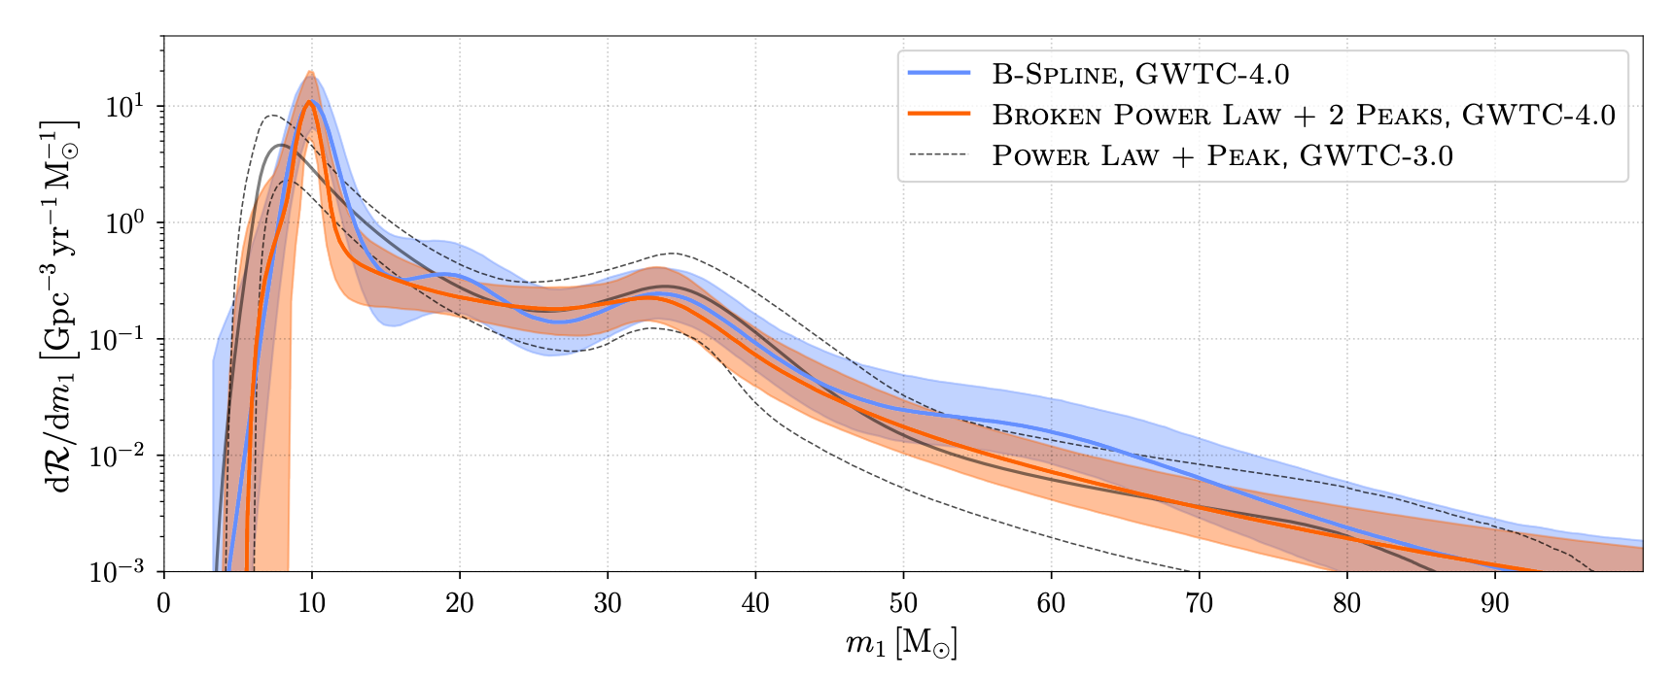
The Inference Problem
Many uncertain measurements from different sources
Measurements of population properties [LVK+, arXiv:2508.18083]

Slide 10
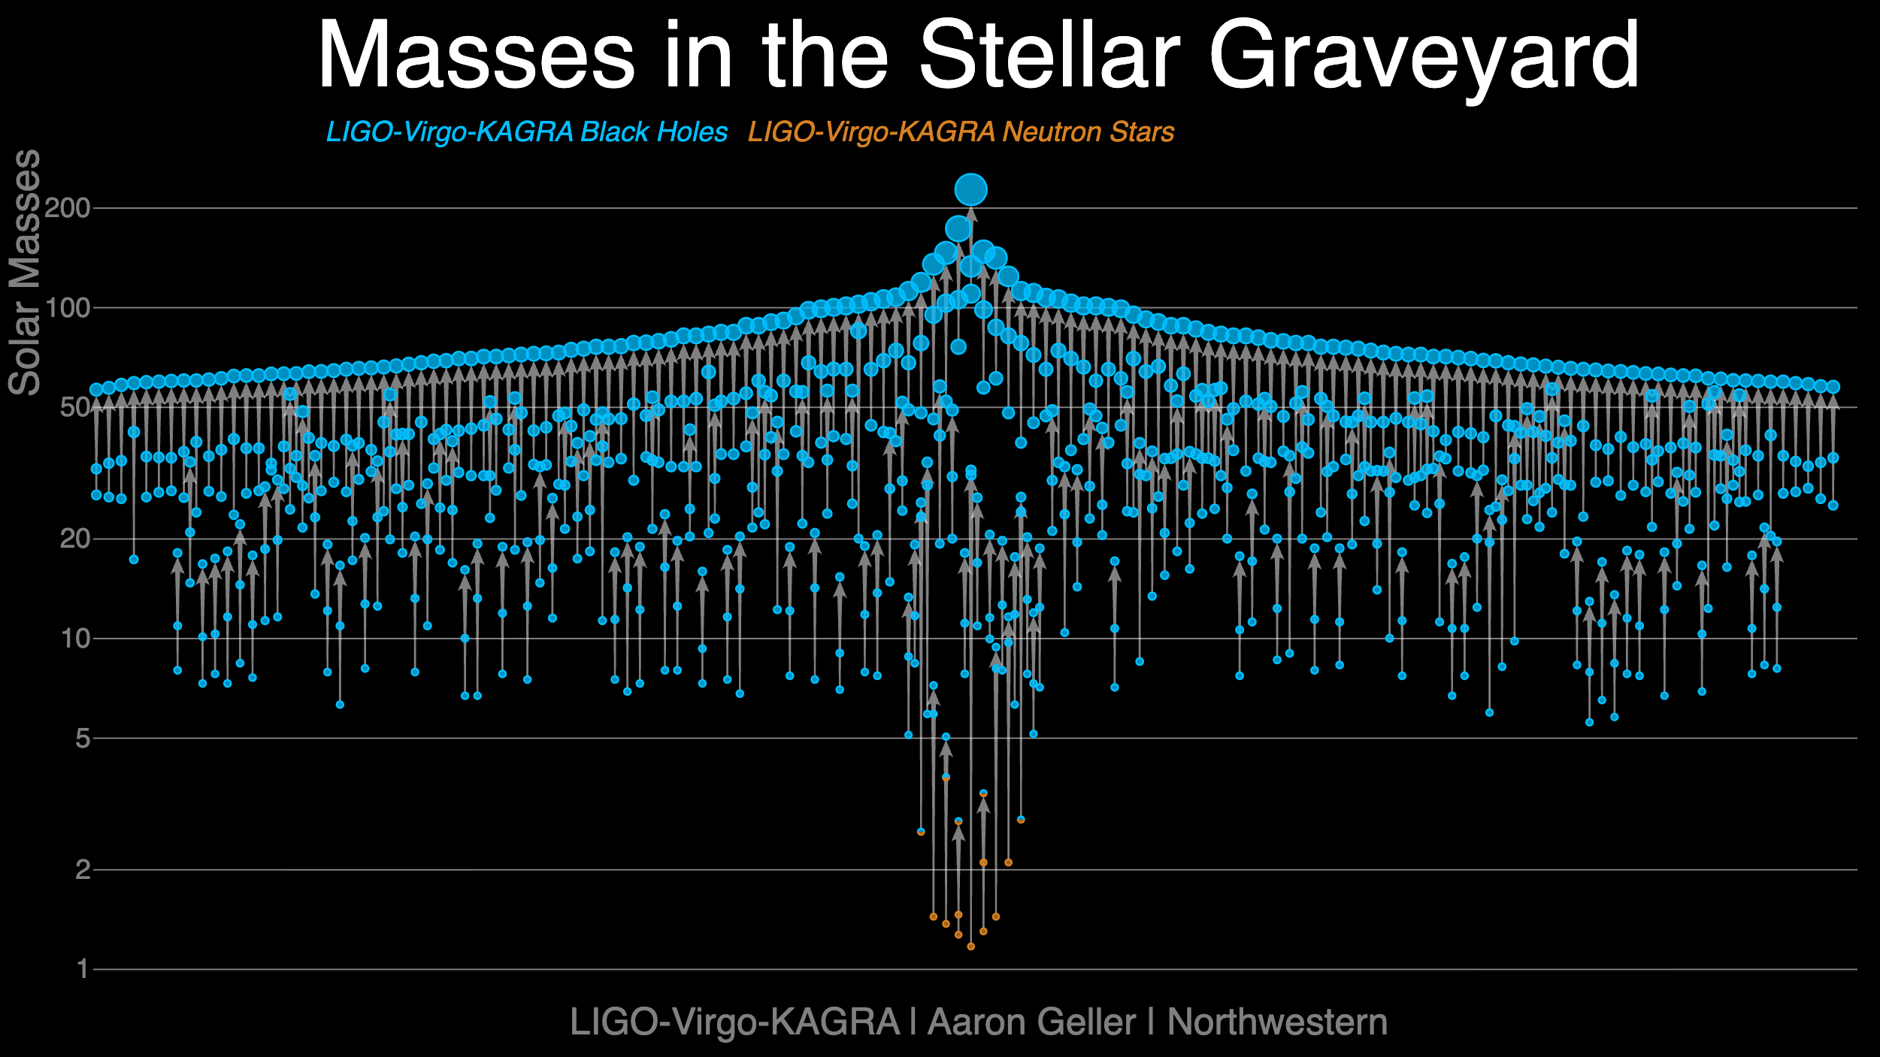

Main Ingredient: Selection Effects
Inherently easier to detect massive binaries, and binaries that are close by.
…but we can correct for this!

Slide 11
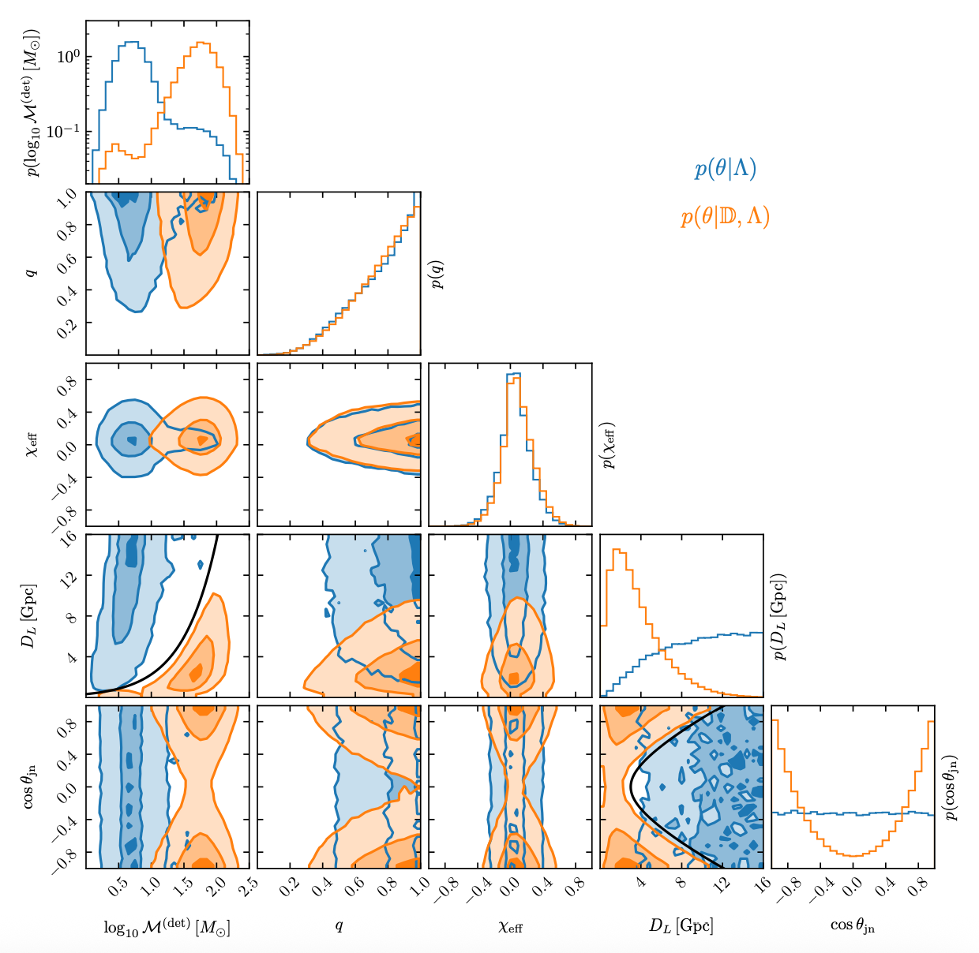
Main Ingredient: Selection Effects
Essick+ 2025, arXiv:2508.10638
Blue: Injected Population
Orange: Recovered Population
In practice, one also needs to account for search behaviour
Solution: inject millions of fake signals in the data stream and have searches recover them [Essick+ 2025]

Slide 12
Primary Mass Distribution of Binary Black Holes
Intrinsic population, corrected for selection effects
Similar plots can be made for mass ratio, spin, etc.
LVK+, arXiv:2508.18083
A lot of astrophysics hiding in here!

Slide 13
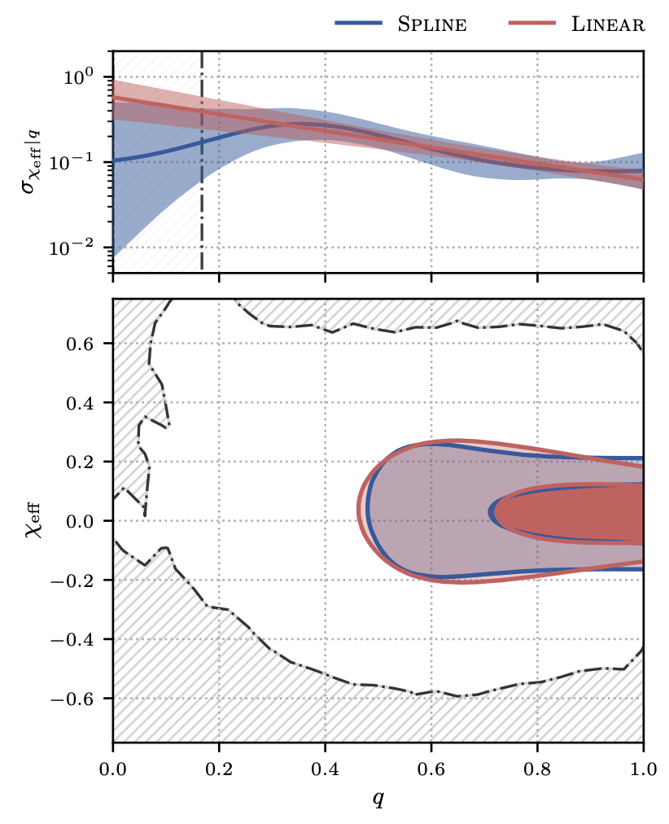
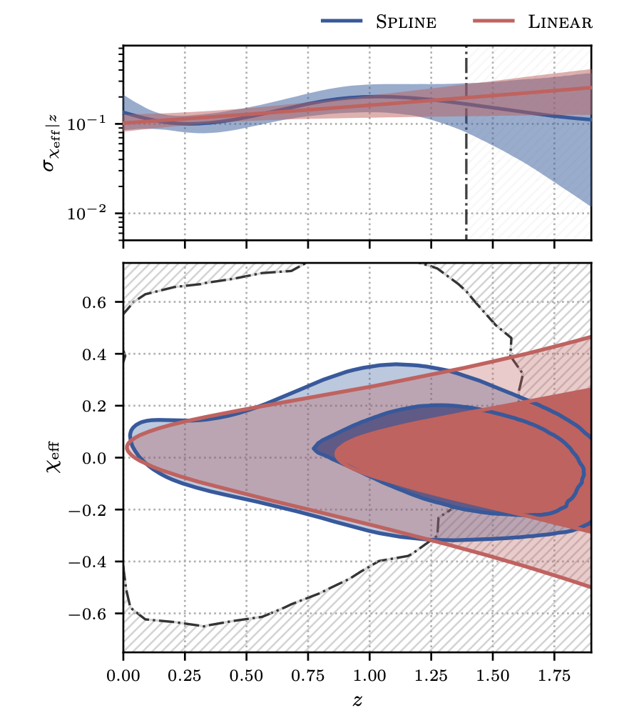
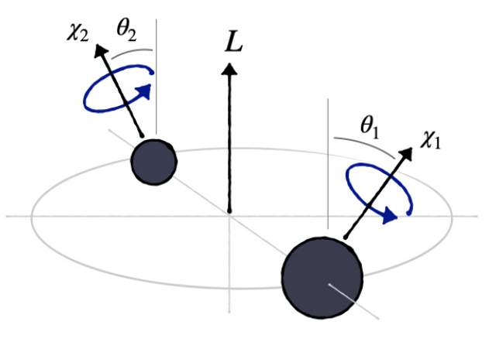

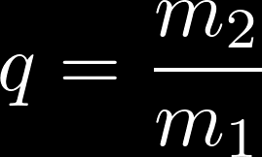
Observed trends in the GW source population
Inferred Population
Zoe Ko / Tom Callister
Width
Width
The width of the effective spin distribution decreases with mass ratio
The width of the effective spin distribution increases with redshift.
LVK+ 2026, Callister+ 2021
LVK+ 2026, Biscoveanu+ 2022
Effective Spin
Effective Spin
Mass-weighted projection of spins perpendicular to orbital plane; Best measured combination of spins
What astrophysics governs these correlations?
Mass Ratio
Redshift

Slide 14
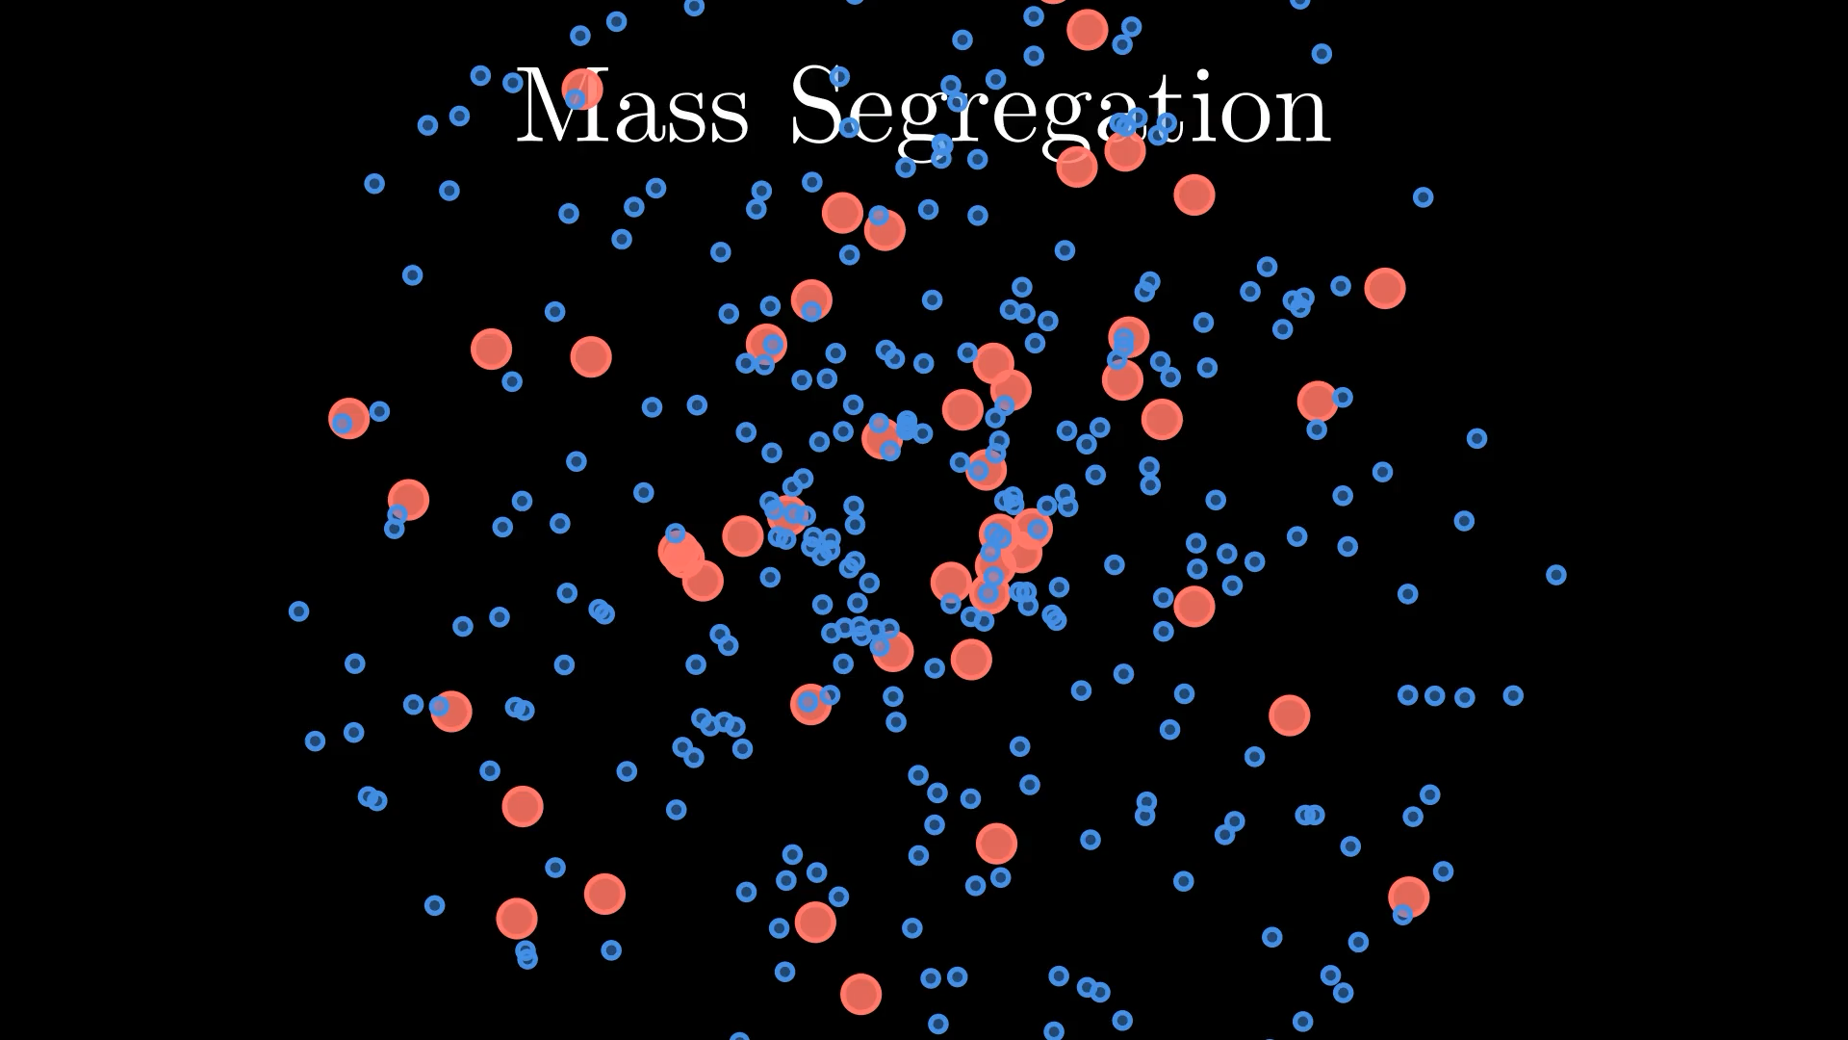
Dense Star Cluster
~10⁵ Msun, ~1 pc radius
Direct Consequence of dynamical friction and the virial theorem

Slide 15
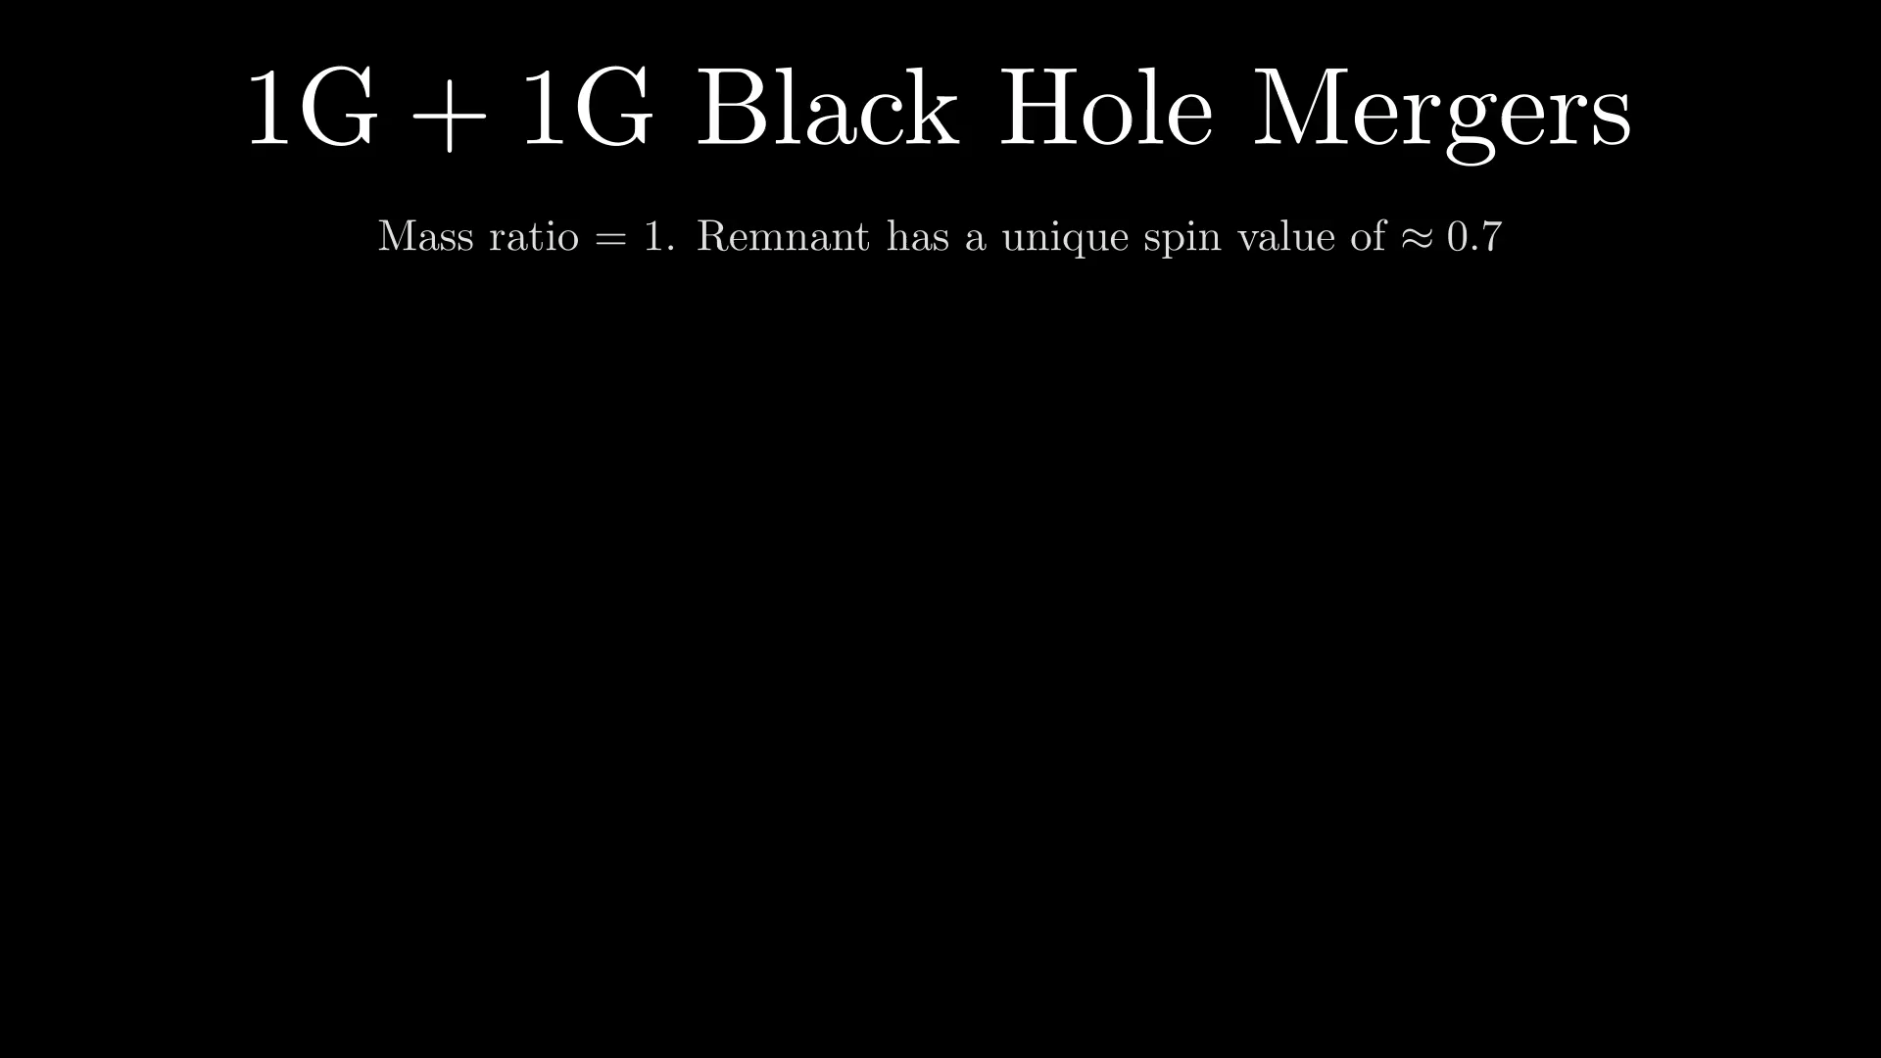

Slide 16
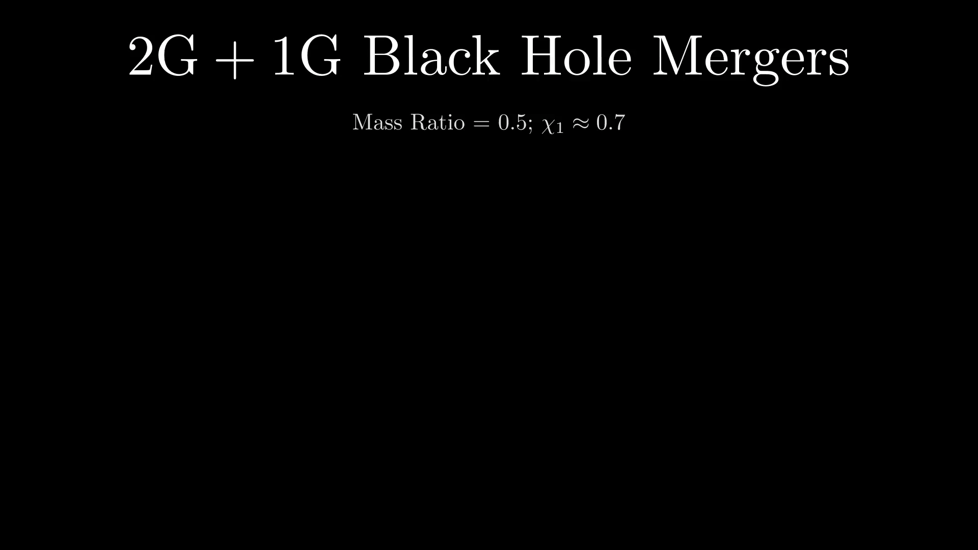

Slide 17
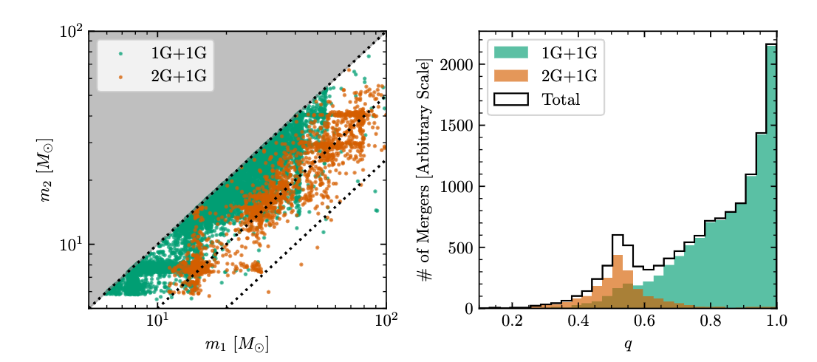
Theoretical Expectation: Population Synthesis
Vijaykumar, Farah, Fishbach 2026, ApJL
arXiv:2601.03457
These binaries have ≈0.7 primary spin!
Adapted from the Cluster Monte Carlo simulations [Kremer+ 2021] of dense star clusters.
Depending on cluster mass and density, 2G+1G mergers can make up 5-30% of all mergers in dense star clusters.

Slide 18
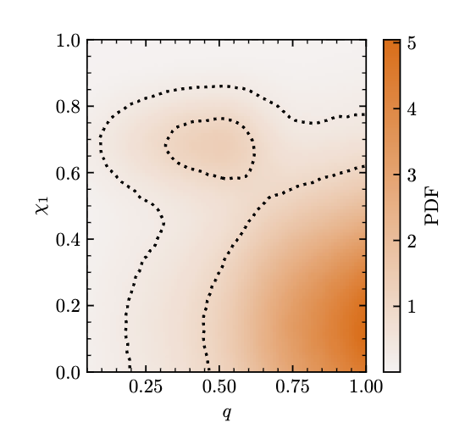
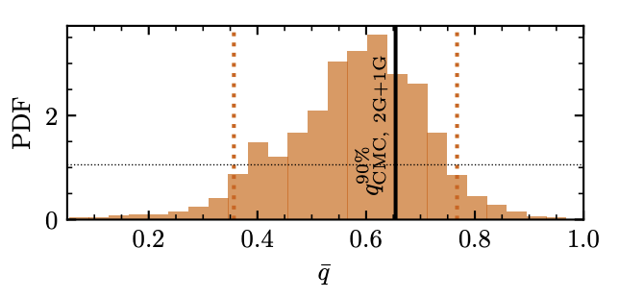
Which mass ratios in the GW data have spin ≈0.7?
Inferred Population
Vijaykumar, Farah, Fishbach 2026, ApJL
arXiv:2601.03457
Posterior PDF
Primary Spin
PDF
Maximum Mass Ratio of the Spin ≈0.7 Subpopulation
Mass Ratio
There is a subpopulation in the data that lies at spin ≈0.7 and unequal mass ratio! Makes up about ~5-15% of the total population.
Taken with the rest of the population, primary spin and mass ratio appear anti-correlated.

Slide 19
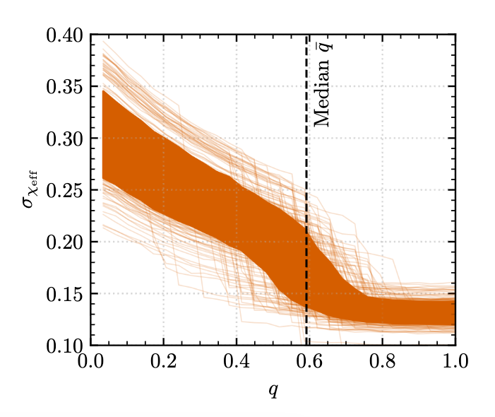


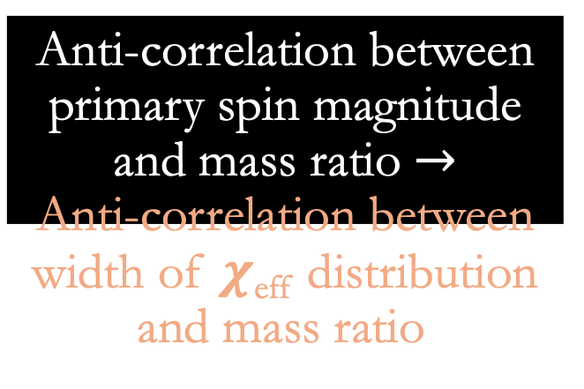
This May Explain the q -$χ$_{eff} Correlation!
Anti-correlation between primary spin magnitude and mass ratio $→$
Anti-correlation between width of 𝝌_{eff} distribution and mass ratio.
Vijaykumar, Farah, Fishbach 2026, ApJL
arXiv:2601.03457
Width of $χ$_{eff} distribution
Mass Ratio

Slide 20
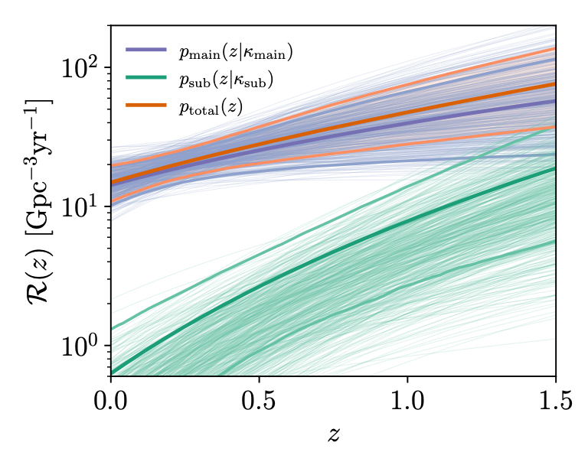
How does the merger rate of spin ≈0.7 objects evolve with redshift?
The hierarchical merger rate, while lower than the rate of all other mergers, increases faster with redshift.
That is, hierarchical mergers preferentially lie at higher redshift.
Farah, Vijaykumar, Fishbach 2026, ApJL
arXiv:2601.03456
All other mergers
Hierarchical mergers

Slide 21
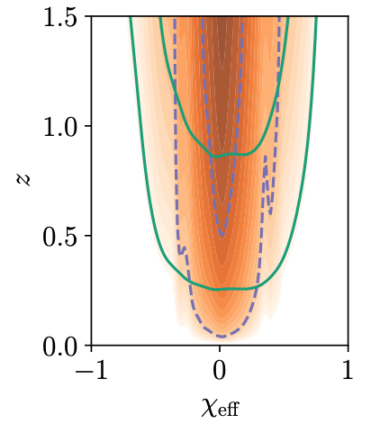
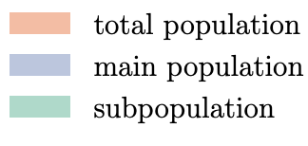

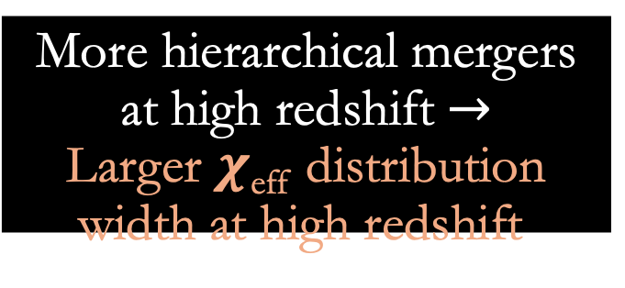
This May Explain the redshift -$χ$_{eff} Correlation!
More hierarchical mergers at high redshift $→$
Larger 𝝌_{eff} distribution width at high redshift.
Farah, Vijaykumar, Fishbach 2026, ApJL
arXiv:2601.03456

Slide 22
Takeaways
Population-level analyses provide information about the formation and evolution of binary black holes.
There is evidence for a subpopulation of hierarchical mergers in gravitational-wave data
Compared to the rest of the population, this subpopulation prefers:
  Mass ratios away from 1
  Larger redshifts
This subpopulation may explain the observed population-level trends between effective spin, mass ratio, and redshift.

Slide 23
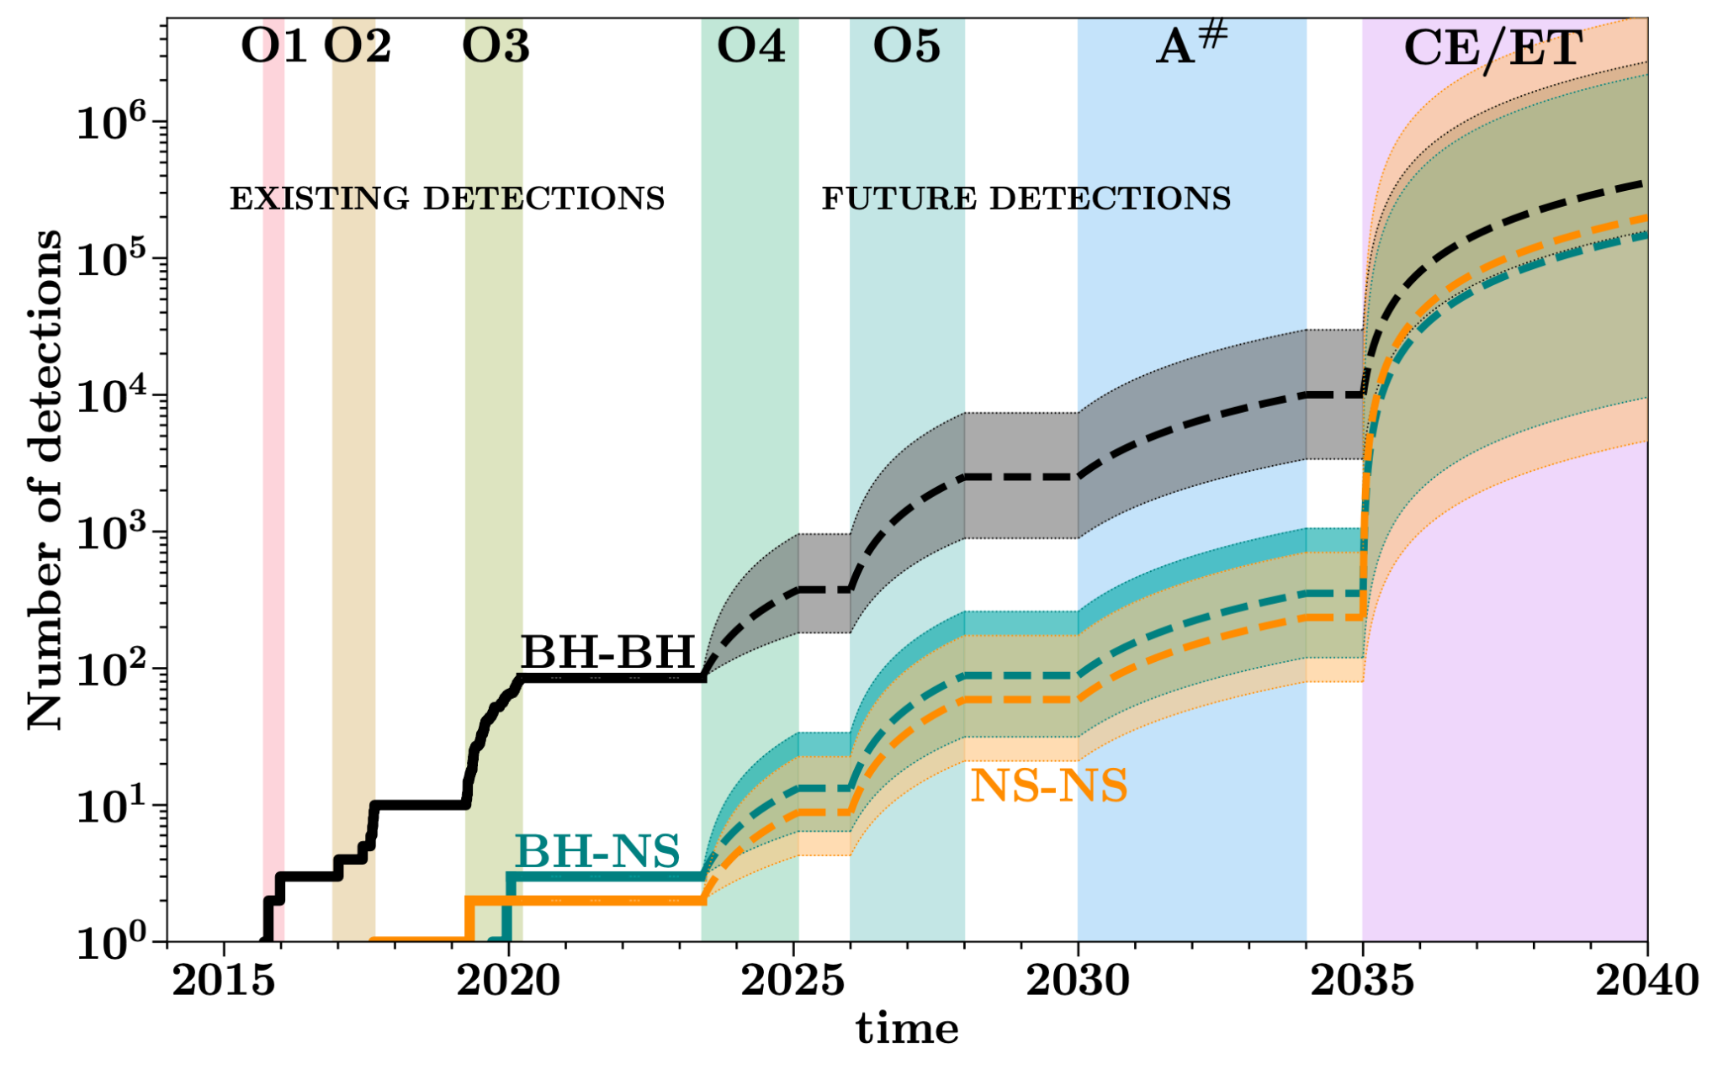
The future is LOUD and abundant, but also presents numerous challenges!

Slide 24
Thanks for Listening!
Any Questions?
Get in Touch!
Website: adivijaykumar.github.io
Email: aditya@utoronto.ca

Slide 25
Extra Slides

Slide 26
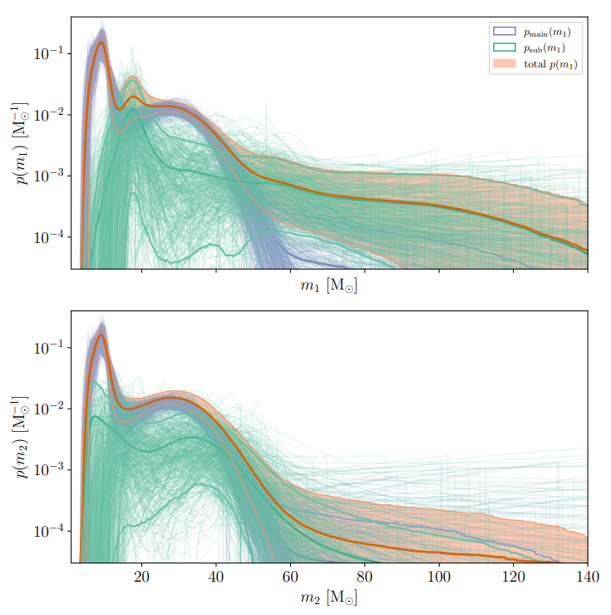
The mass distribution of hierarchical mergers
Farah, Vijaykumar, Fishbach 2026, ApJL
arXiv:2601.03456
The hierarchical merger subpopulation extends to higher primary masses, and peaks at roughly twice the mass.
All other mergers
Hierarchical mergers

Slide 27
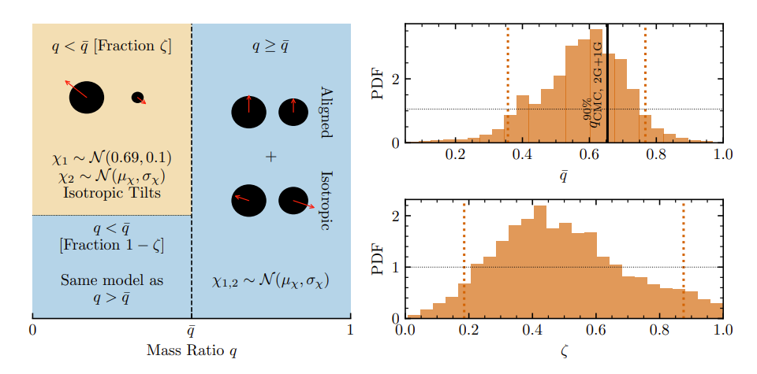
Model
Vijaykumar, Farah, Fishbach 2026, ApJL
arXiv:2601.03457
All other mergers
Hierarchical mergers

Slide 28
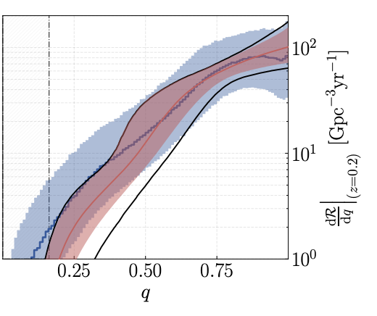
Model

Slide 29
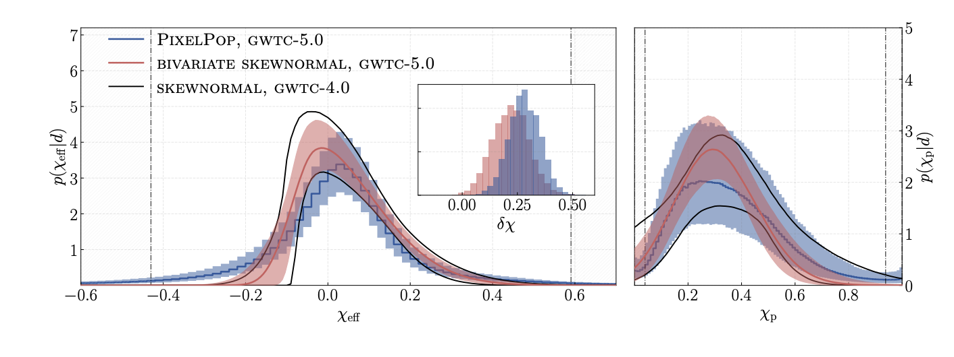
GWTC-5.0 Population Results

