Slide 1
Microscopic Dust, Macroscopic Downtime: The impacts of micron sized particulates in superconducting particle accelerators.
Aveen Mahon (she/her)
Accelerator Division
TRIUMF | UVic

Slide 2
TRIUMF is located on the traditional, ancestral, and unceded territory of the xʷməθkʷəy̓əm (Musqueam) People

Slide 3
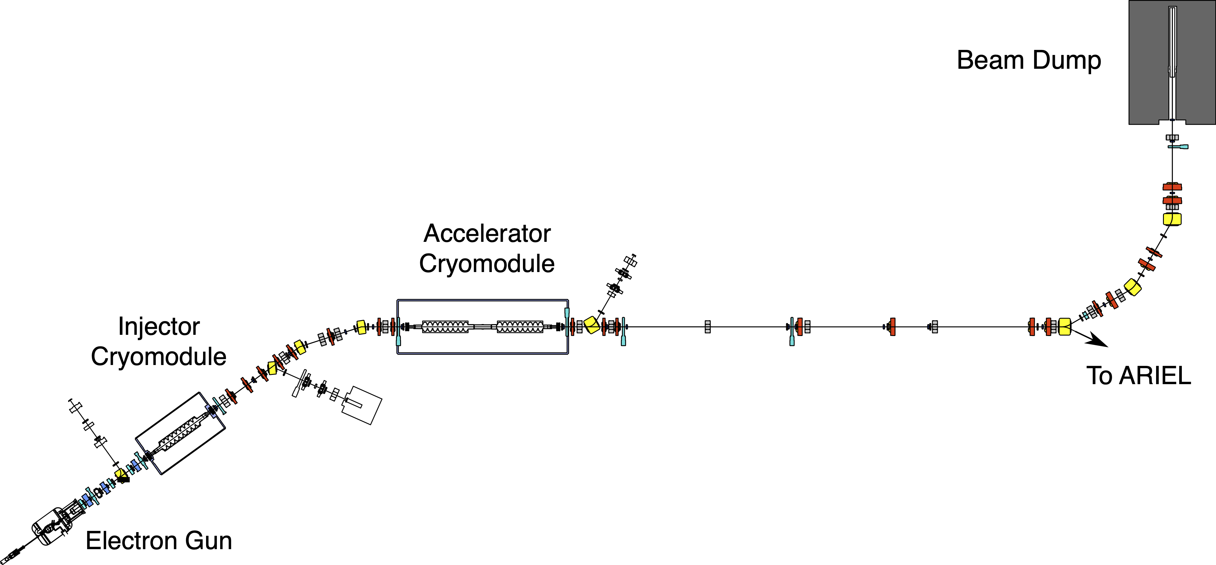
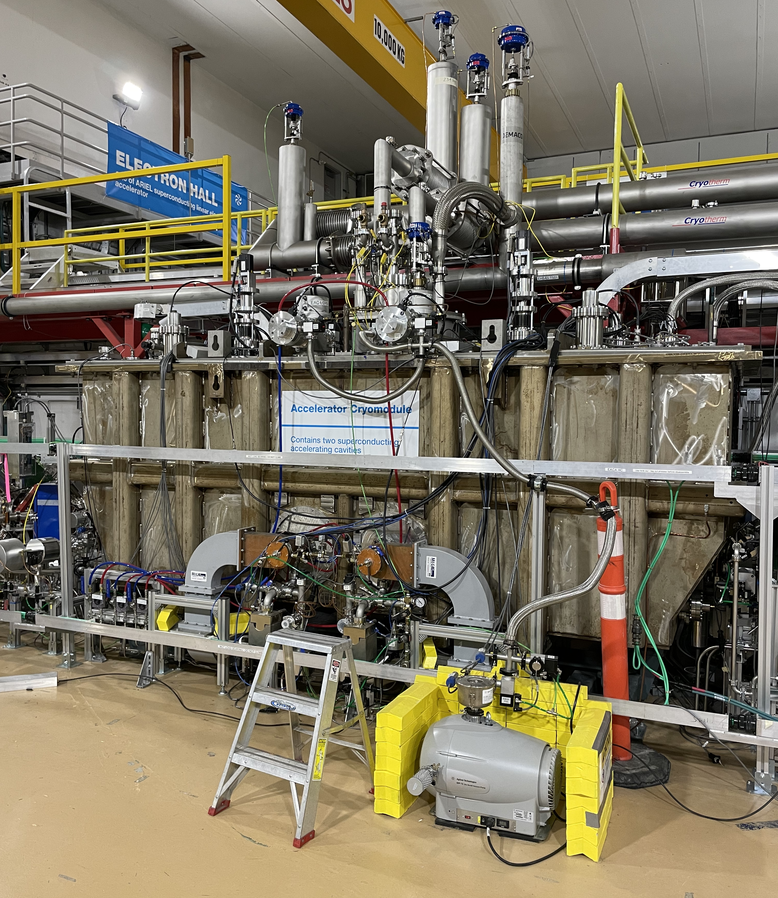
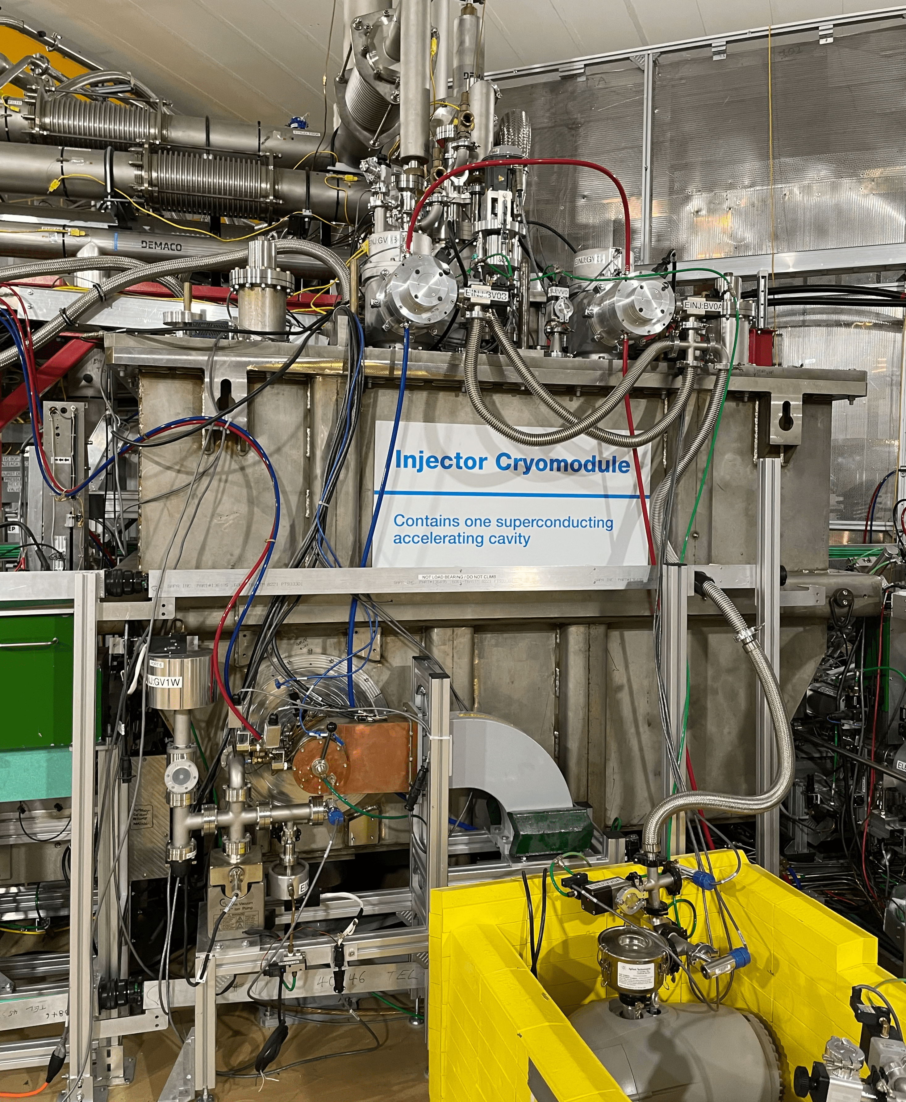
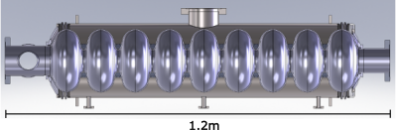
TRIUMF e-Linac
Superconducting electron linear accelerator (e-Linac)
Beam Energy | 30 MeV
Nominal Beam Current | 10 mA
RF frequency | 1.3 GHz
Cavity Type | Elliptical (9-cell)
Cavity Material | Bulk Niobium
Cavity Temp | 2K
A. Mahon – CAP – June 22nd 2026

Slide 4
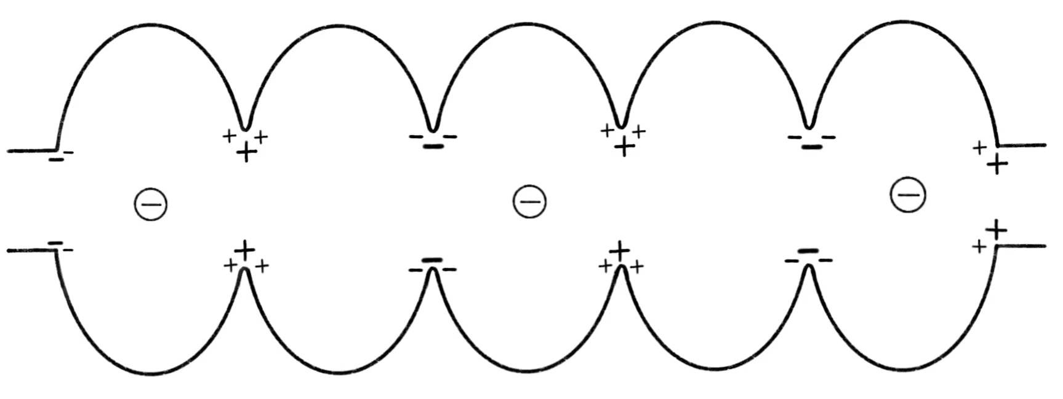
Superconducting Radio Frequency (SRF)
Technique of applying time varying electromagnetic (EM) fields to particles.
Cavities designed to resonate at a specific frequency in synch with passage of particles to supply them with energy and accelerate them.
A. Mahon – CAP – June 22nd 2026

Slide 5
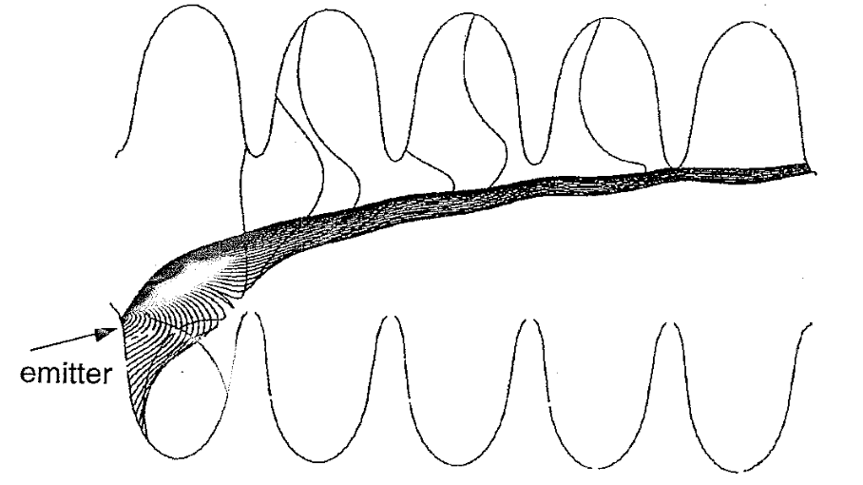
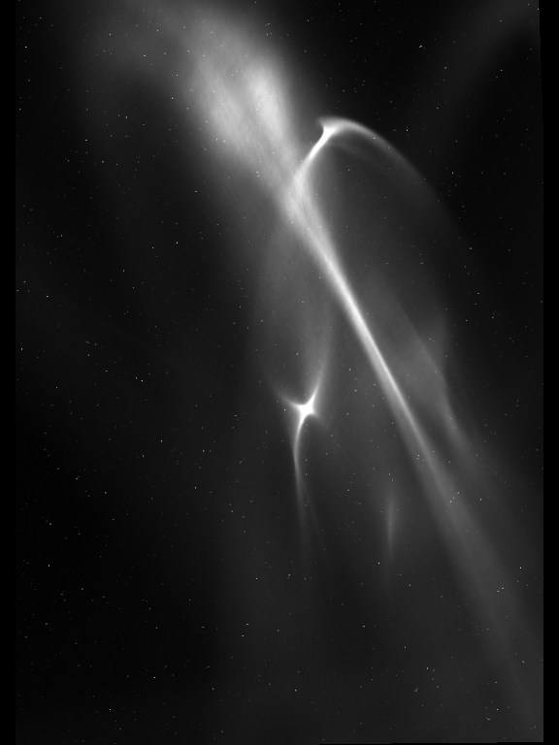
Field Emission (FE) at the TRIUMF e-Linac
Emission of e− from regions of high surface electric field.
Prevalent in SRF cavities due to high gradient.
5 mm
Padamsee, H., Knobloch, J., & Hays, T. (2008)
RF superconductivity for accelerators
FE root cause – micron sized particulates aka DUST!
Degradation over time → migration?
EABT:VS1
May 7 2026
A. Mahon – CAP – June 22nd 2026

Slide 6
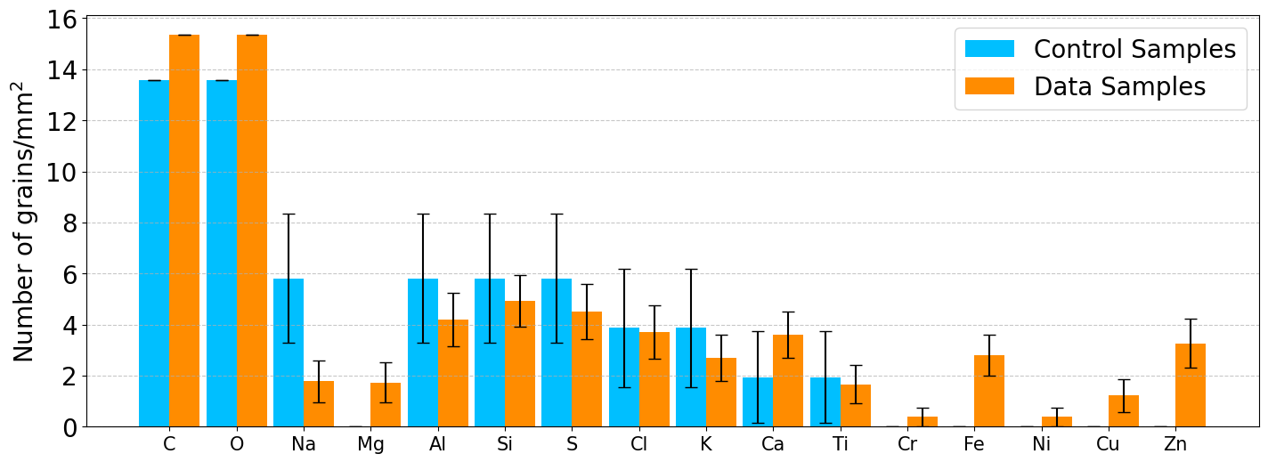
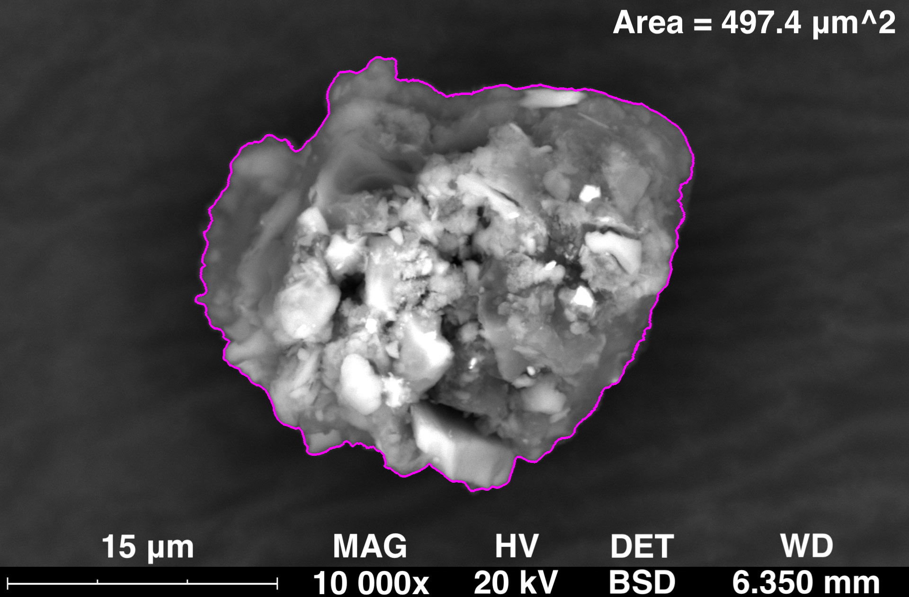
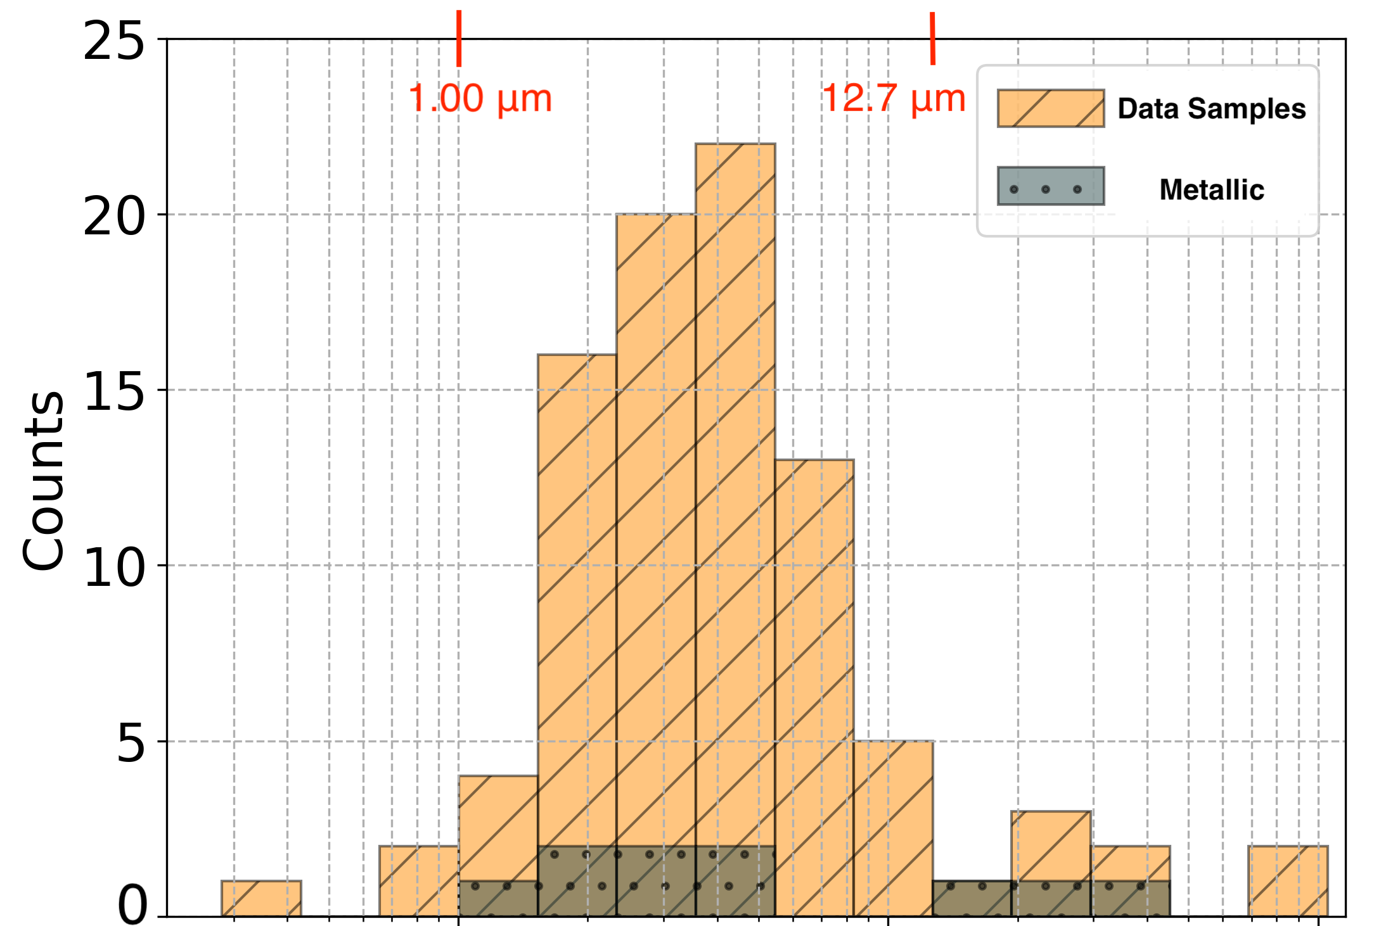
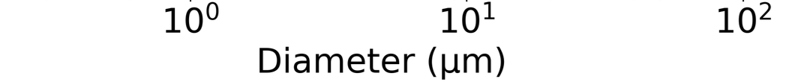
Nature of Contamination
Composition:
MOTIVATION:
Are there ways we can design our systems to prevent particulate migration during operation?
Necessary to understand the conditions of the dust particles (composition, velocity, charge…)
Size:
MICROSCOPY STUDIES:
Scanning electron microscopy (SEM) analysis of dust in TRIUMF e-Linac
  Influenced choice of particulates to study!
A. Mahon – CAP – June 22nd 2026

Slide 7
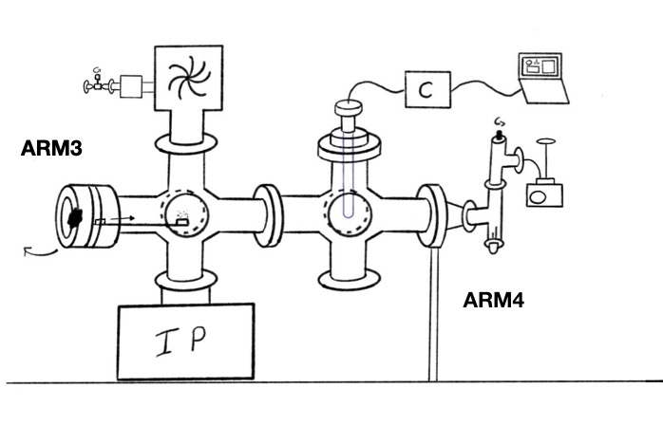
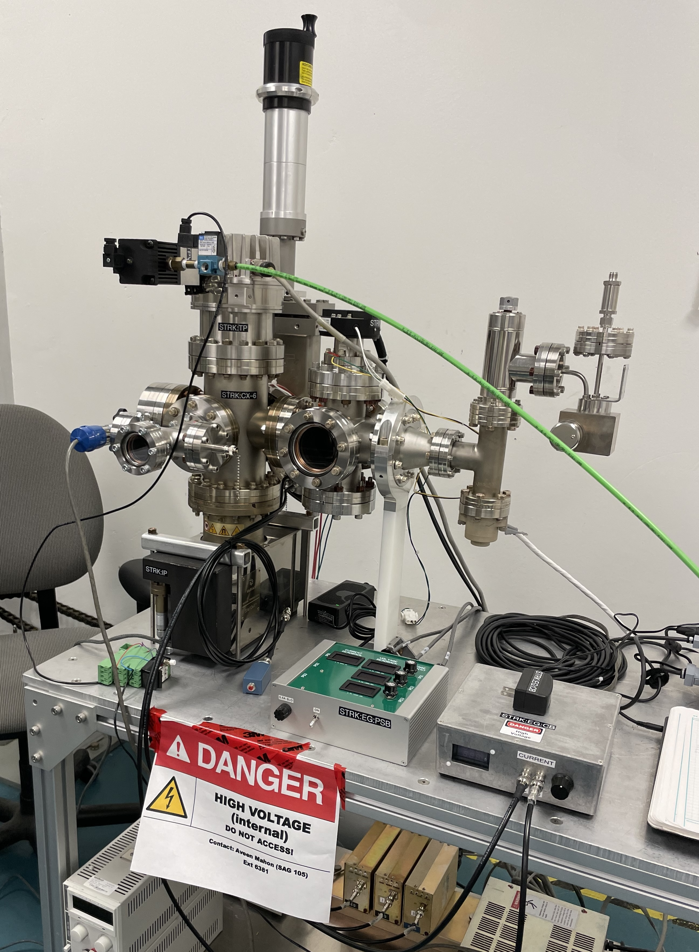
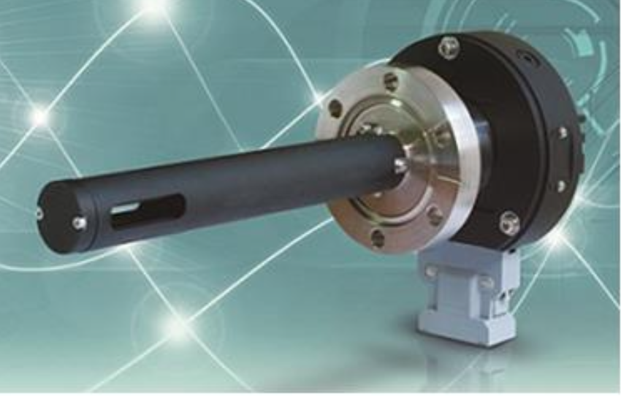
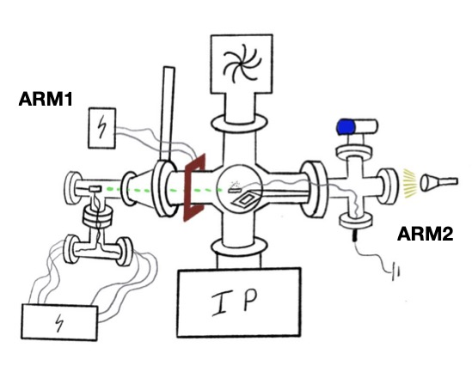
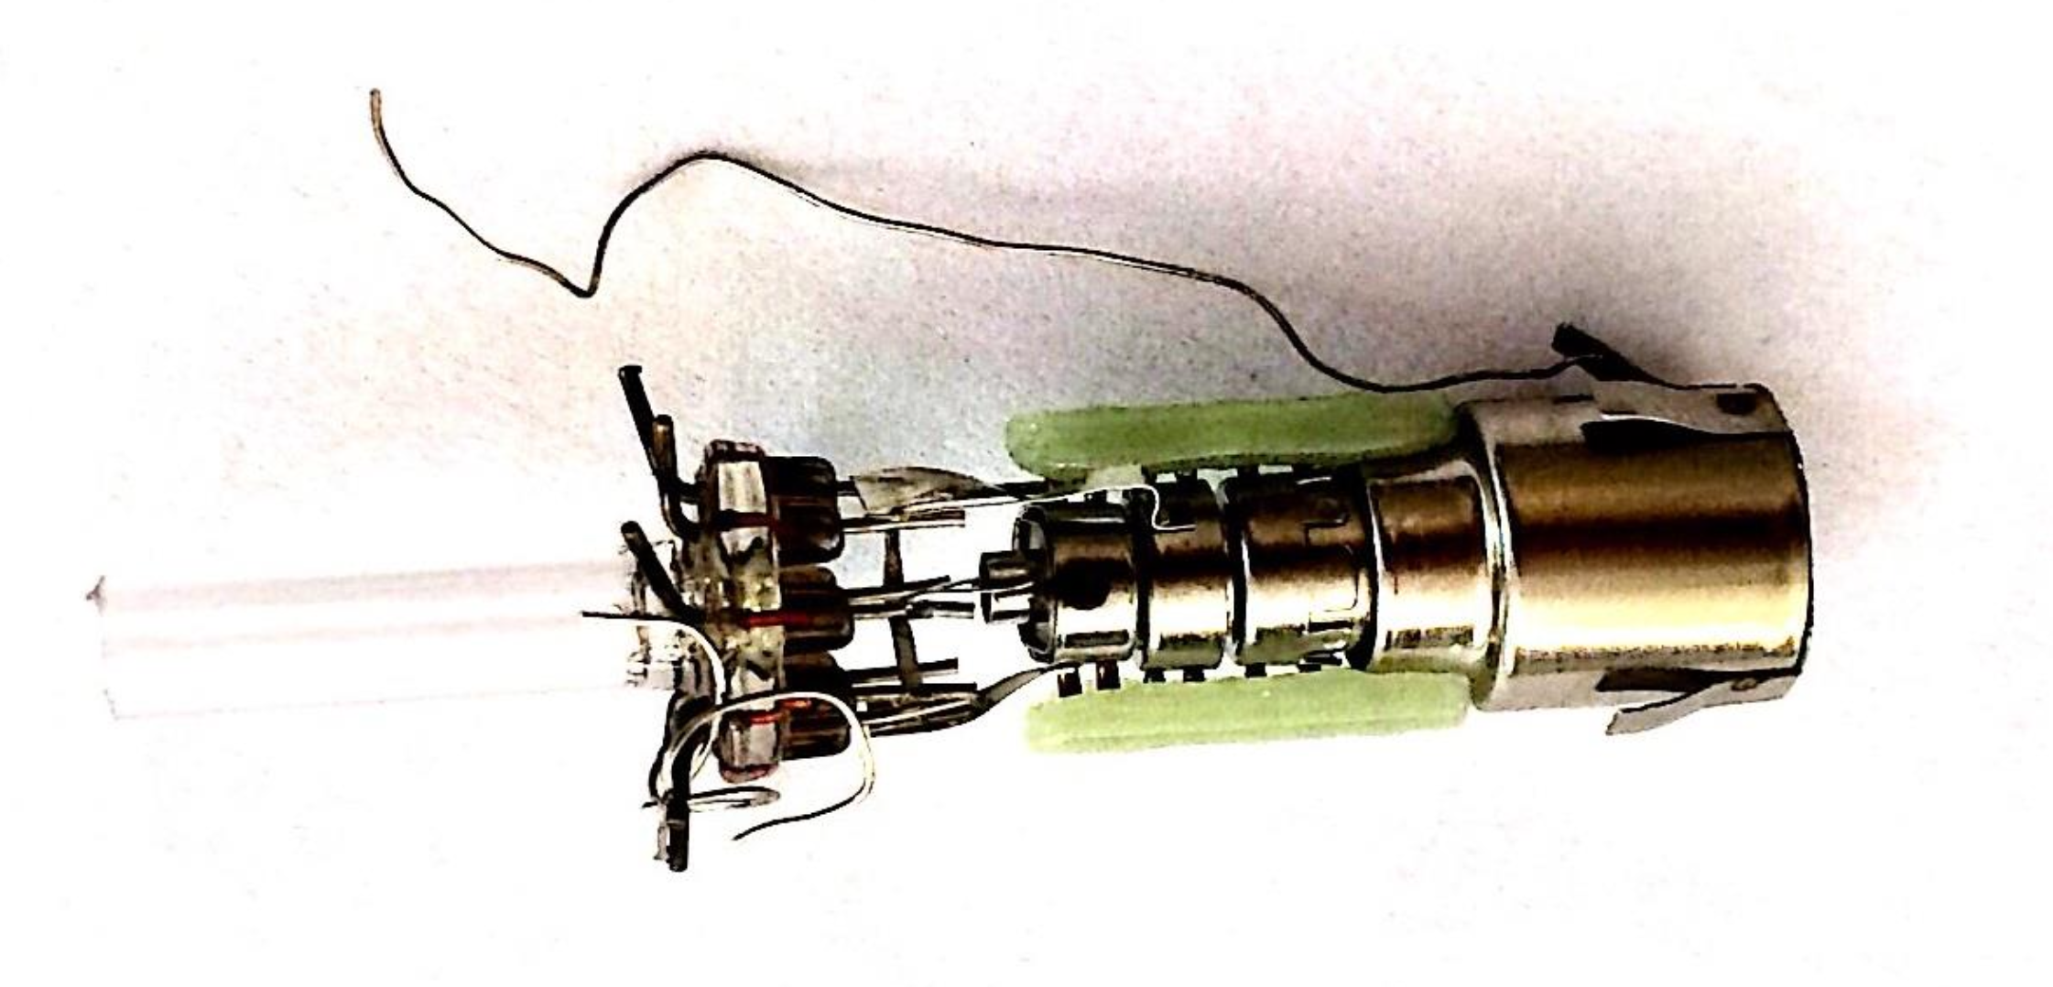
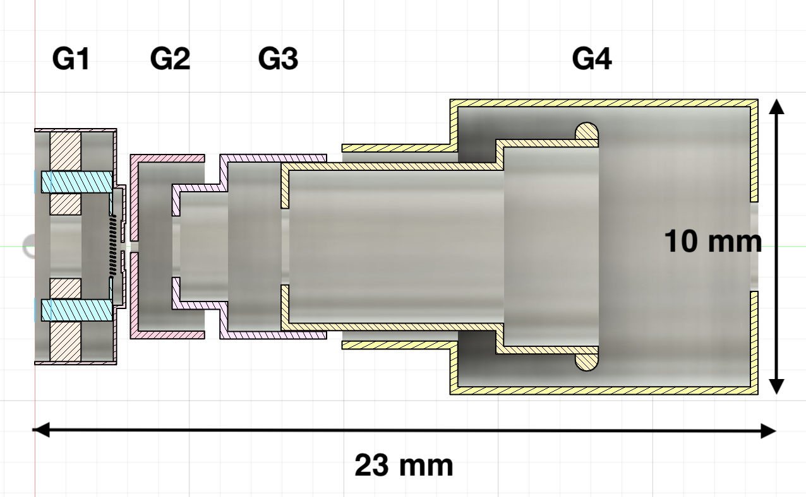
Lofting and Migration Test Setup
Front View
Vacuum ~10⁻⁷ Torr
Low energy electron gun (up to 1.5 keV)
In Vacuum Particle Counter (WEXX)
Particulate Samples:
  SiO2
  Fe based Stainless Steel (SS)
  AlSi10Mg
  CuSn10
}
1-45um diameter
Side View
}
15-45um diameter
Electron Gun:
Components:
A. Mahon – CAP – June 22nd 2026

Slide 8
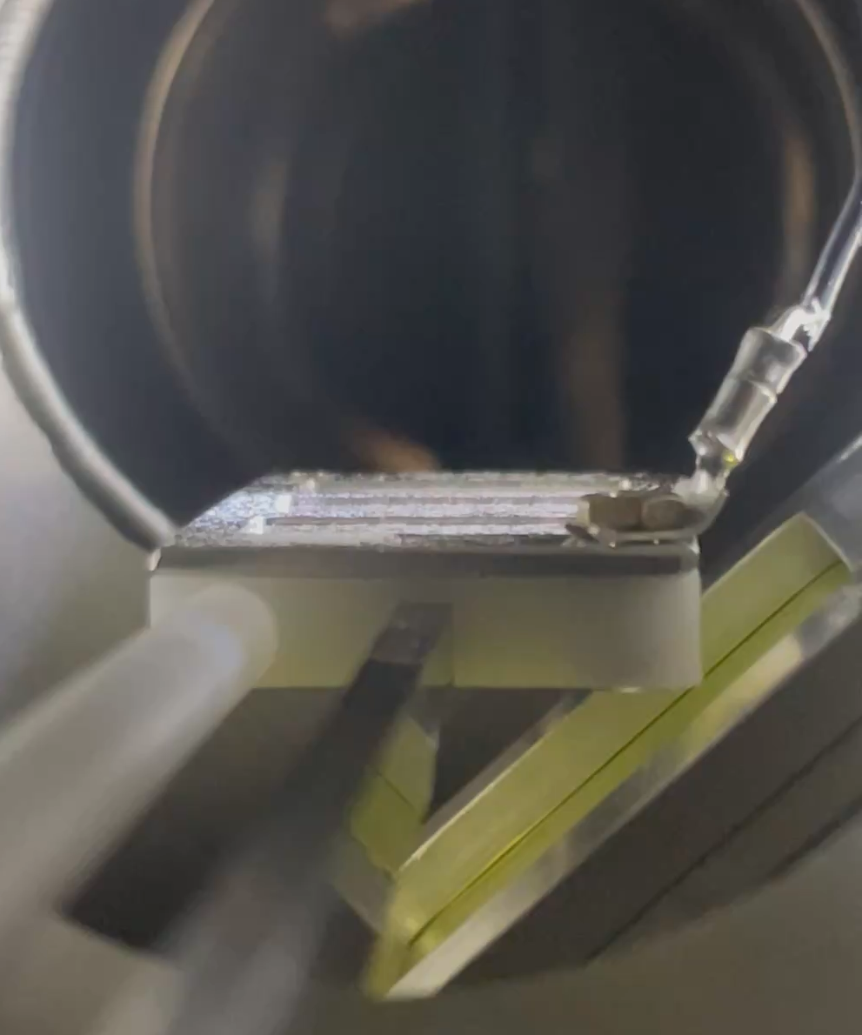
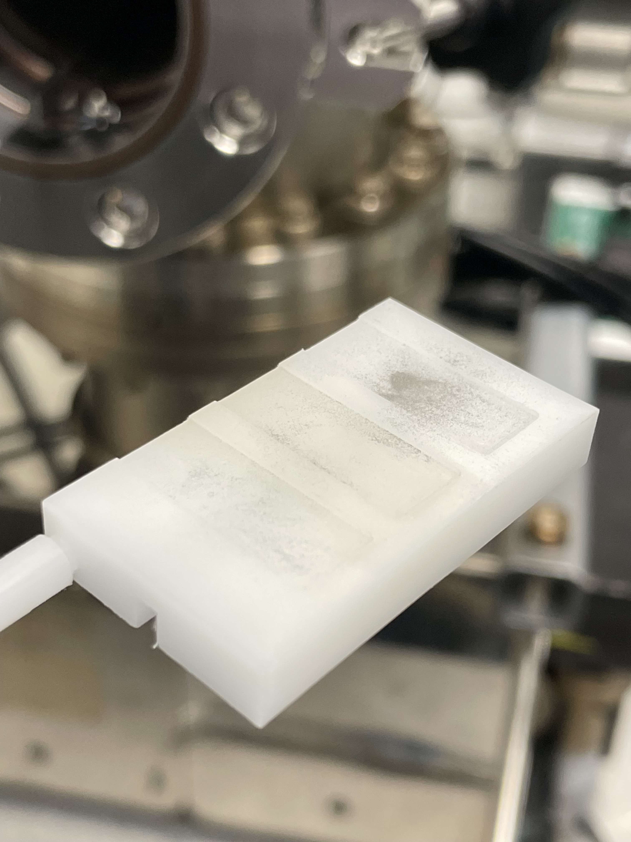
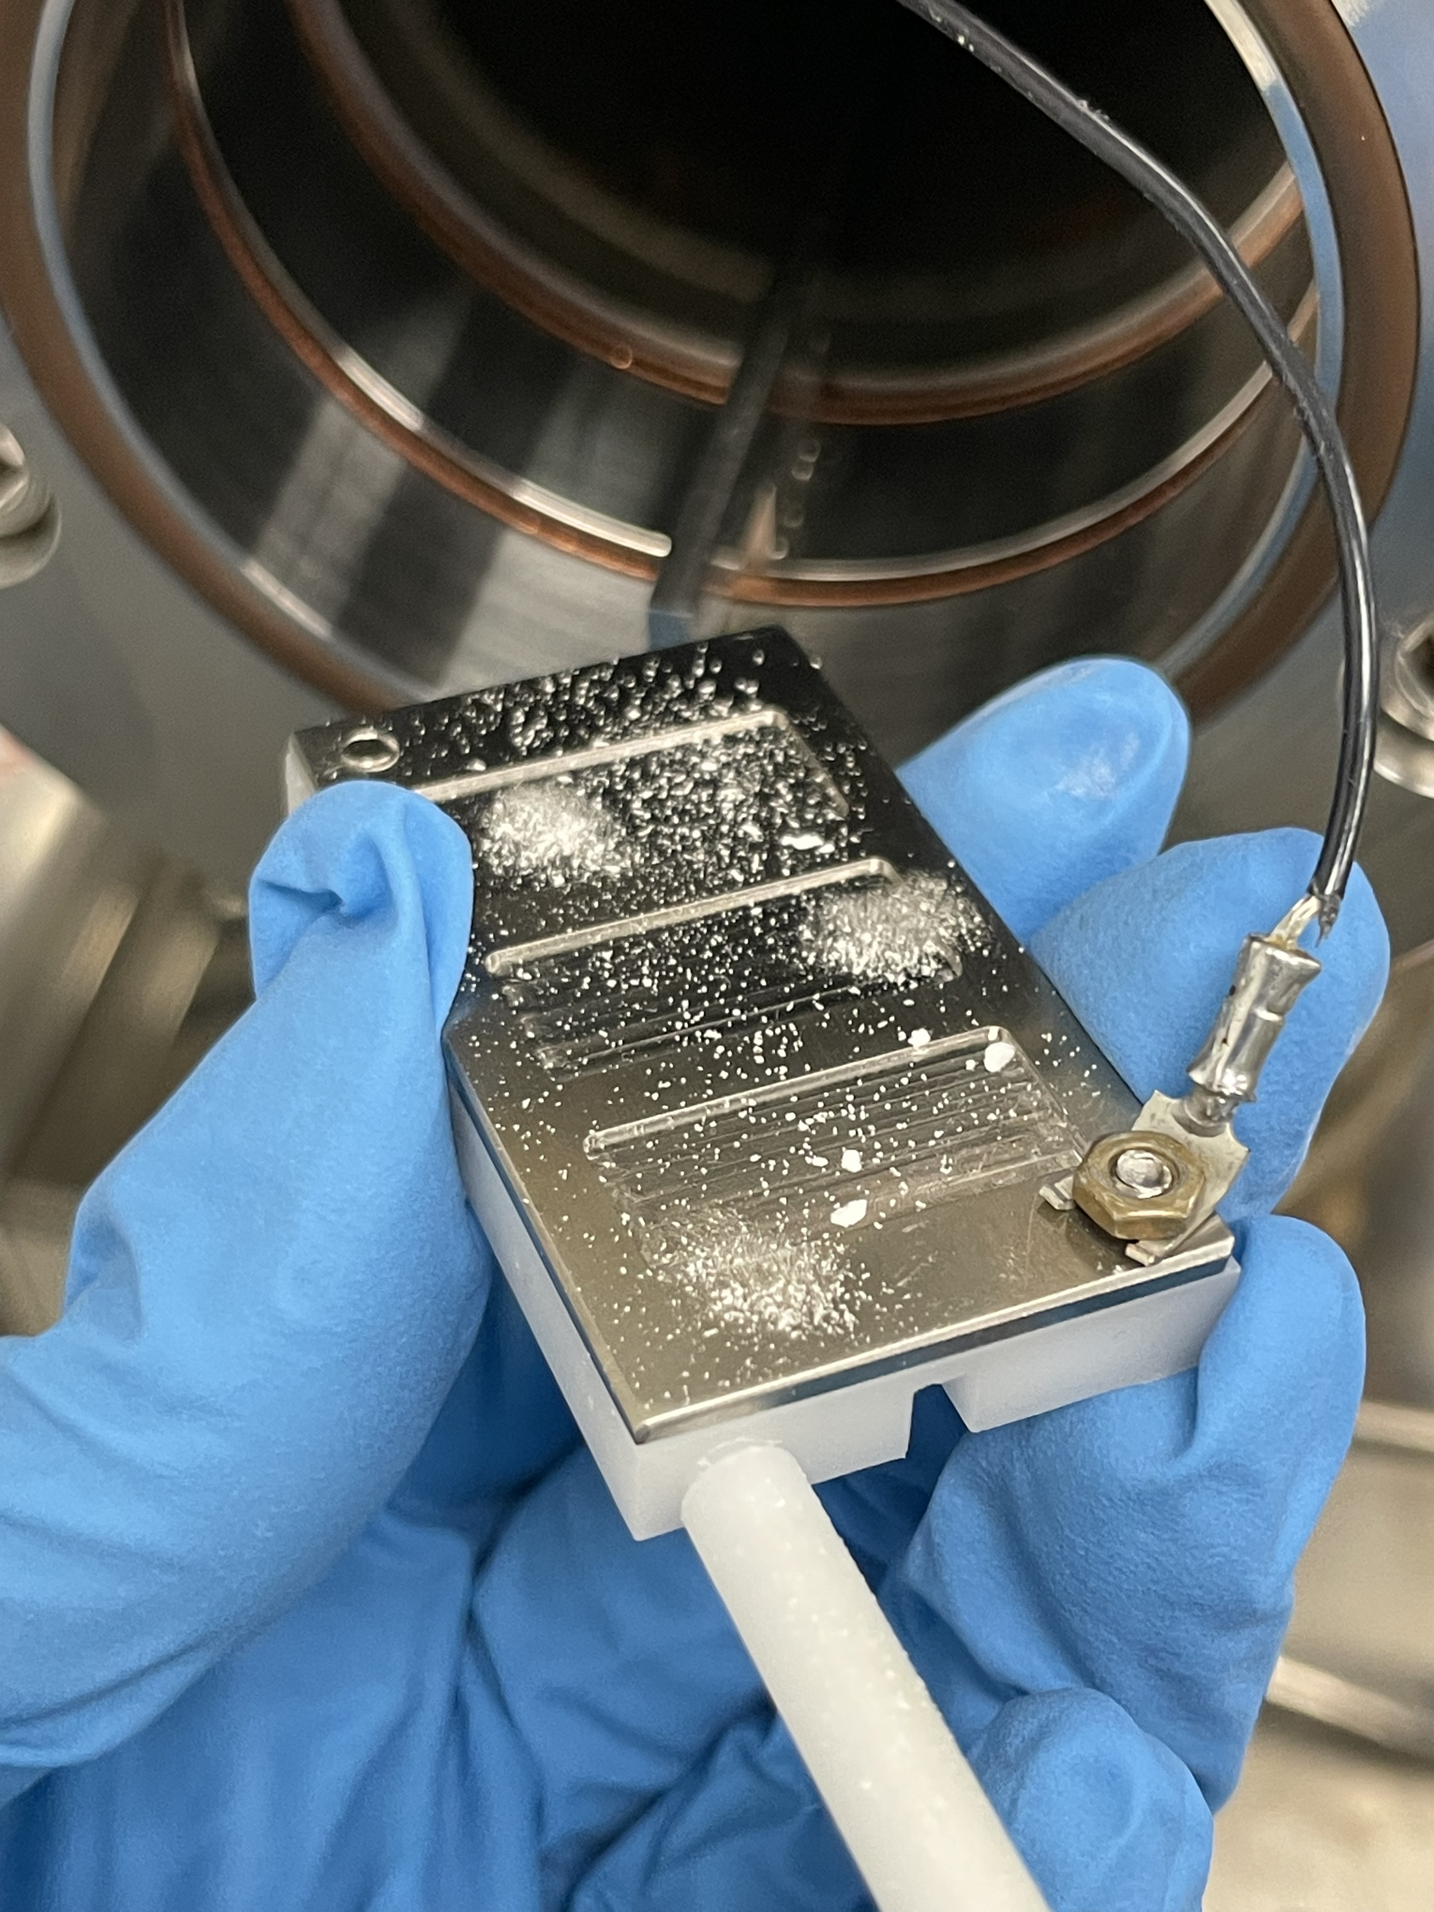
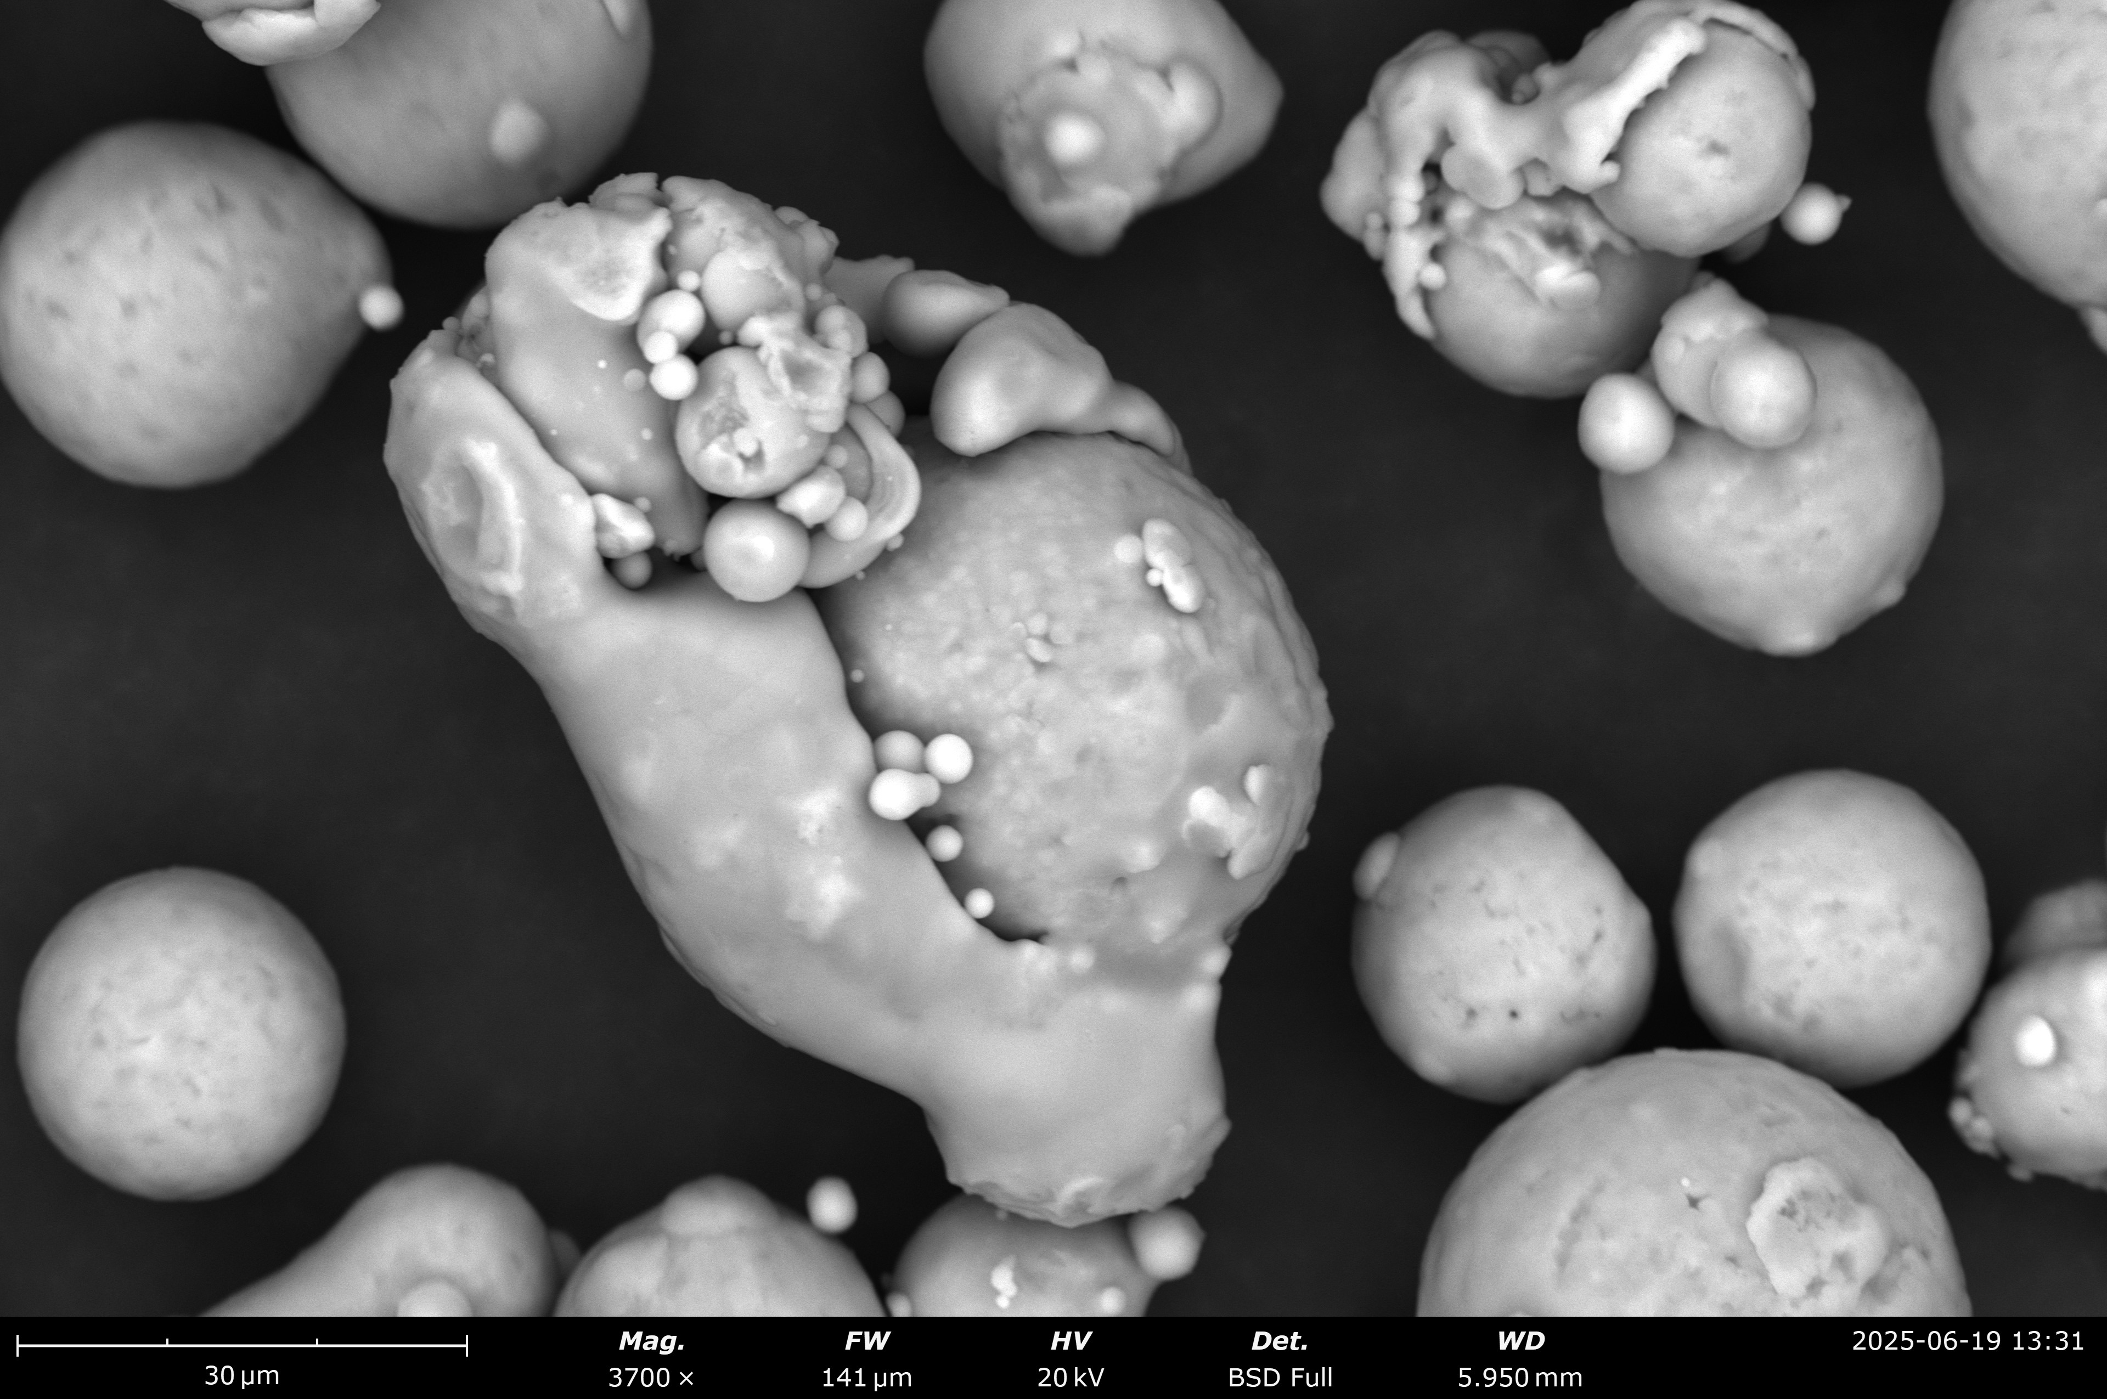
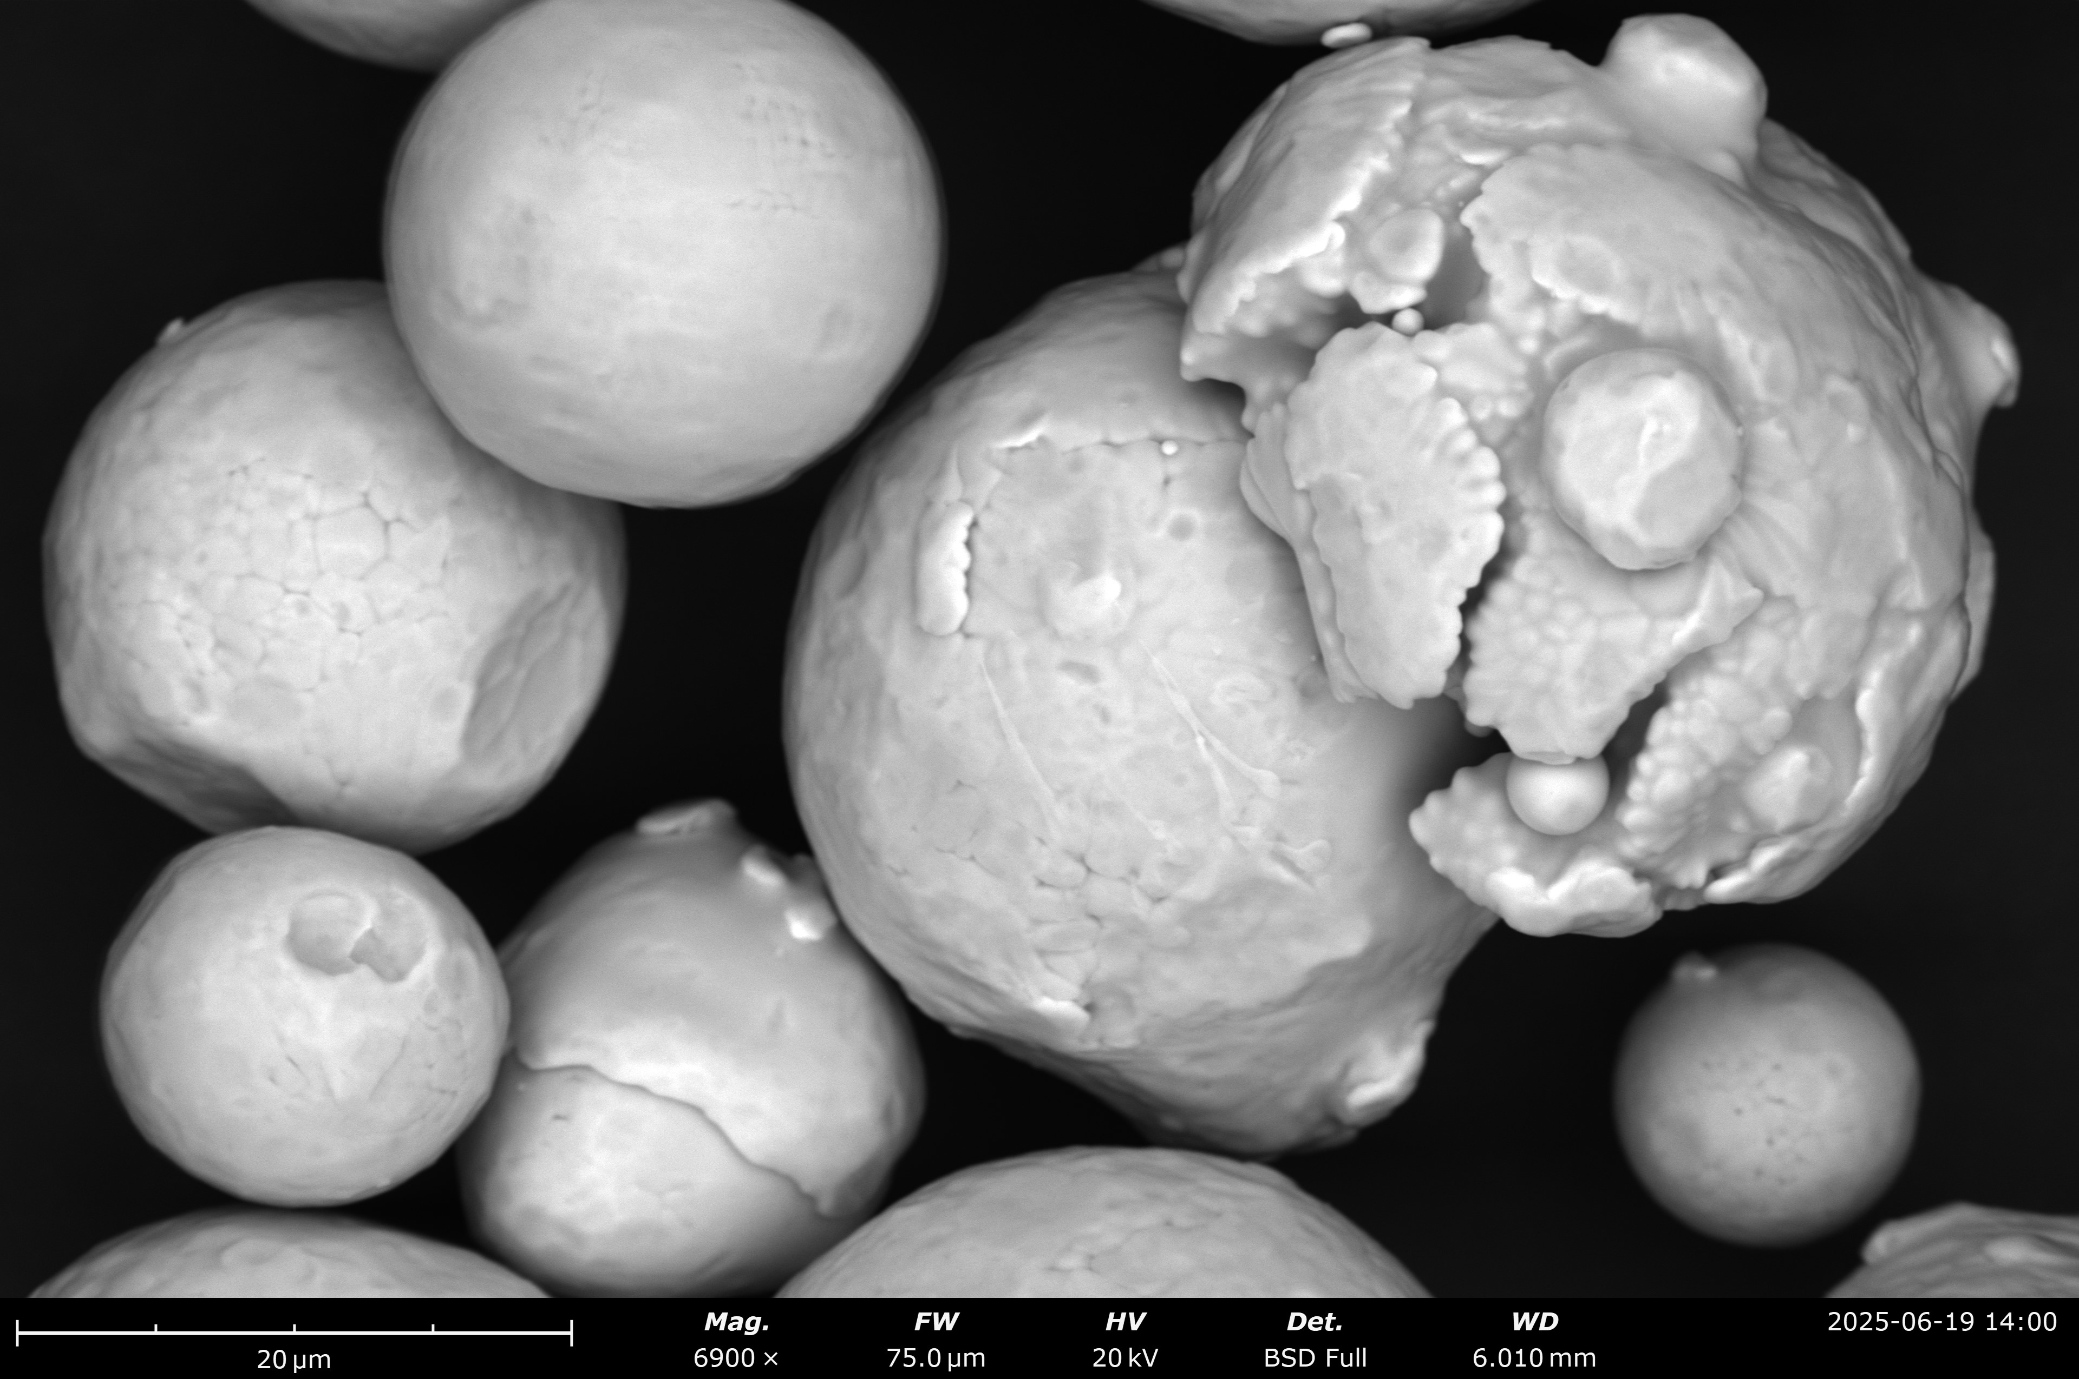
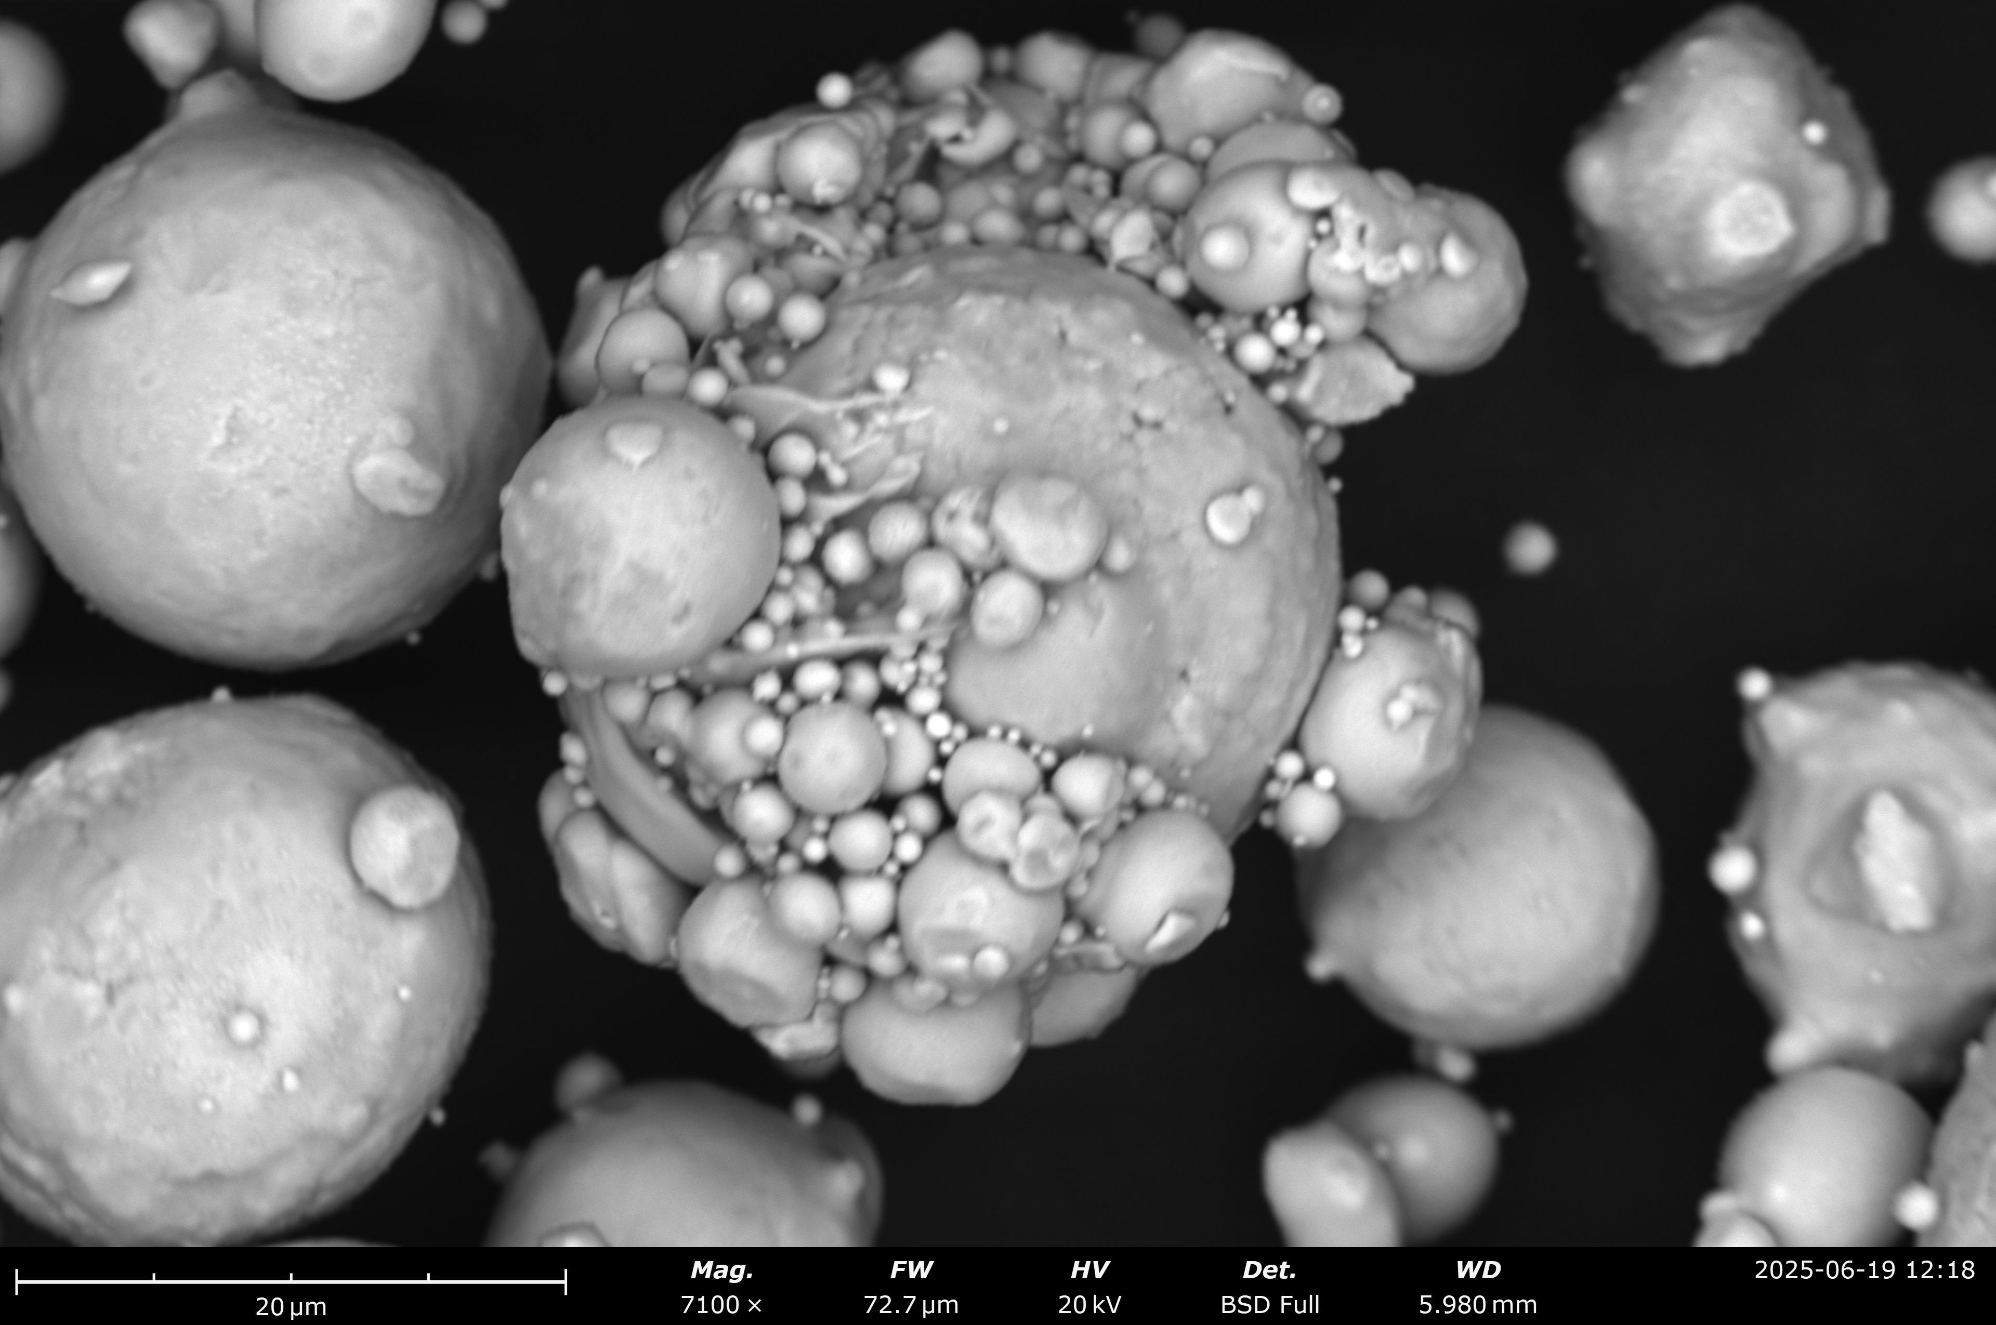
Lofting Results
Incident electron energies where lofting observed:
  Between 50-200eV depending on dust/substrate combination
Combinations tested thus far
  ✅ SiO2 on Delrin
  ✅ SS on Delrin
  ✅ SiO2 on SS (grounded)
  ✅ SS on SS (grounded)
  ✅ AlSi10Mg on SS (grounded)
  ❌ CuSn10 on SS (grounded)
e⁻
A. Mahon – CAP – June 22nd 2026
AlSi10Mg
Fe
CuSn10

Slide 9
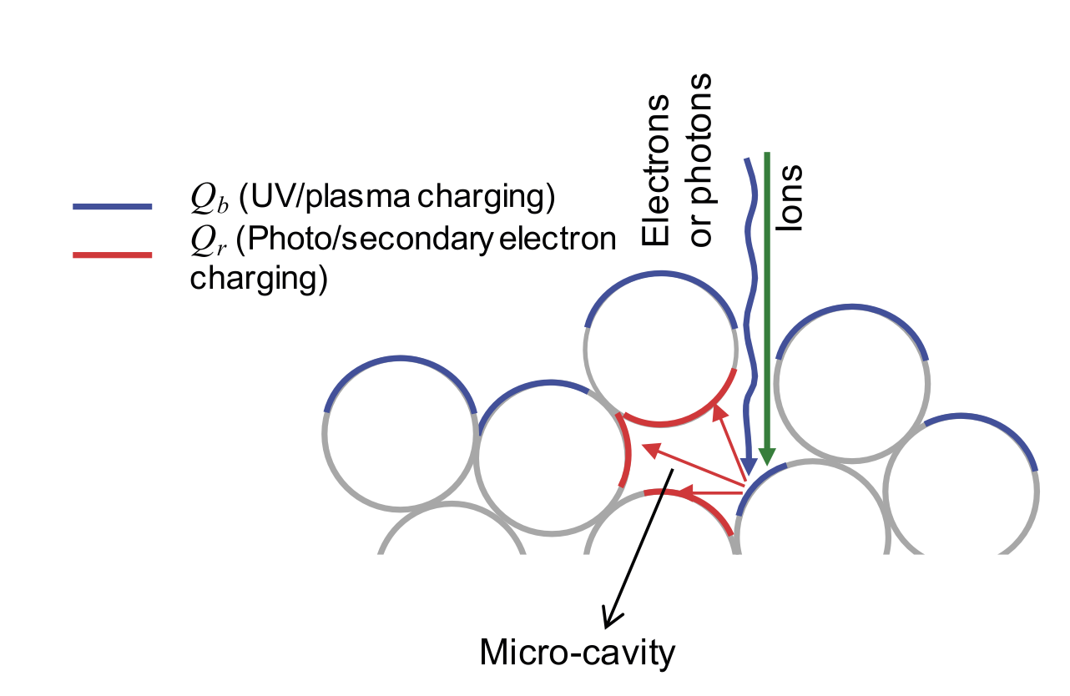
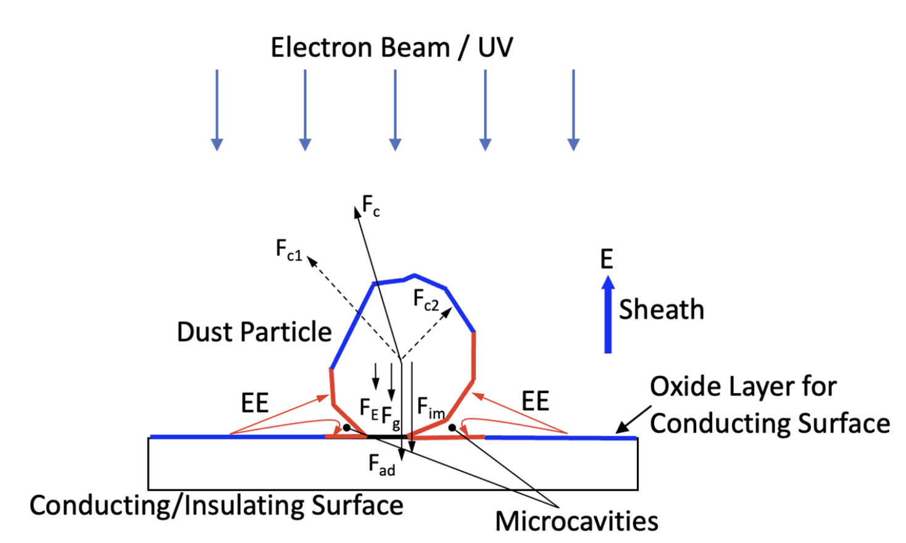
Lofting Theory
Patched Charge Model
Mono-layer:
Multilayer:
Dynamics of particulates (dust) in vacuum influenced by charge
  Evidence from CERN UFO events [1]
  Studies at U. Colorado on dust in space [2,3]
Principle:
  Emission of secondary electrons from primary electron impact
  Re-absorbed into microcavities → negative charge buildup
  Repulsive forces > adhesive forces → LIFTOFF
[3]
[2]
Adhesive Forces | Repulsive Forces
Gravity | Coulomb repulsion (microcavities)
Surface Adhesion
Sheath electric field
Image force (conducting)
A. Mahon – CAP – June 22nd 2026

Slide 10
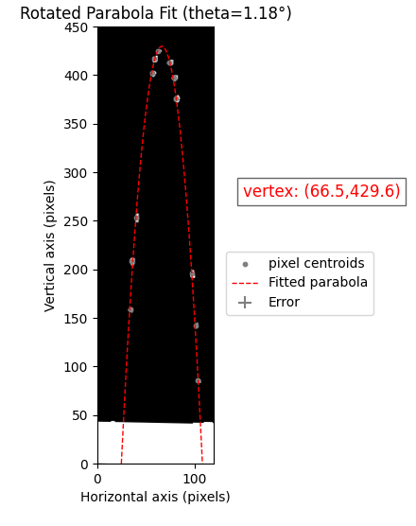
Launch Velocities
Kinetic Energy (velocity dependent) in combination with charge (q) gives electric potential
Can inform strength of potential barrier needed to halt migration → stopping voltage
E = K/q
Dust type | Launch Speed and Angle | Dust Type | Launch Speed and Angle | Dust Type | Launch Speed and Angle
AlSi10Mg on SS: | 0.56 m/s at 86º | SiO2 on SS: | 0.35 m/s at 80º | SS on SS: | 0.31 m/s at 73º
 | 0.34 m/s at 58º |  | 0.31 m/s at 73º |  | 0.34 m/s at 76º
 | 0.27 m/s at 60º |  | 0.44 m/s at 67º |  | 0.32 m/s at 89º
 | 0.69 m/s at 89º |  | 0.34 m/s at 73º |  | 0.30 m/s at 64º
 | 0.47 m/s at 83º |  | 0.31 m/s at 79º |  | 0.25 m/s at 51º
A. Mahon – CAP – June 22nd 2026
E-Gun Energy
60 eV
50 eV
50 eV
160 eV
160eV
170 eV
120 eV
120 eV
200eV
200eV
110eV (?)
110 eV
110 eV
110 eV
110eV
Errors:
Statistical – run code bunch of times and see by how much values change
Systematic – assuming bottom of stage is zero for each event even though it could be anywhere on the stage - unknown

Slide 11
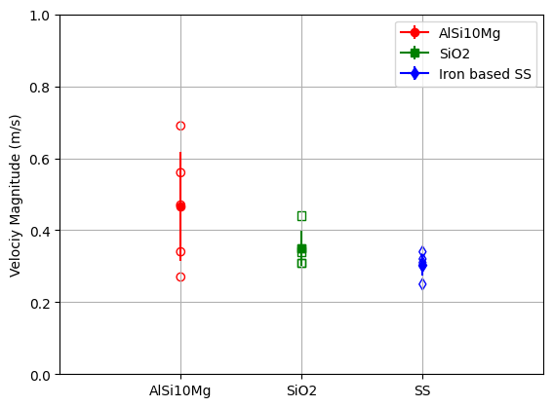
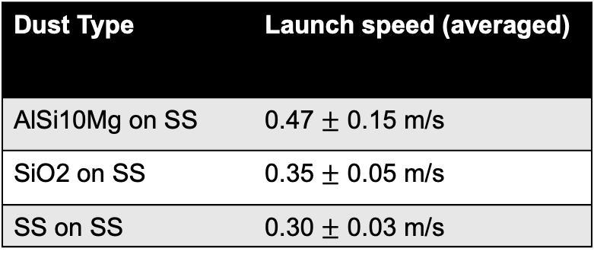
Launch Velocities
Kinetic Energy (velocity dependent) in combination with charge (q) gives electric potential
Can inform strength of potential barrier needed to halt migration → stopping voltage
E = K/q
Dust Type | Launch speed (averaged)
AlSi10Mg on SS | 0.47 $±$ 0.15 m/s
SiO2 on SS | 0.35 $±$ 0.05 m/s
SS on SS | 0.30 $±$ 0.03 m/s
A. Mahon – CAP – June 22nd 2026

Slide 12
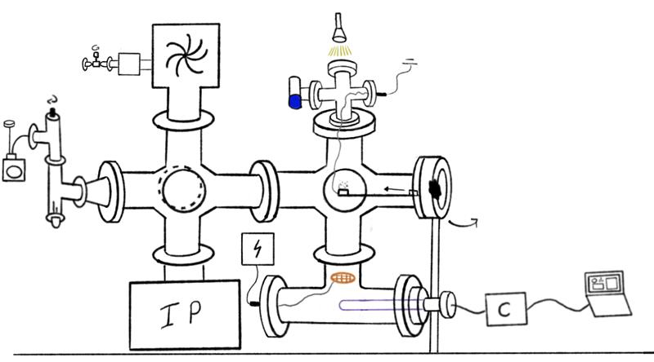
Next step...charge!
Millikan oil drop-type experiment
Can estimate charge of particulates from magnitude of voltage on grid required to halt them
In combination with velocity results will provide estimate (polarity, order of magnitude) of potential barrier needed stop passage of charged dust into cavities
Upgrade underway with expected results by end of Summer 2026
Grid
A. Mahon – CAP – June 22nd 2026

Slide 13
To Conclude
The Problem:
High energy accelerators use superconducting cavities.
Extremely sensitive to contamination – dust!
Understanding origin and migration is essential.
My Results:
Dust LOFTS when exposed to low energy electron beam.
Extracted initial launch parameters.
Inform mitigation techniques to maintain accelerator performance.
Questions?

Slide 14
References
[1] Goddard, B., et al. "Transient beam losses in the LHC injection kickers from micron scale dust particles." Conf. Proc.. Vol. 1205201. No. CERN-ATS-2012-219. 2012.
[2] Wang, X., et al. "Dust charging and transport on airless planetary bodies." Geophysical Research Letters 43.12 (2016): 6103-6110.
[3] Taylor, Kelyan, et al. "Charging and lofting of dust particles on surfaces exposed to a pulsed electron beam." Physics of Plasmas 32.11 (2025).

Slide 15




Thank you
Merci
www.triumf.ca
Follow us @TRIUMFLab

Slide 16
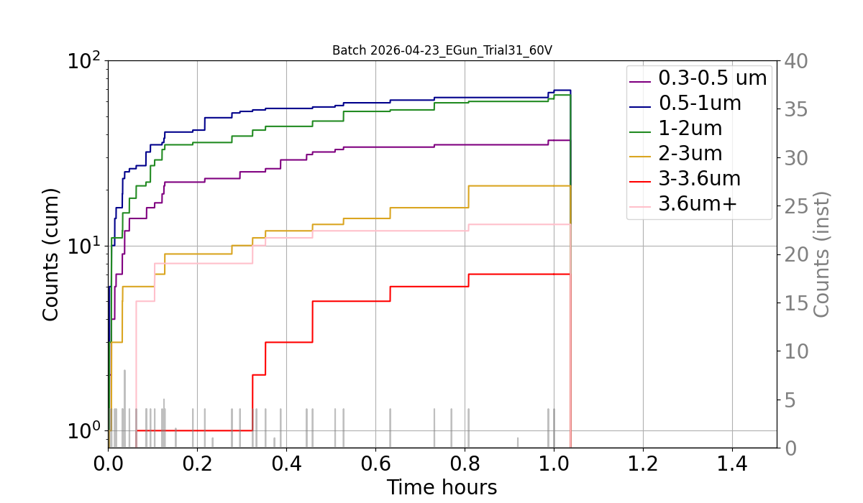
Front View
Backup slides
Particle Counter (PC):
~ 20 cm from sample stage
Only dust sample to register counts → SiO2!!
Also classifies
based on size
20cm

