Slide 1



Hybrid system
Radon-222 trapping with liquid nitrogen
2026 CAP CONGRESS, June 23rd

Slide 2
Outline
Motivation
Commissioning
System description
Calibration step
Characterization
Conclusion

Slide 3
Motivation
Gas assay: (low pressure)
Rn trap : activated carbon as sole material
Excellent adsorption capacity at ⇣ T∘
Hybrid system
Increase sensitivity of radon measurement in large volume systems: PICO (PV 10 m³)
Rn trap : Bronze wool + Activated carbon
Water trap→ absorb the water before it reaches the charcoal
Wool: Not prone to blockage + limited adsorption of O₂ and N₂
Wool: To absorb residual moisture upstream
Wool: Allowing the system to breathe + limits the drop in P & Q.
Prone to clogging at ⇣ T∘ → moisture, O₂ & N₂ condensation

Slide 4
Commissioning
Charcoal:
Purification & Cleaning
Nitric acid (5 % HNO3) → leach out and remove contaminants (238-U & 226-Ra)
Increase surface roughness and the number of pores
Rinsed with UPW
Bake → 150°C for 24 to 48 hours, with a nitrogen flow
Materials: Pipe, Fittings, Flexible tube & Wool
USC: nuclear radioactive decontamination solution
Methanol cleaning : valve, ss & bronze wool
Passivation and pickling

Slide 5

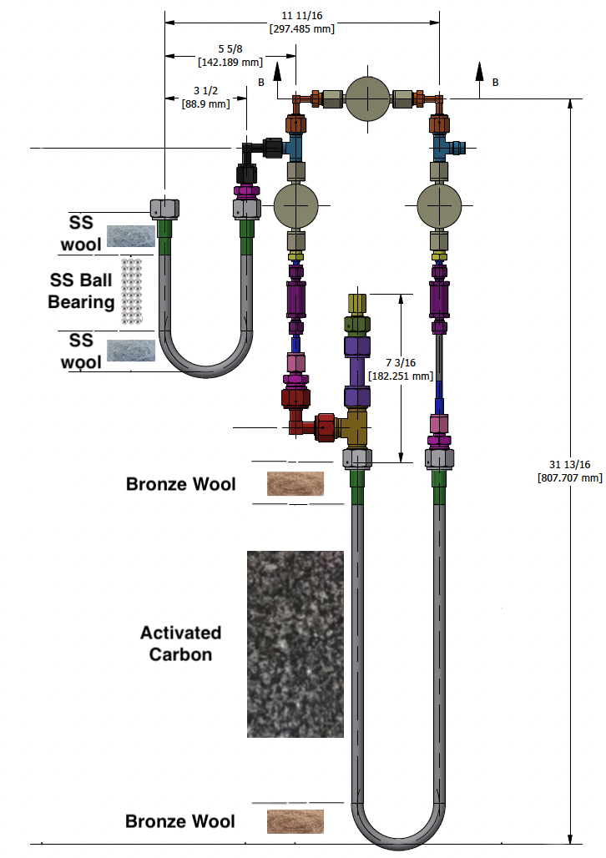
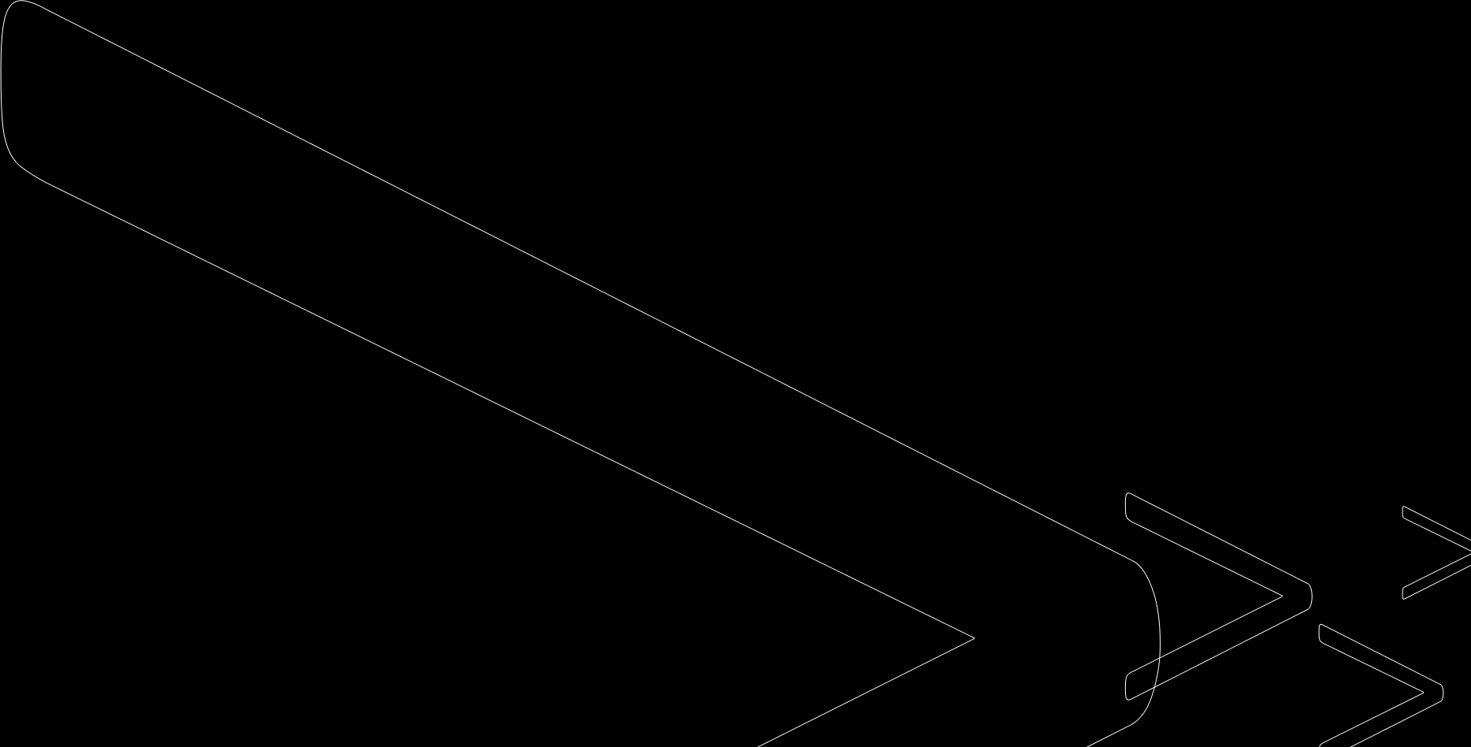
System description
Water trap (short U-shaped ½” pipe)
SS wool
3/16" AISI 316 stainless steel bearing balls
3X FVCR Bellows sealed valves
2X VCR Particle filter, 0.5 µ, 316 SS
11.22-inch, Type T Thermocouple, Probe
Carbon trap (long U-shapped ½” pipe)
Carbo-Act International (0.2mBq/kg)
Bronze wool

Slide 6
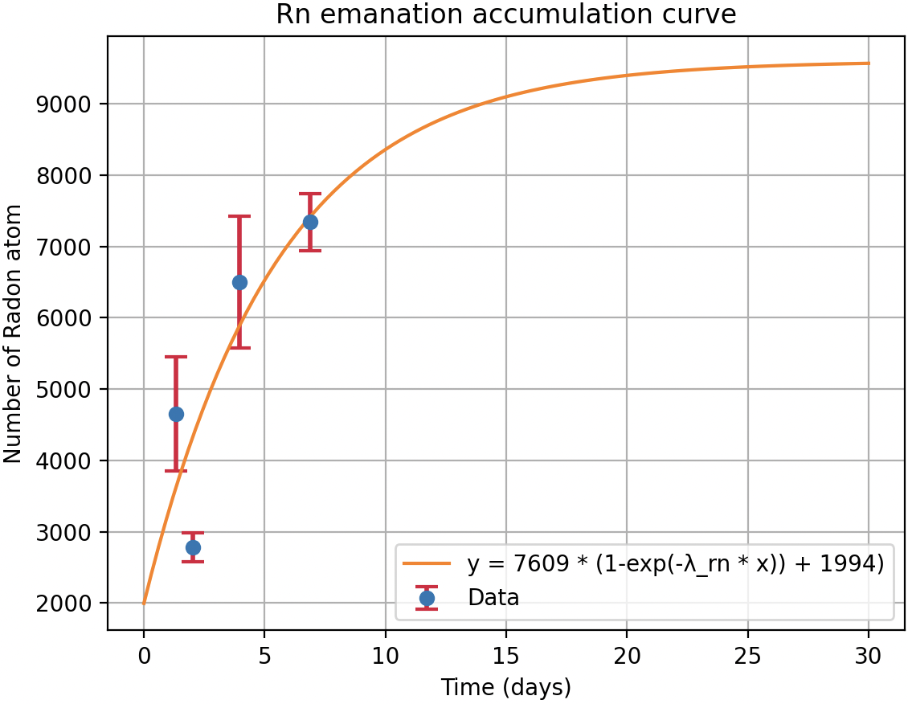
Calibration step
Rn emanation (exhalation)
  Radon atoms generated by the decay of radium in a material and escape through its interstices, mainly due to recoil effects
Radon source : # of Rn when reaching secular equilibrium
Rn capture by the trap system from the calibration source

Slide 7
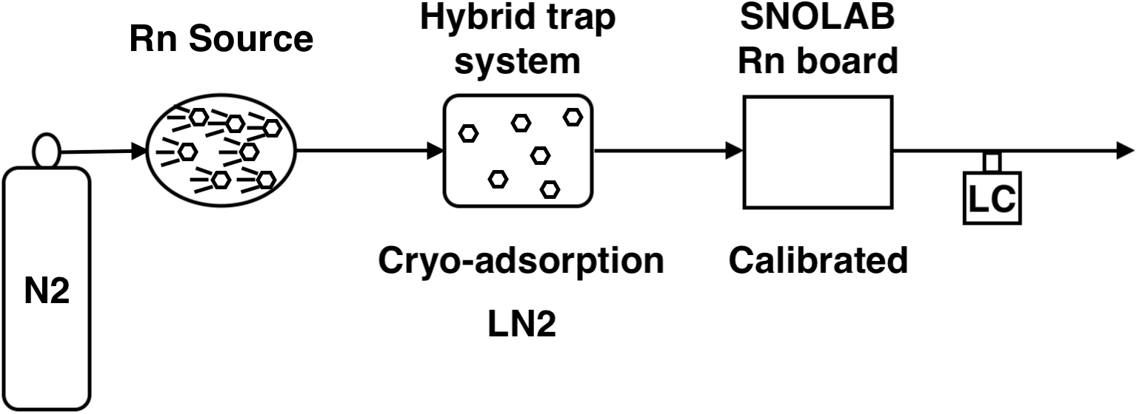
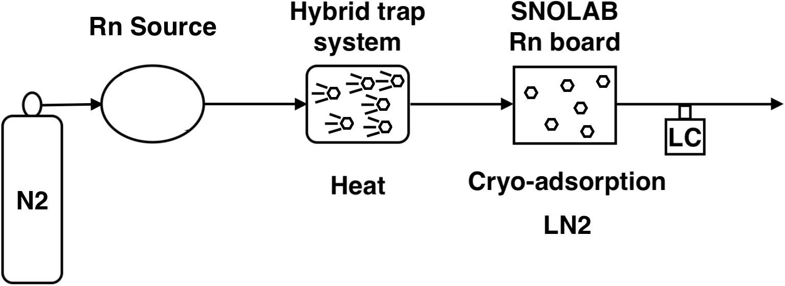
Calibration & Counting
Radon source
  Use to calibrate the hybrid system → determine trapping efficiency
  Detector (component) : Counting the Rn rate release (radon assay)
SNOLAB radon board
  Contains two traps
  Calibrated : known efficiency
  Not designed to handle large volumes of N2 → efficiency decreases

Slide 8
Characterization
Moisture :
  Reduces the dynamic adsorption coefficient
  Can take the places of Rn on the microscope pores of the adsorbent.
  Increase the probability that Rn escapes the trap
  LC → reduces & distorts the counting efficiency.
    Can condensate on scintillating material

Slide 9
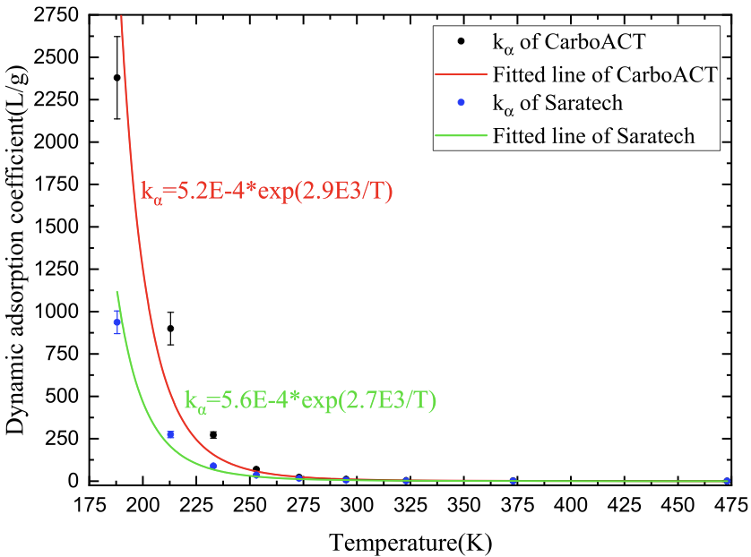

Characterization
Dynamic Adsorption (K_{a})
  $Ka\left[L/g\right]=\frac{τ\left[min\right]Q\left[SLPM\right]}{m[g]}$
  $τ$Is the retention (breakthrough) time
  $m$ is the mass of the absorbent
  Increases exponentially as the temperature decreases
Wang et al., Applied Radiation and Isotopes 191 (2023) 110564

Slide 10

Characterization
Retention (Breakthrough) time →
  Designates the period during which carbon reaches saturation and can no longer reliably retain radon.
  The breakthrough time must always be greater than the assay (exposure) time.
  $m\left[g\right]=15.3±0.3g ; Q=0.5±0.1SLPM$
  $τ\left[min\right]=\frac{Ka\left[L/g\right]m\left[g\right]}{Q\left[SLPM\right]}\sim 102−107 min$

Slide 11
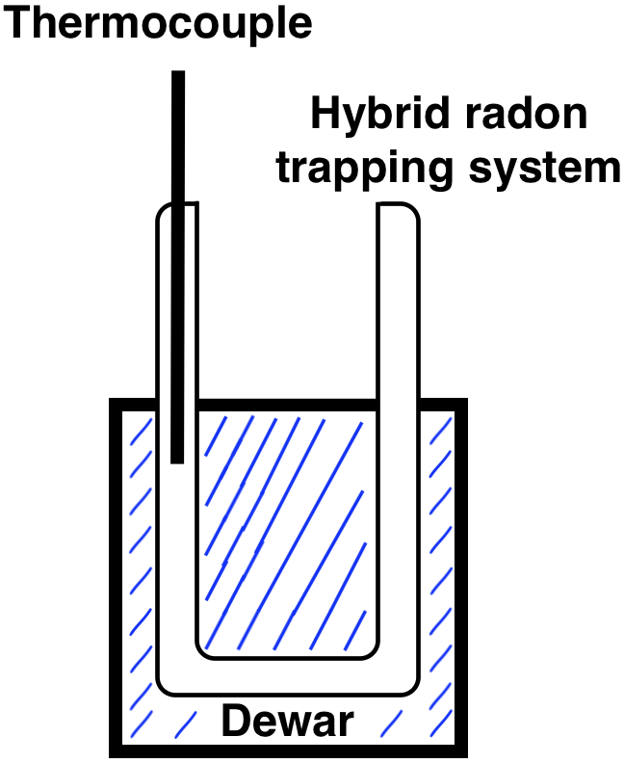
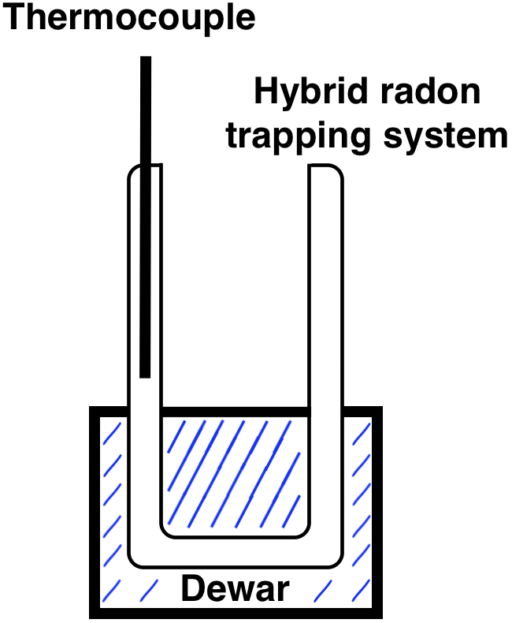
Characterization
Inside
Understanding the behavior of the system under vacuum
  Flow rate on T, P
  P and flow rate drop
  Homogeneity of T in the charcoal column
    Thermocouple directly in the carbon
    Cryofluid level in the dewar
    T around the probe region: internal material vs. external fluid
Outside

Slide 12
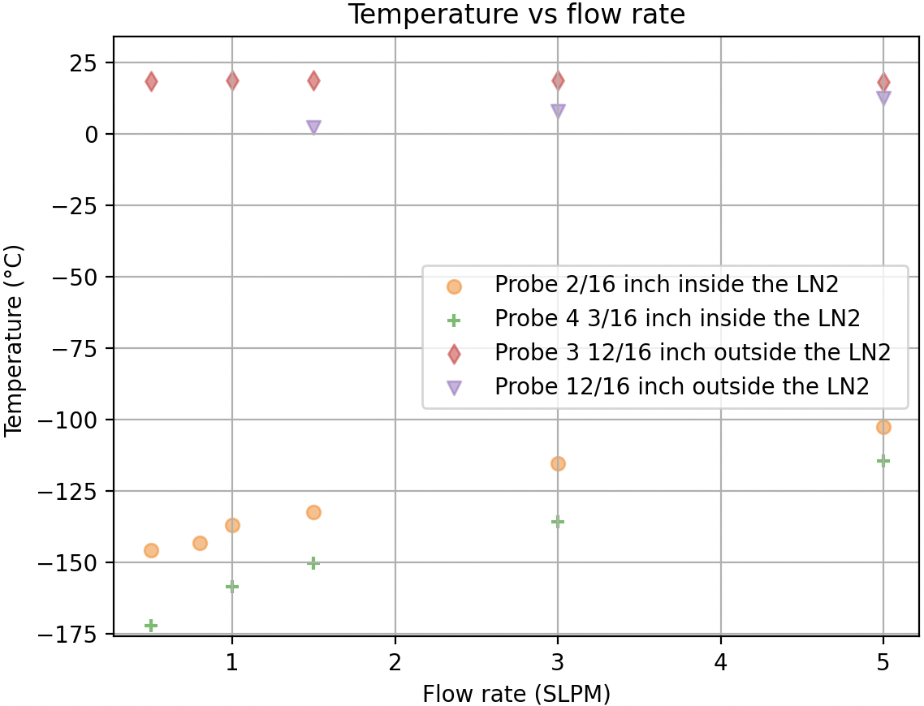
Internal Temperature
Cryogenic fluid level in dewar dependent
T of the external fluid is not the same as that of the internal system.
Without heating, the temperature of liquid nitrogen (LN2) would have to be reached over a long period.
  However, the analysis is carried out within a limited time frame

Slide 13
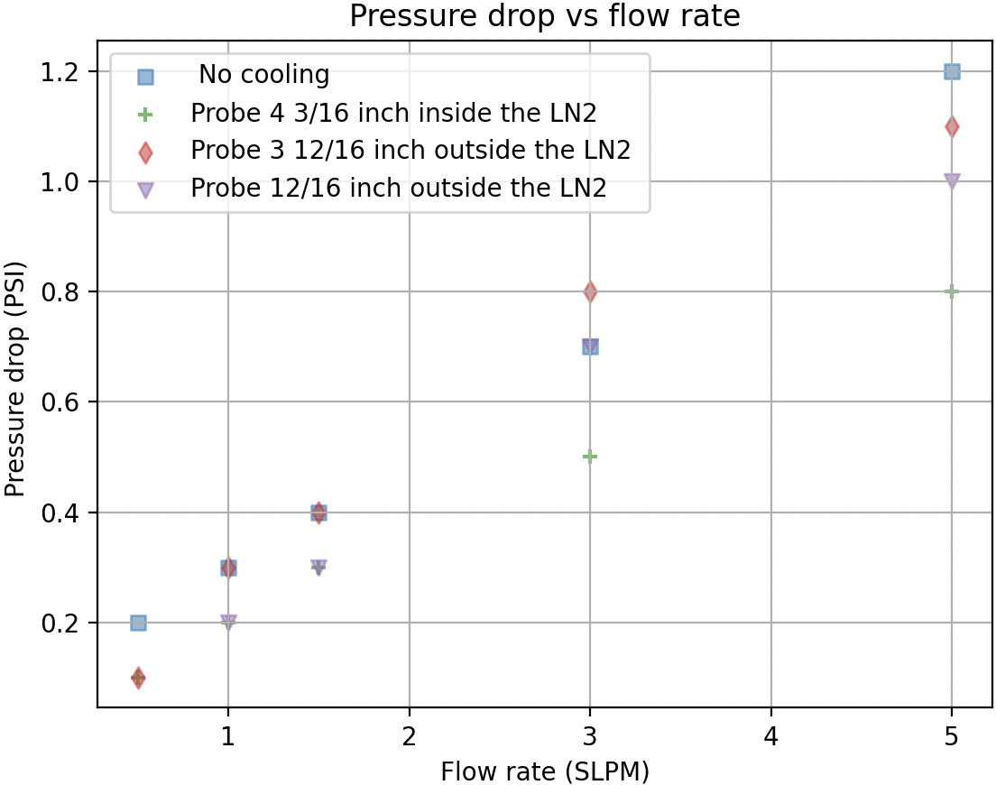
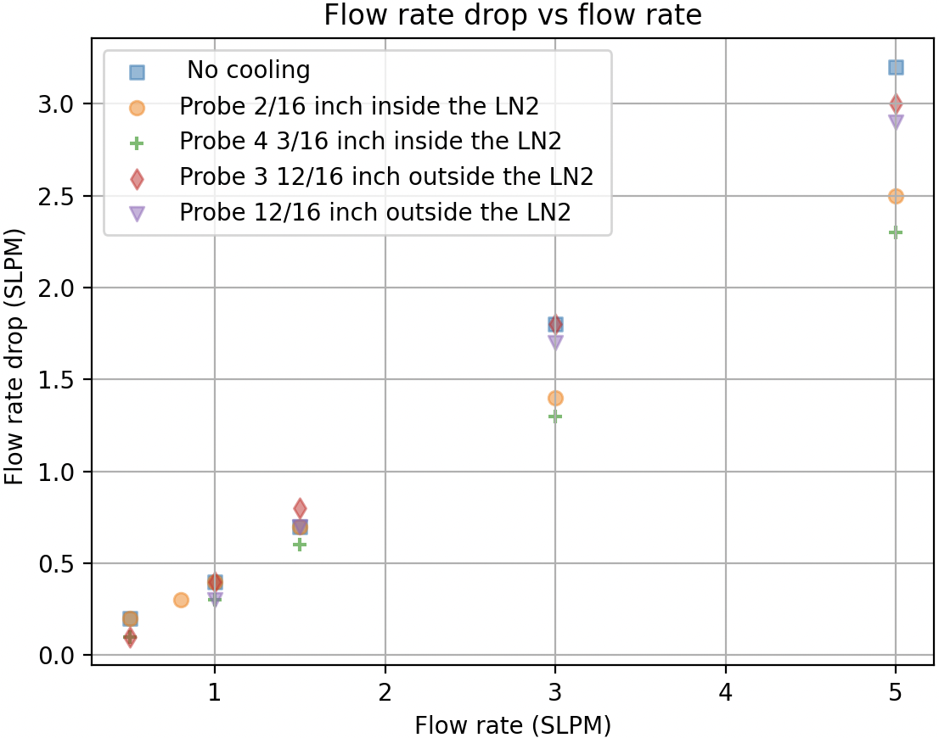

Flow rate & Pressure drop
$i_{drop}=\left(i_{Bypass}−i_{Trap}\right)$
$i_{drop}$ amplify with flow rate
Should be monitored during an assay : assess clogging.
Trapping efficiency
  more time to interact and adhere with adsorbent material

Slide 14
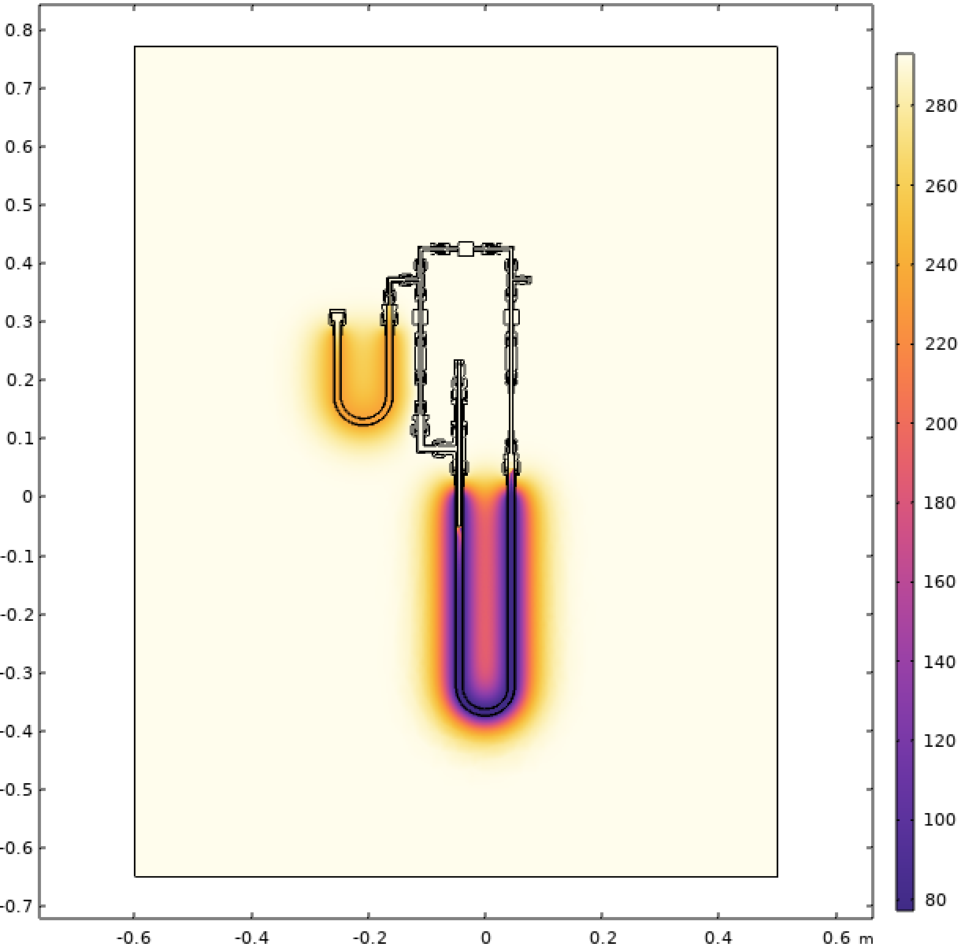
Conclusion
Has been done
  Hybrid system to trap Rn
  No blockage when LN2 is used as a cryo-fluid
  Characterize : P & T change in the system with the input flow
  Improve procedure, calibrate initial T as an example
Need to be done
  Add an CO₂ trap
    ↑ trapping efficiency: competes for the same adsorption sites
    Prevents and reduces cryogenic blockages
  Run thermal model to have a better understanding
    Compared with recorded data: T, P & Q

Slide 15

Annex
Reynolds
  $Re=\frac{ρvL}{μ}=\frac{ρ\left(Q/A\right)L}{μ}=\frac{\left(1.165 kg/m^{3}\right)\left(\left[8.333X{10}^{−6}m^{3}/s\right]/\left[1.266769X{10}^{−4}m^{2}\right]\right)\left(0.0127 m\right)}{1.7X{10}^{−5}Pa∙s}=55.3$
  $<<2100$→ laminar flow
Laminar flow
  Uniform
  Predictable residence time

Slide 16

Annex
Parameters :
  $N_{Rn}^{sample} defines the number of Rn decay in a given sample$ $∙$ 𝜆 (activity=N𝜆→ Bq or disintegration / day)
  $N_{α} is the number of alpha counts$
  $N_{Bkg}^{LC} and{ N}_{bkg}^{board}are the bkg count for the LC and board for the counting period and syst. conf. respectively$
  $ε_{i} are the efficiency of transfer, trapping and counting of the system used$
  $ε_{trans}=0.64±0.16 , PV→water trap →charcoal →Trap A →Trap B →LC$
  $ε_{trap}=0.94±0.06, efficiency of trapping radon from the combination of Trap A \& B$
  $ε_{counting}=0.74±0.07$LC in count alpha
  $t_{i} are the time parameters$
  Please note : the expression in (parentheses) is the number of radon atoms
$$N_{Rn}^{sample}=\left(\frac{N_{α} − N_{Bkg}^{LC} t}{3ε_{trans}ε_{trap}ε_{counting}(e^{λ_{Rn}t_{delay}})(1−e^{λ_{Rn}t_{count}})(1−e^{λ_{Rn}t_{eman}})}−N_{bkg}^{board}\right)\frac{ln\left(2\right)}{T_{1/2}}$$

Slide 17
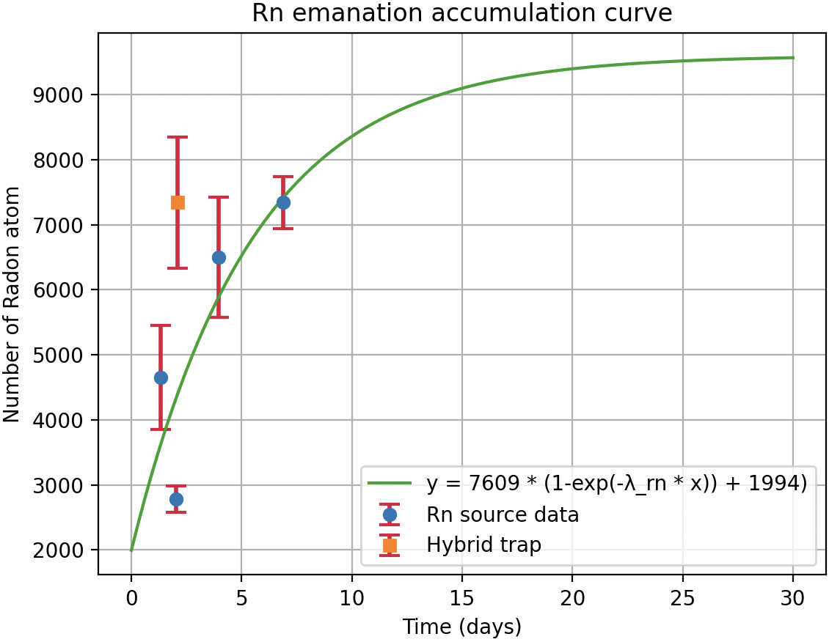
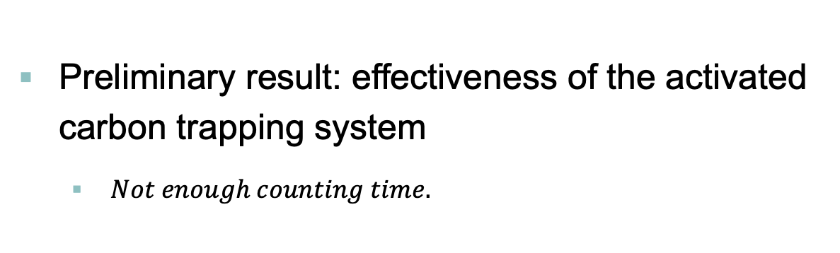
Annex
Preliminary result: effectiveness of the activated carbon trapping system
  $Not enough counting time.$

Slide 18
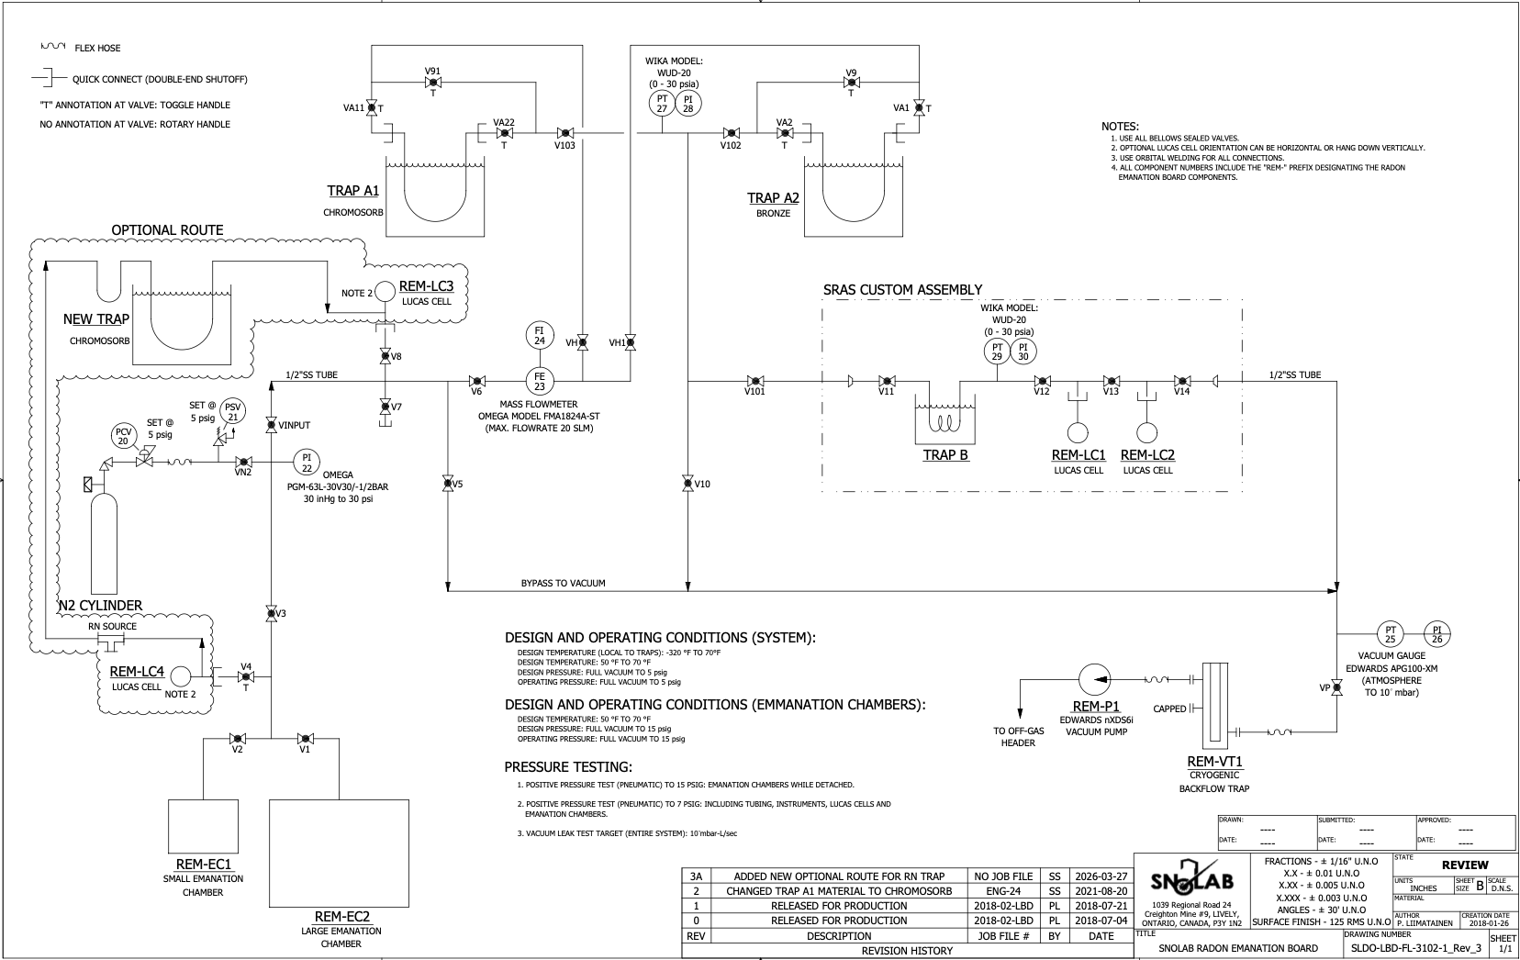
Annex

