Slide 1
2026/07/22
Improving SNOLAB Radon counting sensitivity with low-background ZnS
Peter Qin (He/Him)
Research Assistant

Slide 2
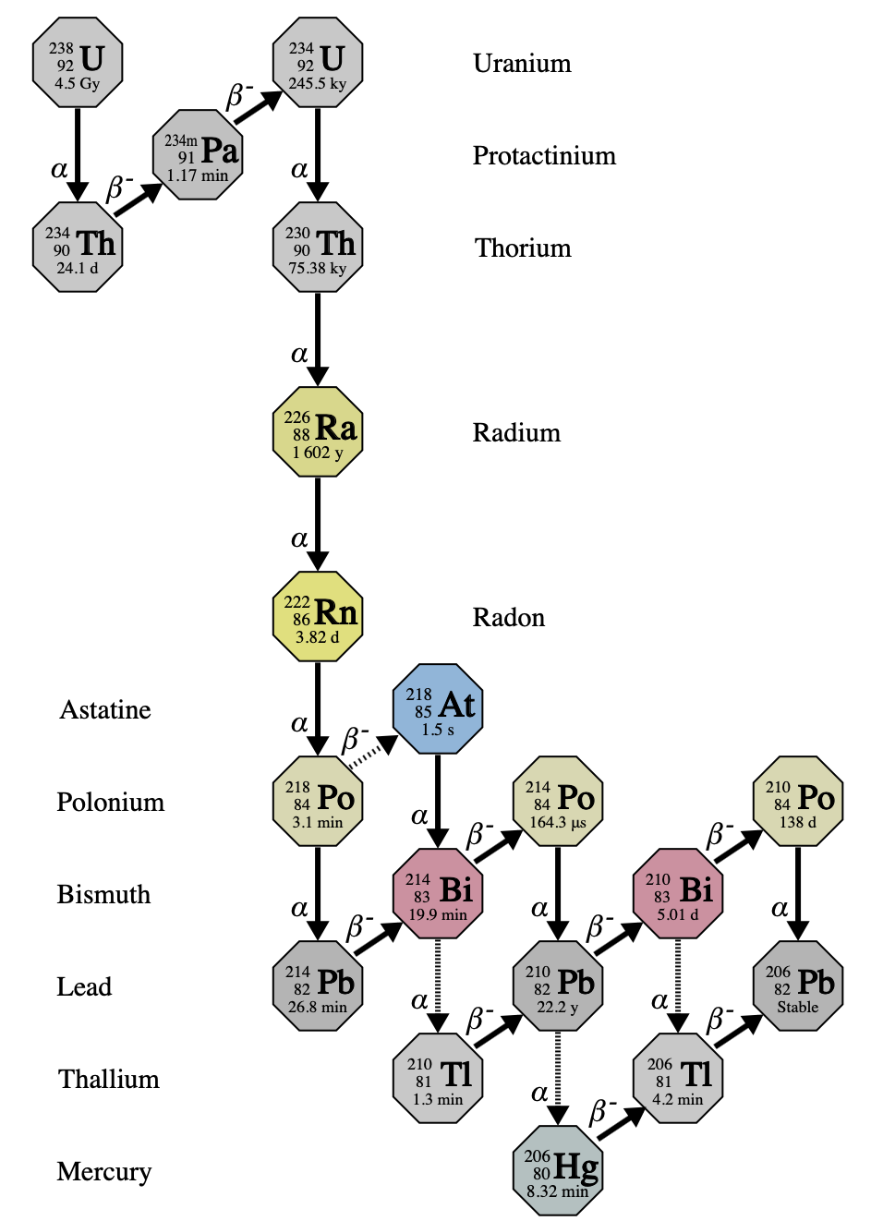
²³⁸U chain and ²²²Rn
Notes:
I’d like to begin my presentation with a bit of background on Radon-222, the first gaseous member of the U-238 chain. You have heard this already, but it cannot be overstated - Radon is a perennial problem for low-background science. Why?

Slide 3
²³⁸U chain and ²²²Rn
Abundant underground
Notes:
Firstly, Uranium-238 and therefore radon are found everywhere, but are especially common underground, which presents a problem to low-background physics which might want to make use of overburden as background reduction

Slide 4
²³⁸U chain and ²²²Rn
Abundant underground
Background to rare-event searches
Notes:
Second, Radon daughters contribute direct background to rare event searches at SNOLAB including for 0vbb and WIMP DM

Slide 5
²³⁸U chain and ²²²Rn
Abundant underground
Background to rare-event searches
Gaseous
Notes:
Thirdly, Radon being gaseous means it is highly mobile, it emanates from surfaces and can migrate distances and can ingress into any volumes that are not completely leaktight

Slide 6
Radon control is a priority for low-background science
Notes:
So for these reasons Radon control is a priority for low-background science. And we know this to be true - I count on the CAP congress indico seven contributed talks and 1 invited talk today all on Radon.

Slide 7
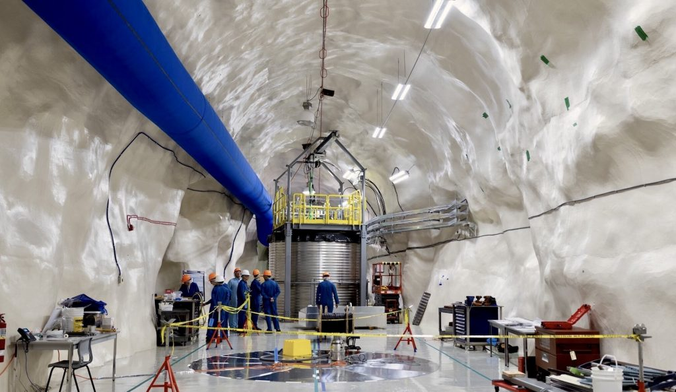
Radon control at SNOLAB
Lab infrastructure
Notes:
At SNOLAB, Canada’s deep underground research facility, we host the most sensitive rare physics searches – meaning we have a mandate for radon control. The lab therefore is built around it – we maintain a class 2000 cleanroom to prevent uranium-containing rock dust from getting in, and the cavern walls are coated with material to reduce radon emanation from surrounding rock.

Slide 8
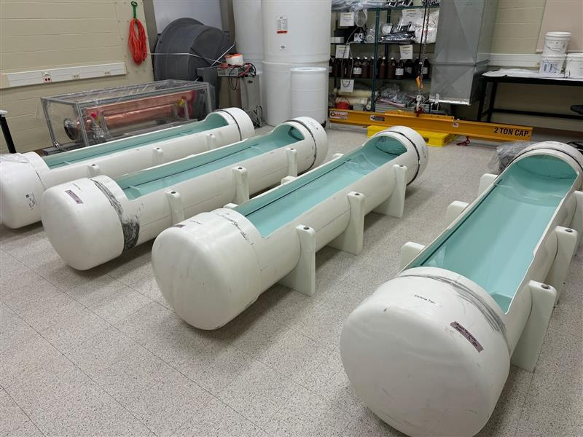
Radon control at SNOLAB
Lab infrastructure
Surface prep (etching/passivation)
Notes:
We conduct materials treatment processes for experiments, including acid etching and passivation of surfaces to deal with radon plate-out

Slide 9
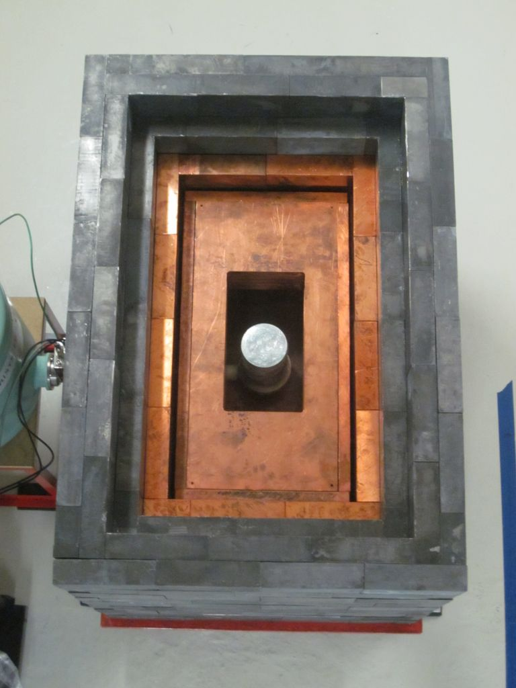
Radon control at SNOLAB
Lab infrastructure
Cleanroom fabrication, surface prep (etching/passivation)
Materials screening program (ICP-MS, HPGe, XIA, etc.)
Notes:
And we host a comprehensive materials screening program, with capabilities like HPGe counting, ICPMS, and XIA

Slide 10
The SNOLAB Radon Assay
Notes:
But the technique this talk focuses on is the SNOLAB radon assay

Slide 11
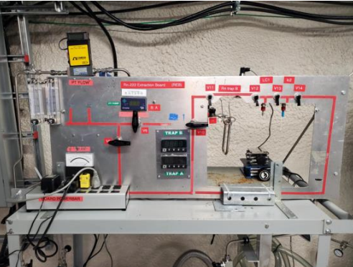
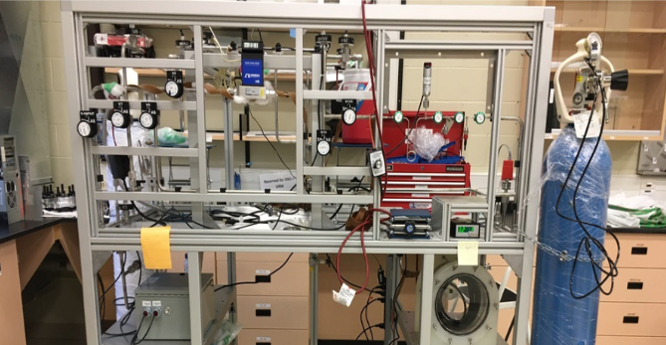
Radon assays
Concentrator trap
Port to scintillator cell
Primary trap
Primary trap
Concentrator trap
Port to scintillator cell
Notes:
This is highly sensitive system for measuring radon out of solid, liquid and gas samples. As a quick recap, radon is cryogenically trapped by adsorption onto charcoal or bronze wool traps and then cryopumped into a concentrator trap, and from there transferred into Lucas cells, which are scintillating alpha counters.

Slide 12
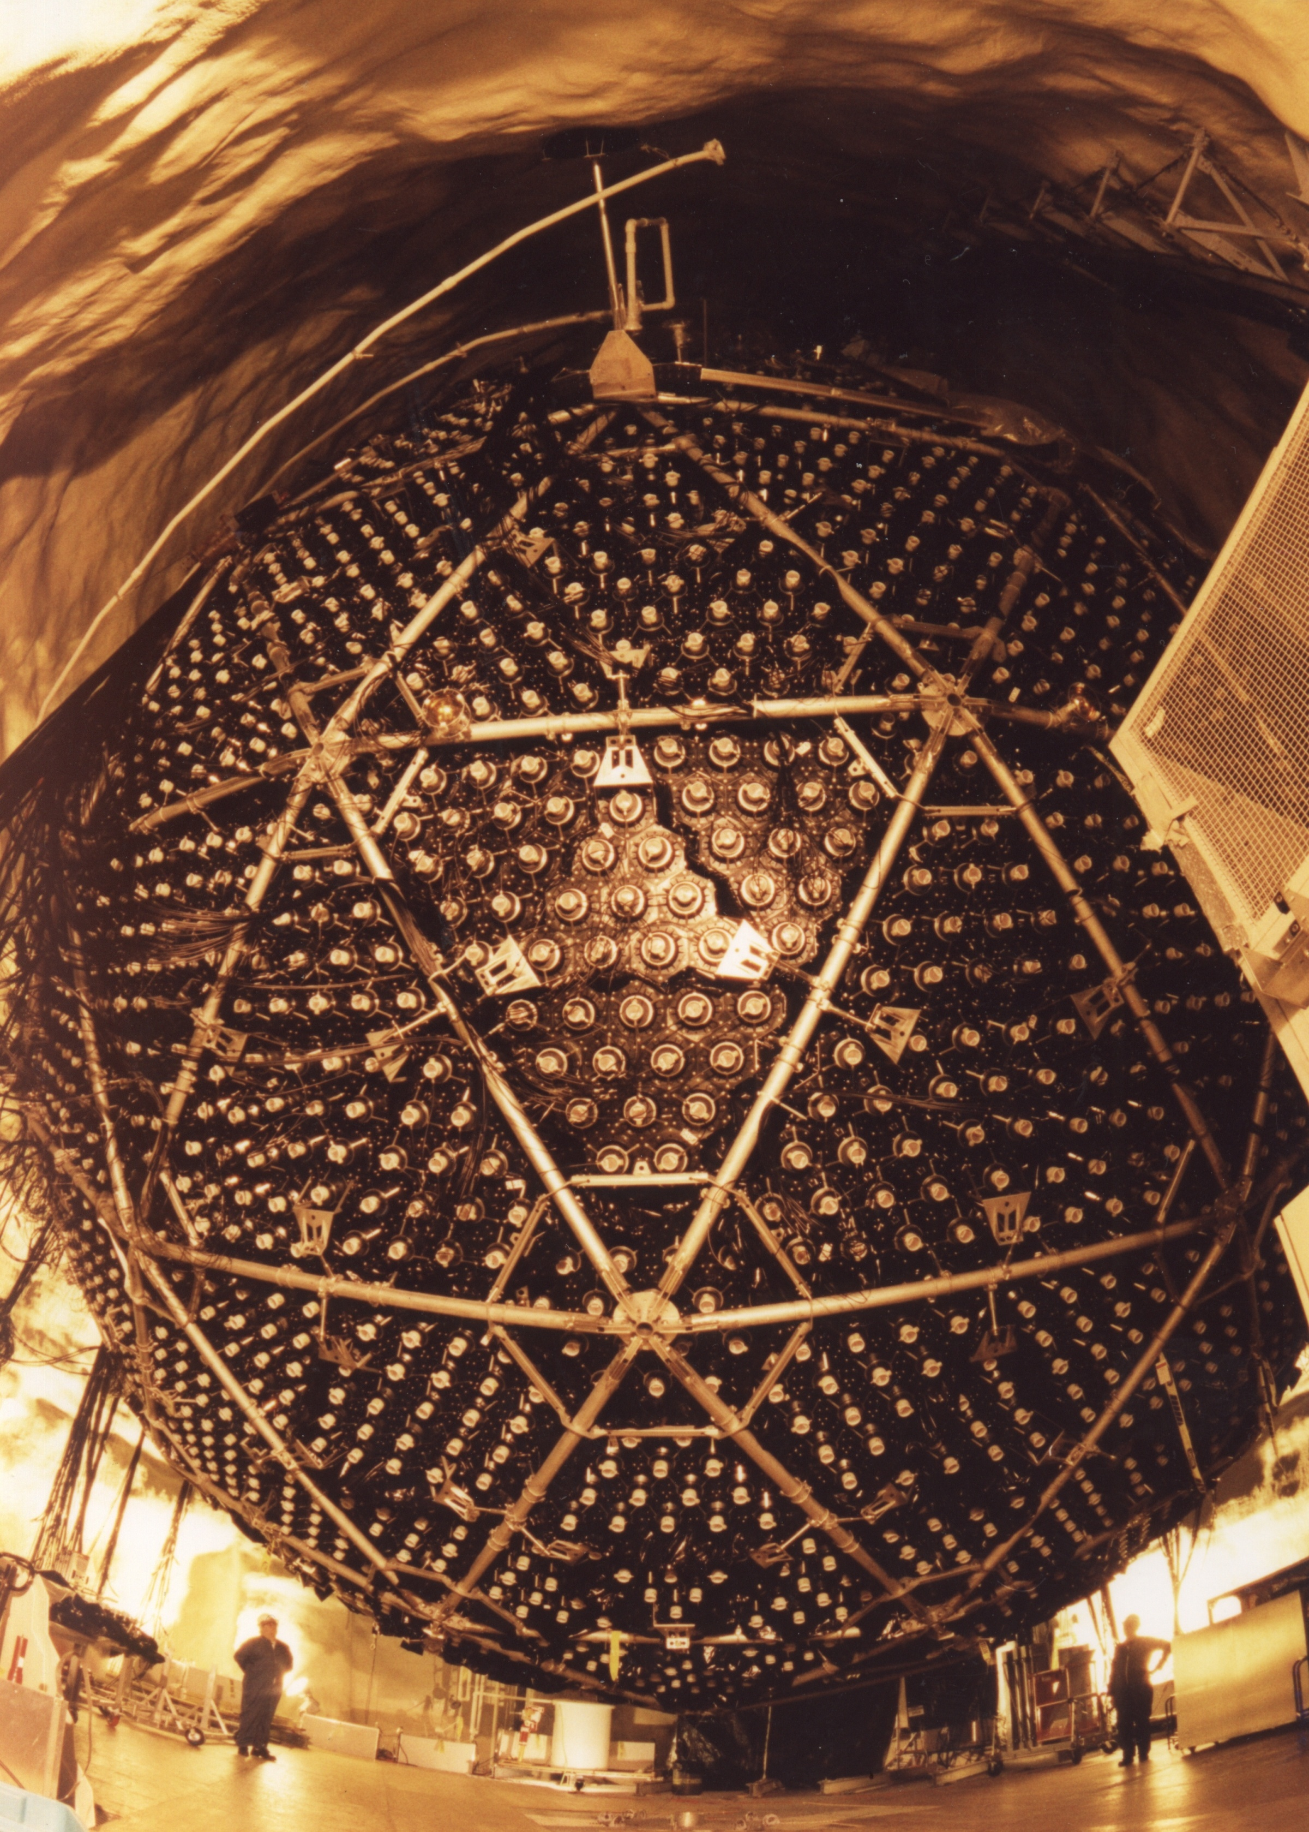
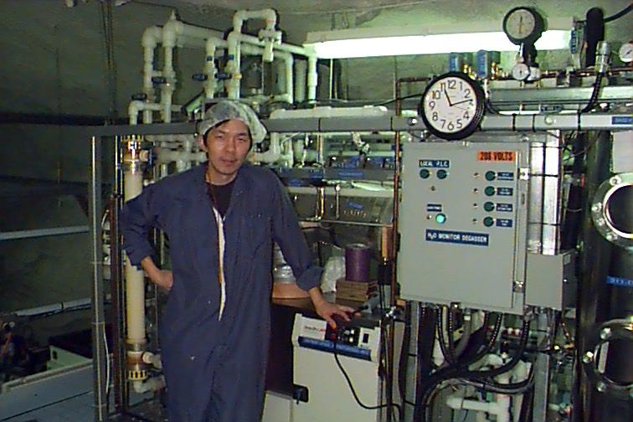
Origin of the SNOLAB Rn assay
Technique developed ~1991
Used during SNO for radon emanation of solids and radon measurement in UPW
Credit: SNO
Credit: SNO
Notes:
The technique dates back to the SNO experiment, which along with Super K discovered neutrino oscillation and solved the solar neutrino problem. There, it was used for materials screening to measure radon emanation of materials, and also for assays of the cavity water.

Slide 13
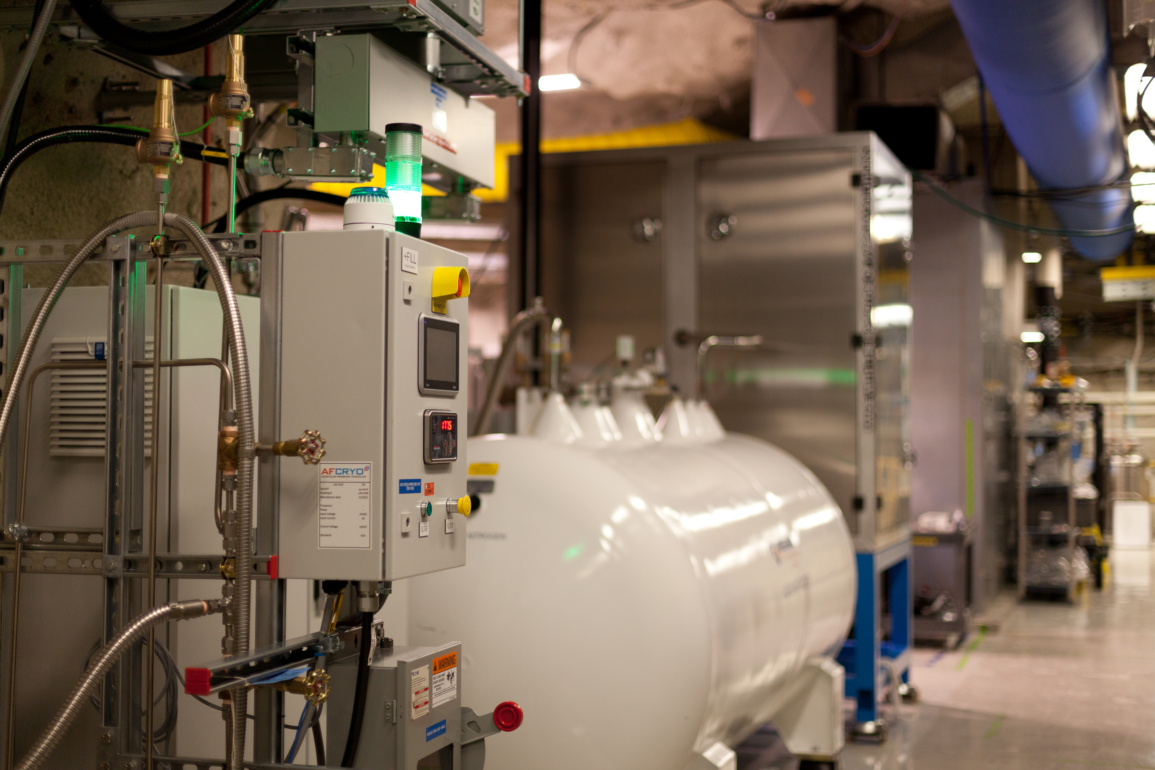
Current state of the Radon assay
Mobile board was recommissioned in 2019
Used by SNO+ for assays of cover gas, UPW
Measurements of SNOLAB LN2 plant
Radon emanation as part of SNOLAB low-background counting facility
Notes:
When SNOLAB and SNO+ were established, they inherited the technique, with SNO+ repurposing the emanation board for assays of its new cover gas system, and continuing the use of the UPW assay system. At SNOLAB, it is also used to sample the nitrogen distilled by our liquid nitrogen plant, and functions as part of the SNOLAB low-background counting facility, which is open not just to SNOLAB experiments but to the wider scientific community as well.

Slide 14
Experiments using Rn emanation results
SNO+
CUTE
DAMIC
DarkSide
DEAP-3600
DM-Ice
XLZD

Slide 15
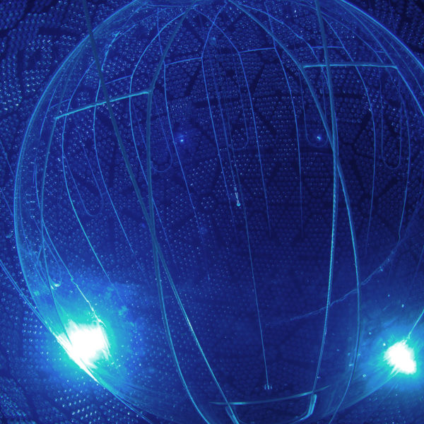
Experiments using Rn emanation results
SNO+
CUTE
DAMIC
DarkSide
DEAP-3600
DM-Ice
XLZD

Slide 16
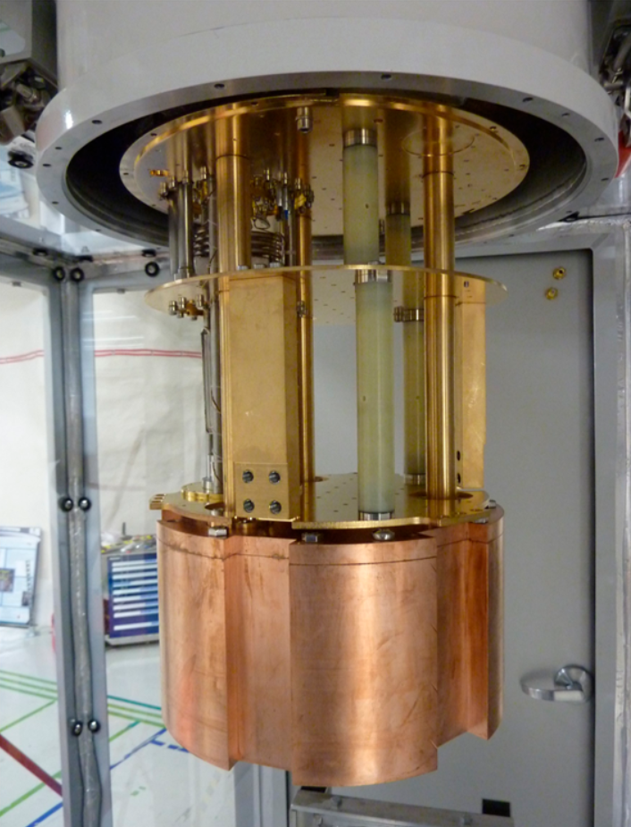
Experiments using Rn emanation results
SNO+
CUTE
DAMIC
DarkSide
DEAP-3600
DM-Ice
XLZD

Slide 17
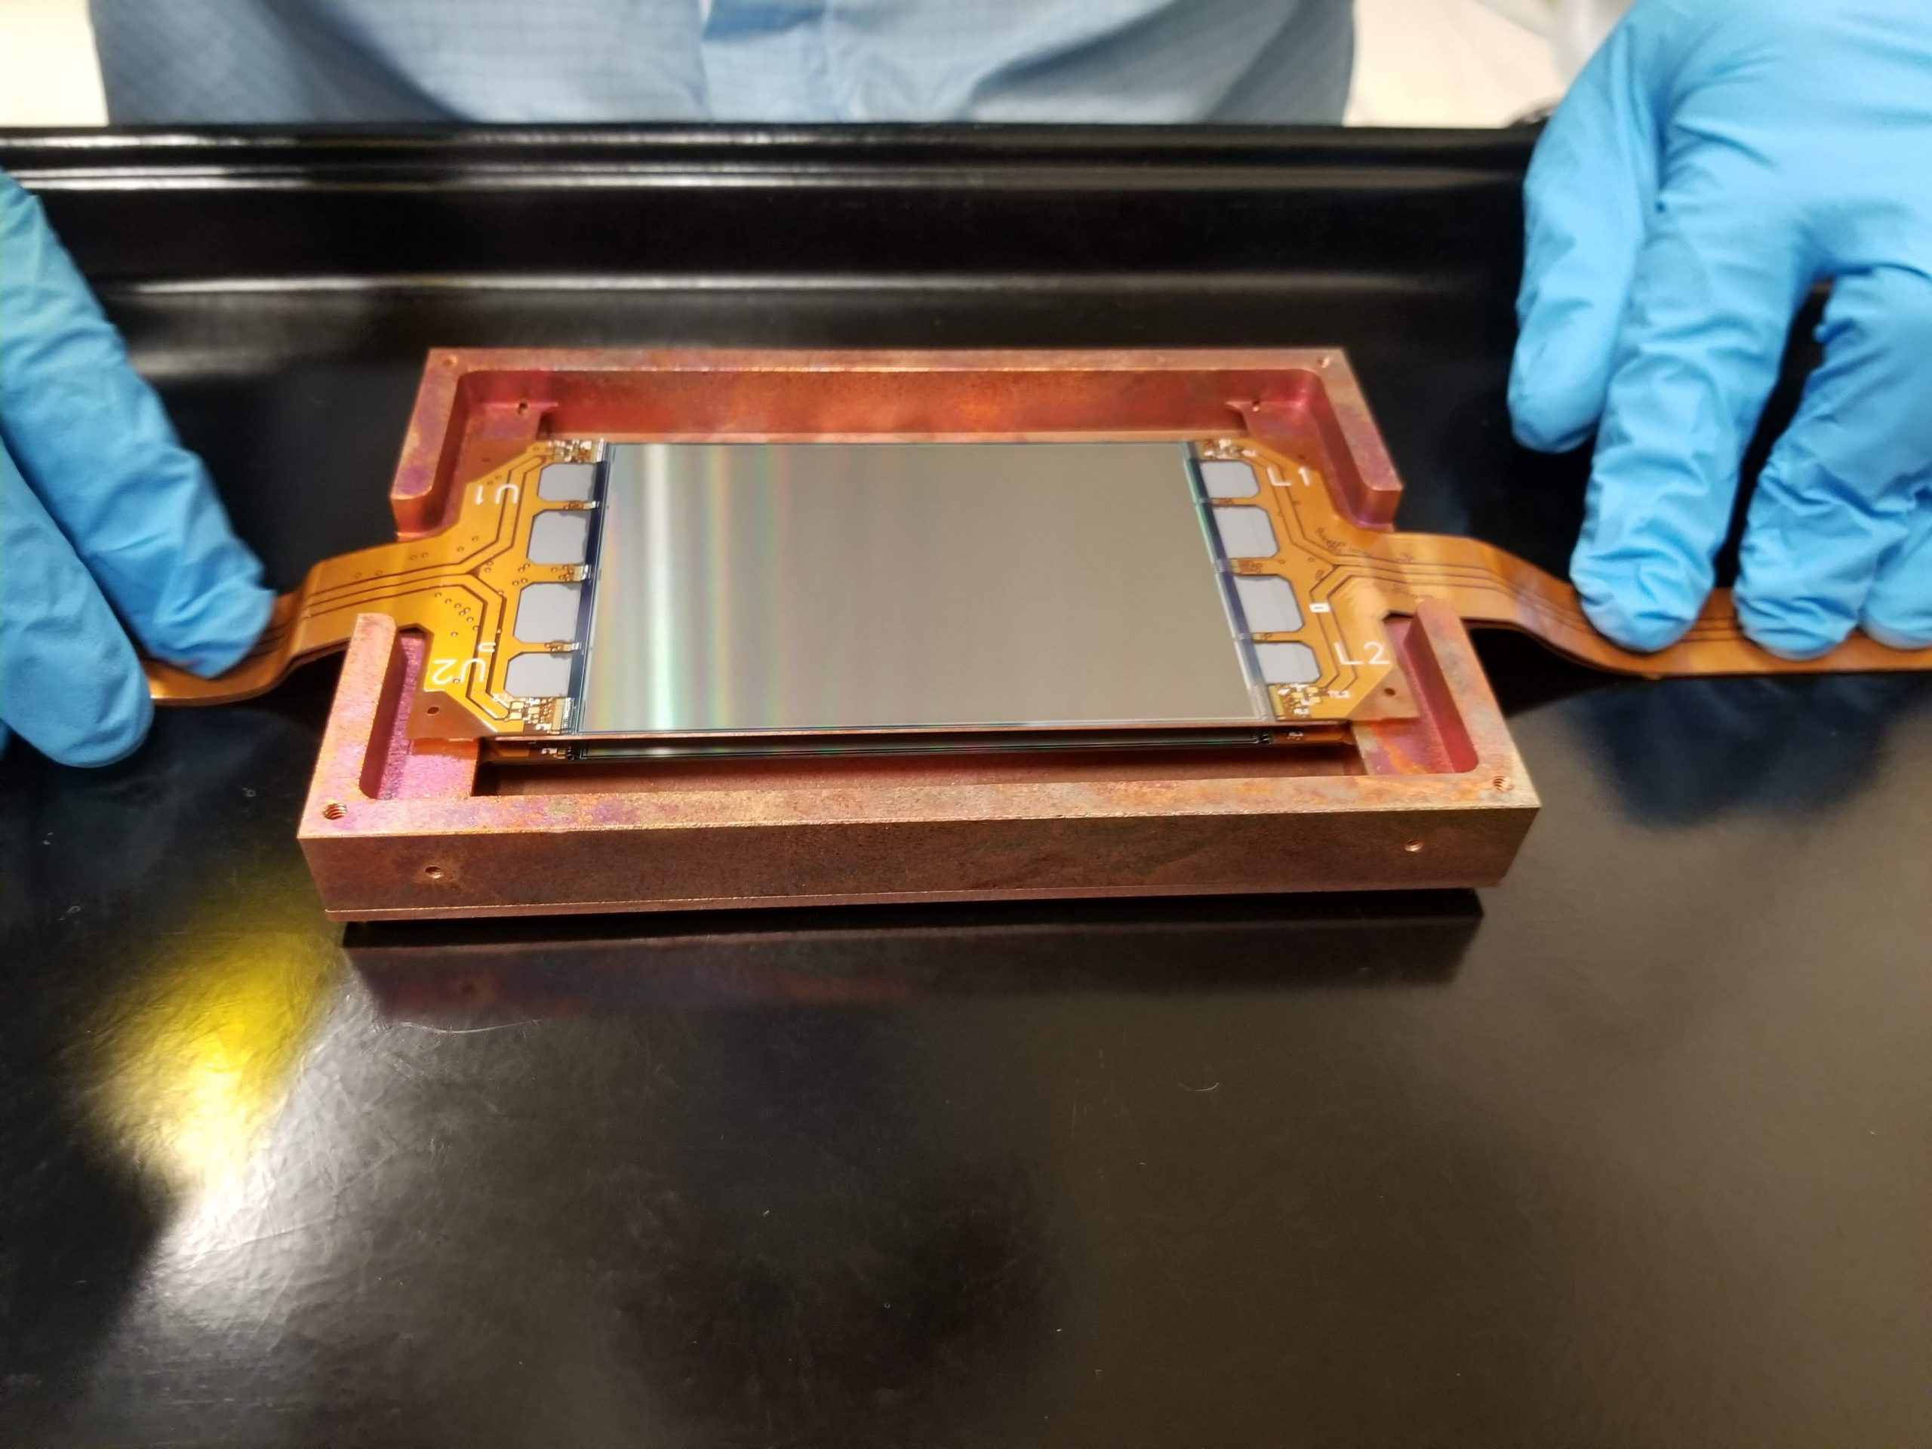
Experiments using Rn emanation results
SNO+
CUTE
DAMIC
DarkSide
DEAP-3600
DM-Ice
XLZD

Slide 18
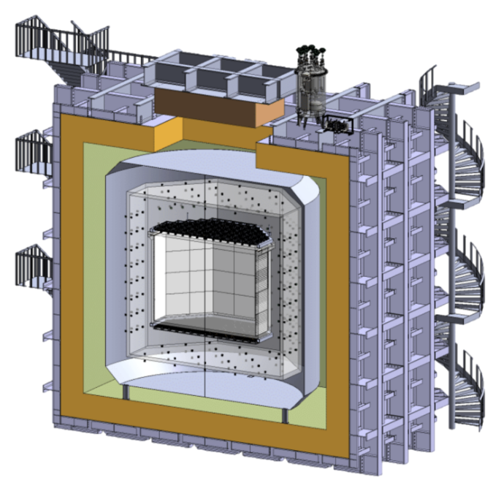
Experiments using Rn emanation results
SNO+
CUTE
DAMIC
DarkSide
DEAP-3600
DM-Ice
XLZD

Slide 19
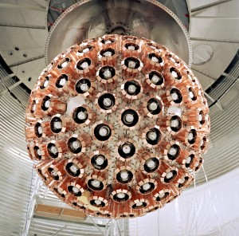
Experiments using Rn emanation results
SNO+
CUTE
DAMIC
DarkSide
DEAP-3600
DM-Ice
XLZD

Slide 20
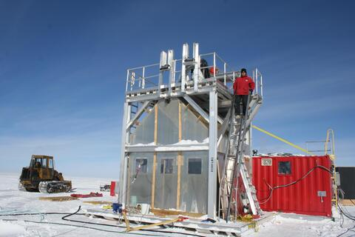
Experiments using Rn emanation results
SNO+
CUTE
DAMIC
DarkSide
DEAP-3600
DM-Ice
XLZD

Slide 21
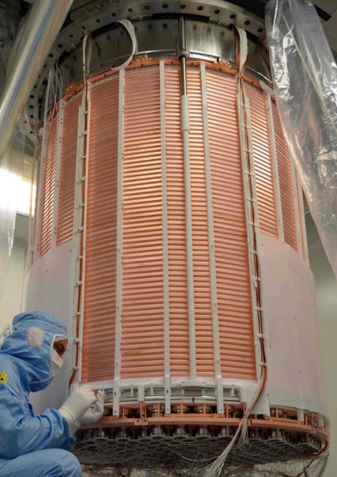
Experiments using Rn emanation results
SNO+
CUTE
DAMIC
DarkSide
DEAP-3600
DM-Ice
XLZD

Slide 22
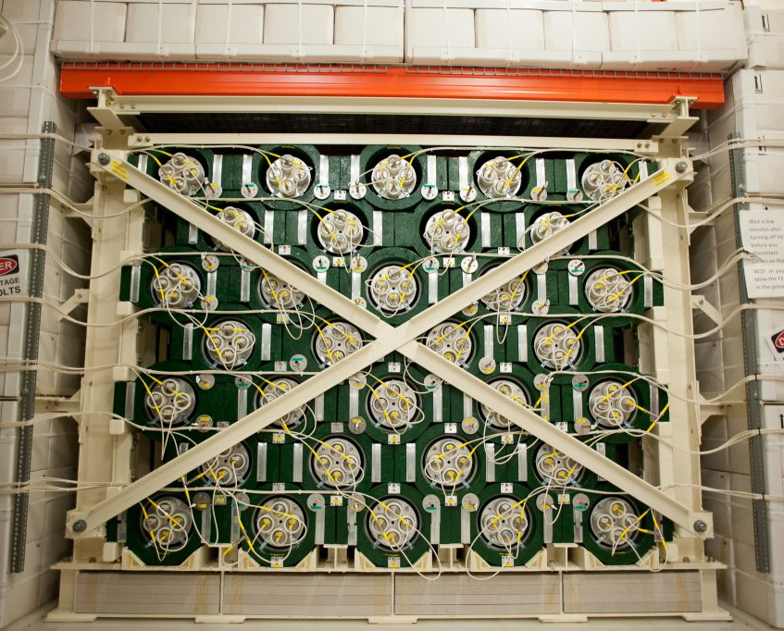
Experiments using Rn emanation results
SNO+
CUTE
DAMIC
DarkSide
DEAP-3600
DM-Ice
XLZD
HALO
NEWS-G
PICO
REPAIR
SBC
SENSEI
SuperCDMS

Slide 23
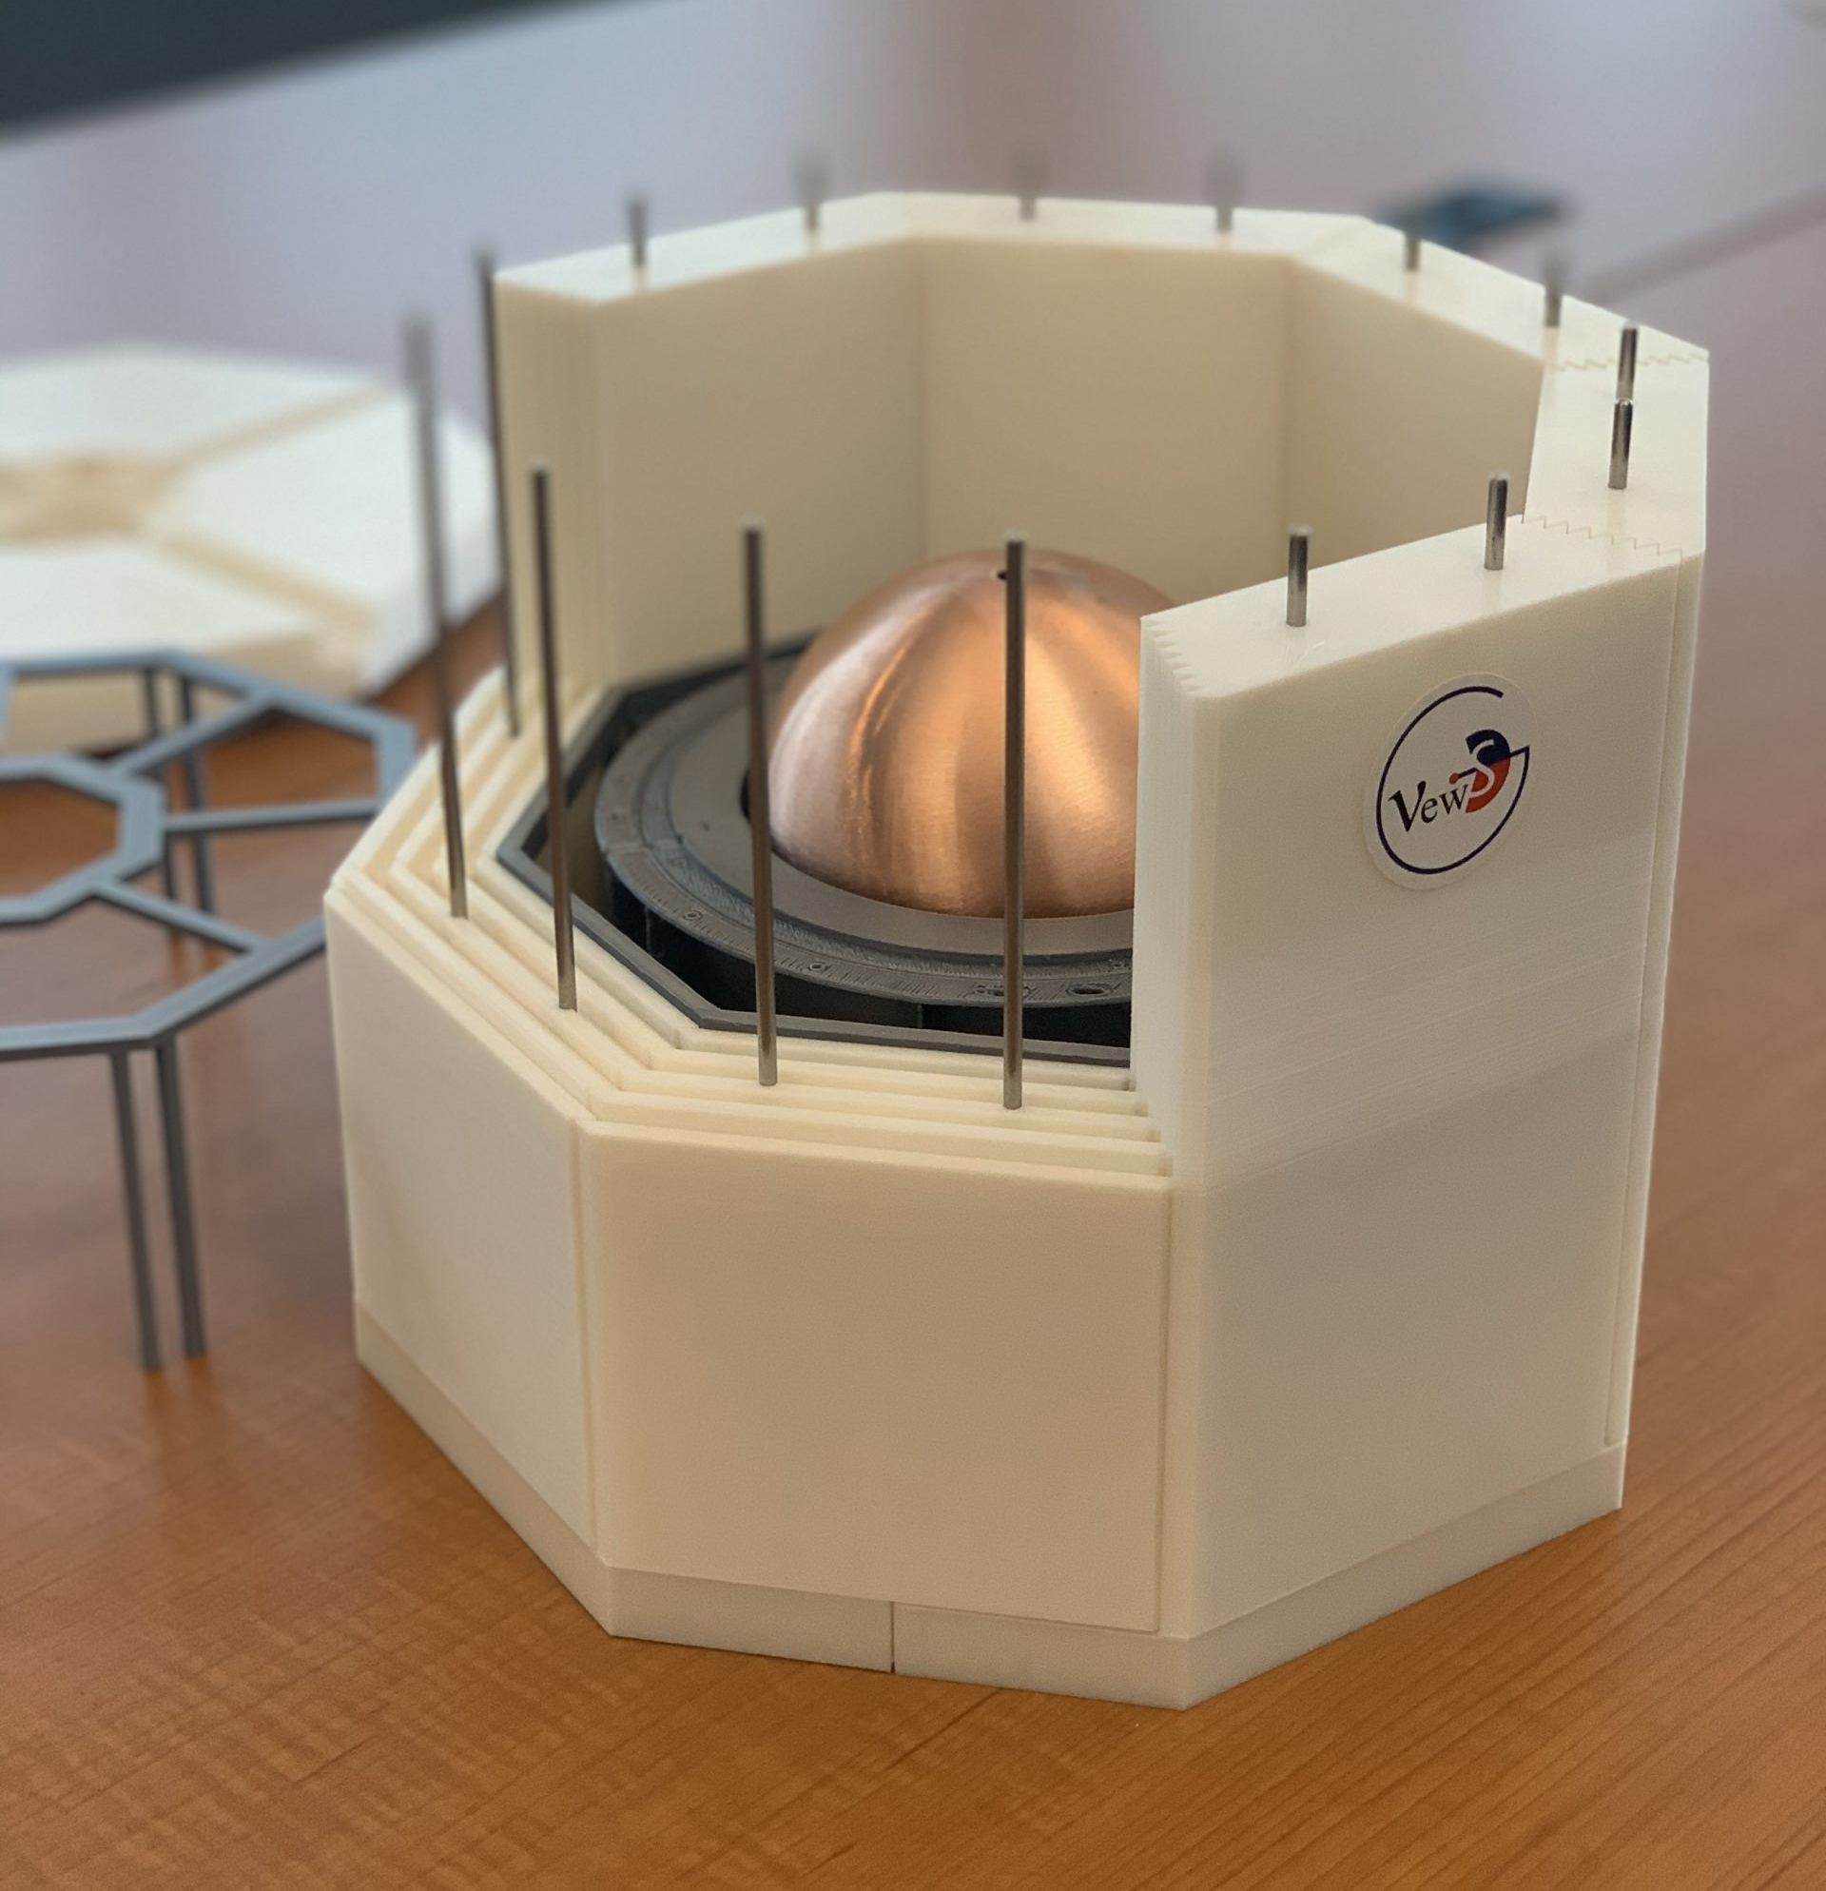
Experiments using Rn emanation results
SNO+
CUTE
DAMIC
DarkSide
DEAP-3600
DM-Ice
XLZD
HALO
NEWS-G
PICO
REPAIR
SBC
SENSEI
SuperCDMS

Slide 24
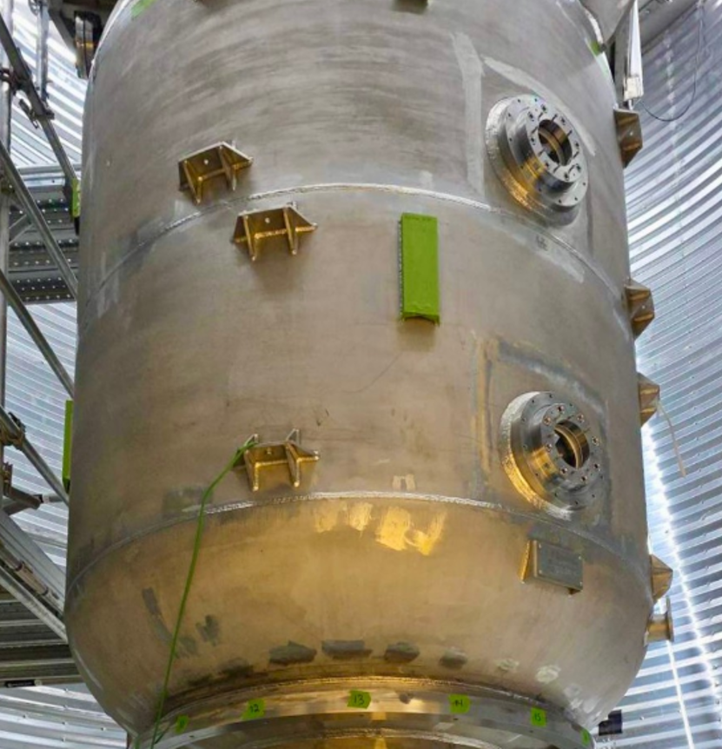
Experiments using Rn emanation results
SNO+
CUTE
DAMIC
DarkSide
DEAP-3600
DM-Ice
XLZD
HALO
NEWS-G
PICO
REPAIR
SBC
SENSEI
SuperCDMS

Slide 25
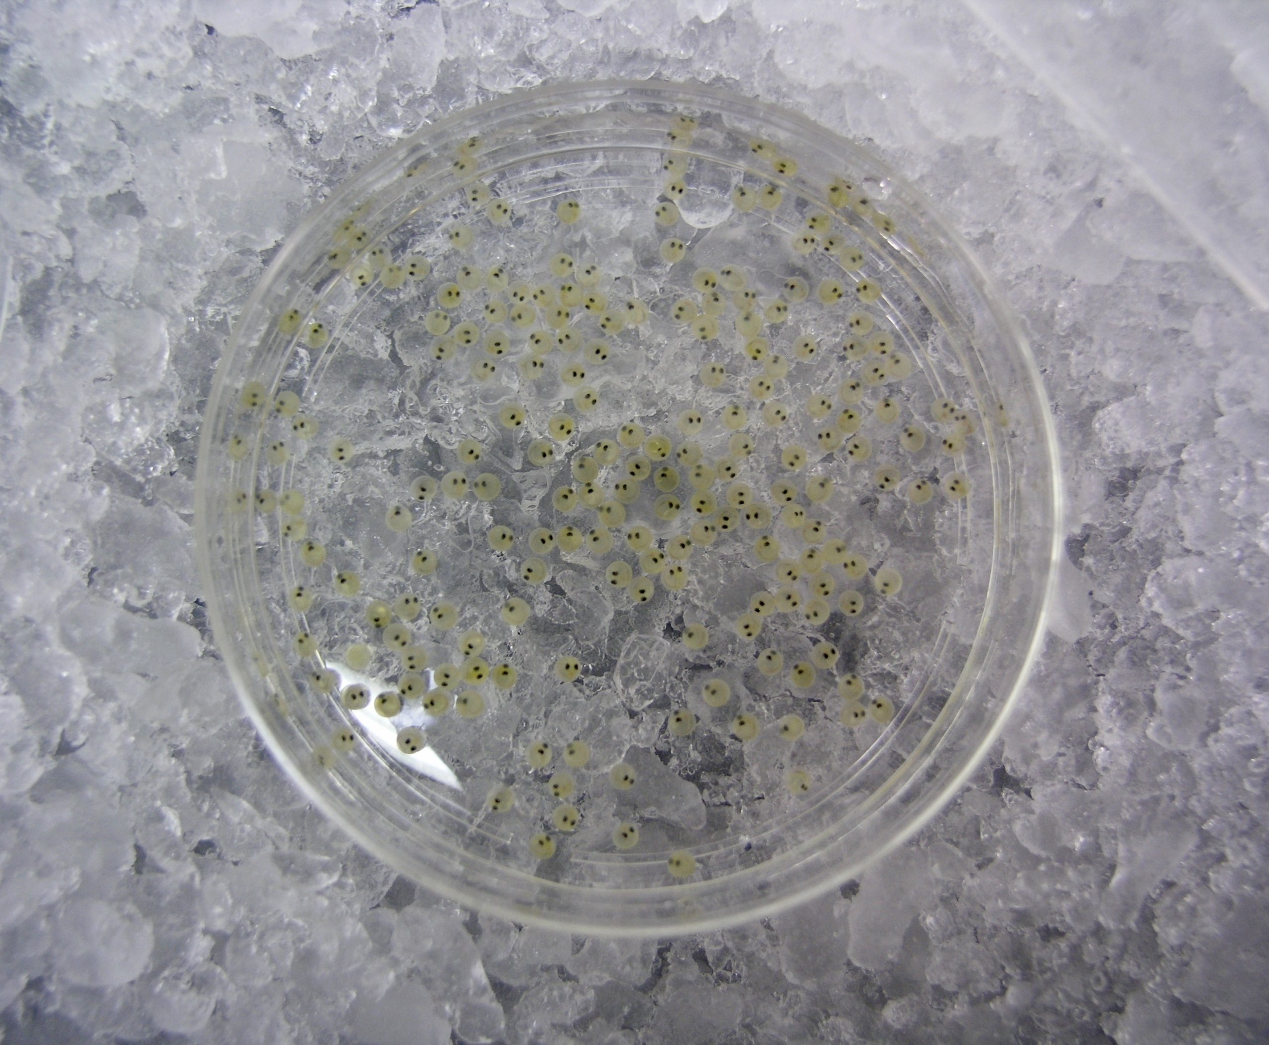
Experiments using Rn emanation results
SNO+
CUTE
DAMIC
DarkSide
DEAP-3600
DM-Ice
XLZD
HALO
NEWS-G
PICO
REPAIR
SBC
SENSEI
SuperCDMS

Slide 26
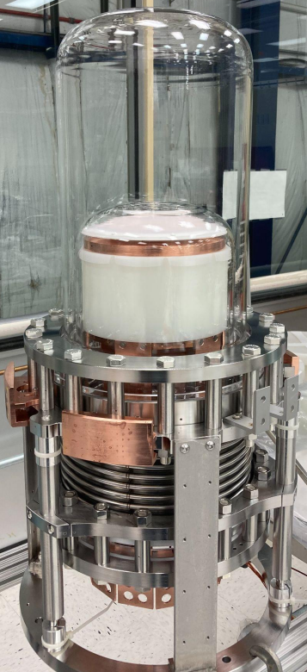
Experiments using Rn emanation results
SNO+
CUTE
DAMIC
DarkSide
DEAP-3600
DM-Ice
XLZD
HALO
NEWS-G
PICO
REPAIR
SBC
SENSEI
SuperCDMS

Slide 27
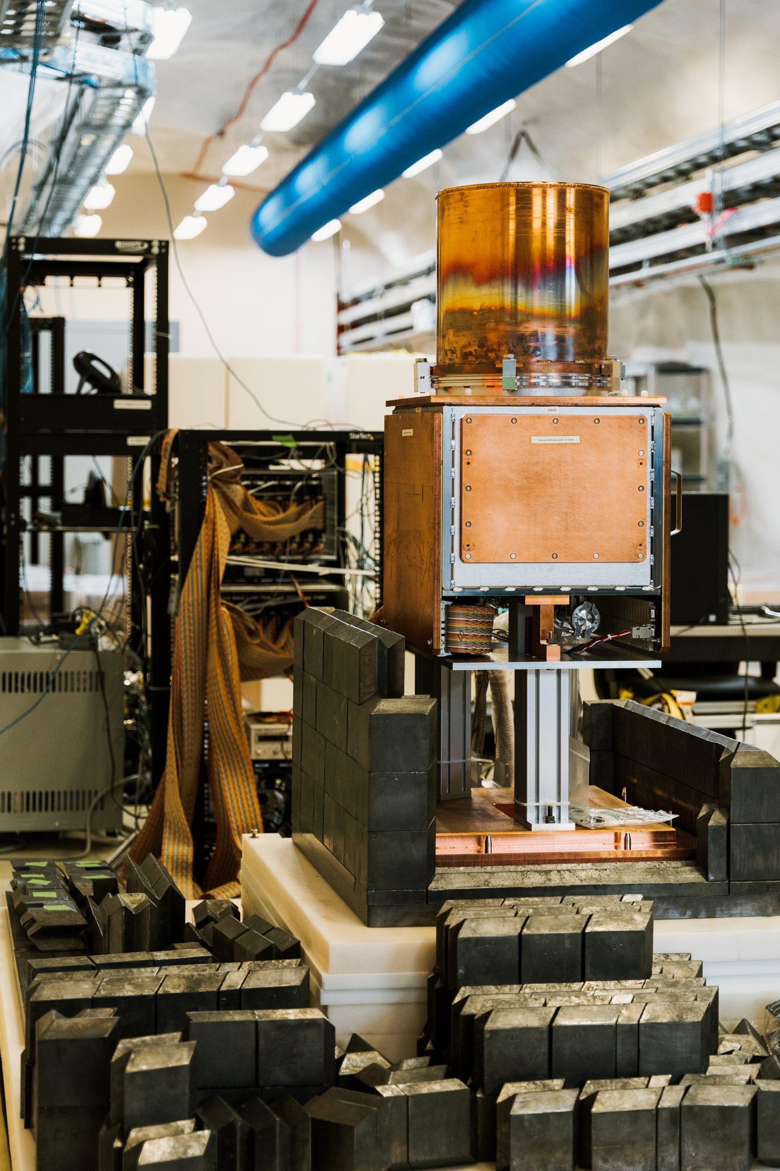
Experiments using Rn emanation results
SNO+
CUTE
DAMIC
DarkSide
DEAP-3600
DM-Ice
XLZD
HALO
NEWS-G
PICO
REPAIR
SBC
SENSEI
SuperCDMS

Slide 28
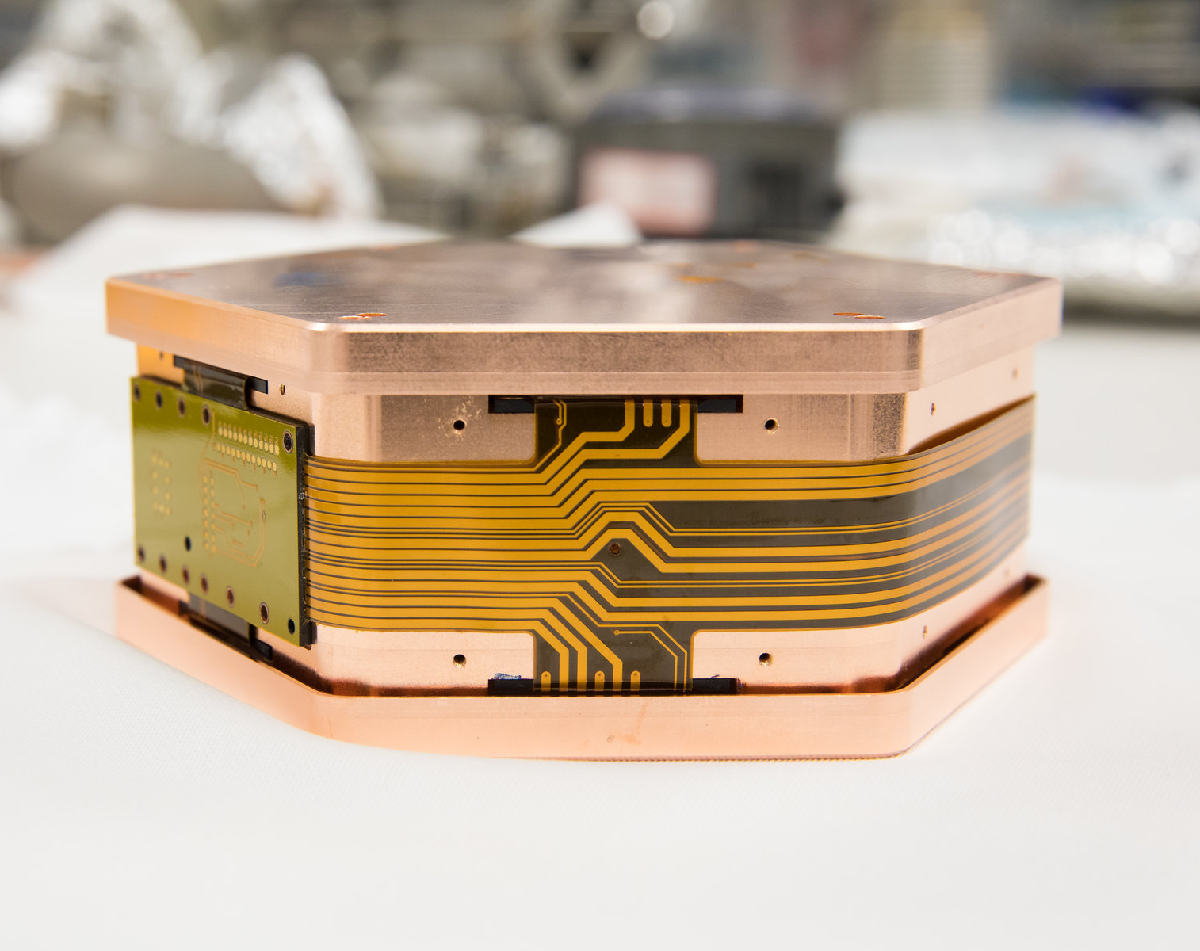
Experiments using Rn emanation results
SNO+
CUTE
DAMIC
DarkSide
DEAP-3600
DM-Ice
XLZD
HALO
NEWS-G
PICO
REPAIR
SBC
SENSEI
SuperCDMS

Slide 29
Experiments using Rn emanation results
SNO+
CUTE
DAMIC
DarkSide
DEAP-3600
DM-Ice
XLZD
HALO
NEWS-G
PICO
REPAIR
SBC
SENSEI
SuperCDMS
Improvements to SNOLAB Rn counting have far-reaching benefits for low-background science!

Slide 30
Maintaining and improving the Radon assay capability is a priority for SNOLAB
Notes:
Because of this, maintaining and developing the radon assay capability is a priority for SNOLAB. And this is what has motivated the R&D for the project I am talking about today

Slide 31
Improved sensitivity Rn assays
Notes:
Which is improving the sensitivity of the radon assay. Right now, the radon assay can count the presence of just a few atoms of radon. But meeting the zero-background requirements of next generation physics experiments requires taking that sensitivity even further.

Slide 32
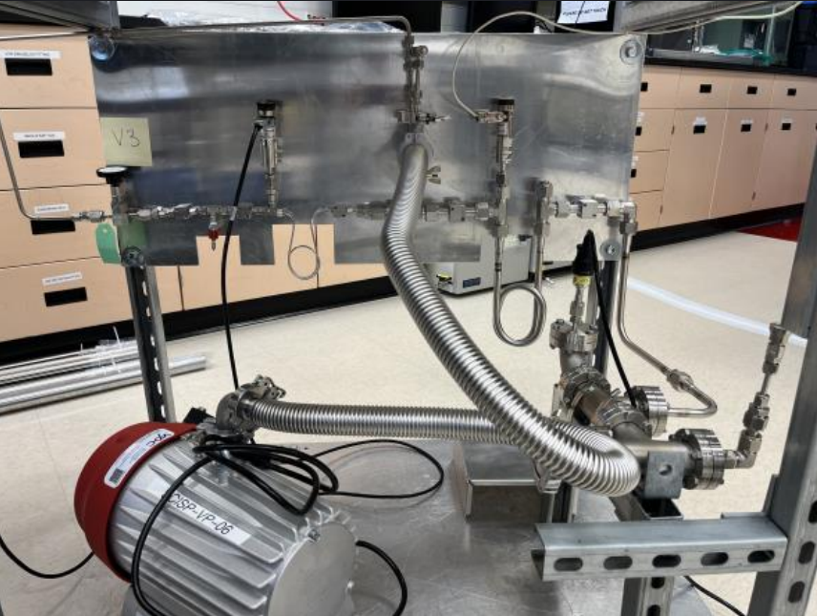
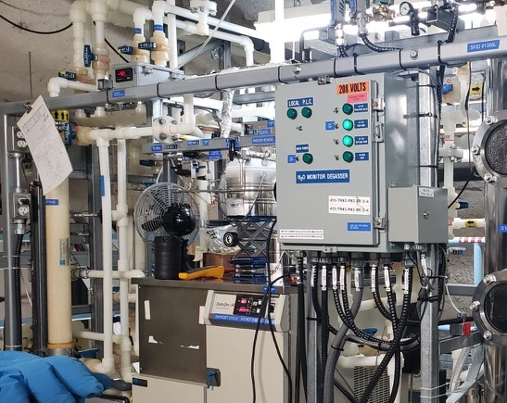
Four radon boards…
SNOLAB surface lab radon board
Underground mobile radon assay board
DEAP-3600 radon board
SNO+ UPW plant radon board
Notes:
SNOLAB has four of these radon boards, which are known to emanate a negligible amount of radon over the length of an assay.

Slide 33
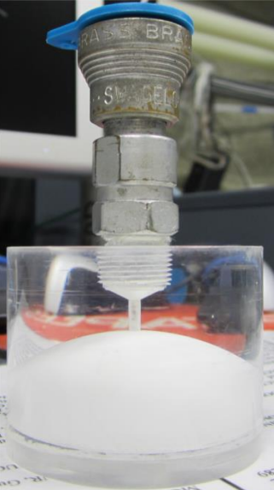
One Lucas cell!
Notes:
What they all share in common is use of the Lucas cell. So that is where we have focused our efforts in background reduction.

Slide 34
What are Lucas cells?
Scintillator alpha counter
ZnS(Ag)-coated inner volume stores Rn
Used to count decays of Rn atoms trapped using assays
Notes:
I’ll now properly introduce the Lucas cell - Lucas cells are a type of scintillator counter. They consist of a cylindrical acrylic body holding a gas sample, with that internal volume coated with silver-activated zinc sulfide which is an inorganic scintillator sensitive to alphas. As mentioned, they are used in the radon assay method to count trapped atoms.

Slide 35
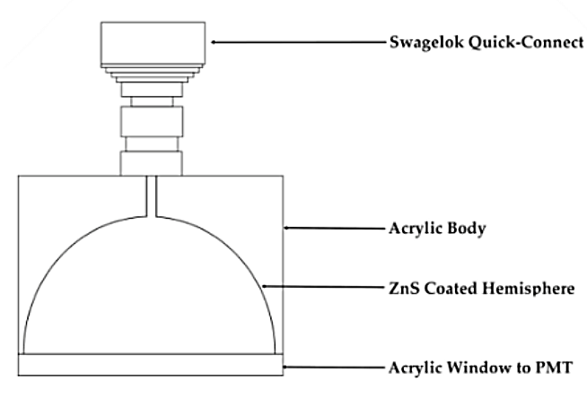
Principle of operation
Rn-222
PMT
Notes:
Radon enters a Lucas cell at the end of an assay and is coupled to a PMT.

Slide 36
Principle of operation
α
Po-218
PMT
Notes:
Radon undergoes an alpha decay (in reality, it’s three in quick-succession) and the emitted alpha incident on the ZnS coating deposits its energy

Slide 37
Principle of operation
PMT
Notes:
The ZnS emits scintillation light which is read out by the PMT

Slide 38
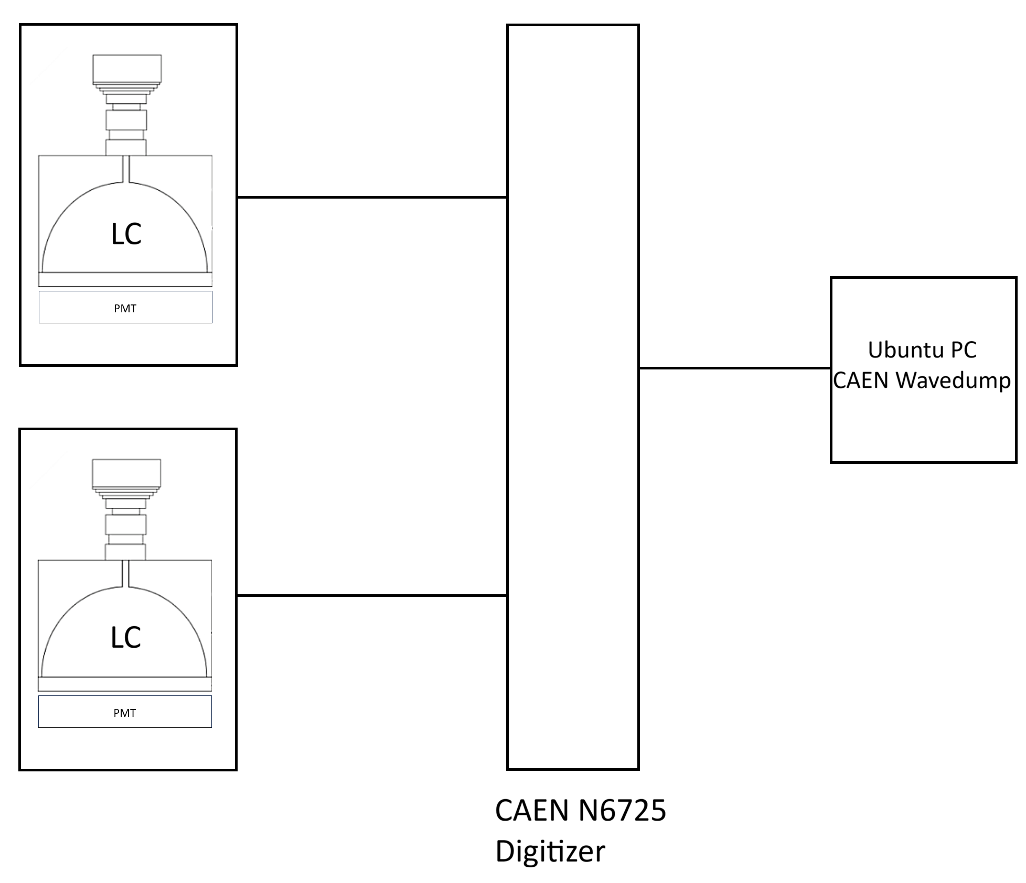
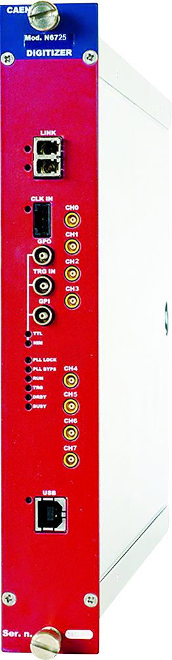
Principle of operation
Dark box
Notes:
The PMT electronic signal is digitized with a CAEN N6725 digitizer and processed with CAEN readout software

Slide 39
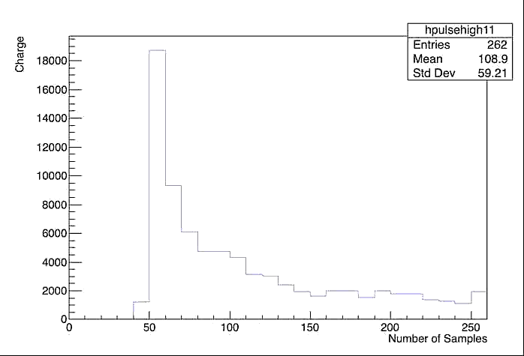
Principle of operation
Dark box
Notes:
Producing events which look like this, this is a real sample alpha trace, which is a charge time series

Slide 40
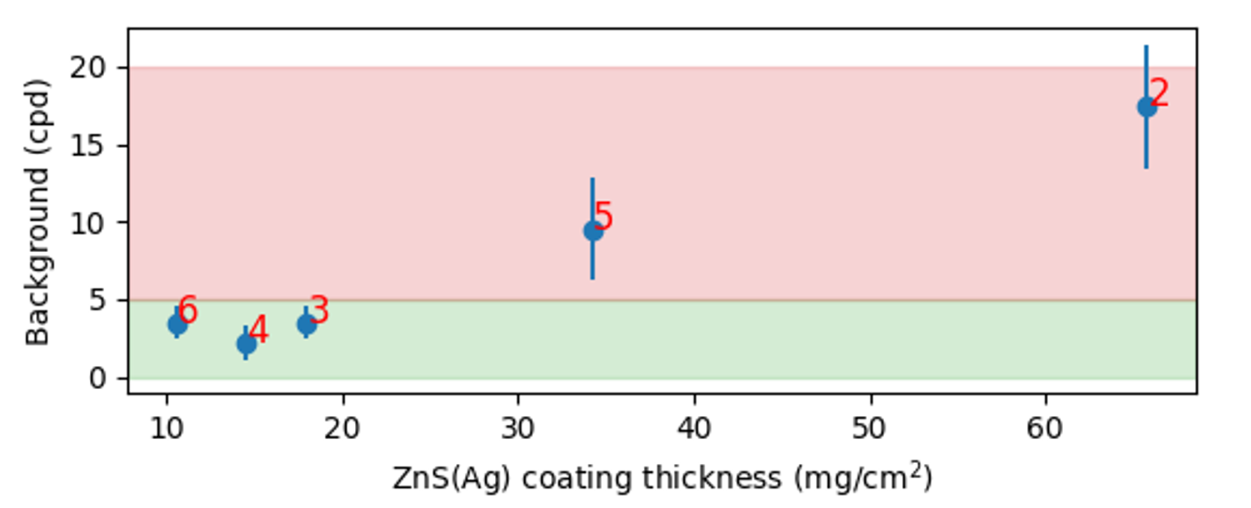
Lucas cell backgrounds
Radon assays are background limited by Lucas cells!
Intrinsic background due to Lucas cell materials
ZnS scintillator is greatest background contributor in Lucas cells
Current Lucas cells use most radiopure ZnS commercially available
Notes:
As I’ve mentioned, the Radon assay is background-limited by Lucas cells. Our Lucas cells have a baseline floor of about 3-4 alphas of background per day simply from the activity of the materials used in them. As I’ve described however, the Lucas cell has few components, so by gamma counting the acrylic, acrylic bonder and Swagelok components, we were able to determine that the Zinc Sulfide scintillator is responsible for this background. But this conclusion leads to another problem – there is no lower background Zinc sulfide on the market which we can use to product lower-background Lucas cells.

Slide 41
Can we produce our own low-background ZnS?
Notes:
But this supposed dead end has lead to our research question: we’re already capable of fabricating Lucas cells at SNOLAB - we can machine, coat, tap and bond the acrylic ourselves. Can we produce our own ZnS with reduced background too?

Slide 42
Selective precipitation of ²³⁸U chain impurities
We can selectively precipitate Zinc Sulfide from solution while leaving behind ²³⁸U chain impurities
Log(ZnS K_{sp}) ≈ -22
Log(PbS K_{sp}) ≈ -28
Log(U(IV)O₂ K_{sp} )≈ -53
42
Notes:
With the help of chemistry expertise at SNOLAB, we devised a method based on existing literature to produce zinc sulfide and selectively precipitate out compounds containing lead and uranium, long-lived u-238 chain isotopes, by making use of their different solubility constants. Since ZnS has the highest solubility constant, it will precipitate last – by precipitating a little bit of our product and discarding it, we can ensure that lead and uranium are left behind.

Slide 43






Preliminary ZnS synthesis
Notes:
I prepared an animation to demonstrate the process of the main precipitation reaction we use to produce ZnS. Two solutions of Zinc acetate and sodium sulfide in UPW are prepared, each dissociates into its constituent ions

Slide 44
Notes:
The two solutions are then mixed

Slide 45

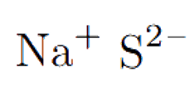


Pb(II), U(IV)
Notes:
Upon mixing a double displacement reaction occurs forming aqueous sodium acetate and with zinc sulfide precipitating out. by performing this step in two stages that we can discard impurities. Afterwards, we anneal the zinc sulfide with silver at 900C to dope it.

Slide 46

Notes:
Upon mixing a double displacement reaction occurs forming aqueous sodium acetate and with zinc sulfide precipitating out. by performing this step in two stages that we can discard impurities. Afterwards, we anneal the zinc sulfide with silver at 900C to dope it.

Slide 47
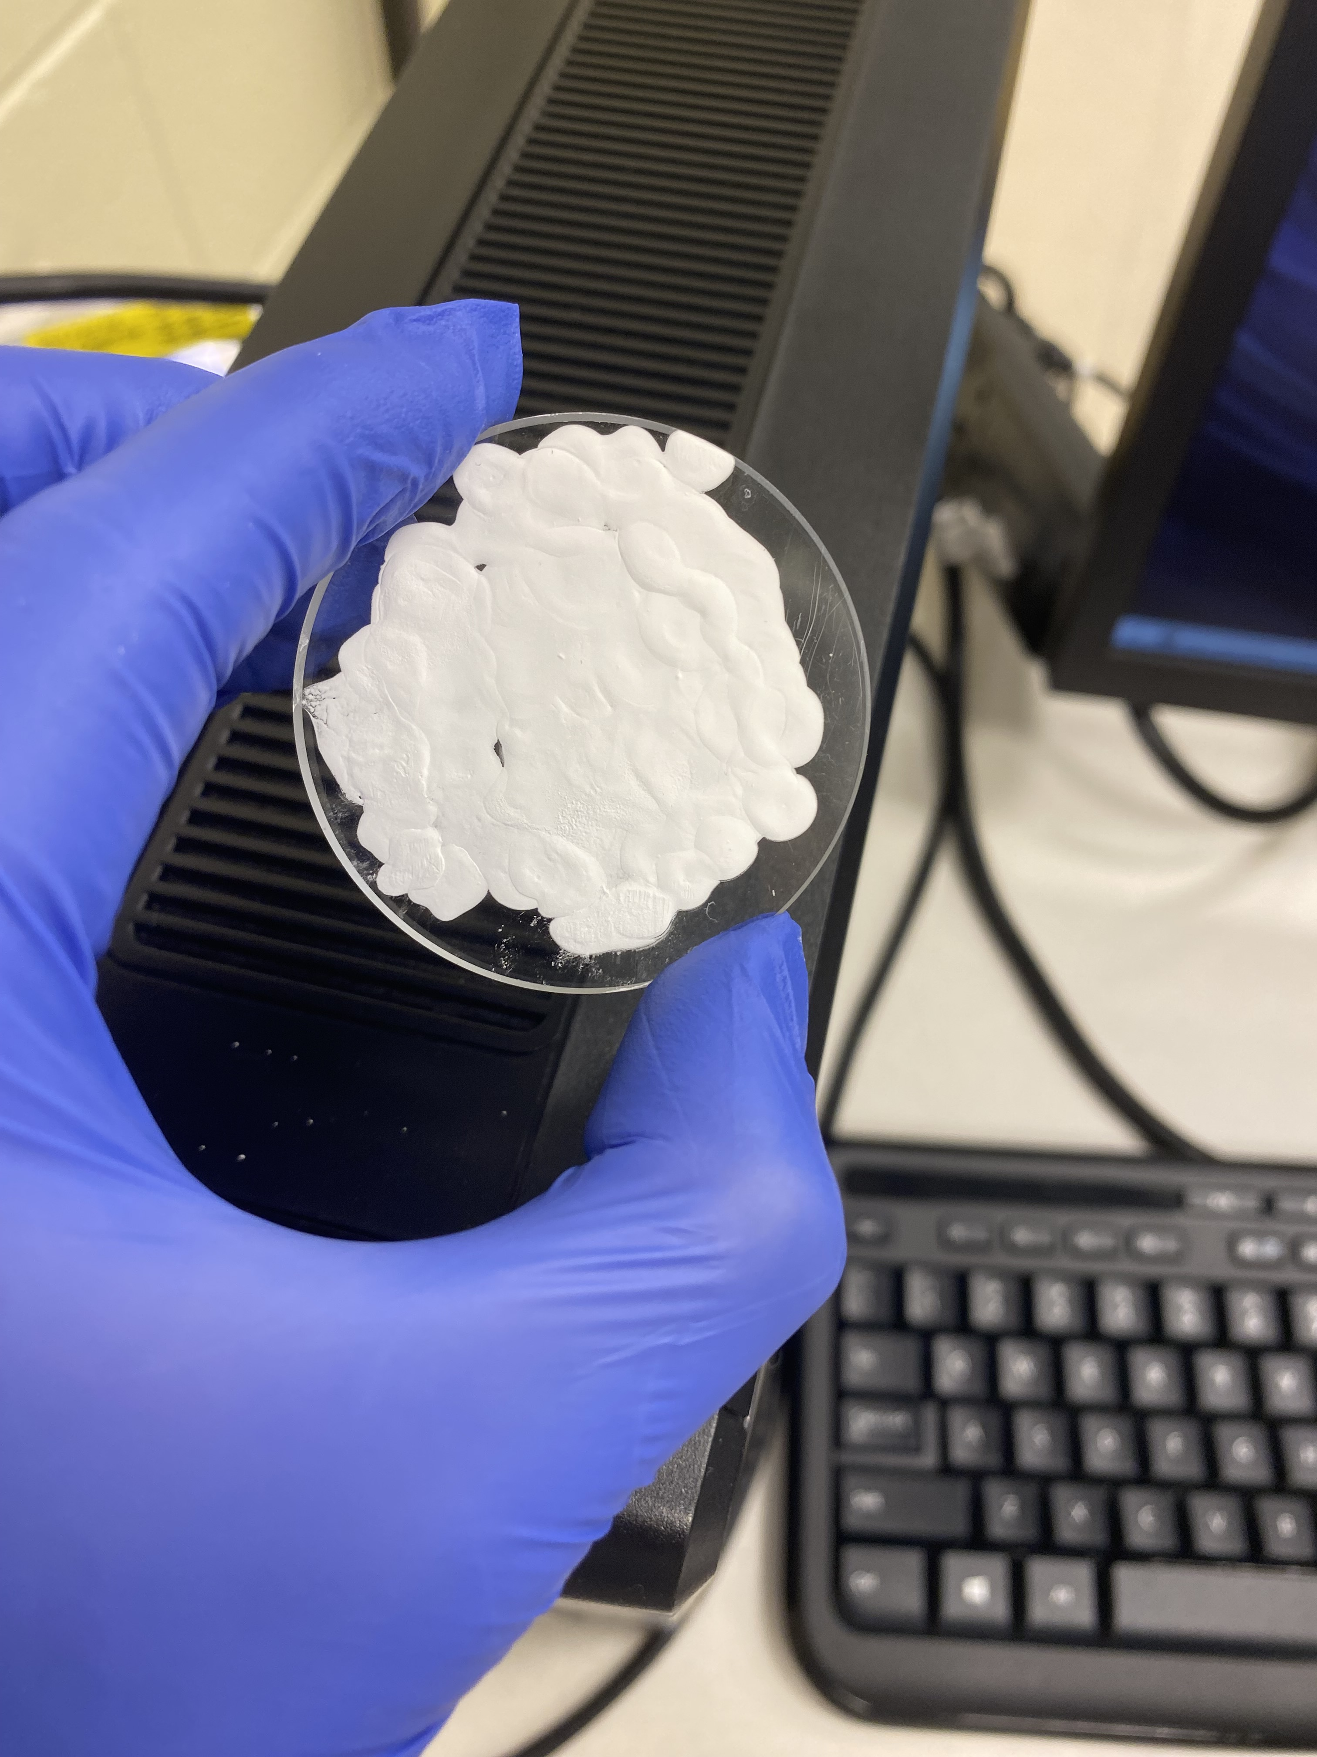
Alpha scintillation test
ZnS painted on an acrylic disk may scintillate in response to alphas
If PMTs detect alpha pulse:
  Our ZnS is sensitive to alphas, AND
  Our PMTs are sensitive to light emitted by our ZnS
Notes:
We devised a test process to verify the scintillation capability and measure the background of the zinc sulfide we produce. A fixed weight of ZnS is sandwiched between acrylic windows. If the ZnS is a scintillator, it should produce events from radon in the lab air. After a few half-lives, the event rate should converge to the intrinsic background of the zinc sulfide. This gives us a relative measurement of radiopurity of SNOLAB ZnS

Slide 48
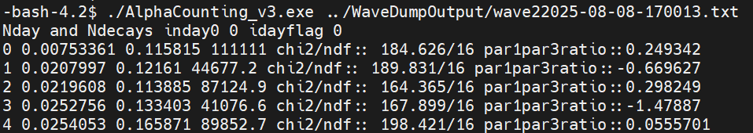
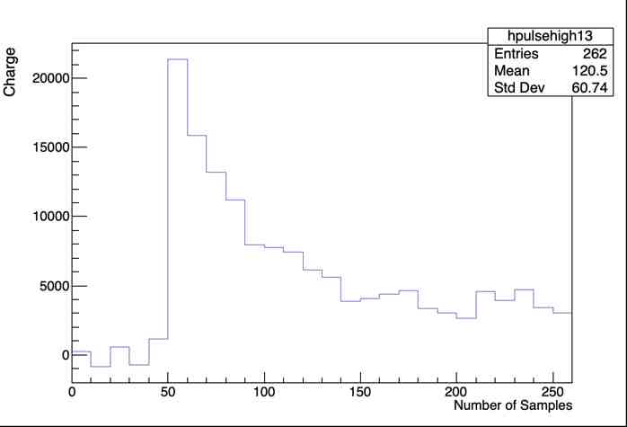
A working Rn counter
These are alphas!
Sample alpha trace
4 μs window
Notes:
And these windows do produce alpha signals! But there is a problem -

Slide 49
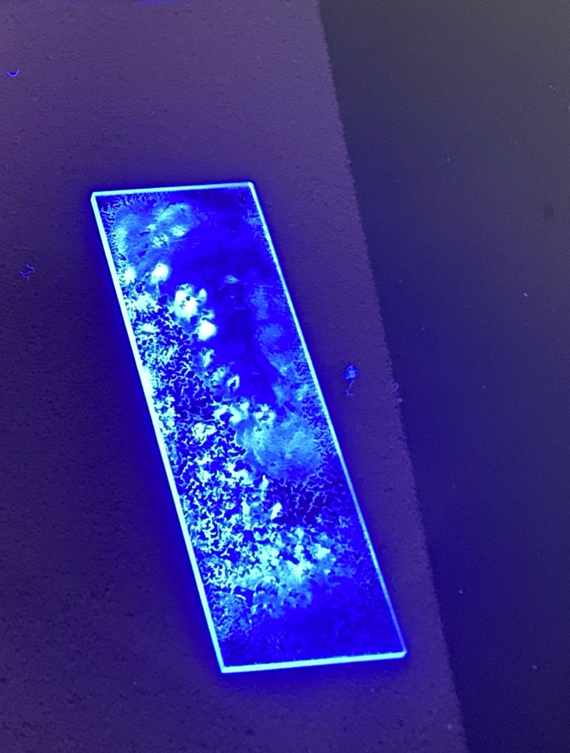
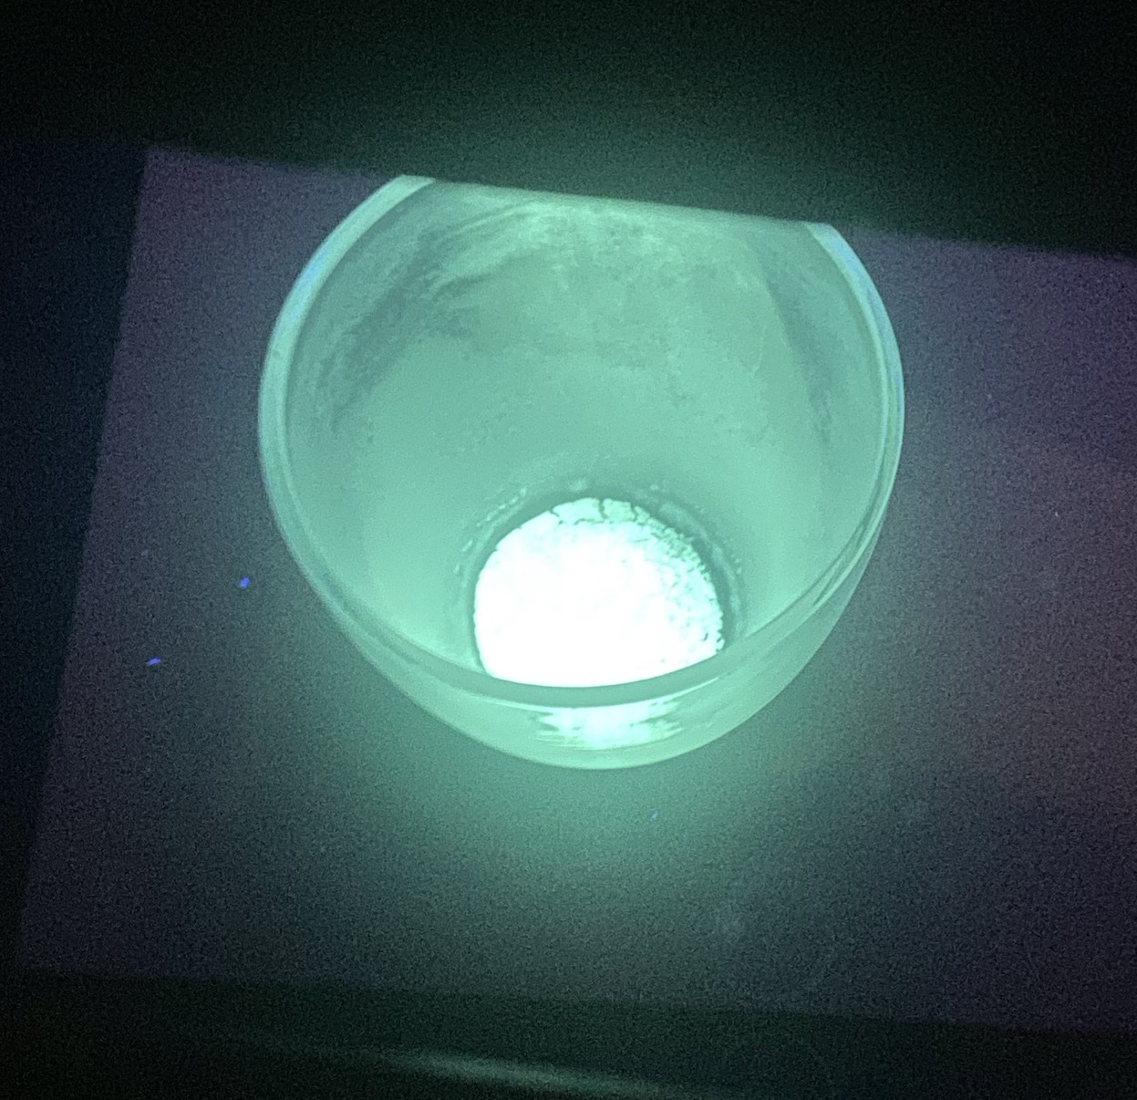
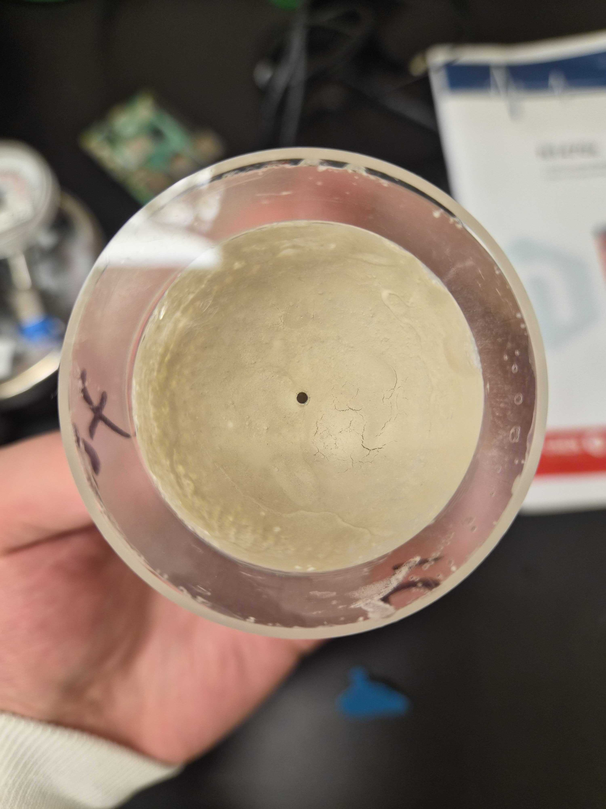
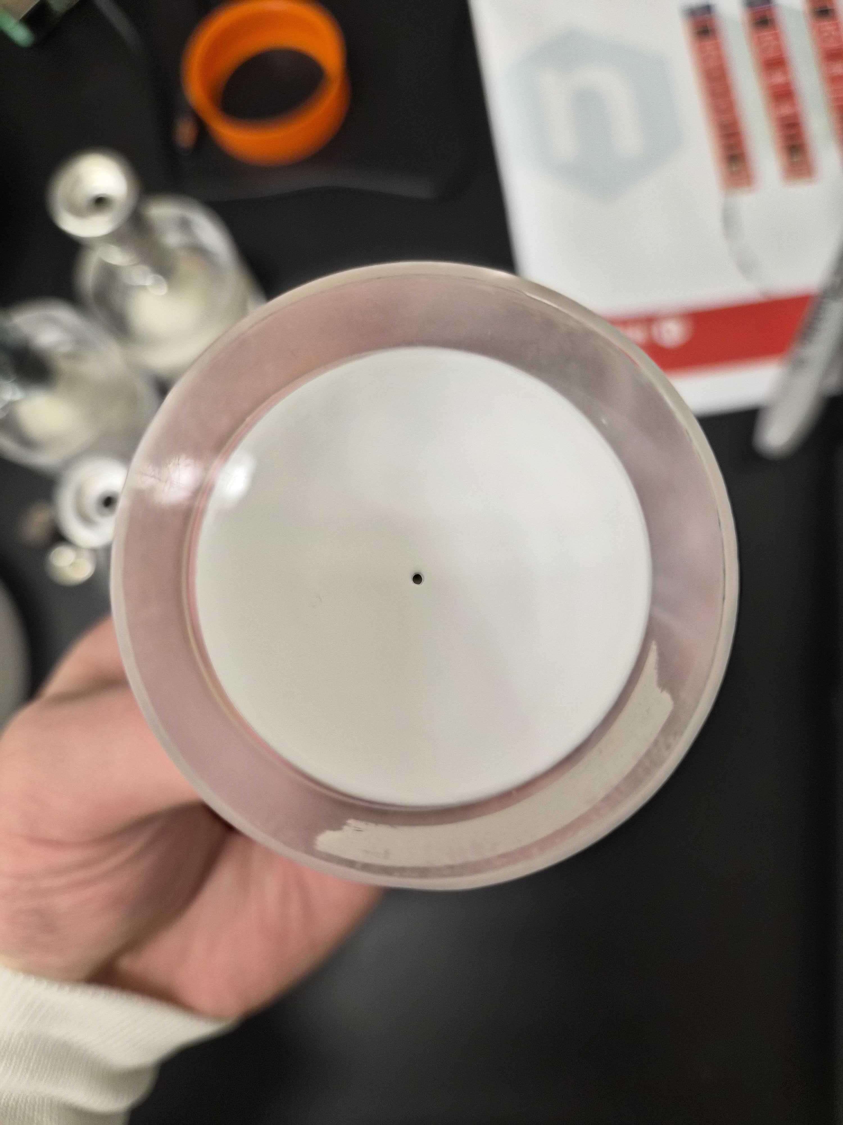
First Lucas cells with SNOLAB ZnS
SNOLAB ZnS
Commercial ZnS
SNOLAB ZnS
Commercial ZnS
Notes:
We weren’t able to follow the literature on ZnS production precisely, and as a result we can observe some qualitative, differences under visible light and 365 nm UV light. The color is different, and the texture of SNOLAB ZnS is also ‘grittier’

Slide 50
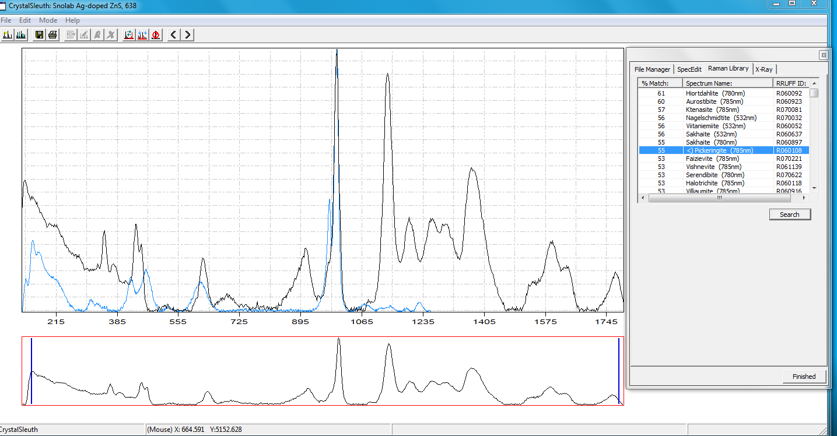
Insights from Raman spectroscopy
Notes:
To quantitatively characterize this difference, we collaborated with professors at the Laurentian University geology department. We used Raman spectroscopy to identify significant presence of Zinc Oxide in our product, owing to a step where we heat treat the zinc sulfide in an open air furnace. Raman spectroscopy probes materials using the vibrational modes of their chemical bonds – incoming light may be wavelength-shifted by interacting with the bond electric field. This software allows us to compare the resulting light spectrum with a library of minerals. It’s designed for geology, but it’s perfectly applicable to our use case as both zinc sulfide and zinc oxide are found in nature.

Slide 51
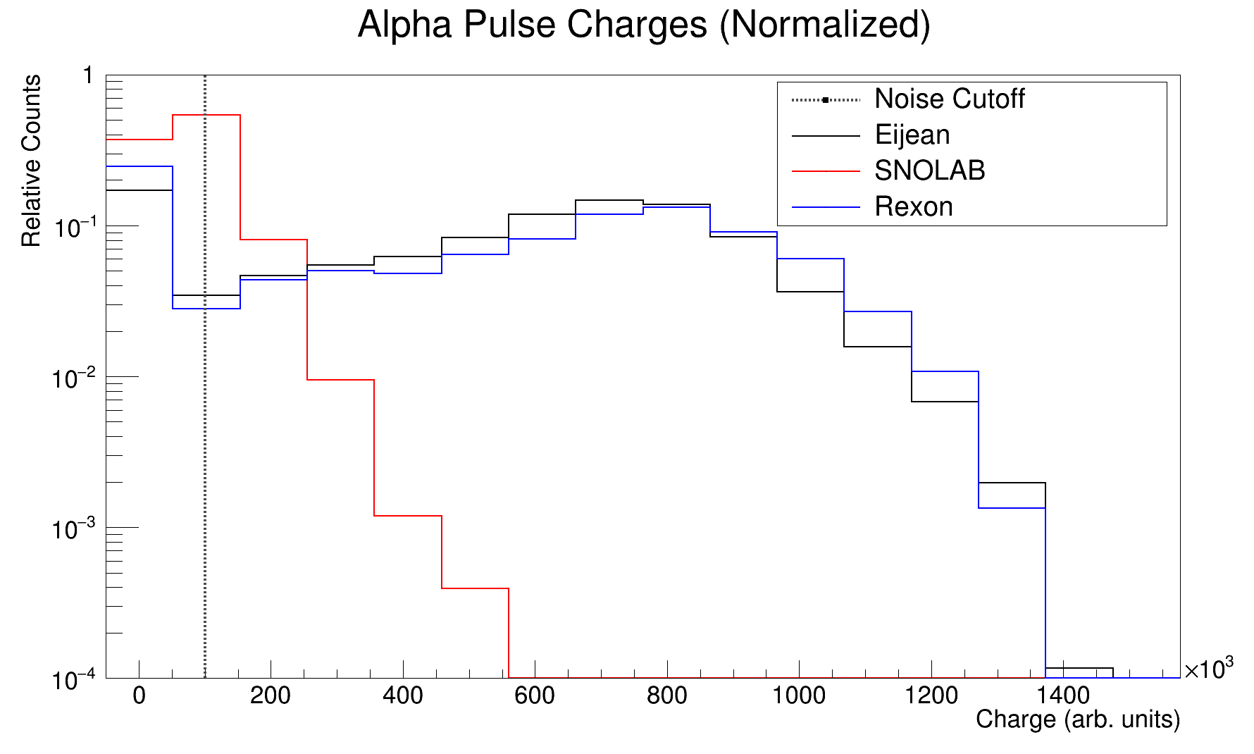
Credit: Connor Stubbs
Notes:
The presence of this Zinc oxide appears to quench scintillation light. The total light yield produced by scintillation events in Lucas cells made with SNOLAB ZnS is considerably lower than Lucas cells made with pure Zinc Sulfide. Currently, we are acquiring a vacuum furnace for this project which will arrive in the coming months that will enable us to produce zinc sulfide without oxygen in the environment.

Slide 52
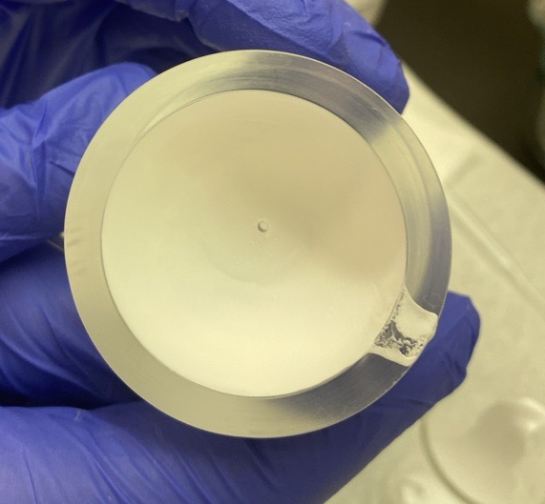
Summary
Determined the source of Lucas cell backgrounds
Developed method to fabricate Lucas cells/low-background ZnS
Developed a procedure to rapidly produce and test scintillator for Lucas cells
Identified ZnO presence as obstacle in usability of SNOLAB ZnS

Slide 53
Outlook and next steps
SNOLAB has acquired a vacuum furnace for production of ZnS in low-oxygen environment
A calibrated radon source is also being procured for precision measurement of counting efficiency of Lucas cells

Slide 54
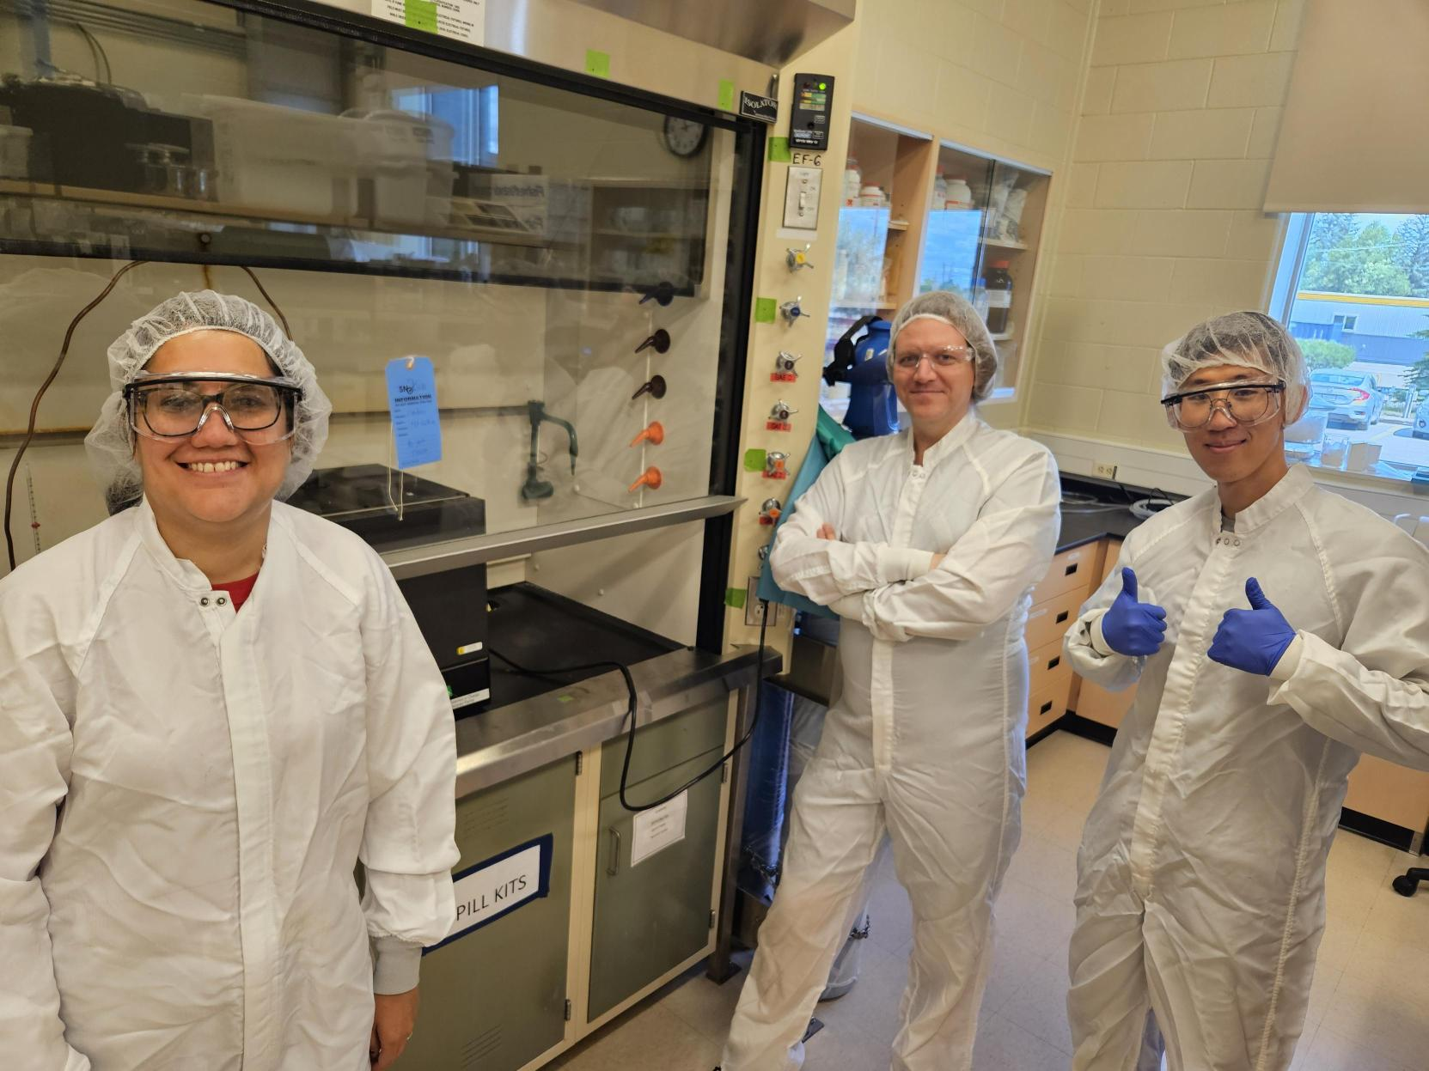
Acknowledgements
Nasim Fatemighomi
Lina Anselmo
Steve Maguire
Scientific Support
Keegan Paleshi
Connor Stubbs
Varshini Rajakumaran
Notes:
Before I conclude my talk, I want to thank my supervisors, Lina and Nasim, Steve for his chemistry expertise which provided the foundation for this project, the chemical technologists who were always there to answer questions or help out

Slide 55
Thanks for listening!
Notes:
Thank you for listening!

Slide 56
Questions?

Slide 57
Backup slides

Slide 58
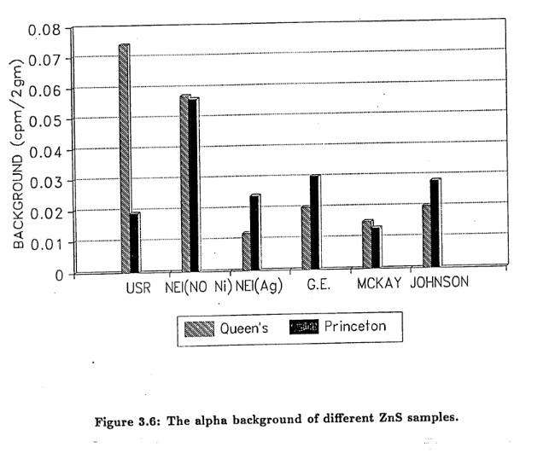
ZnS alpha background
ZnS alpha background varies by manufacturer
Current standard for Lucas cells is 3-4 cpd
Motivates us to investigate synthesizing our own
M. Liu (1991)
Notes:
We know from both our own work last term and previous studies that ZnS background can vary quite a lot between manufacturers. Even the lowest background ZnS tested yields LCs with alpha background 4 cps. We concluded that if we want to push for a zero-background Lucas cell, we would need to make our own ZnS

Slide 59
The SNOLAB Radon assay
UPW plant Radon board, 2000 (Credit: SNO)
UPW plant Radon board, 2026
Notes:
The technique dates back to the planning stages of the venerable SNO experiment, which along with Super K discovered neutrino oscillation and solved the solar neutrino problem. There, it was used for materials screening to measure radon emanation of materials, and also for assays of the cavity water.

Slide 60
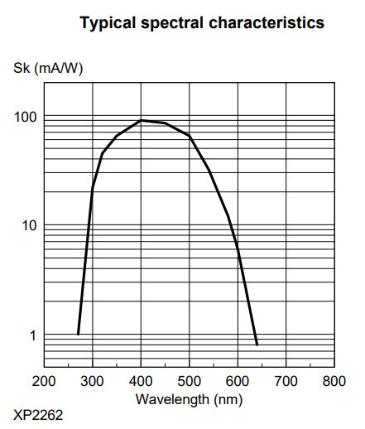

rgb(0, 255, 203)
Hex: #00ffcb
λ = 495 nm
Notes:
It’s apparent that our product emits a different color than the commercial ZnS. Using software tools, we get a naïve conversion of the color to wavelength, giving us an estimate of 495 nm light. Reading off the PMT datasheet, our PMT is 90% as efficient at converting this light to current compared to the commercial ZnS

Slide 61
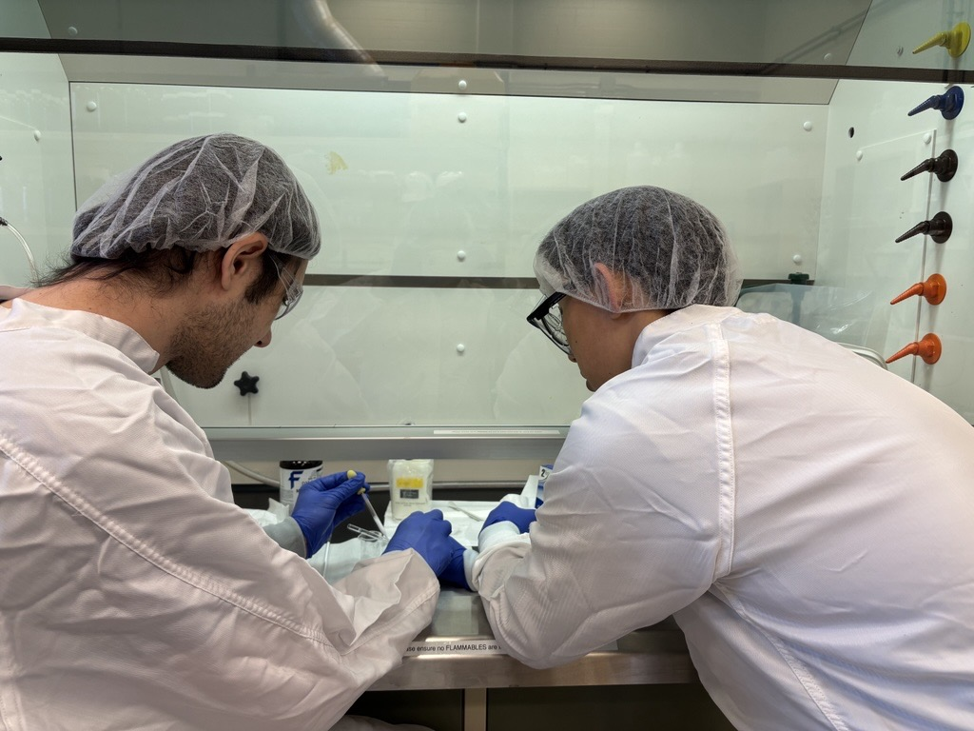
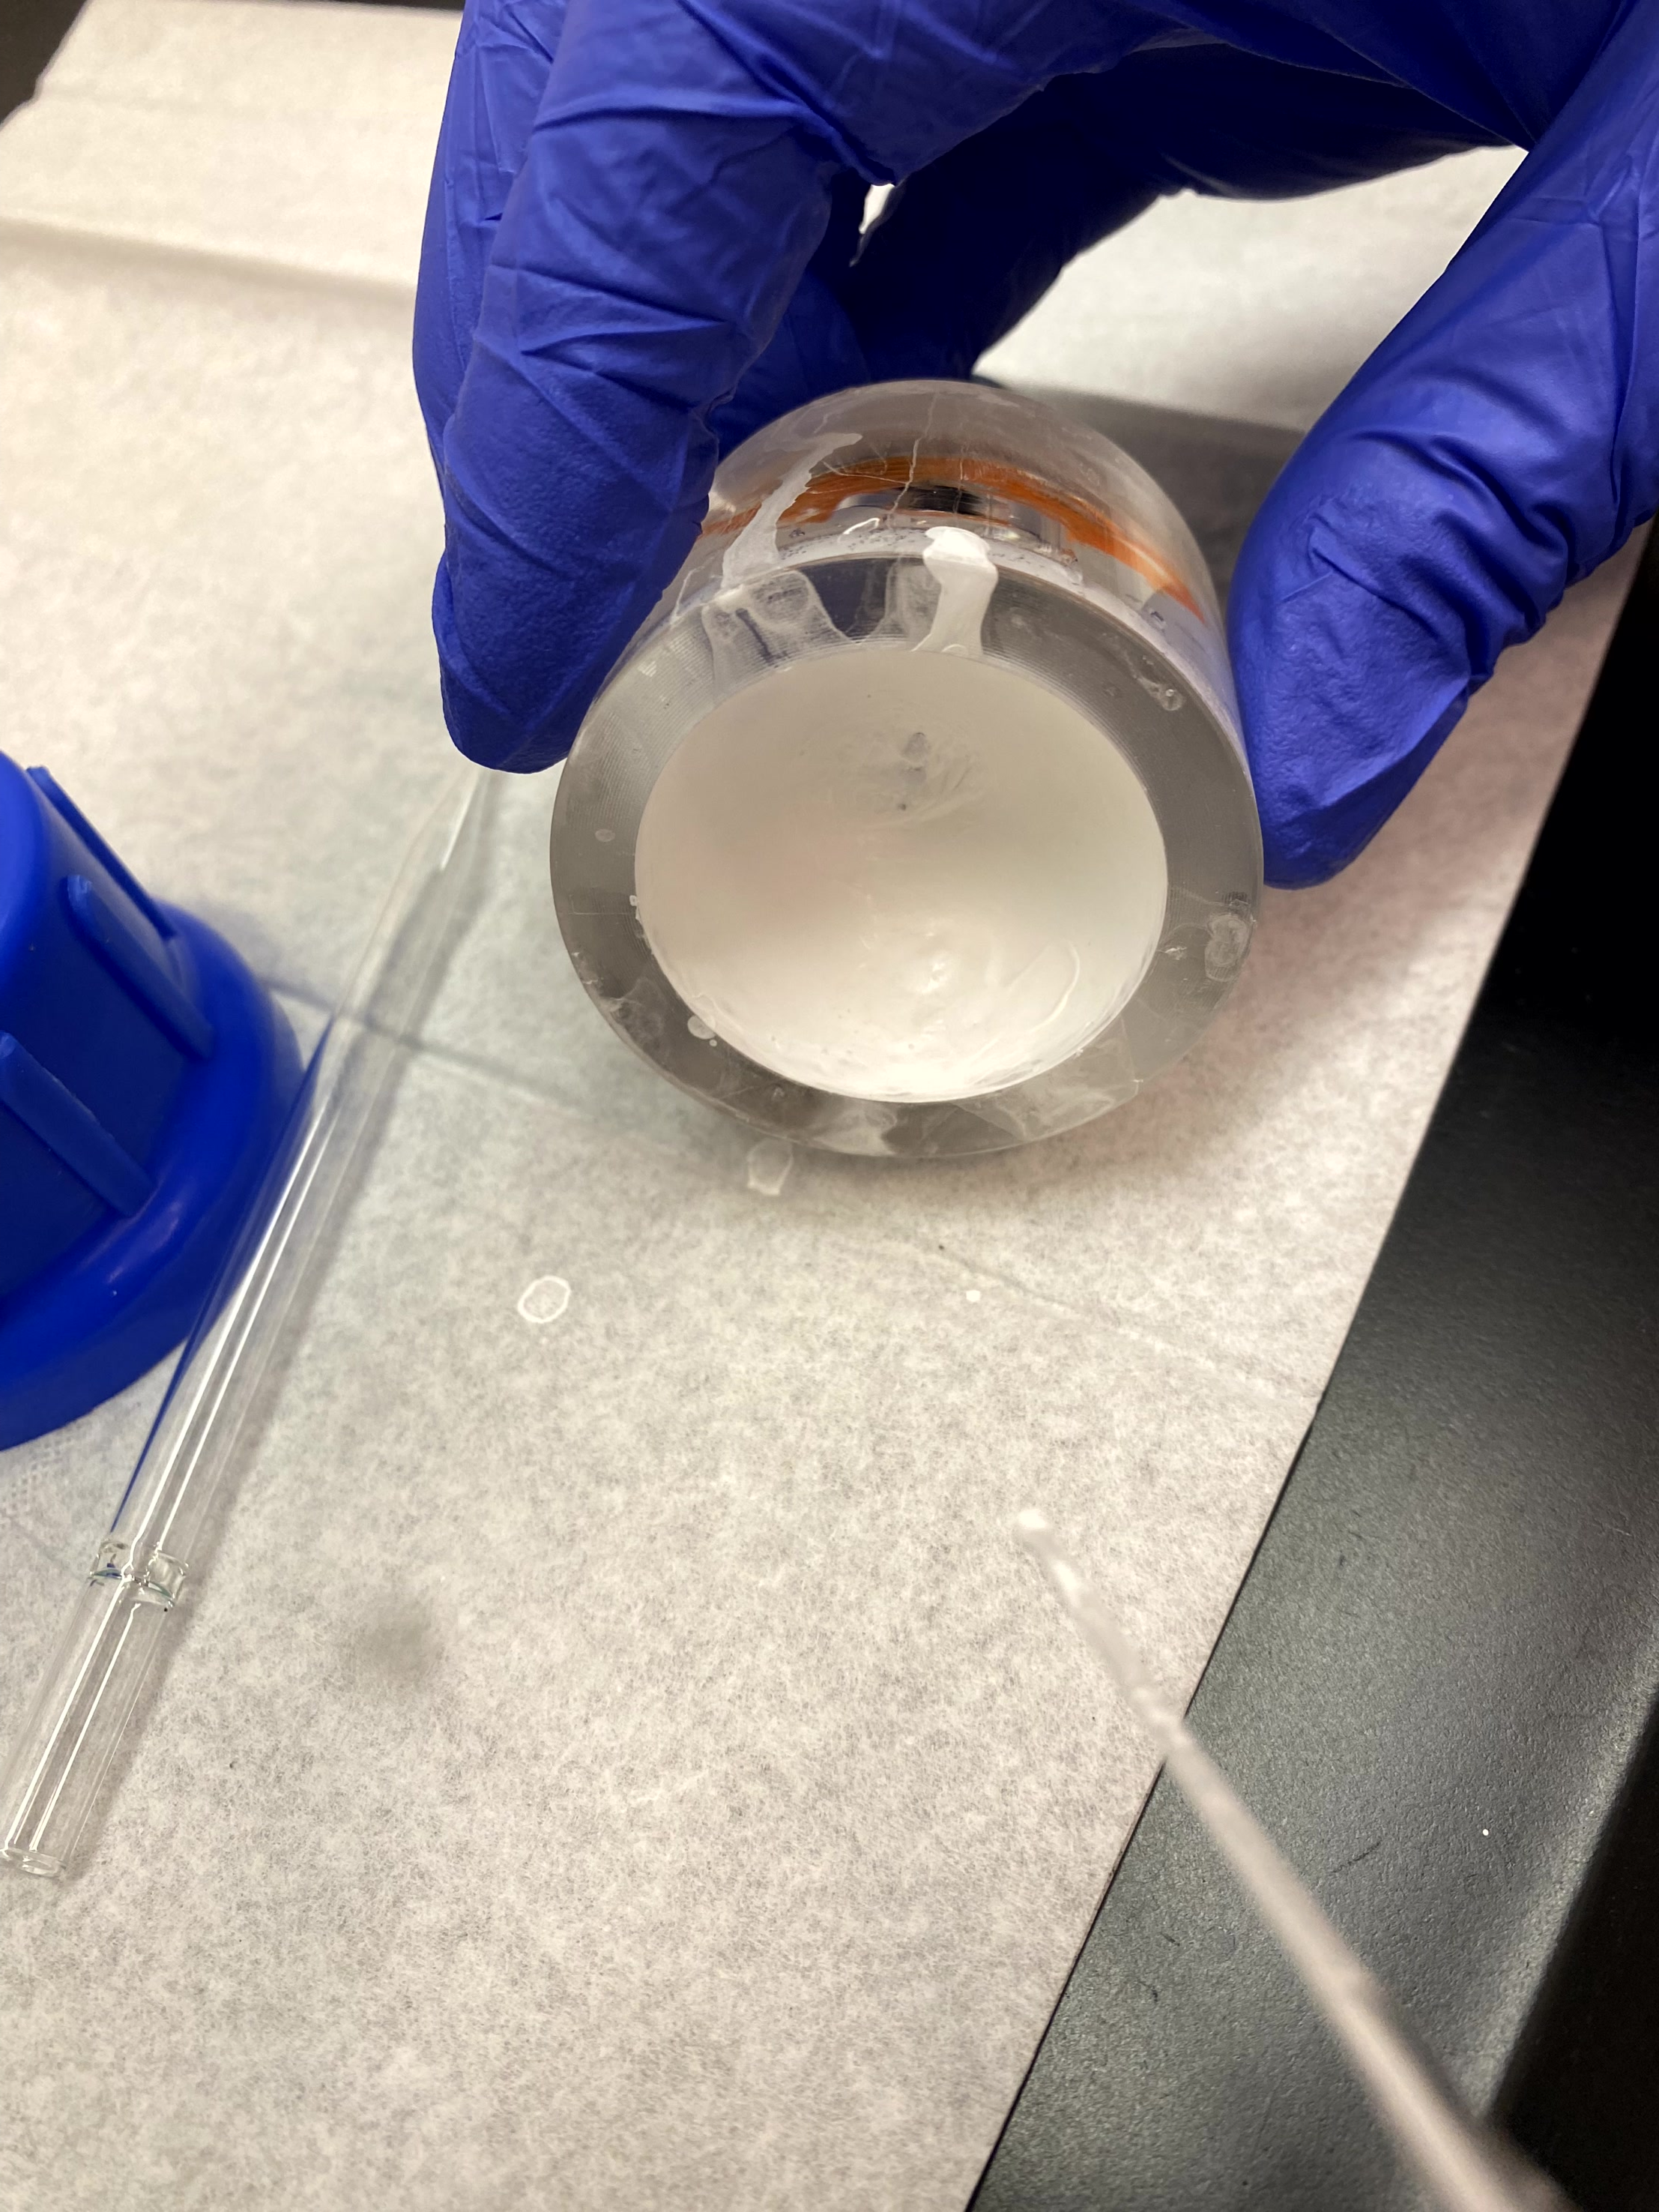
Lucas cell coating: process
Notes:
Here’s a photo of Keegan and I learning to coat Lucas cells. Once the cells were complete, we measured background by counting the cells empty cells and measured alpha counting efficiency by spiking the cells with radon from a known high activity source.

Slide 62
Notes:
Upon mixing a double displacement reaction occurs forming aqueous sodium acetate and with zinc sulfide precipitating out. by performing this step in two stages that we can discard impurities. Afterwards, we anneal the zinc sulfide with silver at 900C to dope it.

Slide 63
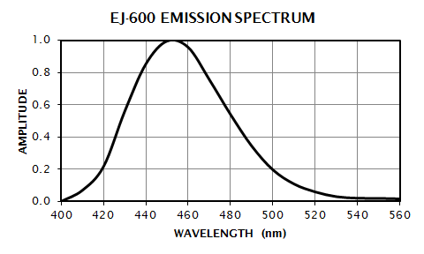
ZnS luminescence goals
Commercial ZnS emits around 450nm, while our PMTs are most sensitive around 420 nm
Light sensitivity of Philips XP2262 PMTs
Commercial ZnS(Ag) emission spectrum
Notes:
In addition to radiopurity, we need our ZnS to emit light in a wavelength matched to the spectral sensitivity of our PMTs, which peaks for wavelengths about 420nm. For comparison, the commercial ZnS we use emits in a spectrum peaking at 450nm

Slide 64
Improving the radon assay starts with improved Lucas cells
Notes:
Now the assay boards themselves emanate negligible amounts of radon over the length of an assay. So we turn our efforts towards pursuing lower background in our Lucas cell alpha counters. I’ll begin with an introduction to the concept of these Lucas cells

