Slide 1
2026/06/23
Radon-222 Removal and Screening Capability at SNOLAB
Dr Nasim Fatemighomi (she/her)
SNOLAB Research Scientist
Queen’s University Adjunct Professor
CAP2026, Ottawa, June 23rd 2026

Slide 2
Outline
Introduction to SNOLAB physics and background sources
Why controlling radon background is important
Techniques applied to measure radon at SNOLAB
Radon Removal Techniques
Techniques to create low radon environment
Summary
Notes:
Put a Rn isotope, less white space. Use the white space

Slide 3
Introduction

Slide 4
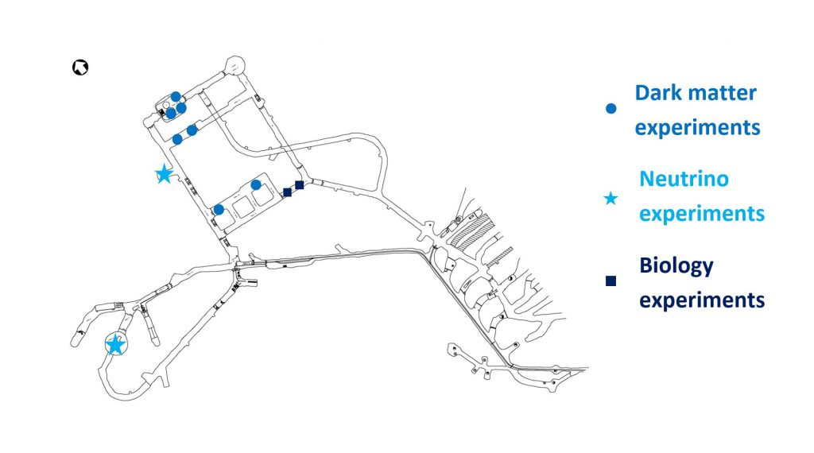
SNOLAB Underground Facility
Situated 2 km Underground at Creighton Mine, Lively, Ontario
Most experiments are looking for extremely rare signal
Background sources to be controlled and mitigated
Notes:
Merge slide 4 and 5

Slide 5
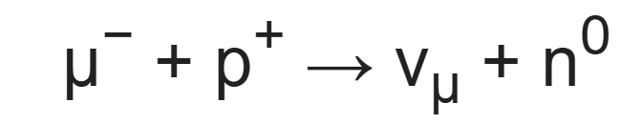





Background sources
Gammas ($γ$) and betas ($β$) from natural radioactivity
Alphas ($α$) from natural radioactivity
  $(α, n)$: interaction of $α$s with detector material
  Surface alphas $α$s
Muons
    Muon-induced neutrons
    Cosmogenic activation
¹³C
$$n$$
$$α$$
Detector Medium
Detector Wall
¹⁶O
$$α$$
$$α$$
Notes:
For these experiments to be successful, they need to control and mitigate background , these are gamma and betas from natural radioactivity, alphas from natural radioactivity which can create neutrions by interacting with detector material. Can create surface alpha background which can have similar recoil energy as a dark matter candidate. Or muons. The focus of my talk today is radon induced background which can create gamma and betas from natural radioactivity and alphas from natural radioactivity.

Slide 6

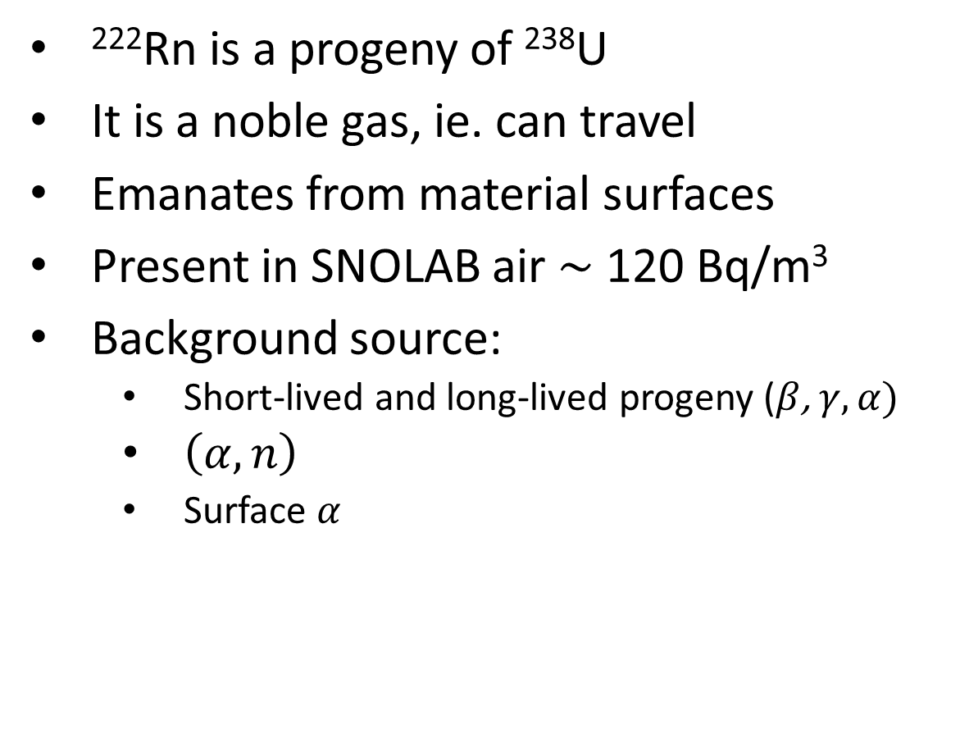
Radon in ²³⁸U Chain
²²²Rn is a progeny of ²³⁸U
It is a noble gas, ie. can travel
Emanates from material surfaces
Present in SNOLAB air $\sim$ 120 Bq/m³
Background source:
  Short-lived and long-lived progeny ($β$, $γ,α)$
  $\left(α, n\right)$
  Surface $α$
From Wikipedia

Slide 7
Mitigation and controlling strategy
Strict material selection by performing radon emanation measurements
Regular monitoring of Rn levels
Rn removal from liquid and gas
Controlling radon ingress in the detector
Preventing surface contamination
Cleaning and removal of surfaces to remove ²¹⁰Pb

Slide 8
Radon Emanation Systems at SNOLAB

Slide 9
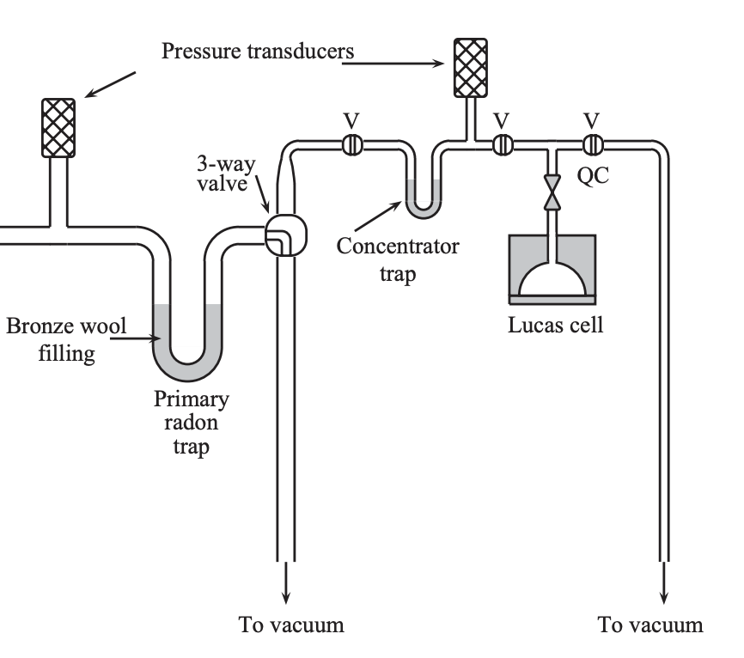
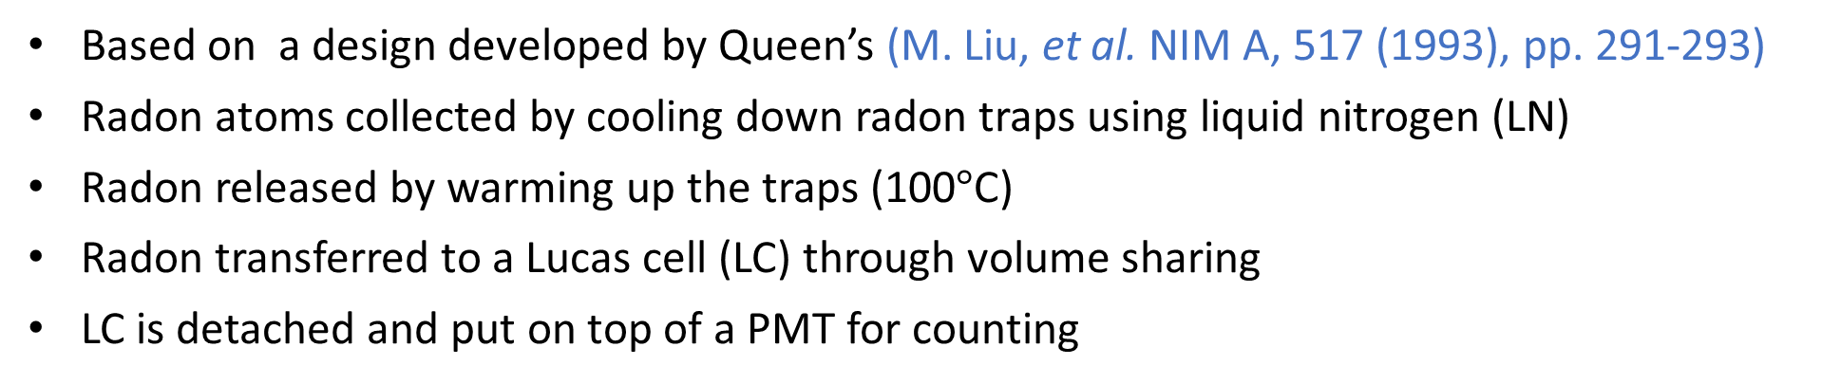
Radon Emanation System Technique
Based on a design developed by Queen’s (M. Liu, et al. NIM A, 517 (1993), pp. 291-293)
Radon atoms collected by cooling down radon traps using liquid nitrogen (LN)
Radon released by warming up the traps (100$°$C)
Radon transferred to a Lucas cell (LC) through volume sharing
LC is detached and put on top of a PMT for counting
Emanation Chamber
(negative pressure)
Notes:
Bigger figures, remove white space, make the text more readable

Slide 10
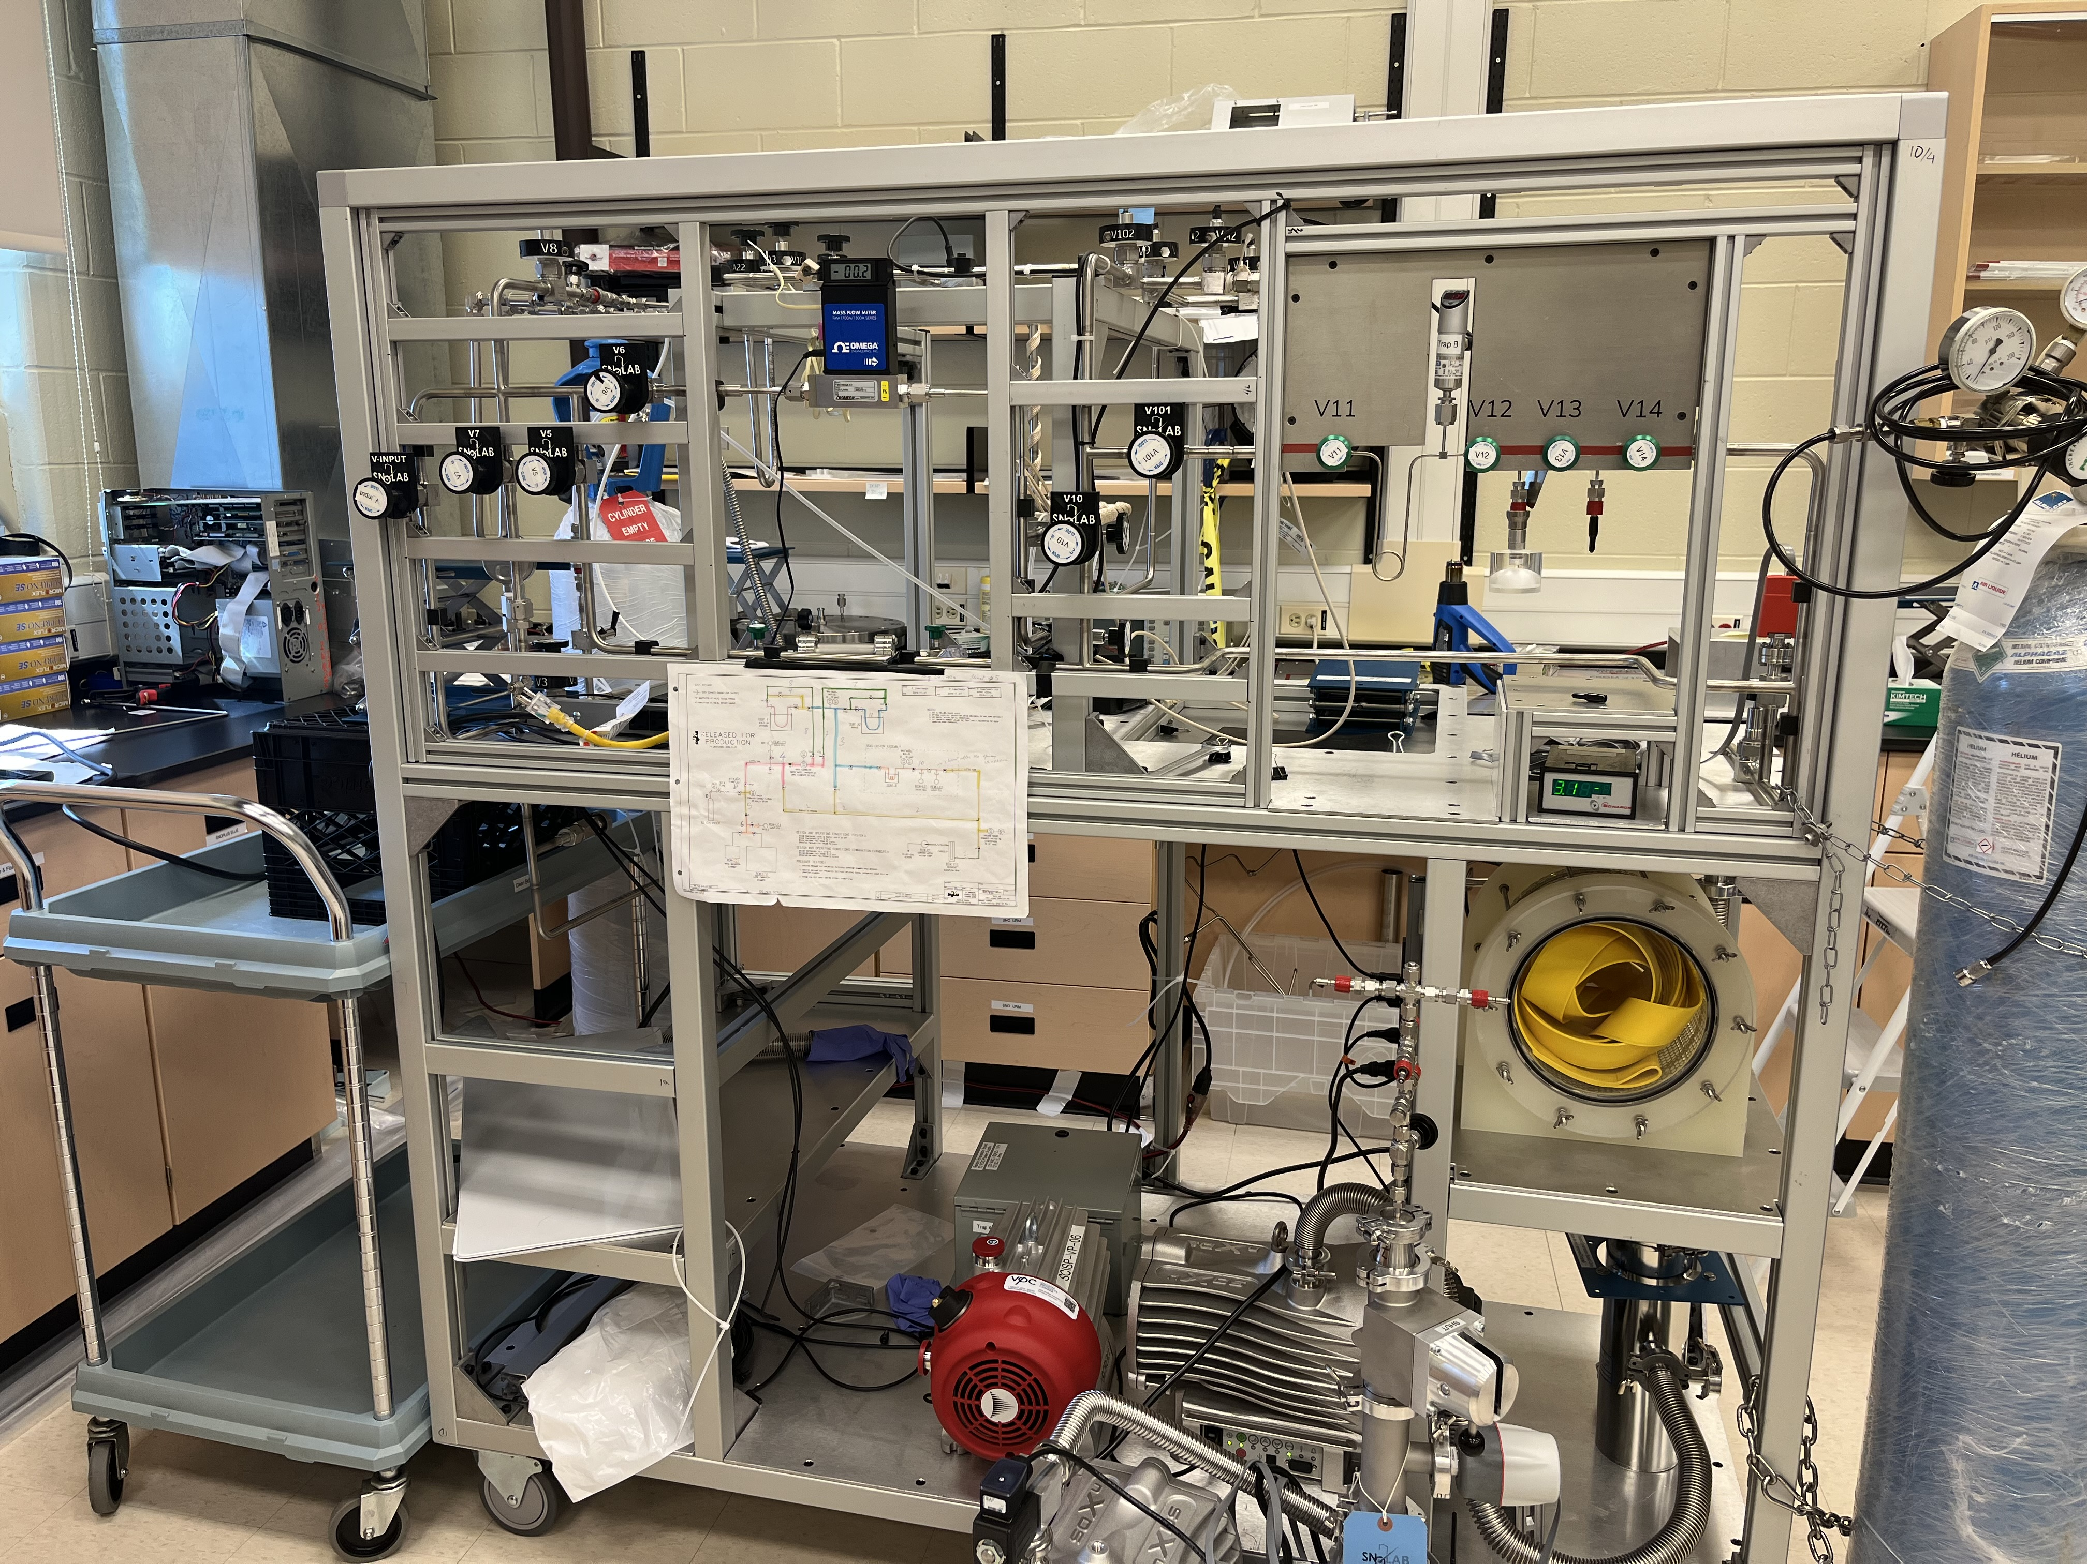
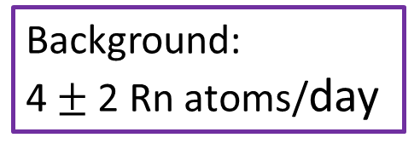
SNOLAB Radon Emanation System
Background:
4$±$ 2 Rn atoms/day
Emanation
Chamber
Vacuum Pump
Plan to increase the emanation chambers
Notes:
Make the picture bigger, cover the whole slide, and put the information in text boxes ,

Slide 11
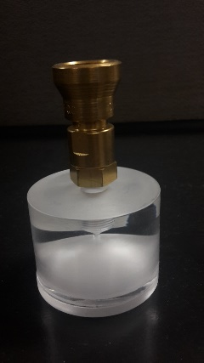
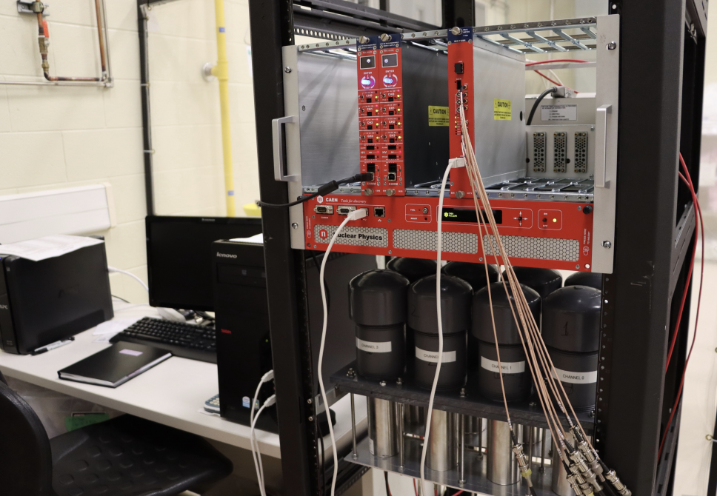
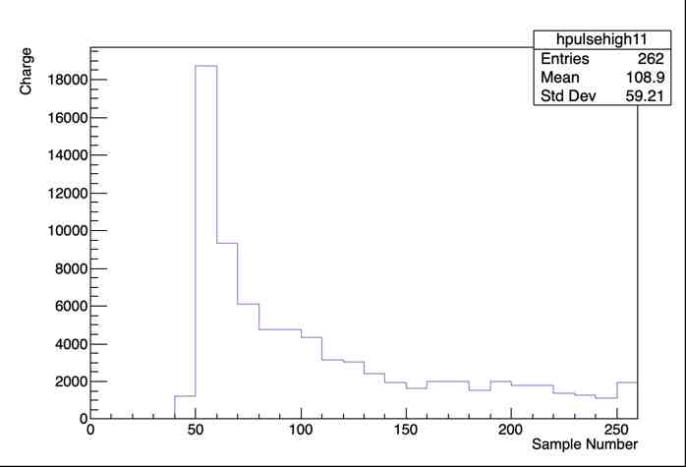
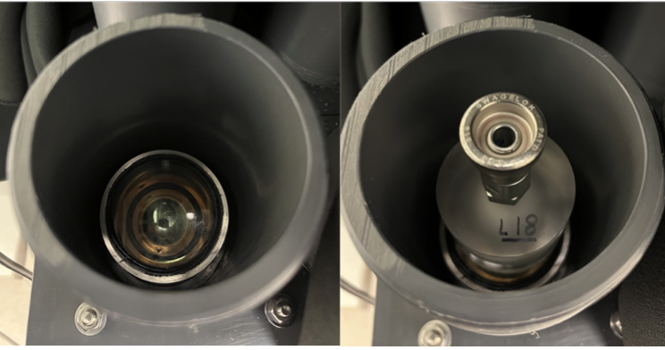
Radon Counting
Portable Lucas cells (LCs) with ZnS(Ag) coating
ZnS(Ag) scintillates with α particles → ideal for radon detection
Sixteen LC channels available
2” diameter
2” diameter PMTs and CAEN electronics
4 μs window
Notes:
Justify why LC compare to other type of like electorstatic chamber, cheap to produce, if you want to count 16 assays at the time you need to make 16 electrostatic chamber.. Which makes it expensive. I think this type of detector is unique to SNOLAB and while we should investigate other type of technology, high efficiency compare with electrostic chambers… I think we should push impoving this as well… talk about justin , keegan etc work … less sensitive to moisture and other impurities compare to electrostic and proportional counters. Less affected by noise during radon correction.

Slide 12
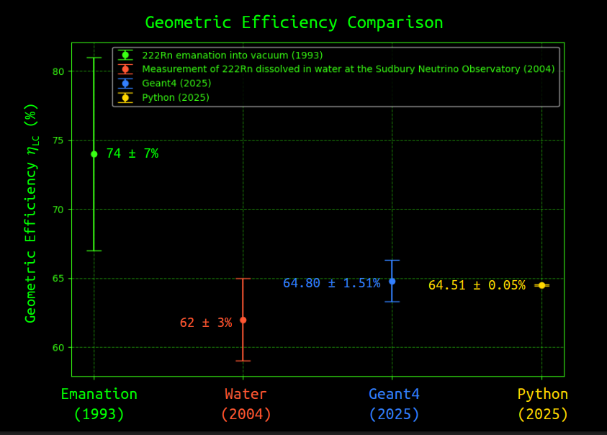
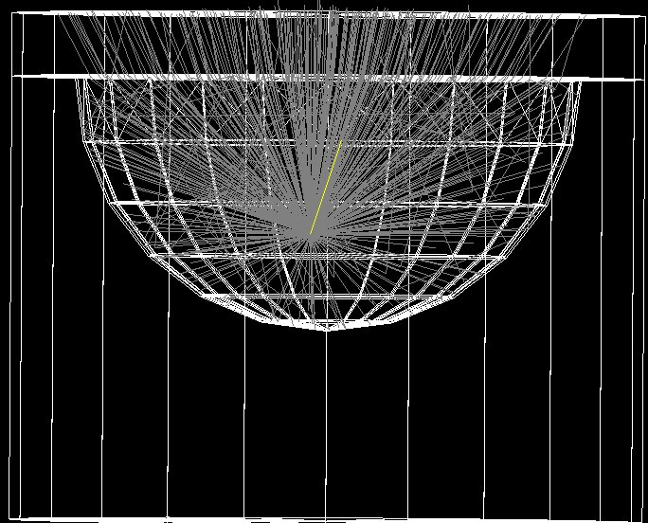
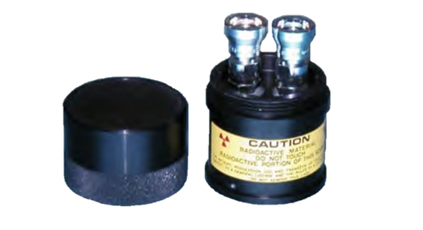
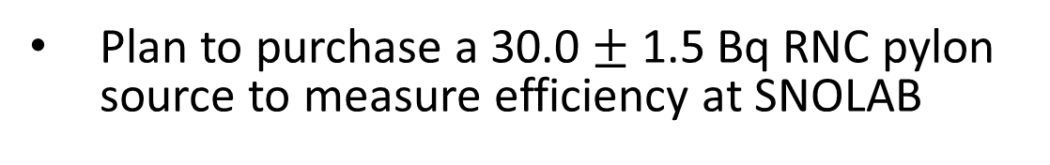
LC Efficiency
  I. Blevis, et al. NIM A, 517
GEANT4 simulation
Justin Suys CAP 2025
  M. Liu, et al. NIMA, 517
Courtesy of J. Suys
Plan to purchase a 30.0 $±$ 1.5 Bq RNC pylon source to measure efficiency at SNOLAB
Notes:
Put Justin’s plot here, how to make the error in data smaller.

Slide 13
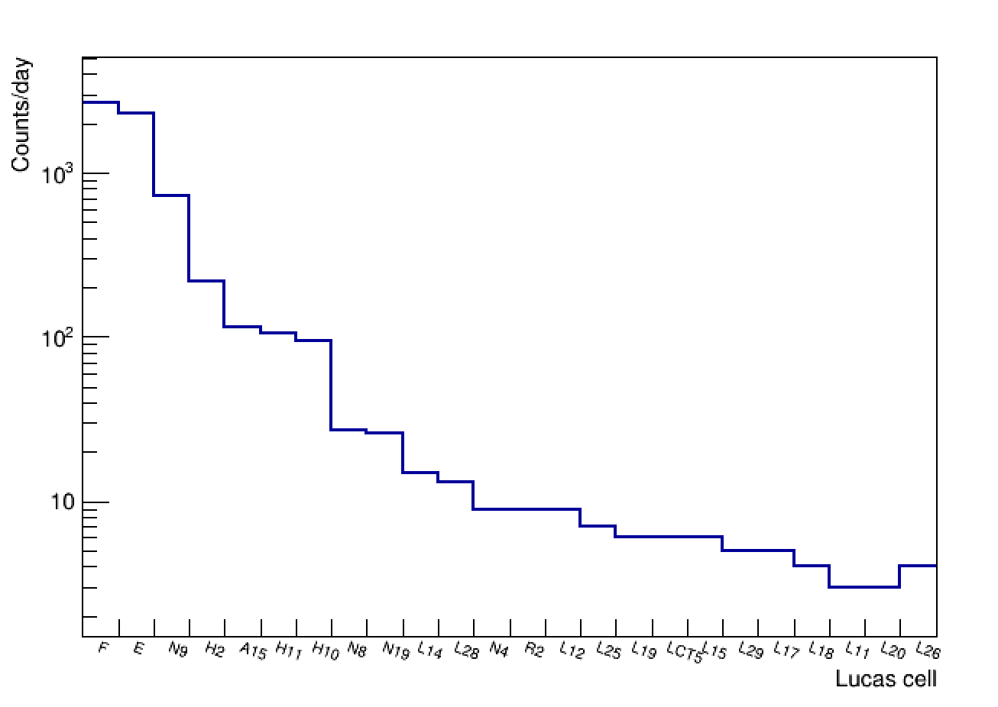
LC Background
New LCs have background of 3 to 5 alpha counts day
LC ²¹⁰Po background increases with ²¹⁰Pb build up
Increasing age
Notes:
Background cells build over time
Reduce the background, think about conclusion, ages

Slide 14
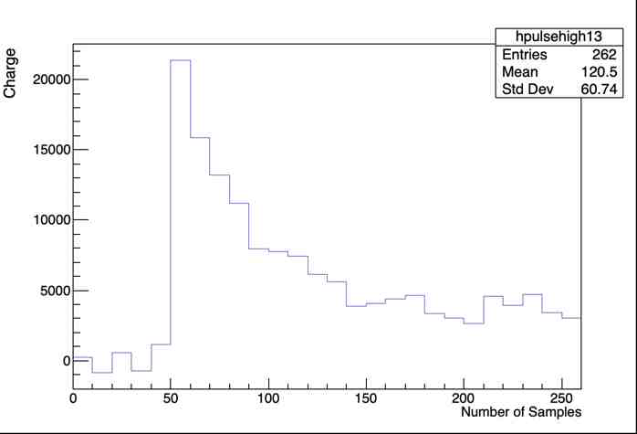
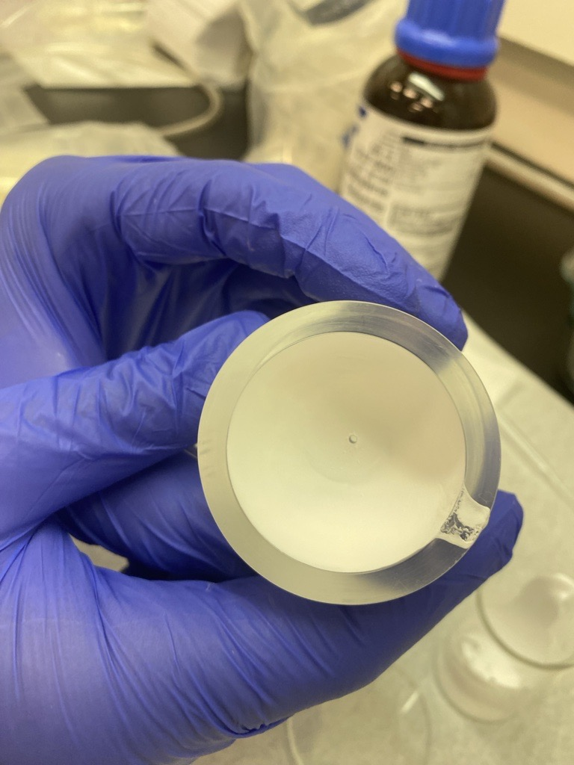
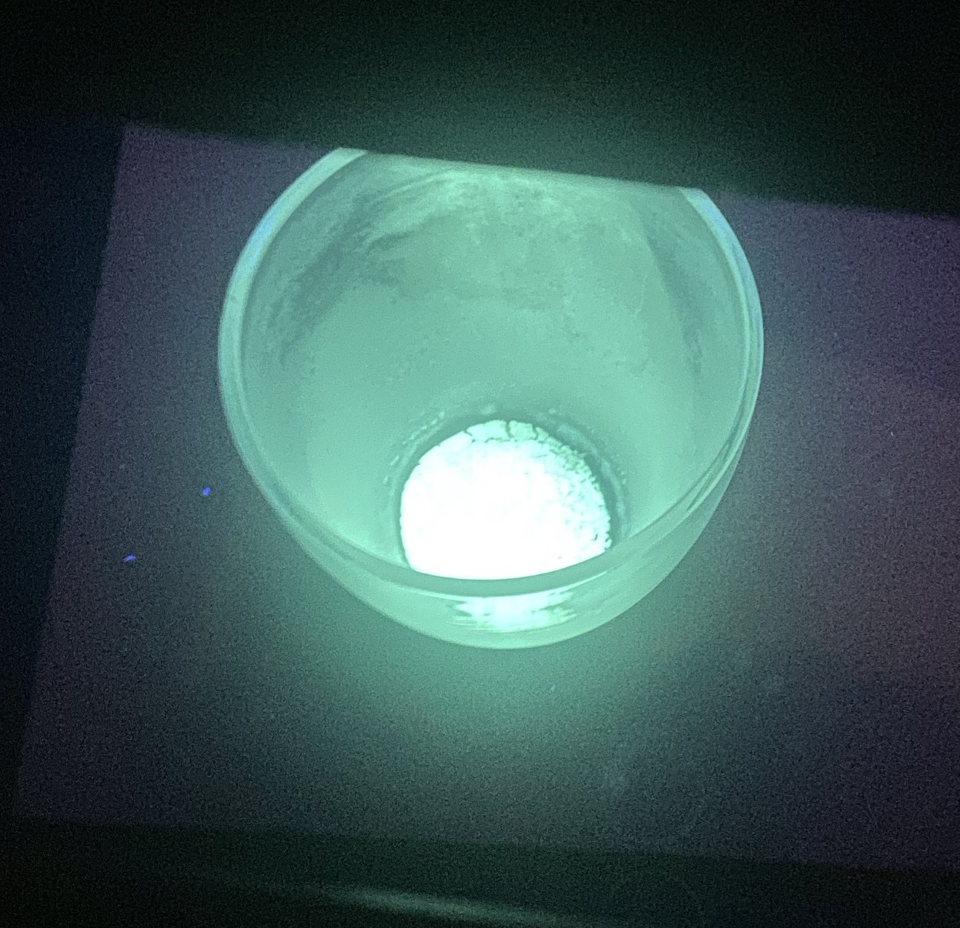

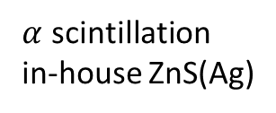
Reducing LC Background
New low background Lucas cells were fabricated: 3 to 5 $α$/day
R&D toward lower background ZnS(Ag) using selective precipitation technique (See Peter Qin’s talk:DAPI T2-1)
$α$ scintillation
in-house ZnS(Ag)
New Lucas cell
(made with commercial ZnS(Ag))
In-house ZnS(Ag)
Notes:
Here talk about both making new LC and to make ZnS

Slide 15
Measurement of ²²²Rn concentration in N₂

Slide 16
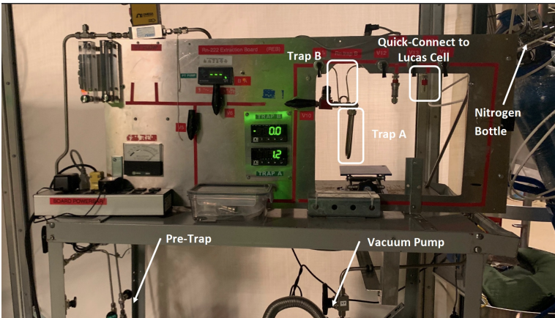
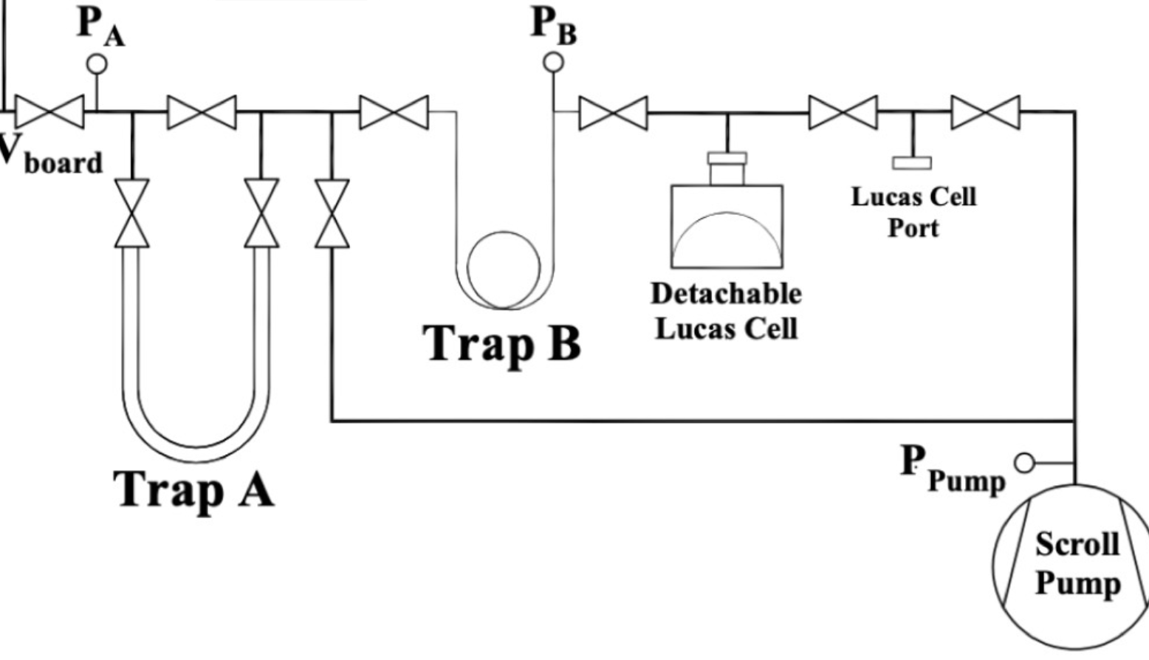
The UG Radon Board
Designed for vacuum radon emanation measurement
Was adopted to perform N₂ gas assays
Cover Gas system
filled with N₂
vapor trap
Notes:
. The commercial trap contained a helically wound titanium coil filled with a coolant called R290/R1150 (a blend of propane and ethylene) a

Slide 17
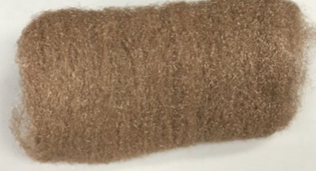
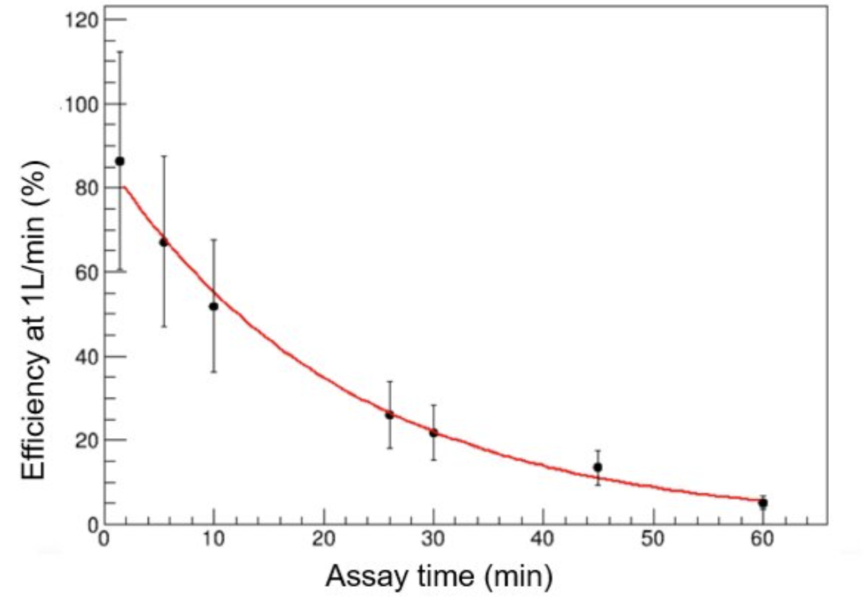
Primary Trap Limitation for Gas Assays
Radon traps use porous materials to enhance trapping
Bronze wool highly efficient under high vacuum
Gas assay efficiency decreases with longer duration or >1 SLPM flow
Limited extracted gas volume constrains sensitivity (> 3.3 mBq/m³)
Need for traps with more porous material
S.M.A. Hussain MSc thesis (2022)

Slide 18
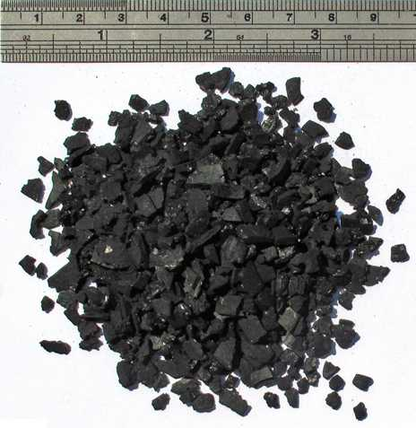
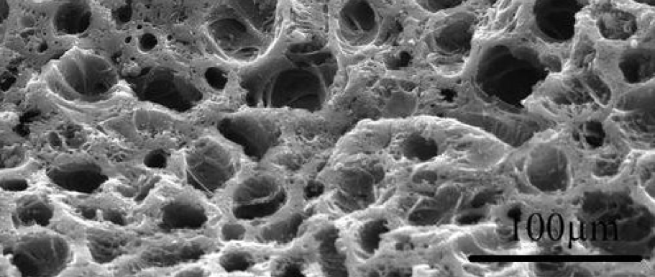
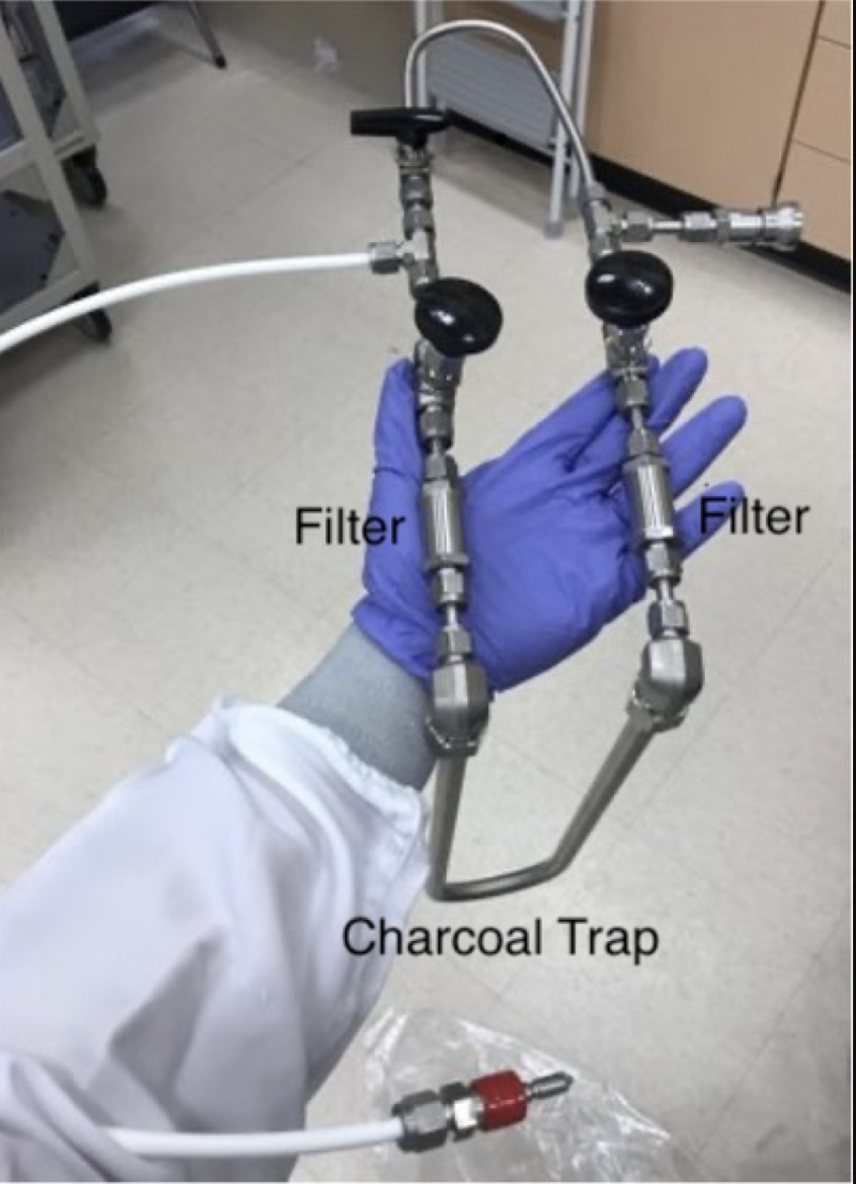
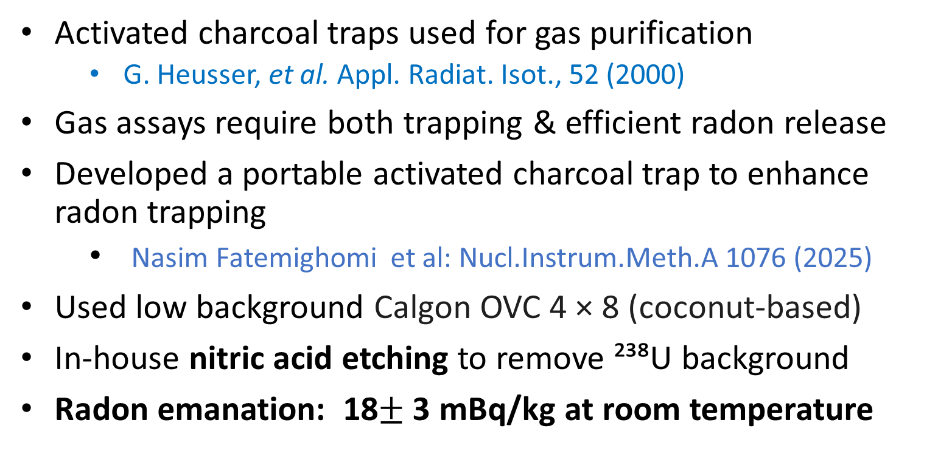
Activated Charcoal Trap
Activated charcoal traps used for gas purification
  G. Heusser, et al. Appl. Radiat. Isot., 52 (2000)
Gas assays require both trapping & efficient radon release
Developed a portable activated charcoal trap to enhance radon trapping
  Nasim Fatemighomi et al: Nucl.Instrum.Meth.A 1076 (2025)
Used low background Calgon OVC 4 × 8 (coconut-based)
In-house nitric acid etching to remove ²³⁸U background
Radon emanation: 18$±$3 mBq/kg at room temperature
100μm
22 g trap

Slide 19
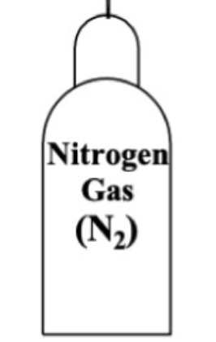
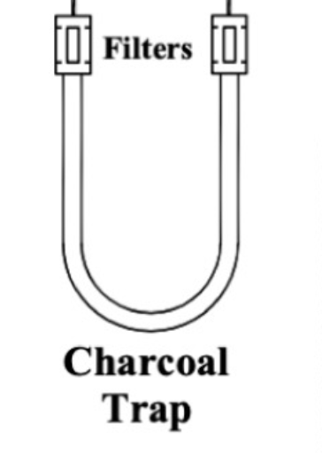
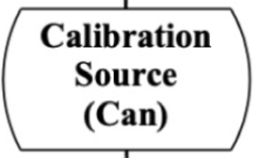
Trap Efficiency Test Set-up
N₂ flow through the source introduces radon atoms to trap
Charcoal cooled with LN₂–alcohol mix to trap radon
Radon released from charcoal trap by heating
Released radon were extracted using the radon board

Slide 20
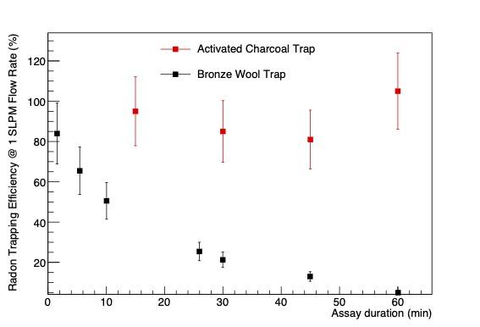
Charcoal versus Bronze Traps
Unlike bronze wool trap, charcoal trap is 100% efficient after one hour of assay duration
The trap is also 100% efficient for flow rate of up to 5 SLPM
The method developed to test this charcoal trap can be used to test other radon traps

Slide 21
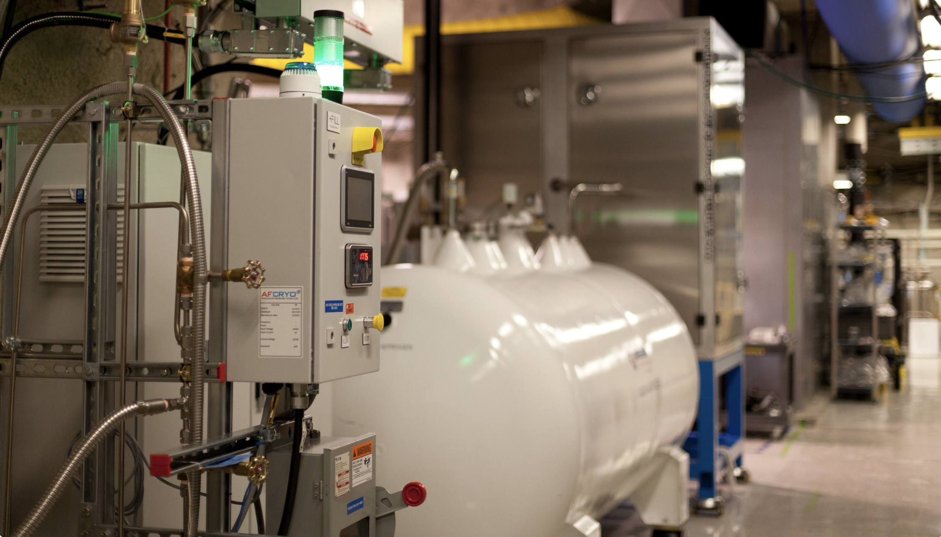
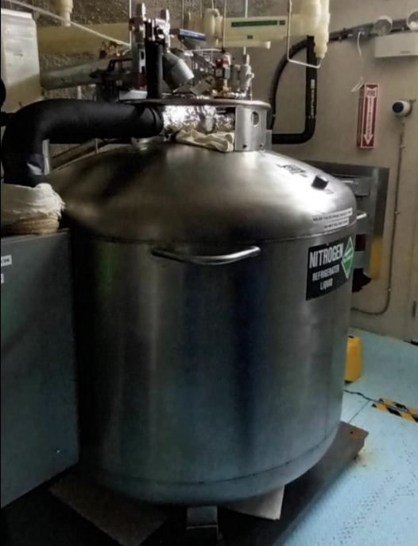
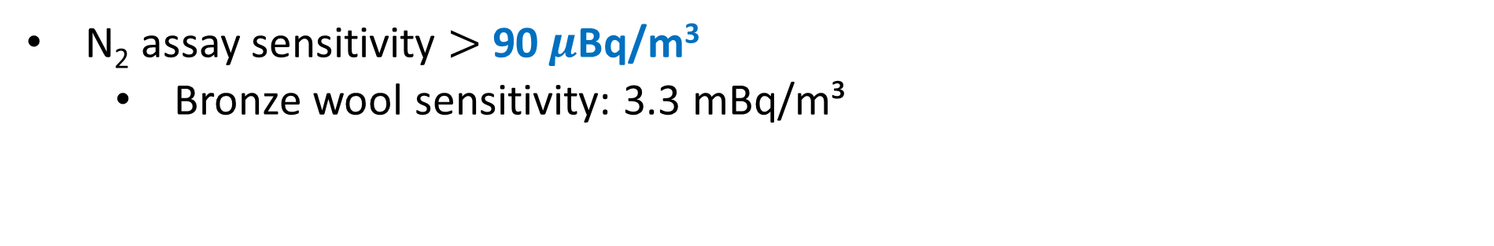
Charcoal Trap Sensitivity and Use
N₂ assay sensitivity $>$90$μ$Bq/m³
  Bronze wool sensitivity: 3.3 mBq/m³
Trap used to measure radon in N₂ systems, incl. SNOLAB LN₂ plant boil-off
SNOLAB LN₂ plant
SNOLAB International Dewar

Slide 22
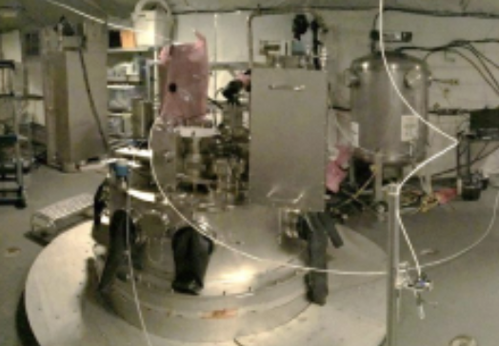
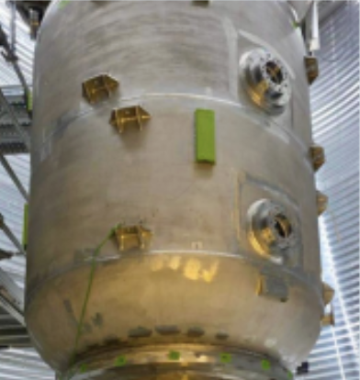
Application on Experiments
SNO+: provided radon level in the cover gas system
PICO-500 (see Hantz Nozard talk: DAPI T2-1)

Slide 23
Radon Removal Techniques

Slide 24
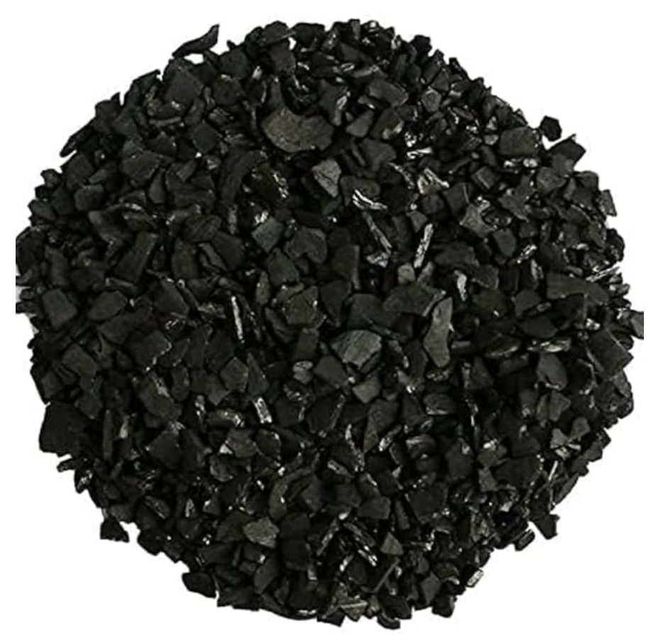
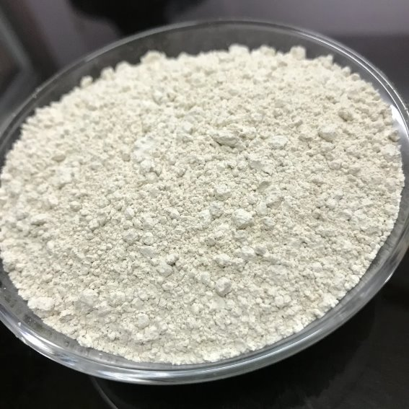
Removal of Rn from liquid/gas
Cryogenic Distillation
Physical Adsorption
Condenser
Boiled-off
liquid/gas
Liquid/gas
Rn
Heater
Using Raoult’s law:
the concentration (Rn) in the gas
equals the vapor pressure times its mole fraction
Application: Liquid Xenon
Making a trap with
silver exchanged zeolite
Room temperature
Application: Liquid Argon, boil-off N₂
Making a cryogenic trap from activated charcoal
Application: Liquid Argon, boil-off N₂

Slide 25
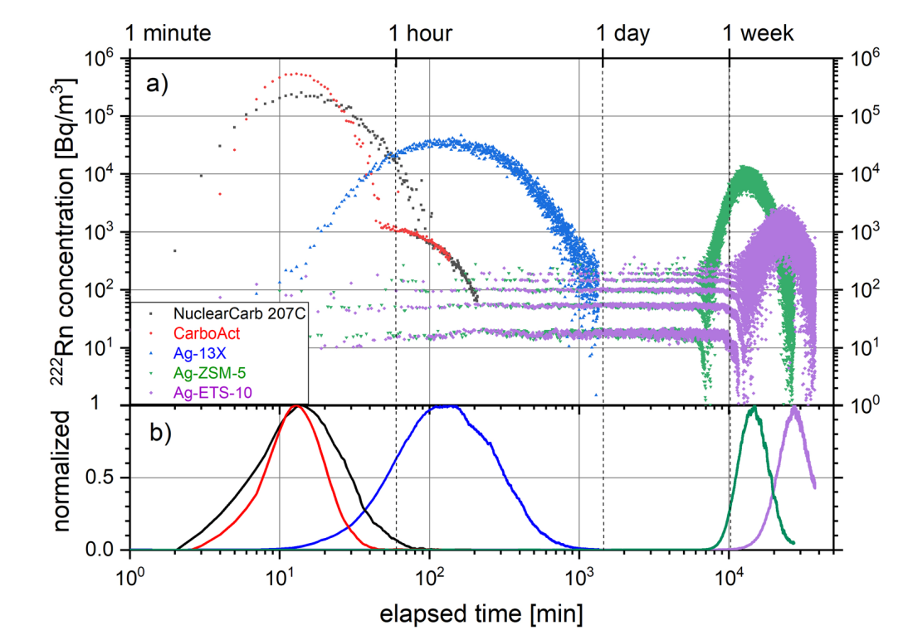
Silver Exchanged Zeolite for Rn Removal
Demonstrates 10–100 times higher adsorption efficiency than activated charcoal at room temperature
Planned usage at SNOLAB radon removal from N₂ cover gas systems
Currently testing Ag-13X at room temperature at SNOLAB
Efficiency measurements of a radon trap is ongoing using surface board setup
Collaboration with Queen’s argon and xenon astroparticle group to develop a radon trap for argon and xenon systems
17 g adsorbent at room temperature
Nitrogen
S. Heinitz, et al. Nature: Sci Rep 13, 6811 (2023)
Notes:
Time that radon breakthrough the trap, ideal trap is lets everything through but radon

Slide 26
Controlling Radon Ingress in the Experiments

Slide 27
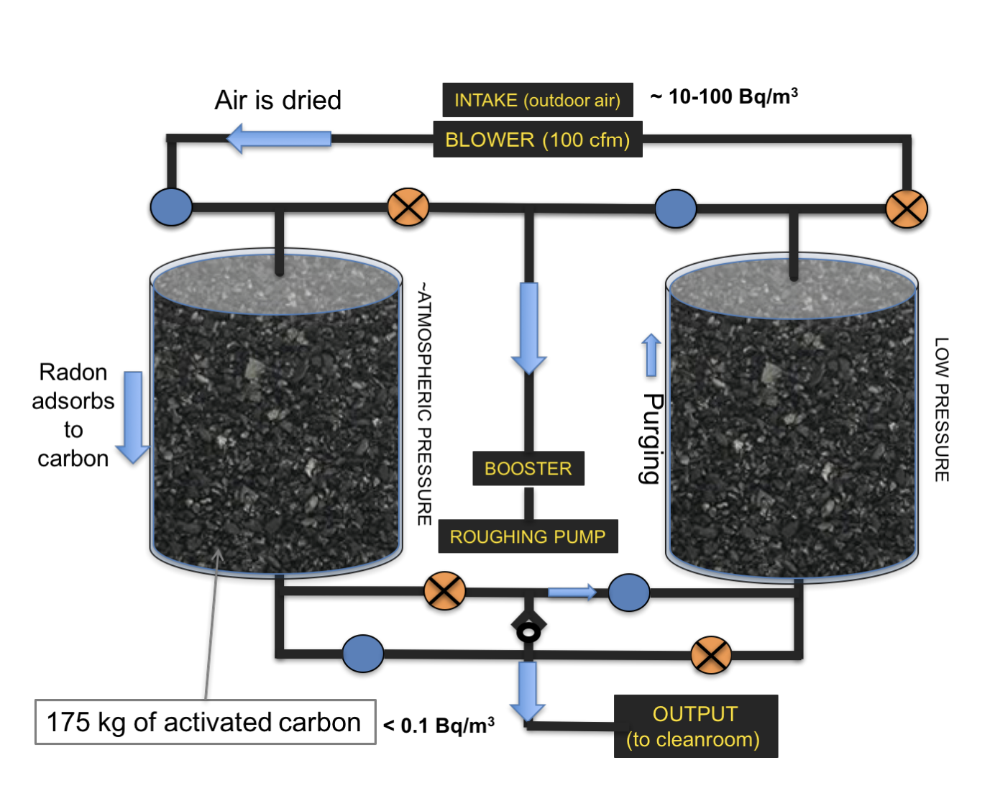
Radon Reduced air
arXiv:1708.08535
Can use columns of activated charcoal (or silver exchanged zeolite) to create a low radon concentration environment
SuperCDMS achieved <0.1 Bq/m³
Such systems will be needed for future large-scale projects

Slide 28
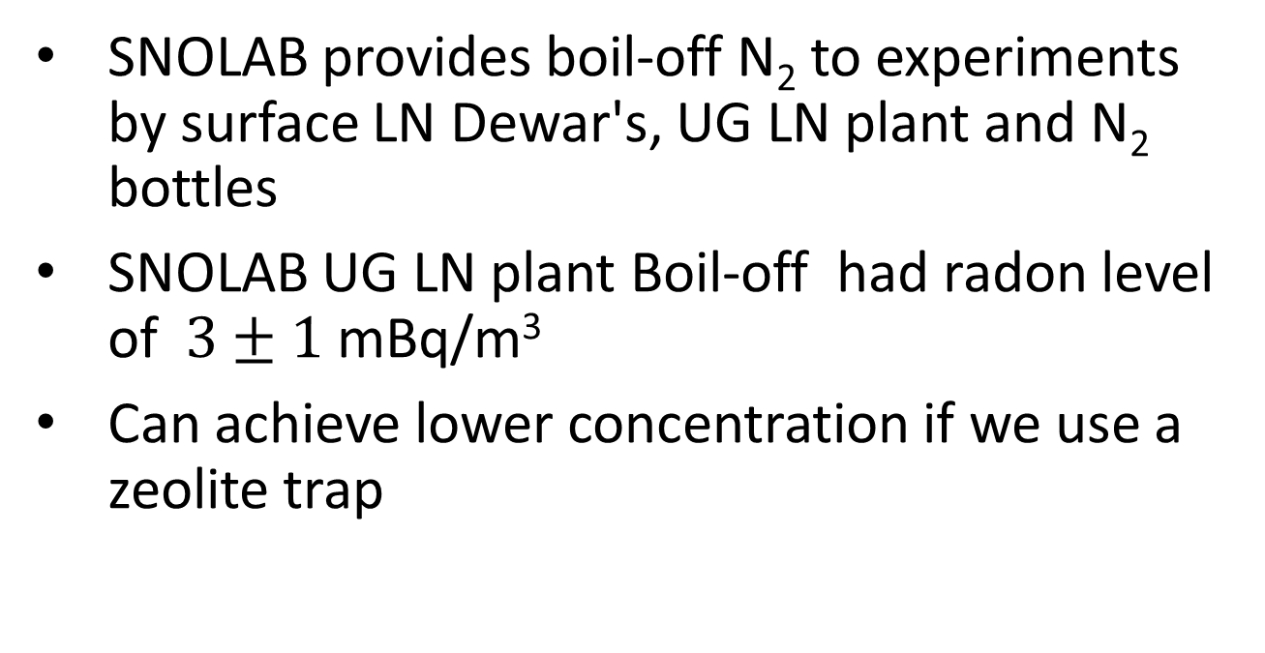
N₂ Cover Gas Systems
SNOLAB provides boil-off N₂ to experiments
by surface LN Dewar's, UG LN plant and N₂ bottles
SNOLAB UG LN plant Boil-off had radon level of $3±1$ mBq/m³
Can achieve lower concentration if we use a zeolite trap

Slide 29
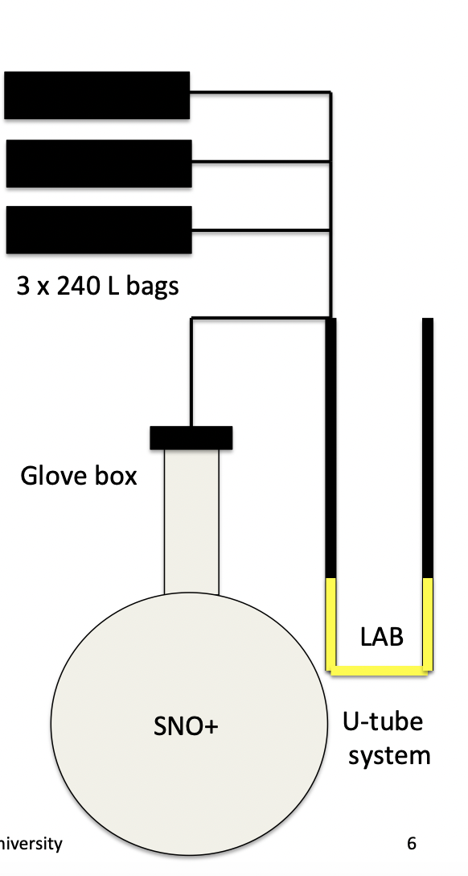
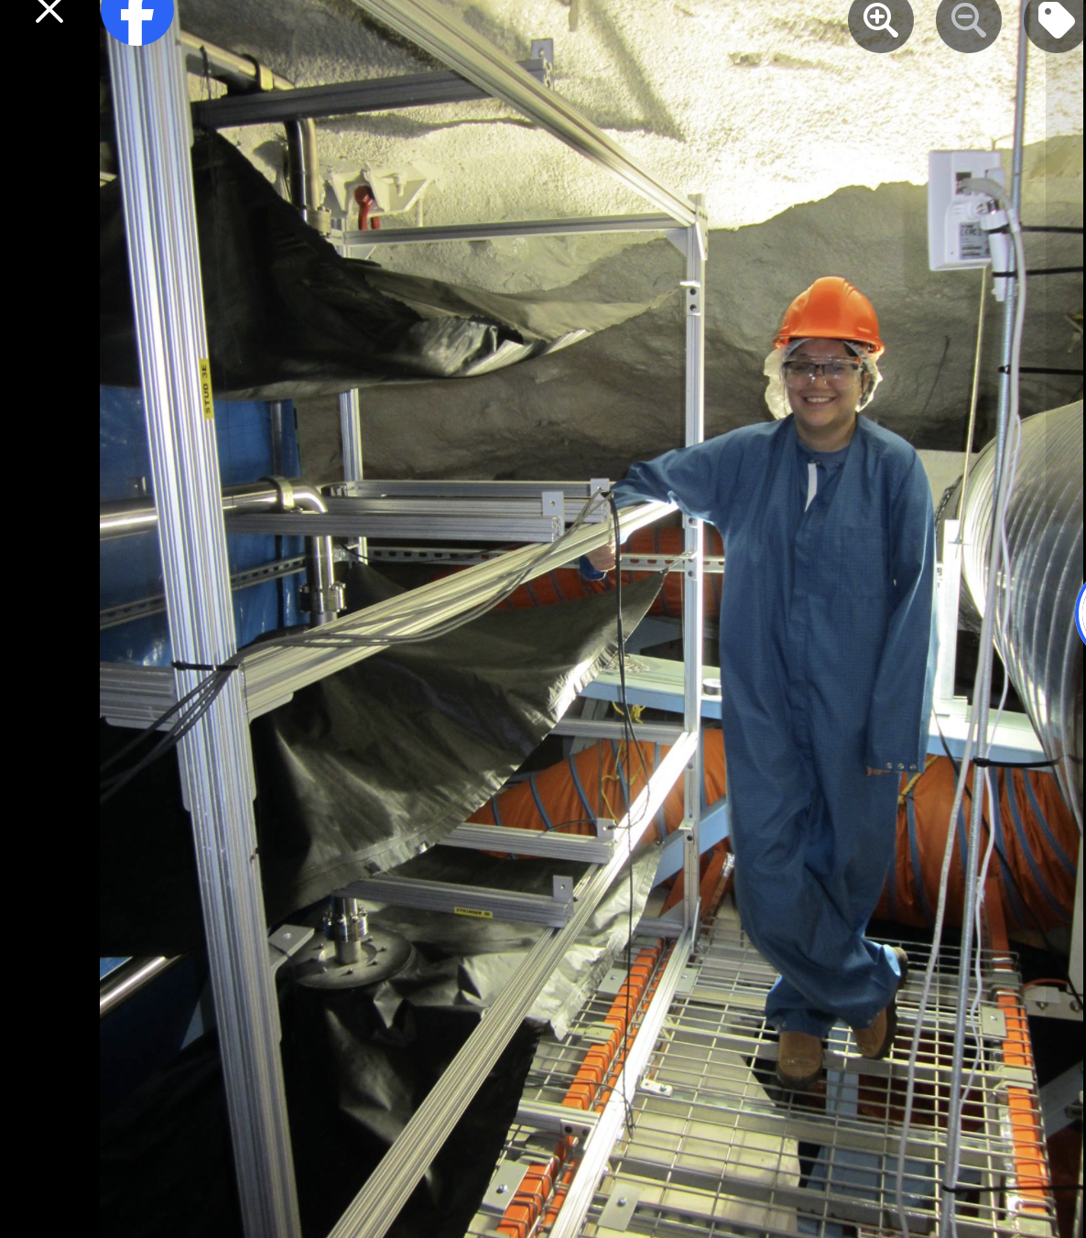
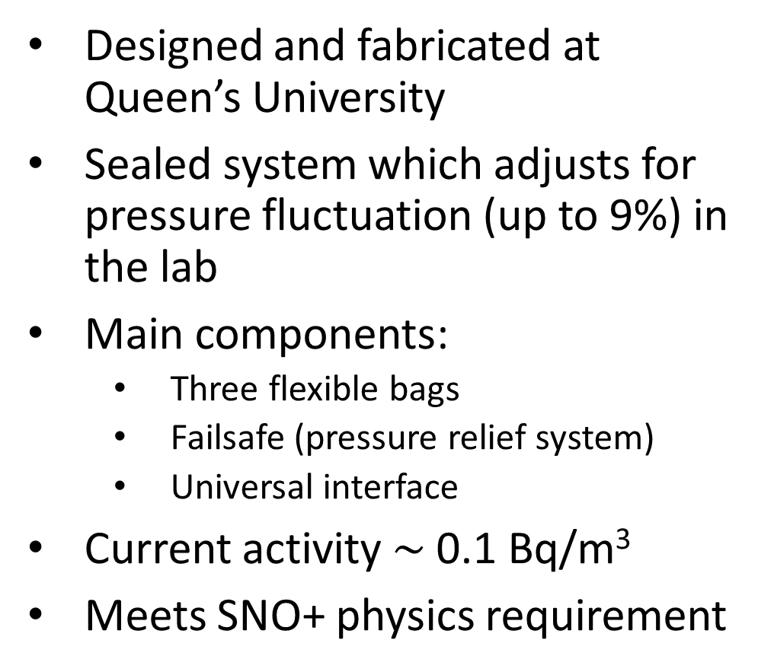
SNO+ unique N₂ Cover Gas system
Designed and fabricated at Queen’s University
Sealed system which adjusts for pressure fluctuation (up to 9%) in the lab
Main components:
  Three flexible bags
  Failsafe (pressure relief system)
  Universal interface
Current activity $\sim$0.1 Bq/m³
Meets SNO+ physics requirement
Notes:
Slide 20 to 22 put it later at the end

Slide 30
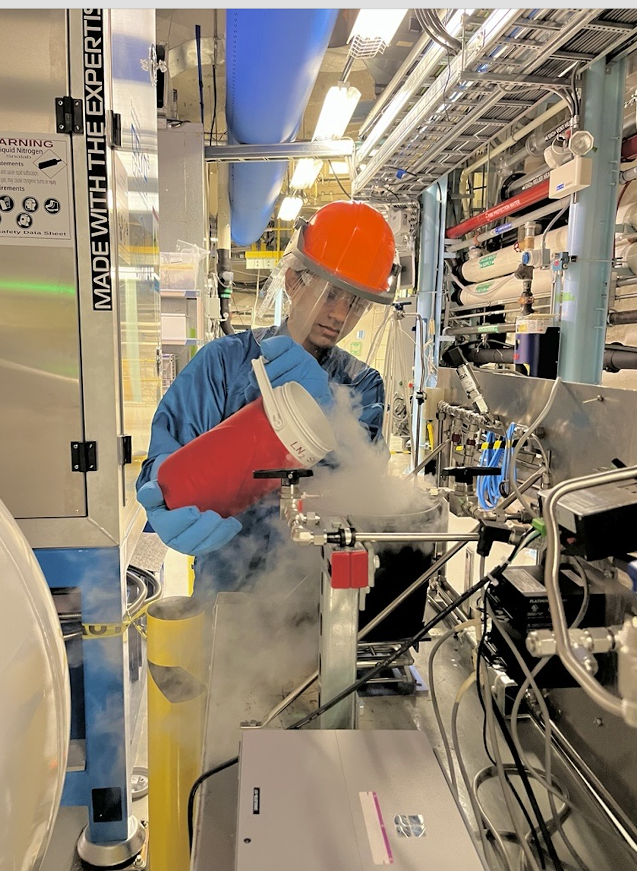
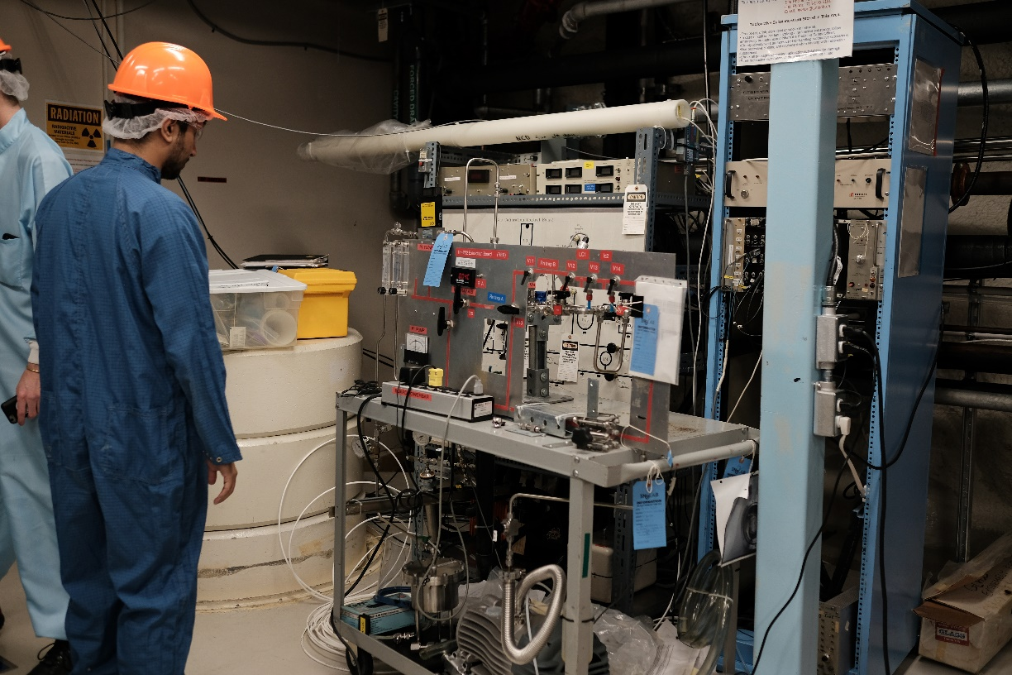
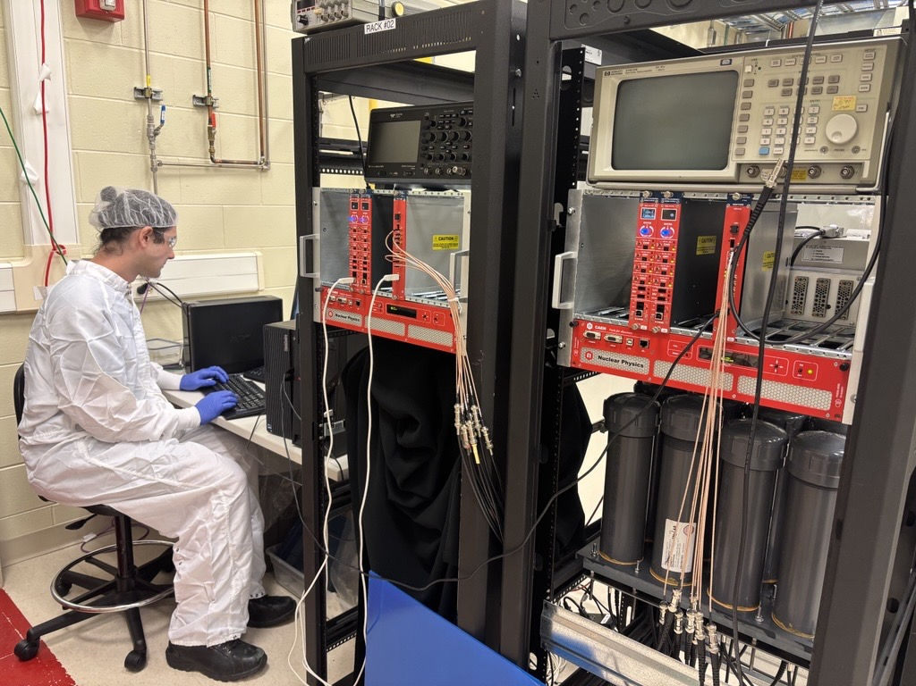

Acknowledgement
Research Students (SNOLAB/SNO+):
Yusuf Ahmed, Juliette Deloye, Peter Qin, Justin Suys, Keegan Paleshi, Adil Hussain, Jerry Lu, Ariana Pearson, Julia Azzi, Madeleine Berube and Gurpreet Kainth and Connor Stubbs
Scientific Support Team:
Lina Anselmo, Steven Maguire, Sharayah Read, Deena Fabris and Dimpal Chauhan

Slide 31
Summary
SNOLAB’s rare-event experiments probe fundamental questions in particle physics
Controlling ²²²Rn-induced backgrounds is critical to achieving physics goals
SNOLAB continues to strengthen its radon mitigation program by:
  Building and operating low-background radon assay systems
  R&D toward making low background radon counting systems
  Developing advanced radon removal techniques
  Creating radon reduced environments with boil-off N₂
  Maintaining existing radon systems
Majority of the work presented today is done by SNOLAB undergraduate research students

Slide 32
Back up

Slide 33


Water Radon Assay System
Designed and built by the SNO collaboration (DOI: 10.1016/j.nima.2003.10.103)
Operated by SNOLAB and SNO+ to monitor ²²²Rn level of SNO+ cavity UPW
and SNOLAB UPW plant
The SNO+ experiment
Degassser
Trap B
Water trap
Trap A
Water shielding
(7000 tonnes UPW)

Slide 34


Water Radon Assay System
Degasser
Water trap (-60 C)
Radon extraction board
H₂O from SNO+ cavity/UPW plant
(19 SLPM)
Water return to cavity

Slide 35



V203: Between Acrylic Vessel and PMTs
Results are consistent with SNO times
SNOLAB UPW plant radon level is (2.4$±$0.7)$×{10}^{−14}$g²³⁸U/gH₂O equivalent
= (0.14 $±$0.04) Rn atoms/L

Slide 36



Radon Calibration Source for Trap testing
A calibrating source was made using Nora Xp 5319
rubber floor tile
10cm
Fit is based on²²⁶Ra-supported emanation
and ²²²Rn outgassing from porous rubber tiles
14 x 10 cm² floor tiles
Calibration Can

Slide 37




Detector Medium
Detector Wall
$$α$$
¹³C
$$n$$
$$α$$
$$α$$
¹⁶O

