Slide 1

Alice and Rob Revisited
How Quantum Reference Frames can provide New Insights into Entanglement Degradation
June 23, 2026
CAP 2026 (U. Ottawa)
Everett A. Patterson
Notes:
Give a verbal description of Map here.

Slide 2



“Entanglement transference and non-inertial quantum reference frames”
https://arxiv.org/abs/2603.23601
arXiv pre-print
Sijia Wang
Robb Mann

Slide 3
Outline
(1) Introduce Quantum Reference Frames (QRFs)
+ Entanglement Degradation
(2) Results in Relativistic Quantum Information (RQI)
and in Quantum Information (QI)
(3) Discussion

Slide 4
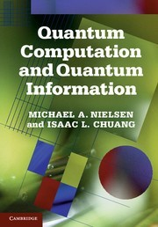
What is RQI?
Relativistic Quantum Information (RQI) asks two things:
(1) How does relativity affect QI protocols?
(2) Can relativity enable new QI protocols/phenomena?

Slide 5
RQI in practice
‘Classical’ RQI Examples
Gravity-Induced Entanglement
Entanglement Harvesting
Quantum Energy Teleportation
Entanglement Degradation
‘New’ RQI Examples
Relativistic Quantum Resources
  (Beyond Entanglement)
  Magic, Contextuality, etc.
Indefinite Causal Order
Holographic RQI
Quantum Reference Frames
Notes:
Emphasize that all examples focus on the resource of Quantum Entanglement

Slide 6
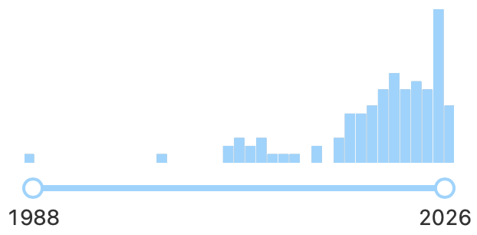

Why Quantum Reference Frames?
All physics is described relative to some Reference Frame
  Implicitly or Explicitly
Assume the Universe is fundamentally quantum
Self-consistent description of Quantum Theory?
Requires notion of Quantum Reference Frame (QRF)
Renewed interest in last 10 years

Slide 7
Quantum Reference Frames
Physics is described relative to RFs
Reference Frames (RFs) crucial for Gravity (GR)
Quantum Reference Frames (QRFs) should extend this notion of relationality to Quantum Theory
Not present in Quantum Theory a priori
QRFs may offer insights in Quantum Gravity
Notes:
Consider citing GCB 2019

Slide 8
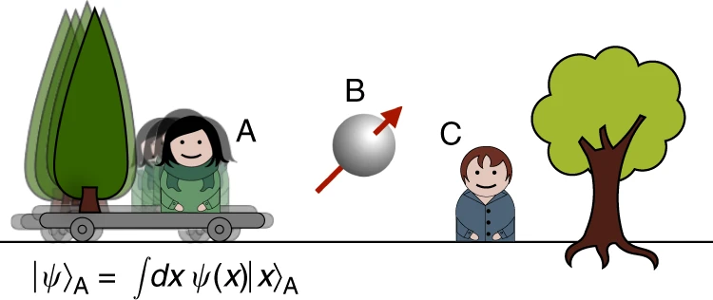
Perspectival QRF
Giacomini, Castro-Ruiz, Brukner 2019 Nat. Comm.
de la Hamette, Galley 2020 Quantum
Describes multipartite system, relative to subsystem
QRF Transformations between subsystems
Assume: Cannot perceive oneself to be superposed
Figure from Giacomini, Castro-Ruiz, Brukner 2019 Nat. Comm.
Notes:
Maybe explicitly include the E+C invariant formula here.
(2) Describe QRF Transformations here.

Slide 9
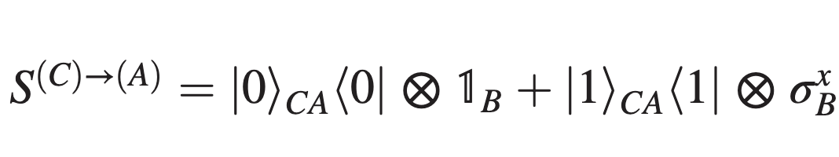
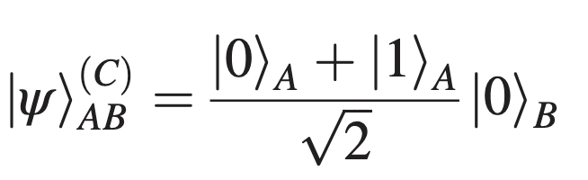
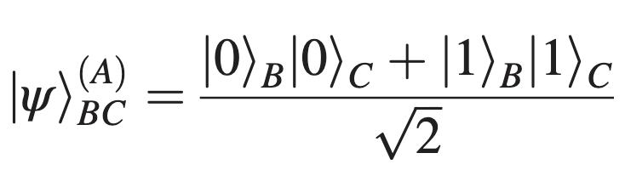
Example (QRF)
Cepollaro et al. 2025 PRL
Entanglement: E^(C)_{AB} = 0
Coherence: C^(C)_A =1
Entanglement: E^(A)_{AB} =1
Coherence: C^(A) =0
Notes:
Describe QRF Transformations here.

Slide 10
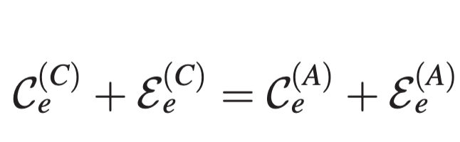
Entanglement & Coherence (QRF)
Cepollaro et al. 2025 PRL
Entanglement: E^(C)_{AB} = 0
Coherence: C^(C)_A =1
Entanglement: E^(A)_{AB} =1
Coherence: C^(A)_C =0
Notes:
”Despite QRFs purported application to QG, this example is purely QI.”
“How might we extend or apply these results to QG? Or more specifically, to RQI?”

Slide 11
Entanglement Degradation
Alice and Rob share a pair of entangled field modes in flat spacetime
Alice follows a static trajectory
Rob follows a uniformly accelerated trajectory
The entanglement shared between the modes degrades monotonically with Rob’s acceleration
Explanation: Accelerated observers experience the quantum vacuum to be in a thermal state. (Unruh Effect) This temperature decoheres Rob’s mode, leading to the loss of entanglement.
Notes:
CAP version – i.e., lay audience

Slide 12
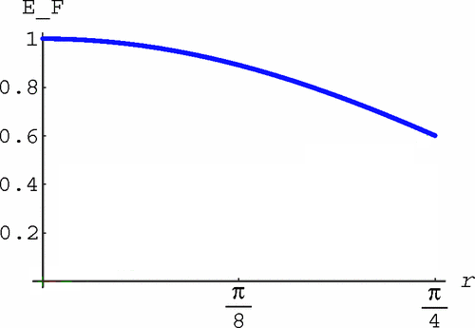
Entanglement Degradation
20 years ago!
Fuentes, Mann 2005 PRL
Alsing, Fuentes, Mann, Tessier 2006 PRA
“Entanglement is observer-dependent quantity in non-inertial frames”
“Consequence of the Unruh effect”
~ acceleration
Notes:
Next: Technical details

Slide 13
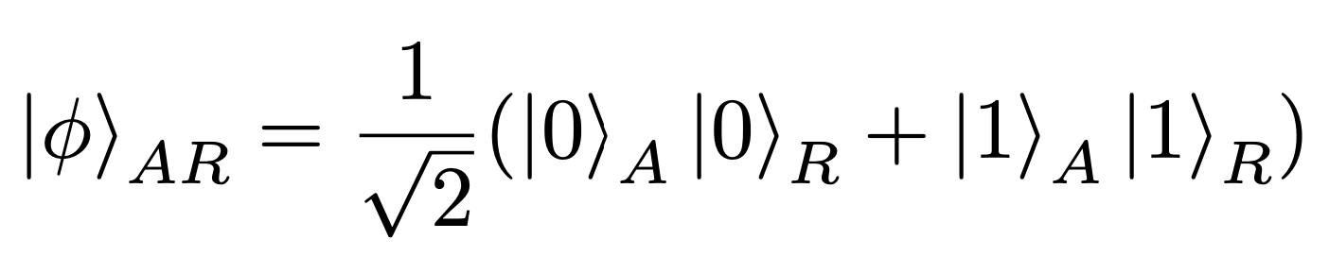
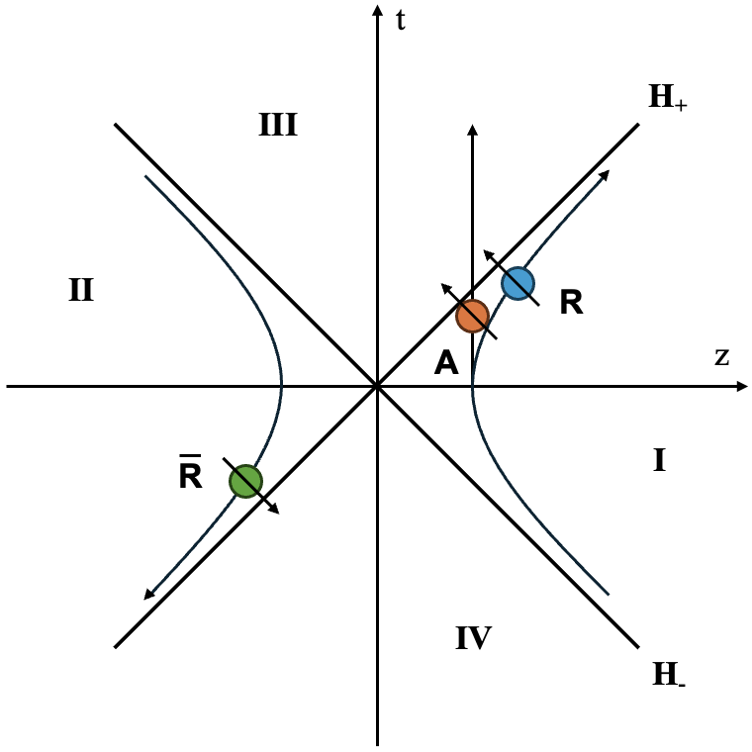
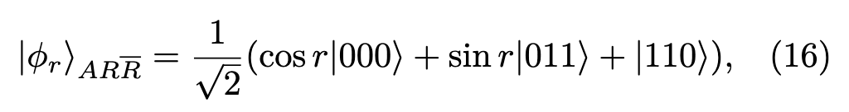
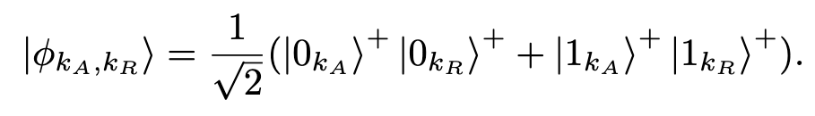
Entanglement Degradation
Fuentes, Mann 2005 PRL
Alsing, Fuentes, Mann, Tessier 2006 PRA
Fermionic field in flat spacetime
Alice and Rob share a pair of entangled field modes
Rob undergoes uniform acceleration
-> Rindler modes

Slide 14
Entanglement Degradation
Fuentes, Mann 2005 PRL
Alsing, Fuentes, Mann, Tessier 2006 PRA
Joint state
Want entanglement between
Alice and Rob
Trace over anti-Rob
Compute entanglement of reduced density matrix

Slide 15
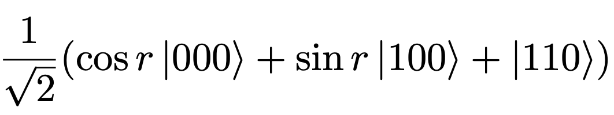
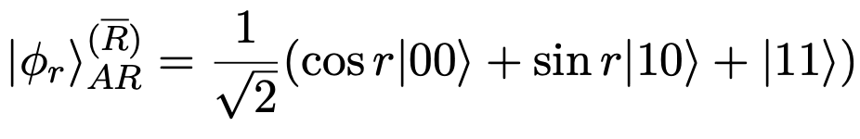
Entanglement Deg. w QRFs
Same set up as before
But ‘Perspective Assignment’
rather than trace:
Notes:
Add intermediate step with $\\ket{0}_C$ to be traced out.

Slide 16
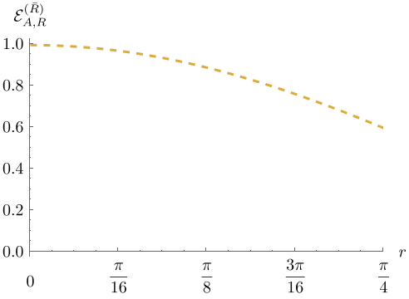
Entanglement Deg. w QRFs
Global state
Compute Entanglement Entropy:
Entanglement Degrades!
Perspectival State

Slide 17
Entanglement Deg. w QRFs
Global state
Perspectival State
Plot from Alsing, et al. 2006 PRA
Notes:
”So, we are able to reproduce the known results, using QRFs, which is good. But we want more…”
“We want to know what role coherence has in this, and how it relates to entanglement degradation.”

Slide 18
Coherence Generation(!) w QRFs
What about coherence?
Notes:
(1) Include plot of just coherence, (2) Add entanglement to plot, so E and C, but separate. (3)

Slide 19
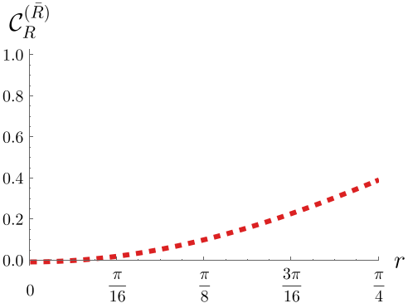
Coherence Generation(!) w QRFs
What about coherence?
Coherence increases with acceleration!
Notes:
(1) Include plot of just coherence, (2) Add entanglement to plot, so E and C, but separate. (3)

Slide 20
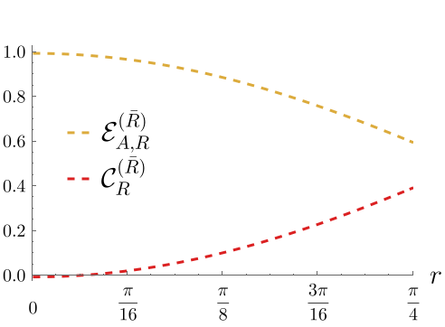
E+C for RQI
What about coherence?
Coherence increases with acceleration!
Notes:
(1) Include plot of just coherence, (2) Add entanglement to plot, so E and C, but separate. (3)

Slide 21
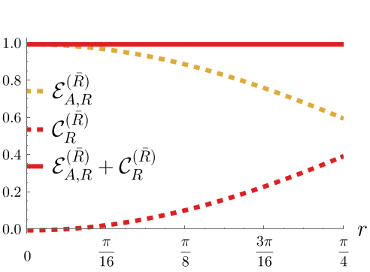
E+C for RQI
What about coherence?
Coherence increases with acceleration!
AND exactly offsets the lost entanglement!
Thermalization no longer a good explanation!
Notes:
(1) Include plot of just coherence, (2) Add entanglement to plot, so E and C, but separate. (3)

Slide 22
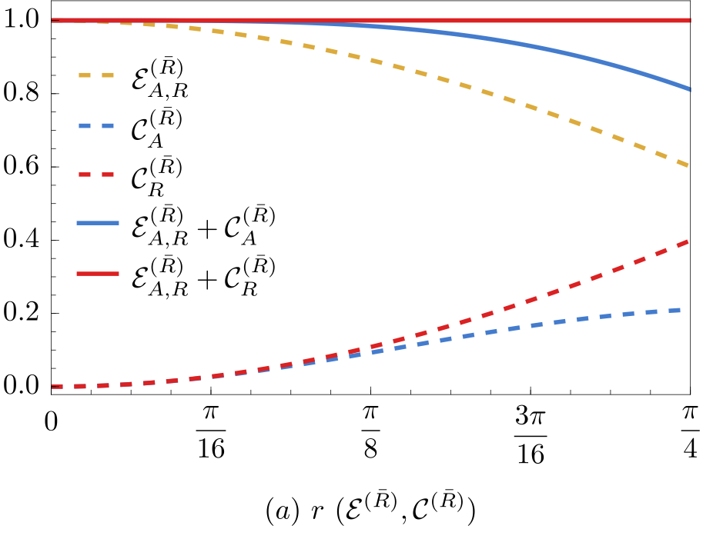
E+C for RQI
What about other subsystem coherence?
E+C should be invariant for QRF transformations.
Notes:
(1) Include plot of just coherence, (2) Add entanglement to plot, so E and C, but separate. (3)

Slide 23
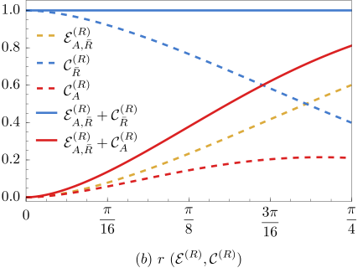
E+C for RQI
Alice
Anti-Rob
Rob
Notes:
(1) Include plot of just coherence, (2) Add entanglement to plot, so E and C, but separate. (3)

Slide 24
E+C for RQI
Alice
Anti-Rob
Rob
Notes:
(1) Include plot of just coherence, (2) Add entanglement to plot, so E and C, but separate. (3)

Slide 25
E+C for RQI
Alice
Anti-Rob
Rob
Notes:
(1) Include plot of just coherence, (2) Add entanglement to plot, so E and C, but separate. (3)

Slide 26
E+C for RQI
Alice
Anti-Rob
Rob
Notes:
(1) Include plot of just coherence, (2) Add entanglement to plot, so E and C, but separate. (3)

Slide 27
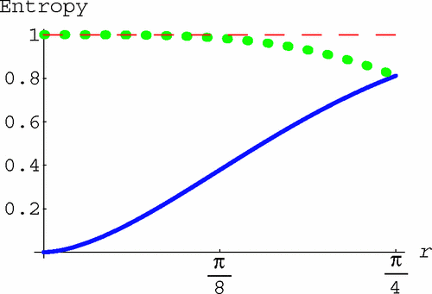
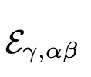
E+C for RQI
Alice
Plot from Alsing, et al. 2006 PRA
Rob
Notes:
(1) Include plot of just coherence, (2) Add entanglement to plot, so E and C, but separate. (3)

Slide 28
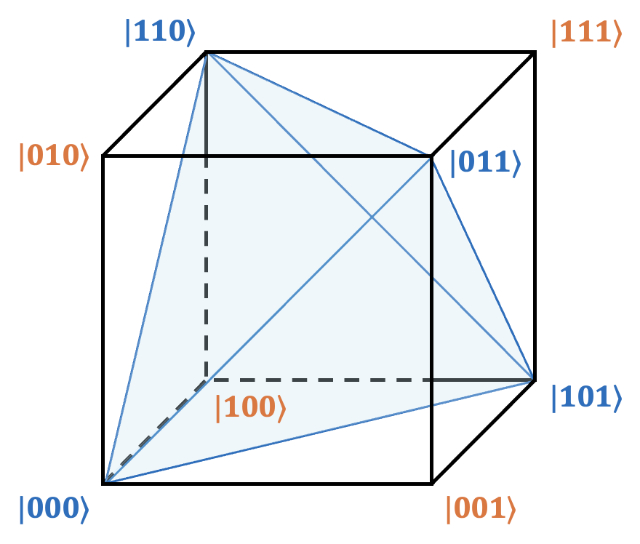
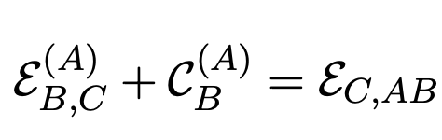
Entanglement Transference
Connects perspectival and global quantum resources!
Restricted to “Parity States”
Because of perspective assignment procedure

Slide 29

Concluding Remarks
QRFs seem interesting and useful
Open questions include:
Other resources?
Apply QRFs to the ‘non-inertial frames’
QRFs insights for you?
https://arxiv.org/abs/2603.23601

Slide 30
Supplementary Materials

Slide 31
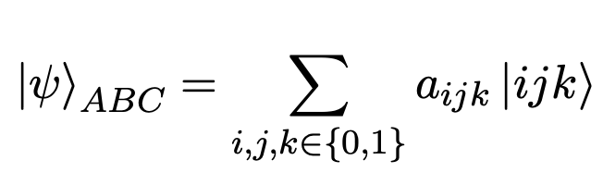
Perspective Assignment
Describe the 5-step procedure
Comment on the reduction of state space and compression of information

Slide 32
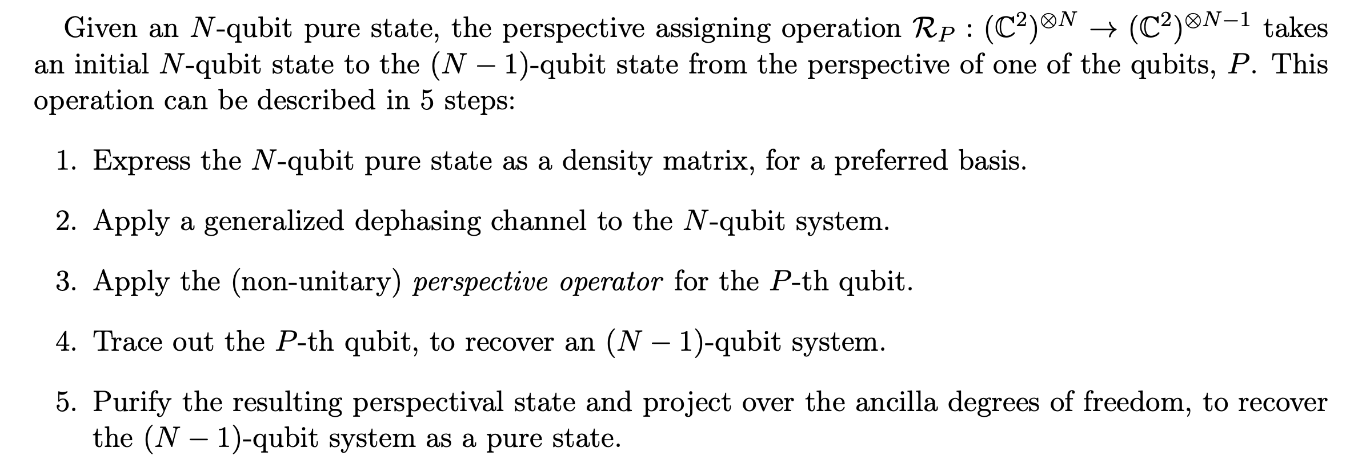
Perspective Assignment

Slide 33
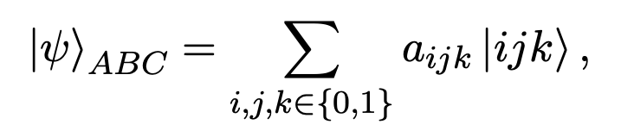
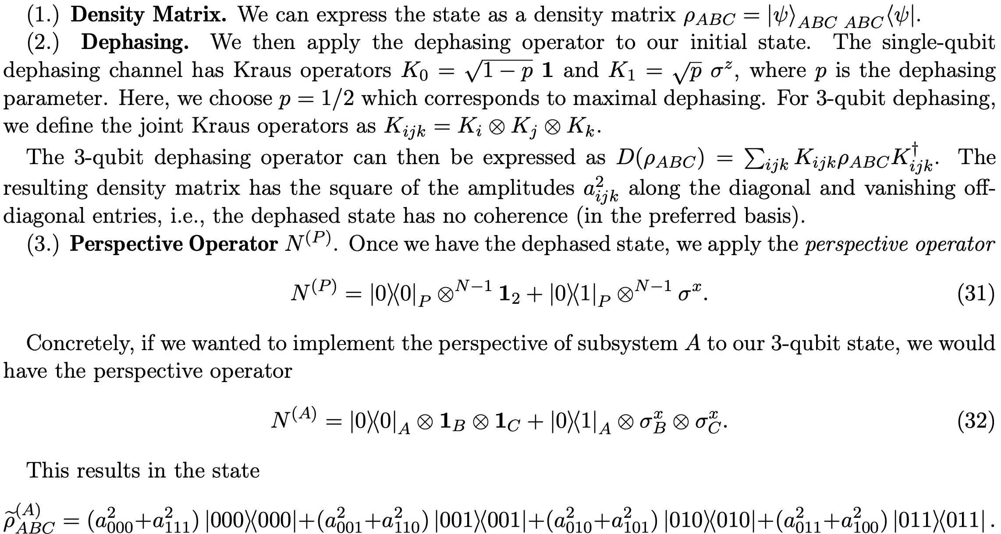
Perspective Assignment (1-3)

Slide 34
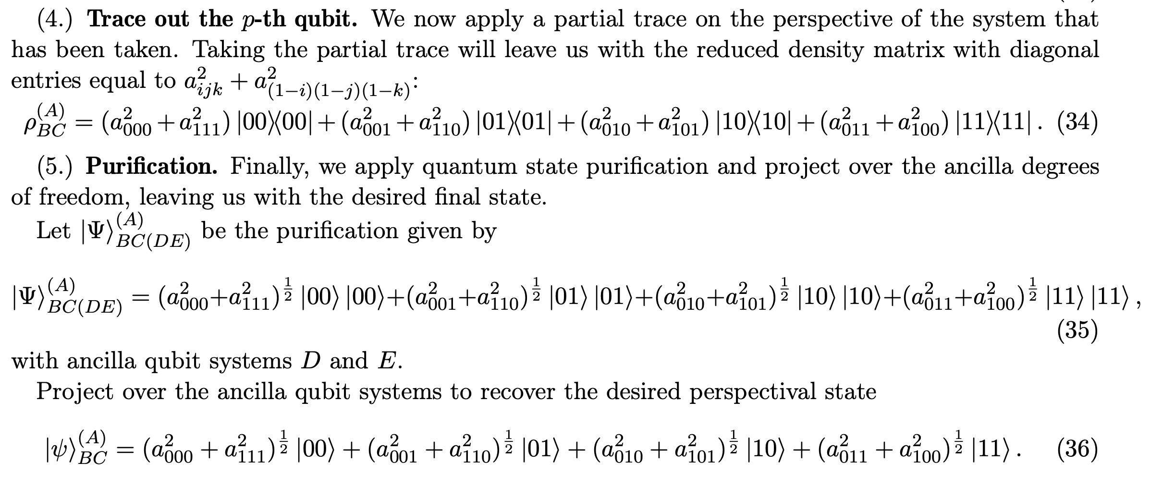
Perspective Assignment (4-5)

Slide 35
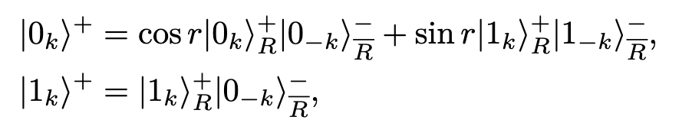
Ent. Deg. Set-Up (RQI)
Include figure of set-up
Mention Dirac (fermionic) fields
Bogoliubov transformation
Single-Mode Approximation

Slide 36
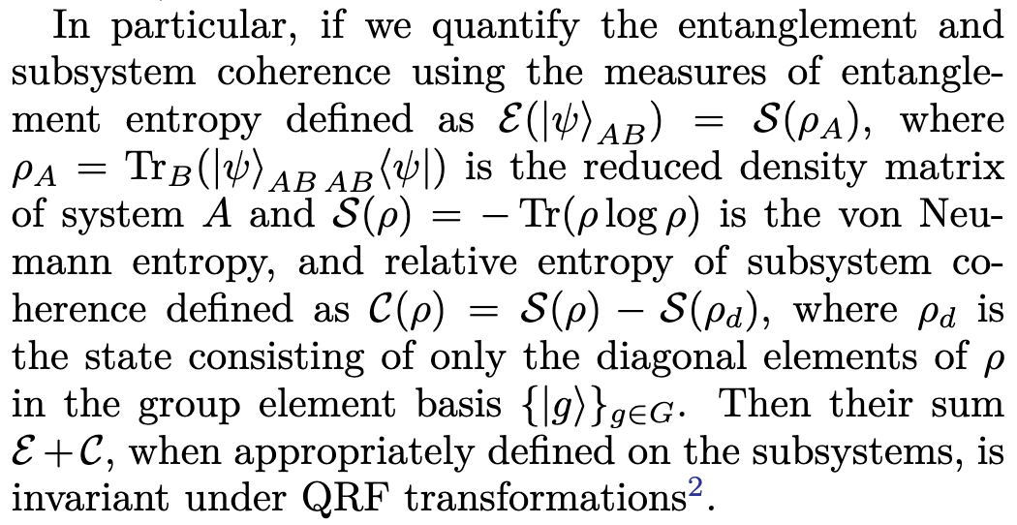
QI Definitions
Entanglement Entropy
Relative Entropy of Coherence
Entanglement of Formation
Linear Entropy
L_2-norm of Coherence

