Slide 1
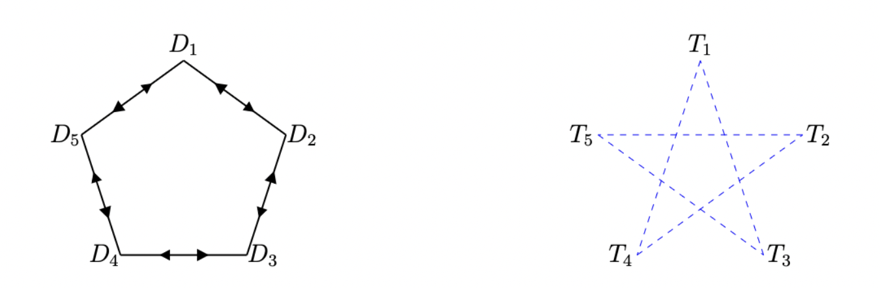
Entanglement summoning
from entanglement sharing schemes
Lana Bozanic, Alex May, Stanley Miao
Perimeter Institute for Theoretical Physics

Slide 2
Background

Slide 3
Quantum information with relativistic constraints
Basic question: What is physically possible when imposing certain quantum mechanical and relativistic constraints?
E.g.
QM: No-cloning, monogamy of entanglement, etc.
SR: No-signalling.

Slide 4
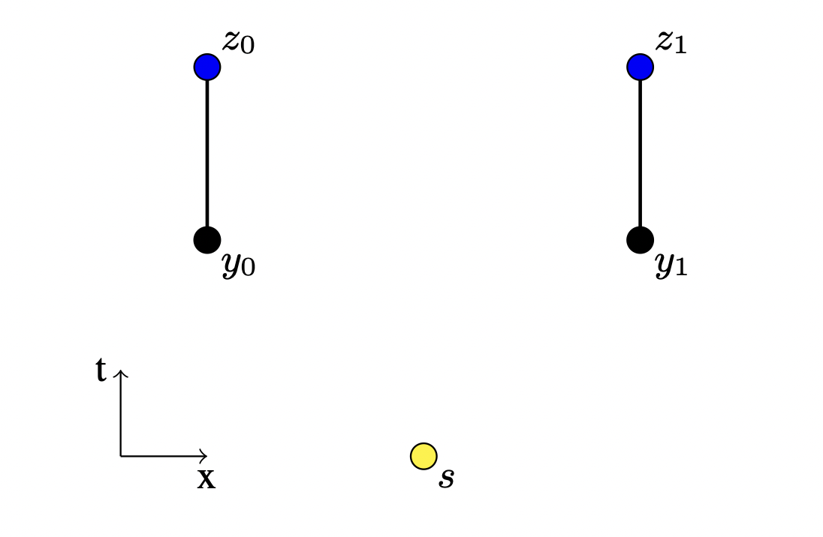








A no-summoning theorem
Reveal points
Quantum state is initially localized at
A request will be made at a call point at some point in the causal future of
If a request is made at , then should be returned to the reveal point .
Call points
Start point
No summoning: The above task cannot be completed successfully 100% of the time due to the spacelike separation of the causal regions defined by and
(Kent 2011, Hayden & May 2012)

Slide 5
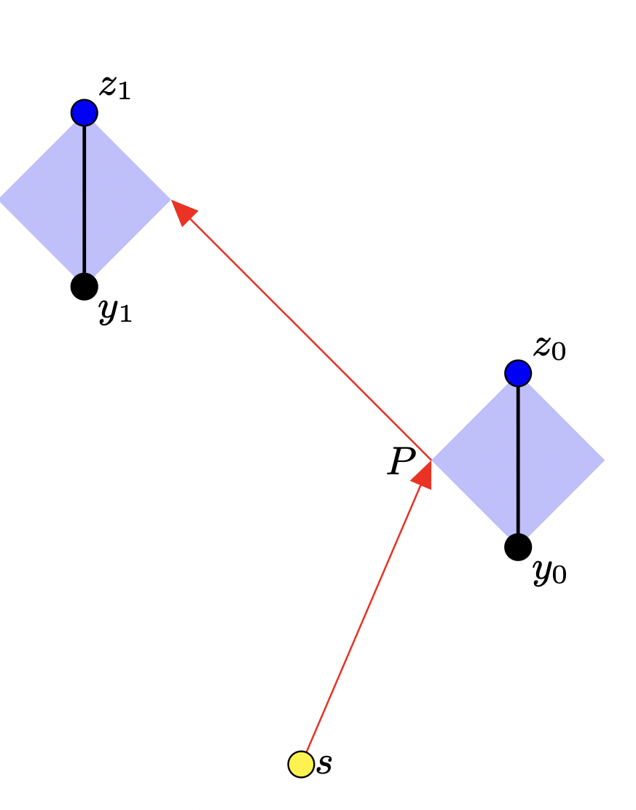



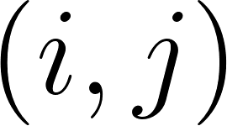

When is summoning possible?
Hayden & May established a theorem that characterizes all possible instances of single-state summoning.
We define a causal diamond to each call-and-reveal pair. This is the spacetime region that is the intersection of the causal future of and the causal past of
Single-state summoning: Summoning is possible if and only if
Every reveal point is in the causal future of
2) For each pair , there is a causal connection between and
(Hayden & May 2012)

Slide 6
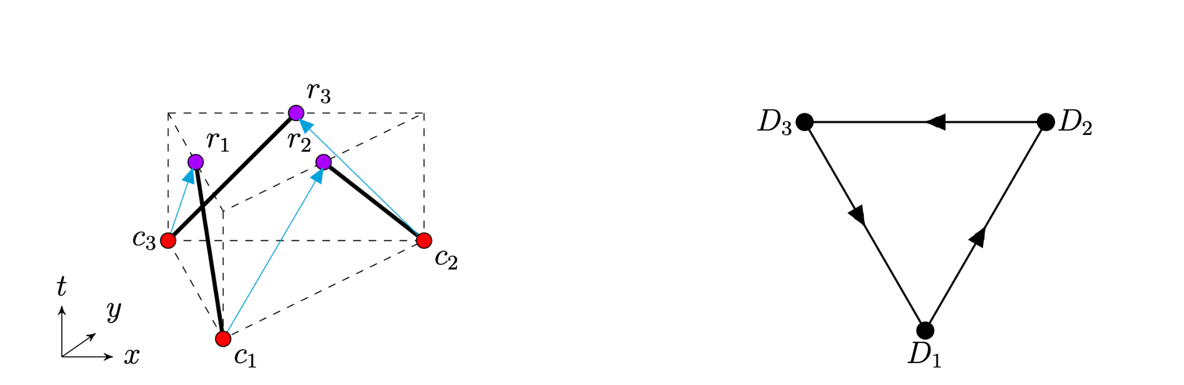

When is summoning possible?
Causal graphs
Only care about causal connections between diamonds
Geometry of summoning task reduced to a graph problem.
Theorem: Summoning is possible if and only if the causal graph is a tournament.

Slide 7
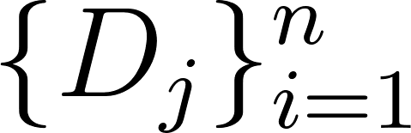

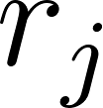

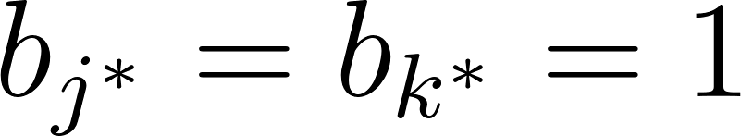
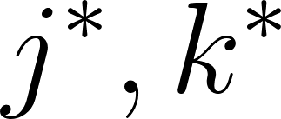


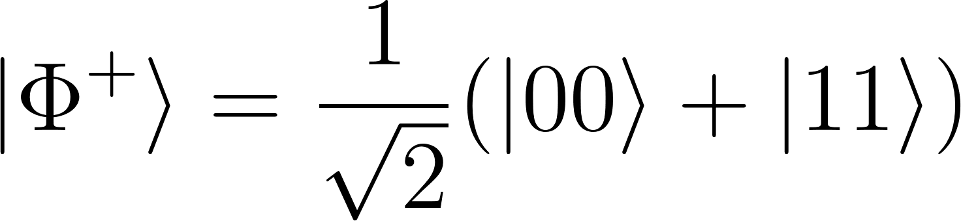
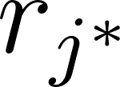


Entanglement summoning
Definition: An entanglement summoning task is specified by a set of causal diamonds each of which is defined by a call point and return point . The task involves two agencies, Alice and Bob, which perform the following:
At each , Bob gives Alice a classical bit . Alice is promised that for exactly two , but these are unknown to her beforehand.
We say the task is achievable if for any choice of by Bob, Alice can return system at and at such that the state on is
(Adlam 2018, Dolev, May & Wan 2021)

Slide 8
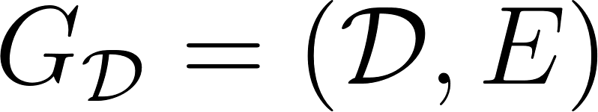
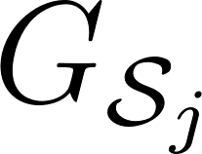
Entanglement summoning
Oriented entanglement summoning: An entanglement summoning task whose causal graph is an oriented graph is possible if and only is the subgraph induced by
is a tournament.
(Dolev, May & Wan 2021)

Slide 9

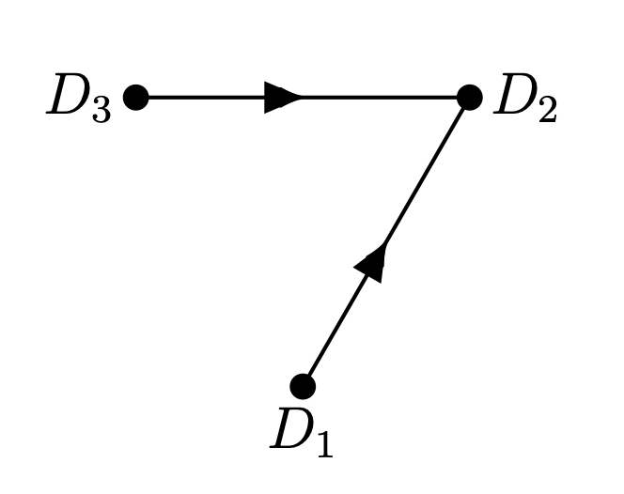
Entanglement summoning
Oriented entanglement summoning: An entanglement summoning task whose causal graph is an oriented graph is possible if and only is the subgraph induced by
is a tournament.
(Dolev, May & Wan 2021)

Slide 10

Entanglement summoning
Oriented entanglement summoning: An entanglement summoning task whose causal graph is an oriented graph is possible if and only is the subgraph induced by
is a tournament.
(Dolev, May & Wan 2021)

Slide 11
This work
Previously: Entanglement summoning only characterized for directed graphs (Dolev, May, Wan 2021)
Our contribution:
  We fully characterize the bidirected entanglement summoning case
  We partially characterize the most general case of entanglement summoning (both oriented and bidirected edges).
How?: By leveraging entanglement sharing schemes.

Slide 12
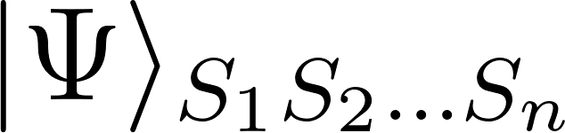

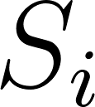
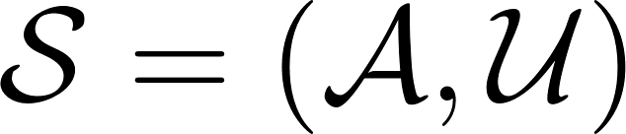
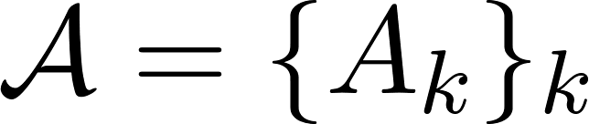

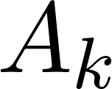

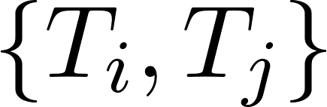
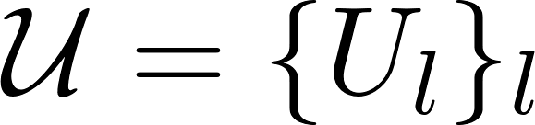
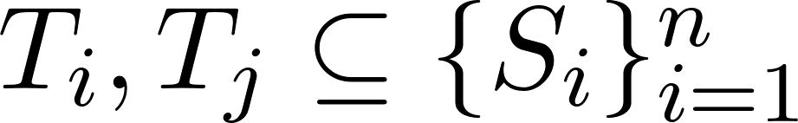
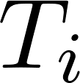
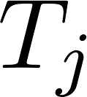
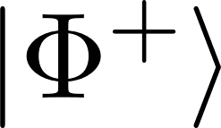

Entanglement sharing schemes (ESS)
A dealer prepares a state and sends share to party
We define an access-pair structure
authorized sets
Each and is a pair where
unauthorized sets
Each should be able to, by means of local maps on subsystems in and to recover
No should be able to recover a state arbitrary close to
* This definition is for an ESS with an unknown partner
Entanglement sharing scheme =
+
(Khanian et al. 2025)

Slide 13
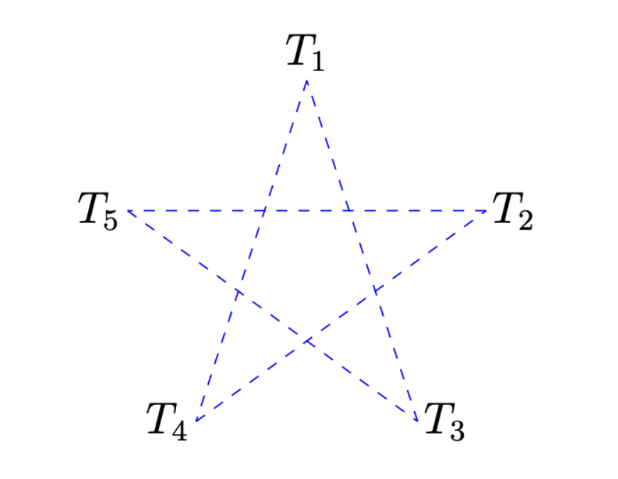
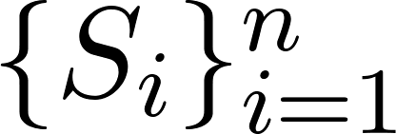
Entanglement sharing schemes
ESS can be described with an undirected graph. The “Access-Pair Graph”
Edges represent authorizations between pairs
Vertices are the subsets of
(Khanian et al. 2025)

Slide 14
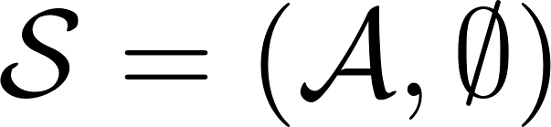
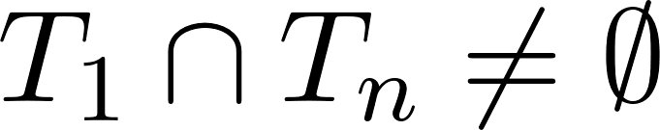
Entanglement sharing schemes
Special case of ESS: No unauthorized sets,
Theorem: A pair access structure is realizable as an ESS if and only if the following condition is satisfied.
Monogamy: For every even-length path in the access-pair graph of , it is the case that .
(Khanian et al. 2025)

Slide 15
Summoning from ESS
Main idea:
Map entanglement summoning to ESS
Use ESS characterization theorem to characterize summoning

Slide 16
Results

Slide 17
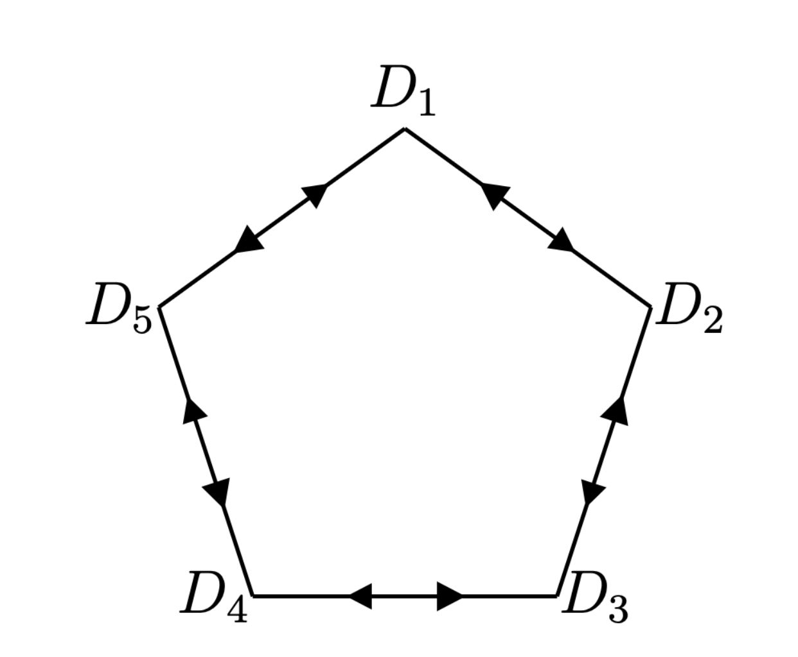
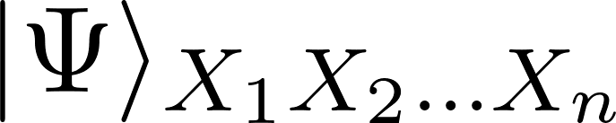
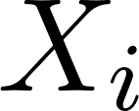

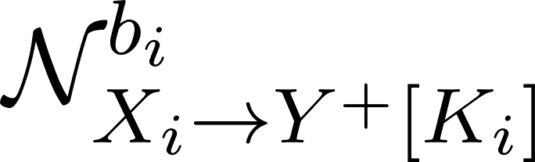
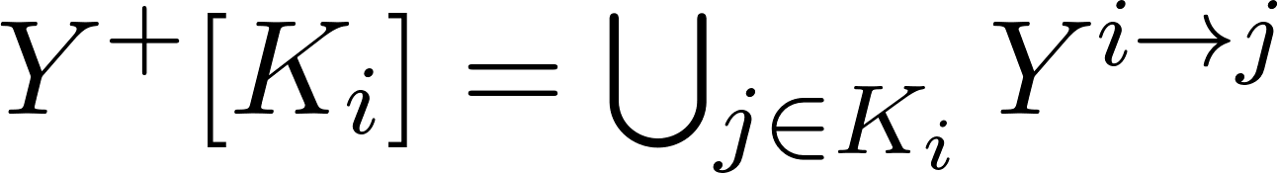
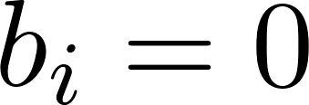
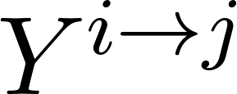

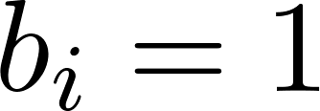

Bidirected summoning
We restrict our attention to the case where non-neighbouring diamonds receive calls
Prepare a state and send to
Alice applies a map where
- If , Alice forwards the shares to each
- If , Alice forwards all outputs to

Slide 18
Bidirected summoning
We restrict our attention to the case where non-neighbouring diamonds receive calls; > we can handle this with a dedicated EPR state between each pair.

Slide 19
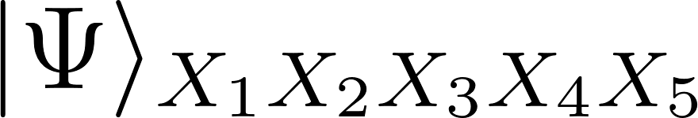
An example
0) Prepare resource

Slide 20
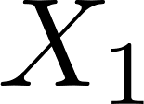
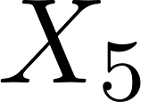
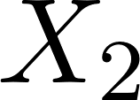
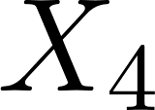
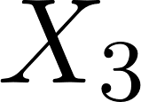
An example
1) Share the resource state.

Slide 21
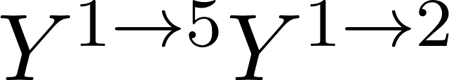
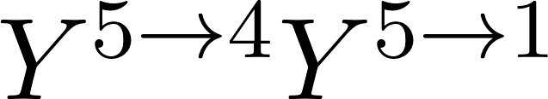
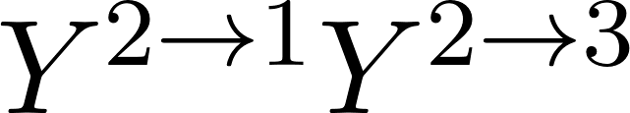
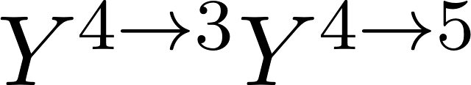
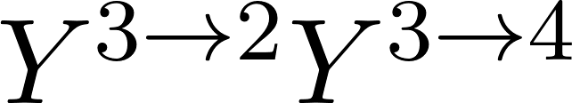
An example
2) Apply map.

Slide 22
An example
Suppose 1 and 3 get calls.

Slide 23
An example
3) 1 and 3 receives their neighbours’ shares, all other diamonds send out their shares.

Slide 24
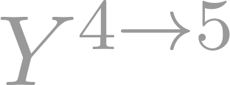

An example

Slide 25

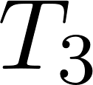
An example
The shares currently at 1 and 3 should have enough information to recover a Bell pair. They form an authorized pair.
We define

Slide 26



An example
Similarly, for the other diamonds we have

Slide 27


An example
Drawing the access-pair graph, we have
The state along with the access structure of the above defines an ESS.

Slide 28

An example
Recalling the characterization of realizable ESSs,
Theorem: A pair access structure is realizable as an ESS if and only if the following condition is satisfied.
Monogamy: For every even-length path in the access-pair graph of , it is the case that .
For ESS derived from a summoning task
No odd cycles: There are no odd cycles in the access-pair graph of

Slide 29



Bidirected summoning
The previous analysis can be generalized to come up with the following theorem that characterizes all achievable entanglement summoning tasks.
Theorem: An entanglement sharing scheme whose causal graph is bidirected is achievable if and only if the complement of the causal graph contains no odd cycles.
E.g. unachievable
E.g. achievable

Slide 30


Bidirected summoning
We can also make use of some graph theory to get a natural characterization in terms of the original graph.
We call a graph whose complement has no odd cycles co-bipartite.
Theorem: A graph is co-bipartite if and only if it admits a two-clique partition.
Theorem: An entanglement summoning task whose causal graph contains only bidirect edges is possible if and only if the causal graph admits a two-clique partition.

Slide 31


Bidirected summoning
Recall that single-state summoning requires a tournament.
We can interpret the theorem as telling us that bidirected summoning needs to admit a partitioning to summon half a Bell pair through each clique.

Slide 32
Thanks!

