Slide 1


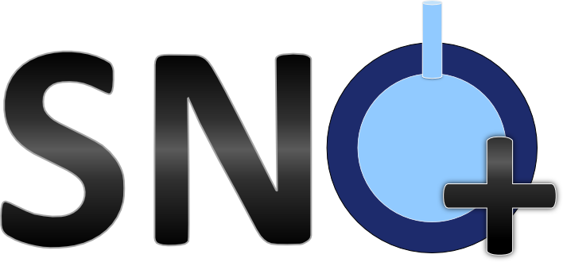
Optical Calibration of the SNO+ Scintillator Phase using a Laserball
June 22, 2026
Jamie Grove, Ph.D. Candidate
Supervisor: Dr. Alex Wright, Dr. Christine Kraus

Slide 2
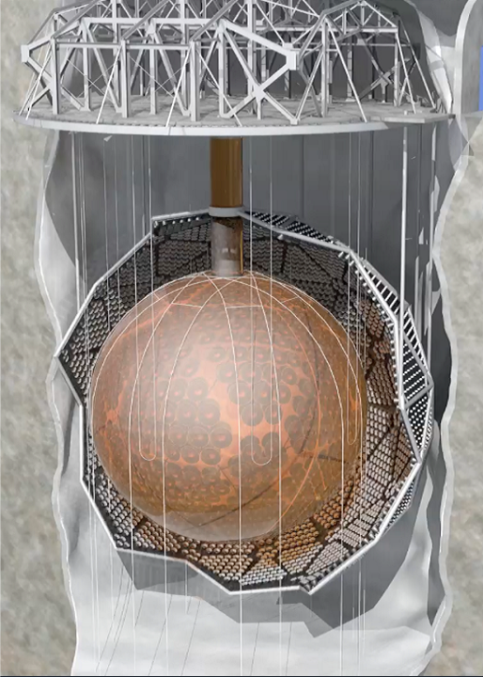
SNO+ Detector Overview
Detector is in SNOLAB, in Sudbury, Ontario Canada.
12m diameter acrylic vessel (AV), currently filled with 780 tonnes of liquid scintillator.
  LAB + 2.2g/L PPO + 2.2mg/L bis-MSB + 6.5mg/L BHT.
Viewed by ~9400 inward-facing photomultiplier tubes (PMTs) mounted on the 18m diameter stainless steel support structure (PSUP).
7000 tonnes of external ultrapure water (UPW).
AV hold-down ropes.
[1] SNO+ Collaboration

Slide 3
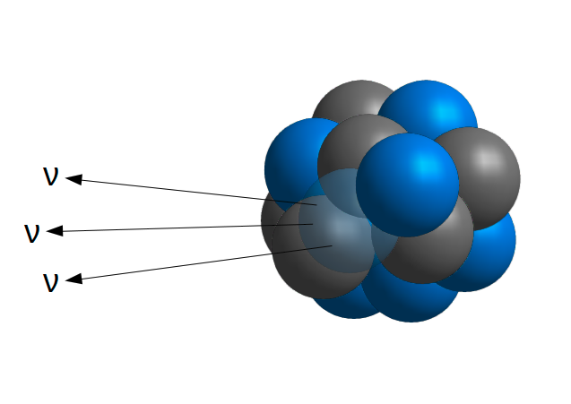
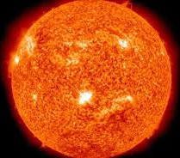
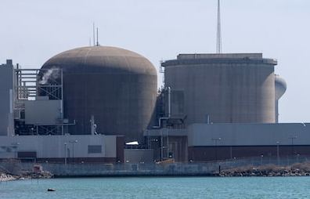
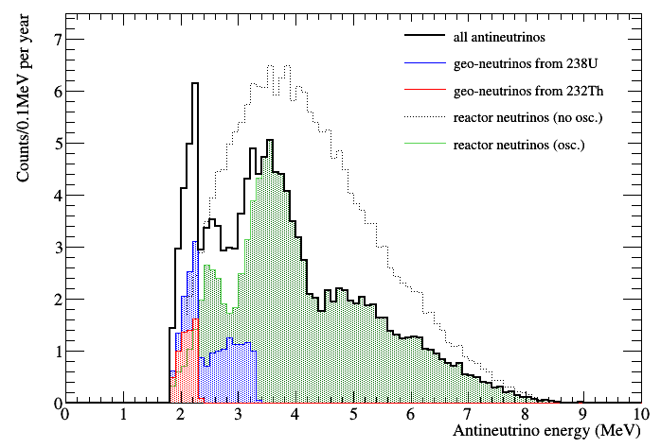
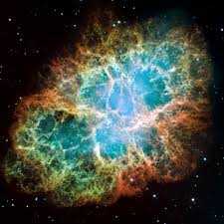
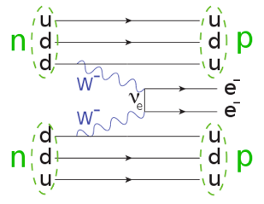
SNO+ Phases and Physics Goals
Water Phase
Scintillator Phase
Tellurium Phase
May 2017 – July 2019
905 tonnes of UPW
Started April 2022
780 tonnes of liquid scintillator
4 tonnes of natural Te loaded into scintillator
Invisible nucleon decay
Solar neutrinos
Rector antineutrinos
Solar neutrinos
Rector antineutrinos
Geo-neutrinos
Supernova neutrinos
Dark matter and axion-like particle searches
Full scintillator physics program
Neutrinoless double beta decay in ¹³⁰Te (0νββ)

Slide 4
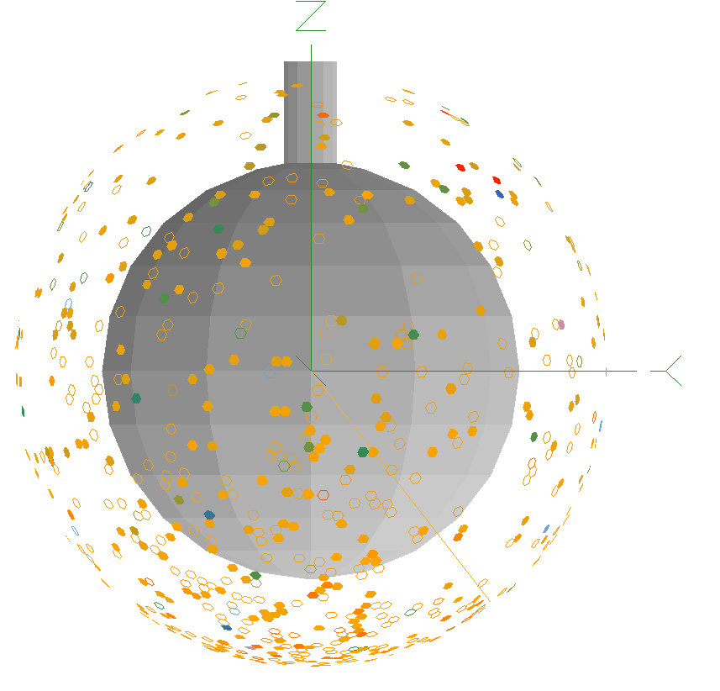
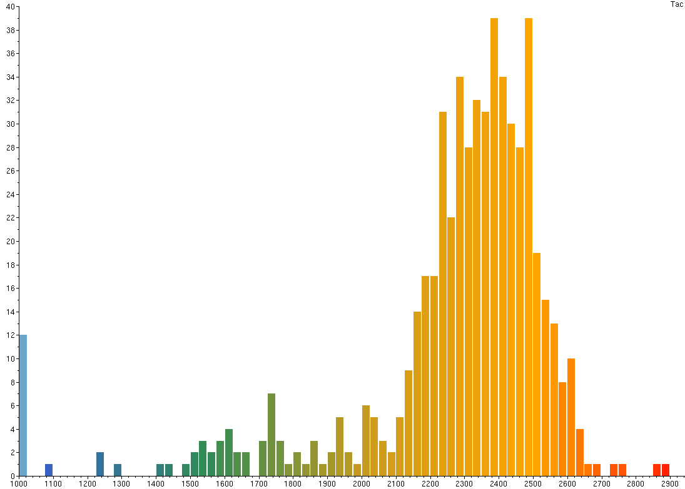
SNO+ Event Reconstruction
A key aspect of the physics program is the energy and position reconstruction.
The most important quantities for reconstruction are:
These quantities are influenced by the scintillator optics.
Number of PMTs hit (nhit)
PMT hit time

Slide 5

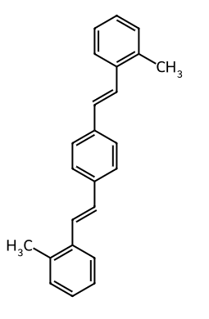
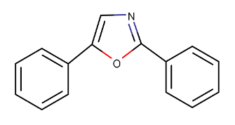
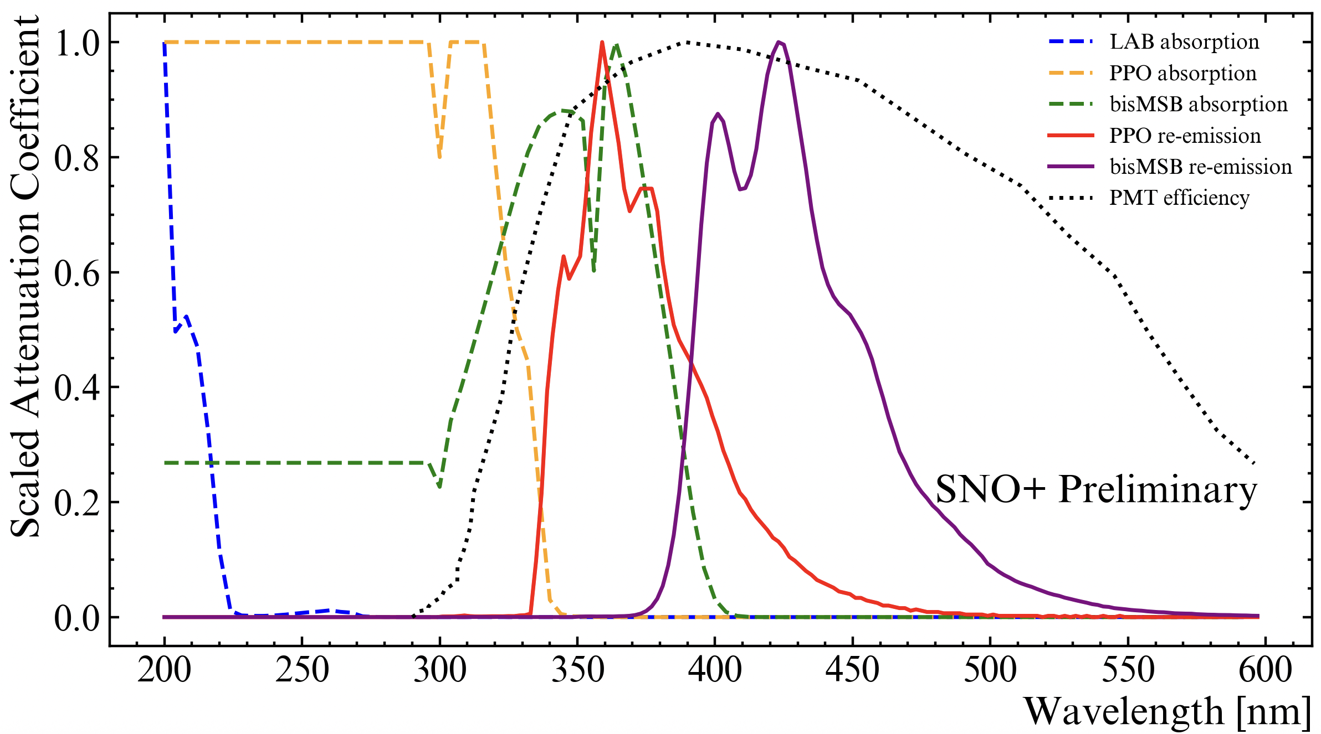
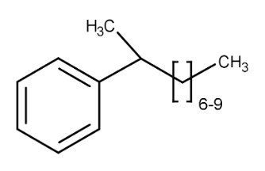
SNO+ Scintillator Optics
[Scaled for illustrative purposes]
Scintillator Cocktail
LAB (Linear Alkyl Benzene)
2.2 g/L PPO (2,5-diphenyloxazole)
2.2 mg/L bis-MSB (4-bis(2-methylstyryl)benzene)
Main takeaway: the complex scintillator absorption and re-emission spectrum is wavelength dependent. The number of PMTs hit will depend on this spectrum.
Notes:
Jamie it could be fun to make a little cocktail glass or bottle.

Slide 6
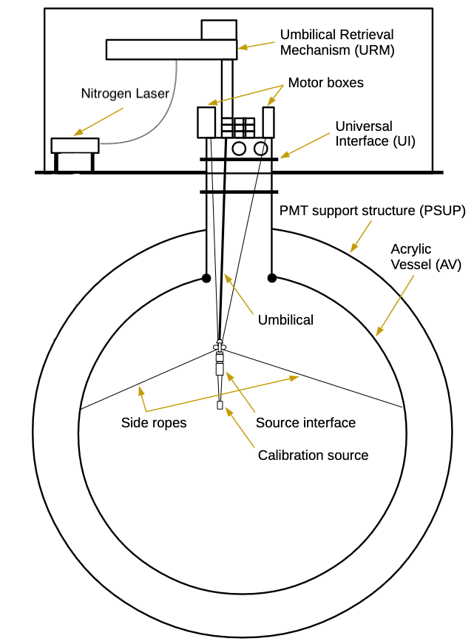
SNO+ Calibration Deployment Systems
All new scintillator phase calibration hardware.
[Session R2-6 (PPD) Dr. Ryan Bayes, Contribution #804]
Calibration Sources
Laserball, optical source
²⁴¹Am- ⁹Be, neutron source [Session M2-9 (PPD) Anthony Allega, Contribution #856]
**Not an exhaustive list, further sources in commission.
[1] SNO+ Collaboration

Slide 7
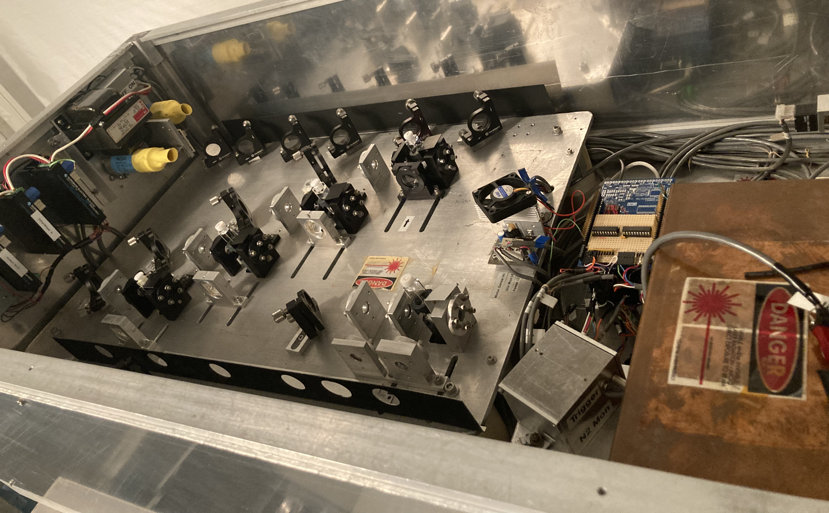
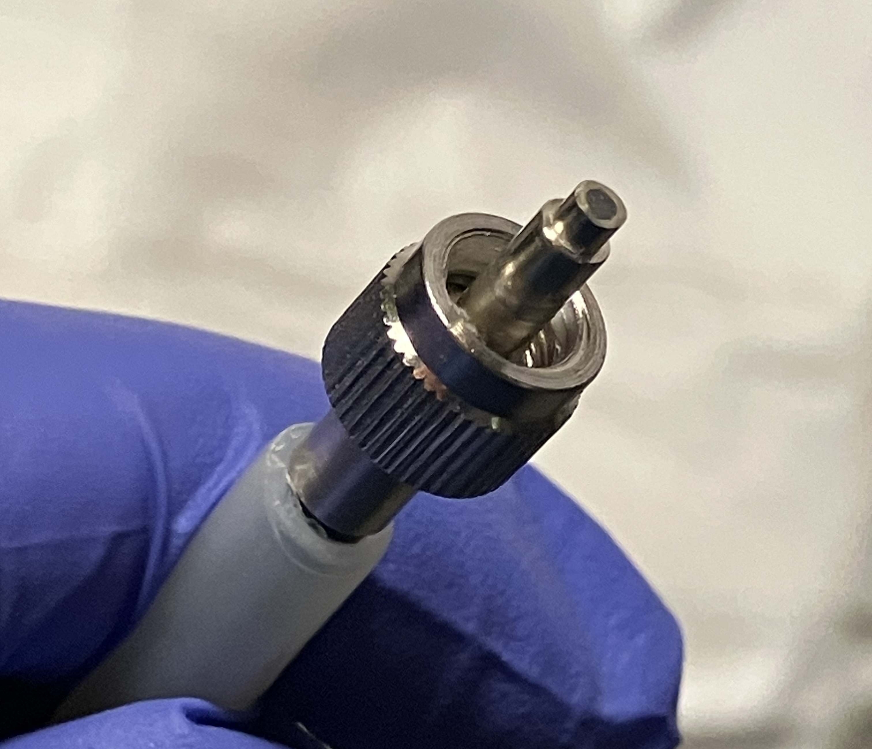
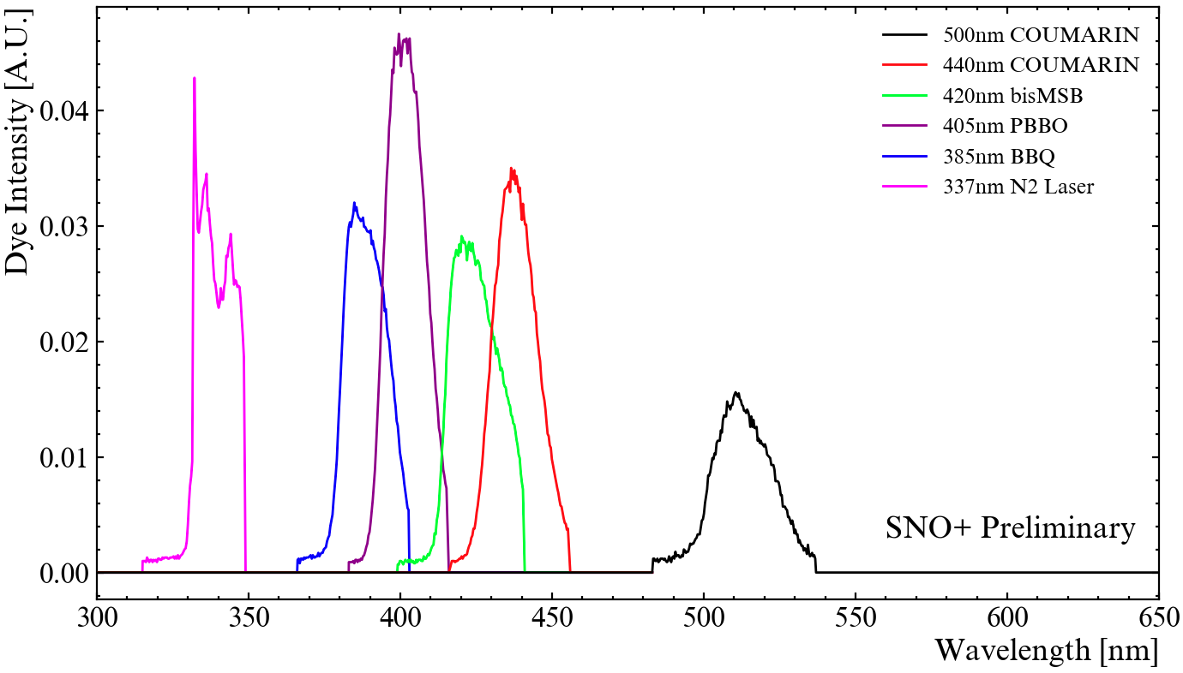
SNO+ Laserball Calibration Systems
Neutral Density Filters (not pictured)
Photodiode
Dye cells
A nitrogen laser produces light pulses at 40Hz -> beamsplitter -> triggers detector.
Transmitted via fibre optic cables to the umbilical retrieval mechanism (URM).
[1] SNO+ Collaboration
Notes:
A nitrogen laser, on the SNO+ deck, produces light pulses at 40Hz. The laser passes through a beam splitter, where the trigger from a photodiode is sent to the detector.
The light travels through one of a series of dye cells, before going through two neutral density filters, and out of an aperture coupled to one end of the umbilical fibres.

Slide 8
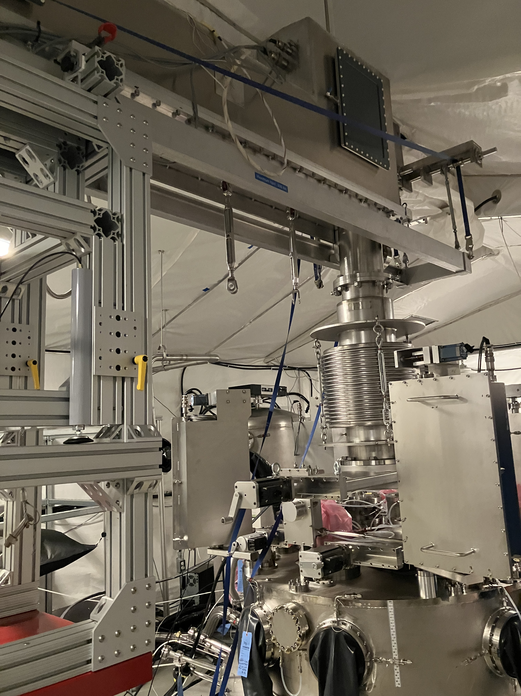
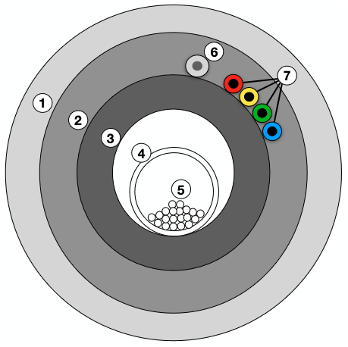
SNO+ Laserball Calibration Systems
Umbilical Retrieval Mechanism (URM).
Attaches to universal interface (UI).
Pulley system for umbilical.
  Z-axis position.
Umbilical Retrieval Mechanism (URM).
Pulley system for umbilical.
Side-rope motor boxes
Side-ropes for the x, and y axes position.
Cross-section of the umbilical, the optical fibres (5)
[1] SNO+ Collaboration
Notes:
A nitrogen laser, on the SNO+ deck, produces light pulses at 40Hz. The laser passes through a beam splitter, where the trigger from a photodiode is sent to the detector.
The light travels through one of a series of dye cells, before going through two neutral density filters, and out of an aperture coupled to one end of the umbilical fibres.

Slide 9
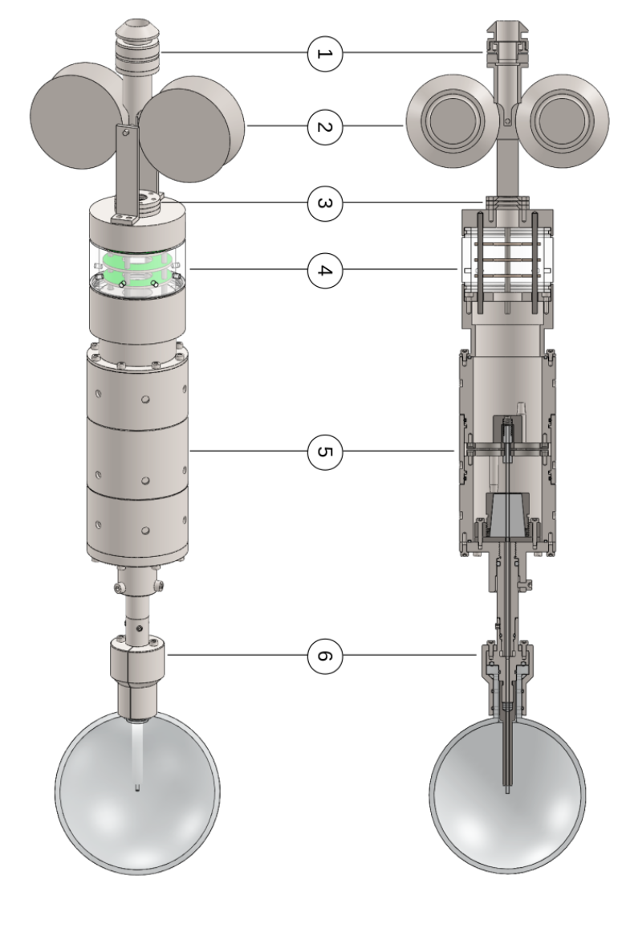
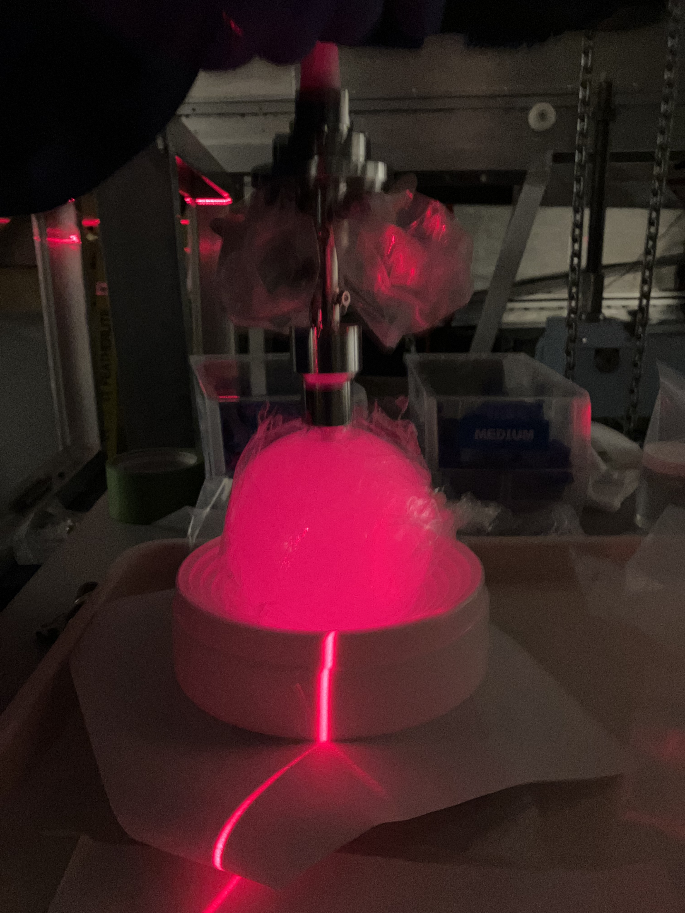
SNO+ Laserball
The diffuser flask is filled with Silgel and suspended glass microspheres that provide necessary scattering.
Ideal calibration source for measuring scintillator optics and PMT response.
Triggered light pulses.
Produces pulses at multiple, selectable wavelengths.
Diffuse light throughout the detector.
Deployed in multiple positions.
[1] SNO+ Collaboration
[1] SNO+ Collaboration
Notes:
A nitrogen laser, on the SNO+ deck, produces light pulses at 40Hz. The laser passes through a beam splitter, where the trigger from a photodiode is sent to the detector.
The light travels through one of a series of dye cells, before going through two neutral density filters, and out of an aperture coupled to one end of the umbilical fibres.

Slide 10
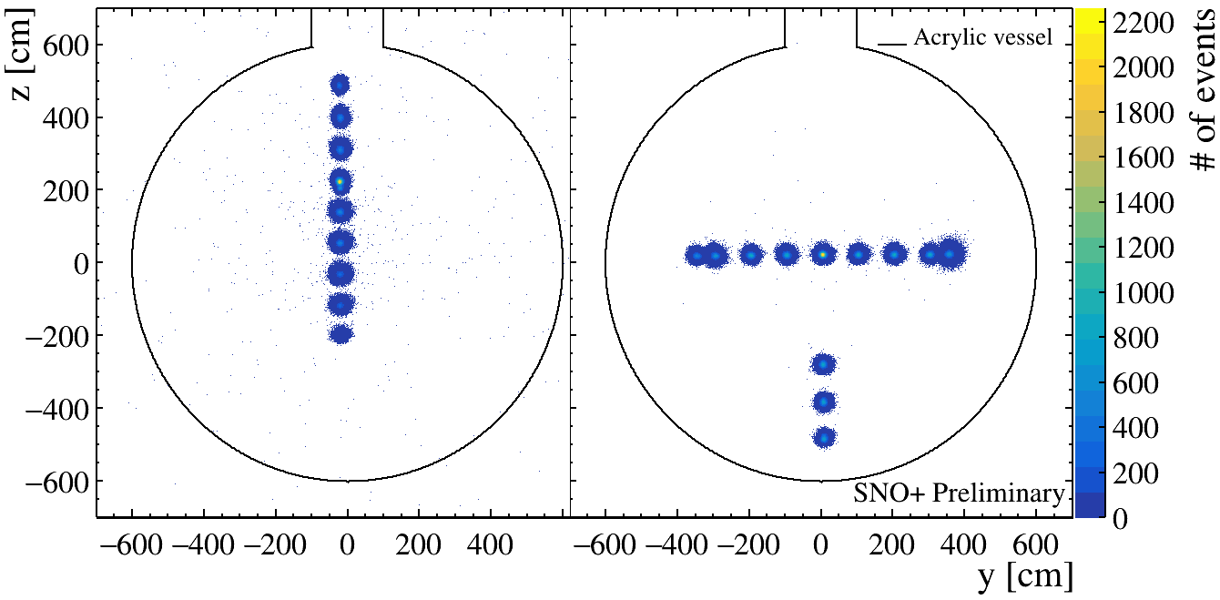
SNO+ Laserball Deployment
First SNO+ internal scintillator deployment with the Laserball.

Slide 11
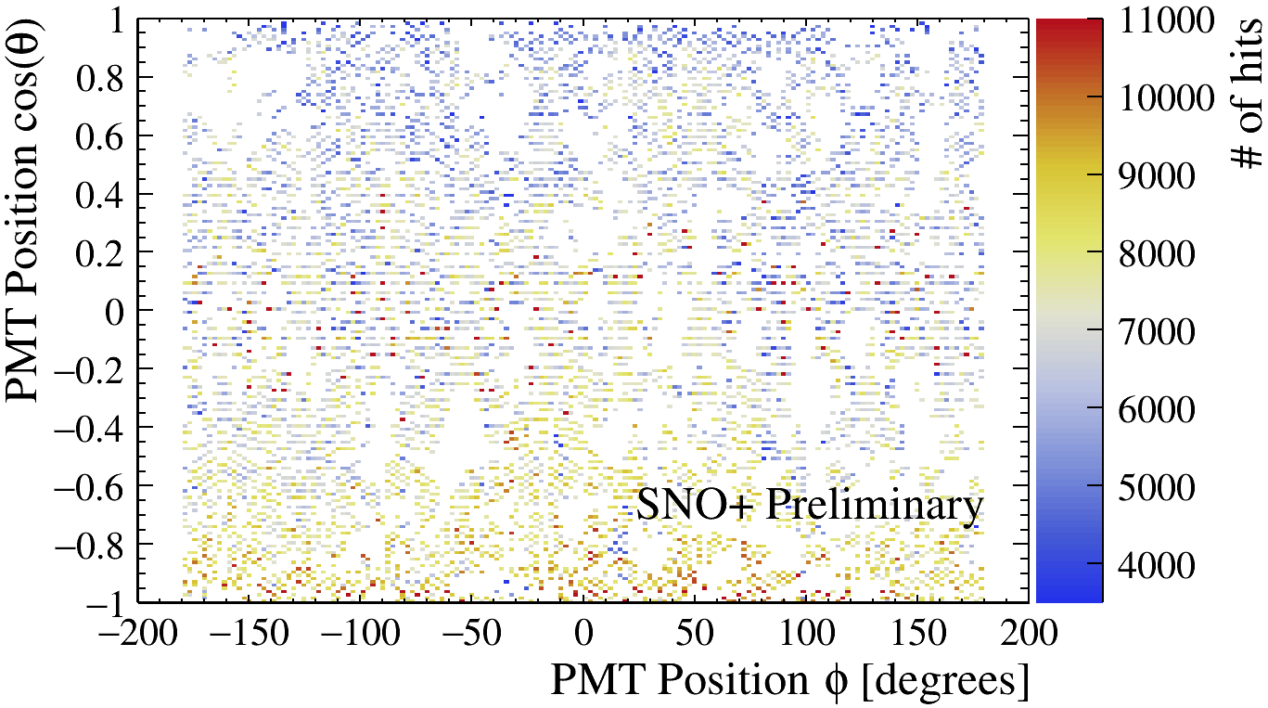
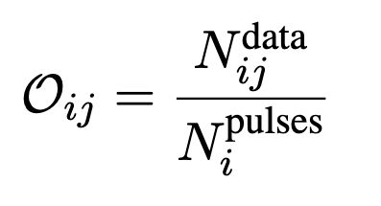
SNO+ Laserball Occupancy
Central (0, 0, 0), 500nm Laserball run
Occupancy describes the number of hits a PMT, j, is hit for a Laserball run, i.
Number of hits registered by PMT, j.
Total number of pulses emitted by the Laserball
The PMT Occupancy map displays expected polar anisotropy and detector components shadowing.
Occupancy can be used to extract the optical parameters for the optics model.
Notes:
Add link to the Laserball design paper

Slide 12
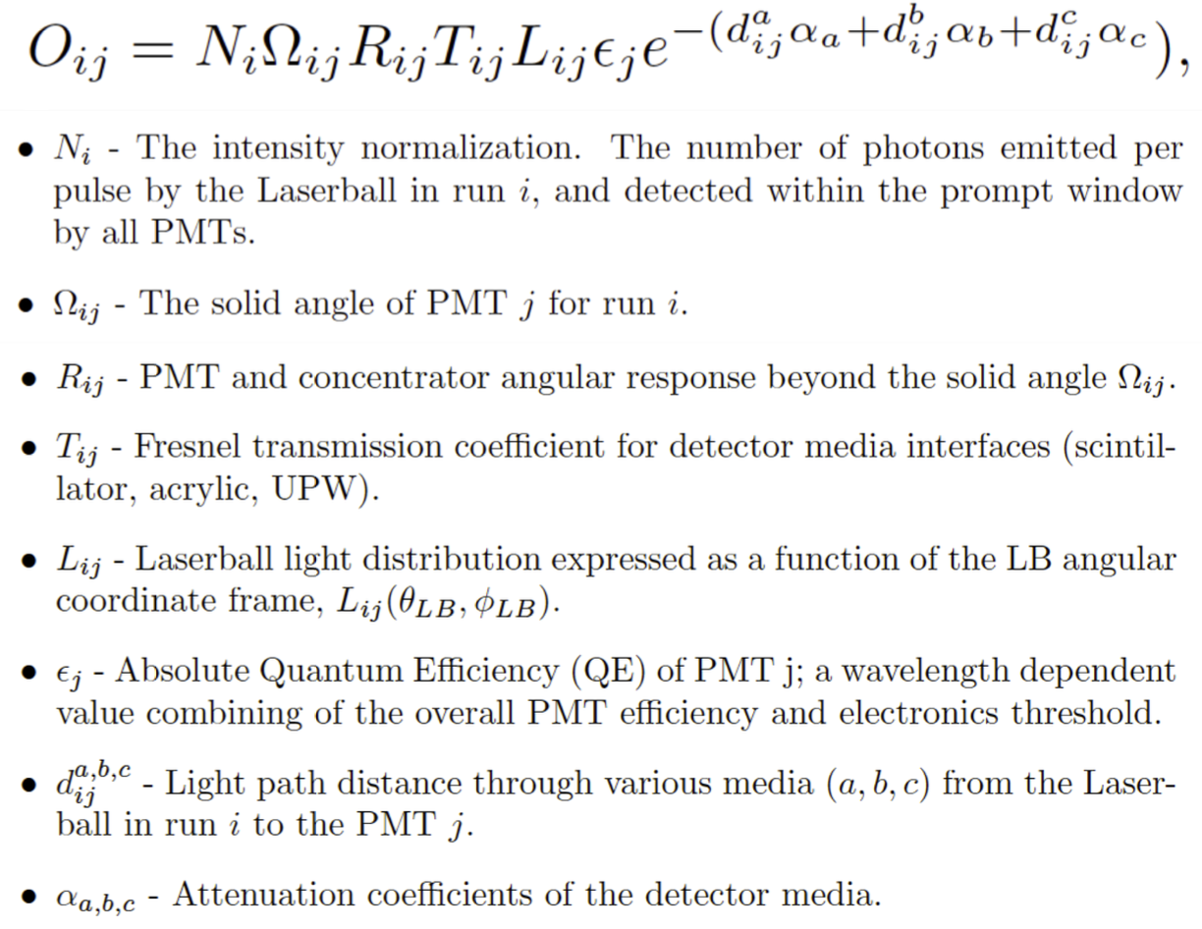
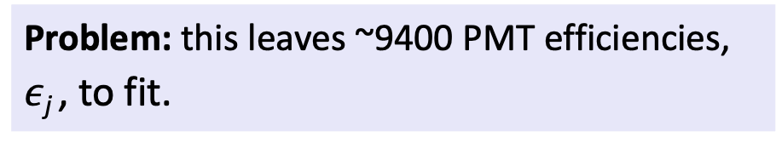
SNO+ Laserball Occupancy
The occupancy is parameterized by,
Problem: this leaves ~9400 PMT efficiencies, $ε$_{j} , to fit.
** This talk
[2] SNO+ Collaboration
Notes:
Add link to the Laserball design paper

Slide 13
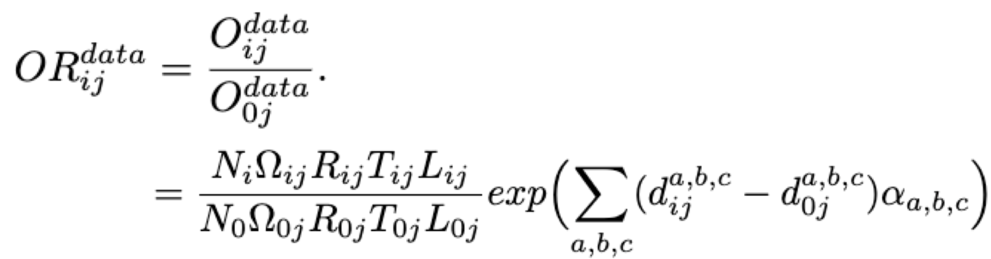
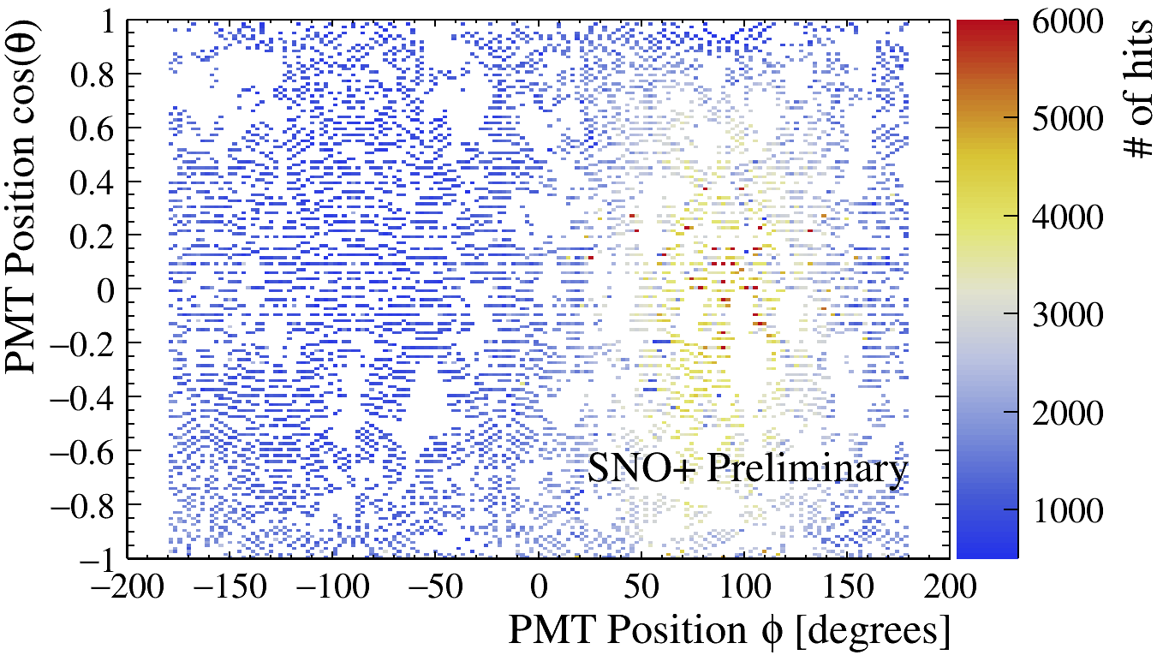
SNO+ Laserball Occupancy
If we take the ratio of the occupancy of a given PMT, j, for a Laserball run, i, with PMT, j, for a central Laserball run, 0, we eliminate the PMT efficiency parameters.
[2] SNO+ Collaboration
The attenuation coefficients
(Scintillator, Acrylic, and External water)
(0, 300cm, 0), 500nm Laserball run
Central (0, 0, 0), 500nm Laserball run
Notes:
Add link to the Laserball design paper

Slide 14
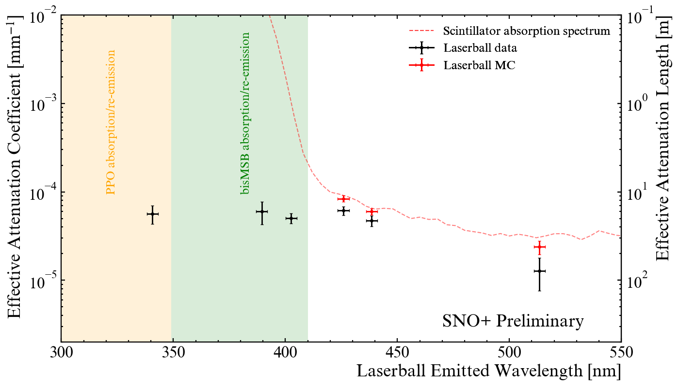
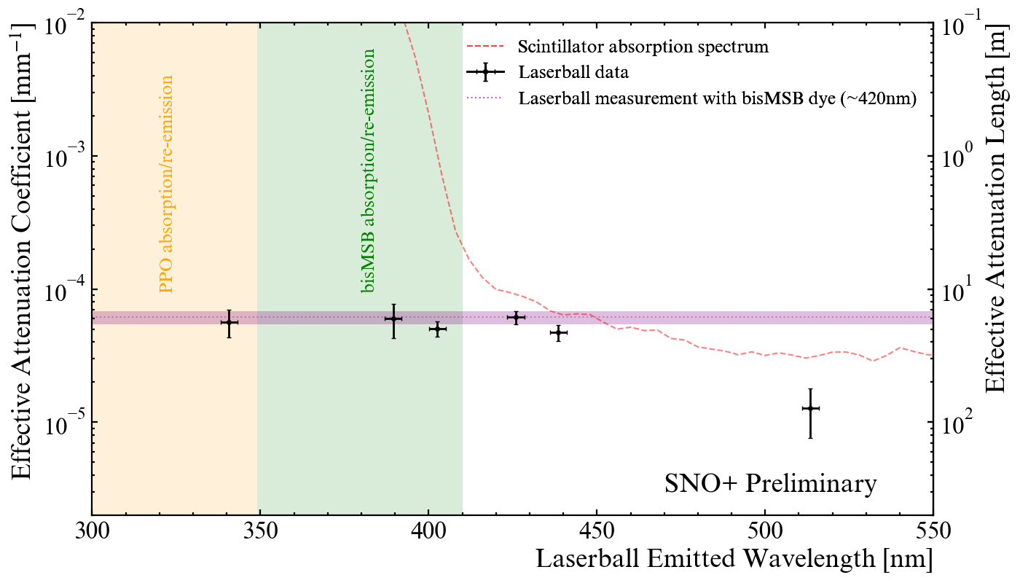
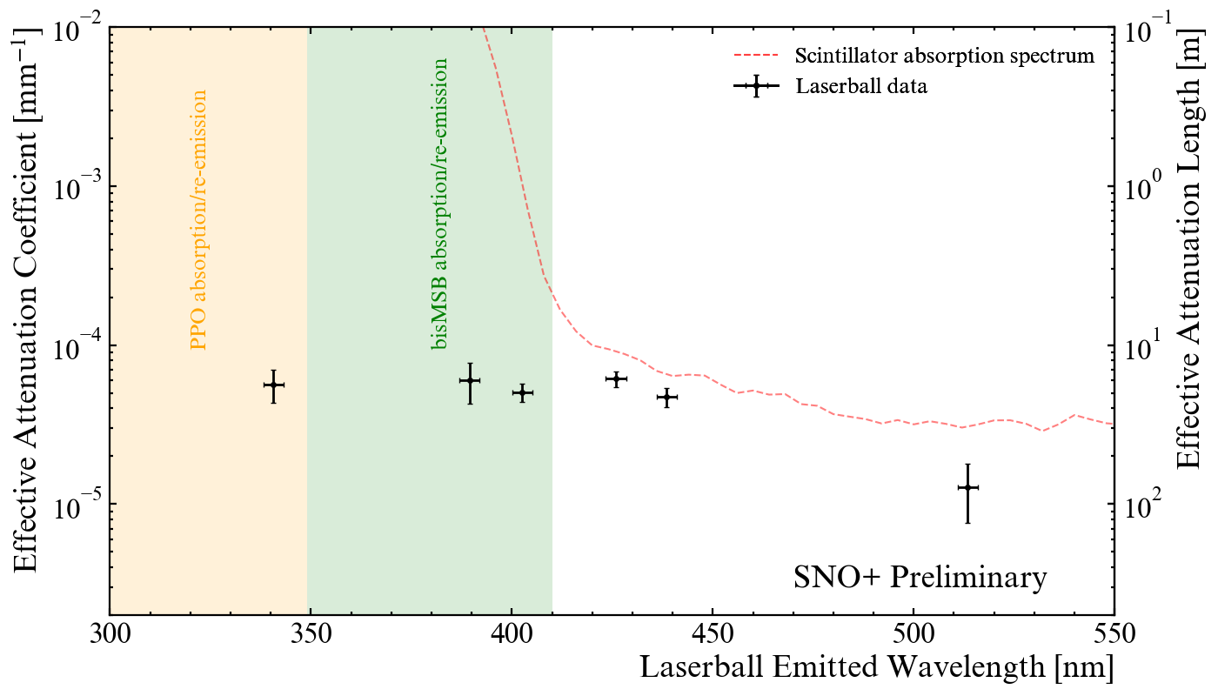
SNO+ Laserball Fit Results
Scintillator absorption spectrum based on UV-VIS measurements, susceptible to variations in baseline subtractions at long wavelengths.
The Laserball measures that baseline and improves our optics model in this region.
Short wavelengths are consistent with the Laserball measurement at the bisMSB dye (~420nm).
Notes:
Add link to the Laserball design paper

Slide 15
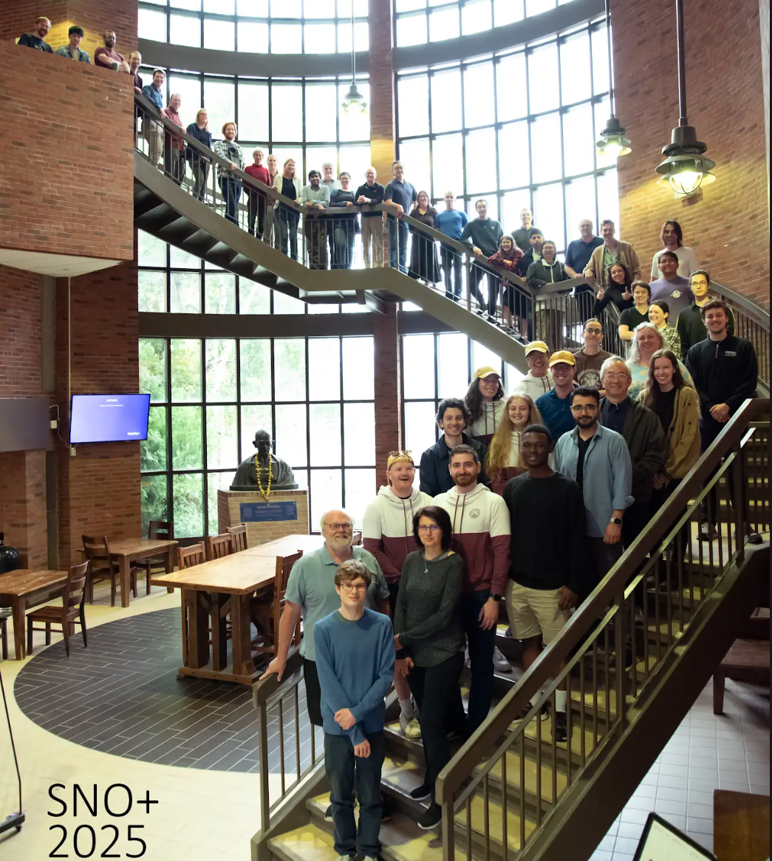
Summary
Calibration campaign designed to measure and improve the energy and position reconstruction for the SNO+ physics program.
Deployed the SNO+ Laserball in the scintillator.
Preliminary measurements of the SNO+ scintillator optics.
Future improvements to scintillator optics model.

Slide 16
References
[1] SNO+ Collaboration, The SNO+ Experiment, arXiv:2104.11687v3 (2021).
[2] SNO+ Collaboration, Optical calibration of the SNO+ detector in the water phase with deployed sources, JINST 16 P10021 (2021)

Slide 17
Back-up Slides

Slide 18
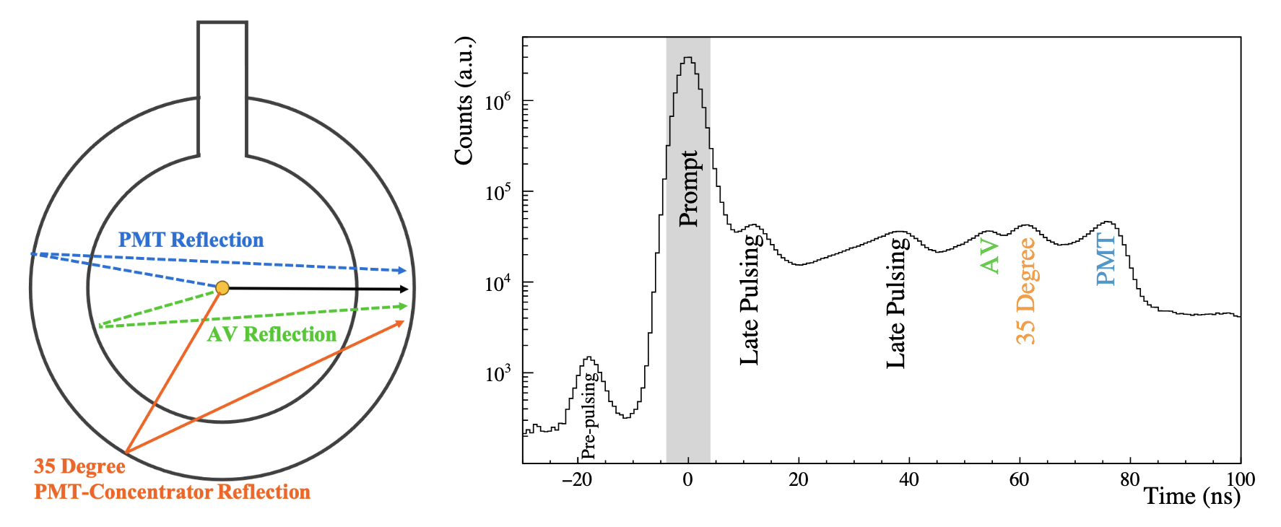
Hit Time Residuals, AV reflections, PMT response
[2] SNO+ Collaboration
The prompt peak represents a direct light path from the Laserball to the PMT.
Other paths, and PMT late pulsing features are seen in the late and early light in the PMTs.

Slide 19
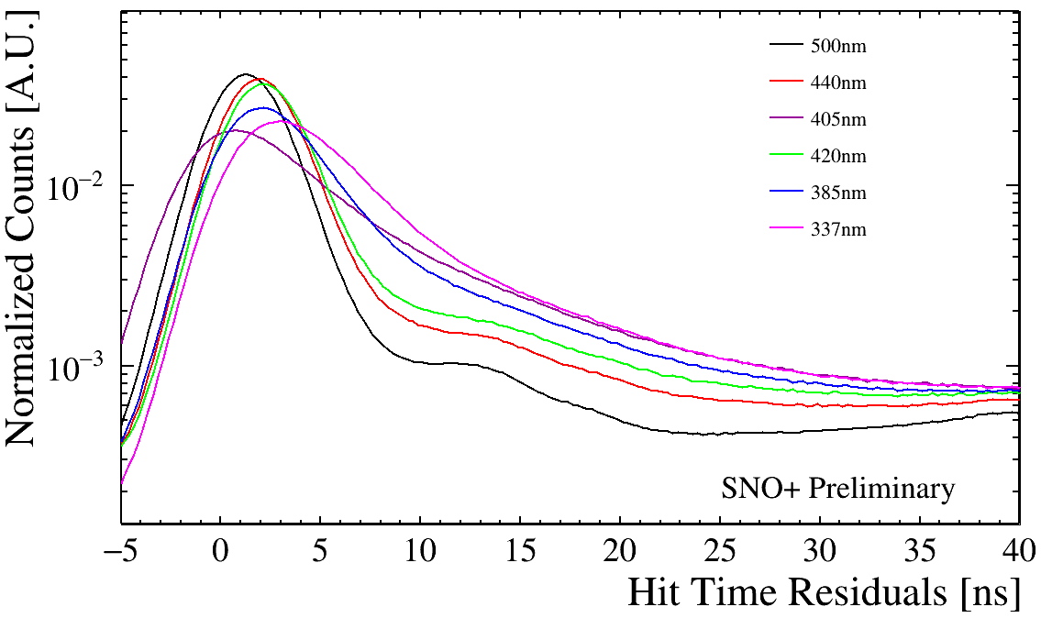

Hit Time Residuals, AV reflections, PMT response
The hit time residual is defined as,
t_{PMT, i} is the hit time of PMT, i
t₀, is the time of the event (triggered by laser light pulse)
t_{TOF}, is the calculated time of flight from the Laserball position to the PMT.

Slide 20
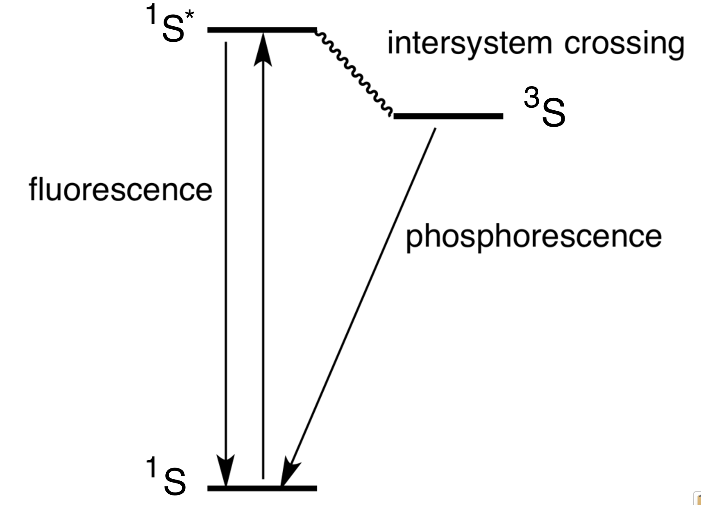
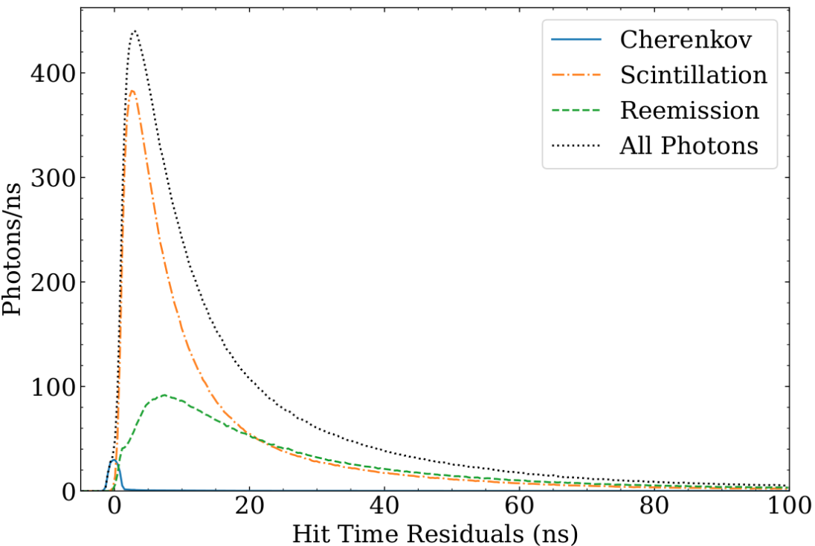
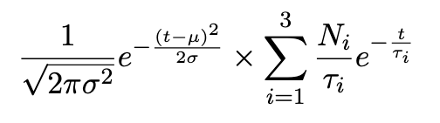

SNO+ Scintillator Optics Timing
Scintillator Cocktail
LAB (Linear Alkyl Benzene)
2.2 g/L PPO (2,5-diphenyloxazole)
2.2 mg/L bis-MSB (4-bis(2-methylstyryl)benzene)
Time constant
Main takeaway: the scintillator has a scintillation and re-emission timing and will therefore impact the PMT hit time.

Slide 21
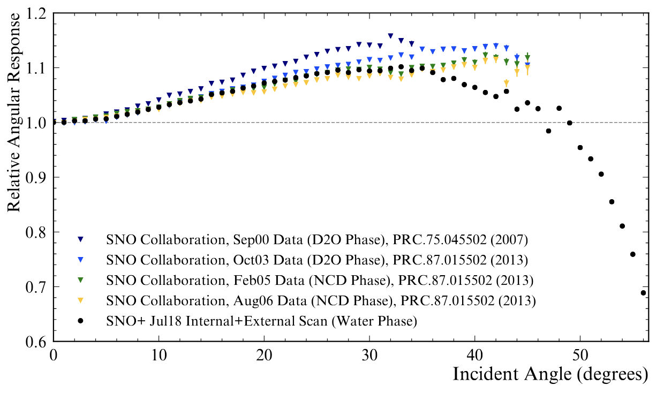
PMT Angular Response and Concentrator Efficiency
PMT Angular response and concentrator efficiency were monitored throughout SNO and the SNO+ water phase.
Observed degradation in the reflectivity of the concentrators.
[2] SNO+ Collaboration

Slide 22
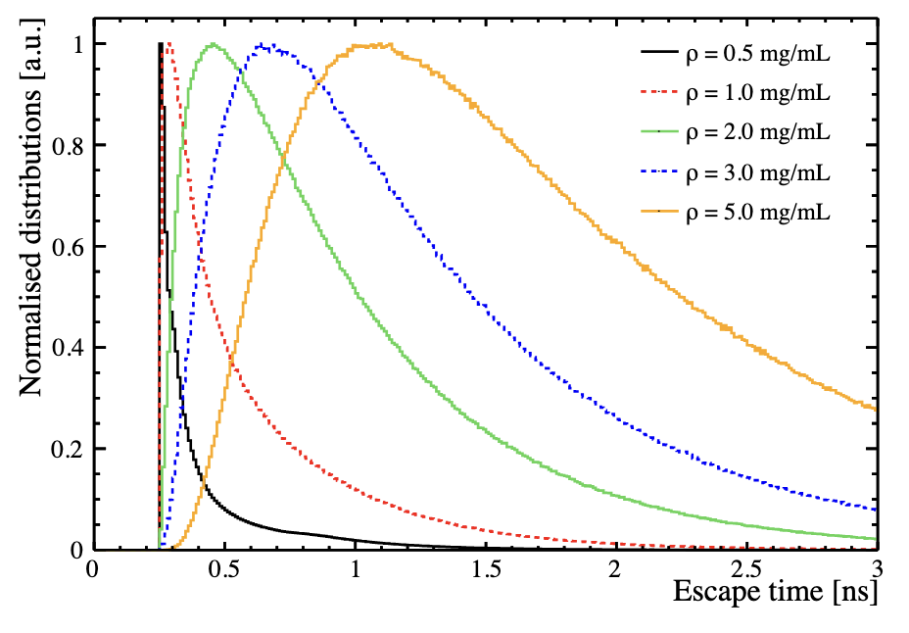
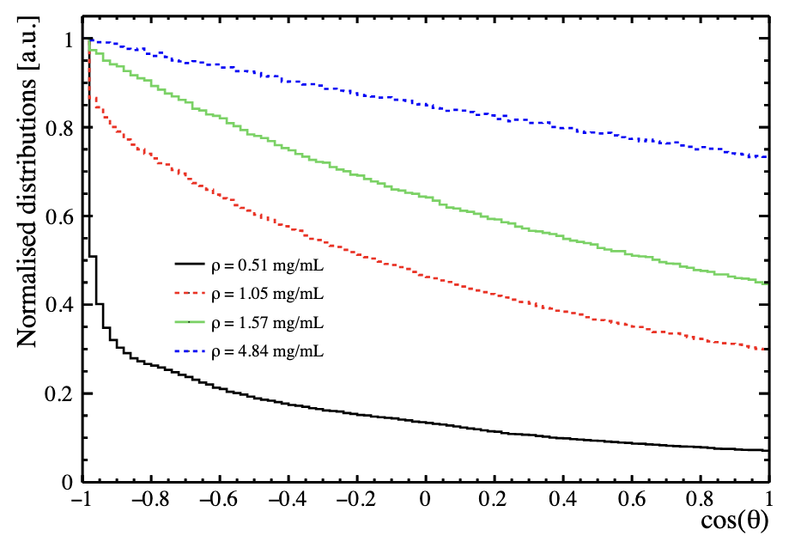
Laserball Filling
The 11cm diameter flask is filled with 600mL of SilGel suspended with glass microspheres (average ⌀ 40 μm). The microspheres provide the necessary light scattering, however the concentration is an optimization of pulse time width and isotropy.
[3] S. Valder, et. al.

Slide 23
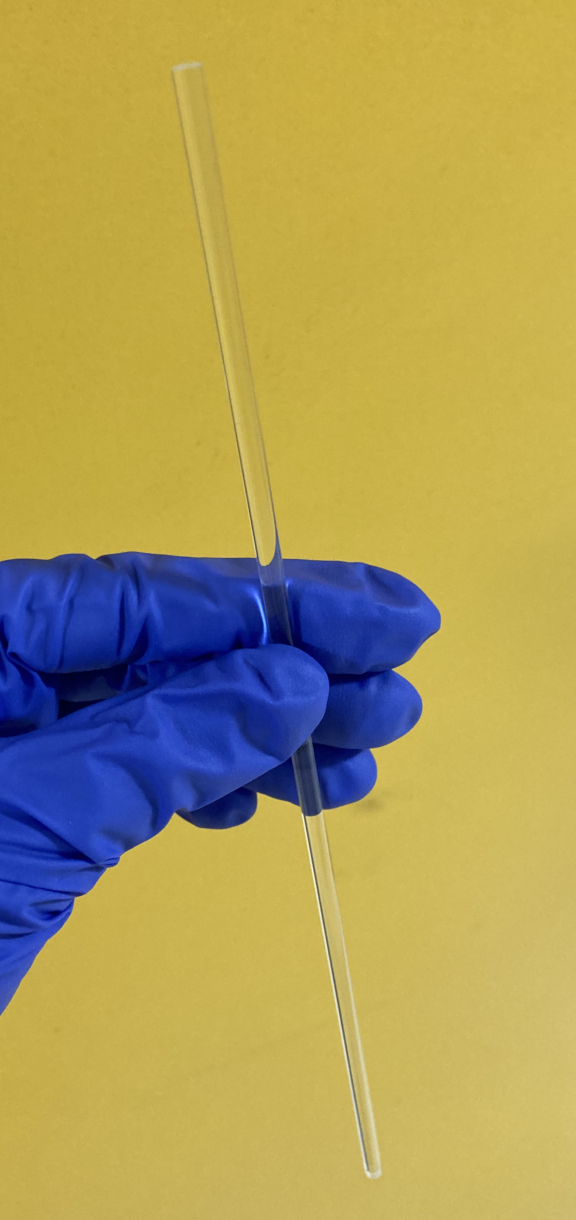
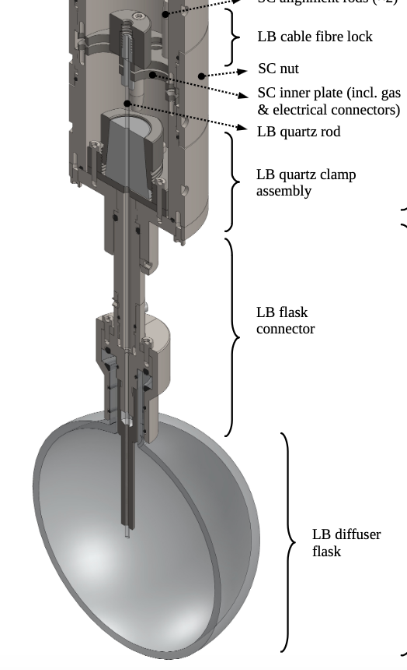
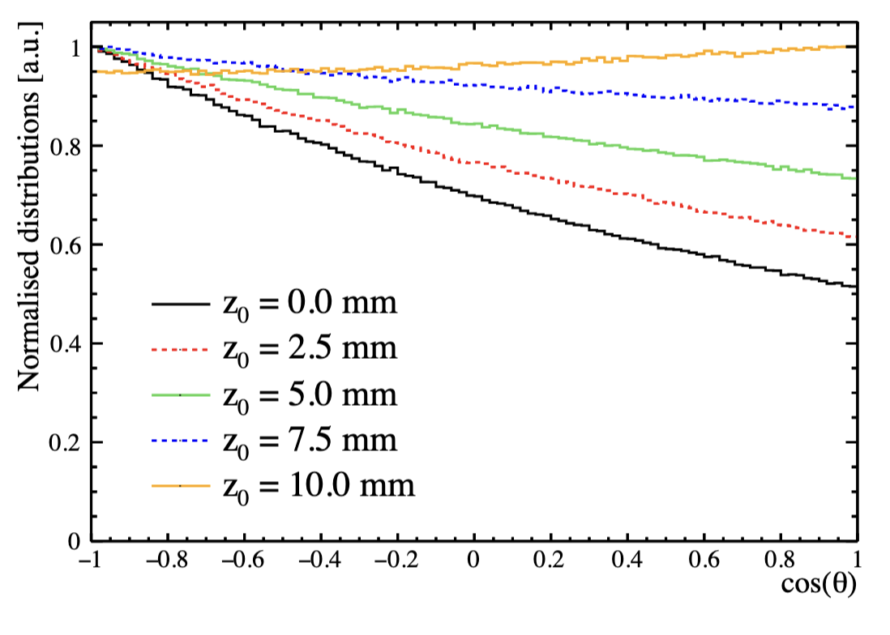
Laserball Filling
The light injection point defined as, z₀, is the distance above the centre to the quartz rod end within the Laserball flask.
[3] S. Valder, et. al.

Slide 24
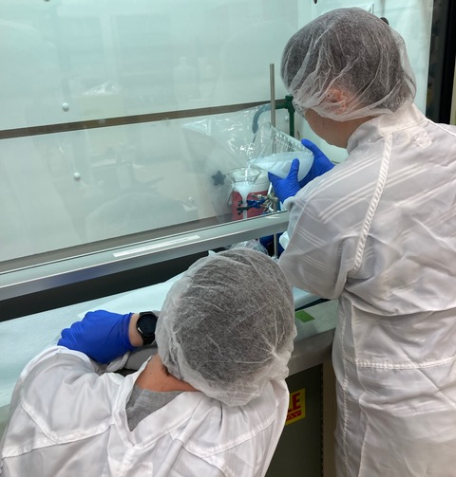
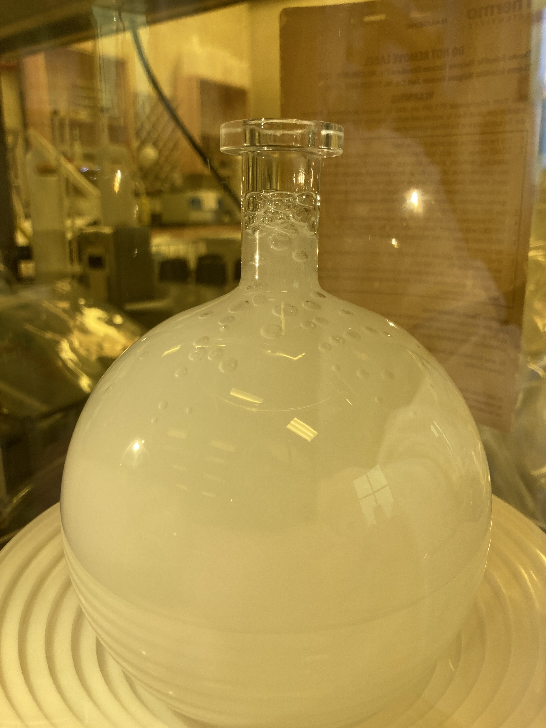
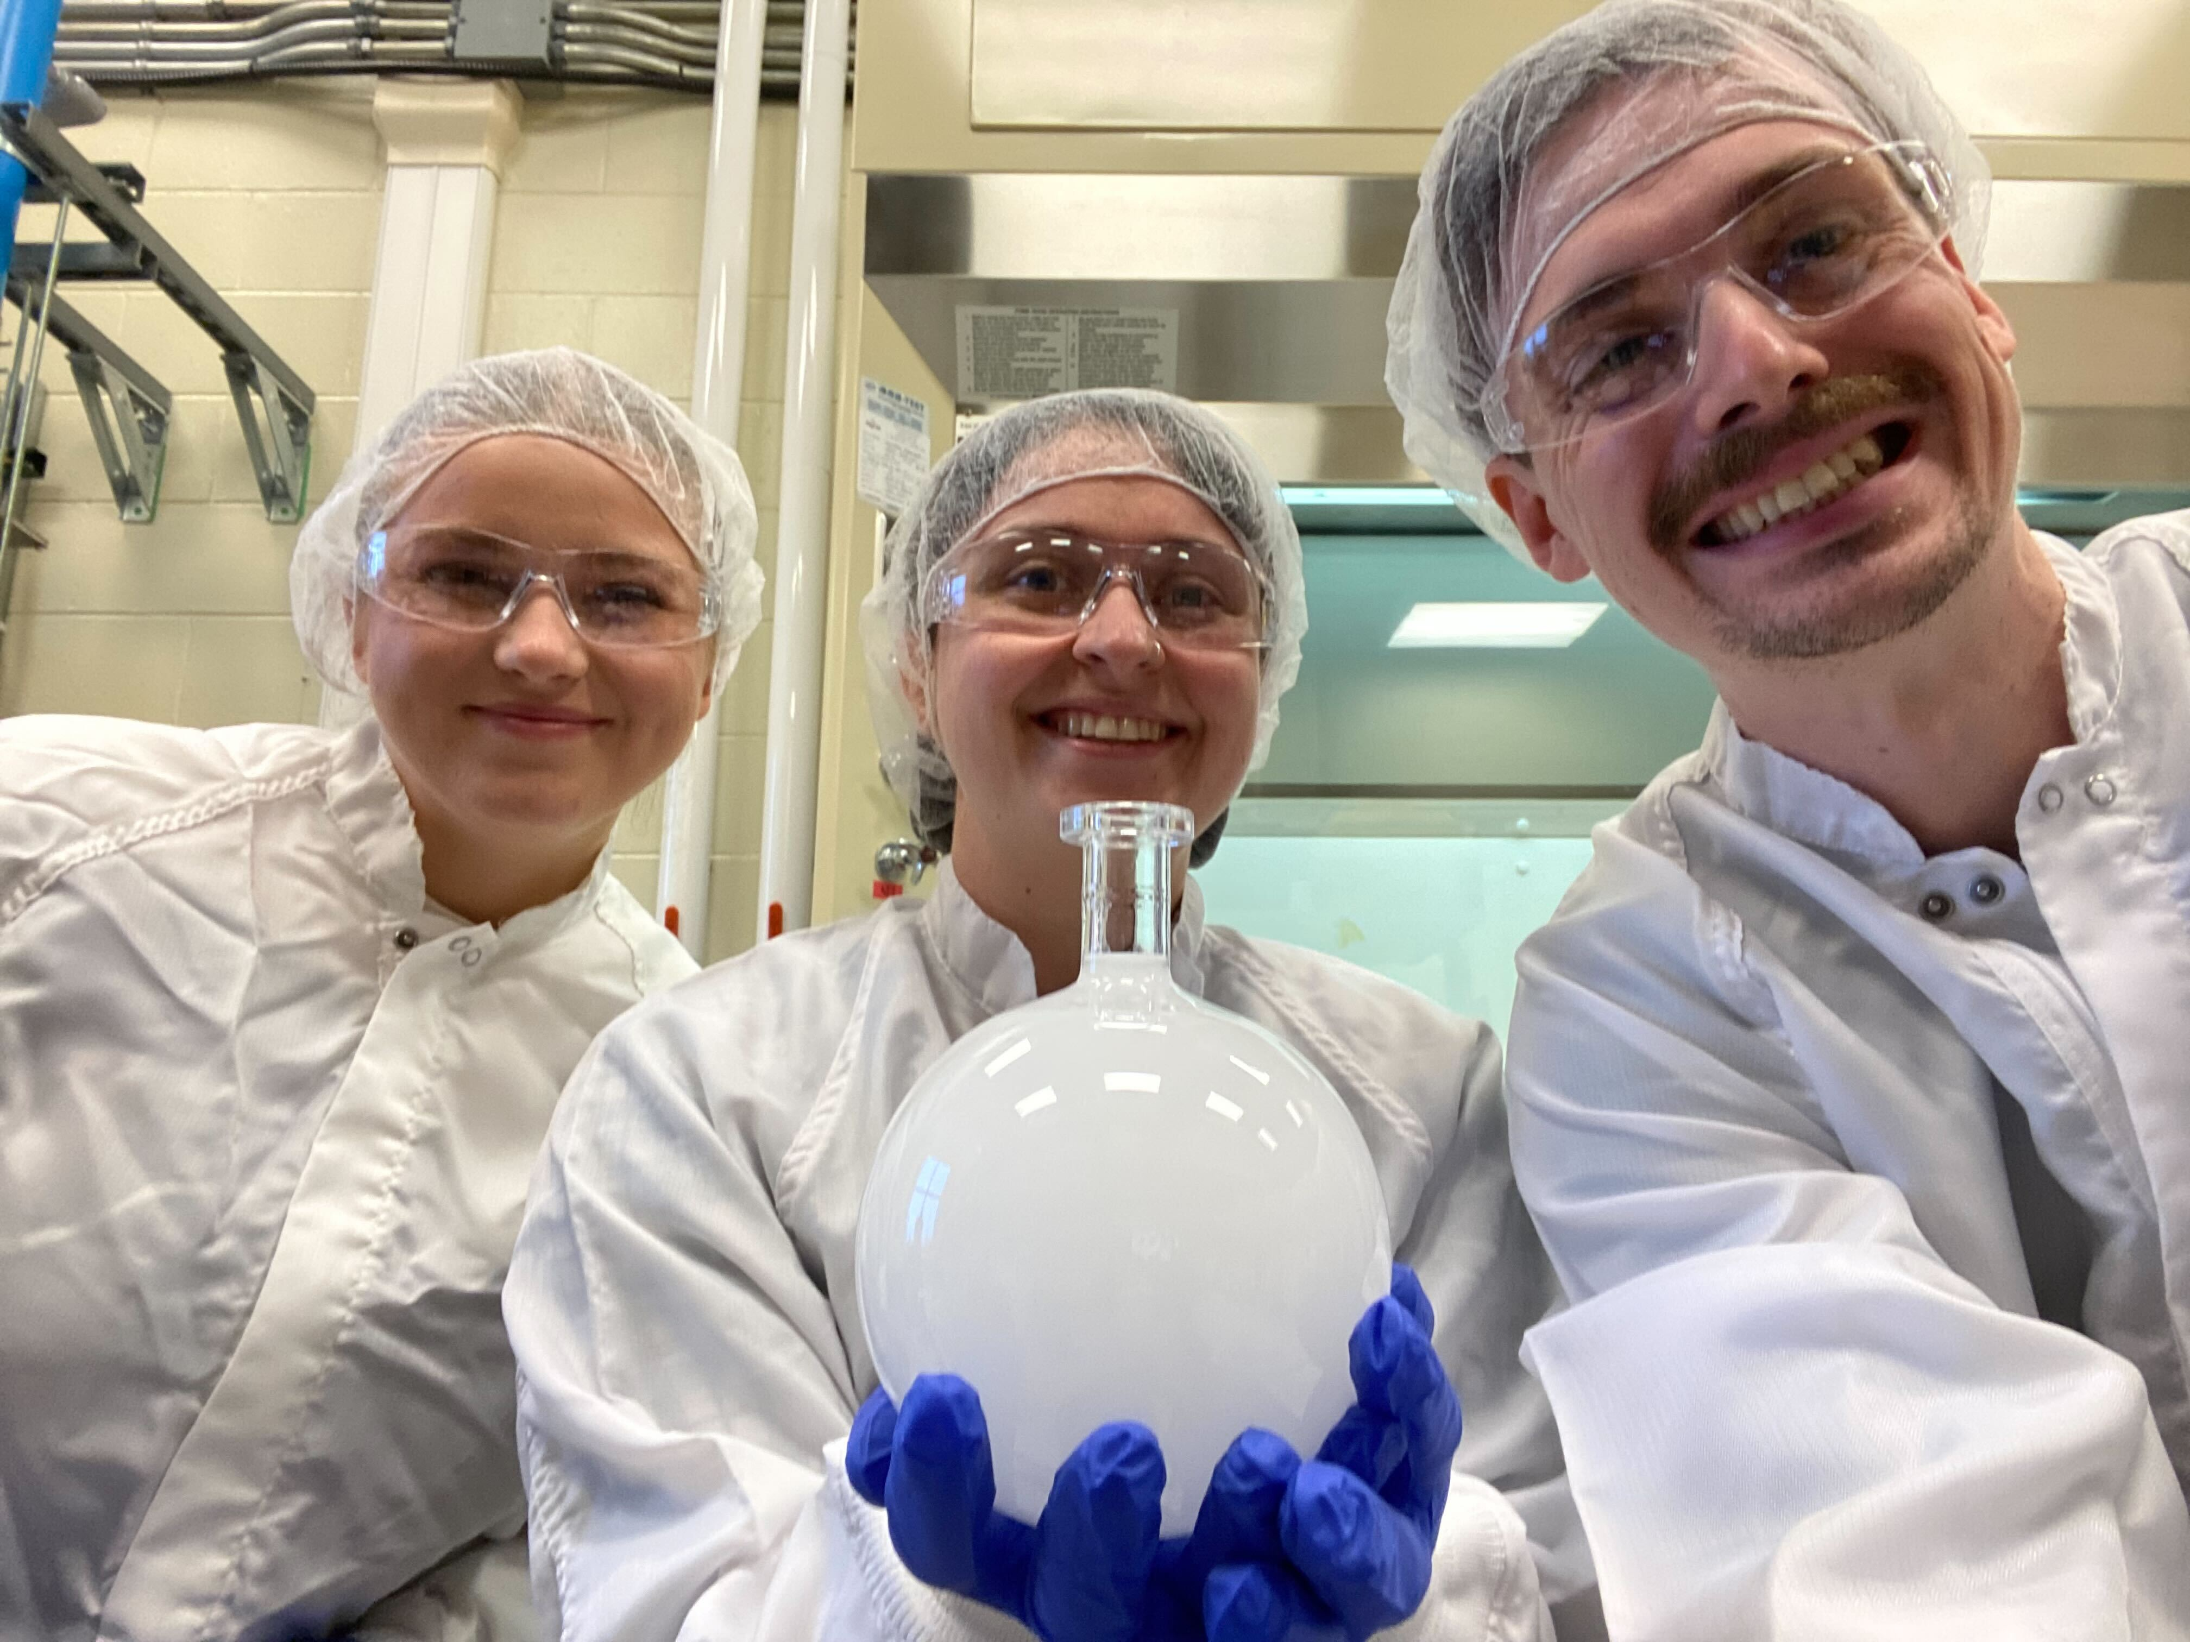
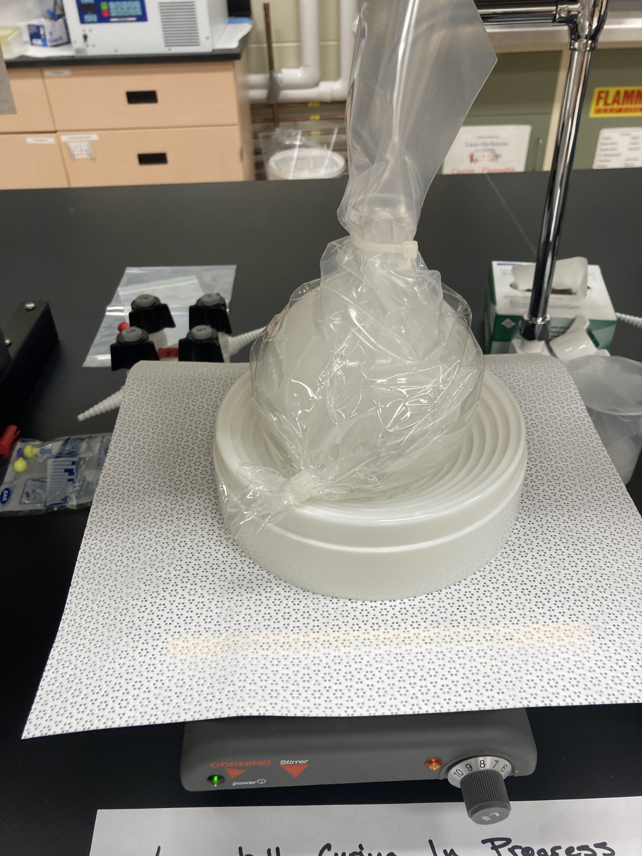
Laserball Filling
The Laserball diffuser flask is filled with 600 mL SilGel with homogeneously suspended glass microspheres at a concentration ~1.5mg/mL.
Mixing/pouring SilGel
Degas
Successful testing fill
Final flask fill

Slide 25
References (Back-up Slides)
[1] SNO+ Collaboration, The SNO+ Experiment, arXiv:2104.11687v3 (2021).
[2] SNO+ Collaboration, Optical calibration of the SNO+ detector in the water phase with deployed sources, JINST 16 P10021 (2021).
[3] S. Valder, et. al., A Laserball Calibration Device for the SNO+ Scintillator Phase, JINST (2024).
Notes:
Jamie, separate these into the back-up slides references and the slides references.

