Slide 1

Thermal Simulations for the Scintillating Bubble Chamber Dark Matter Experiment
Ezri Wyman [Supervisor: Dr. Ken Clark]
Queen’s University, Department of Physics, Engineering Physics, and Astronomy
CAP 2026

Slide 2
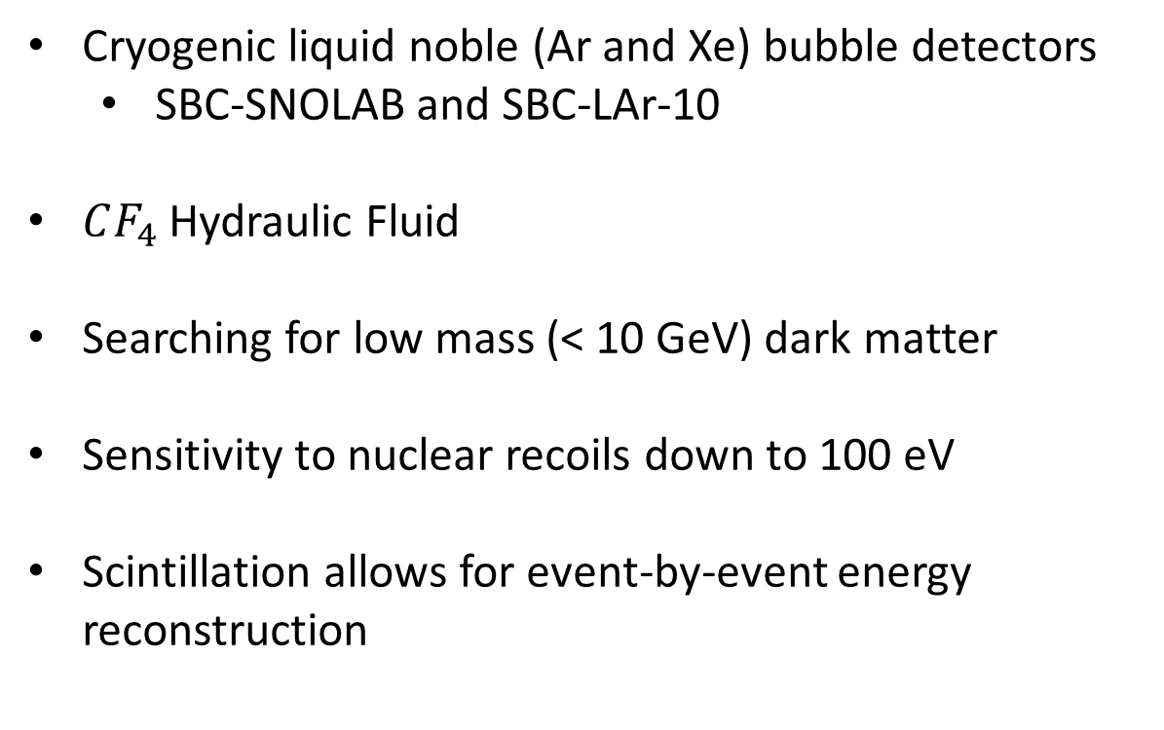
The Scintillating Bubble Chamber Detector
130 K
Cryogenic liquid noble (Ar and Xe) bubble detectors
  SBC-SNOLAB and SBC-LAr-10
$CF_{4}$ Hydraulic Fluid
Searching for low mass (< 10 GeV) dark matter
Sensitivity to nuclear recoils down to 100 eV
Scintillation allows for event-by-event energy reconstruction
90 K

Slide 3
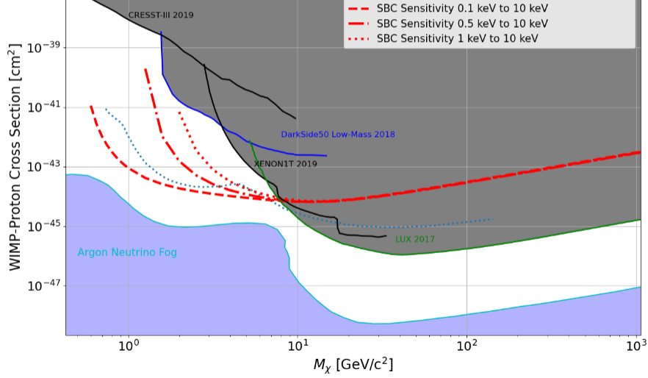
M. J. Bressler, PhD Thesis, 2022

Slide 4
Thermal Simulations

Slide 5
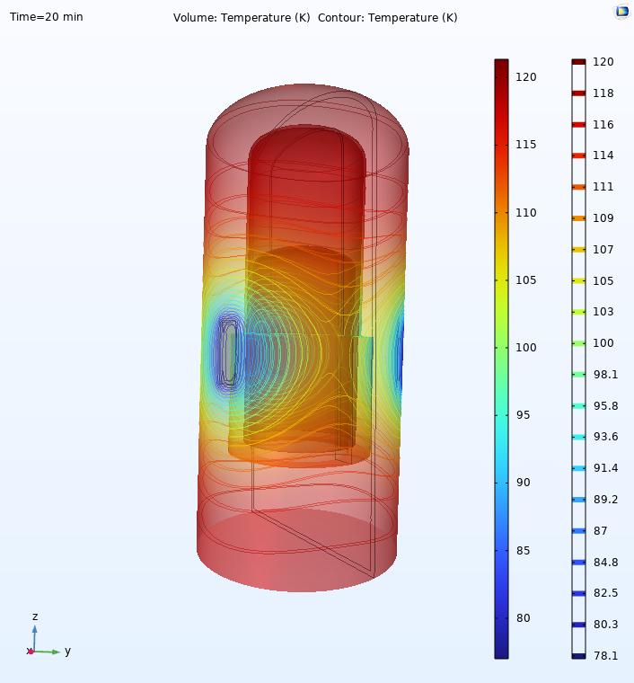
Bulk Fluid Simulations
Modelling fluid flow in the detector
Used for engineering design and operational tuning
Limited by material properties available

Slide 6
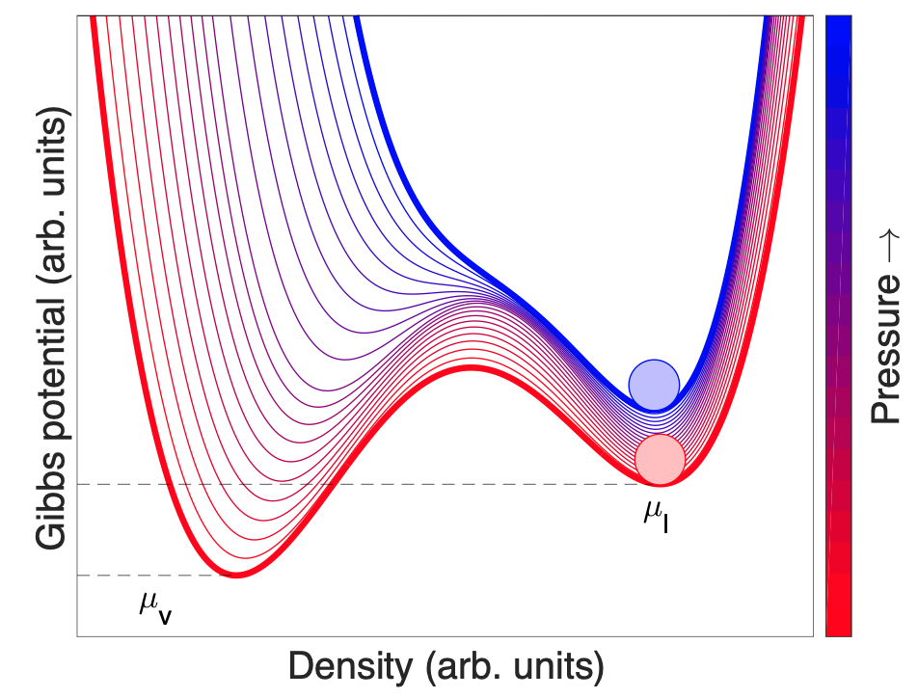
Superheated Fluid

Slide 7

Image credit: Studio 52 Magic

Slide 8
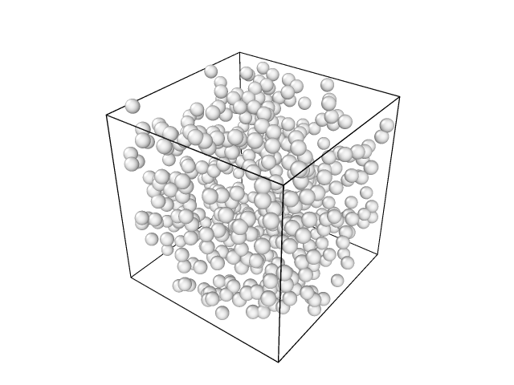
Molecular Dynamics (MD) Simulations
Lennard-Jones pair potentials → Bulk Properties
Pair potential → Forces on each particle → Movement
Multi-stage modelling approach

Slide 9
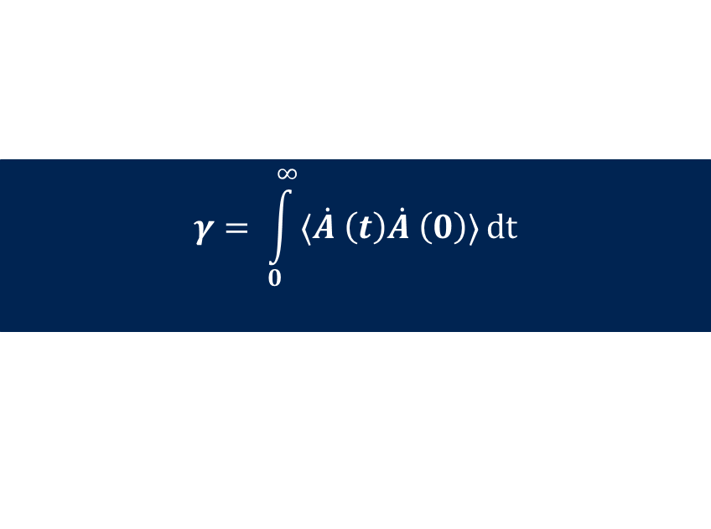
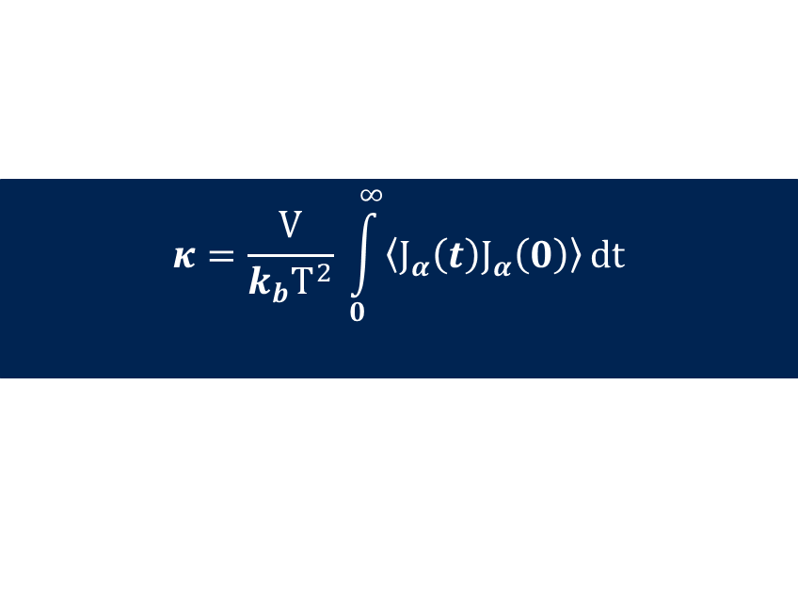
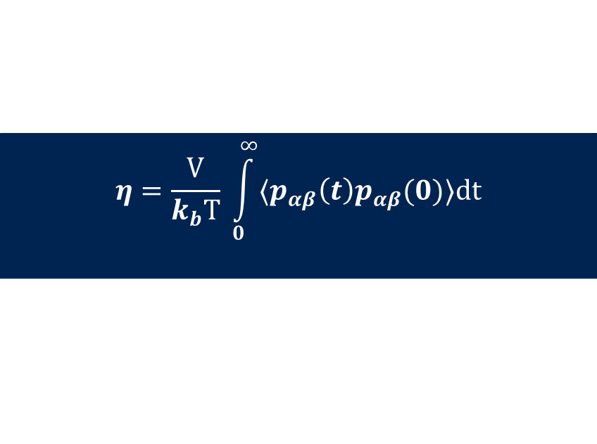
Green-Kubo Relations
$$γ= \int_{0}^{∞}{⟨\dot{A }\left(t\right)\dot{A }\left(0\right)⟩}dt$$
Relates random fluctuations at equilibrium to externally perturbed responses
Allow for calculation of a transport coefficient based on the time correlation function of a corresponding “microscopic” variable
Examples:
  Viscosity from pressure tensors
  Thermal conductivity from heat flow
  Diffusion coefficient from velocity
$$η=\frac{V}{k_{b}T} \int_{0}^{∞}{⟨p_{αβ}\left(t\right)p_{αβ}(0)⟩dt}$$
$$κ=\frac{V}{k_{b}T^{2}} \int_{0}^{∞}{\left\langle J_{α}\left(t\right)J_{α}\left(0\right)\right\rangle }dt$$

Slide 10
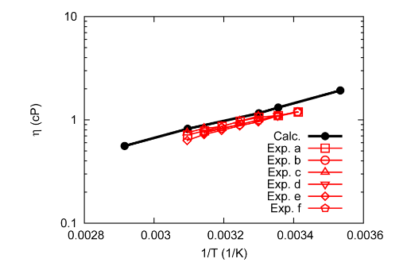
Successful in other contexts to calculate:
  Viscosity
  Heat capacity
  Thermal conductivity
  Density
Allows for calculation across a wide range of temperatures and pressures
Viscosity of Ethanol
Reliable Viscosity Calculation from Equilibrium Molecular Dynamics Simulations: A Time Decomposition Method, Zhang, Y. ; Otani, A. ; Maginn, E. J.

Slide 11
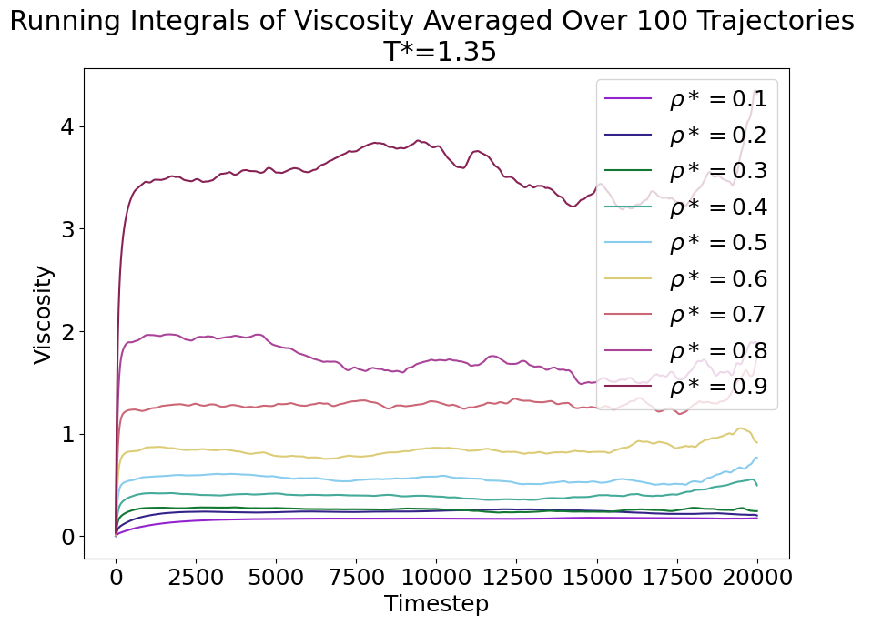
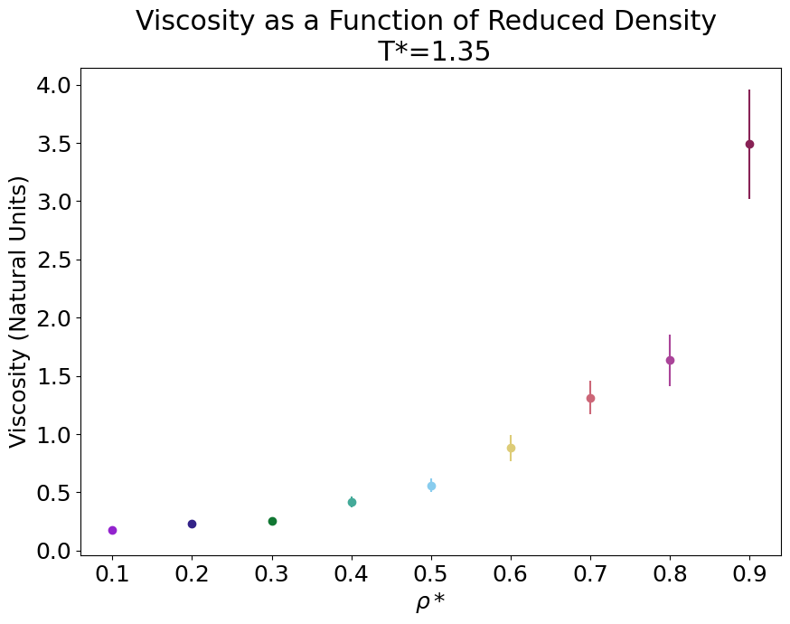
Calculation of Viscosity in Natural Units

Slide 12
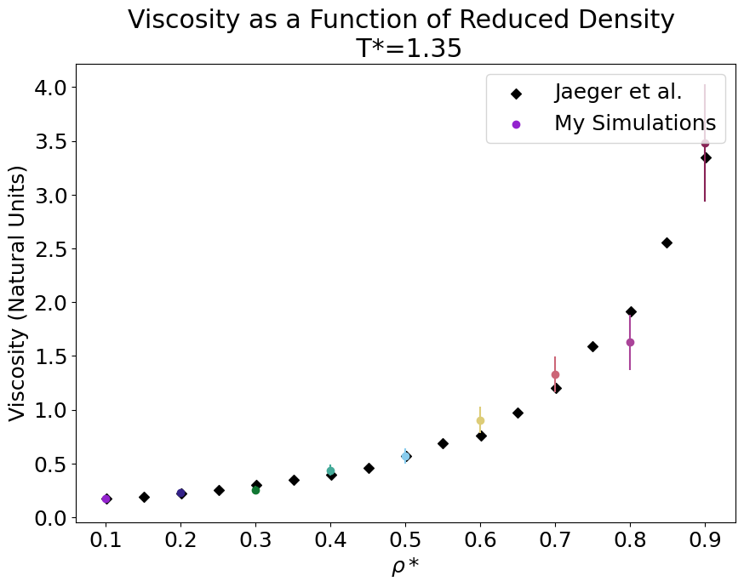
Comparison in Natural Units
Black points from “Bulk Viscosity of Molecular Fluids” by Jaeger, Matar, and Müller.

Slide 13
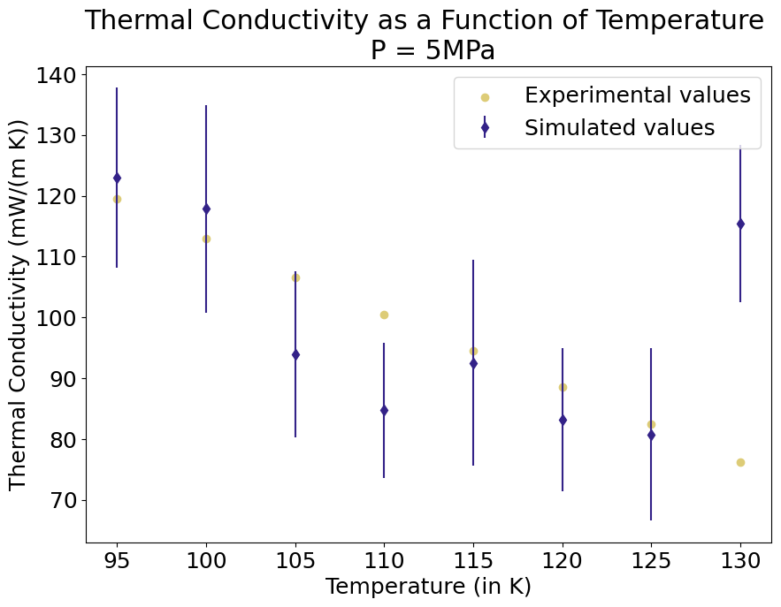
Simulations of
Liquid
Argon

Slide 14
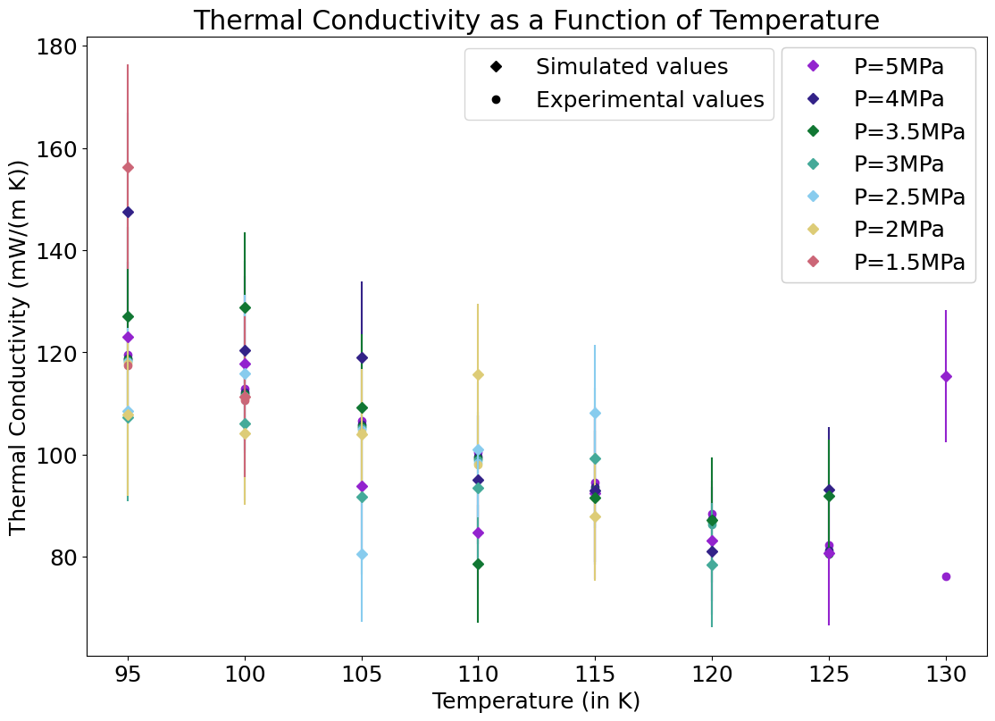

Slide 15
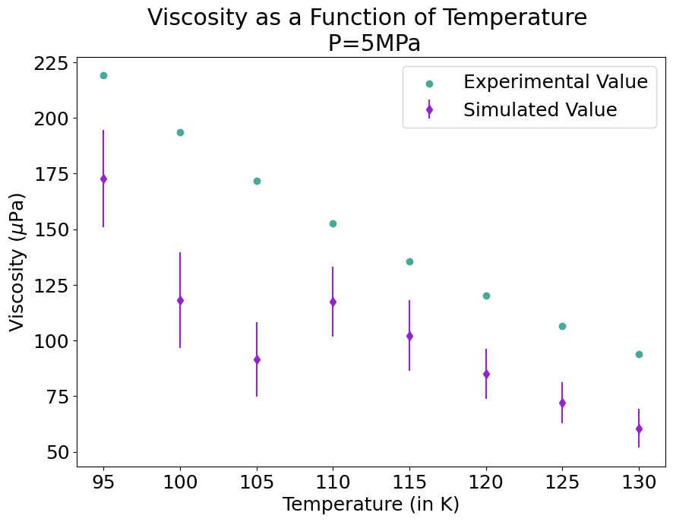

Slide 16
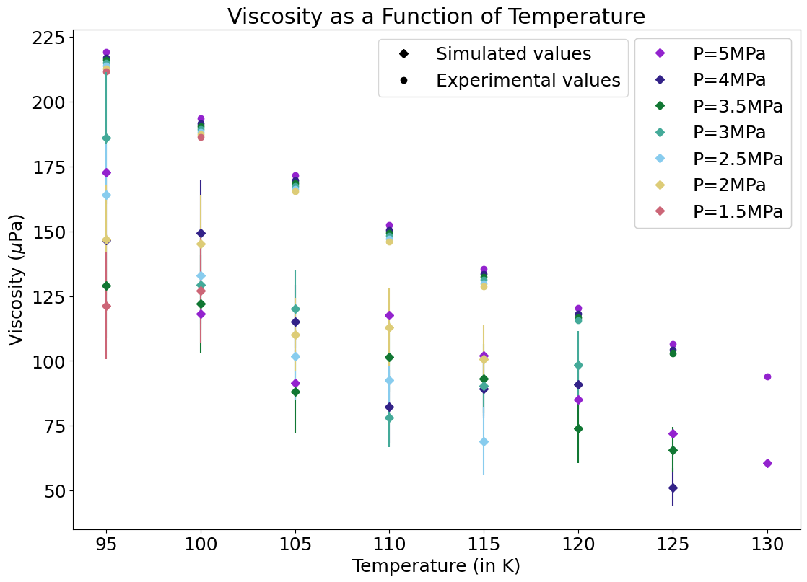

Slide 17
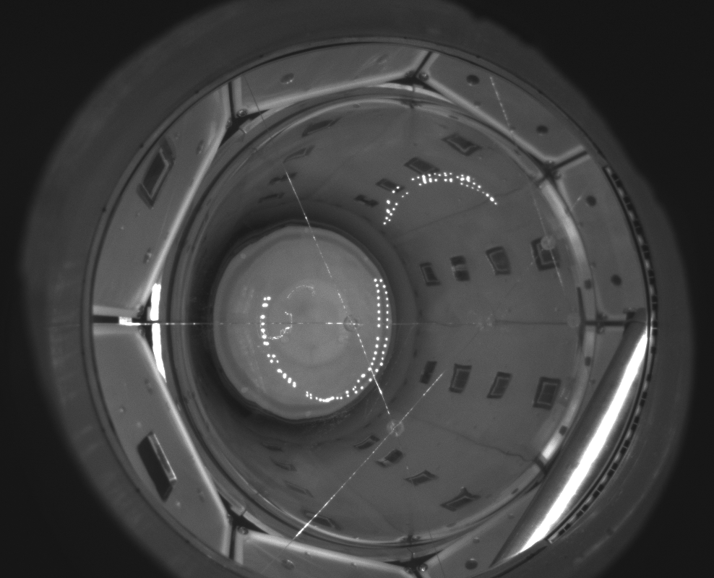
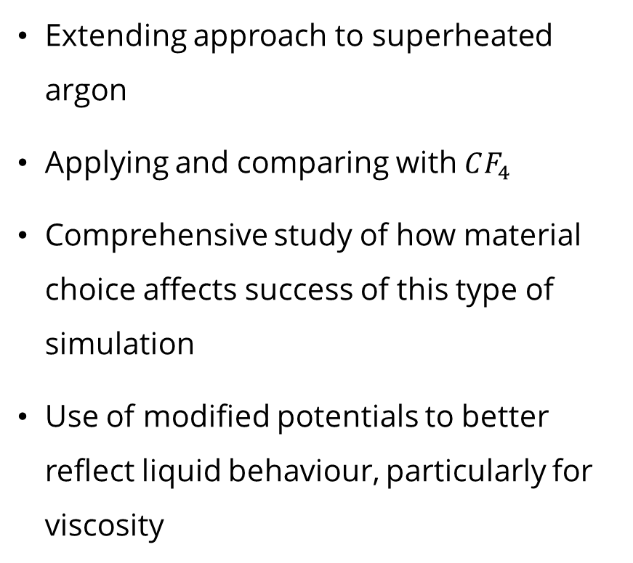
Future Work
Extending approach to superheated argon
Applying and comparing with $CF_{4}$
Comprehensive study of how material choice affects success of this type of simulation
Use of modified potentials to better reflect liquid behaviour, particularly for viscosity

Slide 18












Conclusions
Detection capability depends on strong thermal and fluid dynamic models:
Nucleation threshold
Two distinct temperature regions
Molecular dynamics → bulk fluid simulation framework
- Works well within some constraints
Lots of interesting future work!
Stay tuned for a thesis and a paper!

