Slide 1



Toward SME-Sensitive Antihydrogen Hyperfine Spectroscopy
Supervisor: Dr. Timothy Friesen.
Pouya Heidari
PhD Student
Department of Physics and Astronomy
June 23, 2026

Slide 2

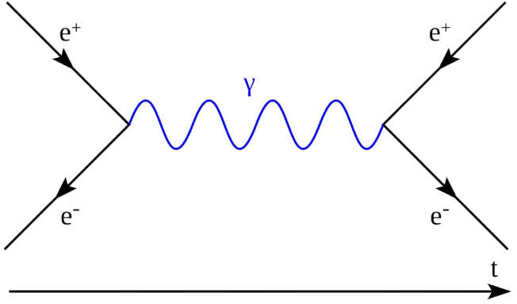
Matter-Antimatter
Equal amount of Matter and Antimatter were created 14 B years ago.
Whenever they meet, they annihilate.
For every billion pairs of matter and antimatter, one extra matter existed.
After Annihilation, leftover matter formed the universe.
Antimatter
Matter

Slide 3
CPT and Lorentz Symmetry
Where is the Antimatter?
Lorentz Symmetry: The laws of physics should be unchanged under rotations and boosts of the observer’s reference frame.
Reverse Charge (C)
All the Laws of Physics should remain the same
CPT
Mirror Image of Space (P)
Reverse Time (T)
Any deviation from CPT Symmetry
Could explains why the universe is made of matter

Slide 4
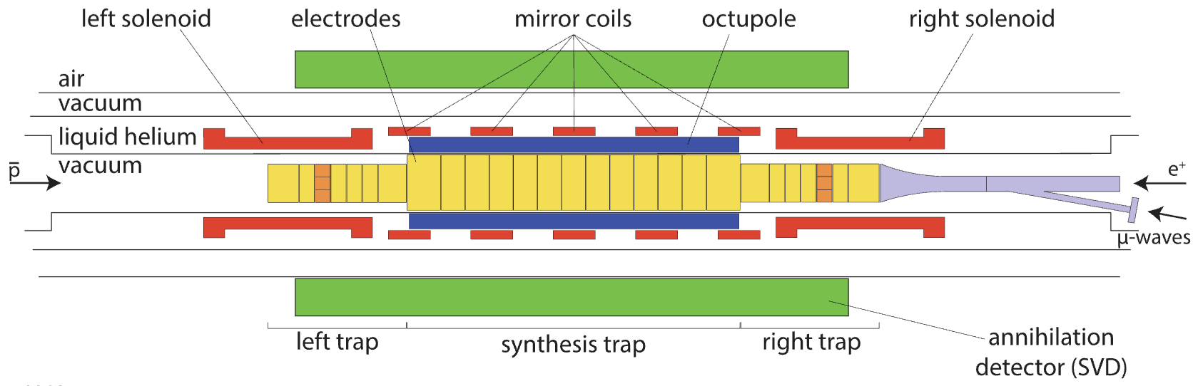
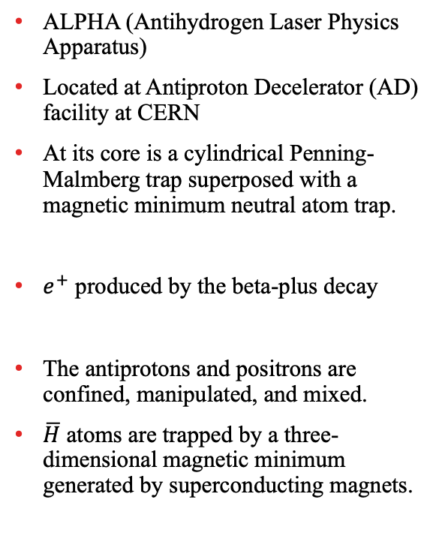
ALPHA Experiment
ALPHA (Antihydrogen Laser Physics Apparatus)
Located at Antiproton Decelerator (AD) facility at CERN
At its core is a cylindrical Penning-Malmberg trap superposed with a magnetic minimum neutral atom trap.
$e^{+}$ produced by the beta-plus decay
The antiprotons and positrons are confined, manipulated, and mixed.
$\overline{H}$ atoms are trapped by a three-dimensional magnetic minimum generated by superconducting magnets.

Slide 5
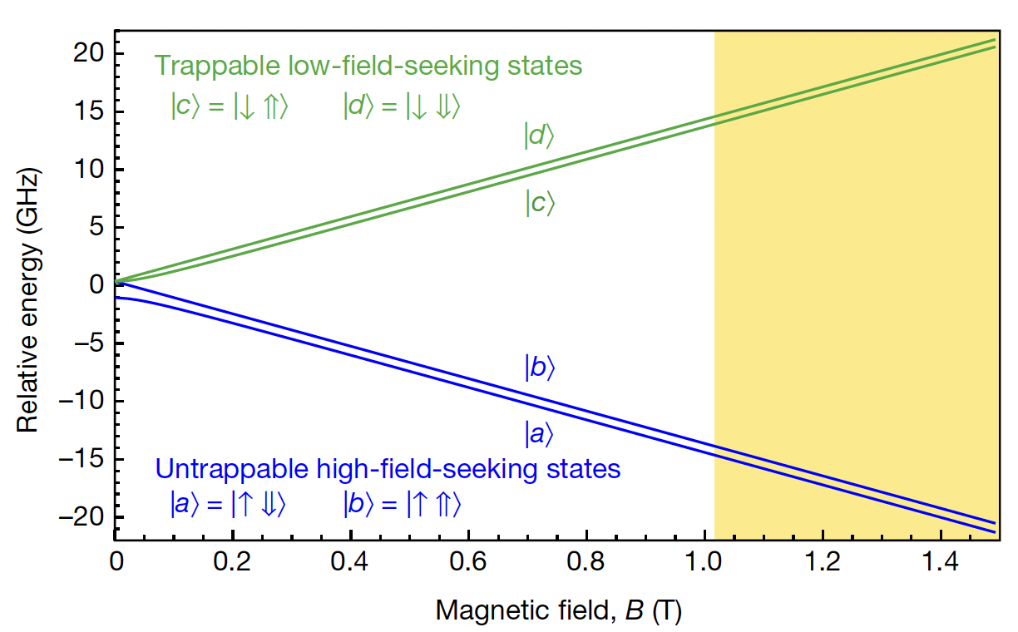

Hyperfine Splitting in ALPHA
$${GSHFS=f}_{da}\left(B_{min}\right)−f_{cb}\left(B_{min}\right)$$
Antihydrogen: $ν_{\overline{H}}^{HFS, 1S}\text{=}\text{1,420,404.8}±1.1\left(stat.\right)± 5.6 \left(sys.\right)$kHz
Hydrogen: $ν_{H}^{HFS, 1S}\text{=}\text{1}\text{,}\text{420}\text{,}\text{405.751768}±\text{2}×{10}^{−6} \text{kHz}$
Hellwig, H. W. et al. IEEE TIM 19 (1970): 200-209
Akbari, R et al. (ALPHA Collaboration) Nature 653, 1022–1026 (2026)

Slide 6
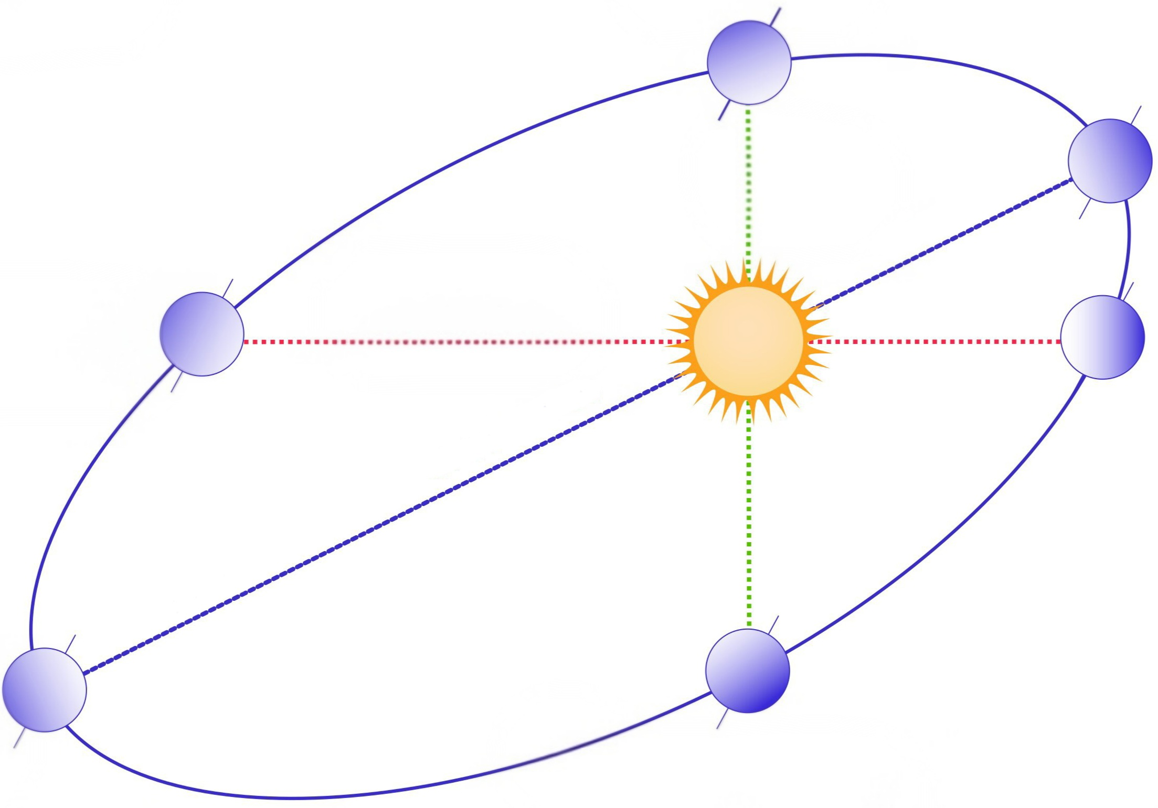

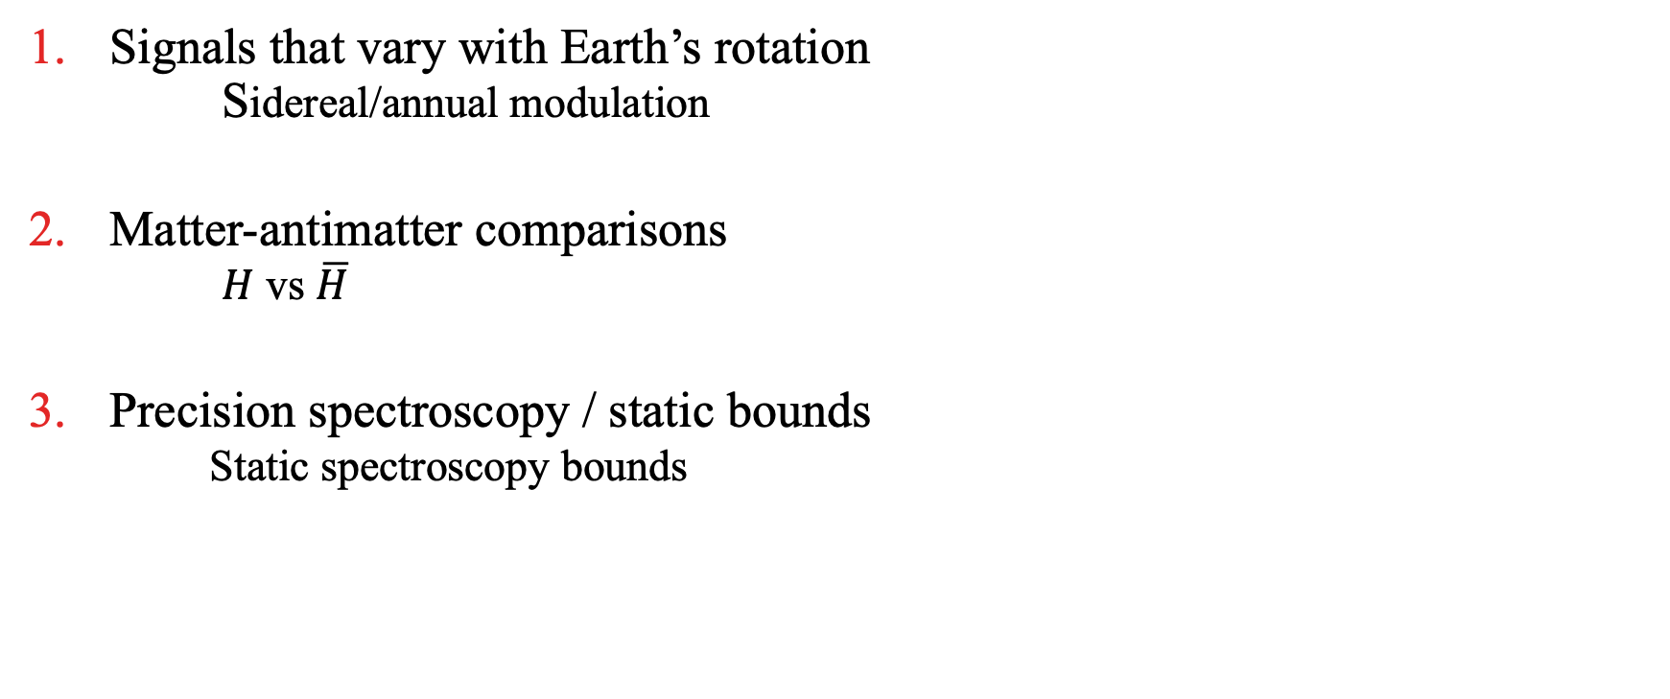
Standard Model Extension
SME=Standard Model + all Lorentz/CPT-violating terms
Signals that vary with Earth’s rotation
Sidereal/annual modulation
Matter-antimatter comparisons
$H$ vs $\overline{H}$
Precision spectroscopy / static bounds
Static spectroscopy bounds
Lehnert, R., The Standard-Model Extension, EPJ Web of Conferences 282, 01004 (2023)

Slide 7



SME Hyperfine Prediction
Spin independent
Spin dependent
$$E_{d}^{SME}=A^{e}+A^{p}−\left(B_{3}^{e}+B_{3}^{p}\right)$$
$$E_{c}^{SME}=A^{e}+A^{p}−\cos\left(2θ_{1}\right)\left(B_{3}^{e}−B_{3}^{p}\right)$$
$$E_{b}^{SME}=A^{e}+A^{p}+\left(B_{3}^{e}+B_{3}^{p}\right)$$
$$E_{a}^{SME}=A^{e}+A^{p}+\cos\left(2θ_{1}\right)\left(B_{3}^{e}−B_{3}^{p}\right).$$
$$ΔE_{d↔a}^{\overline{H},SME}=ΔE_{c↔b}^{\overline{H},SME}=−2\cos^{2}{θ_{1}} B_{3}^{e}−2\sin^{2}{θ_{1}} B_{3}^{p}$$
M. Charlton, S. Eriksson, and G. M. Shore, Testing Fundamental Physics in Antihydrogen Experiments, arXiv:2002.09348 (2020).

Slide 9
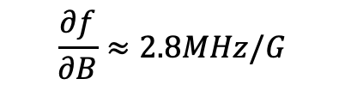
Why are individual transition frequencies challenging?
Magnetic field consideration:
  Zeeman sensitivity
  On-axis ECR vs 3D effective field
  Magnetic field drift and stability
  Non-uniform field
Spectroscopy extraction challenges:
  Empirical onset/lineshape model
  Microwave coupling and power dependence
  Broadening
  Reproducibility and binning
$$\frac{∂f}{∂B}≈2.8MHz/G$$

Slide 10
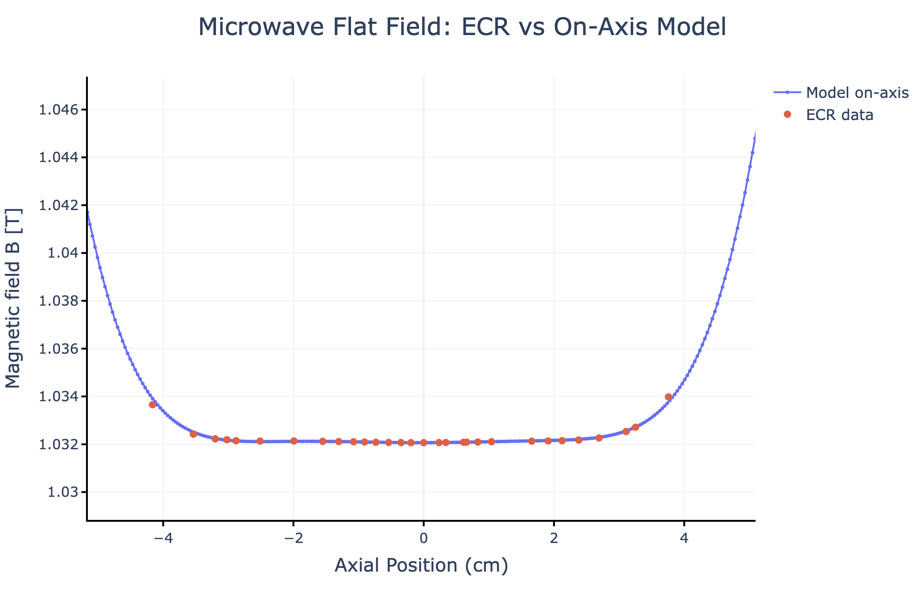
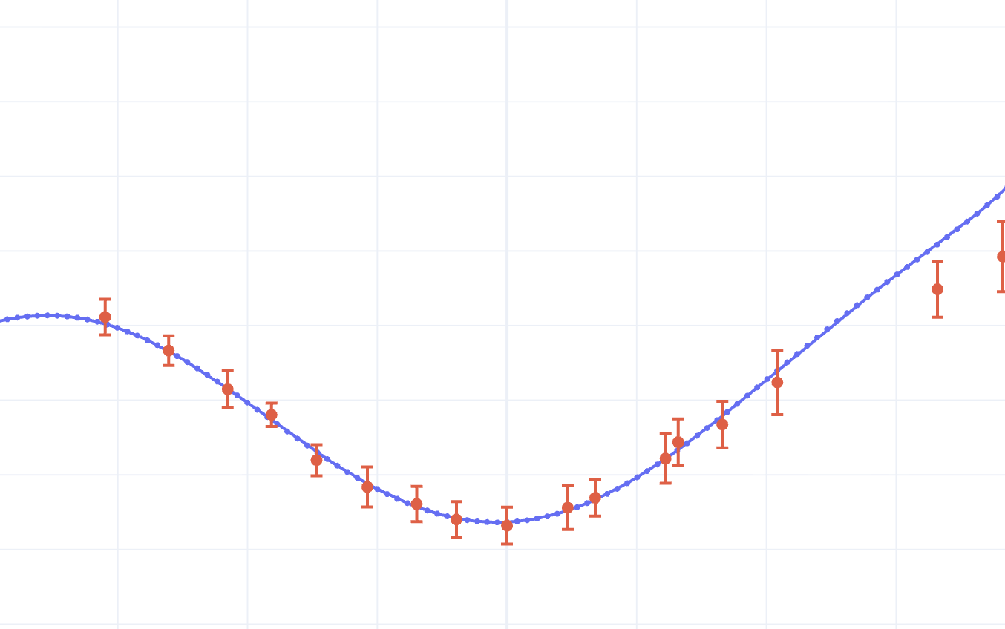
ECR-Constrained Magnetic Field Model

Slide 11
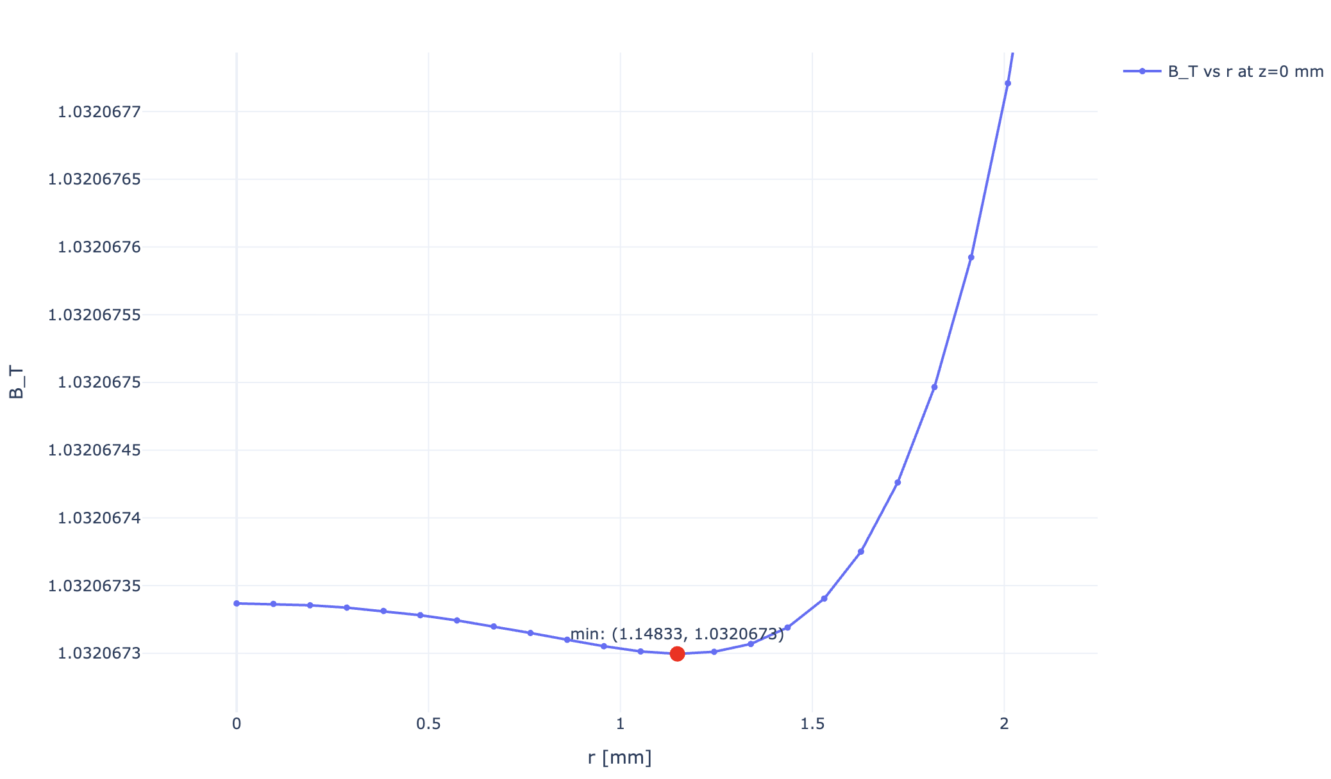
ECR-Constrained Magnetic Field Model
Radial Magnetic Field Profile Near the Trap Minimum

Slide 12
Preliminary Magnetic Field Effects for Individual Transitions
Contribution | Shift in Frequency | Uncertainty
Off-axis extrapolation | ∼165 kHz | TBD
Local on-axis ECR/model uncertainty | NA | ∼56 kHz
ECR field precision | NA | ∼30 kHz
B-drift / Timing correction | ∼30 kHz | ∼10 kHz
Reproducibility
Binning
Signal model
Preliminary magnetic field contribution only.

Slide 13
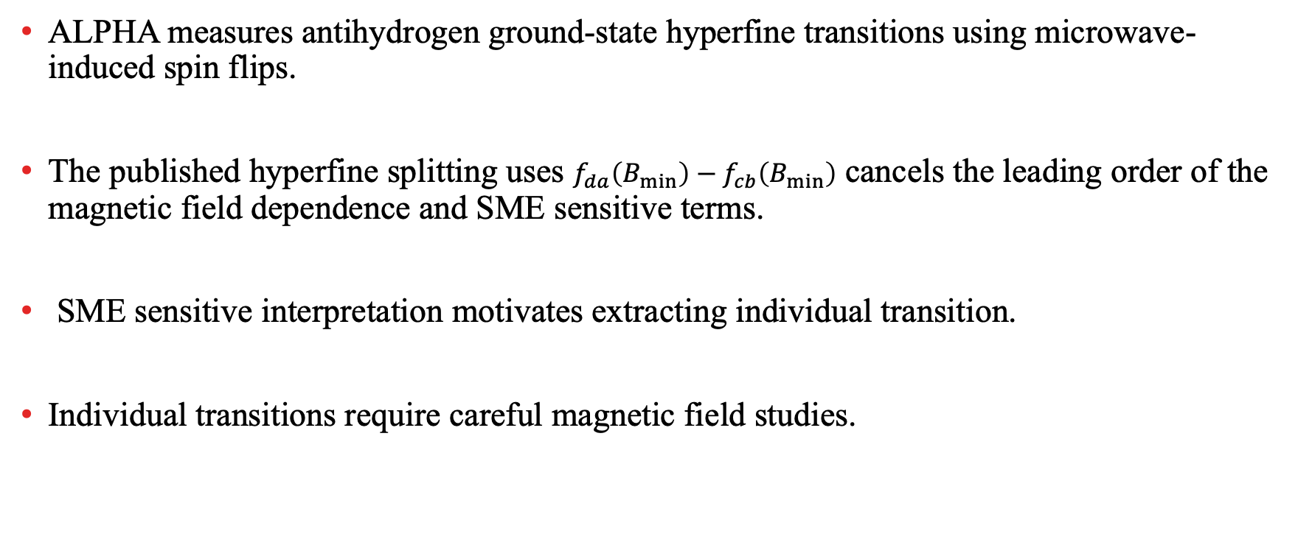
Summary
ALPHA measures antihydrogen ground-state hyperfine transitions using microwave-induced spin flips.
The published hyperfine splitting uses $f_{da}\left(B_{min}\right)−f_{cb}\left(B_{min}\right)$ cancels the leading order of the magnetic field dependence and SME sensitive terms.
SME sensitive interpretation motivates extracting individual transition.
Individual transitions require careful magnetic field studies.

Slide 14


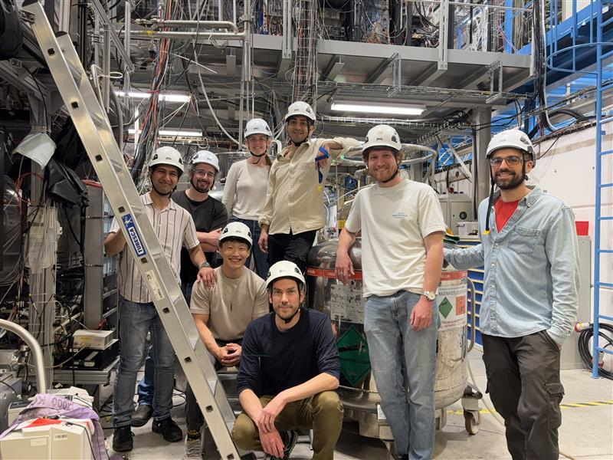

TH NK YOU!

Slide 15
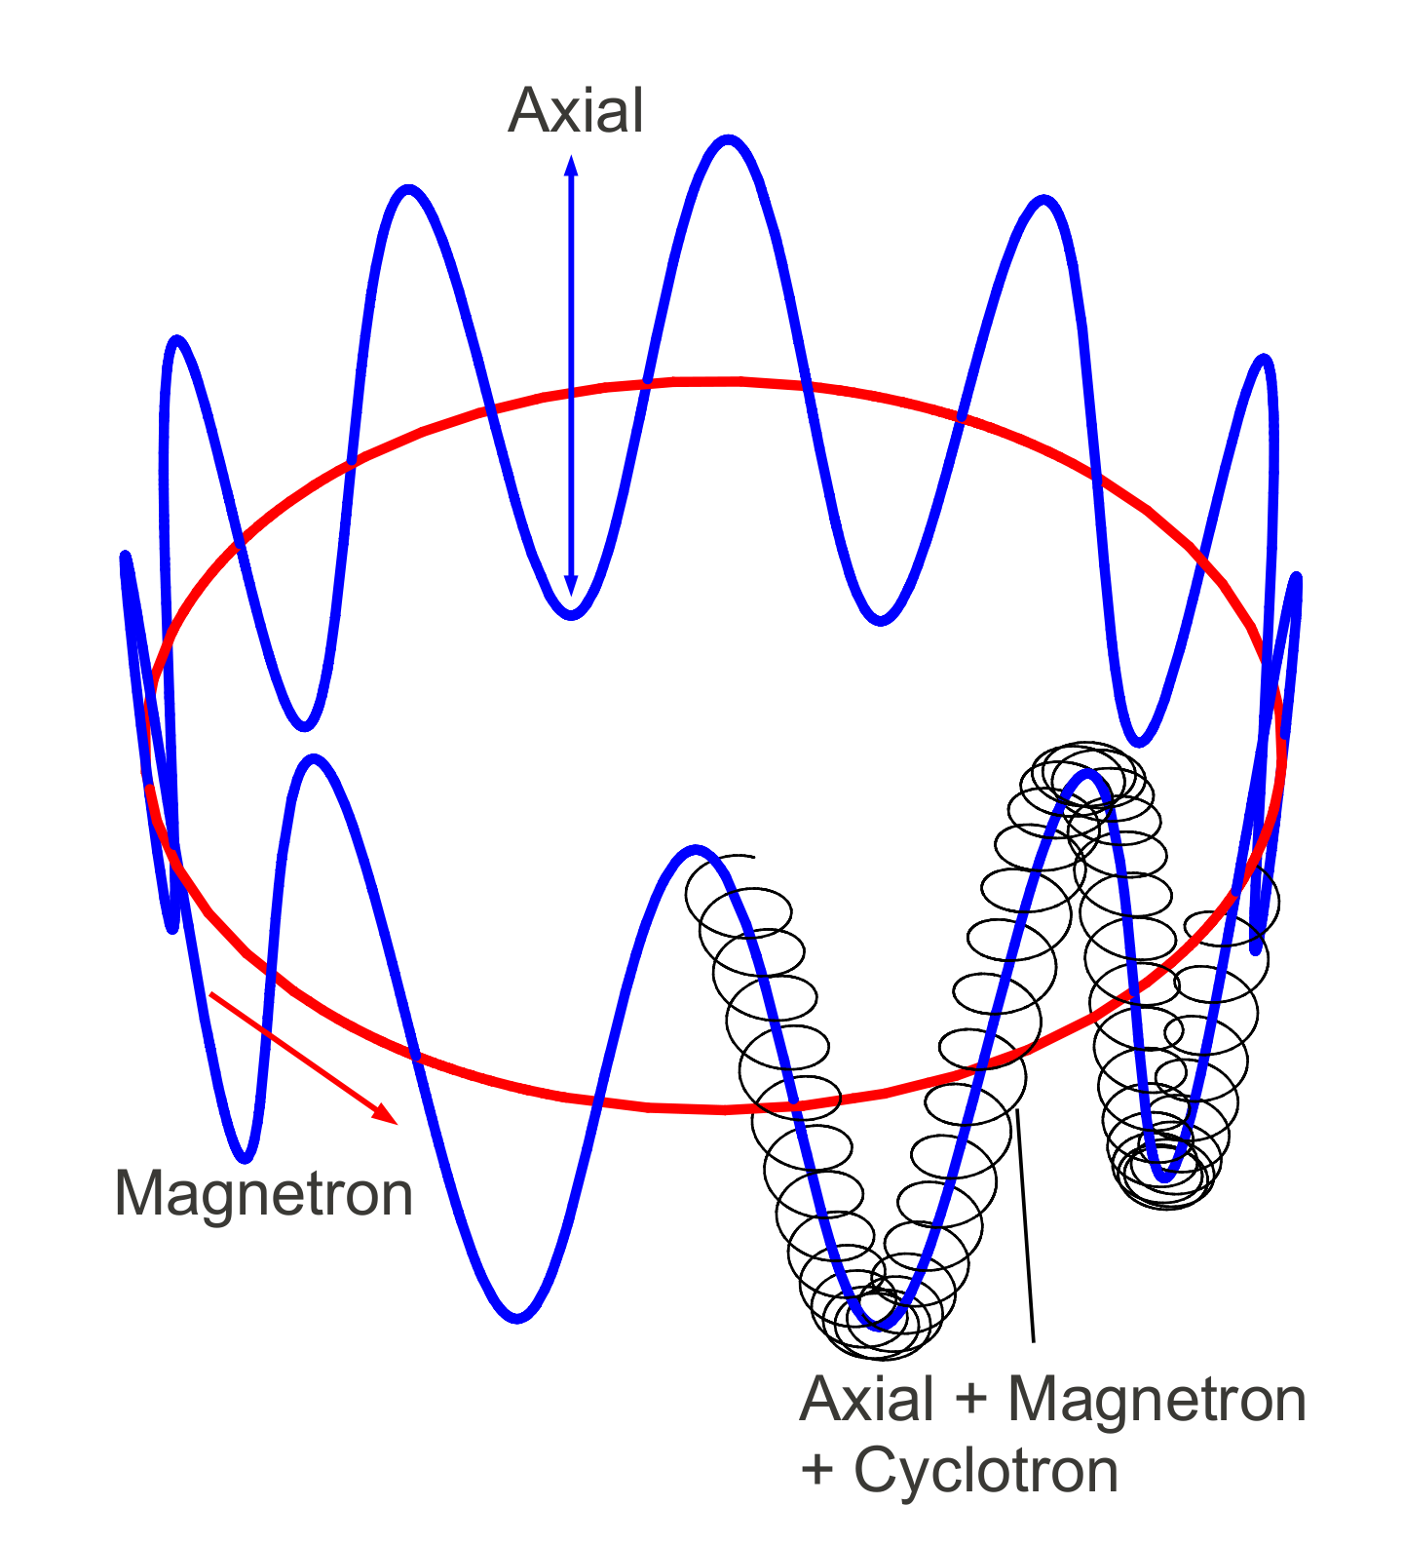
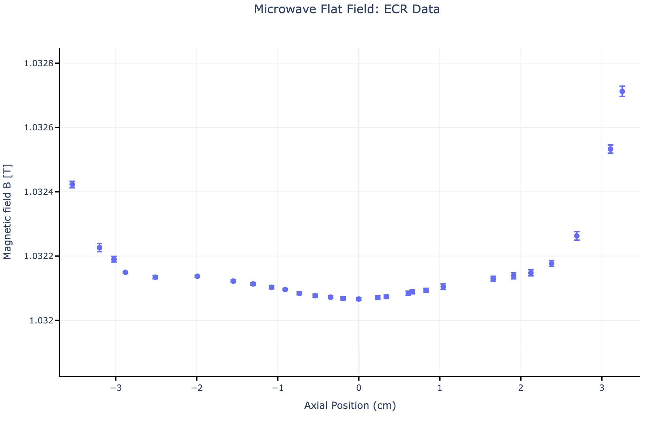
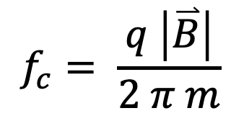
Electron Cyclotron Resonance (ECR) Method
Z axis
$$f_{c}= \frac{q \left|\overset{⃑}{B}\right|}{2 π m}$$

Slide 16
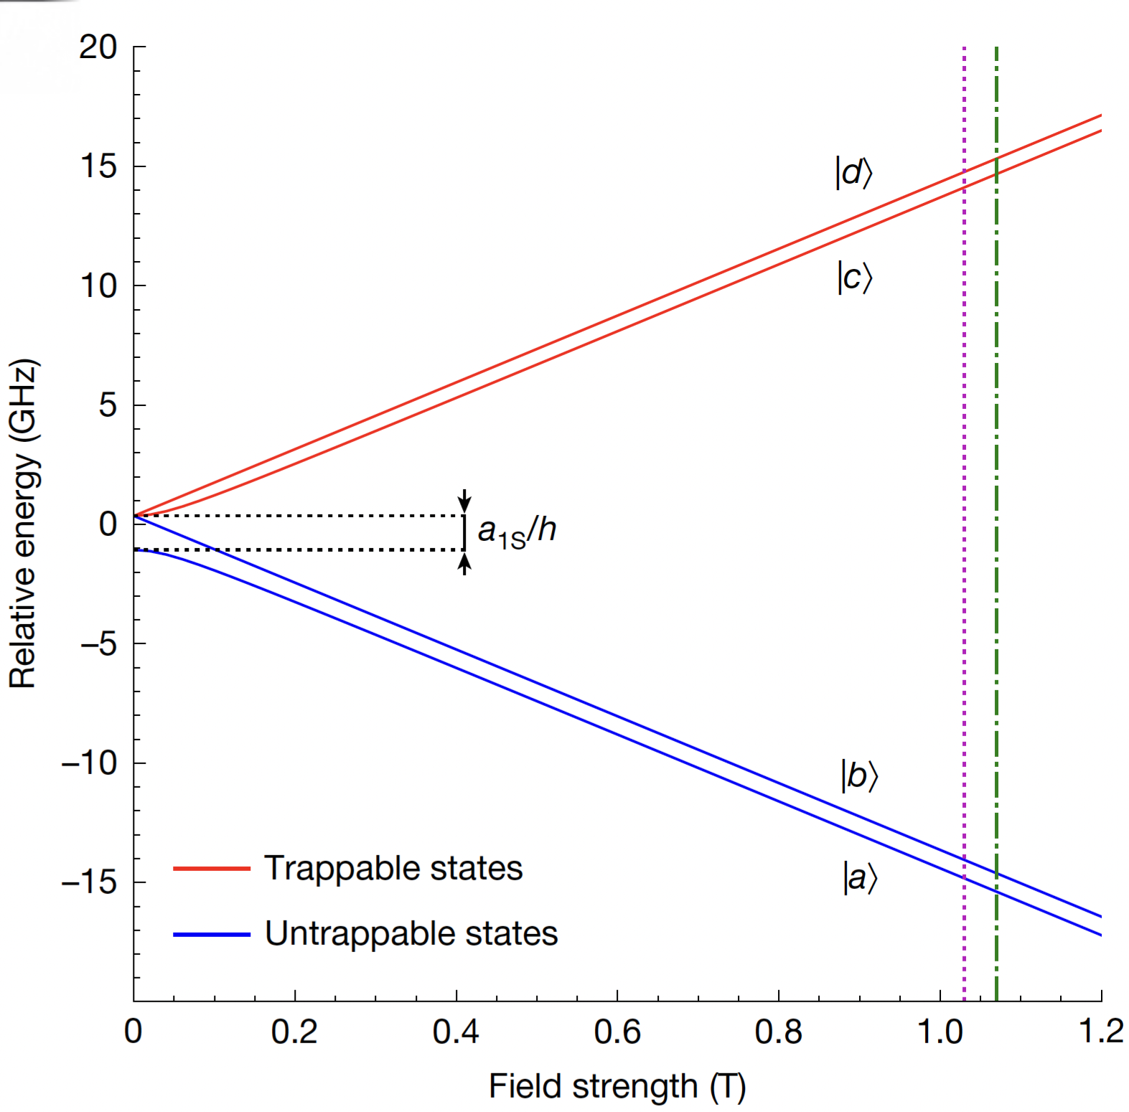
Individual Transition Frequencies

