Slide 1
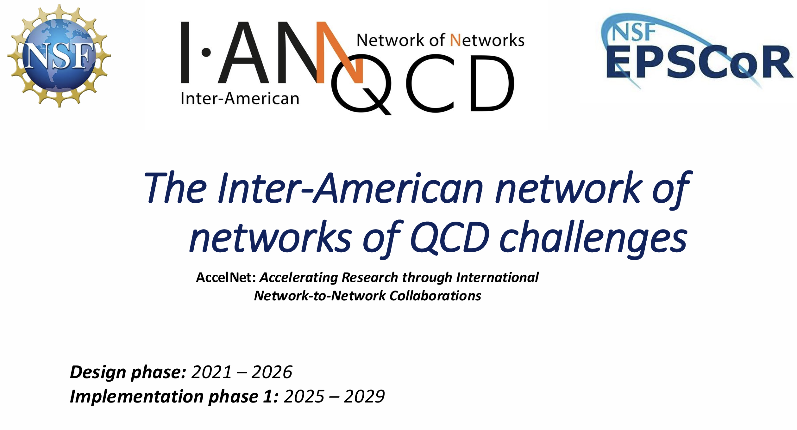

Daniel Tapia Takaki
Ottawa, Canada June 22, 2026

Slide 2
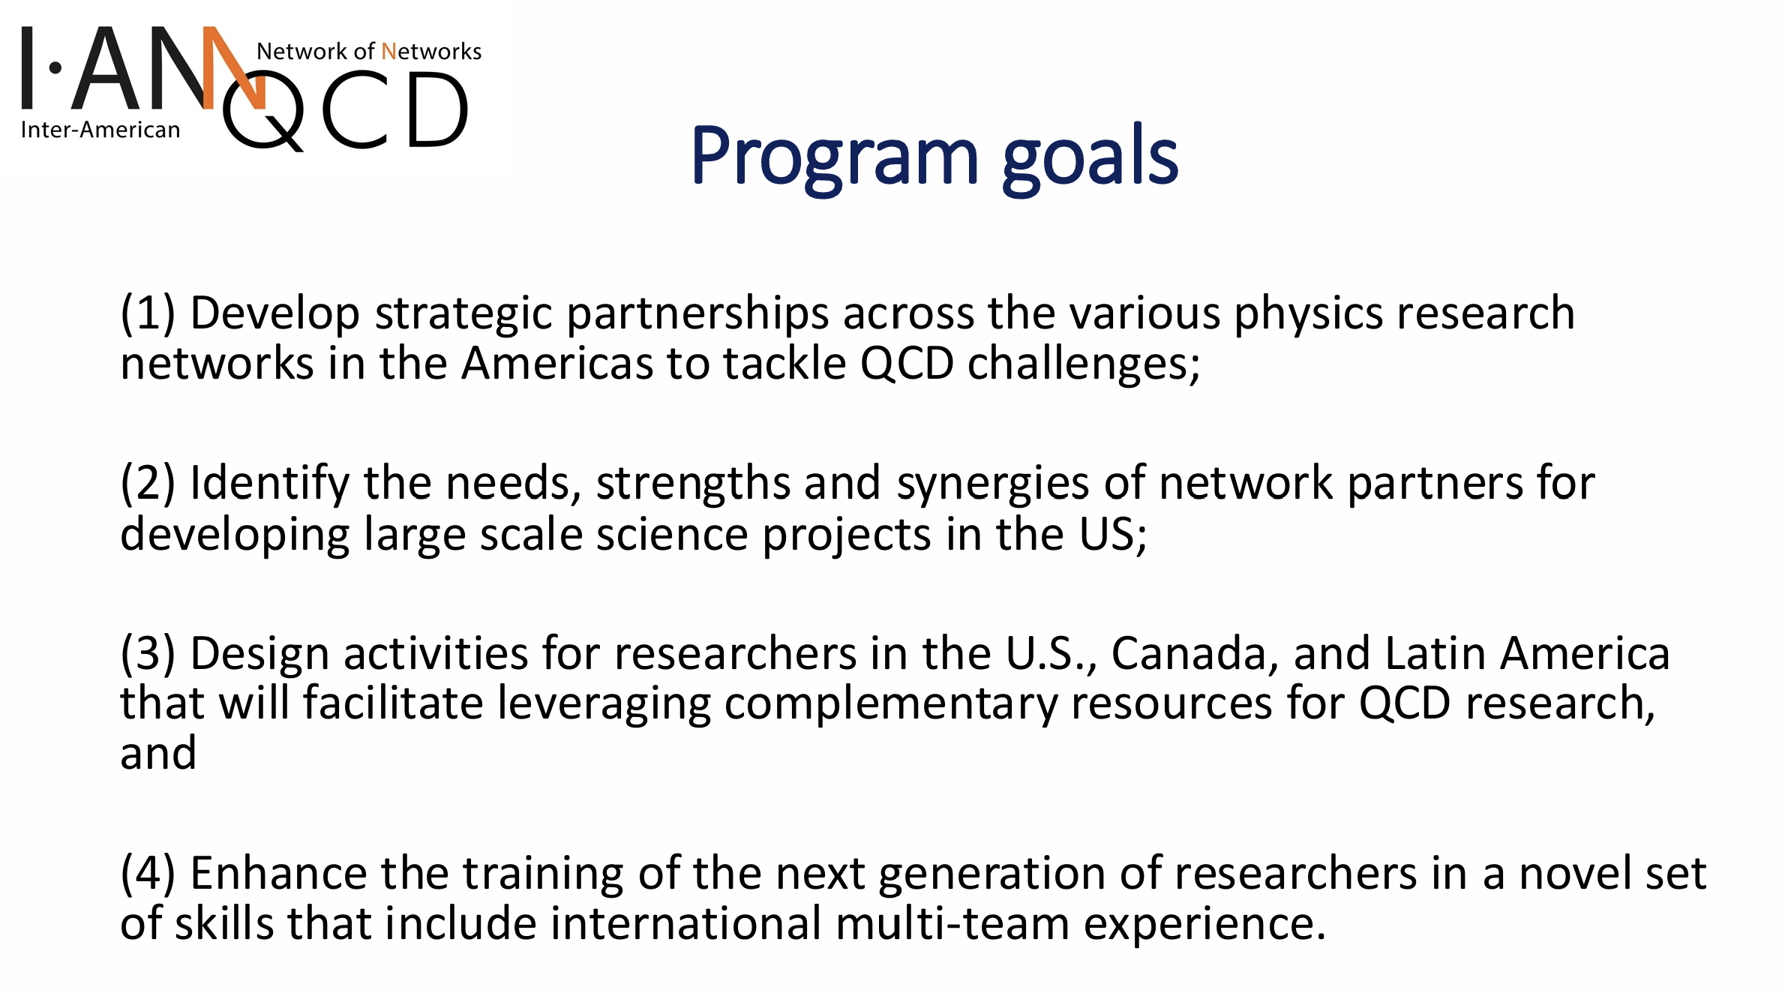

Slide 3
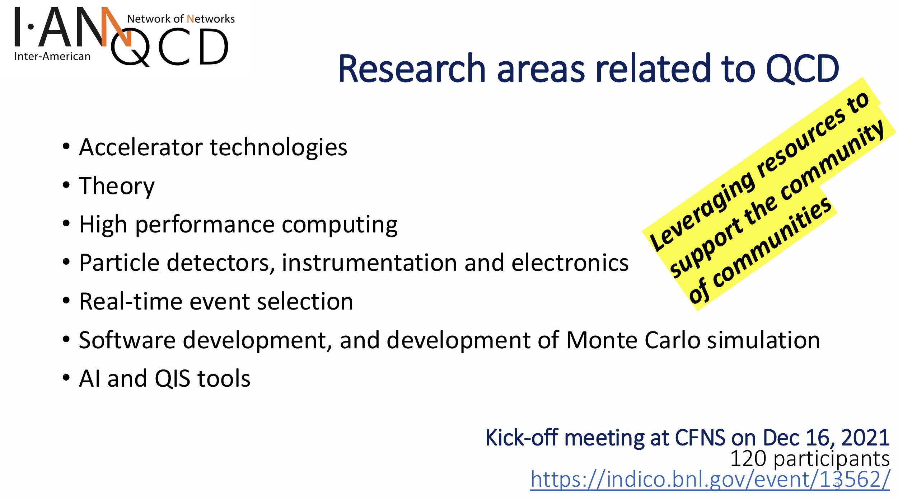

Slide 4
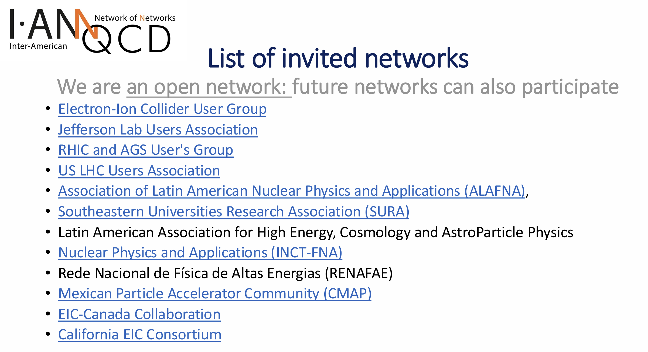

Slide 5
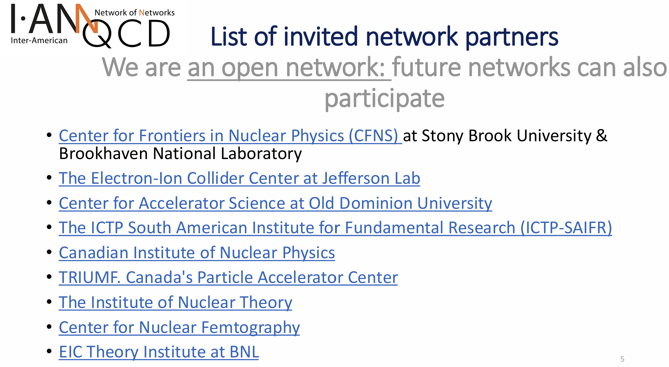

Slide 6
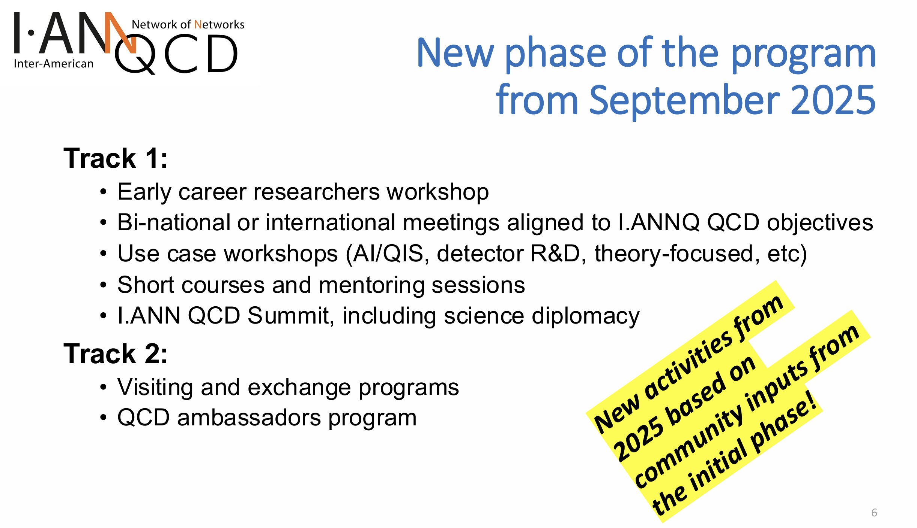

Slide 7
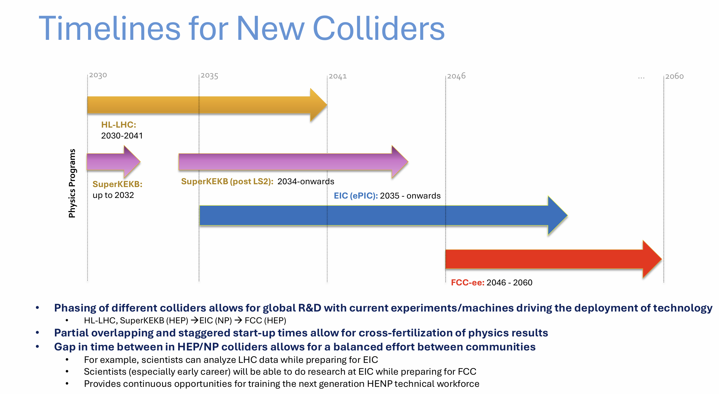
From J. Lajoie Joint APS DPF/DNP Meeting
https://indico.global/event/17474

Slide 8
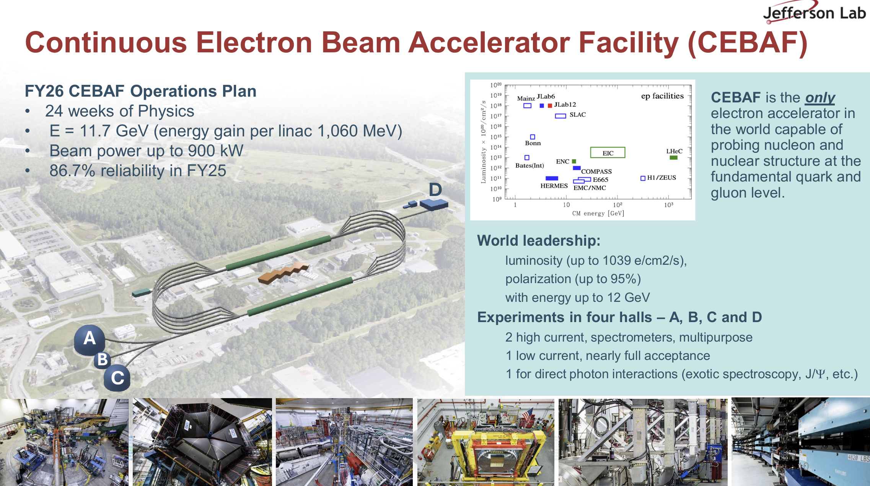

Slide 9
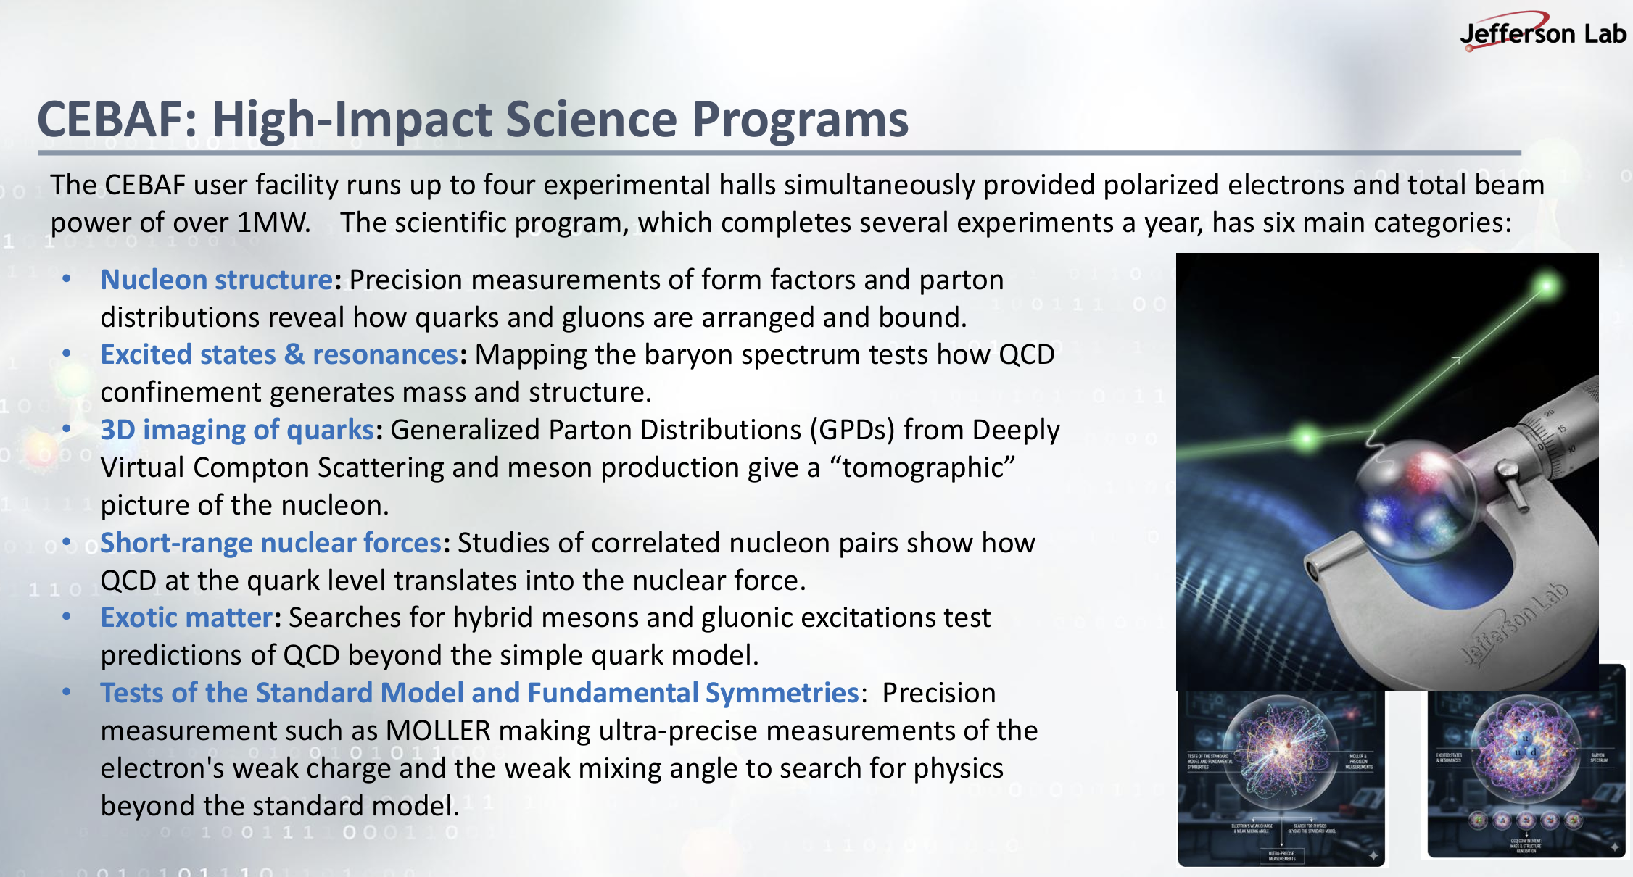

Slide 10
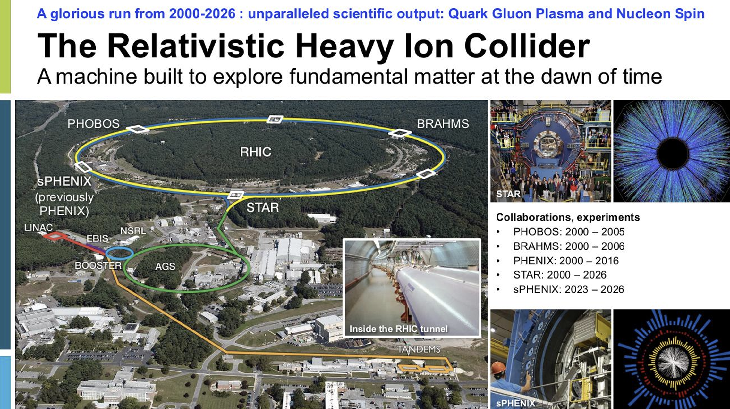

Slide 11
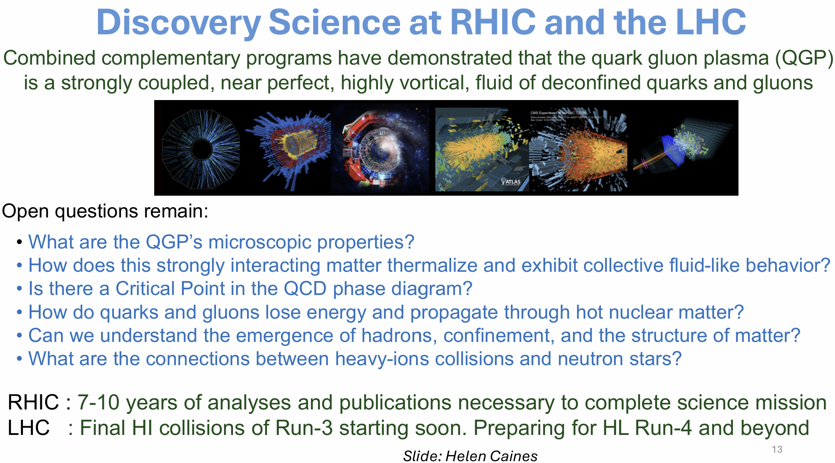

Slide 12
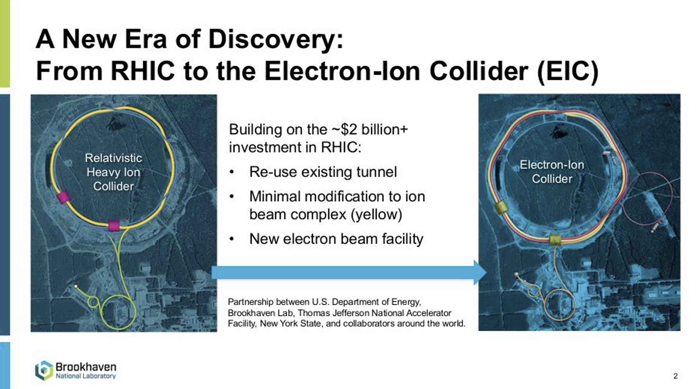

Slide 13
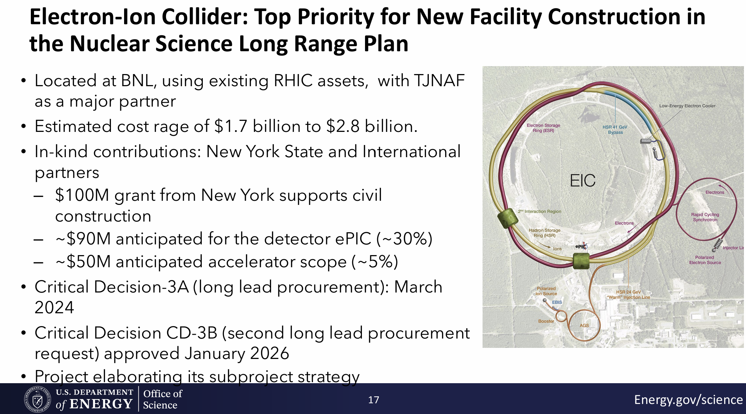
Regina Rameika. From Joint APS DPF/DNP Meeting https://indico.global/event/17474

Slide 14
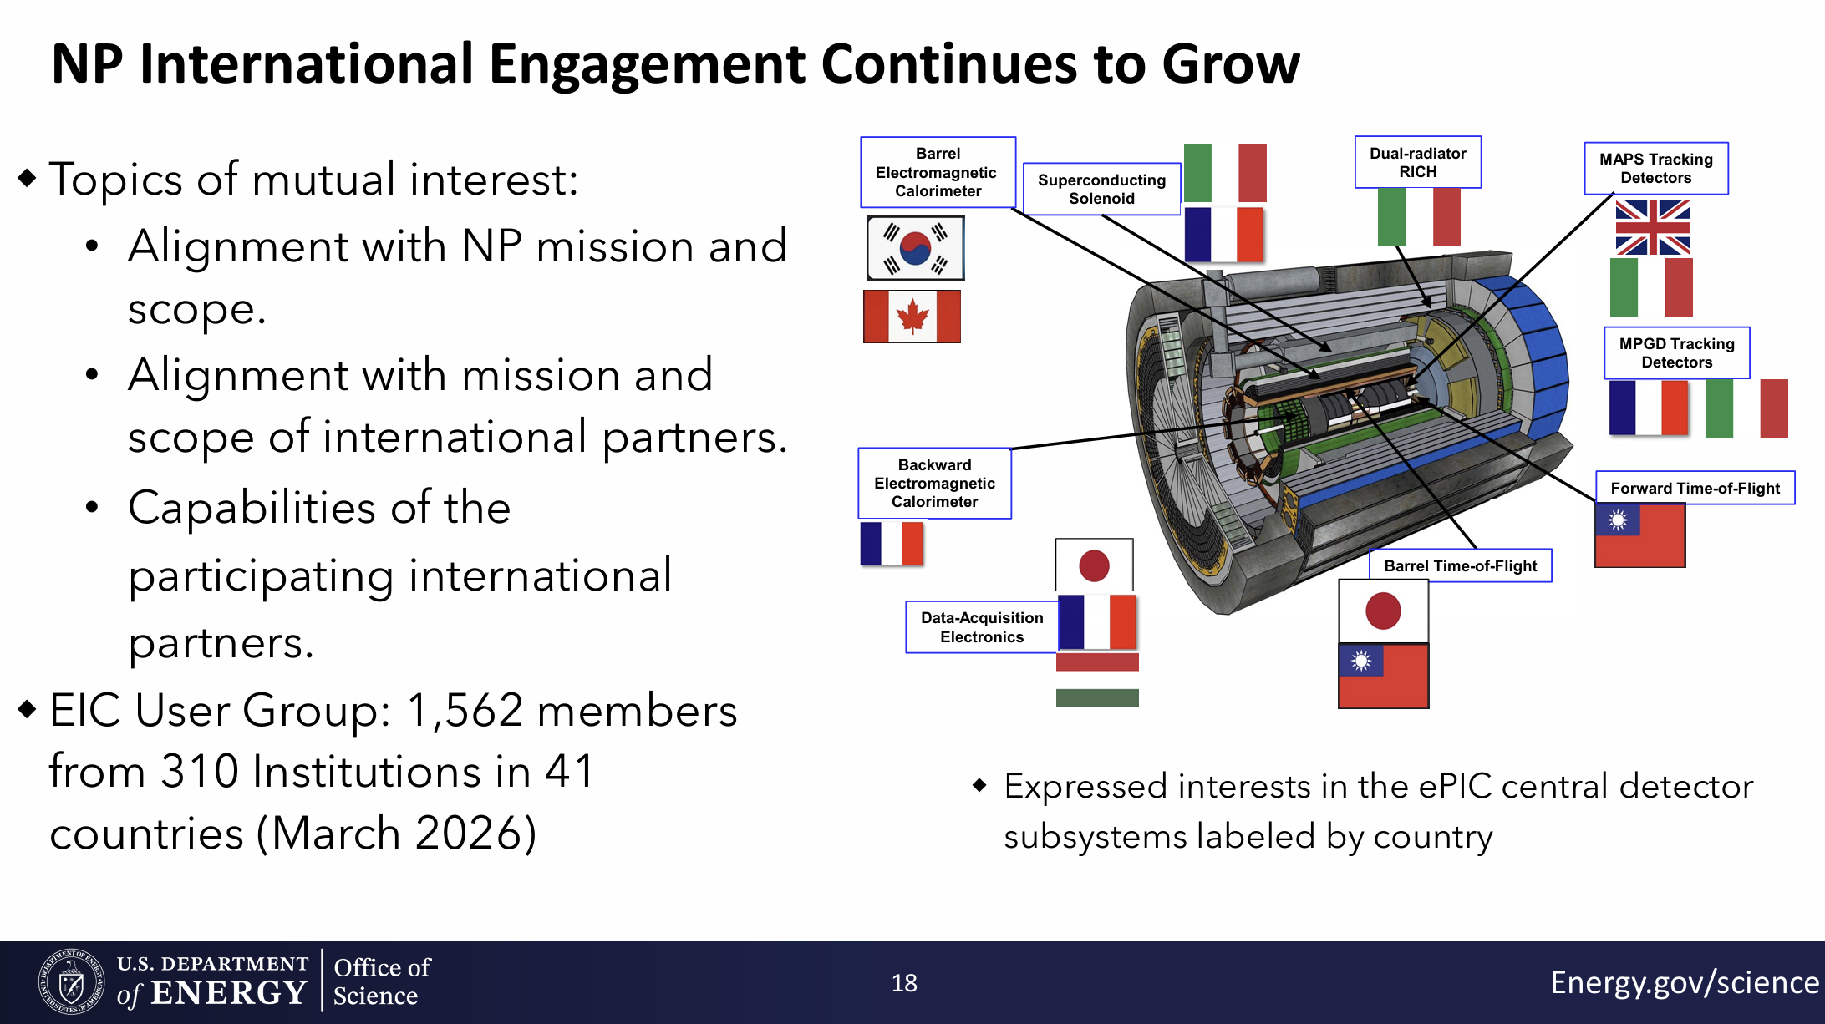
Regina Rameika. From Joint APS DPF/DNP Meeting https://indico.global/event/17474

Slide 15
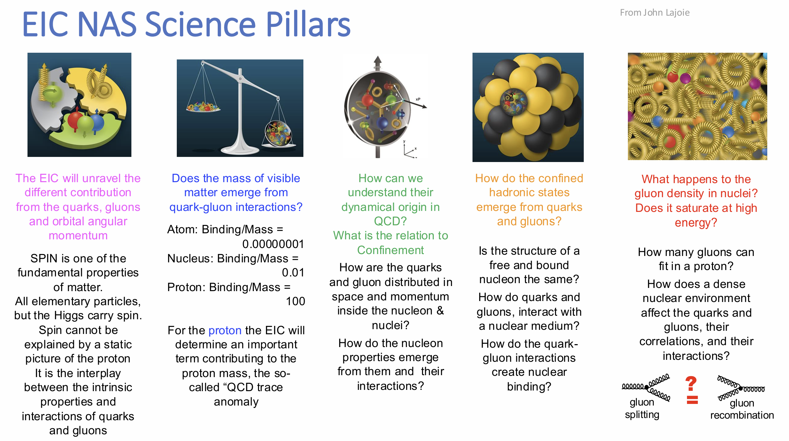

Slide 16
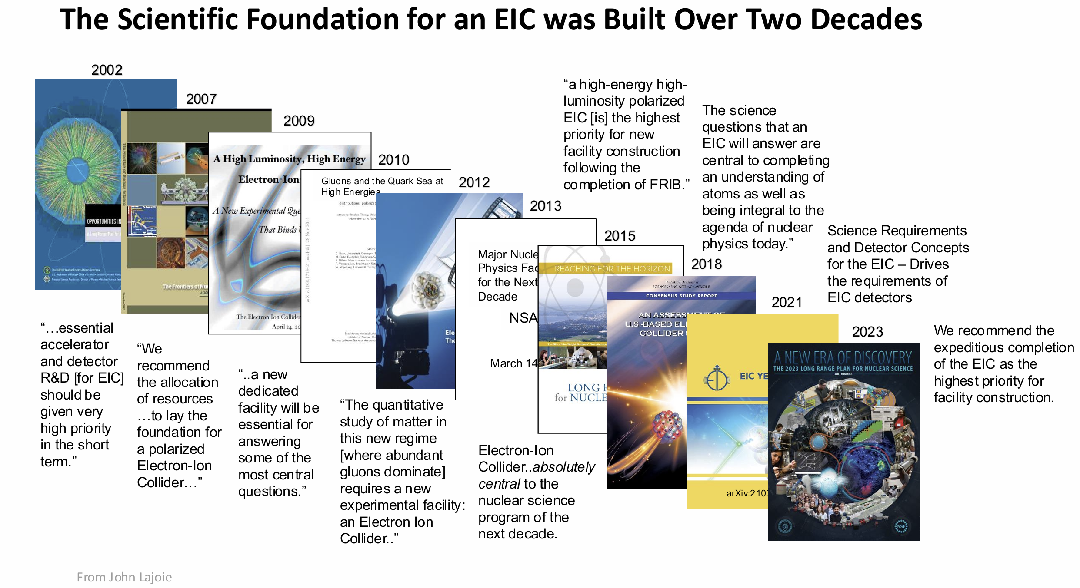

Slide 17
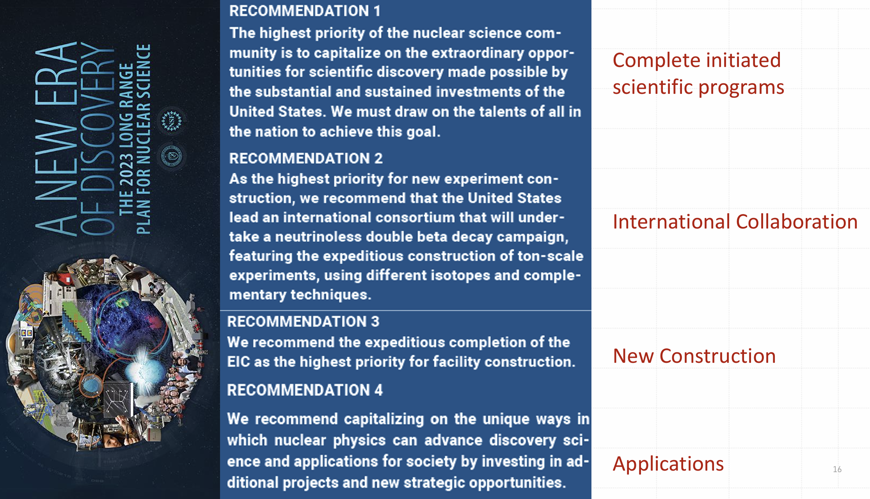

Slide 18
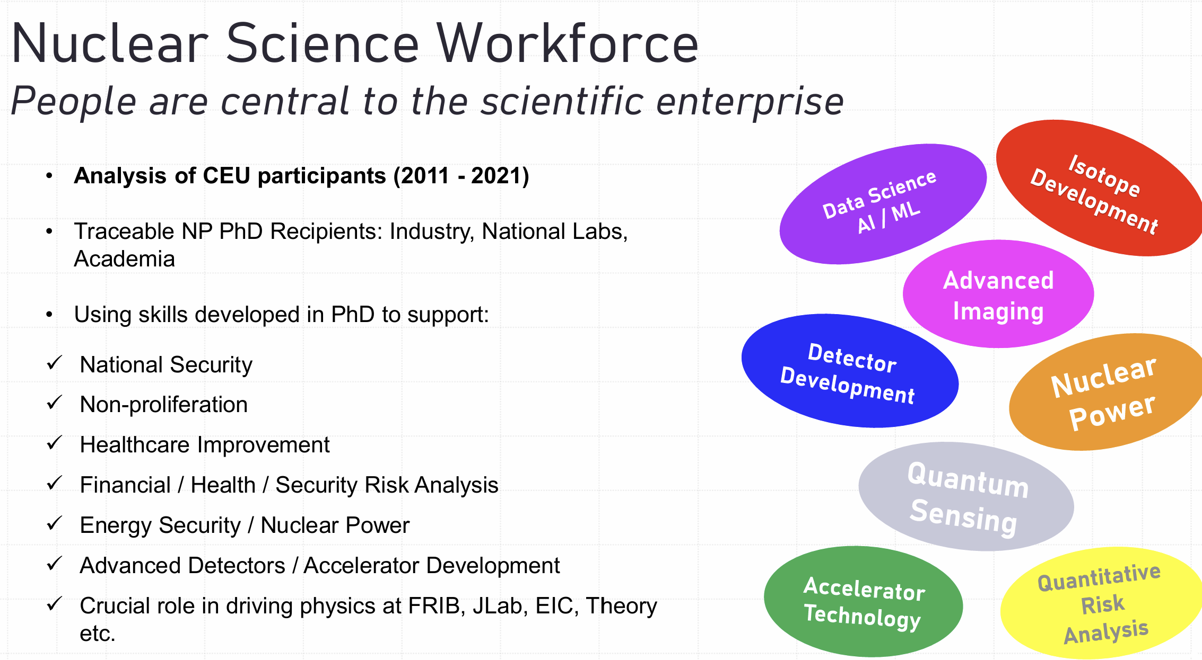
From Nadia Fomin DNP Chair
https://indico.global/event/17474

Slide 19
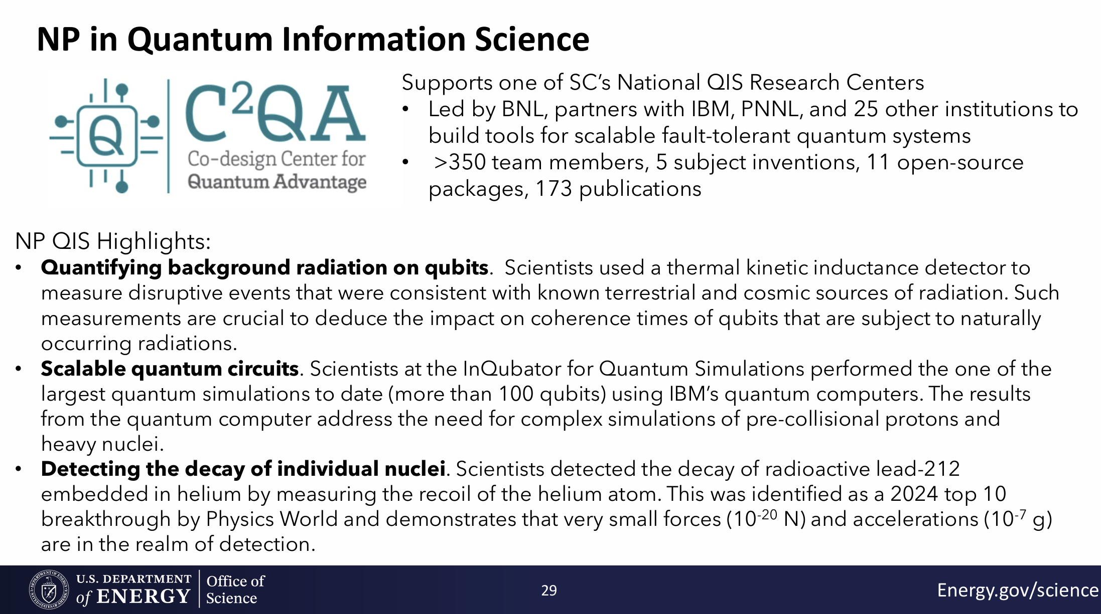
Regina Rameika. From Joint APS DPF/DNP Meeting https://indico.global/event/17474

Slide 20
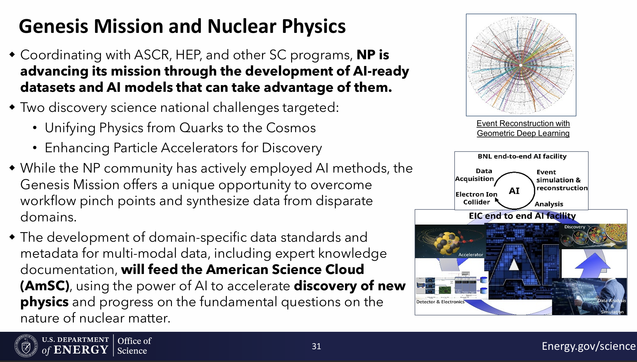
Regina Rameika. From Joint APS DPF/DNP Meeting https://indico.global/event/17474

Slide 21
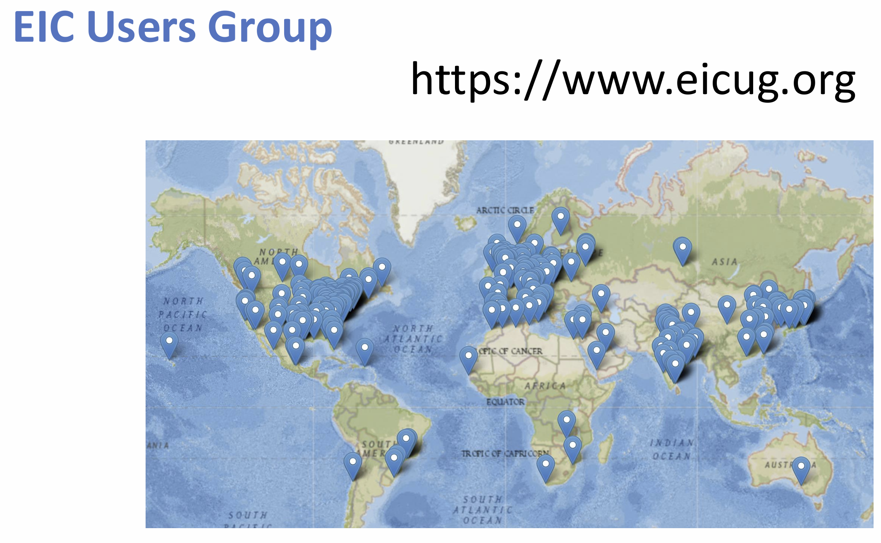

Slide 22
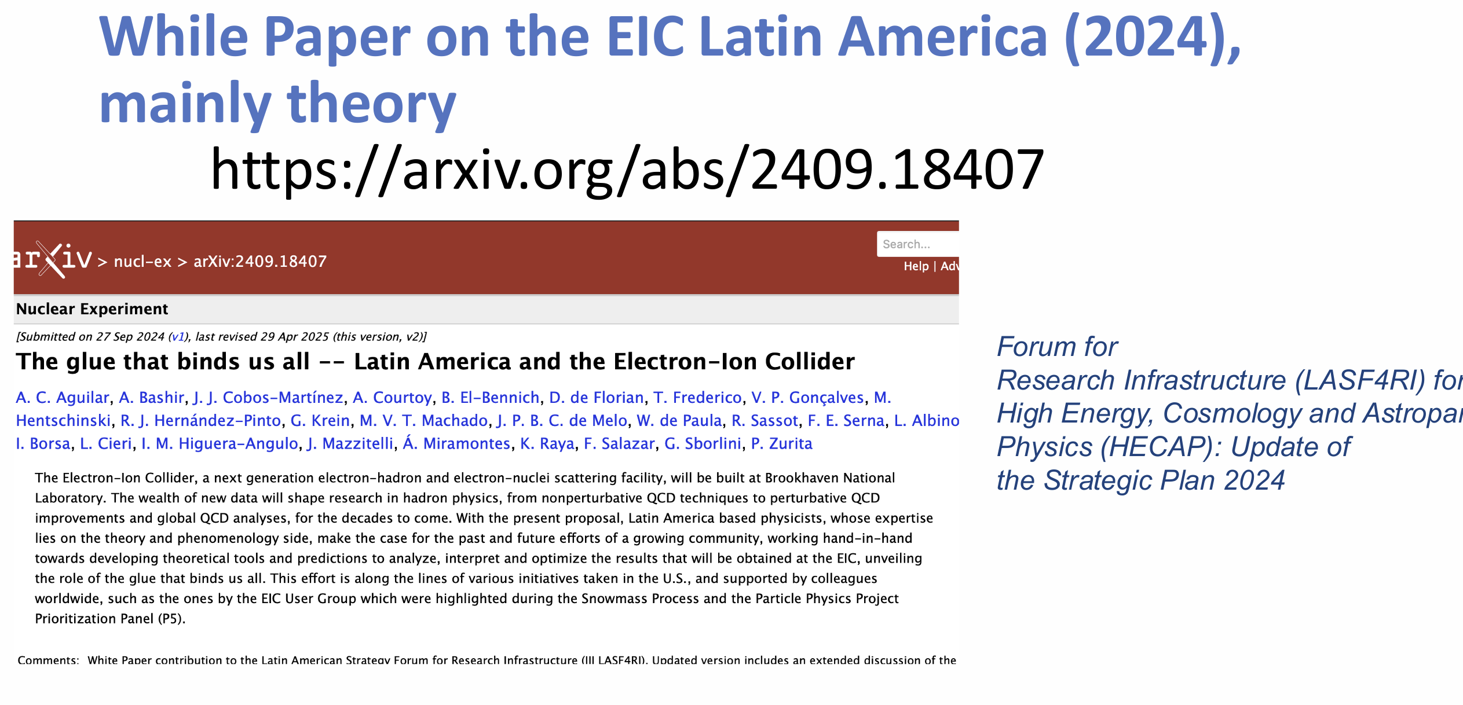

Slide 23
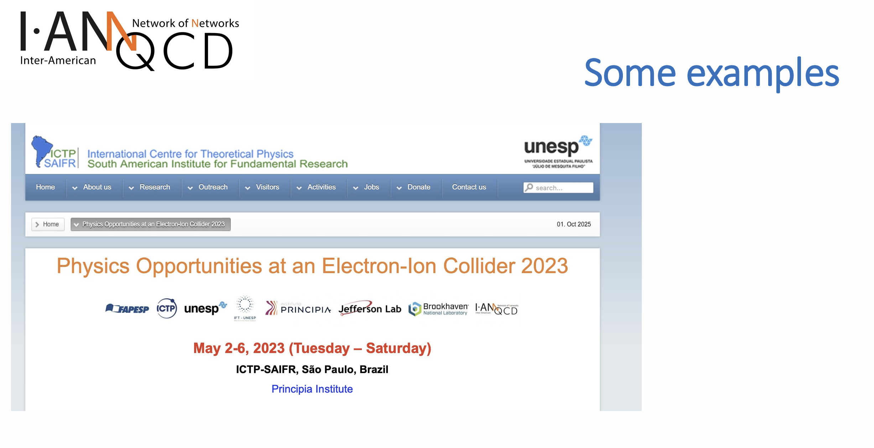

Slide 24
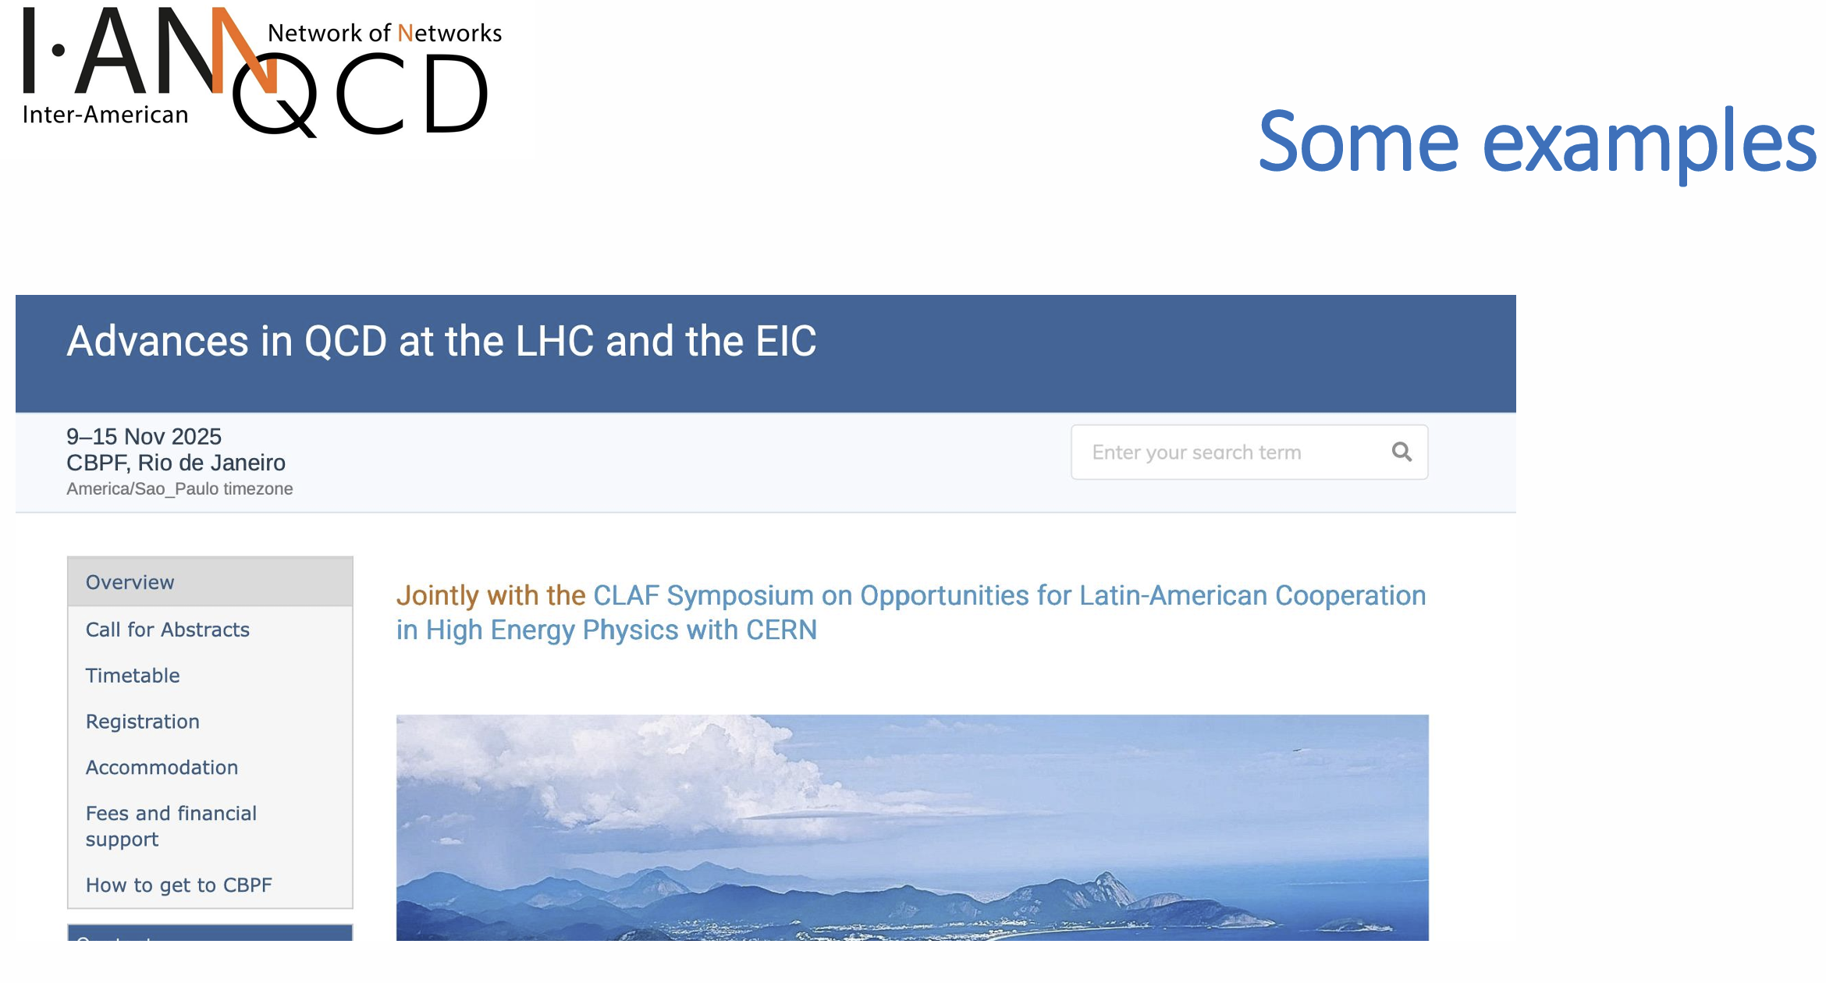

Slide 25
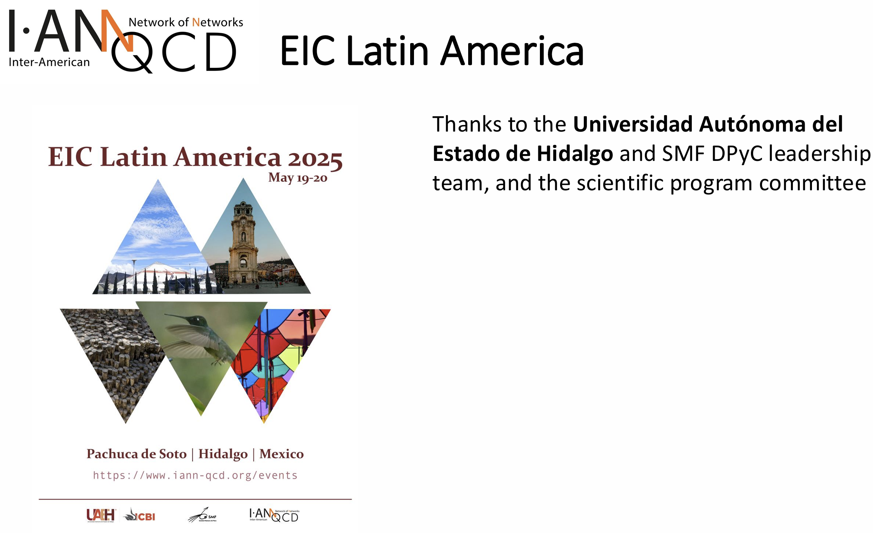

Slide 26
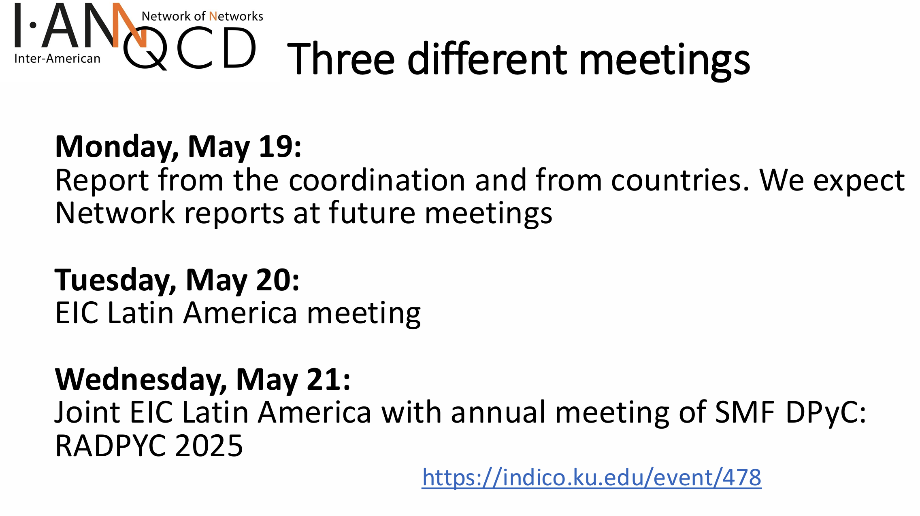

Slide 27
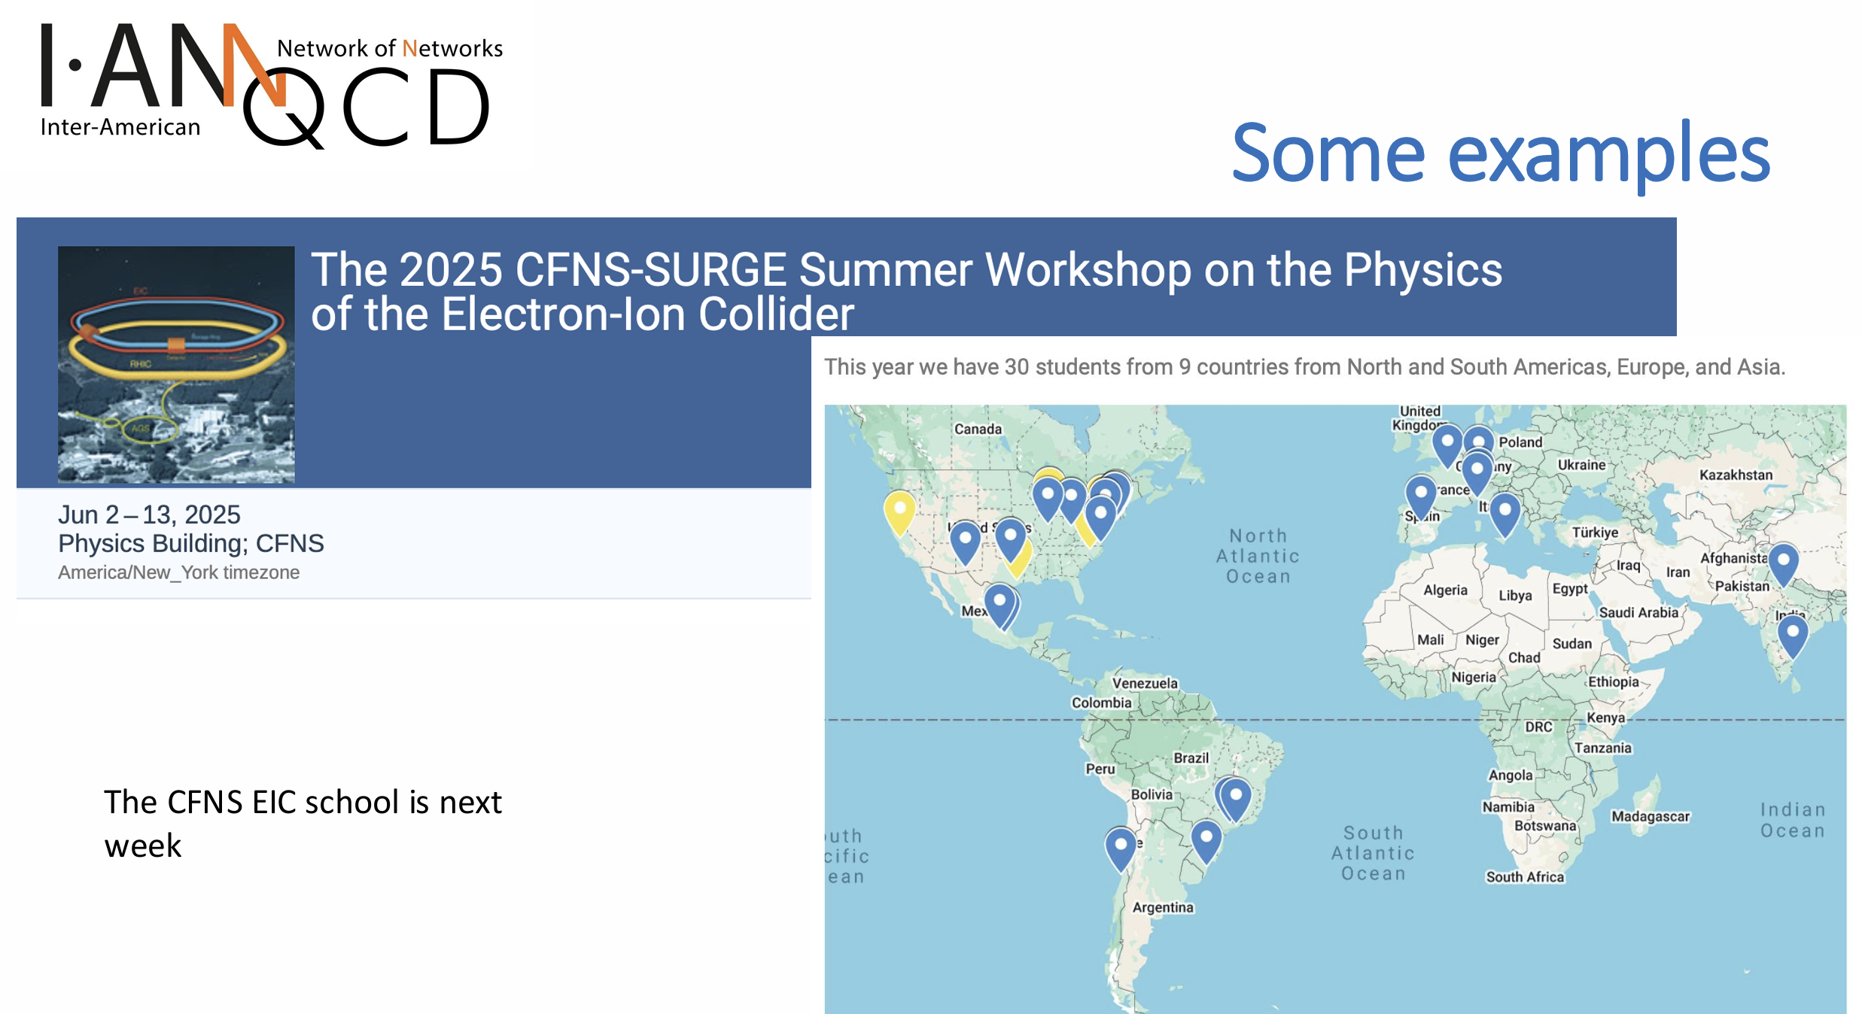

Slide 28
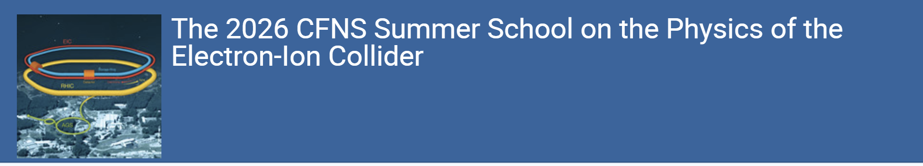
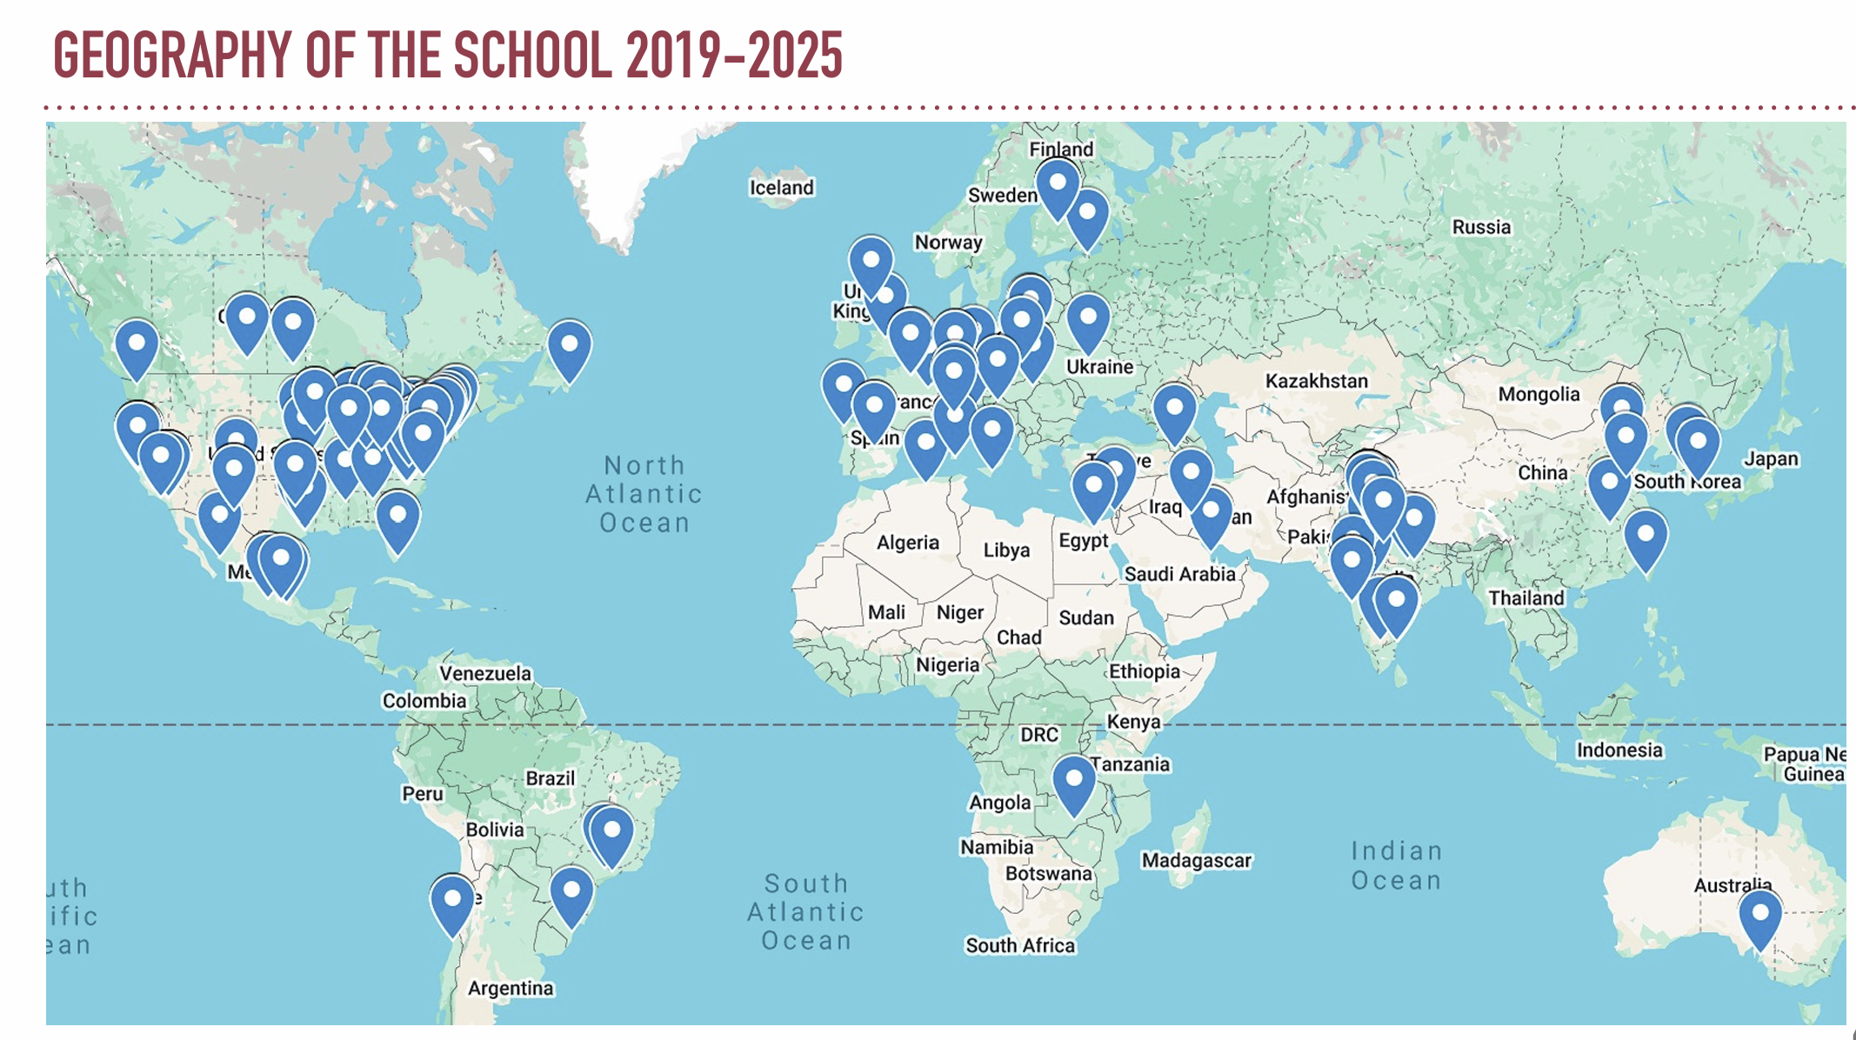

Slide 29

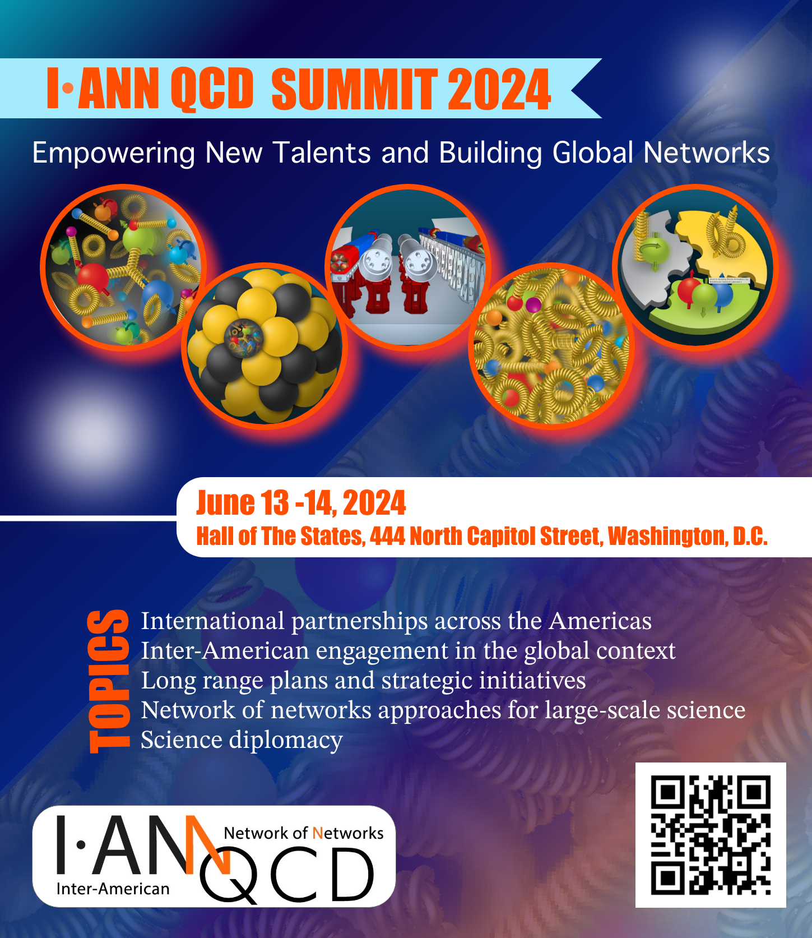
Science diplomacy activities
I.ANN QCD Summit 2024: Empowering New Talents and Building Global Networks (13-14 June 2024): Overview · Indico

Slide 30

Recent activities https://indico.ku.edu/event/495

Slide 31
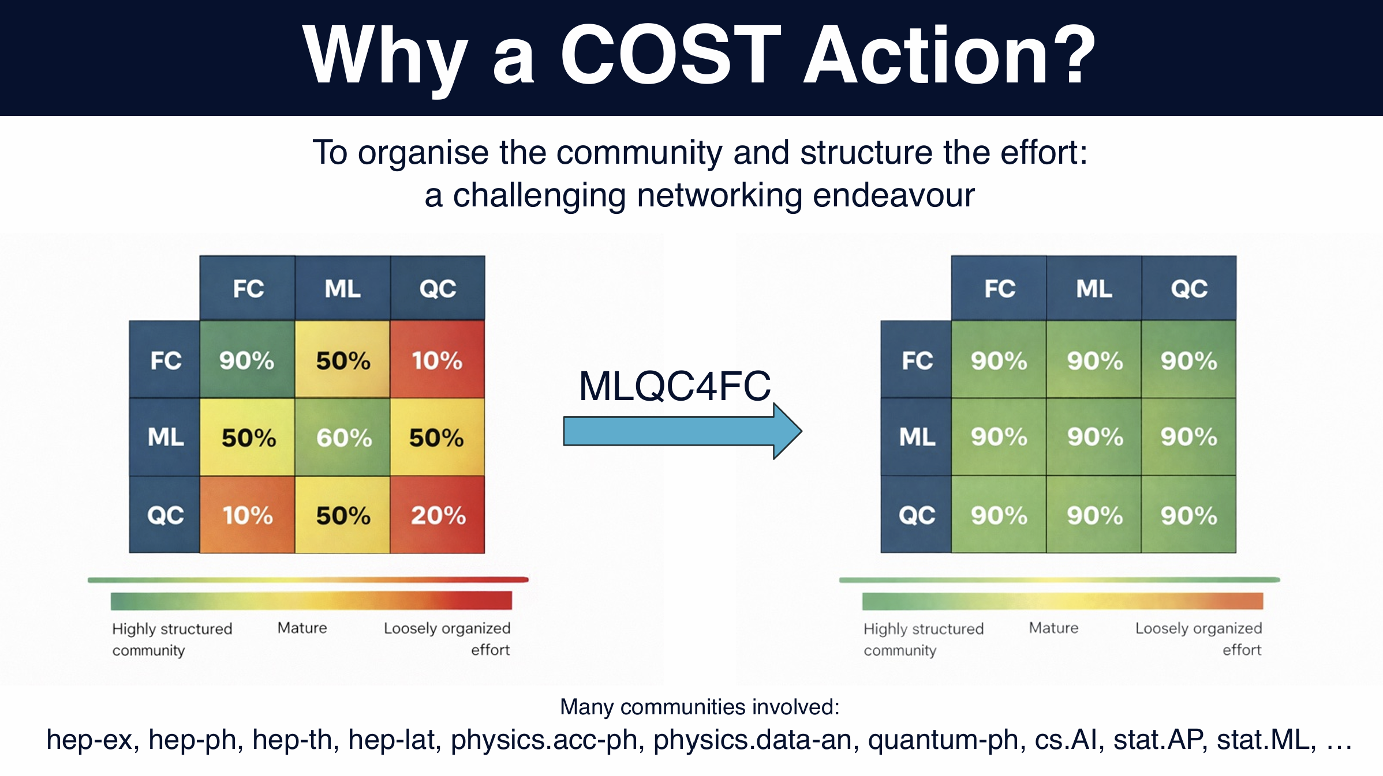
Example of EU COST Action: Machine Learning & Quantum Computing for Future Colliders
https://indico.ku.edu/event/495

Slide 32
Some upcoming meetings partly supported by I.ANN QCD
XV Latin American Symposium on Nuclear Physics and Applications. Sao Paulo, Brazil. December 7-10, 2026
2026 International Workshop on the Physics of Ultra Peripheral Heavy Ion Collisions. Playa del Carmen, Mexico. December 7-12, 2026
ICTP-SAIFR School and Workshop “Electron-Ion Collider as a Probe of Quantum Chromodynamics” during the week of May 17-22, 2027 at the ICTP-SAIFR, São Paulo, Brazil.

Slide 33
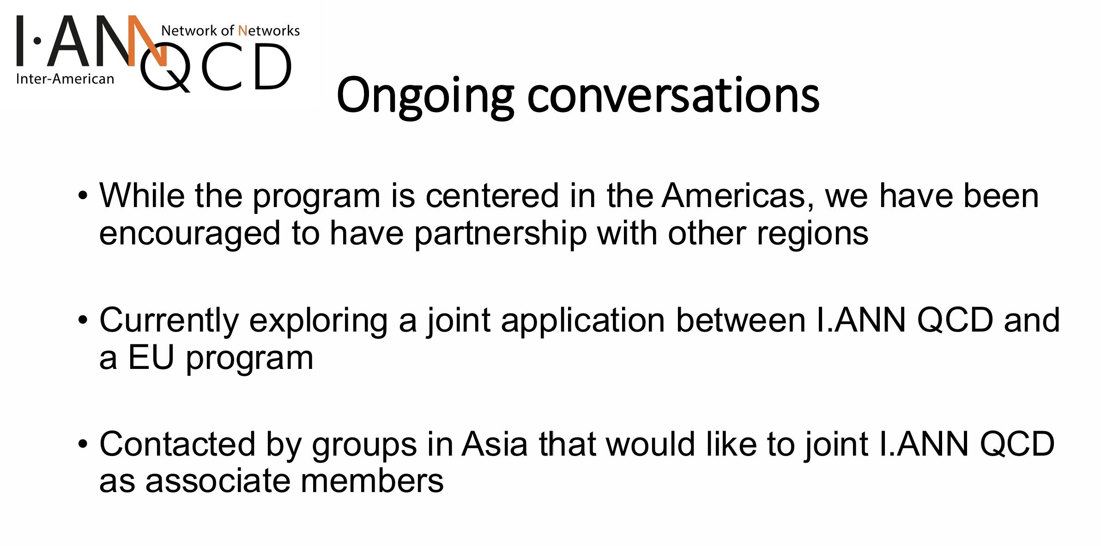
Promoting activities with EU COST networks

Slide 34
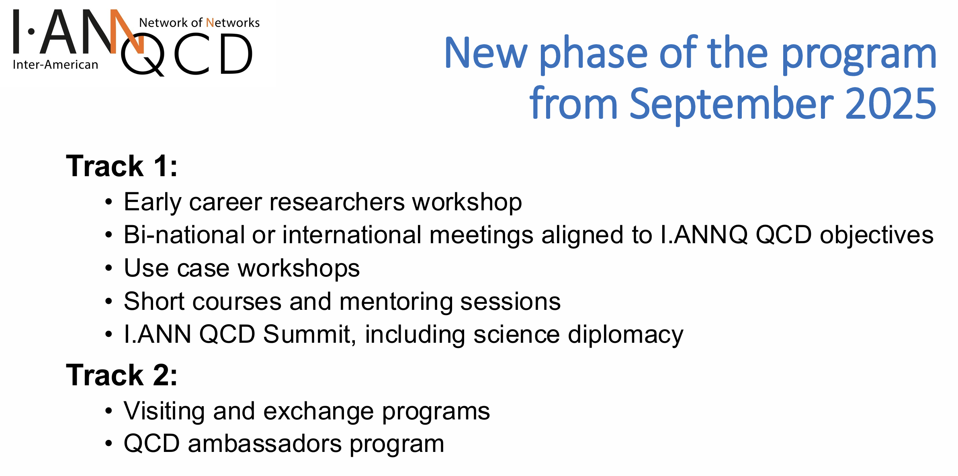

Slide 35

Coordination team:
Daniel Tapia Takaki, Director
Christine Aidala, co-PI
Carlos Bertulani, co-PI
Abhay Deshpande, co-PI
Currently working on preparing a new structure for the National contacts and network representatives

Slide 36


